Slide 1




Validating LIGO Interferometer Models
Abhiram Sharma, Cecilia Ochoa, Mary Ranjbar, Xuesi Ma, Jonathan Richardson
LIGO-T2600158
ask40@gatech.edu
August 21, 2026

Slide 2

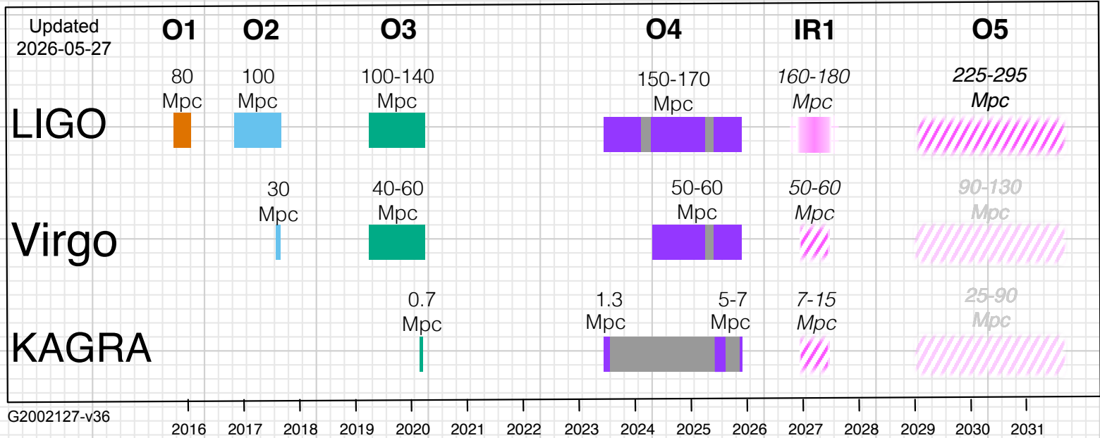
Commissioning Modeling
LIGO is currently in between observing runs, improved knowledge on discrepant design parameters (such as mirror position displacement) is important
Having an accurate model would help determine how future upgrades would affect the interferometer’s behavior/performance
Present

Slide 3


Commissioning Goal:
Create a model of the interferometer which can reproduce experimentally measured channel values

Slide 4
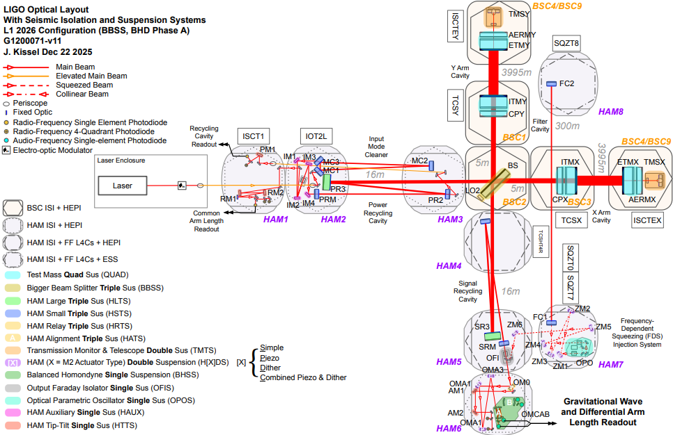
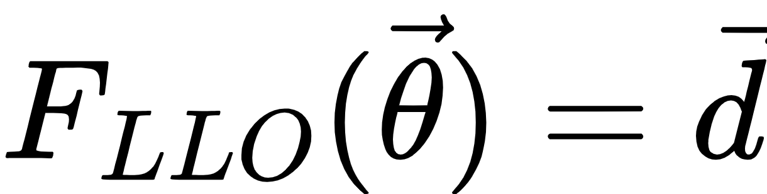
LLO from a Modeling Perspective
LLO is a complicated optomechanical system with hundreds of ports, optics, etc
The physics of the interferometer dictate what we measure from the dozens of detectors/channels
For the purpose of optical modeling, let’s reduce this system into a nonlinear function:
DCC: G1200071

Slide 5
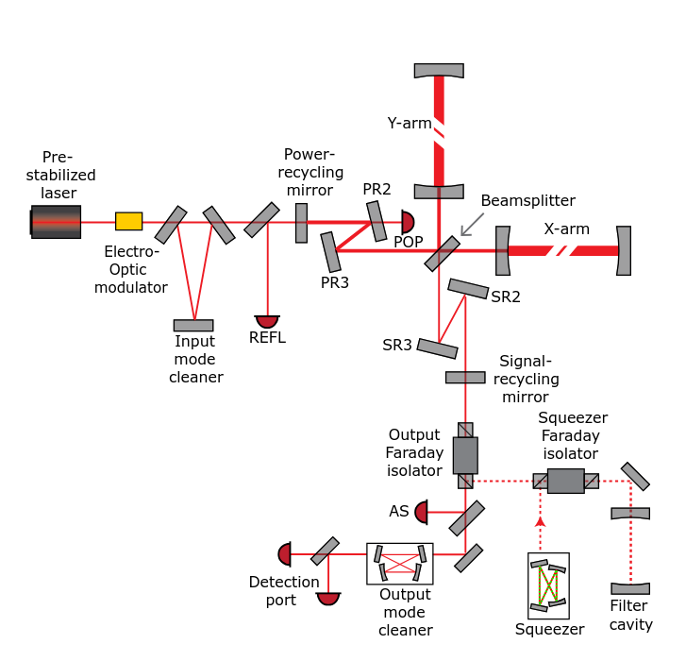
LLO from a Modeling Perspective
LLO is a complicated optomechanical system with hundreds of ports, optics, etc
The physics of the interferometer dictate what we measure from the dozens of detectors/channels
For the purpose of optical modeling, let’s reduce this system into a nonlinear function:
Capote, E., et al. , arXiv:2411.14607 (2024)

Slide 6
LLO from a Modeling Perspective
LLO is a complicated optomechanical system with hundreds of ports, optics, etc
The physics of the interferometer dictate what we measure from the dozens of detectors/channels
For the purpose of optical modeling, let’s reduce this system into a nonlinear function:
Parameters/Inputs
Capote, E., et al. , arXiv:2411.14607 (2024)

Slide 7
LLO from a Modeling Perspective
LLO is a complicated optomechanical system with hundreds of ports, optics, etc
The physics of the interferometer dictate what we measure from the dozens of detectors/channels
For the purpose of optical modeling, let’s reduce this system into a nonlinear function:
Detectors/
Outputs
Capote, E., et al. , arXiv:2411.14607 (2024)

Slide 8
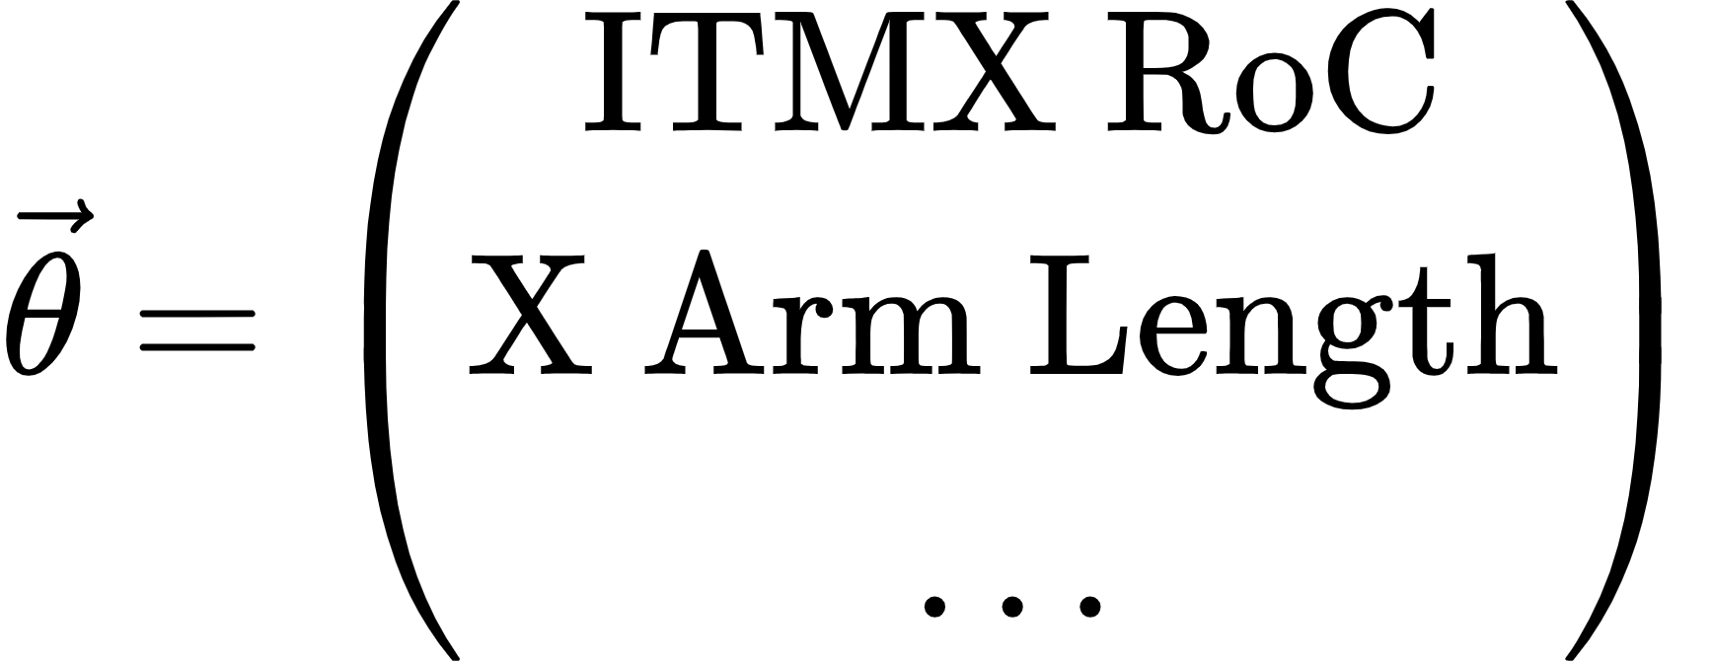
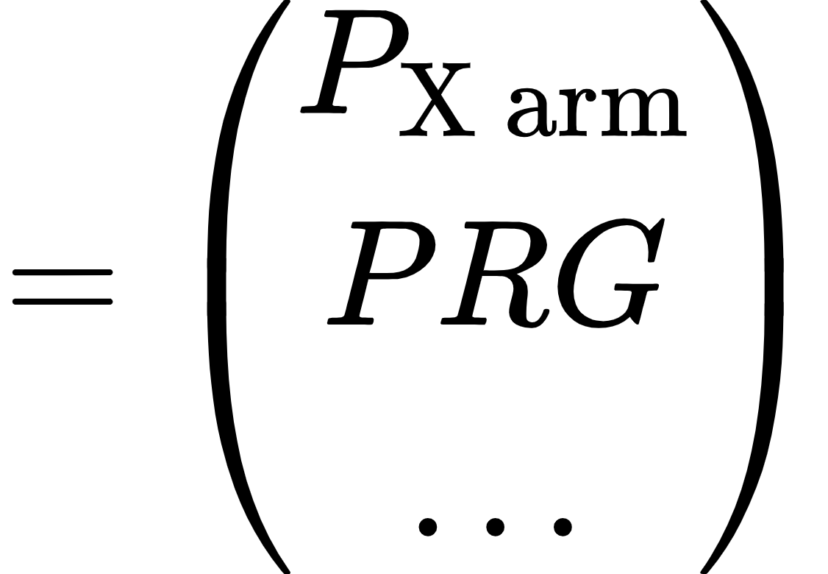
LLO from a Modeling Perspective

Slide 9
Thermal Dynamics in LIGO
At high circulating arm power, heating effects from the laser into optics (such as the test masses) significantly alter the cavity mode structure
Heating deformations are compensated by the TCS components, like ring heaters, but this needs to be included into our model
FROSTI
Thermal Dynamics in ITM
Compensation
Plate
Laser Heating
CO2 Laser
CO2 Laser
Surface Deformation
Compensation Plate
ITM
FROSTI
Ring Heater

Slide 10
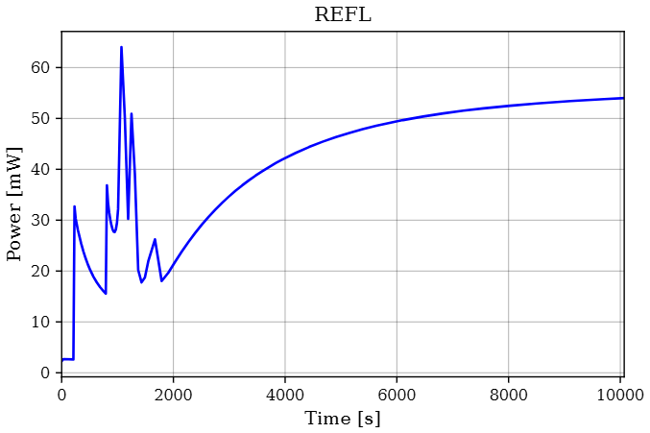
LLO Thermal Steady State Data
Segments where the interferometer was locked >24 hours and the TCS components were fixed
Data coming from this period will be much more comparable to a steady state model compared to using the transient regime
~3 hrs

Slide 11
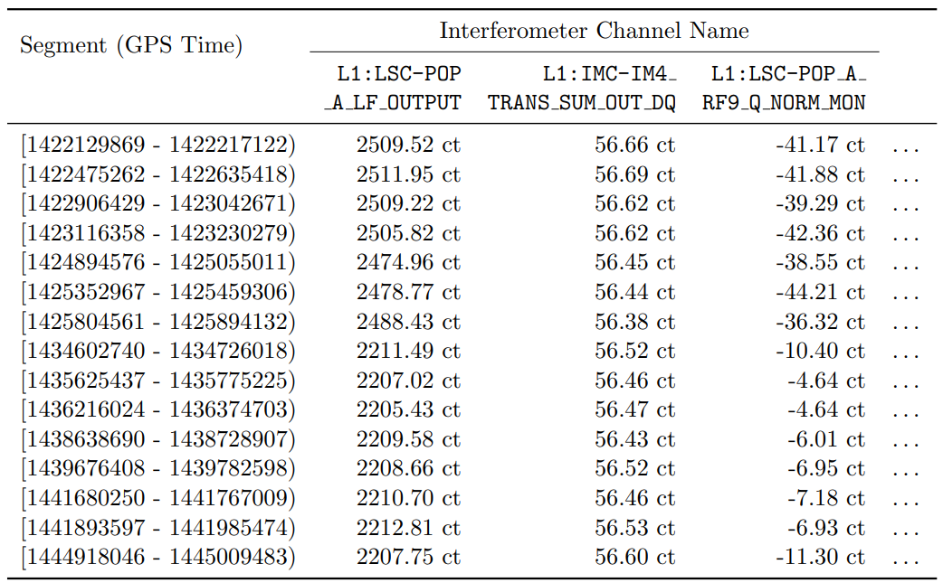
LLO Thermal Steady State Data

Slide 12
LLO Thermal Steady State Data
Input Laser Power

Slide 13

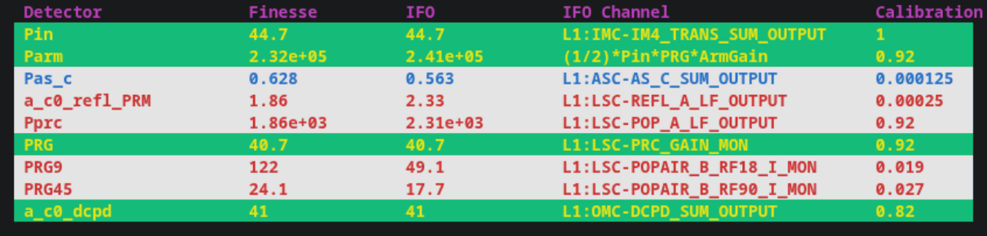
Commissioning Model Results
This comparison table shows the agreement with the FINESSE model and experimental values after calibration
FINESSE
Detector
FINESSE
Output (W)
LLO
Output (W)
LLO
Channel (cts)
Channel
Calibration (W/ct)
Gain (Unitless)
(mW)
(mW/mA)

Slide 14
SURF Project Goal:
Diagnosing discrepancies between model and experimental results with MCMC sampling

Slide 15
*Parameter Estimation for the Interferometer Instead of Black Holes
Abhiram Sharma, Cecilia Ochoa, Mary Ranjbar, Xuesi Ma, Jonathan Richardson
LIGO-T2600158
ask40@gatech.edu
August 21, 2026

Slide 16
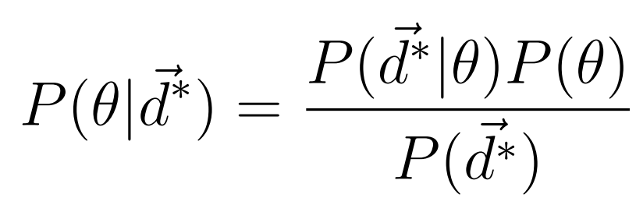
MCMC parameter estimation
Implementing Markov chain Monte Carlo (MCMC) sampling into the FINESSE commissioning model allows us to estimate the posteriors of various parameters
The emcee python package was chosen for sampling
Likelihood
Prior
Posterior
arxiv: 1202.3665

Slide 17
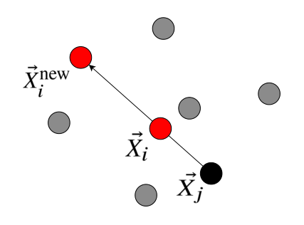
MCMC parameter estimation
Emcee’s main sampling methods are affine invariant (unchanged by location-scale transformations)
This means we don’t have to choose a characteristic scale for every parameter
arxiv: 1202.3665, 2605.30412

Slide 18
MCMC parameter estimation
TRUE PARAMETER VALUES
(ETM RH Power, PR2 dX)
FINESSE Model Parameter Values
FINESSE Detector Outputs
(Pin, Parm, PX)
Calibration Uncertainty
+
Sensing
Noise
LLO Detector Outputs
(L1:LSC-POP_A_LF_OUTPUT)
Measurement Uncertainty
Simulation
(Encoded in Prior)

Slide 19
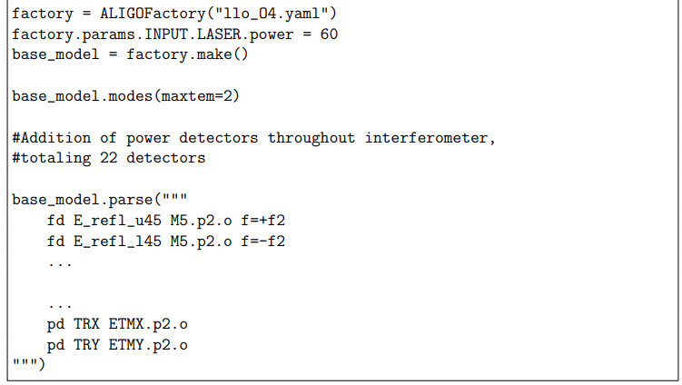
MCMC parameter estimation - Cold Model
My initial implementations for the sampler were tested on simple LLO cold models, provided in the finesse-ligo package

Slide 20
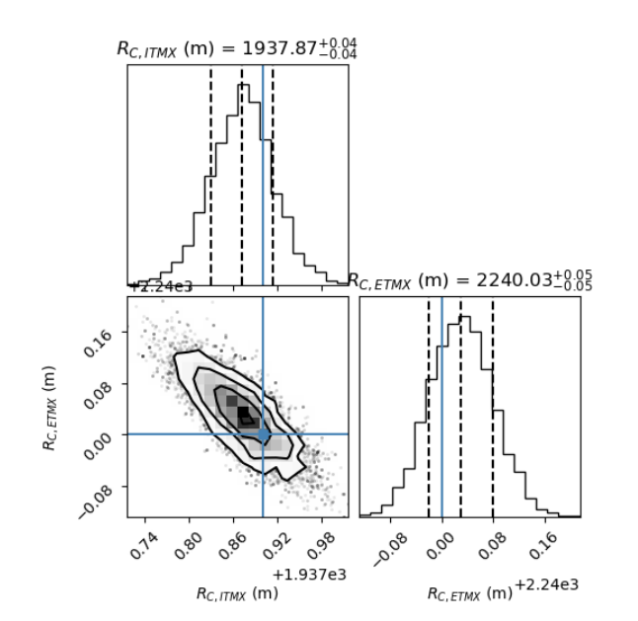
MCMC parameter estimation - Cold Model

Slide 21
MCMC parameter estimation - Cold Model
Corner plot showing posterior distribution of radius of curvatures of ITM vs ETM in X arm
Unrealistically low 1 sigma values for prior distribution leads to narrow uncertainty

Slide 22
MCMC parameter estimation - Cold Model
Modifying the sampler to eventually work directly with experimental data also means only using detectors we have calibration factors for
This significantly reduces the amount of information we can obtain from a parameter perturbation
76 Detectors
10
Detectors

Slide 23
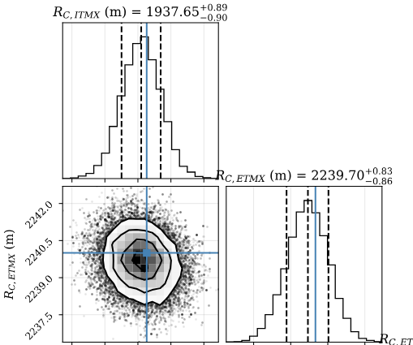
MCMC parameter estimation - Cold Model
Loss in RoC correlation due to removal of certain field detectors and power detectors

Slide 24
MCMC parameter recovery
Perturbed PARAMETER VALUES
(ETM RH Power - 0.1W,
PR2 dX + 0.1 mm)
FINESSE Model Parameter Values
FINESSE Detector Outputs Given Proposed Θ
(Pin, Parm, PX)
LLO Detector Outputs
(L1:LSC-POP_A_LF_OUTPUT)
Measurement Uncertainty
Detector Uncertainty
Simulation
(Generate data vector)

Slide 25
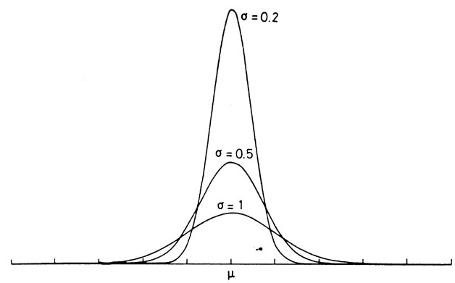
MCMC parameter recovery - Sensitivity
We can gauge how sensitive the detectors in the model are to parameters by comparing posterior width to prior width
(Constraining power/informativeness)
Unchanged detectors are insensitive
Decreased detectors are sensitive

Slide 26
MCMC parameter recovery - Accuracy
We can also gauge the accuracy of the sampler by perturbing where the initial data is generated from
If the sampler starts with prior means far from these perturbed true values, and is able to recover the perturbed values in the posterior distribution, the sampler can accurately recover those parameters
(Bias/Injection-Recovery)

Slide 27
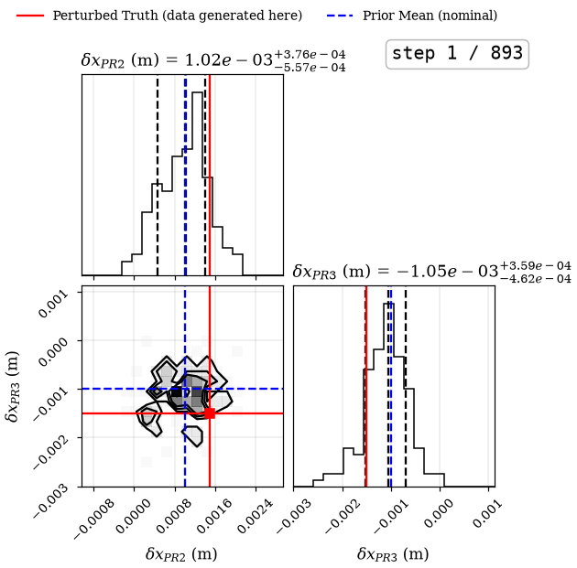
MCMC parameter recovery - PRC Mirror Displacements

Slide 28
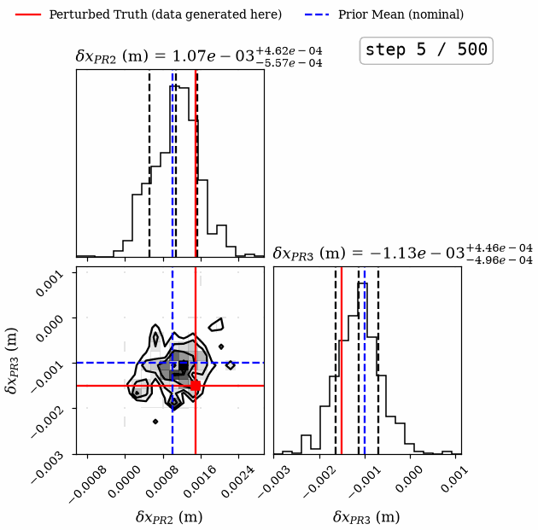
MCMC parameter recovery - PRC Mirror Displacements

Slide 29
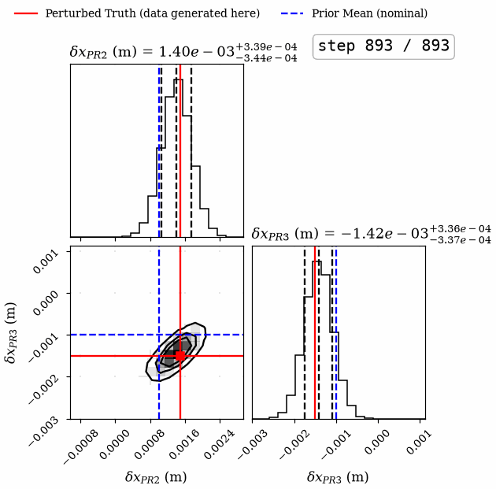
MCMC parameter recovery - PRC Mirror Displacements
Model is sensitive to PRC mirror displacements (uncertainty shrinks from 0.5 mm to 0.34 mm)
Model can accurately recover the true mirror displacement

Slide 30
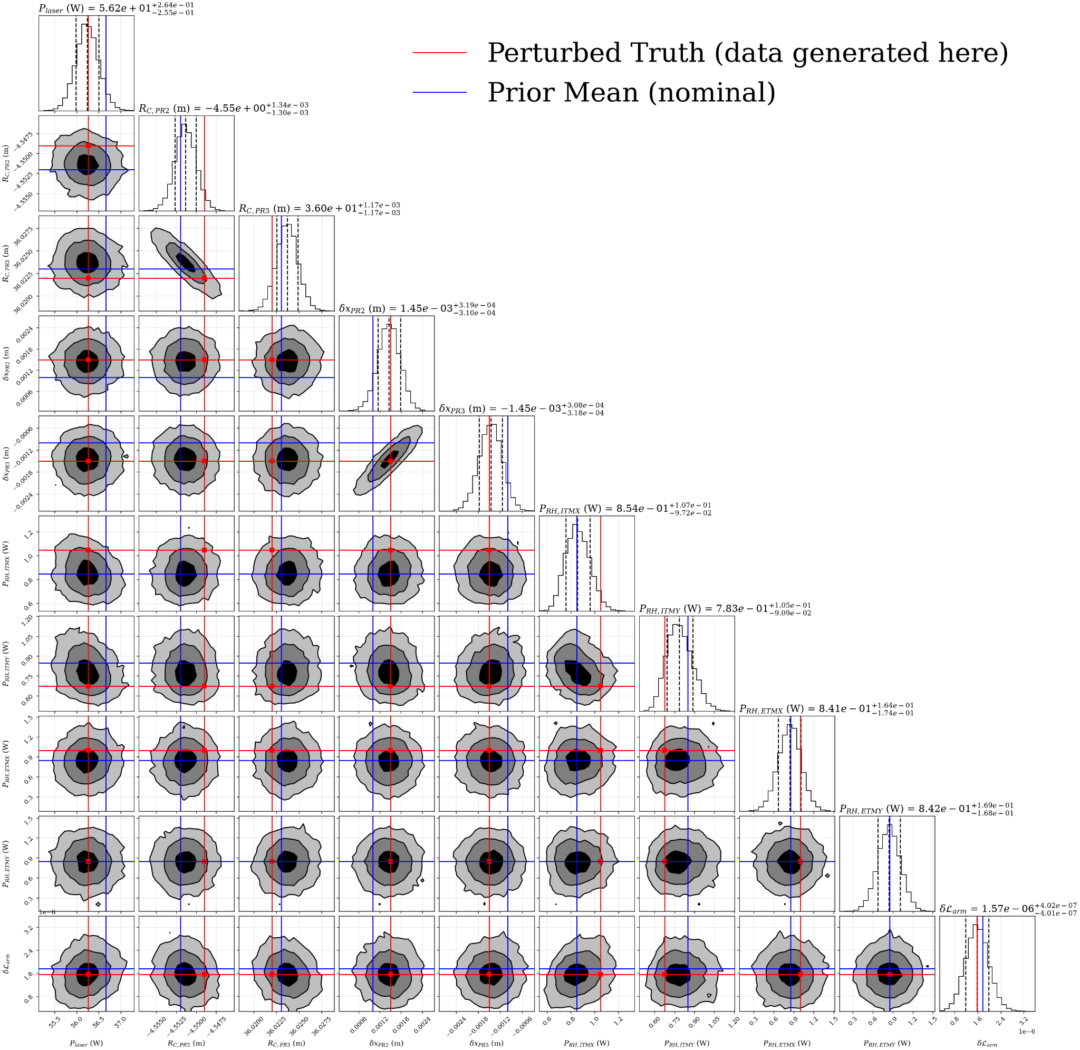
Conclusions
We have developed a diagnostic sampler that can recover certain LLO design parameters given a thermal steady state dataset
We are currently sampling ~10 parameters at a time

Slide 31
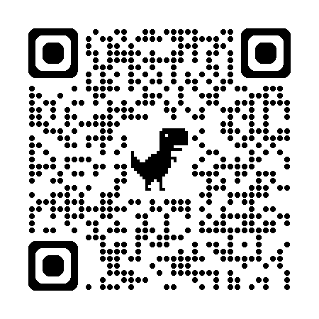
Future Work
Running the sampler with the calibrated experimental data to recover experimental design parameter posterior distributions
Adding further complexity into the sampler/model
Running more stringent, repeated tests to validate sampling methods
Code is currently maintained in this repo: https://git.ligo.org/IFOsim/ligo-commissioning-modeling/

Slide 32

Acknowledgements
I would like to thank my graduate student mentors and
Dr. Richardson for all their support during the LIGO SURF program.
I also want to acknowledge the support of the NSF, UCR, the LSC, Dr. Barry Barish, and the Caltech LIGO SURF program for making this experience possible.

Slide 33
Appendix - Locking
Ensuring that the 0th order mode (HG00) is at 0 Hz DC
As we change parameters farther from an initial model’s nominal values, the locking process will take more iterations, or possibly not converge
Locking iterations are a significant fraction of runtime, so minimizing this is important

Slide 34
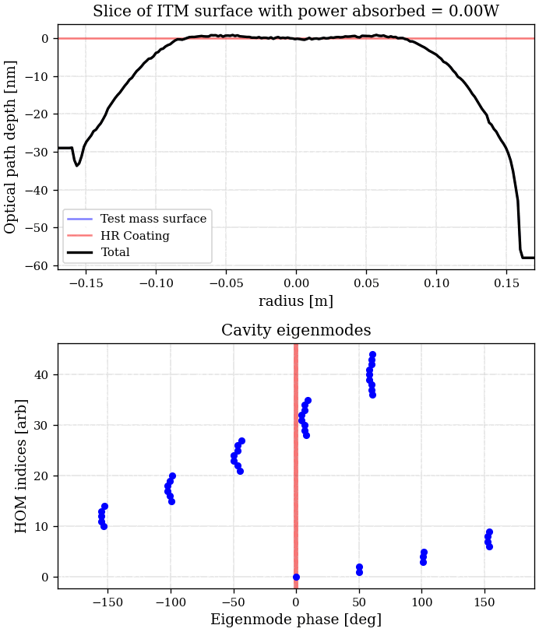
Appendix - Thermal Dynamics in LIGO
Surface Deformation

Slide 35
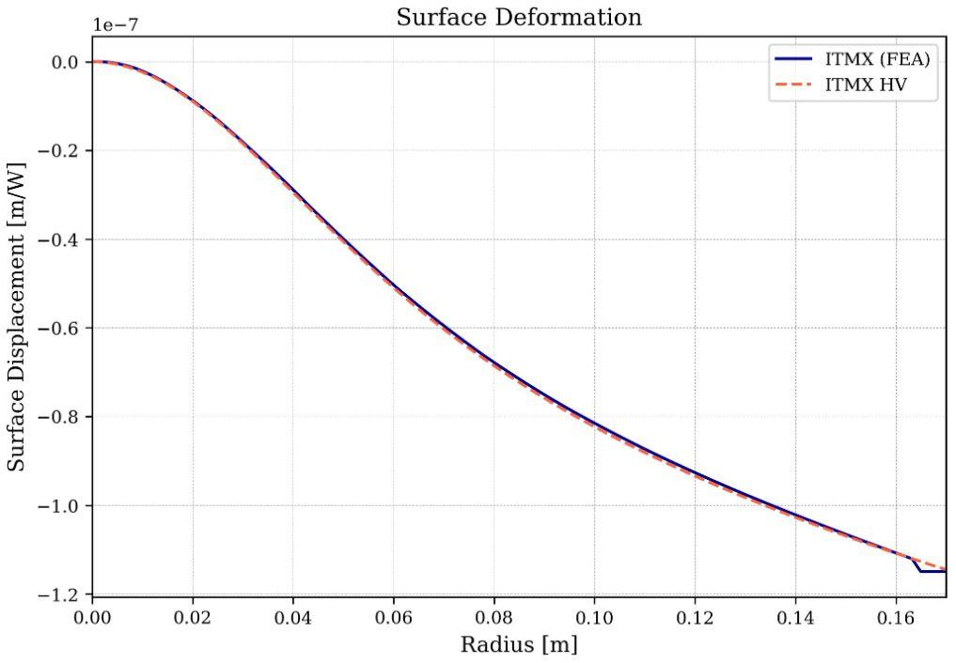
Appendix - Thermal Dynamics in LIGO
Surface deformations in ITMX due to self heating
Hello Vinet (HV) analytical implementation is what is used in sampling

Slide 36
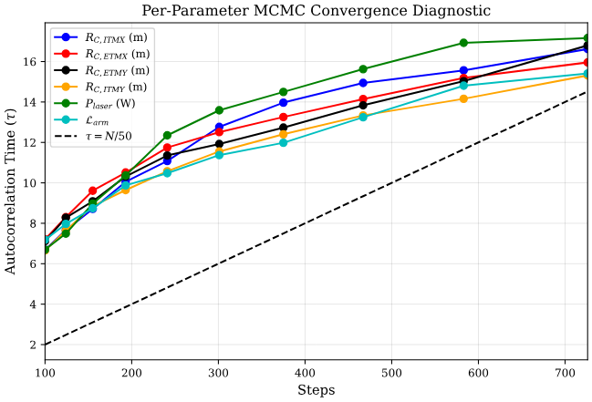
Appendix - MCMC Convergence

Slide 37

Appendix - MCMC parameter estimation
To prevent numerical underflow during computation, we evaluate the non-normalized posterior in log-space:
Log Posterior
Log Likelihood
Log Prior
arxiv: 1202.3665, 2605.30412

Slide 38
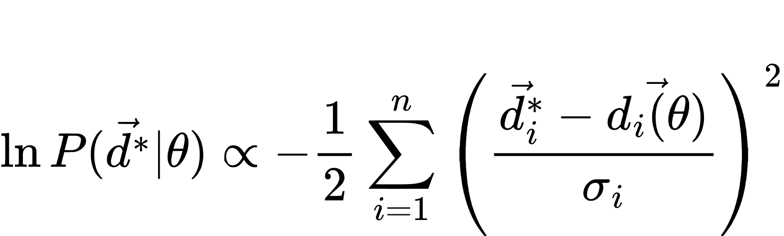
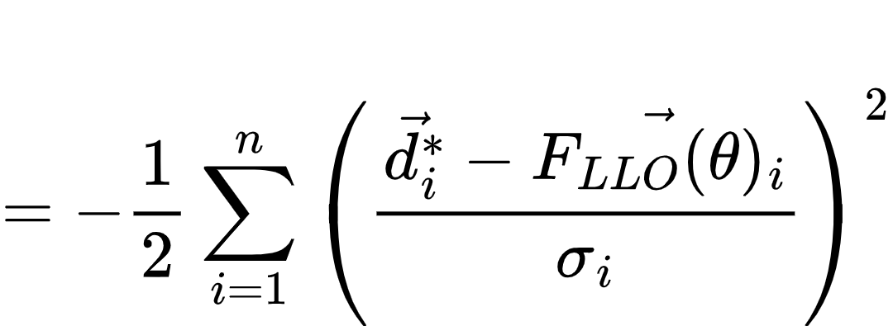
Appendix - MCMC parameter estimation - Cold Model
We construct the log-likelihood using a χ² statistic:
True Data Vector
FINESSE Output

Slide 39
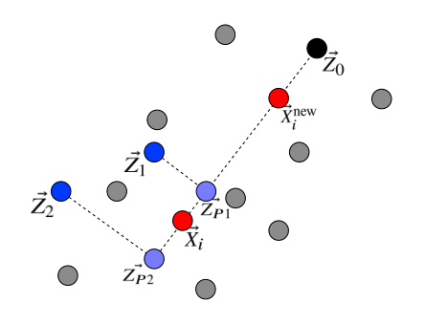
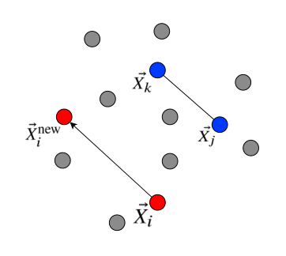
Appendix - Sampling Move
We chose to implement a (80/20) combination of the DE move and Snooker move, since this shortened convergence time for correlated posteriors
Snooker Move
DE Move
arxiv: 1202.3665, 2605.30412

Slide 40
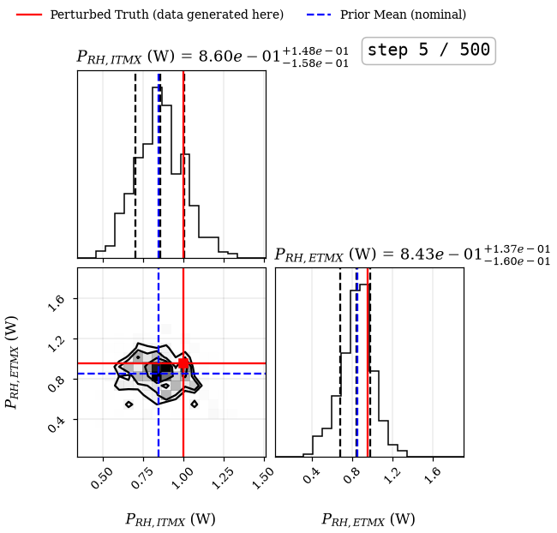
MCMC parameter recovery - Ring Heater Power

Slide 41

MCMC parameter recovery - Ring Heater Power

Slide 42

MCMC parameter recovery - Ring Heater Power
Model is more sensitive to ITM RH Power (lower uncertainty)
With chosen systematic error and prior uncertainty, we are currently unable to accurately recover the RH power

