Slide 1
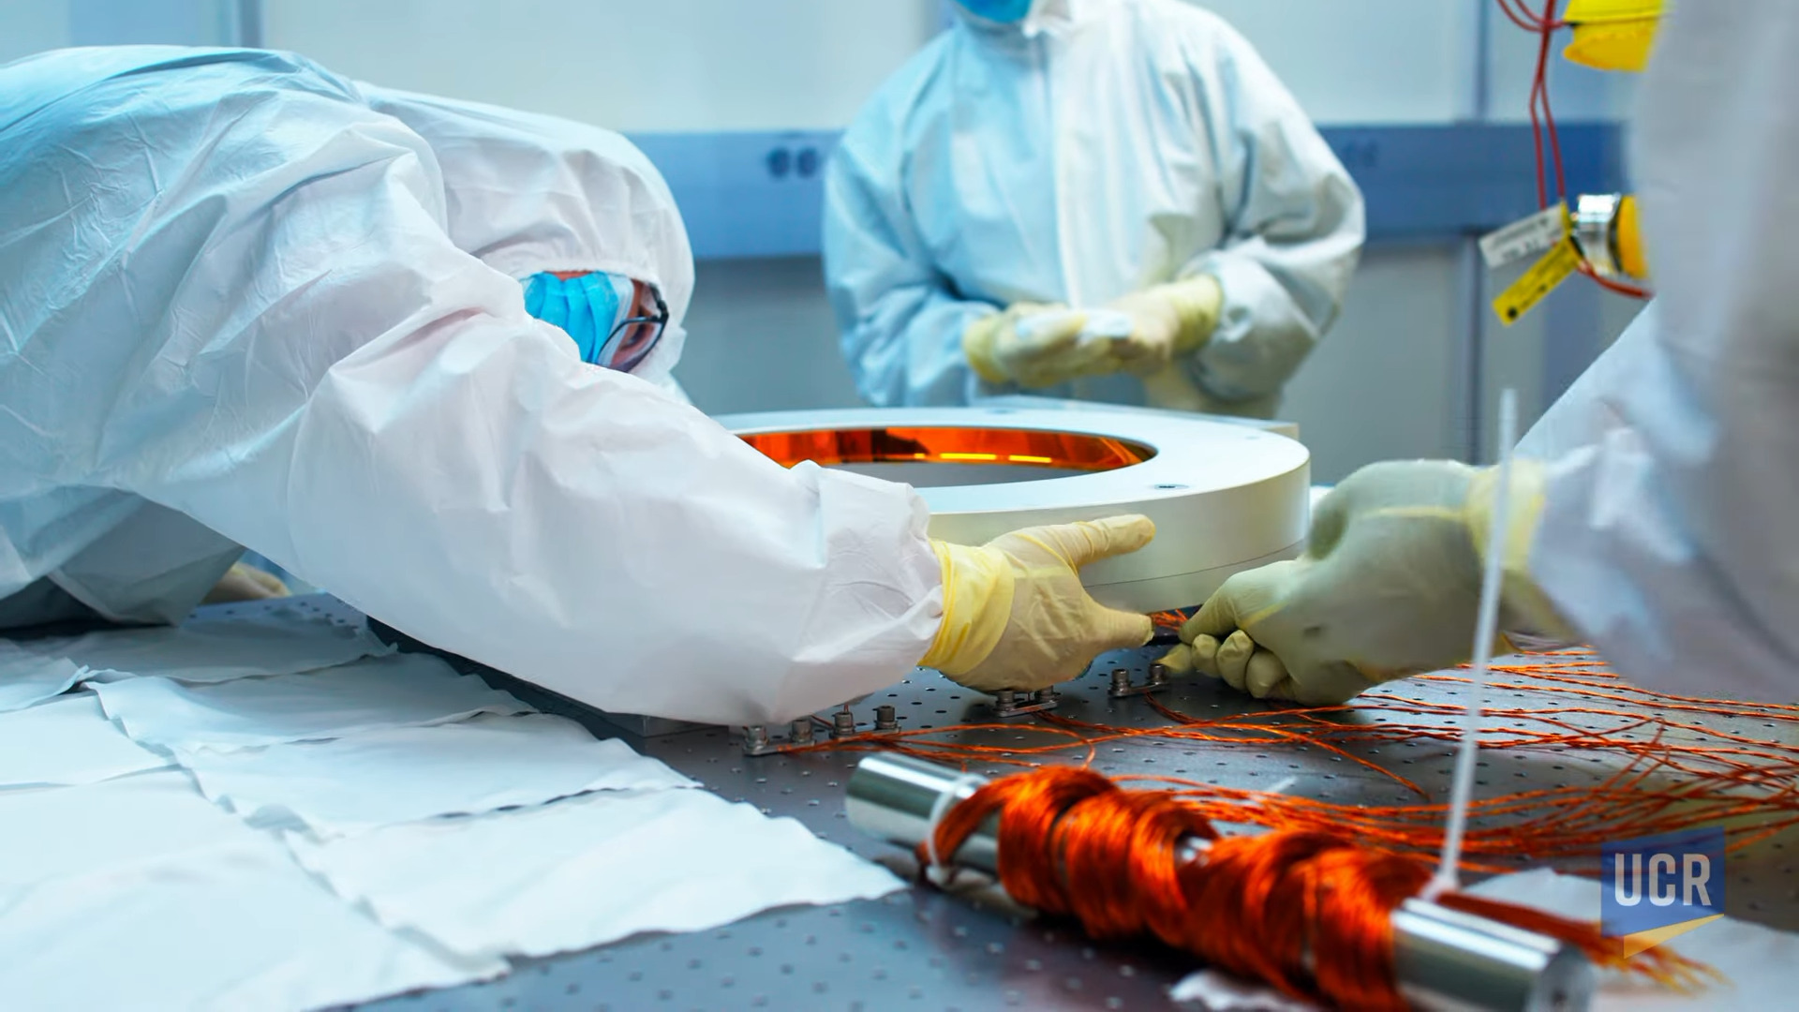



Measuring Photon Bunching in Next-Generation Adaptive Optics
LIGO-T2600151
Joshua Marmor, Texas A&M University

Slide 2
Introduction to Thermal Effects in LIGO
ITM
Laser Heating
Surface Deformation
CO2 Laser
Compensation Plate
Ring Heater
Brooks et al.

Slide 3
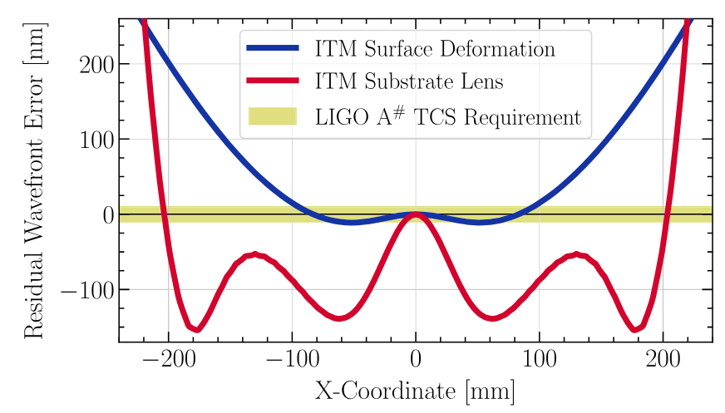
Introduction to Thermal Effects in LIGO
Current TCS does not meet A# requirements in the center or edges!
Absorption of the laser power generates thermal gradients inside the optics which create aberrations. This degrades both available arm power and squeezing levels.
Optical aberrations are generated through:
Thermoelastic deformation of the high reflective surfaces
Thermo-refractive lensing within the substrate
If we want more laser power and squeezing, we need something better!
Figure 1. Residual Wavefront Error of a 100kg A# ITM due to surface deformation and substrate lensing.
Brooks et al.,
Rosauer et al.

Slide 4
Introduction to Thermal Effects in LIGO
ITM
FROSTI
Laser Heating
Surface Deformation
CO2 Laser
Compensation Plate
Ring Heater
FROSTI
Brooks et al, Rosauer et al.

Slide 5
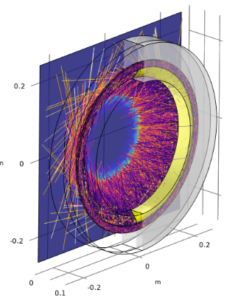
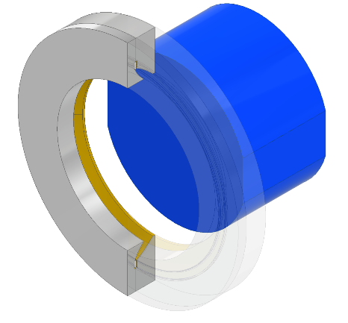
Introduction to FROSTI
The FROnt Surface Type Irradiator (FROSTI) is a new type of active wavefront control which projects 3-14 μm thermal radiation directly onto the high reflective surfaces of the test-masses. Left: Reflector design showing aluminum body and gold reflective surface. Right: Ray tracing simulation
G2201732

Slide 6
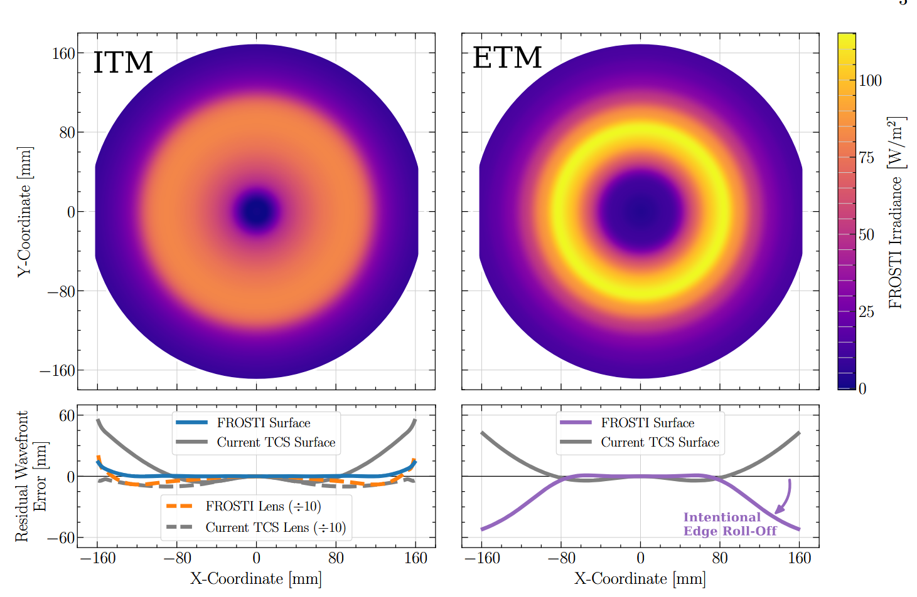
Figure 2. Left: FROSTI irradiance profile on ITM. Right: FROSTI irradiance profile on the ETM.
Tao et al.

Slide 7
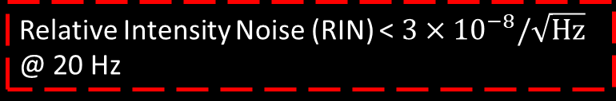
Why measure the Relative Intensity Noise?
A major challenge is posed because the heating pattern is applied directly onto the high-reflective surface.
Intensity noise from FROSTI can couple optomechanical and photothermal into displacement noise.
Relative Intensity Noise (RIN) < $3×{10}^{−8}/\sqrt{Hz}$ @ 20 Hz
A+ Requirement for FROSTI
Tao et al.
G2201732

Slide 8
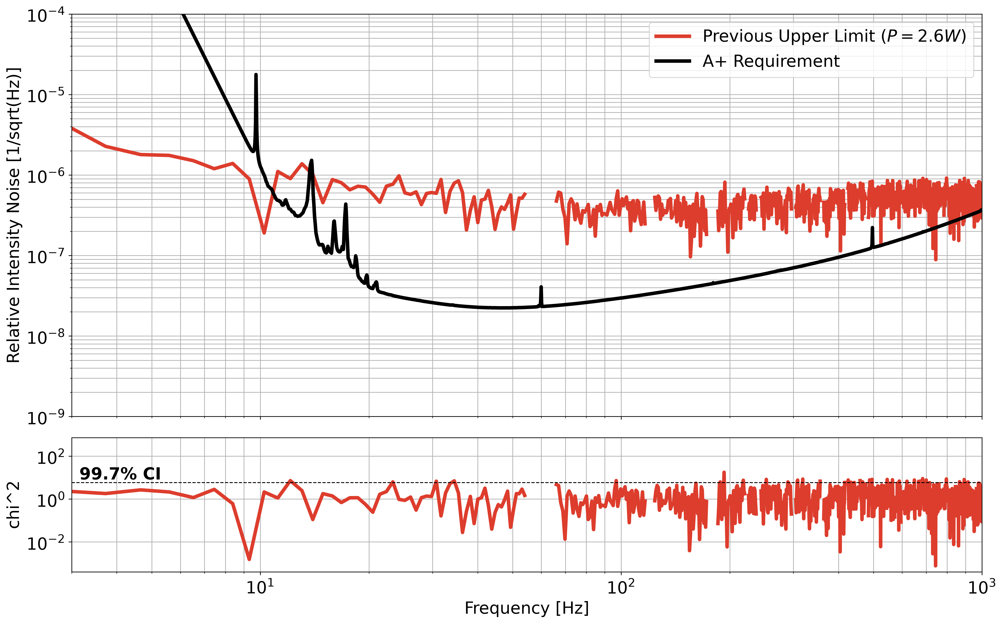
Why measure the Relative Intensity Noise?
Statistical limit
This project seeks to develop an optical test bed which can prove that our FROSTI protype can operate near its theoretical minimum.
1 order of magnitude
We want to place a better upper limit on the performance of FROSTI
Figure 3. Upper limit of FROSTI’s Relative Intensity Noise projected into strain sensitivity.

Slide 9
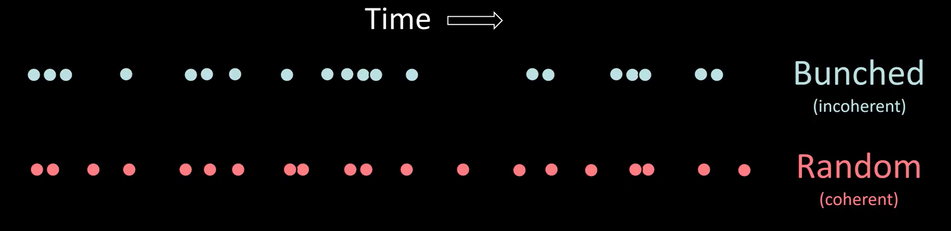
A Note on Photon Bunching
Idea: Photon bunching is a very small effect that lies just above the shot noise limit. Thermally emitted photons follow Bose-Einstein Statistics and do not arrive randomly in time.
Huygens Optics

Slide 10


The RMS fluctuations in the arrival rate of thermally emitted photons are larger than the shot noise by:
Goal: Measure this very small fluctuation in the Relative Intensity Noise to prove that FROSTI can operate near its theoretical minimum.
A Note on Photon Bunching
$$\frac{σ_{thermal}}{σ_{shot}}=\sqrt{\frac{e^{hν/kT}}{e^{hν/kT}−1}}=1.0069 (for T_{FROSTI}=218C, λ=5.9μm)$$
$$>1$$
Notes:
Fundamental limit of a coherent measurement

Slide 11
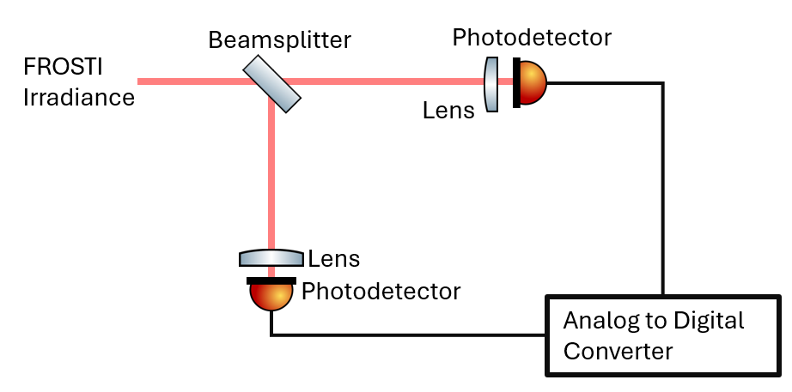
Figure 3. Schematic of experiment design
We want to measure this using a Hanbury-Brown-Twiss apparatus. When a bunch occurs, it is statistically likely that the photodiodes will see a ‘spike’ in voltage readout at the same time. This should result in a cross-correlated signal between the two photodiodes.
Huygens Optics
Notes:
This is for the case of classical noise

Slide 12
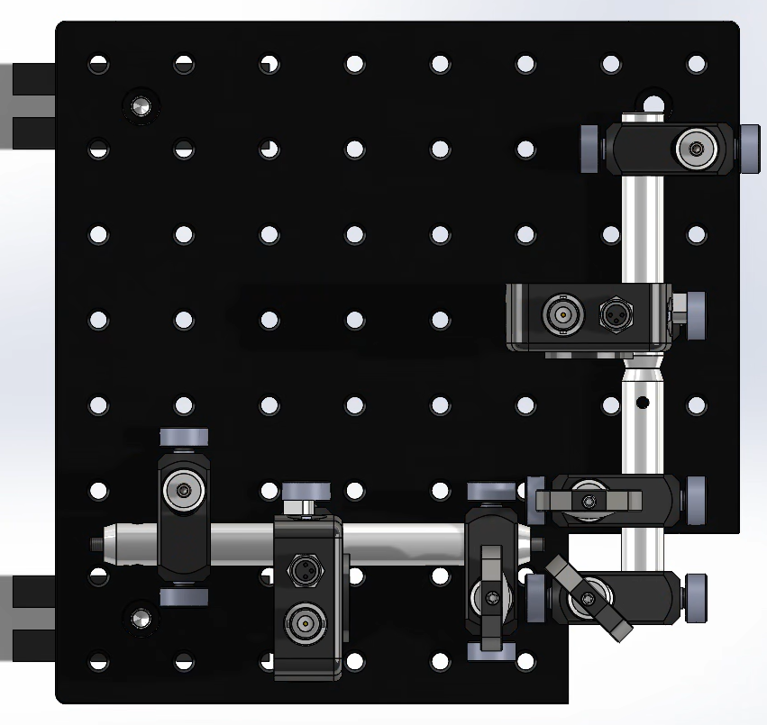
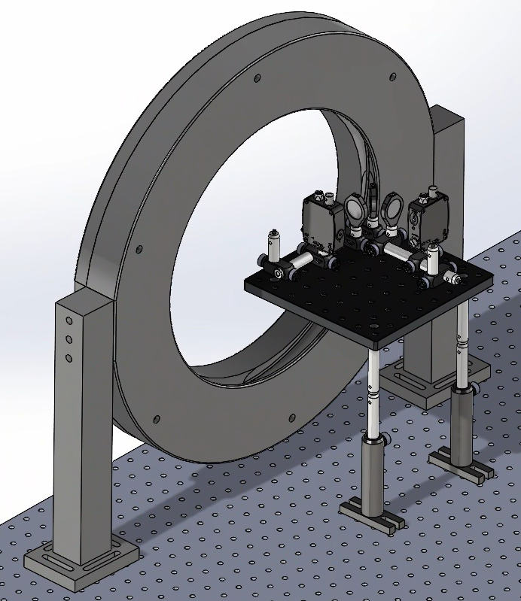
Experiment Design
Figure 4. Top-down view of Solidworks Model
Figure 5. SolidWorks model of the experiment mounted at FROSTI opening.
FROSTI Radiation
Notes:
We want this to be compact ah

Slide 13
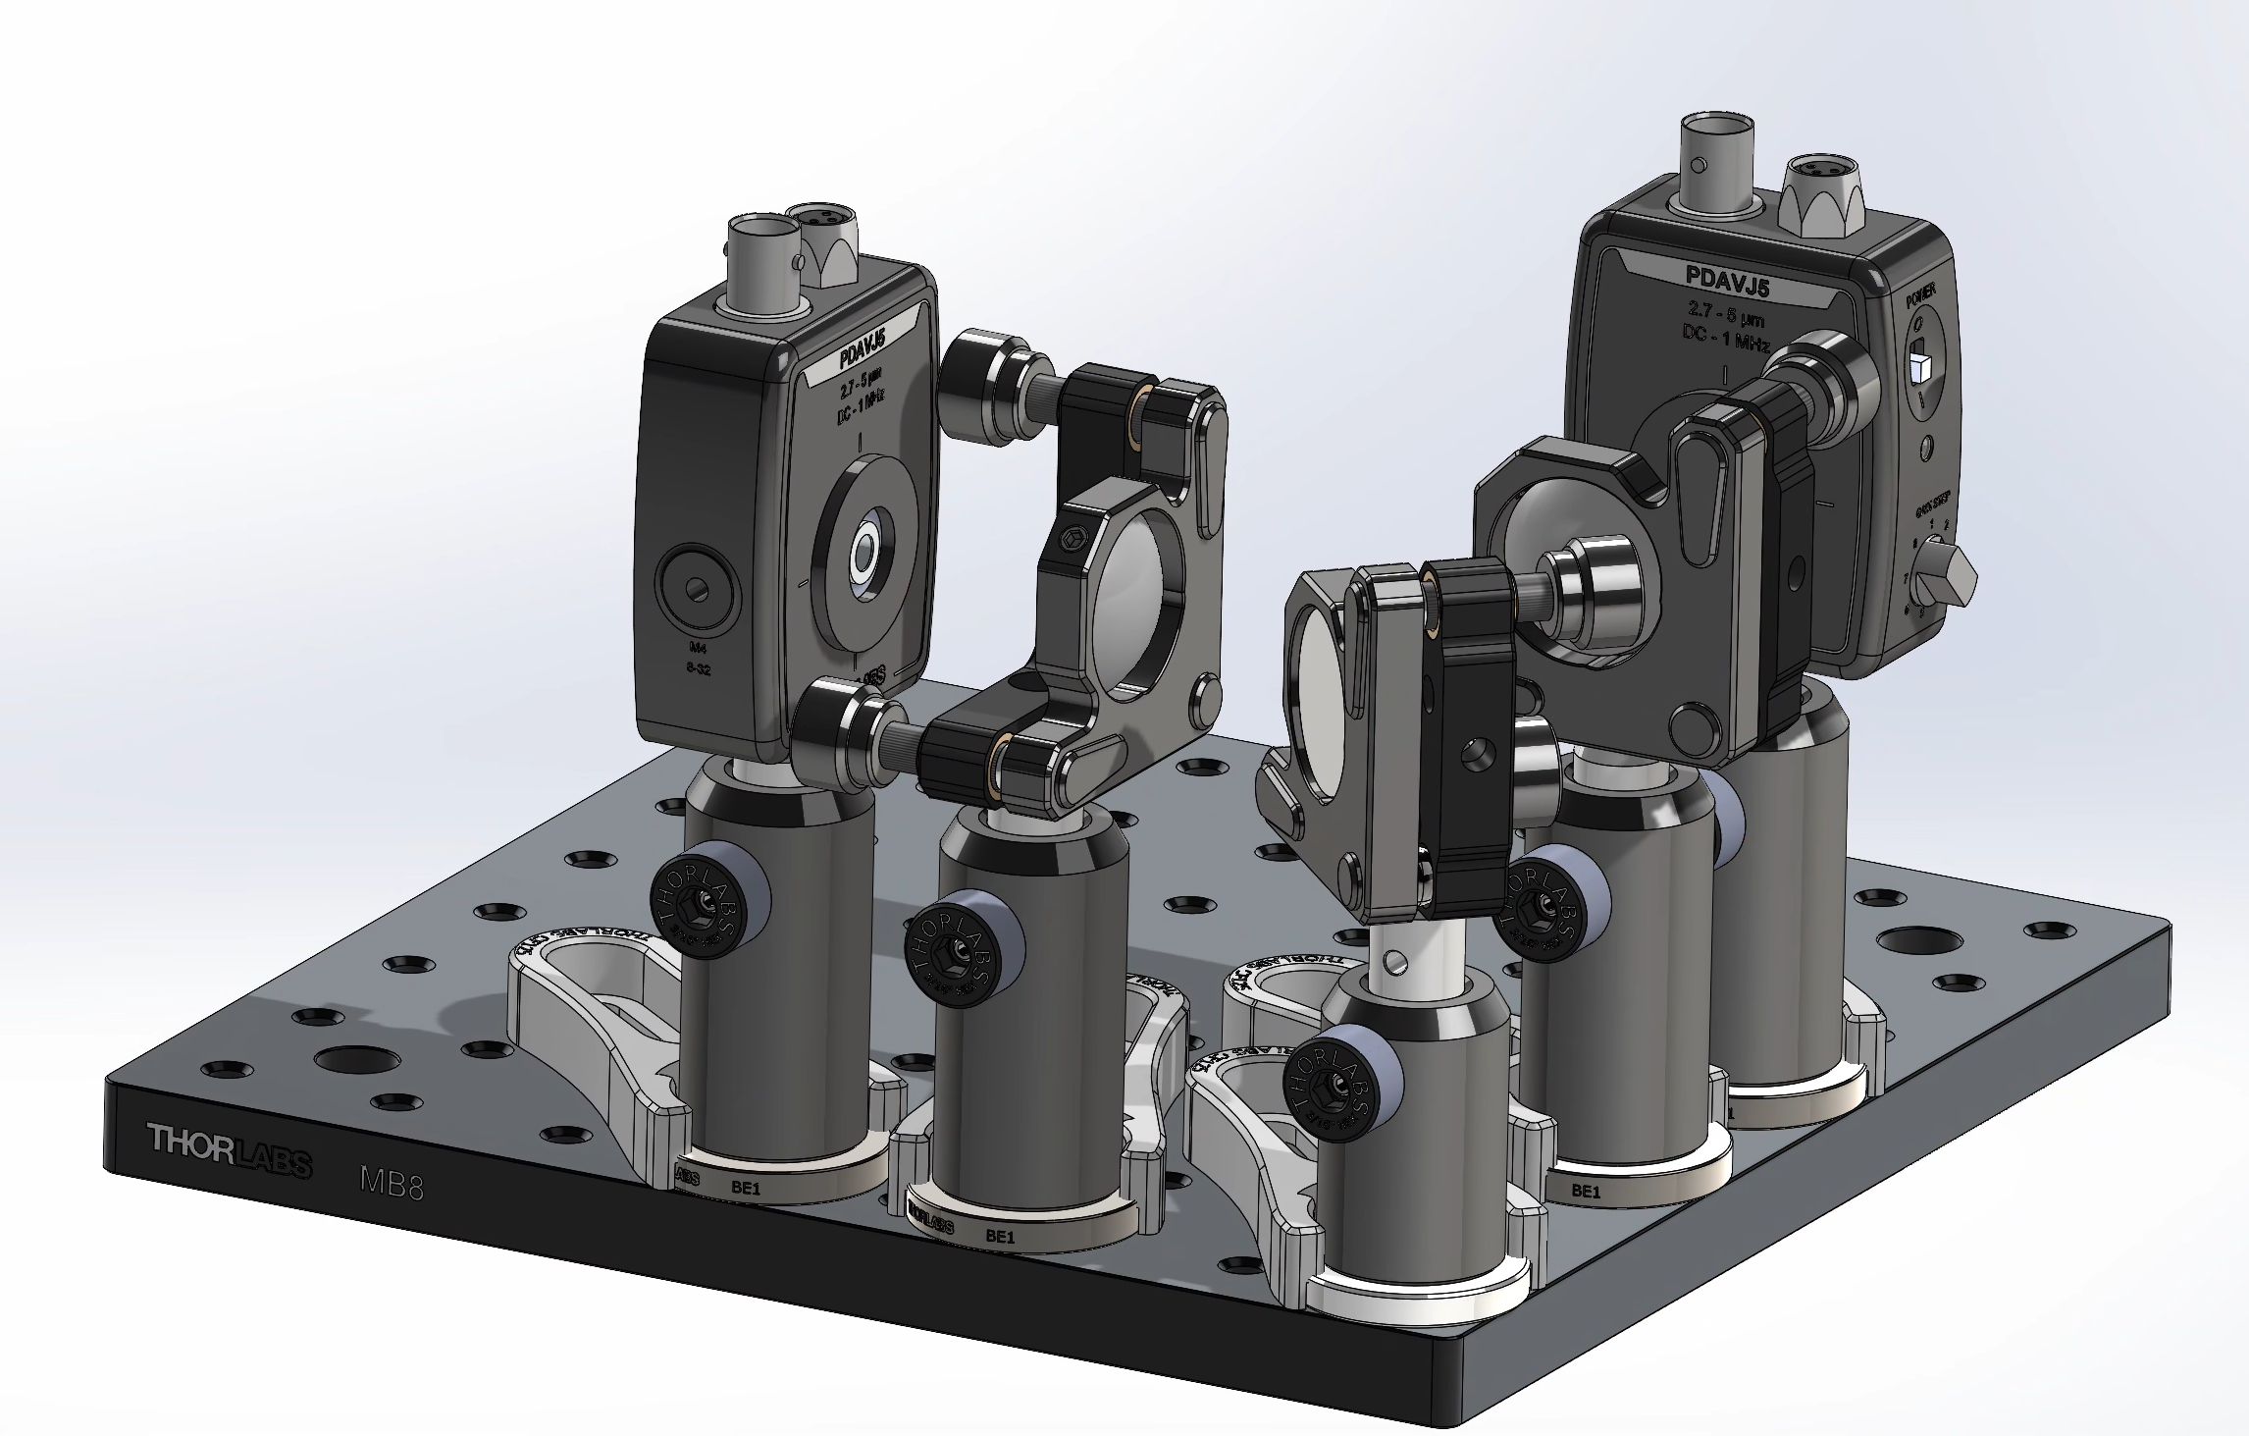
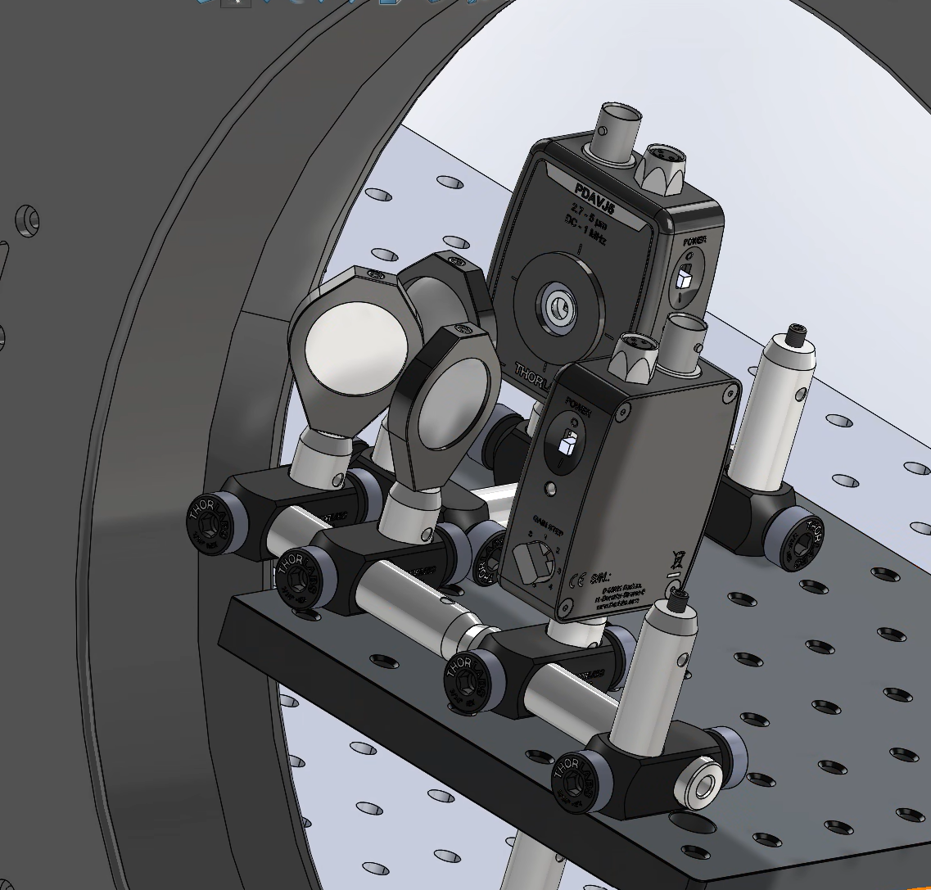
Experiment Design: How to maximize power?
Improved design lets our optics be <10mm from FROSTI
Figure 6. Preliminary SolidWorks design
Figure 7. Improved design with “notch”, and telescoping mount.

Slide 14
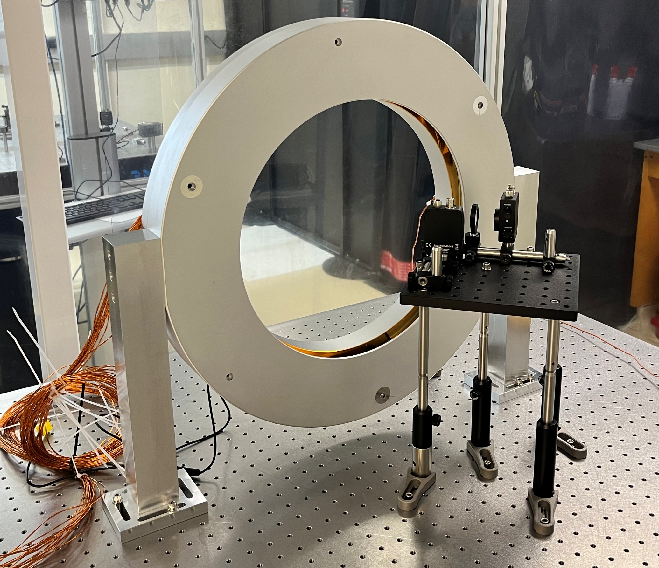
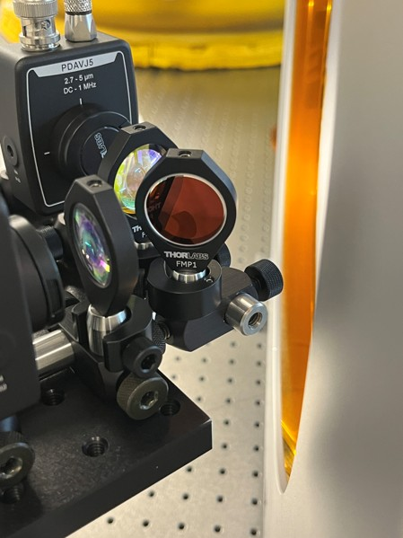
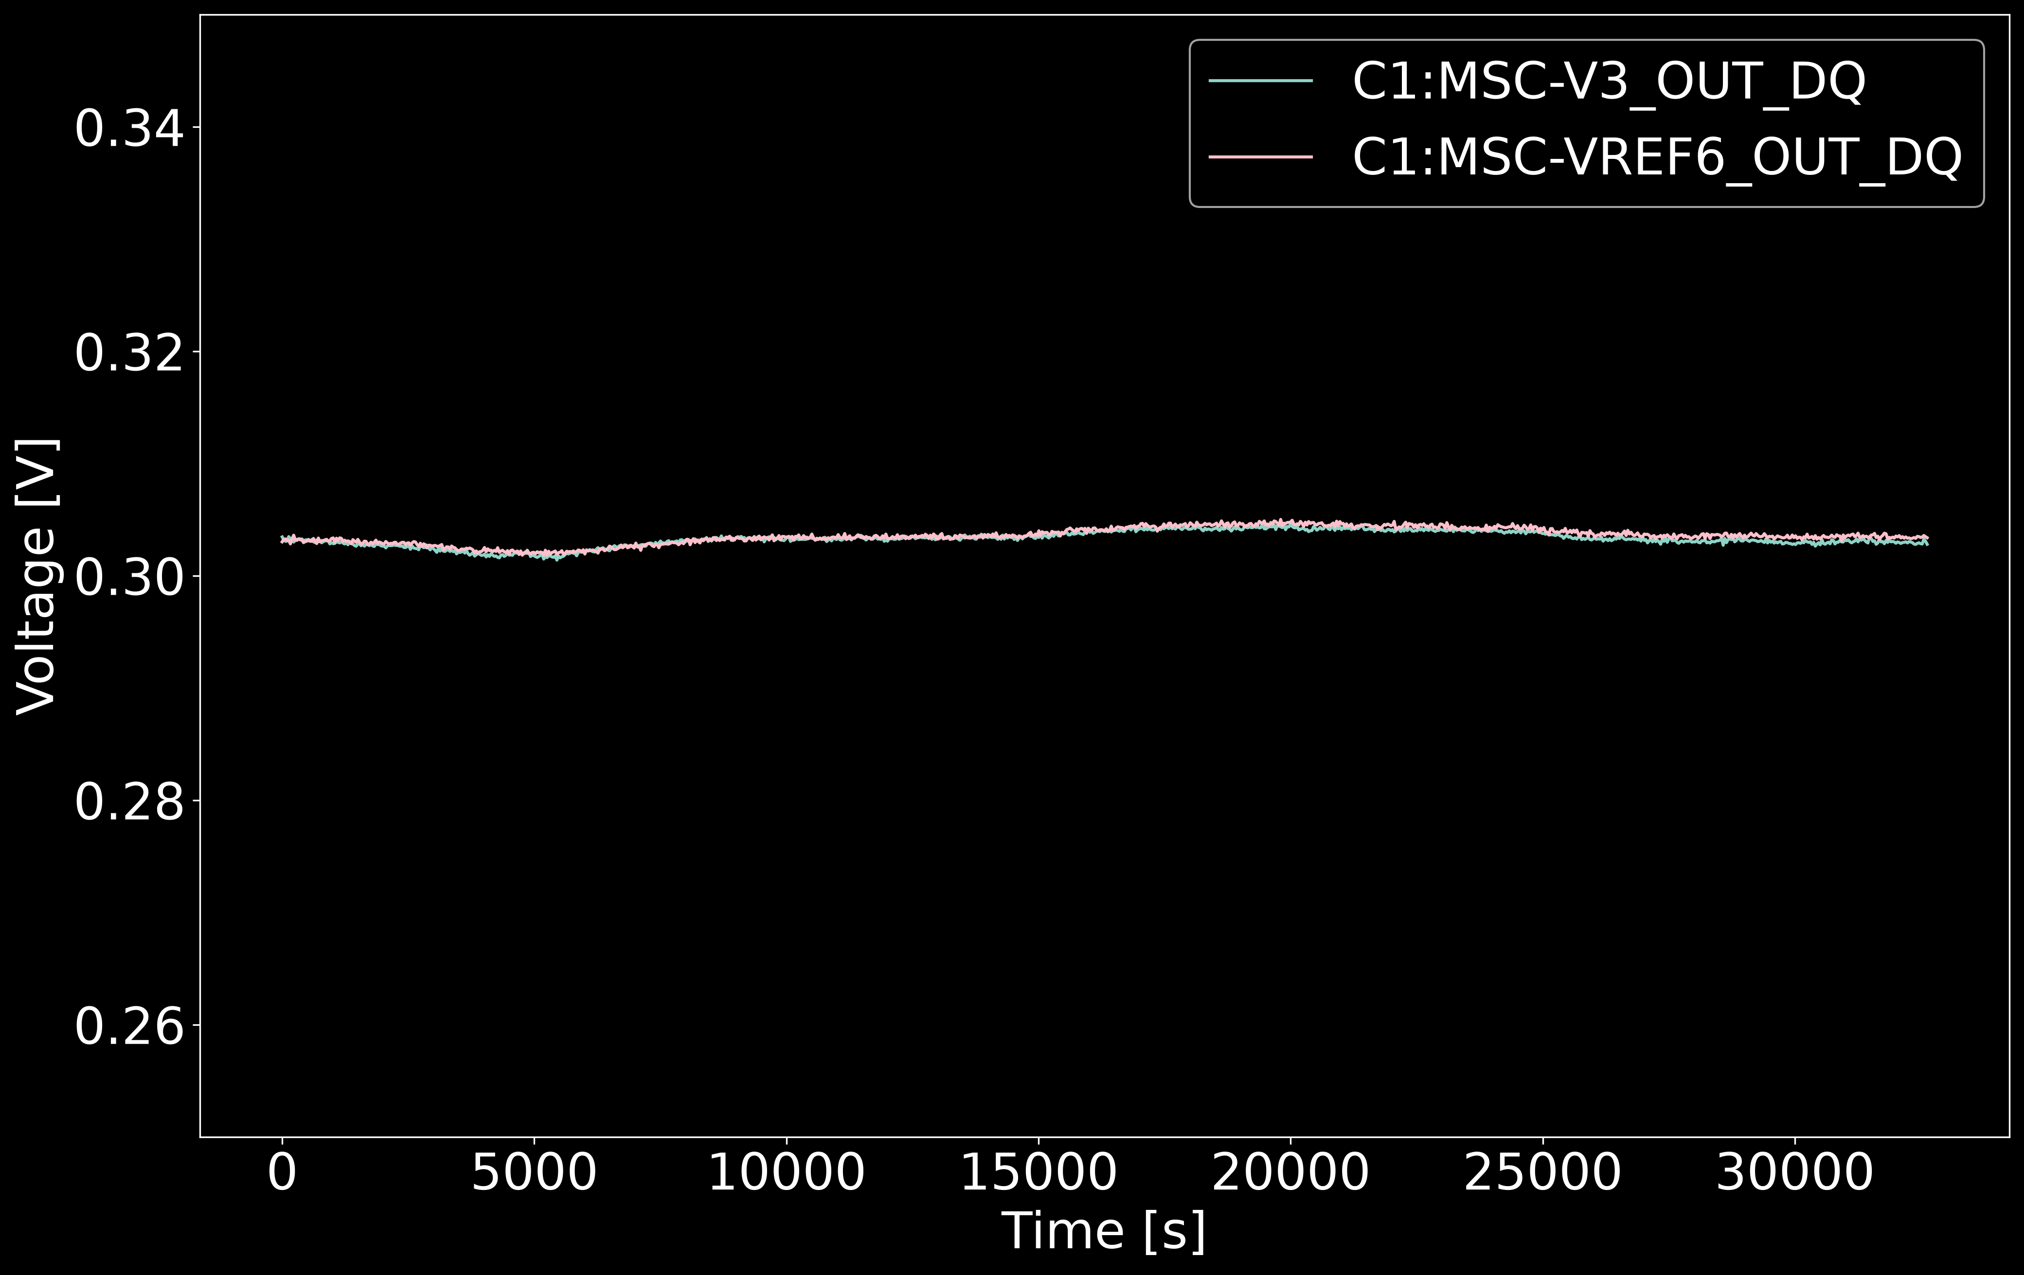
Experiment Assembly
Figure 10. Experiment assembled at the aperture opening of FROSTI. Aligned such that each photodiode is within ±1mV.
Figure 8. FROSTI and the experiment on the optical table.
Figure 9. Experiment mounted to the aperture opening of FROSTI.

Slide 15



With no extra noise, we can model our noise linearly with shot noise and photon bunching
$${\hat{x}}_{1}={\hat{x}}_{shot,1}+{\hat{x}}_{bunching}$$
$${\hat{x}}_{2}={\hat{x}}_{shot,2}+{\hat{x}}_{bunching}$$
Shot noise is independent to each detector
$$PSD[{\hat{x}}_{1}]=ℱ({\hat{x}}_{1})ℱ∗({\hat{x}}_{1})={\left|ℱ({\hat{x}}_{shot,1})\right|}^{2}+{\left|ℱ({\hat{x}}_{bunching})\right|}^{2}$$
The PSD would contain both shot noise and photon bunching
$CSD[{\hat{x}}_{1},{\hat{x}}_{2}]=ℱ({\hat{x}}_{1})ℱ∗({\hat{x}}_{2})$
$=ℱ({\hat{x}}_{shot,1})ℱ∗({\hat{x}}_{shot,2})$
$+ℱ({\hat{x}}_{shot,1})ℱ∗({\hat{x}}_{bunching})$
$+ℱ({\hat{x}}_{bunching})ℱ∗({\hat{x}}_{shot,2})$
$+ ℱ({\hat{x}}_{bunching})ℱ∗({\hat{x}}_{bunching})$
Each shot noise is independent
$CSD[{\hat{x}}_{1},{\hat{x}}_{2}]={\left|ℱ({\hat{x}}_{bunching})\right|}^{2}$
Shot noise and bunching are independent processes
covariance = 0!
Given enough time, the CSD will average down to just the photon bunching signal. We can measure below the quantum shot noise limit!

Slide 16
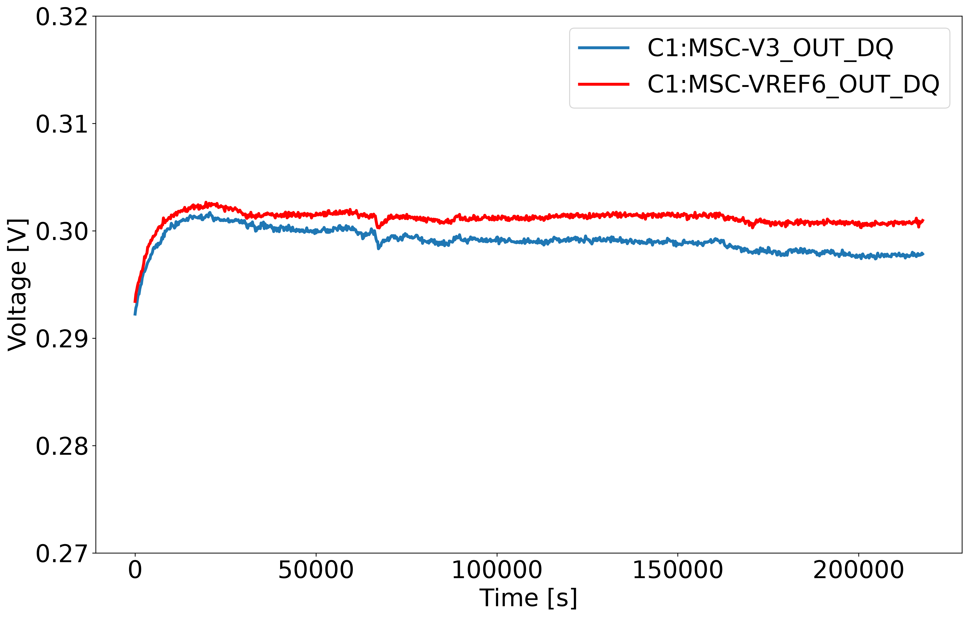
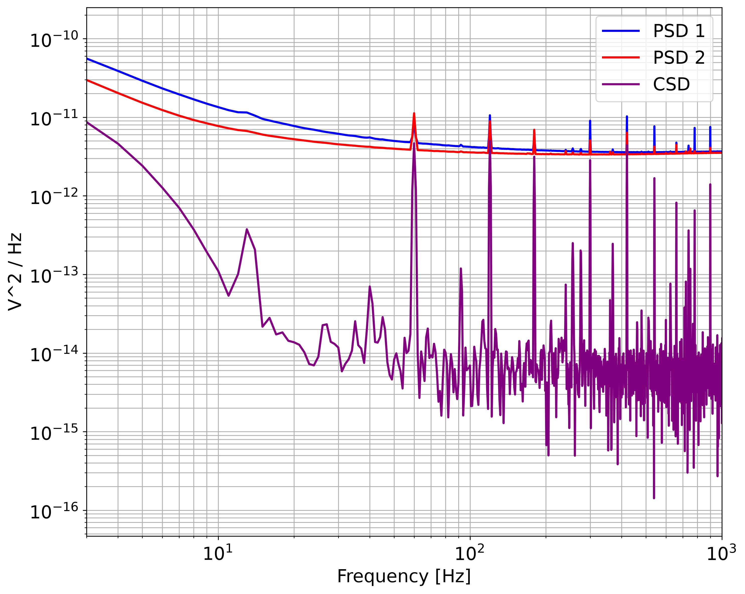
Data Acquisition
3 orders of magnitude
Figure 10. Time series of PD readout voltage
Figure 11. Power Spectral Densities of each voltage reading and their Cross Spectral Density
Taking the Cross Spectral Density eliminates uncorrelated noise between photodetectors!

Slide 17
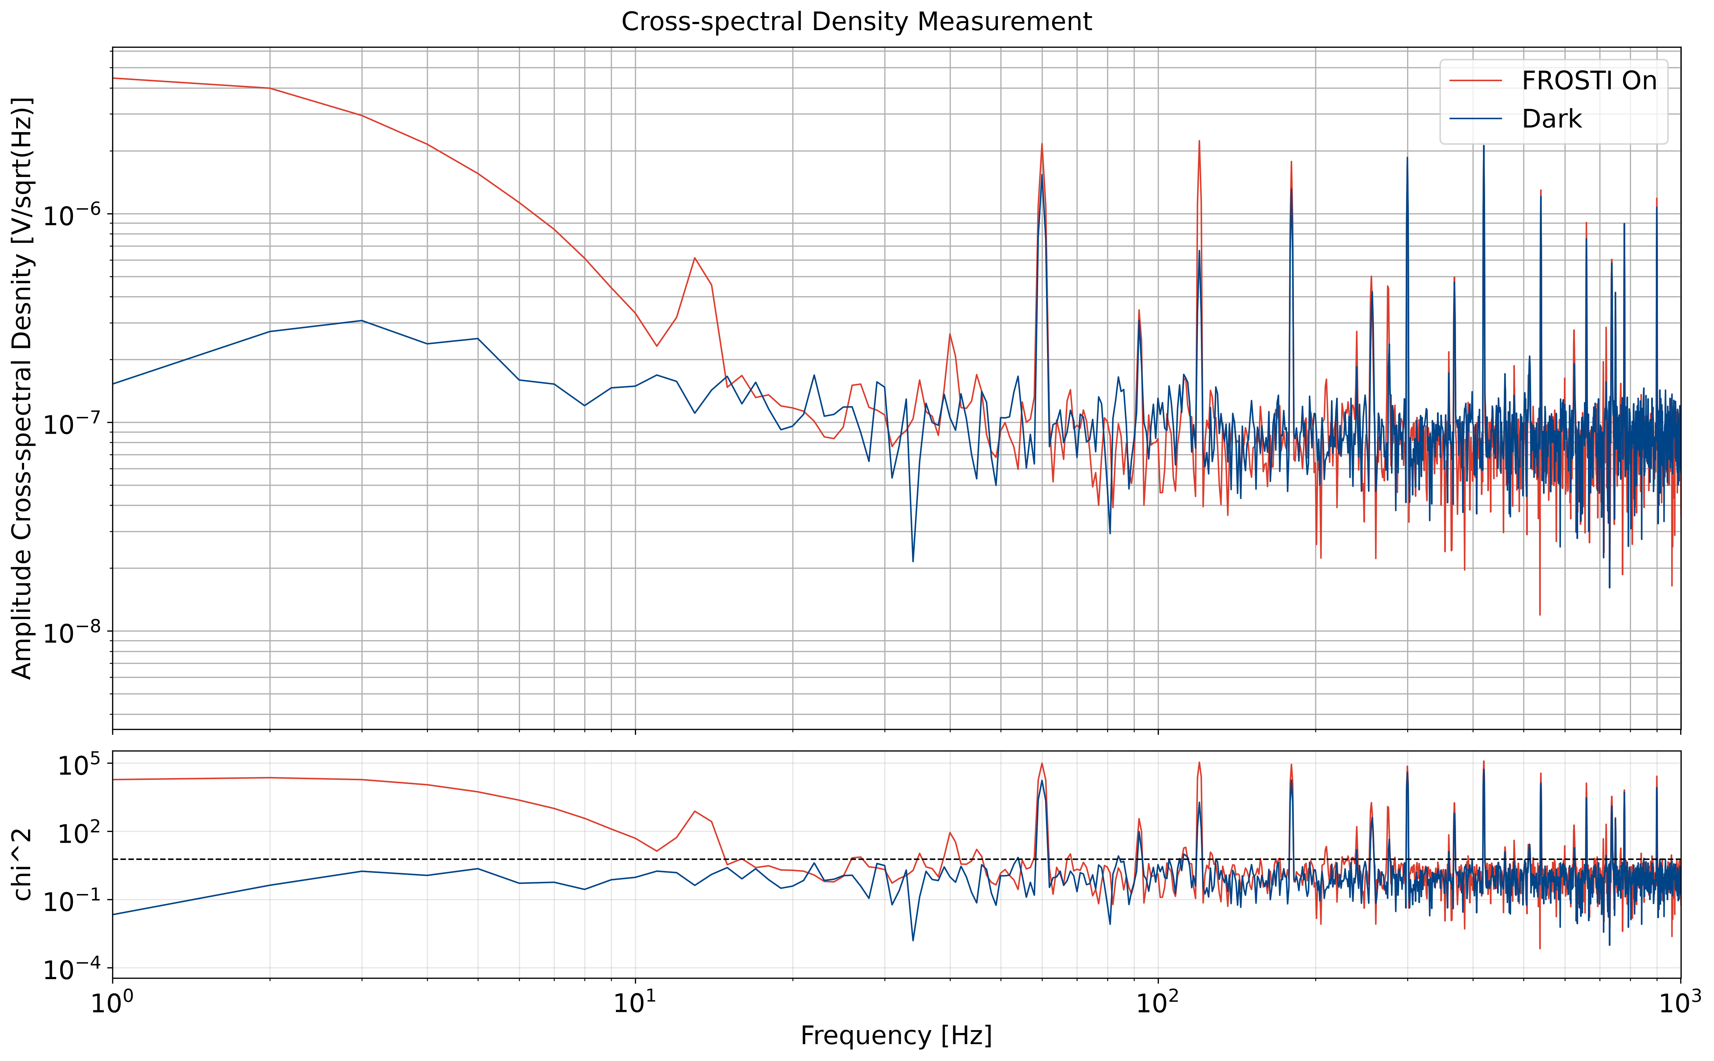
Noise hunting – electrical noise
60Hz Harmonic electronic noise
We identify several peaks in the data correlated with electrical noise.
The peaks are clearly visible in the dark blue curve, which is sensitive only to the electronics noise.
These correlated bands can be excluded without affecting the RIN measurement.
Figure 12. Cross spectral density of preliminary measurements

Slide 18
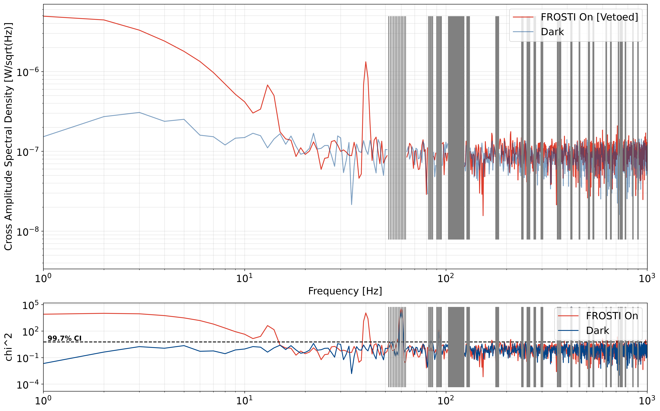

Noise hunting – electrical noise
We identify significant peaks in the dark noise using:
$$χ^{2}=\frac{{S_{12}}^{2}}{S_{1}S_{2}/N}$$
These frequency bins are vetoed from the ‘on’ dataset
Figure 13. Rejection of the 60Hz harmonics electronic noise

Slide 19
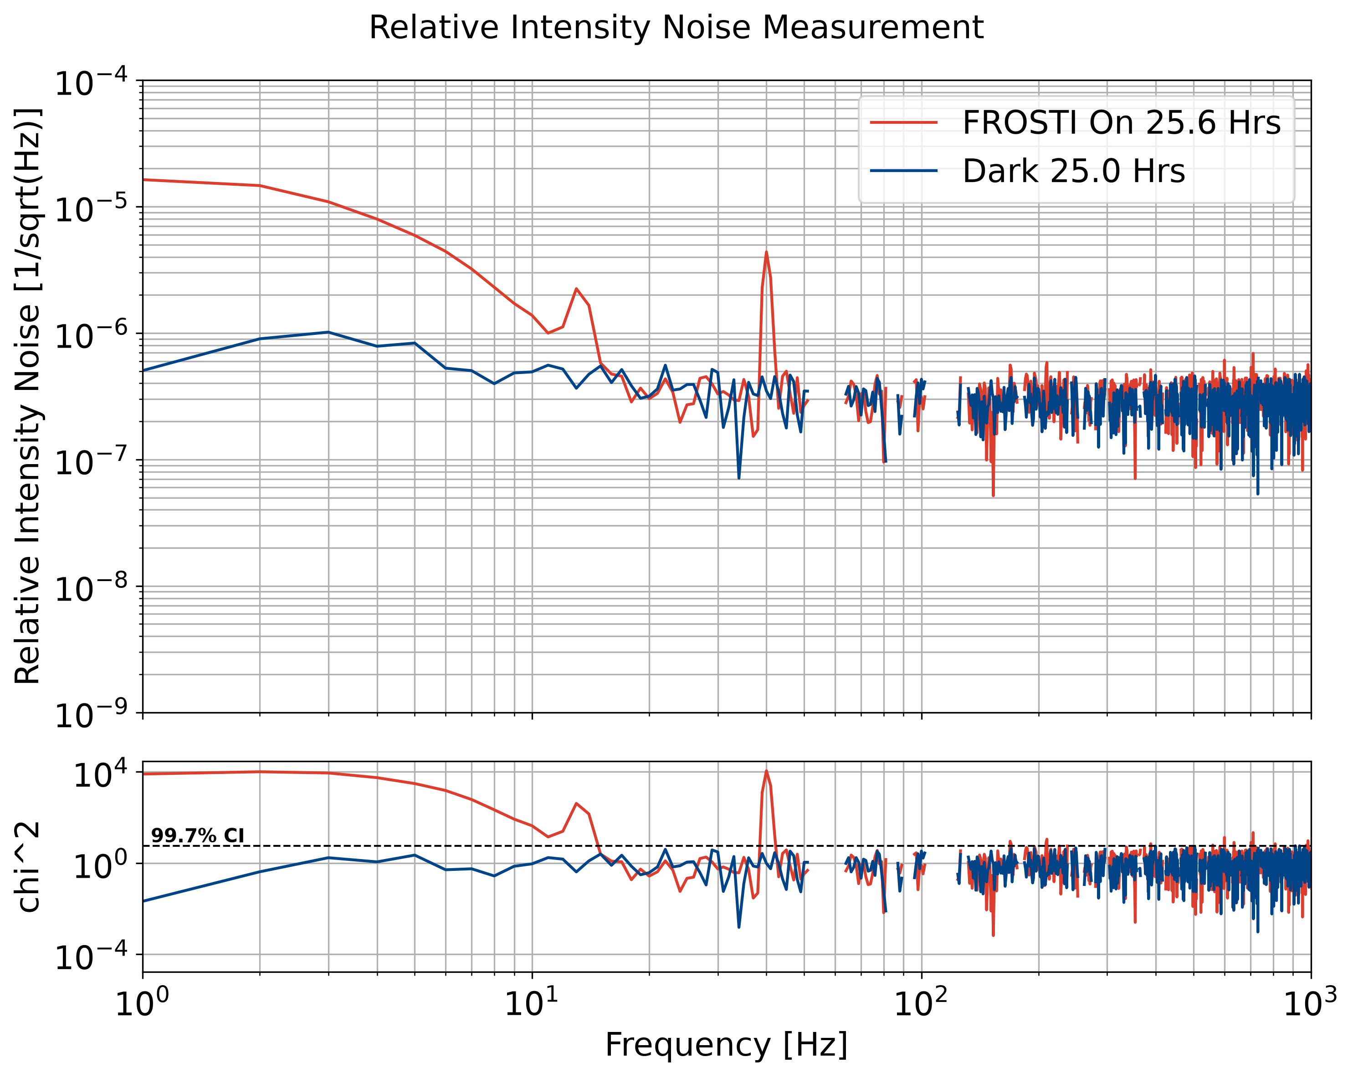

Noise hunting – mechanical resonance
Figure 14. Changing the moment of inertia of the platform yielded a damped peak. This is mechanical vibrations coupling into the platform structure.

Slide 20
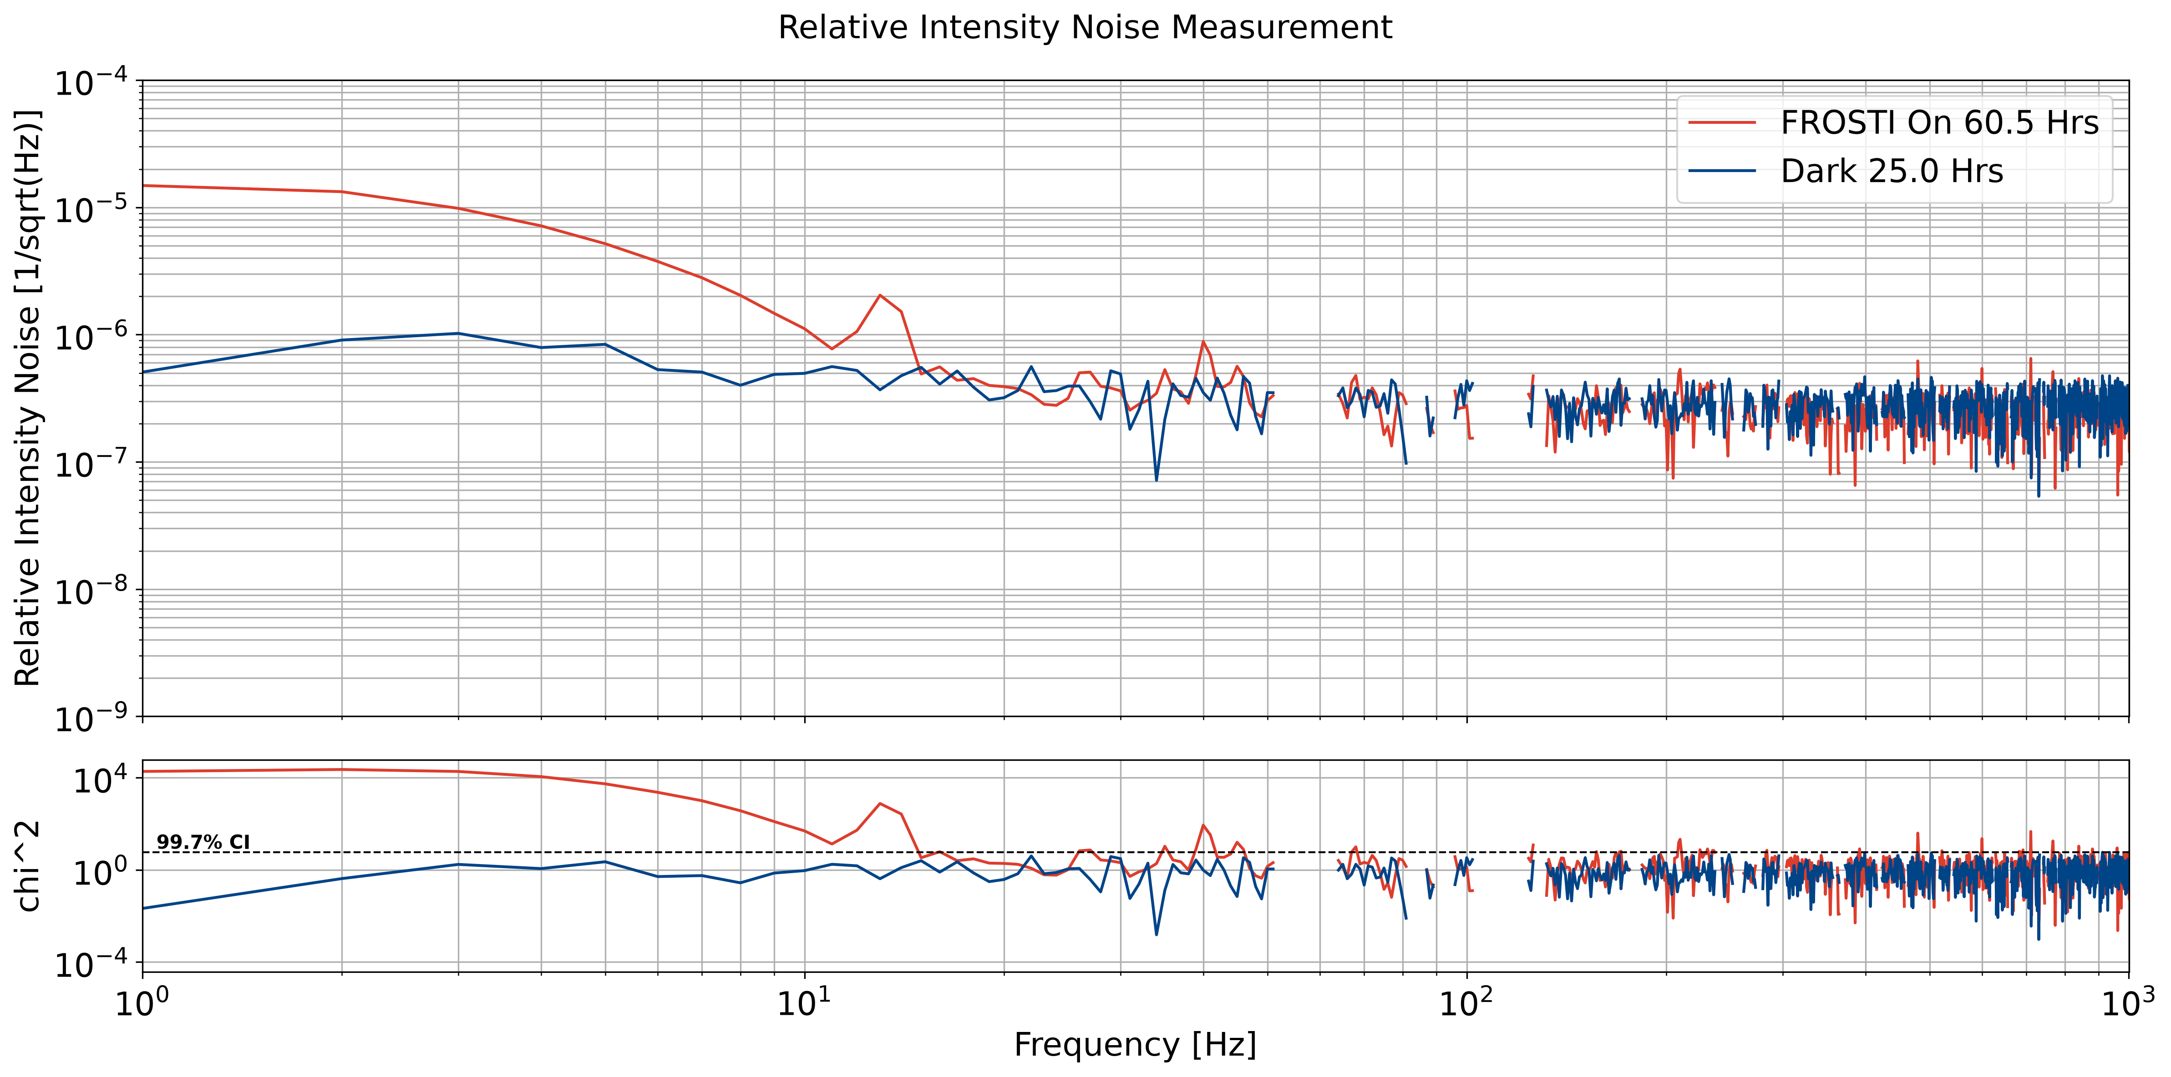
Background noise unrelated to FROSTI
mechanical resonance of sensor platform
(table vibrations, environmental noise, optomechanical vibrations)
Figure 15. Relative Intensity Noise Measurement using new experimental setup

Slide 21
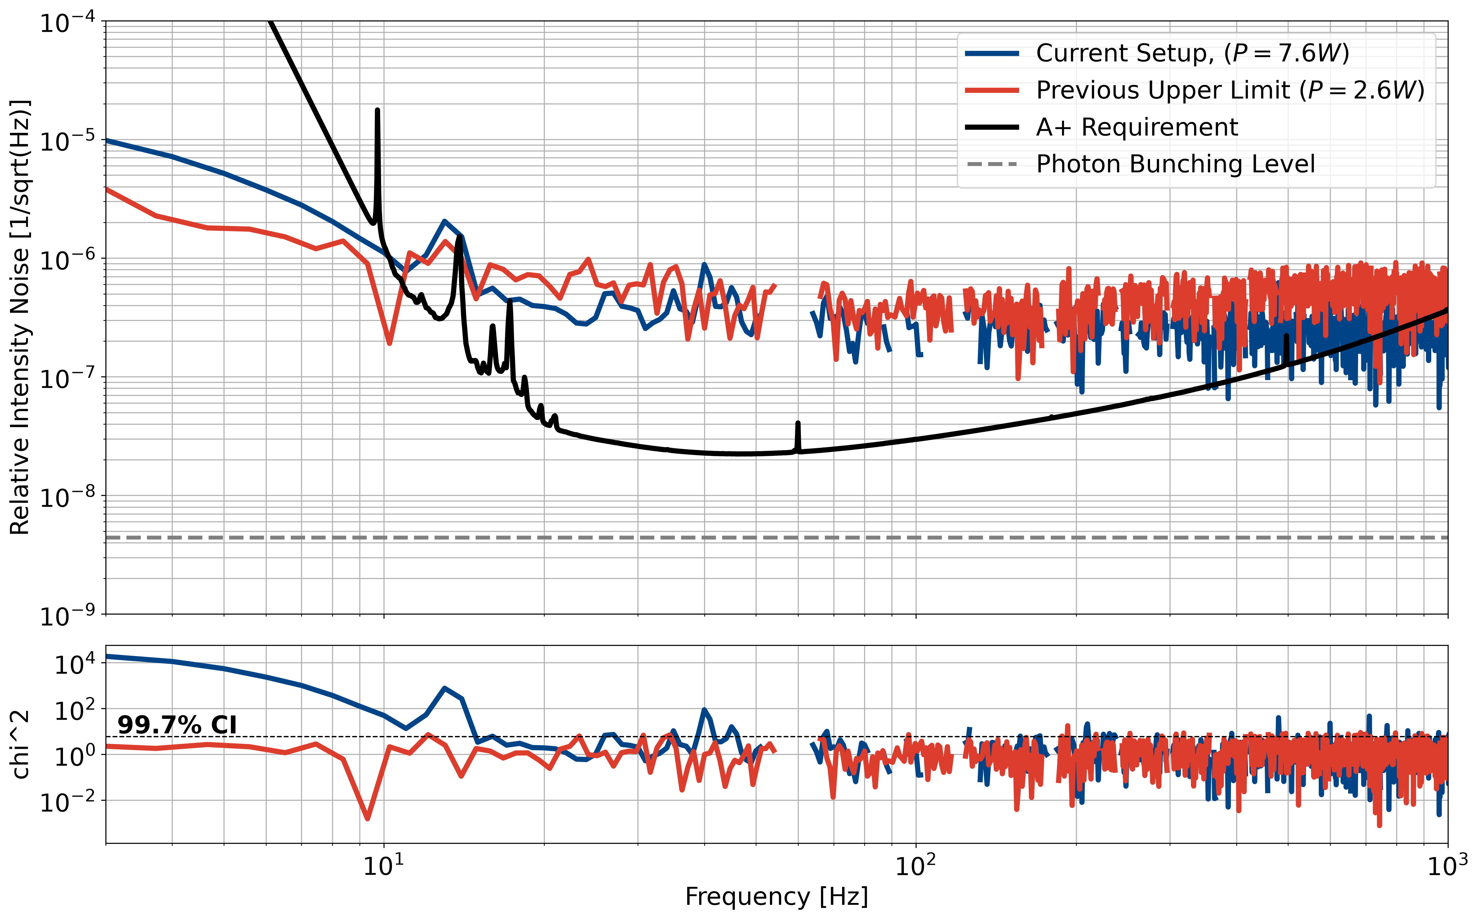
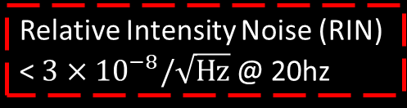
The path to photon bunching
This is just the beginning of measurements!
Measure for ~30 days
More power
Improve electronical sensing noise
Upgrade photodetectors
We will either find technical noise or reach the photon bunching limit.
mechanical resonance of sensor platform
Background noise unrelated to FROSTI
Statistical limit, more averaging
needed
Relative Intensity Noise (RIN) < $3×{10}^{−8}/\sqrt{Hz}$ @ 20hz
A+ Requirement for FROSTI
Figure 16. Current best Relative Intensity Noise (RIN) measurement
Tao et al.
Notes:
It goes down with 1/t^1/4

Slide 22
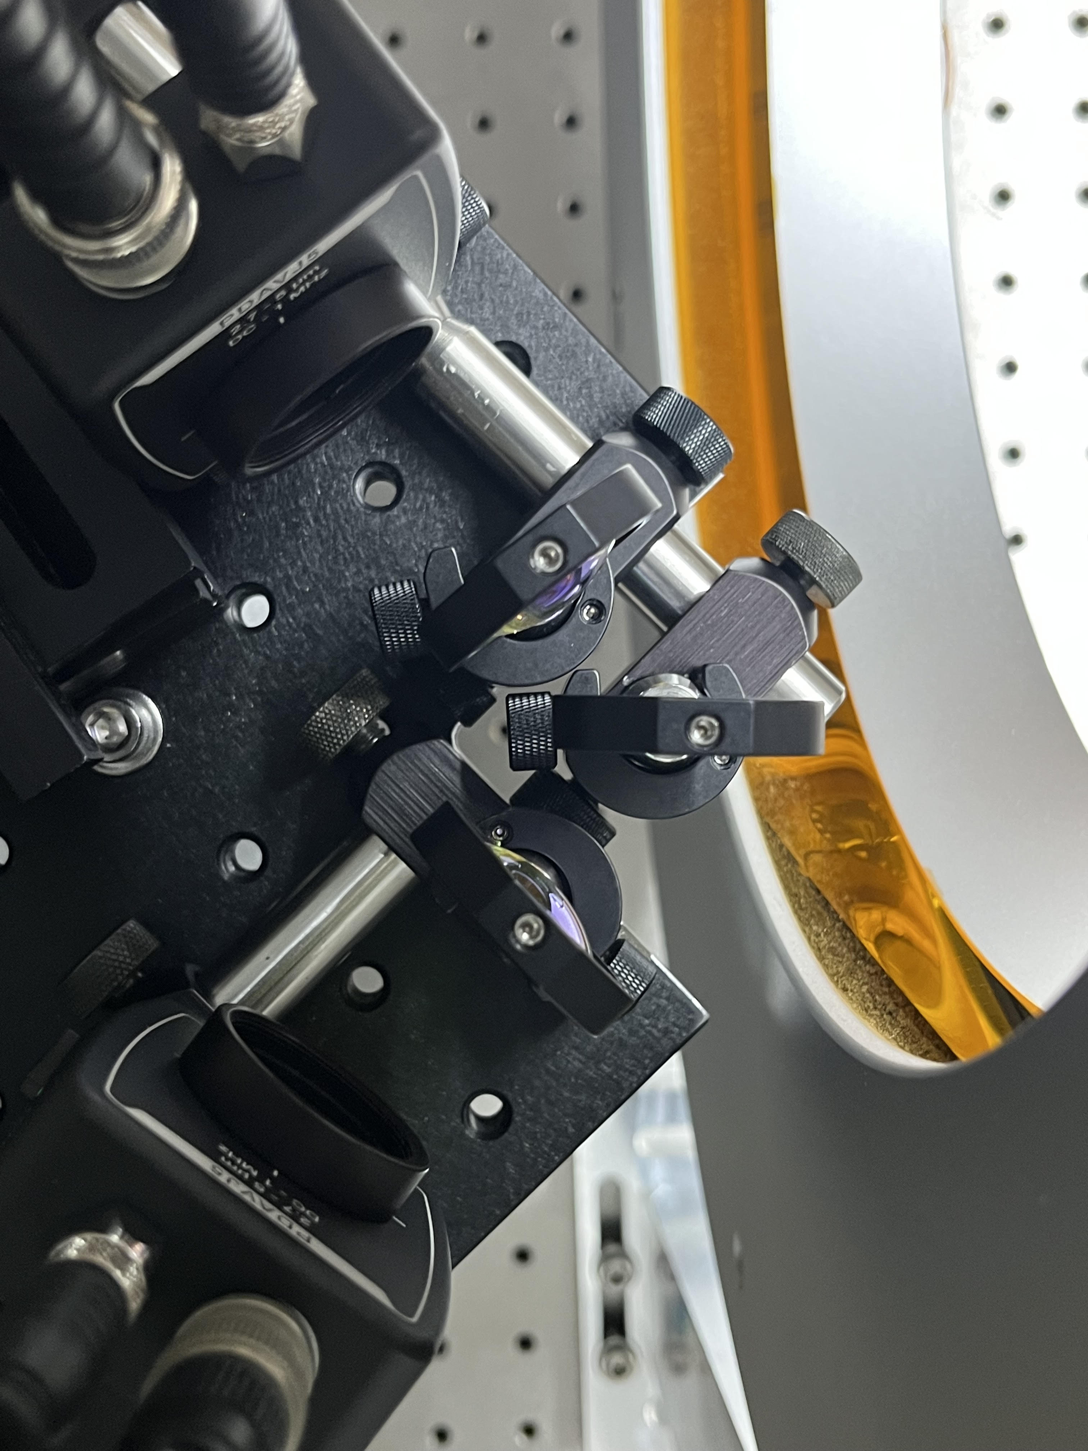
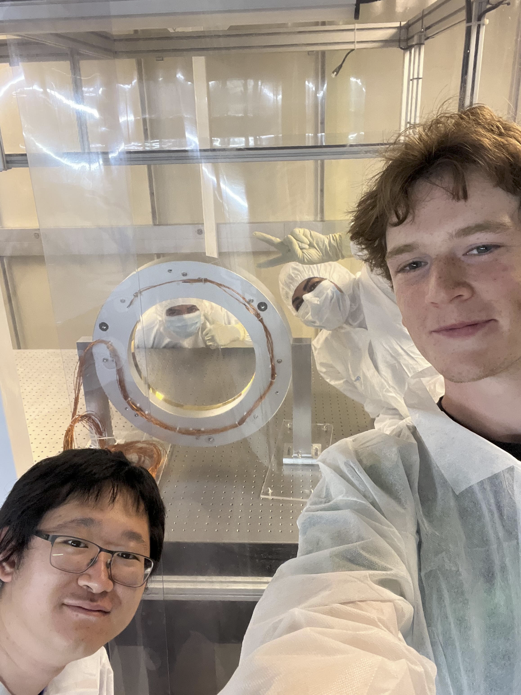
Conclusions
1. We designed, built, and commissioned a new experimental test bed to measure photon bunching within FROSTI’s relative intensity noise.
2. This is only the beginning of a measurement campaign to prove that FROSTI can meet LIGO’s strict requirements.
3. This optical testbed will be used to characterize future FROSTI prototypes as well! (A#)

Slide 23

Acknowledgements
Thank you to all the graduate students at UC Riverside for your mentorship and support during the program.
I would like to acknowledge the Caltech LIGO SURF program, NSF, UC Riverside, Dr. Jonathan Richardson, and Dr. Barry Barish for making this experience possible.

Slide 24
References
Brooks, Aiden, et al. “Overview of Advanced LIGO Adaptive Optics.” Applied Optics,vol. 55, no. 29, 2016, pp. 8256-8265., https://doi.org/10.1364/AO/55.008256.
Tyler Rosauer et al. Demonstration of a next-generation wavefront actuator for gravitational-wave detection. Optica, 12(10):1569–1577, Oct 2025
Liu Tao et al. Expanding the quantum-limited gravitational-wave detection horizon. Physical Review Letters, 134(5), February 2025.
Huy Tuong Cao, “Updates on FroSTI for use in LIGO”, 2023, LIGO-G2300506.
Huygens Optics. (2024, October 19). PMT2: Photon bunching / Hanbury Brown & Twiss effect [Video]. YouTube. https://www.youtube.com/watch?v=NVqT2Gbrvxs

Slide 25
Appendix

Slide 26
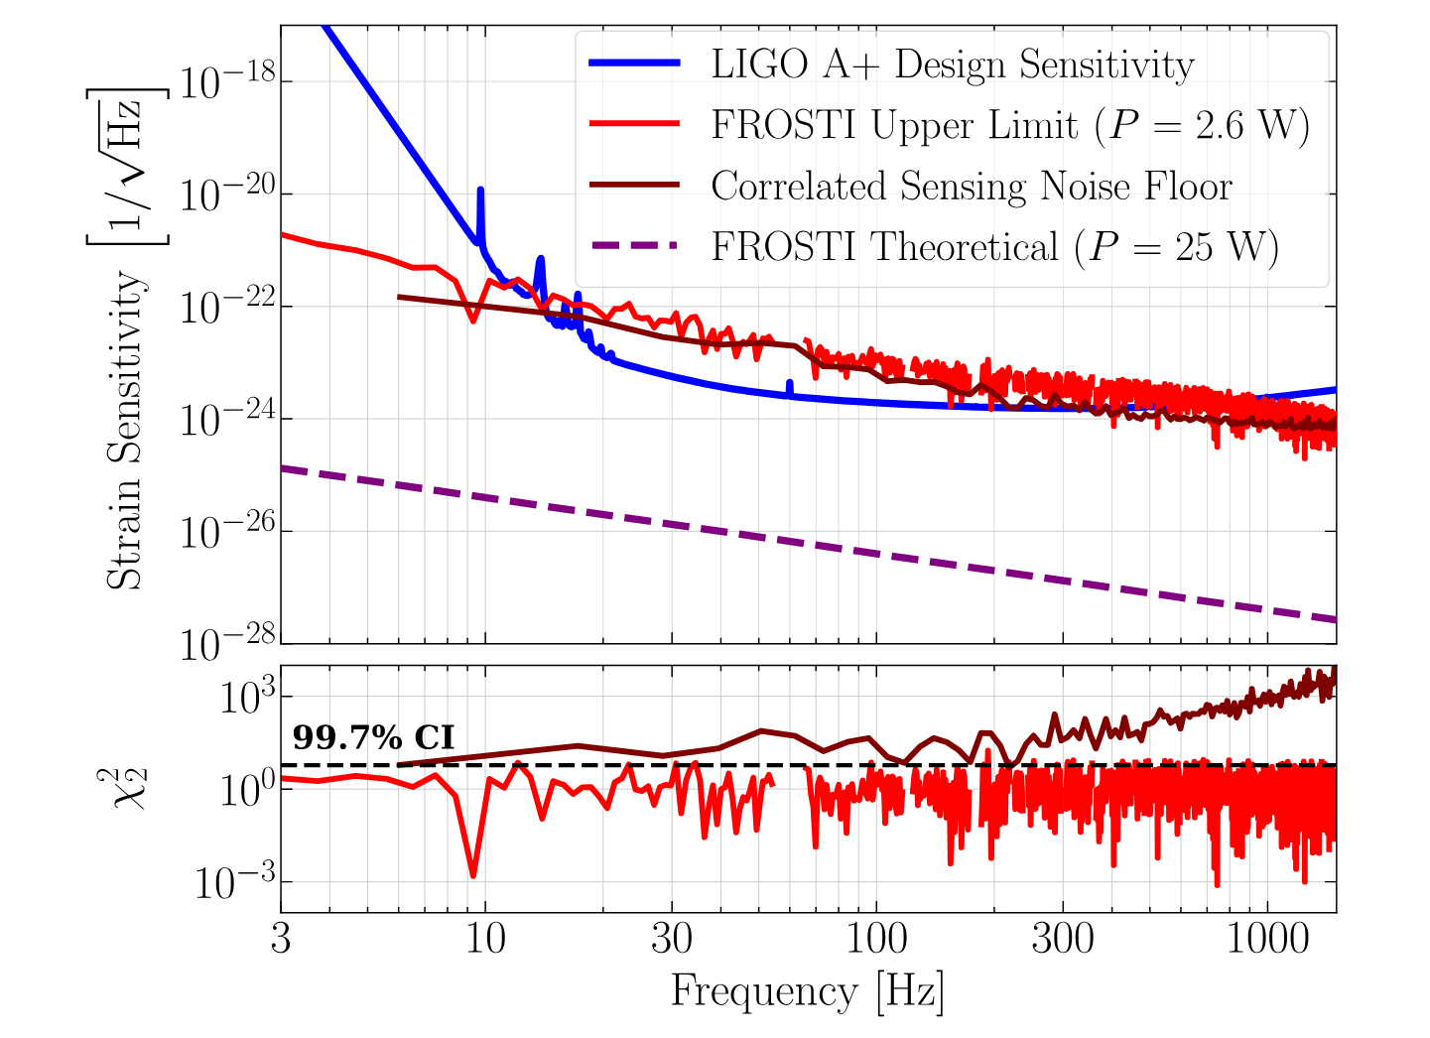
Rosauer et al.

Slide 27
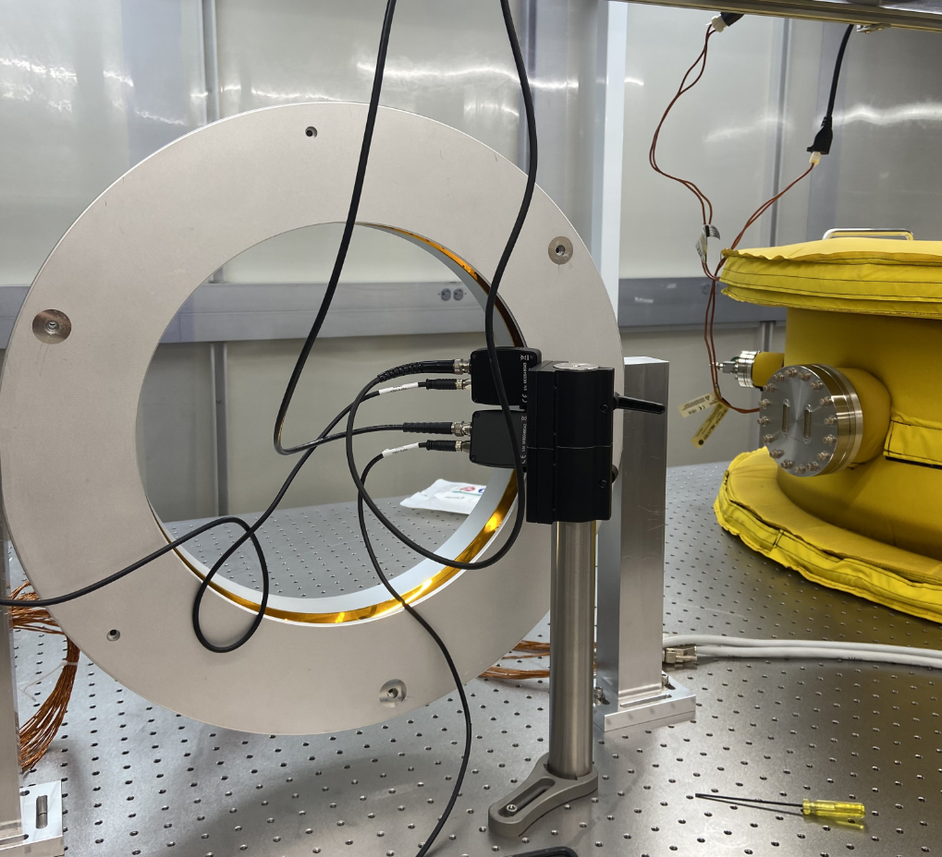
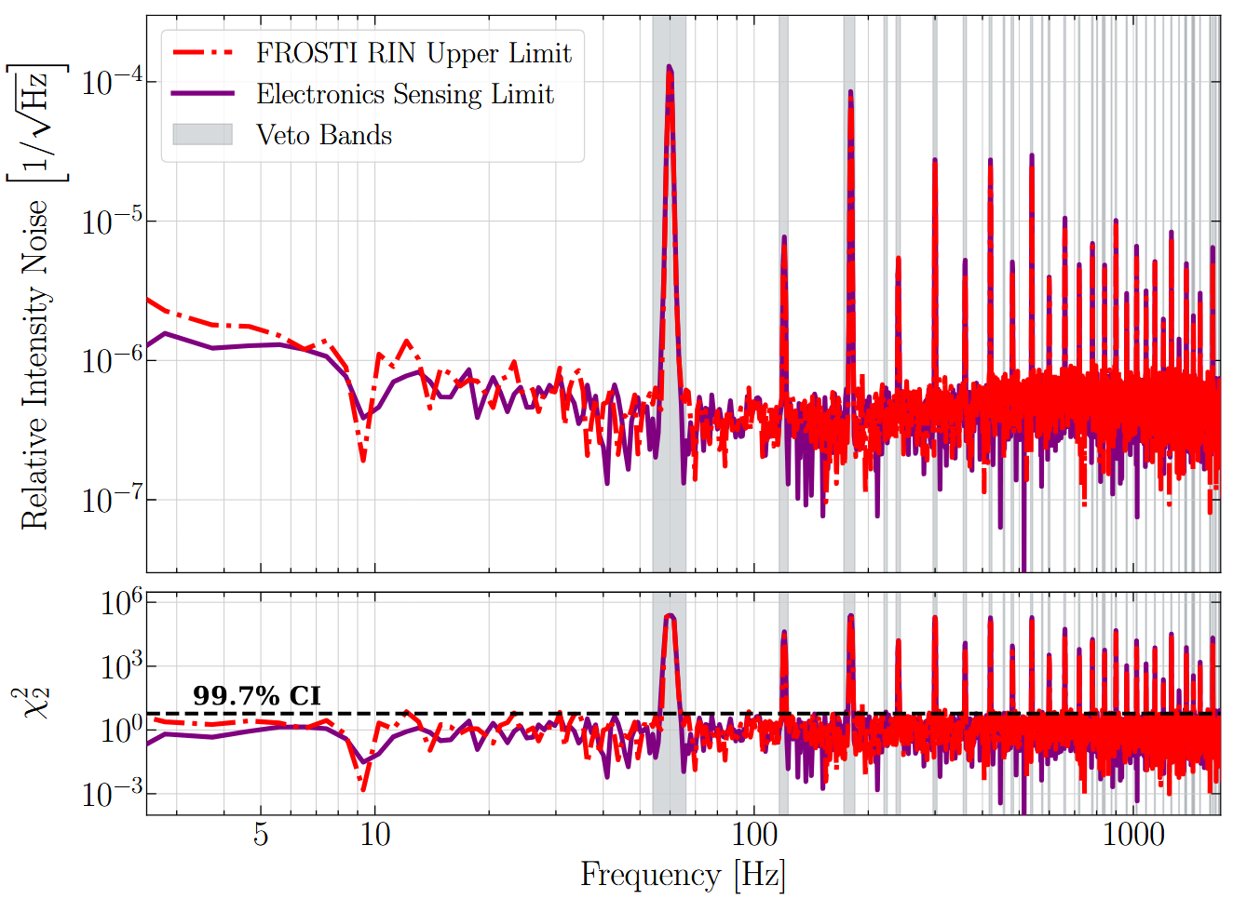

Slide 28
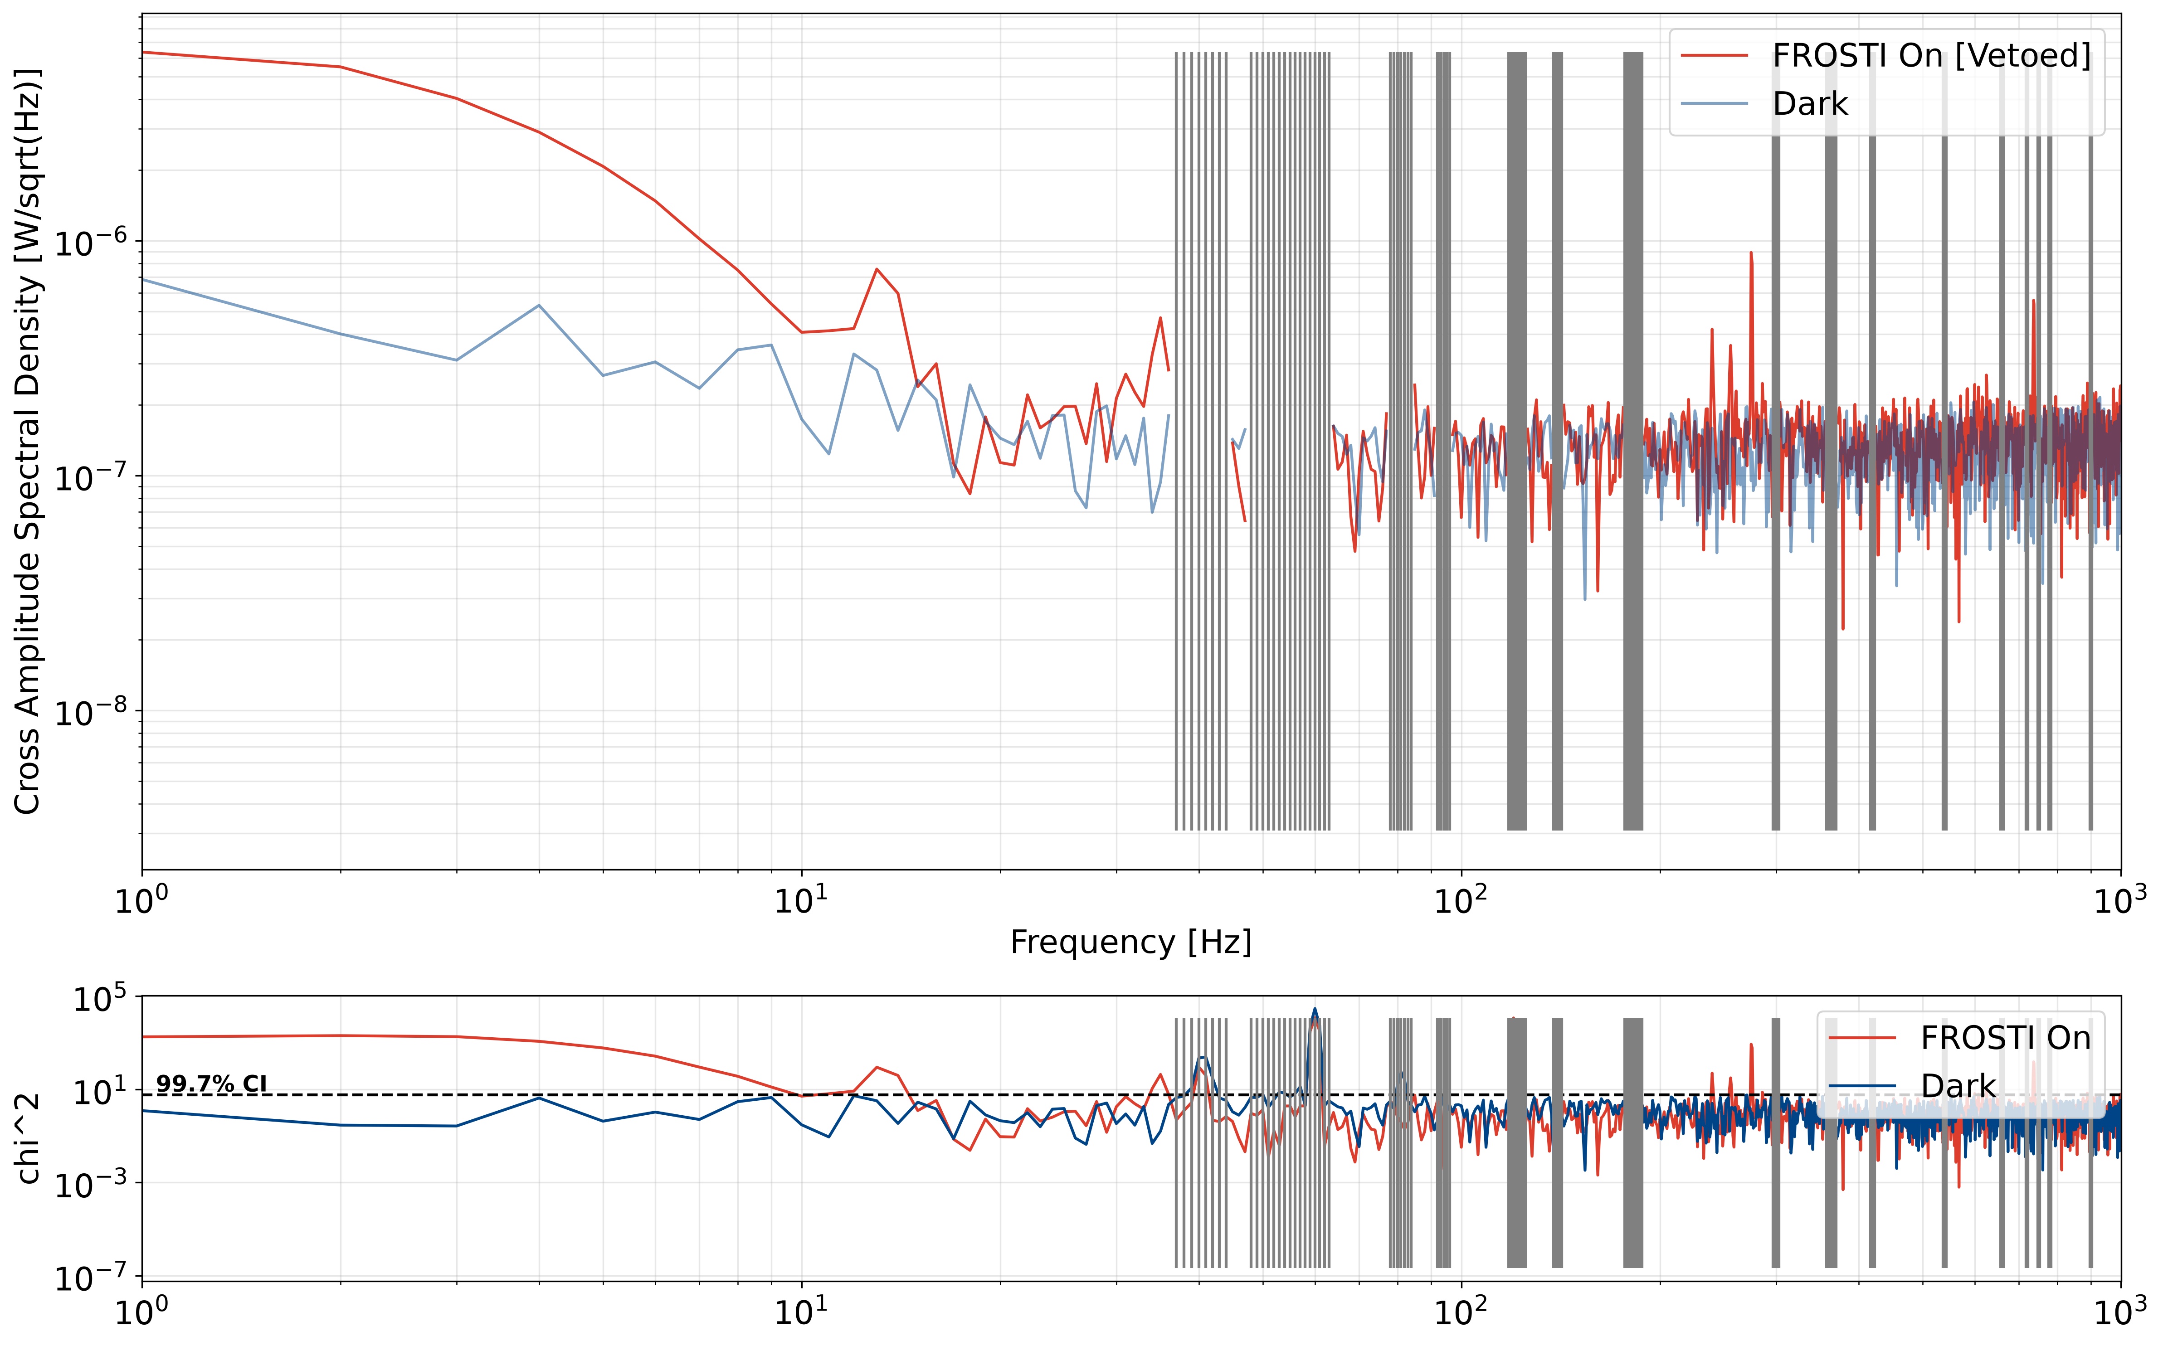

Noise hunting – frequency bin vetoes
We use a 2-DOF χ² statistic to identify non negligible peaks in the electronics sensing.
$$χ^{2}=\frac{{S_{12}}^{2}}{S_{1}S_{2}/N}$$
We use a confidence level of 99.7%, corresponding to a χ² value of 5.9. We reject frequency bins where the dark noise exceeds this value.
Figure. Rejection of the 60Hz harmonics electronic noise

Slide 29
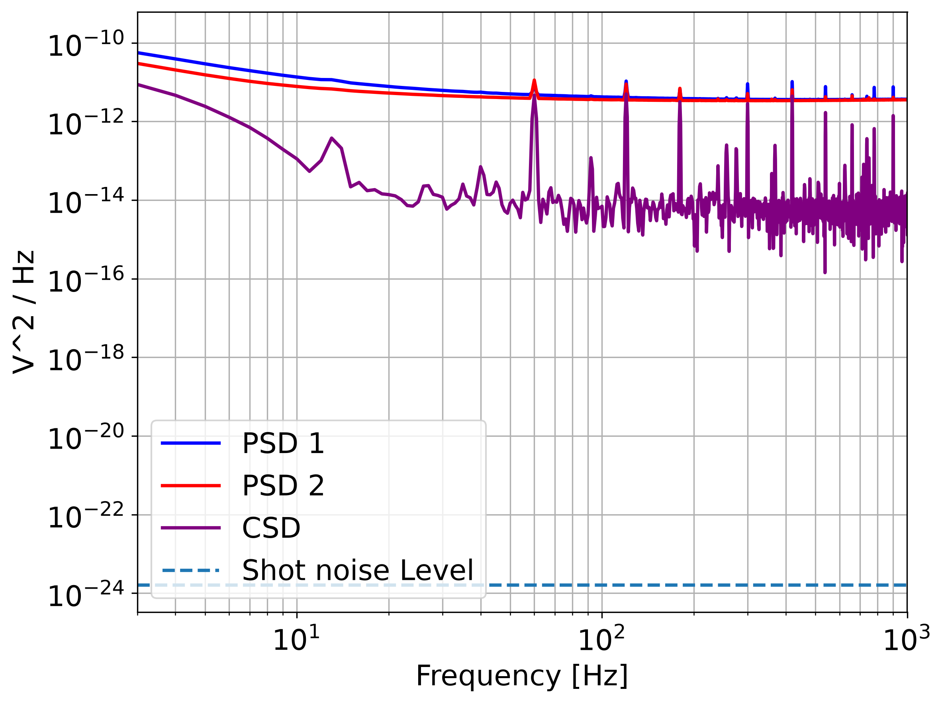

Slide 30
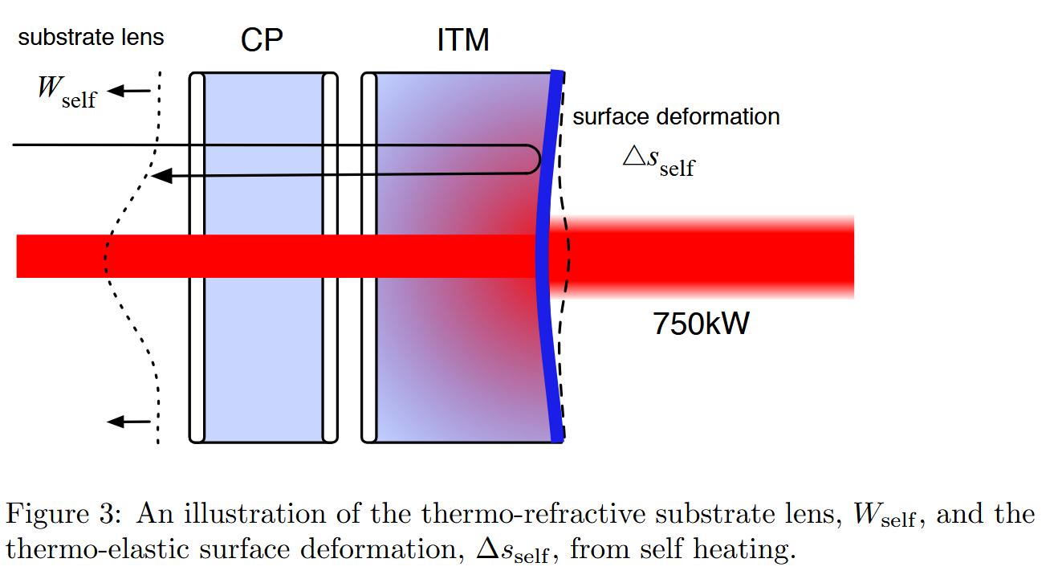
Brooks et al.

Slide 31
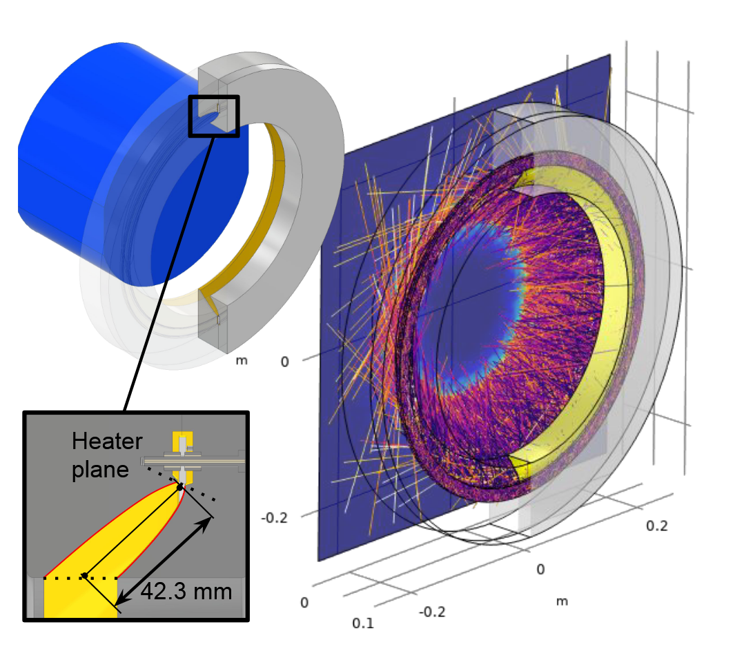

Slide 32
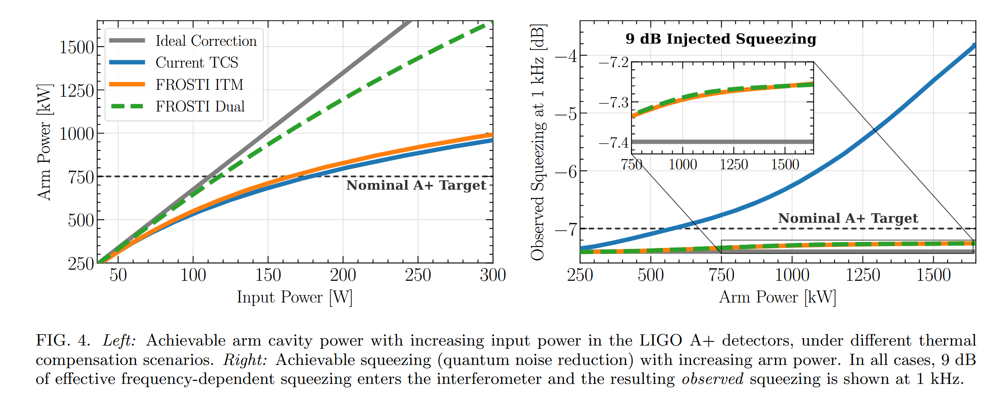

Slide 33

$${σ_{thermal}}^{2}=(\frac{e^{hν/kT}}{e^{hν/kT}−1}−1){σ_{shot}}^{2}+{σ_{shot}}^{2}$$
$${σ_{thermal,correlated}}^{2}=(\frac{e^{hν/kT}}{e^{hν/kT}−1}−1){σ_{shot}}^{2} \\ {CSD}_{thermal}={PSD}_{shot}(\frac{e^{hν/kT}}{e^{hν/kT}−1}−1)$$
$$RIN_{thermal}={{PSD}_{shot}}^{1/2}\sqrt{\frac{e^{hν/kT}}{e^{hν/kT}−1}−1}/P=RIN_{shot}\sqrt{\frac{e^{hν/kT}}{e^{hν/kT}−1}−1}$$

