Slide 1
running update on LIGO beam tube dynamics analysis
For CEBEX (Cosmic Explorer Beam Tube Experiment), pursuing discrepancy between previous dynamic analysis of the LIGO BT and measurements
The following pages are excerpts from running CEBEX team log (G2500320)
  29-Oct-2025
  5-Nov-2025
  19-Nov-2025
See also:
  Original dynamic analysis: LIGO-T1400698, “Vacuum Beam tube FEA notes”
  BT dynamic measurements: LHO Logbook entry #6418
  BT anchor stiffness estimates: LIGO-T2500383, “LIGO Beamtube Support Anchors”

Slide 2
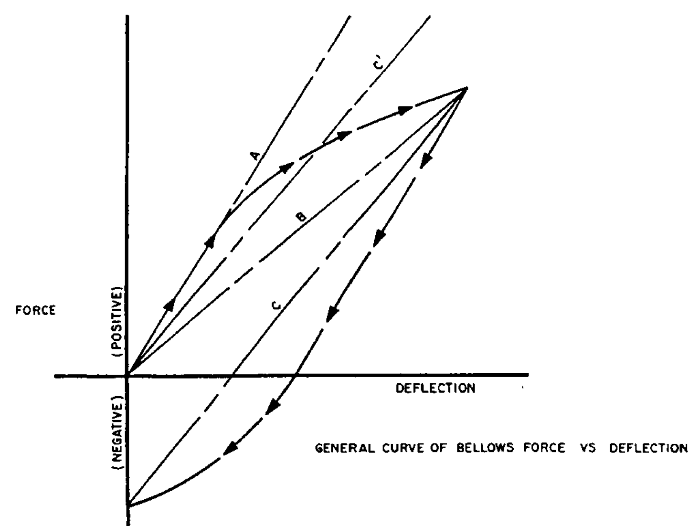
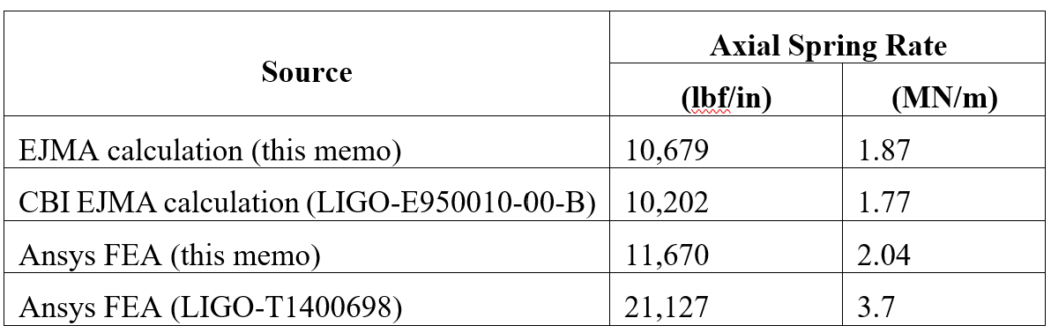
Modal and Dynamic analysis of the beamtube
Last week Mike mentioned that Fabrice had done some extensive FEA of the LIGO BT but couldn’t match Robert’s frequency response measurements - see T1400698 and LHO Logbook entry #6418
  FEA computed bellows axial spring rate was much stiffer than CBI measurements
  Refined FEA first mode frequency of 12.4 Hz compared to 8 Hz from measurements
Bellows axial spring rate discrepancy:
Initial Elastic SR
Initial Elastic SR
Working SR

Slide 3
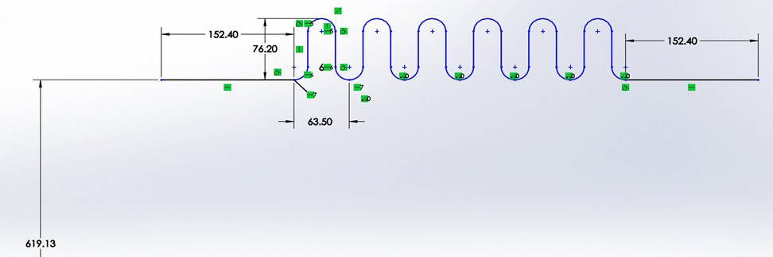
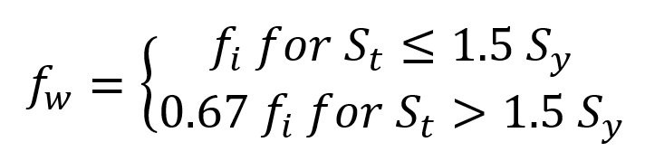
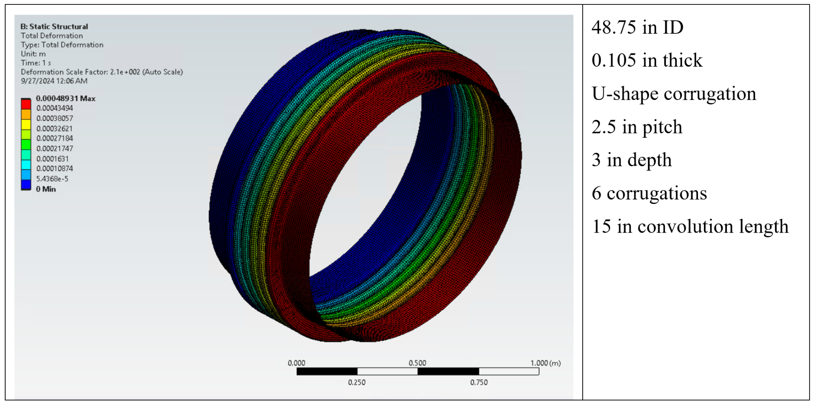
Modal and Dynamic analysis of the beamtube (continued)
Working spring rate:
Stress range, S_{t}, for bakeout far exceeds yield strength, S_{y}
Calculated working SR = 0.67 x 1.8 MN/m = 1.2 MN/m
Measurements of the spring rates of the first 125 bellows = 0.845 MN/m ± 10%
Closer agreement between analysis and SR measurement … and not the reason for the modal frequency disagreement

Slide 4
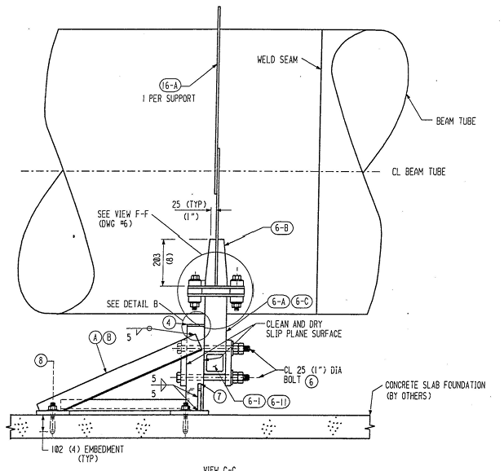
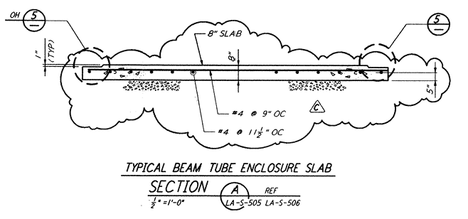
Modal and Dynamic analysis of the beamtube (continued)
T1400698 FEA boundary condition is for the bases (bottom faces) of the Fixed Support and Guided Support to be clamped (fixed)
The bases are in fact bolted to the cement slab which rests upon the ground
The embedded bolts and the cement slab, supported by the ground (semi-infinite, elastic half-space), may have significant compliance relative to the steel tube and its supports
  → I plan to include this in a revised FEA …

Slide 5
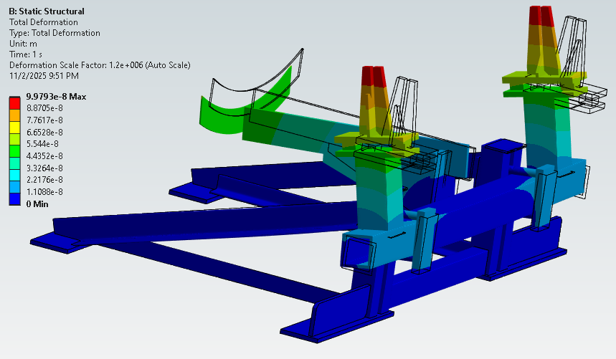
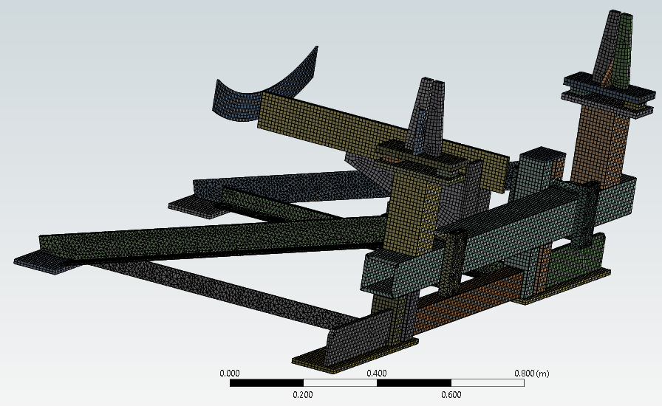
Match LIGO Vibration Measurements with FEA
Revisit the dynamic FEA in LIGO-T1400698
Repeated fixed support stiffness analysis in T1400698 as first step
Modeled using CBI drawings D950035, D950036, D950037
Same result, k = F/x = 1.00e7 N/m
Next step is to add reinforced concrete slab to model

Slide 6
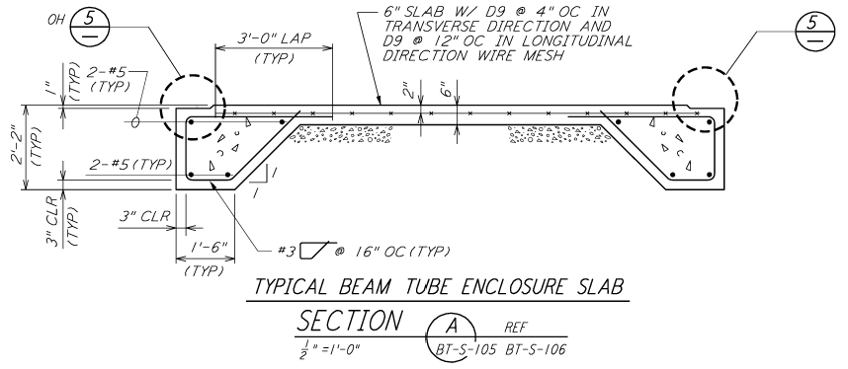
Reinforced concrete slab model
Hanford Final Design Report, C960774 (Vol. III-A-2)
  Volume II, section 10, Concrete Slabs on Grade
    Modulus of subgrade soil reaction, K=100 #/in^3 (conservative based on soil reports)
  Volume II, section 9, Strip Footing Design
    Soil
      Ks = 190.1 kcf (modified for rectangular shape of footing/pad, see pg. 56 of 222)
      Qa = 3 ksf ?
    Concrete
      Ec = 3122 ksi
      𝝂 = 0.250
LHO Geotechnical Survey (aka soil report), C930032 (see pg. 14 of 204)
ACI-318-99:
  “For nonprestressed slabs, it is normally appropriate to reduce slab bending stiffness to between one-half and one-quarter of the uncracked stiffness”
D961240-C, Parsons LA-S-505
LLO issued for bid
D961582-A, Parsons BT-S-105
LHO issued for as-built

Slide 7
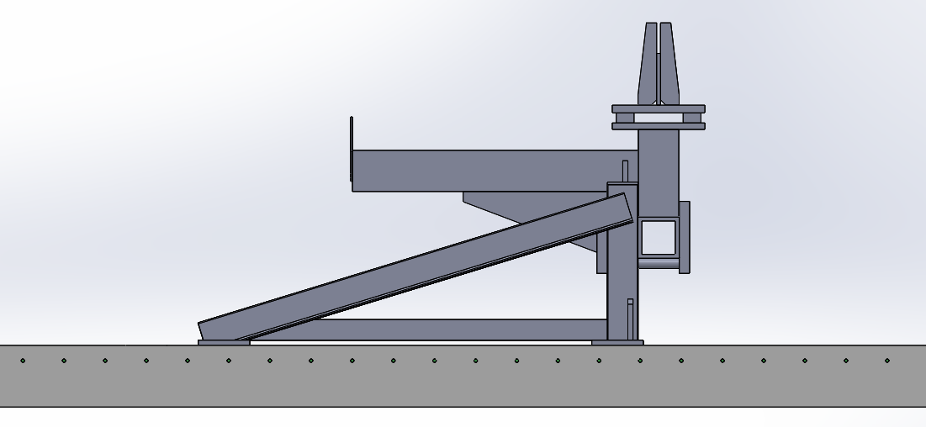
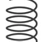
Reinforced concrete slab model
Transformed section method
  composite beams/slabs (e.g. reinforced concrete) transformed into a single, homogeneous cross-section by converting one material (rebar) into an equivalent area of the other material (concrete)
  Modular ratio, n = E_{steel}/E_{concrete} = 9.3
  Reinforcing wire mesh is small diameter:
  D9 = 0.338” diameter (8.58 mm)
  Longitudinal spacing is large:
  12” (0.305 m)
  Bending is not about the slab neutral axis
  Effective increase in slab thickness due to wire mesh is trivial (1.6 mm)

Slide 8
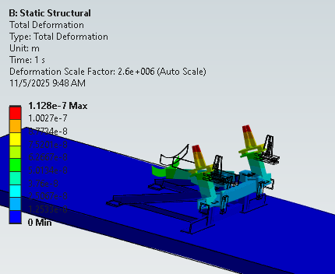
Reinforced concrete slab model
k = F/x = 0.887E7 N/m
transformed slab & elastic soil foundation
¼ cement modulus for nonprestressed, cracked slab
Not enough to explain the T1400698 predicted 12.4 Hz vs 8 Hz measurement

Slide 9
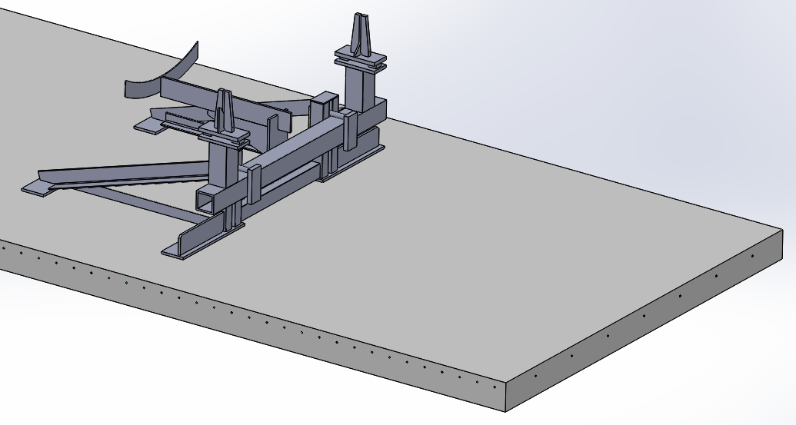
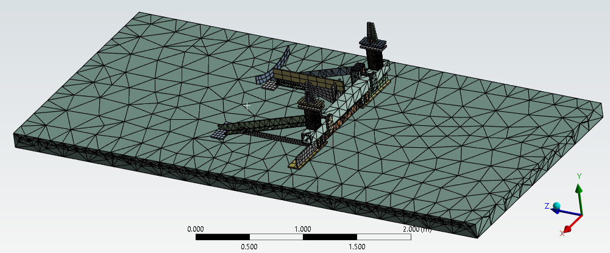
Reinforced Concrete with Reinforcement Mesh Explicitly Modeled & Elastic (Soil) Foundation
Insufficient memory on pleione … need to try again on eng10 when available
Can also do more explicit/detailed modeling of the bolted joints in the fixed support

Slide 10
Expansion anchor preload (torque) relaxation & spring rate
See E2500383 for details
In search for reason that finite element modeling of the LIGO beam tube dynamics (T1400698) didn’t match measurements (LHO Logbook entry #6418), discovered:
  CBI may not have specified a quantitative torque value to be applied at the time of installation
    Important to “set” the expansion wedge
  The preload (torque) declines to between 40% and 50% of the initial value over a period of a few months to a year
    However, Hilti strength values are based on 50% relaxation of pre-load, so not a problem
Anchor spring rate
  Hilti software PROFIS:
    does not directly provide a single output value for the spring stiffness, but rather incorporates these proprietary, test-based stiffness values into its internal calculations to determine load distribution on the anchors
    Will attempt to “reverse engineer” anchor stiffness from load distribution calculations
    Does not include the LIGO 1990s model of the expansion anchor (KB-II)
  Found Hilti value for current generation expansion anchor (Kwik Bolt TZ2) and will use in updated LIGO BT dynamic analysis to determine first modal frequency

