Slide 1
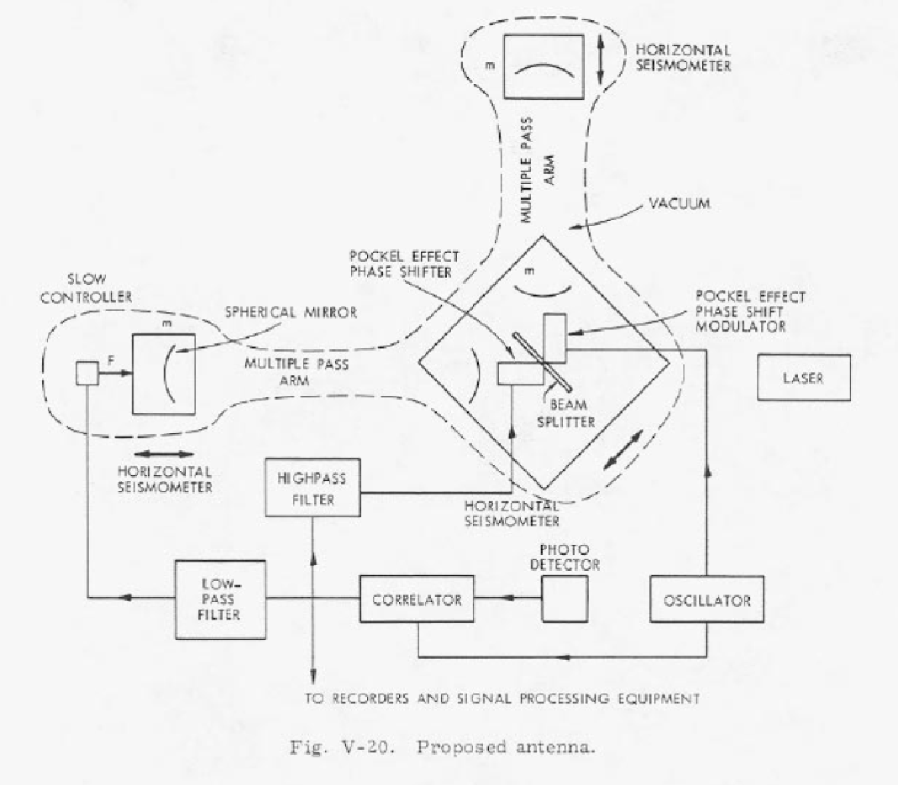
Rai Weiss and the Origins of LIGO
Stan Whitcomb
Symposium
to celebrate Rai's life
27 February 2026

Slide 2
Three Key Documents
“Rai’s RLE paper”
  “Electromagnetically Coupled Broadband Gravitational Antenna”
  R. Weiss, Quarterly Reports of the Research Laboratory of Electronics MIT 105, p. 54 (1973).
  “… grew out of an undergraduate seminar that I ran at M.I.T. several years ago…”
The “Blue Book”
  “A Study of a Long Baseline Gravitational Wave Antenna System”
  Dated October 1983, but never really published
  Authors: Paul Linsay, Peter Saulson, Rai Weiss + 2 Eng Co.
1989 Proposal to NSF for LIGO Construction
  Proposal team: Robbie Vogt, Ron Drever, Rai Weiss, Kip Thorne, Fred Raab, but proposal had contributions from many others

Slide 3
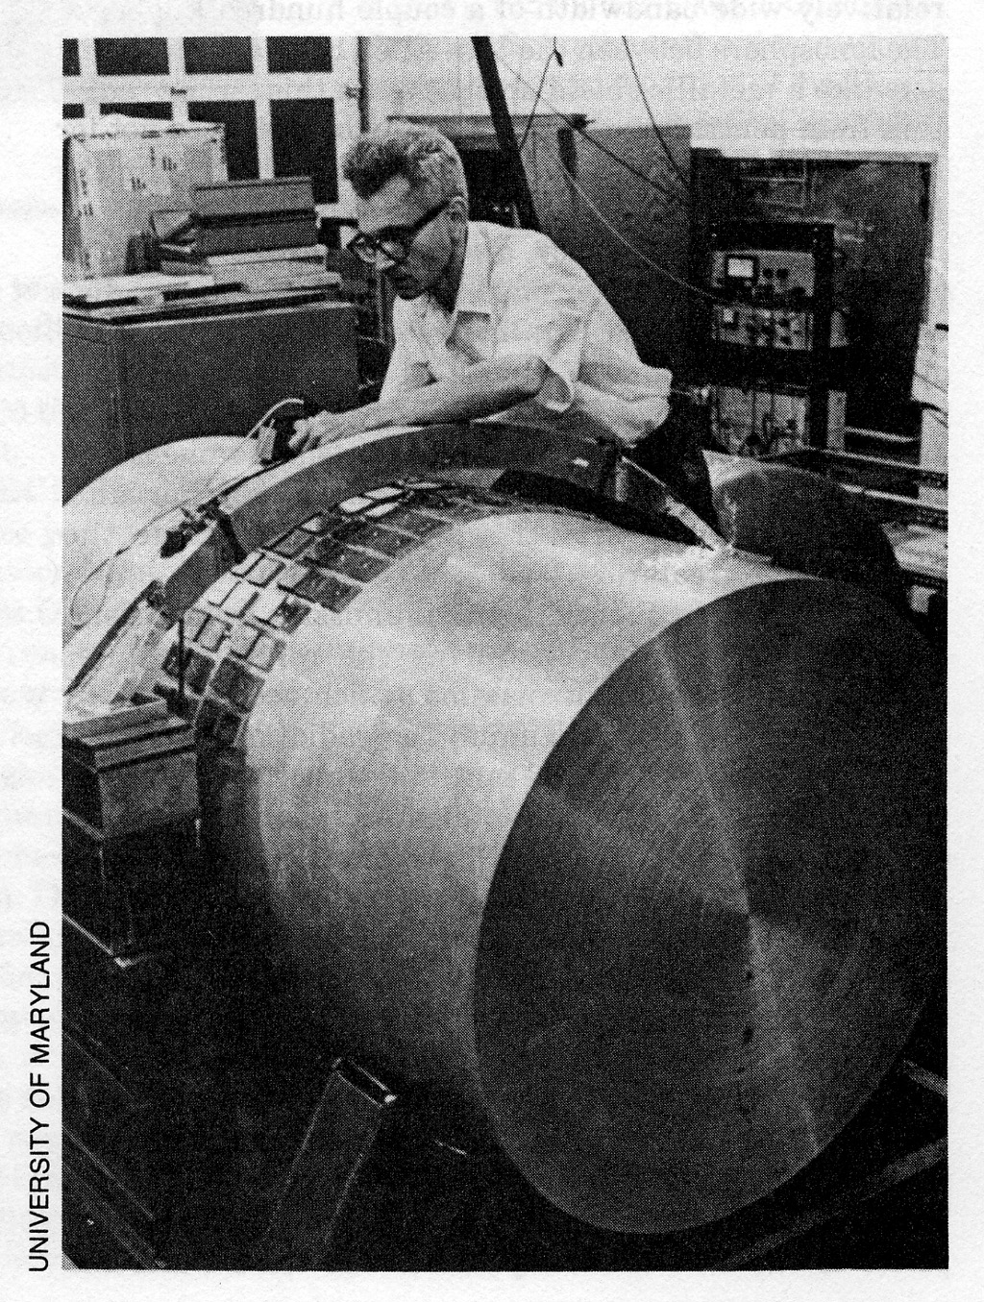
Setting the Stage
Einstein predicted gravitational waves in 1915
Assessments for experimental tests were bleak, and GWs remained largely off the radar for ~50 years
In 1969, Joseph Weber announced his bar detectors were seeing evidence for GWs
Triggered a sudden interest in
GW detection
  Roughly a dozen groups began to design
  and build bar detectors
Search for other detection techniques
Laser interferometry for GW detection
was an obvious candidate
  Several (at least four) independent “inventions”

Slide 4

Why was Rai’s RLE Paper so Important?
First detailed noise / sensitivity analysis
Quantitative estimates for possible noise sources
  Shot noise/ radiation pressure
  Thermal noise
  Seismic noise
  …
Rai’s scientific style:
1 figure and 72 eqns
in 24 pages

Slide 5
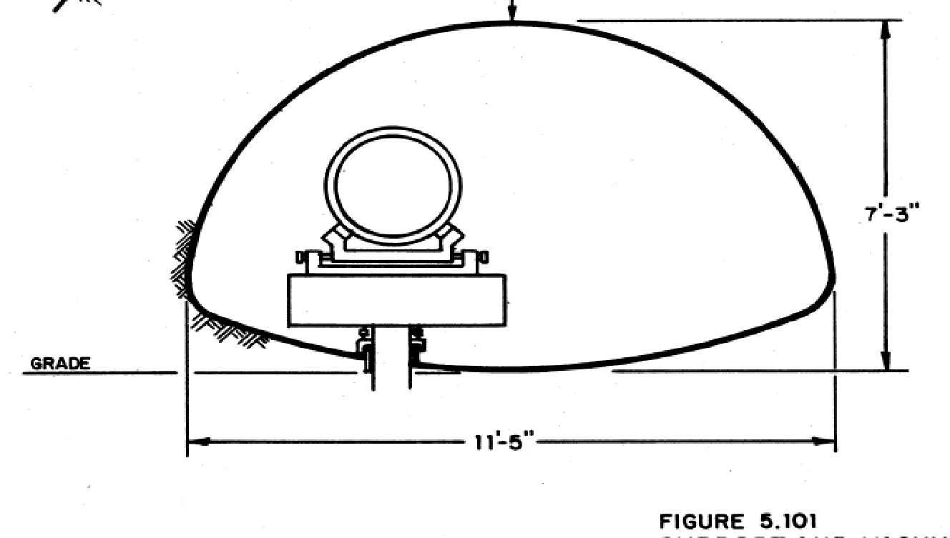
The “Blue Book”
“A Study of a Long Baseline Gravitational Wave Antenna System”, Paul Linsay, Peter Saulson, Rai Weiss, + 2 engineering firms, October 1983
Complete Science and Engineering feasibility study
Comprehensive scope—Over 400 pages
  Sources of Gravitational Radiation
  Physics and Detection
  Prototypes and Optical Concepts
  Noise sources
  Vacuum System
  Site survey
  Construction
  Proposed Design

Slide 6
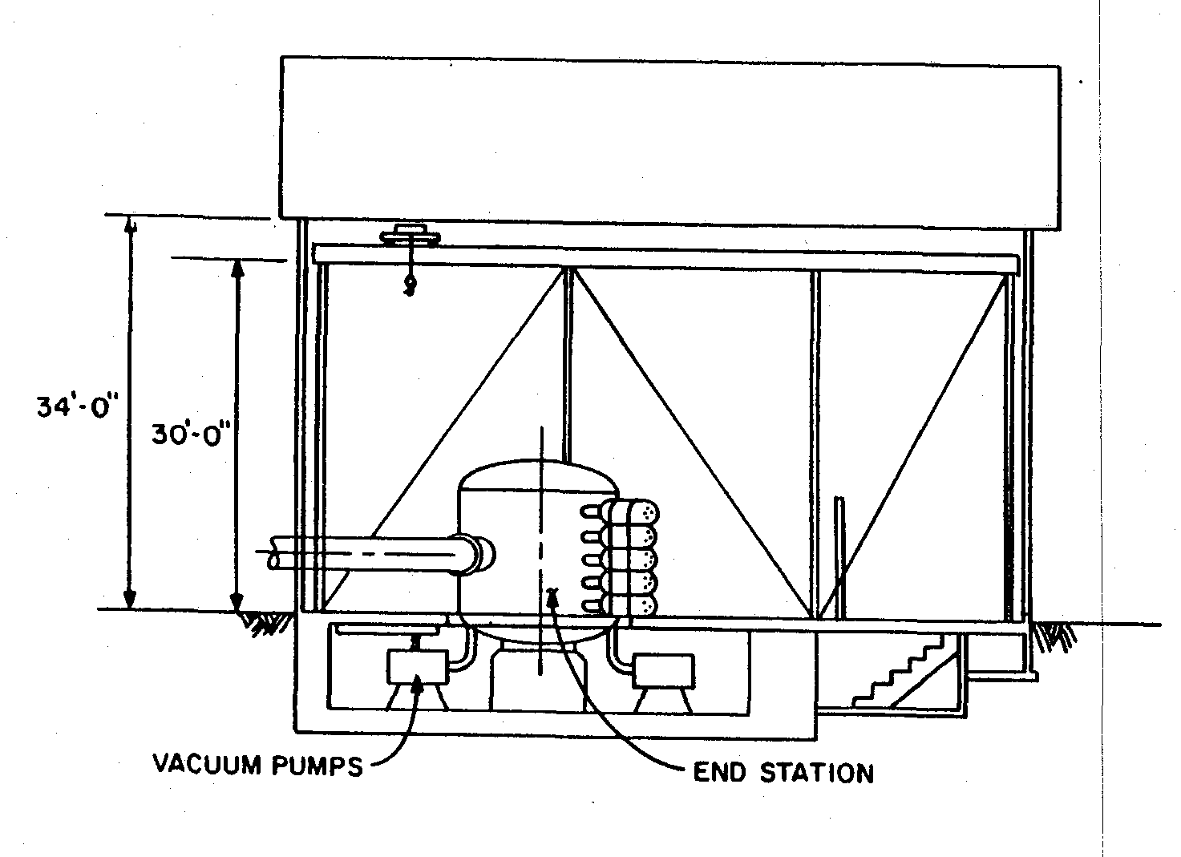
Real Innovation of the “Blue Book” is the Inclusion of Engineering
Rai was the first to recognize the engineering challenges that must be overcome
Less “glamorous”
than prototype
interferometers
Essential to overall
LIGO effort
”Blue Book” looks
like a practice run
for a full proposal

Slide 7
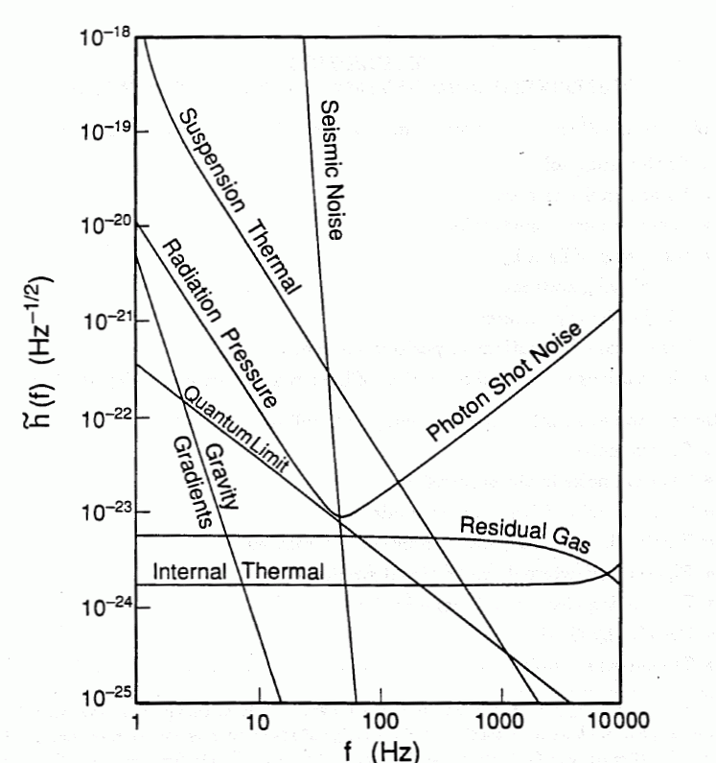
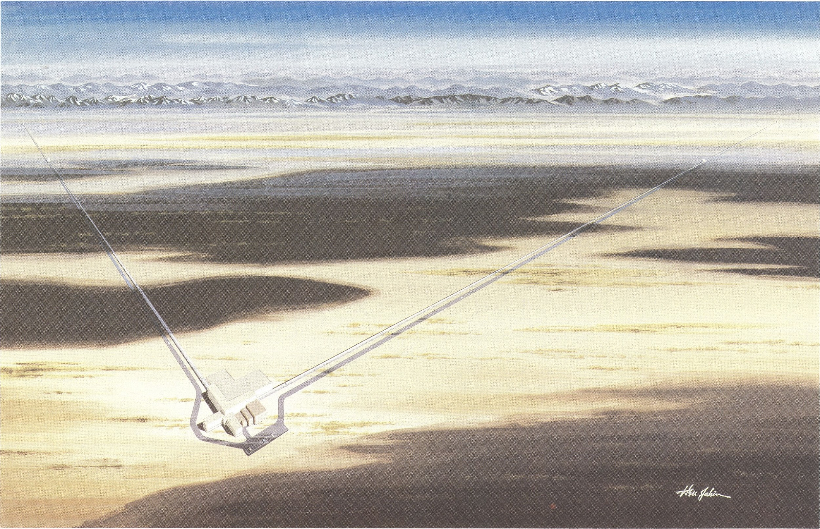
The ‘89 Proposal
Two Volumes
  Science case: GW sources, detector physics, noise analysis, prototype
  Engineering conceptual design and cost basis
Defined scope, sensitivity goals, phased approach, …

Slide 8
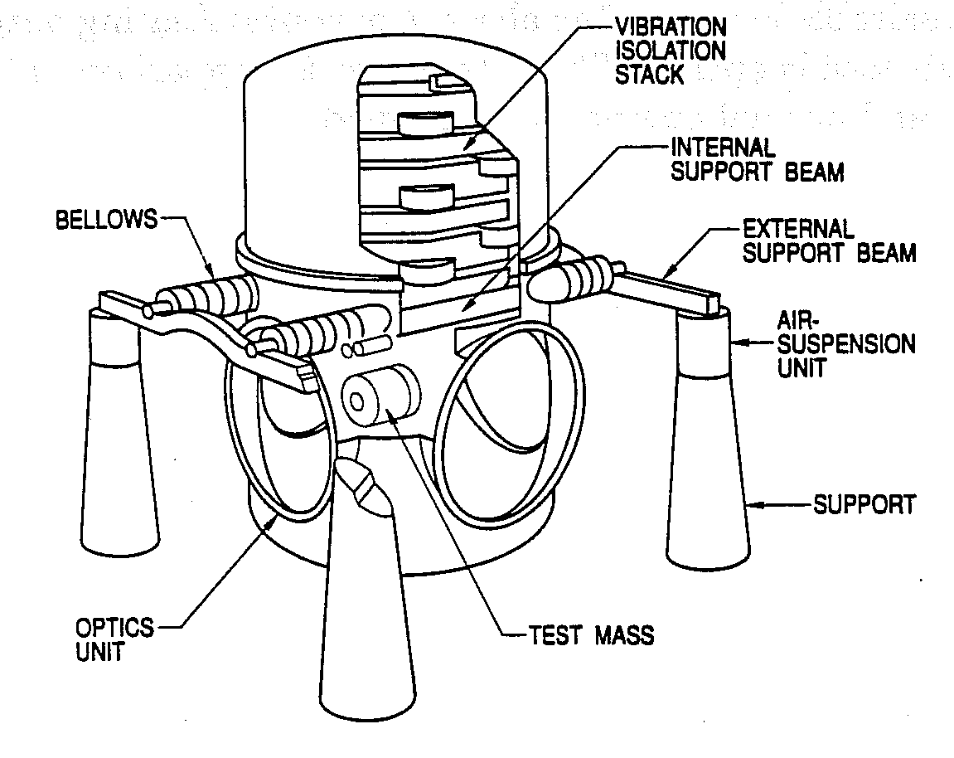
Rai’s Role in the ‘89 Proposal
Proposal team: Robbie
Vogt, Ron Drever, Rai
Weiss, Kip Thorne, Fred
Raab
Rai recognized that LIGO would need contributions from many individuals
  Began working with others across the LIGO team, not just at MIT
His style of collaboration and mentoring led others adopt approaches
Began the creation of a vibrant and effective GW community

Slide 9
Rai’s Greatest Contributions to LIGO
Insistence on a rigorous and quantitative understanding of the LIGO detectors
Leadership in advocating for synthesis of science and engineering in LIGO
Creating and mentoring a community of GW scientists

