Slide 1
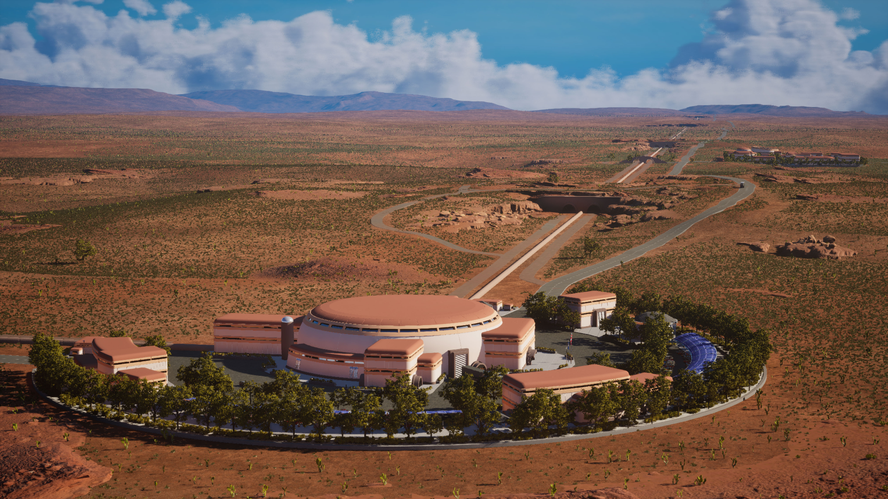

Lessons from Rai on how to lead
with courage, stamina, and grace.

Slide 2
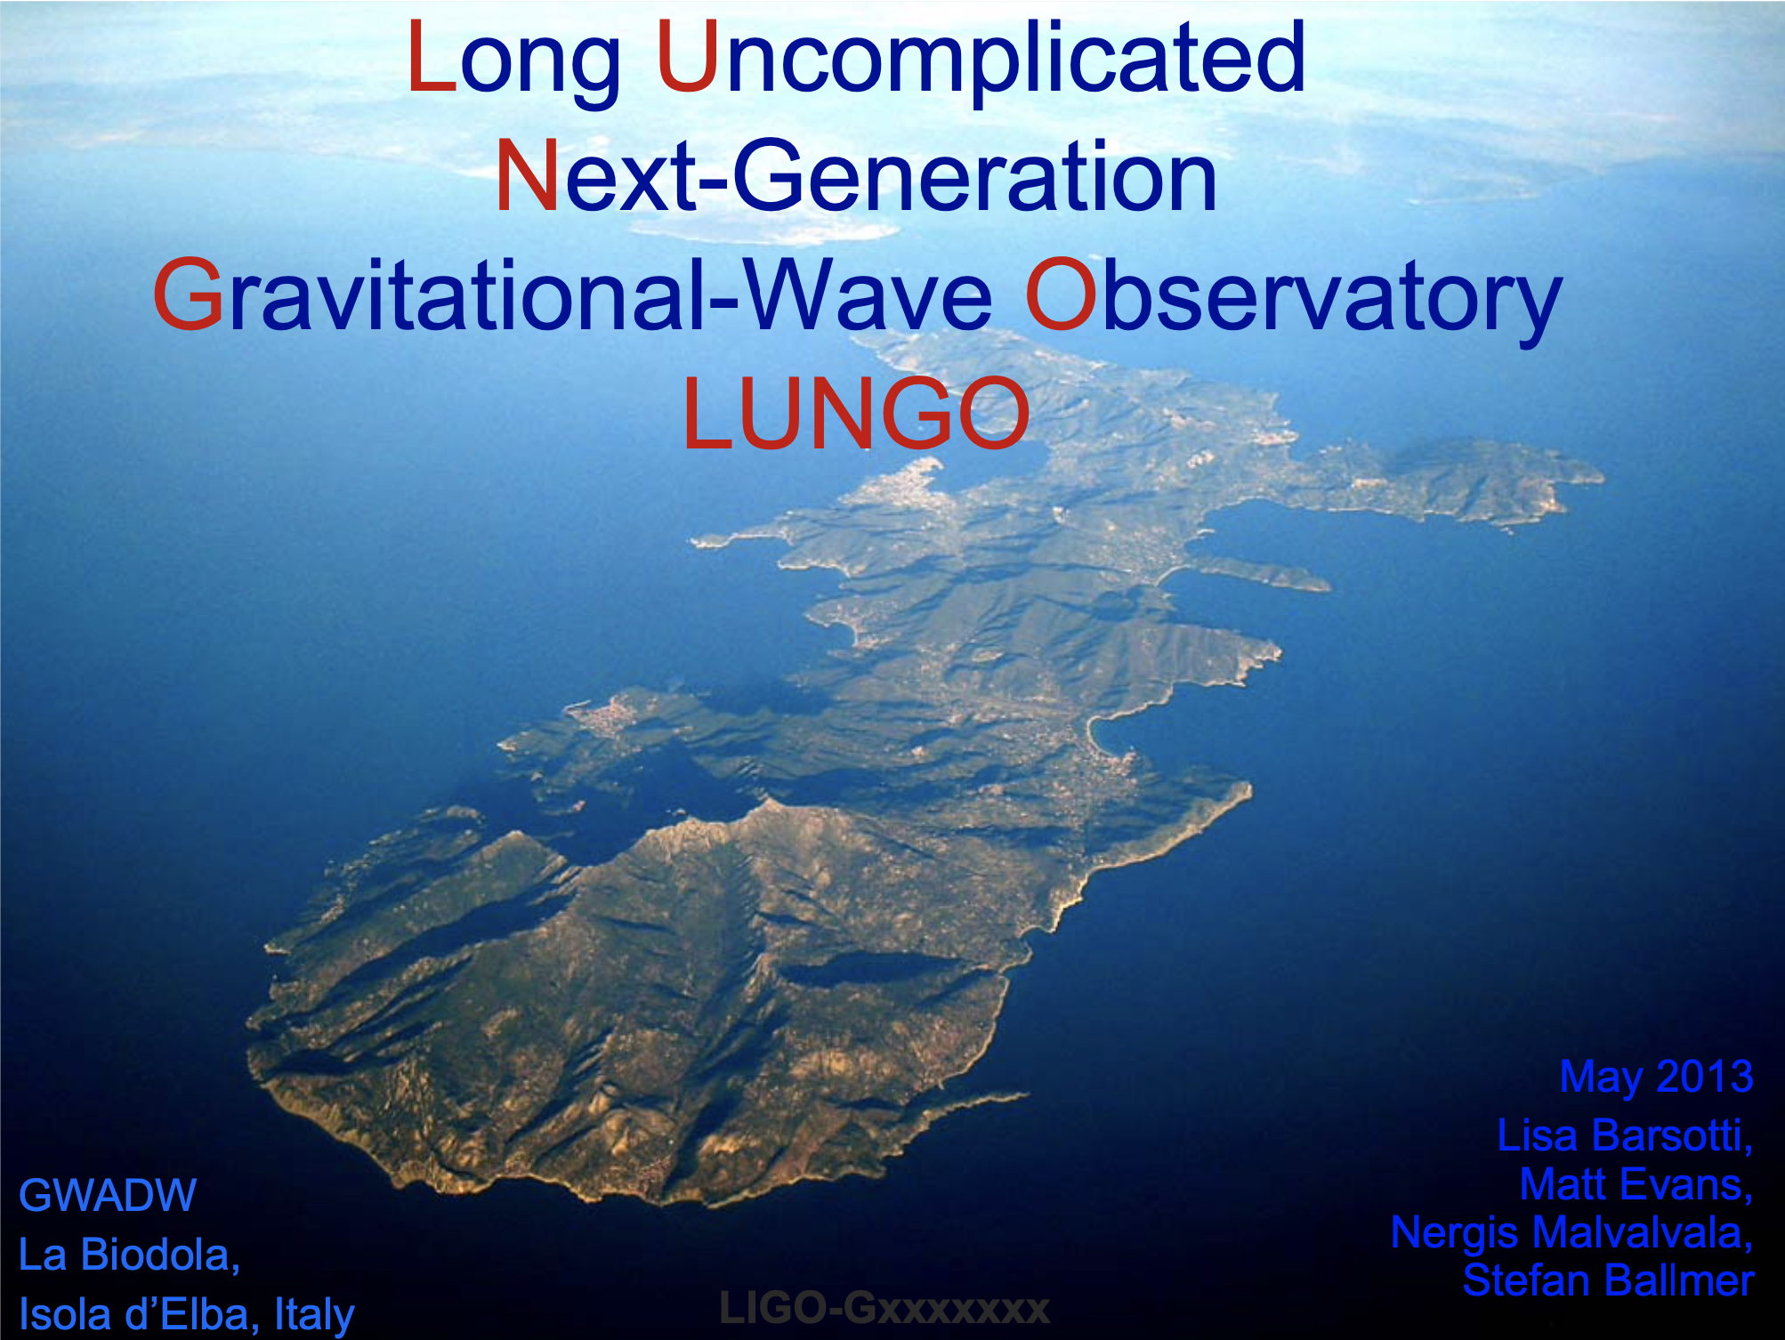
What is Cosmic Explorer?
4 physicists walk into a bar…
Started at GWADW 2013
First publication in 2014:
40km-long scaled-up LIGO

Slide 3
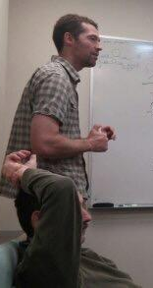
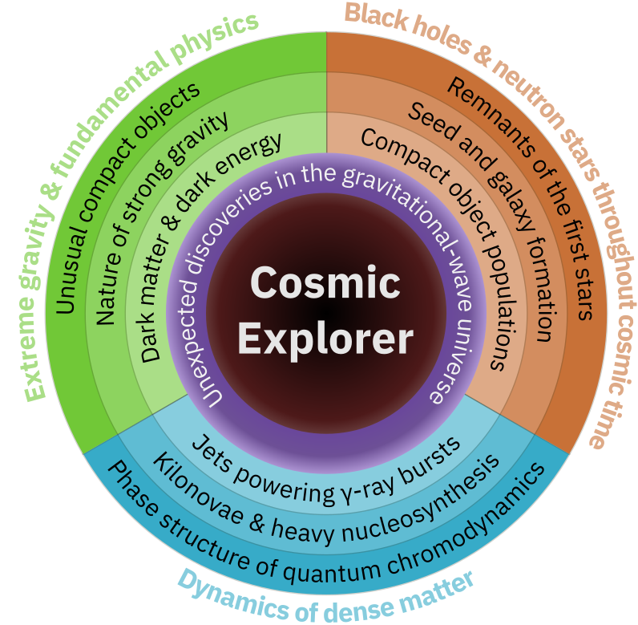
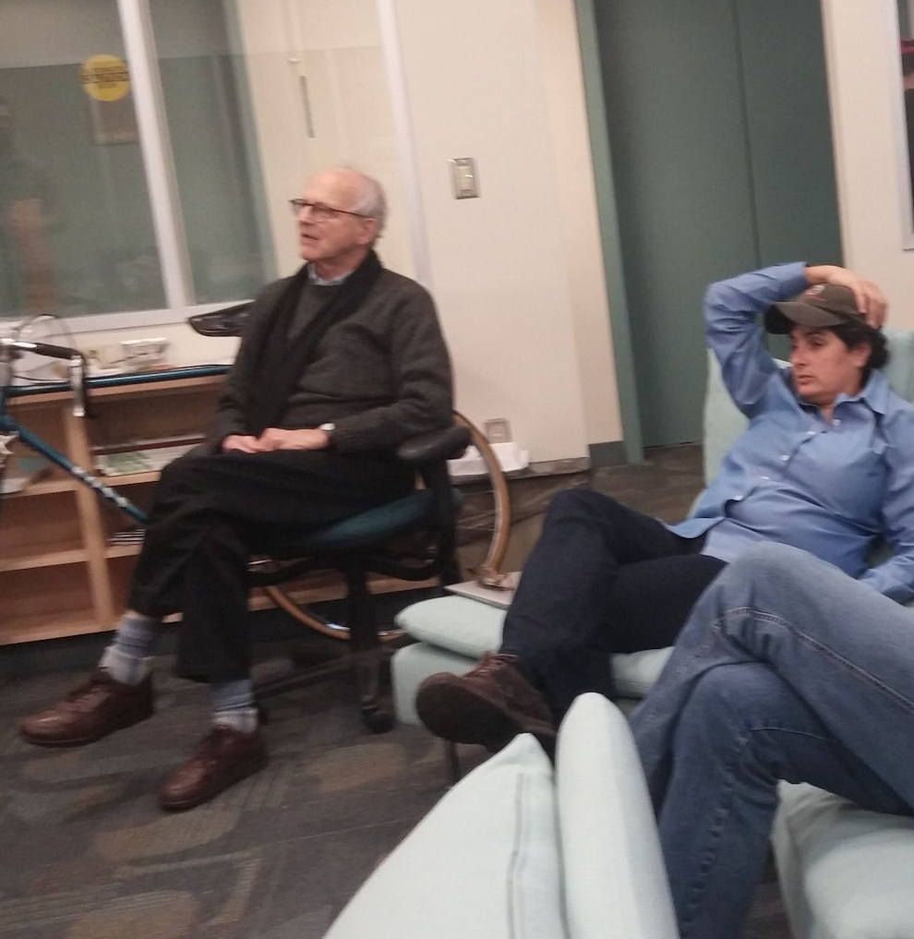
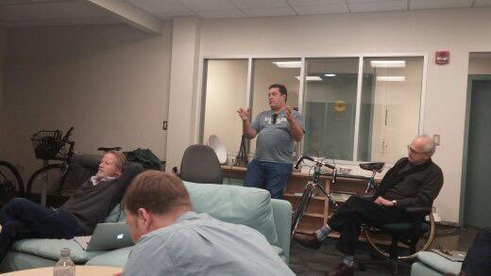
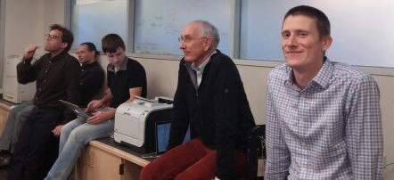
First “official” CE gathering (2015)

Slide 4
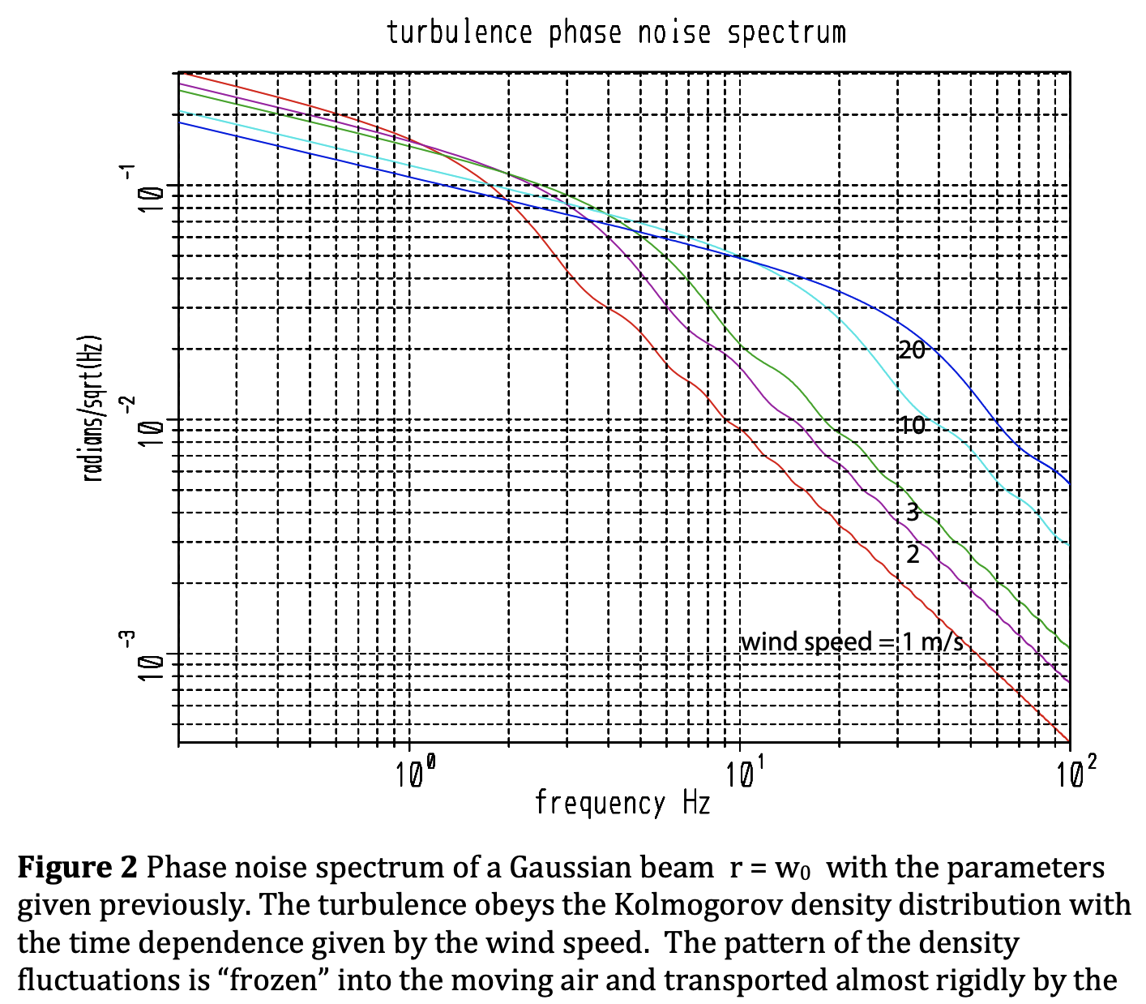
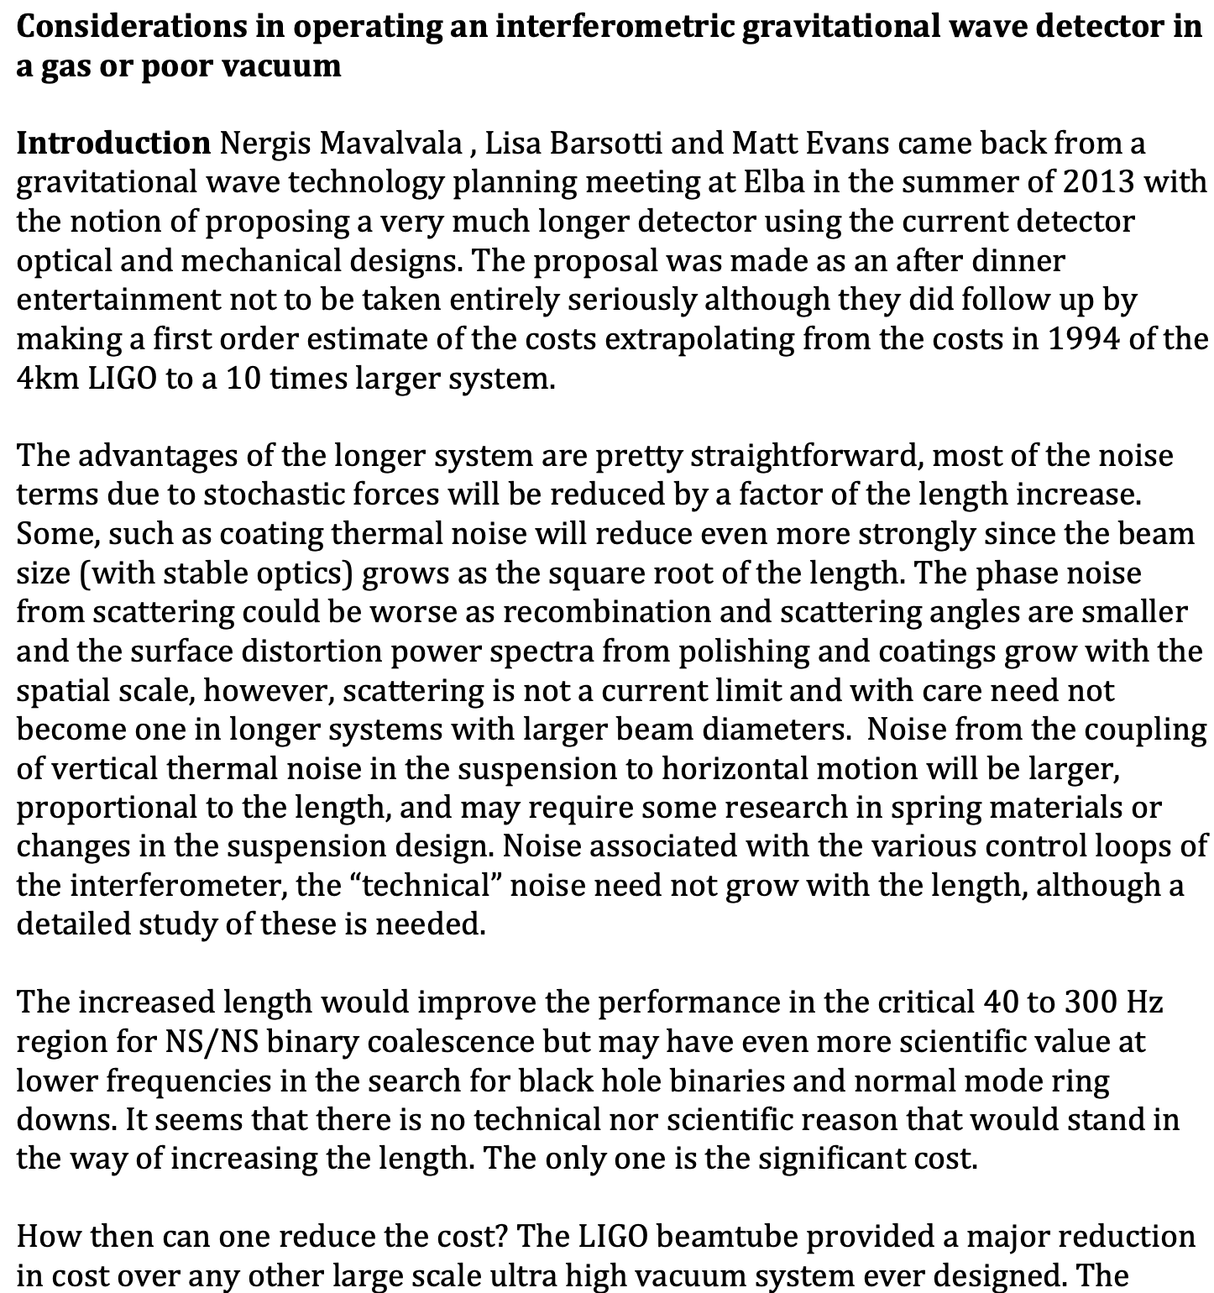
Cosmic Explorer in air? Rai dives in!
https://dcc.ligo.org/T2200336
Once we started taking this more seriously, Rai dove into thinking about how to realize such a thing. Clearly, 80km of vacuum system will be expensive… do we need it?
That was thinking outside the box!
…

Slide 5
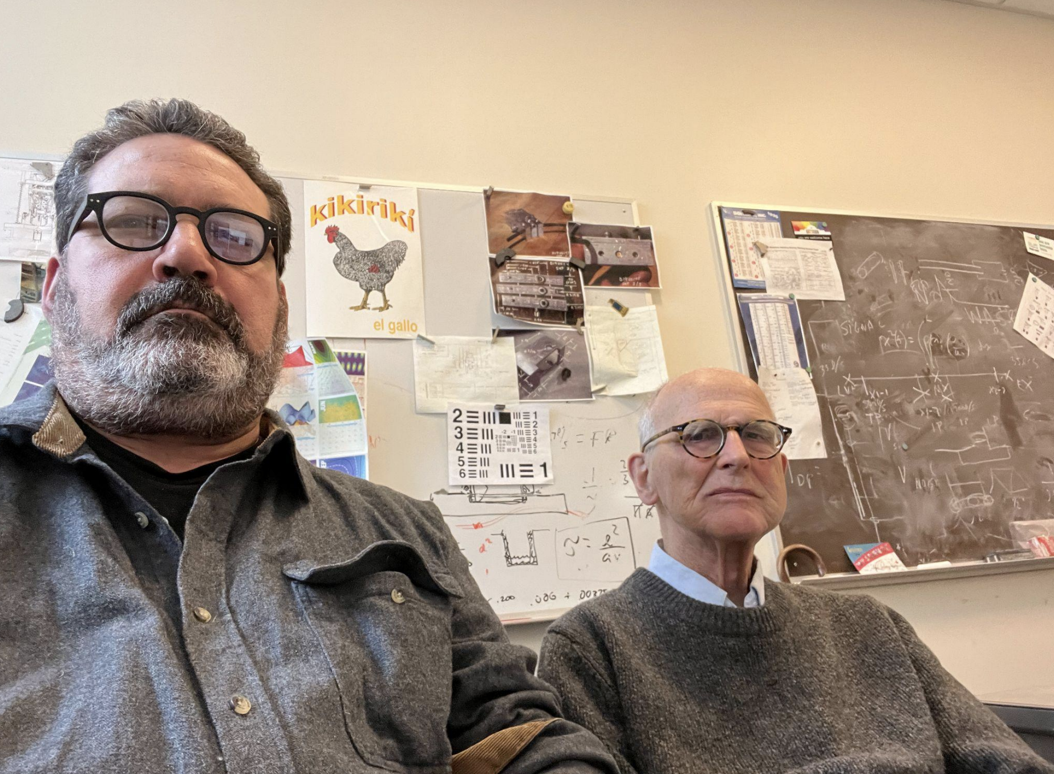
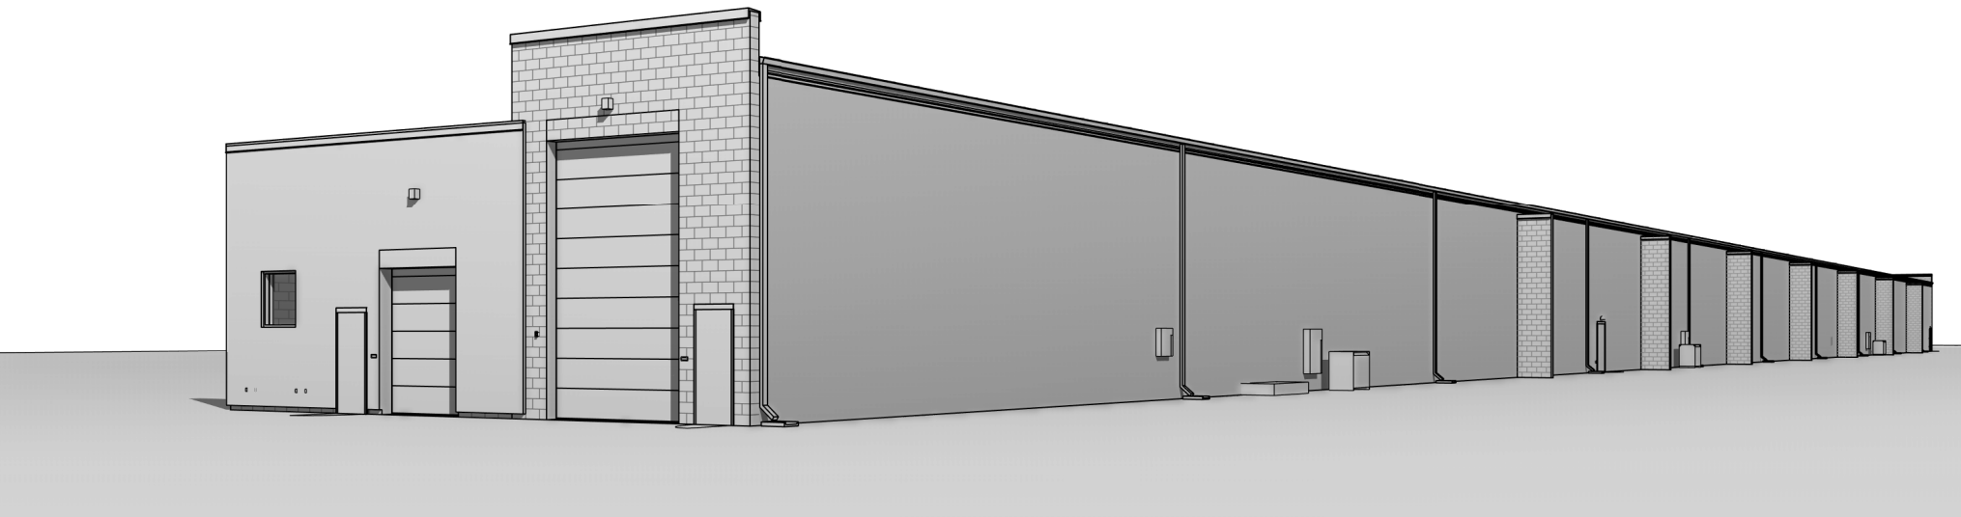
CE Beamtubes – an engineering challenge
Once it was clear that we would need 80km of vacuum tube, Rai helped Mike Zucker and me to make a cost estimate (still the best we have), and identified this as the highest-priority research task facing CE.
What materials do we use for the beamtubes? How do we make them cost-effective?
This resulted in several vacuum technology workshops (starting in 2019), with which Rai engaged experts like Fred Dylla and the folks at CERN.
Which brought us the CE Beamtube Experiment (CEBEX)!
Mike and Rai, thinking about vacuum systems!

Slide 6
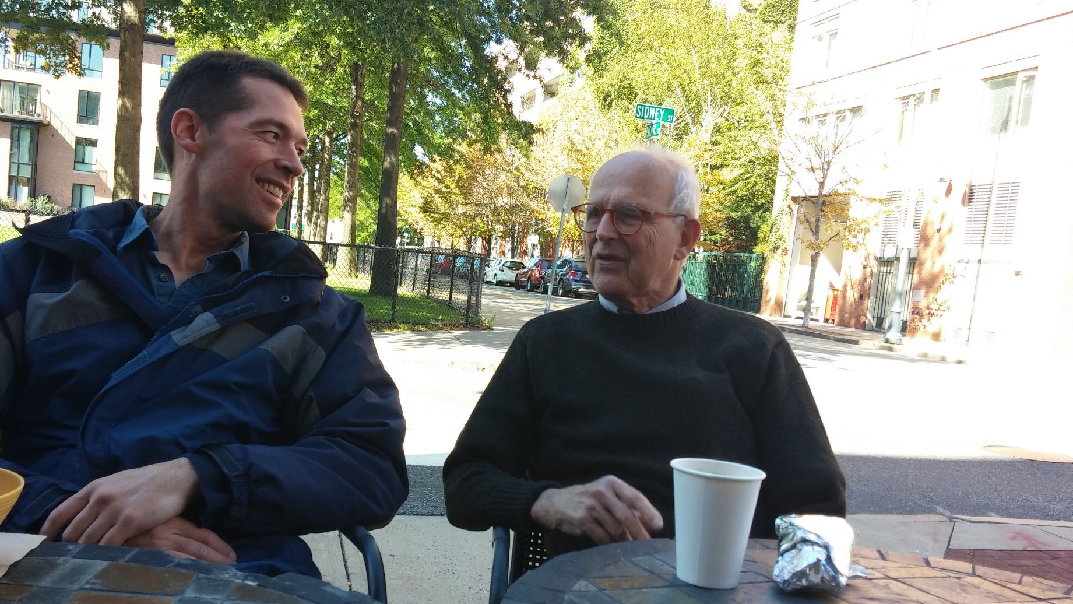

Slide 7
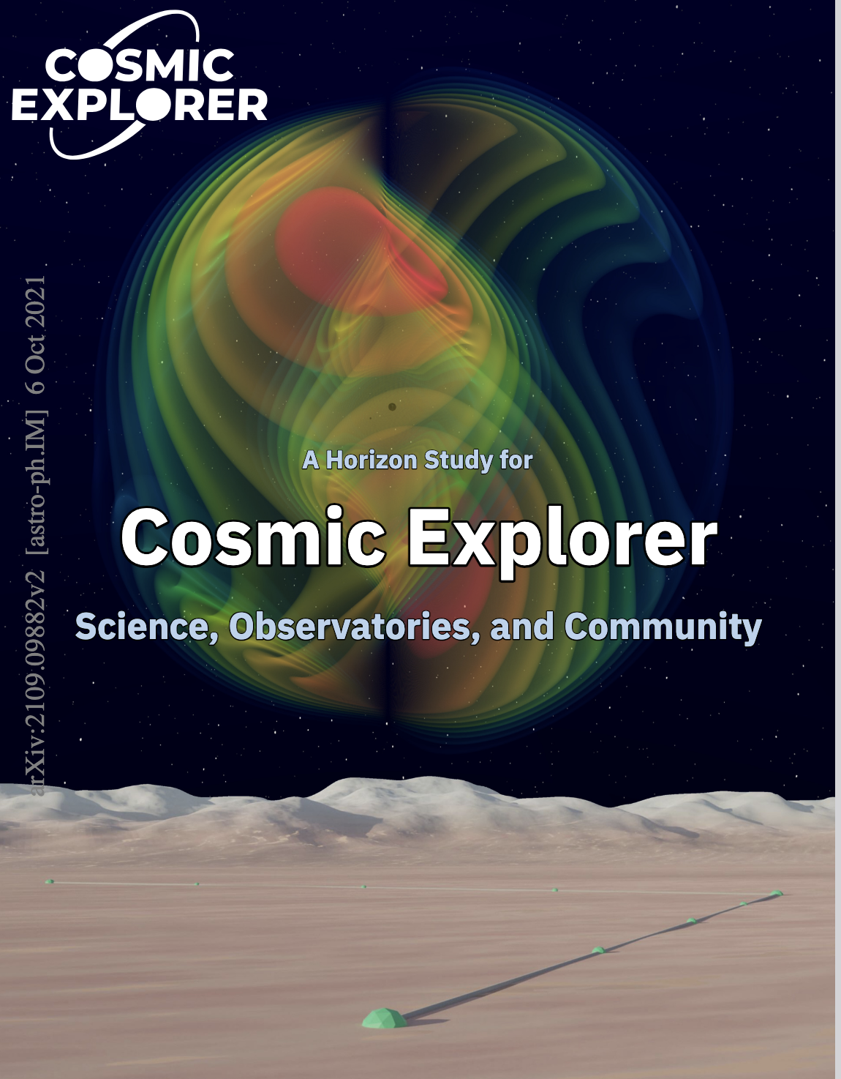
Cosmic Explorer
As CE has evolved, Rai was involved at all levels; from oil pipes to NSF committees to international politics.
He would regularly sit in my office and help me work through the latest barrier to progress, no matter what sort of barrier it was.
Nothing was too small, nothing was too big, and none of it was contingent on him getting any credit.
“A man may do an immense deal of good, if he does not care who gets the credit for it.” - Strickland 1863

Slide 8
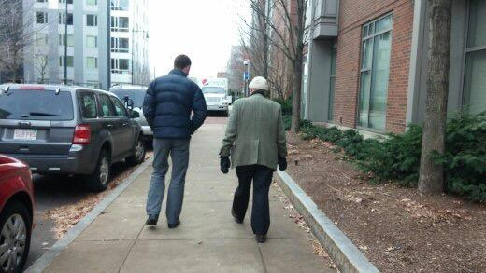
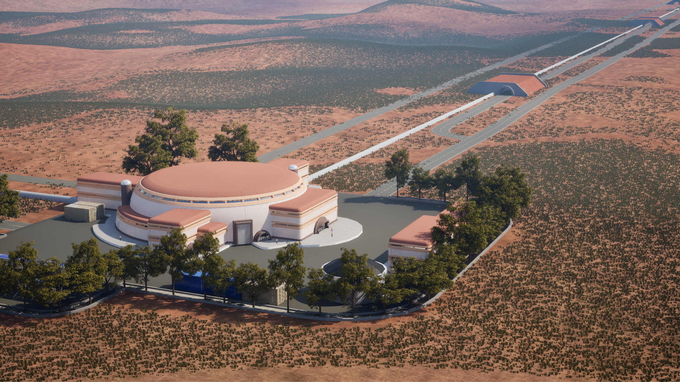

Slide 9
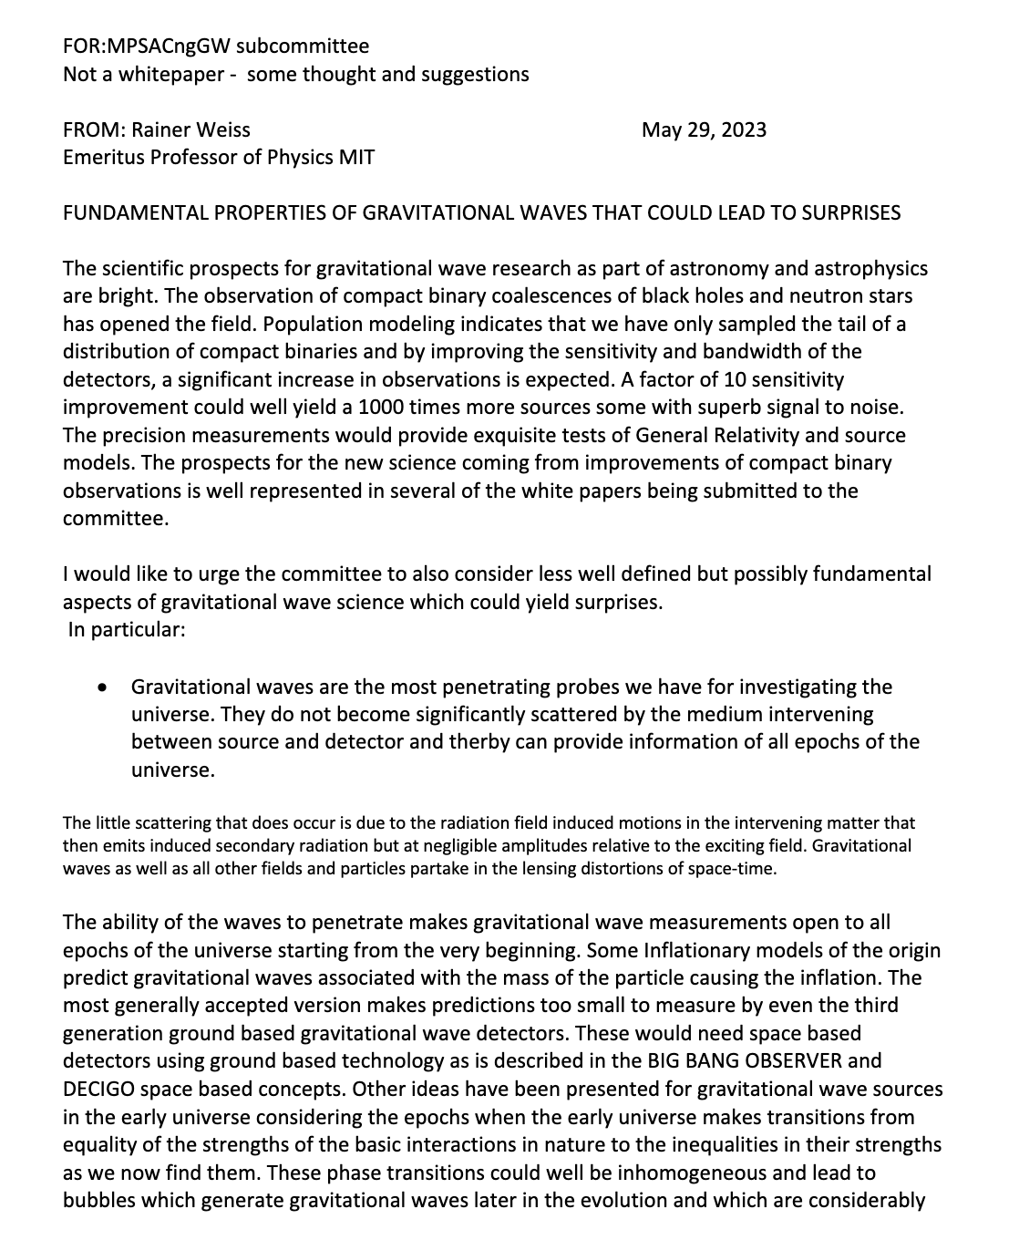
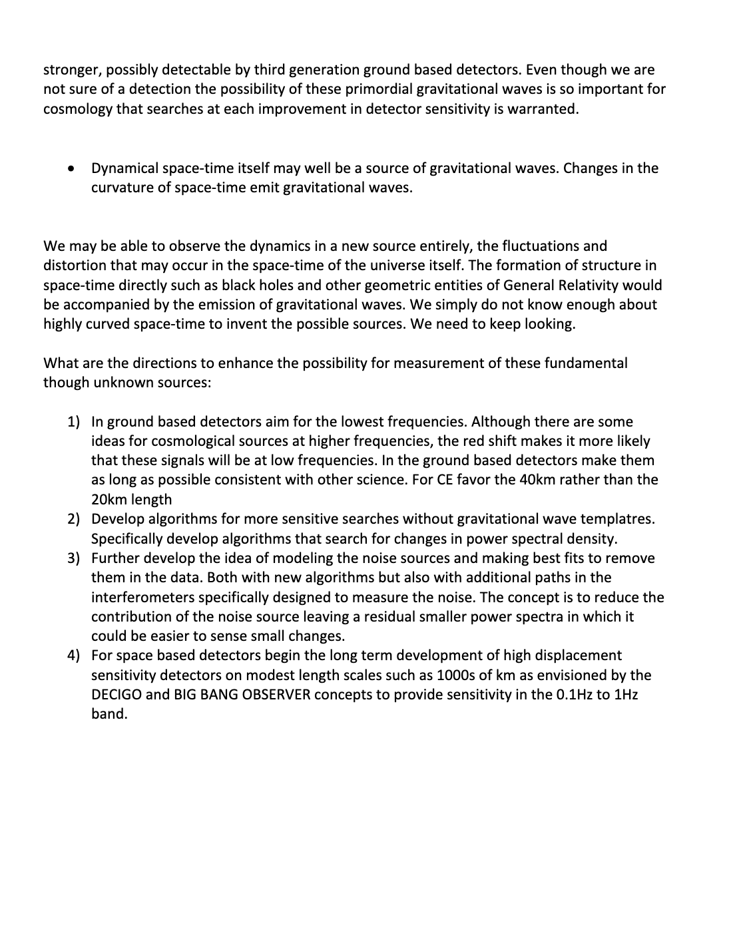
Contribution to MPSAC committee, May 29, 2023

