Slide 1
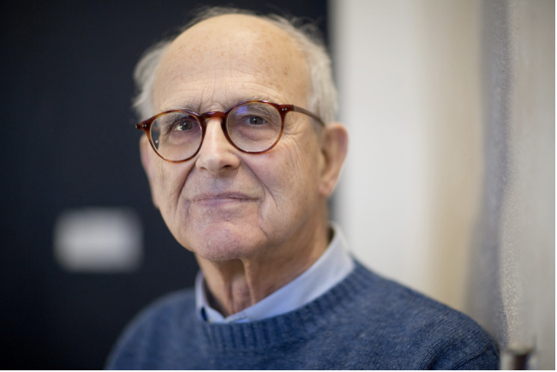
Rainer Weiss (1932-2025)
Absorbing Vacuum Science (and a lot more) from Rai from the Clutter of Building 20 to LIGO
Fred Dylla
Executive Director, Emeritus, American Institute of Physics

Slide 2
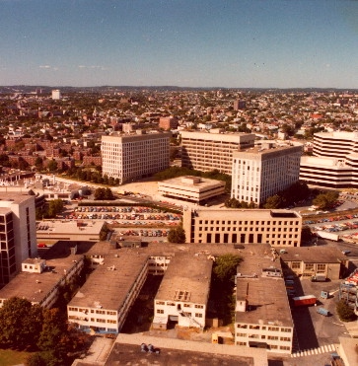
MIT’s Fabled Building 20 “The Plywood Palace”

Slide 3
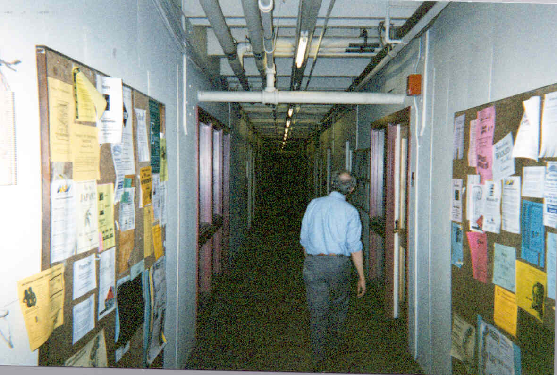
Building 20 Hall

Slide 4
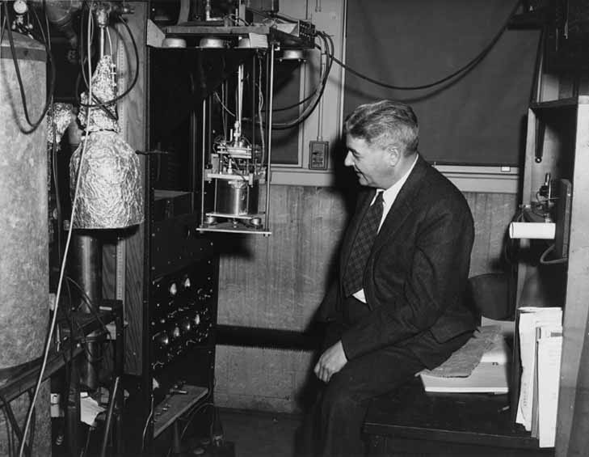
Jerrald Zacharias’ Cesium Atomic Clock (1955)
Credit: MIT Museum

Slide 5
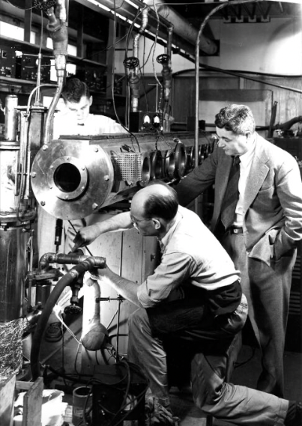
J.R. Zacharias in the Molecular Beam Lab
Credit: MIT Museum

Slide 6
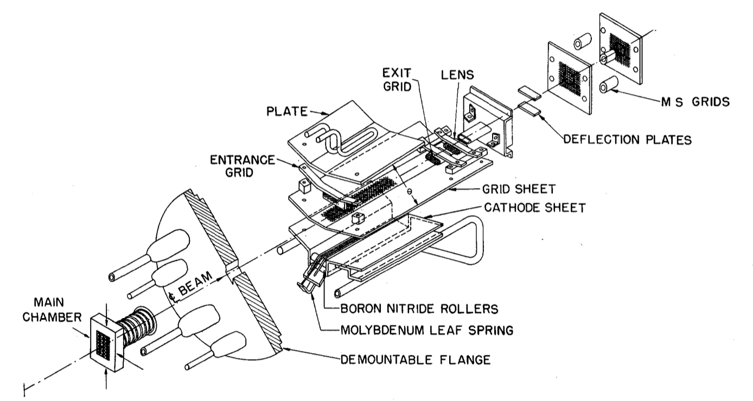
Rai’s World Record Ion Source
From Rai’s 1961 article in Review of Scientific Instruments 32,397,1961

Slide 7
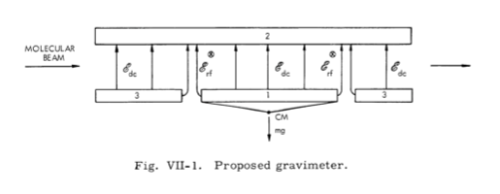

Rai’s early gravitational ventures in the Molecular Beam Lab
Proposed molecular beam experiment to measure
Reference: Research Laboratory for Electronics QPR, 58, July 1960
Notes:
From QPR Research in this group is concerned with investigating the nature of the gravitational
interaction, in particular, with performing experiments that might distinguish between
different theories of gravitation and cosmology. These aims are admittedly grandiose,
especially in view of the inadequacy of present techniques which preclude performing
many of the experiments that one can think of. The subject is, however, of such funda-
mental importance that even marginal experiments appear to be justified.
From RLE QPR 58, July 15,1960
Experiments in gravitation tend to engender advances in instrumentation. An adjunct
to the gravimeter program was the development of a long-term stable Earth strain seis-
mometer to try to measure radius changes of the Earth. The basic problem here appears
to be the inadequate long-term stability of existing lasers. One of the major efforts of
the research in this group is the frequency stabilization of a laser with an optical res-
onance as observed in an atomic beam used as reference.

Slide 8
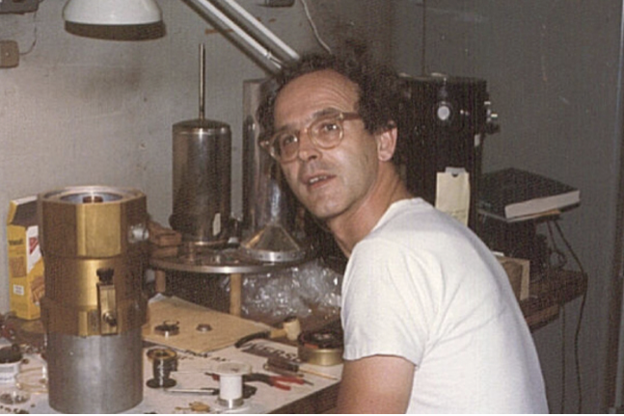
Rainer Weiss, in his lab in MIT’s Building 20 in the late 1970s, works on a cryogenically cooled detector for cosmic microwave background radiation. Credits: Credit: Peter Kramer, courtesy of MIT LIGO Laboratory
Notes:
From QPR 112 (Jan 1974) : Our objective is to carry out an experimental investigation of gravitational interac -
tion which embraces terrestrial experiments and astrophysical observations. For several
years the work of this group has covered a broad range. Experiments have led to the
development of long-term stable gravimeters, laser strain seismometers, and
molecular-beam frequency-stabilized lasers. We have also measured the fundamen-
tal phase noise in lasers and made preliminary designs of gravitational oscillators
for spacecraft experiments. Astrophysical measurements have been carried out to mea-
sure the spectrum of the cosmic background radiation in the far infrared from balloon
platforms, to make tests of alternative explanations of the cosmological red shift, and
to study atmospheric emission in the far infrared, as well as the properties of far-
infrared detectors. The inner logic or coherence of this research may not be immedi-
ately apparent. A listing of our projects demonstrates, however, that gravitational
research, at least in its experimental aspects, is bound to have many facets and to
spread out in various directions.

Slide 9
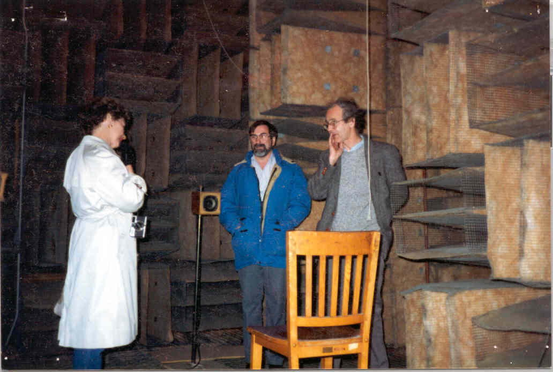
Rai in the Bldg. 20 Anechoic Chamber
Credit: MIT Museum

Slide 10
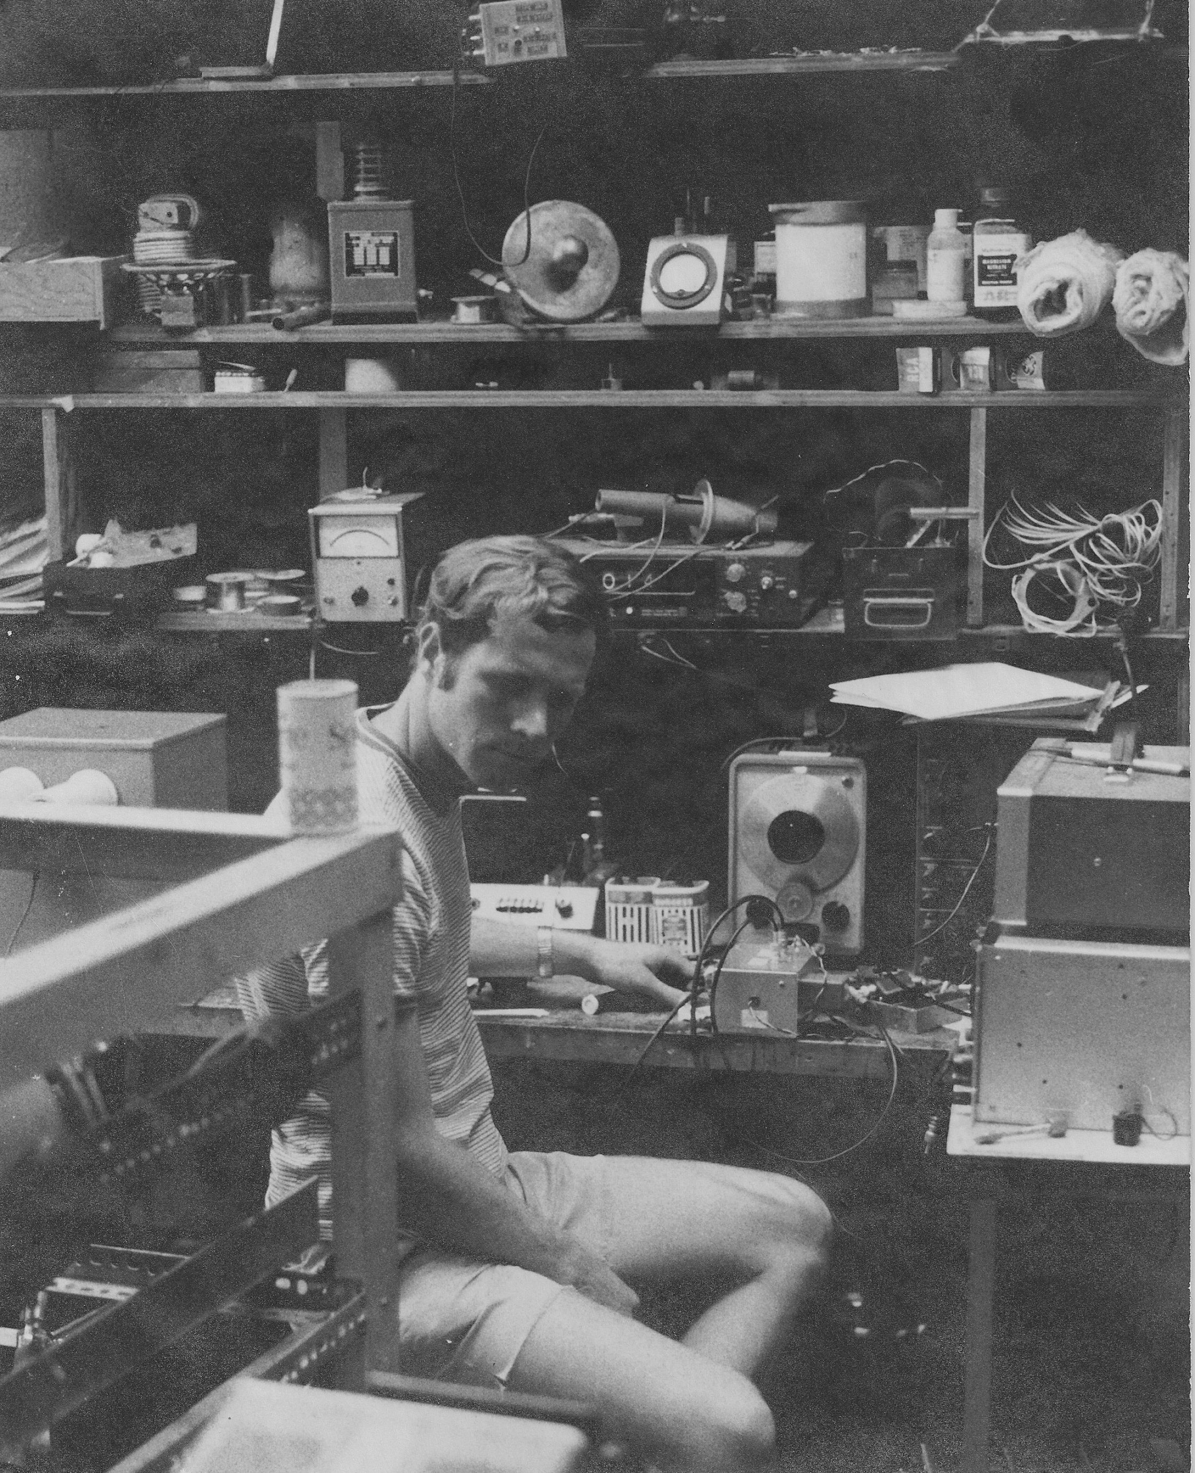
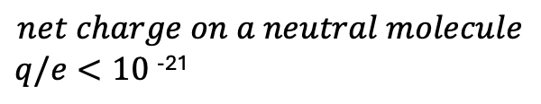
Fred in 1968 at MIT working on an e-p charge neutrality measurement
One of my lessons from both Rai Weiss and John King:
-Stamina is needed and rewards are generated from “null” experiments
After months in the anechoic chamber (3rd shift):
Dylla and King, Phys. Rev A7,1224 (1972)

Slide 11
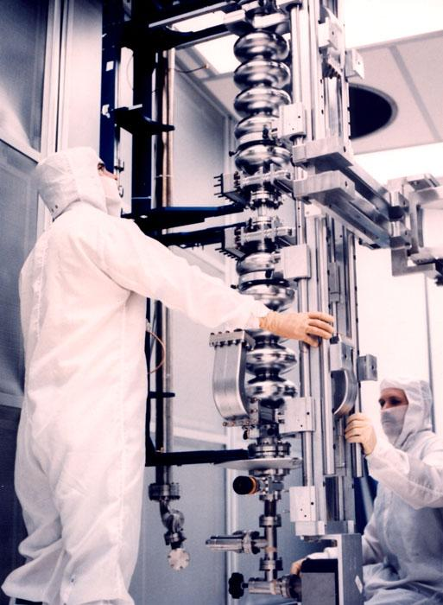
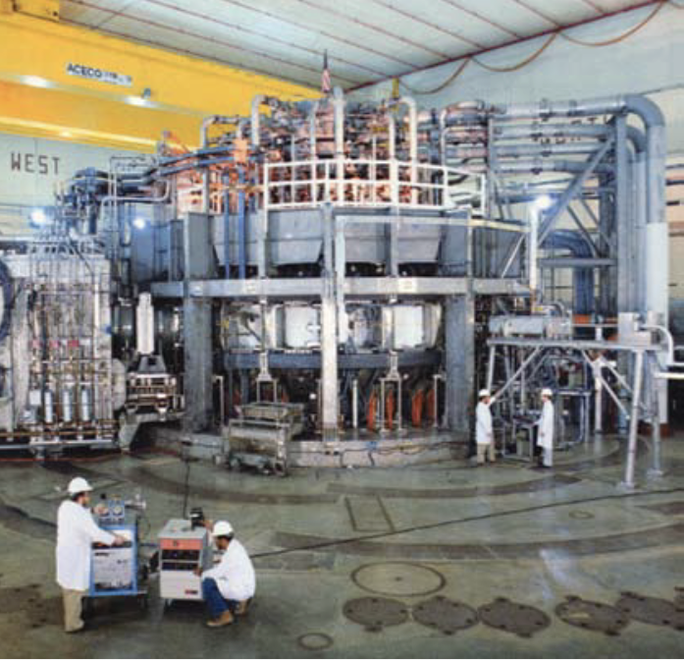
Of interest to Rai: my training ground for leak-free large vacuum systems
Princeton’s Tokamak Fusion Test Reactor (TFTR) (1975-1990)
CEBAF Superconducting linac (1990-96)

Slide 12
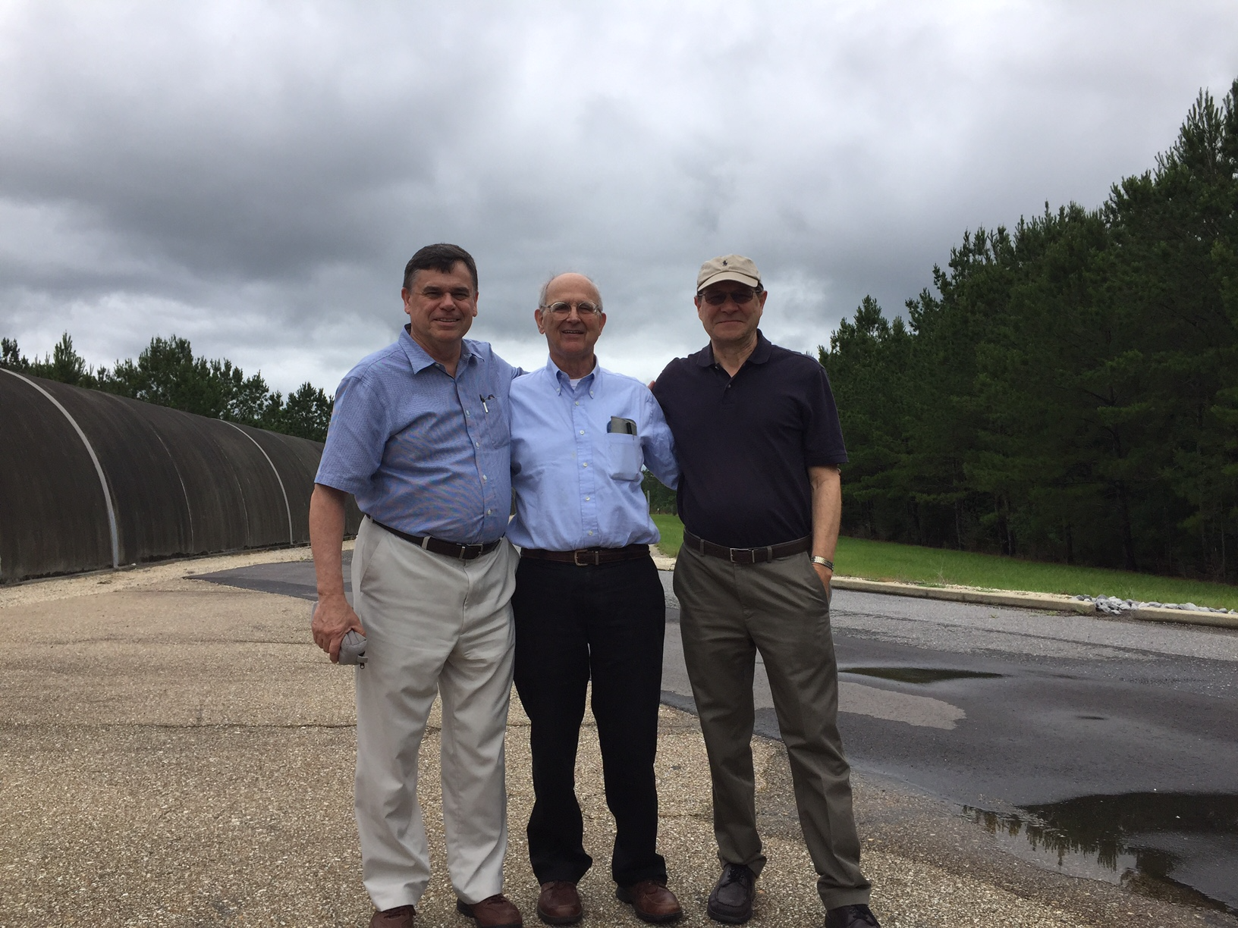
Rai, Fred and Dan Henkel at LLO (2019)
NSF Workshop on Large Ultrahigh-Vacuum Systems for
Frontier Scientific Research Instrumentation, LLO, January 29-31,2019

