Slide 1
LIGO 32 Channel Low Noise ADC
Marc Pirello & Daniel Sigg
E2300322

Slide 2

Outline
History
LIGO Timing Board (completed and installed post Covid 2022)
LIGO DAC (completed and installed for O5 2026)
LIGO ADC (prototype hell)
LIGO FDS (future)
Prototype
Layout Issues
Current Issues
Heat Issues aka Space Heater Issues

Slide 3
History
LIGO Timing Board
Simplified design for legacy Duotone board.
Completed 2020, deployed along with V5 IO Chassis.
LIGO DAC
Increased channel density, massive cost reduction over COTS boards.
Completed 2025, deployed LHO for O5 2026.
LIGO ADC
Improved performance, cost reduction over COTS boards.
Completed 2026, production 2026.
LIGO FDS
Required to improve bandwidth of common mode servo.
Prototype Spring 2026

Slide 4
Production Timing Board
The timing board is required to propagate site GPS timing to the LIGO DAC and LIGO ADC boards.
This allows the LIGO DAC and LIGO ADC to phase lock with the site, using the same 2^n timing as the site, and reducing low frequency products from unlocked drifting clocks.
The timing board paired with the DAC and ADC boards allow these boards to keep their own microsecond timing.

Slide 5
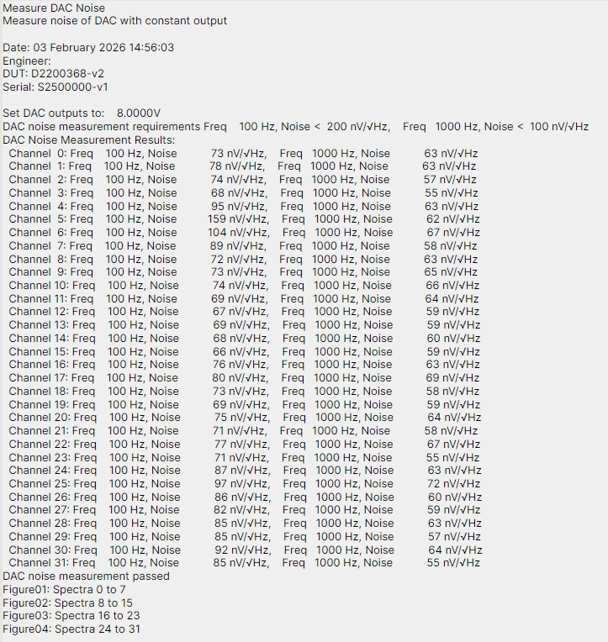
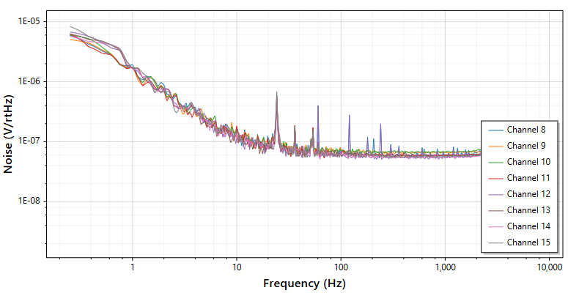
Production LIGO DAC Results
Noise performance of the LIGO DAC at 100 HZ is typically less than 200nV/rtHz, 1kHz is less than 100nV/rtHz.
Channel density replaces 4 of the 20 bit DACS with one of the LIGO DACS. This allows more flexibility in IO chassis deployment.
Cost of the LIGO DAC is $2500 for 32 channels compared to $10k for 8 channels, or $40k for 32 channels.

Slide 6

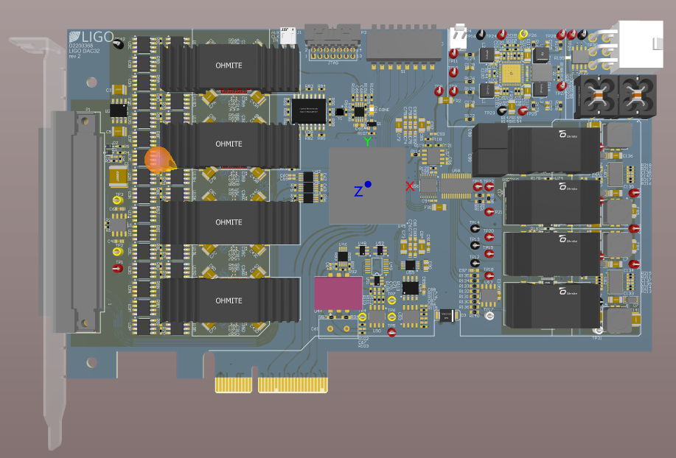
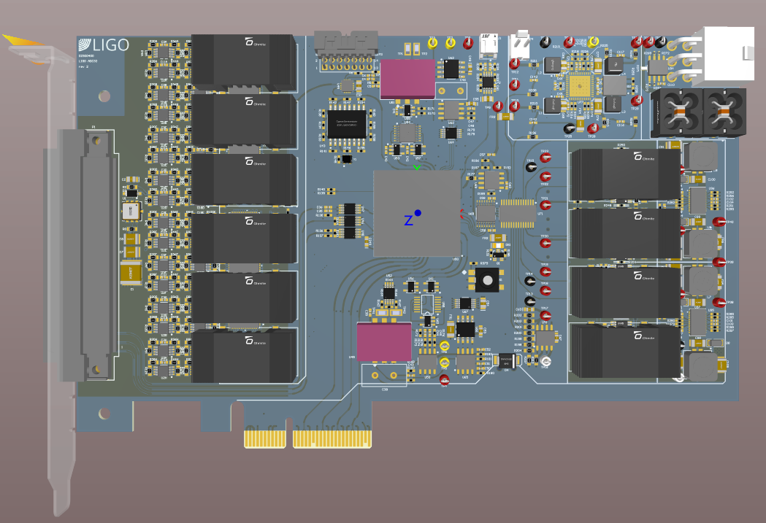
Prototype
Many solutions were common between the DAC and ADC.
Problems solved on the DAC propagate to solutions on the ADC, and vice versa.
With the full production of the DAC, the ADC benefits from all of the lessons learned on the DAC.

Slide 7
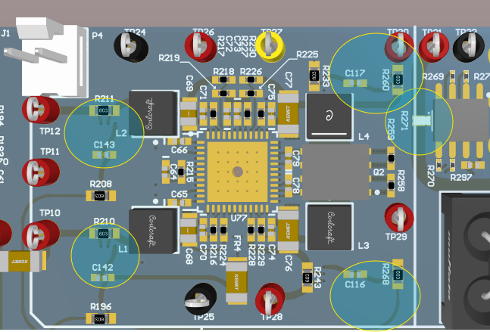
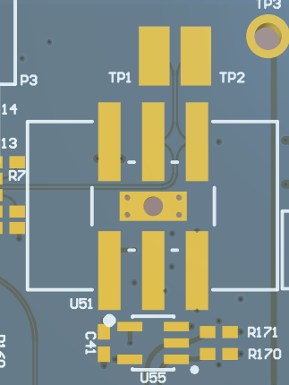
Prototype - Layout Issues
Current Sensors were all wrong on the original DAC and that issue propagated to the ADC. In the production DAC these issues were solved, and this solution has been implemented on the ADC.
Pads were fixed on the ADC to allow more VCXO options for locking phase, SI-TIME.

Slide 8
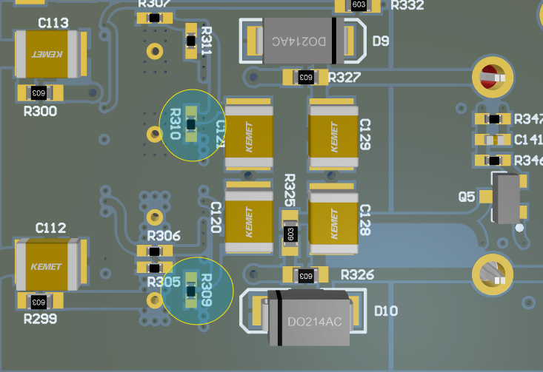
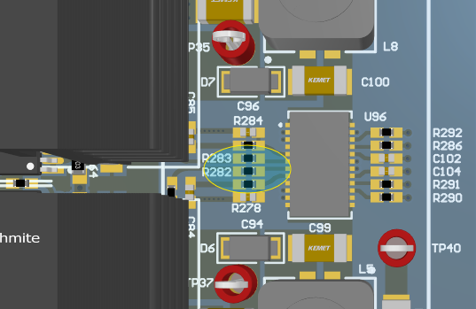
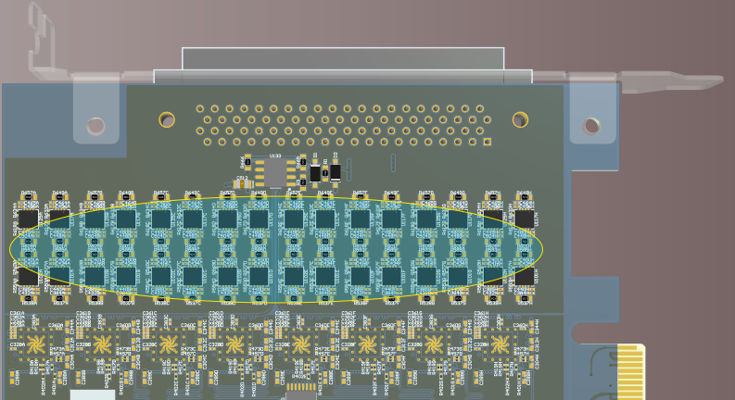
Prototype – Current Issues
Initial current draw for the stock ADC was 2A at 12V, we were not ready for this and the power dissipation was not sufficient, this caused lots of heat, see next slide.
We reduced the +/- 15V rails to +/-12.5V then finally to +/-11.2V which is sufficient margin for the front end opamp rails. We also reduced the +4V supply to +2.5V further reducing current loss. These two changes reduced current draw by 250mA.
Swapping the OPA1612 out with the ADA4084-2 reduced the current by another 500mA, putting us at parity with the DAC current draw.
COM reference front end supply from +11.2V to +5V further reduces current by 110ma. This is a 4.096V reference will run fine on +5V.

Slide 9
Prototype – Heat Issues
The stock LIGO ADC was hot. Daniel called it a space heater.
By reducing current we have solved the heat issue. We also found better FPGA heatsinks from Radian which are more affordable and that conform to the PCIe space requirements.
The fully upgraded ADC board measured 57.1C after many hours of testing in an enclosed IO chassis, matching the production DAC for heat generation.

Slide 10
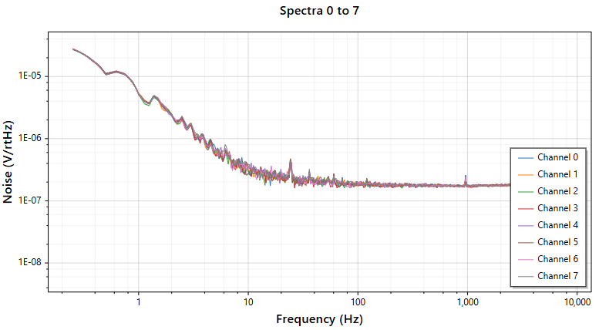
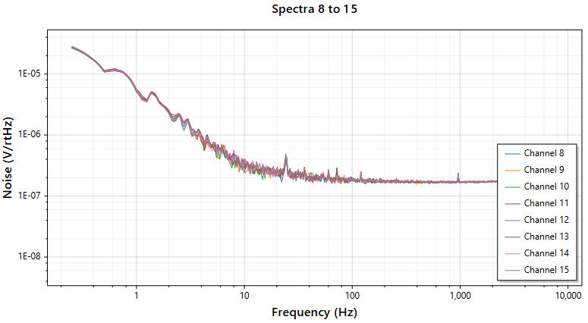
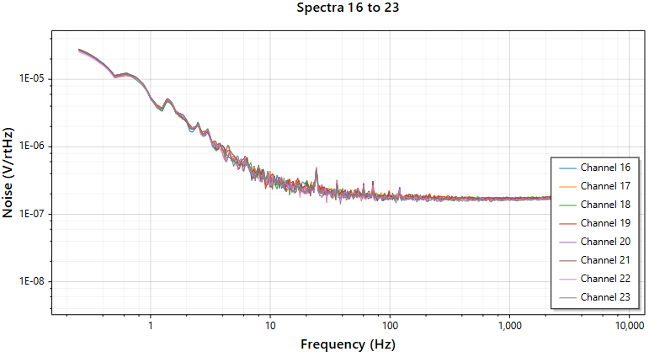
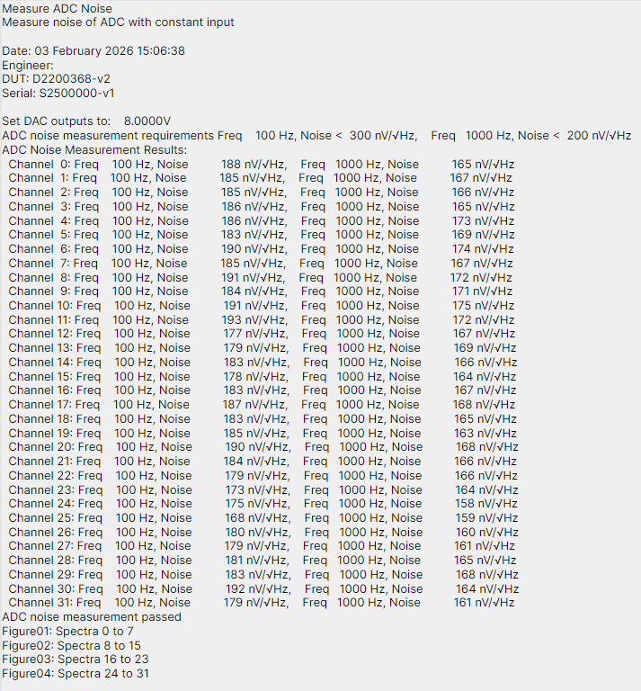
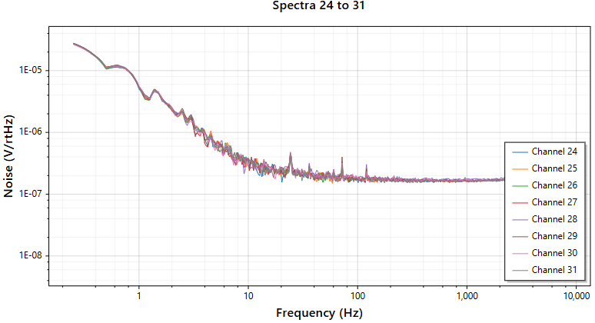
Results

Slide 11
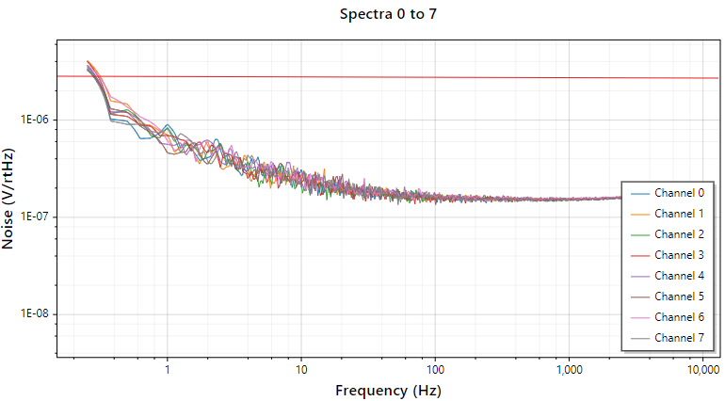
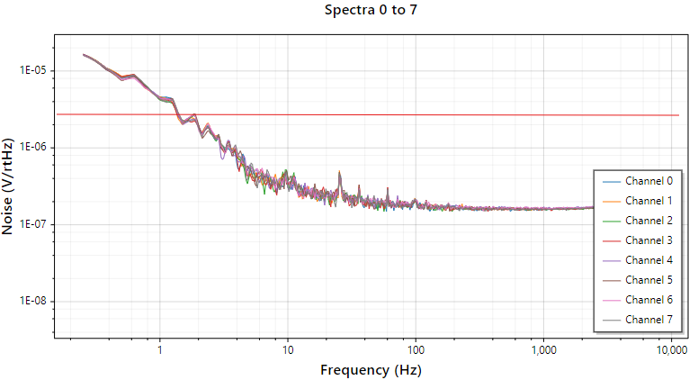
Results Discussion – Daniel Notes
The GS PCI66-16AI64SSA noise measures at 4uV/rtHz at 100Hz with small input signal
The LIGO AD32 ADC noise measures at 200nV/rtHz at 100Hz with small input signal.
Left is 0V input signal, Right is 10V input signal

