Slide 1
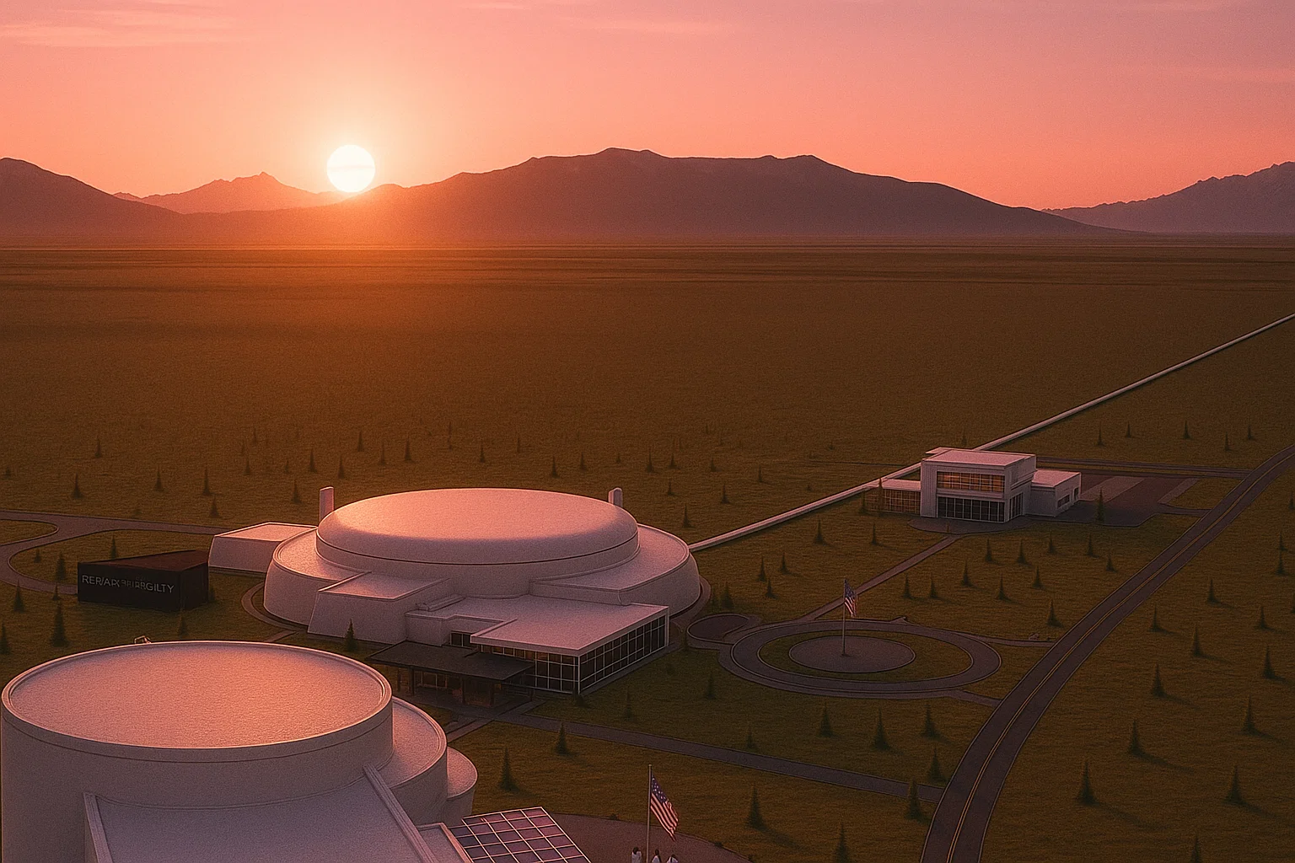


Cosmic Explorer ​
Beamtube Experiment (CEBEX):​
Design proposal of tube supports, end caps,
and pump port spools for CEBEX/CE
Cosmic Explorer (CE)-Einstein Telescope (ET) Beam Tube Workshop III
LIGO-CERN
Anna Iudintseva​
Mechanical Engineer at CEBEX, LIGO – Caltech
LIGO-G2502110
LIGO Hanford Observatory, Richland, Washington, USA
September 30 – October 2, 2025

Slide 2
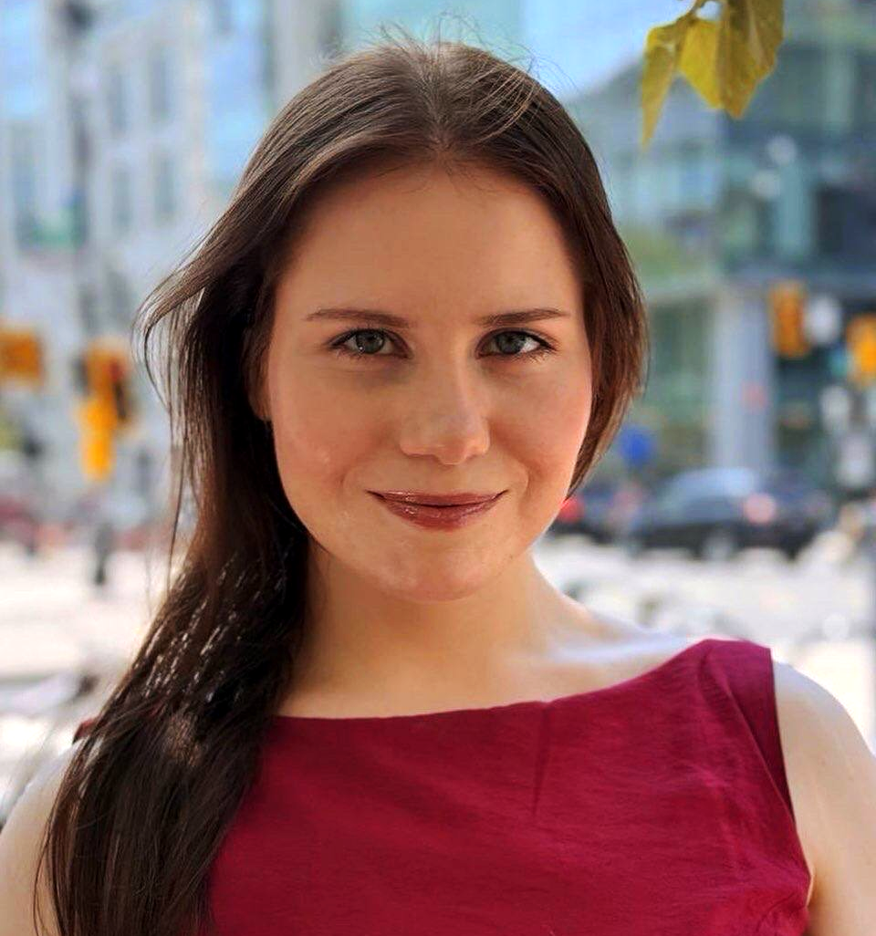


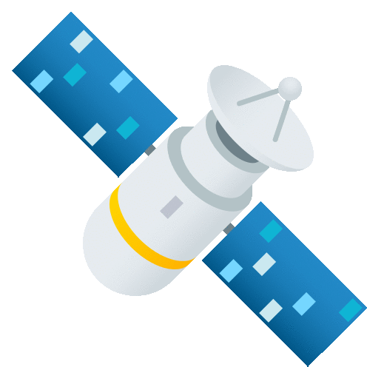
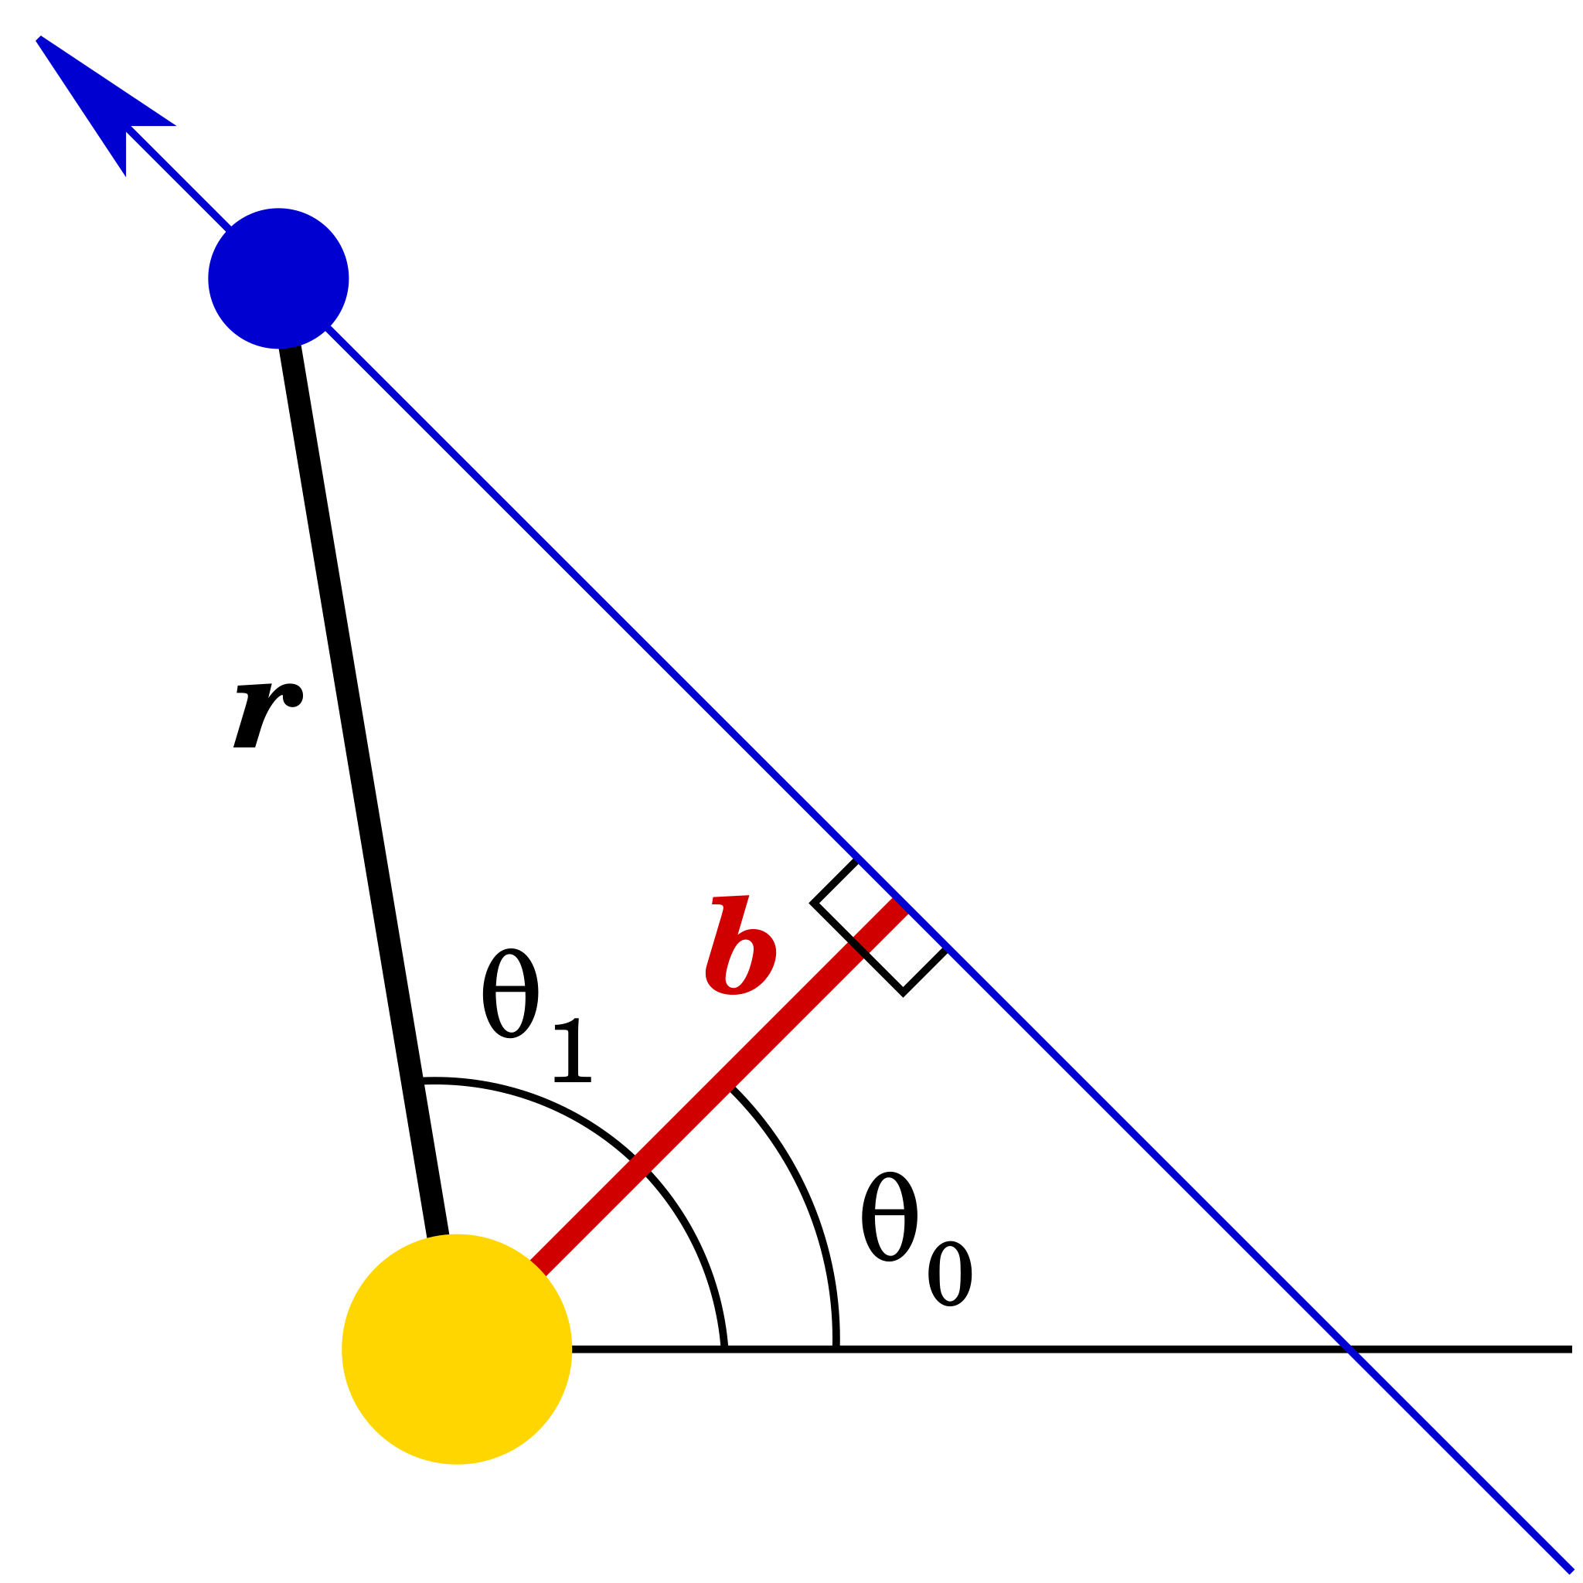
Introduction
LIGO Hanford, WA
CEBEX engineering
Space Systems engineering background (Russia and the US)
Anna Iudintseva (AI)
Mechanical Engineer – CEBEX, Caltech
Parametric design of supports, end caps, spool pieces for CEBEX
Today is 3 months since my 1st day at LIGO!

Slide 3
Summary
Design requirements and decision points for CEBEX
LIGO reference
Update on the SolidWorks CAD models parametric design:
End Caps
Spool pieces for the pumping instrumentation
Supports for CEBEX
Ongoing and future work
Things to keep in mind and consider for CE

Slide 4
Credits and Acknowledgement
CEBEX technical team: Michael Zucker, Dennis Coyne, Janos Csizmazia, Alberto Franco-Ordovas, Jon Feicht, Jan-Carlo (JC) Sanchez, Albert Lazzarini
– design requirements, mentorship
LIGO Hanford staff: vacuum team – training me on the LIGO systems, facilities team – CEBEX building, CE researchers – discussions of the real-life integration and feasibility, administrative team – CE site discussions, navigating diplomacy, and supporting my outreach initiatives

Slide 5
CEBEX design background

Slide 6
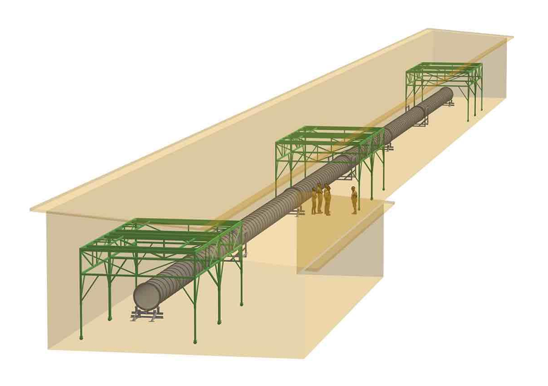
CEBEX: goals, design requirements, and considerations
The project goal: to mimic a subsection of the 80 km long Cosmic Explorer system by testing a 110 meter-long UHV beamtube w/ instrumentation & bakeout at LIGO Hanford as a proof-of-concept to reduce the cost of manufacturing.
Major milestones:
Construct the beamtube at LIGO
Test the technology
Make the CE-scale decisions
Figure 1. – CEBEX project concept [LIGO-G2402499]

Slide 7
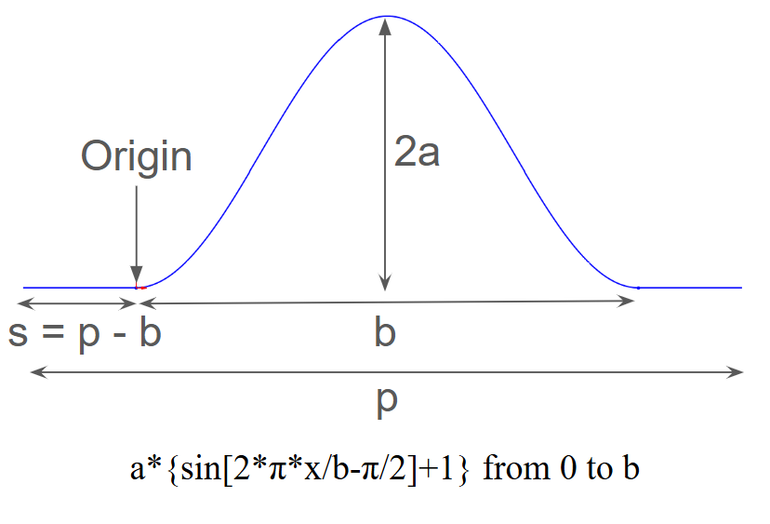
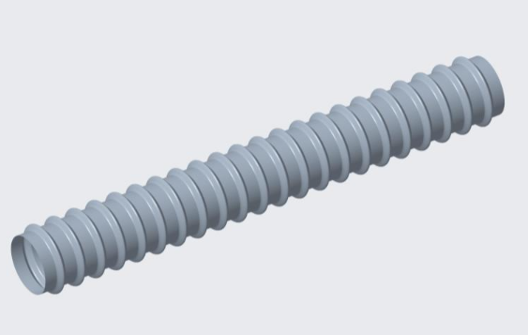
Corrugated BT (base) idea
Sine Corrugations are chosen to increase the moment of inertia of the tube, eliminating the need for ring stiffeners, and to account for the thermal expansion.
304/304L is being used for modelling since it has the lowest yield stress, other materials can be analyzed later on.
Figure 2. a - sine corrugation function, b - a 10 m tube section model [LIGO-G2500320]

Slide 8
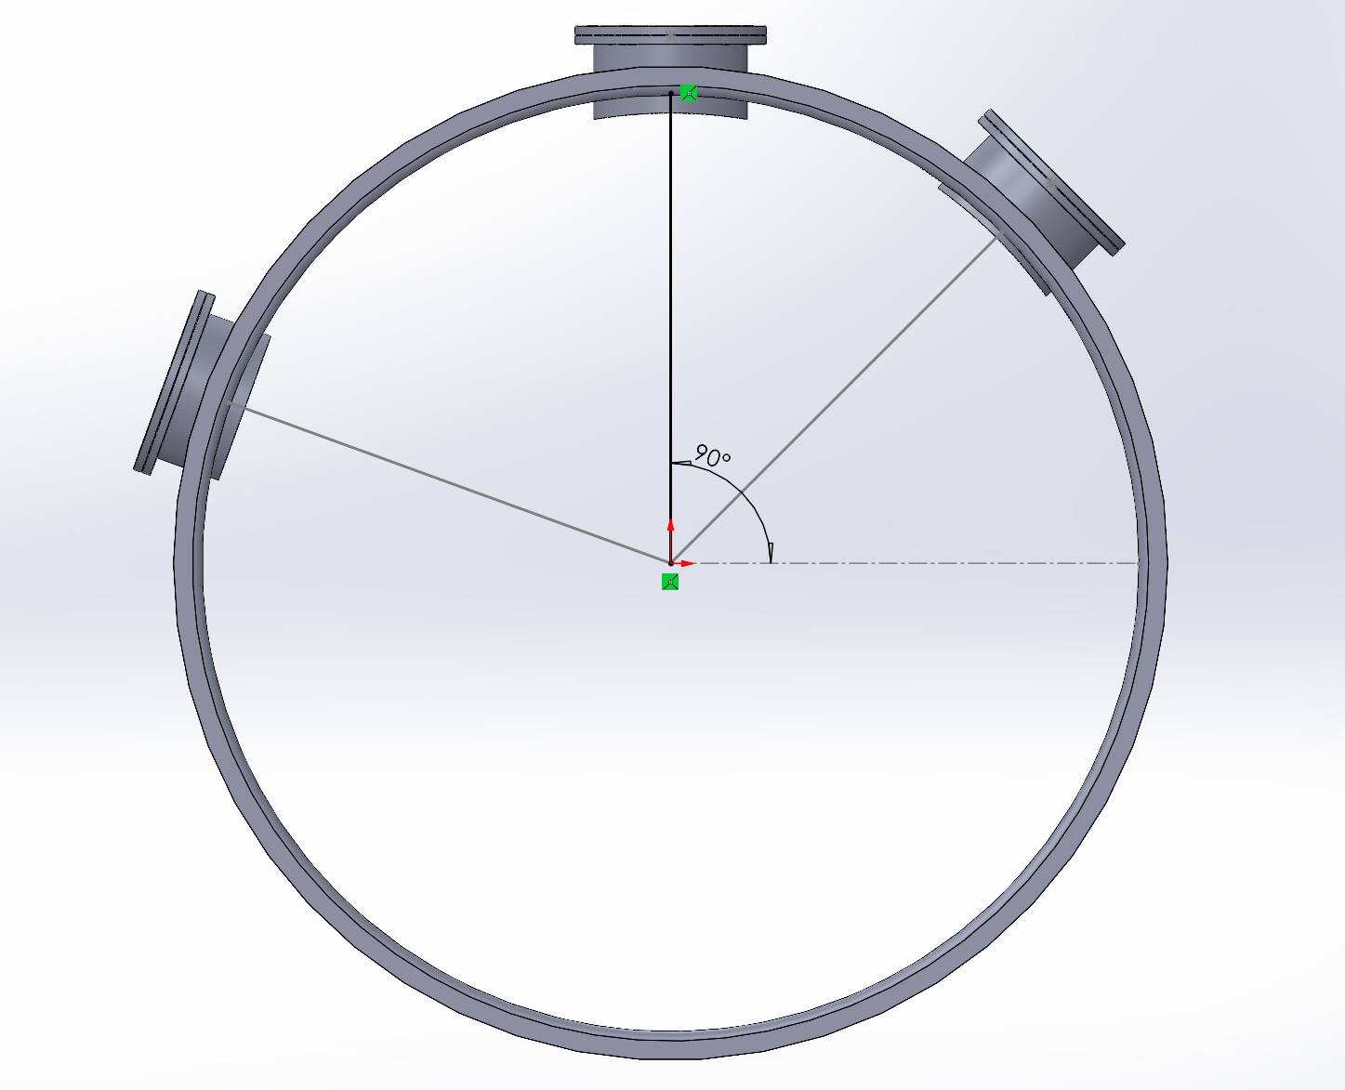
Parametric Design Definition
The way of developing CAD models with an opportunity to change any geometric parameter without re-creating the model.
Figure 3. — Spool SolidWorks model with an adjustable ports positioning

Slide 9
End Caps

Slide 10
General decisions drivers and requirements
Geometry and thickness:
Thinner the material = easier to bake it out
Simple enough shape for manufacturing
Material: 3 options and 1 question: do we care about H2?
Parametric design: geometry, orientation
Ports positioning: in alignment with the instrumentation requirements

Slide 11
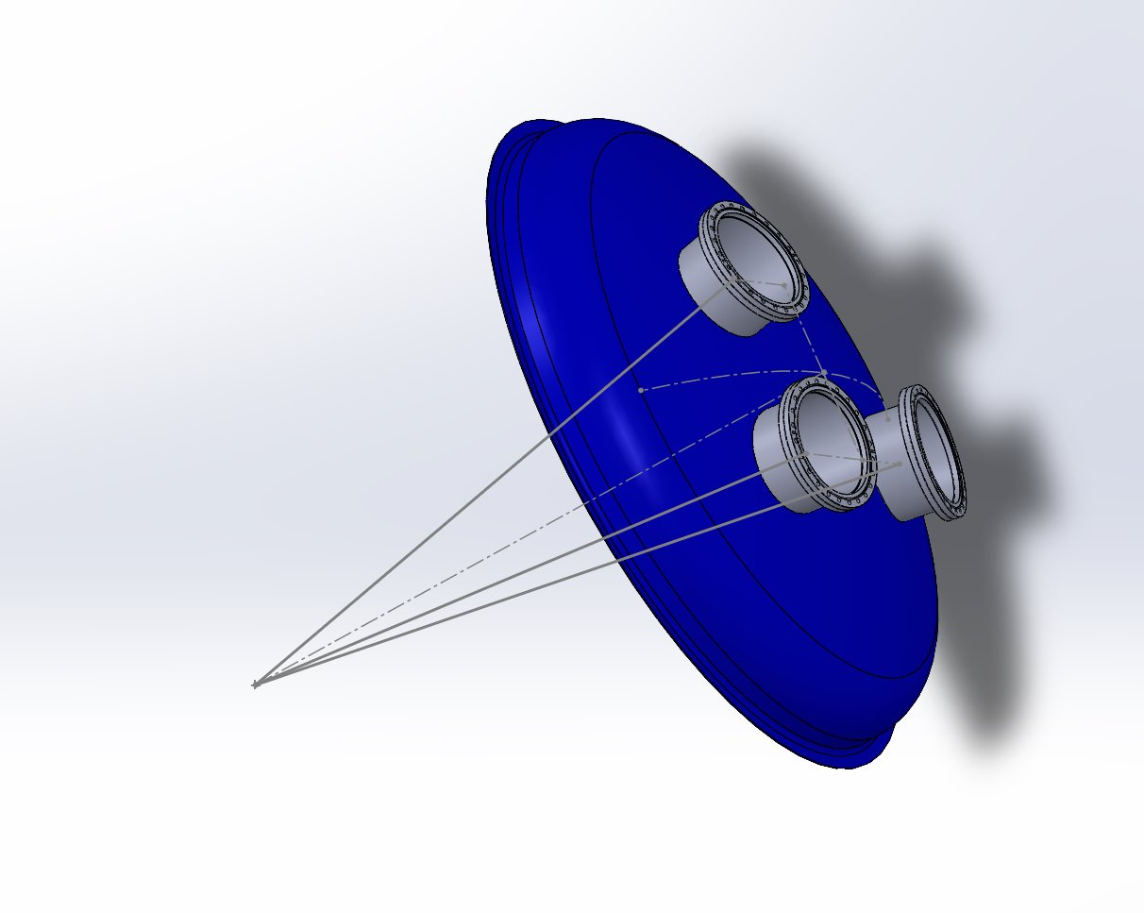
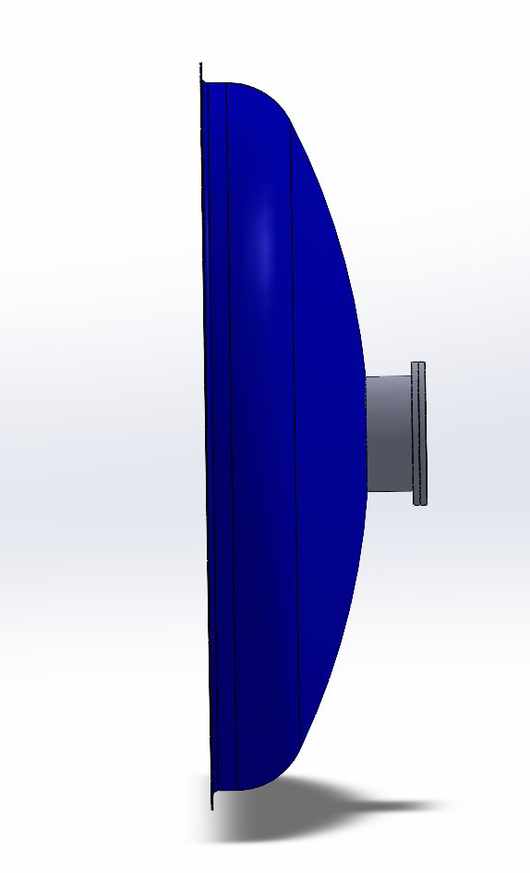
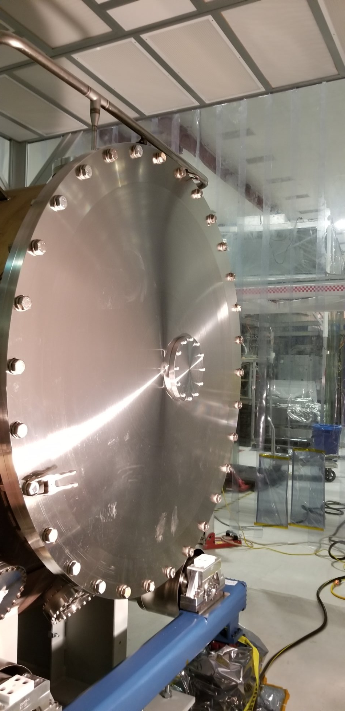
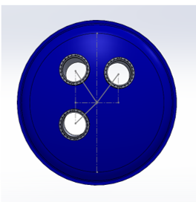
1. Shape
Torispherical End Cap (model) vs Septum Plate (LIGO)​
Shape: The torispherical geometry [Figure 4- a,b,c] minimizes membrane stresses, enabling reduced wall thickness compared to a flat septum plate as shown on the Figure 4 - d. ​
This lowers thermal mass and diffusion path length, improving hydrogen degassing efficiency during bakeout.​
If low residual H2 content is critical, the
torispherical end cap can be depleted
prior the welding.
Figure 4 a,b,c – toripsherical SolidWorks model;​
d – a photograph of the LIGO septum plate

Slide 12
2. Material
Table 1 – Material comparison for the end caps
Material | Thickness | H2 contamination | Structural Additions
304 L Stainless Steel (same as BT) | low (~3 mm) | low H2​ | strengthening ribs required
304 L Stainless Steel (same as BT) | thick (10+ mm) | high H2 | no ribs
A36 Carbon Steel | thick (10+ mm) | low H2​ | no ribs
An open question: do we care about H2 contamination?

Slide 13
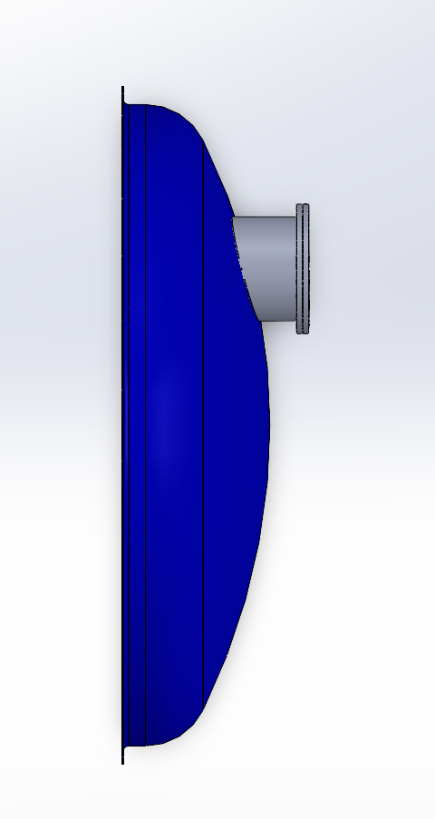
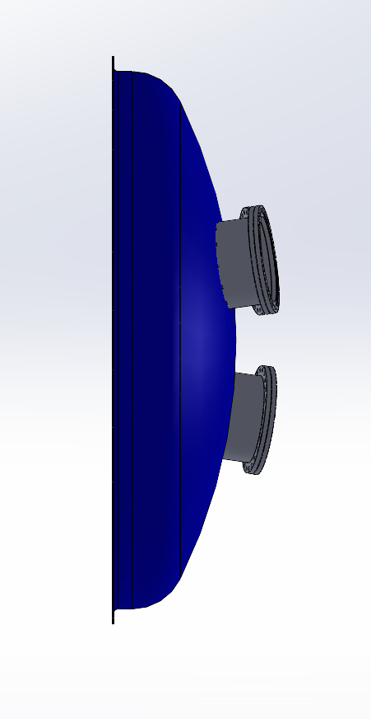
3. Parametric Design
Variables/adjustable parameters:
Positioning of the ports
D of the ports
Thickness of the walls
Weld geometry
Ports positioning: radially aligned [Figure 5 - a] or parallel to the main plane [Figure 5 - b]
The final design depends on the cost of manufacturing and practicality.
Figure 5 - 2 options of the ports positioning in a parametric model of the end cap
a) 90 deg (fixed) to the main plain
b) adjustable radial positioning

Slide 14
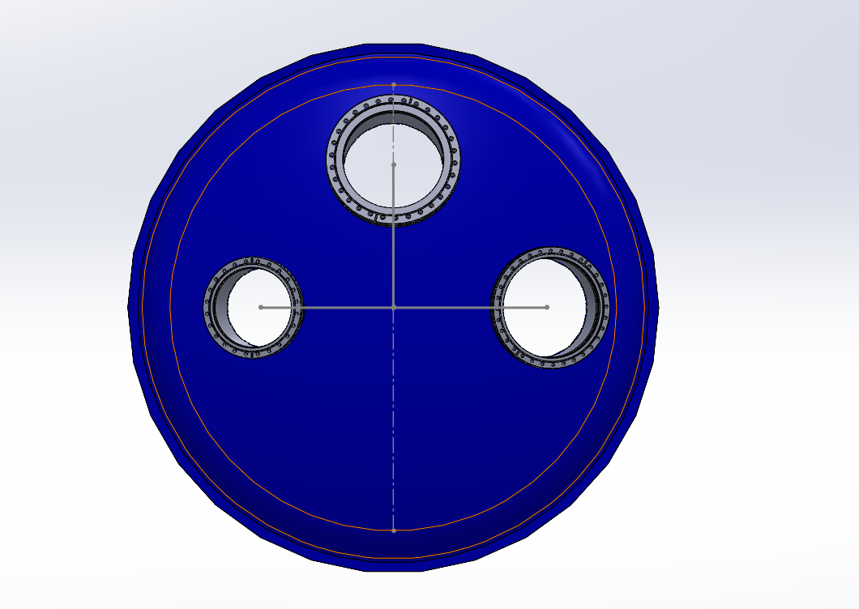
4. Ports Positioning
Per vacuum instrumentation requirements:
  Top 12” CF flange for Turbo pump
  Side 10” CF for roughing + spare
  Side 13 ¼” CF for gauge + RGA equipment
[See Janos Csizmazia’s report on the instrumentation]
Figure 6 – toripsherical SolidWorks end cap model with 3 vacuum ports

Slide 15
2. Pump port spools

Slide 16
General decisions drivers and requirements
Geometry: same D as tubes
Material: same options apply as for the end cap
Parametric design: geometry, port orientation
Ports positioning: in alignment with the instrumentation requirements

Slide 17
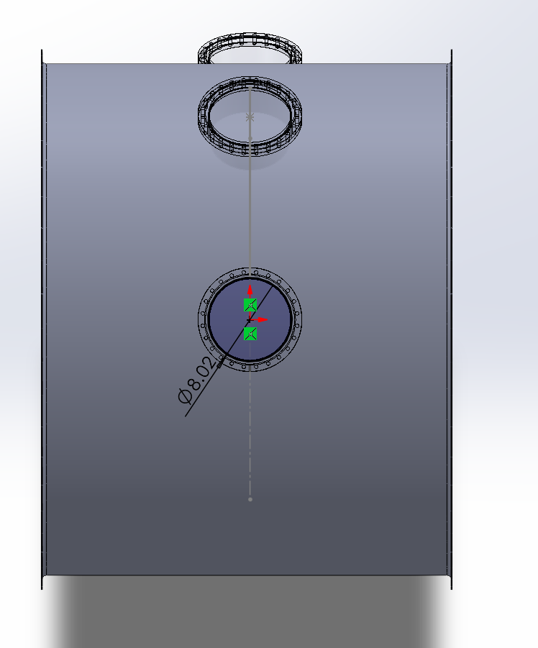
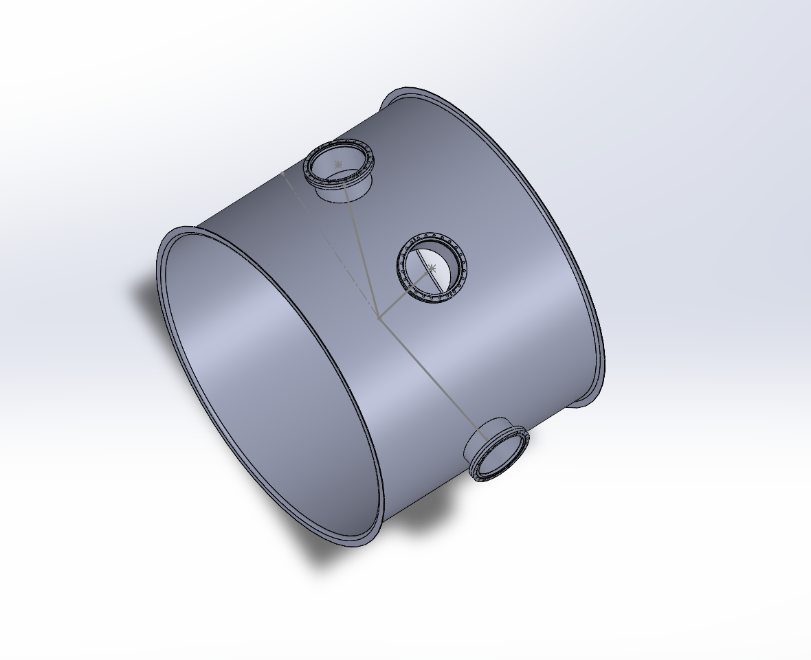
3. Parametric design
Variables/adjustable parameters:
Radial positioning of the ports
D of the ports
Thickness of the walls
D of the tube
Linear positioning of the ports (right/left along the tube)
Figure 7 a,b,c – parametric SolidWorks model of the spool piece

Slide 18
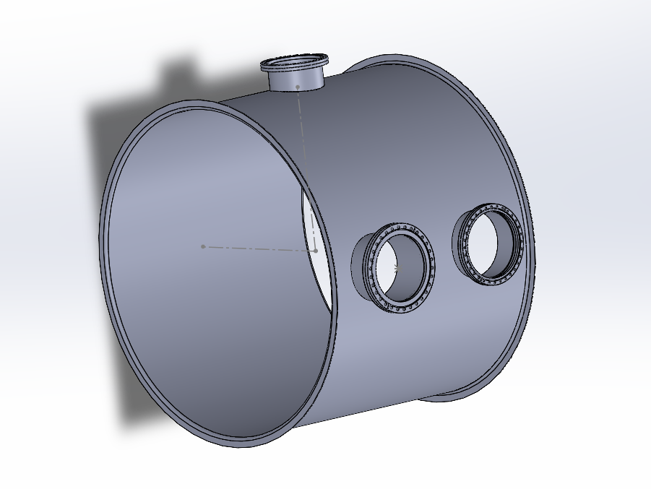
4. Specific Ports positioning
Per vacuum instrumentation requirements:
10” CF nipple on the top
13 ¼” CF nipple on the left
12” CF nipple on the right
[See Janos Csizmazia’s report on the instrumentation]
Figure 8 – SolidWorks model of the spool with 3 vacuum ports

Slide 19
3. Supports

Slide 20
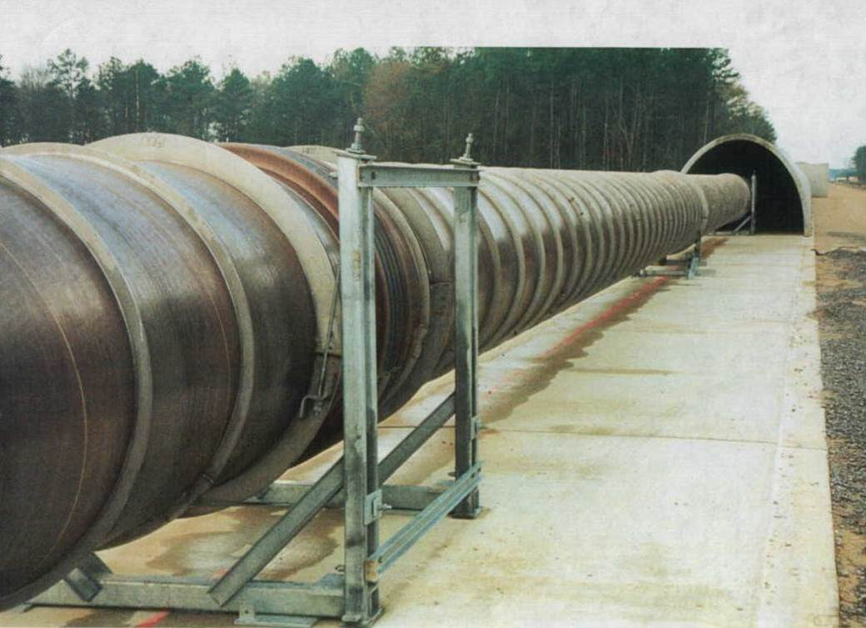
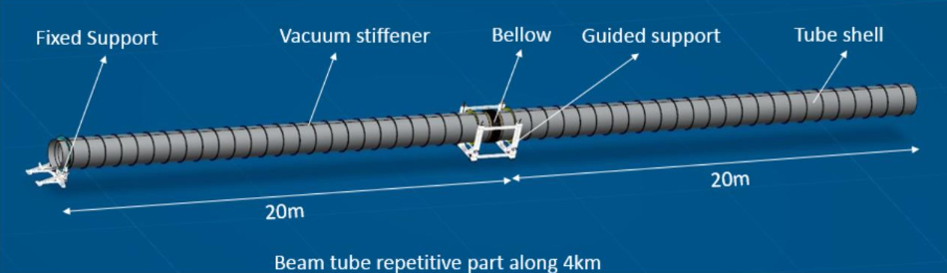
LIGO beamtube supports
Figure 9 a – LIGO Livingston BT picture; b – 20+20 m LIGO BT section [LIGO- L2500049]
Each LIGO module (20+20m tube) contains:
A bellow (not needed for CEBEX due to corrugated design on the slide #7)
A fixed support every 40 m
A “guided” cable support every 20 m [LIGO- L2500049]

Slide 21
General decisions drivers and requirements
CEBEX assembly model: spools+tubes+end caps
Number of supports and spacing: need for the Fixed and/or movable “guided” supports?
Design priorities: simplicity for manufacturing and degrees of freedom for the alignment

Slide 22
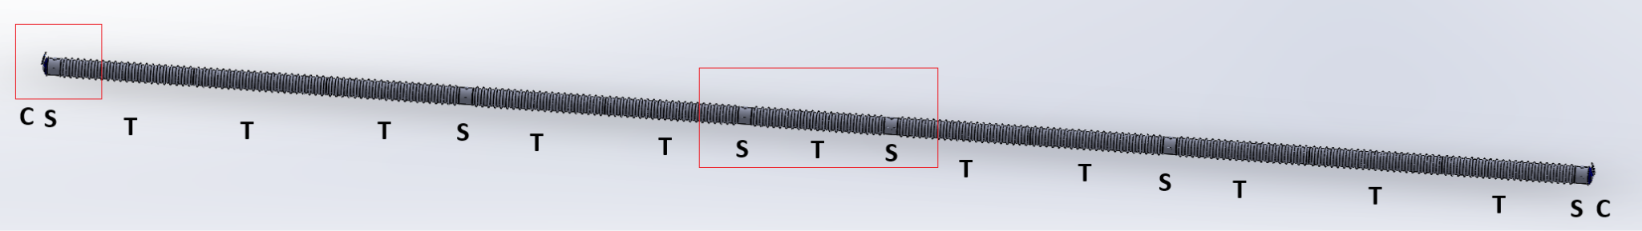
1. CEBEX assembly model
Figure 10 – CEBEX SolidWorks assembly model: spools+tubes+end caps [credits: Janos Csizmazia]
Sequence:
CSTTTSTTSTSTTSTTTSC
  C: torispherical end cap - 1 at each end
  S: spool piece - 6 pcs. symmetrical
  T: tube section, 10 m - 11 pcs. symmetrical

Slide 23
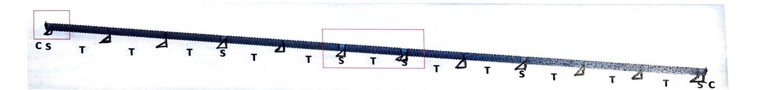
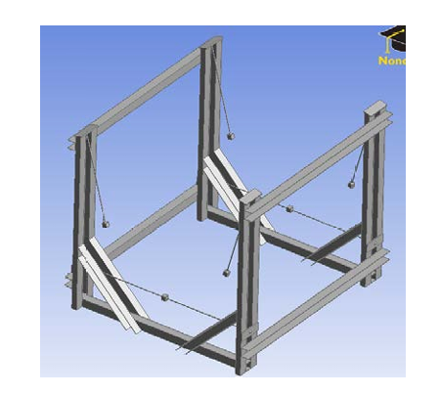
2. Number of supports and spacing
Figure 11 – CEBEX supports placement schematic
Fixed supports every 10 m per Dennis Coyne’s and Alberto Franco-Ordovas’s axial forces and buckling analysis
No guided supports [Figure 12] because the corrugations account for the thermal expansion
Figure 12 – LIGO Guided support model
[LIGO-T1400698]

Slide 24
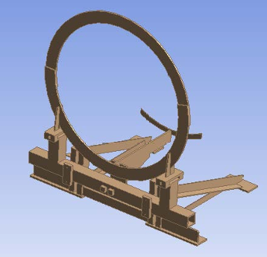
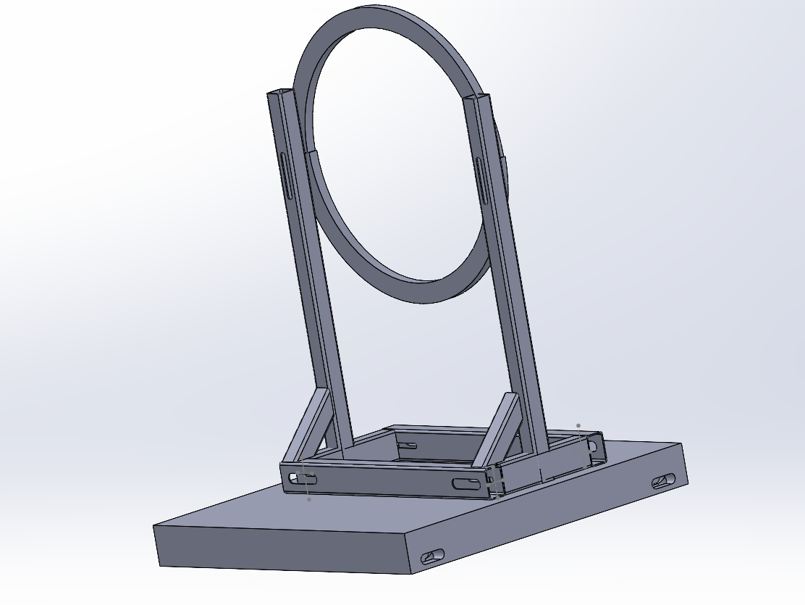
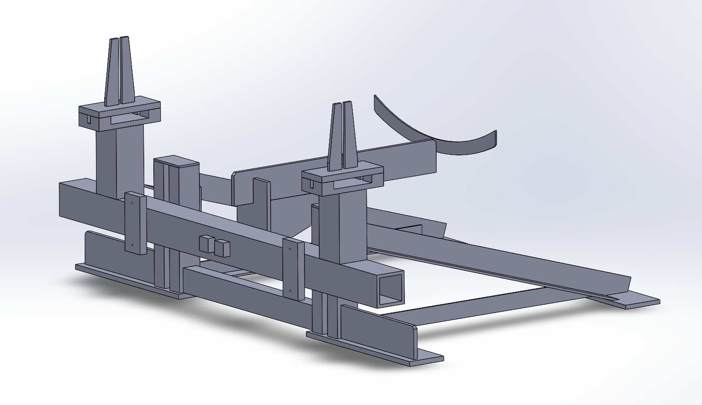
Parametric Design in progress
Referencing the LIGO fixed supports, the goal is to simplify the structure on Figure 13 to have less separate pieces while preserving the degrees of freedom for the tube alignment.
Attached to the support ring at the center line (helps with the seismic and reaction forces)
Prevents the potential “fisting” force at the support-ring joints
Dimensions are adjustable
Figure 13 a,b – LIGO fixed support model
[LIGO-T1400698]
Figure 14 - conceptual CEBEX fixed support design in progress

Slide 25
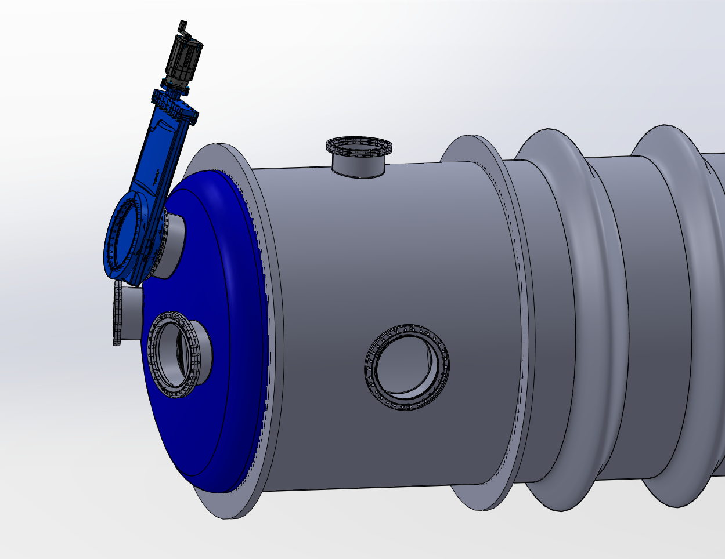
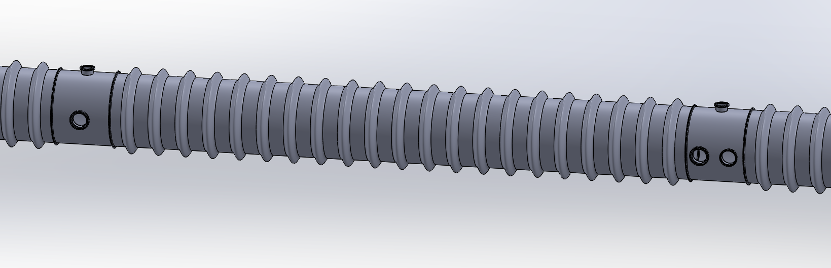
Ongoing and Future Work
End Caps:
1) H2 requirement open question
2) Stiffening features (ribs)
Spools: material selection, similar to the End caps
Supports:
Adding ports for DC Power Cables for the bakeout
Electric insulation pieces
Different steel profile assembly (L shape) to make it even lighter
Testing the mechanical integrity in ANSYS
Figure 15 - SolidWorks assembly of the end cap + spool + instrumentation + the tube [credits: Janos Csizmazia]

Slide 26
Things to keep in mind for CE

Slide 27
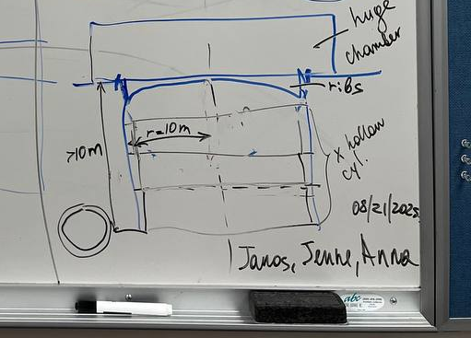
Fun: Supports for the CE BT ends considering the Newtonian Noise
CE scientists’ concern:
Newtonian noise - local gravity fluctuations/gravity gradient, do not affect the optics on the LIGO scale but are concerning at the CE scale.
“Small changes in the mass distribution of the environment surrounding the test masses — caused mainly by ambient seismic and atmospheric waves — accelerate the test masses and add noise to Cosmic Explorer’s gravitational-wave readout”
Leading solution discussed: “Soil excavation is therefore suggested primarily for its ability to suppress gravity gradients sourced by Rayleigh waves”*.
= Digging a 10-meter hole under the ends of BT.
*CE–T2300010–v3
Figure 16 - Corridor white board doodle in collaboration with Jenne Driggers (CE, LHO) and Janos Csizmazia (CEBEX)

Slide 28
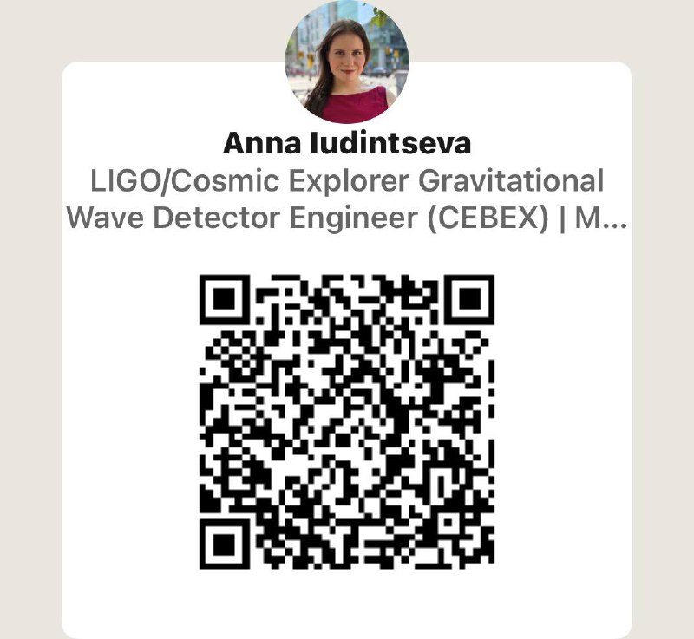
Contact Information
Anna Iudintseva / aiudints@caltech.edu

