Slide 1
Vacuum Tube Design for the Einstein Telescope
Alexandre Lacroix (CNRS LAPP)
CE-ET Beamtube workshop III
01/02/2025

Slide 2
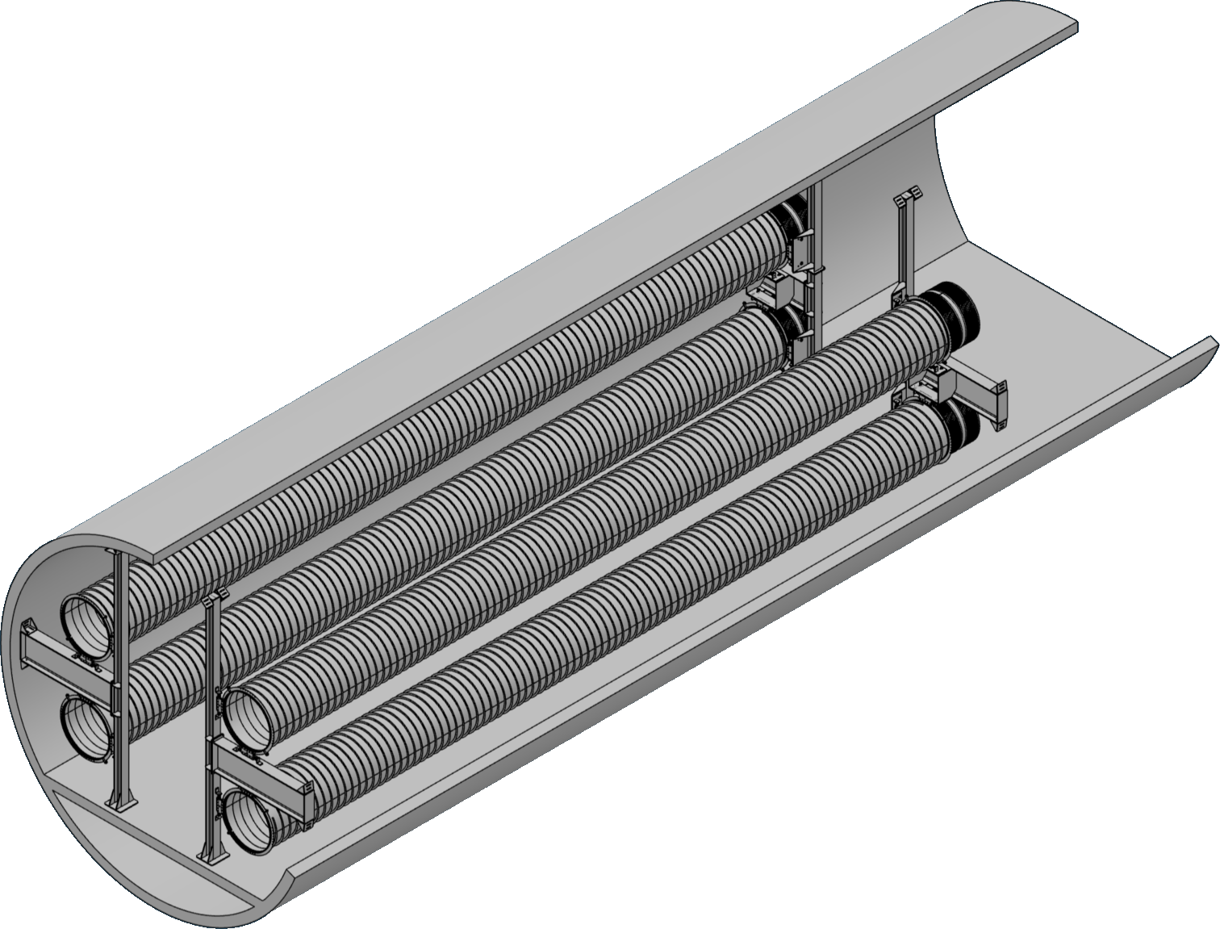
Summary
Alternative lightweight tube design
Support
Simulation
Action in progress and to be continued
Notes:
I will begin my presentation with a description of this new alternative tube, which has the advantage of being lightweight.
I will then present a support system compatible with any type of tube.
These systems will be followed by a presentation of the simulations that guided their design.
Finally, I will conclude with a presentation of the prototype currently under construction, the aim of which is to obtain realistic proof of concept.

Slide 3
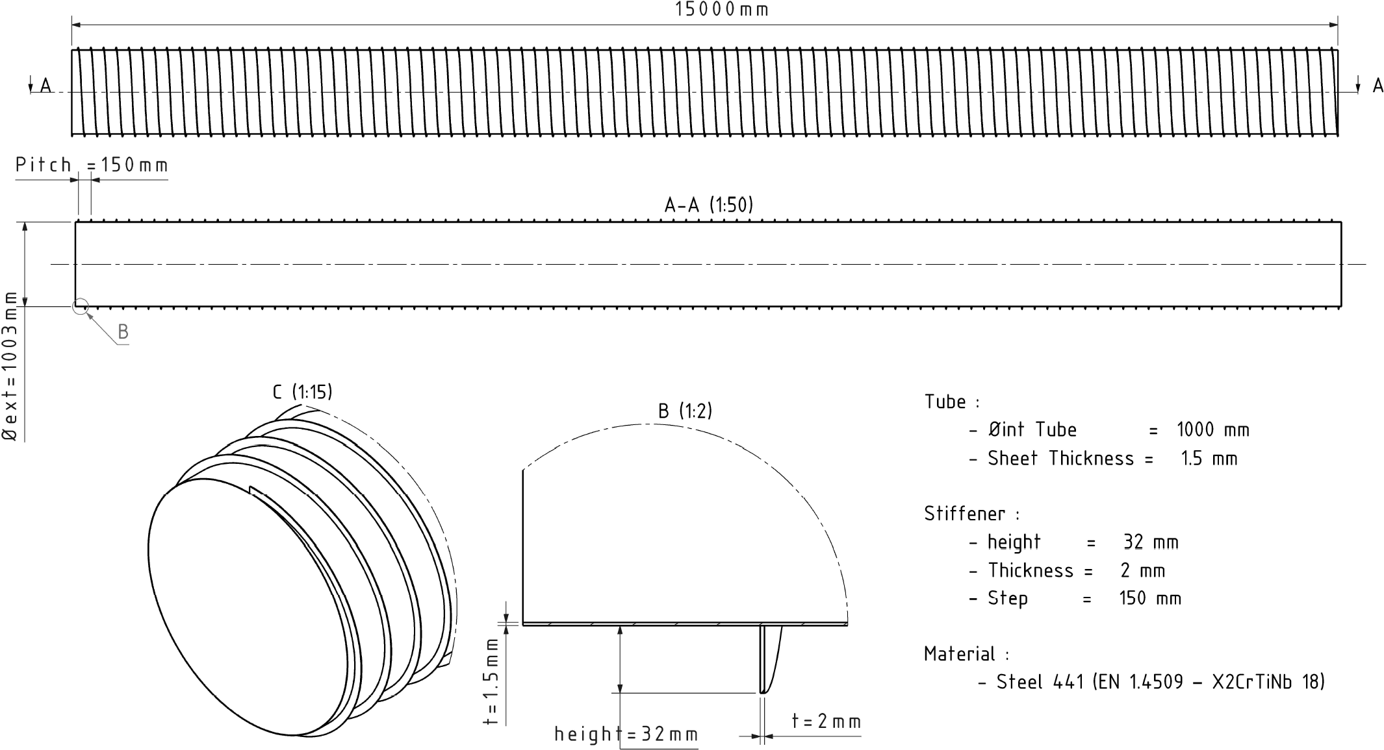
Tube Design – Lightweight and Optimized
Length :
  15 m,
  Φint : 1 m,
  wall thickness: 1.5 mm
External spiral stiffener :
  2 mm thickness,
  pitch 150 mm
Total weight: ~750 kg →
lightweight, reduced steel usage
Cost-effective for medium-series production (120 km of tube planned)
Exploits automation/robotization to produce slightly more complex geometry than VIRGO
Notes:
The tube is 15 meters long, with an internal diameter of 1 meter and a wall thickness of 1.5 mm. To increase rigidity without adding weight, we use an external spiral stiffener, 2 mm thick with a pitch of 150 mm. This design keeps the total weight around 750 kg, significantly reducing steel usage compared to a simple cylindrical tube.
"Although the spiral geometry is slightly more complex than that of VIRGO, we can exploit medium-series production – we are planning 120 km of tube – to benefit from automation and robotization, keeping potential production costs under control.“
"The design offers a balance between lightness and rigidity. Combined with large-scale deployment, it should reduce production costs.“
This pipe requires a support system to be installed in the Einstein Telescope tunnel, which I will present.

Slide 4
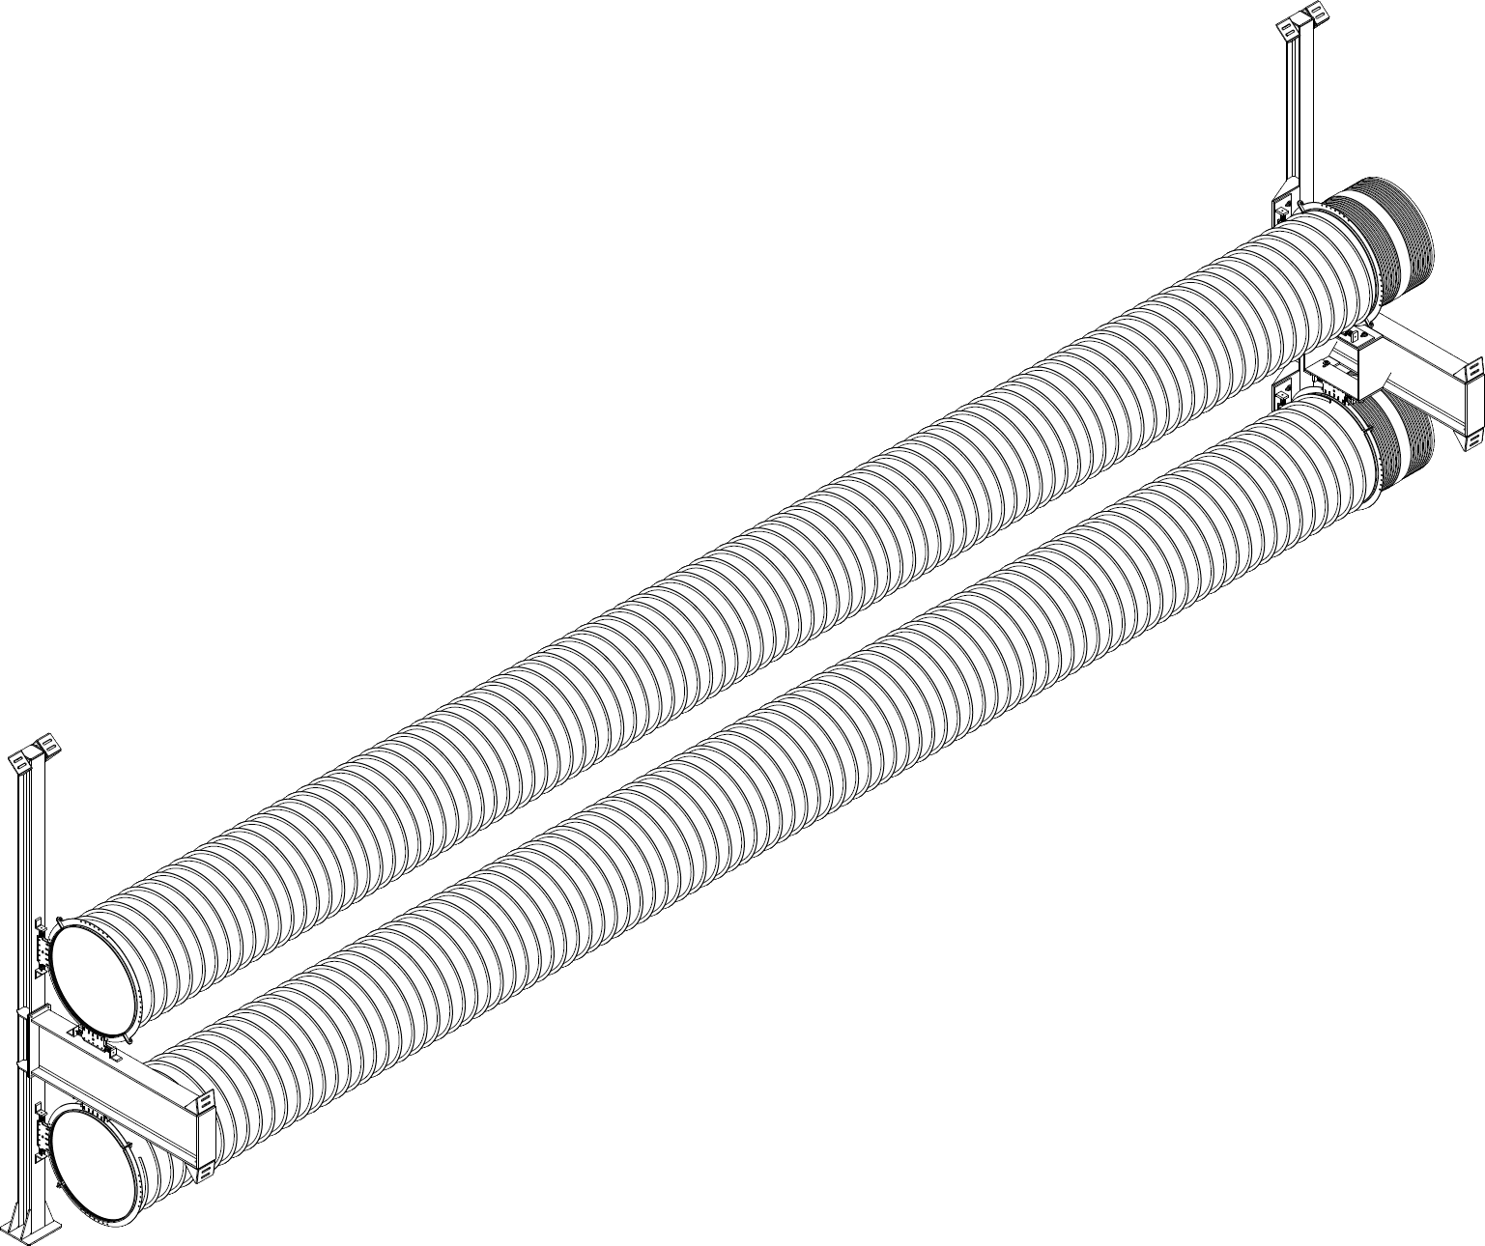
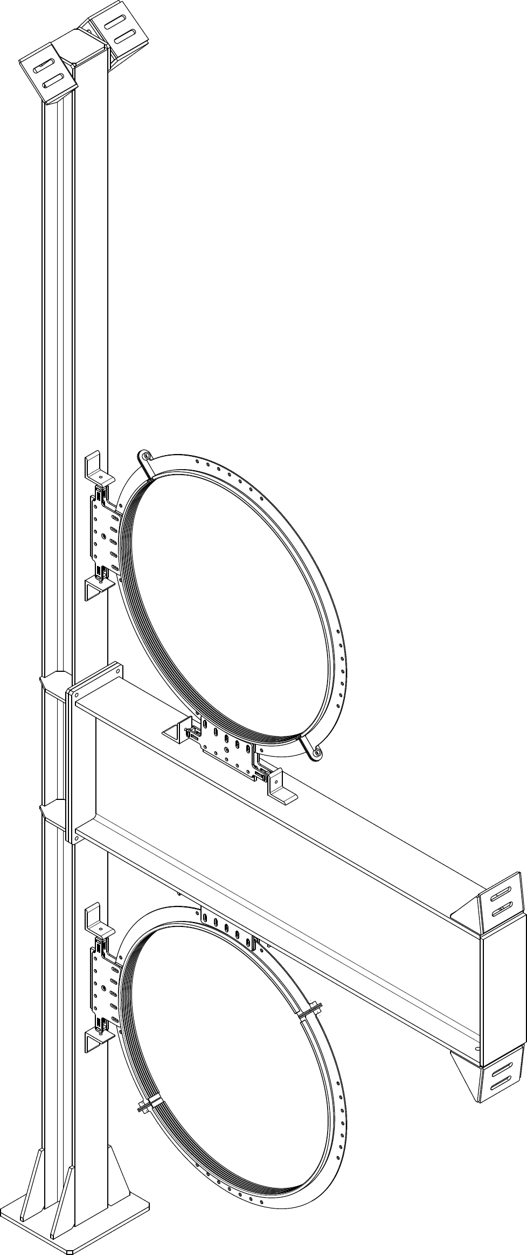
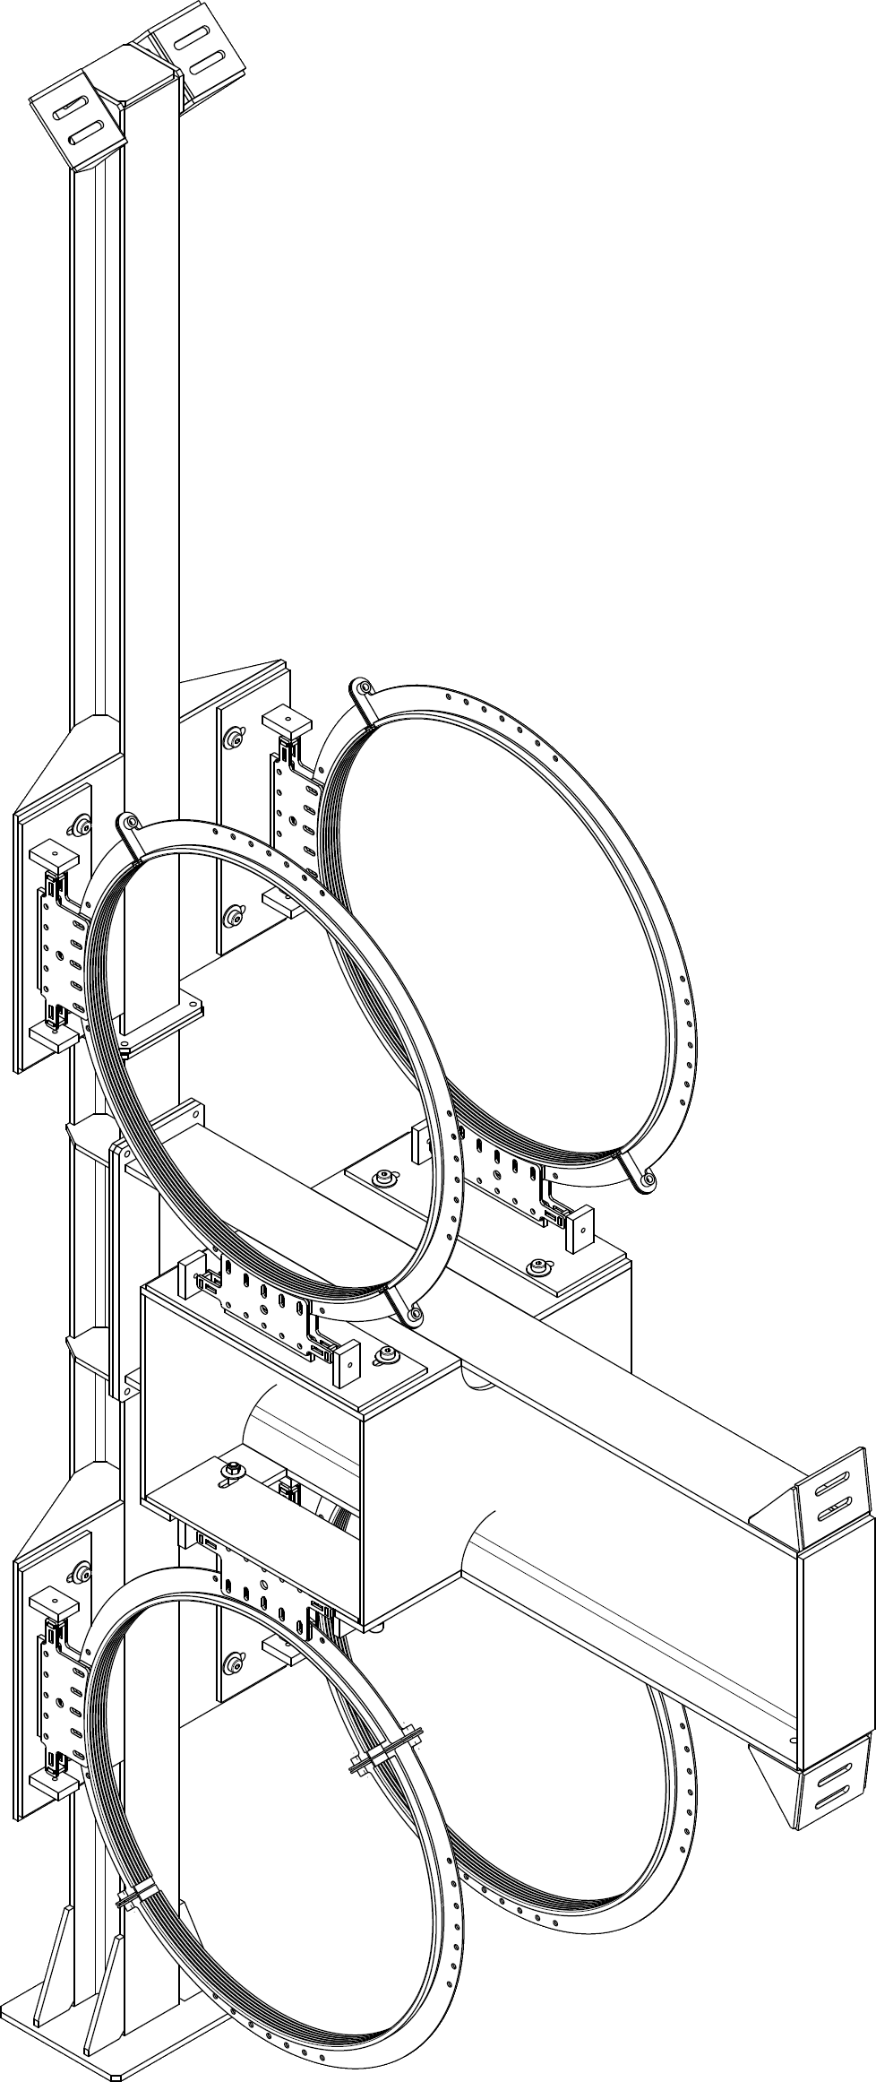
Supports Design
Notes:
The tube will be held at these ends by supports. One will be fixed, while the other will be able to assist the expansion of the tube during the bakeout phase. The supports consist of a simple frame supporting two tubes by means of adjustable clamping rings. The supports are located at the tube interconnections, either on the connection sleeve or on the bellows.

Slide 5
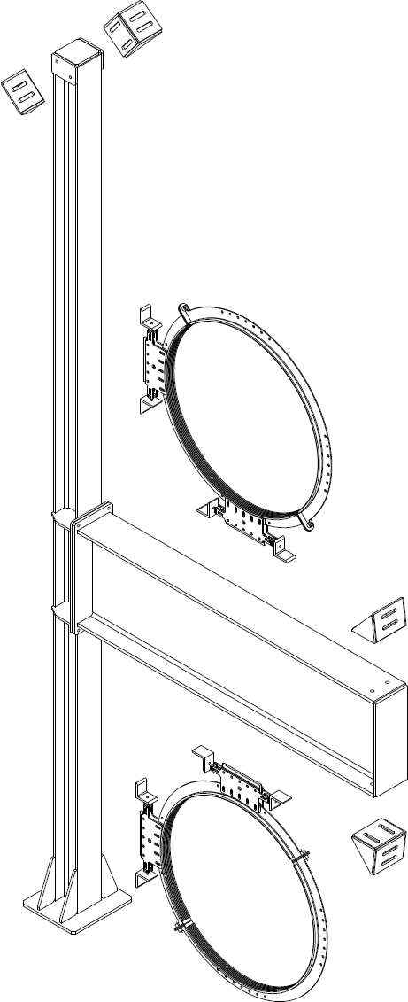
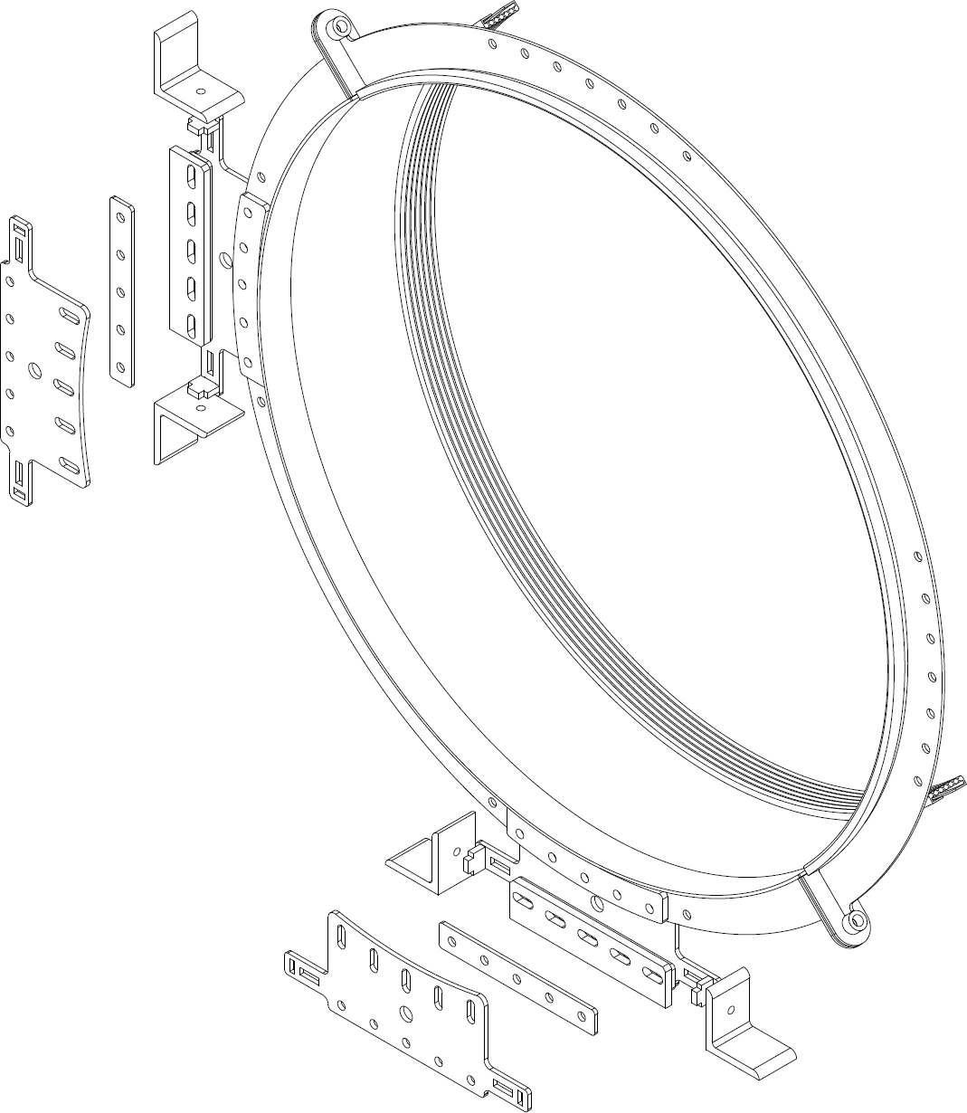
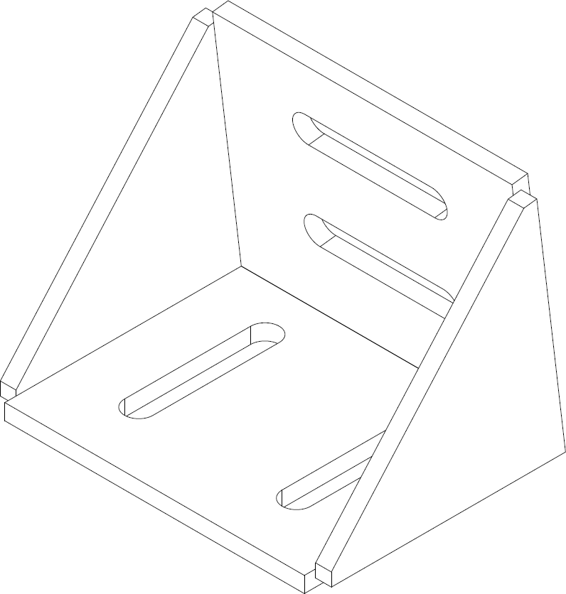
Support Design – Structure & Mounting
H-beams: vertical + horizontal → carry 2 tubes (top/bottom)
Rings clamp the tube, with adjustable jaws → ensure alignment & tolerances
Electrical + mechanical isolation during bake-out (up to 200 °C)
Anchored at floor (base plate) and tunnel wall (sliding brackets) → compensate tunnel irregularities
Notes:
Each tube is supported at both ends by H-beam structures. One vertical and one horizontal beam form a T-shaped frame, carrying two tubes – one above, one below. The tubes are clamped by adjustable rings, which ensure linearity and installation tolerances. These rings also provide electrical isolation during bake-out, with a thermal resistance up to 200 °C, well above the 150 °C required.
The supports are anchored both to the floor, via a base plate, and to the tunnel wall using sliding brackets. This compensates for potential irregularities in the tunnel structure.

Slide 6
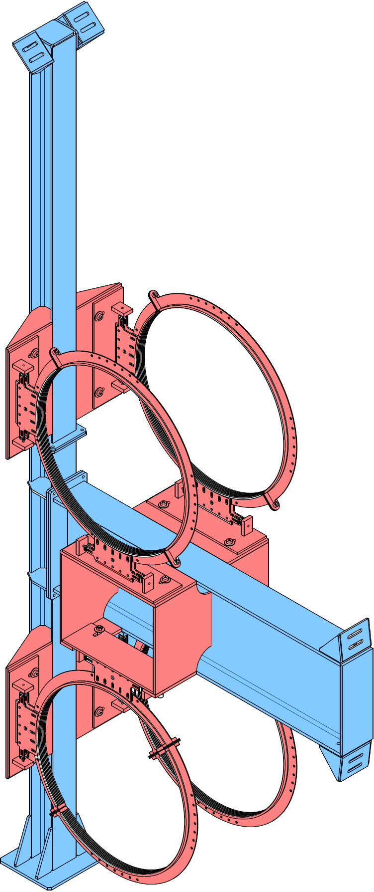
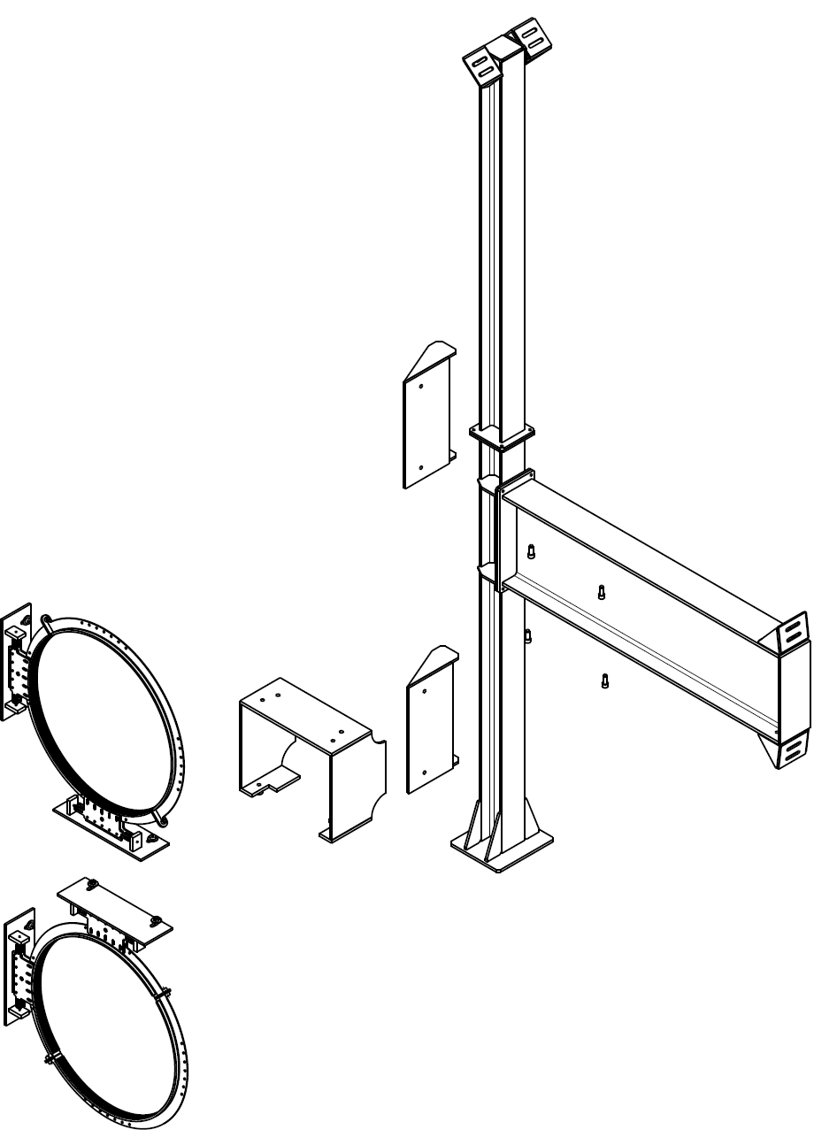
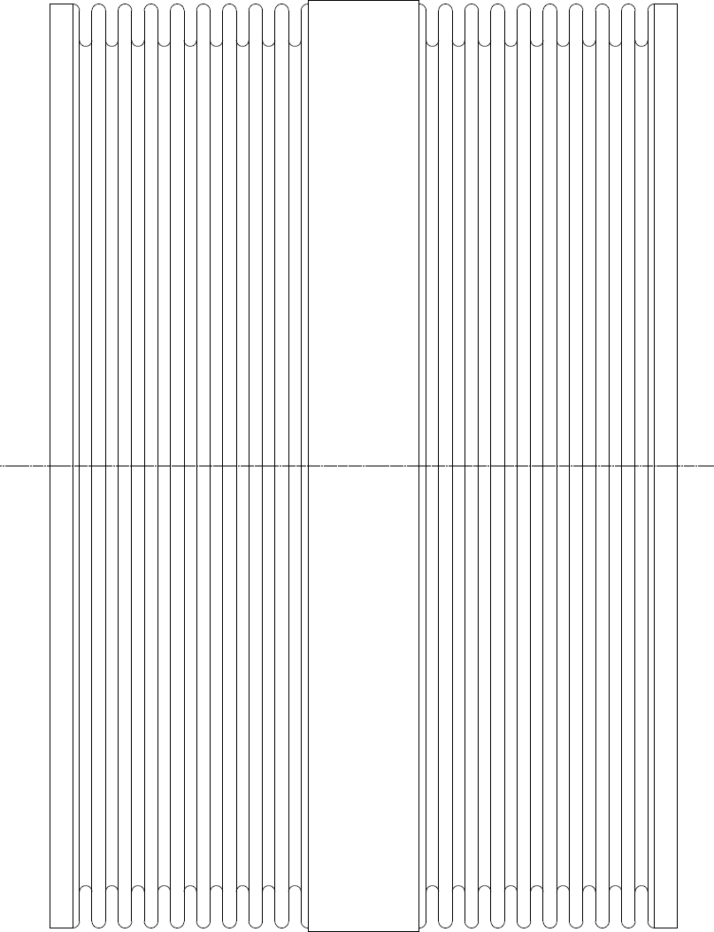
Support Design – Functional Features
Sliding support allows tube expansion (~20 mm during bake-out)
Helps bellows compress under thermal dilation
Design independent from bellows → avoids excessive torque (weight deflection + spiral stiffener torsion)
Optional damping plates → reduce vibrations and tube displacement
Notes:
Functionally, one support per tube end ensures continuity and stability. One of them includes a sliding system that absorbs tube expansion during bake-out, approximately 20 mm. This also helps bellows to compress under thermal dilation. Additional damping plates can be integrated to reduce vibrations and limit displacement.
Finally, supports are designed independently from the bellows. This avoids excessive torque from tube self-weight deflection and torsion induced by the spiral stiffener during thermal expansion.
"So these features ensure that the supports can carry the tubes reliably, compensate for thermal effects, and limit vibrations during operation."
"But beyond their immediate functionality, I also wanted the supports to be flexible enough to adapt to future needs."

Slide 7
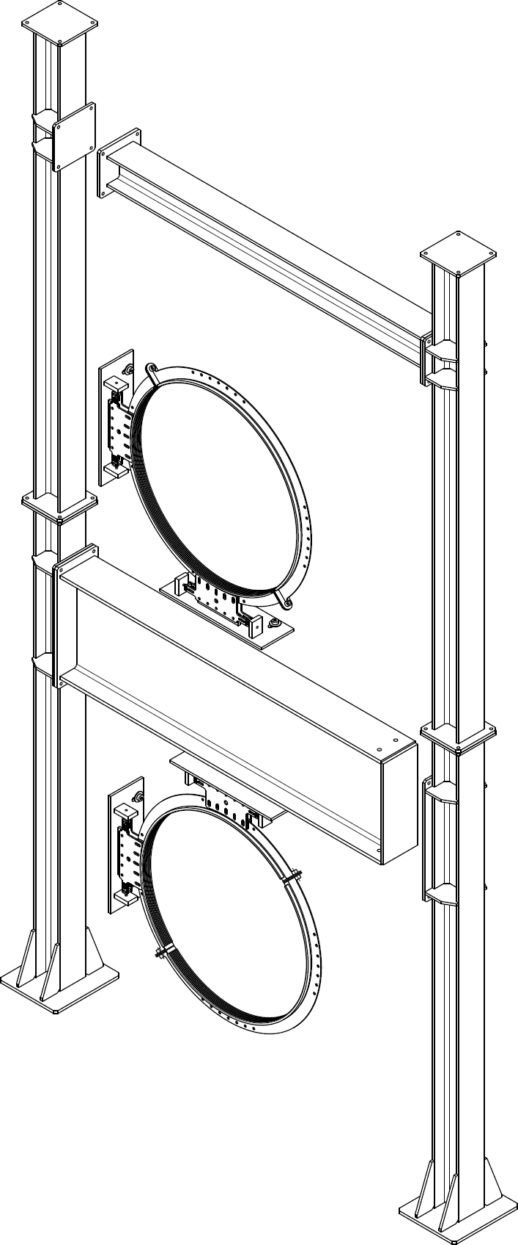
Support Adaptability
Modular design: components can be reused in new configurations (“like Lego bricks”)
CAD skeleton method → easy dimensional changes, automatic updates of assemblies
Enables adaptation to future pilot sector at CERN (2026)
Notes:
The supports have also been designed with adaptability in mind. Their different components can be reused in new environments, almost like Lego bricks. This modular approach reduces the need to redesign everything from scratch.
In addition, the CAD models were developed using a skeleton-based method. This means that if one dimension is modified, the entire assembly automatically updates. Positions of parts are readjusted consistently, preventing errors and saving time.
Thanks to this approach, the support design can evolve to fit the needs of the CERN pilot sector, which will undergo modifications in 2026. My adapted version of the support will be implemented there.
So far, I have shown the design of the tubes and the supports, as well as how these supports can adapt to different configurations. But design alone is not enough. We also need to understand how the tubes and supports behave under real conditions.
That’s why I performed numerical simulations, to evaluate mechanical stability, thermal effects, and overall performance before moving to prototyping.

Slide 8
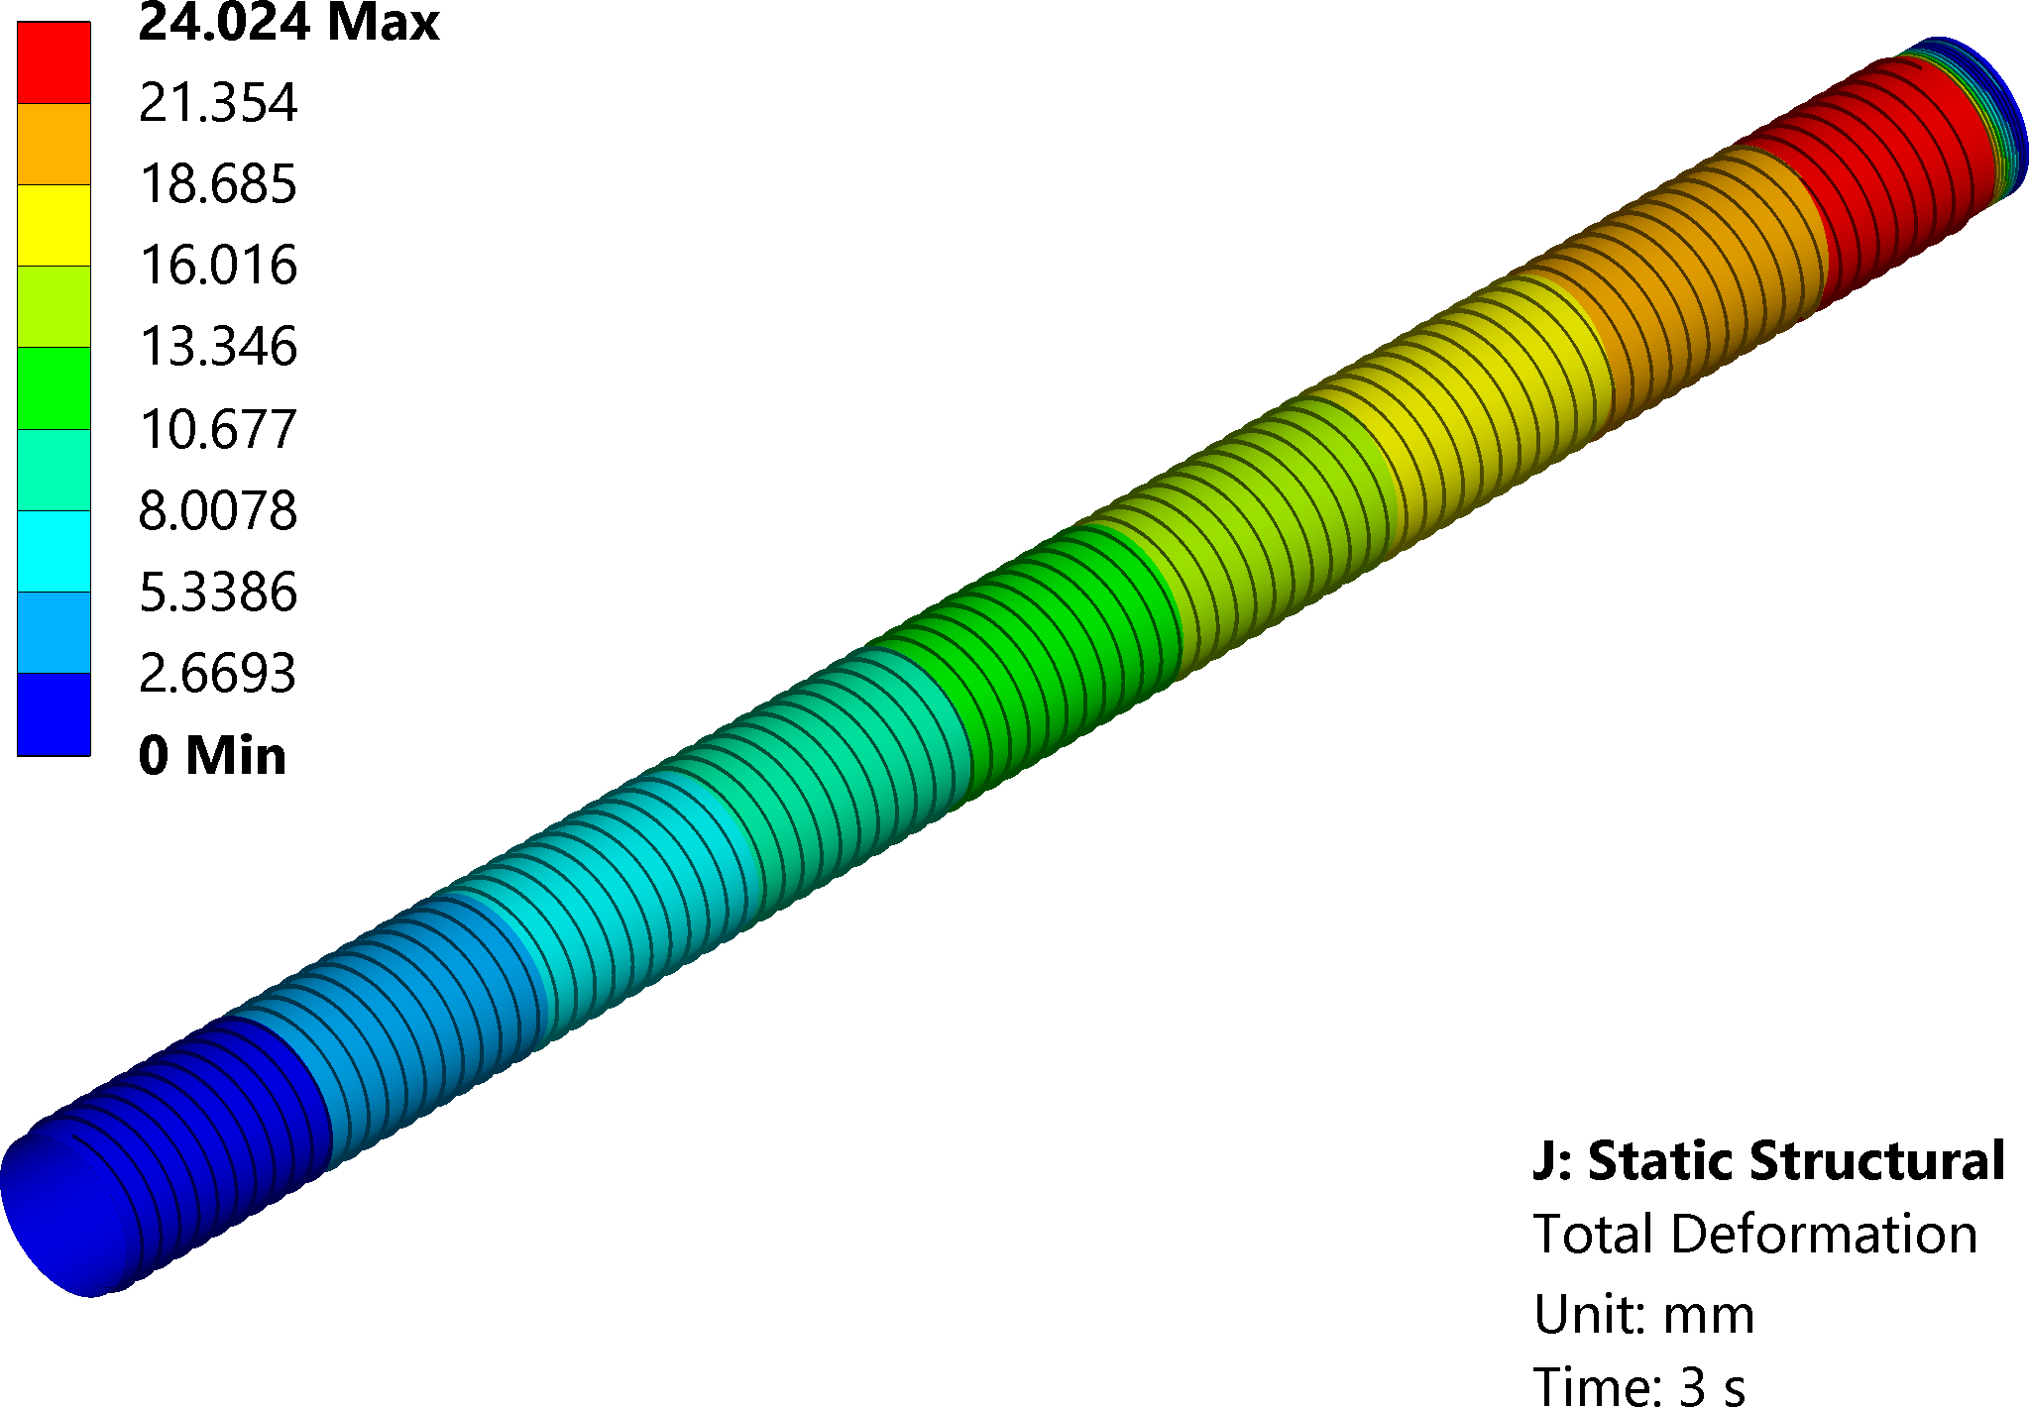
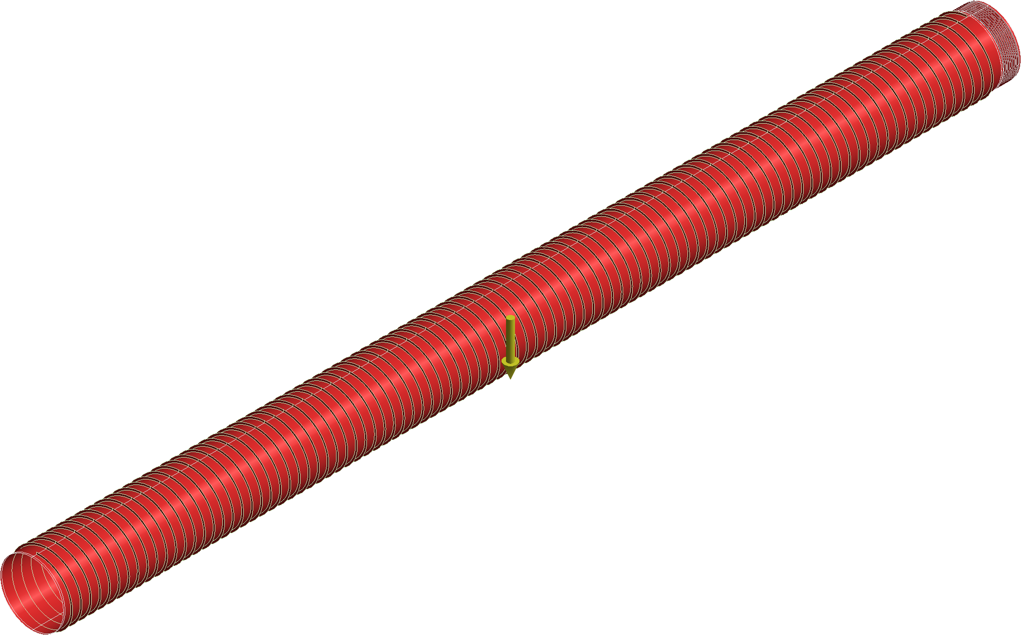

Thermal Expansion Model
Thermal expansion & deformation model
Tube with bellows (one end) + 80 kg distributed load (thermal insulation)
Symmetry conditions at both ends + rings blocking radial expansion
Sequential load steps: gravity → +150 °C → vacuum (-1 bar)
Outputs:
  Tube elongation & bellow compression
  Torque on the bellow (weight + thermal + stiffening spiral)
👉 Led to design change: support with sliding system
Symmetry
Z
X
Y
Step 1 : $M_{Y}=367 N.m$
Step 2 : $M_{Y}=347 N.m$
Step 3 : $\begin{matrix}M_{X}=413 N.m \\ M_{Y}=259 N.m\end{matrix}$
Symmetry
Notes:
In a first, simplified model, I focused on thermal expansion and the mechanical effect on the bellows. The simulation combined gravity, a thermal load of 150 °C, and external pressure simulating vacuum. This allowed me to evaluate tube elongation, deflection, and the resulting torque on the bellows. The results showed the need for a sliding support system, which I later integrated into the design.

Slide 9
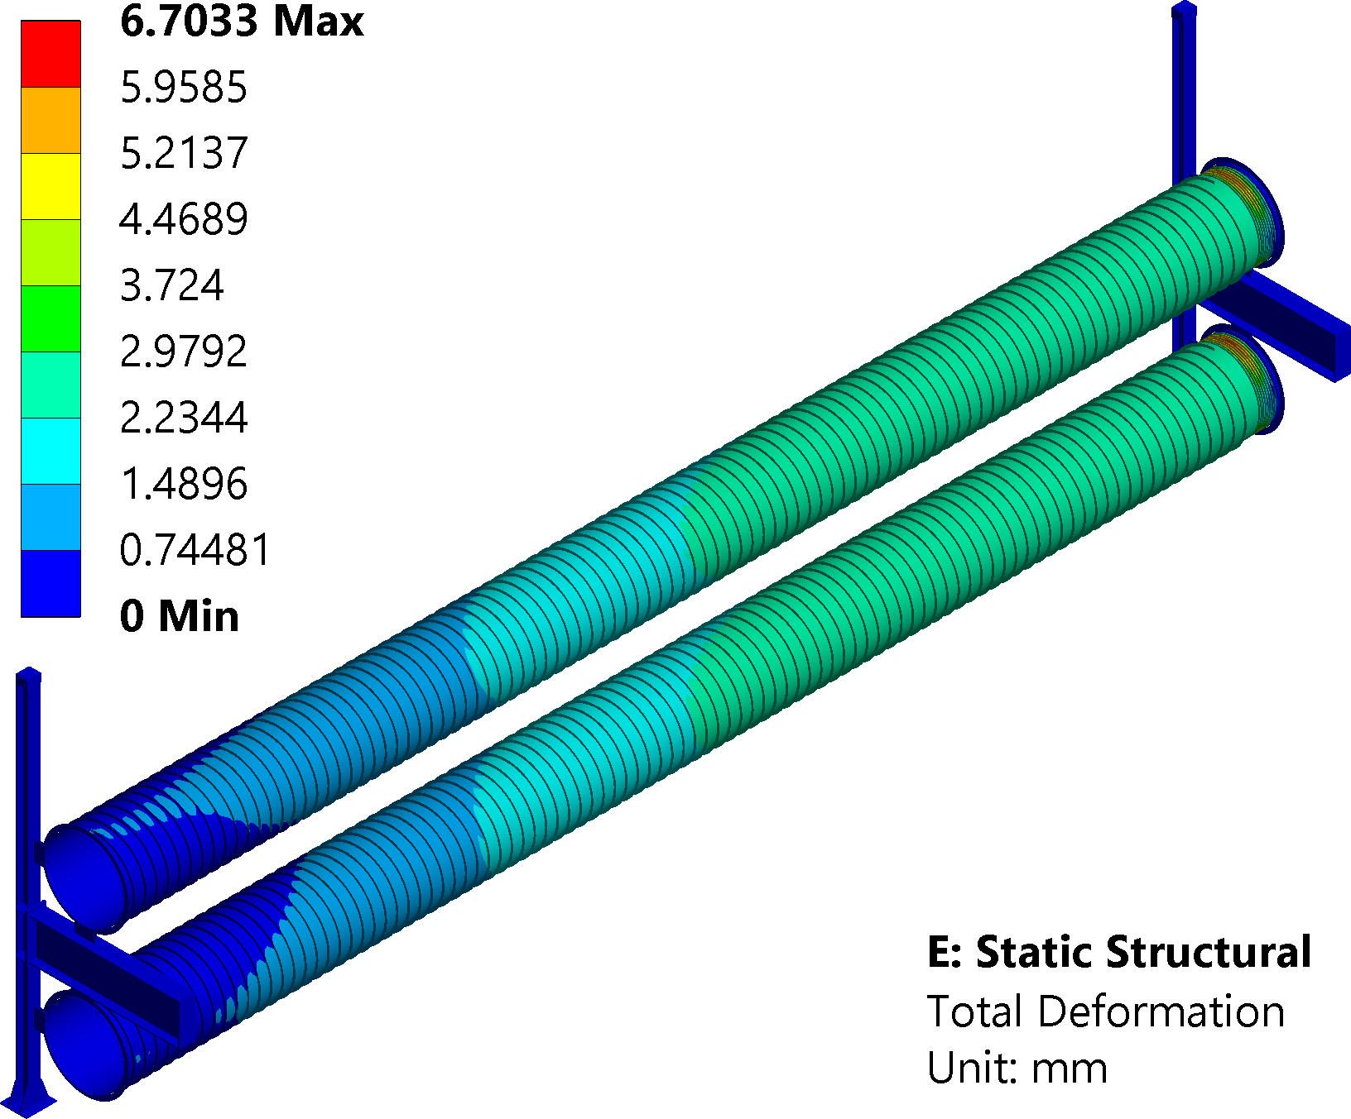
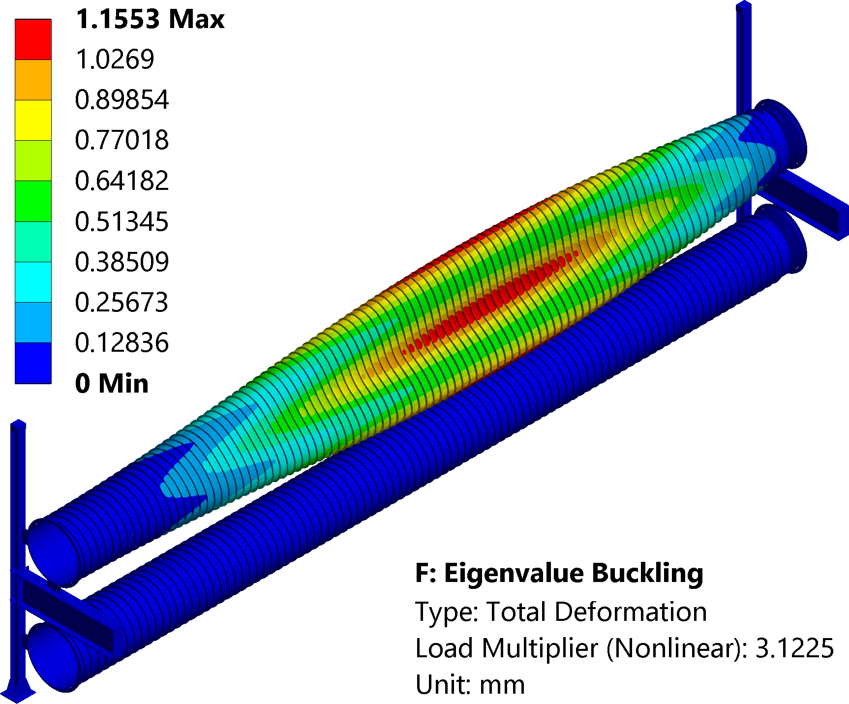
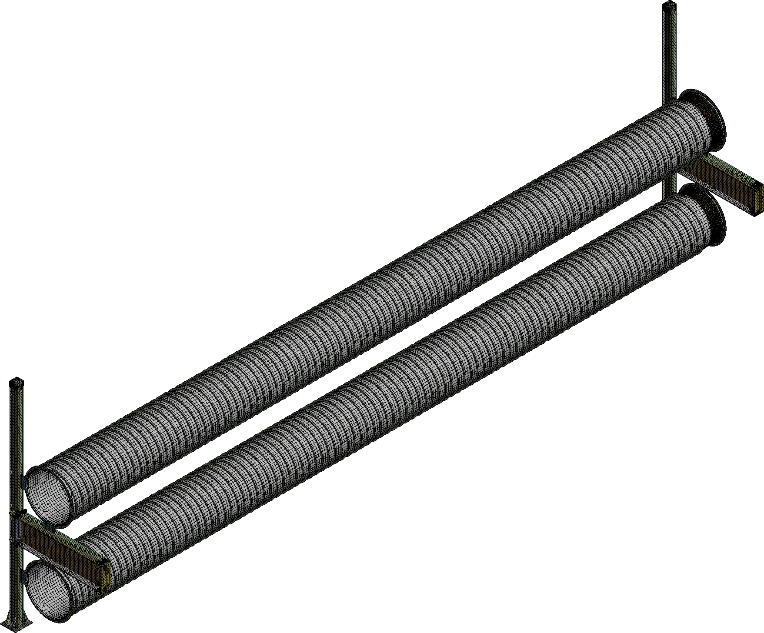
Support Model – Static & Buckling
Static deformation & buckling analysis
Two tubes with supports (old design, connected through bellows).
Loads: gravity + vacuum
Max deflection: < 7 mm over 15 m (< 3 mm without bellow)
Buckling analysis performed from static equilibrium (Safety Coef.: 4.1)
👉 Design validation choice : no risk of collapse under operating conditions
Notes:
In the first step of the full support model, I studied static behaviour under gravity and vacuum. The maximum deflection remained below 3 mm over 15 meters, which is acceptable. From this equilibrium state, I performed a buckling analysis to verify structural stability. The results confirmed that the design is safe against collapse.

Slide 10
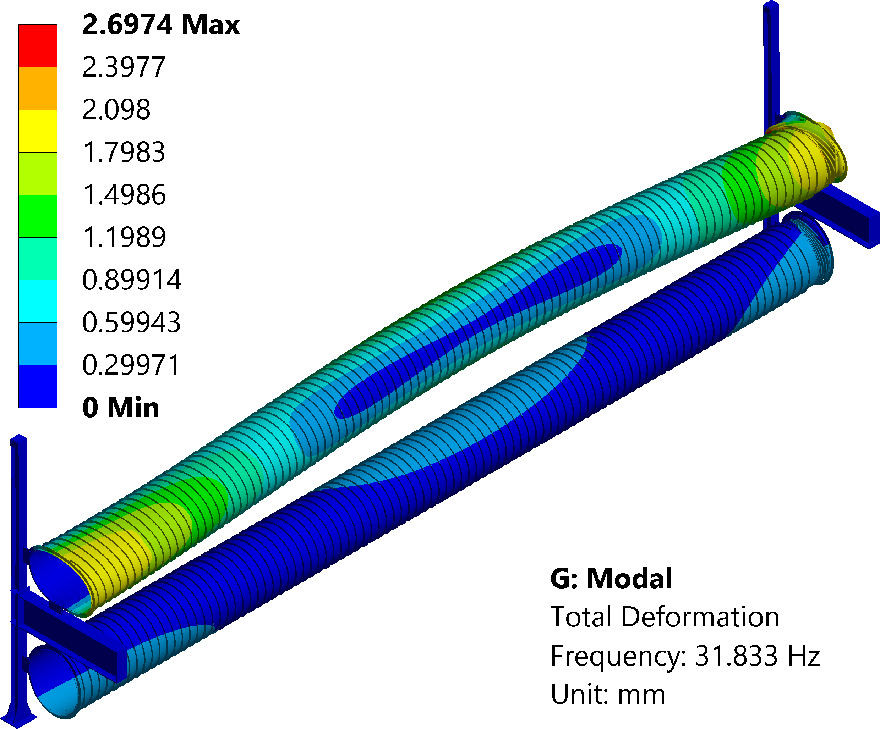
Support Model – Modal & Transfer Function
Modal behaviour & Harmonic response
Modal analysis up to 100 Hz (2% damping)
Excitations applied at support fixations in X, Y, Z (1 mm displacement)
Transfer functions computed at baffles (end of tubes)
👉 Validation: These provisional results are given for a 1 mm excitation. They must be multiplied by the seismic spectrum measured at the final installation site to ensure that they are acceptable
70 first modes calculated (0 → 100 Hz) :
  37 from the bellows
  28 from the tubes
  5 from the supports
Notes:
In the second step, I studied the dynamic response of the supported tubes. I performed a modal analysis up to 100 Hz, then applied harmonic excitations at the fixation points. The response was measured at the baffles. This gave transfer functions and highlighted the natural frequencies of the system. The results confirmed that the structure has acceptable vibration behaviour for our environment.
After completing these simulations — from thermal expansion, to static and buckling analysis, and finally to the modal response — we had sufficient confidence in the concept to move forward to the next step: the construction of a prototype tube

Slide 11
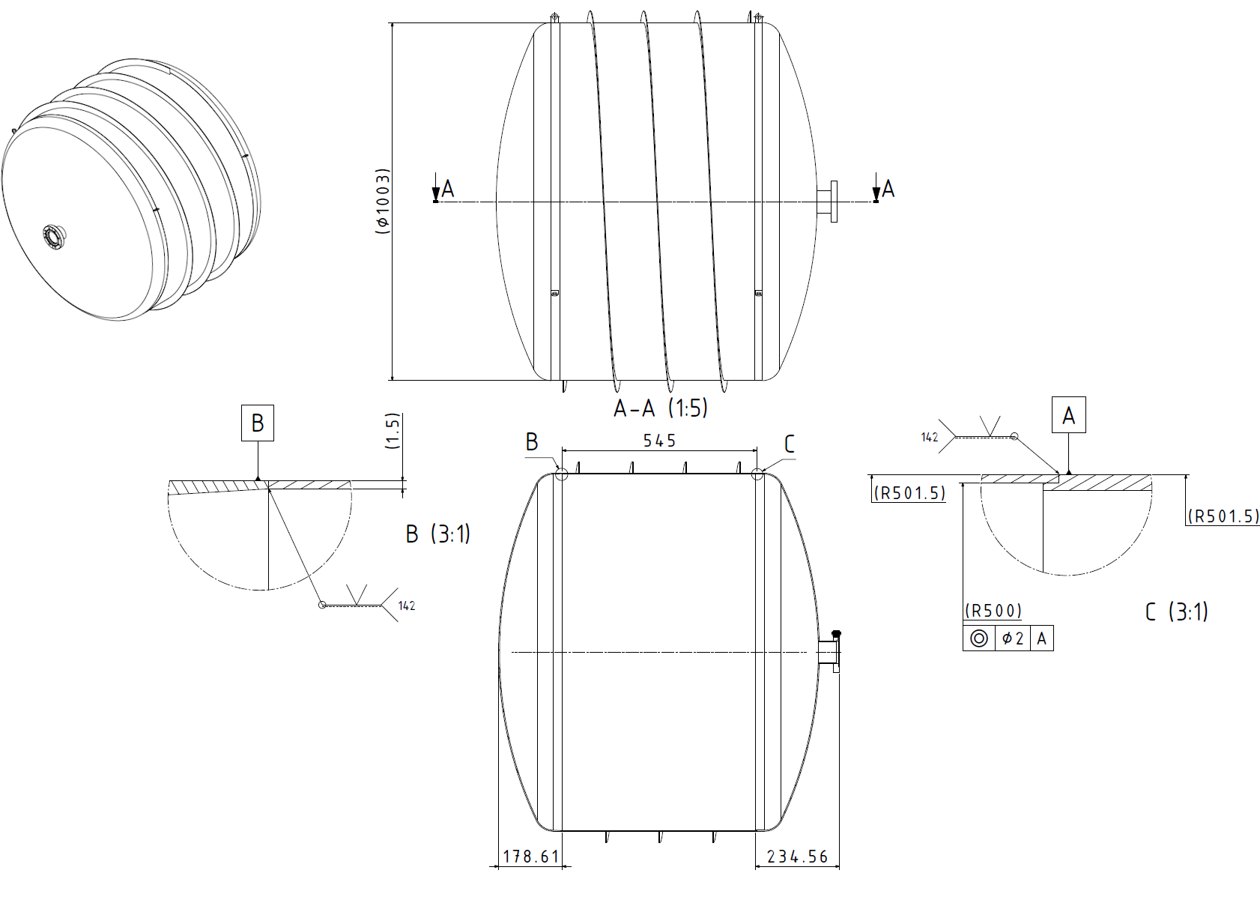
Small Prototype
Prototype tube under fabrication
Dimensions: 0.5 m length, Ø1 m internal, 1.5 mm thickness
Spiral stiffener: 2 mm, 150 mm pitch
Ends: domed caps, one with pumping port
Material: stainless steel 441
Objectives:
  Validate leak-tightness down to 10⁻⁸ mbar
  Test feasibility of rolling/soldering thin 1.5 mm sheet with stiffener & domed ends
  Ensure no distortion, cracks, or leaks during manufacturing
Status:
  Sheets delivered, welding procedure written
  Fabrication ongoing during this workshop
Notes:
This prototype is a crucial step. If successful, it will validate the manufacturing process, the leak-tightness, and the feasibility of building long tubes. From there, we can move to the next milestone: the pilot sector planned for 2027.

Slide 12
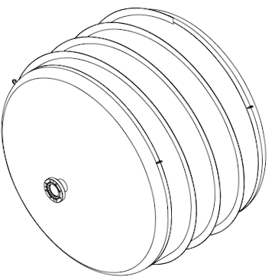
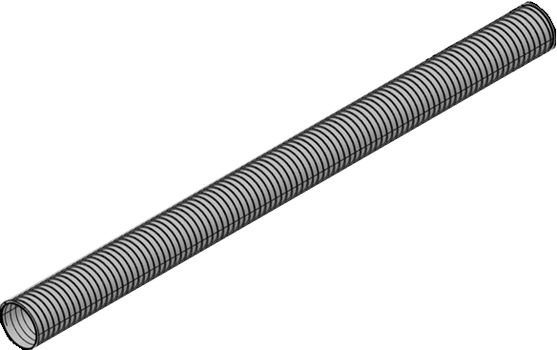
RoadMap & Vision
2025 - 2026
2026
2027
Prototype
CERN Pilote Sector Evolution
+
New Supports
New Pilot Sector Design
Notes:
This roadmap shows the continuity of our work. We start with the short prototype this year to validate manufacturing and vacuum tightness. In 2026, my responsibility will be to adapt and implement the new supports in the CERN pilot sector. Finally, if successful, we aim at a complete pilot sector for the Einstein Telescope in 2027, preparing for large-scale production and installation

Slide 13
Thank You for Your Attention

