Slide 1

Cosmic Explorer
Beamtube Experiment (CE-BEX):
Design Specifications
& Tube Design Overview for CE
Beamtube Workshop #3 (29-Sep – 2-Oct 2025)
Caltech
Dennis Coyne
24-Sep-2025 v1
Artist: Eddie Anaya (Cal State Fullerton)
LIGO-G2502099-v1

Slide 2
Scope
Design
  Beamtube/pipe segments
  Circumferential joints between tube/pipe segments
  Bellows (expansion joints), if needed
  Support structures, including
    Support configuration
    alignment provisions
    slab attachments
    vibration isolation (*if required)
  Ports for pumps and instrumentation
  Valving to isolate pumps & instruments
  Valving to isolate BT sections
  Baffle attachment
  **Pumping & Instrumentation System
Fabrication
  ***Beamtube material (coil) processing (rolling, forming, welding, cleaning, …)
  Beamtube/pipe segment manufacturing
  Beamtube segment cleaning
  Beamtube segment leak testing
  Transport/logistics
Assembly
  In-situ installation
  Alignment
  Field circumferential joint welding
  Bake-out system
  Quality Assurance
  Module Leak Testing
***except material pre-processing (coil hydrogen degassing, surface passivation, etc.) which is covered in WG#1
*Potentially big design driver; Awaiting WG#3 input
**deferred scope for WorkShop#3

Slide 3
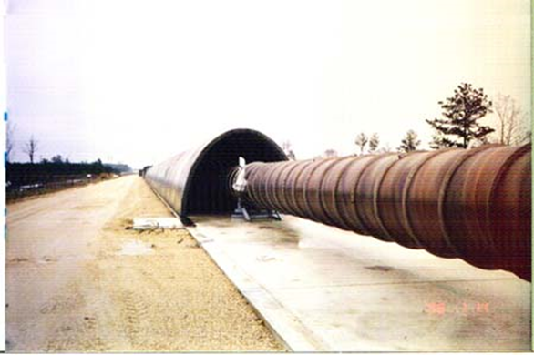
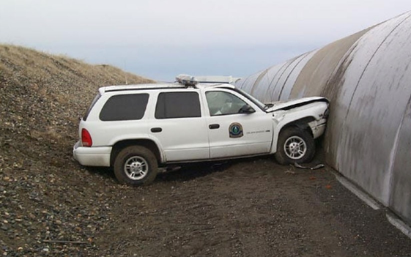
Assumptions & Interfaces
Above ground
Concrete slab interface for beamtube supports
Enclosure assumed
  impact and ballistic protection
  mitigation of environmental factors (lightning, wind, snow, solar heating, …)
Light Baffling
  Separate baffles placed/secured in the beamtube interior
  Potential requirements on beamtube interior surface reflective properties
Simply repeating LIGO beamtube design/fab will fail:
  Fab/Assy. Time scaling: LIGO BTs (8km) required > 1yr; Scaled to CE (80km) would require > 10 yr
  Cost scaling: LIGO BTs (8 km) were $76M (1994);
  Estimate CE (80km) $700M in 2028

Slide 4
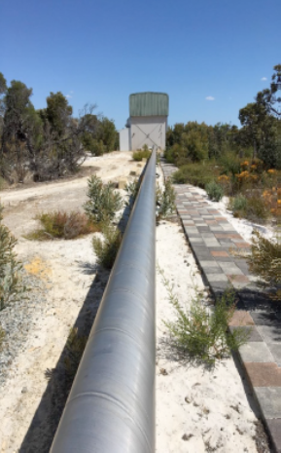
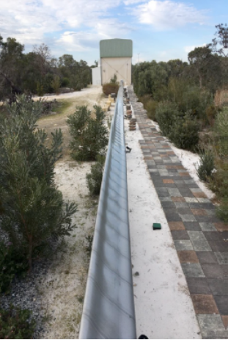
Structural evaluation with the
ASME BPVC 2023 edition
Costs are always important. However …
Long Term Reliability
is far more important than Minimizing Cost

Slide 5
Beamtube Mechanical Requirements
80 km length (two 40km perpendicular arms)
1.245 m diameter (same as LIGO)
1.0 m clear aperture through internal baffles
  *Tube straightness to ~10 mm (beam transmission, diffraction)
  Determines allowable sag between supports
  Determines alignment precision requirement (Standard differential GPS may not be adequate)
*Seismic vibration isolation
Capable of **150C bake
Compliant with applicable codes for all load factors (ASCE, ASME, EJMA)
≥ ~50 year lifetime
≤ ~1 UHV leak per 10 years (10⁻⁹ Torr-L/s)
*Potentially significant design driver; Awaiting WG#3 input
**WG#1 considering lower temp. bake (~80C)

Slide 6
Structural evaluation with the
ASME BPVC 2023 edition
CE Pressure < 15 psig
See LIGO-E2500064 (in-process) for details
Plastic Collapse
Local Failure
Buckling
Cyclic Fatigue
Vessel Class 2
 | Class 1 | Class 2
Allowable stress values | Section II, Part D, Subpart 1, Table 2A or Table 2B | Section II, Part D, Subpart 1, Table 5A or Table 5B
*Design margin against tensile ultimate strength | 3.0 | 2.4
*Design margin against yield strength | 1.5 | 1.5
Design Rules | The Design by Analysis rules in Part 5 cannot be used in lieu of the rules in Part 4. | Components for Class 2 pressure vessels may be designed using a combination of Part 4 or Part 5.
Using buckling factor of 3 alone may not be sufficient –see examples below
*N.B.: Design margin against buckling is at least 3.0
and generally higher for Division 1.

Slide 7
Structural evaluation with the
ASME BPVC 2023 edition
Load Case Combinations for Buckling Analysis
  D = deadload load = beamtube weight plus attachments such as pump ports, bellows, flanges, etc.
  P = Pressure load = 1 atm for CE
  T = Thermal load = compressive load from restraining the thermal expansion during a bake-out
  E = Earthquake load (defined by ASCE/SEI 7 standard)
  Loads not relevant to CE removed (i.e. static head loads, live loads, wind loads, snow loads)
  User Design Specification (UDS) may specify additional loads such as transport loads, cantilevered pump/instrumentation loads, etc.
Dominant
Load when in Bake-out mode
Load Case (k) | Load Combination
(1) | β_{b} (P + D)
(2) | 0.88 β_{b} (P + D + T)
(5) | 0.88 β_{b} (P + D) + 0.71 b_{b} E
(n) | per the User Design Specification (UDS)
β_{b} = buckling load factor

Slide 8
Beamtube Structural Support Layout/Configuration
EJMA Guidance
CBI/LIGO Design
MA = Main Anchor (or fixed support)
G# = Guided Support
EJ = Expansion Joint (aka Bellows)
Beamtube Support Layout Options
to Prevent Tube Squirm and Column Buckling
Fixed Support Spacing: bellows displacement capacity = bake-out BT expansion
CE Choice if ring-stiffened or thick-walled tube
Dimensions shown are per LIGO and only for illustration, not prescriptive for CE

Slide 9
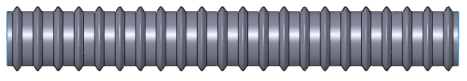
Beamtube Structural Support Layout/Configuration for Corrugated Tube
Gate Valve (GV)
Spacing determined by sag
BT segment
MA
(Fixed Support)
MA
Termination
Support/Anchor
MA = Main Anchor (or fixed support)
No Guided Supports
No Expansion Joints (EJ, aka Bellows)

Slide 10
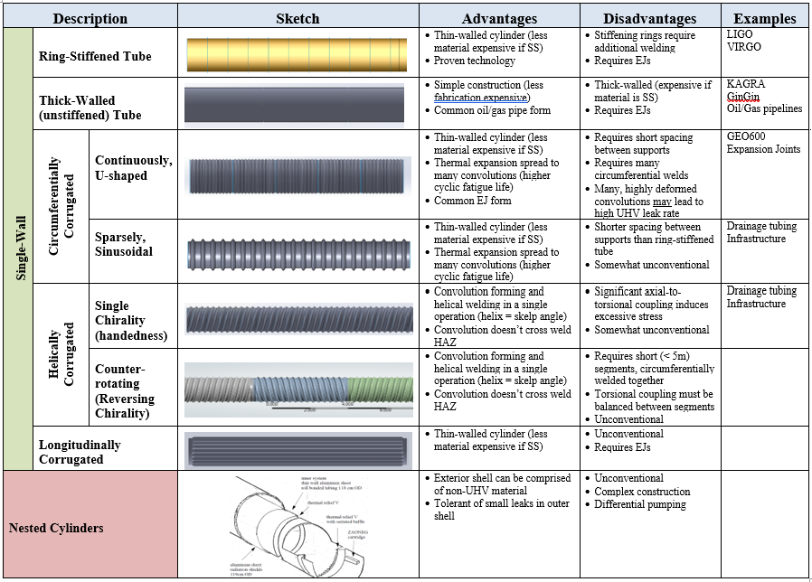


Beamtube
Taxonomy

Slide 11
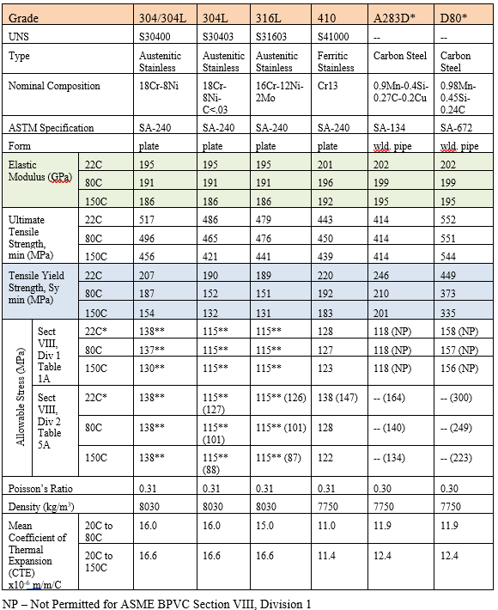
Structural Properties of Potential BT Materials
Material pre-requisites
  UHV compatible
  Low hydrogen outgassing (inherently or with pre-processing)
  Low particulate generation (with or without passivation layer, coating)
  Weldability
Extant GW BTs use austenitic stainless steel:
  AISI 316L for GEO600
  AISI 304L for all the others (LIGO, Virgo, Kagra) .
Ferritic stainless steel (AISI 400 series) is also of interest
Duplex stainless steels
  mixed microstructure of both austenitic and ferritic phases
  Superior strength, enhanced toughness (compared to ferritic), and lower cost due to less nickel content
Low-carbon steel (aka mild steel) found to be UHV compatible (lower H2 outgassing rate than SS)
  Trade pipe steel (API 5L) is readily available and less expensive
NP – Not Permitted for ASME BPVC Section VIII, Division 1
-- Not listed in Table 5A for ASME BPVC Section VIII, Division 2
*actually at 40C
**Use of these stresses may result in dimensional changes due to permanent strain; Sy/1.5 given in parentheses

Slide 12
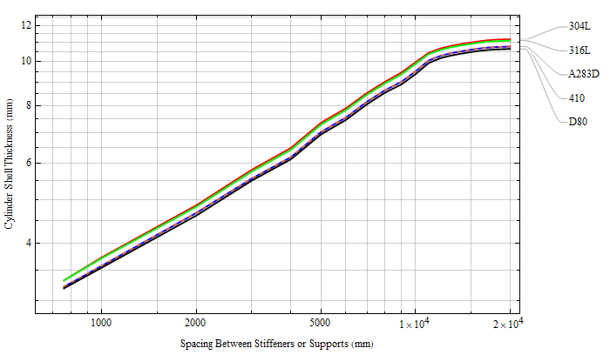
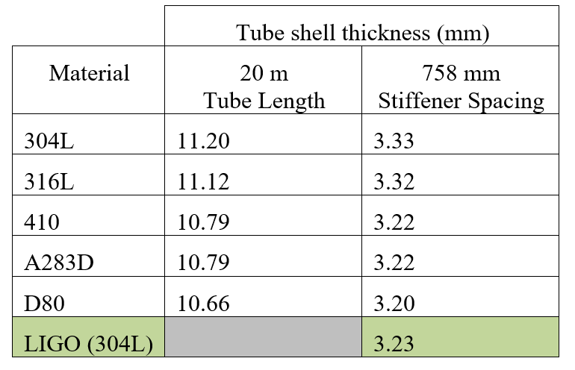
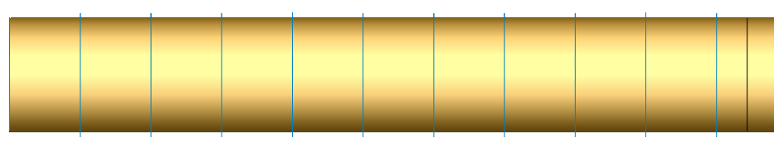
Material considerations in Structural Analyses:
Ring-Stiffened and Thick-Walled Cylinders
Ring-Stiffened and Thick-Walled Tube design is generally stiffness critical for adequate buckling factor
Since all the materials of interest have similar values of elastic modulus,
analyses are conducted for material with lowest yield stress (dual-rated 304/304L)
Asymptotes to Unstiffened, Thick-Walled Cylinder
Shell Thickness is not strongly dependent on Material Choice
Required Cylinder Shell Thickness vs External Ring Stiffener Spacing
LIGO
Shell Thickness Required
for 20 m Tube Length
(per ASME.2023.VIII.Division1)

Slide 13
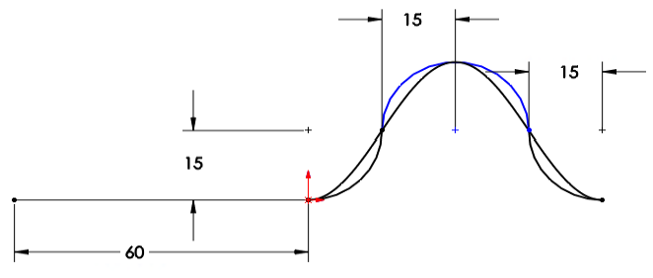
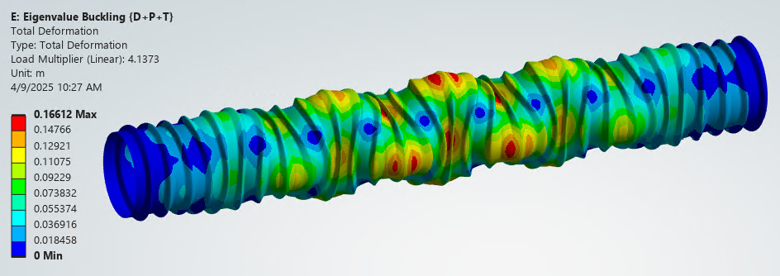
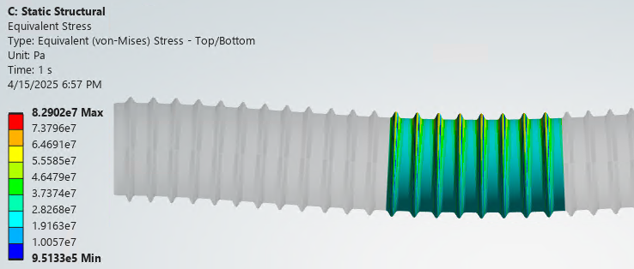
Considerations in Structural Analysis of
Corrugated Cylinders
r
U-shape
r
Circumferentially Corrugated Tube design
is generally stiffness critical for adequate
buckling factor and acceptable sag
We have a 7-dimensional design space:
  Tube Material
  Corrugation shape
  L = length of unsupported span
  a = corrugation amplitude
  b = corrugation period
  p = corrugation pitch
  t = tube thickness
We apriori choose:
  304L stainless steel material (lowest yield stress)
    … but once other parameters are chosen
    we can explore material options
  Sinusoidal shape since it is efficient for buckling
  while maintaining bending stiffness
  (and a triangular shape with bend radii
  to minimize stress is basically the same)
    … but can adapt for manufacturing considerations
h = 2a
a, amplitude
sine
s, flat
b, period
p, pitch = b+s
1.245 m diameter x 10 m length, t = 2.1 mm, 304L
Sinusoidal convolutions: a = 40, b = 160, p = 300 mm
Load Case {D+P+T}, *Buckling factor = 4.14
Sag = 13 mm over span of 10 m
Corrugated Tube Example
Max von Mises stress of 83 MPa for load case 0.88 {D+P+T} < *allowable stress of 130 MPa @ 150C (304/304L)
*compliance with ASME.BPVC.2023 is more complex

Slide 14
Conclusion
The Beamtube will be a cost driver for the CE observatory
  Cost reduction (value engineering)
  high confidence for long facility lifetime is essential
Simply repeating LIGO beamtube design/fab will fail
  We need designs capable of fast fabrication and fast field assembly with excellent QA
  Automation will likely be the key when scaling up to production
From the design perspective we have at least four viable basic tube designs
  Ring-stiffened cylinder
  Thick-walled cylinder
  U-shaped, continuously corrugated cylinder (i.e. continuous bellows)
  Sine-shaped, sparsely corrugated cylinder

