Slide 1

Cosmic Explorer
Beamtube Experiment (CE-BEX):
Convolution UHV Leak Failure Rate Estimate
Beamtube Workshop #3 (29-Sep – 2-Oct 2025)
Caltech
Dennis Coyne
24-Sep-2025 v1
Artist: Eddie Anaya (Cal State Fullerton)
LIGO-G2502098-v1

Slide 2
Convolution UHV Leak Failure Rate Estimate
All laser interferometric GW detectors employ corrugated tubing
  either as convoluted tubing or as bellows
  accommodates thermal expansion associated with diurnal temperature swings & vacuum bake-outs
Residual stresses and cyclic flexing of the convolutions raises long-term reliability concerns regarding UHV leaks
  If the dominant leak failure mechanism is due to cyclic fatigue, then corrugated tubes are preferred (other issues aside) since the cyclic movement is spread over many more convolutions
  If the dominant failure mechanism is Stress Corrosion Cracking (SCC) then smooth tubes with bellows is likely preferred in order to reduce the number/area of potential failure sites
Structural reliability vs UHV leak tightness
  Ultra-High Vacuum (UHV) leak on the order of 10E-9 Torr-L/s as a failure criteria is considerably more stringent than a structural failure of the vacuum envelope
  data and methods to predict lifetimes for structural failure may not be conservative enough for the UHV application
Review project experience with bellows leak failures …
See LIGO-E2400425 for more detail, speculation and theorizing

Slide 3
Bellows Leak Rate Experience
LEP (Large Electron Positron collider) facility
  LEP small vacuum leak rate of 1e-5 Pa-L/s (75e-9 torr-L/s) is larger than LIGO's leak rate limits: 1e-10 torr-L/s at the component level and 1e-9 torr-L/s for each 2 km BT module
  Assuming leak location is associated with (scales with) the convolution number and using LEP's 5% lower bound on the leak failure rate per Bellows-Hour, gives a leak failure rate of 2e-9 per convolution-hour
  Operational requirements for LIGO (and potentially the CE) bellows are more stressing than for LEP bellows: -11/+31 mm for 13k cycles with 6 convolutions for LIGO vs 6mm for 10k cycles with 10 convolutions for LEP
  LEP bellows were overdesigned (more capable than their requirements)
  ... and yet they failed at rates
  unacceptable to LIGO or CE

Slide 4
Bellows Leak Rate Experience
Using LEP's 5% lower bound, operational, bellows leak failure rate (per convolution) …
  LIGO
    ~0.018 leaks per year for LIGO, or ~0.4 failures in 23 years, i.e. not inconsistent with LIGO experience of no failures to date
  GEO
    No “significant” leaks in two decades
    However, end station pressures suggest an upper limit air leak rate of 6E-6 torr-L/s, or 80 small (LEP threshold) leaks, implying 11E-9 leaks/convolution-hr
  CE
    Assuming a convolution pitch of 190 mm would result in ~7 leaks per year for CE
      → clearly unacceptable

Slide 5
UHV Leak Failure Mechanisms
We hypothesize the following mechanisms in the operating environment in an attempt to explain the LEP UHV leak data:
  Cyclic Fatigue induced cracking
  Stress Corrosion Cracking (SCC)
  Microbial Induced Corrosion (MIC)
    CE will likely be located in a dry/arid western region of the US,
    so MIC should not be a problem

Slide 6
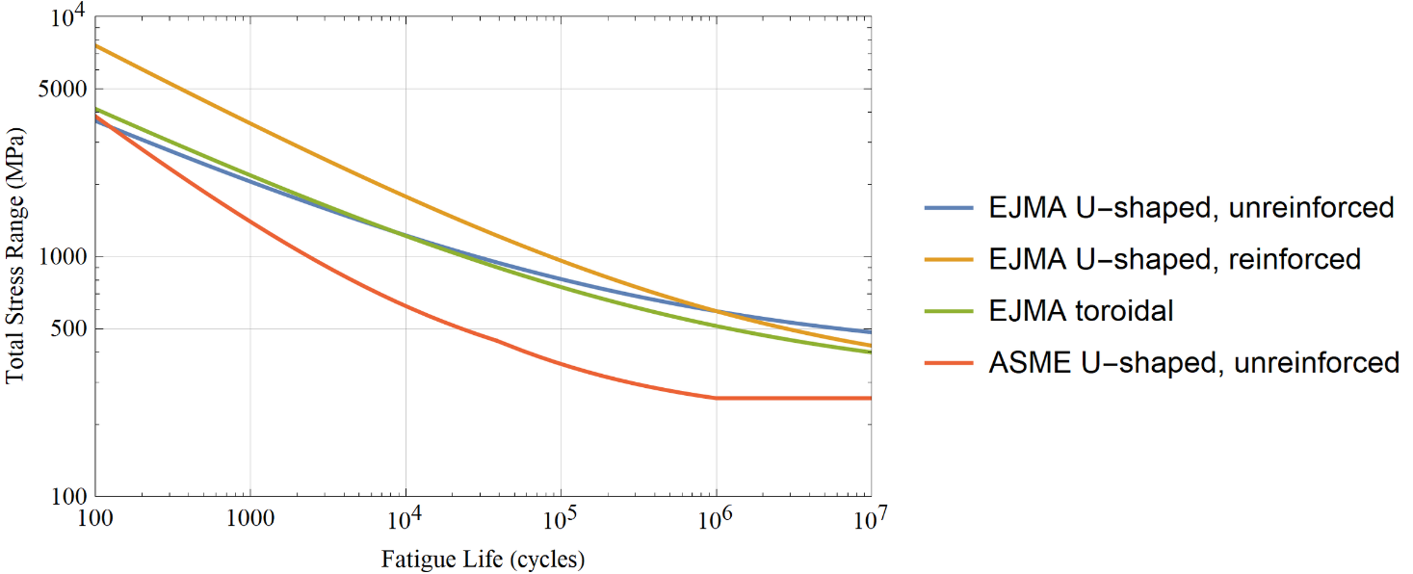
Cyclic Fatigue Cracking
EJMA and ASME provide methods to calculate fatigue lifetime for bellows
  ASME is considerably more conservative
  ASME formulation is limited to length < 3 x diameter
Comparison of Fatigue Curves for Austenitic Stainless Steel
(no heat treatment)

Slide 7
Cyclic Fatigue Cracking
LIGO Bellows
  Based on manufacturer’s (CBI) very conservative diurnal movement estimate:
    EJMA operational life was calculated to be 13.3k cycles (37 yrs) for diurnal temperature cycling
    ASME calculation yields identical stress amplitudes but only 1.6k cycles (4.5 yrs) life (if cycle margin of 2.6 is removed still only 12 yrs)
  Using diurnal temperature fluctuations measured at LIGO LLO:
    ASME calculation yields 4.1k cycles (11 yrs) life (if cycle margin of 2.6 is removed 29 yrs)
  The LIGO beamtube was installed 27 yrs ago
Corrugated tube
  Expect stress range < fatigue limit → infinite life
  As an example, GEO600 stress range is only 14 MPa, so life > 10^6 cycles

Slide 8
Stress Corrosion Cracking (SCC)
Caution: The following is plausibility argument (not a proof) for SCC initiated UHV leaks
SCC requires combination of
  a susceptible material
  a corrosive chemical species in the operating environment
  tensile stress
    Unlikely to be a threshold value for stress intensity for SCC propagation
    (below which SCC would not occur)
    can be the applied and/or residual stress (aka built-in or locked-in stress resulting from the forming and welding processes)
SCC has a crack initiation phase followed by crack propagation. Relatively little data are available for the crack initiation process

Slide 9
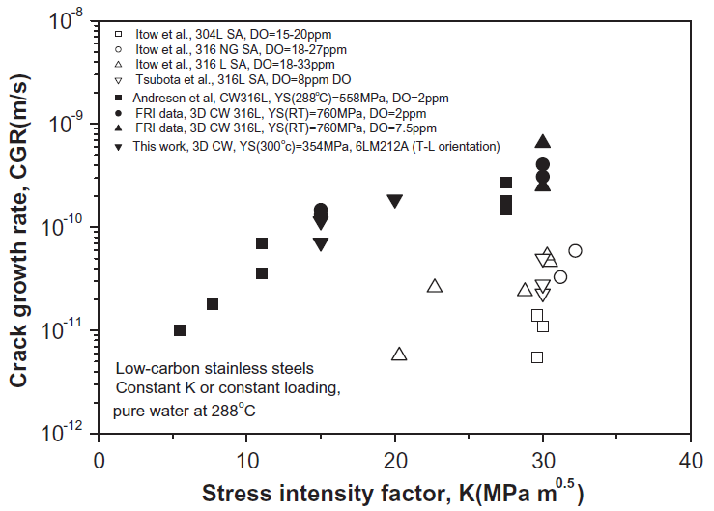
Stress Corrosion Cracking (SCC)
For austenitic stainless steel, the chlorine ion, CL⁻, is one of the most aggressive chemical species
Soil and any nearby cement structures can leach salts (efflorescence)
Sea water (and air) is a complex mixture of chlorides and sulphates.
304L exposed to simulated sea air (MgCl₂) showed a temperature threshold for SCC at room temperature and humidity threshold at 30% (27% is the fixed point humidity of MgCl₂, whereas the fixed point humidity of NaCl is 75%)
SCC propagation rates for 316L in atmospheric conditions under MgCl₂ deposits (100 microgm/cm^2) at 40C and 40% RH for was 1-3 x 10^-11 m/s

Slide 10
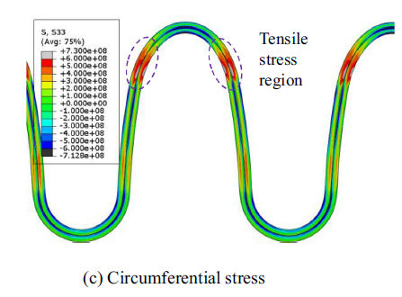
SCC: Residual Stresses
Forming convolutions results in significant residual stresses
  post-forming heat treatment could reduce the SCC risk while decreasing the cyclic fatigue lifetime
  A nonlinear FEA could be done to calculate the residual stresses
  From an example calculation from the literature, estimate ~115 Mpa for 304L
Welding
  Tensile stress in the fusion zone (FZ) and heat-affected zone (HAZ) can be ~100 to ~300 MPa for SAW
  Laser welding can reduce residual stress
  Low Transformation Temperature Welding (LTTW) wire can induce compressive stresses and improve corrosion resistance
Example residual stress calculation after hydroforming bellows (Pa)
0.45 m long x 0.5 m diameter bellows
comprised of two 1 mm thick layers of Inconel 71

Slide 11
SCC
Example: LIGO Bellows
  Leak testing LIGO Bellows (< 10^-9 Torr-L/s) serves as a proof test that the maximum crack/hole diameter is < 0.34 micron
  (molecular slip flow calculation)
  stress intensity factor, K_{I}, for hypothetical initial crack/hole:
    For bellows total stress range, K_{I} = 1.2 MPa-√m
    For residual circumferential stress, K_{I} = 0.1 MPa-√m
  Extrapolating crack growth rate data for 316L in pure hydrogenated water at 288C for K_{I} = 1.2 MPa-√m, implies possible rate of ~2 x 10^-12 m/s
  For a 3 mm thick shell, this growth rate would take ~32 yrs to propagate through thickness

Slide 12
Convolution UHV Leak Failure Rate
SCC and MIC seem unlikely to dominant (leak failure) lifetime especially if CE is in an arid western US region
Cyclic fatigue due to diurnal temperature fluctuations seems the likely dominant failure mechanism
  Suggests using corrugated tubing rather than bellows
  If bellows or convoluted tubing are employed use conservative ASME rather than EJMA
The observed rate of UHV leaks in the LEP bellows during operation is unacceptably high for CE & the mechanism for these leaks is unknown/unexplained
  Requires more study to resolve. What are our next steps?

