Slide 1

Cosmic Explorer
Beamtube Experiment (CE-BEX):
Circumferential Joint Design
Beamtube Workshop #3 (29-Sep – 2-Oct 2025)
Caltech
Dennis Coyne
Jon Feicht
Mike Zucker
24-Sep-2025 v1
Artist: Eddie Anaya (Cal State Fullerton)
LIGO-G2502097-v1

Slide 2
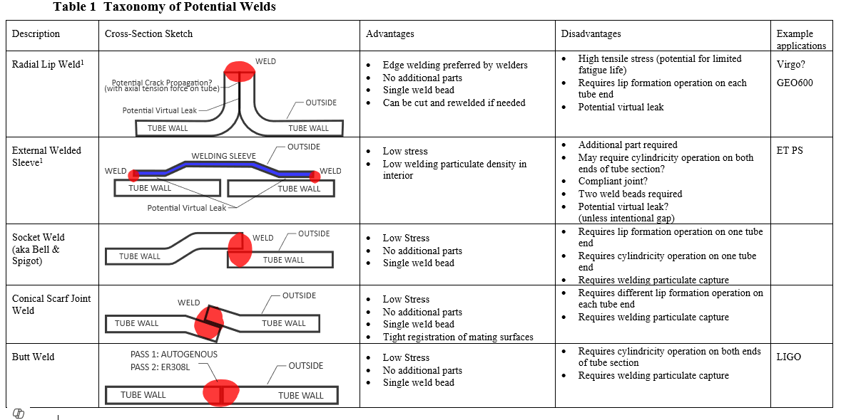
Circumferential Welded Joint Taxonomy
¹ C. Garion, “Design of the ET beampipe pilot sector”, 22-Jan-2024, pg. 15
2

Slide 3
General Circumferential Joint Comments
Factory swage to precise end circumference seemeds relatively easy
Fussy butt joint fitup in field dominated CBI time/joint
Back shielding isn’t “extra step” if a field He leaktest is needed in any case
Virtual leak (of gas) a non-issue in volumetric perspective
Trapping contaminants is only an issue if welding precedes final cleaning step;
this does not seem practical in any scenario
Welding generated particulates are not a significant concern:
  Far from optics
  Not a frangible surface layer that can “rain” down through the laser beam when excited by vibration
Pre-formed “self-aligning” end features with no extra parts seems a good solution

Slide 4
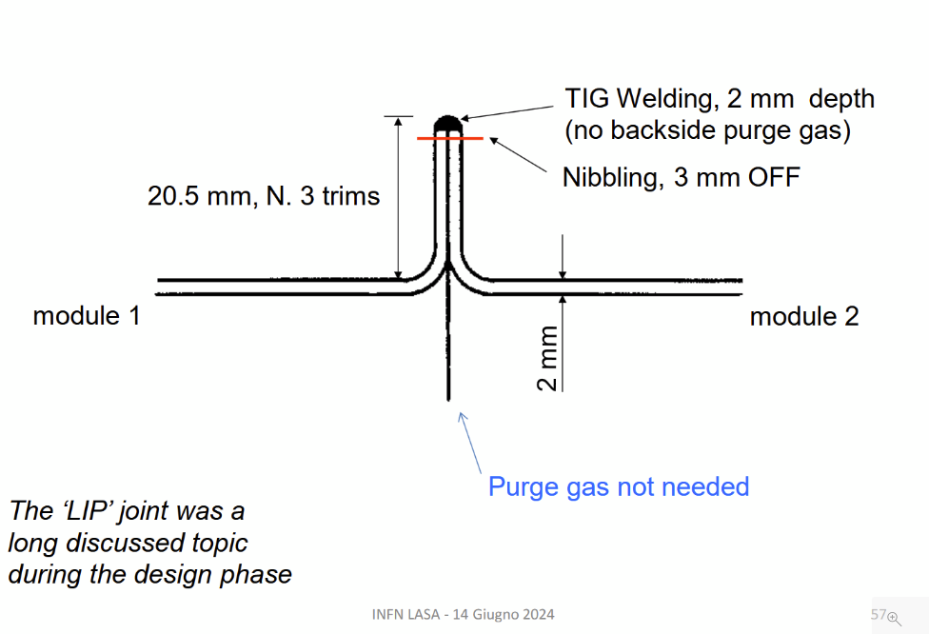
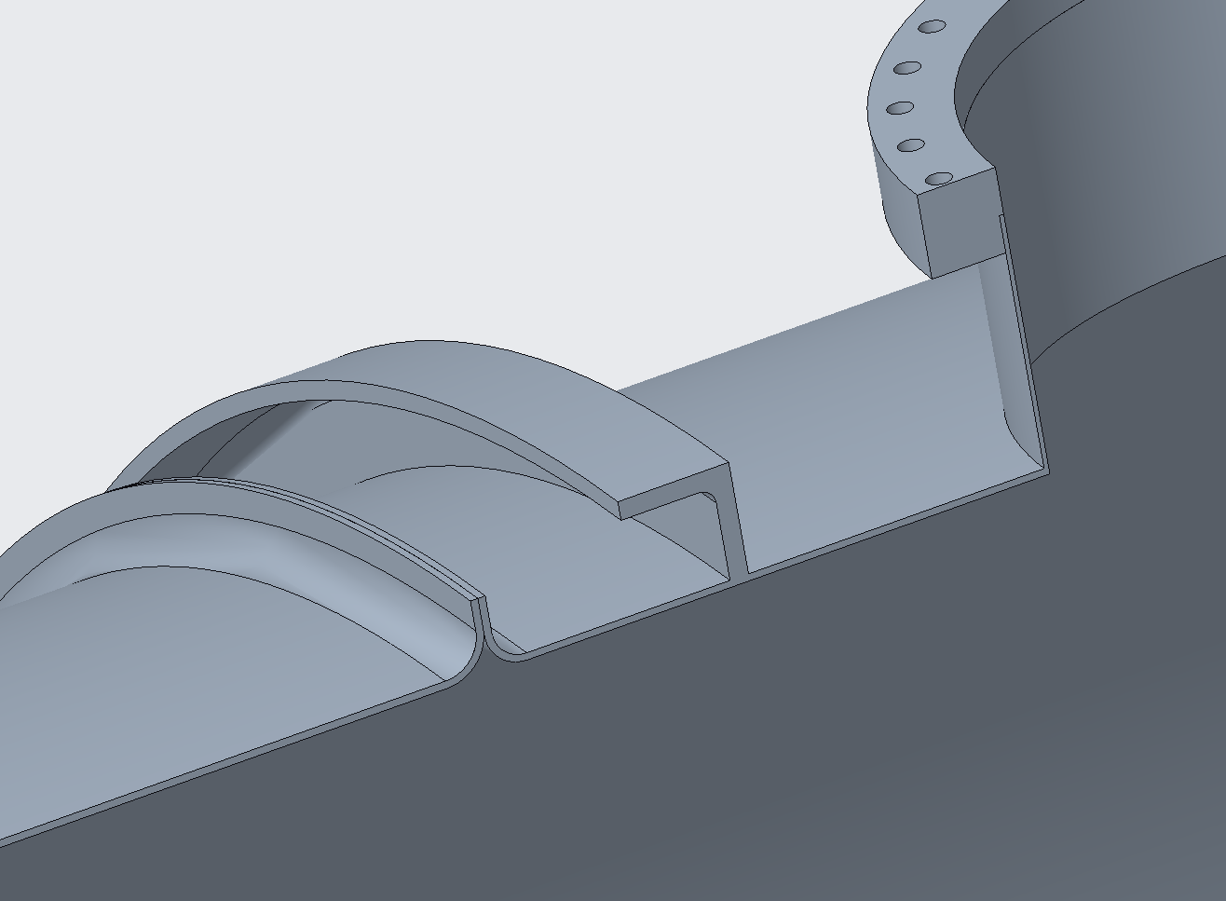
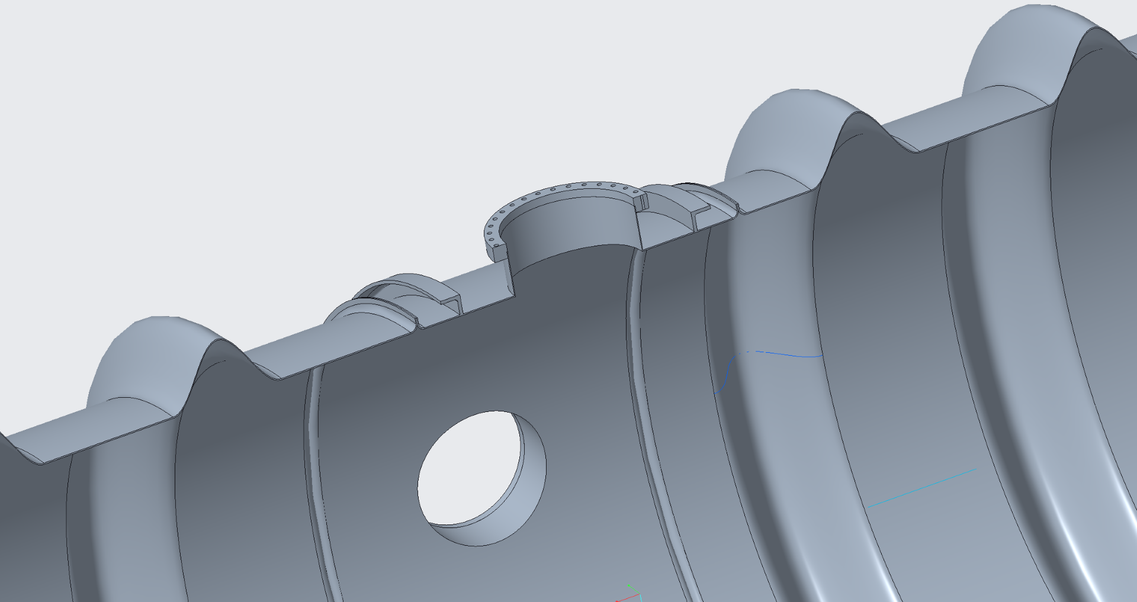
Draft corrugated specification
From A. Pasqualetti, Corso Nazionale di formazione Vuoto Avanzato June 2024.
https://agenda.infn.it/event/42143/contributions/237797/attachments/122532/179379/04_02_VirgoVacuum_ET_13_06_2024_Lasar2.pdf
Also the joining method employed by RAL and GEO600

Slide 5
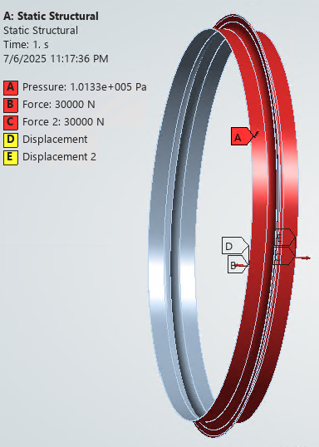
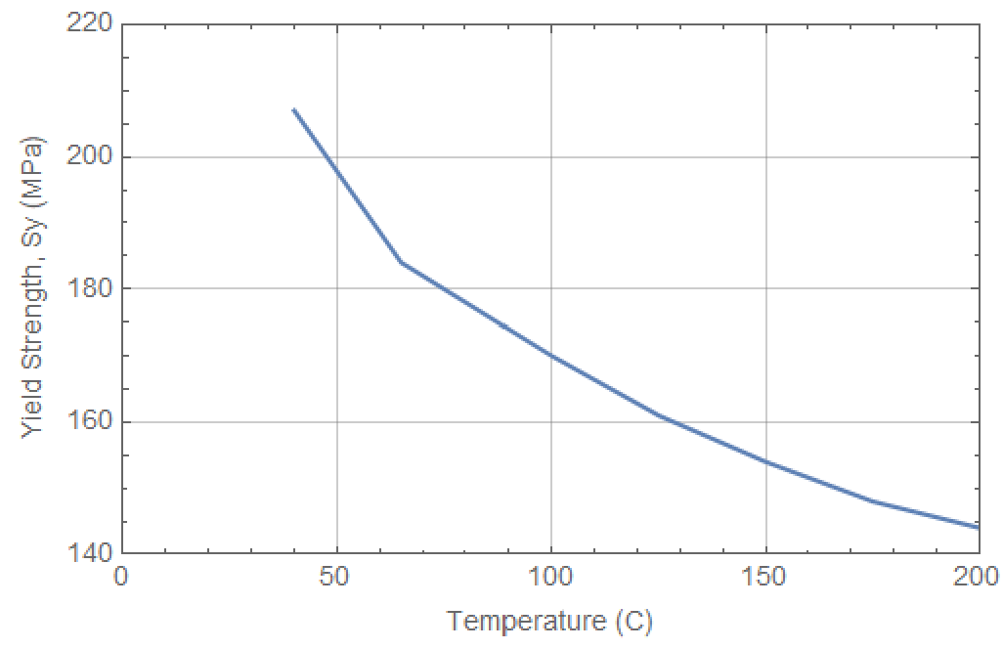
Welded Lip Joint
Thermal expansion during a bakeout of a corrugated tube adds axial compressive loading
Countered by the external atmospheric pressure when evacuated
During normal operation the vacuum-induced axial tension load should not exceed the capacity of the fixed support stands
LIGO BT Fixed Support maximum axial load is ~30 kN (a soft/suggested limit for CEBEX)
The allowable stress for 304 and dual rated 304/304L is 138 MPa up to 150C

Slide 6
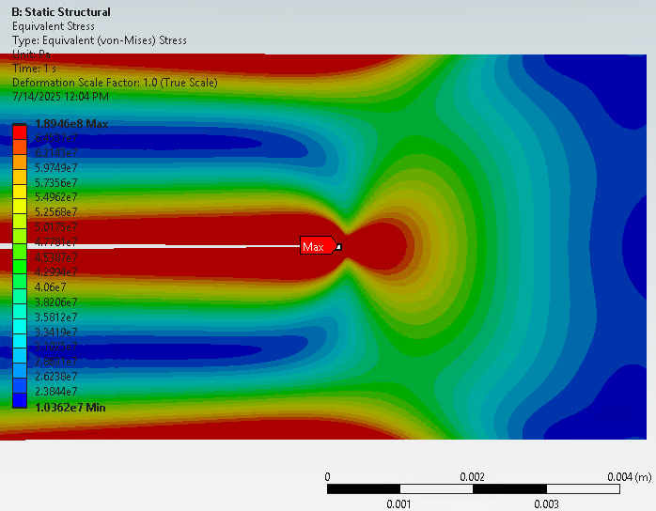
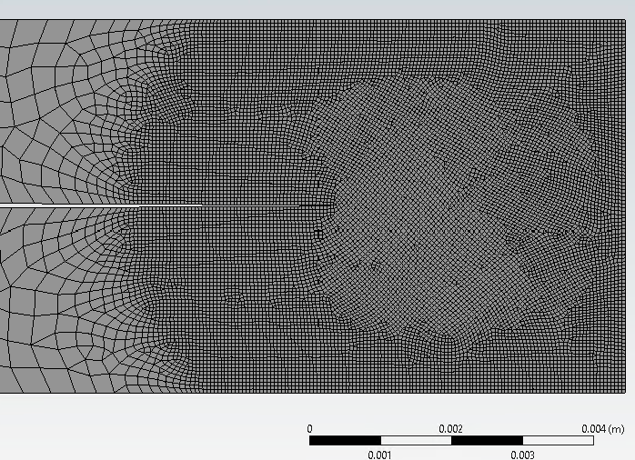
Linear Stress analysis of welded radial lip joint
(2D, axisymmetric)
As the mesh is refined a "singularity" at the “crack tip” becomes apparent (189 MPa)
The material at the “crack tip” should yield and redistribute the stress …and the crack may grow

Slide 7
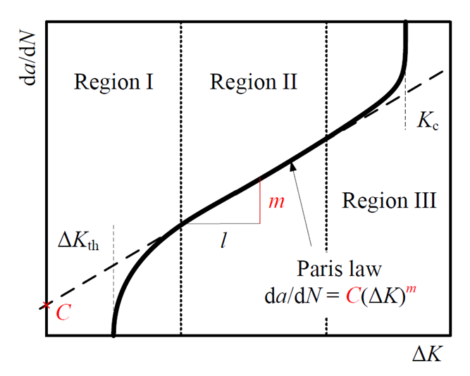
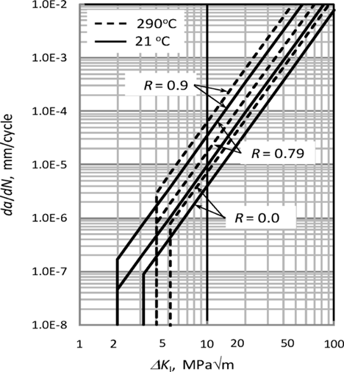
Crack propagation threshold
Paris’ law for crack growth per cycle (da/dN) as a function of Stress Intensity Factor (K)
Proposed addition (2018) of threshold stress intensity factors for ASME BPVC Section XI, “Rules for Inservice Inspection of Nuclear Power Plant Components"
Ideally want K_{I} << 2 MPa √m
  Otherwise must rely on crack cyclic fatigue lifetime calculation
  … and hope stress field doesn’t promote UHV leaks
Proposed fatigue crack growth rates for austenitic stainless steel exposed to air environment*
*Hasegawa, Usami, “Development of Fatigue Crack Growth Thresholds for Austenitic Stainless Steels Exposed to Air Environment for ASME Code Section XI”, J. of Pressure Vessel Technology, Jun 2018, Vol. 140

Slide 8
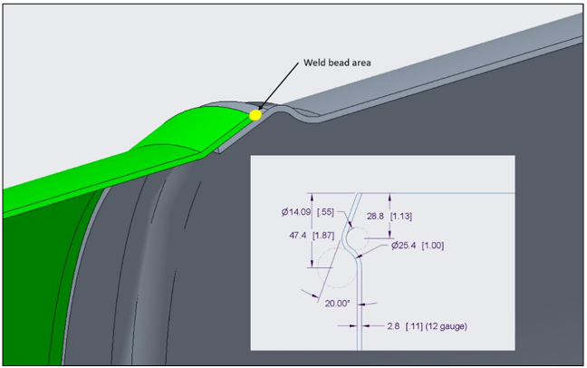
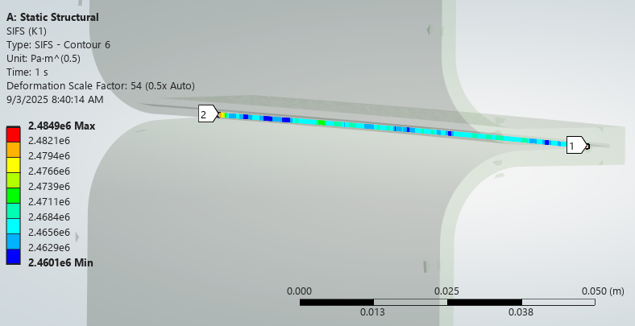
Welded Radial Lip Stress Intensity
The stress intensity factor, K_{I} = 2.47 with a 20 mm high lip
  > 2.0 MPa √m threshold for crack growth
Could be reduced if:
  Chosen corrugated design results in << 30kN axial force in operation
  Can reduce the lip height (reduces bending stress), but this would only slightly decrease K
  Could rely on long crack fatigue life but this seems risky/unwarranted
  Could use a different material with higher threshold
    However ferritic steel has ~same threshold
Also not clear how much margin or safety factor
we should have relative to this threshold value
∴ recommend using conical scarf joint
Stress Intensity Factor (K) contour integrals along the crack front - converge to 2.47 MPa √m
For lip height of 20 mm (beyond the bend radius)

