Slide 1

Investigations of Binary Neutron Star Inspiral Range Oscillations at LIGO Livingston
Gabe Grant
Mentor: Jane Glanzer
LIGO SURF 2025
Minnesota State University Moorhead

Slide 2
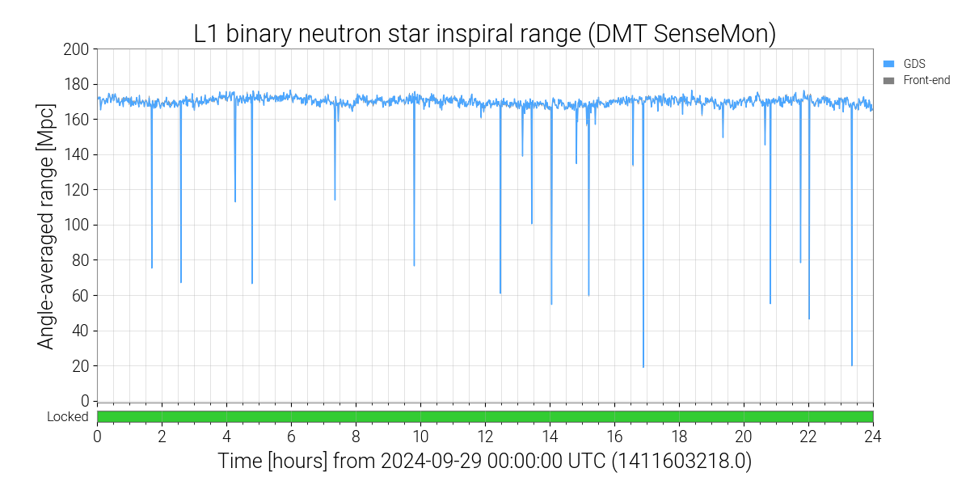
BNS Range
Binary Neutron Star Inspiral Range (BNS) is a metric used to monitor detector sensitivity
BNS range: the distance to which we can measure a binary neutron star inspiral of 1.4 M⊙ each with a signal-to-noise ratio of 8

Slide 3
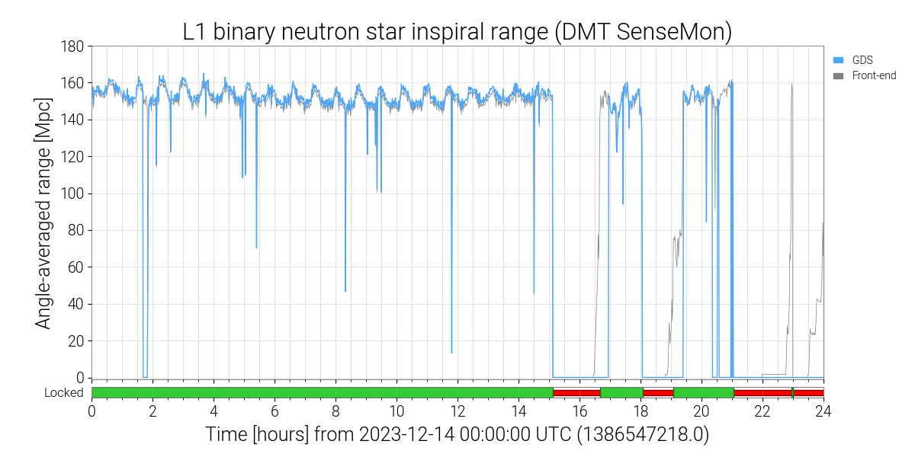
BNS Range Oscillations
Recurring oscillations that happen at random in O4
Roughly 30-minute period
Changes of 5-15 megaparsecs

Slide 4
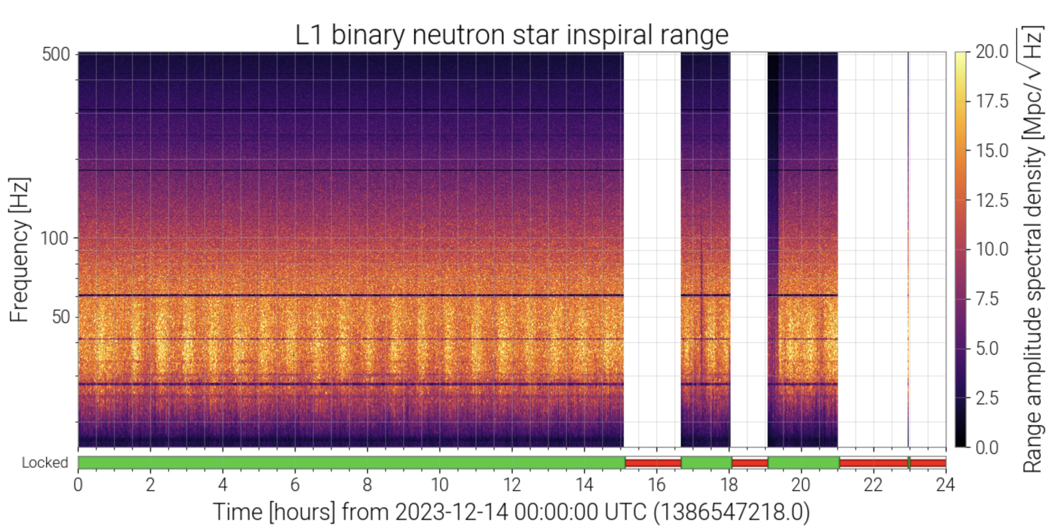
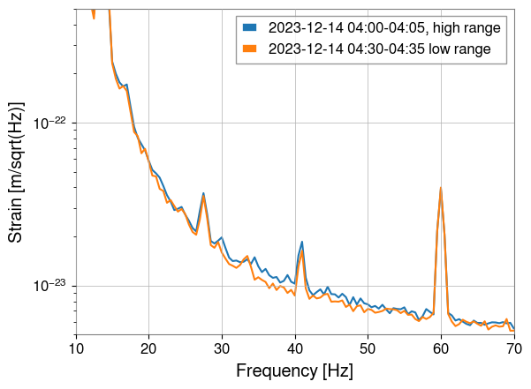
BNS Range Oscillations
Noise seen in the 30-50 Hz range
This noise effects the sensitivity at which we can detect higher mass binary black holes
Strain/sqrt(Hz)
Notes:
Bands show a change in amplitude of the BNS ~30 minutes
Second plot is amplitude spectral density of a time when the amplitude was high and low. We can see some noise in the 30-50 Hz

Slide 5
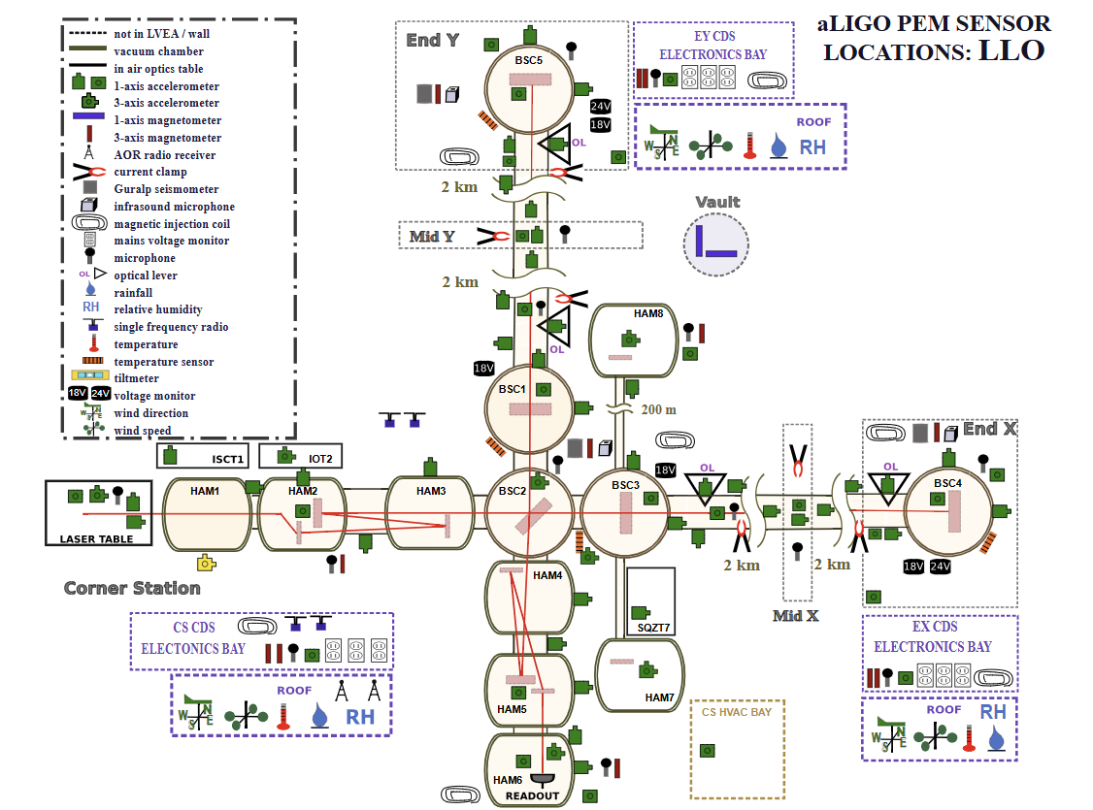
Detector Characterization
Responsible for identifying and mitigating noise sources in detector
LIGO is complicated and large, potential for noise everywhere
Many sensor types throughout LIGO facilities

Slide 6
Auxiliary Channels Subsystems
FMC: “Facility Management and Control”
PEM: “Physical Environment Monitoring”
SUS: “Suspension”
HPI: “Hydraulic External Pre-Isolator”
ISI: “Internal Seismic Isolation”
ALS: “Arm Length Stabilization”
Notes:
SUS: optical sensing actuators measures relative motion between the test mass and the cage
HPI: “Hydraulic External Pre-Isolator”, first line of defense against ground motion (~0.1 to 3 Hz)
ISI: “Internal Seismic Isolation”, passive and active seismic isolation within the vacuum chamber (~0.1 to 30 Hz). ISI are in vacuum while HPI is not. ISI has both active and passive isolation.
ALS: “Arm Length Stabilization”, a locking system that uses auxiliary lasers to help sense and control arm cavities

Slide 7
Objective
Identify the source and the coupling mechanism of the oscillations in the BNS range
Many auxiliary channels exhibiting ~30 minute oscillatory behavior
Oscillations have been occurring since the start of O4
Cross-correlation with a time lag between band-limited RMS (BLRMS) of the gravitational wave strain data, and BLRMS of auxiliary channel data to identify potential couplings
  Do specific auxiliary channels lead the strain?
Examined 19 days of 04 so far in the End-X station
  Roughly 150 channels per day

Slide 8
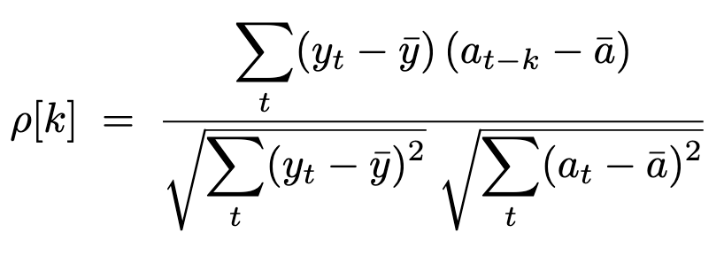
Cross-Correlation
Cross-correlation: a data analysis technique that calculates how similar a signal is to another
  Sliding two time series together at different lags to see what fits best and when
y = 30-50 Hz strain data BLRMS, a = 30-50 Hz auxiliary data BLRMS, k = lags
Pearson style normalization: correlations comparable across channels/days
Looking for auxiliary channels that precede everything else
  Negative time-lag
Cross correlation
Pearson style normalization = [-1,1]

Slide 9
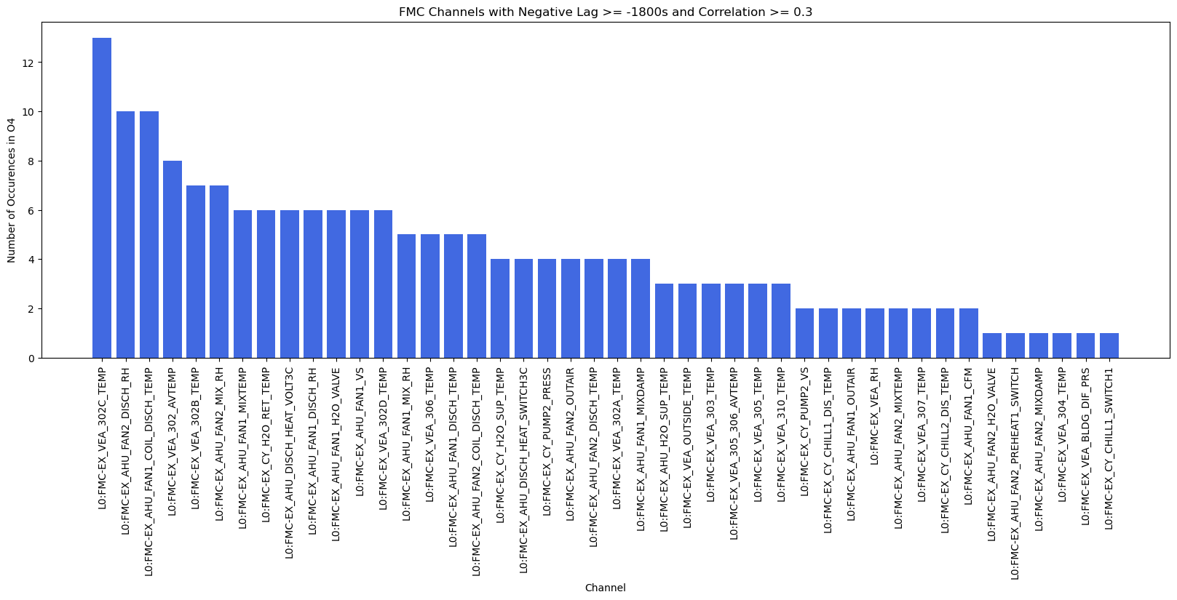
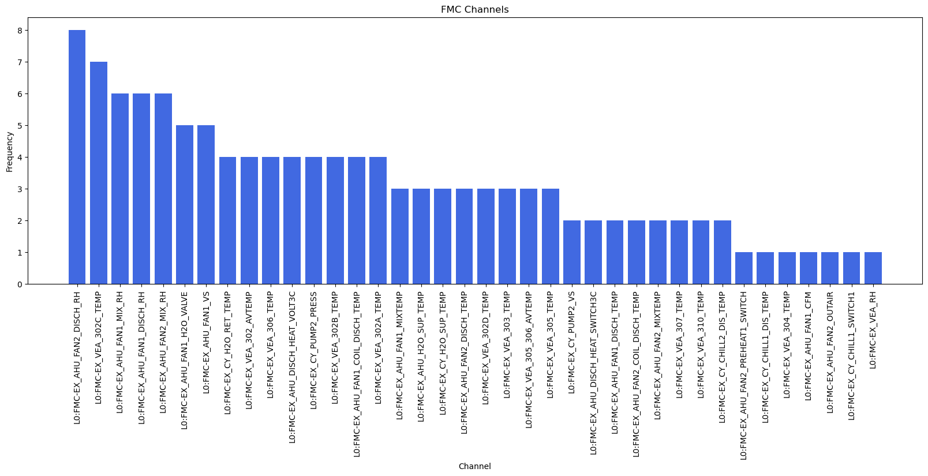
Results: FMC
Selection criteria: between lags -1s and -1800s with a correlation of 0.3 or greater
L0:FMC-EX_AHU_FAN2_DISCH_RH 8
L0:FMC-EX_VEA_302C_TEMP 7
L0:FMC-EX_AHU_FAN1_MIX_RH 6
L0:FMC-EX_AHU_FAN2_MIX_RH 6
L0:FMC-EX_AHU_FAN1_DISCH_RH 6

Slide 10
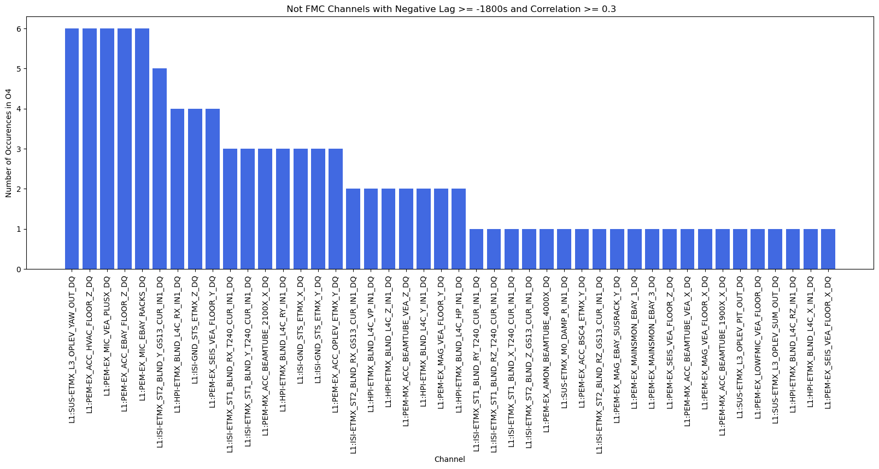
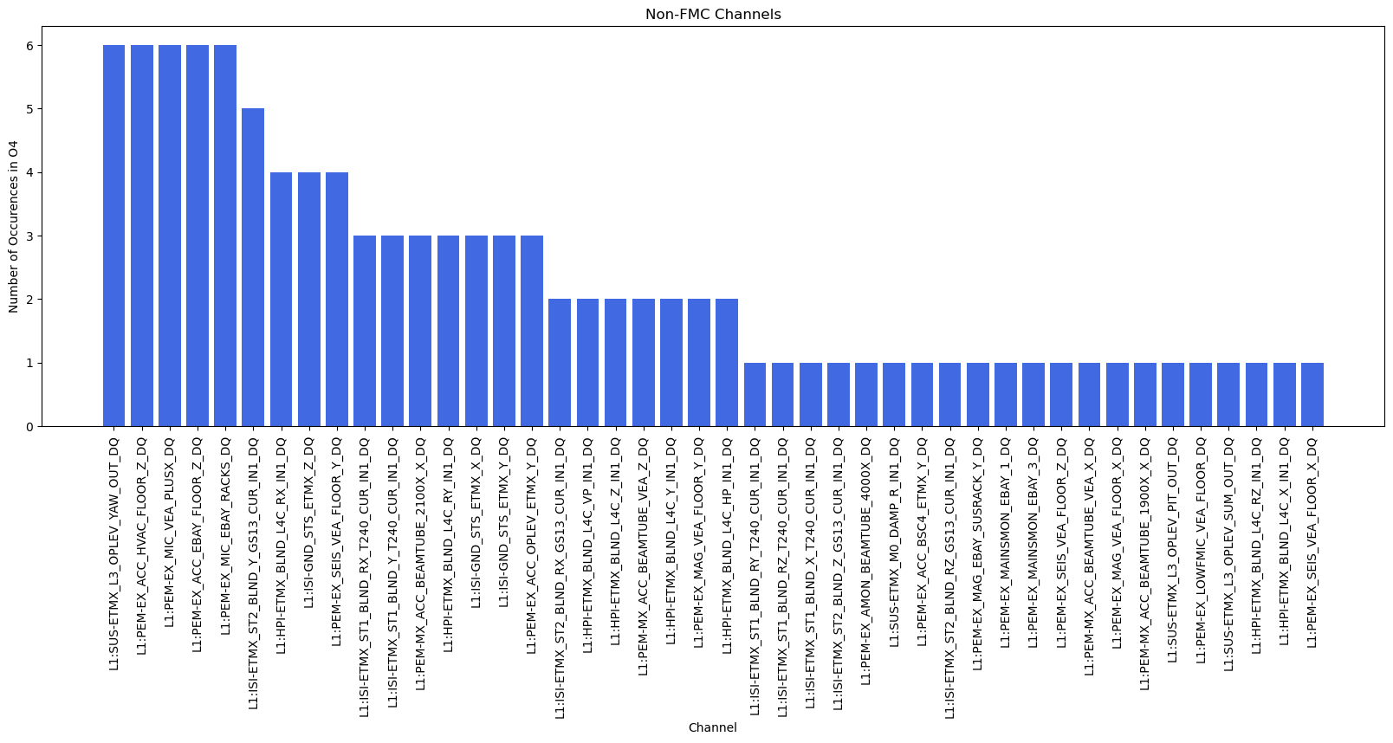
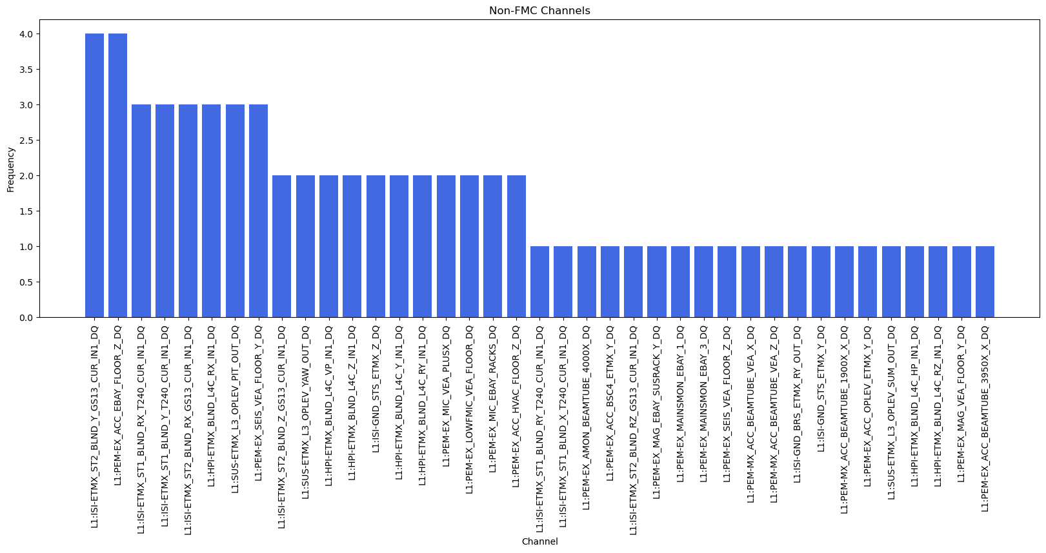
Results: PEM/SUS/ISI/HPI/ALS
L1:ISI-ETMX_ST2_BLND_Y_GS13_CUR_IN1_DQ 4
L1:PEM-EX_ACC_EBAY_FLOOR_Z 4

Slide 11
Channel Location
Electronics bay
ISI seismometer
HVAC

Slide 12
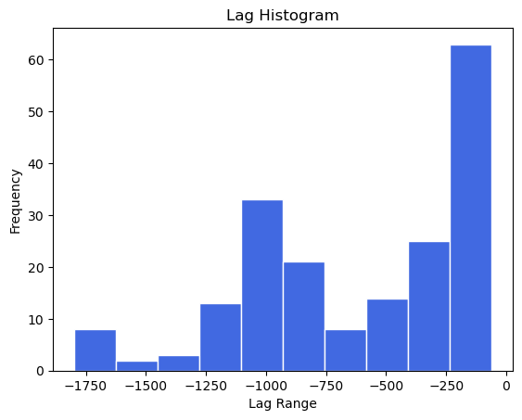
Histogram of Time-Lags
Peak around -250 seconds is on the scale of seconds to a few minutes, possibly indicating a quick response from the BNS range
Bump around -1000s (15 min), which is roughly half of our 30-minute period

Slide 13
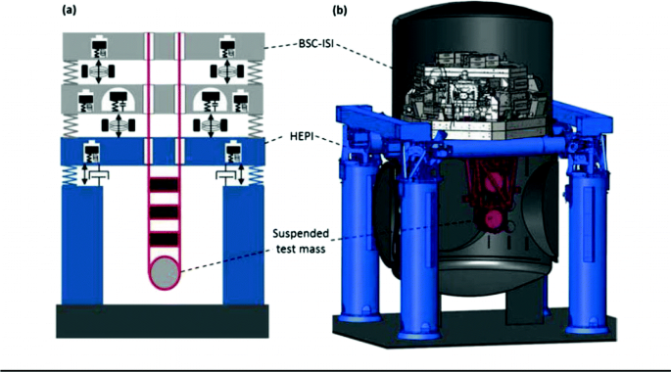
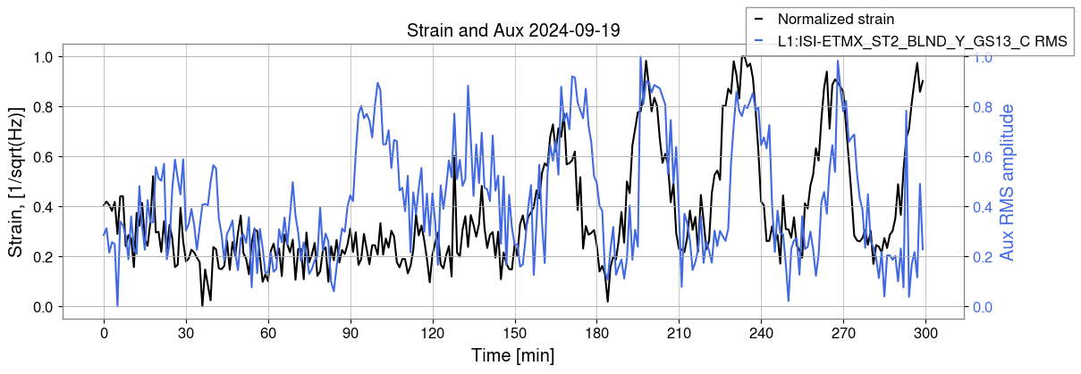
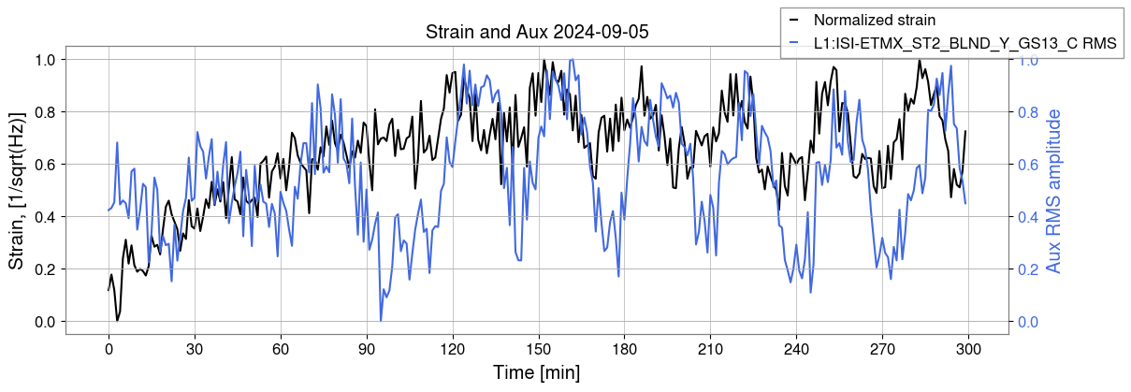
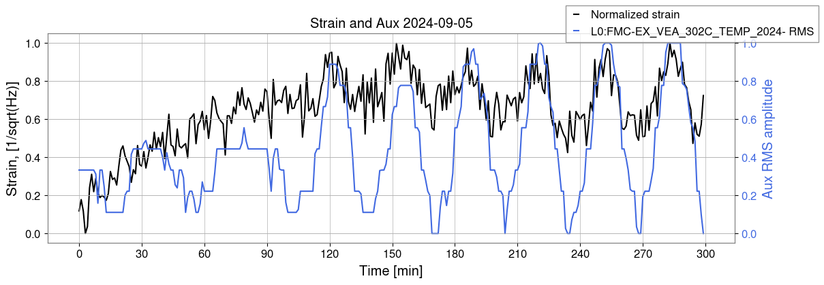
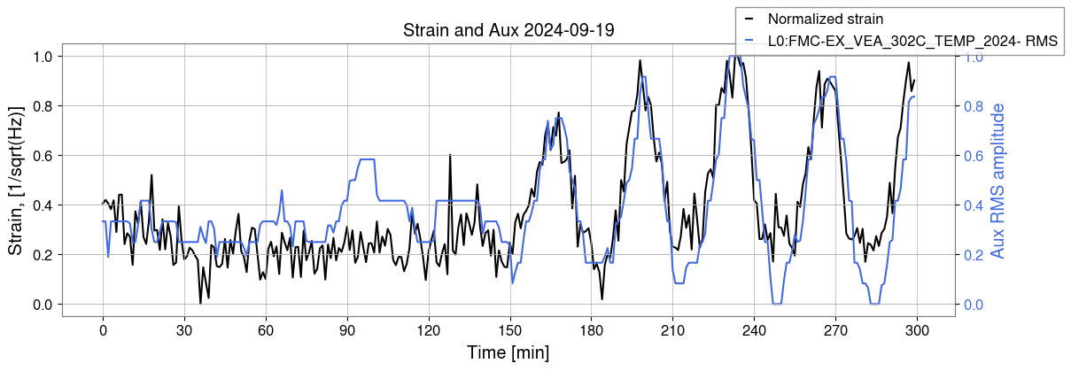
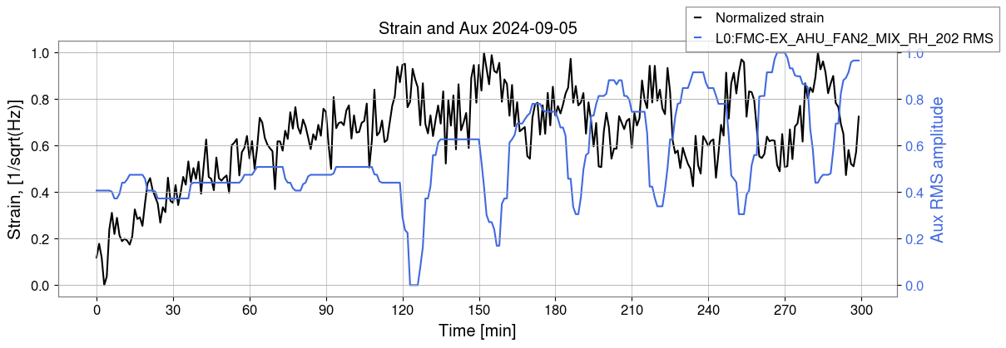
ISI Coupling with FMC
End-X test mass: Seismometer on second stage ISI (no lag)
optimum lag of -300 seconds
Relative humidity sensor (no lag)
optimum lag of -300 seconds

Slide 14
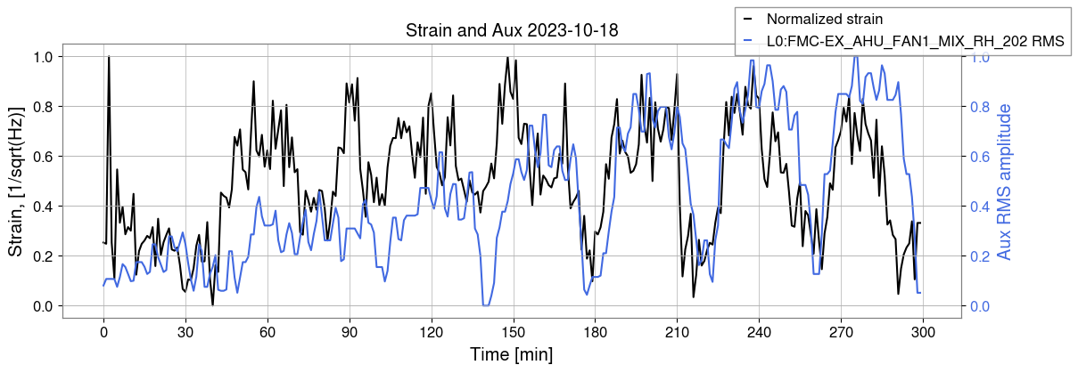
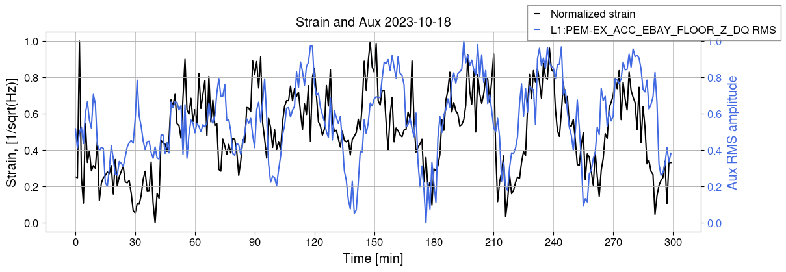
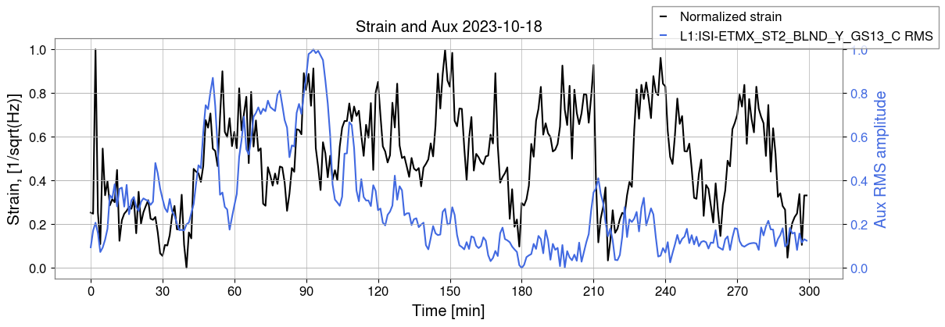
More Coupling Mechanisms?
Relative humidity sensor
Electronics bay accelerometer has a negative lag of -120 seconds
Same ISI seismometer as before not observing the noise

Slide 15
Conclusions
FMC channels (temperature and relative humidity sensors) most frequently have the highest correlation with negative lag of all sensor types
  Humidity cycling in the AHU may be a driver
Suspect multiple coupling mechanisms with FMC as PEM and ISI channels are not oscillating every day the BNS oscillations are present
  FMC w/ ISI: temperature and/or humidity fluctuations are somehow propagating into the vacuum
  FMC w/ PEM: possible airflow or structural vibrations originating from the electronics bay or HVAC

Slide 16
Future Steps
Comprehensively cross-correlate auxiliary channels at other stations (corner station and End-Y)
Develop some method to track how the amplitude of the oscillations in the auxiliary channels change over time
Follow-up with the LIGO Livingston commissioners for potential temperature related tests

Slide 17



Acknowledgements
This project was supported by:
National Science Foundation Research Experience for Undergraduates (NSF REU)
LIGO Laboratory Summer Undergraduate Research Fellowship (LIGO SURF)
California Institute of Technology Student-Faculty Programs (Caltech SFP)
I would like to thank my mentor, Jane Glanzer, for her guidance on this project and my first foray into detector characterization.

Slide 18
Questions?

Slide 19
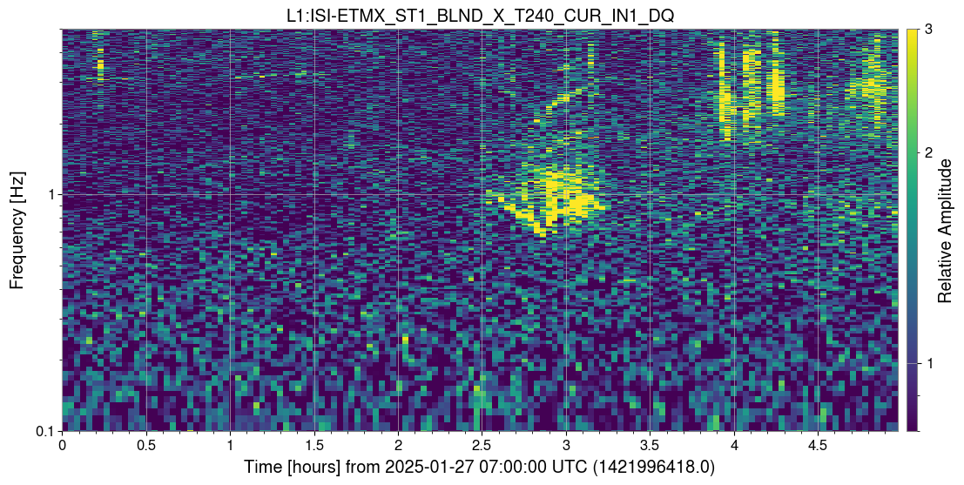
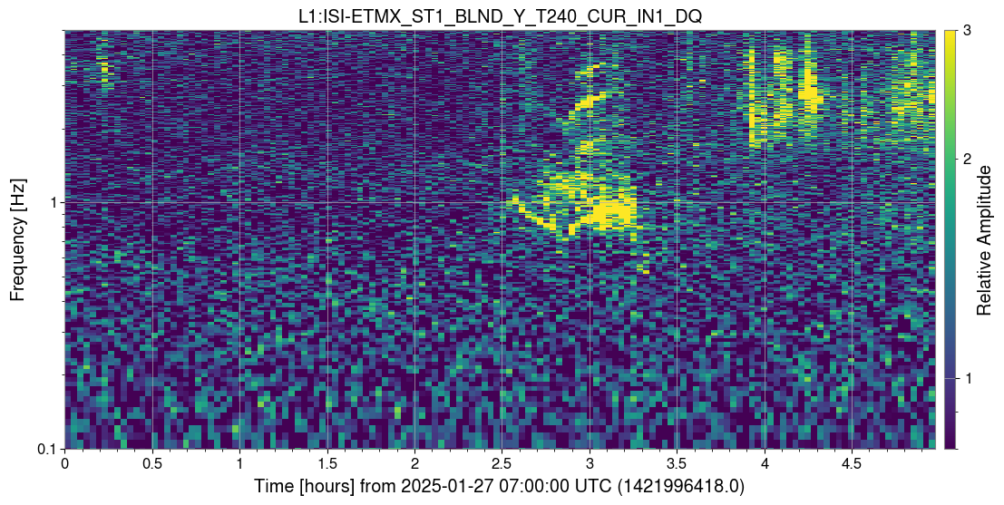
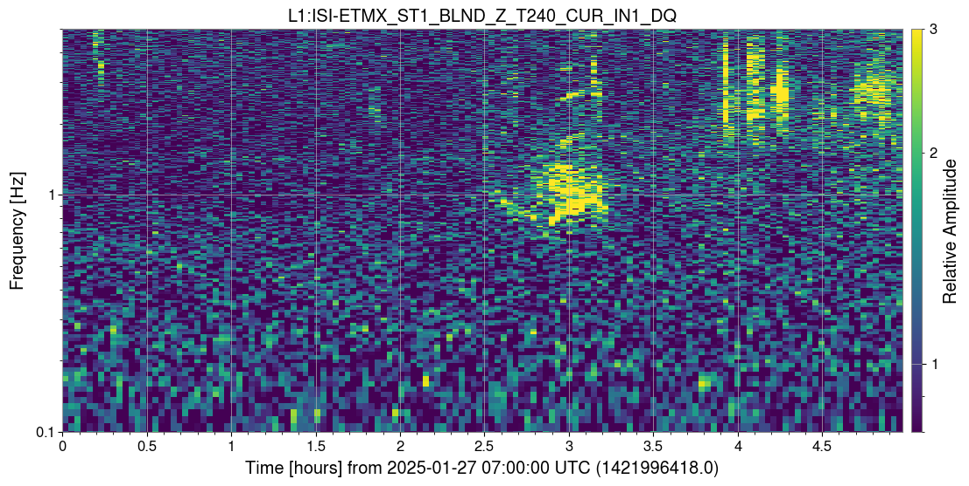
Low Frequencies
Explored low frequency behavior in 0.1-0.25 Hz range because motion at low frequencies has the possibility to up convert into higher frequencies
No substantial evidence of low frequency, periodic noise

Slide 20
Second stage ISI →
HPI →

