Slide 1
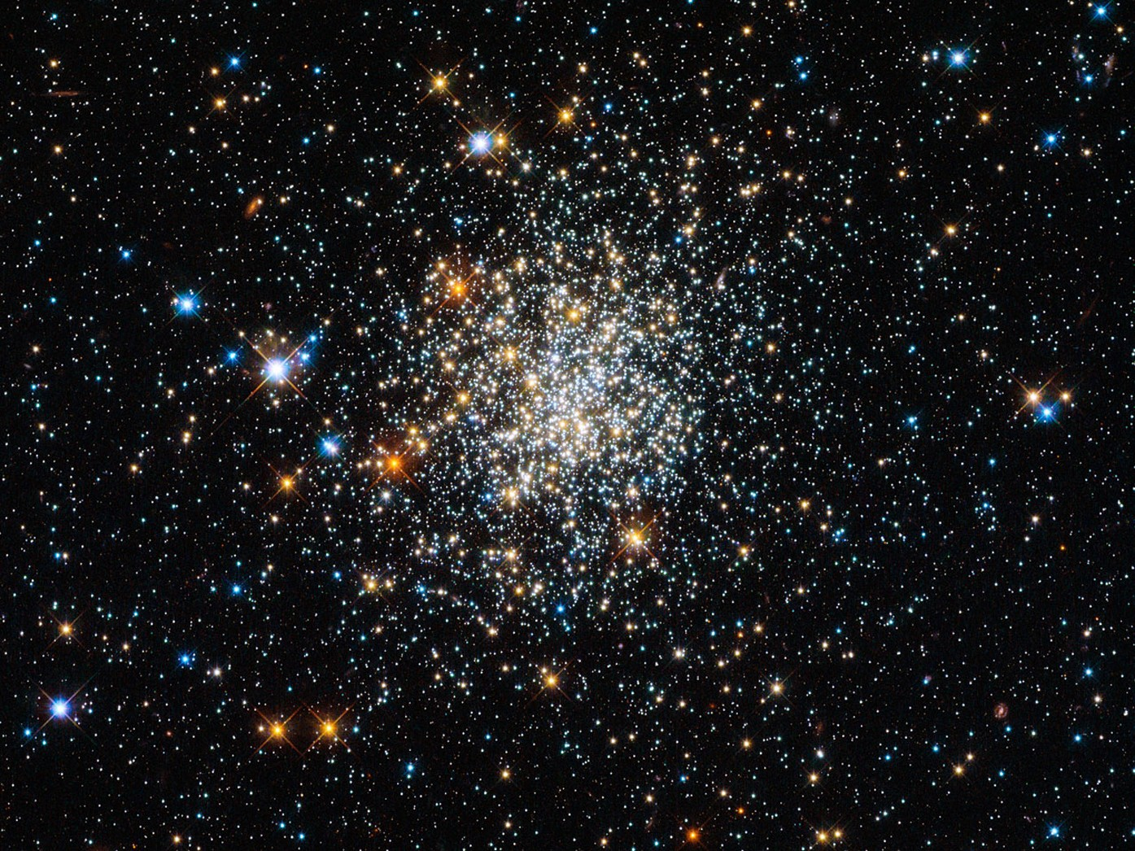
Predicting the rate of fast radio bursts in globular clusters from binary black hole observations
11th June 2025
Aryamann Rao

Slide 2
Introduction
Background:
  Fast radio bursts (FRB) either follow star formation history (SFH) or they don’t.
  Recent studies suggest that FRBs are delayed from the SFH (Zhang & Zhang, 2022).
  FRB detected in a globular cluster near M81 (Bhardwaj et al. 2021).
Aim of the project:
  To test whether young NSs formed via BWD coalescences in old GCs can explain FRBs.
Our approach:
  Compare the predicted rate of BWD coalescences to FRB source rate as a function of redshift.
References: Bhardwaj, M., Gaensler, B. M., Kaspi, V. M., et al. 2021, ApJL, 910, L18, doi: 10.3847/2041-8213/abeaa6726
Zhang, R. C., & Zhang, B. 2022, ApJL, 924, L14, doi: 10.3847/2041-8213/ac46ad850

Slide 3
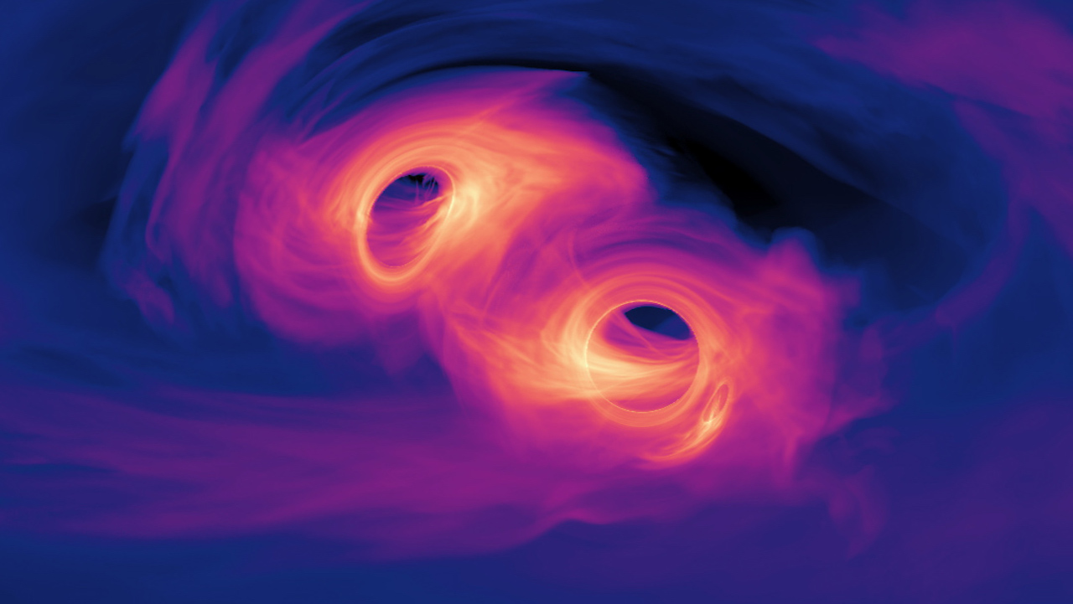
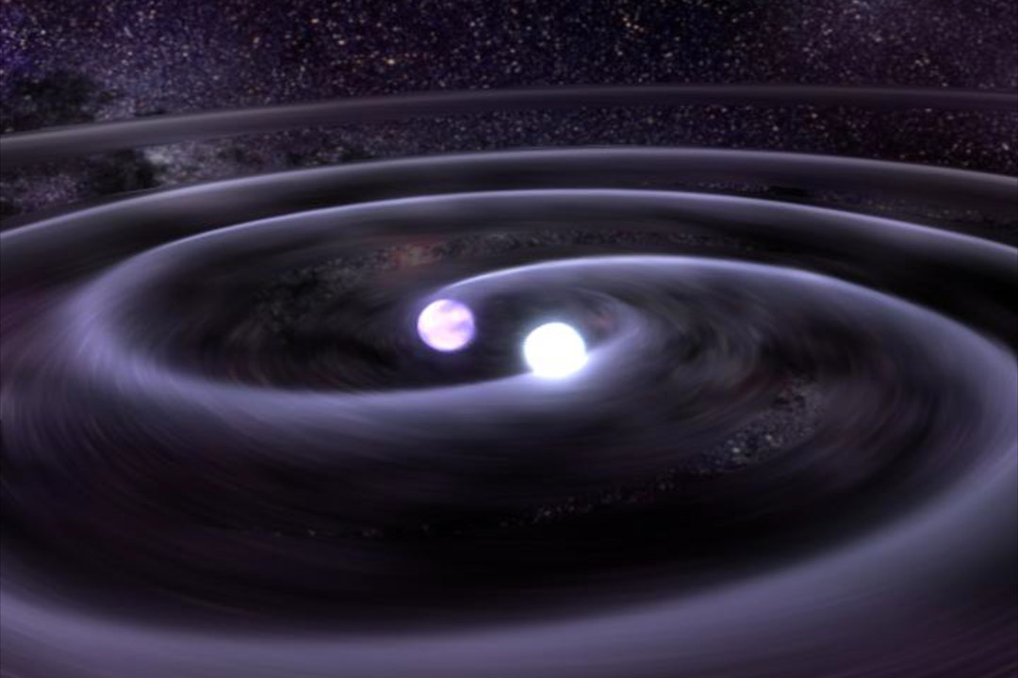
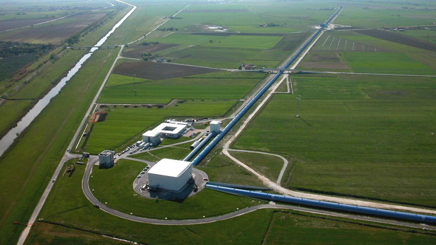
GC formation histories and property distributions
Influences
Influences
Constrains (Fishbach &
Fragione, 2023)
Infer the rate
(this project)
Hence, we are “Predicting the rate of fast radio bursts in globular clusters from binary black hole observations”
Binary black hole coalescences
Binary white dwarf coalescences
Observations
Infer the rate
(this project)
LIGO observations of gravitational waves
CMC simulations of GCs
(Kremer et al. 2020)
References: Fishbach, M., & Fragione, G. 2023, MNRAS, 522, 5546, doi: 10.1093/mnras/stad1364749
Kremer, K., Ye, C. S., Rui, N. Z., et al. 2020b, ApJS, 247,48, doi: 10.3847/1538-4365/ab7919

Slide 4
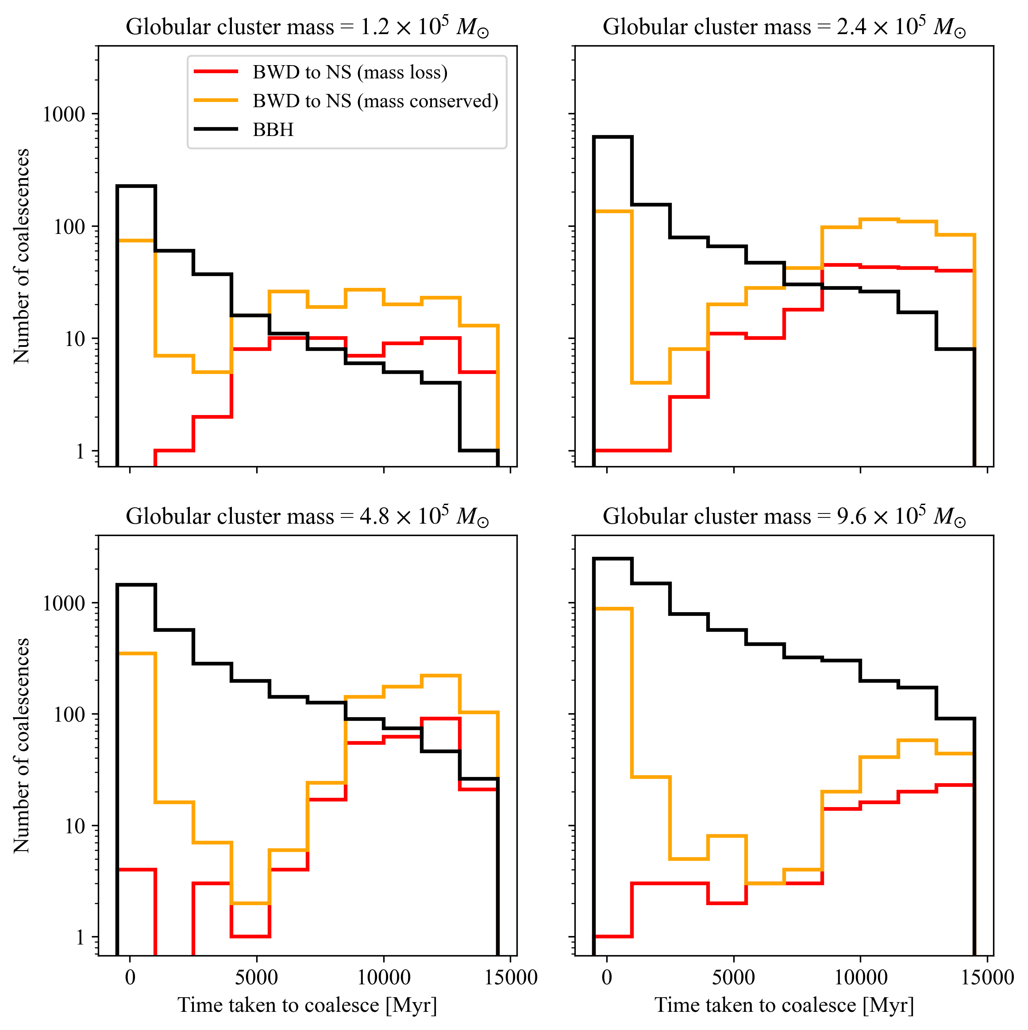
Globular clusters and compact object mergers
BBH coalescences occur earlier in a GC’s life.
BWD coalescences occur later in a GC’s life.
Explained by mass segregation:
  Heavier BHs sink to the GC center first.
  This kicks many BHs out of the GC.
  Less heavy WDs to sink to the center later.
Only looking at BWD coalescences forming NS.
Which BWD coalescence forms a NS?
  Mass-conserved scenario (Ye et al. 2024)
  Mass-loss scenario (Breivik et al. 2020)
Mass conserved case includes primordial events.
Figure from (Rao et al. 2024)
References: Breivik, K., Coughlin, S., Zevin, M., et al. 2020, ApJ, 898, 71, doi: 10.3847/1538-4357/ab9d85734
Ye, C. S., Kremer, K., Ransom, S. M., & Rasio, F. A. 2024, ApJ, 961, 98, doi: 10.3847/1538-4357/ad089a845
Rao, A., Ye, C. S., & Fishbach, M. 2024, arXiv e-prints, arXiv:2409.20564, doi: 10.48550/arXiv.2409.20564

Slide 5
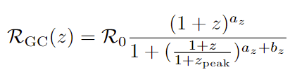
What do I mean by constrain?
We are interested in GC formation histories and GC property distributions.
Quantifying this:
  Can be mathematically defined using certain functions.
  The functional form is determined by a group of parameters.
Constraining this:
  Involves constraining the values the parameters can take.
  Done by fitting to GWTC-3 observations (Fishbach & Fragione, 2023).
References: Fishbach, M., & Fragione, G. 2023, MNRAS, 522, 5546, doi: 10.1093/mnras/stad1364749

Slide 6
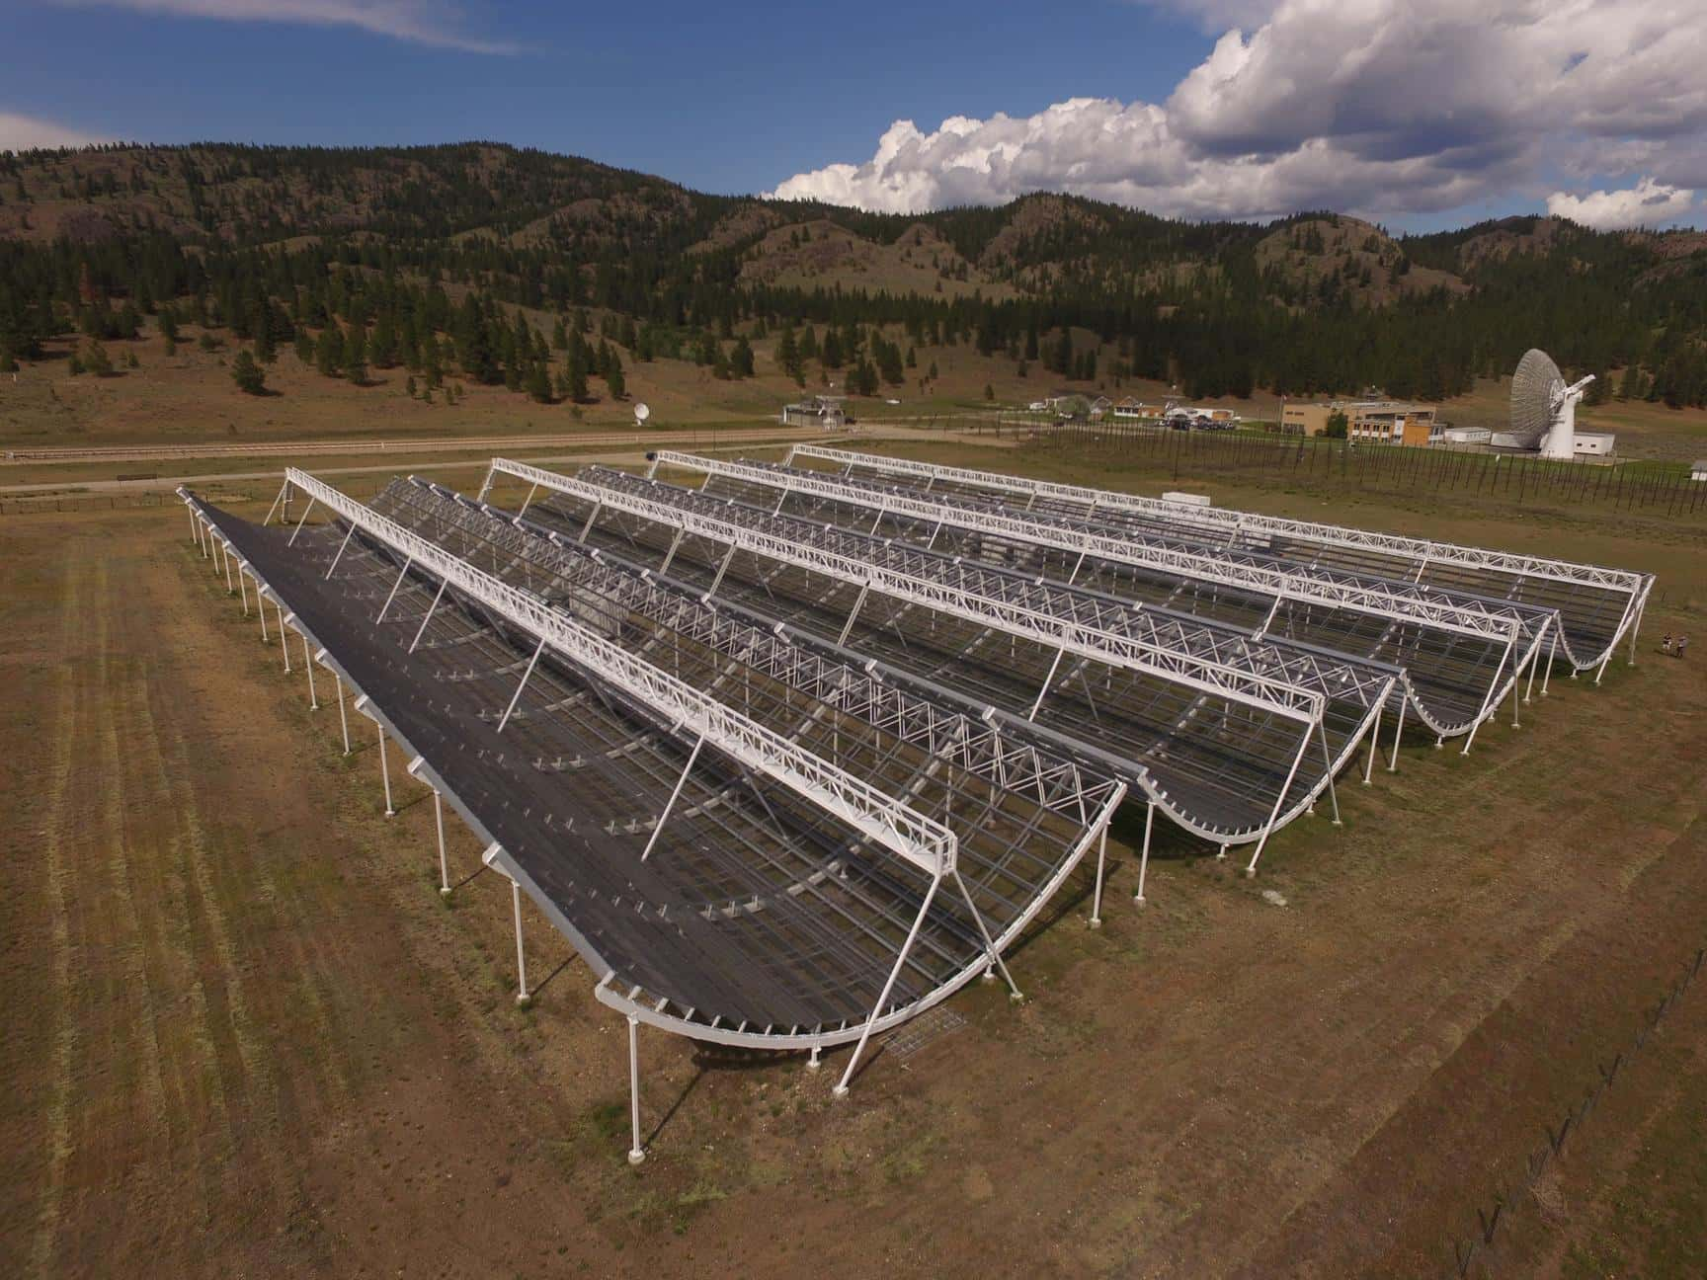
Fast Radio Burst Rates
These models are based on observations of FRBs.
For this project we only consider FRB source rates.
There are two types of FRB rate models:
  Models that trace the star formation history (SFH)
  Models that are delayed from the SFH
BWD coalescences are delayed from the SFH.
Hence, we only consider the latter group of FRB models.
The CHIME Experiment

Slide 7
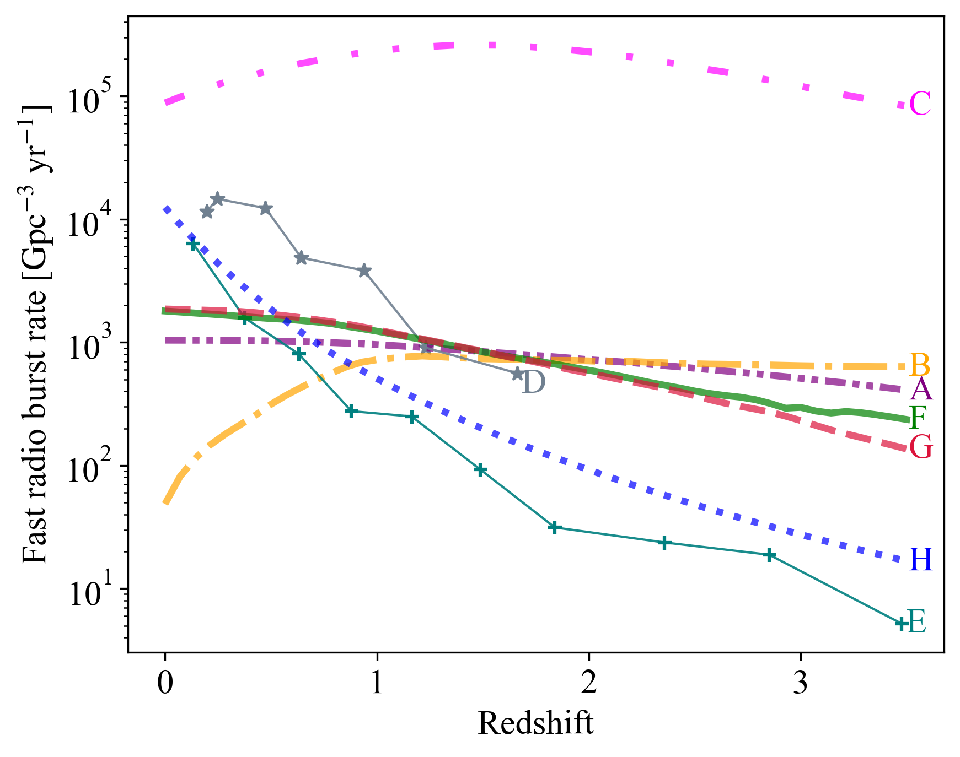
SFH Models:
A: Accumulated model (Zhang & Zhang, 2022)
B: SFH model (Zhang & Zhang, 2022)
C: SFH model (Shin et al. 2023)
Time Delayed Models:
D: Model from (Hashimoto et al. 2022)
E: Model from (Chen et al. 2024)
F: Hybrid model (Zhang & Zhang, 2022)
G: Lognormal delay model (Zhang & Zhang, 2022)
H: Model from (Zhang et al. 2024)
Figure from (Rao et al. 2024)
References: Rao, A., Ye, C. S., & Fishbach, M. 2024, arXiv e-prints, arXiv:2409.20564, doi: 10.48550/arXiv.2409.20564
Chen, J. H., Jia, X. D., Dong, X. F., & Wang, F. Y. 2024, arXiv e-prints, arXiv:2406.03672, doi: 10.48550/arXiv.2406.03672741
Hashimoto, T., Goto, T., Chen, B. H., et al. 2022, MNRAS, 511, 1961, doi: 10.1093/mnras/stac065755
Shin, K., Masui, K. W., Bhardwaj, M., et al. 2023, ApJ, 944, 105, doi: 10.3847/1538-4357/acaf06831
Zhang, K. J., Dong, X. F., Rodin, A. E., et al. 2024, arXiv e-prints, arXiv:2406.00476, doi: 10.48550/arXiv.2406.00476848
Zhang, R. C., & Zhang, B. 2022, ApJL, 924, L14, doi: 10.3847/2041-8213/ac46ad850

Slide 8
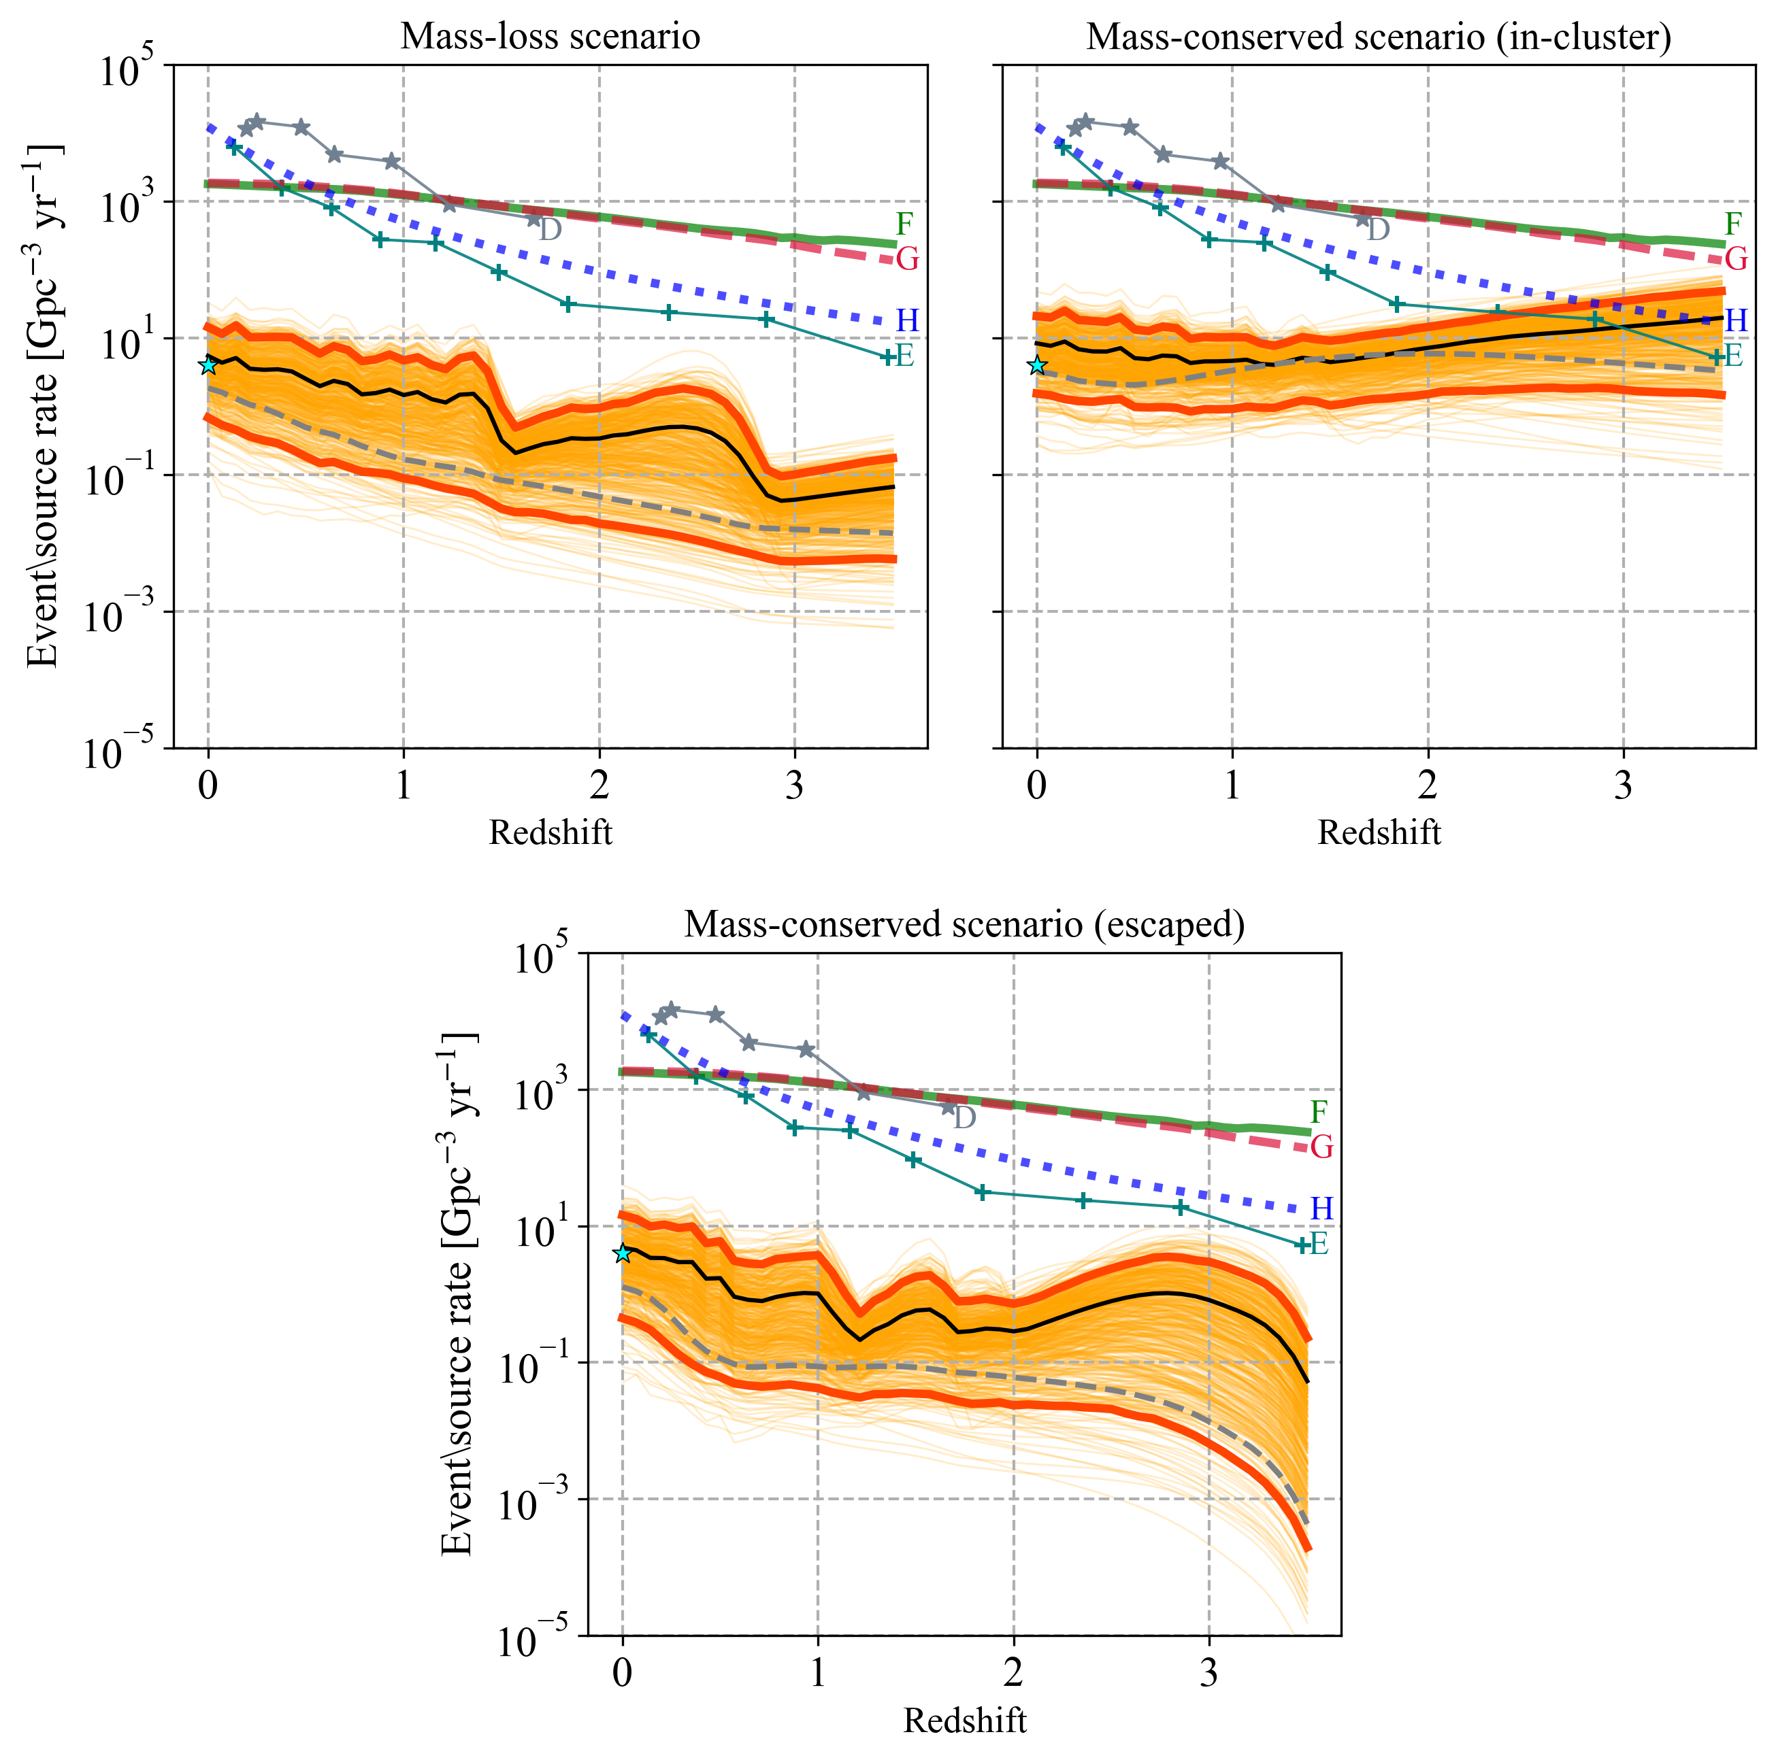
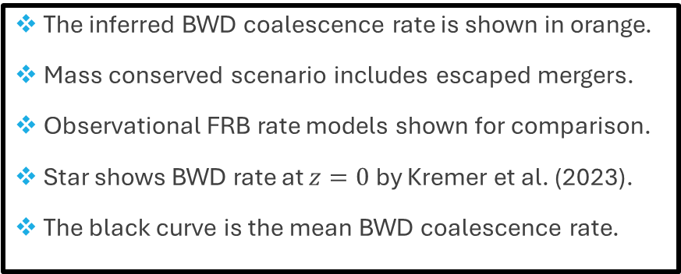
Results
The inferred BWD coalescence rate is shown in orange.
Mass conserved scenario includes escaped mergers.
Observational FRB rate models shown for comparison.
Star shows BWD rate at $z=0$ by Kremer et al. (2023).
The black curve is the mean BWD coalescence rate.
References: Rao, A., Ye, C. S., & Fishbach, M. 2024, arXiv e-prints, arXiv:2409.20564, doi: 10.48550/arXiv.2409.20564
Fishbach, M., & Fragione, G. 2023, MNRAS, 522, 5546, doi: 10.1093/mnras/stad1364749
Kremer, K., Li, D., Lu, W., Piro, A. L., & Zhang, B. 2023, ApJ, 944, 6, doi: 10.3847/1538-4357/acabbf772
Shin, K., Masui, K. W., Bhardwaj, M., et al. 2023, ApJ, 944, 105, doi: 10.3847/1538-4357/acaf06831
Results from (Rao et al. 2024)

Slide 9

Conclusions
Main takeaways:
  BWD coalescences in GCs cannot account for a large fraction of FRBs in the local Universe.
  Multi-messenger nature of gravitational wave astronomy.
  Future GW observations of BWDs can shed light on mechanism of their coalescences.
Refining the results:
  Better localizations of FRBs to higher redshifts and further refine FRB rate models.
  Further observations of gravitational waves from LVK will help better constrain GC formation histories.
  Will allow more accurate inference of BWD coalescence rate.
Full paper available at:

