Slide 1

Preparing the Third International Pulsar Timing Array Data Release
Deborah Good (Again)
June 11, 2025

Slide 2
What is the International Pulsar Timing Array?

Slide 3
What is the International Pulsar Timing Array?
Let’s start here.

Slide 4
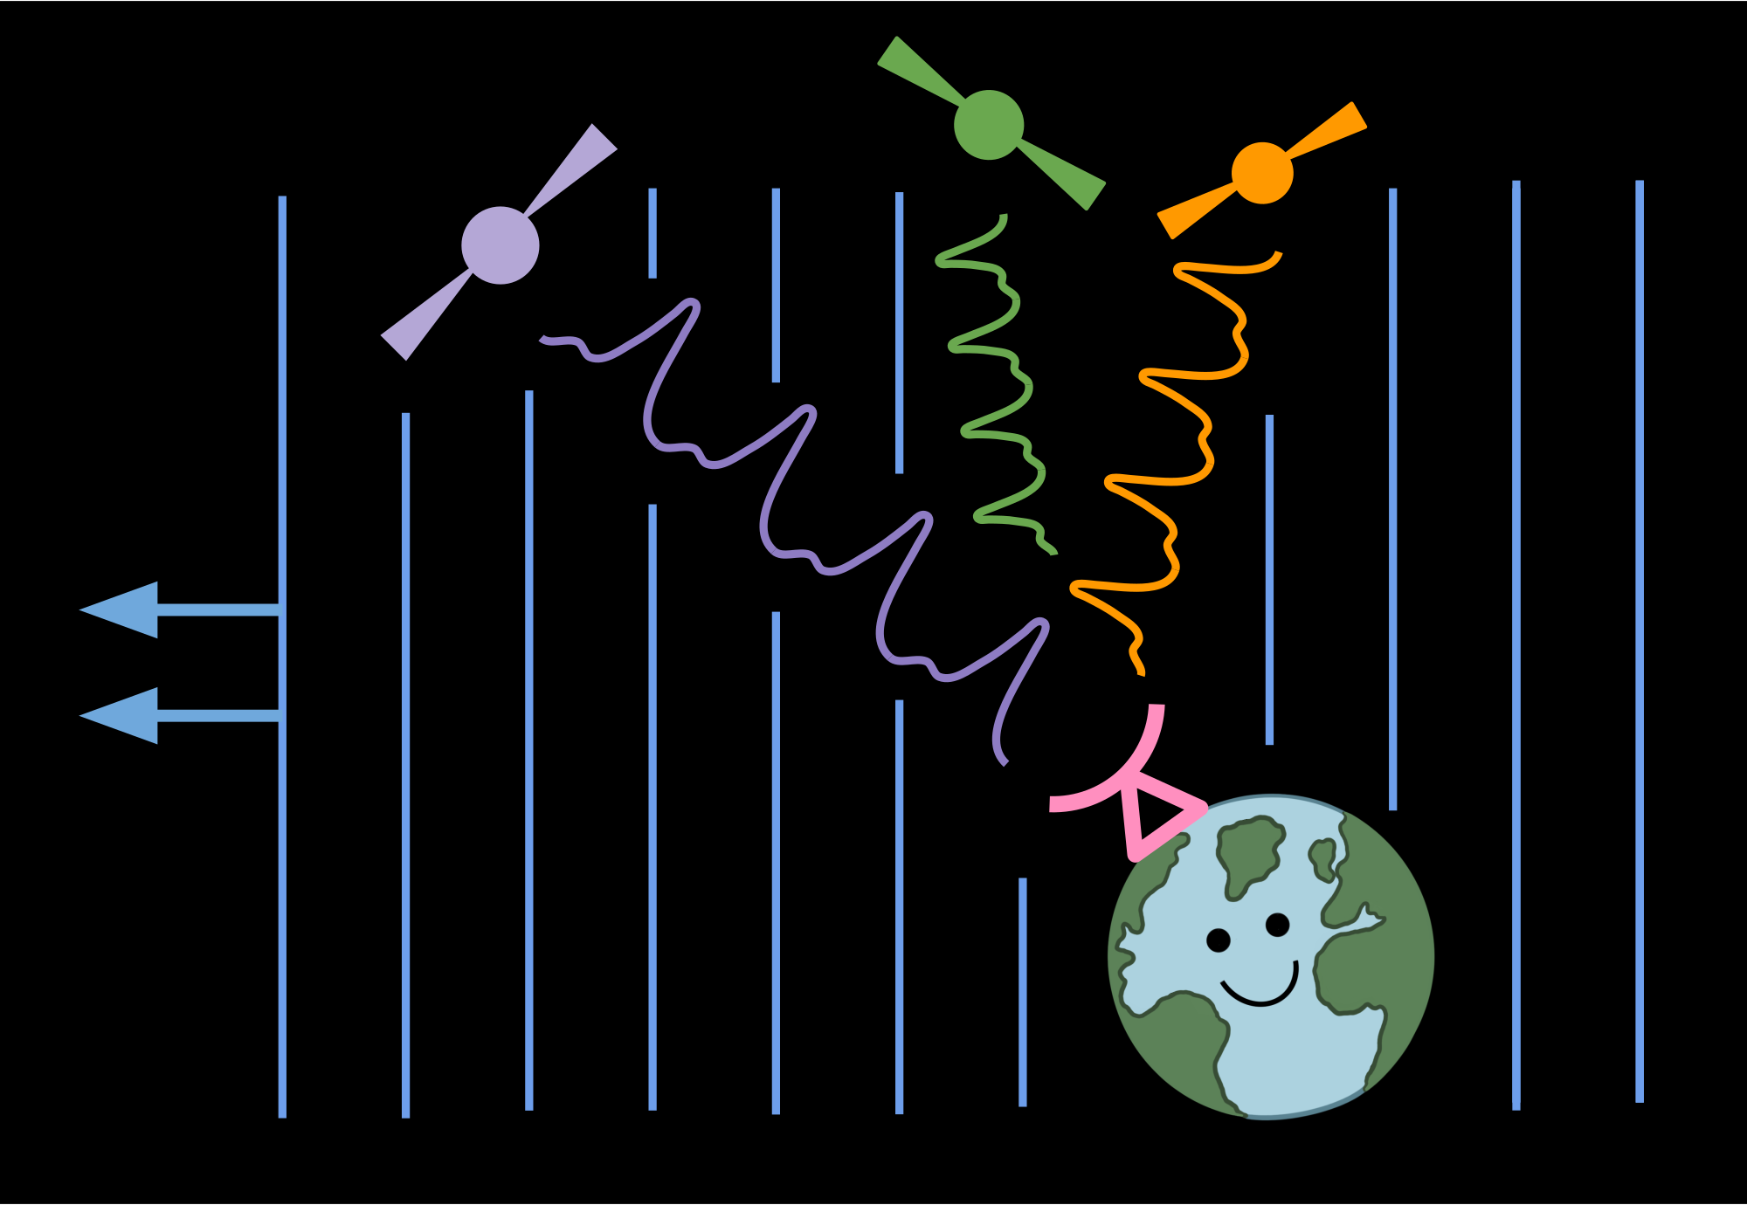

What is a pulsar timing array?
A tool to detect nanohertz gravitational waves using high-precision timing of millisecond pulsars.
GWs perturb spacetime and change times-of-arrival from their predicted value.
Observing many MSPs allows us to build a “galaxy scale gravitational wave detector.”
Observing = high-precision timing observations ($≤1 μs$ rms residual)
Image Credit: H. Thankful Cromartie

Slide 5
Current status:
PTAs around the world see “strong evidence” for a stochastic gravitational wave background.
Image Credit: H. Thankful Cromartie

Slide 6

Current status:
PTAs around the world see “strong evidence” for a stochastic gravitational wave background.
Strong evidence $≠$ Detection.
How do we get to detection?
Image Credit: H. Thankful Cromartie

Slide 7
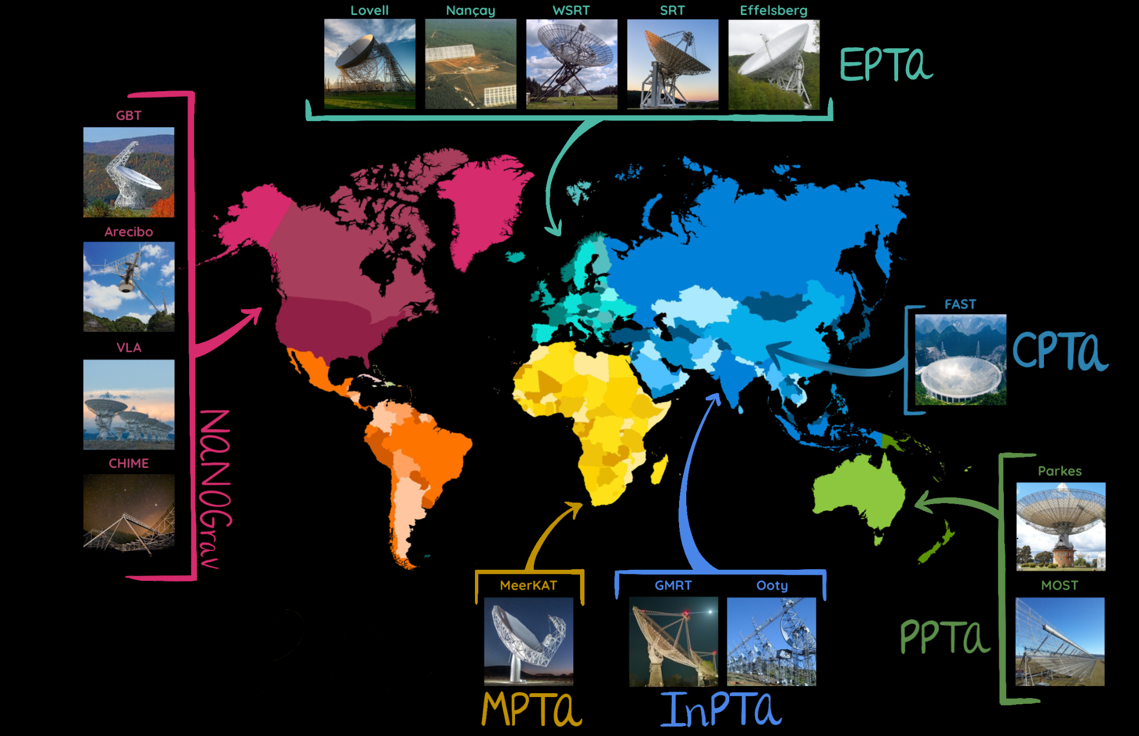
Image Credit: H. Thankful Cromartie

Slide 8
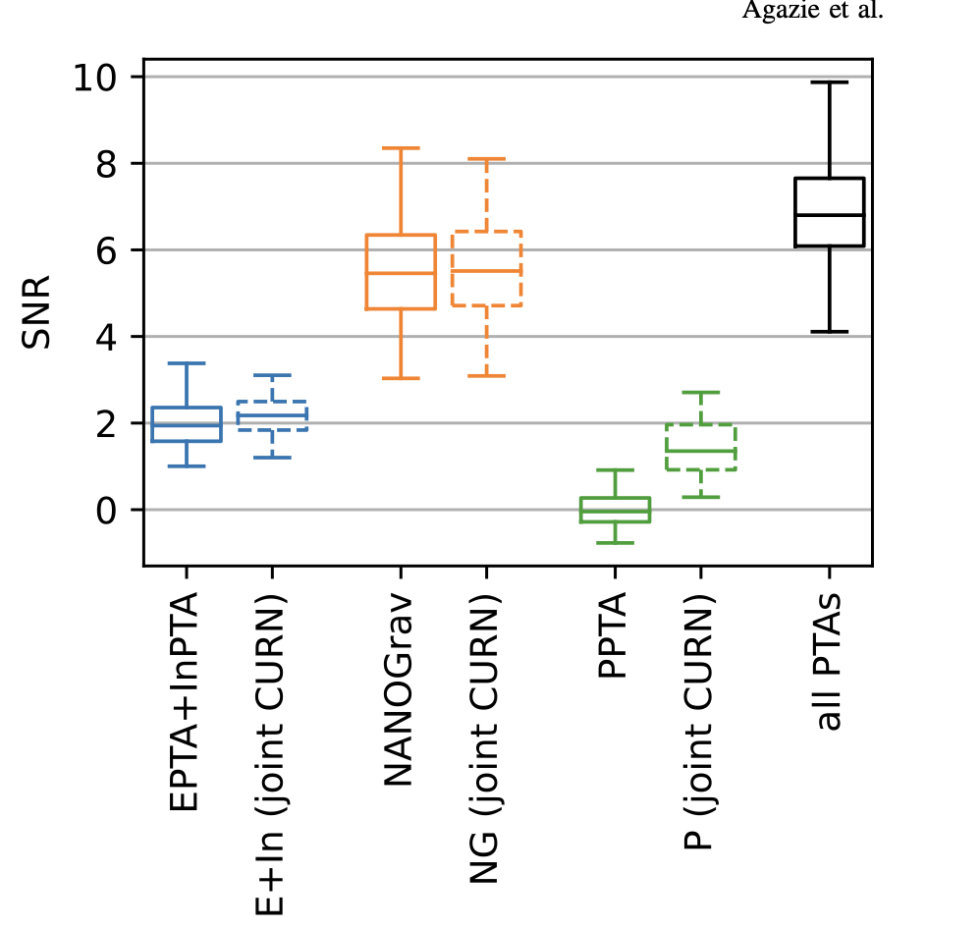
Why the IPTA?
To get more bang for our buck!
By combining all PTA datasets, we get more signal-to-noise than any PTA individually.
Image credit: Agazie et al. 2024

Slide 9
Let’s make an IPTA dataset!
No problem, right?

Slide 10
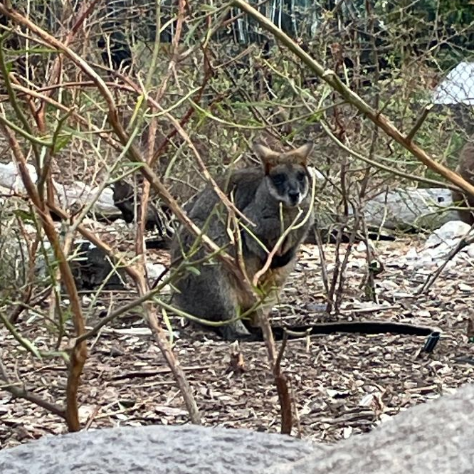
Data Combination Wallaby says…
“Wait, BIG PROBLEM!”
Concerned Pulsar Astronomer Wallaby (Sydney, NSW)

Slide 11
How do we create an IPTA dataset?
Collect each PTA’s very best dataset (pulsar times of arrival (TOAs); pulsar timing models).
Re-fit the pulsar timing model for each pulsar.
New, joint single pulsar noise analyses.
Search new IPTA dataset for gravitational waves.

Slide 12
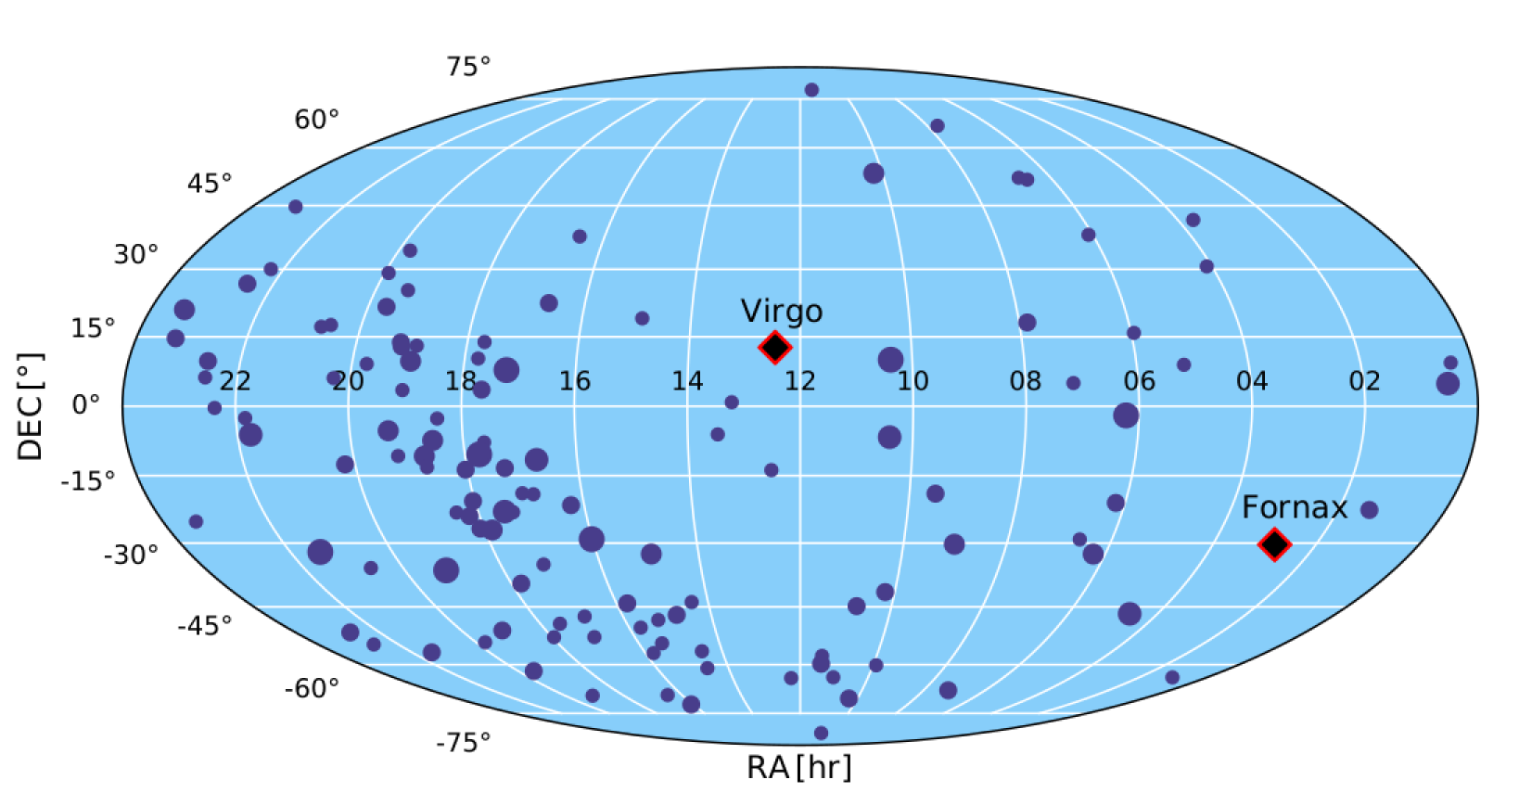
IPTA Dataset Challenges
Challenge 1: Lots and lots of pulsars!
Challenge 2: Lots and lots of approaches.
Challenge 3: The interstellar medium.

Slide 13
Challenge 1: Lots and Lots of Pulsars
DR3 (2026)
5(+?) PTAs
121 Pulsars
DR1 (2016)
3 PTAs
49 Pulsars
DR2 (2019)
3 PTAs
65 Pulsars

Slide 14
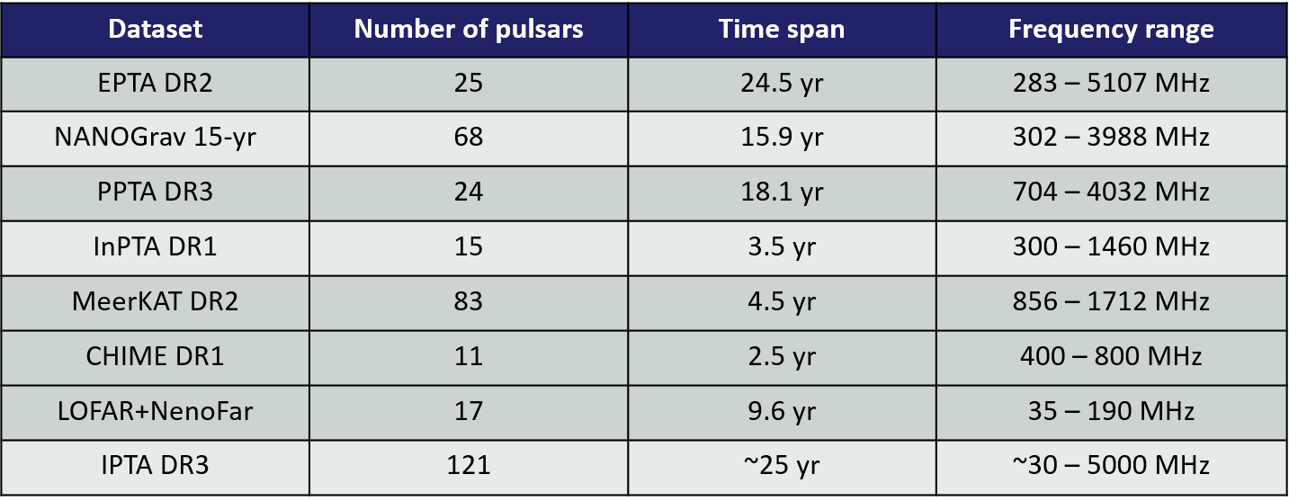
Challenge 1: Lots and Lots of Pulsars
NANOGrav: 68 Pulsars
EPTA:

Slide 15
IPTA Dataset Challenges
Challenge 1: Lots and lots of pulsars!
Challenge 2: Lots and lots of approaches.
  Different methods for TOA generation
  Parallel software pipelines
  Designing our noise budgets
Challenge 3: The interstellar medium.

Slide 16
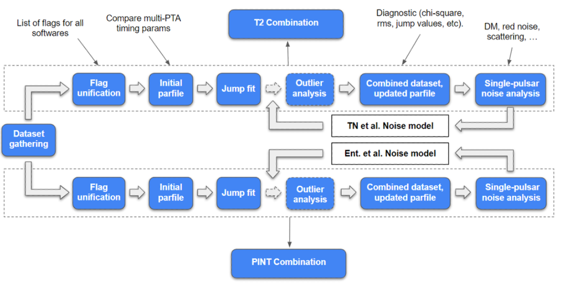
IPTA Workflow Chart

Slide 17
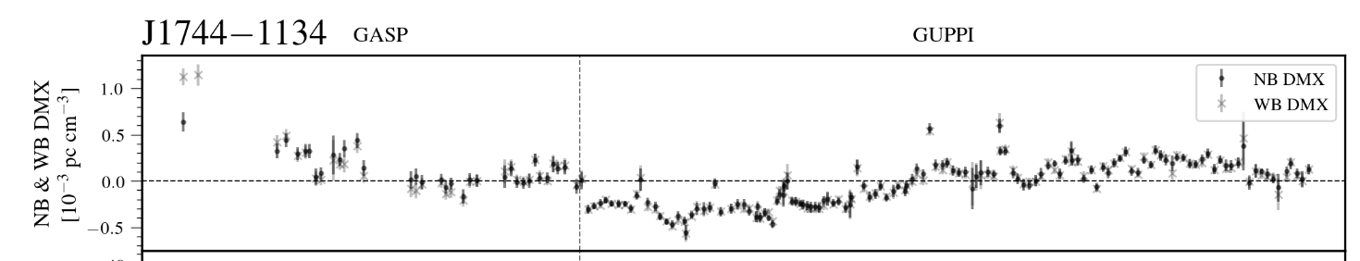
IPTA Dataset Challenges
Challenge 1: Lots and lots of pulsars!
Challenge 2: Lots and lots of approaches.
Challenge 3: The interstellar medium.
  Modeling time-dependent variation in the ISM (as seen in dispersion measure) is critical for PTA science.
Total DM: 3.13848(15) pc/cm³
Image: Agazie et al. 2023

Slide 18
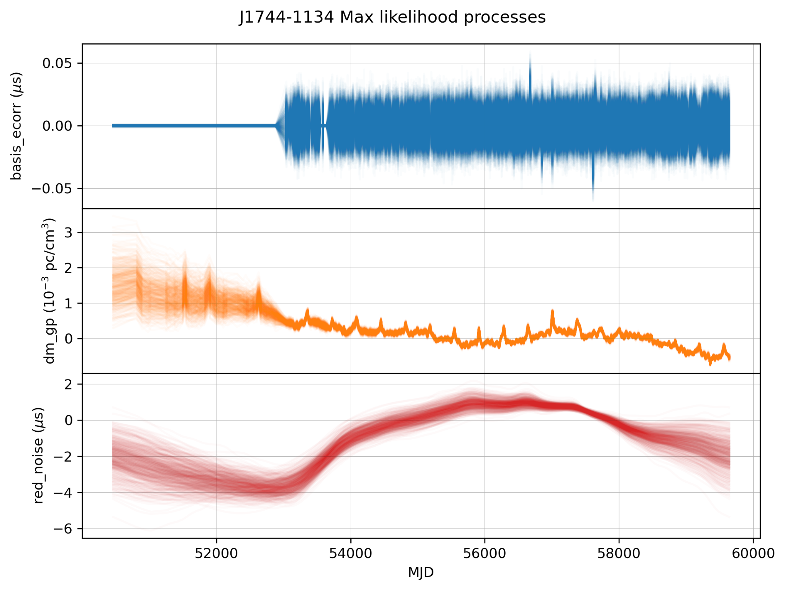
IPTA Dataset Challenges
Total DM: 3.13848(15) pc/cm³
Image: Agazie et al. 2023; Bjorn Larsen

Slide 19
IPTA dataset…success?
Currently completed:
Pre-noise timing analysis for 20+ priority pulsars, with all* datasets included
“Single-PTA” timing and noise analysis for 69 pulsars observed by only 1 PTA.
In-progress now:
Noise analysis and post-noise timing analysis for priority pulsars
Final dataset additions
Pre-noise timing analysis for remaining approx. 30 pulsars.

Slide 20
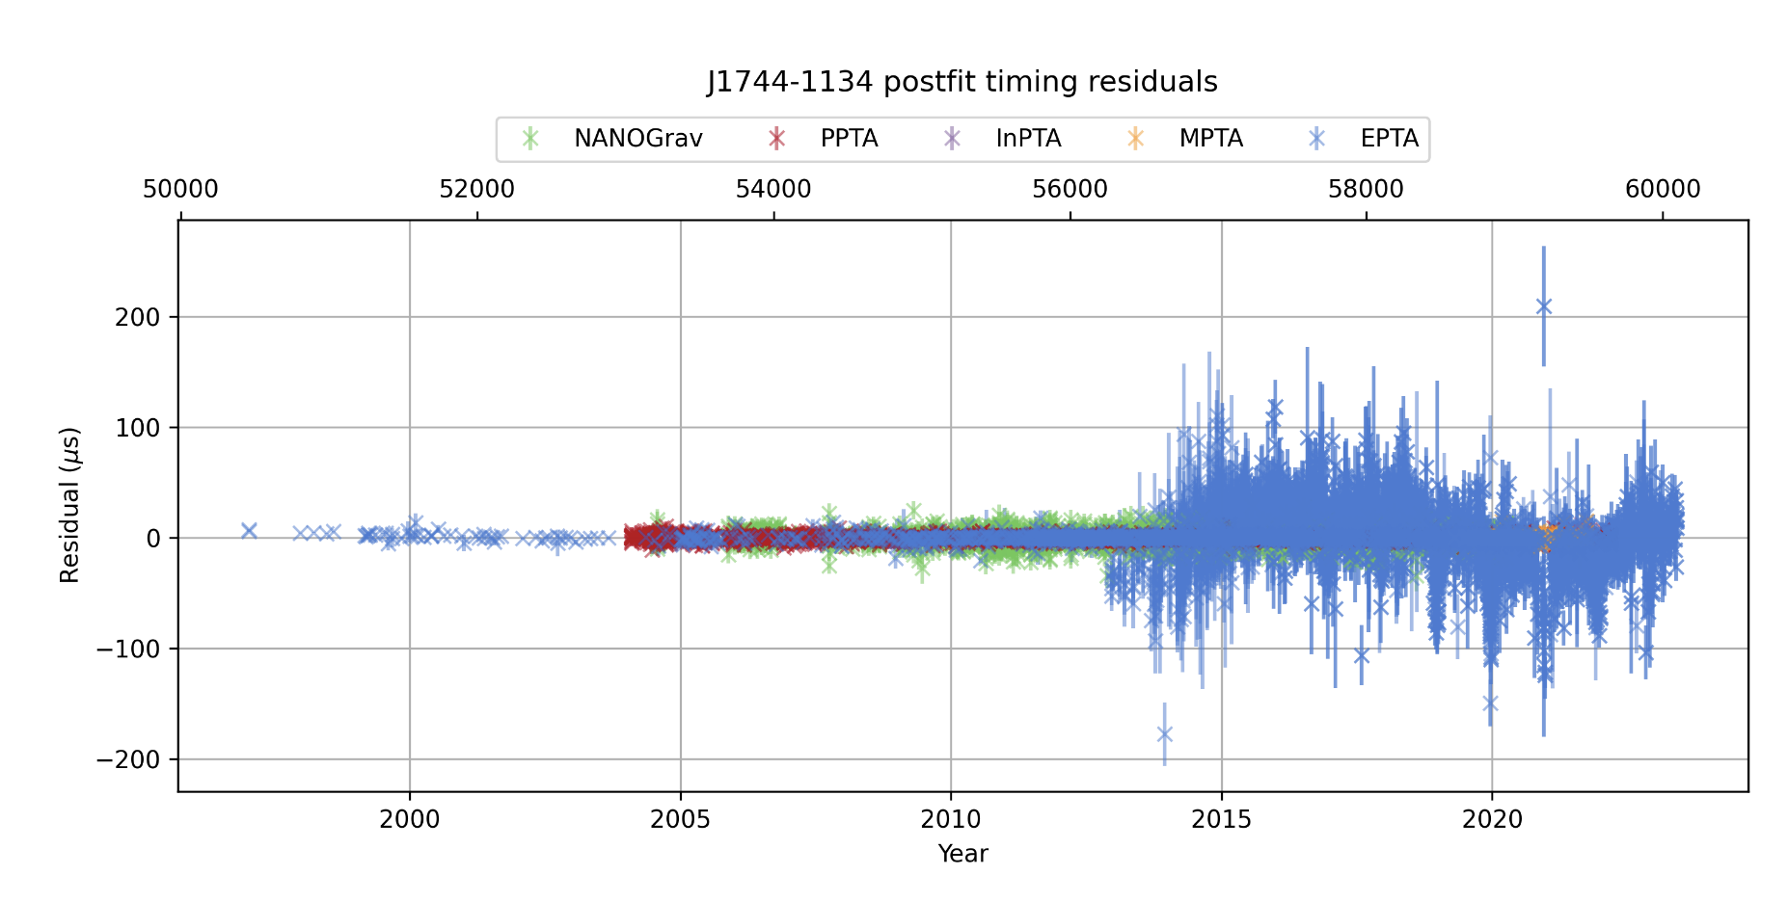
IPTA dataset…success?
Pre-noise -- full dataset

Slide 21
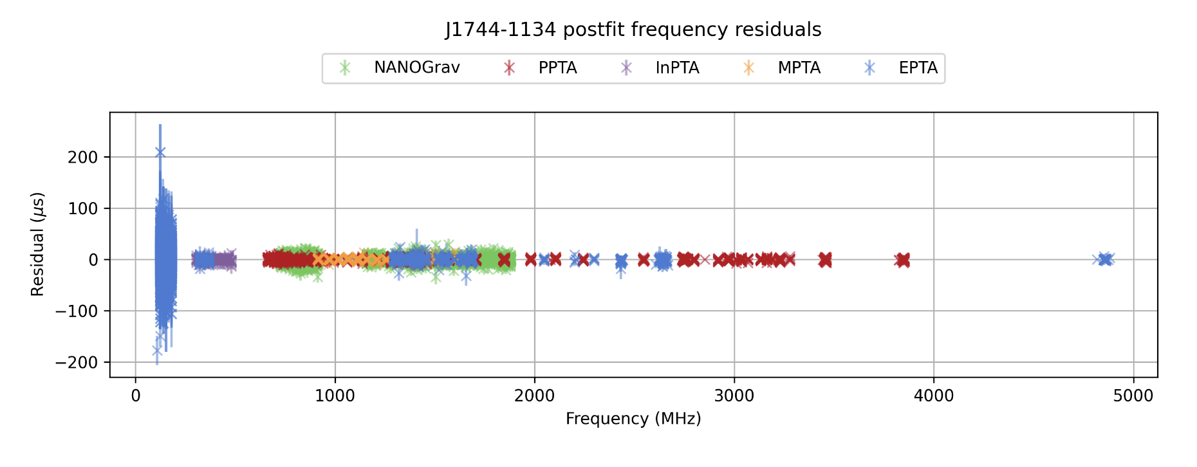
IPTA dataset…success?
Pre-noise -- full dataset

Slide 22
Summary
IPTA dataset creation is a big challenge!
But we’re getting close to IPTA DR3.
IPTA DR3 will be the best PTA dataset ever:
  Most pulsars.
  Most observatories.
  Longest baselines (tied with previously released sets)
  Best gravitational wave sensitivity.
We’re on track to finish dataset creation in 2025!

Slide 23
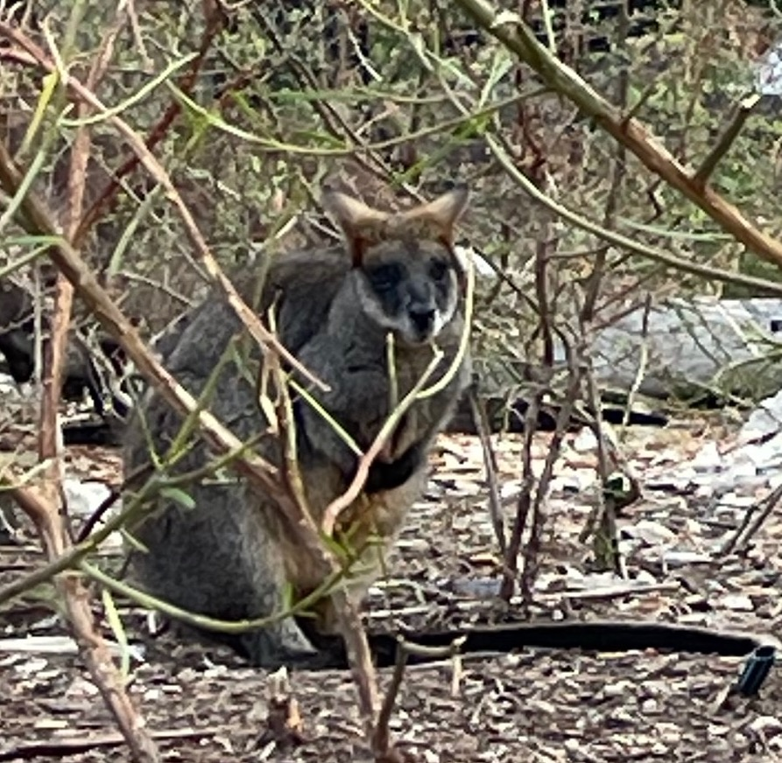
Summary
IPTA dataset creation is a big challenge!
But we’re getting close to IPTA DR3.
IPTA DR3 will be the best PTA dataset ever:
  Most pulsars.
  Most observatories.
  Longest baselines (tied with previously released sets)
  Best gravitational wave sensitivity.
We’re on track to finish dataset creation in 2025!
I’m so excited!

Slide 24
Bonus Slides

Slide 25
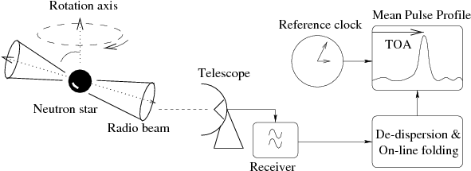
A (simplified) pulsar timing procedure
Observe a pulsar for a long period of time.
Determine Times of Arrival (TOAs) for every observation
Fit a timing solution to the total set of data.
Focus in on residuals and model out as much structure as possible.
Lorimer & Kramer 2005

Slide 26
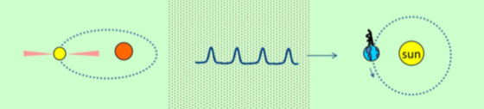
What do we see when we time pulsars?
Rotation Period Rotation Period Derivative Keplerian Orbital Elements Relativistic Orbital Elements Kinematic Perturbations of Orbital Elements | Dispersion Measure Dispersion Measure Variation | Position Proper Motion Parallax Solar Electron Density
Slide from Jeff Hazboun (and ultimately David Nice)

Slide 27
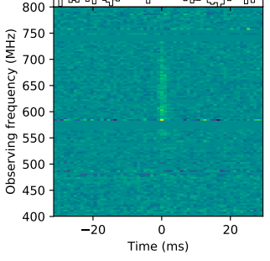

What is dispersion measure?
“The column density of electrons between the source and observer”
$$DM\left(t\right)=\int_{0}^{D}{ds n_{e}}(s\hat{n}\left(t\right),t)$$
The speed of light in the ISM is frequency dependent; different frequencies of light arrive at different times.
CHIME/FRB inc. D. Good
(Lorimer et al. 2007)

