Slide 1
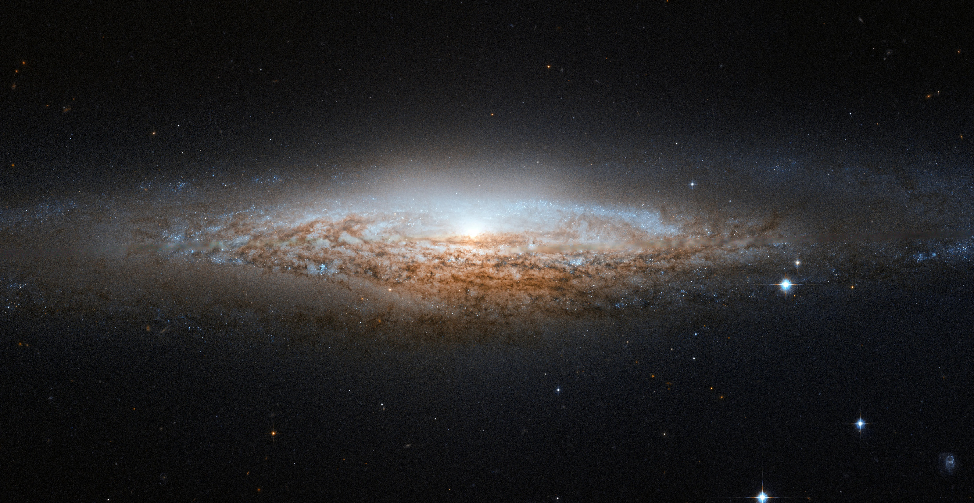
A Characterization of Loosely-Coherent Searches for Continuous Gravitational Waves
Clare Nelle
Keith Riles (U. Michigan), Gordon Jones, Seth Major, and Brian Collett (Hamilton College)
Notes:
Reduce computation time!!

Slide 2

BC
My Knowledge about CWs
Big Bang
Einstein
Today
Colliding Black Holes
My Birth
Last Week
Started My Thsis
Finished My Thesis

Slide 3
Simulate a CW Signal
(2) Build a search algorithm
(3) Analyze computational cost (template spacing)

Slide 4
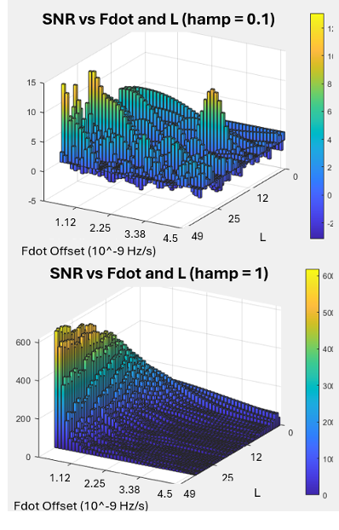
To Do:
Simulate a CW Signal
(2) Build a search algorithm
(3) Analyze computational cost (template spacing)

Slide 5
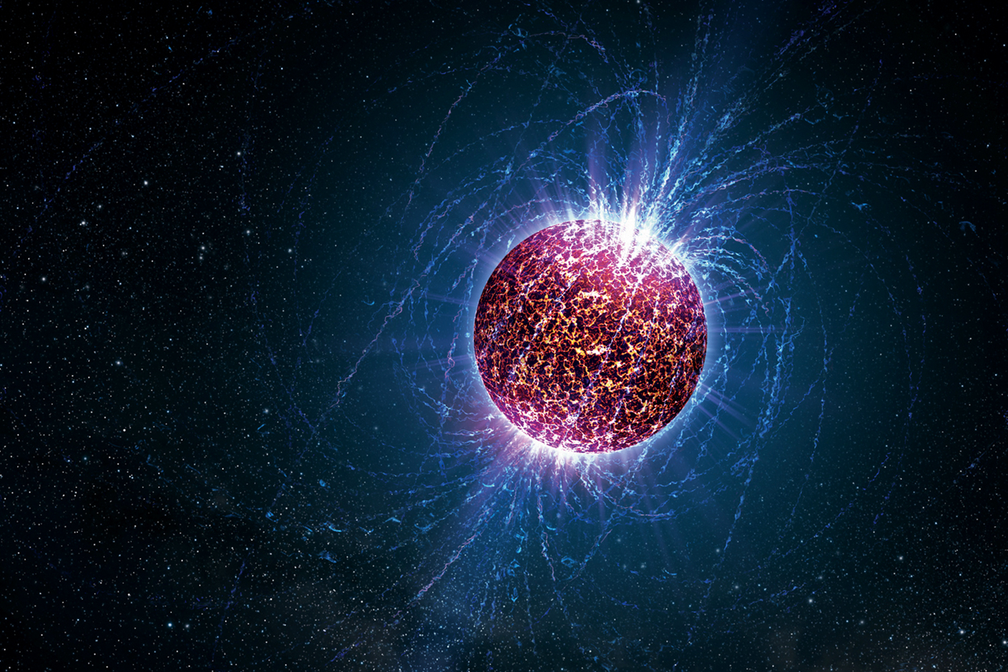
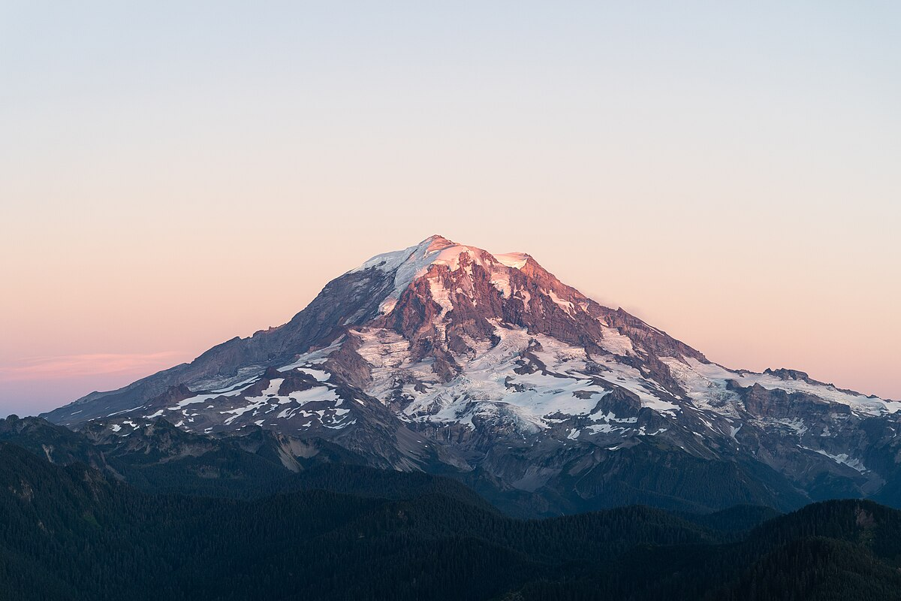
Continuous Gravitational Waves
Credit: Casey Reed/Penn State University
Notes:
CWs are Long time and small strain amplitude
Look specifically at neutron stars

Slide 6
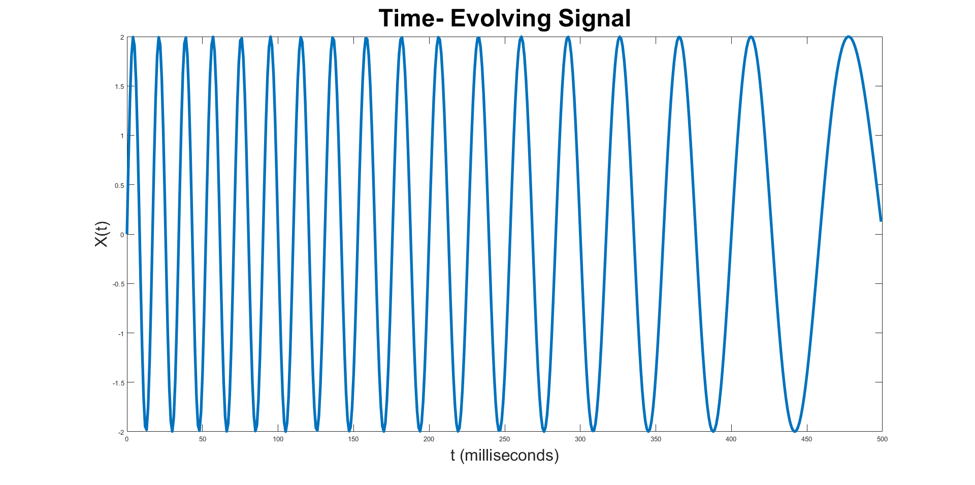

Continuous Gravitational Waves
$$h0sin\left[ωt{−\frac{ⅆω}{ⅆt}t^{2}}\right]$$
Small!
Credit: Casey Reed/Penn State University
Notes:
CWs are Long time and small strain amplitude
Look specifically at neutron stars - Strain amplitude at least 1000x smaller than merging events

Slide 7
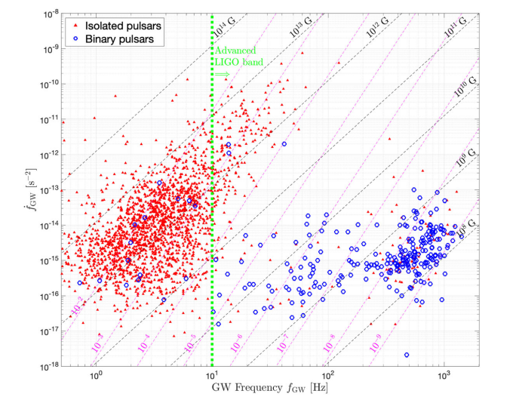
10 orders of magnitude!
Credit: Riles 2023
Notes:
HOWEVER this is a huge parameter space – Deborah’s talk

Slide 8
Newborn Neutron Stars
Notes:
This is too much, so we need a multimessenger counterpart. So let’s frontload our problem with making the signal processing easier so that we can look for CWs from neutron stars that have an electromagnetic counterpart. BUT now, we are looking at higher magnitude frequency derivative space. Two cases that would make a Newborn Neutron star that we are looking for

Slide 9
Hypermassive NS
Nonaxisymmetric NS
- Chirp GWs
- BNS merger event
- Outside our galaxy
- Rare
- Neutrinos and stuff
- Supernova
- Inside our galaxy
- Needs to be close!
Newborn Neutron Stars
Notes:
This is too much, so we need a multimessenger counterpart. So let’s frontload our problem with making the signal processing easier so that we can look for CWs from neutron stars that have an electromagnetic counterpart. BUT now, we are looking at higher magnitude frequency derivative space. Two cases that would make a Newborn Neutron star that we are looking for

Slide 10
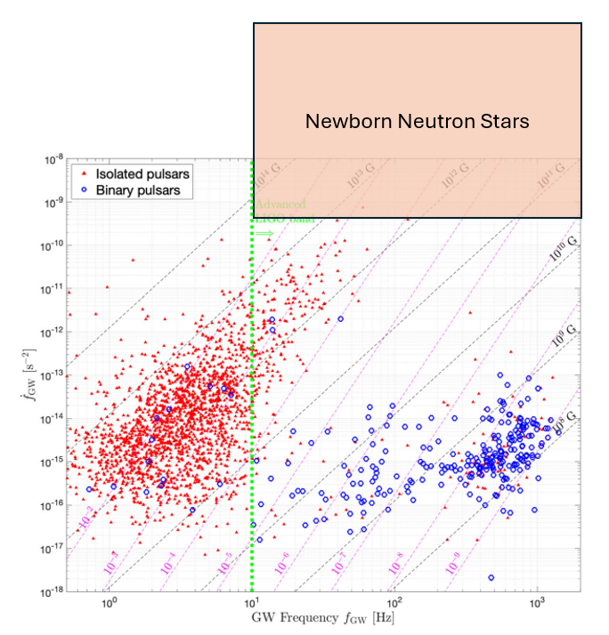
Credit: Riles 2023
Notes:
Frequency derivative will be higher bc they are newborn!

Slide 11
The Question:
Given limited data analysis computers, how do we extract a small, changing, mystery GW signal?
The Answer:
Find clever ways to analyze our short Fourier transforms!
Notes:
With computational power

Slide 12
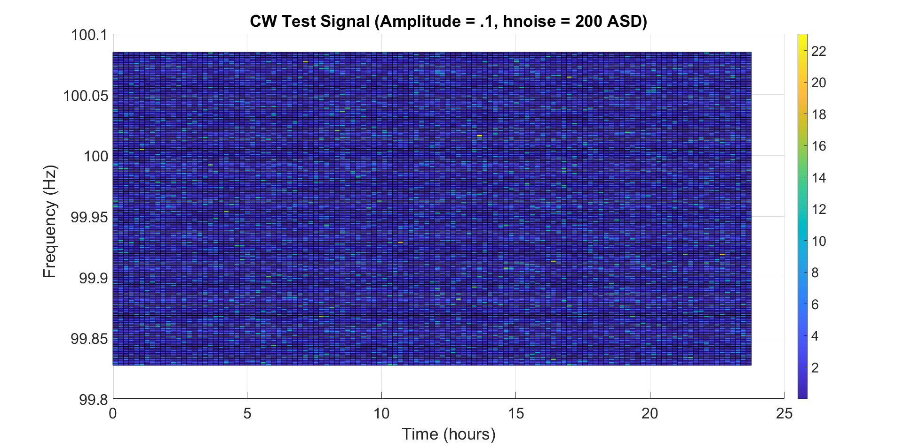
Simulated CW Signal

Slide 13
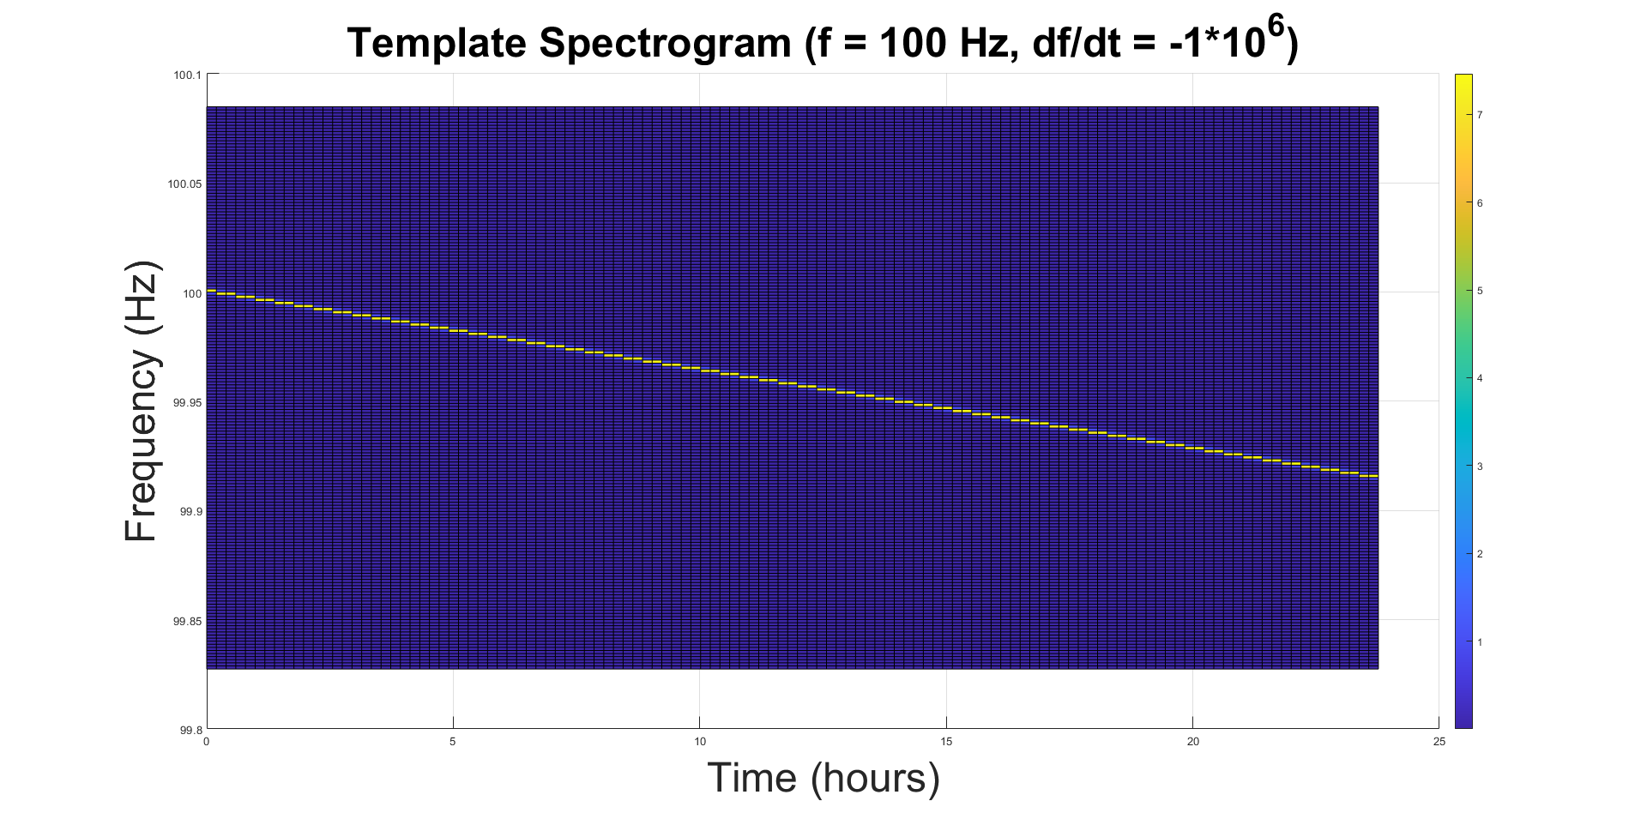
Matched Filtering
Can we find a frequency-decaying sine wave?

Slide 14
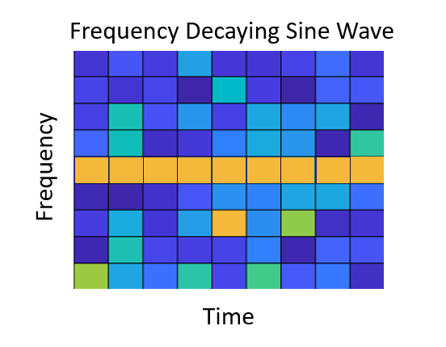

Slide 16
Template
Data

Slide 17
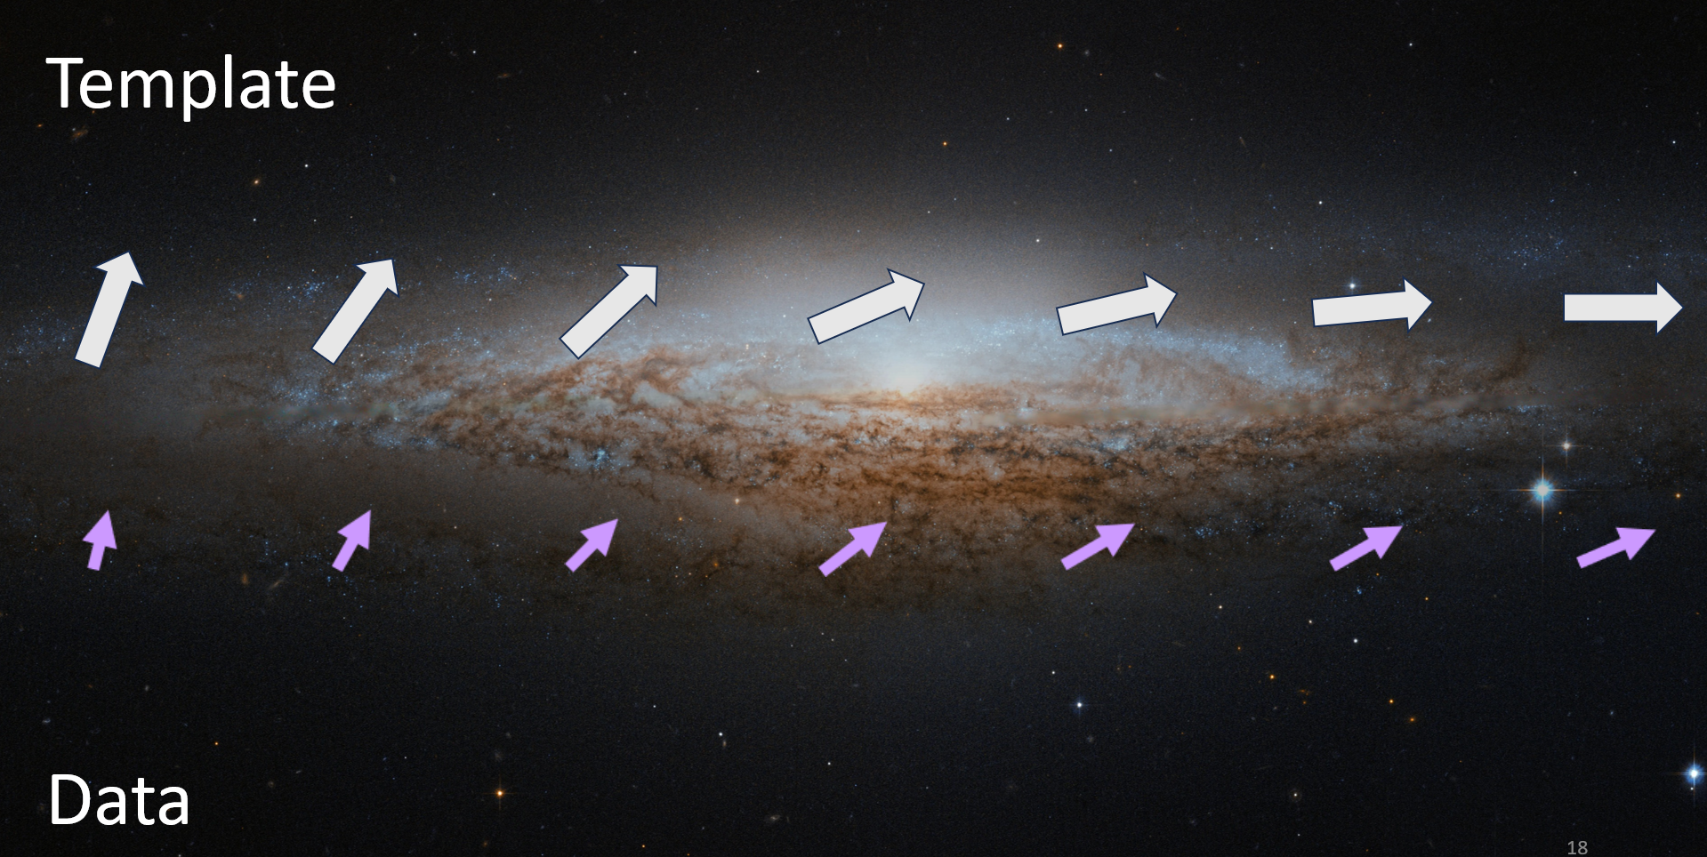

Slide 18
Choose a template
Choose a part of parameter space
Credit: Riles 2023

Slide 19
Loose Coherence

Slide 20
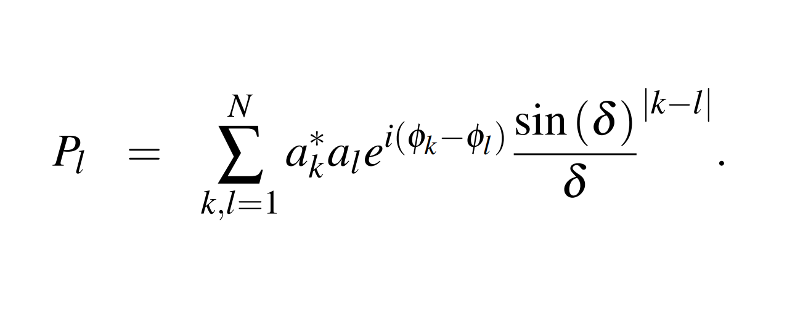

A_{l}$=a_{1 }+ib1, a2+ib2 , … , a_{n}+ibn$
c
Effective Coherence Time

Slide 21
No weighting
Total length² = how much signal
Notes:
This method is very good if you happen to guess the signal exactly right, but remember that our parameter space is over 10 orders of magnitude! So what if we de-emphasize some of the phasors that we are not sure about…

Slide 22
If we guess df/dt incorrectly,
Total length² = how much signal
Notes:
This method is very good if you happen to guess the signal exactly right, but remember that our parameter space is over 10 orders of magnitude! So what if we de-emphasize some of the phasors that we are not sure about…

Slide 23
Loose-Coherence
Vary N, δ to de-emphasize out-of-phase phasors
Retain some signal when a little bit off
Total length² = how much signal
Notes:
This method is very good if you happen to guess the signal exactly right, but remember that our parameter space is over 10 orders of magnitude! So what if we de-emphasize some of the phasors that we are not sure about…

Slide 24
Loose Coherence → more parameter space
Credit: Riles 2023

Slide 25
Results

Slide 26
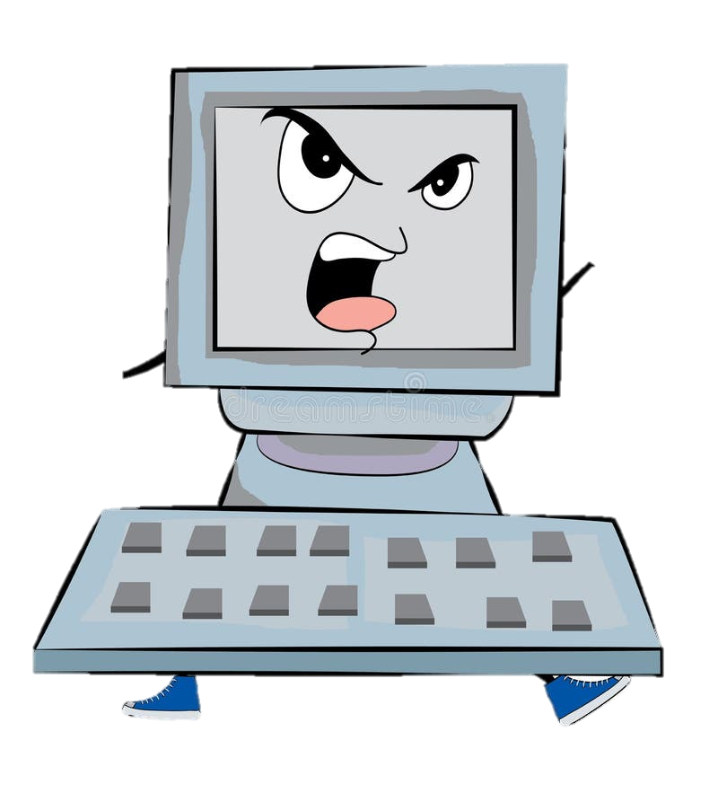
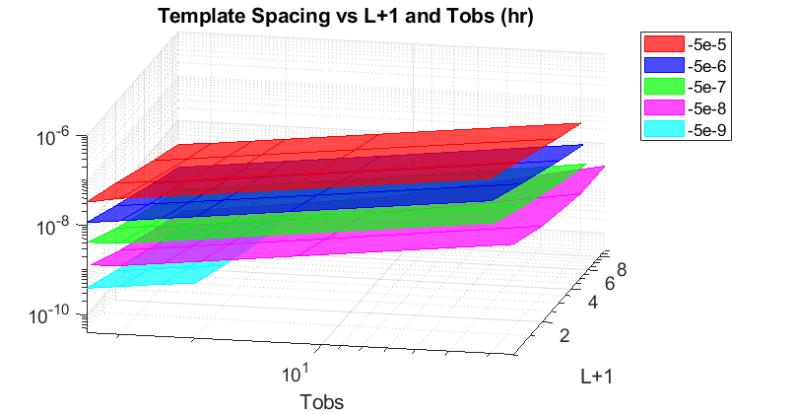
Results: Template Spacing
Position in Parameter Space
Effective Coherence Time
Amount of Data
Notes:
Gives the Riles group the tools to decide what parameters they want to use for a loosely-coherent search

Slide 27
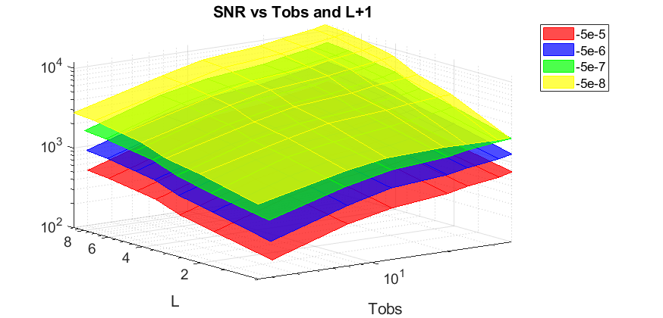
Results: Sensitivity
Position in Parameter Space
Effective Coherence Time
Amount of Data
Notes:
Gives the Riles group the tools to decide what parameters they want to use for a loosely-coherent search

Slide 28
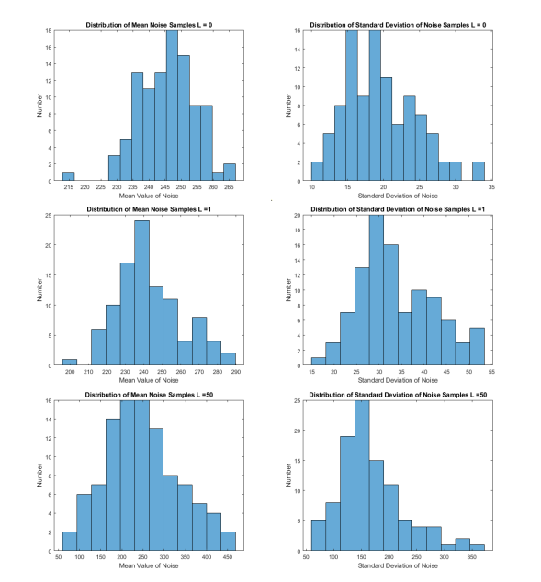
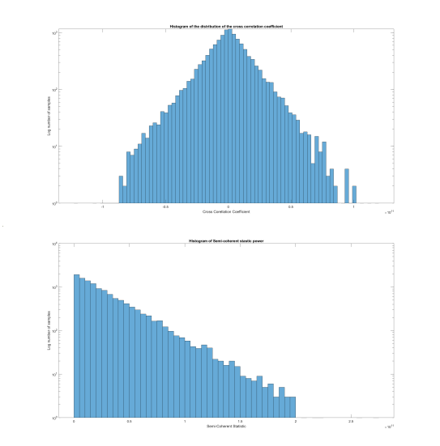
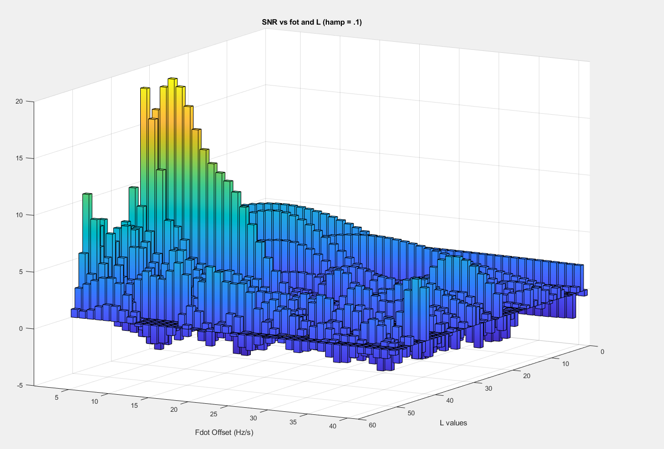
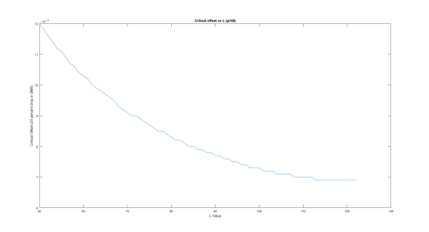
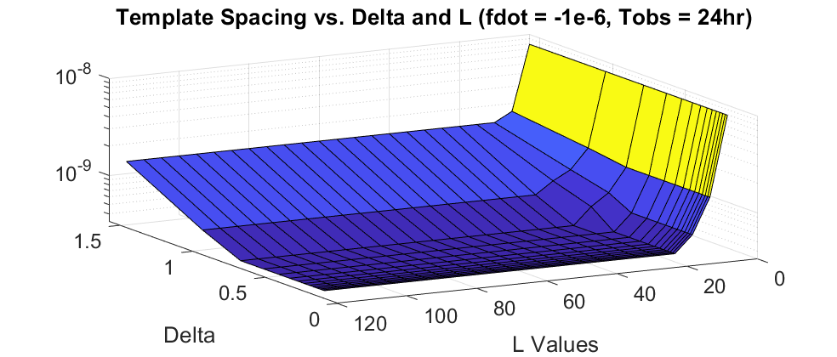
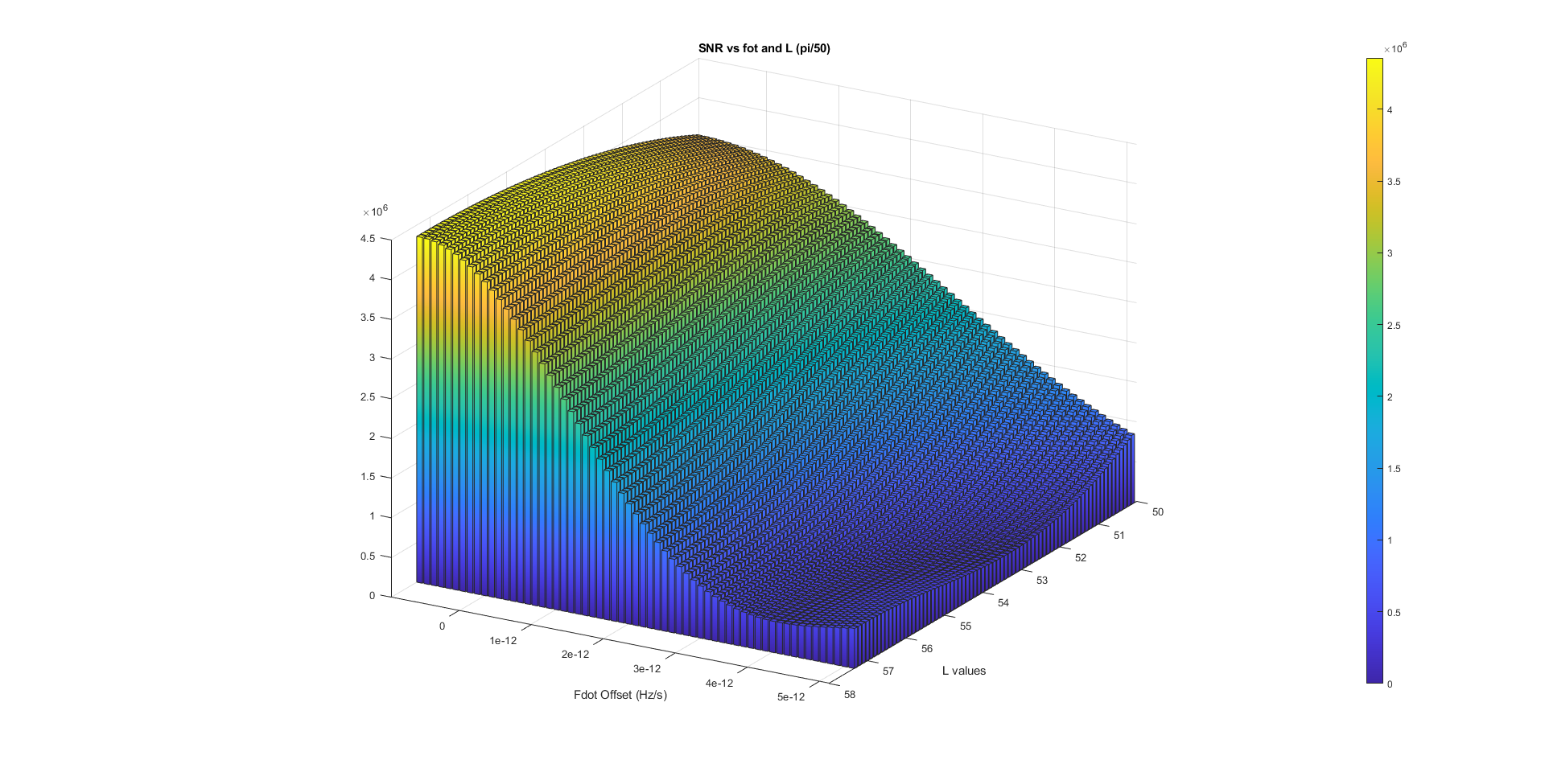
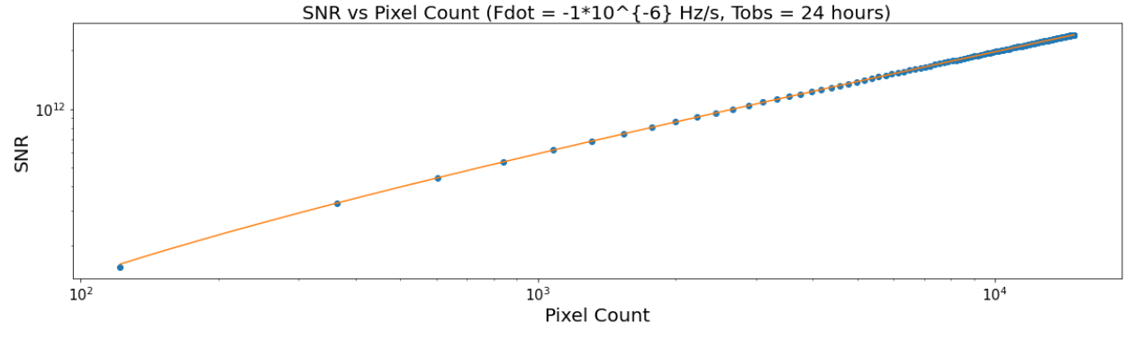
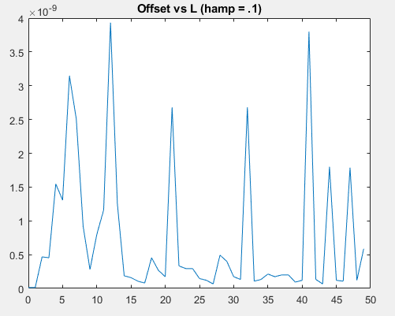
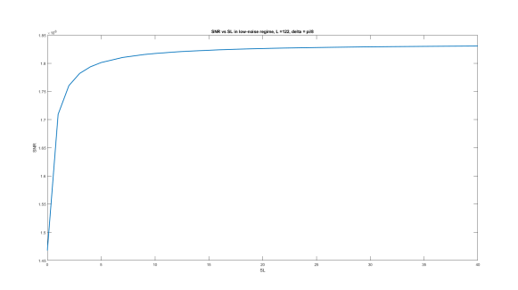
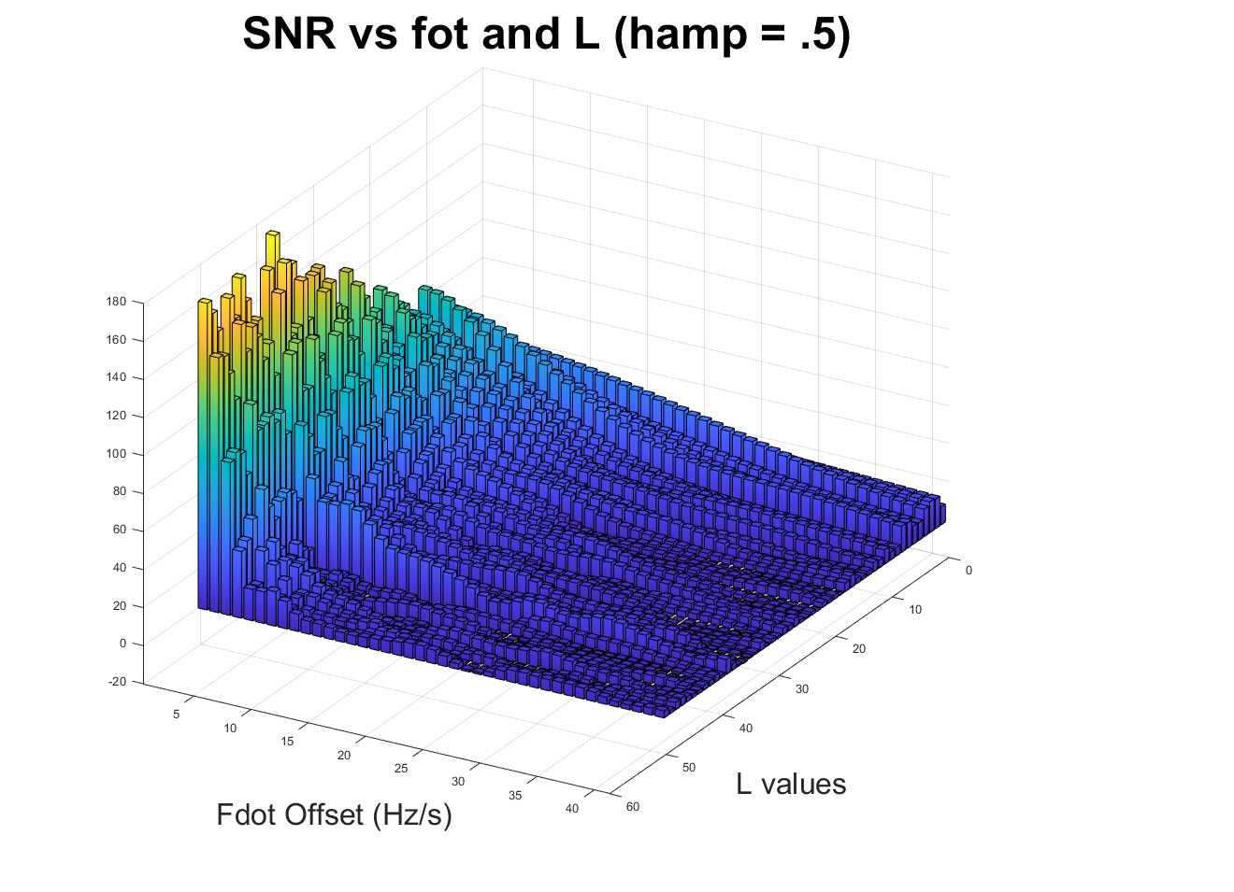
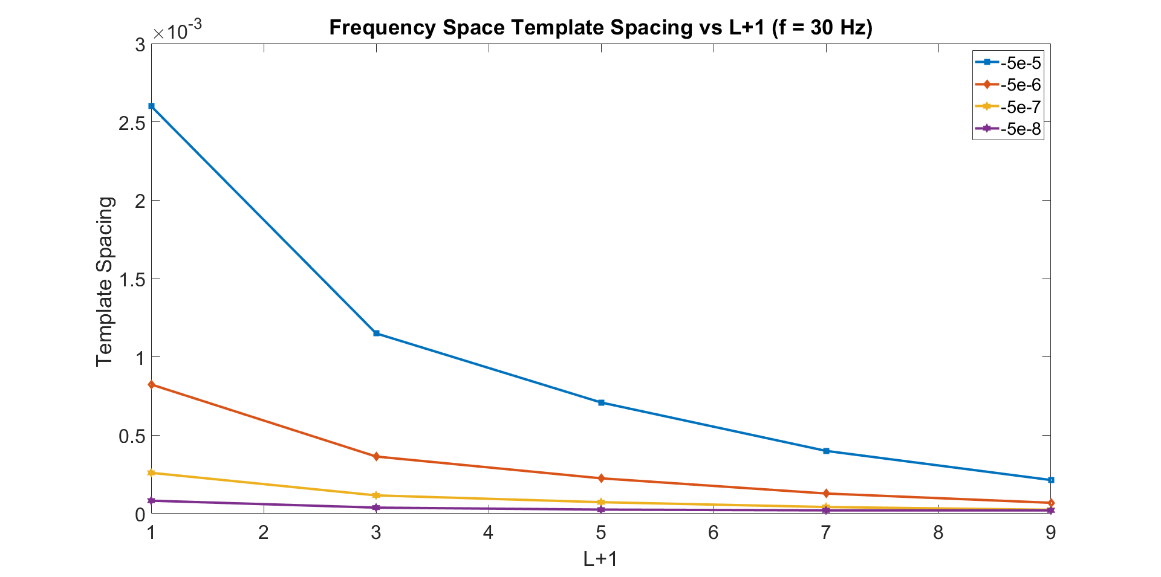
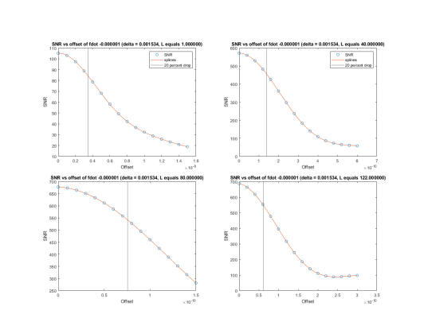
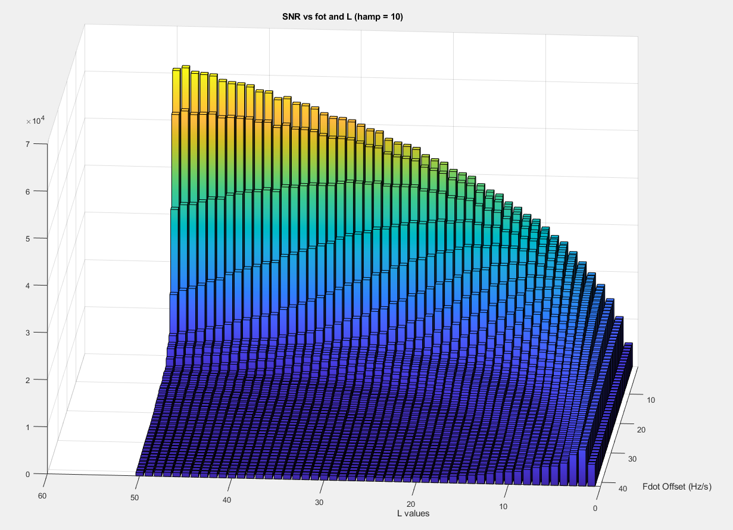
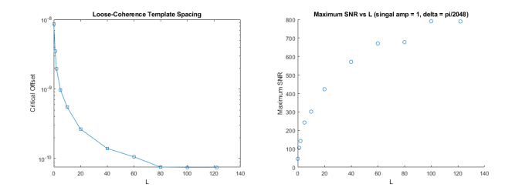
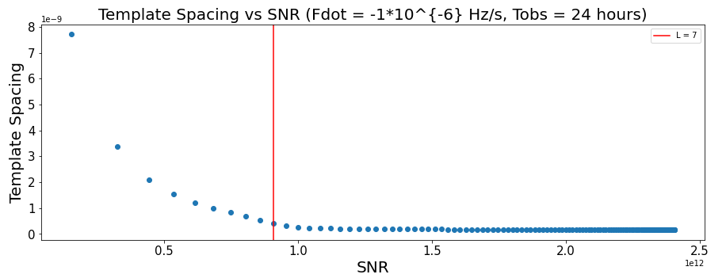
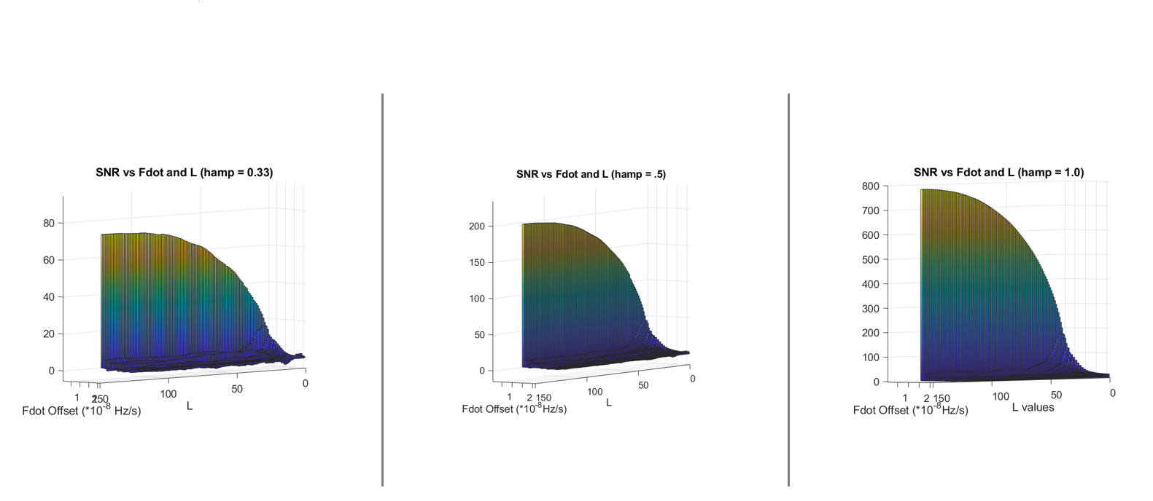
Notes:
Of course I have done a lot of other work to characterize the statistics of the simulation.

Slide 29

Loose Coherence!
Low Sensitivity,
Low Computational Cost
High Sensitivity,
High Computational Cost
Notes:
Sweep areas of parameter space and gradually increase the coherence time
“Hone in” on a signal

Slide 30
Loose Coherence!
Low Sensitivity,
Low Computational Cost
High Sensitivity,
High Computational Cost
Notes:
Sweep areas of parameter space and gradually increase the coherence time
“Hone in” on a signal

Slide 31




Questions?
Sources:
Searching for Continuous Gravitational Waves from Unknown Isolated Neutron Stars in Advanced LIGO Data. Sauter, 2018.
https://www.ligo.org/science/Publication-O1Noise/index.php
Abbott, B. P., Abbott, R., Abbott, T. D., et al. 2017, Phys. Rev. Lett., 119, 141101
Dergachev, V. 2010, Classical and Quantum Gravity, 27, 205017
Gittins, F., Andersson, N., & Jones, D. I. 2020, Monthly Notices of the Royal Astronomical Society, 500, 5570
Morales, J. A. & Horowitz, C. J. 2022, Monthly Notices of the Royal Astronomical Society, 517, 5610
Riles, K. 2023, Living Reviews in Relativity, 26, 3
B. P. Abbott et al. (LIGO Scientific Collaboration and Virgo Collaboration)
Phys. Rev. Lett. 116, 061102 – Published 11 February 2016

Slide 32
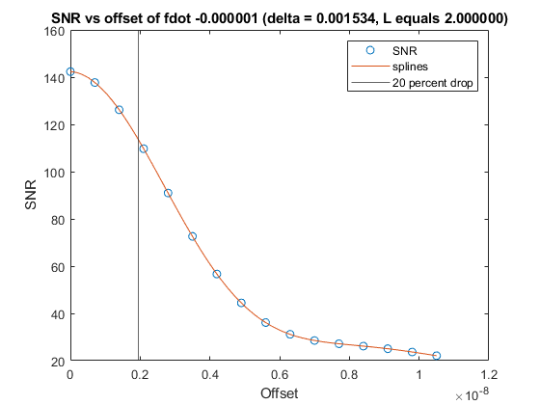
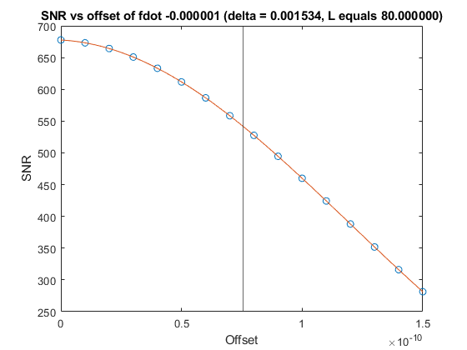
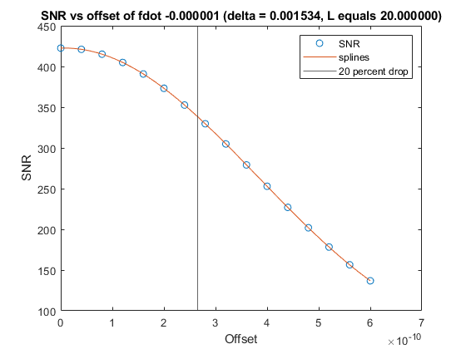
Characterizing Loosely-Coherent Searches

Slide 33
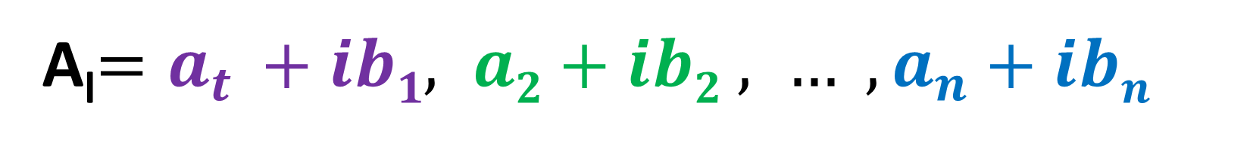
Choose pixels to analyze
A_{l}$=a_{t }+ib1, a2+ib2 , … , a_{n}+ibn$

Slide 34
Extract a Signal
Signal
Noise
Data
Template
Imag
Real
Notes:
Find out how much green is along yellow

Slide 35
Extract a Signal
Signal
Noise
Data
Template
Imag
Real
Notes:
Find out how much green is along yellow

Slide 36
The detection statistic
(1)
Total length² = how much signal
(2)
Notes:
This method is very good if you happen to guess the signal exactly right, but remember that our parameter space is over 10 orders of magnitude! So what if we de-emphasize some of the phasors that we are not sure about…

