Slide 1
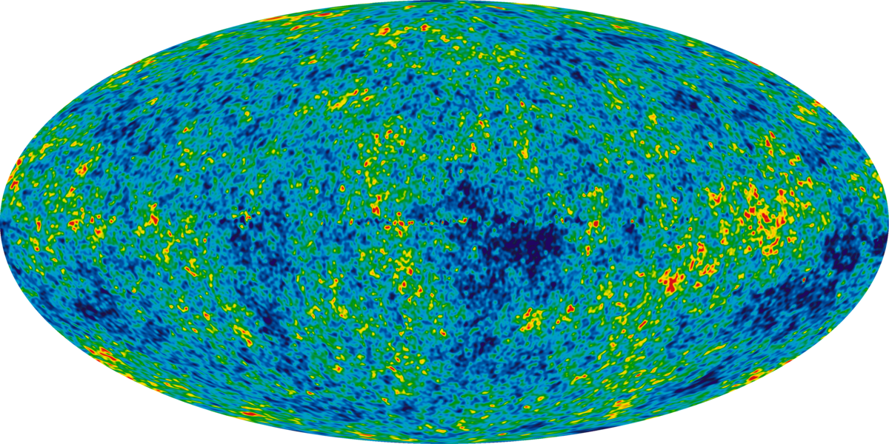
GWANW Meeting | June 11, 2025
1

Slide 2
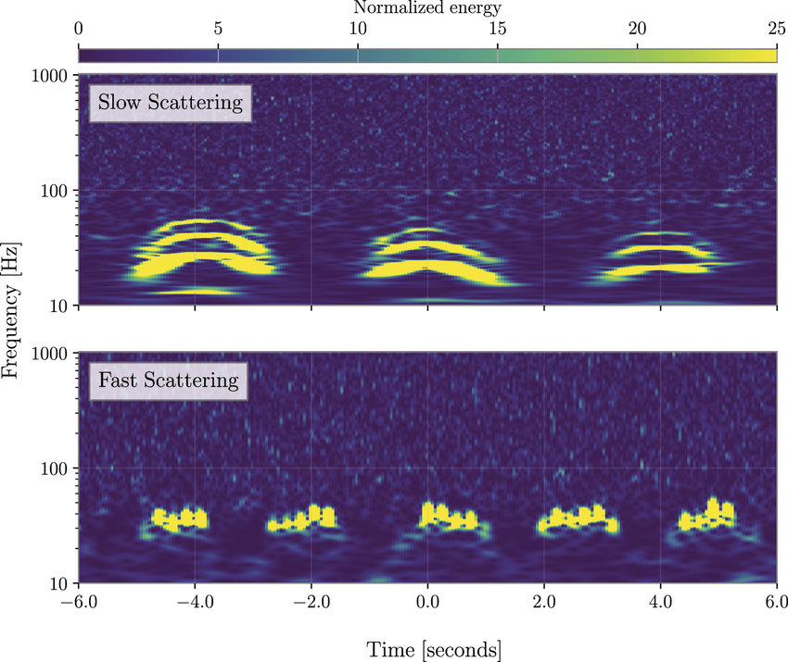
GWANW Meeting | June 11, 2025
2

Slide 3
Aislinn McCann,
Rhiannon Udall, Derek Davis
GWANW Meeting | June 11, 2025
1

Slide 4
Aislinn McCann,
Rhiannon Udall, Derek Davis
GWANW Meeting | June 11, 2025
1

Slide 5
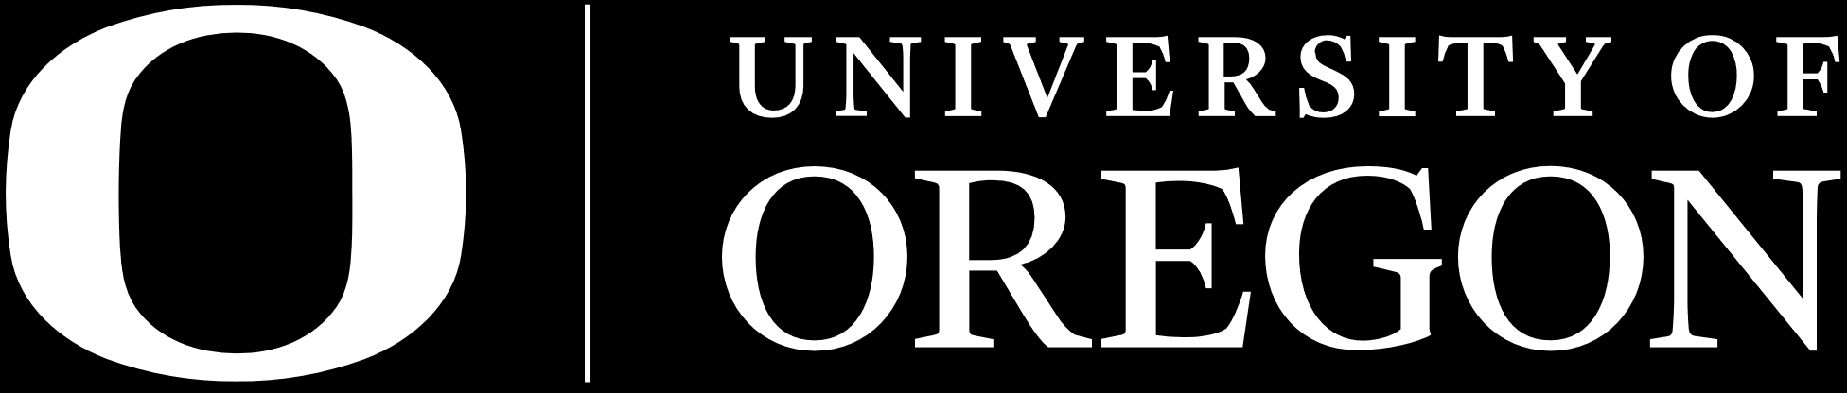



Modeling and Mitigating Fast Scattering Glitches with Bayesian Inference
Aislinn McCann,
Rhiannon Udall, Derek Davis
GWANW Meeting | June 11, 2025
1
NASA / WMAP

Slide 6
Modeling and Mitigating Fast Scattering Glitches with Bayesian Inference
Aislinn McCann,
Rhiannon Udall, Derek Davis
GWANW Meeting | June 11, 2025
1
Soni+ 2021

Slide 7
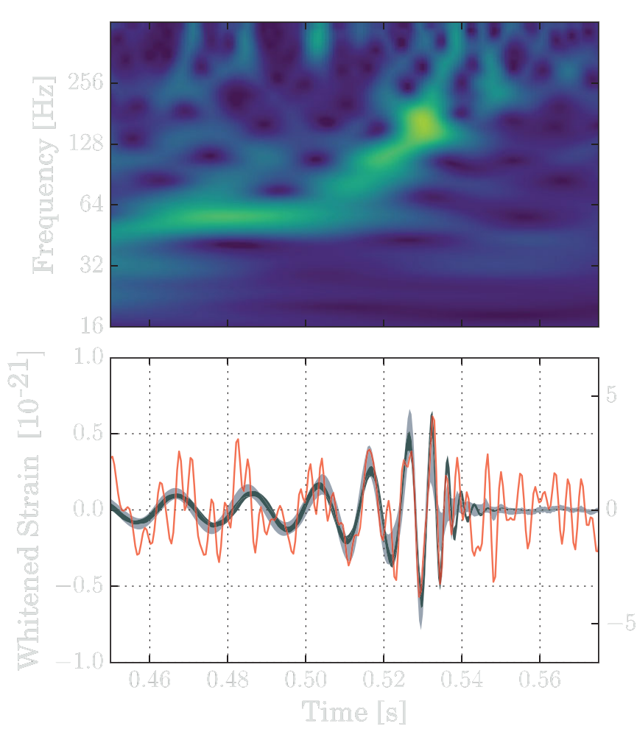
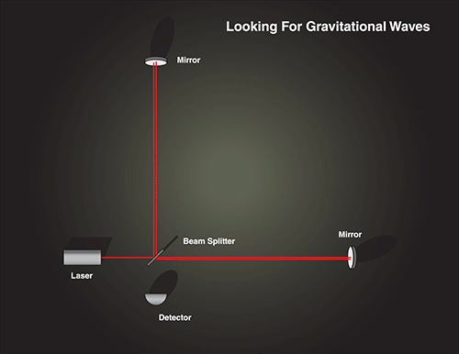
Background
Soni+ 2020
LIGO detector: Michelson interferometer with 2 Fabry-Perot arms
Gravitational wave (GW) passes through, slightly displaces each arm
Phase shift converted to measurable signal
GWs help us probe the universe in a new way and verify general relativity!
NASA 2020
Abbott+ 2017
7
Notes:
So, I’m going to start off by talking about what LIGO is. LIGO consists of two detectors in Hanford, Washington and Livingston, Louisiana. Each of them are giant Michelson interferometers, where a laser passing through a beam splitter is sent through two 4 kilometre Fabry-Perot interferometer arms and sent back. When a gravitational wave passes through a detector, it slightly displaces each arm. When the two beams join together again, they exhibit this displacement as well, which we call a phase shift. This phase shift is then picked up by the detector and converted to a measurable signal, which we see as something like these figures here. On the bottom is a representation of the strain caused as a GW passes through. This happens when, for example, two black holes orbit each other at a higher and higher frequency until they coalesce, called a compact binary coalescence. The evolution of the frequency over time is depicted in the top figure known as a spectrogram. GW astronomy allows us to study the history of the universe using a new medium of study than conventional astronomical means by collecting information on distant astrophysical sources and also verifying Einstein’s theory of general relativity!

Slide 8
Outline
Motivation
  What are glitches?
  Parameter estimation
Objectives
Approach
  Model derivation
  Model testing (waveforms)
  Model testing (itself)
    Parameter estimation
    P-P testing
  Model testing (hardware-injected events)
  Model testing (real events)
Conclusions

Slide 9
Outline
Motivation
What are glitches?
Parameter estimation
Objectives
Approach
Model derivation
Model testing (waveforms)
Model testing (itself)
Parameter estimation + injection
Model testing (hardware-injected events)
Model testing (real events)
Conclusions
P-P testing

Slide 10
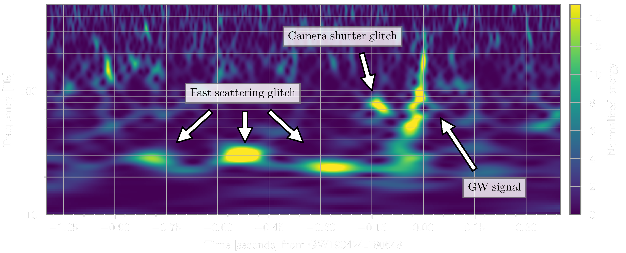
What are Glitches?
Soni+ 2020
Persistent, short-duration noise transients in LIGO detector data
  Environmental interference or electronic malfunction
Can overlap gravitational wave (GW) signals, prevent further analysis
Scattered light glitches: laser segments diverging from main beam path
  Reflect off surrounding instrumentation w/ different relative motion
  Rejoin main beam path and produce additional phase shift
Fast scattering (FS) produced by anthropogenic (1-5 Hz) and microseism (0.1-0.3 Hz) motion
Davis+ 2021
Notes:
So, what are glitches? Glitches are short duration noise transients seen in LIGO detector data and are caused by environmental interference or electronic malfunction. They’re a problem because they often overlap on top of gravitational wave signals and prevent further analysis. In particular, there’s one form of glitch we’re concerned about called scattered light glitches which happen when laser segments in the detector’s interferometer arms scatter off of tiny imperfections on the surfaces of the mirrors within. These segments bounce off surrounding surfaces of differing relative velocity and rejoin the main beam path, which produces an additional phase shift picked up by the detector. One of these scattered light glitches, known as fast scattering glitches, are the concern of this project. These glitches come from combined motion in the anthropogenic and microseismic bands, or human and oceanic activity.

Slide 11
What are Glitches?
Soni+ 2020
Persistent, short-duration noise transients in LIGO detector data
  Environmental interference or electronic malfunction
Can overlap gravitational wave (GW) signals, prevent further analysis
Davis+ 2021
Scattered light glitches: laser segments diverging from main beam path
  Reflect with different relative motion
  Rejoin and produce additional phase shift
Fast scattering (FS) produced by anthropogenic (1-5 Hz) and microseism (0.1-0.3 Hz) motion
Notes:
So, what are glitches? Glitches are short duration noise transients seen in LIGO detector data and are caused by environmental interference or electronic malfunction. They’re a problem because they often overlap on top of gravitational wave signals and prevent further analysis. In particular, there’s one form of glitch we’re concerned about called scattered light glitches which happen when laser segments in the detector’s interferometer arms scatter off of tiny imperfections on the surfaces of the mirrors within. These segments bounce off surrounding surfaces of differing relative velocity and rejoin the main beam path, which produces an additional phase shift picked up by the detector. One of these scattered light glitches, known as fast scattering glitches, are the concern of this project. These glitches come from combined motion in the anthropogenic and microseismic bands, or human and oceanic activity.

Slide 12

Parameter Estimation
Romero-Shaw+ 2020
Ashton+ 2019
Bayesian inference for CBC signals (or glitches!) - posterior probability distributions from prior knowledge
PE pipelines infer CBC posteriors using Bayes’ theorem:
Likelihood
Prior
$$p\left(θ | d,ℳ\right)=\frac{ℒ\left(d | θ,ℳ\right)π\left(θ | ℳ\right)}{𝒵(d|ℳ)}$$
(1)
Evidence
Given parameters $θ$, data $d$, and model $ℳ$
PE pipelines assume GW noise data is Gaussian and stationary
  Transient glitches are non-Gaussian – removal necessary to improve functionality of PE pipelines
4
Notes:
So, a lot of CBC analysis is done with parameter estimation pipelines, which may also be used to infer glitch parameters by injecting a custom model. A particularly popular PE pipeline which we used is Bilby, which employs Bayesian inference using Bayes’ theorem to infer the posterior probability distribution of the parameters in question given the data and a model hypothesis. Bayes’ theorem states that the parameter posteriors given the data d and model M is equal to the likelihood of measuring the data, assuming the source has some parameters with the model hypothesis, multiplied by the prior parameter distribution given the model, over the data evidence given the model. PE pipelines assume noise data is Gaussian and stationary. However, transient glitches are non-Gaussian in nature which contradicts the assumption that PE pipelines make. So, to improve their functionality, it’s especially necessary to remove these instances from LIGO data so that CBC events can be better analysed.

Slide 13
Objectives
Derive mathematical model to describe waveform of FS glitches
Test validity of model by:
  Generating sample FS waveforms
  Parameter estimations + injections w/ Bilby
Then, test model on:
  Artificial (more simple structure) FS instances
  Real (more complex structure) FS instances
Focus: mitigate instances of FS in GW data to improve CBC analysis in future observing runs
13

Slide 14
Objectives
Derive a mathematical model to describe waveform of FS glitches
Test validity of model by:
Generating sample FS waveforms
Parameter estimations + injections w/ Bilby
Model Validity
5

Slide 15
Objectives
Test validity of model by:
Then, test model on:
Generating sample FS waveforms
Parameter estimations + injections w/ Bilby
Model Validity
Artificial (more simple structure) FS instances
Real (more complex structure) FS instances
Tested Model
5

Slide 16
Objectives
Model Validity
Tested Model
5

Slide 17
Objectives
Test
Validate
Derive
Mitigate instances of FS in GW data to improve CBC analysis in future observing runs
5

Slide 18





Model Derivation
Tolley+ 2023
Udall+ 2022
$$h\left(t\right)=\overline{A}sin[\frac{4π}{λ}x\left(t\right)+φ]$$
Excess strain noise equation:
(2)
  $\overline{A}$: amplitude of noise produced by glitch from surface motion $x\left(t\right)$ w/ phase shift $φ$
  On assumption that reflecting surface is a simple harmonic oscillator:
$$x\left(t\right)=C_{1}\sin\left(f_{1}t\right)+C_{2}sin⁡(f_{2}t)$$
(3)
$C_{1}$ and $C_{2}$: amplitudes from driving frequencies $f_{1}$ and $f_{2}$
($d_{1}=C_{1}f_{1},d_{2}=C_{2}f_{2}, C_{1}f_{1}+C_{2}f_{2}=f_{max}$)
Therefore, we have our model:
$$h\left(t\right)=\overline{A}sin[\frac{d_{1}}{f_{1}}\sin\left(f_{1}t\right)+\frac{d_{2}}{f_{2}}\sin\left(f_{2}t\right)+φ]$$
(4)
6
Notes:
So, we started with the equation that describes the excess strain noise in GW data shown in Equation 2, where A bar is the amplitude of the noise produced by the glitch from the motion of the relevant surface x of t, with a phase shift phi. On the assumption that the reflecting surface is a simple harmonic oscillator, we use Equation 3 to describe the motion that comes from the two driving frequencies f1 and f2 with amplitudes C1 and C2. Combining both equation 2 and 3 and reparameterising C1 and C2 to depend on f1 and f2 based on a maximum frequency gives us equation 4, which generally describes a fast scattering glitch.

Slide 19

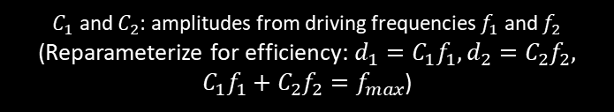
Model Derivation
Tolley+ 2023
Udall+ 2022
$$h\left(t\right)=\overline{A}sin[\frac{4π}{λ}x\left(t\right)+φ]$$
Excess strain noise equation:
(2)
  $\overline{A}$: amplitude of noise produced by glitch from surface motion $x\left(t\right)$ w/ phase shift $φ$
  We assume that reflecting surface is a simple harmonic oscillator:
$$x\left(t\right)=C_{1}\sin\left(f_{1}t\right)+C_{2}sin⁡(f_{2}t)$$
(3)
$C_{1}$ and $C_{2}$: amplitudes from driving frequencies $f_{1}$ and $f_{2}$
(Reparameterize for efficiency: $d_{1}=C_{1}f_{1},d_{2}=C_{2}f_{2}, C_{1}f_{1}+C_{2}f_{2}=f_{max}$)
Therefore, we have our model:
$$h\left(t\right)=\overline{A}sin[\frac{d_{1}}{f_{1}}\sin\left(f_{1}t\right)+\frac{d_{2}}{f_{2}}\sin\left(f_{2}t\right)+φ]$$
(4)
6
Notes:
So, we started with the equation that describes the excess strain noise in GW data shown in Equation 2, where A bar is the amplitude of the noise produced by the glitch from the motion of the relevant surface x of t, with a phase shift phi. On the assumption that the reflecting surface is a simple harmonic oscillator, we use Equation 3 to describe the motion that comes from the two driving frequencies f1 and f2 with amplitudes C1 and C2. Combining both equation 2 and 3 and reparameterising C1 and C2 to depend on f1 and f2 based on a maximum frequency gives us equation 4, which generally describes a fast scattering glitch.

Slide 20
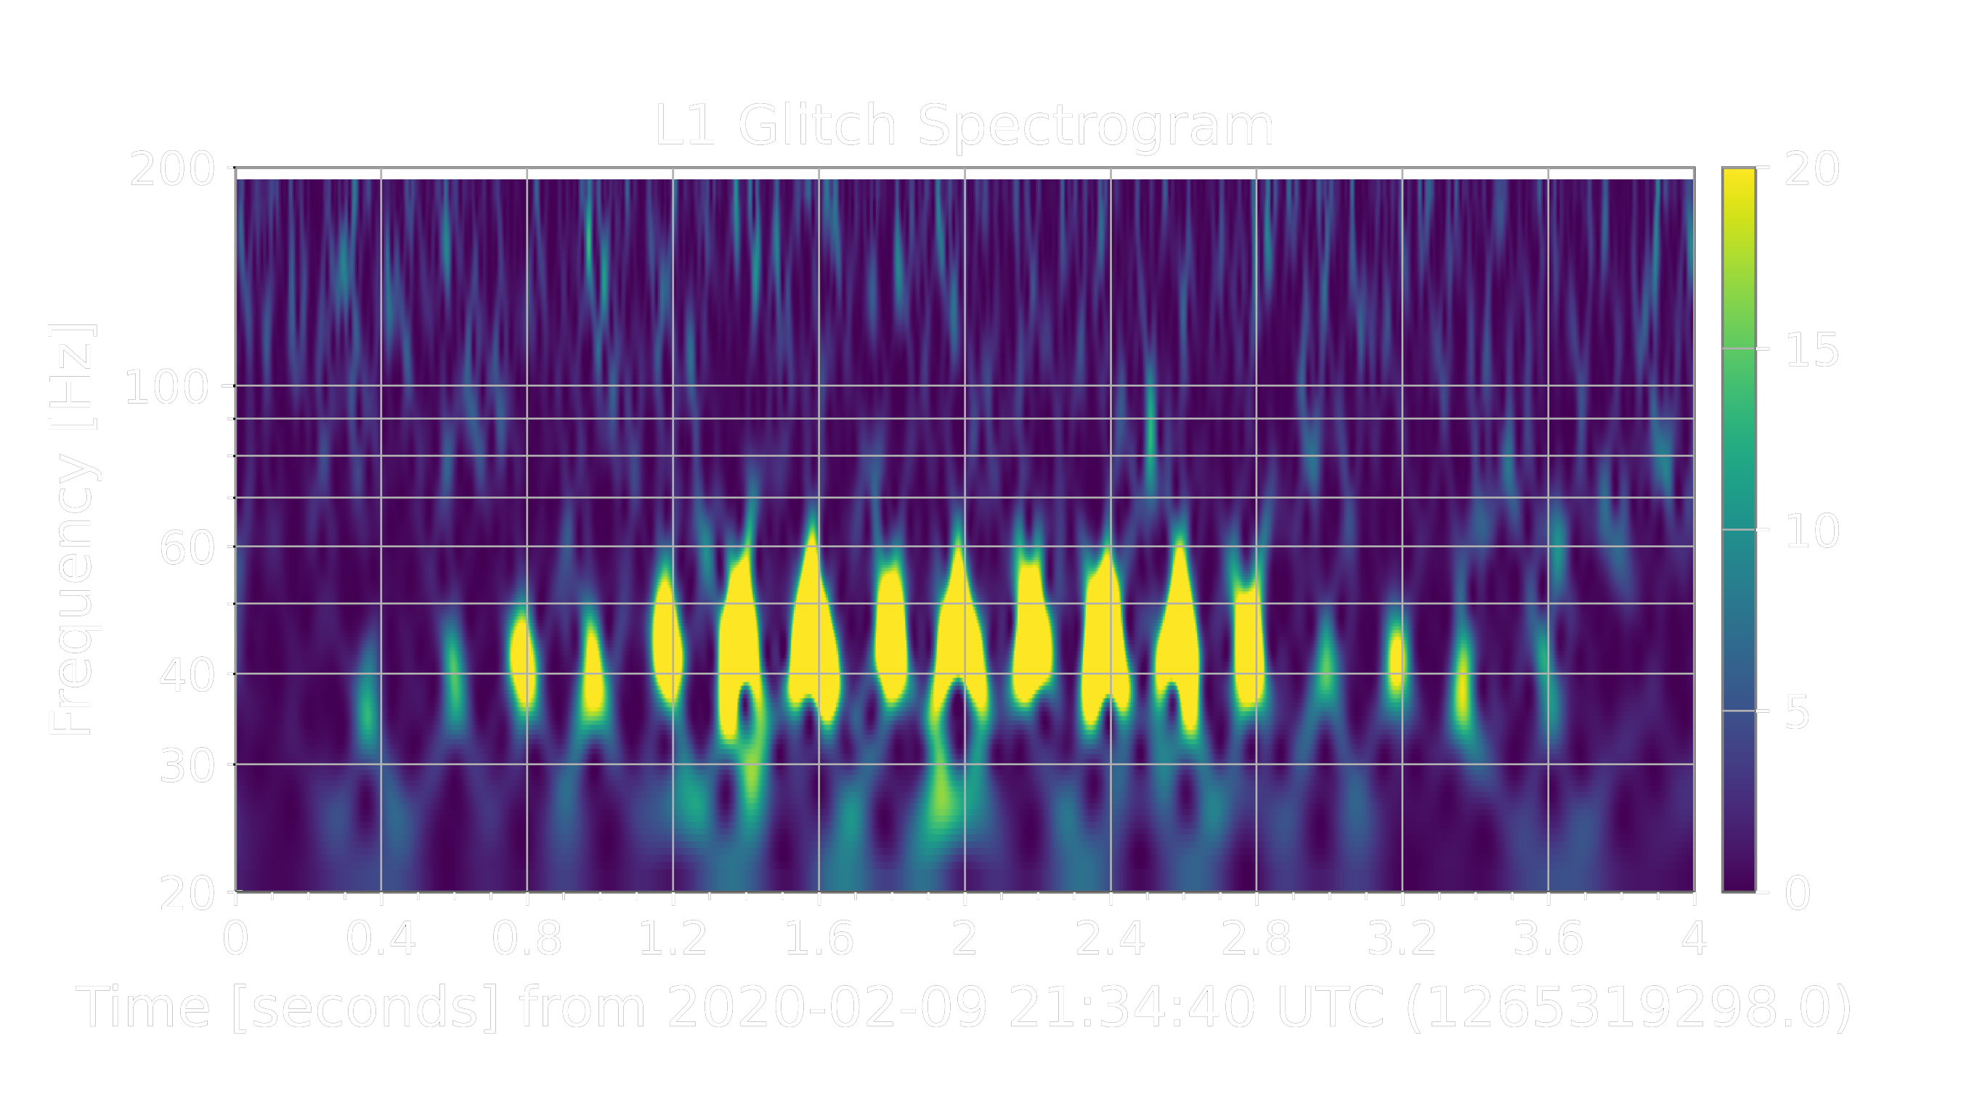
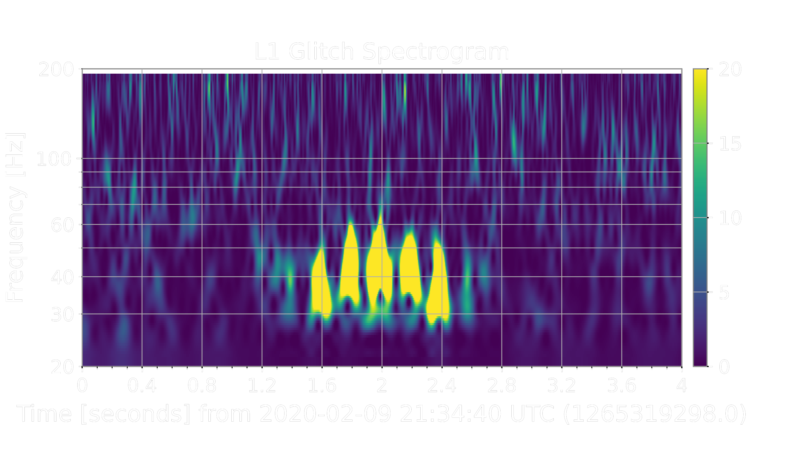
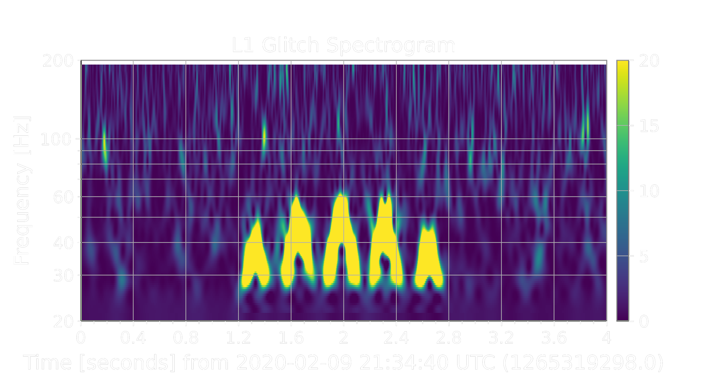
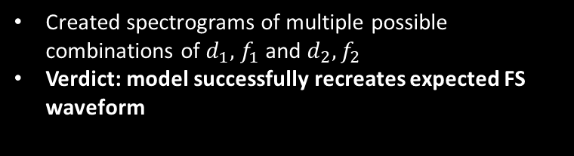
Generating Waveforms
Created spectrograms of multiple possible combinations of $d_{1},{ f}_{1}$ and $d_{2}{,f}_{2}$
Verdict: model successfully recreates expected FS waveform
7
Notes:
So, our first order of business was to pick values for each of our parameters in the model we derived that agreed with our constraints and pretty much play around with the values to see how well they depict the fast scattering seen in detector data. Each of these three spectrograms corresponds to different possible combinations of each of the four parameters d1, f1, d2, and f2. We found that the model successfully recreates the expected waveform characteristic of fast scattering, so we moved onto our next tests which were done using Bilby.

Slide 21
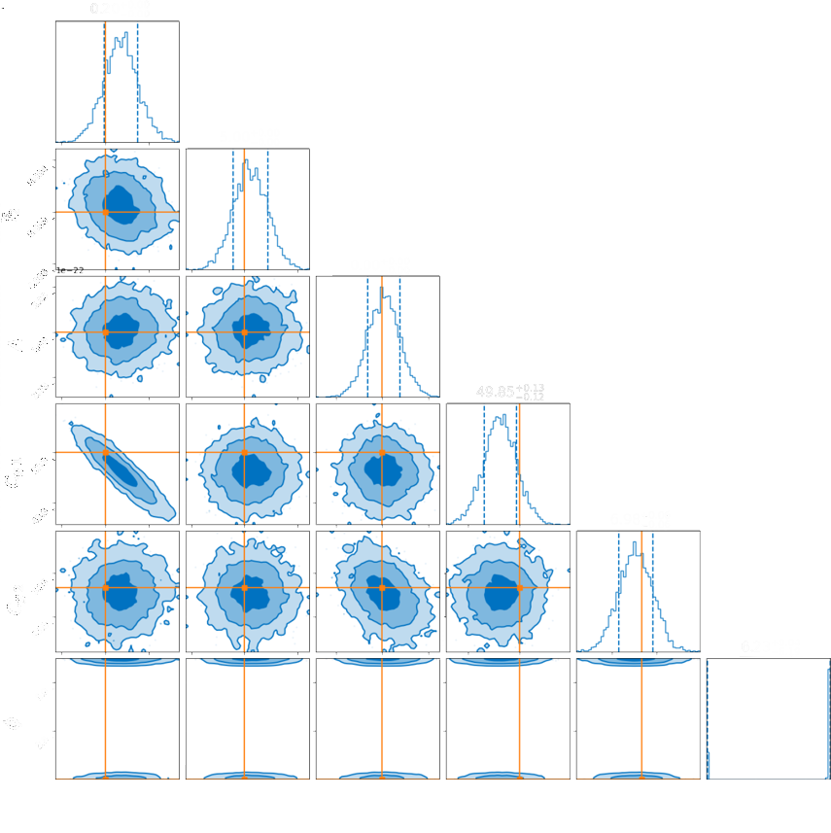
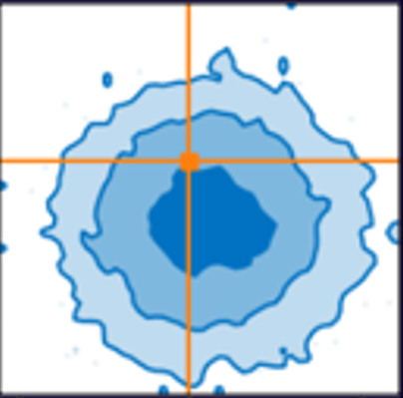
Parameter Estimation + Injection
8
Notes:
So, after you feed a model and priors through Bilby, it’ll churn out something called a corner plot, which describes the posterior probability densities of each parameter in the model using a Gaussian curve and probability maps. This is depicted in the figure here, which generally shows where the value of each parameter lies with respect to another, where the darkest areas are the greatest probability regions and the lightest regions are the least probable regions. Our injected values, shown by the orange dots and lines, lie pretty close to the greatest probability density regions, which tells us that our model can accurately perform parameter estimation, at least on itself. So, we move onto actual events!

Slide 22
Parameter Estimation + Injection
Corner plots show probability densities of parameter values
Dark regions: most probable
Light regions: least probable
Injected parameters lie within greatest probability density regions
Verdict: model testing on itself successful!
8
Notes:
So, after you feed a model and priors through Bilby, it’ll churn out something called a corner plot, which describes the posterior probability densities of each parameter in the model using a Gaussian curve and probability maps. This is depicted in the figure here, which generally shows where the value of each parameter lies with respect to another, where the darkest areas are the greatest probability regions and the lightest regions are the least probable regions. Our injected values, shown by the orange dots and lines, lie pretty close to the greatest probability density regions, which tells us that our model can accurately perform parameter estimation, at least on itself. So, we move onto actual events!

Slide 23
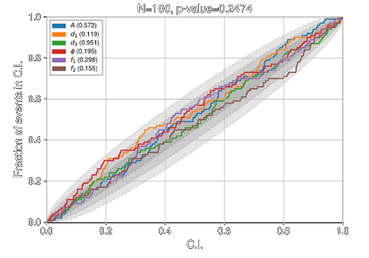
P-P Testing (no not that kind)
How well sampler produces parameters in credible intervals (CI)
Correct value in 10% CI 10% of time, etc. (should follow linear trend if unbiased)
Dark regions: high credibility
Light regions: low credibility
Verdict: model testing on itself successful!
9
Notes:
We performed PP testing on our model’s parameters over 100 samples to essentially see how well our model describes itself. For PP tests, the correct value for a parameter should lie in the 10% credible interval 10% of the time, the 20% credible interval 20% of the time, and so on. This would follow a linear trend given that the parameters are unbiased. A biased result would show a deviation from this diagonal, which is minimal for our PP test and indicates that our model passed.
On the right is a corner plot that describes the posterior probability densities of each parameter in our model, which generally shows where the value of each parameter lies with respect to another. Our injected values, shown by the orange dots and lines, lie pretty close to the greatest probability density regions, which tells us that our model is able to accurately perform parameter estimation, at least on itself. So, we move on from self-testing onto actual events!
CREDIBLE INTERVAL (Bayesian results), not confidence interval (Frequentist results)

Slide 24
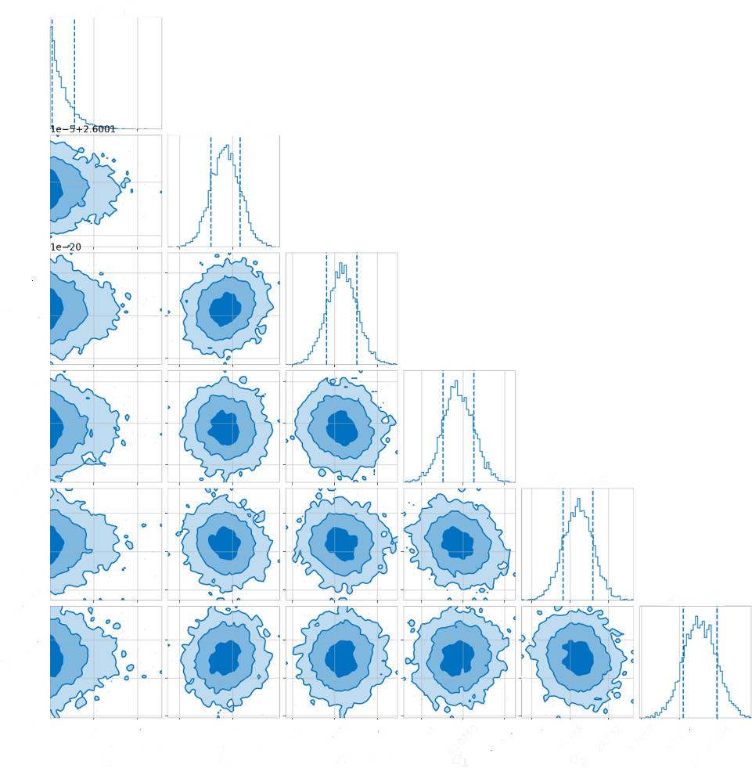
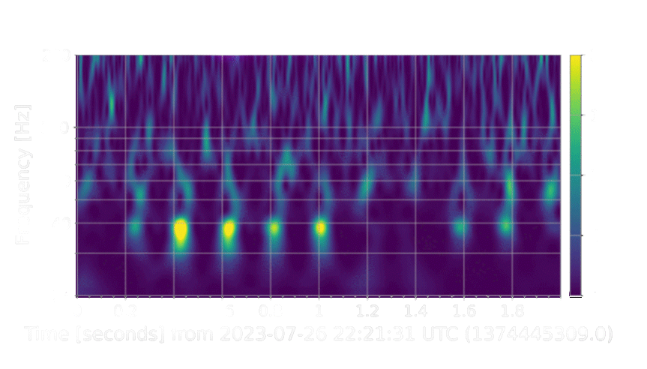
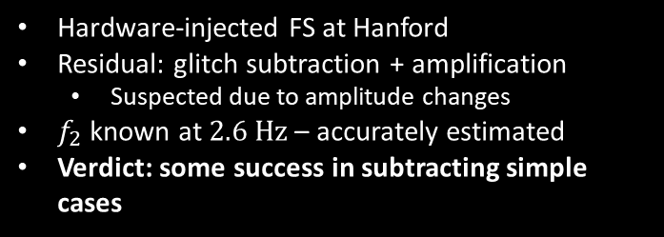
Model Testing: Hardware-Injected Events
Hardware-injected FS at Hanford
Residual: glitch subtraction + amplification
  Suspected due to amplitude changes
$f_{2}$ known at $2.6 Hz$ – accurately estimated
Verdict: some success in subtracting simple cases
10
Notes:
Our first actual event test was on a hardware injection of fast scattering glitches, which as you can see have a pretty uniform structure with their even spacing. Subtracting the actual data from our model yielded a residual with glitch subtraction in some places, but amplification in others. We think this may be due to changes in the injection’s amplitude over time. On the left, I want to draw your attention to how well our model does in estimating f2. The hardware injected fast scattering happens with a mass that is shook at a frequency of 2.6 Hz, which, as you can see for f2, was estimated pretty accurately in Bilby. So, all in all, our model did a decent job with this simple fast scattering case.
Hardware injected: take a large mass and shake it at 2.6 Hz which shakes the detector. Shaker injection

Slide 25
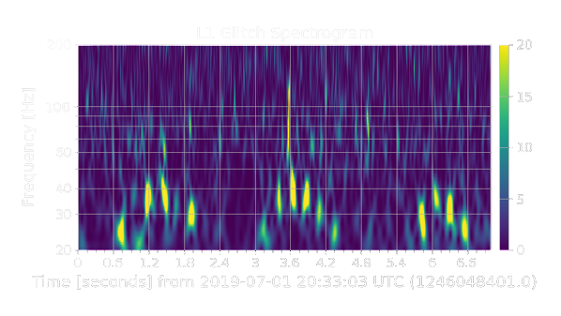
Real Events (GW190701)
Tested model capabilities for FS mitigation in GW event example at Livingston (L1)
Both on-GW and off-GW cases
GW190701
FS
Off-GW
On-GW
11
Notes:
We then moved onto an actual GW event called GW190701 with instances of fast scattering overlapping on top of the merger to test the model’s capabilities in this case. We did this analysis on a fast scattering arch that happened both on and off the merger, which are each boxed.

Slide 26
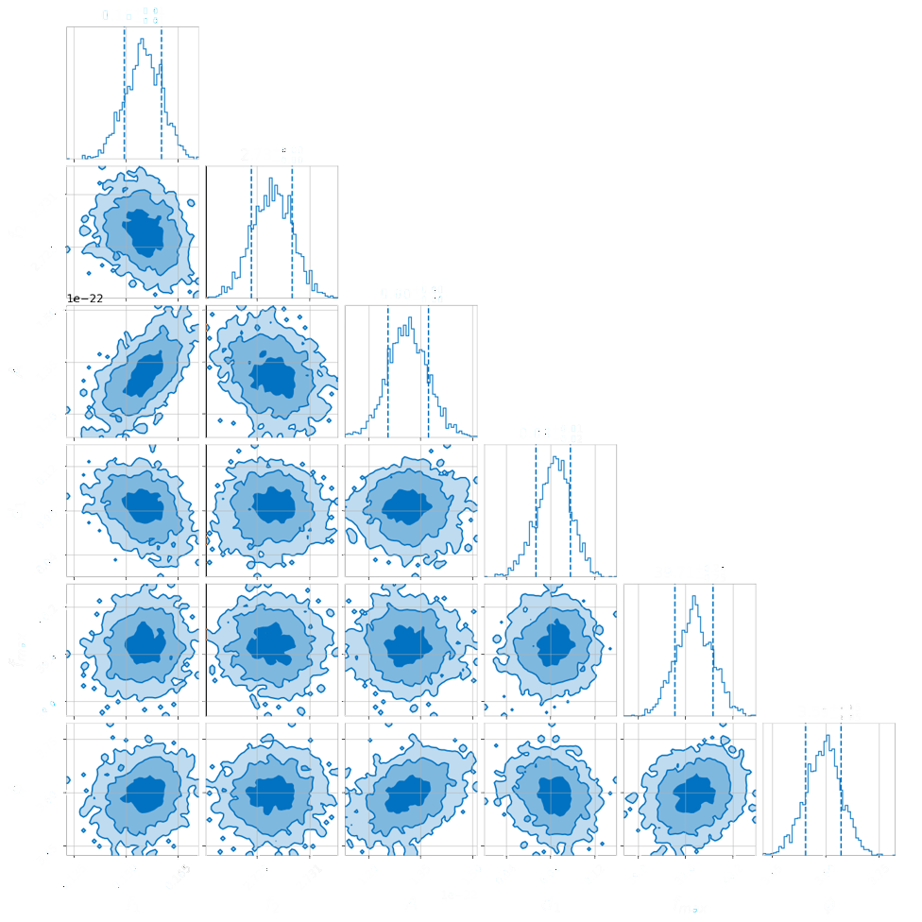
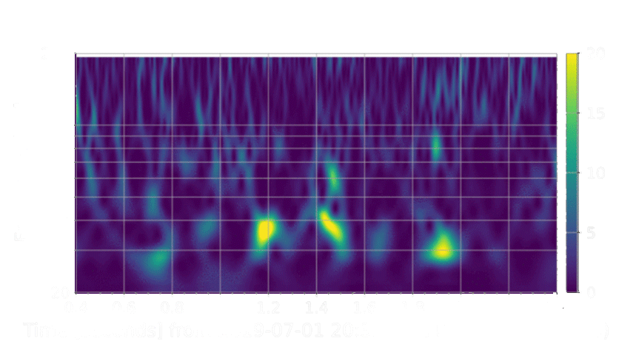
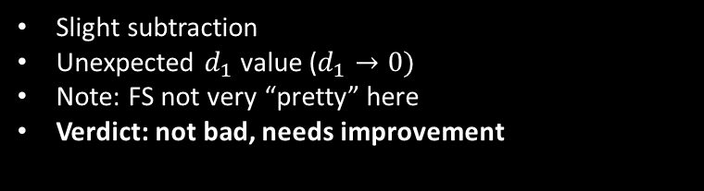
Real Events (GW190701 off-GW)
Slight subtraction
Unexpected $d_{1}$ value ($d_{1}→0)$
Note: FS not very “pretty” here
Verdict: not bad, needs improvement
12
Notes:
Starting with the off GW case, we see that there is some slight subtraction happening in our residual spectrogram, but only for the glitch within the 20-30 hz frequency range. Our corner plot yielded an unexpected d1 value, implying that it lies close to zero. The fast scattering happening for the off-GW case is not very pretty in this segment, being that the blobs are pretty non-uniform and don’t occur at equal time intervals, so our model had a bit of a hard time compensating for that. All in all, it’s not bad but it needs improvement

Slide 27
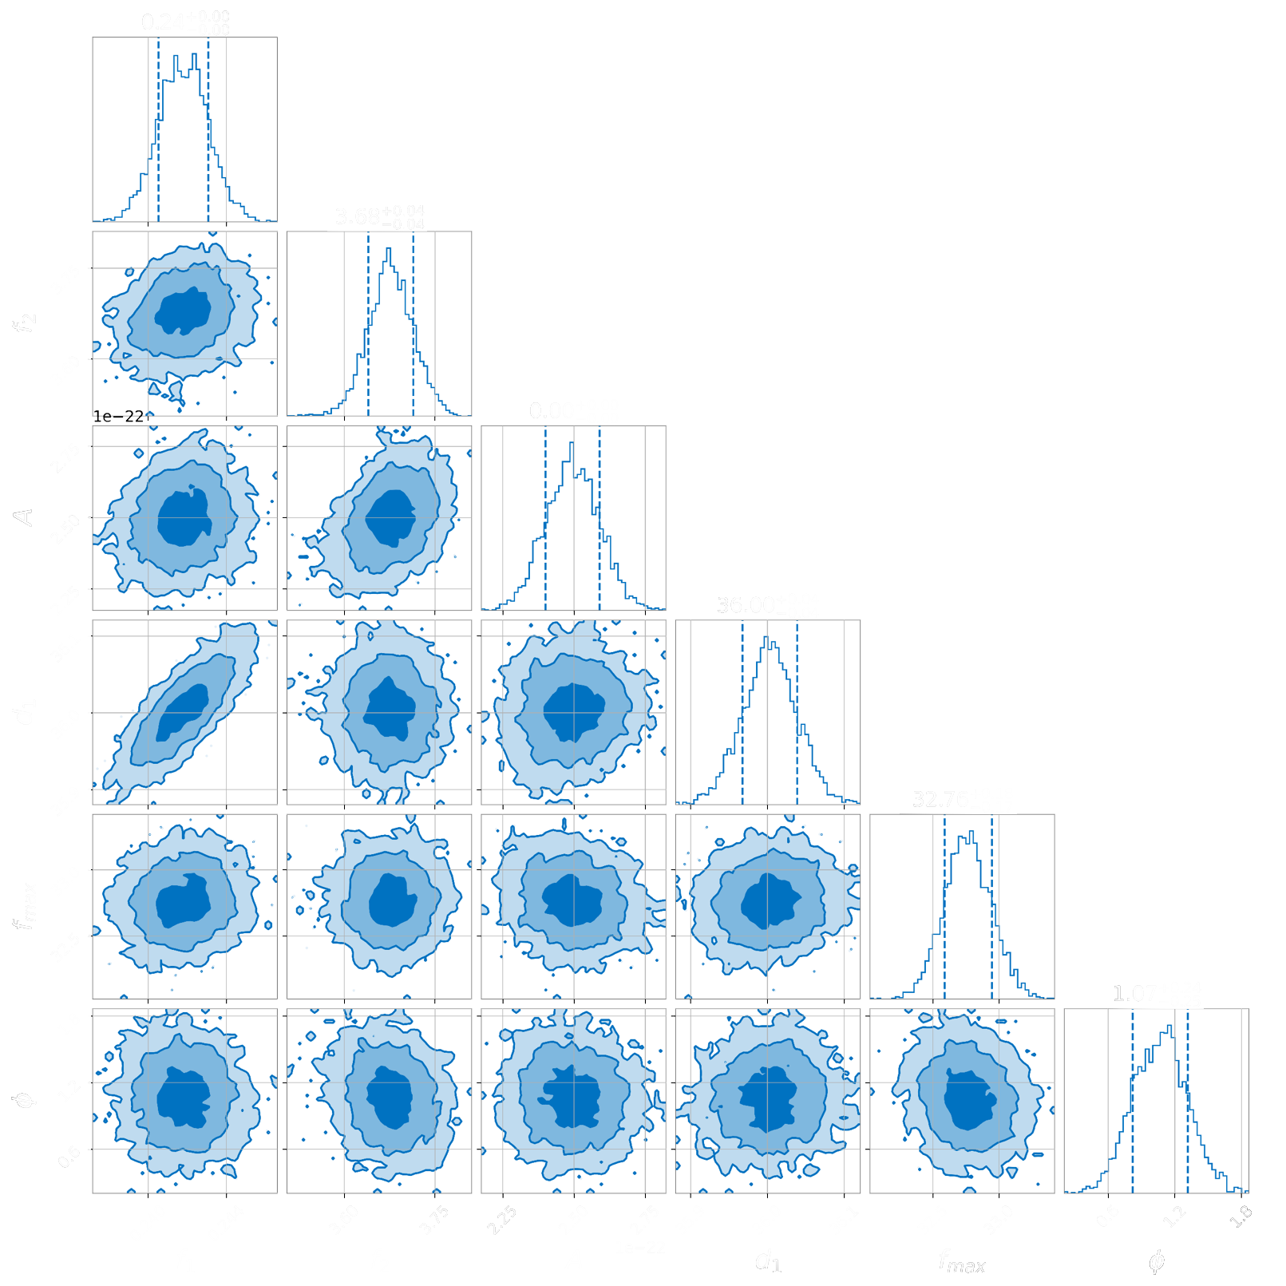
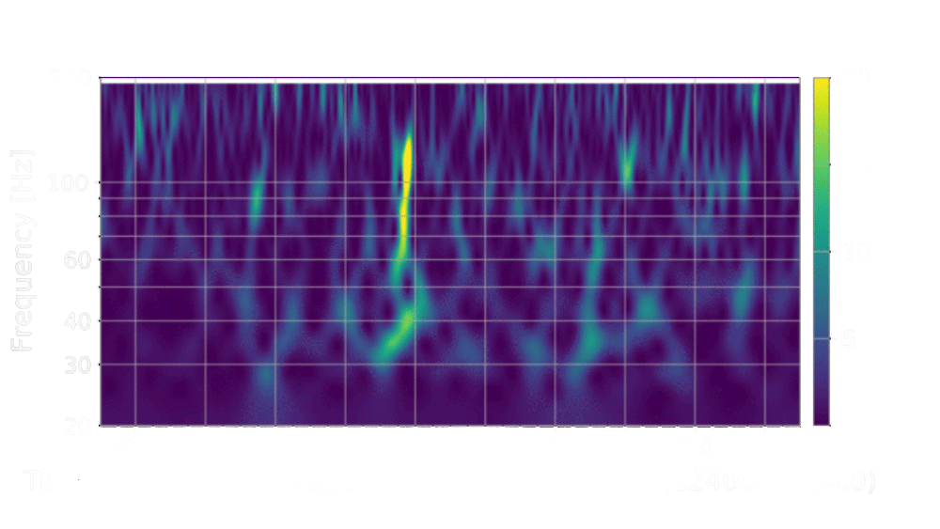
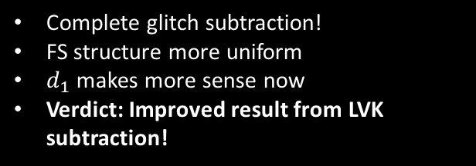
Real Events (GW190701 on-GW)
Complete glitch subtraction!
FS structure more uniform
$d_{1}$ makes more sense now
Verdict: Improved result from LVK subtraction!
13
Notes:
And here is the on GW case. In the residual the glitch is completely subtracted, leaving only the merger, which was pretty exciting to see! In the corner plot, we saw that the value for d1 makes a lot more sense than our previous result. Because the structure for the fast scattering glitch is a lot prettier and more uniform than the previous case, the model does a lot better in its subtraction. So, the model performed flawlessly and actually yielded an improved result from a LIGO-Virgo-Kagra collaboration paper, which shows great potential for our model to become a reliable method for fast scattering glitch mitigations in future GW observing runs.
Gaussian in corner plots implies that parameters are linearly correlated, even though they don’t really look like they would be in our model. Because we set our priors to zero in on a small space around the correct answer – basically a fisher matrix. How the parameters vary with each other

Slide 28
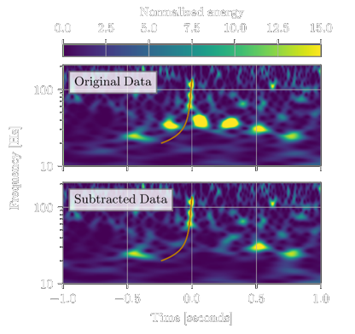
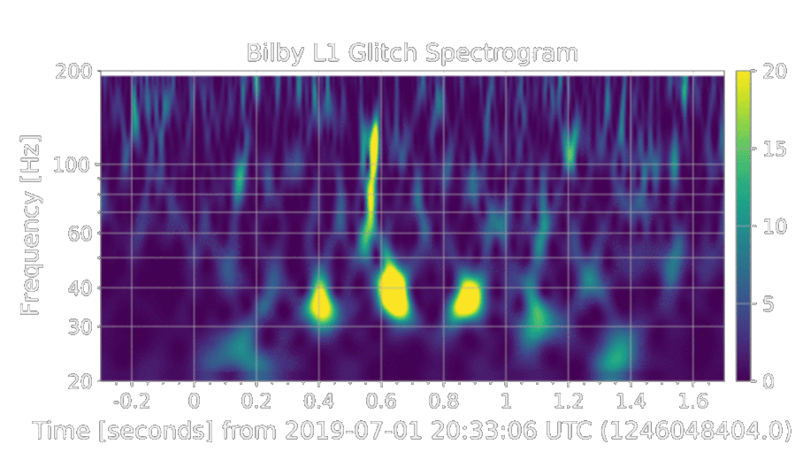
Real Events (GW190701 on-GW)
Abbott+ 2021
LVK result
Our result!
14
Notes:
So, here’s a preview of our big result that we achieved this summer! We were able to successfully subtract an instance of fast scattering from on top of a CBC merger, which was done previously in an LVK paper. As you can see, there are still some sub-arches present after LVK mitigation efforts in the spectrograms seen on the left. In the right spectrogram, you can see that our model performed beyond this and completely removed the fast scattering arch as a whole, leaving only the CBC merger. We just achieved this result yesterday so it was a really great way to end the summer!

Slide 29
Conclusions
Summary
Model performs well with self-tests
Challenges
Model struggles with more complex and less predictable FS
Success in mitigating simpler, uniform FS structures (including on mergers)
Might need future revision or testing
15

Slide 30
Acknowledgements
My LIGO SURF mentors Rhiannon Udall and Derek Davis
Caltech LIGO Lab
LIGO SURF Program
National Science Foundation
Thank you!
16

Slide 31



Model Derivation
FS characterised by peak frequency at $\sim 50 Hz$ ($f_{max}$)
  At $f_{max}$, Eqn (4) is described by:
$$C_{1}f_{1}+C_{2}f_{2}=f_{max}$$
(5)
Reparameterising model for efficiency ($d_{1}=C_{1}f_{1},d_{2}=C_{2}f_{2}$):
$$h\left(t\right)=\overline{A}sin[\frac{d_{1}}{f_{1}}\sin\left(f_{1}t\right)+\frac{d_{2}}{f_{2}}\sin\left(f_{2}t\right)+φ]$$
(6)
Notes:
So, we have constraints already mentioned for our two driving frequencies, so we then needed to constrain the two amplitudes with respect to these possible values. Various examples of fast scattering seen in gravitational wave data showed that fast scattering is very well characterised by a peak frequency at around 50 Hz, which we set as a guideline by introducing fmax into our model. Equation 4 yields then that the sum of C1 times f1 and C2 times f2 is equal to fmax, a relation we used to determine the values for C1 and C2. We then reparameterised our model to make it more efficient, calling C1 times f1 and C2 times f2 d1 and d2 respectively.

Slide 32
References
Soni, S., Austin, C., Effler, A., Schofield, R. M. S., González, G., Frolov, V. V., ... & Ryan, K. (2020). Reducing scattered light in LIGO’s third observing run. Classical and Quantum Gravity, 38(2), 025016.
Davis, D., & Walker, M. (2022). Detector characterization and mitigation of noise in ground-based gravitational-wave interferometers. Galaxies, 10(1), 12.
Udall, R. P., & Davis, D. (2023). Bayesian modeling of scattered light in the LIGO interferometers. Applied Physics Letters, 122(9).
Tolley, A. E., Davies, G. S. C., Harry, I. W., & Lundgren, A. P. (2023). ArchEnemy: Removing scattered-light glitches from gravitational wave data. arXiv preprint arXiv:2301.10491.
Ashton, G., Hübner, M., Lasky, P. D., Talbot, C., Ackley, K., Biscoveanu, S., ... & Thrane, E. (2019). BILBY: A user-friendly Bayesian inference library for gravitational-wave astronomy. The Astrophysical Journal Supplement Series, 241(2), 27.
Romero-Shaw, I. M., Talbot, C., Biscoveanu, S., D’emilio, V., Ashton, G., Berry, C. P. L., ... & Xiao, L. (2020). Bayesian inference for compact binary coalescences with bilby: validation and application to the first LIGO–Virgo gravitational-wave transient catalogue. Monthly Notices of the Royal Astronomical Society, 499(3), 3295-3319.

