Slide 1
LIGO – What goes into a GW detector
Dr. Jennie Wright
June 10th, 2025
DCC: LIGO-G2501210-v3

Slide 2
Optical Systems

Slide 3
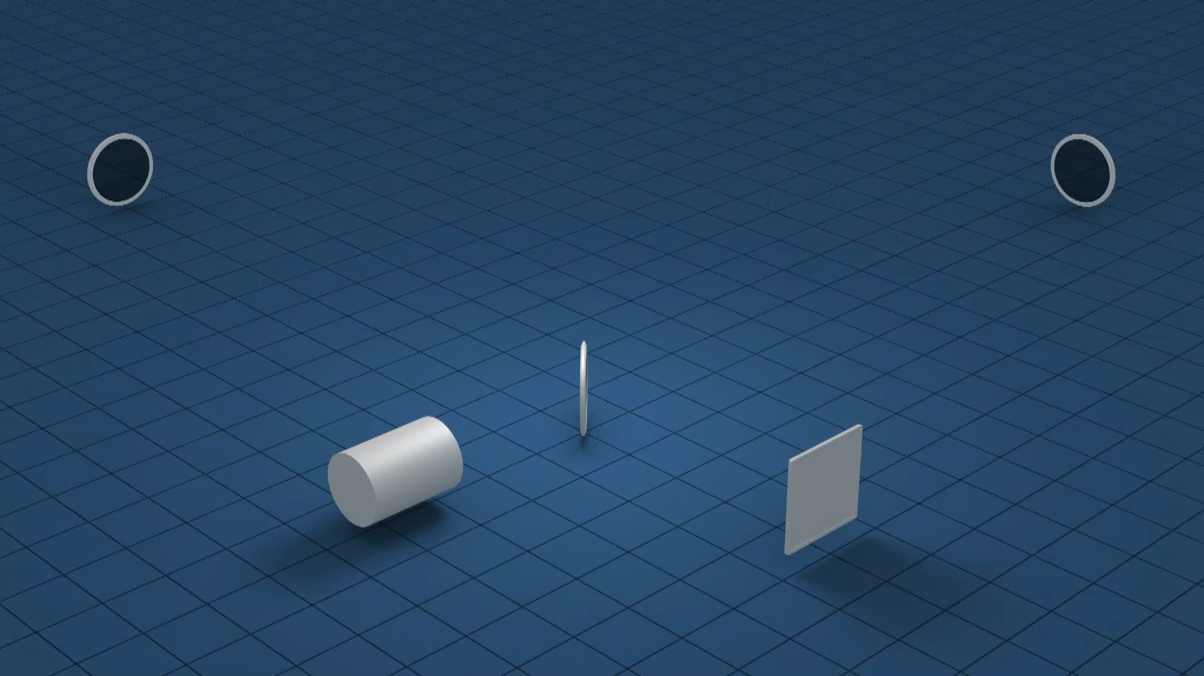
Michelson Interferometer
Top level text
  First bullet
  Sub-bullet
  B
  B
  b

Slide 4
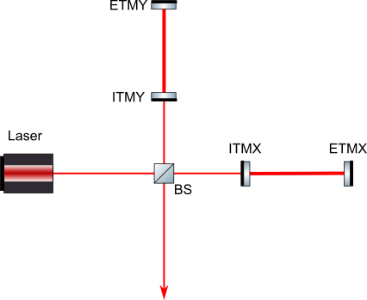
Add Arm Cavities
Increase light travel time
  Mirrors added are called ‘input test masses’.
    Create resonant optical cavities.
    Light trapped between two mirrors.
    Equivalent to making arms longer -> smaller strain detectable.
Simplified Michelson with Arm Cavities

Slide 5
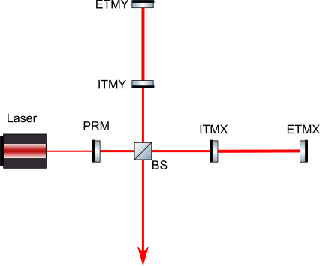

Add Arm Cavities
Increase input power
  Quantum Shot Noise
    SNR = $\sqrt{n}$
    More photons, higher SNR
  Technical limits to laser power.
  Add mirror between ITMs and Laser.
    Light builds up to higher power inside interferometer.
Power Recycled Michelson

Slide 6
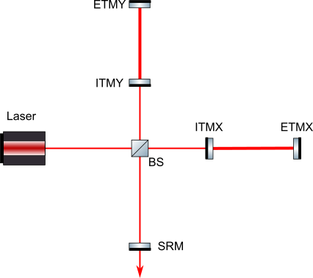
Add Signal Extraction
Extracts GW signal
  Original beam circulates back into interferometer but signal is extracted from IFO.
  Broadens frequency sensitivity of IFO.
Adds mirror before output.
Dual-Recycled Michelson

Slide 7
Mechanical Systems

Slide 8
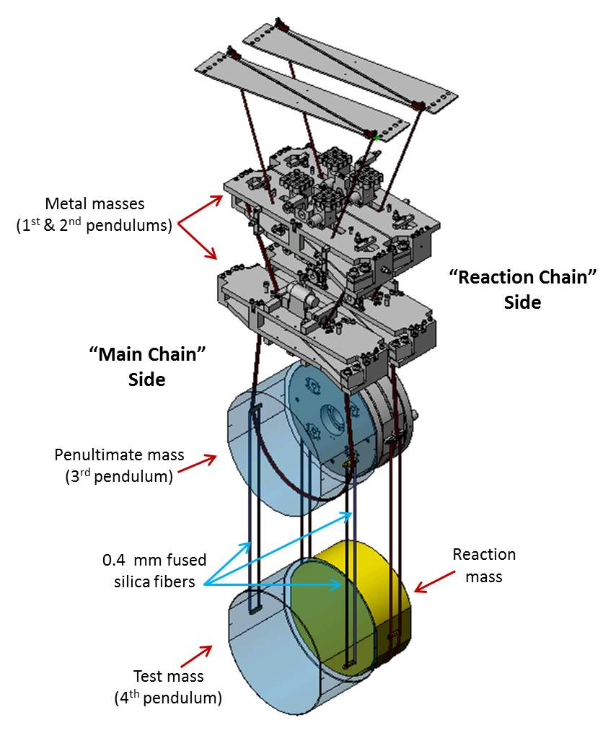
Suspensions
End mirrors must be in free-fall
  Can achieve in horizontal direction.
  Use Mirror Suspensions.
  Provide isolation above resonance.
Cascaded Suspension stages
  Give extra noise filtering above resonance.
Credit: IGR, University of Glasgow / LIGO Lab

Slide 9
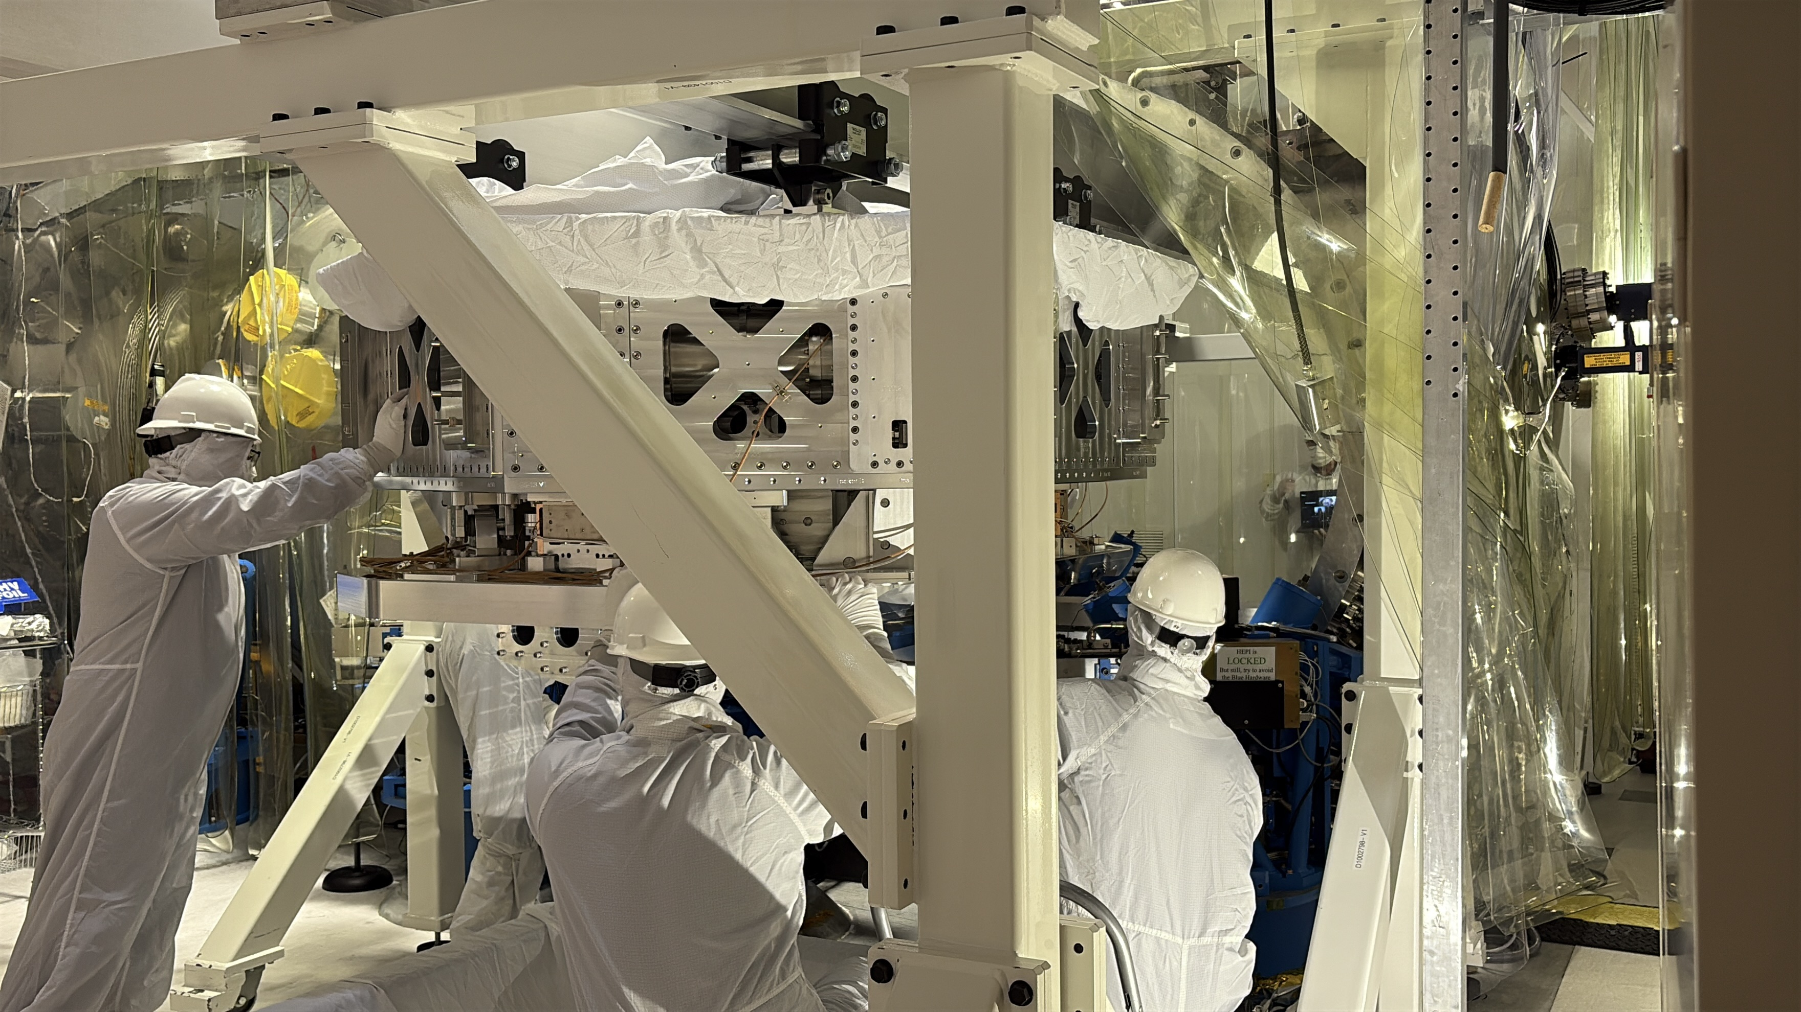
Seismic Isolation
Ground Motion
  Earthquakes.
  Wind.
  Waves.
  Traffic.
Seismic Isolation Tables
  Uses position and inertial sensors.
  Feedback & feedforward used to keep table still.
Credit: Betsy Weaver

Slide 10
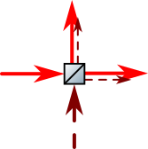



Quantum Noise
Amplitude squeezed vacuum
phase
vacuum noise
amplitude
Vacuum adds in uncorrelated noise
Phase squeezed vacuum

Slide 11
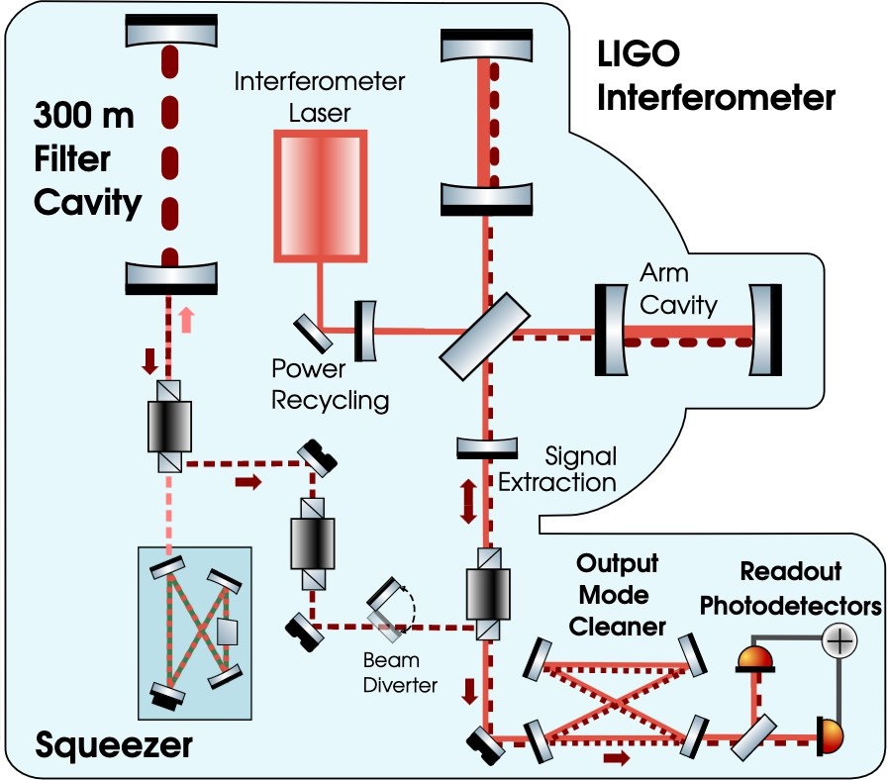
LIGO Squeezer
Makes squeezing ellipse rotate with frequency
Cleans output beam of higher order modes and sidebands
Squeezed light injected through dark port
Produces squeezed light using non-linear crystal
[3] D. Ganapathy et. al. Physical Review X 13, 041021 (2023)
Notes:
Use bs exp for squeezer ,losses adding in noise
explain mode mis-match adding in noise.

Slide 12
Any Questions?

Slide 14

Template Guidelines
Duplicate standard slide layouts as needed
Overwrite slide description with slide heading
You may swap text/figure fields side-to-side to suit your content (PPT’s automated ‘Design’ sidebar may show alt suggestions) but try to keep vertical placement of text boxes consistent between slides
Resize photos/figures as needed while maintaining font size
Use the provided bullet formats and caption fields. Click in “Caption” box to add caption.
To add a new level bullet, click: to increase list level.

