Slide 1
Decoding the Effects of Varying Frequency Bands on GW Source Characterization
Sena Kalabalık, Bogazici University
Mentors: Rhiannon Udall, Lucy M. Thomas and Derek Davis

Slide 2
Overview
01
02
03
04
05
Motivation
Roadmap
Methods
Conclusions and Future Work
Acknowledgements

Slide 3
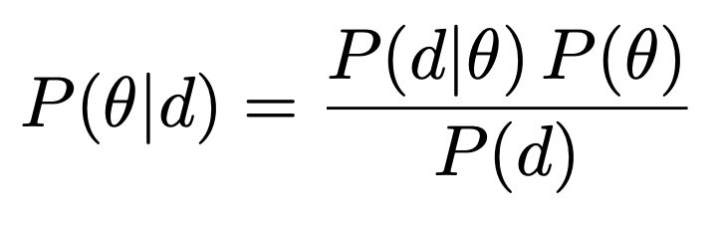
GW Source Characterization
Parameter Estimation for CBC: Understanding the properties of merging compact objects using Bayes’ Theorem with GW strain data.
15 parameters
Likelihood
-> Typical Noise Assumption: stationary and Gaussian
Prior
Posterior
strain data

Slide 4
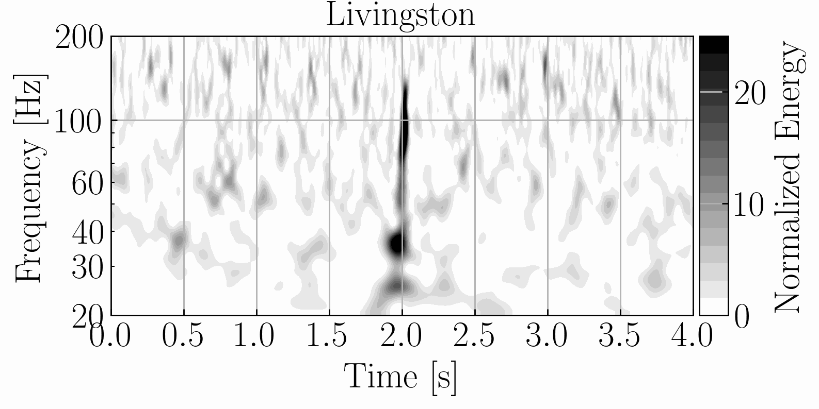
Motivation
GW191109
Glitches: Noise transients that corrupt the signal and invalidate the noise assumptions necessary for typical GW source characterization
Frequency Cuts: The method to mitigate glitches by cutting off the frequency range where the glitch is present.
The signal becomes clearer, but we lose some information by reducing the number of frequency bins
Based on the noise assumptions, what we expect:
Fewer data points
less constrained model
increased uncertainty
broader, more prior-like, less informative posterior distributions!

Slide 5
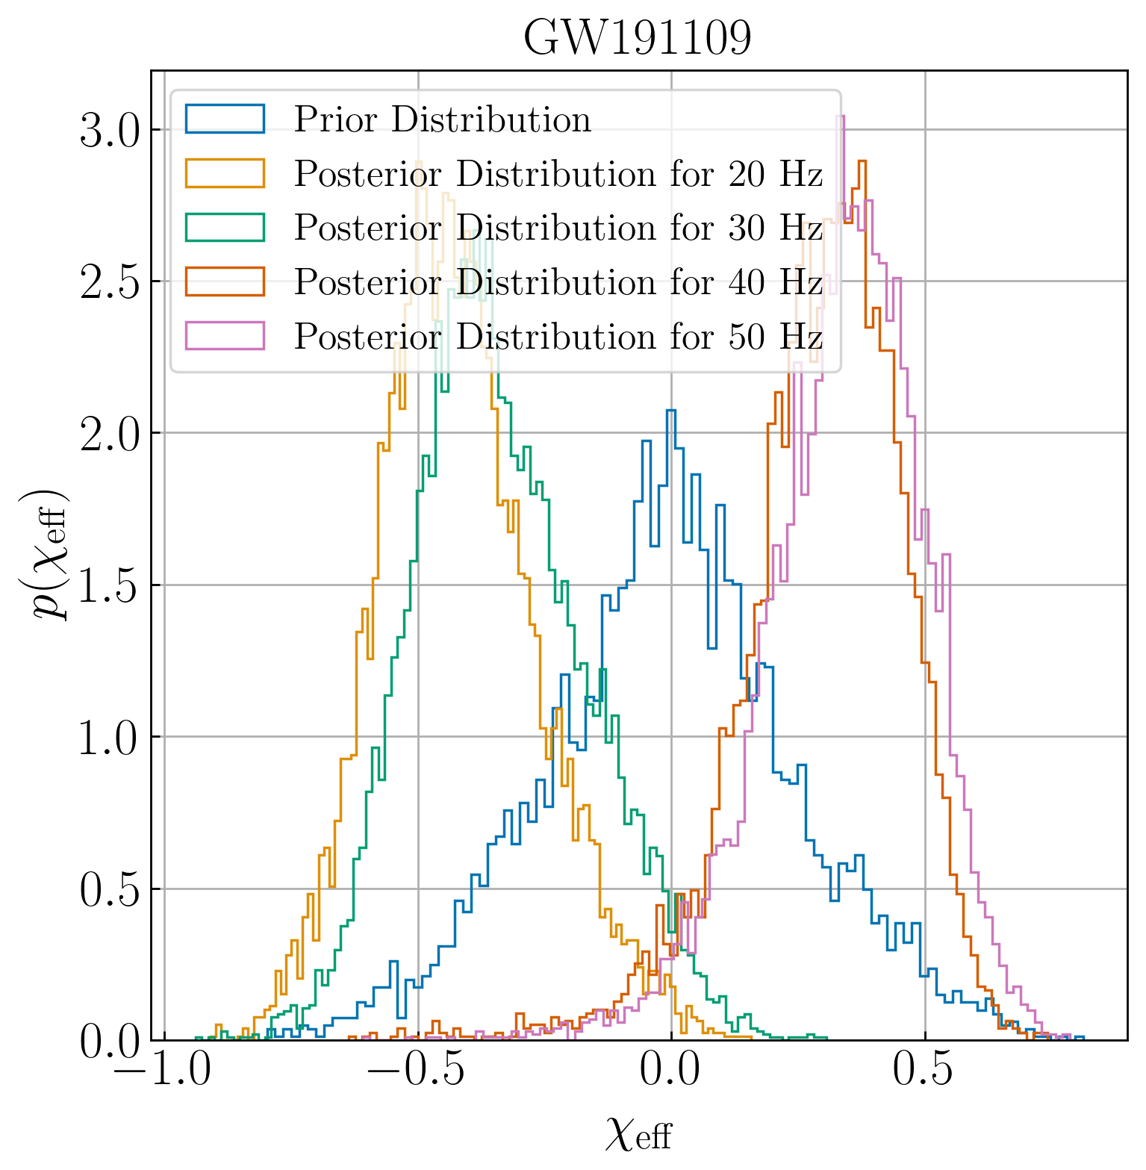
Motivation
However…. We observe a significantly different behavior for GW191109!
Trusting Frequency Cuts vs. Full-Band Analysis?
Need for a robust test to validate frequency cuts!
40 Hz
20 Hz
χeff​ posterior is shifted!

Slide 6
Roadmap
Training the DINGO network using a single ASD
Integrating frequency masking to DINGO network
Applying frequency cuts to injections and infer them by Bilby and DINGO
Developing statistical methods to interpret the frequency cut posteriors
Comparing the results and testing DINGO’s reliability
Training the full DINGO network using an ASD dataset to analyze O4 data.

Slide 7
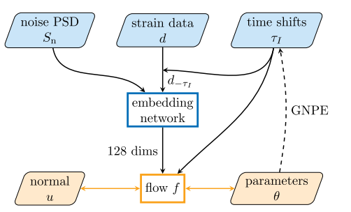
Overview of DINGO Network
A Neural Posterior Estimator performing fast likelihood-free inference
Simulation-based training
q(θ|d) ≈ p(θ|d), an approximation of the true posterior!
Importance Sampling is used to enhance estimation accuracy
Dax+ 2021

Slide 8
Roadmap
Training the DINGO network using a single ASD
Integrating frequency masking to DINGO network
Applying frequency cuts to injections and infer them by Bilby and DINGO
Developing statistical methods to interpret the frequency cut posteriors
Comparing the results and testing DINGO’s reliability
Training the full DINGO network using an ASD dataset to analyze O4 data.

Slide 9
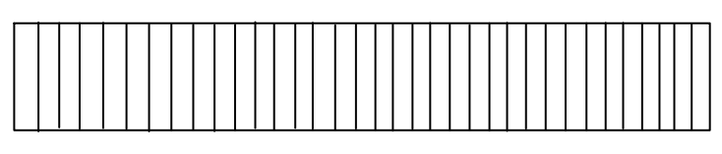

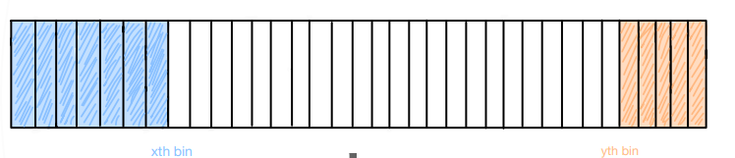
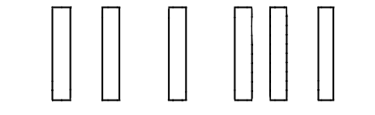
Frequency Cuts Integration to DINGO
n frequency bins
Frequency Masking
f_min
Embedding Network
f_max
f_min_upper
f_max_lower
128 dimensions

Slide 10
Roadmap
Training the DINGO network using a single ASD
Integrating frequency masking to DINGO network
Applying frequency cuts to injections and infer them by Bilby and DINGO
Developing statistical methods to interpret the frequency cut posteriors
Comparing the results and testing DINGO’s reliability
Training the full DINGO network using an ASD dataset to analyze O4 data.

Slide 11
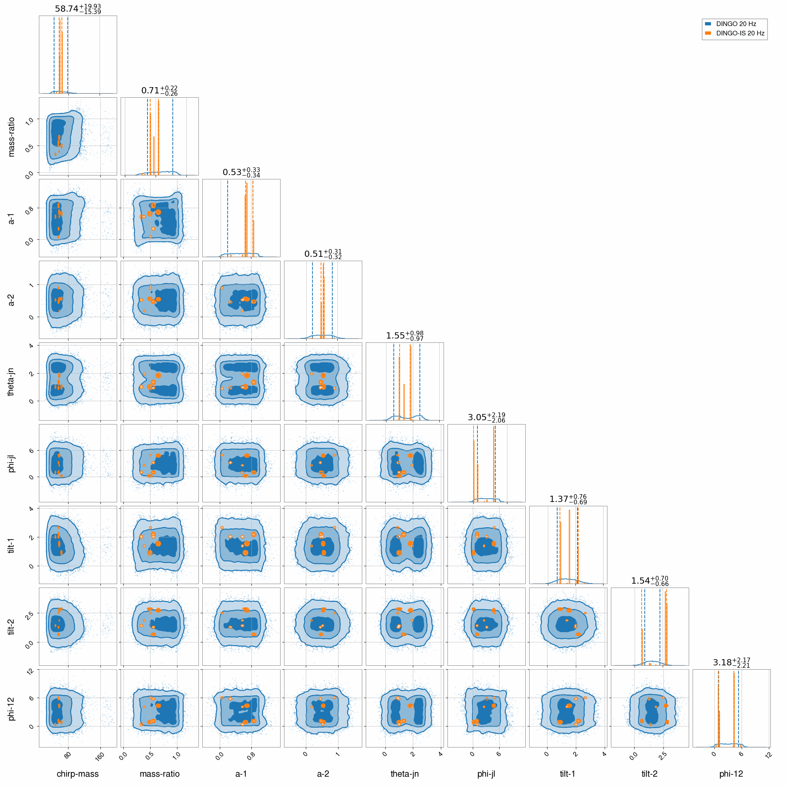
DINGO Results -Current Status
IS: Efficient only when the proposal distribution q is similar to the target distribution p
The current results don’t accurately represent p—showing the network’s insufficiency
New results with a larger dataset and optimized configurations are on the way Updates coming soon!

Slide 12
Roadmap
Training the DINGO network using a single ASD
Integrating frequency masking to DINGO network
Applying frequency cuts to injections and infer them by Bilby and DINGO
Developing statistical methods to interpret the frequency cut posteriors
Comparing the results and testing DINGO’s reliability
Training the full DINGO network using an ASD dataset to analyze O4 data.

Slide 13
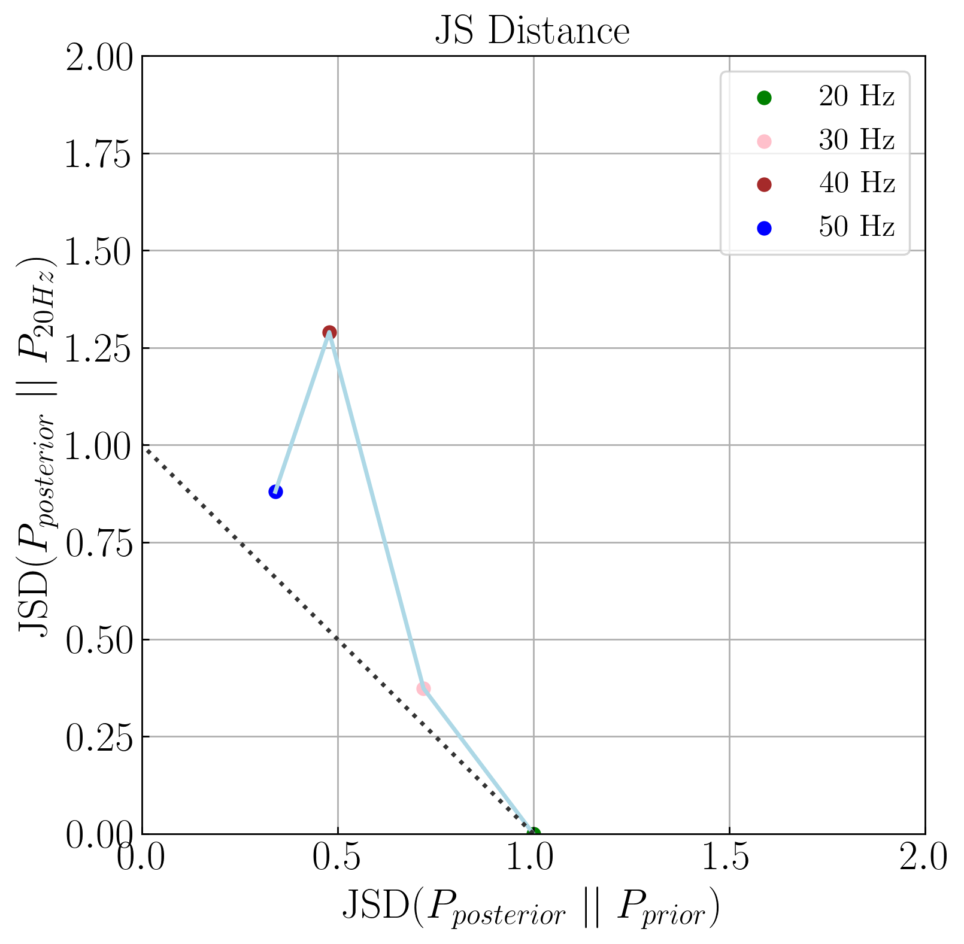
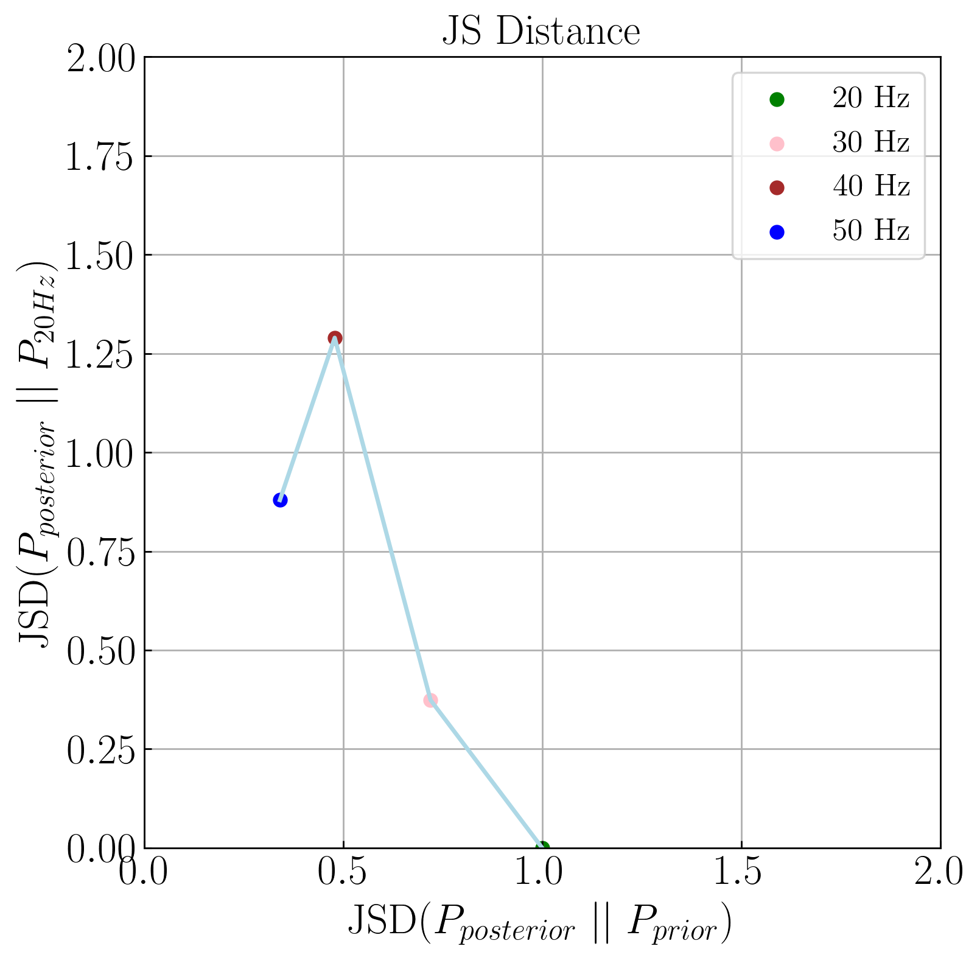

Kappa-D Testing
JS Distance
where m is the pointwise mean of p and q and D is the Kullback-Leibler divergence
Κ-D=Distance from the J0 line
Κ-D(40)
Κ-D(50)
Κ-D(30)
J0=JSD(20Hz Posterior || Prior)
Similarity increases!
y + x = J0
Example JSD plot for a single injection

Slide 14
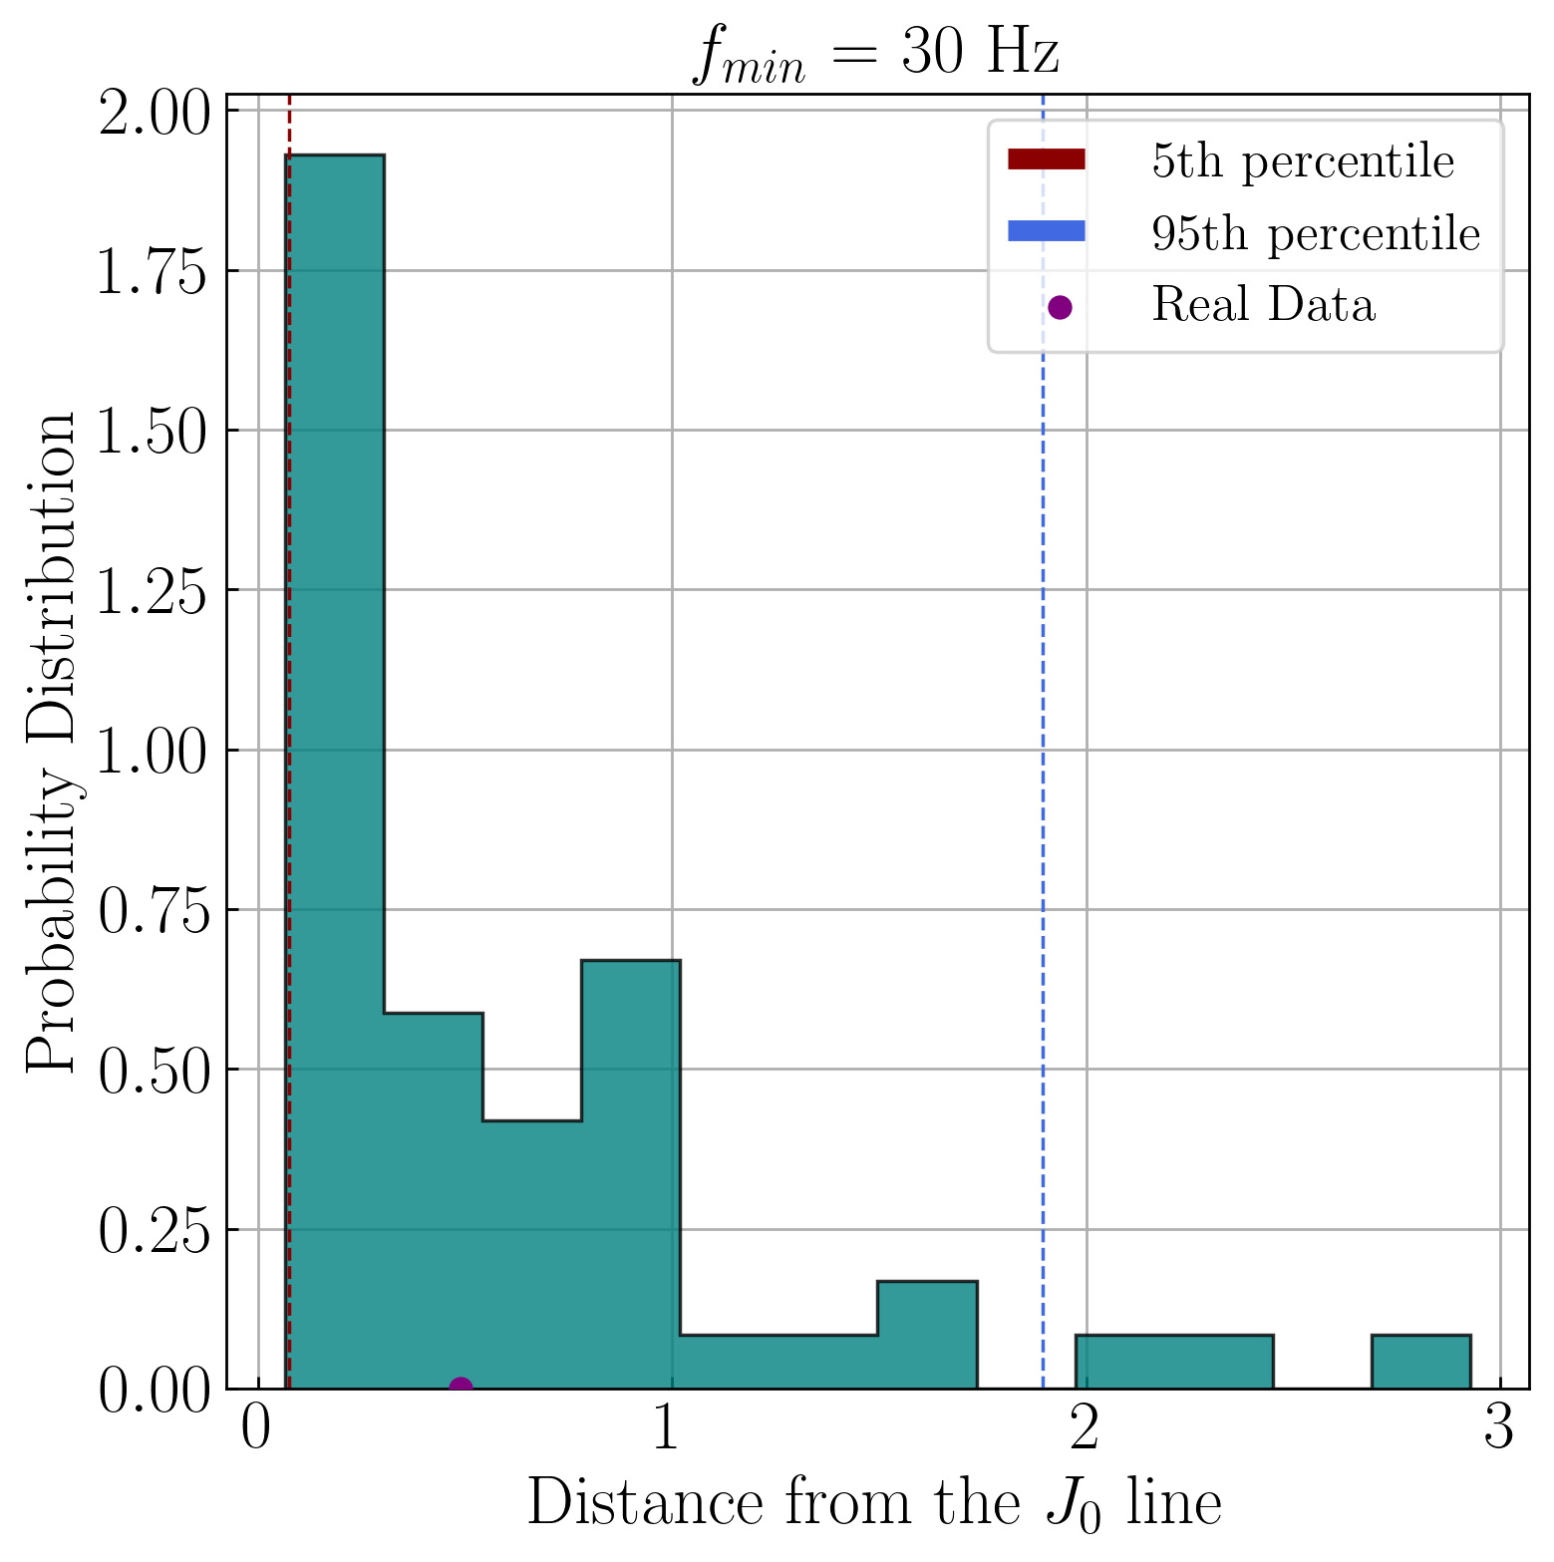
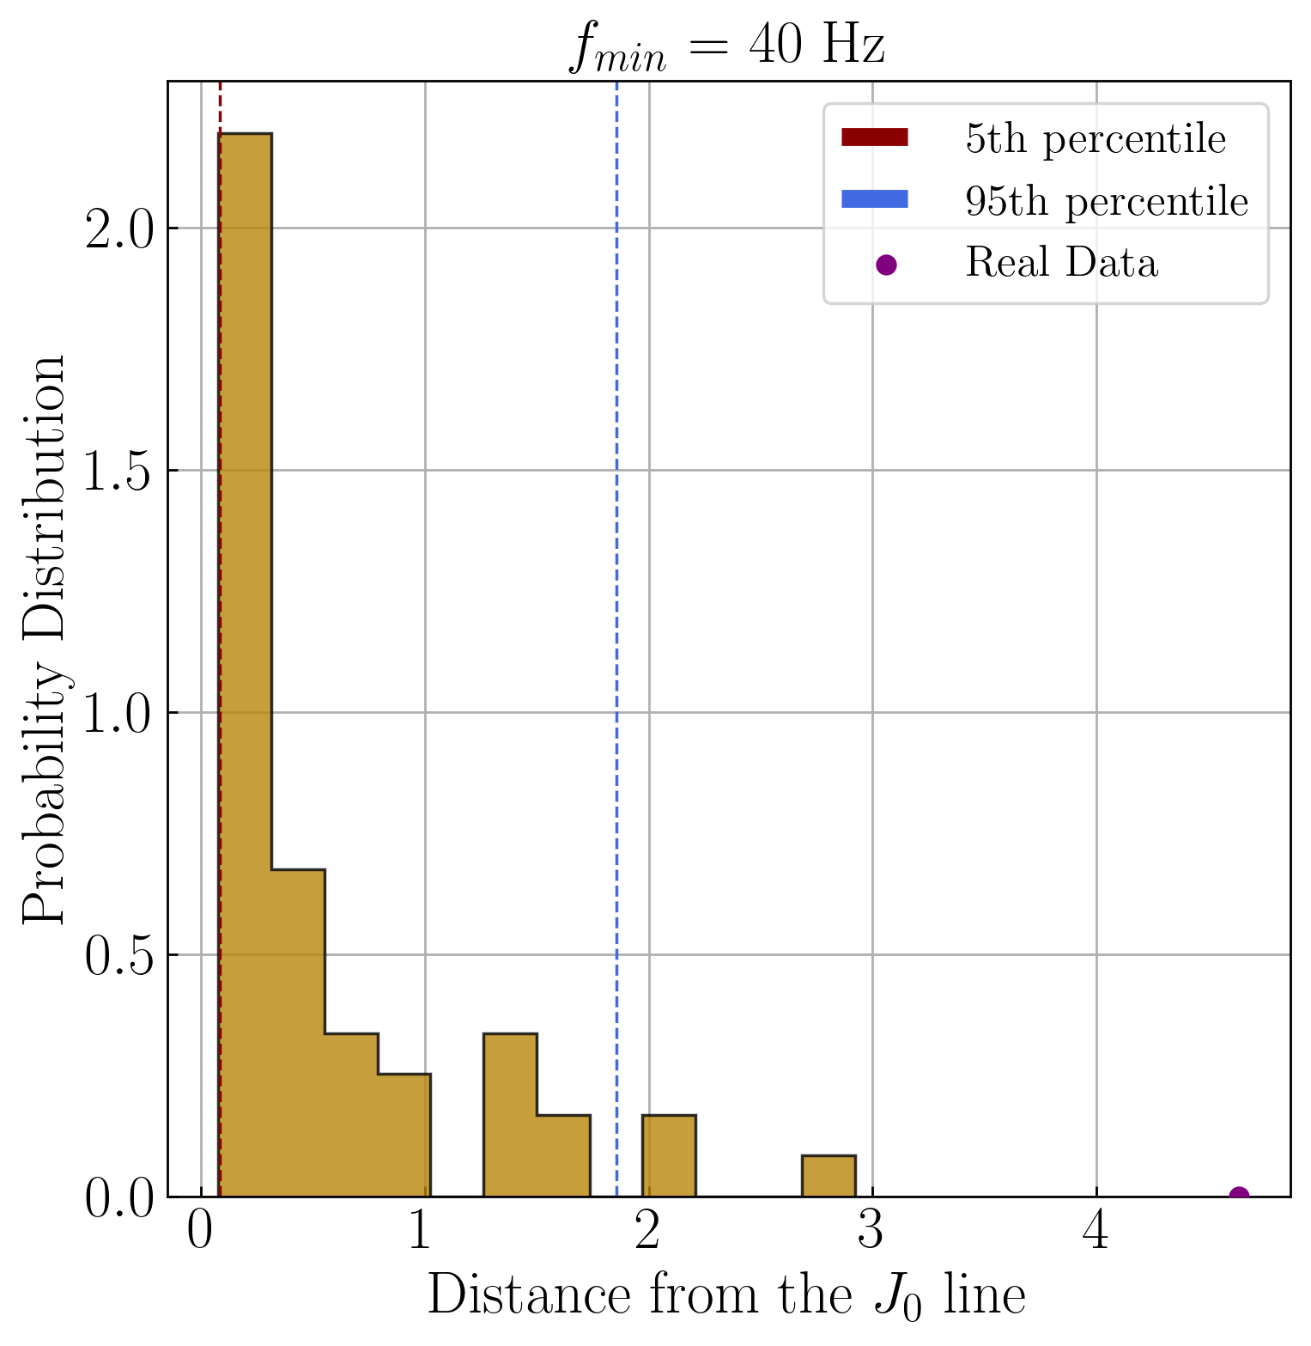
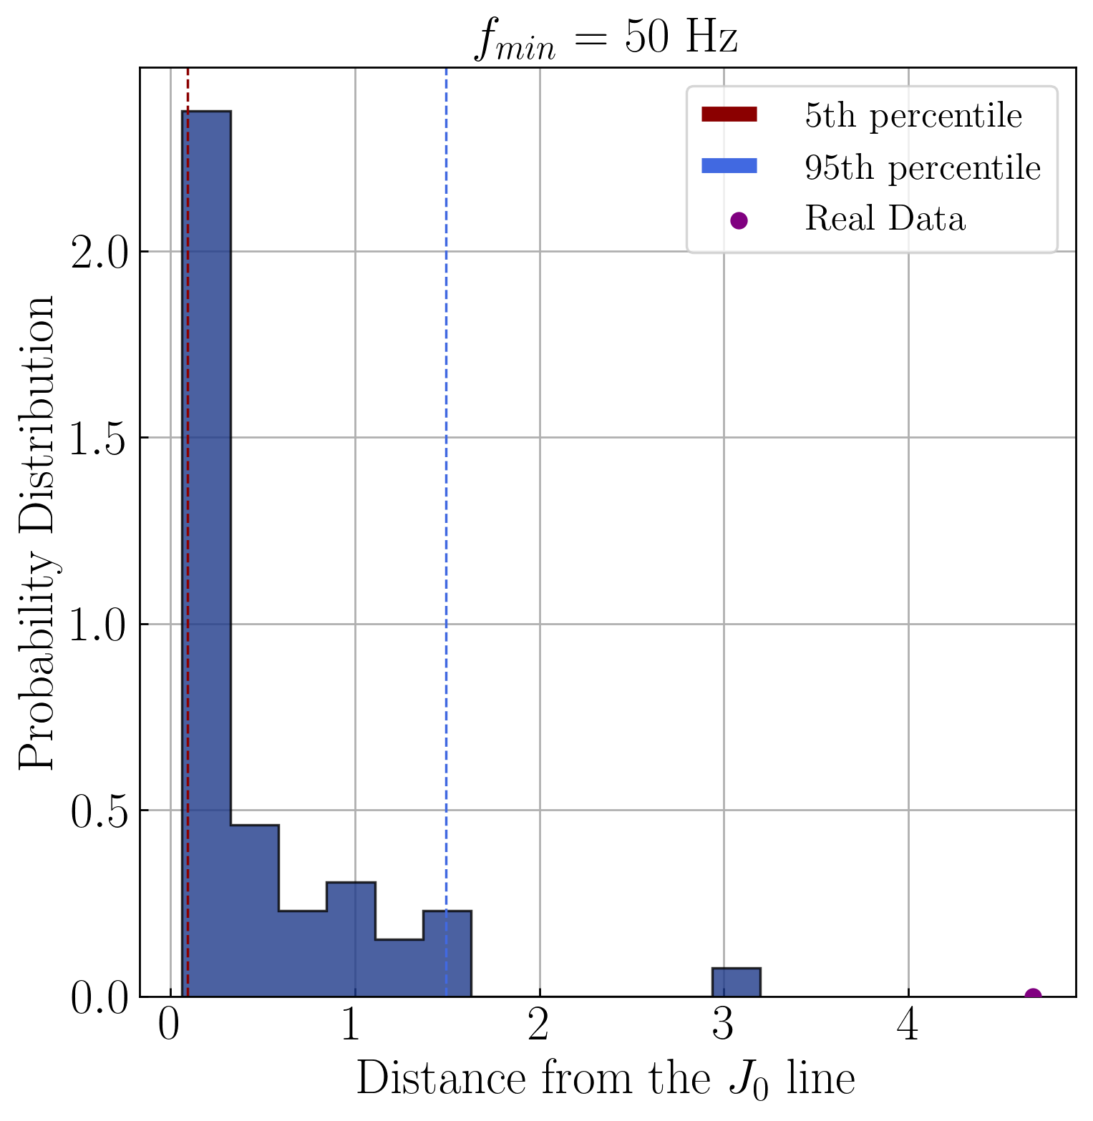
Testing GW191109
With the background set as a benchmark, we can now analyze real data!
K-D(30)
K-D(40)
K-D(50)
Histograms showing the distributions of the expected deviations from the J0 line for 50 injections

Slide 15
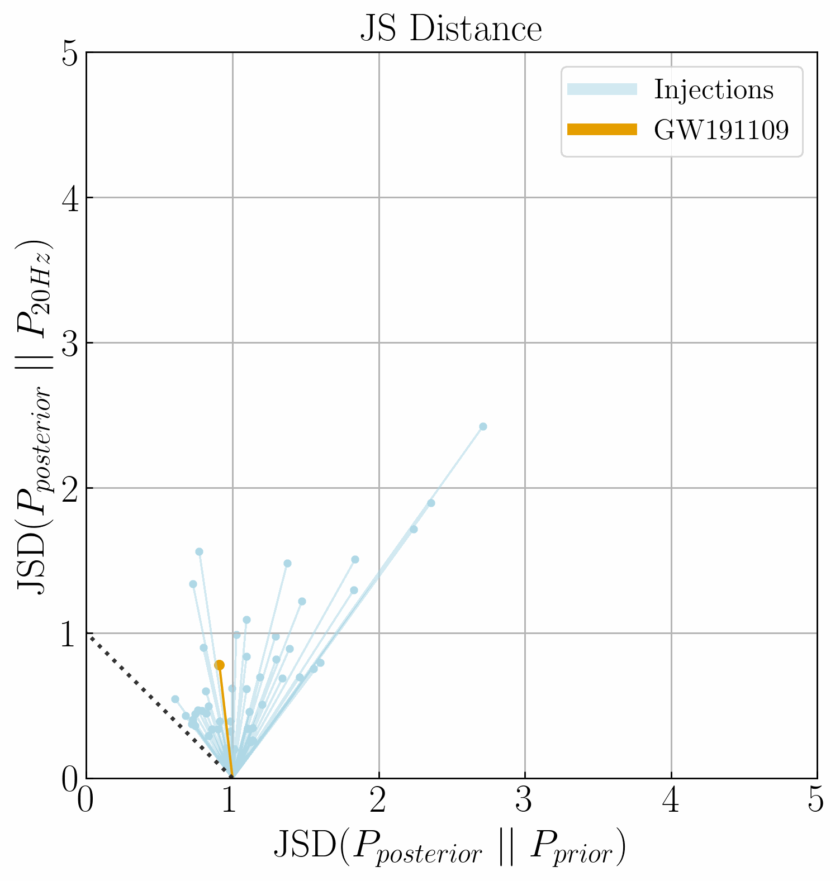
GW191109
The path of the real data is in agreement with the glitch region!
The frequency cuts application for this case is justified!
We can conclude that 40 Hz frequency cut is more trustable than the other posteriors.
Note that the variance of the expected deviations is high.

Slide 16
Conclusions and Future Work
Our Kappa-D deviation test provides a reliable and straightforward approach to identify the more unbiased and informative choice between frequency cuts and full-band signals.
This test can be used on O4 data to make decision-making more systematic.
However, generating a background for each detected event and running over 50 inferences per frequency limit with Bilby is computationally expensive. If DINGO results align with Bilby, we could eliminate the need for Bilby and train a DINGO network using an ASD dataset for O4 data!

Slide 17
Roadmap
Training the DINGO network using a single ASD
Integrating frequency masking to DINGO network
Applying frequency cuts to injections and infer them by Bilby and DINGO
Developing statistical methods to interpret the frequency cut posteriors
Comparing the results and testing DINGO’s reliability
Training the full DINGO network using an ASD dataset to analyze O4 data.

Slide 18

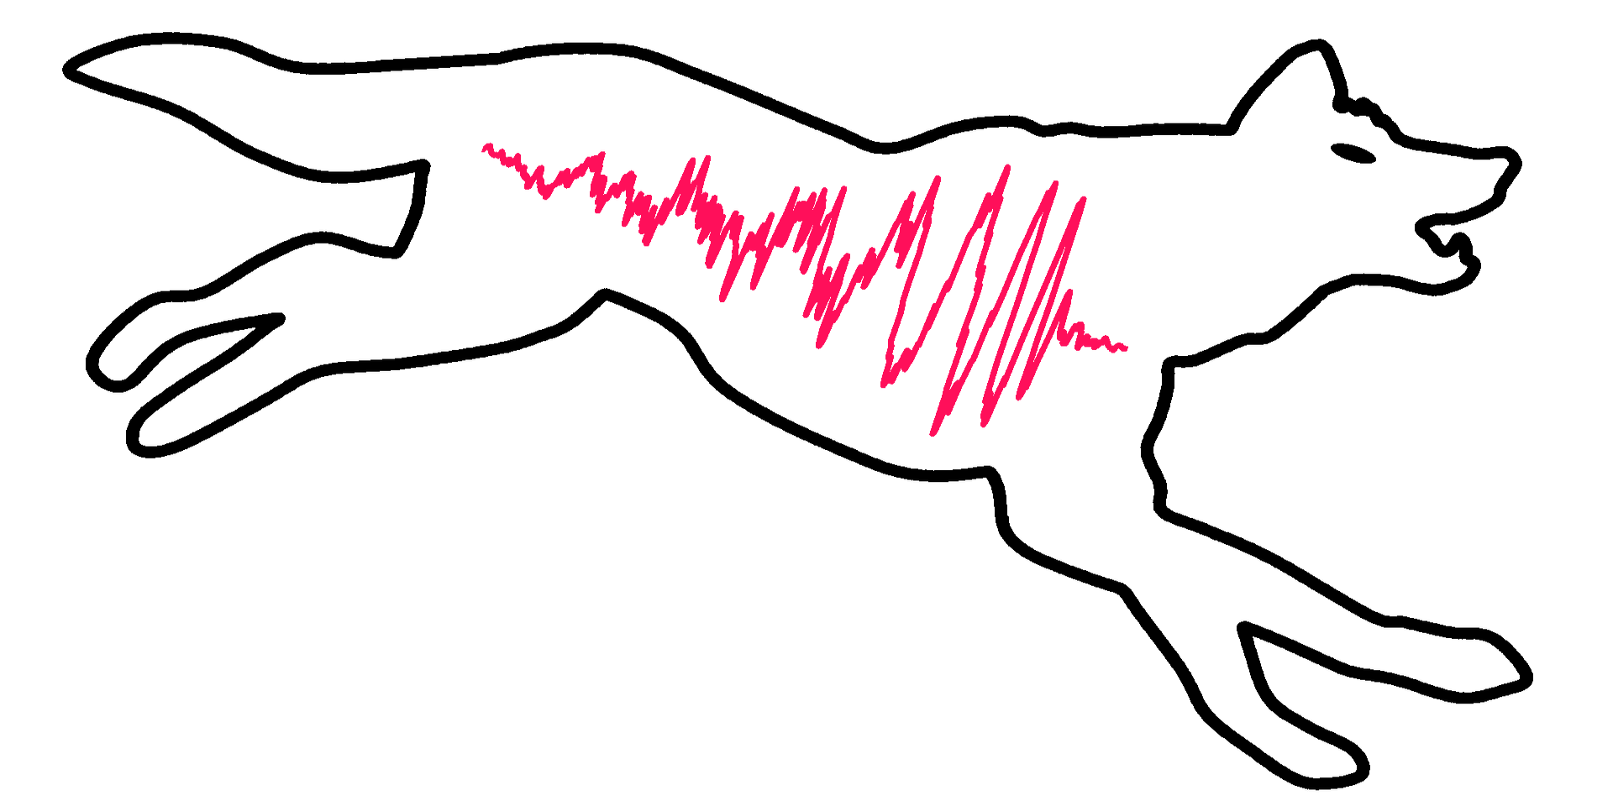



Acknowledgements
Special thanks to my mentors:
Lucy M. Thomas
Rhiannon Udall
Derek Davis
And thanks to DINGO developers.
This work was supported by:
The National Science Foundation Research Experience for Undergraduates (NSF REU) program
The LIGO Laboratory Summer Undergraduate Research Fellowship program (NSF LIGO)
The California Institute of Technology Student-Faculty Programs

Slide 19
Appendix

Slide 20
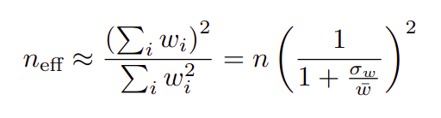
Importance Sampling
A Monte Carlo method to estimate the properties of a distribution
How it works:
Sampling from a secondary distribution and assigns weights to these samples to lower the variance.
Emphasizing important values by sampling them more frequently,
The accuracy is evaluated using “the effective number of samples”:
High weight variance reduces n_eff
Disproportionally high weights:
dominate the distribution
reduce n_eff
lead to undersampling.

Slide 21
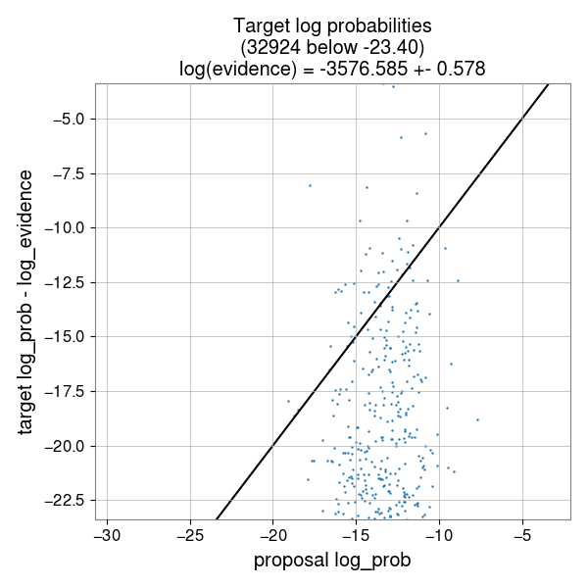
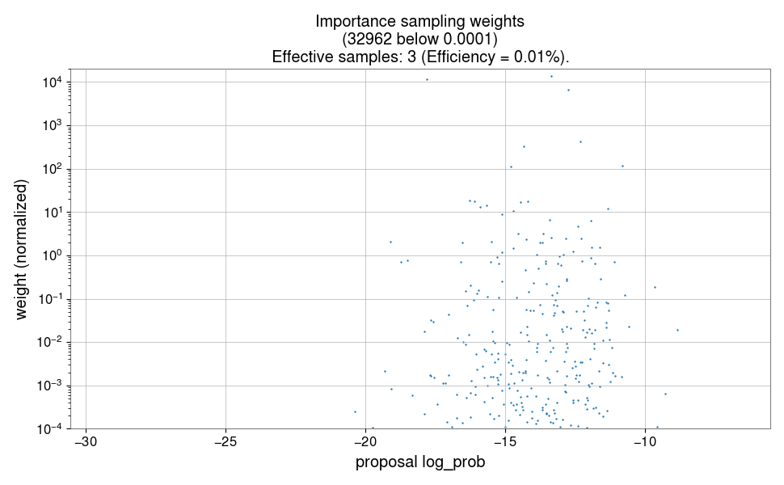
Sampling Efficiency
widely scattered
Samples should ideally align with the line!
low weights -> contributing very little
high weights -> dominate as the effective samples

