Slide 1
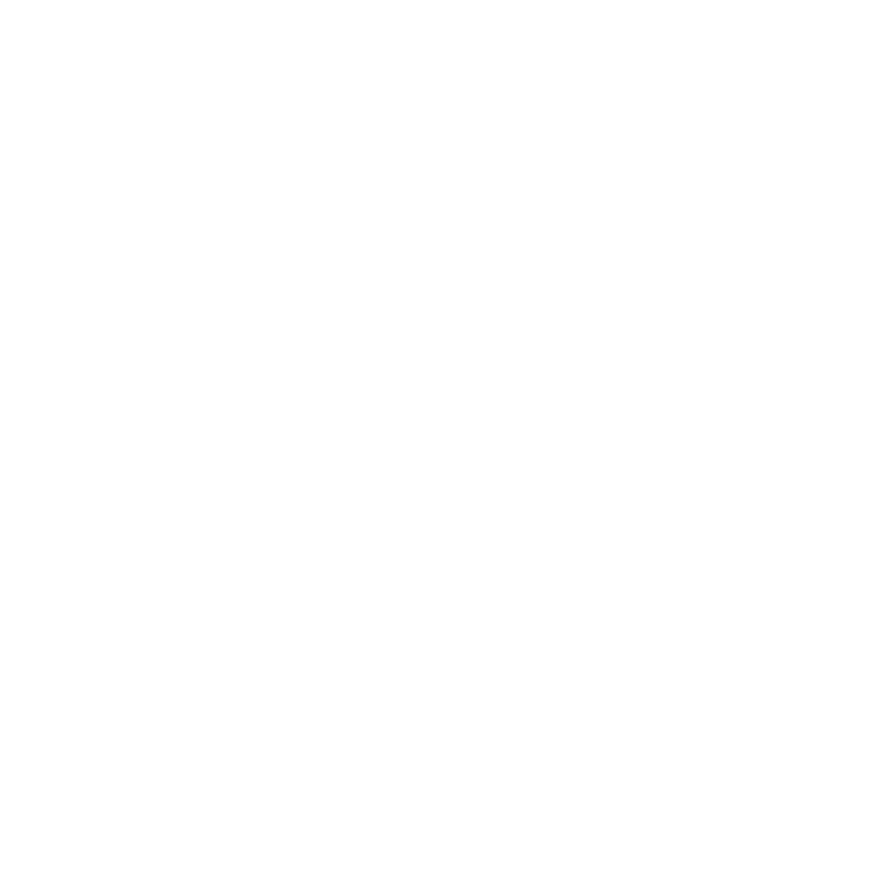


Investigating Eccentric & Precessing Waveform Models
Isaiah Tyler
Loyola Marymount University
Lucy M Thomas & Taylor Knapp

Slide 2
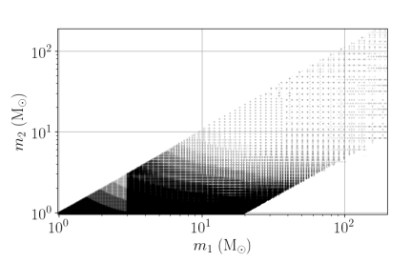
Waveform Templates
Data Analysis algorithms that search for GW events utilize the method of matched filtering
  correlates theoretical template signals to the detector output data
Template banks → increased physics output of data analysis at LIGO
  Parameter estimation relies on waveform templates
Currently no models that include both eccentricity and precession
GstLAL all-sky (O4) template bank:
Image Credit: Sakon, S et al. (2024). Template bank for compact binary mergers in the fourth observing run of Advanced LIGO, Advanced Virgo, and KAGRA. Physical Review D, 109(4), 044066.

Slide 3
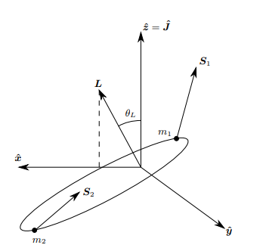
Precession & Eccentricity
Misalignment of spins → changes in orientation of orbital plane (precession)
Eccentricity is a dimensionless parameter that describes how much an orbit deviates from a circular orbit
Image credit: Klein, A. (2021). EFPE: Efficient fully precessing eccentric gravitational waveforms for binaries with long inspirals

Slide 4
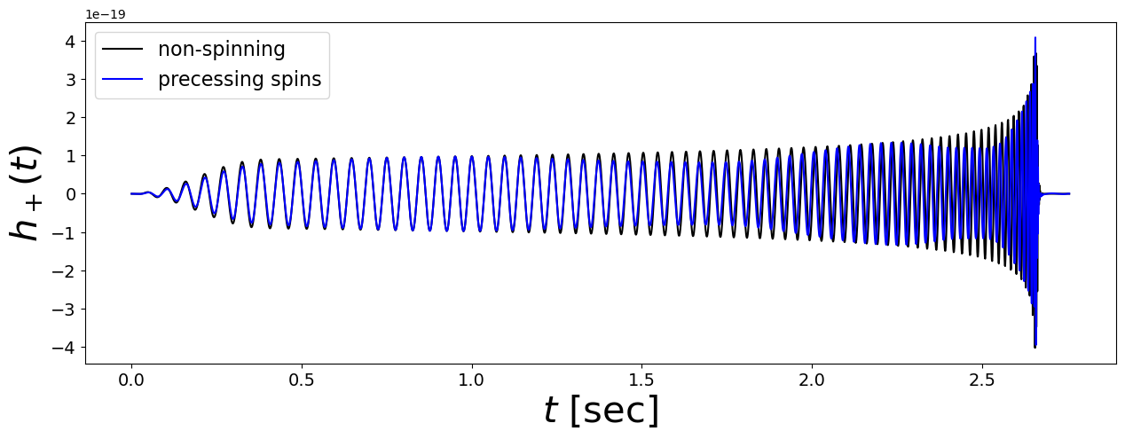
Precession in the Time Domain
Spin precession → modulations in the amplitude and phase of the strain.
  Increasing the magnitude of the spins → stronger modulations
Approximant: IMRPhenomTPHM

Slide 5
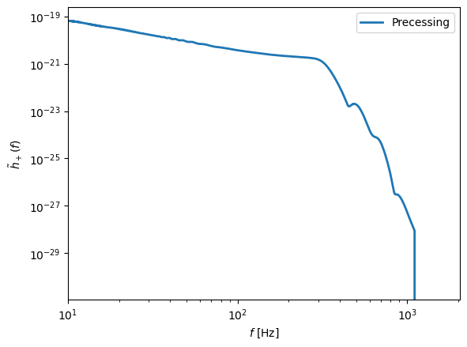
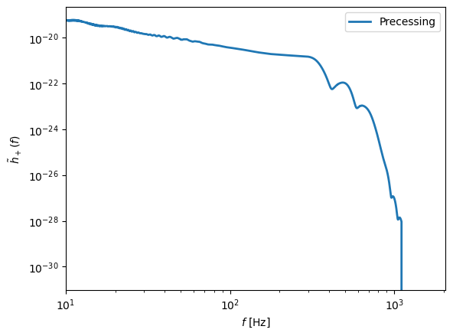
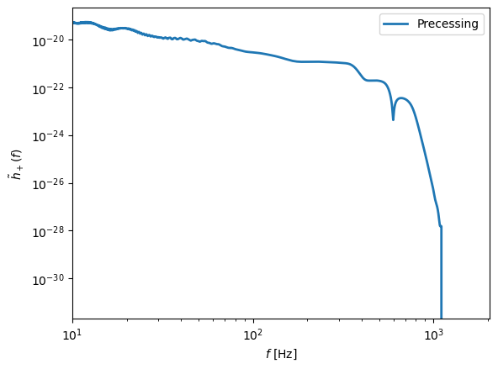
Precession in the Frequency Domain
Systems with more spin exhibit more modulations during the inspiral at low frequencies
Exhibits different modulation behavior in the merger-ringdown at high frequencies
Approximant: IMRPhenomXPHM
Strain
Frequency [Hz]

Slide 6
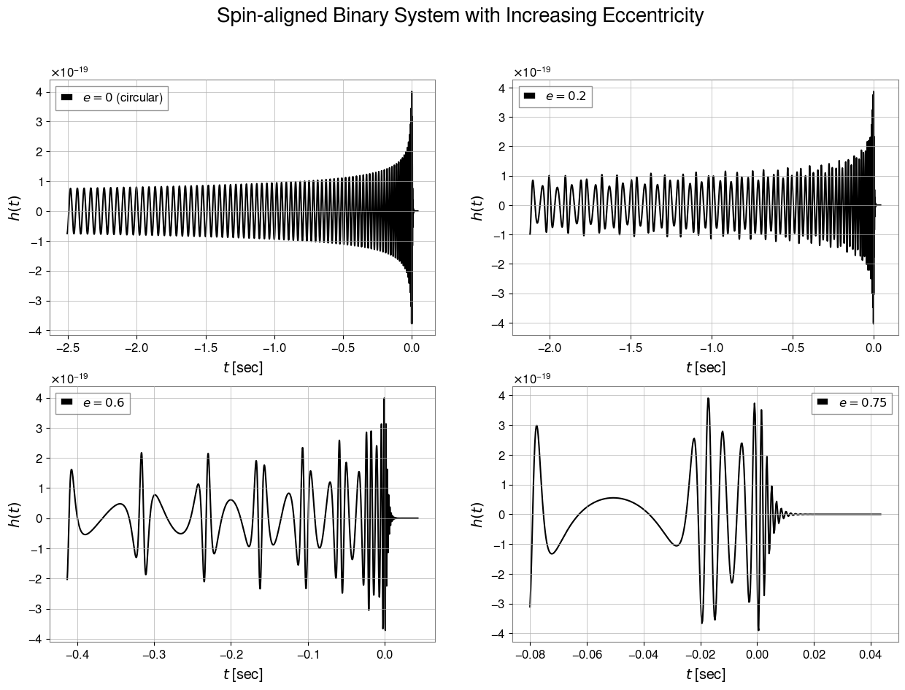
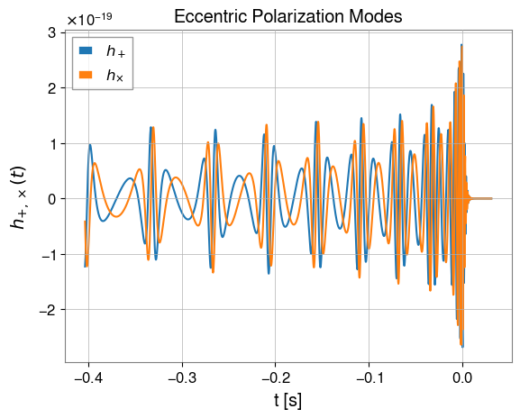
Eccentricity in the Time Domain
The duration of the coalescence decreases as the eccentricity increases since the radiation reaction occurs at a higher rate
The amplitude of the peaks during inspiral increases as eccentricity increases because the periastron of each orbit is closer (more energy is radiated)
h_{×,+}(t)
h(t)
t[s]
Model: TEOBResumS-DALI
t[s]

Slide 7
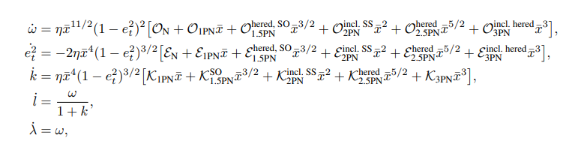
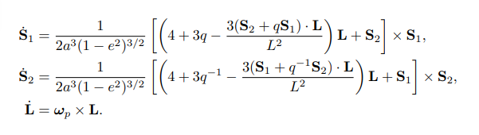
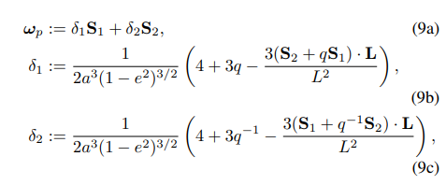
Orbital Evolution
Goal: Obtain h₊(t) and h×(t) polarizations
  Calculate the dynamics and use those to calculate the strain
Investigate the changes in the orbital evolution under varying initial conditions
Orbital Evolution Equations:
Precession Evolution Equations:
Equations: LIGO Document T2400230-v1

Slide 8
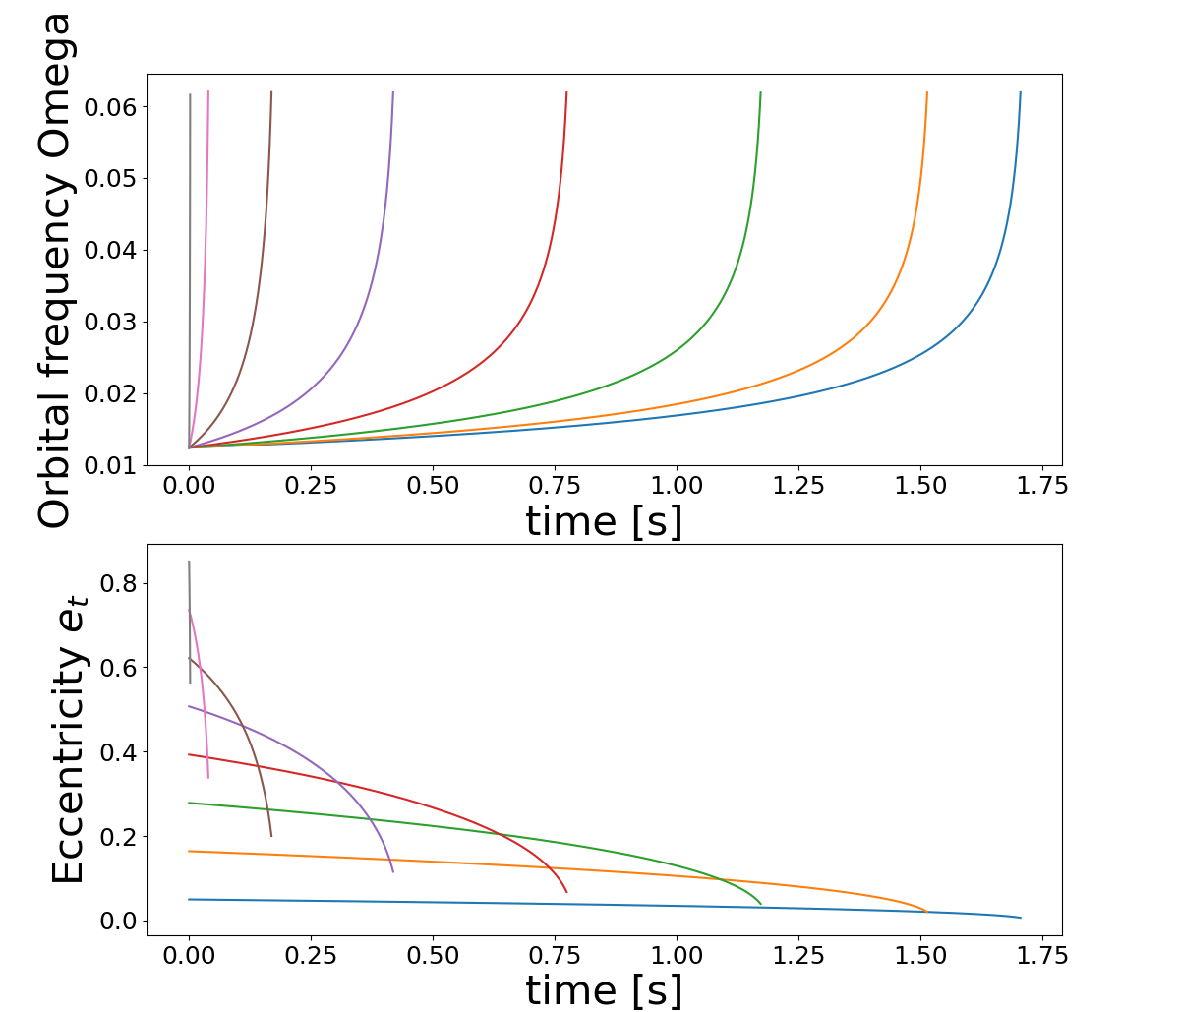
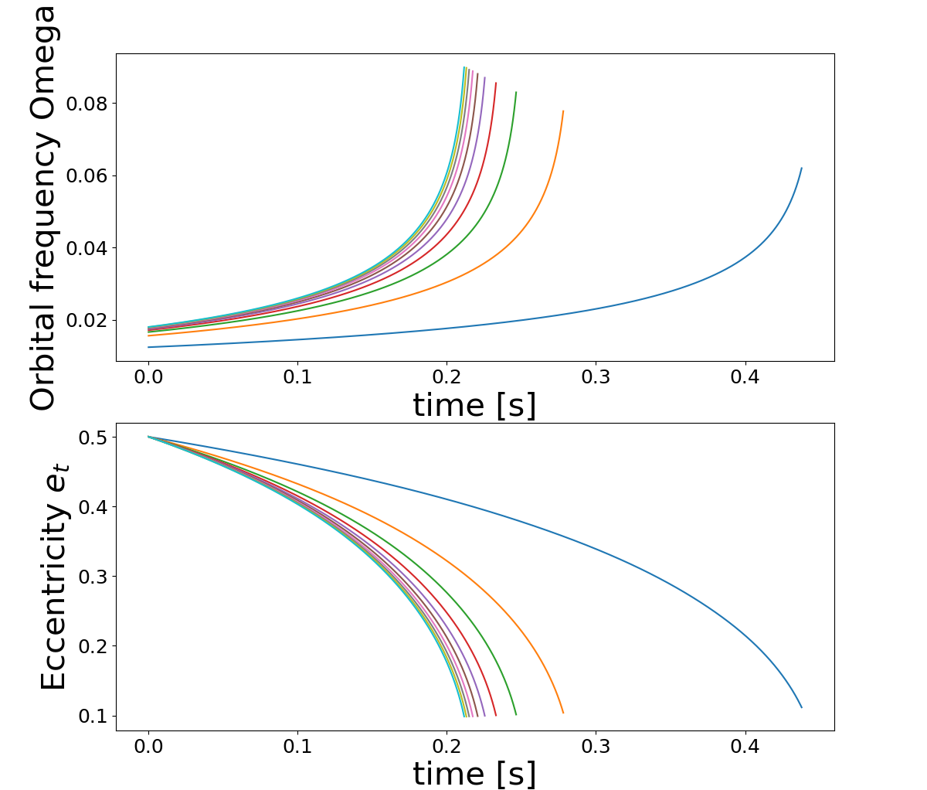
Orbital Evolution
Increasing mass ratio & initial eccentricity
  The orbit circularizes quicker
  The orbital frequency reaches a high maximum
Range of initial eccentricities: (0.05<e<0.85)
Range of mass ratios: (1<q<20)

Slide 9
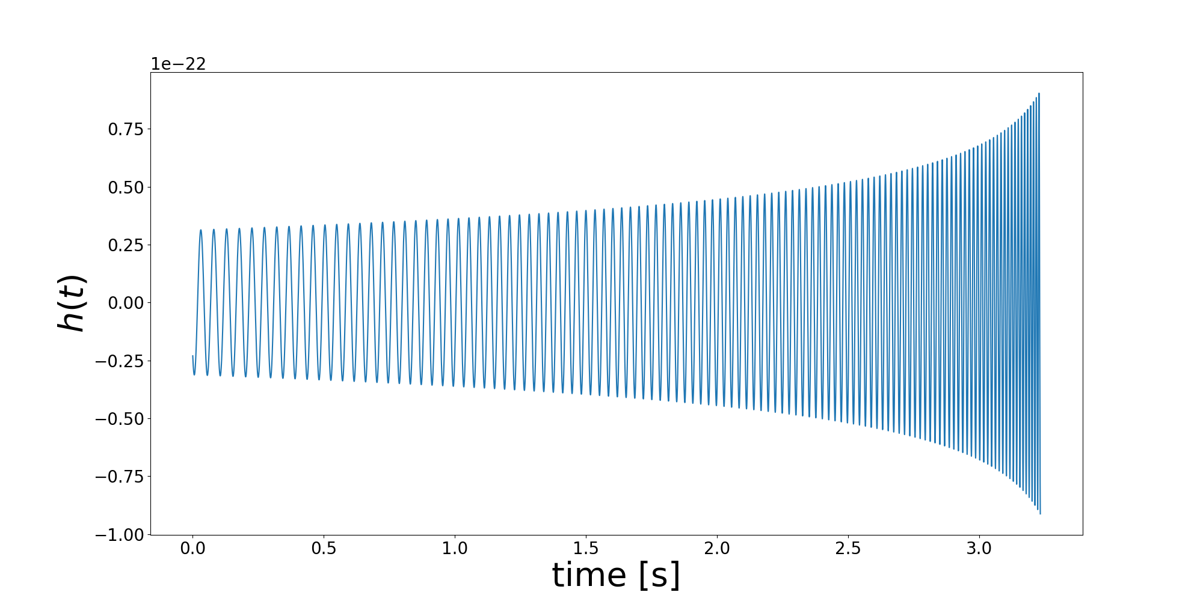
0PN Equations
Equations assume circular obit
Does not exhibit modulation behavior as expected from eccentric or precessing waveforms.
Maggiore, M. (2007). Gravitational waves (Vol. 1). Oxford university press.

Slide 10

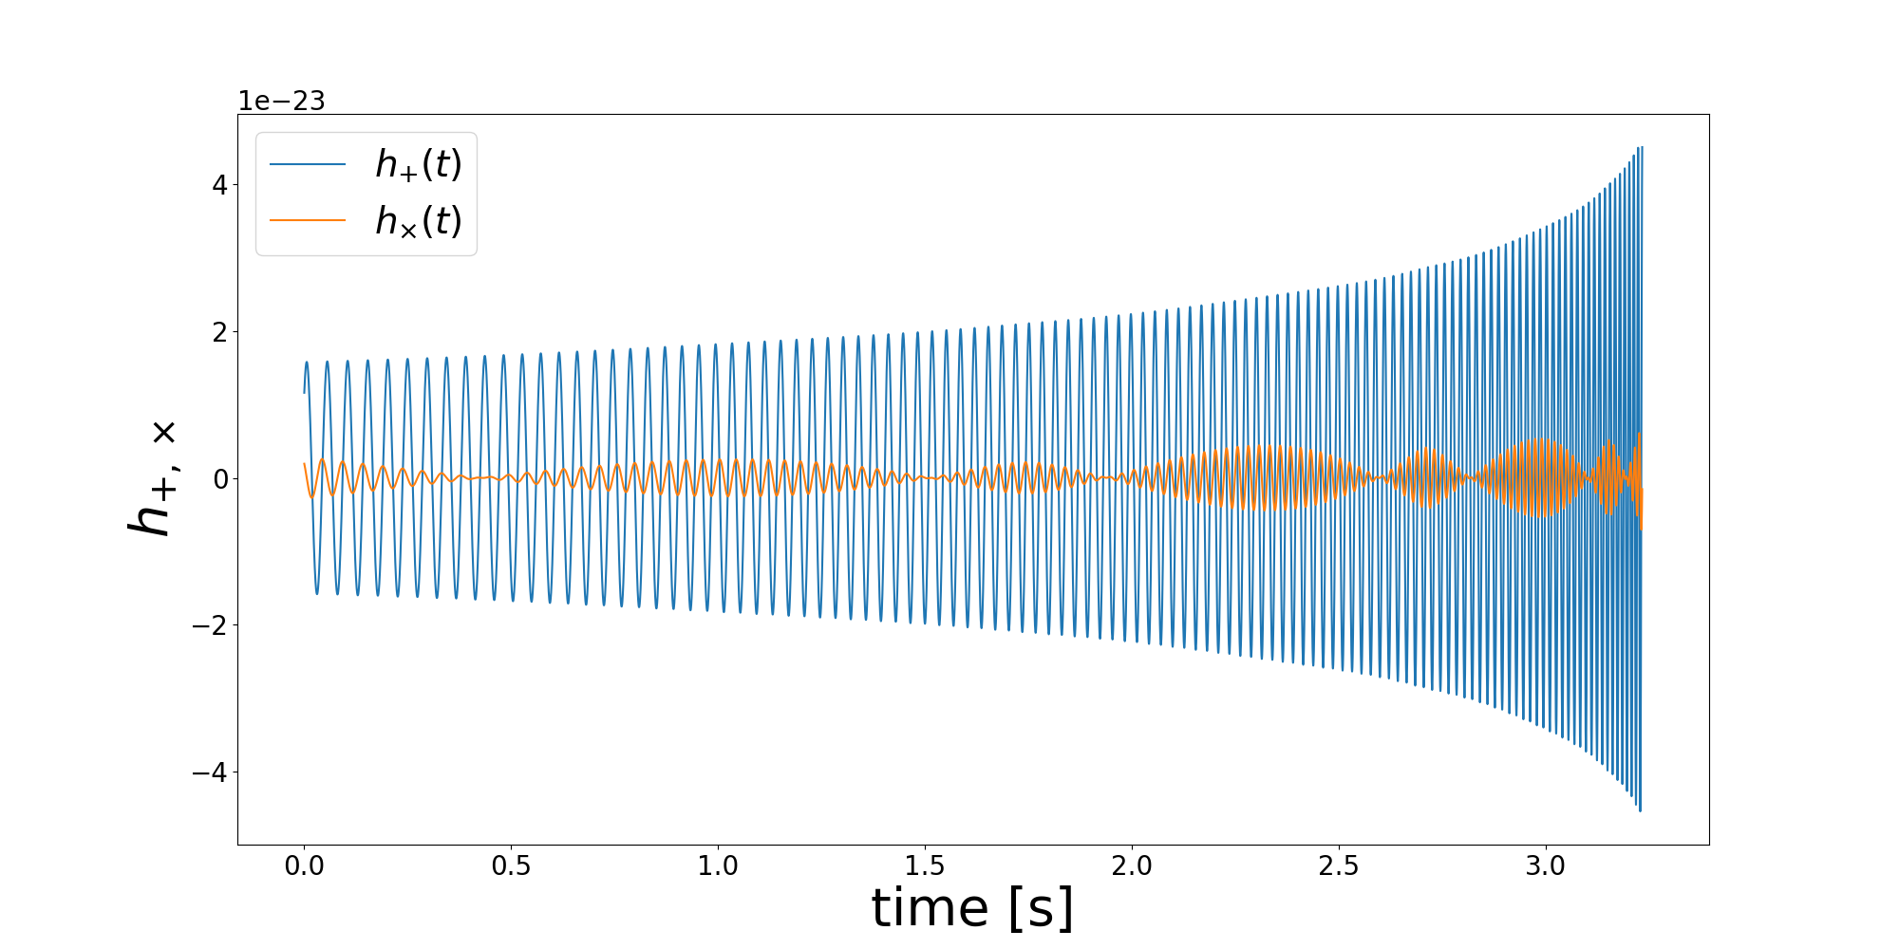
1.5PN Equations
Equations assume a circular orbit
Modulations appear in the h× mode
Poisson, E., & Will, C. M. (2014). Gravity: Newtonian, post-newtonian, relativistic. Cambridge University Press.

Slide 11
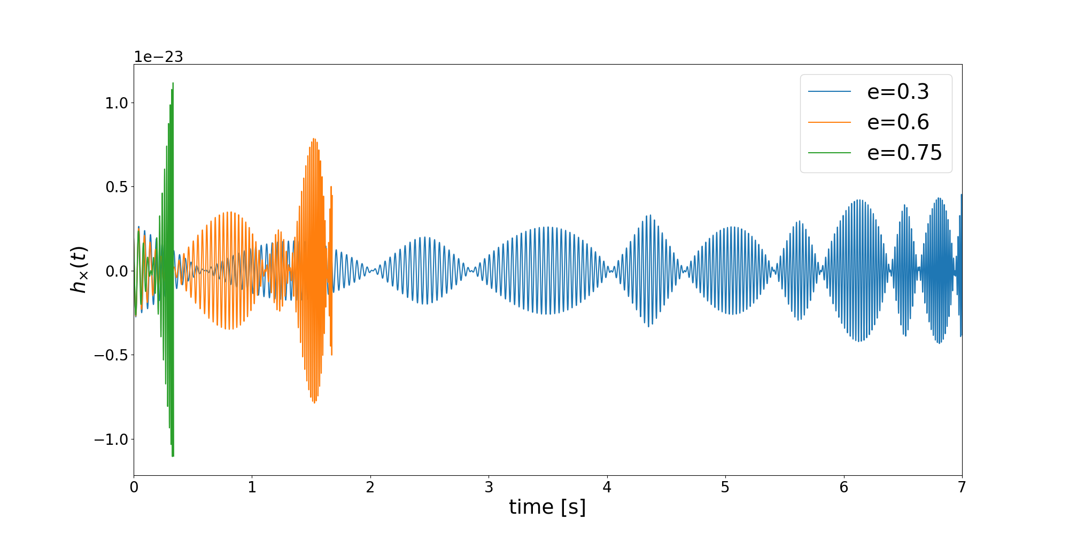
Isolating Eccentricity Effects

Slide 12
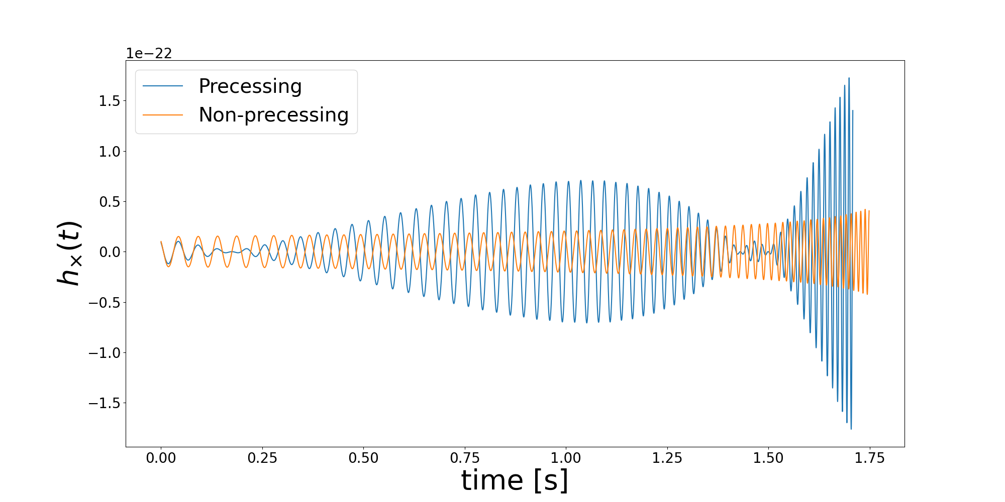
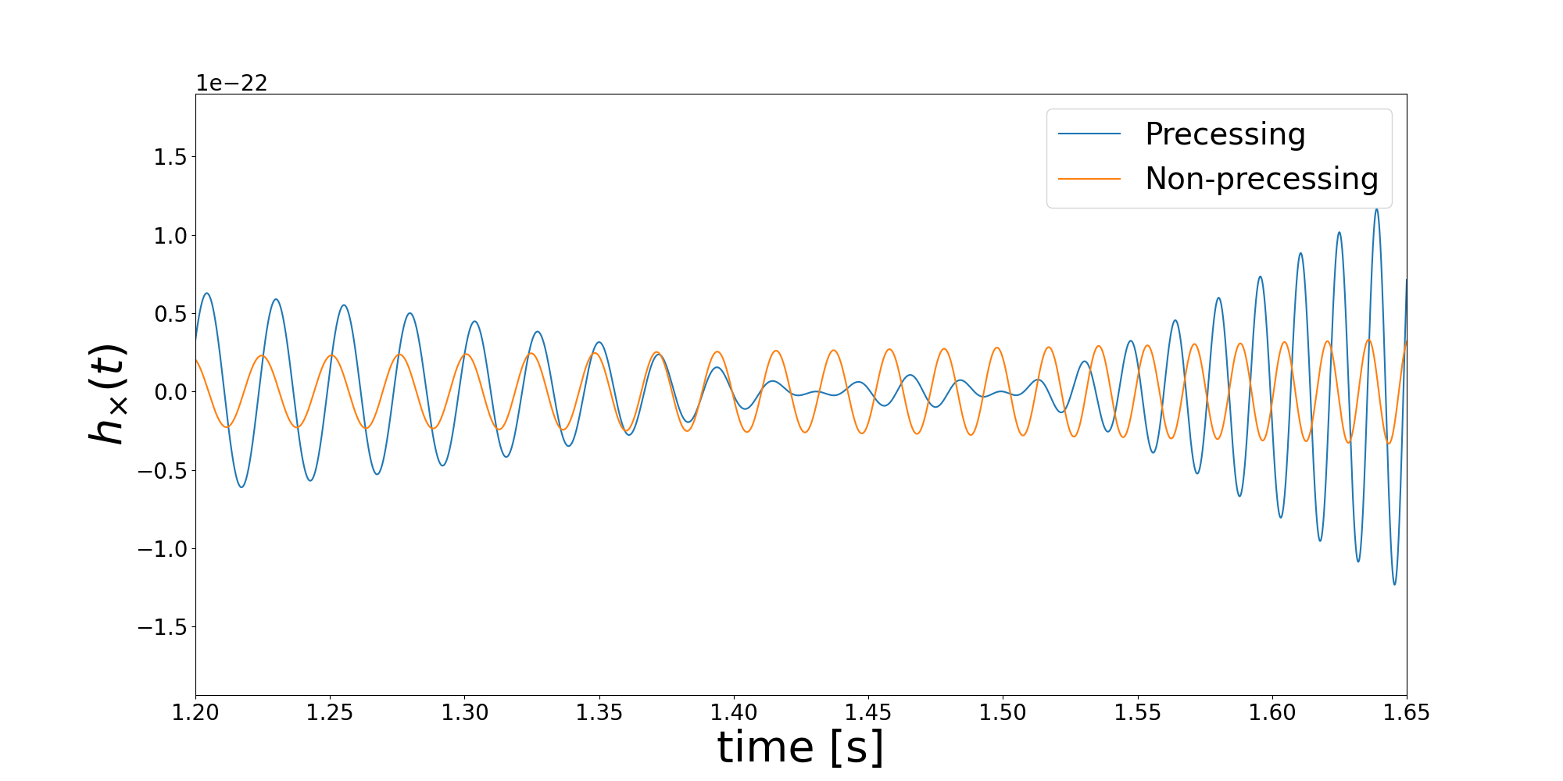
Isolating Eccentricity Effects
No modulations appear in the non-precessing, eccentric waveform

Slide 13
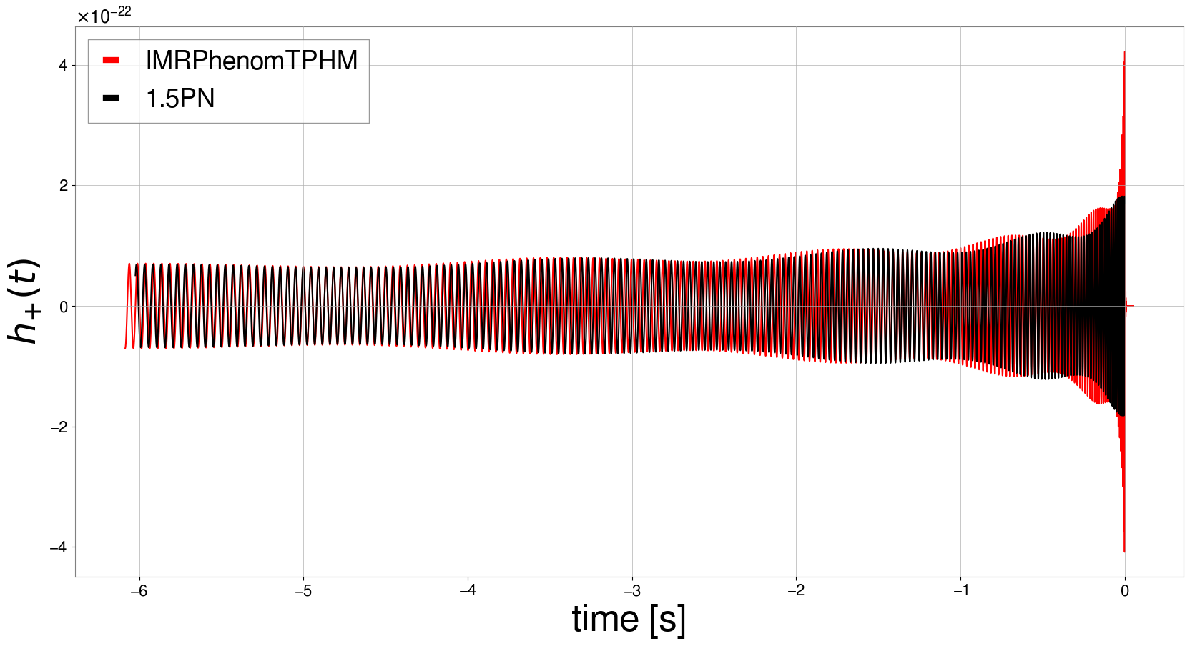
Comparison of Precessing Waveforms
Comparing new code to IMRPhenomTPHM for same set of parameters
  The two waveforms are identical in the early inspiral
  Similar modulation behavior

Slide 14
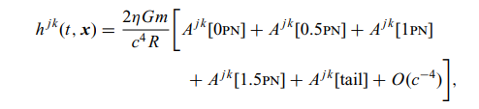


Removing the Circular Assumption
A_{jk} is a function of orbital dynamics quantities
  Mean orbital phase , separation , orientation of orbital plane, velocities
Poisson, E., & Will, C. M. (2014). Gravity: Newtonian, post-newtonian, relativistic. Cambridge University Press.

Slide 15
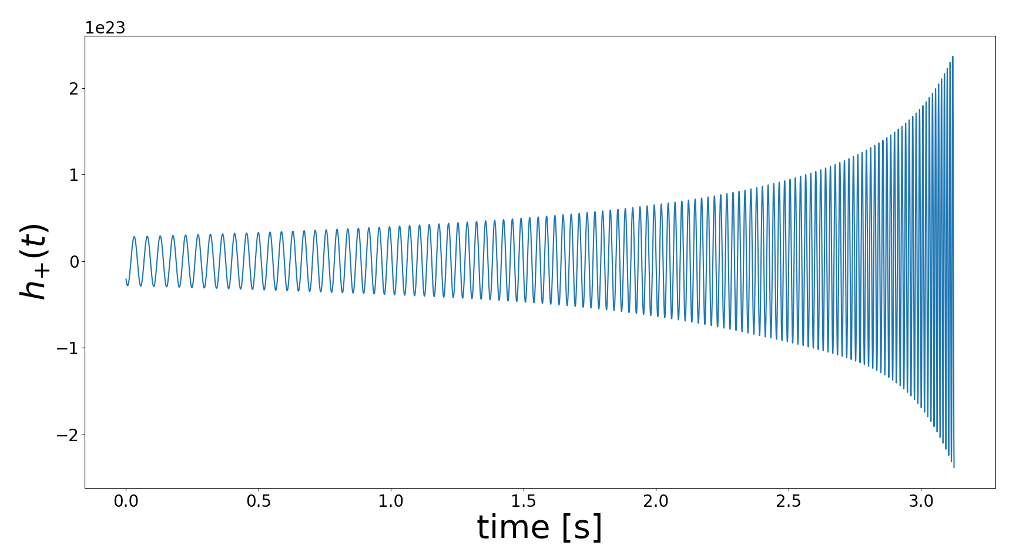
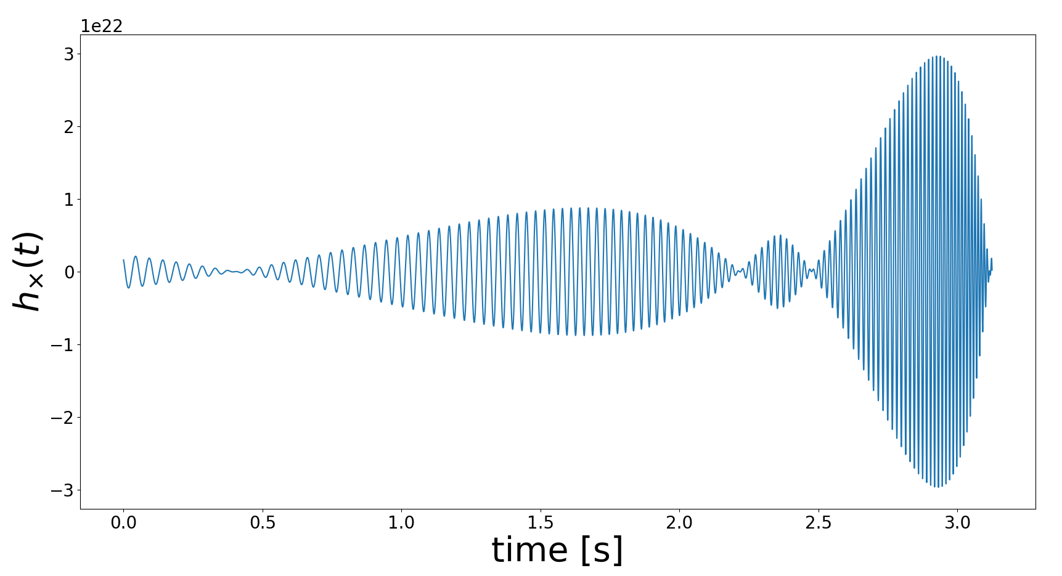
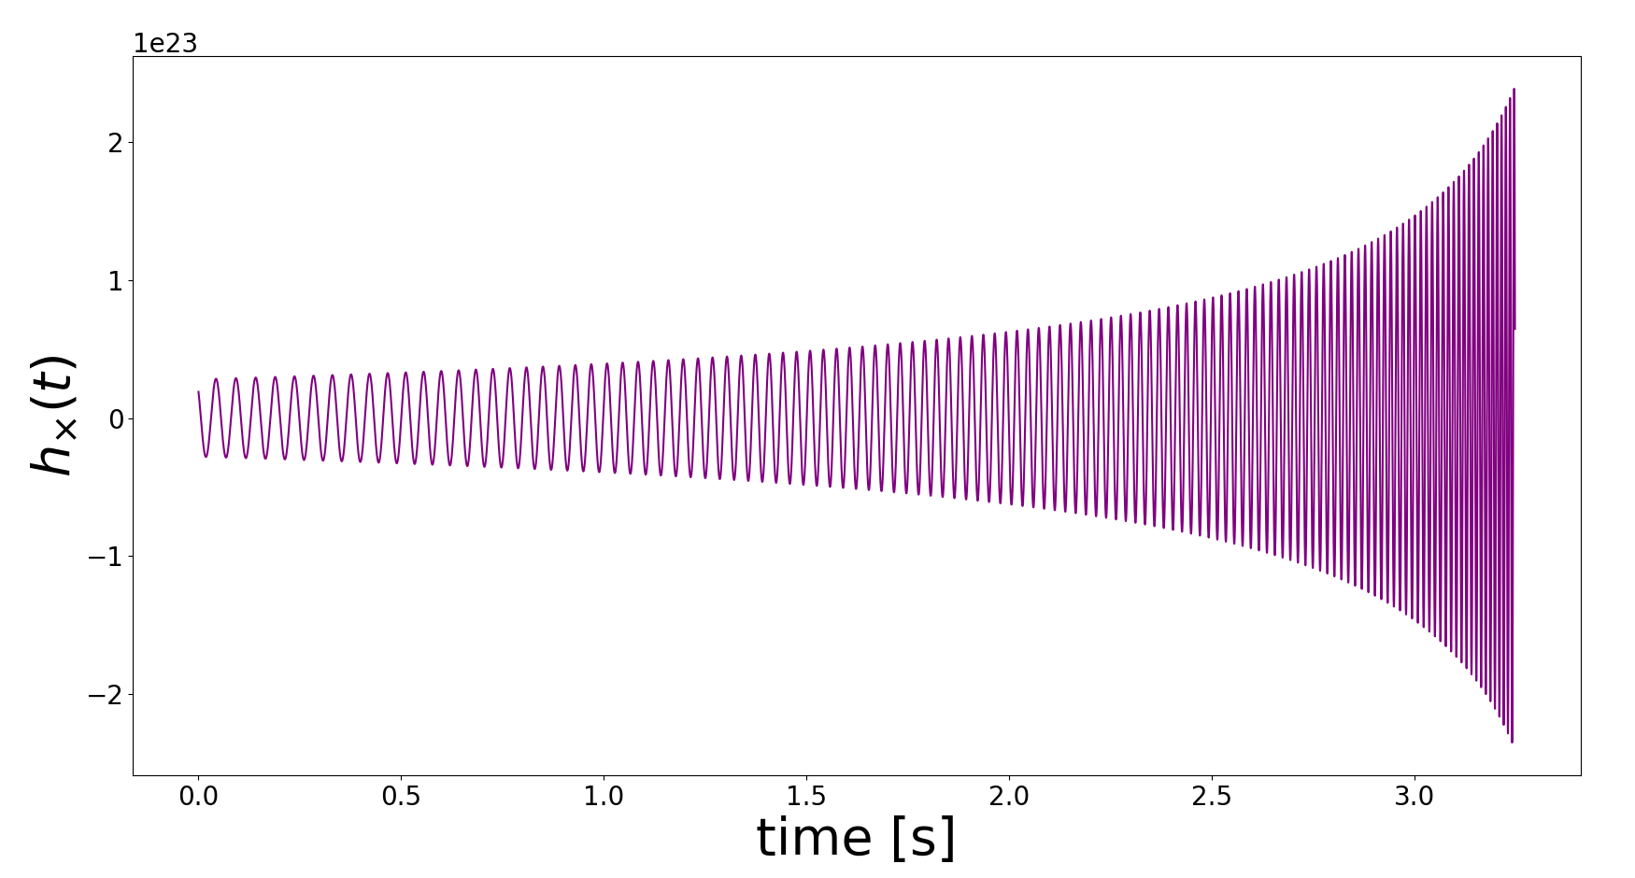
Removing the Circular Assumption
Modular behavior appears in the h× polarization but not h₊ similar to the previous set of waveforms
No modulations appear when spin-precession is removed as seen in the purple waveform

Slide 16
Conclusion
Waveforms generated from the new orbital and spin evolution equations could potentially replicate precessing waveforms from IMRPhenom approximants
Orbit-averaging quantities such as the binary separation when deriving the orbital evolution equations could explain why the effects of eccentricity are not seen in the strain.

Slide 17



Acknowledgements
This work was supported by the National Science Foundation Research Experience for Undergraduates (NSF REU) program, the LIGO Laboratory Summer Undergraduate Research Fellowship program (NSF LIGO), and the California Institute of Technology Student-Faculty Programs.
Credit: This presentation template was created by Slidesgo and includes icons by Flaticon

