Slide 1

Upconverted light for GW detector control and readout
Dhatri Raghunathan | IIT Kharagpur
26th July 2024
Mentors: Rana Adhikari,
Koji Arai, Radhika Bhatt, Francisco Salces Carcoba
1

Slide 2
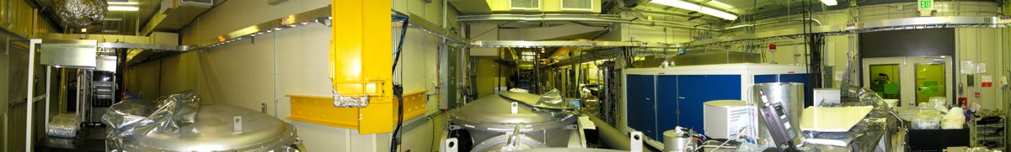
2 Phases: Time Split Between 40m Lab and West Bridge Sub basement
Arm Length Stabilization: Upconverted light for control
Sum-frequency generation: Upconverted light for readout
Auxiliary (AUX) laser reference
Voyager readout: 2 µm to 700 nm
LIGO 40m lab
Single pass demonstration
Image source: 40m wiki
2
Notes:
LIGO and its 40m prototype locks and stabilizes the primary laser to the arm cavity by using an auxiliary (AUX) laser as a reference. Noise budgeting catalogs all relevant noise sources to explain the observed noise, enabling targeted improvements to enhance the interferometer stability and sensitivity.

Slide 3
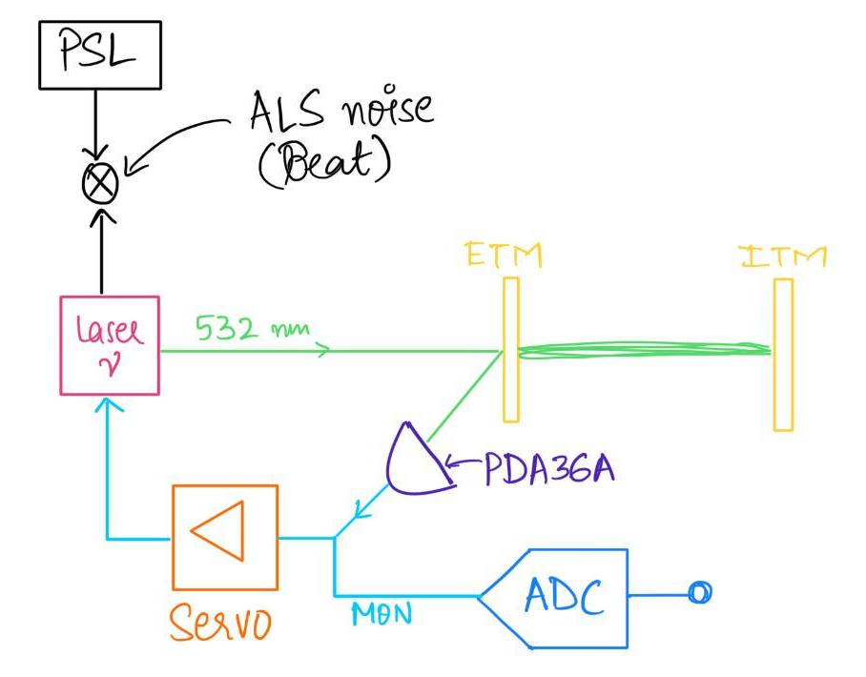
Arm Length Stabilization (ALS)
Sense L_{ARM} independently
Beat signal =
PSL - AUX Laser
Feedback loop:
IMC - PSL
3

Slide 4
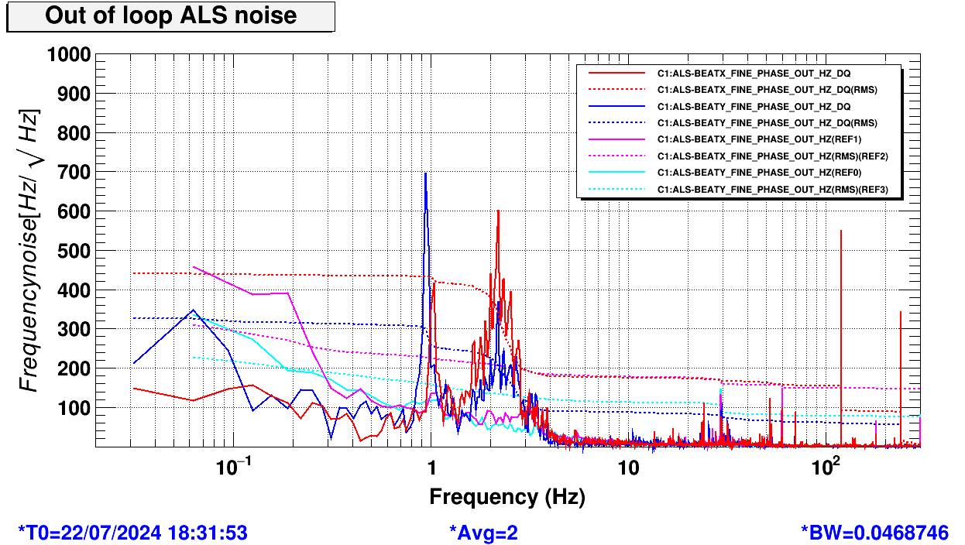
Noise budgeting
Golden Triad:
Noise measurements
Transfer functions
Calibration
Controls noise: Auxiliary laser feedback loop
Physical & Environmental noise: Seismic Contribution
RMS of Beat signal when PSL locked to IMC, AUX lasers locked
4

Slide 5
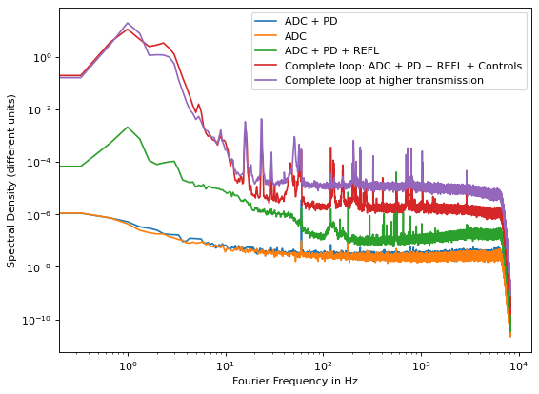
AUX REFL PD Feedback Loop
Isolate different subparts of the feedback loop
Spectral density (Hz/rt(Hz))
The controls noise due to the feedback loop contributes the most to the noise as the plot shows.
Fourier frequency in Hz
5

Slide 6
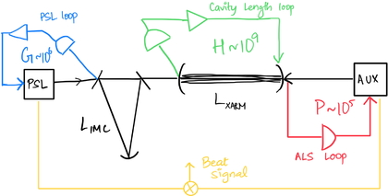
Seismic Noise Contribution
Residual ALS BEAT noise at low frequency
Finite common-mode rejection -> AUX laser gain
Proposal: Increase XAUX servo gain or implement seismic feedforward techniques
6

Slide 7
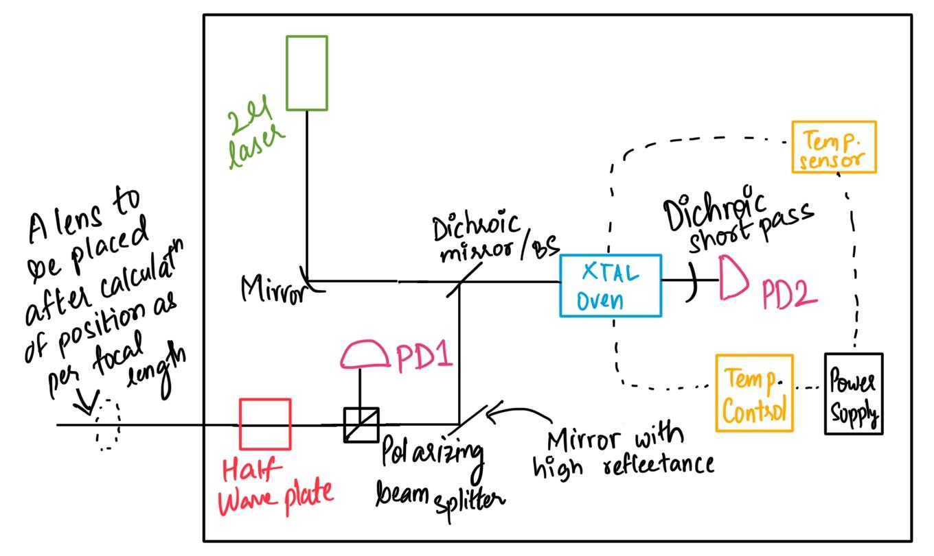
Sum Frequency Generation (SFG)
LIGO Voyager upgrade: requires a quantum efficiency (QE) of at least 99% at the 2 µm operating wavelength
In nonlinear crystal materials, second-order SFG process occurs: ν1 + ν2 = ν3
Demonstrate a single pass of SFG using a PPLN crystal and a pump of 1064 µm, upconverting 2 µm light to 700 nm
7

Slide 8
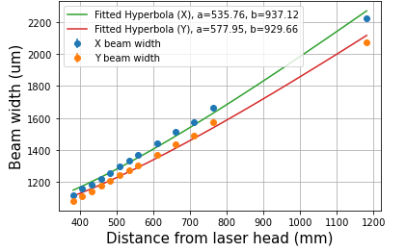
Single 1064 nm laser input to PPKTP crystal, generating 532 nm output
Second Harmonic Generation: Initial Setup
Beam Profiling
Consider crystal damage threshold
Beam Waist determination
x² / a² - y² / b² = 1
x: Rayleigh range,
y: beam width
8

Slide 9
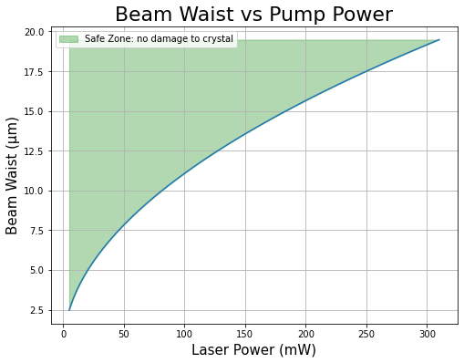
Single 1064 nm laser input to PPKTP crystal, generating 532 nm output
Second Harmonic Generation: Initial Setup
Beam Profiling
Consider crystal damage threshold
Beam Waist determination
8

Slide 10
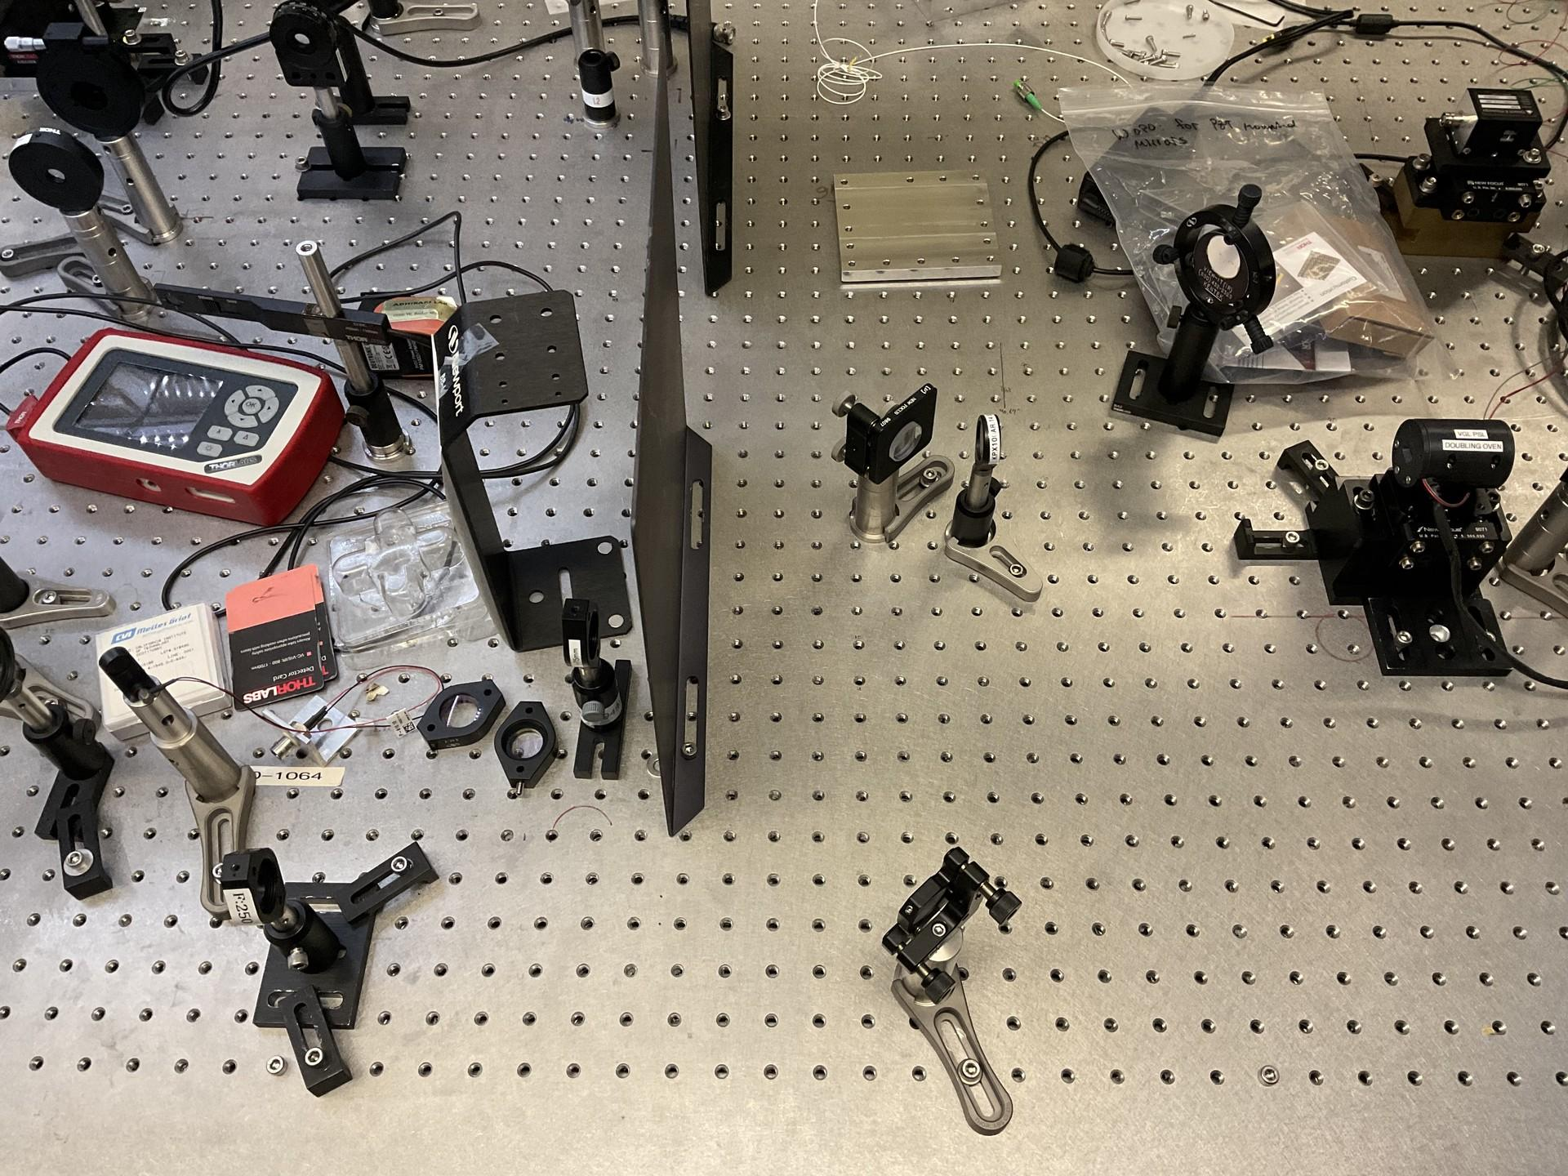
Get the waist required at the crystal position
Mode Matching and Beam Alignment
Optimal focal lengths and lens positions chosen to achieve required beam waist
Using 2 steering mirrors simultaneously for alignment
9

Slide 11


Slide 12
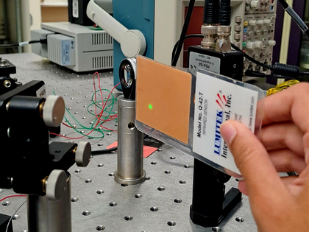
SHG Observed!
9

Slide 13
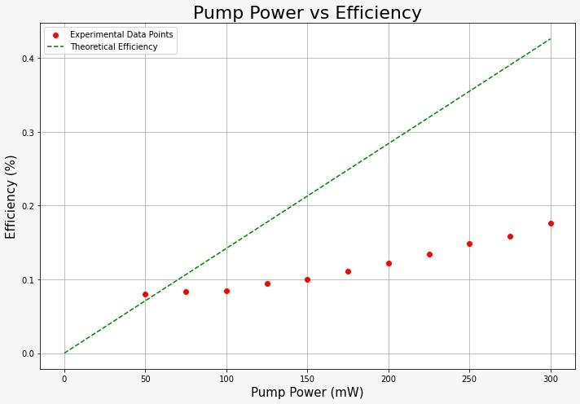
Effect of pump power
SHG
Output Characterization
Polarization checked to account for discrepancy
10

Slide 14
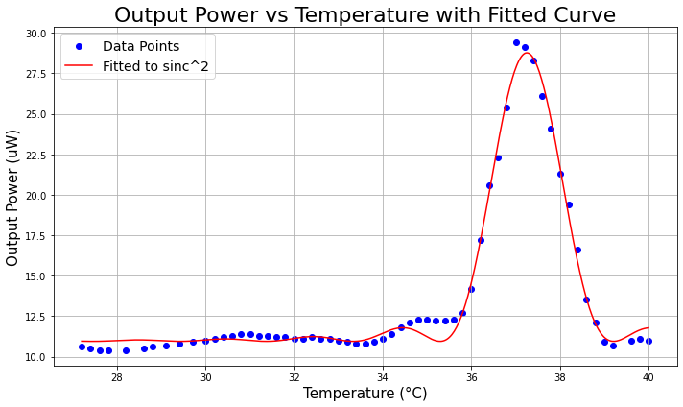
Effect of crystal temperature
SHG
Output Characterization
37.2 °C: Highest efficiency while still first order insensitive to temperature fluctuations!
11

Slide 15
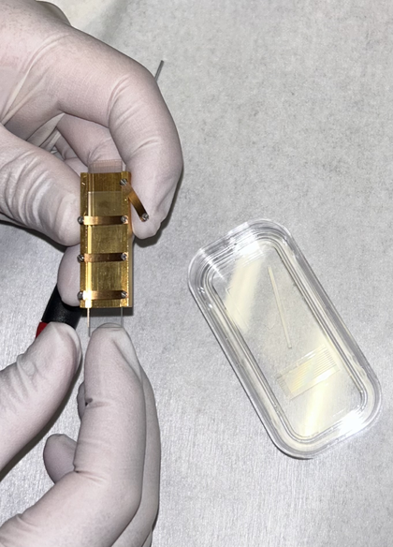
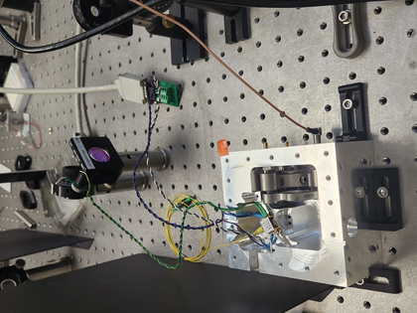
Almost there!
Sum Frequency Generation
Crystal replaced
ECDL ready
12

Slide 16
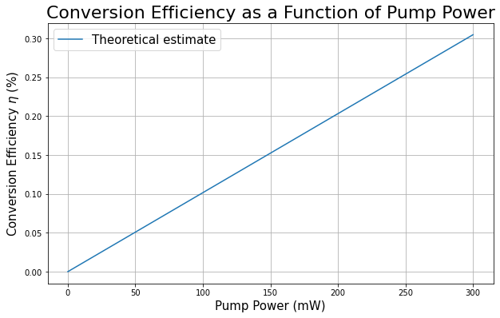
Theoretical estimate: efficiency
Sum Frequency Generation
12

Slide 17
Other efforts
40m interferometer locking controls & challenges
Vacuum pressure tank checker
13

Slide 18
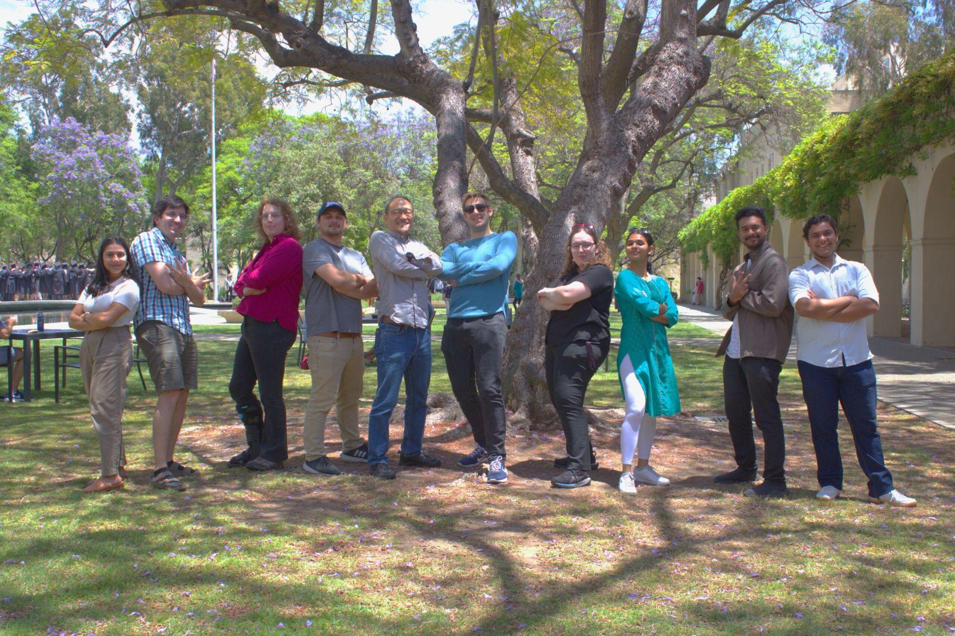
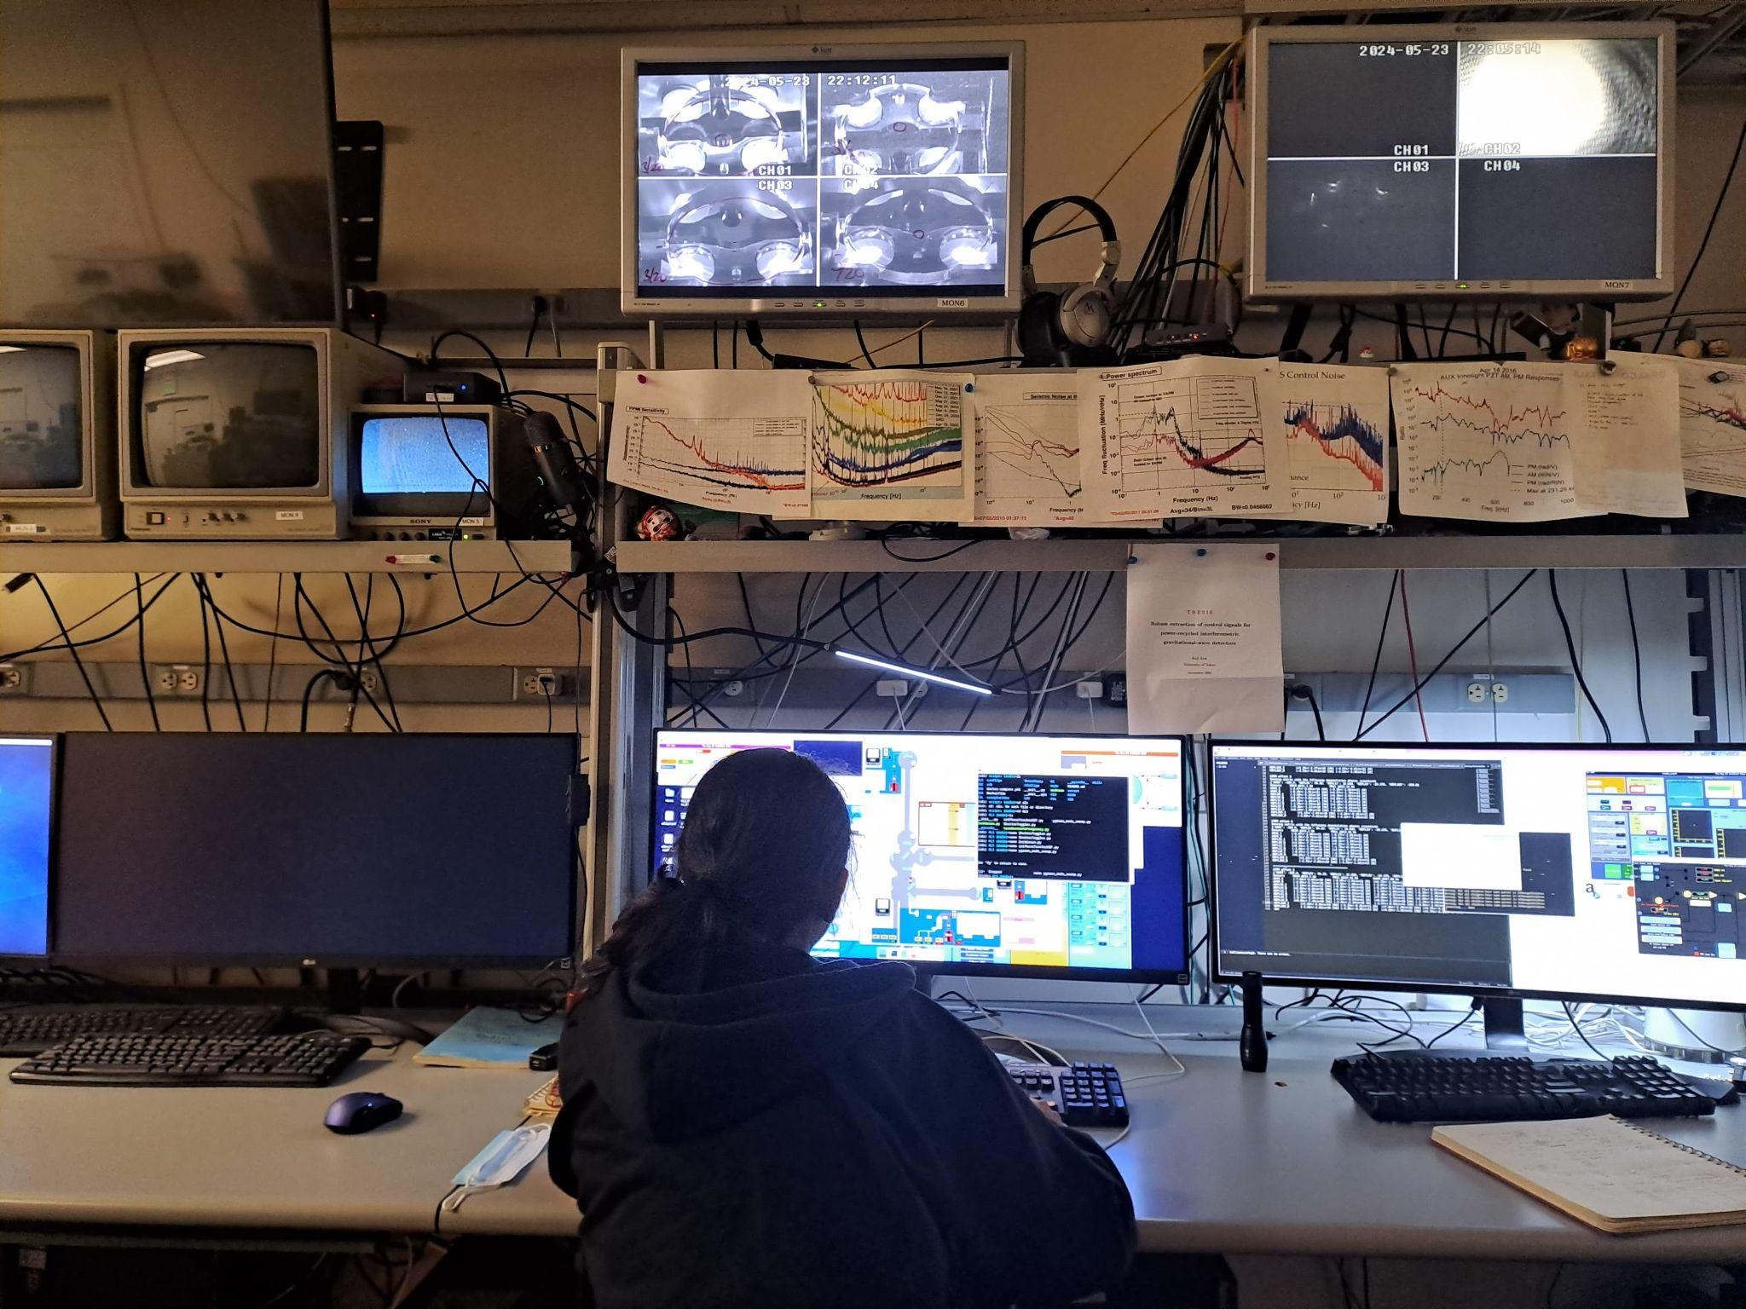
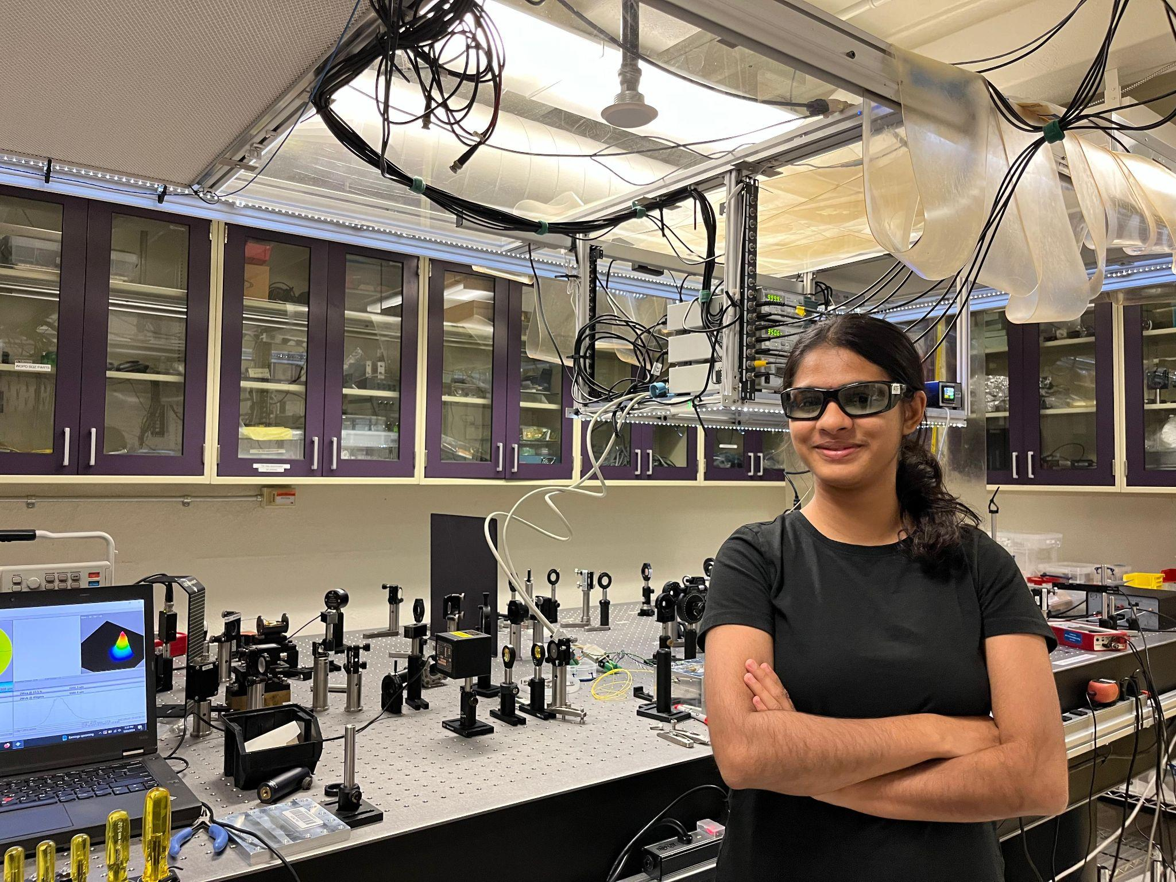
Thank you!
The entire 40m group, folks at WB/Downs and my fellow SURFS!
Questions please
14

