Slide 1

Improving Posterior Predictive Checks for Gravitational Wave Population Analyses
Sophia Winney, Simona Miller, Katerina Chatziioannou
August 22, 2024

Slide 2
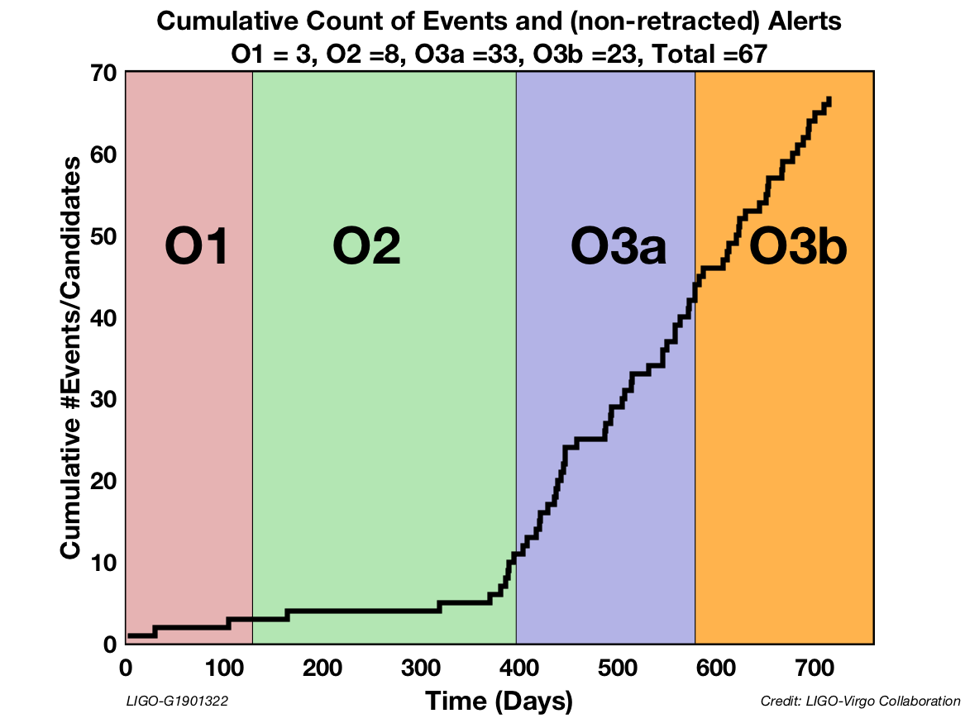
Gravitational Wave Population Analyses
Binary black holes (BBHs) are completely described by 15 parameters
The accumulation of detections from BBHs enables us to propose population models for these parameters
Focus: tilt angle (θ), between the angular momentum vector of the system and the BH
  Insight to stellar evolution, BBH formation channels

Slide 3
Posterior Predictive Checks (PPCs)
Notes:
Add table explaining event-level vs. data-level PPCs/algorithms

Slide 4
Posterior Predictive Checks (PPCs)
Premise: a good population model should predict data that aligns with the observed data.
Notes:
Add table explaining event-level vs. data-level PPCs/algorithms

Slide 5
Posterior Predictive Checks (PPCs)
Premise: a good population model should predict data that aligns with the observed data.
Problem: when uncertainties are high, comparing the observations (or event posteriors) to the predicted data is not very informative about the model’s performance.
Notes:
Add table explaining event-level vs. data-level PPCs/algorithms

Slide 6
Posterior Predictive Checks (PPCs)
Premise: a good population model should predict data that aligns with the observed data.
Problem: when uncertainties are high, comparing the observations (or event posteriors) to the predicted data is not very informative about the model’s performance.
Approach: use simulated populations with known parameter distributions to see if the following PPCs can appropriately identify bad models:
  Traditional (event-level) PPCs: Currently used in GW population analysis
  Maximum likelihood (data-level) PPCs
  Partial PPCs
  Split predictive checks (SPCs)
Notes:
Add table explaining event-level vs. data-level PPCs/algorithms

Slide 7
Bayes’ Theorem in Context
P(θ|{d}) ~ p({d}|θ) π(θ)

Slide 8
Bayes’ Theorem in Context
P(θ|{d}) ~ p({d}|θ) π(θ)
P(θ|{d}) → POSTERIOR: Probability of the BH having tilt angle θ given what has been observed

Slide 9
Bayes’ Theorem in Context
P(θ|{d}) ~ p({d}|θ) π(θ)
P(θ|{d}) → POSTERIOR: Probability of the BH having tilt angle θ given what has been observed
p({d}|θ) → LIKELIHOOD: Probability of collecting the observed data if the tilt were truly angle θ

Slide 10
Bayes’ Theorem in Context
P(θ|{d}) ~ p({d}|θ) π(θ)
P(θ|{d}) → POSTERIOR: Probability of the BH having tilt angle θ given what has been observed
p({d}|θ) → LIKELIHOOD: Probability of collecting the observed data if the tilt were truly angle θ
π(θ) → PRIOR: Probability of a BH having tilt angle θ, regardless of any observations

Slide 11
Bayes’ Theorem in Context
P(θ|{d}) ~ p({d}|θ) π(θ)
P(θ|{d}) → POSTERIOR: Probability of the BH having tilt angle θ given what has been observed
p({d}|θ) → LIKELIHOOD: Probability of collecting the observed data if the tilt were truly angle θ
π(θ) → PRIOR: Probability of a BH having tilt angle θ, regardless of any observations
Population models act as priors.

Slide 12
Traditional (Event-level) PPCs
Key components:

Slide 13
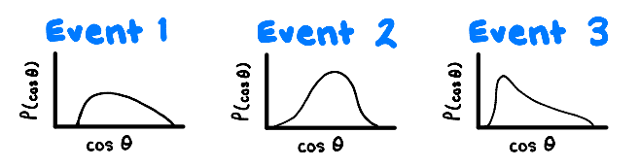
Traditional (Event-level) PPCs
Key components:
Individual events: parameter posteriors inferred from the simulated populations

Slide 14
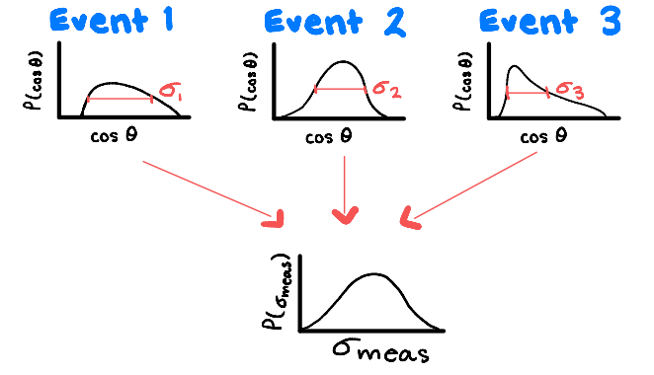
Traditional (Event-level) PPCs
Key components:
Individual events: parameter posteriors inferred from the simulated populations
Hyperposterior: overall distribution of individual event hyperparameters (e.g. mean, standard deviation)

Slide 15
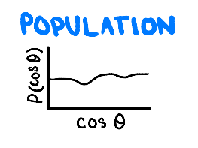
Traditional (Event-level) PPCs
Key components:
Individual events: parameter posteriors inferred from the simulated populations
Hyperposterior: overall distribution of individual event hyperparameters (e.g. mean, standard deviation)
Injected population: a uniform tilt angle population distribution passed through some detectability criteria

Slide 16
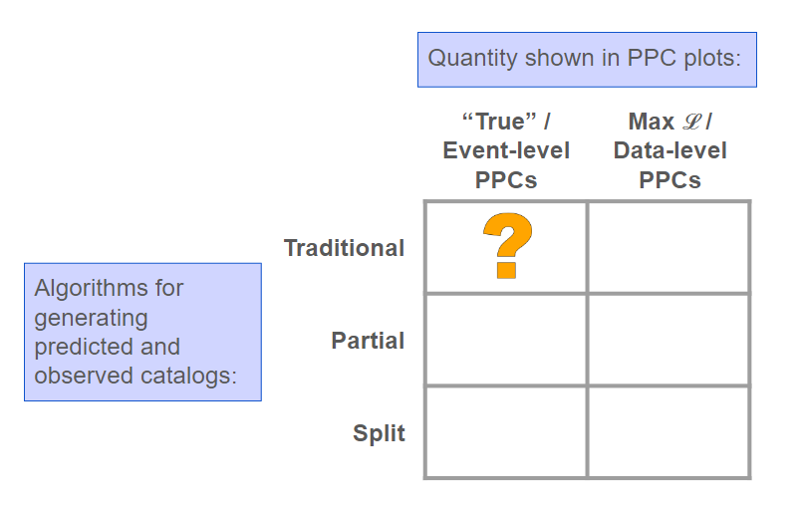
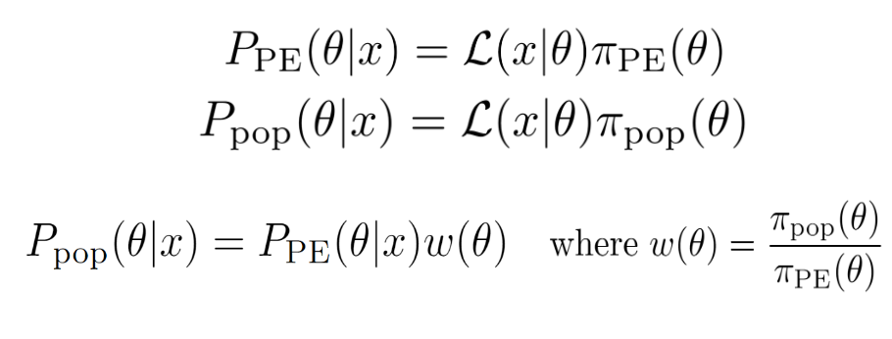
Traditional (Event-level) PPCs
How PPCs are done: reweighting by the ratio of priors

Slide 17
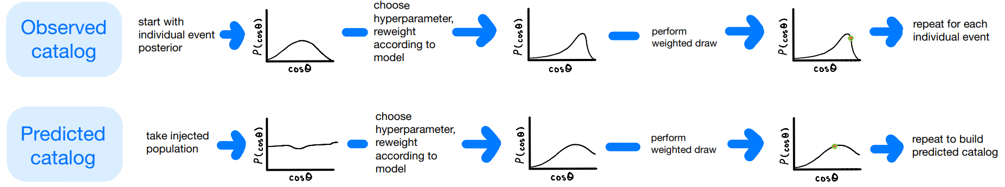
Draw hyperparameter, reweight according to model
Start with event posterior
Perform a weighted draw
Repeat x70 (for each individual event)

Slide 18
Draw hyperparameter, reweight according to model
Start with event posterior
Perform a weighted draw
PROBLEM LIES HERE! Individual events with wide, prior-dominated (uncertain) posteriors conform to the model after reweighting.
Repeat x70 (for each individual event)

Slide 19
Draw hyperparameter, reweight according to model
Start with event posterior
Perform a weighted draw
PROBLEM LIES HERE! Individual events with wide, prior-dominated (uncertain) posteriors conform to the model after reweighting.
Repeat x70 (for each individual event)
Draw hyperparameter, reweight according to model
Start with uniform distribution
Perform 70 weighted draws

Slide 20
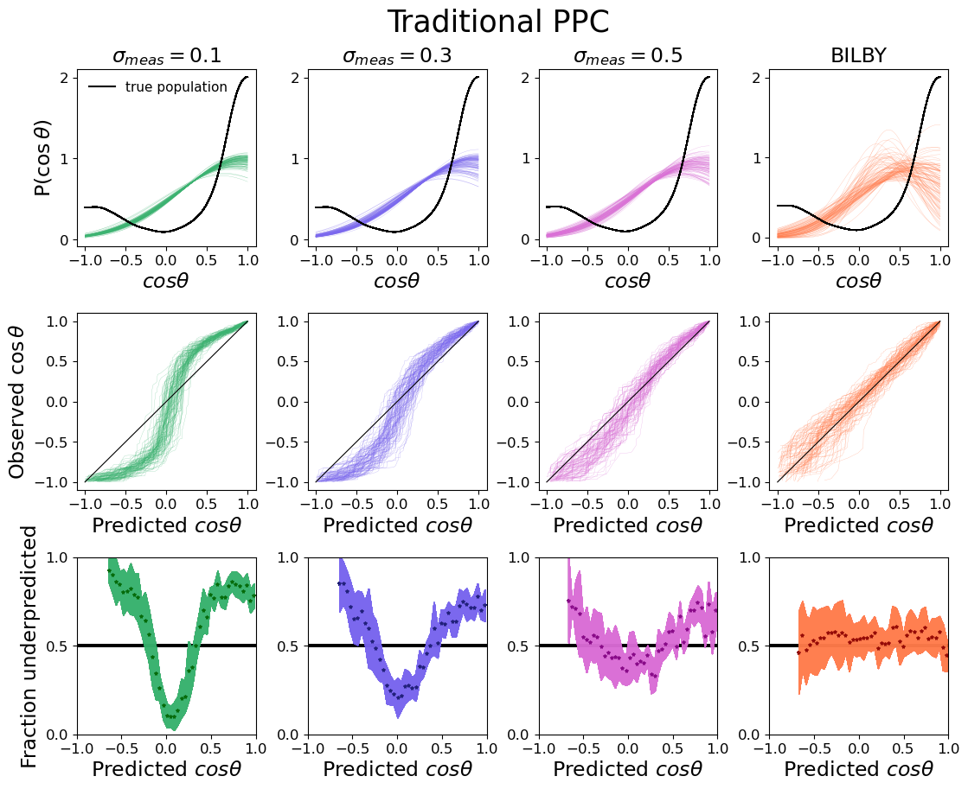

*Replicated from
Miller et al., 2024
Realistic Event Posteriors

Slide 21
*Replicated from
Miller et al., 2024
Realistic Event Posteriors

Slide 22
*Replicated from
Miller et al., 2024
Realistic Event Posteriors

Slide 23
Quantifying Model Misspecification:
p-values
Requires a choice of a diagnostic statistic t.

Slide 24
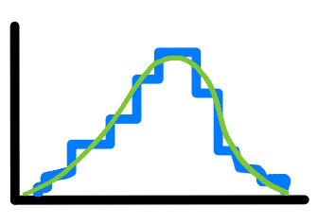
Quantifying Model Misspecification:
p-values
Requires a choice of a diagnostic statistic t.
f_{pred}(t)
Process:
Find the distribution of t across 1000 predicted catalogs → f_{pred}(t)
P(t)
t

Slide 25
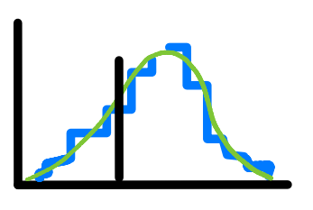
Quantifying Model Misspecification:
p-values
Requires a choice of a diagnostic statistic t.
f_{pred}(t)
Process:
Find the distribution of t across 1000 predicted catalogs → f_{pred}(t)
Calculate t_{obs} for an observed catalog
P(t)
t
t_{obs}
f_{pred}(t)
P(t)
t

Slide 26
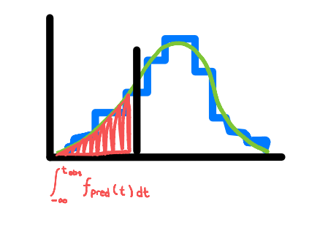
Quantifying Model Misspecification:
p-values
Requires a choice of a diagnostic statistic t.
f_{pred}(t)
Process:
Find the distribution of t across 1000 predicted catalogs → f_{pred}(t)
Calculate t_{obs} for an observed catalog
Integrate f_{pred}(t) from [-∞, t_{obs}] to get the chance of observing that amount of deviation from the model‘s predictions→ p-value
P(t)
t
t_{obs}
f_{pred}(t)
P(t)
t_{obs}
t
f_{pred}(t)
P(t)
t

Slide 27
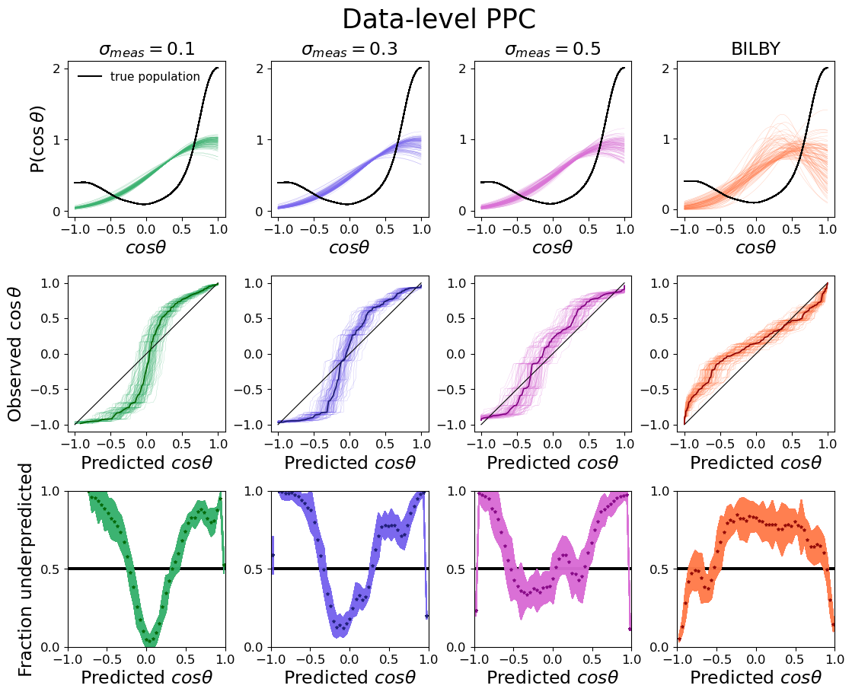

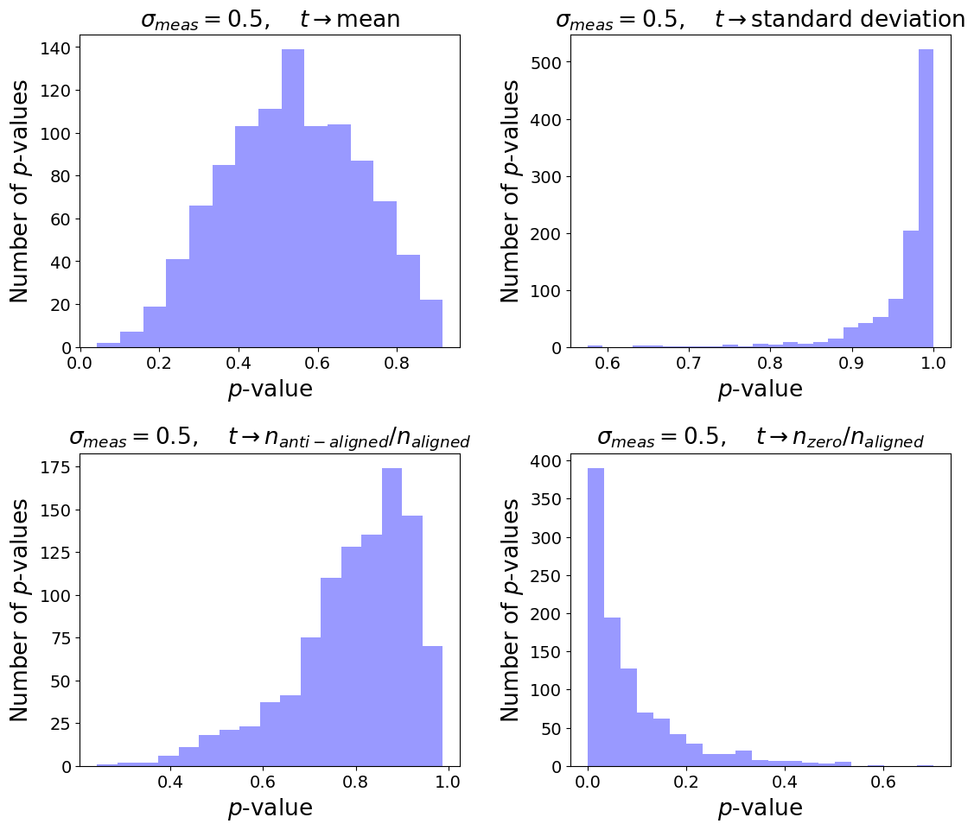

Potential analysis of model mismatch using p-values
Realistic Event Posteriors
Model mean is not inconsistent with true population
Model severely underpredicts width of true curve
Model tends to underpredict anti-aligned spins
Model severely overpredicts cosθ ≈ zero
Notes:
Emphasize novelty of this analysis

Slide 28
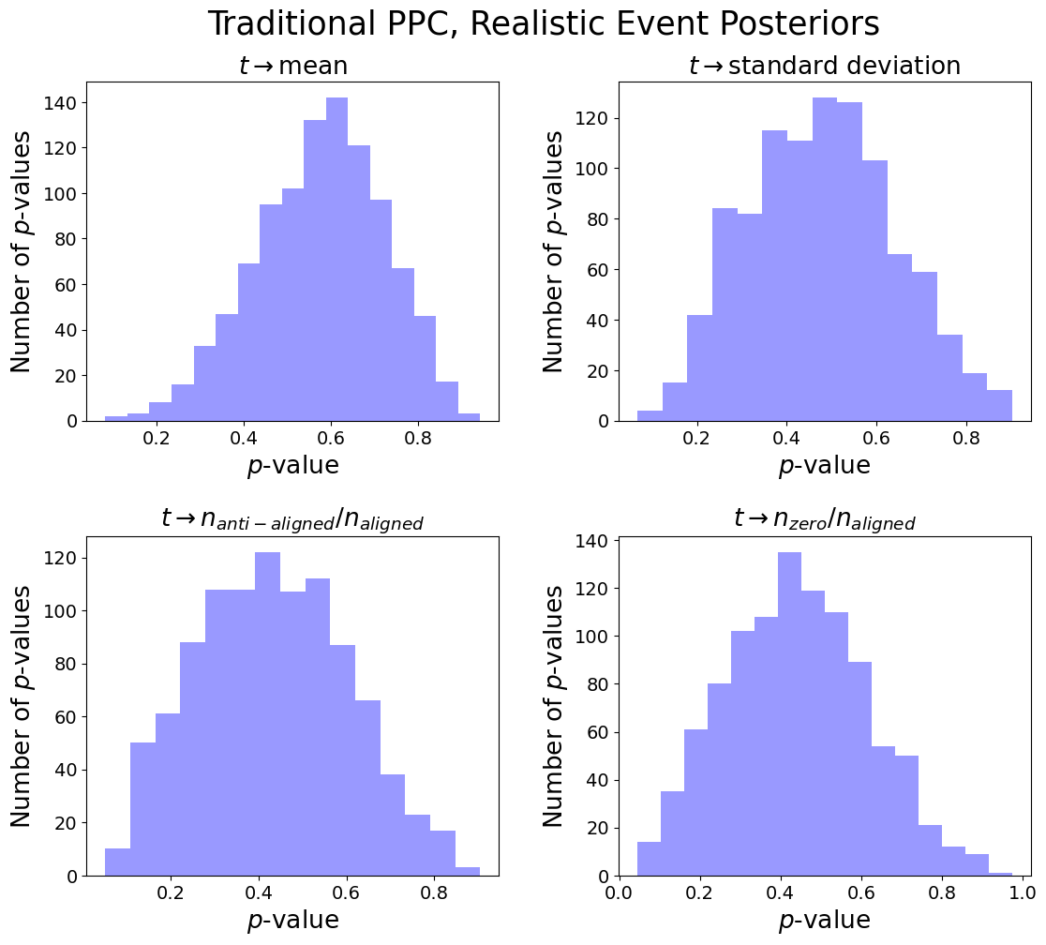
When p-values are uninformative:
Notes:
In theory, p-values distributions are useful, but they normally look like this:

Slide 29
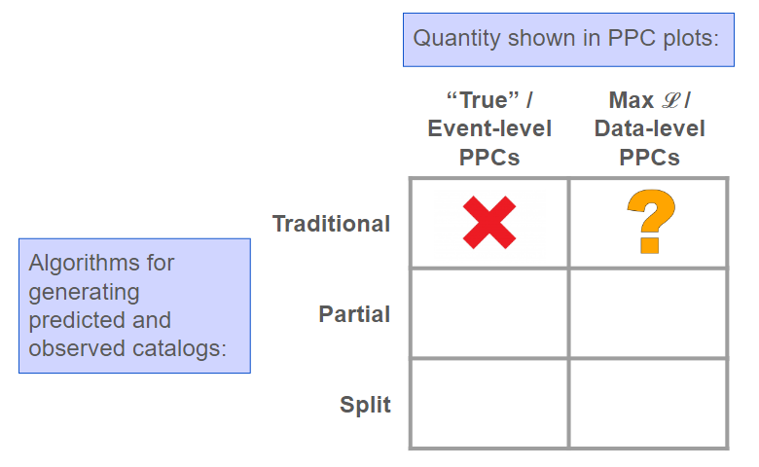
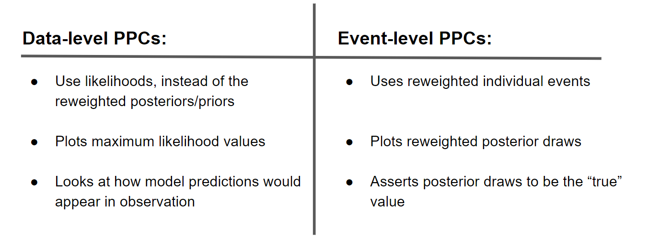
Alternative:
Data-level PPCs
For data-driven PPCs, we avoid reweighting the individual events to the population model and instead emulate observation with the predicted parameters.

Slide 30
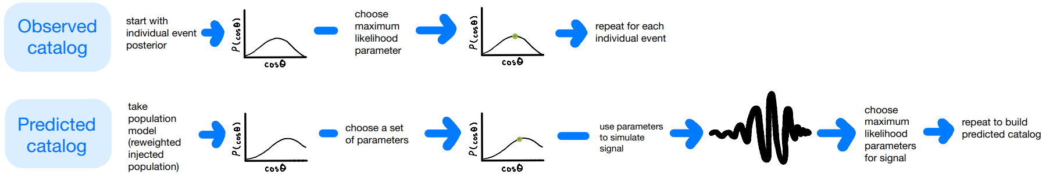
Start with event posterior
Select the maximum likelihood parameters
Repeat x70 (for each individual event)

Slide 31
Start with event posterior
Select the maximum likelihood parameters
Repeat x70 (for each individual event)
Use parameters to generate a signal with noise
Take model predictions
Draw a set of parameters
Select the maximum likelihood parameters for the signal
Repeat x70

Slide 32
Realistic Event Posteriors

Slide 33
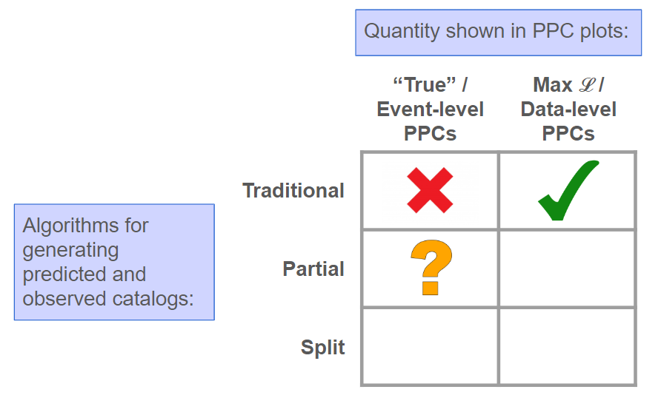
Partial PPCs
Remove one degree of freedom by fixing t_{pred} = t_{obs}. If we fix one attribute of the two distributions to be the same, what other characteristics of the curves are revealed?

Slide 34
Partial PPCs
Remove one degree of freedom by fixing t_{pred} = t_{obs}. If we fix one attribute of the two distributions to be the same, what other characteristics of the curves are revealed?
Process:
Generate an observed and predicted catalog using the same process as traditional PPCs.
Regenerate the predicted catalog until
t_{obs} - δt < t_{pred} < t_{obs} + δt.

Slide 35
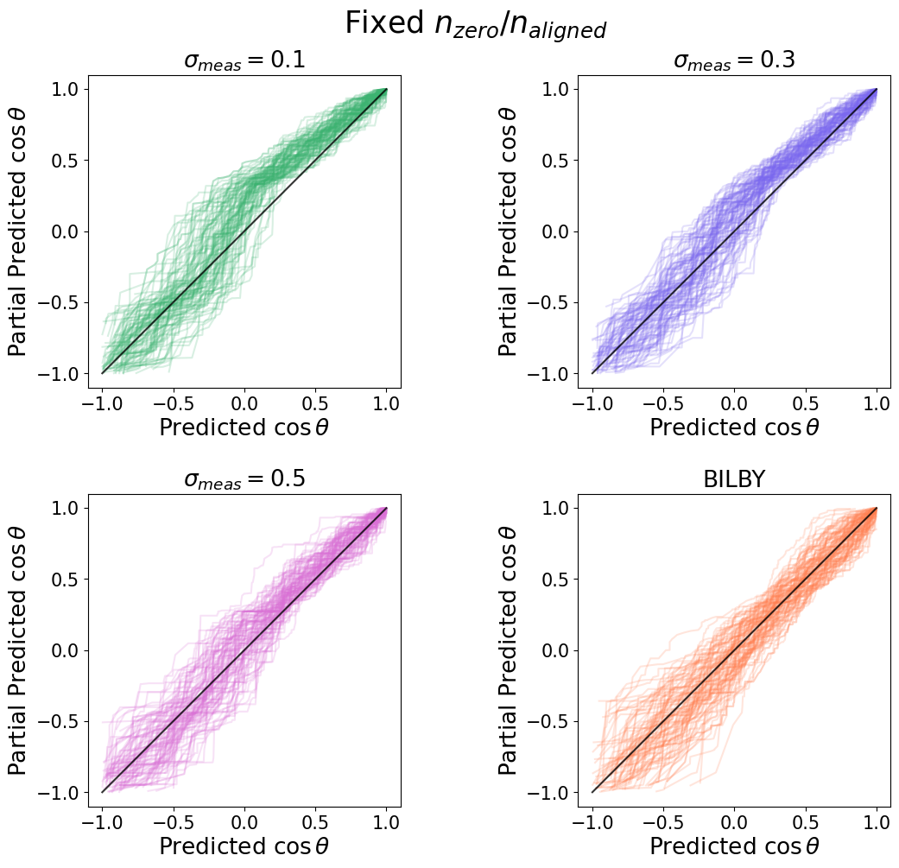
Realistic Event Posteriors

Slide 36

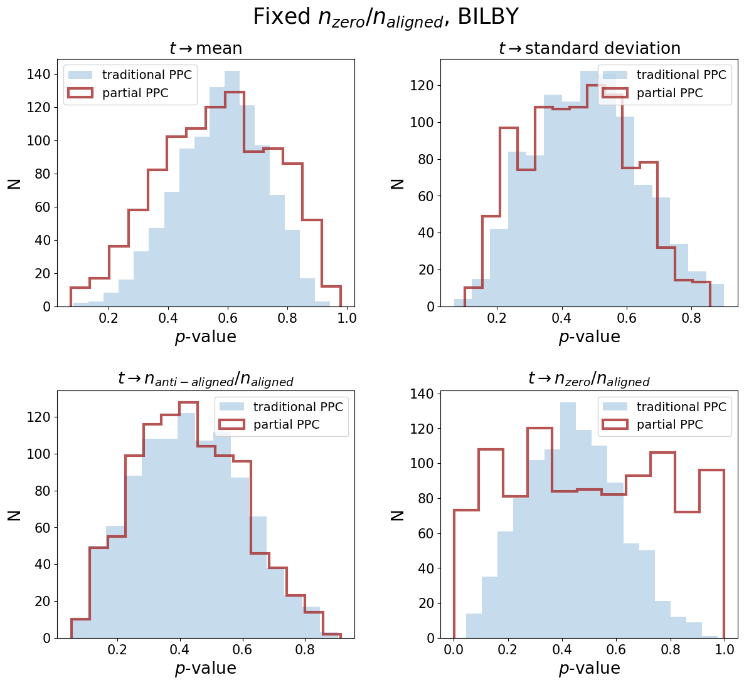
Realistic Event Posteriors

Slide 37
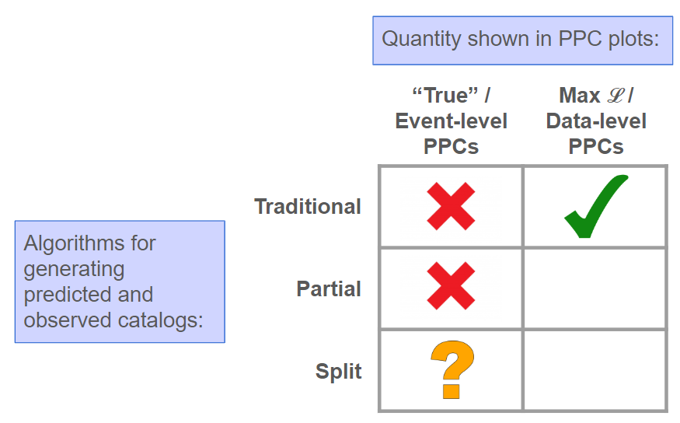
Split Predictive Checks (SPCs)
Partition the individual events into two subsets and use one to learn about the other.

Slide 38
Split Predictive Checks (SPCs)
Partition the individual events into two subsets and use one to learn about the other.
Process:
Calculate the probability of each hyperparameter given half of the individual event posteriors.
Perform weighted draws of hyperparameters instead of uniform draws.
Reweight the other half of the individual events and the injected population.

Slide 39
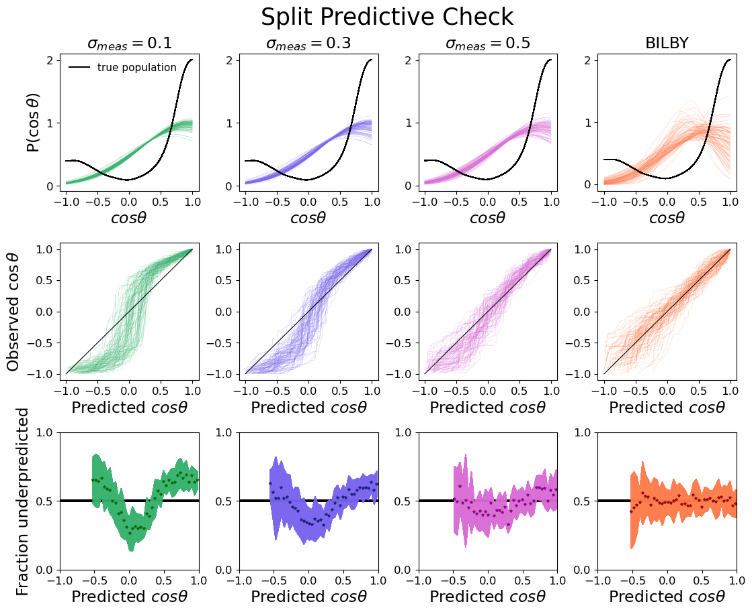
Realistic Event Posteriors

Slide 40
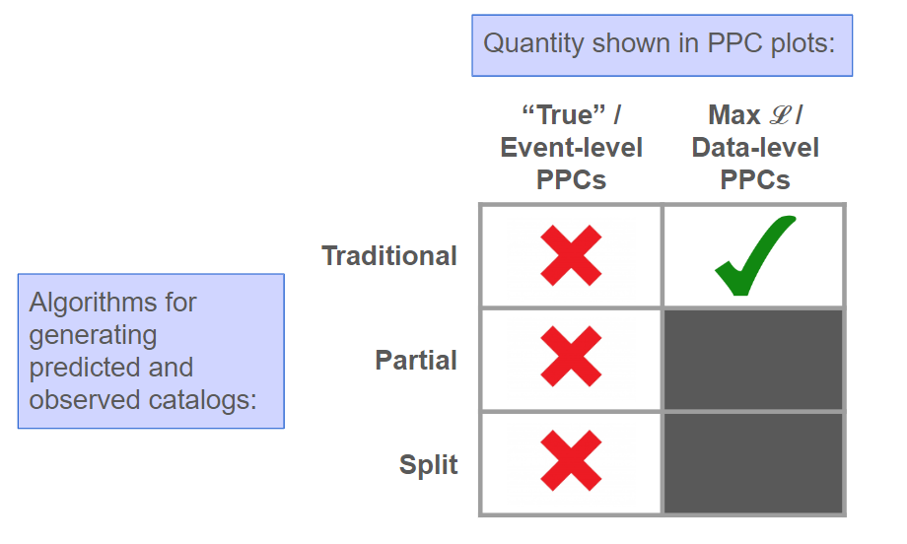
Summary
Event-level (traditional/partial/split) PPCs are not discerning of bad models with high measurement uncertainties, regardless of the method used to generate the observed/predicted catalogs
Data-level PPCs are able to show model misspecification with realistic measurement uncertainties
p-value distributions can demonstrate whether a model checker is informative, as well as show characteristics of the true population

Slide 41



Acknowledgements
Thank you to:
Simona Miller, Katerina Chatziioannou, and Patrick Meyers
NSF REU & NSF LIGO Lab SURF
Caltech Student-Faculty Programs & WAVE Fellowship

Slide 42
References
S. J. Miller, Z. Ko, T. A. Callister, K. Chatziioannou, Gravitational waves carry information beyond effective spin parameters but it is hard to extract (2024), arXiv:2401.05613.
J. Li, J. Huggins, Calibrated model criticism using split predictive checks (2024), arXiv:2203.15897.
M.J. Bayarri, M.E. Castellanos, Bayesian Checking of the Second Levels of Hierarchical Models (2007), DOI:10.1214/07-STS235.
M. Fishbach, W. M. Farr, D. E. Holz, The Most Massive Binary Black Hole Detections and the Identification of Population Outliers (2019), arXiv:1911.05882

Slide 43
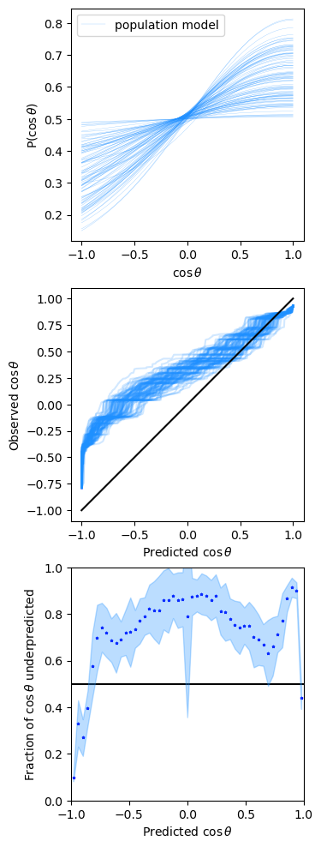
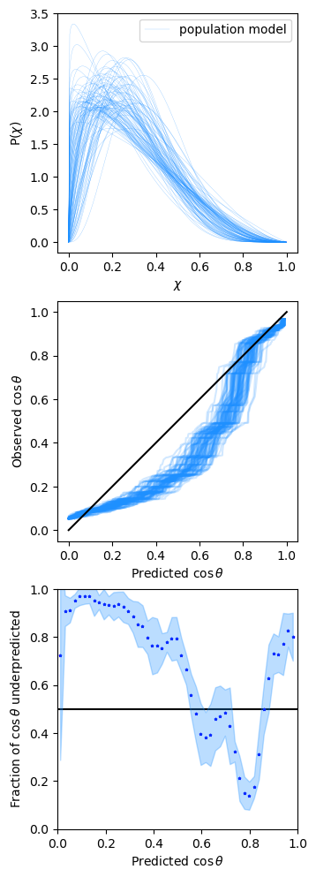
Bonus:
Data-level PPC using O3 data

Slide 44
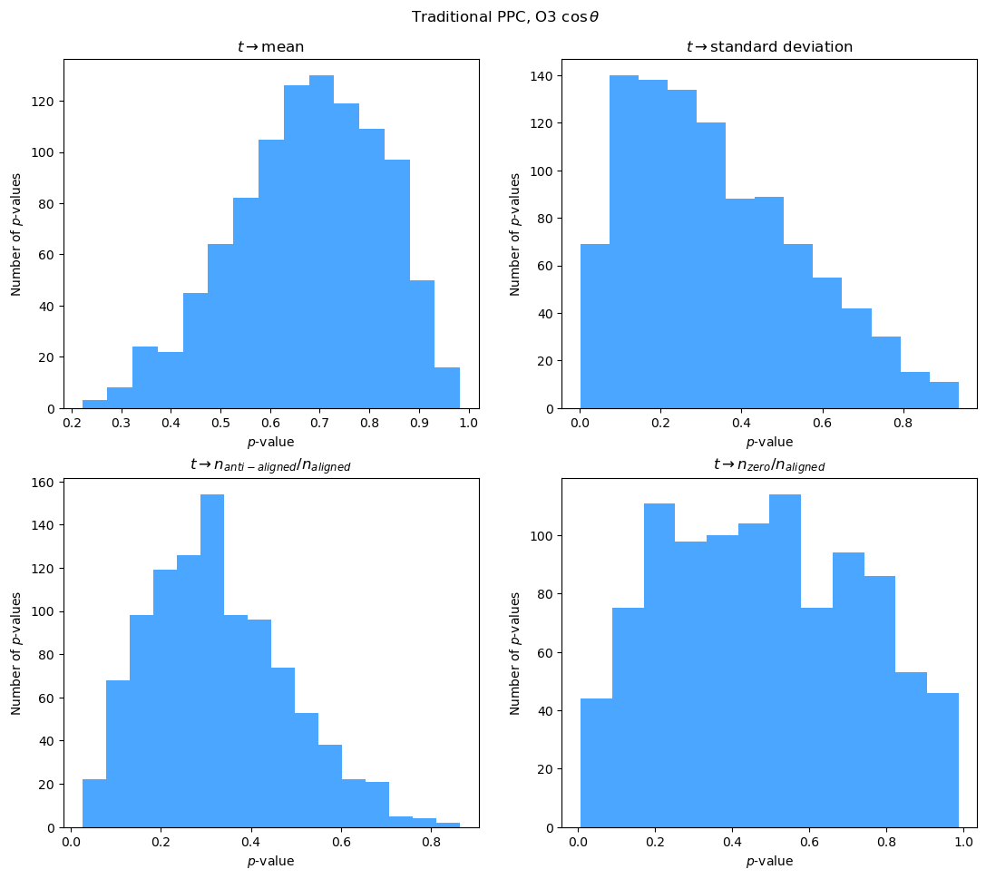

Slide 45
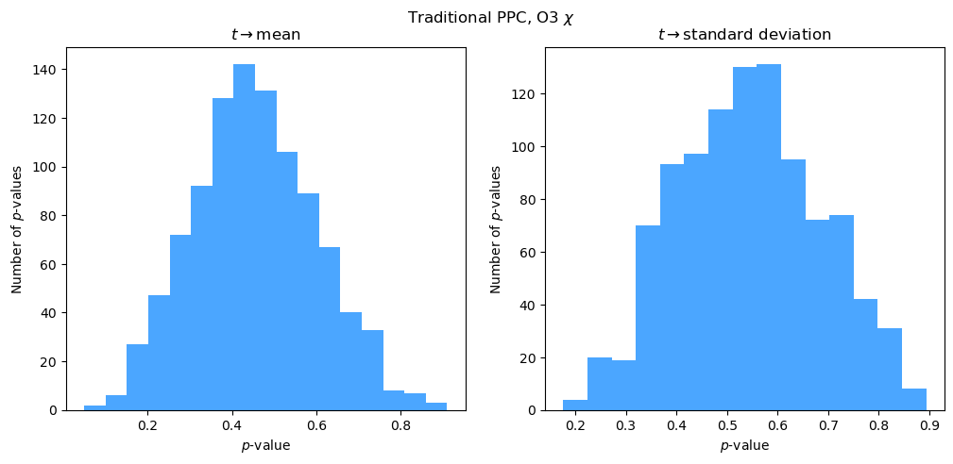

Slide 46
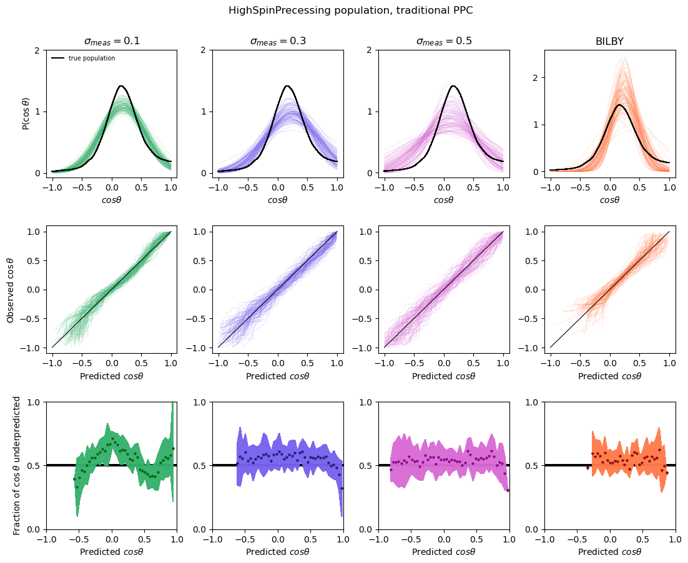

Slide 47
