Slide 1
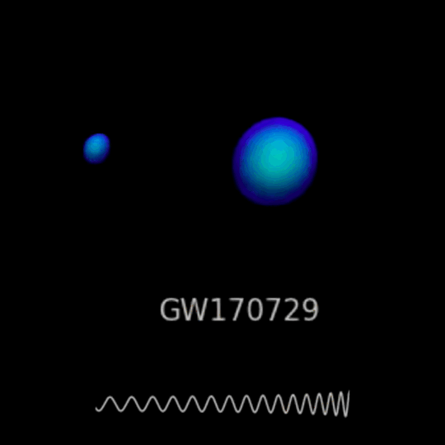
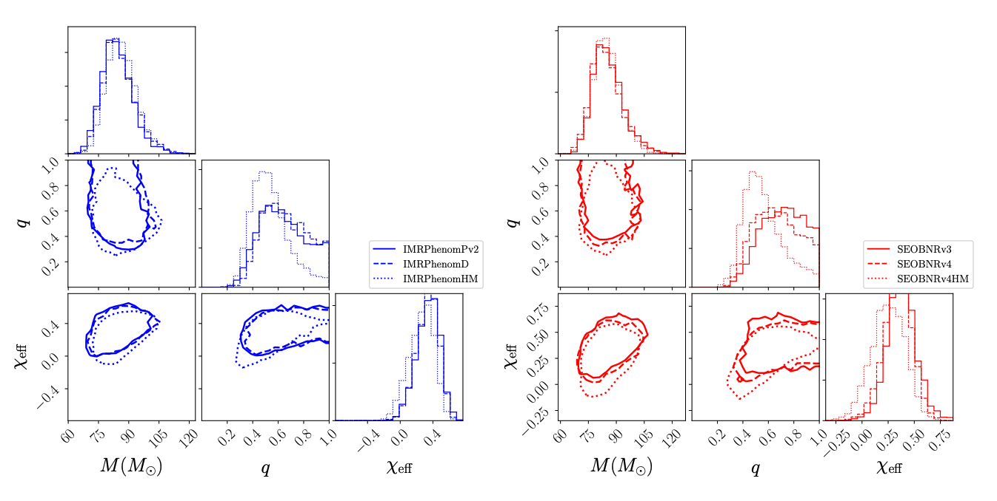
Current and Future capability of Compact Binary Coalescence Parameter Estimation (PE) methods
1
Mentors : Alan Weinstein & Jacob Golomb
Sterling Scarlett LIGO SURF 2024
1

Slide 2
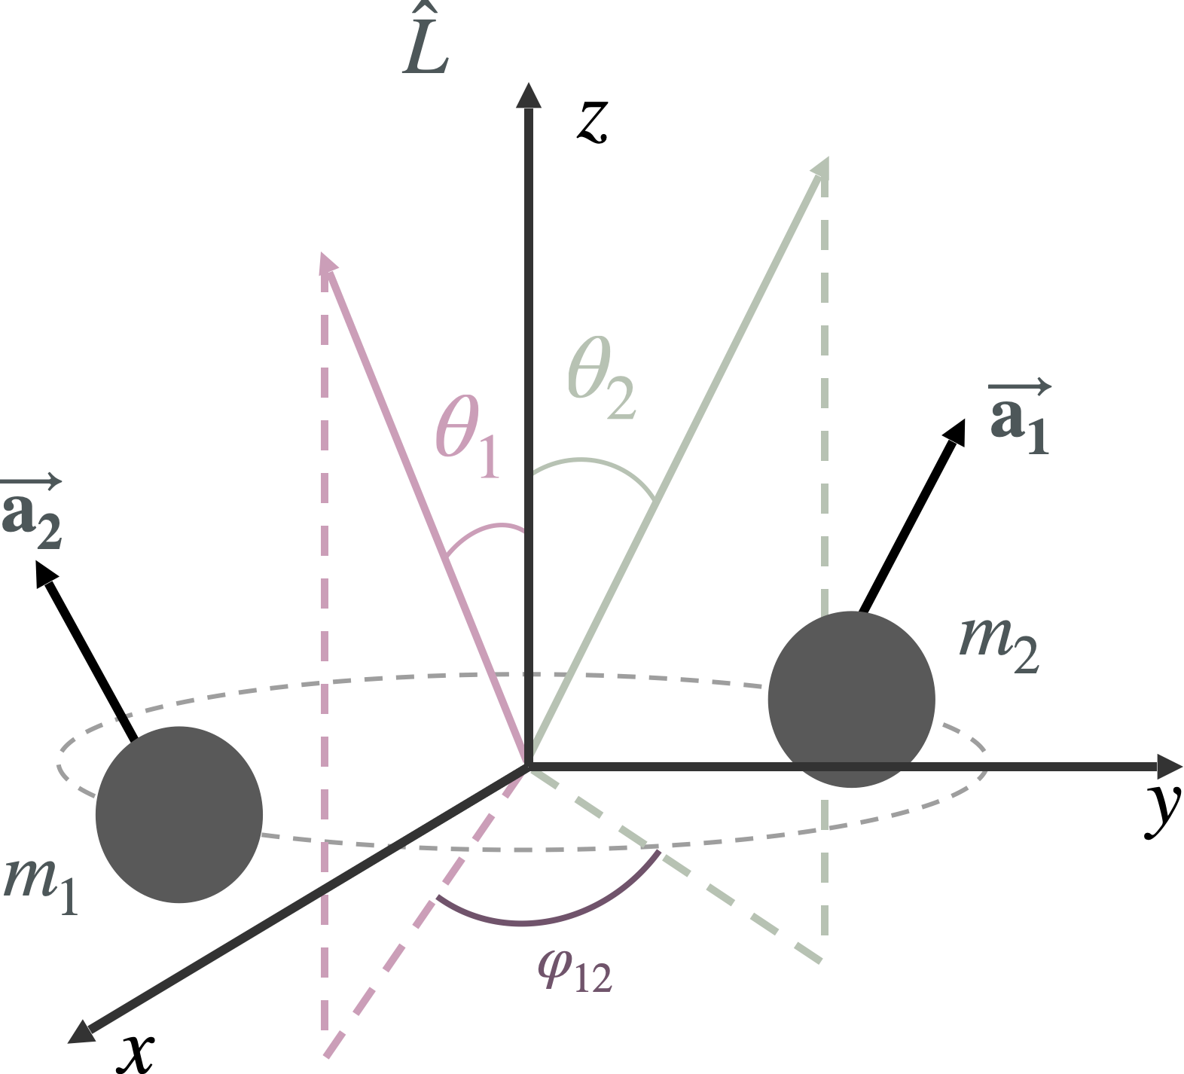
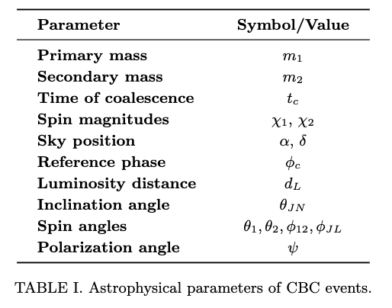
Introduction to PE

Slide 3

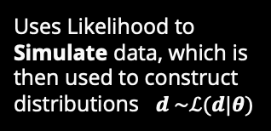





Methods of PE
Bilby
Bayesian Inference Likelihood based
Develops a likelihood for the given parameters then samples the likelihood to construct distributions $p\left(θ | d\right)$
$$p\left(θ | d\right)=\frac{ℒ\left(d | θ\right)π\left(θ\right)}{𝒵}$$
Simulation based likelihood free
$$ℒ\left(d | θ\right)=\frac{1}{2πσ^{2}}\exp\left(−\frac{1}{2}\frac{{\left|d−μ\left(θ\right)\right|}^{2}}{σ^{2}}\right)$$
Dingo
Uses Likelihood to Simulate data, which is then used to construct distributions $d \sim ℒ(d|θ)$
$$q\left(θ | d\right)≈p\left(θ | d\right)$$
Fisher information matrix
GWFish
$$ℒ∝\exp\left(\frac{1}{2}Δθ^{i}ℱ_{ij}Δθ^{j}\right)$$
Approximates likelihood to assume the error distributions
in the parameter errors are Gaussian
$$ℱ_{ij}=\left(\frac{∂h}{∂θ_{i}} | \frac{∂h}{∂θ_{j}}\right),$$

Slide 4
Motivations for Research
Faster Speeds More approximation
More confidence/ Reliability
Understand Current Confidence Layers of PE and Offer Predictions on the Future
Bilby
Dingo
GWFish
- Currently there exist a preestablished hierarchy of PE methods, so one of our focuses is to provide qualitative and quantitative understanding on the current state of PE and potentially offer predictions on the future of it, via comparative analysis of the Speed Accuracy Precision and Gausianity
Test Dingo
Test Reliability of Fisher matrix in 3G detectors
- Given that Dingo isn't fully understood, an aim of my project is to test current Dingo against the standard Bilby, measuring how close/far it is.
- In 3G detectors such as a Cosmic Explorer (CE) we predict less noise interference will make the distributions of parameters look more uniform. This will potentially make fisher matrix approach to PE useful at high SNR.

Slide 5
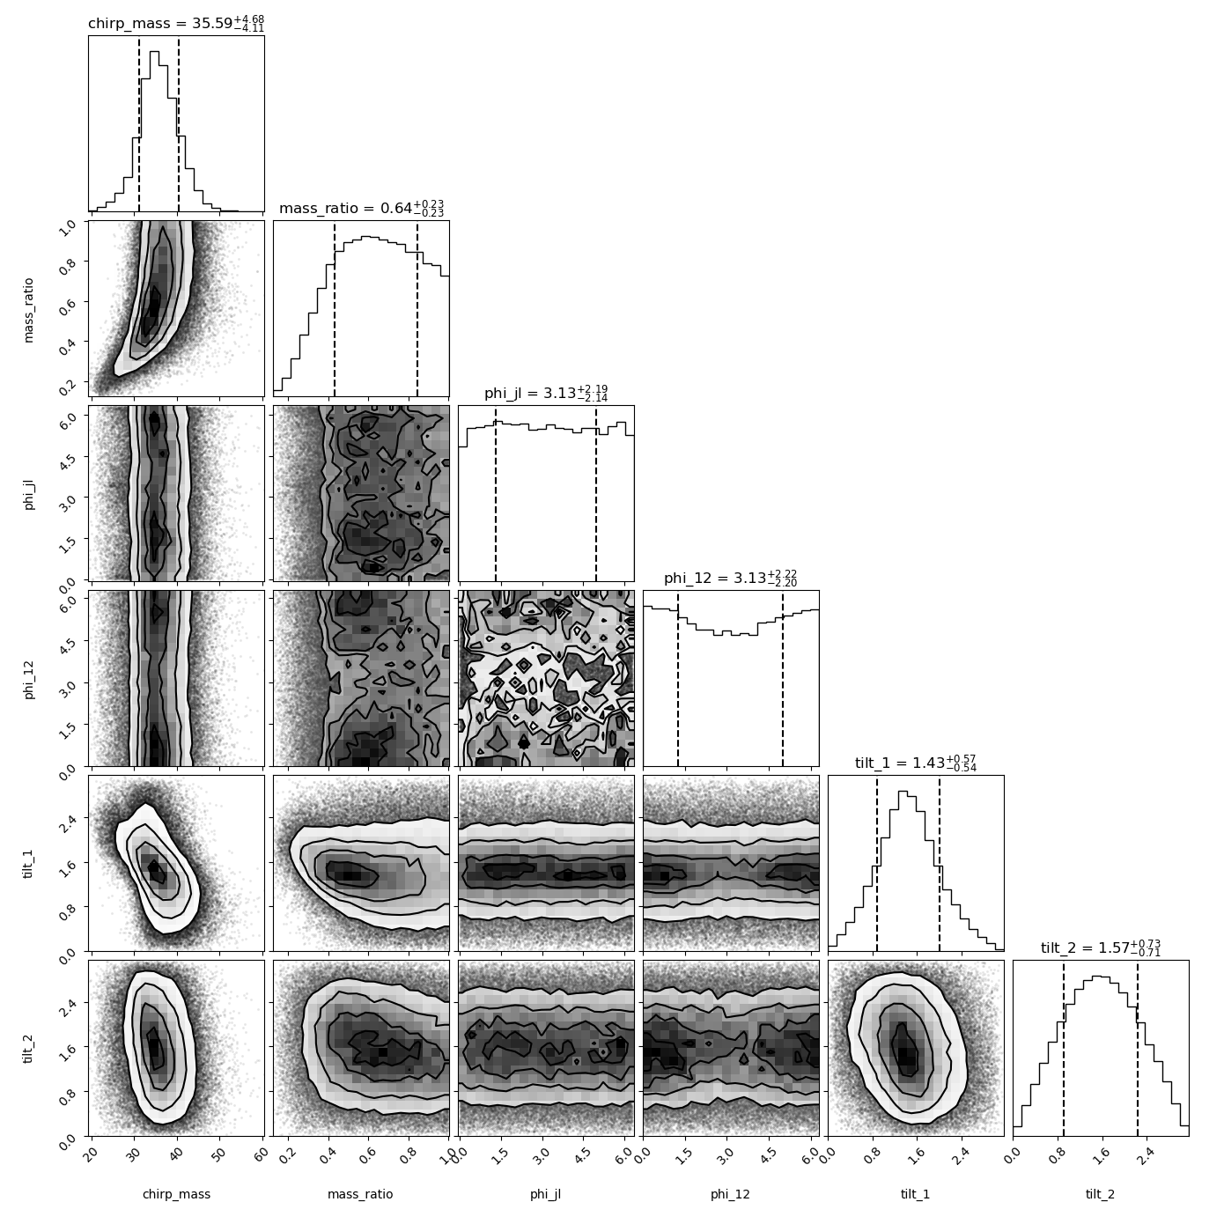
Dingo Challenges
Dingo
- There exist pre trained Dingo networks for 04 real and synthetic noise that can conduct PE, but none for 05 and CE simulations.
- We Aimed to train Dingo to be capable of conducting 05 and CE PE but were unable to train an effective model by the end of the summer, so we focus our comparison of Bilby and Gwfish in this presentation.

Slide 6
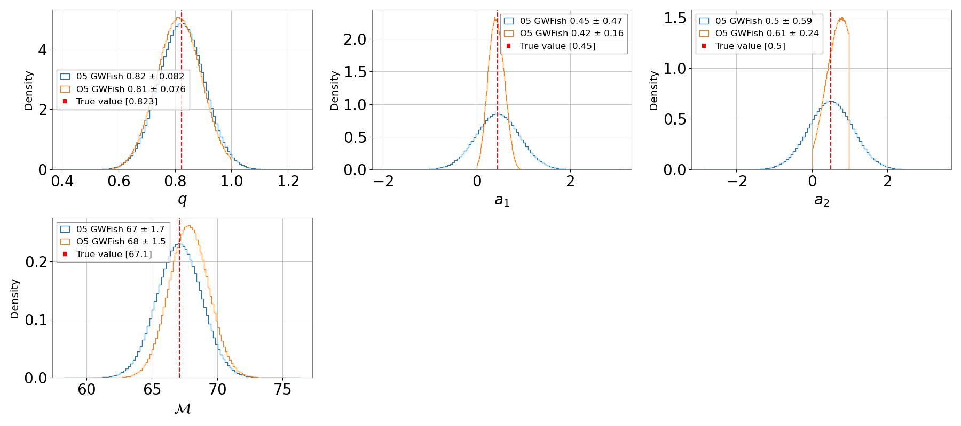

Incorporating Priors into posteriors from GWFish
Calculate the Probability Density Functions (PDFs) for Each Parameter:
${\text{PDF}}_{i,j}=p_{i}\left(θ_{i}^{\left(j\right)}\right)$
2. Compute the Product of the PDFs:
$P\left(θ_{1}^{\left(j\right)},θ_{2}^{\left(j\right)},…,θ_{N}^{\left(j\right)}\right)=\prod_{i=1}^{N}{p_{i}\left(θ_{i}^{\left(j\right)}\right)}$
3. Normalize the Product of PDFs:
$Z=\sum_{j=1}^{M}{\prod_{i=1}^{N}{p_{i}\left(θ_{i}^{\left(j\right)}\right)}}$
$w_{j}=\frac{\prod_{i=1}^{N}{p_{i}\left(θ_{i}^{\left(j\right)}\right)}}{Z}$
4. Resample from the Multivariate Uniform Distribution Using the Weights:

Slide 7
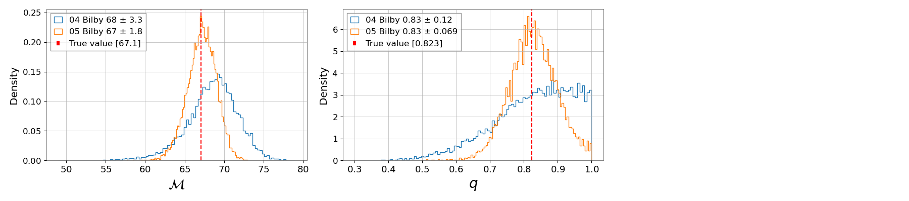
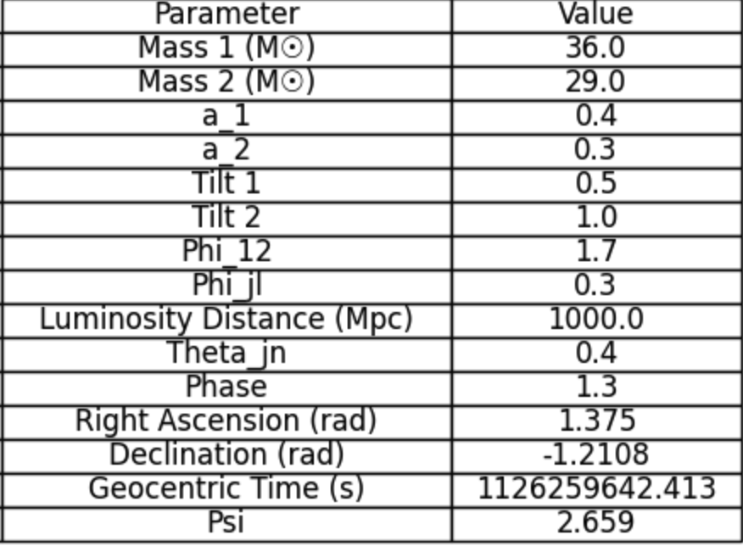
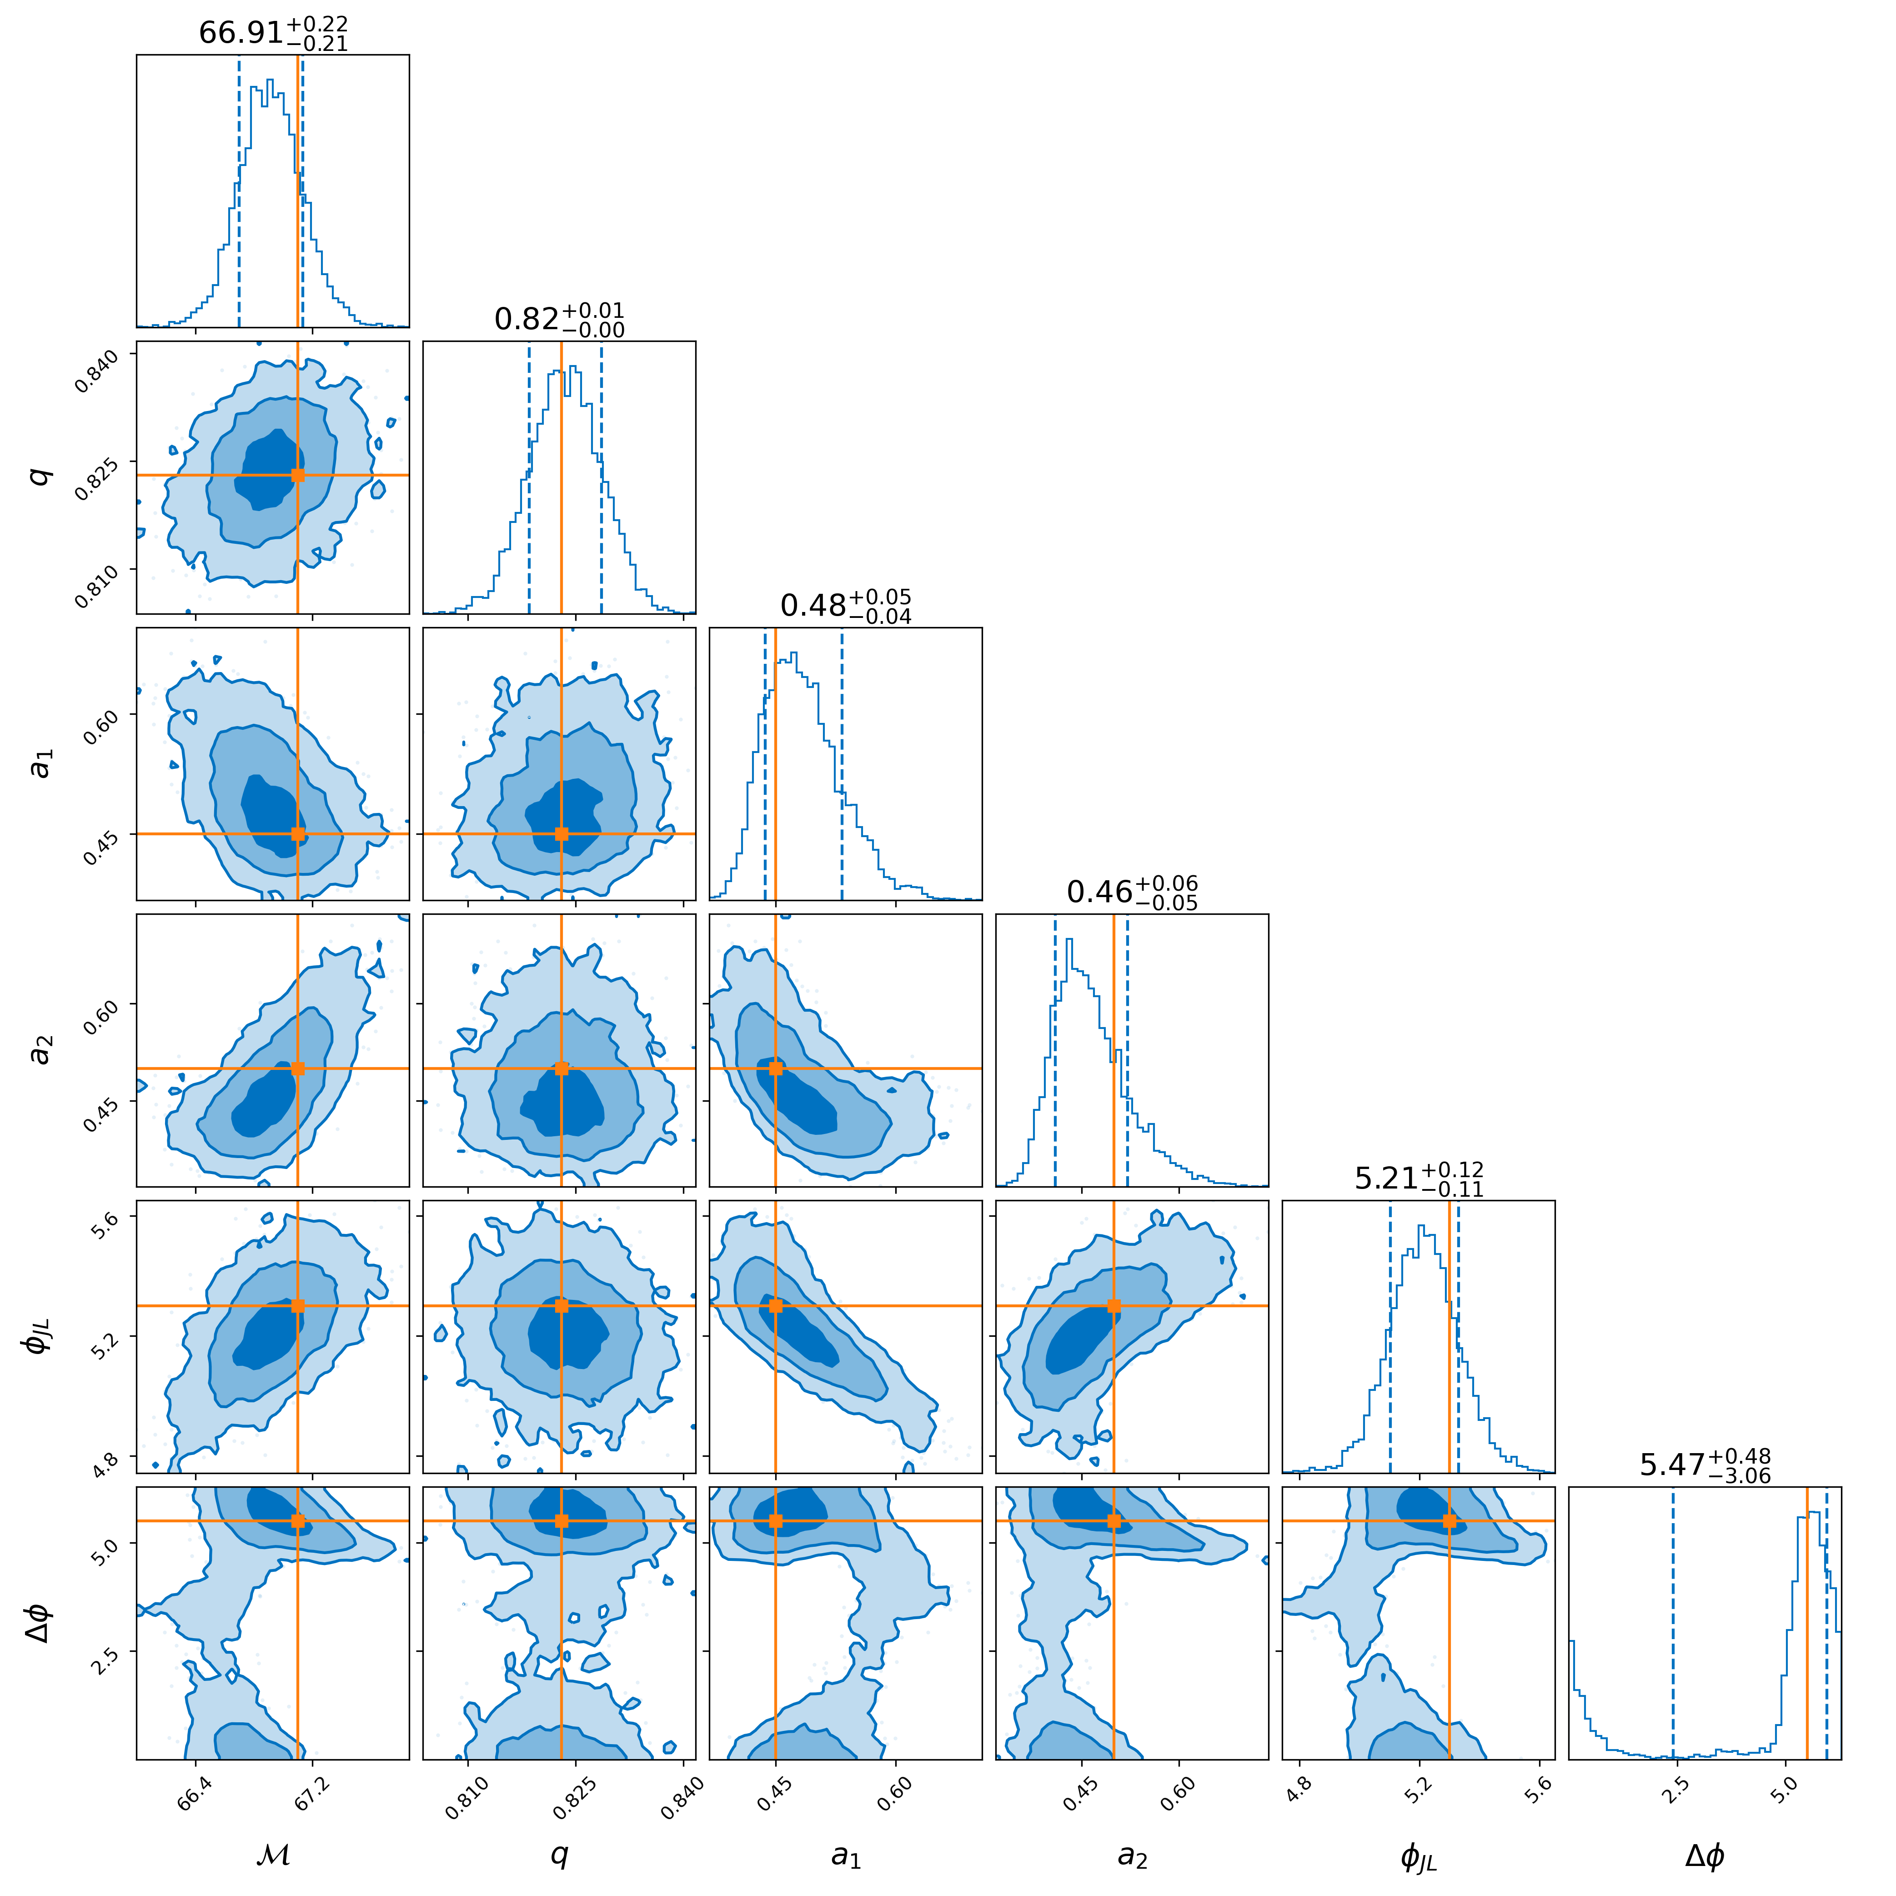
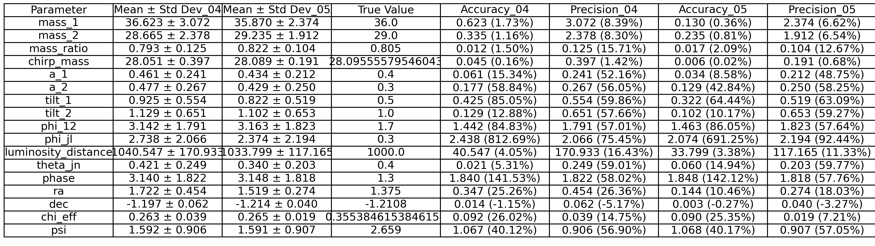
Example Showing Process of Comparions
7

Slide 8
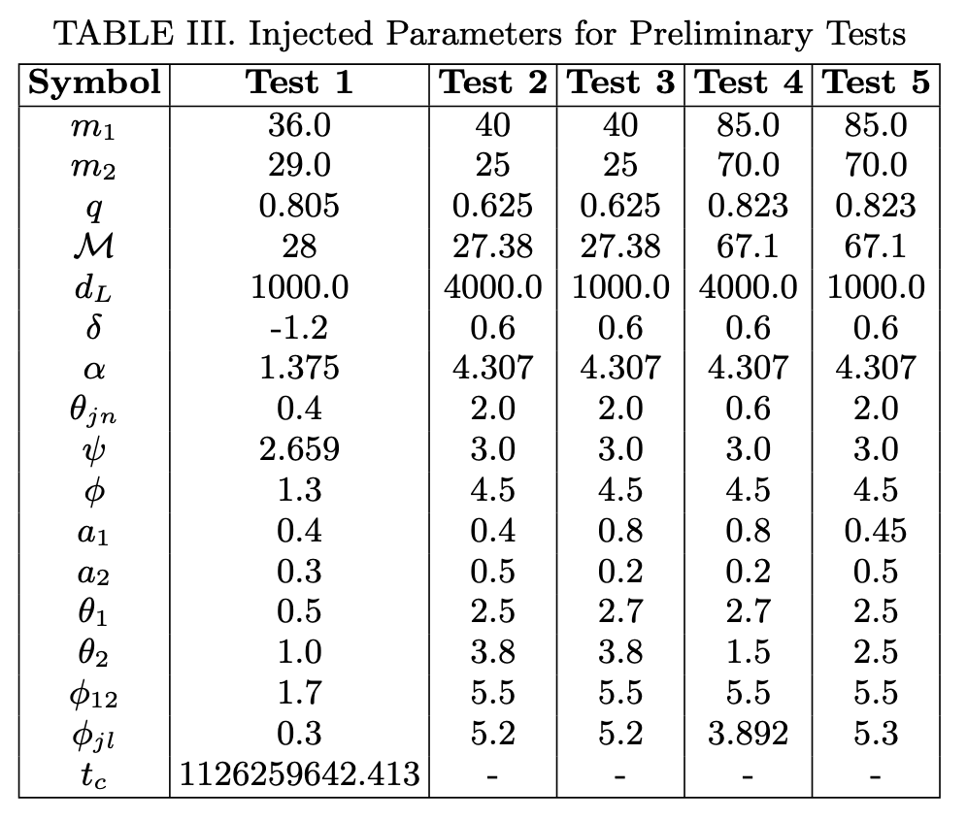
Injections For preliminary test
I choose a spectrum of events for my preliminary test, firstly I had to choose test that wouldn’t result in high SNRS in bilby
I wanted to see how well IMRPhenomXPHM break decencies in the posteriors therefore I chose injections that should and shouldn’t have a degeneracies to see the difference
I also chose events with various chirp masses and spin alignments because I wanted to see the effect changing this parameters have on the overall distribution.

Slide 9
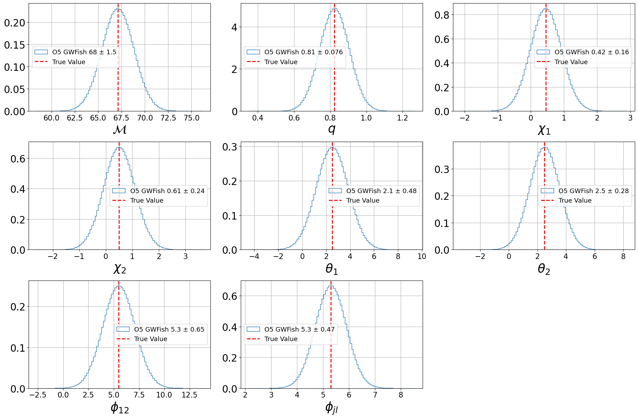
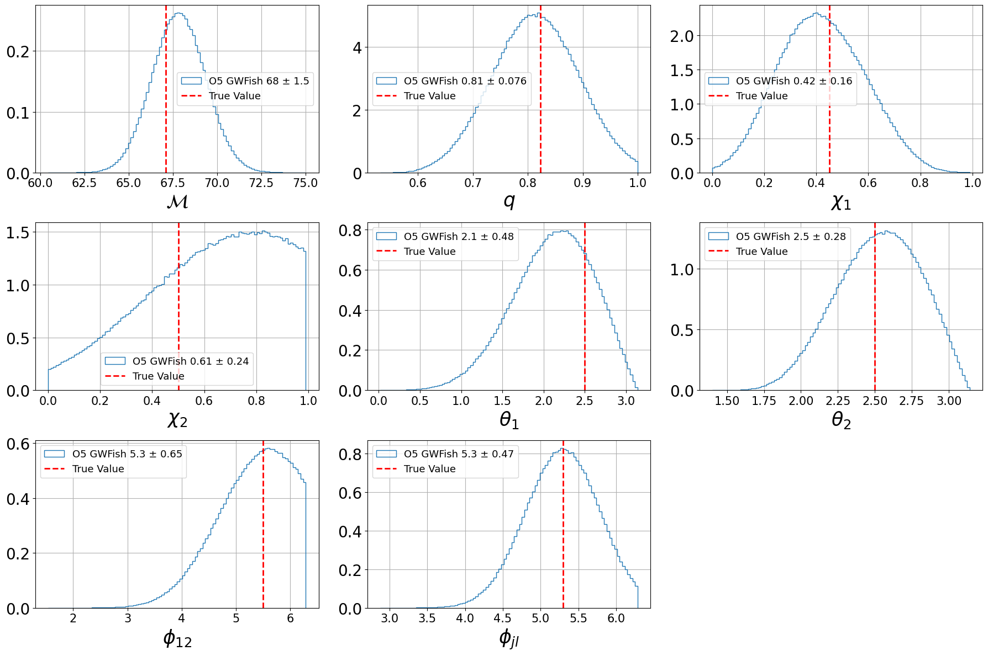
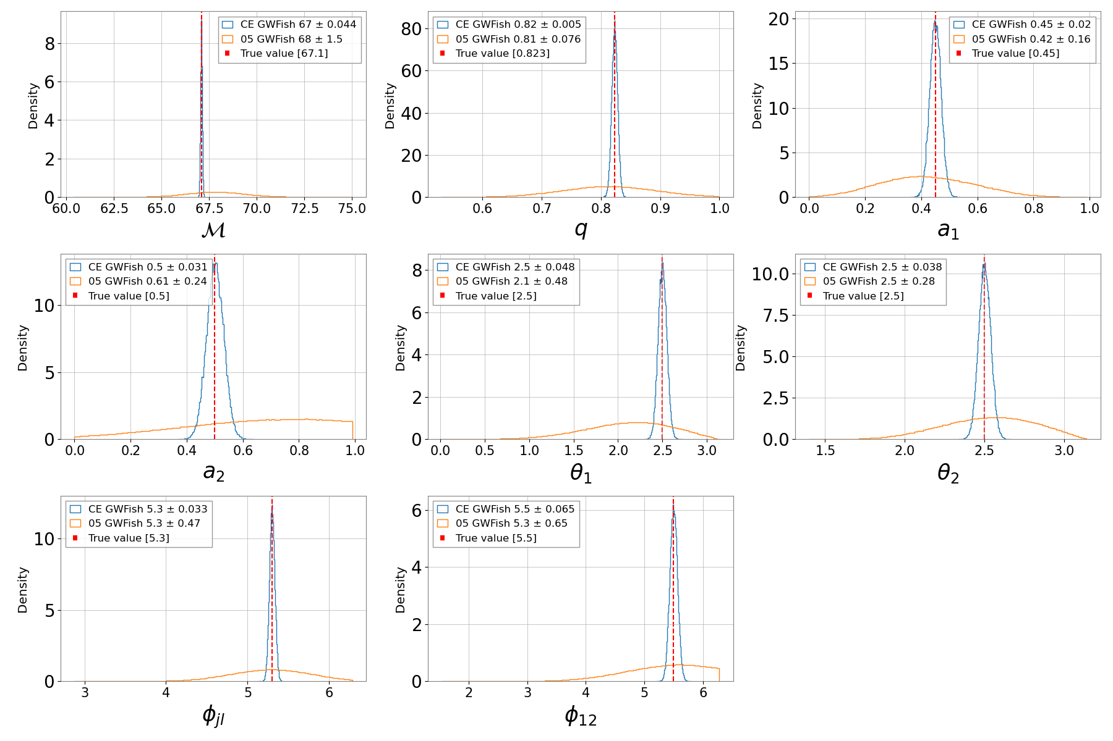
GWFish Results
Visual Comparison
GWFish has some struggles constructing Gaussian shaped distributions for LIGO PE after incorporating priors
These are not an issue though when using CE, and we see much more constrained posteriors
9

Slide 10
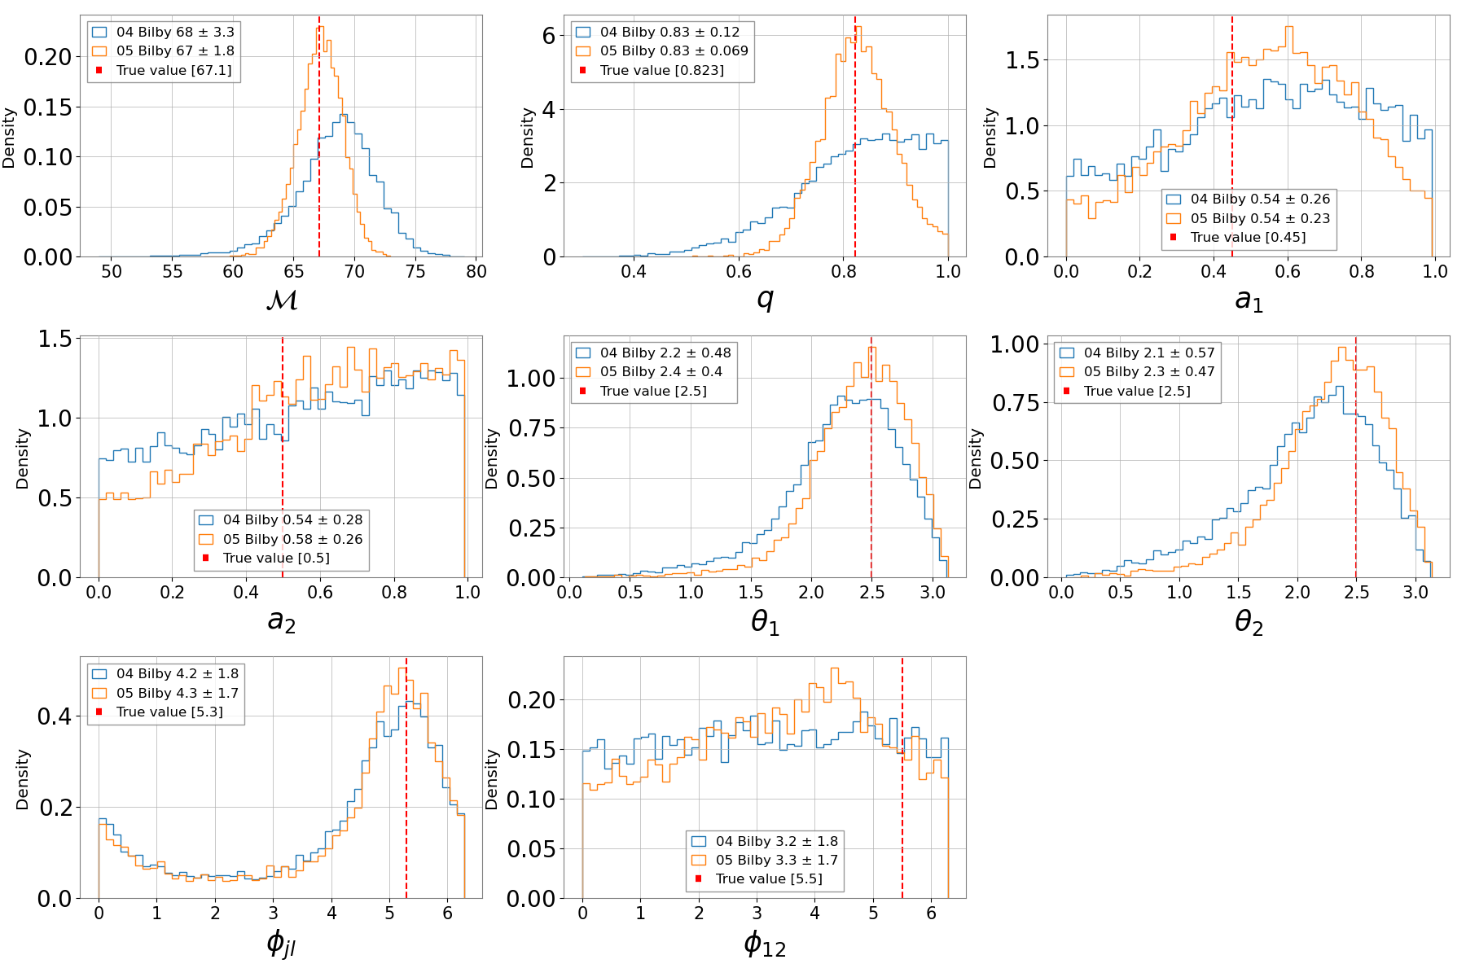
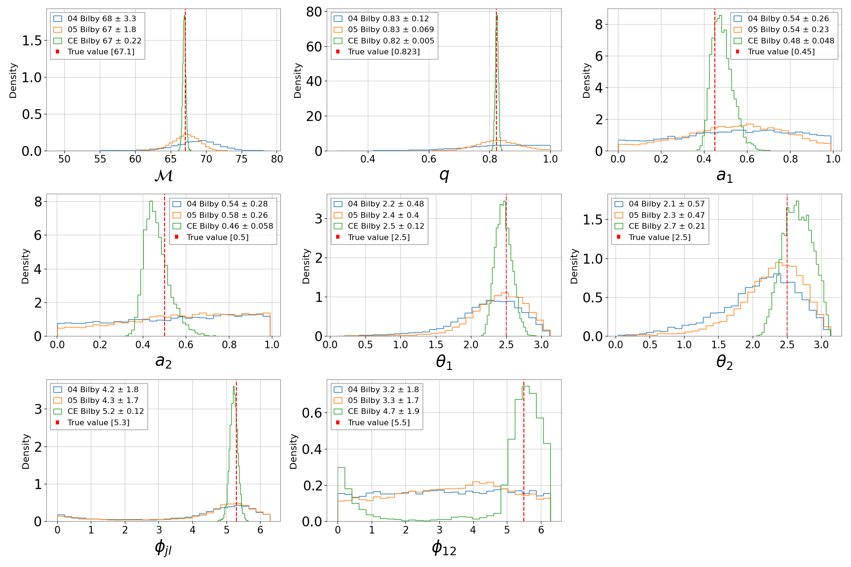

Bilby Results
Visual Comparison
With lower SNRs it is difficult to resolve certain intrinsic parameters such as $a_{1},a_{2}$.
Certain parameters $M_{c}, q, θ_{1},θ_{2},φ_{jl}$ seem to get more constrained Gaussian shaped as noise decreases
10

Slide 11
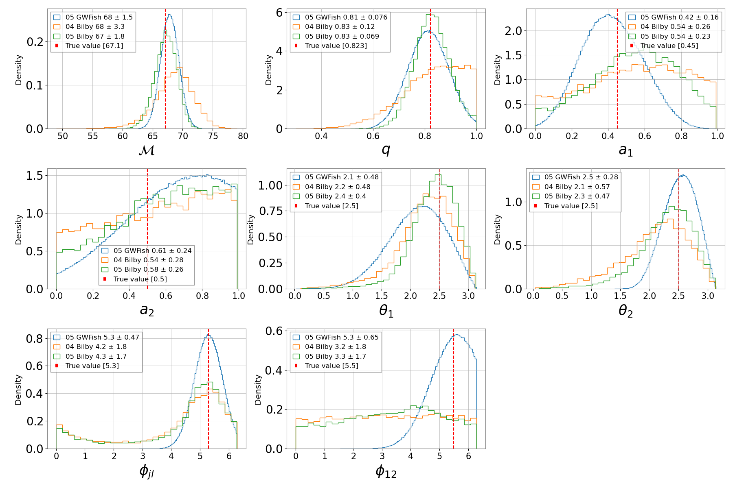
Bilby and GWFish Comparisons

Slide 12
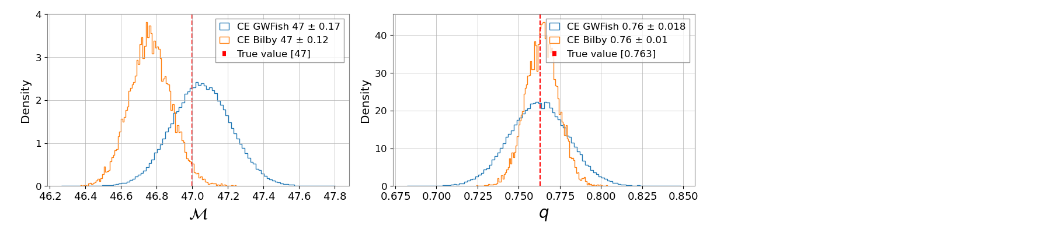
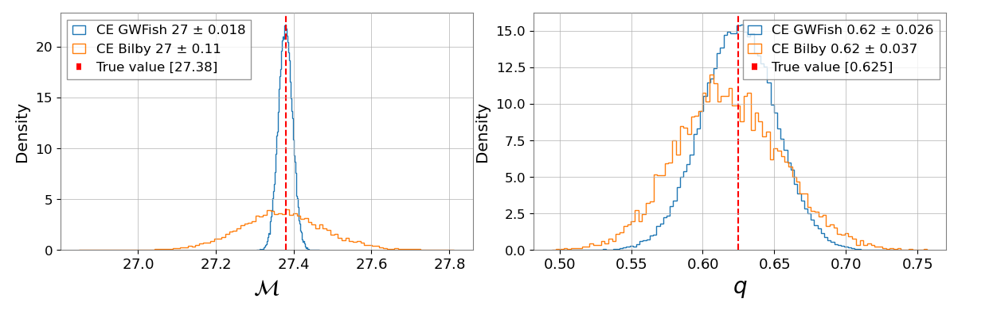
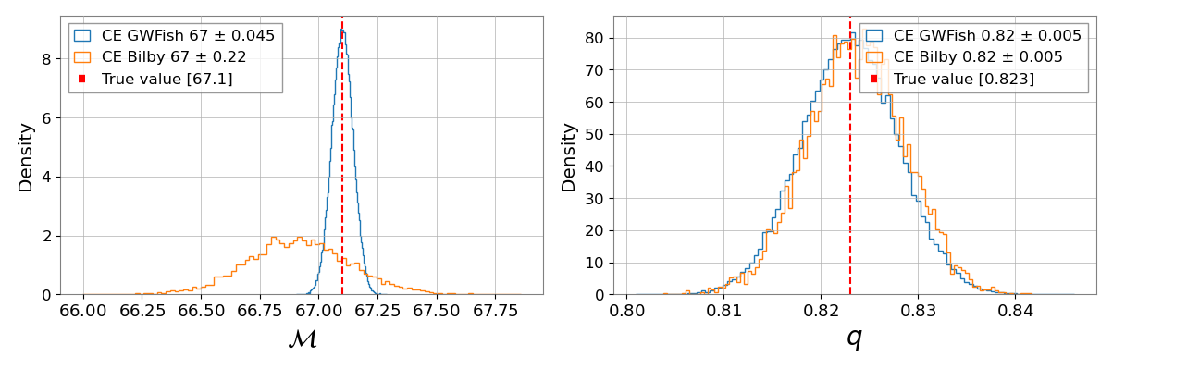
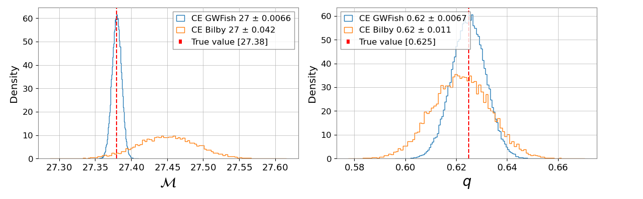
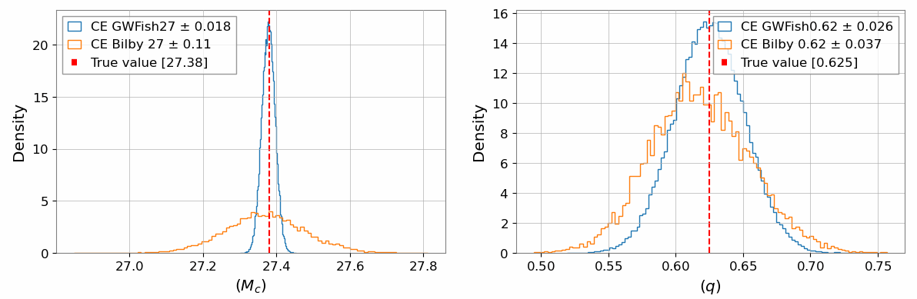
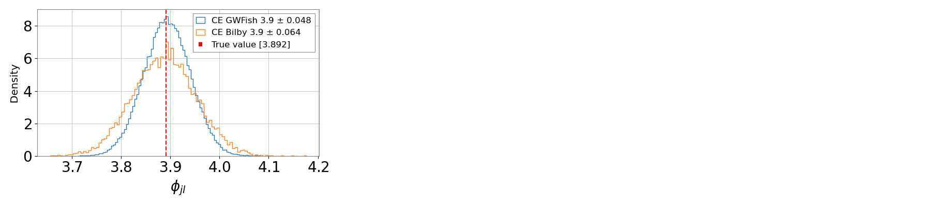
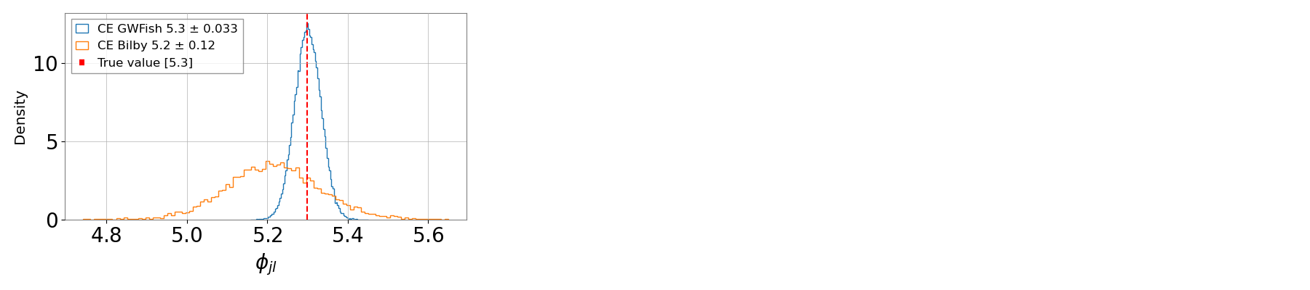
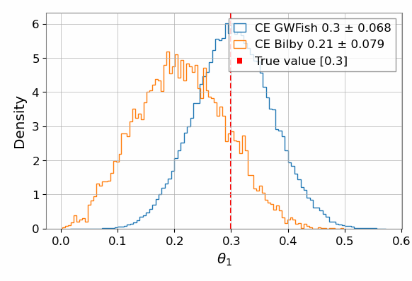
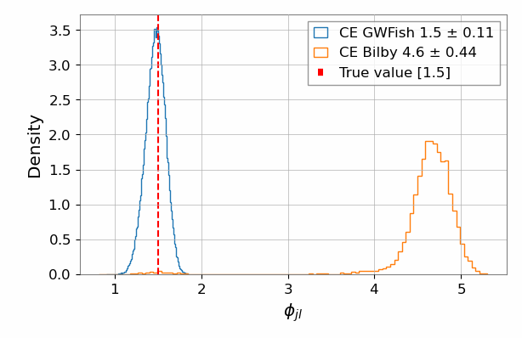
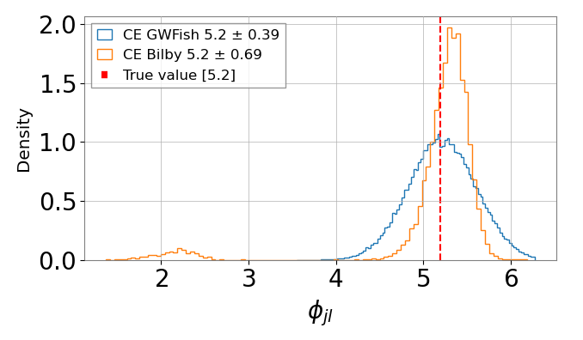
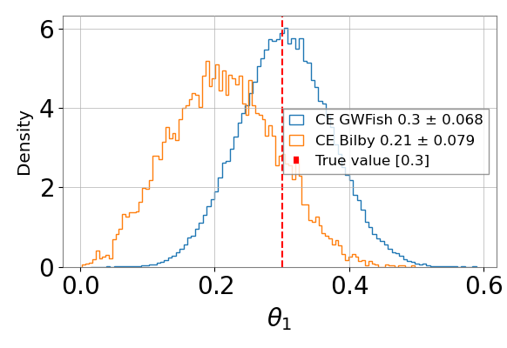
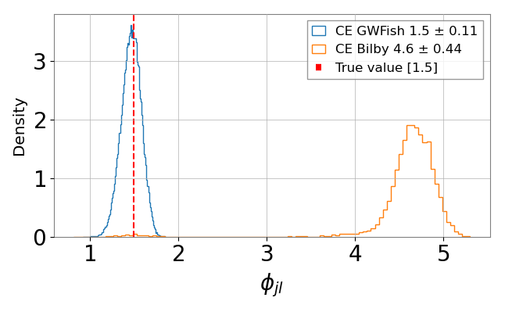
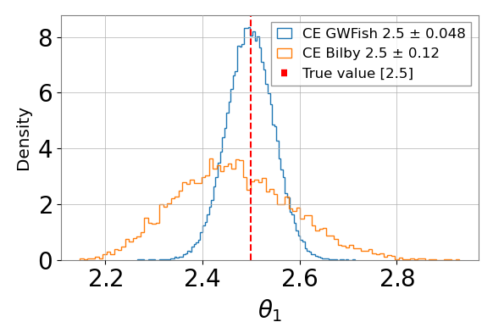
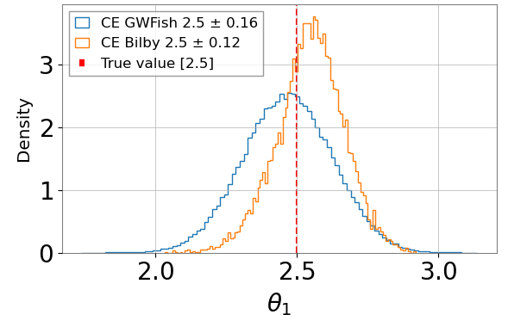
Bilby and GWFish Comparisons
Visual Comparison
The Gaussian posterior trend shown in 05 observations continues in CE for all test injections

Slide 13
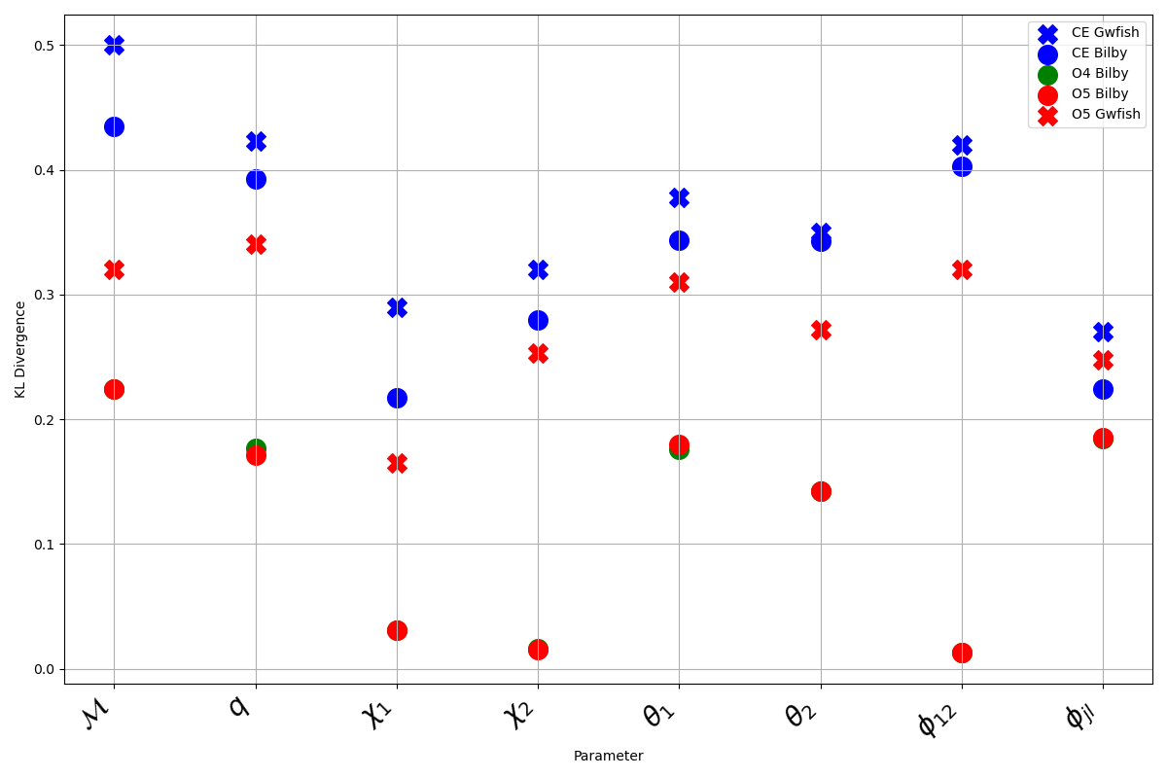
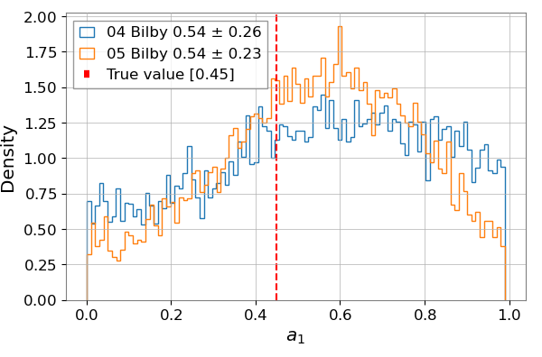
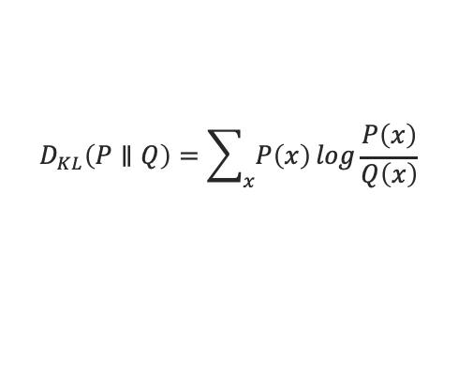
KL Divergence Test For CE,O4,and O5
$$D_{KL}\left(P∥Q\right)=\sum_{x}{P\left(x\right)}log\frac{P\left(x\right)}{Q\left(x\right)}$$
We use a KL divergence test to compare how much constructed distributions deviate from their prior distributions
High KL divergence indicates Gaussian highly informative posteriors
Low KL divergence indicates less Gaussian less informative posteriors

Slide 14
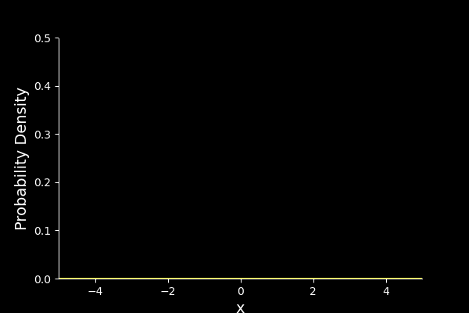


Speed Comparisons
GWFish
Bilby
Time to construct posteriors
Time to construct posteriors
LIGO $107 ±5 s$
LIGO 6-8 hours
CE $40 ±3 s$
CE 24+ hours

Slide 15

Conclusions
1. CE showed increase in capability and reliability compared LIGO detectors.
2. Fisher matrix doesn’t seem reliable for LIGO detectors due to non Gaussian shapes of constructed likelihood posteriors .
3.For specific intrinsic parameters $M_{c}, q, θ_{1},θ_{2},φ_{jl}$ , there is evidence to suggest that a fisher matrix can be a reliable source of PE in CE.

Slide 16
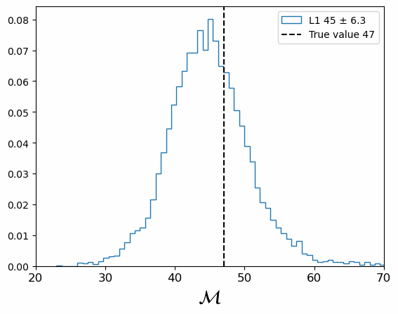
Future Work
Expand Comparisons
Separate Comparisons by SNR, Frequencies,
Train reliable Dingo model
Use a greater quantity of Injections
Conduct comparison using different priors
Conduct Individual detector test

Slide 17


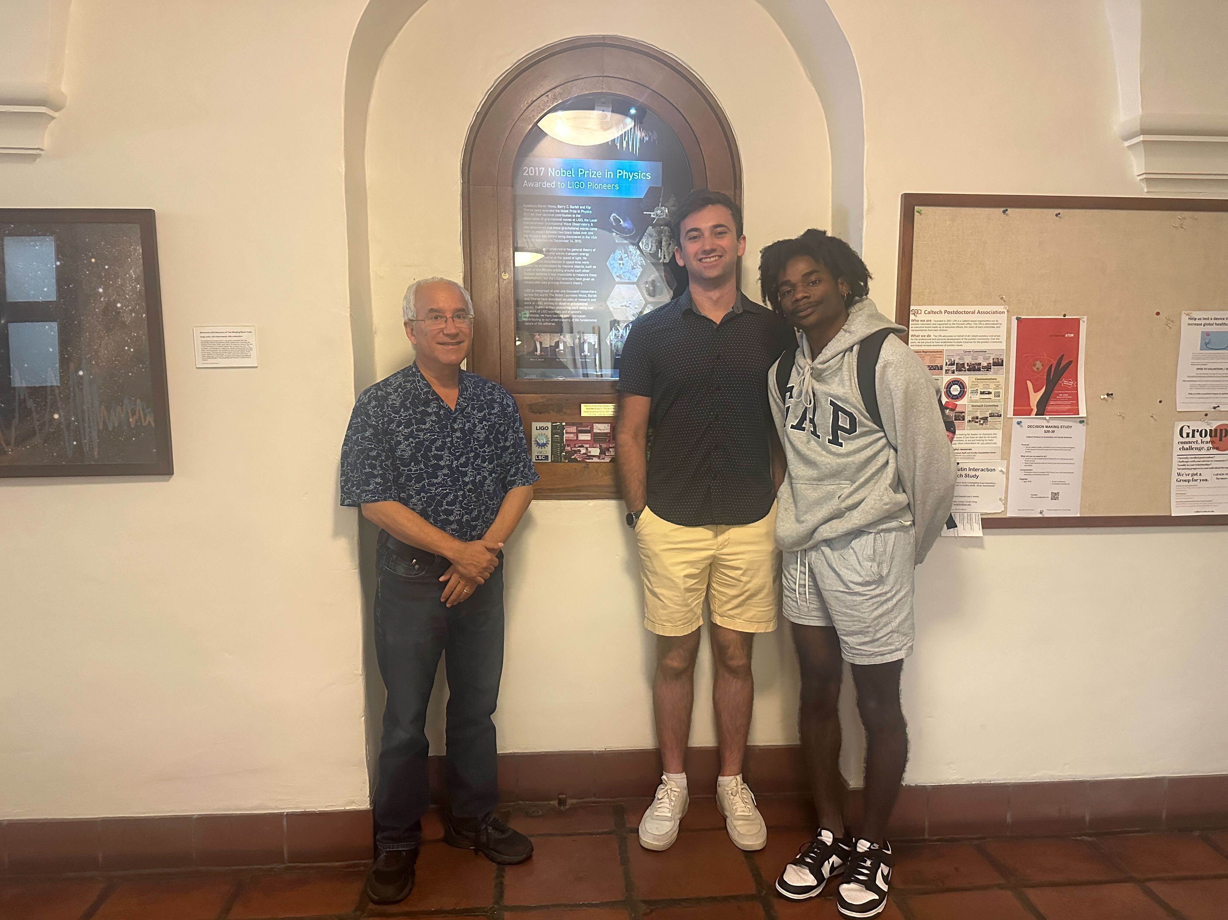

Acknowledgments
National Science Foundation LIGO Laboratory
Caltech SFP
And Special thanks to Alan and Jacob for being amazing mentors

Slide 18
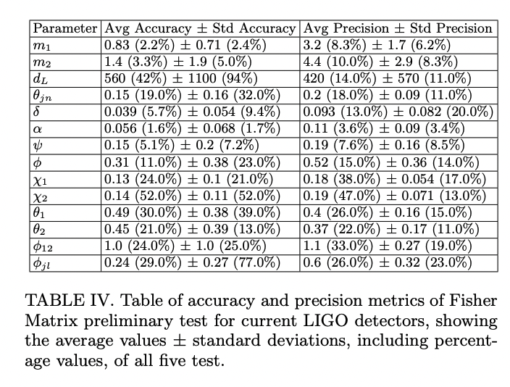
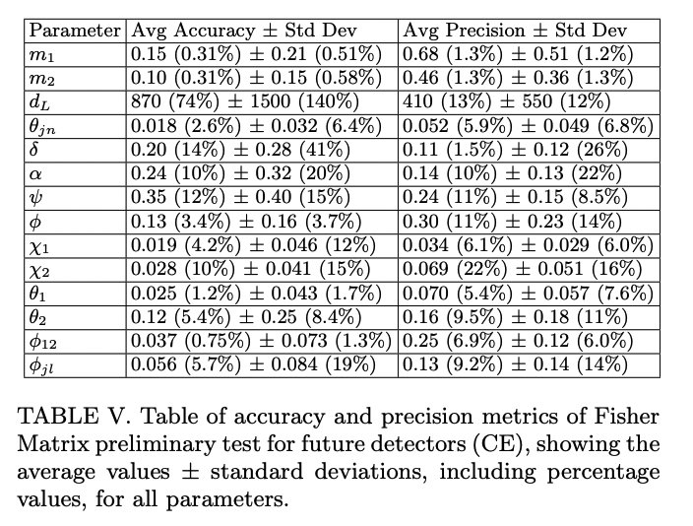
GWFish Results
LIGO Results
CE Results

