Slide 1
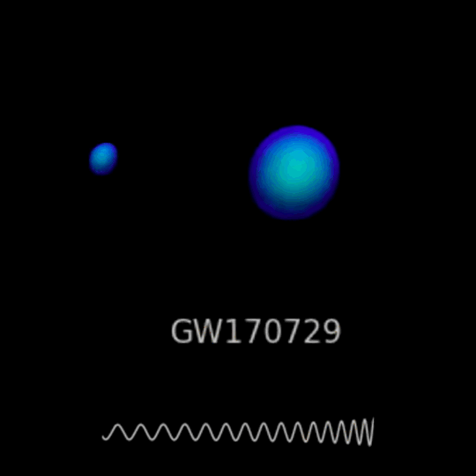
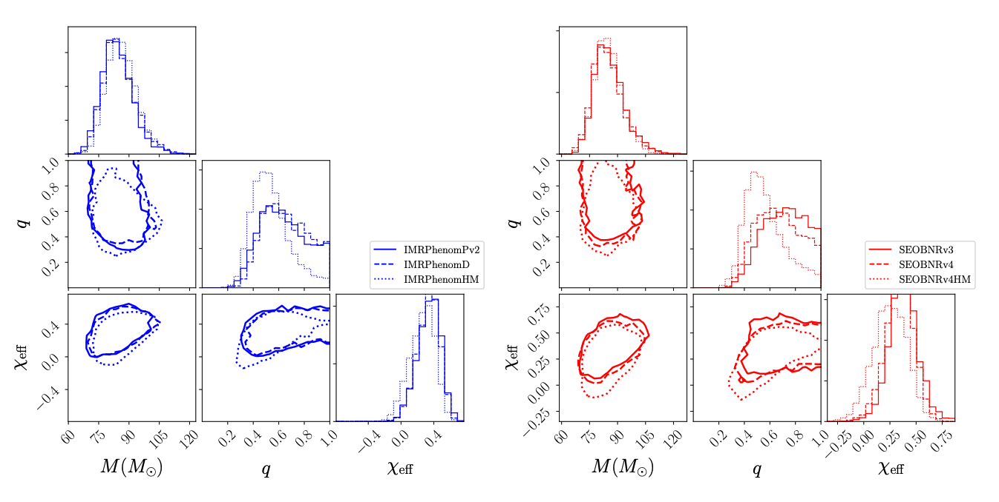
Current and Future capability of Compact Binary Coalescence Parameter Estimation (PE) methods
1
1
Mentors : Alan Weinstein & Jacob Golomb
Sterling Scarlett LIGO SURF 2024

Slide 2
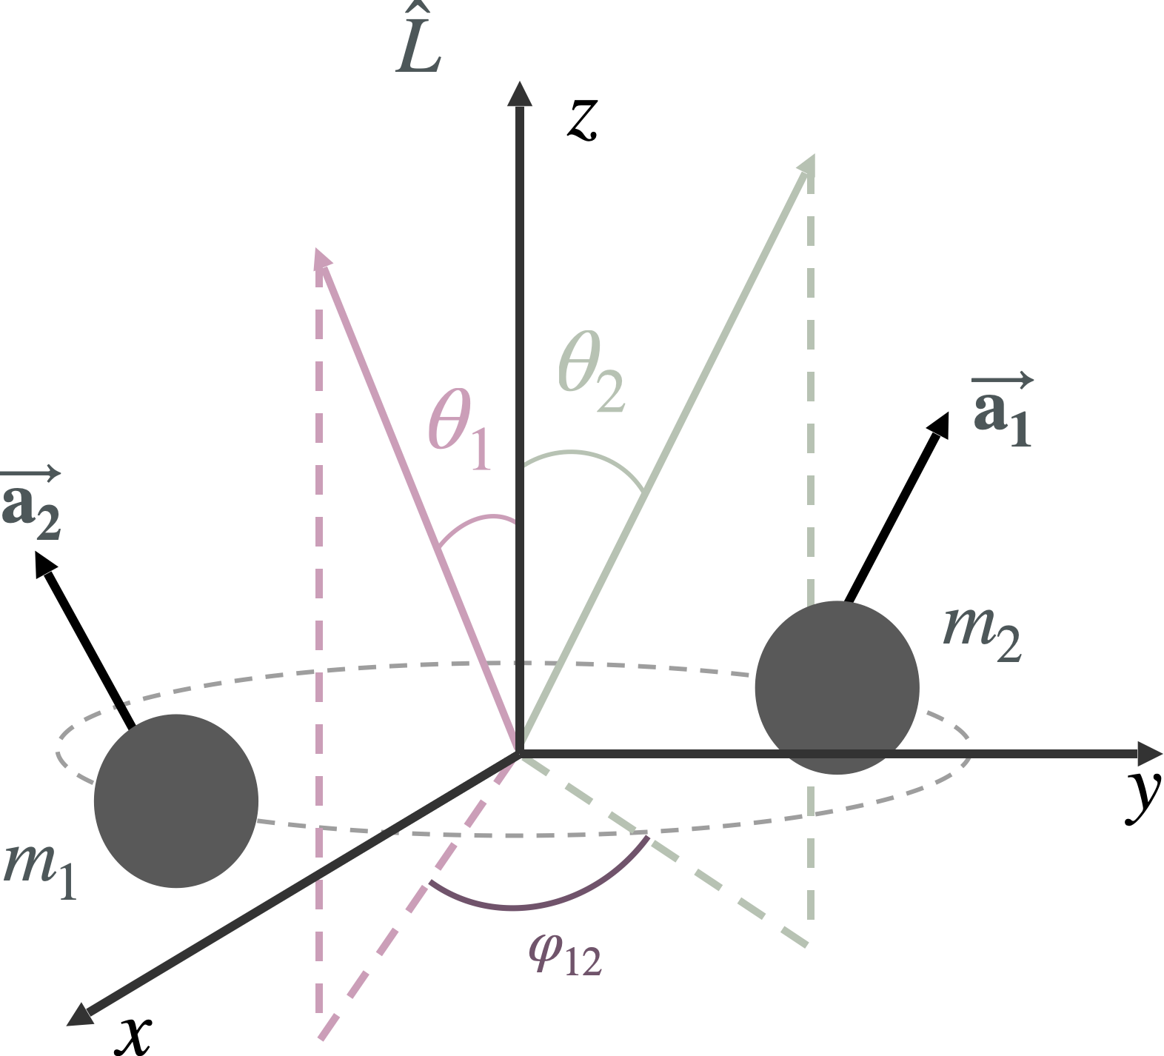
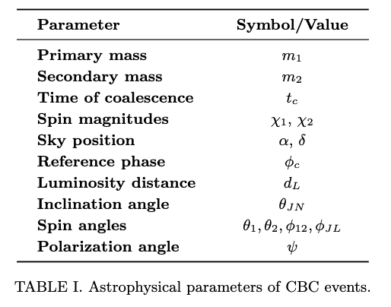
Introduction to PE

Slide 3

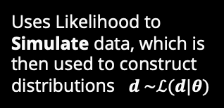





Methods of PE
Bilby
Bayesian Inference Likelihood based
Develops a likelihood for the given parameters then samples the likelihood to construct distributions $p\left(θ | d\right)$
$$p\left(θ | d\right)=\frac{ℒ\left(d | θ\right)π\left(θ\right)}{𝒵}$$
Simulation based likelihood free
$$ℒ\left(d | θ\right)=\frac{1}{2πσ^{2}}\exp\left(−\frac{1}{2}\frac{{\left|d−μ\left(θ\right)\right|}^{2}}{σ^{2}}\right)$$
Dingo
Uses Likelihood to Simulate data, which is then used to construct distributions $d \sim ℒ(d|θ)$
$$q\left(θ | d\right)≈p\left(θ | d\right)$$
Fisher information matrix
GWFish
$$ℒ∝\exp\left(\frac{1}{2}Δθ^{i}ℱ_{ij}Δθ^{j}\right)$$
Approximates likelihood to assume the error distributions
in the parameter errors are Gaussian
$$ℱ_{ij}=\left(\frac{∂h}{∂θ_{i}} | \frac{∂h}{∂θ_{j}}\right),$$

Slide 4
Motivations for Research
Bilby
Understand Current Hierarchy and Offer Predictions on the Future
- Currently there exist a preestablished hierarchy of PE methods, so one of our focuses is to provide qualitative and quantitative understanding on the current state of PE and potentially offer predictions on the future of it, via comparative analysis of the Speed Accuracy Precision and Gausianity
Dingo
Fisher matrix
Test Dingo
Test Reliability of Fisher matrix in 3G detectors
- Given that Dingo isn't fully understood, an aim of my project is to test current Dingo against the standard Bilby, measuring how close/far it is.
- In 3G detectors such as a Cosmic Explorer (CE) we predict less noise interference will make the distributions of parameters look more uniform. This will potentially make fisher matrix approach to PE useful at high SNR.

Slide 5
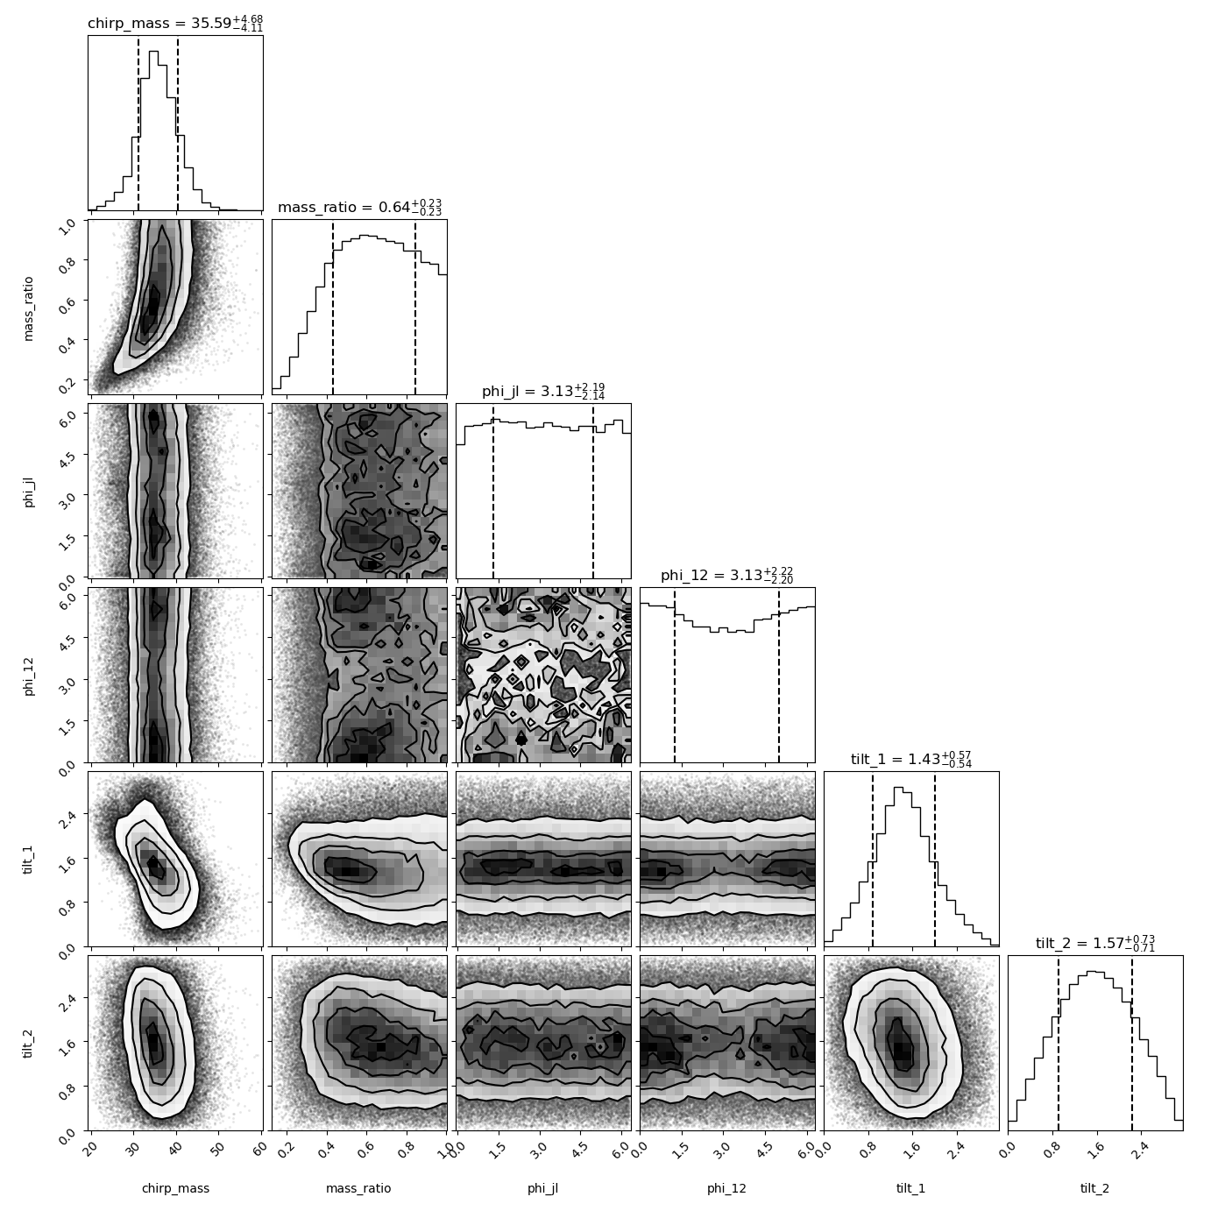
Dingo Troubles
Dingo
- There exist pre trained Dingo networks for 04 real and synthetic noise that can conduct PE, but none for 05 and CE simulations.
- We Aimed train Dingo capable of conducting 05 and CE PE, but were unable to train effective model in the 10 weeks, so we focus our comparison of Bilby and Gwfish

Slide 6
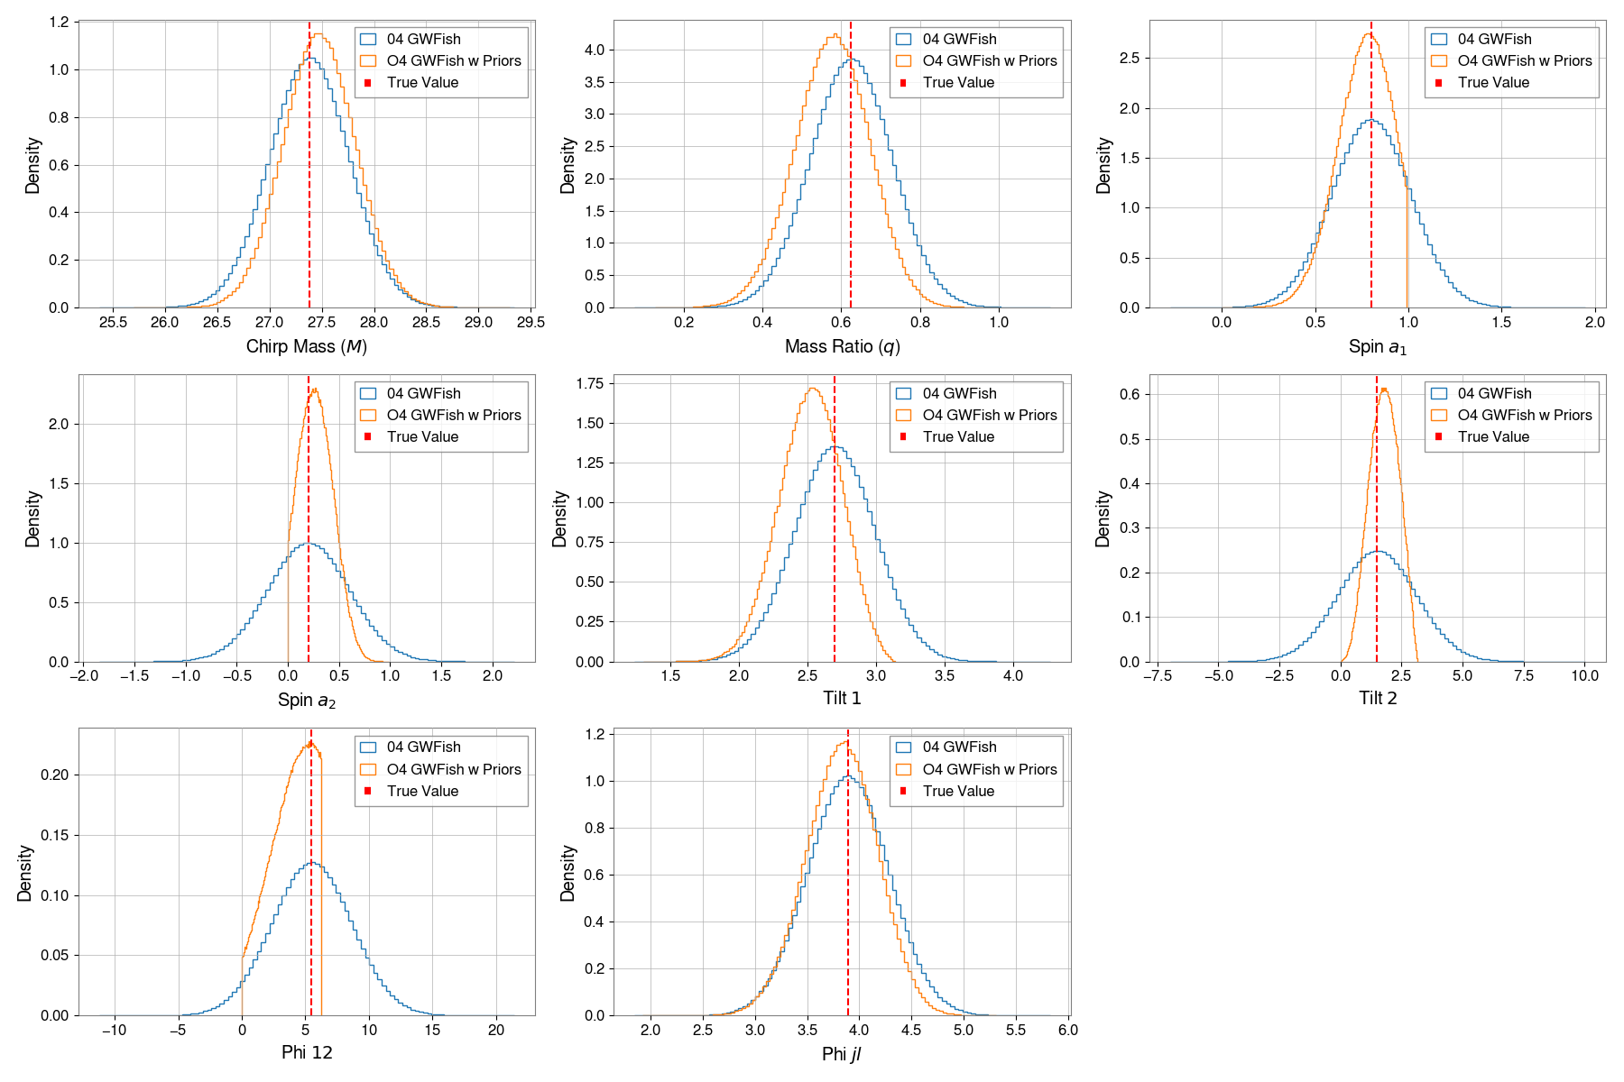

GWFish Implementation of Priors
Calculate the Probability Density Functions (PDFs) for Each Parameter:
${\text{PDF}}_{i,j}=p_{i}\left(θ_{i}^{\left(j\right)}\right)$
2. Compute the Product of the PDFs:
$P\left(θ_{1}^{\left(j\right)},θ_{2}^{\left(j\right)},…,θ_{N}^{\left(j\right)}\right)=\prod_{i=1}^{N}{p_{i}\left(θ_{i}^{\left(j\right)}\right)}$
3. Normalize the Product of PDFs:
$Z=\sum_{j=1}^{M}{\prod_{i=1}^{N}{p_{i}\left(θ_{i}^{\left(j\right)}\right)}}$
$w_{j}=\frac{\prod_{i=1}^{N}{p_{i}\left(θ_{i}^{\left(j\right)}\right)}}{Z}$
4. Resample from the Multivariate Uniform Distribution Using the Weights:

Slide 7
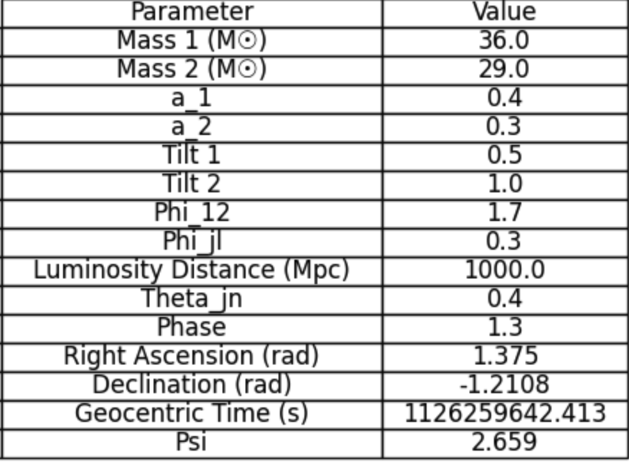
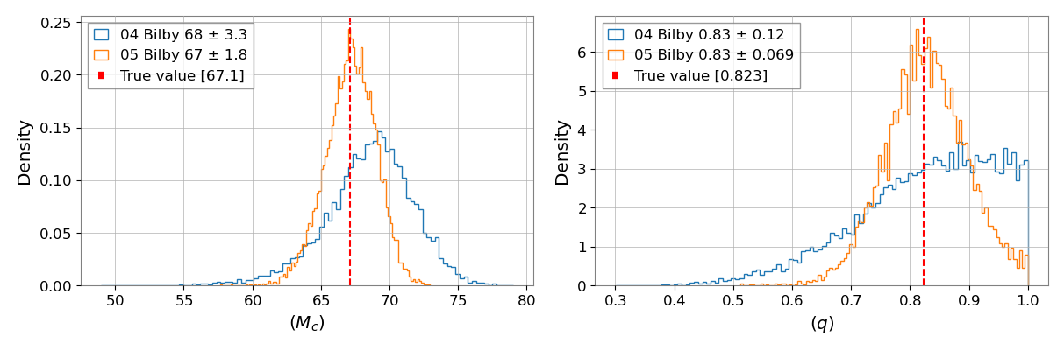
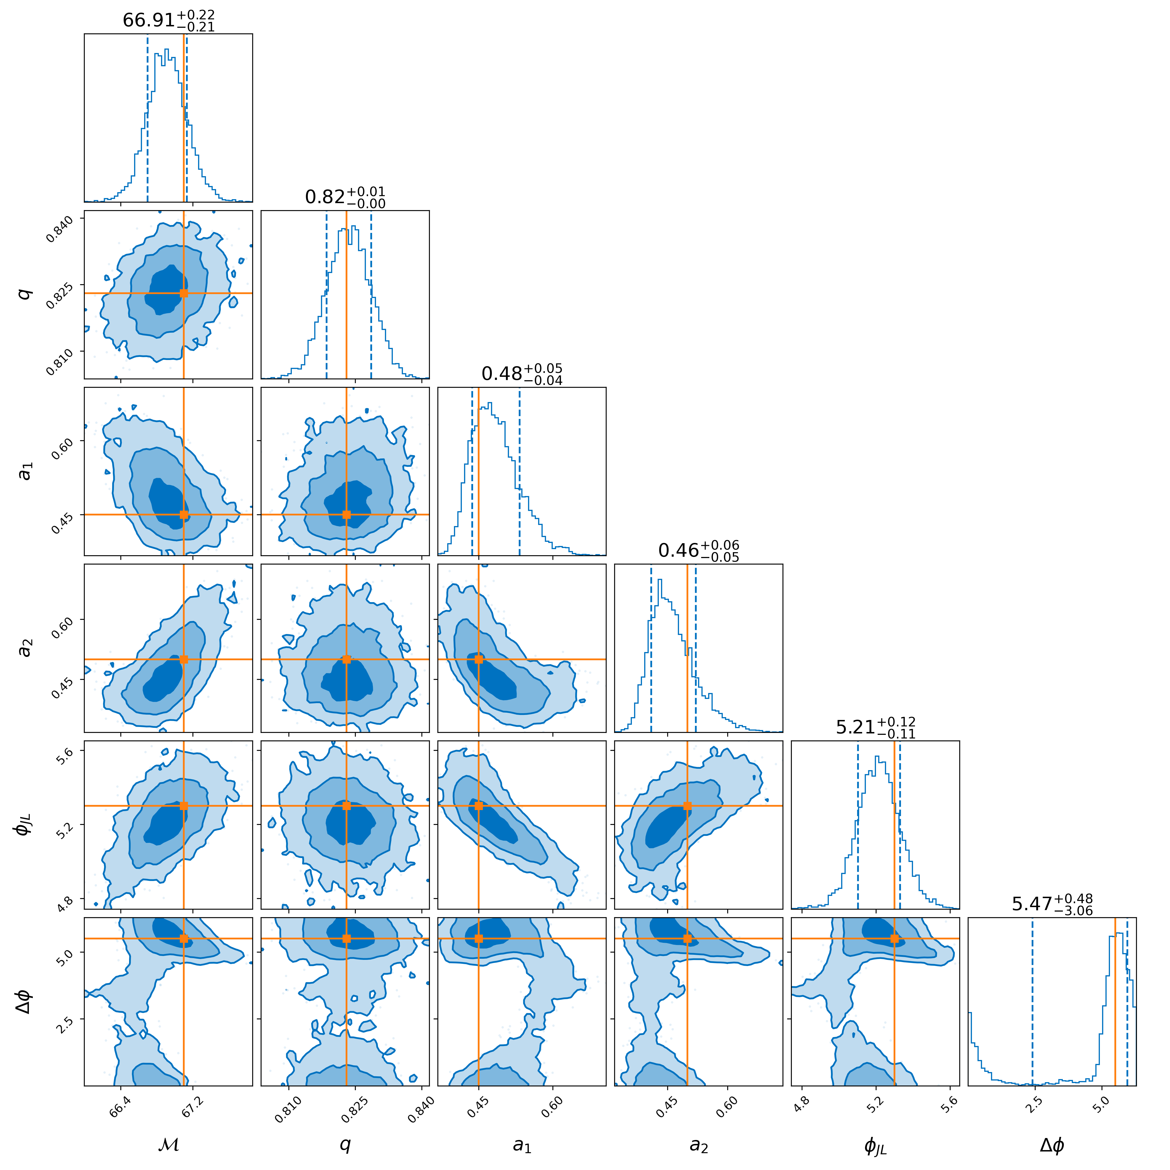
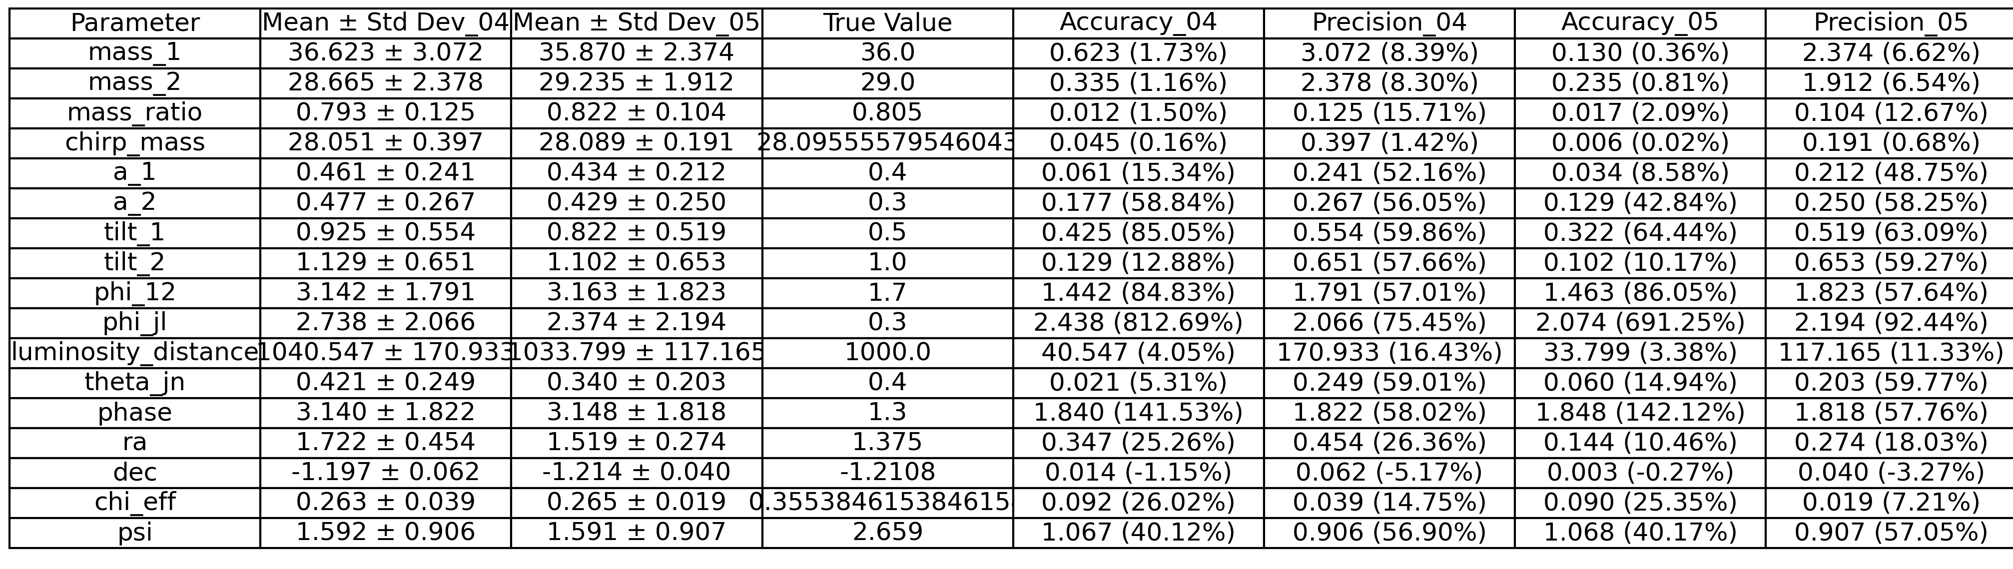
Example showing process

Slide 8
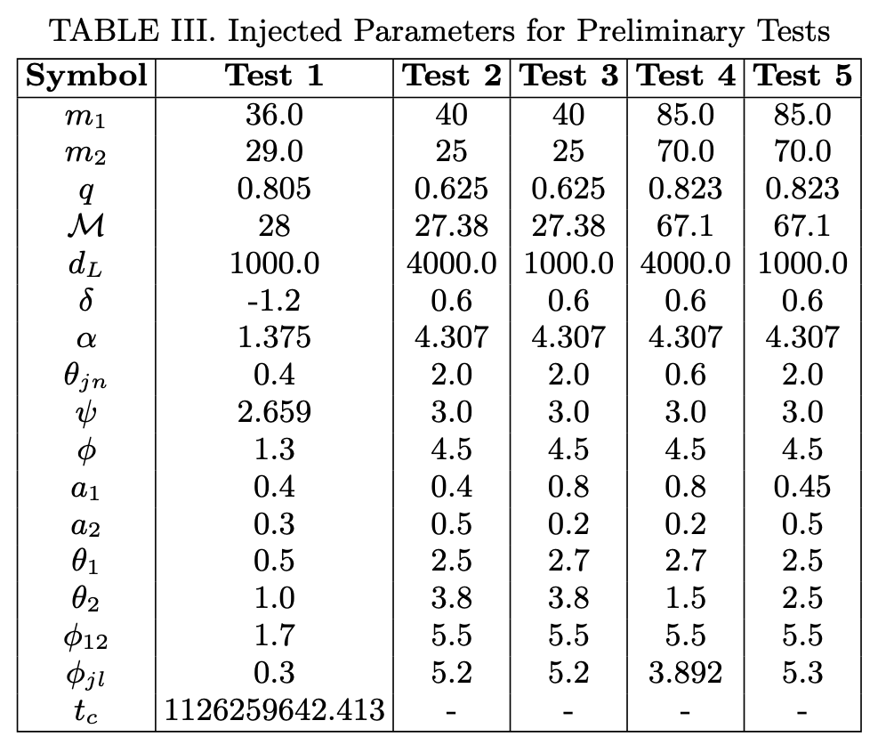
Injections For preliminary test
I choose a spectrum of events for my preliminary test, firstly I had to choose test that wouldn’t result in high SNRS in bilby
I wanted to see how well IMRPhenom broke decencies in the posteriors therefore I chose injections that should and shouldn’t have a degeneracies to see the difference
I also chose events with various chirp masses and spin alignments because I wanted to see the effect changing this parameters have on the overall distribution.

Slide 9
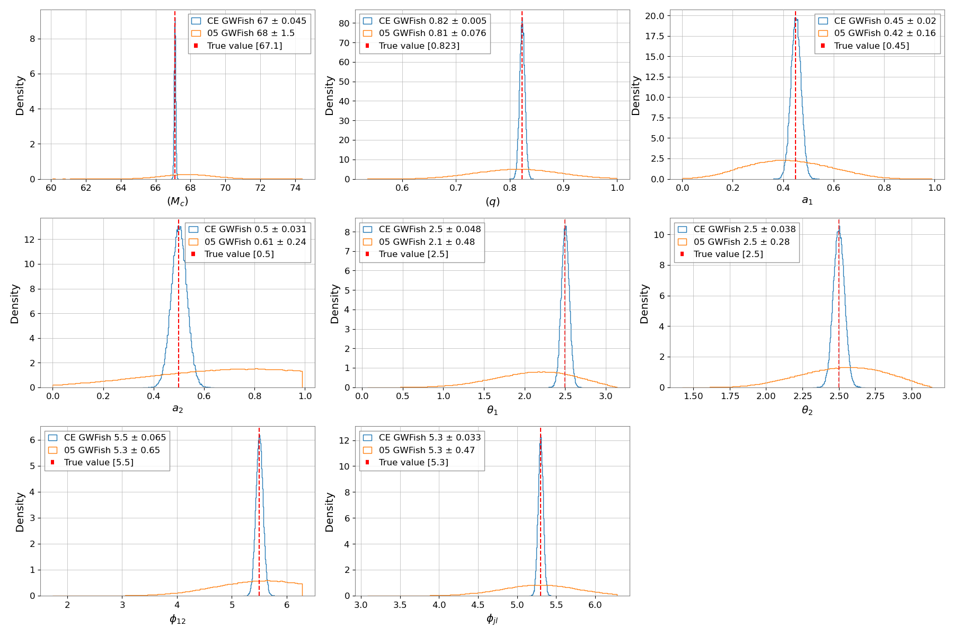
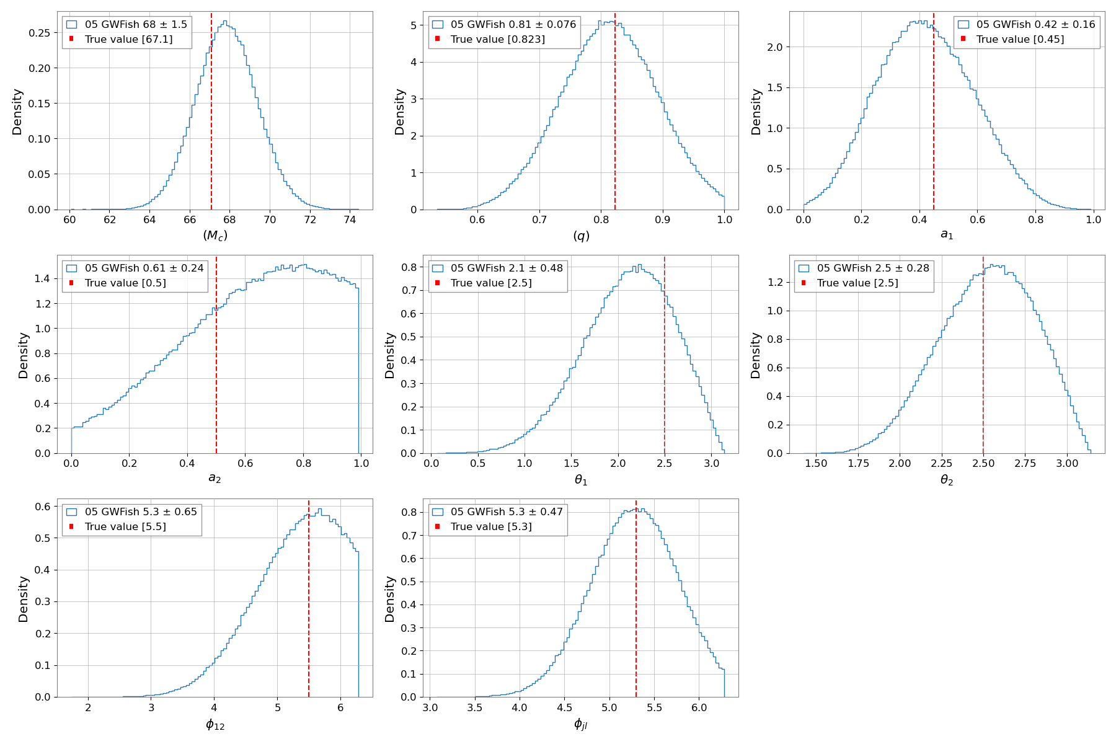
GWFish Results
Visual Comparison
GWFish has some struggles constructing uniform distributions for LIGO PE after incorporating priors
These are not an issue though when using CE, and we see much more constrained posteriors

Slide 10
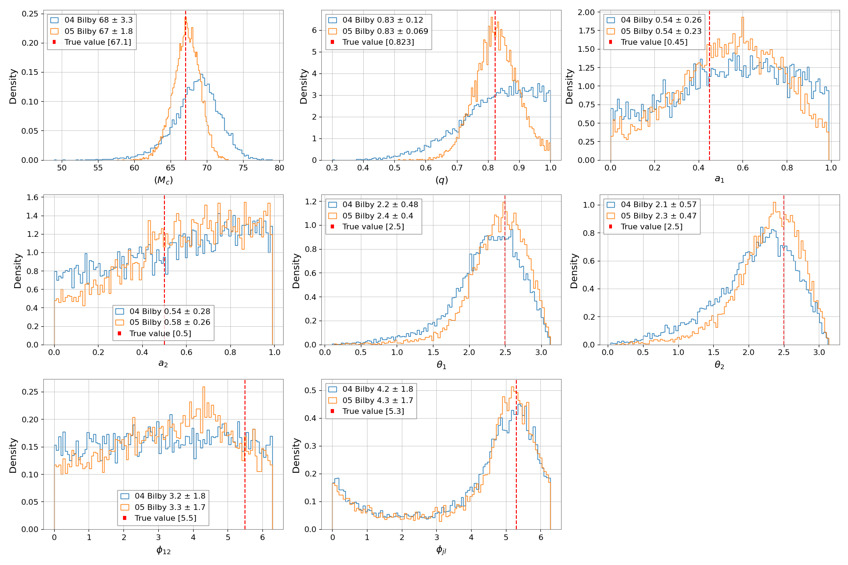
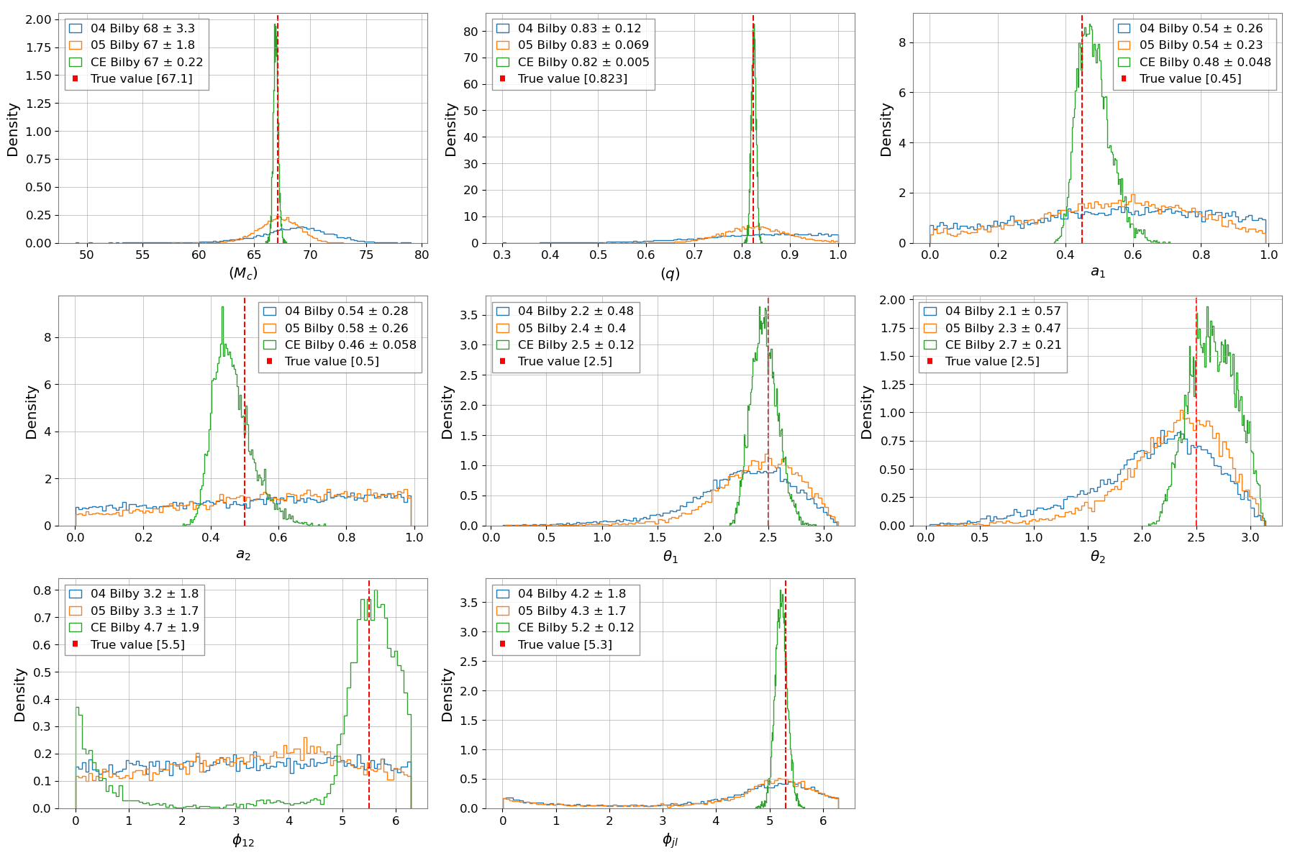

Bilby Results
Visual Comparison
Bilby has known struggles with resolving certain intrinsic parameters such as $χ_{1},χ_{2}$.
Certain parameters $M_{c}, q, θ_{1},θ_{2},φ_{jl}$ seem to get more uniform as noise decreases

Slide 11
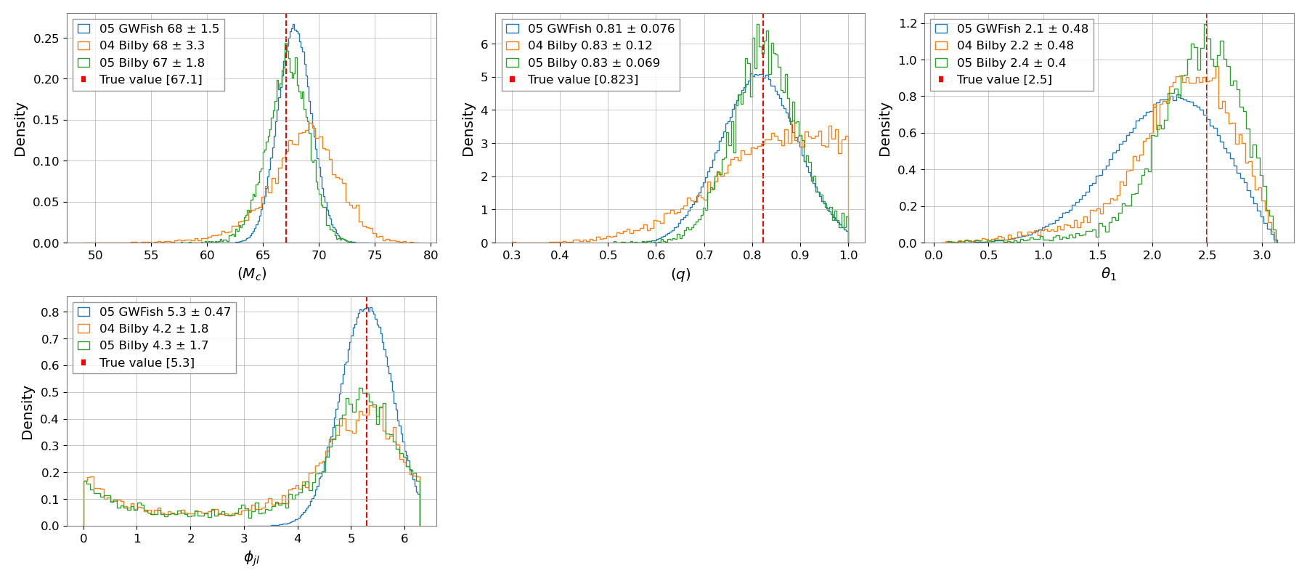
Comparisons
Visual Comparison

Slide 12
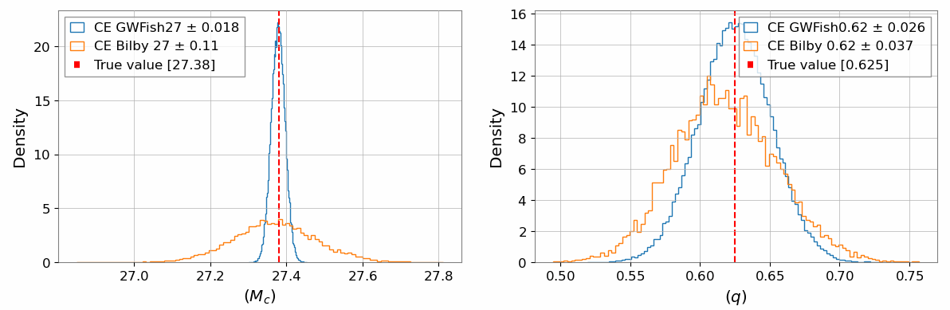
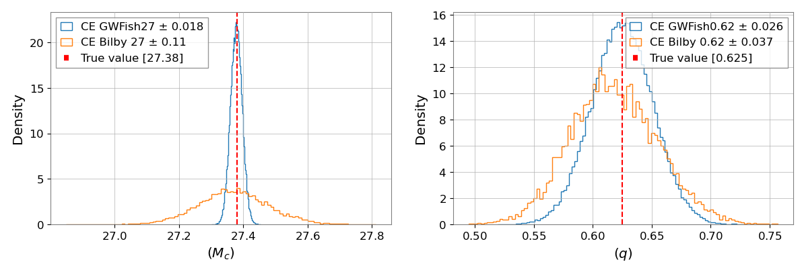
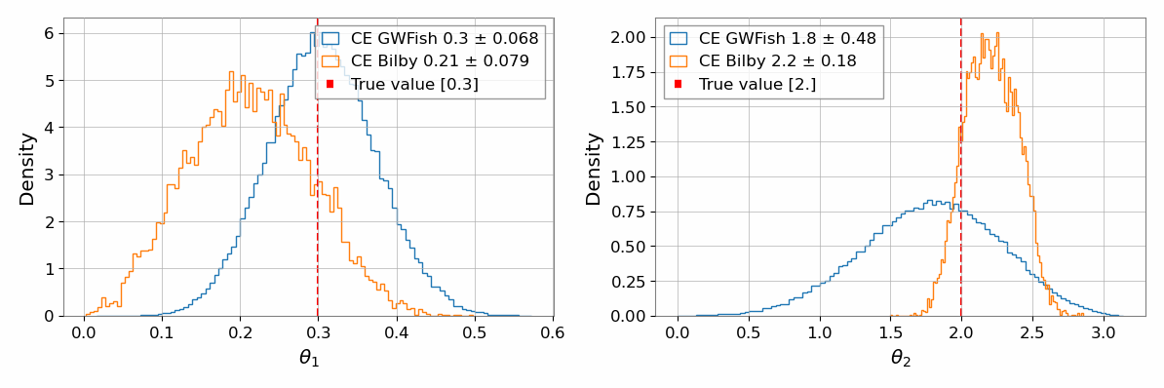
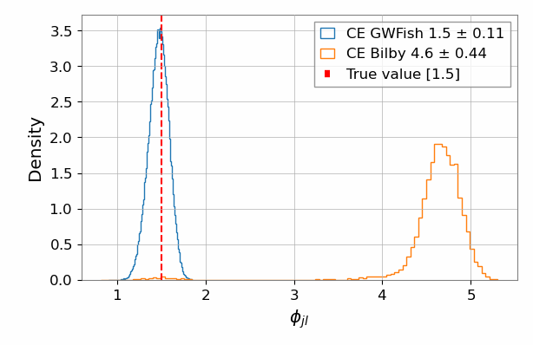
Comparisons
Visual Comparison
The uniform posterior trend shown in 05 observations continues in CE for all test injections

Slide 13
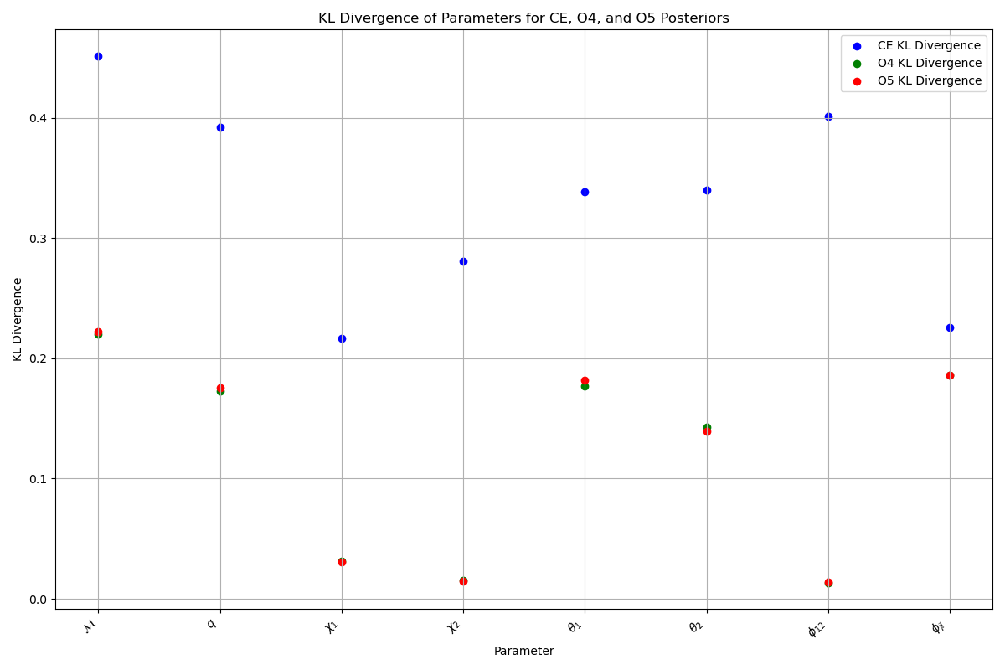
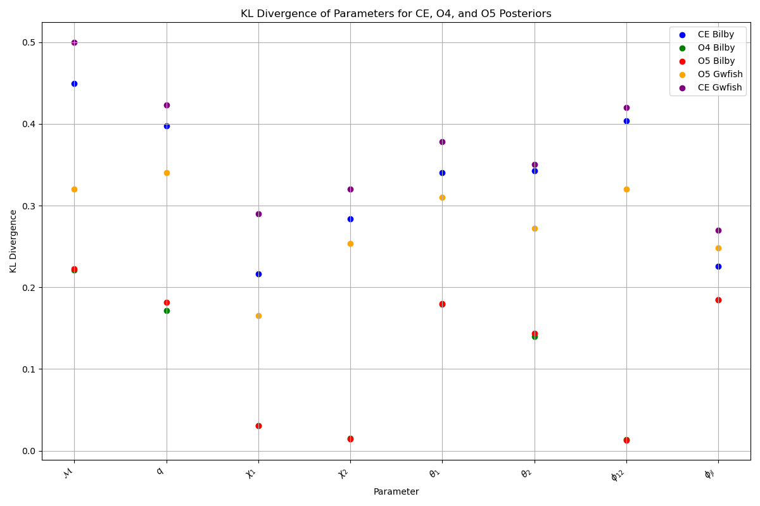
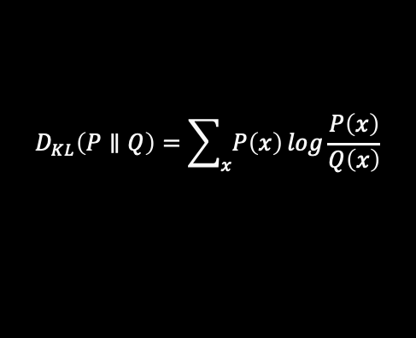
KL Divergence Test
$$D_{KL}\left(P∥Q\right)=\sum_{x}{P\left(x\right)}log\frac{P\left(x\right)}{Q\left(x\right)}$$
Taking the KL divergence of a prior distribution for parameter and the constructed Posteriors via PE, allows us to see how informative the distributions are.

Slide 14
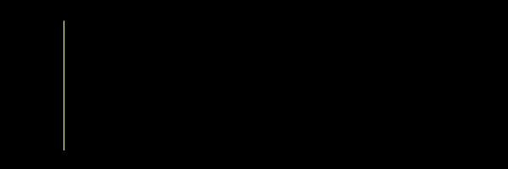


Speed Comparisons
GWFish
Bilby
Time to construct posteriors
Time to construct posteriors
LIGO $107 ±5 s$
LIGO 6-8 hours
CE $40 ±3 s$
CE 24+ hours

Slide 15

Conclusions
1. As expected CE showed a dramatic increase in capability and reliability in all comparable quantities to current LIGO detectors, providing higher accuracies, precisions and more informative distributions
2. Although magnitudes faster, a Fisher matrix doesn’t seem reliable for LIGO detectors due to non uniform posteriors . Though for specific intrinsic parameters $M_{c}, q, θ_{1},θ_{2},φ_{jl}$ , there is evidence to suggest that a fisher matrix can be a reliable source of PE in CE since they are roughly uniform and have similar kl divergences to GWFish

Slide 16
Future Work
Expand Comparisons
Separate Comparisons by SNR, Frequencies,
Train reliable Dingo model
Use a greater quantity of Injections
Conduct comparison using different priors
Conduct Individual detector test

Slide 17


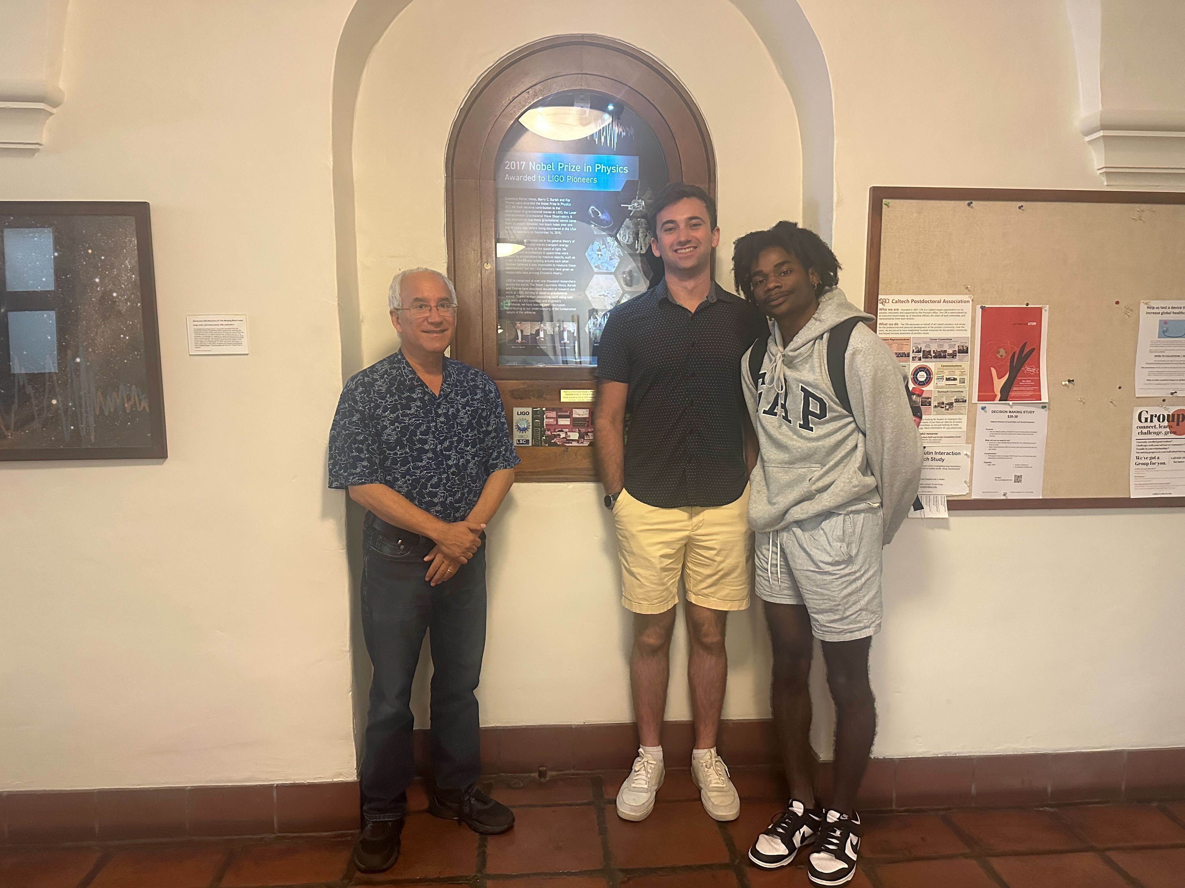

Acknowledgments
National Science Foundation LIGO Laboratory
Caltech SFP
Alan & Jacob

Slide 18
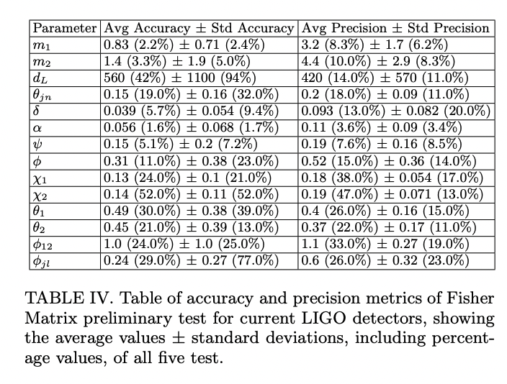
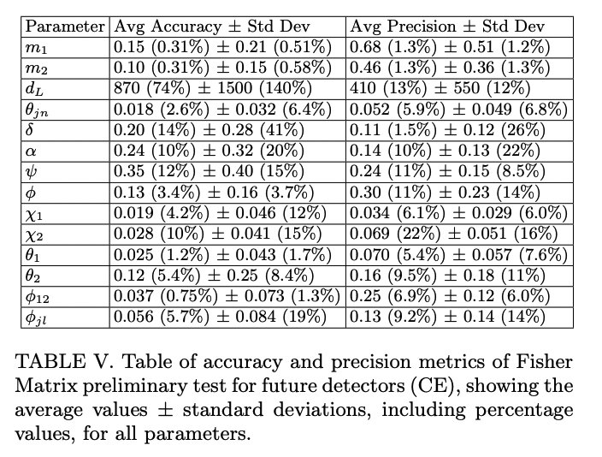
GWFish Results
LIGO Results
CE Results

