Slide 1



The Stochastic Gravitational- Wave Background from the Binary Black Hole Population
Caltech LIGO SURF 2024 Presentation
August 22nd, 2024
Jake Summers
Arizona State University
Mentors: Jacob Golomb & Alan Weinstein
1

Slide 2
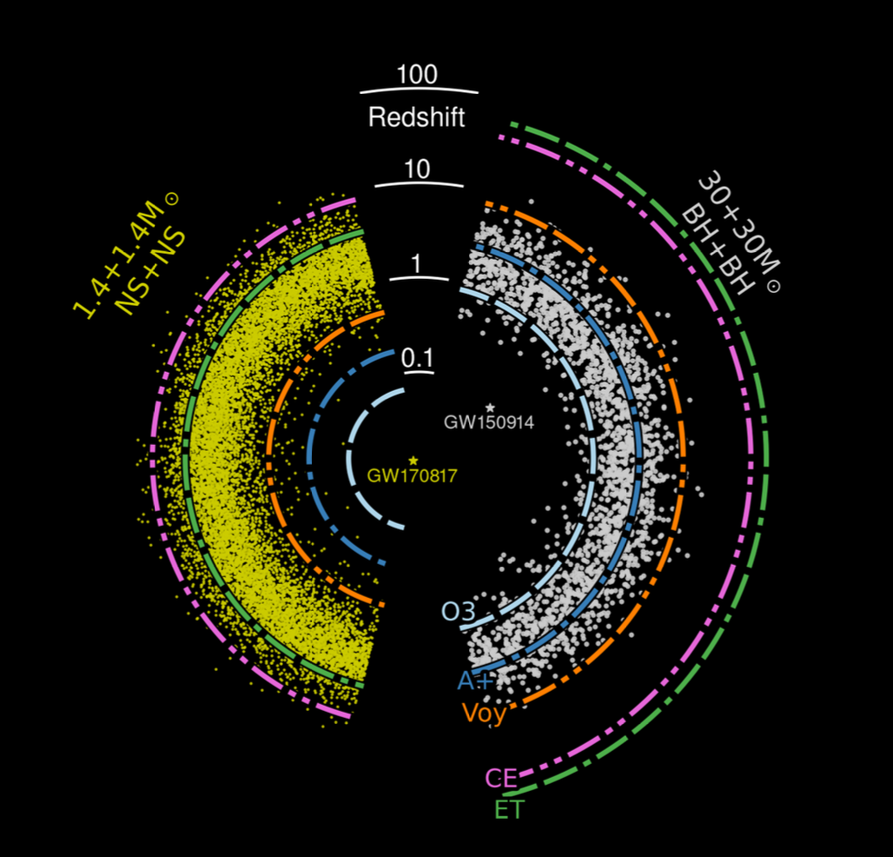
BNS and BBH coalescences seen in past, present, and future observations. Most are buried under the detector noise!
2
Image Credit: Ref. [1]

Slide 3
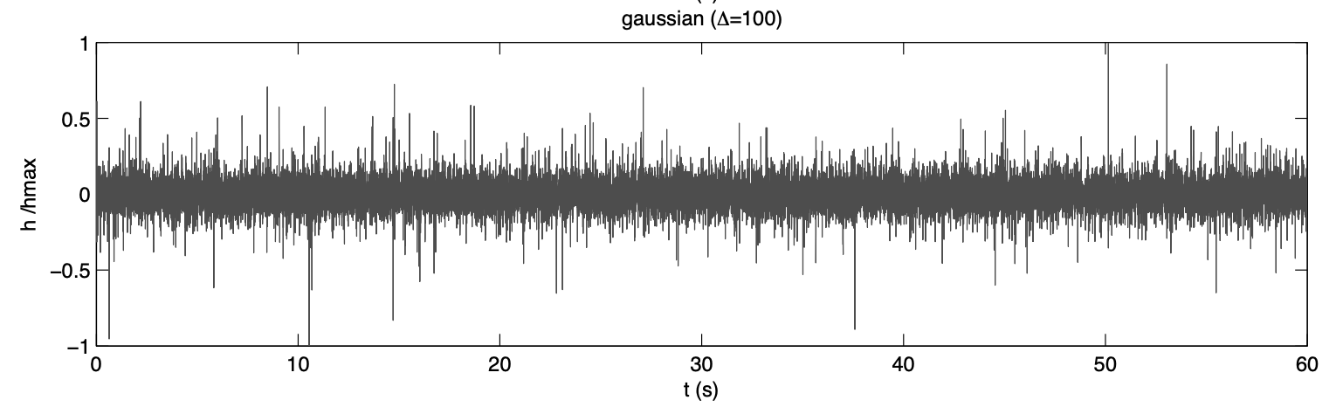
Stochastic GW Background – Noise?
The (astrophysical) stochastic GWB is expected to be stationary, unpolarized, Gaussian, and isotropic. It is a perpetual source of GWs. It is different than detector noise because it is correlated between detectors.
Image Credit: Ref. [2]
3

Slide 4
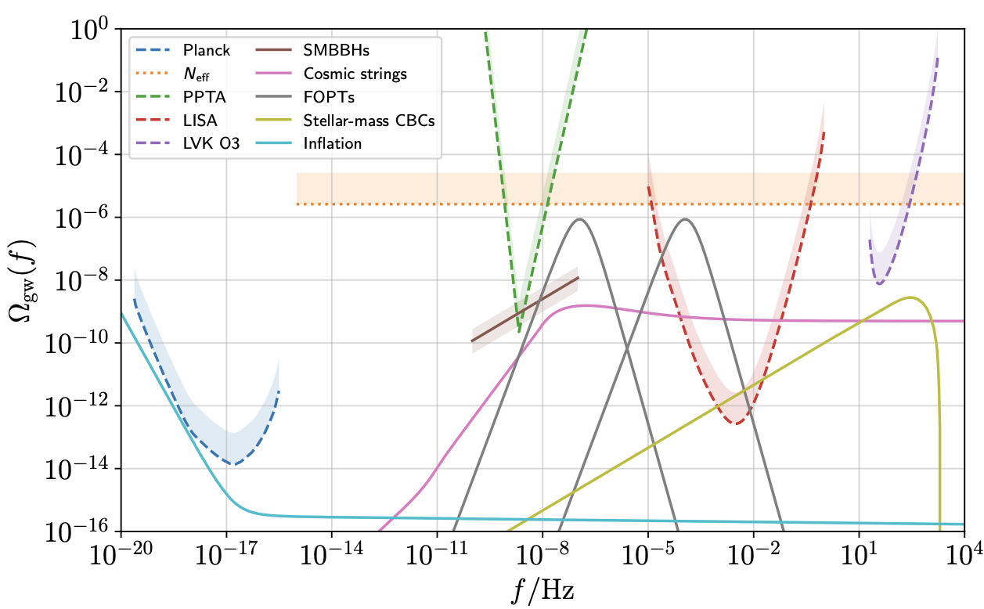
The Overall GW Background
Pulsar Timing Array [4]
LVK
LISA
GWB Energy Density
SMBBHs
CMB
CBCs
Cosmic strings
Slow-roll inflation
Phase transitions
Frequency [Hz]
4
Image Credit: Ref. [3]
Notes:
Dashed lines = sensitivity, solid lines = physical backgrounds

Slide 5
Goals of this Project
Create Population Models
Infer BBH Population with Data
Predict Phenomenological GWB
Predict Empirical GWB
Tells us about cosmology
5
Notes:
Also tells us what to search for.

Slide 6

Modeling the Masses I – Power Law + Peak
Model primary (source) mass as a power-law with a Gaussian peak [5].
  Power-law motivated by the initial mass function of stars.
  Peak motivated by pulsational pair instability but is probably something else [6].
Model mass ratio (not shown) as a power-law.
Account for observational bias!
Merger Rate .
Mass [$M_{⊙}$]
6
Notes:
Detector-frame masses are redshifted to larger masses.

Slide 7

Modeling the Masses II – Paired Masses
Model underlying mass distribution as a power-law with a Gaussian peak.
Primary and secondary mass black holes are both drawn from this distribution.
A pairing function tells the two black holes how to pair up [7].
Merger Rate .
Mass [$M_{⊙}$]
7

Slide 8




So… What’s the Difference?
Paired Masses
Power Law + Peak
Secondary Mass [$M_{⊙}$]
Secondary Mass [$M_{⊙}$]
Primary Mass [$M_{⊙}$]
Primary Mass [$M_{⊙}$]
Different population models could produce a different GWB.
8
Notes:
Paired Masses model slopes upward at the bottom because we parameterize a minimum mass ratio.

Slide 9
Modeling the Redshifts I – Power Law Redshift
Simplest model is to assume merger rate goes as a power-law.
Works well for low-redshift.
Need to assume a cosmological model.
Merger Rate .
Redshift
9
Notes:
Credible intervals become the smallest around z=0.2. That is where LVK detects the most BBH coalescences.

Slide 10
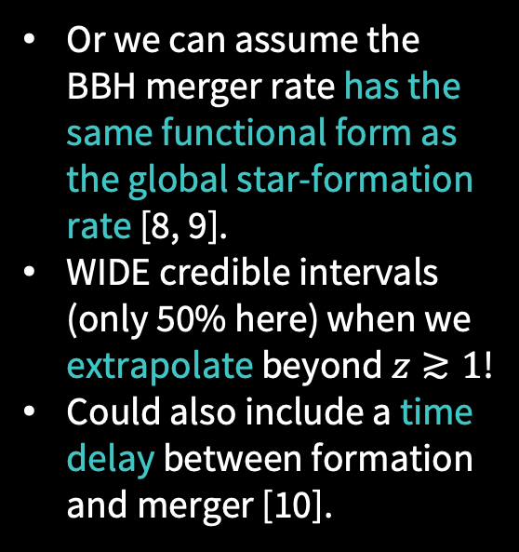
Modeling the Redshifts II – Star Formation Rate
Or we can assume the BBH merger rate has the same functional form as the global star-formation rate [8, 9].
WIDE credible intervals (only 50% here) when we extrapolate beyond $z≳1$!
Could also include a time delay between formation and merger [10].
Merger Rate .
Redshift
10
Notes:
Note that the merger rate should go to zero beyond around redshift 10.

Slide 11
Predicting the Empirical GWB I – Power Law + Peak
GWB Energy Density
Star Formation Rate
Power Law Redshift
Frequency [Hz]
Star Formation Rate model has more parameters, so it has larger uncertainty.
Power Law Redshift only acquires uncertainty from low-redshift behavior: high-redshift parameters are fixed.
11

Slide 12
Predicting the Empirical GWB II – Paired Masses
GWB Energy Density
Star Formation Rate
Power Law Redshift
Frequency [Hz]
Looks essentially the same as the previous slide!
This just means that our models are sufficiently similar.
12

Slide 13
The Phenomenological GWB – Redshift Binning
Normalized Merger Rate
GWB Energy Density
Redshift
Frequency [Hz]
High-redshift mergers have very little effect on the GWB.
13

Slide 14

An Evolving Mass Model???
Normalized Merger Rate
Normalized Merger Rate
GWB Energy Density
Redshift
Primary Mass [$M_{⊙}$]
Frequency [Hz]
Allowing the slope of the Power Law + Peak model to change as a function of redshift leaves an imprint on the GWB [11, 12].
I made an app that allows you to visualize this! (wait for the end)
14
Notes:
Could also allow the peak to change as a function of redshift

Slide 15

The Frankenstein Model
What sort of model would make a noticeable impact to the GWB?
JWST finds that the high-redshift star formation rate is higher than expected [13, 14].
Globular clusters simulations can reproduce the Power-Law + Peak model, except for the low-mass peak [15].
Observations with JWST find massive globular clusters at high-redshifts [14].
Merger Rate .
Turnoff Redshift
Primary Mass [$M_{⊙}$]
Merger Rate
Power-Law Dominated
Cluster Dominated
Redshift
15

Slide 16
What Parameters Affect the GWB the Most?
With our Frankenstein model, we can change the redshift that globular clusters become dominant.
Shape of GWB is most sensitive to major population changes such as these.
Magnitude of GWB is more sensitive to local merger rate, peak redshift, etc.
GWB Energy Density
Frequency [Hz]
16

Slide 17


Conclusions
01
02
03
04
Population Models
BBH Population
Simple models work well for now. We don’t know what they will look like for $z≳1$.
Mass model at low-redshift is well-constrained. Redshift model at $z≳1$ is totally unknown.
Empirical GWB
Phenomenological GWB
Large uncertainties when using Star Formation Rate model. Time delay distribution is unknown.
Can analyze shape of GWB by creating extreme models. Not sensitive to very high-redshift behavior.
17

Slide 18
References I
M. Evans et al., A Horizon Study for Cosmic Explorer: Science, Observatories, and Community, arXiv e-prints 10.48550/arXiv.2109.09882 (2021).
T. Regimbau, The astrophysical gravitational wave stochastic background, Res. Astron. Astrophys. 11, 369 (2011).
A. Renzini et al., Stochastic Gravitational-Wave Backgrounds: Current Detection Efforts and Future Prospects, Galaxies 10, 0 (2022).
G. Agazie et al. (The NANOGrav Collaboration), The NANOGrav 15 yr Data Set: Evidence for a Gravitational-wave Background, ApJL 951, L8 (2023).
C. Talbot and E. Thrane, Measuring the Binary Black Hole Mass Spectrum with an Astrophysically Motivated Parameterization, ApJ 856, 173 (2018).
J. Golomb, M. Isi, and W.M. Farr, Physical Models for the Astrophysical Population of Black Holes: Application to the Bump in the Mass Distribution of Gravitational Wave Sources, arXiv e-prints 10.48550/arXiv.2312.03973 (2023).
M. Fishbach and D.E. Holz, Picky Partners: The Pairing of Component Masses in Binary Black Hole Mergers, ApJL 891, L27 (2020).
P. Madau and M. Dickinson, Cosmic Star-Formation History, Annu. Rev. Astron. Astrophys. 52, 415–86 (2014).
18

Slide 19

References II
M. Fishbach and D.E. Holz and W.M. Farr, Does the Black Hole Merger Rate Evolve with Redshift?, ApJL 863, L41 (2018).
K. Turbang et al., The Metallicity Dependence and Evolutionary Times of Merging Binary Black Holes: Combined Constraints from Individual Gravitational-wave Detections and the Stochastic Background, ApJ 967, 142 (2024).
M. Lalleman et al., Estimating the redshift dependence of the binary black hole population: combining gravitational-wave detections with limits on the stochastic background, in The European Physical Society Conference on High Energy Physics (2024) p. 88.
M. Fishbach et al., When Are LIGO/Virgo’s Big Black Hole Mergers?, ApJ 912, 98 (2021).
Y. Harikane et al., Pure Spectroscopic Constraints on UV Luminosity Functions and Cosmic Star Formation History from 25 Galaxies at $z_{spec}$ = 8.61–13.20 Confirmed with JWST/NIRSpec, ApJ 960, 56 (2024).
A. Adamo et al., The First Billion Years, According to JWST, arXiv e-prints arXiv:2405.21054 (2024).
F. Antonini et al., Coalescing black hole binaries from globular clusters: mass distributions and comparison to gravitational wave data from GWTC-3, MNRAS 522, 466 (2023).
19

Slide 20


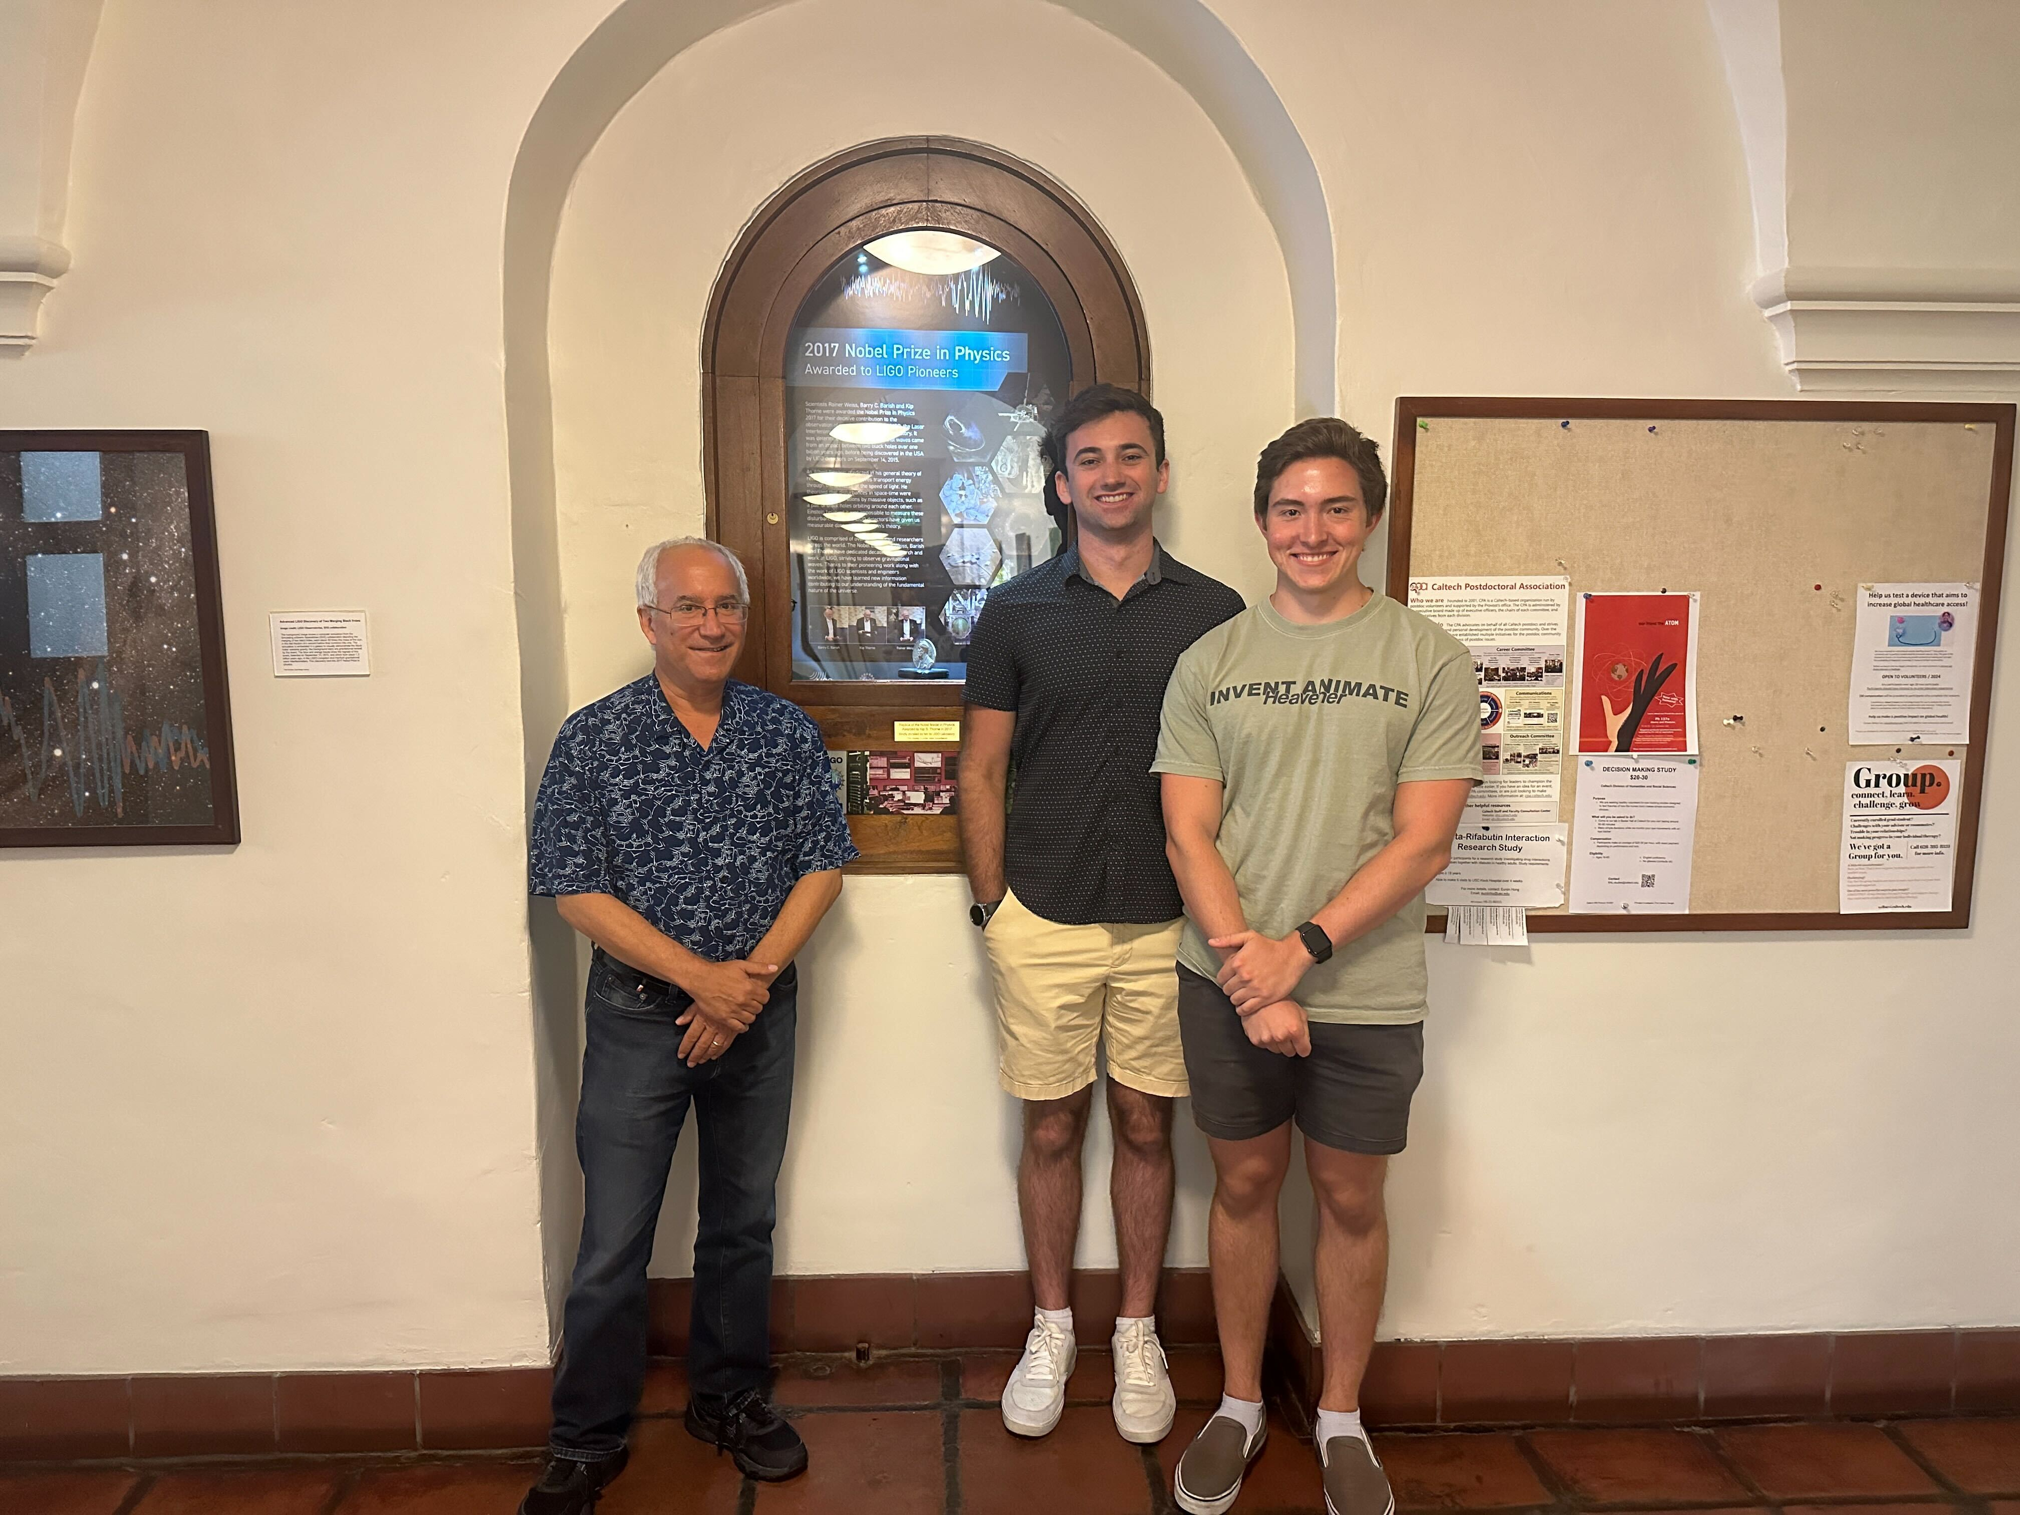

Thanks!
Questions?
Huge thanks to Jacob and Alan for being incredible mentors this whole summer!!!
This work was supported by the National Science Foundation Research Experience for Undergraduates (NSF REU) program, the LIGO Laboratory Summer Undergraduate Research Fellowship program (NSF LIGO), and the California Institute of Technology Student-Faculty Programs.
CREDIT: This presentation template was created by Slidesgo, and includes icons by Flaticon, and infographics & images by Freepik.
Try my streamlit app to play with the GWB!! →
https://ligo-gwb-viewer.streamlit.app
20

Slide 21
EXTRA FIGURES
21

Slide 22
Power Law + Peak – Mass Ratio
22

Slide 23
Paired Masses– M1 and M2
Different distributions for primary mass (left) and secondary mass (right).
23

Slide 24
Paired Masses vs Power Law + Peak
24

Slide 25
Star Formation Rate w/ Fixed High-z Parameters
25

Slide 26
Metallicity-Weighted Time Delay Model
Left: Changing the power-law describing the time delay distribution.
Middle: Changing the minimum time delay.
Right: Changing the maximum metallicity.
26

Slide 27
GWB with NO Pairing Function
Large uncertainty in GWB at low frequencies.
No pairing function allows mergers with large total mass.
27

Slide 28
GWB Effects of Uncertainty
28

Slide 29
GWB with Metallicity-Weighted Time Delay
29

Slide 30
A More Realistic Redshift Model
Using typical values inferred from the population of binary black holes for the redshift model, mid-redshift mergers are still somewhat influential.
30

Slide 31
A More Realistic Redshift Model (at low-redshift)
GWB peaks around z=1 under this redshift model.
31

Slide 32

Evolving Power Law + Peak
$γ$: low-z power-law slope
$z_{peak}$: peak redshift
$κ$: determines high-z power-law slope
$α(z)$: linear change in mass power-law over redshift
$λ(z)$: linear change in area of Gaussian peak
$μ(z)$: linear change in location of Gaussian peak
32

Slide 33

Evolving Frankenstein
$z_{turn}$: turnoff redshift
${Δz}_{turn}$: width of logistic turnoff
$g_{1}$: low-mass power-law slope in GC model
$g_{2}$: high-mass power-law slope in GC model
$η$: power-law redshift model after turnoff
$B$: amplification to merger rate after turnoff
33

