Slide 1
Investigating methods of fitting quasinormal-modes in numerical-relativity ringdown signals
Erin Coleman
Mentor: Eliot Finch

Slide 2
Ringdown
After a black hole merger, the resultant black hole is perturbed and radiates gravitational waves to reach equilibrium
Ringdown can be decomposed as a sum of quasinormal modes (QNMs) with indices (l, m, n)
The fundamental (2, 2, 0) QNM dominates, but its overtones (2, 2, n) are important
Within GR, QNM frequencies depend on only M_{f} and ꭓ_{f}

Slide 3
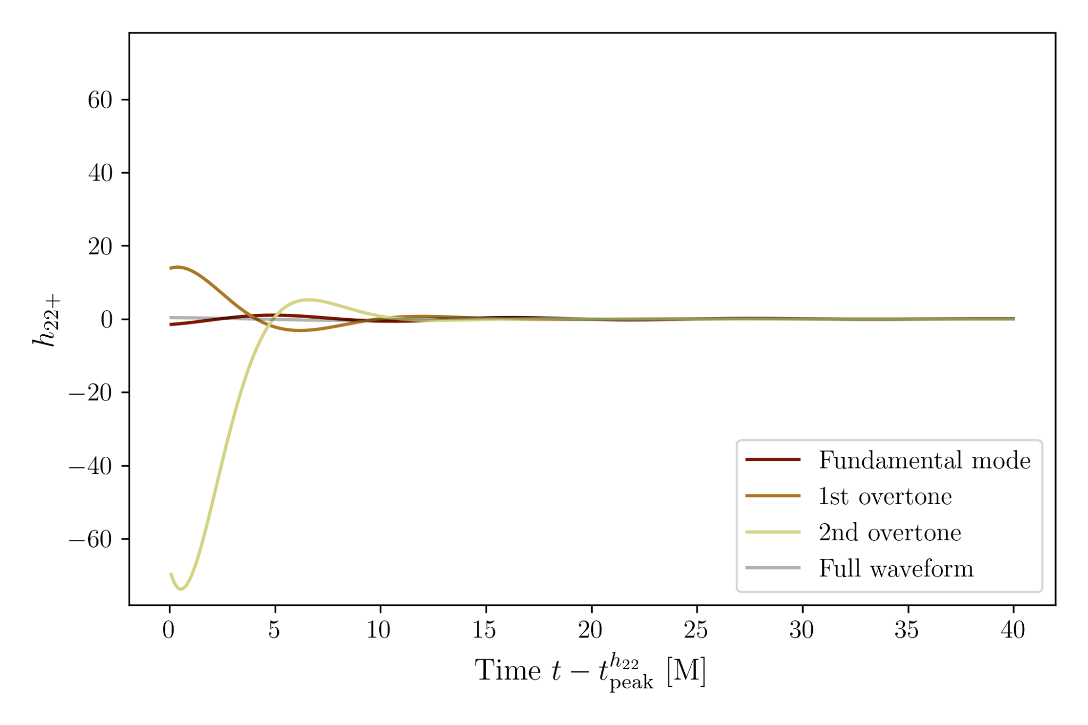
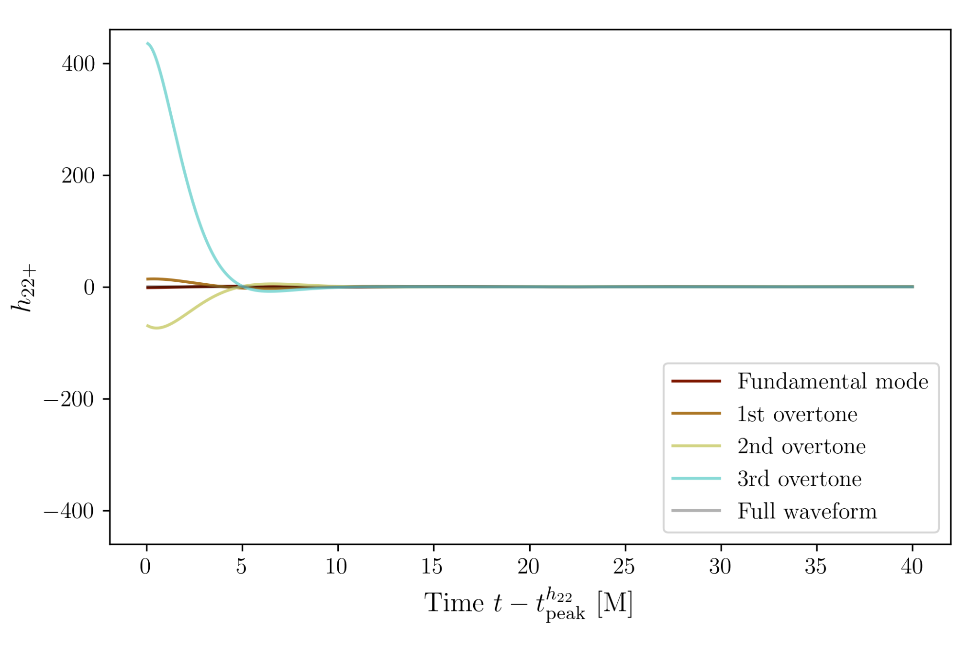
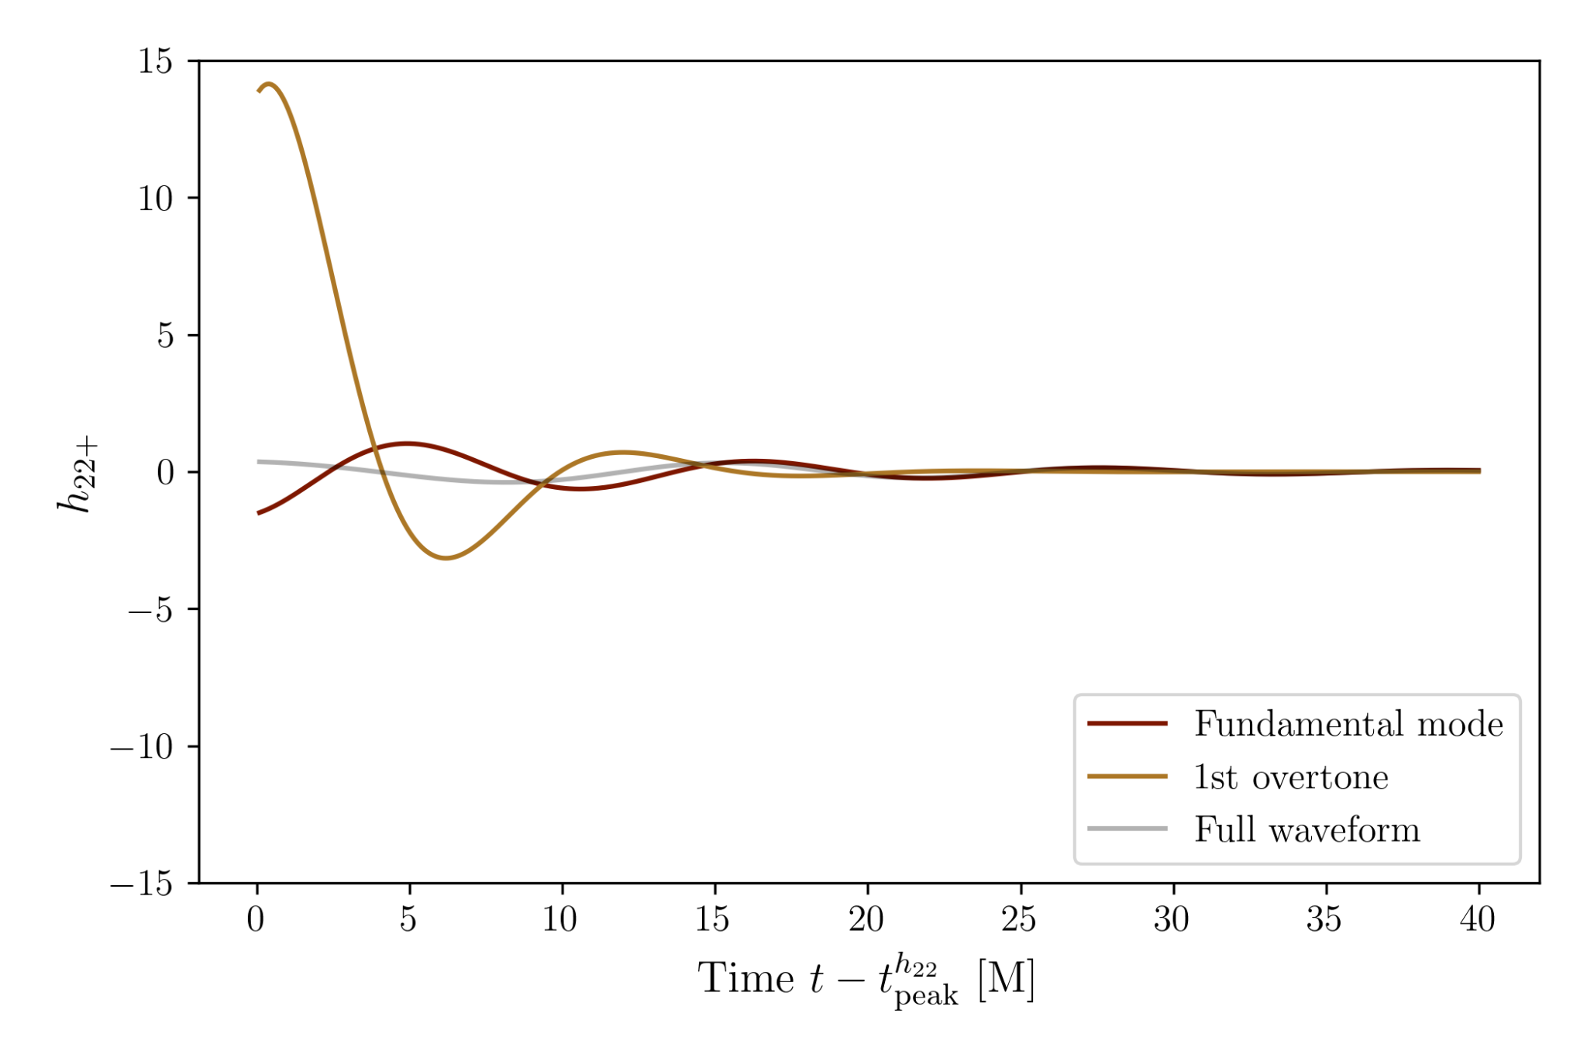
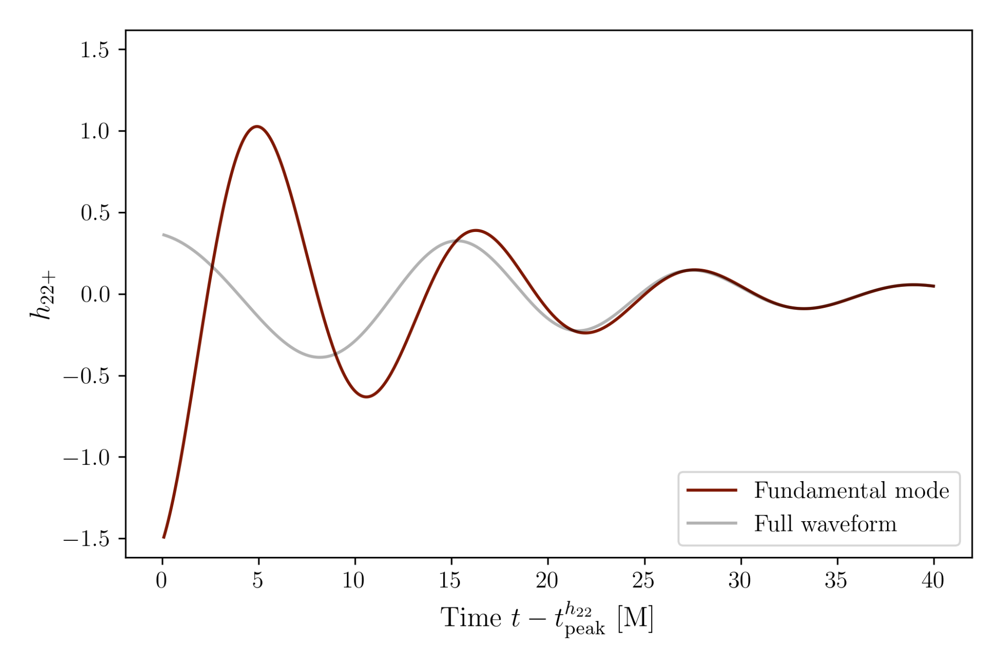
Overtones
Higher n QNMs have larger initial amplitude and decay more quickly
Adding overtones allows earlier fit
Previous work stopped at 7 overtones, but can we go further? [1]
Using 10 non-precessing SXS numerical-relativity waveforms [2]

Slide 4
When is a model with N overtones a good fit?

Slide 5
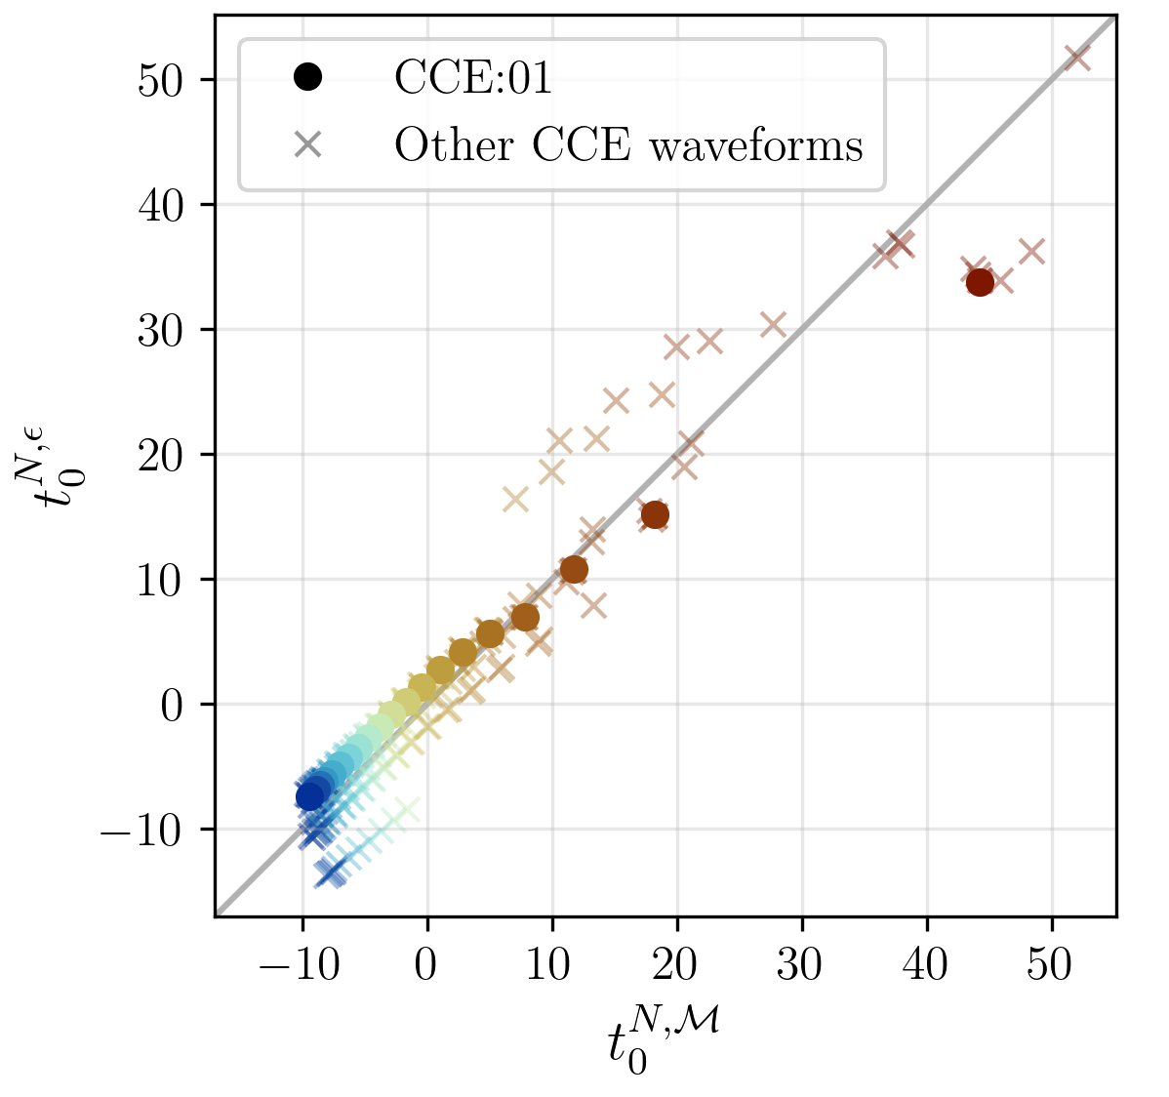
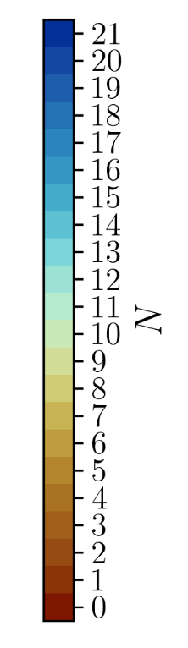
Least-Squares Fit Start Time Analysis
t₀^{N}: earliest time fit with N overtones is valid
Calculated t₀^{N} using two metrics
  Mismatch: numerical metric
  Epsilon: physical accuracy of mass-spin
Start times correlated
Can use up to 17 overtones

Slide 6
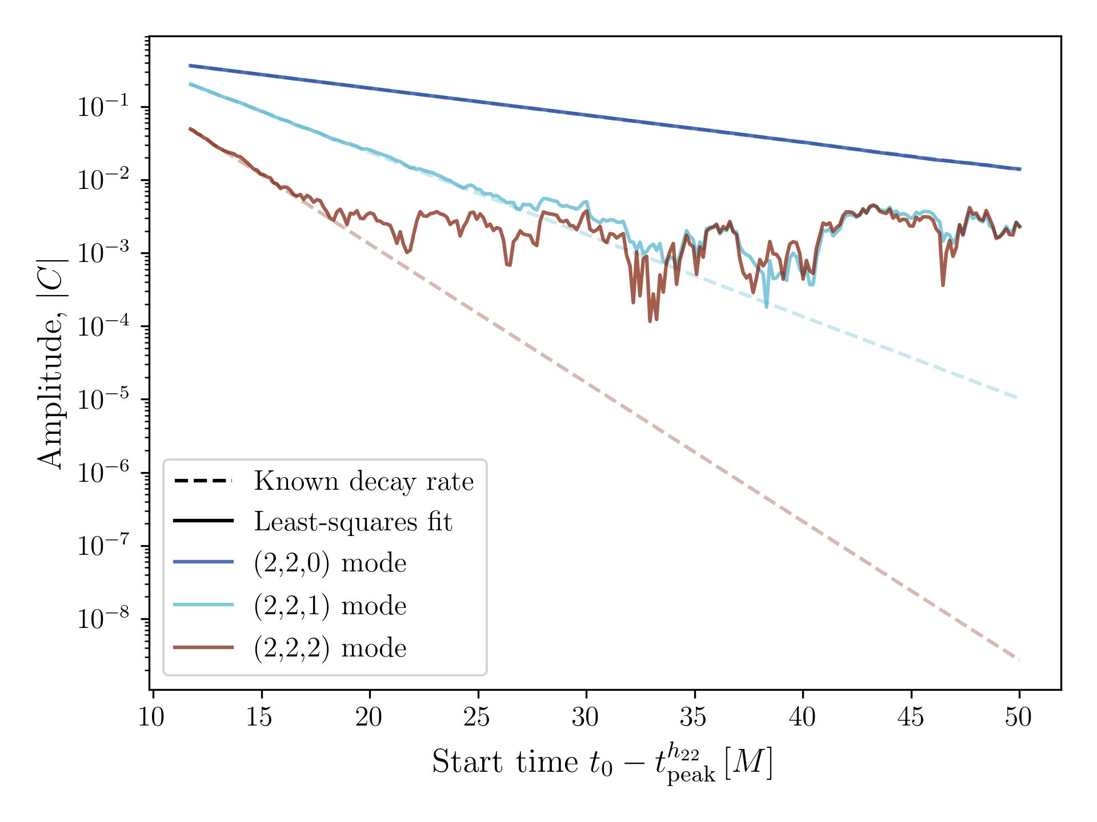
Issues with Least-Squares Fits
NR waveforms contain numerical noise and unmodeled modes
After a mode has decayed, least-squares fits to noise
When does a model cease to be valid?

Slide 7
Bayesian Sampling - dealing with “noise”
Used emcee [3] (an affine-invariant MCMC sampler)
Applies Bayes’ Theorem to generate samples of the posterior distribution for phase and amplitude of each overtone
Assumed time-invariant, Gaussian noise with amplitude σ and uniform priors
(3, 2, 0) QNM dominates unmodeled behavior

Slide 8
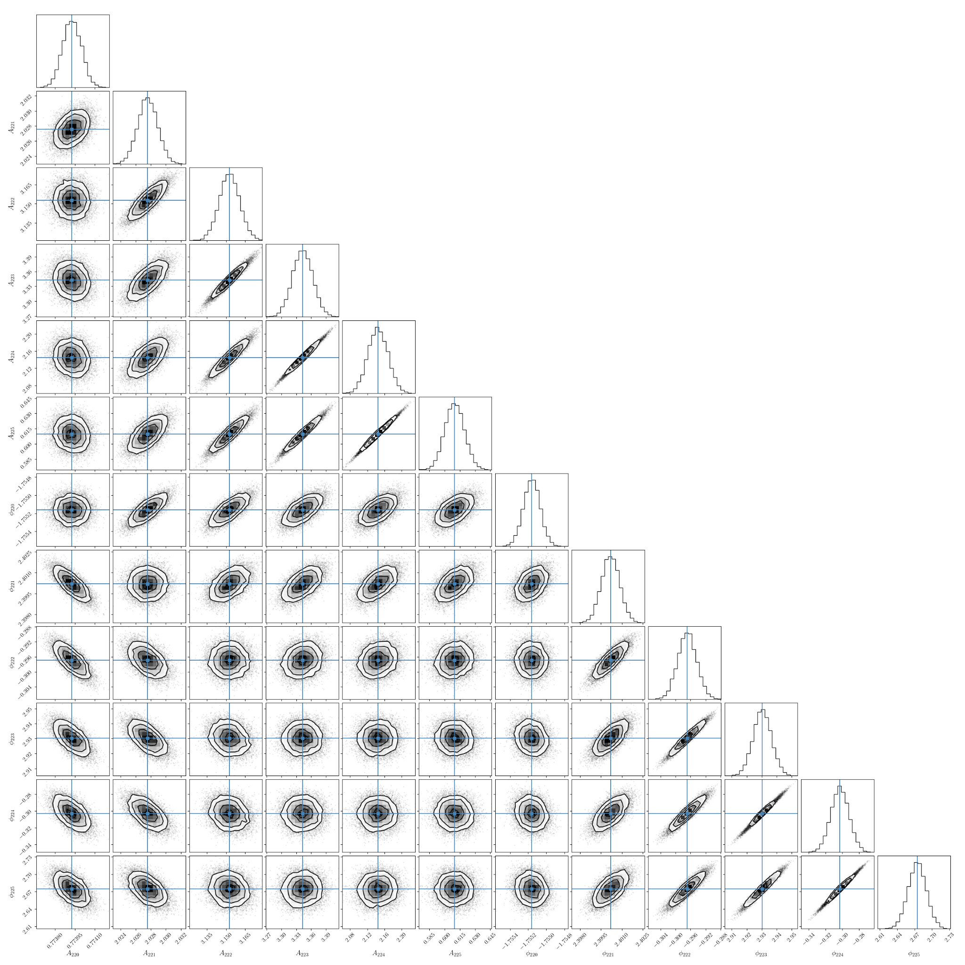
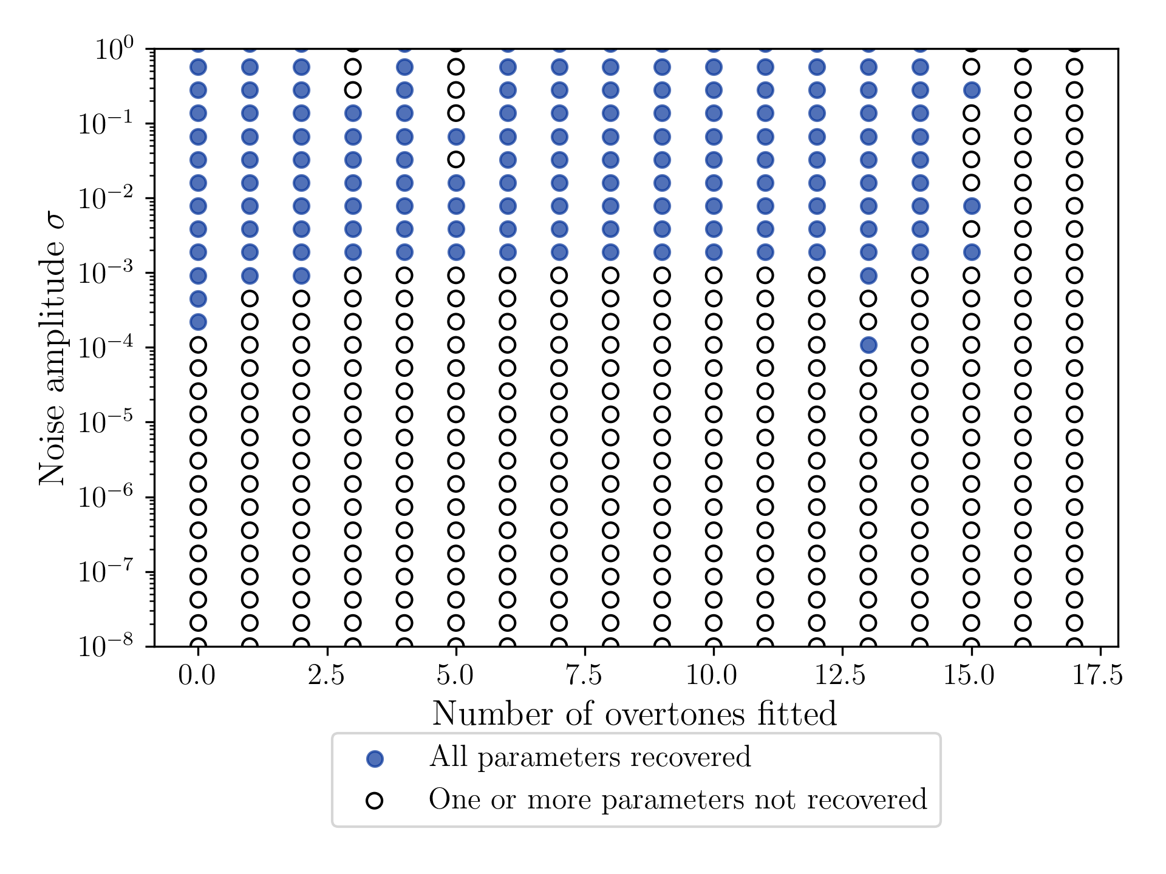
Injections
Able to successfully recover amplitude/phase from zero-noise injections
Investigated limits of emcee sampler in N and σ
Ideal conditions:
  N≈15 and σ≈10⁻⁵ (depends on N)
(3, 2, 0) unmodeled:
  N≈15 and σ≈10⁻³ (no N dependency)
Zero-noise injection with (3, 2, 0) unmodeled

Slide 9
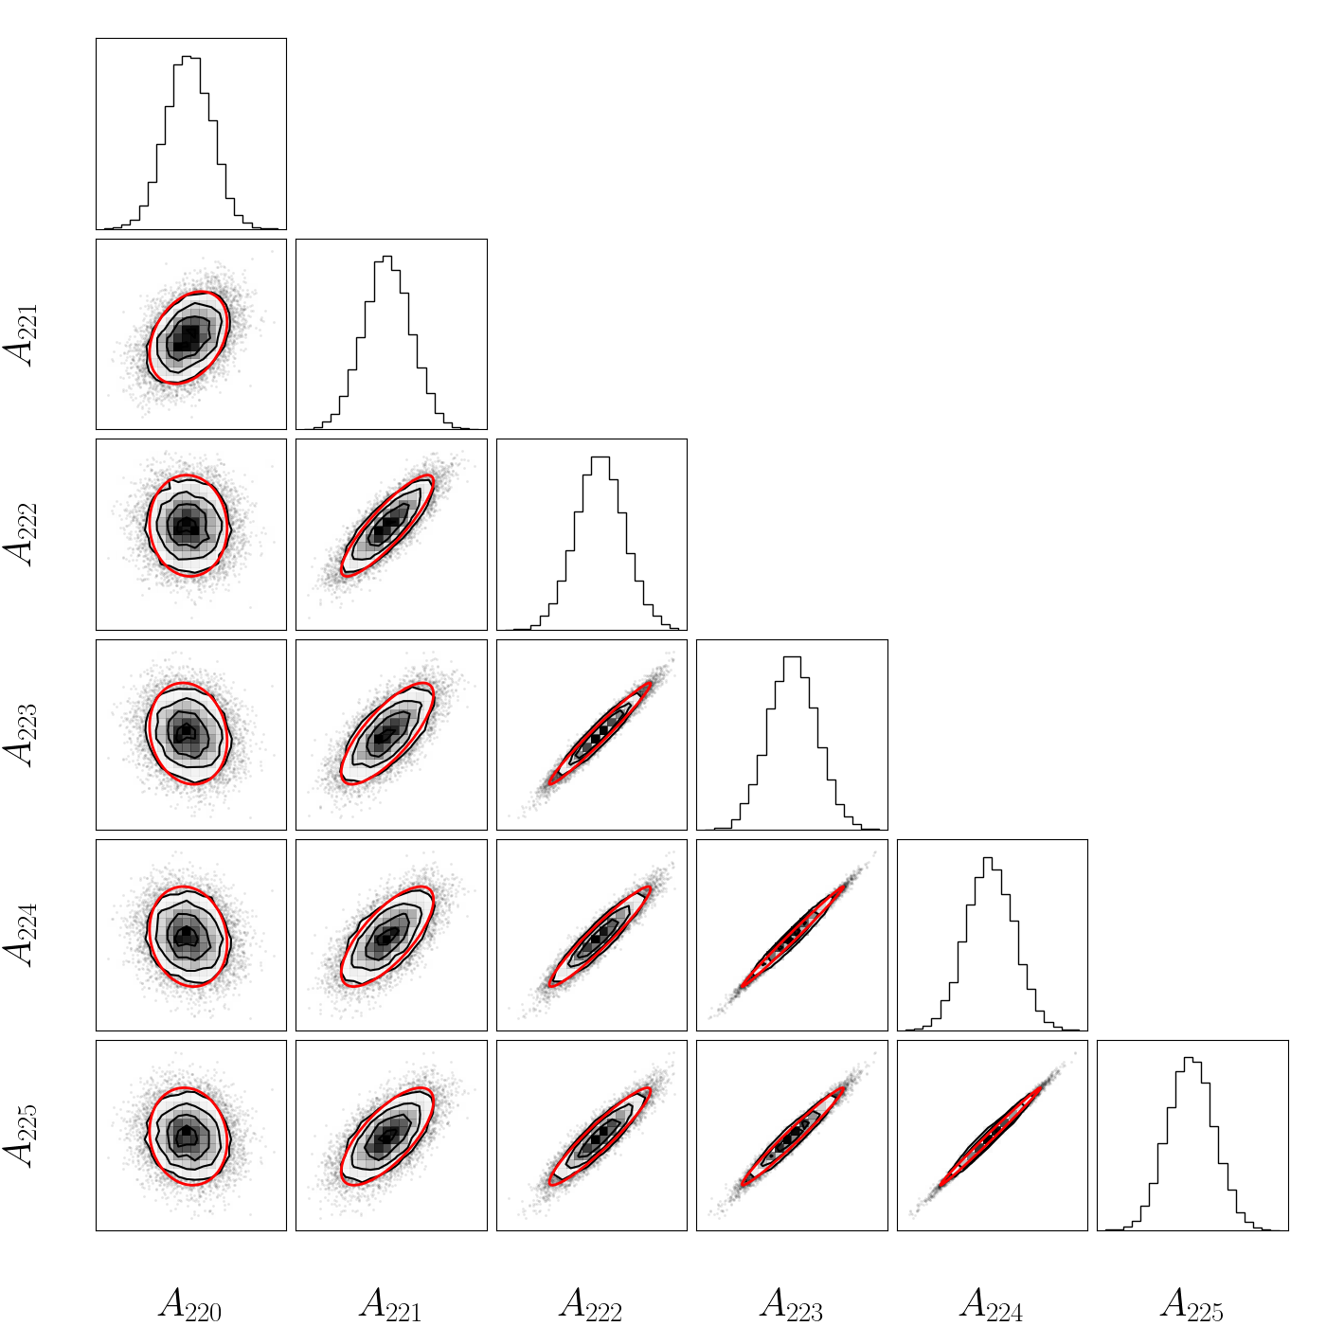
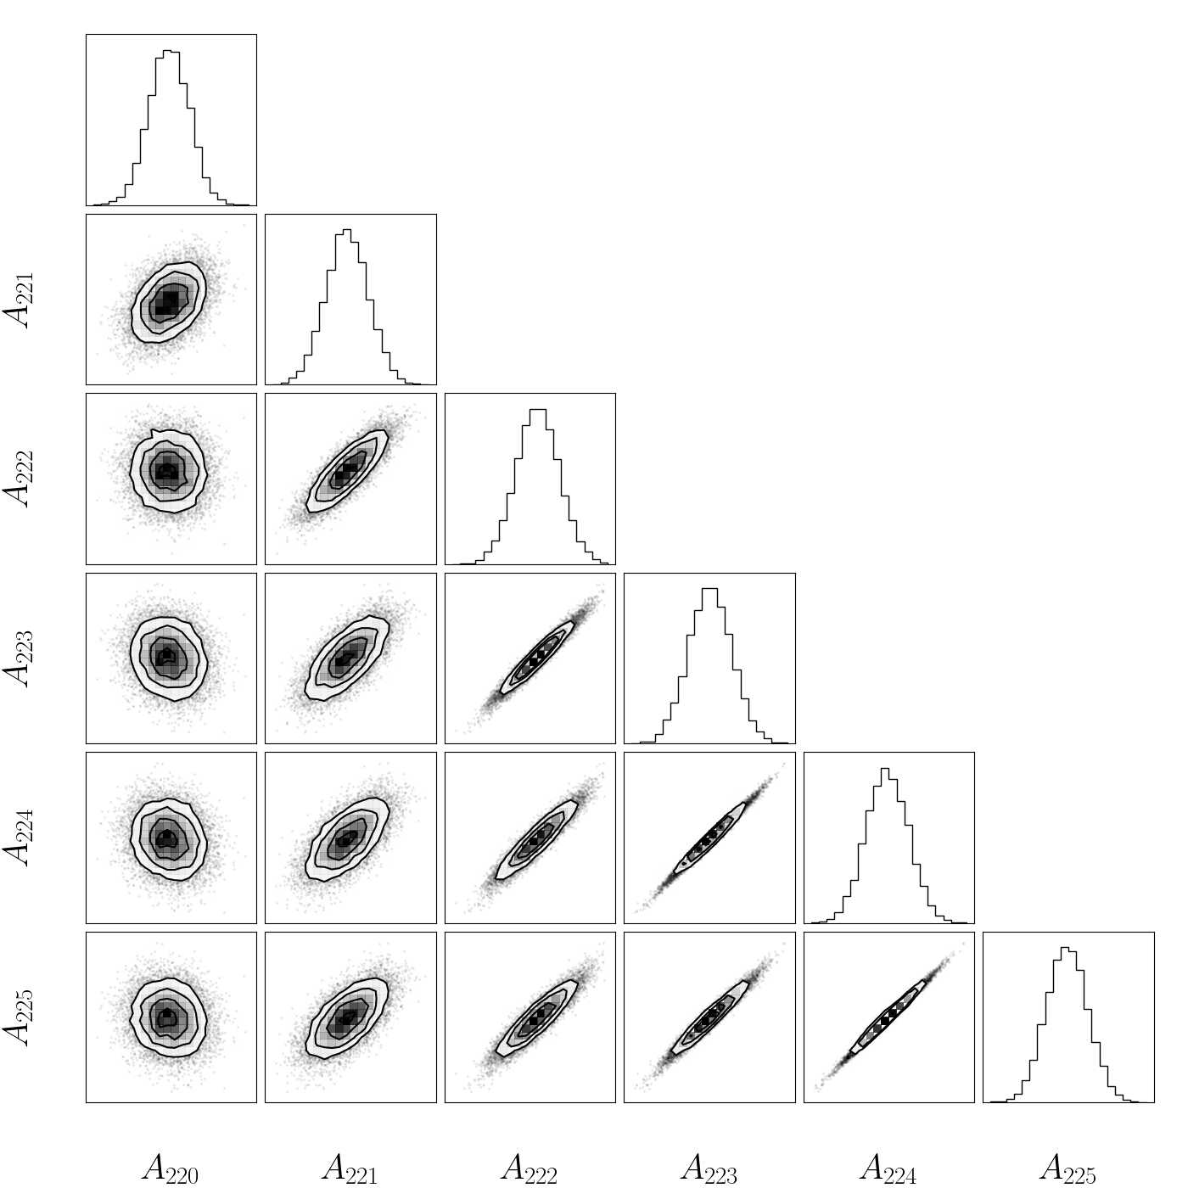
Correlations
Strong correlations between mode amplitudes and phases, especially for higher n
Calculated covariance by inverting the Fisher matrix
Higher overtones are out of phase, have large amplitudes

Slide 10
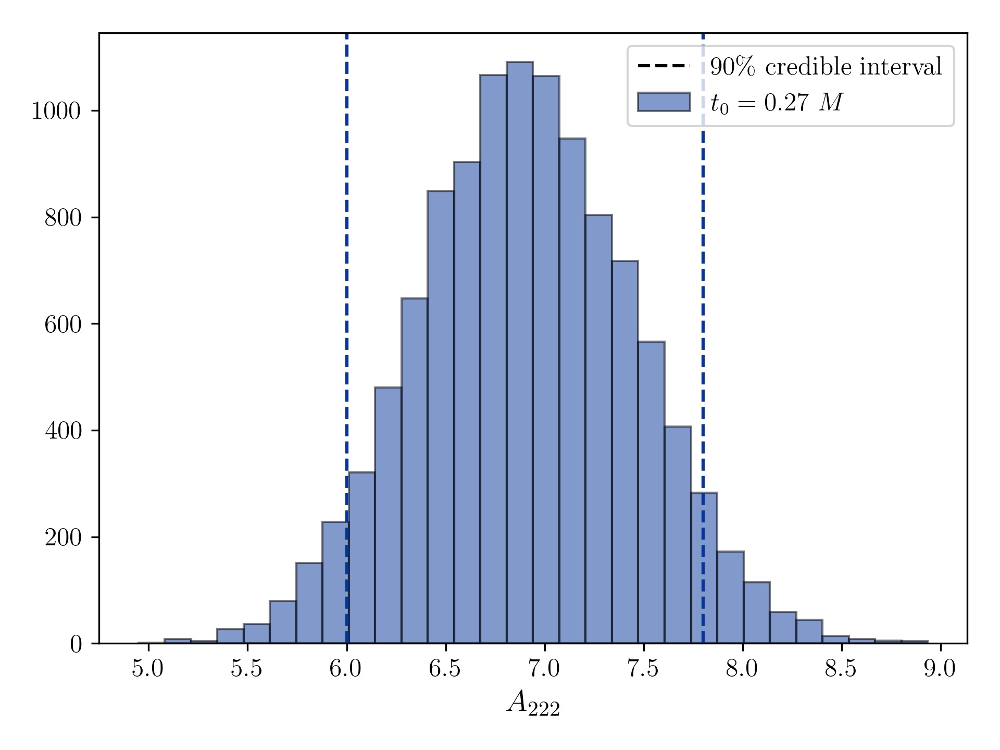
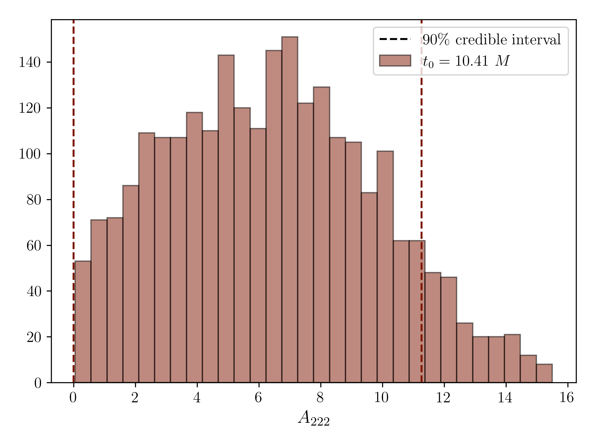
Resolvability
Determines when QNM has decayed below the noise floor
Resolved: highest density interval of QNM amplitude is nonzero

Slide 11
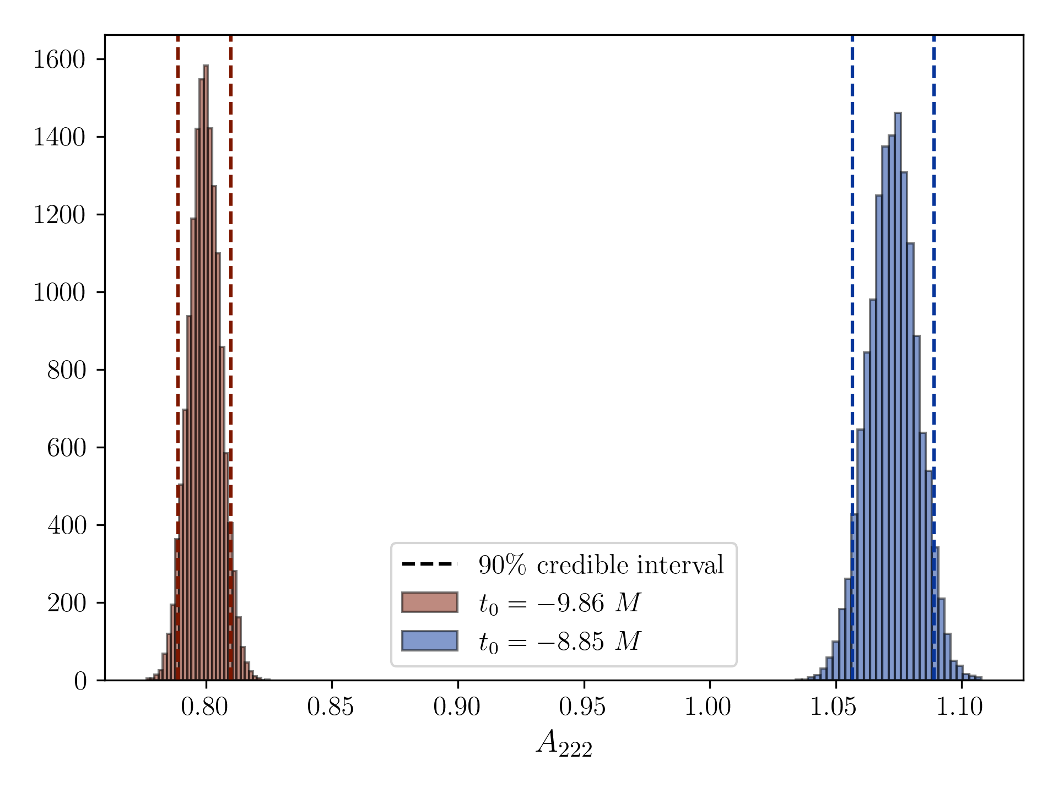
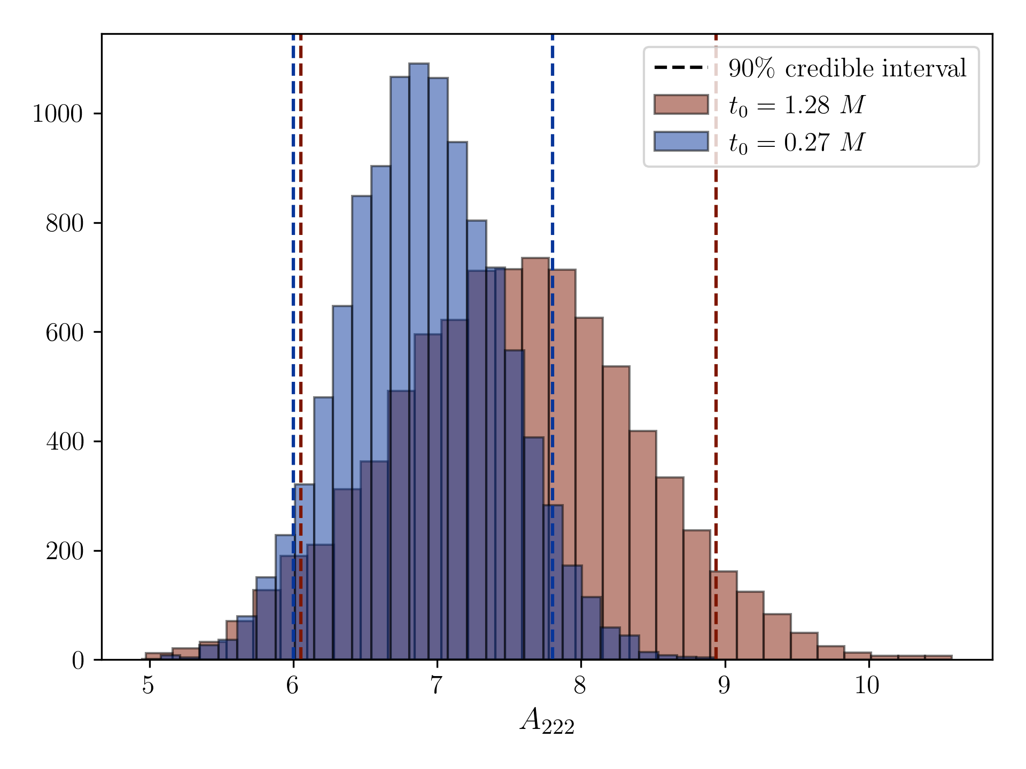
Stability
Before model is good fit, the fit values fluctuate
Stable: 90% credible interval agrees with all resolved fits at later times in both amplitude and phase

Slide 12
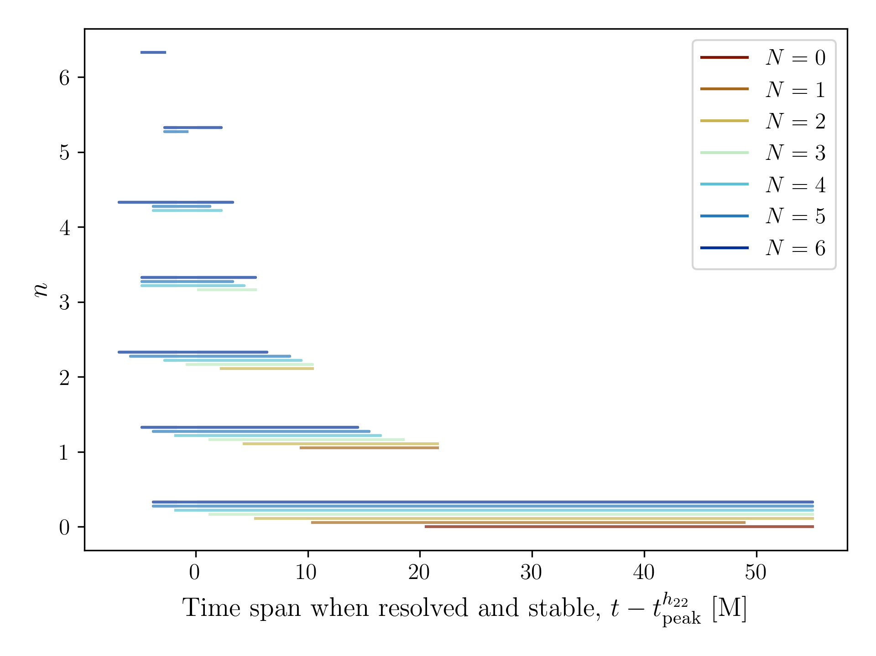
Resolvability and stability
More overtones make fit valid earlier
All overtones in fit become stable at roughly the same time
Each overtone decays below noise floor at a different time

Slide 13
Conclusions
Least-Squares fitting:
Mismatch and mass-spin recovery to find valid model start times up to N = 17
Investigated frequency perturbations (not discussed here) to measure “contribution” of each overtone - contribution decreases
Bayesian fitting:
Needed more careful approach to fitting amplitudes and phases
Revealed correlations between overtones
Future work:
Higher N values in Bayesian fits
Understanding correlations better

Slide 14



References
Matthew Giesler et al. “Black Hole Ringdown: The Importance of Overtones”. In: Phys. Rev. X 9.4 (2019), p. 041060. doi: 10.1103/PhysRevX.9.041060.
SXS Collaboration. The Ext-CCE Waveform Database. https://data.black- holes.org/waveforms/extcce_catalog.html.
Daniel Foreman-Mackey et al. “emcee: The MCMC Hammer”. In: Publications of the Astronomical Society of the Pacific 125.925 (Mar. 2013), p. 306. doi: 10.1086/670067.
This work was supported by the National Science Foundation Research Experience for Undergraduates (NSF REU) program, the LIGO Laboratory Summer Undergraduate Research Fellowship program, and the California Institute of Technology Student-Faculty Programs.

