Slide 1
Spectral Analysis Using BayesWave for Characterizing Remnant Outcomes in Binary Neutron Star Mergers
LIGO SURF Final Presentation, August 23rd 2024
Lana Alabbasi, King Abdulaziz University
Supervised by Isaac Legred and Katerina Chatziioannou, Caltech

Slide 2
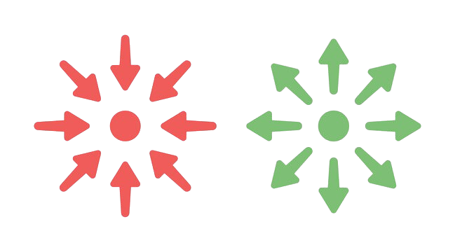
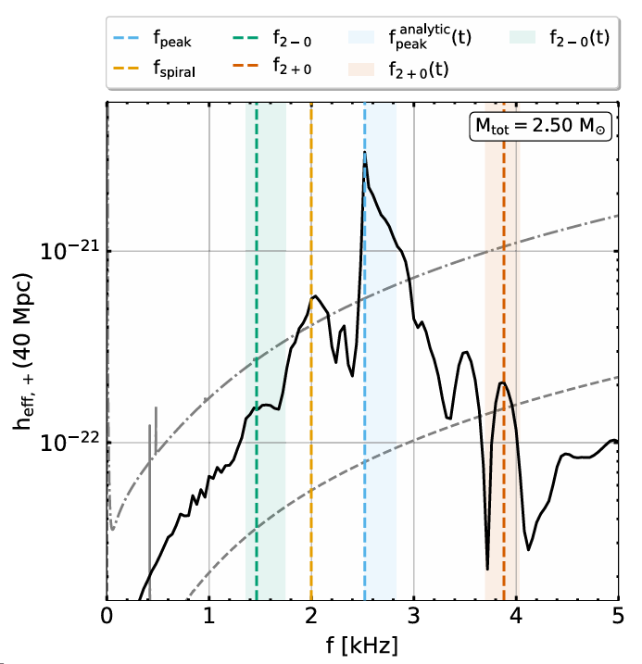
Stiff EoS: Long-lived Neutron Star Remnants
Stiff EoS
Higher P for a given ρ
Interesting modes
Long-lived remnant
Pressure support against collapse
Postmerger modes clearly identified:
Peak Frequency
Secondary frequencies
Plot: Theodoros Soultanis, Andreas Bauswein, and Nikolaos Stergioulas. Analytic models of the spectral properties of gravitational waves from neutron star merger remnants. Physical Review D, 105(4):043020, 2022.

Slide 3
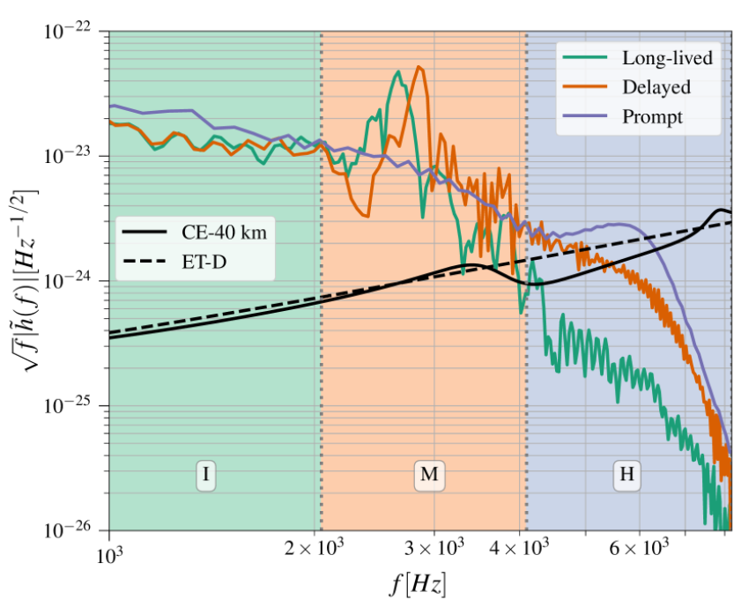
Soft EoS: Promptly Collapsing Remnants
Soft EoS
Lower P for a given ρ
Promptly collapsing remnant
No pressure support against collapse
Postmerger modes less identified:
QNM
Modes associated with star collapse
Plot: Dhani, A., Radice, D., Schütte-Engel, J., Gardner, S., Sathyaprakash, B., Logoteta, D., ... & Kashyap, R. (2024). Prospects for direct detection of black hole formation in neutron star mergers with next-generation gravitational-wave detectors. Physical Review D, 109(4), 044071.

Slide 4
Research Motivations
Theoretical Motivation:
Better identify the prompt collapse modes.
Data Analysis Motivation:
See whether Cosmic Explorer can capture such modes.

Slide 5

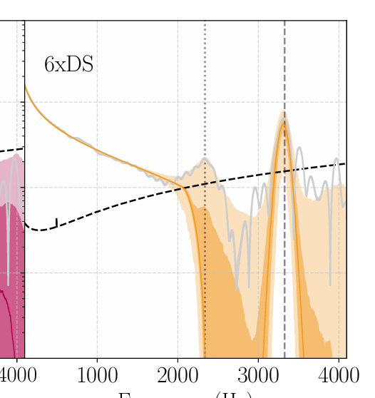
BayesWave CPP Model Agnostic Signal Reconstruction
Injected NR Simulations: DD2 and MPA1
Prior: Sine-Gaussian wavelets
Likelihood: CE PSD
Posterior: Reconstructions
Bayeswave CPP
MCMC Sampling
Strain
Strain
Frequency
Frequency

Slide 6
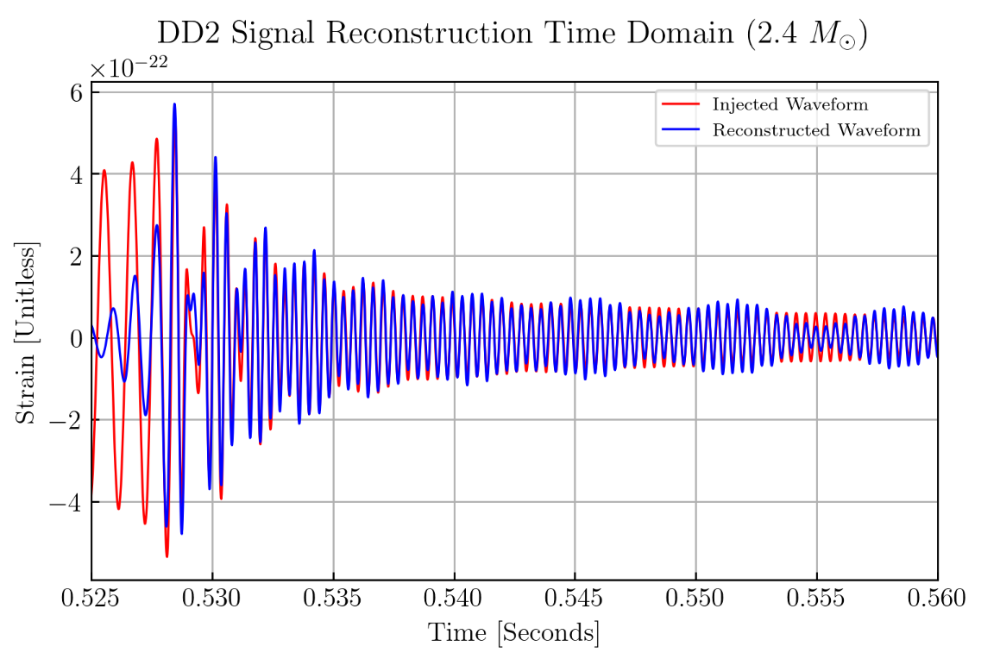
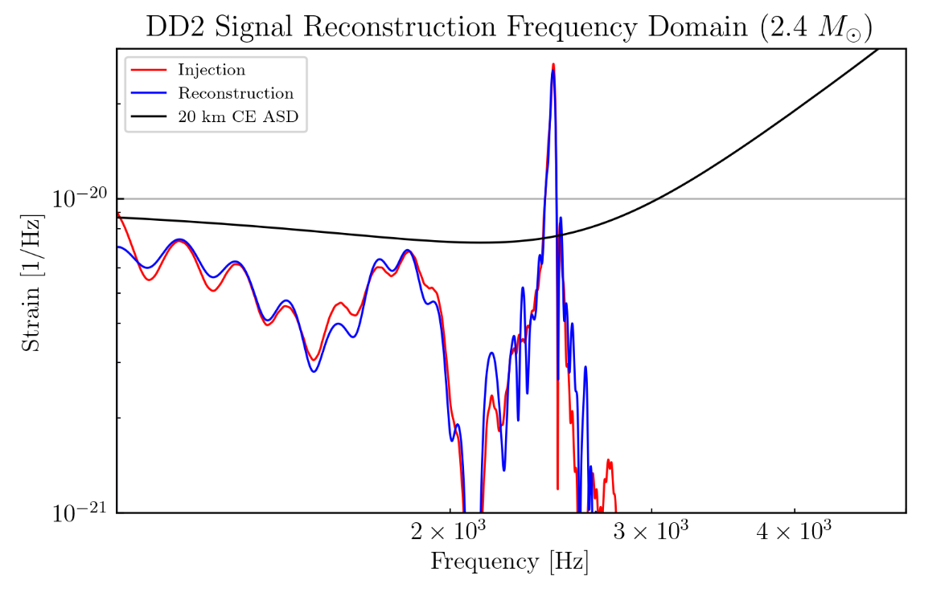
Stiff EoS Long-lived Reconstructions: DD2 EoS
The signal is well reconstructed, with accurate frequency mode identification

Slide 7
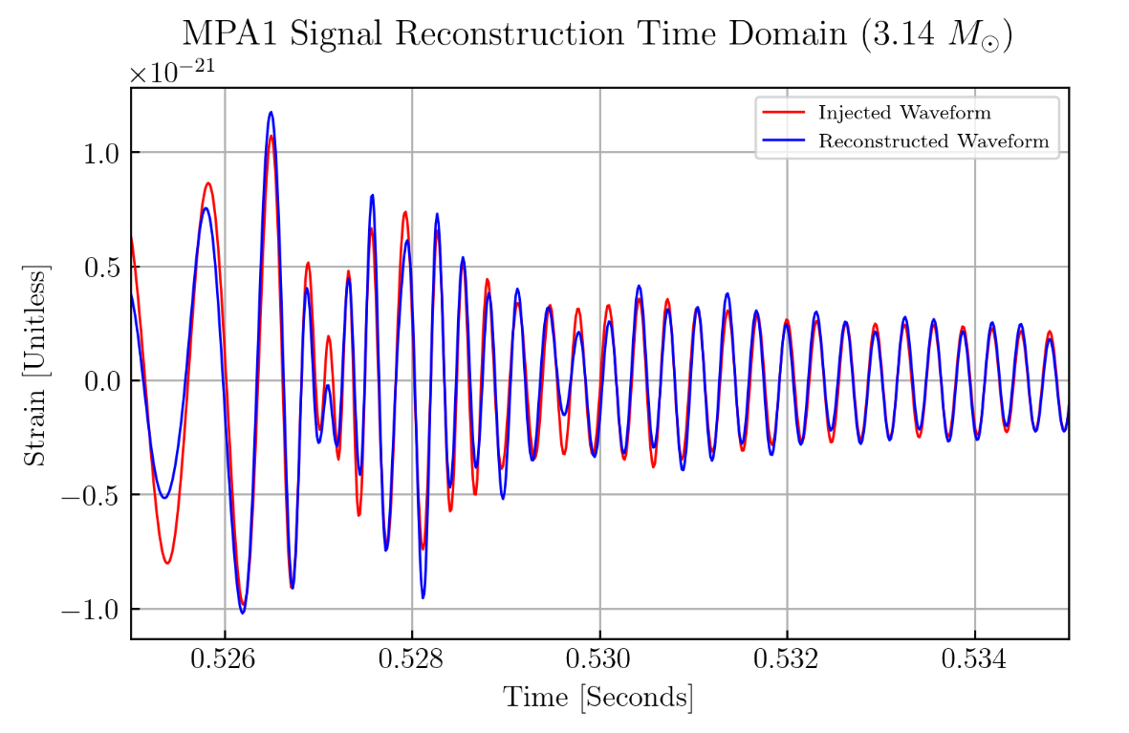
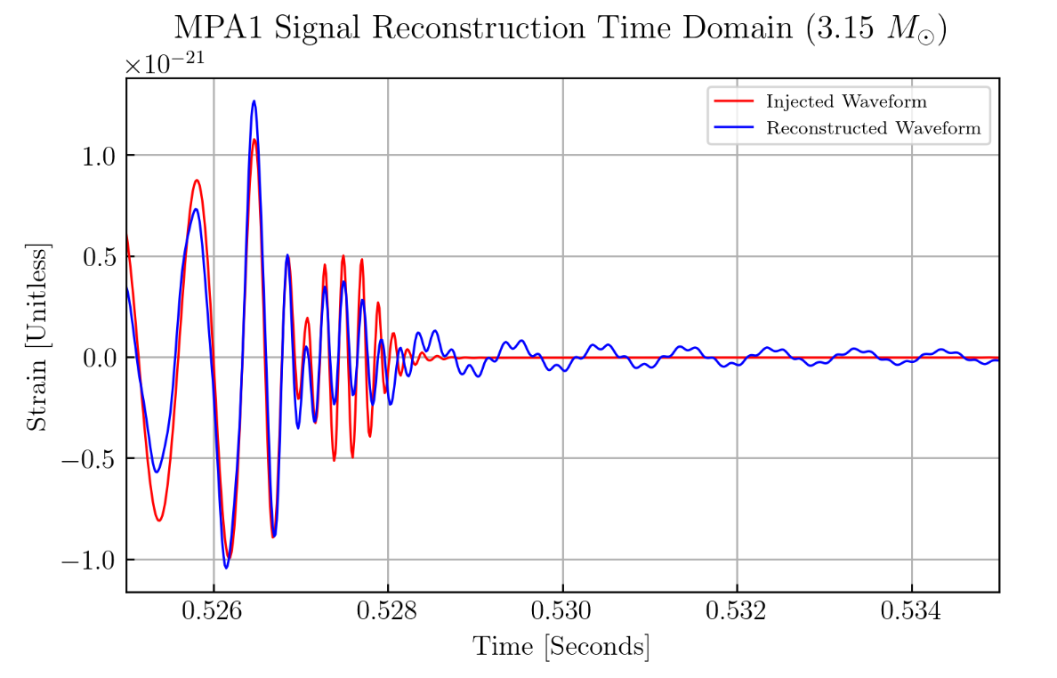
Soft EoS Prompt Collapse Reconstructions: MPA1 EoS
Prompt Collapse
Quick transition to ringdown
3.14
3.15

Slide 8
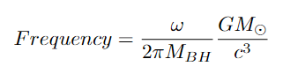
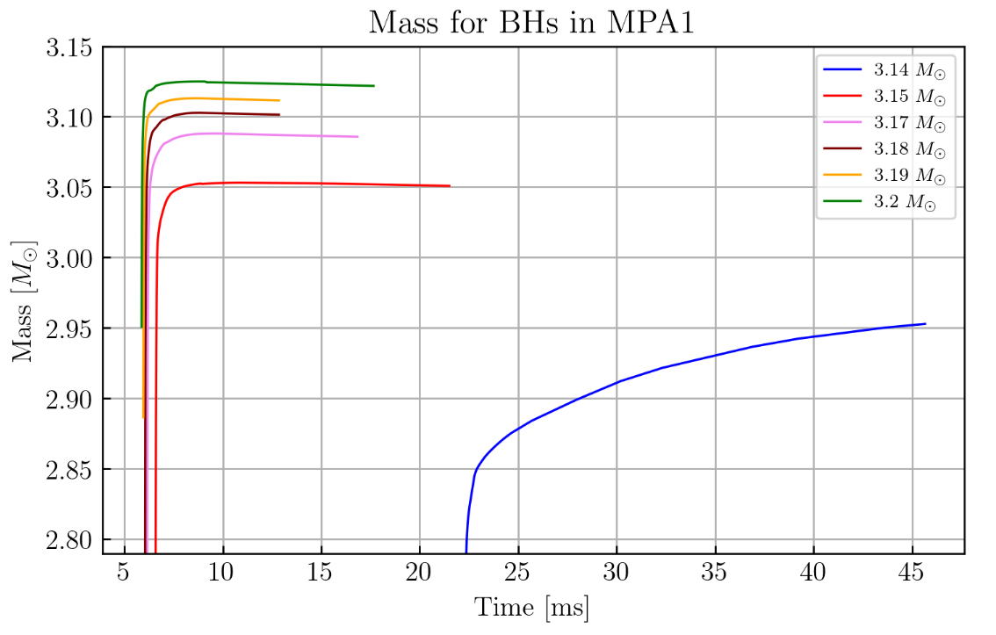
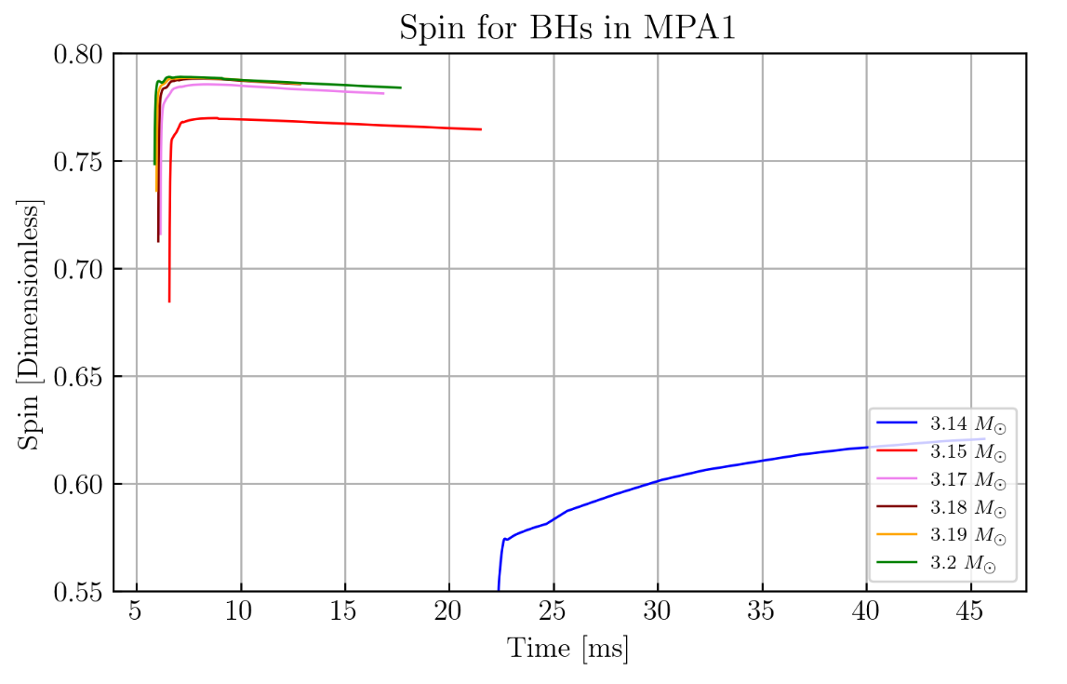
Identifying QNM for MPA1 Prompt Collapse
To compute 220 QNM for simulations using Numerical Data:
The lower the mass, the later the collapse time
Prompt collapse simulations have spins ~ 0.78

Slide 9
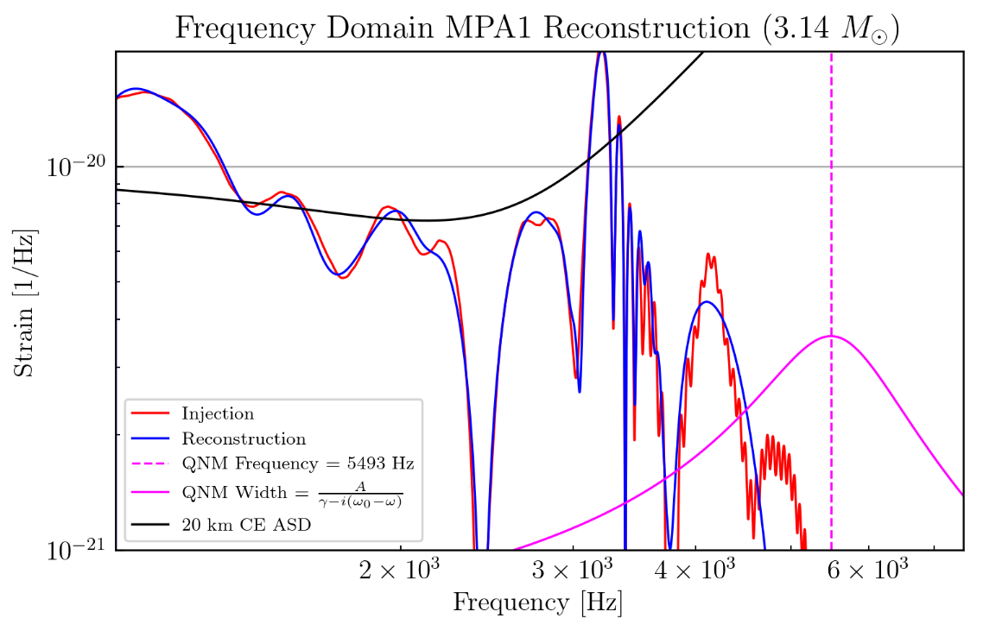
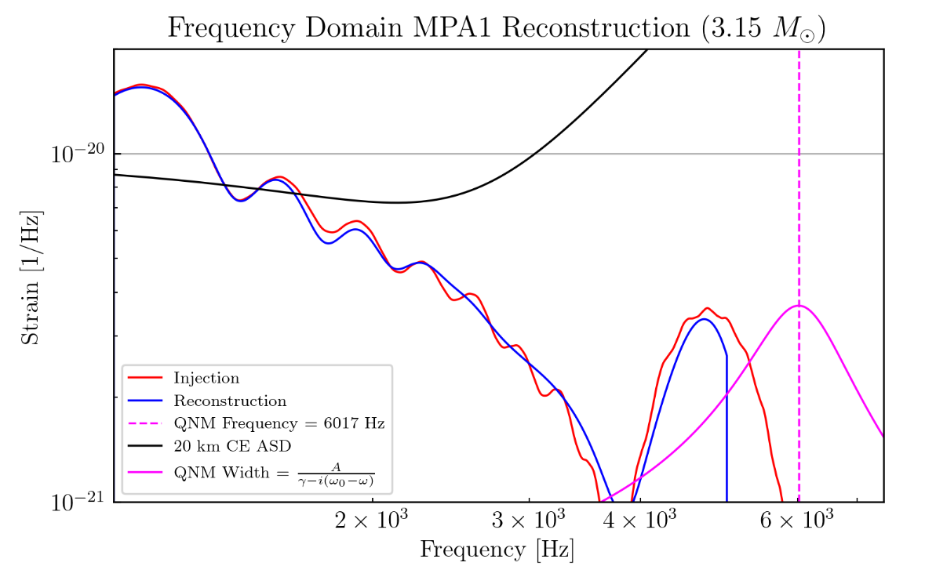
MPA1 EoS Reconstructions with QNM
Prompt Collapse
QNM-bump mismatch suggests f_{2+0} coupling
3.14
3.15

Slide 10
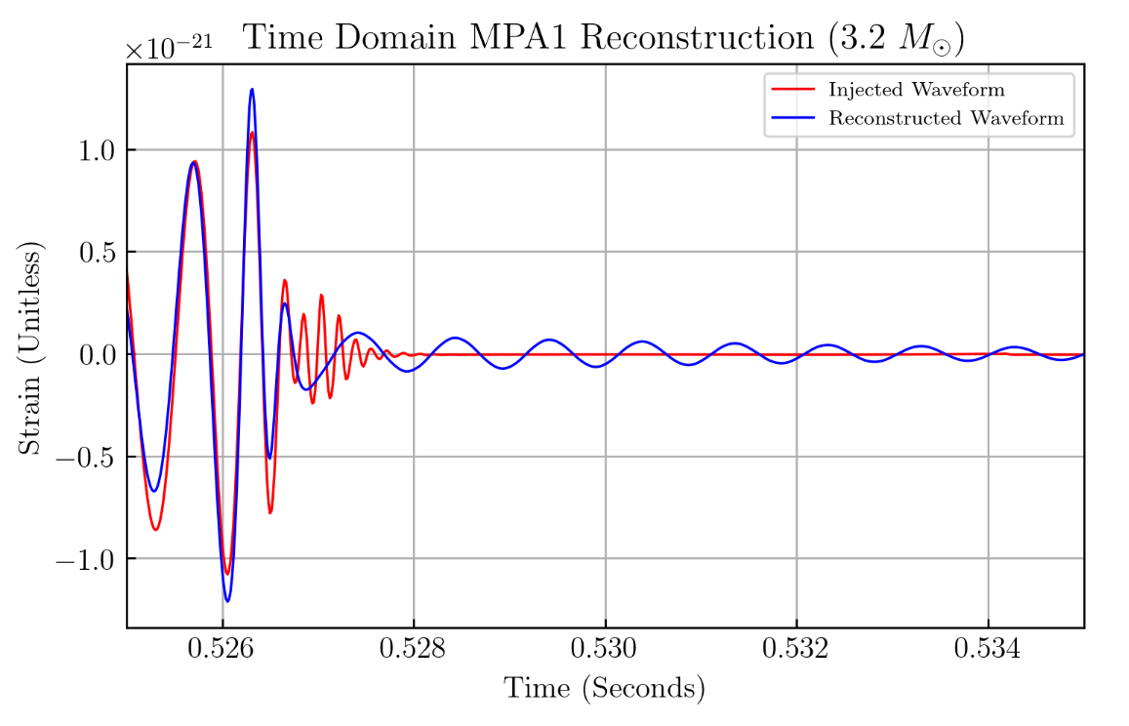
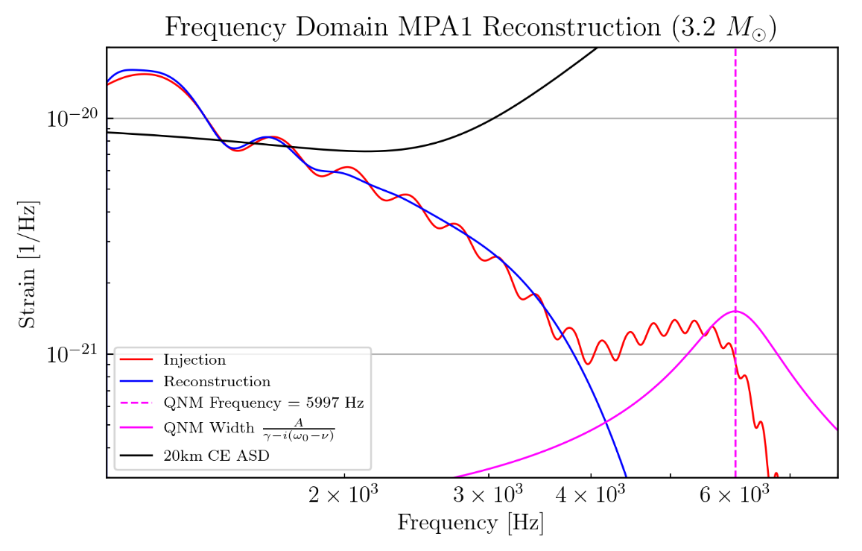
MPA1 EoS Reconstruction with QNM
Higher masses make it difficult to distinguish QNMs from f_{2+0} due to overtones
3.2

Slide 11
Conclusion
Bayeswave CPP efficiently reconstructs signals.
f_{2+0} captured at CE sensitivity, near postmerger collapse.
No evidence of QNM detection at this sensitivity.
Future Prospects
Explain the behavior of the 3.2. Will increasing the mass cause QNM and bump overlap? Could overtones be involved?
Extend PSD for signal reconstruction.
Identify optimal windows for post-merger isolation.

Slide 12
References
1] Alexander Bauswein, Oliver Dreyer, Hans-Thomas Janka, and Georg G Raffelt. Equation of state effects on the gravitational-wave signal from neutron star mergers. Physical Review Letters, 108(16):161101, 2012.
[2] B.P. Abbott, R. Abbott, T.D. Abbott, F. Acernese, K. Ackley, C. Adams, A. Adams, S. Ain, M. Ajello, and G. Allen. Gw170817: Observation of gravitational waves from a binary neutron star merger. Physical Review Letters, 119(16):161101, 2017.
[3] Theodoros Soultanis, Andreas Bauswein, and Nikolaos Stergioulas. Analytic models of the spectral properties of gravitational waves from neutron star merger remnants. Physical Review D, 105(4):043020, 2022.
[4] James Alexander Clark, Andreas Bauswein, Nikolaos Stergioulas, and Deirdre Shoemaker. Observing gravitational waves from the post-merger phase of binary neutron star coalescence. Classical and Quantum Gravity, 33(8):085003, 2016.
[5] Marcella Wijngaarden, Katerina Chatziioannou, Andreas Bauswein, James A Clark, and Neil J Cornish. Probing neutron stars with the full premerger and postmerger gravitational wave signal from binary coalescences. Physical Review D, 105(10):104019, 2022.

Slide 13



Acknowledgment
I would like to express my sincere gratitude to my mentors, Isaac Legred and Katerina Chatziioannou, for their invaluable guidance and support throughout this project.
This work was supported by NSF REU program, the LIGO Laboratory Summer Undergraduate Research Fellowship program (NSF LIGO), and the California Institute of Technology Student-Faculty Programs.
Questions?

Slide 14

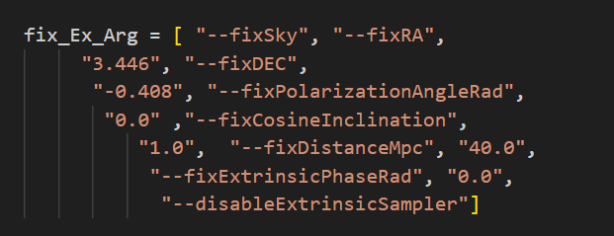
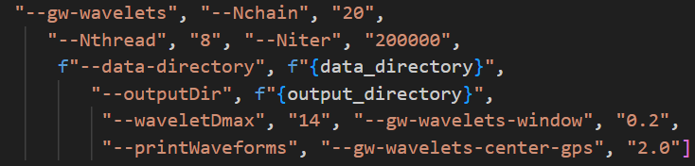

Slide 15
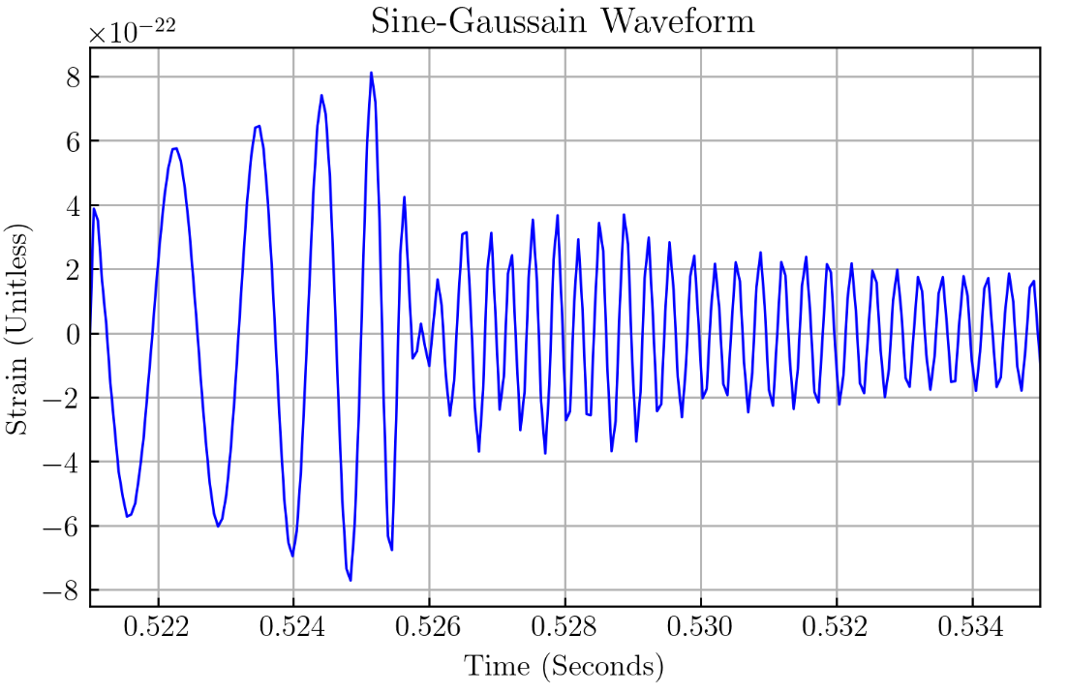
Setup for Bayeswave
We want to reconstruct the postmerger signal and see how it would look like with respect to the cosmic explorer SNR.
To fit the GW signals, a combination of a Gaussian envelope and a sinusoidal function called wavelets are used. Here Sine-Gaussian.
Interesting information for postmerger frequency peaks are from 1024 Hz to 4000 Hz.
At a distance of 40 Mpc.
Strain
Time

Slide 16

Methodology
Bayeswave CPP can help us answer these questions!
It is a software used in an agnostic way to model GW data (fit a GW signal in a Bayesian sense).
The mathematical framework is stated in the Bayes’ theorem:
What's fed into Bayeswave to get the posterior distribution through MCMC sampling
The Posterior
probability of a GW signal presence in the data given the measurements
The Likelihood
Measure of d - h = n (a gaussian)
Seeing how fit the parameters are.
The Prior
Initial belief in the existence of a GW signal.
The Evidence
Probability of observing the d regardless of h. For normalization.

Slide 17
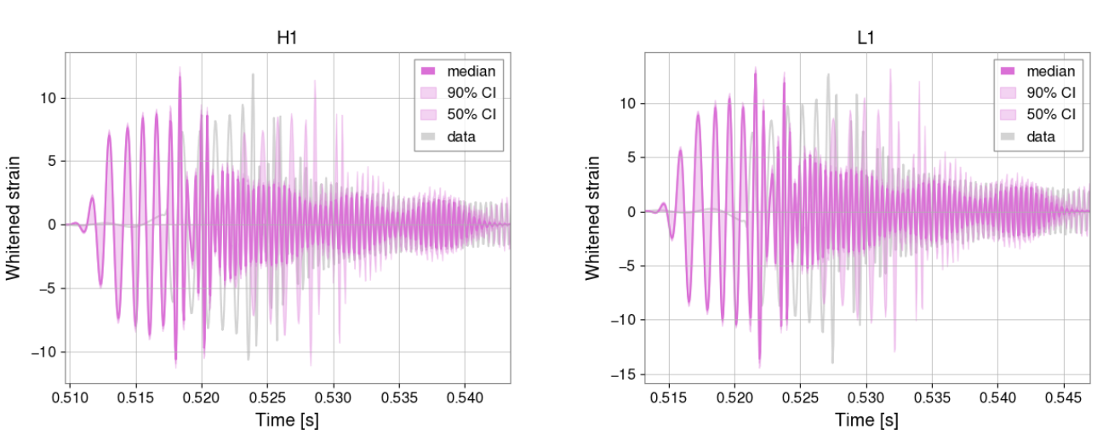
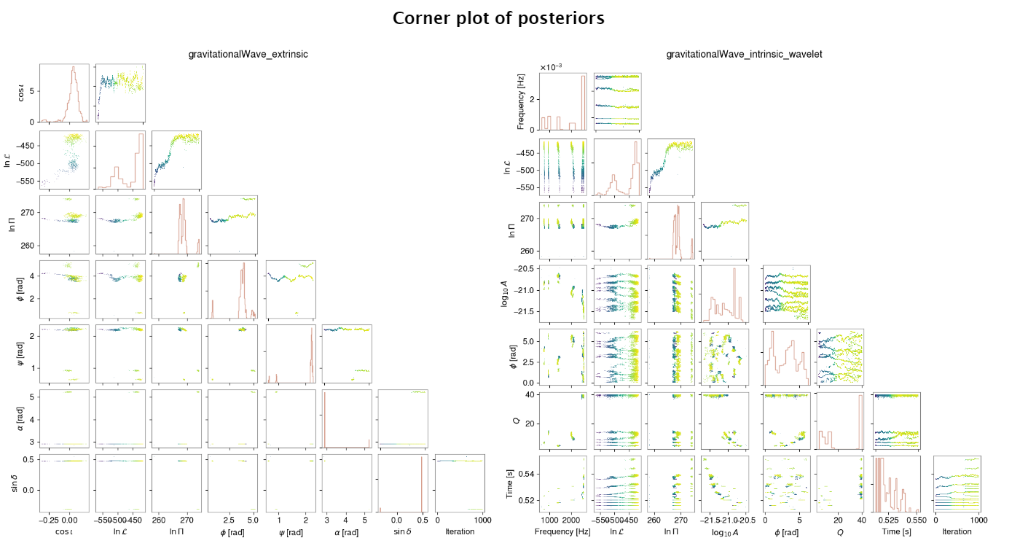
Ongoing Developments
Need further checks with BayesWave:
Fix an issue with a plotting shift for BW post.
Make sure that it is not sampling from what should be fixed extrinsic parameters.
Extend PSD to have the reconstruction truncate at 6k.

Slide 18
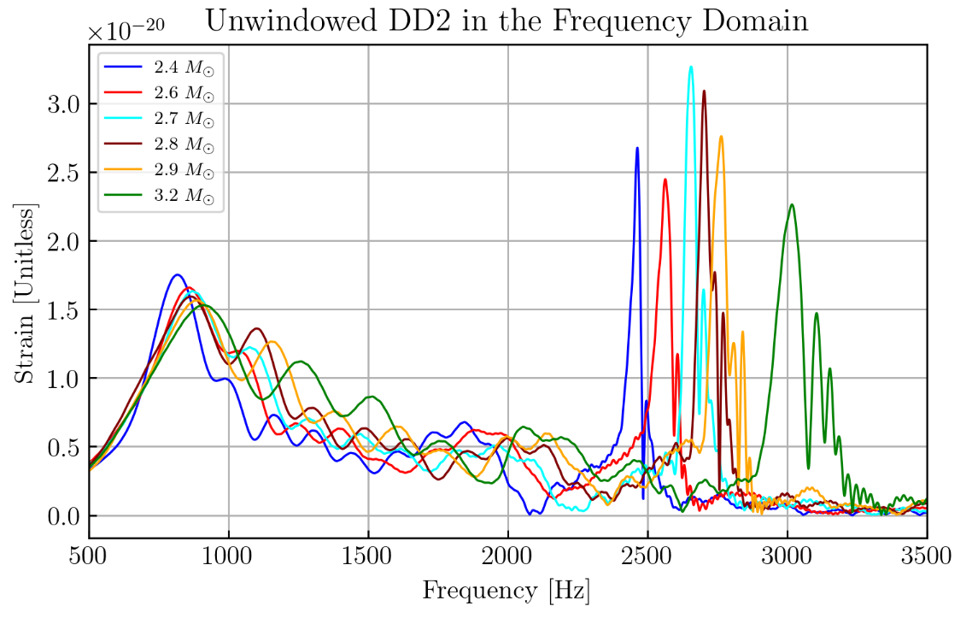
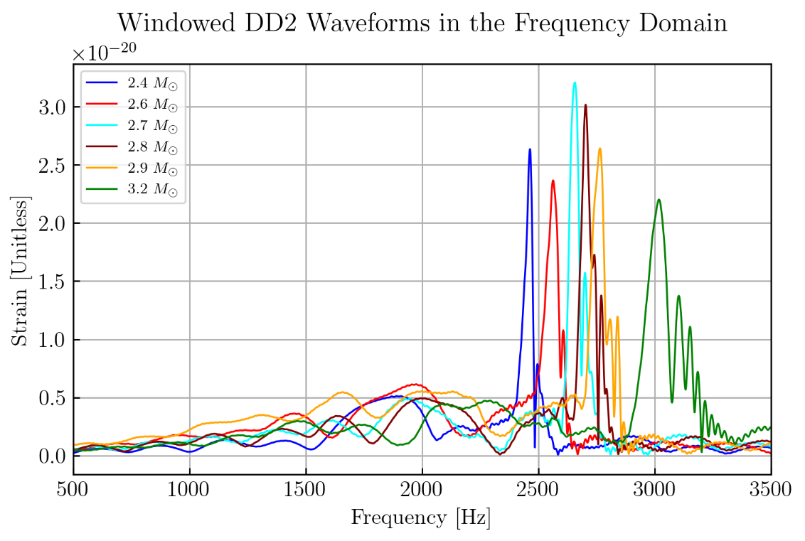
Windowing to remove premerger contribution:
Strain
Strain
Frequency
Frequency

Slide 20
To get refine reconstructions, changes were applied to inputs
Minimum frequency for running: Starting from 1024 Hz instead of 512 Hz.
No need to window for the injected waveforms.
Fixed Extrinsic parameters for the run.
Increase the number of maximum wavelts to 14 instead of 10.

