Slide 1
Geo600 High Frequency Gravitational Wave Detection
Chris Jungkind, Brian Seymour, Andrew Laeuger, Yanbei Chen

Slide 2
Project Plan
I used Finesse 3.0 to compute the sensitivity of GEO600 for high frequency gravitational waves.
Shifting the signal recycling mirror allows for scanning of a range of high frequencies.
This scanning procedure allows us to target proposed high frequency sources.

Slide 3
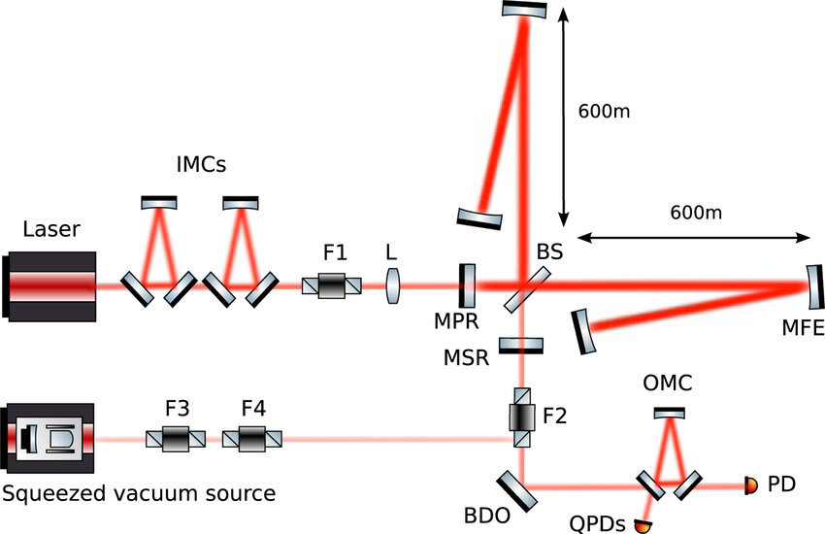
GEO600
GW detector that has 600m folded arms with no Fabry Perot cavities.
Has power recycling and signal recycling mirror.
Finesse model used 30 watts and 6 dB squeezing.

Slide 4
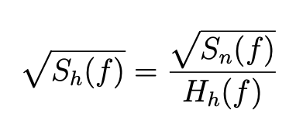

Creating a Noise budget
Create a transfer function $H_{h}$(f) ~$\frac{watts}{h}$
Simulate the raw noise curves $\sqrt{S_{n}(f)}$ ~$\frac{watts}{√Hz}$
Make a noise budget $\sqrt{S_{h}(f)}$ ~$\frac{h}{√Hz}$

Slide 6
Why GEO600?
Both detectors have frequencies where the sideband fields are resonant (peaks in transfer function/ dips in sensitivity curve)
Shifting the signal recycling mirror allows for GEO600 to scan the resonant peak over a range of frequencies

Slide 9
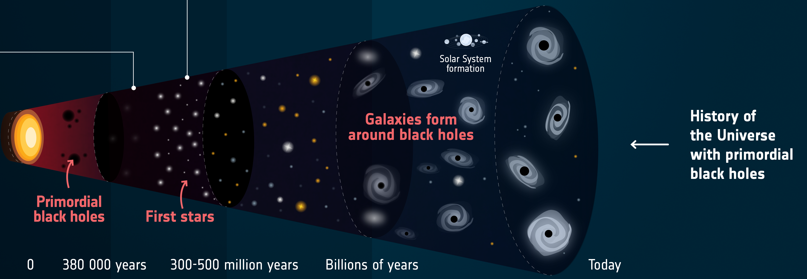
Sub-solar mass Primordial Black Hole Mergers
Primordial black holes (PBH) could have formed in the very early universe.
Sub-solar mass black hole mergers produce GWs in the kHz range.
Coalescing waveform computed using IMRPhenomD.

Slide 10
Detectability
Considering sources within the galaxy
No advantage over aLIGO for binary black hole mergers of any mass
  Strain undetectable at higher emission frequencies

Slide 11
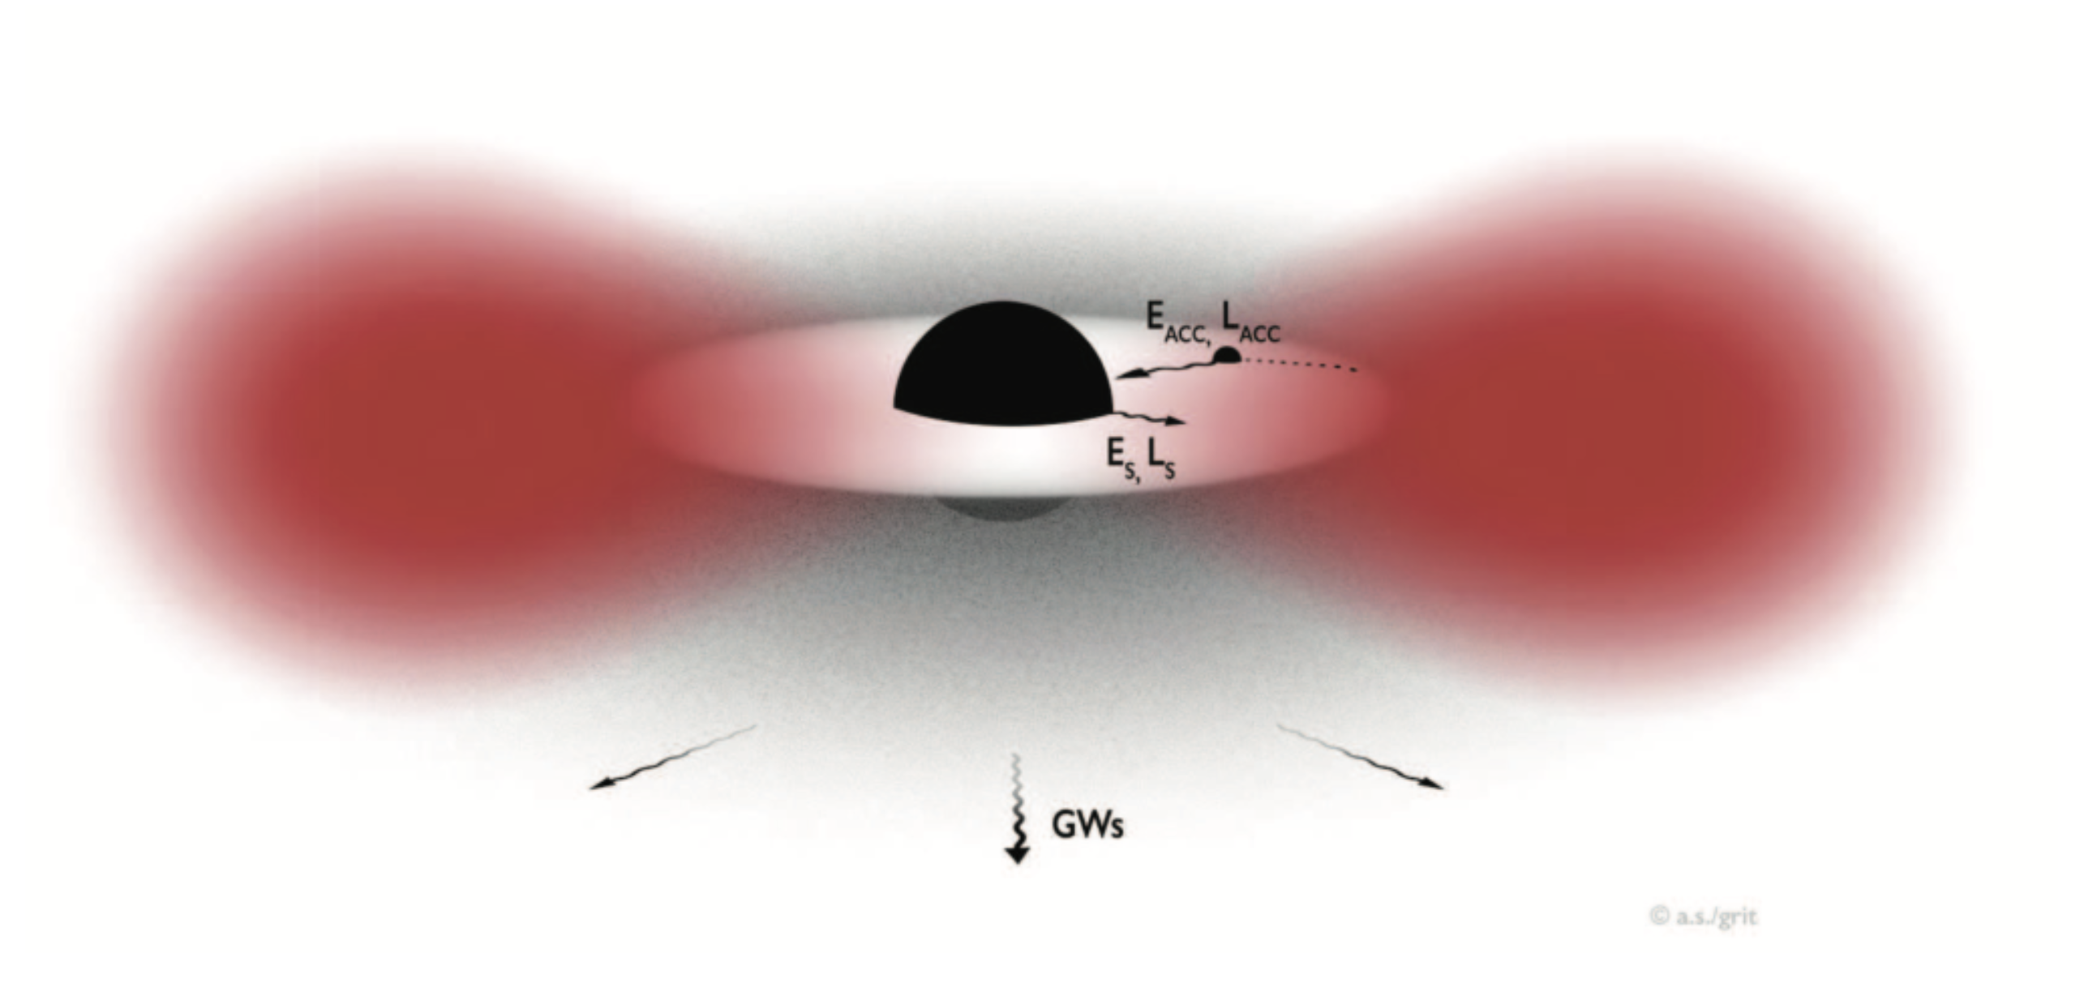
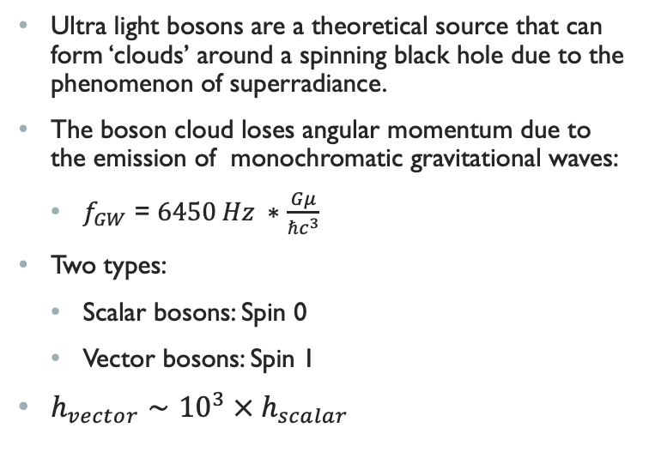
Boson Clouds
Ultra light bosons are a theoretical source that can form ‘clouds’ around a spinning black hole due to the phenomenon of superradiance.
The boson cloud loses angular momentum due to the emission of monochromatic gravitational waves:
  $f_{GW}$ = $6450 Hz ∗$ $\frac{Gμ}{{ℏc}^{3}}$
Two types:
  Scalar bosons: Spin 0
  Vector bosons: Spin 1
$h_{vector}∼{10}^{3} × h_{scalar}$

Slide 12
Detectability
Considering sources within the galaxy
No high frequency scalar boson detection
Advantageous over aLIGO for high frequency vector boson detection

Slide 13
Conclusion
I used Finesse 3.0 to model the noise budget for GEO600 at different detuning angles.
We find not advantage for detecting sub-solar mass binary black hole mergers.
GEO600 can detect high frequency vector boson clouds that aLIGO is unable to detect.

Slide 14
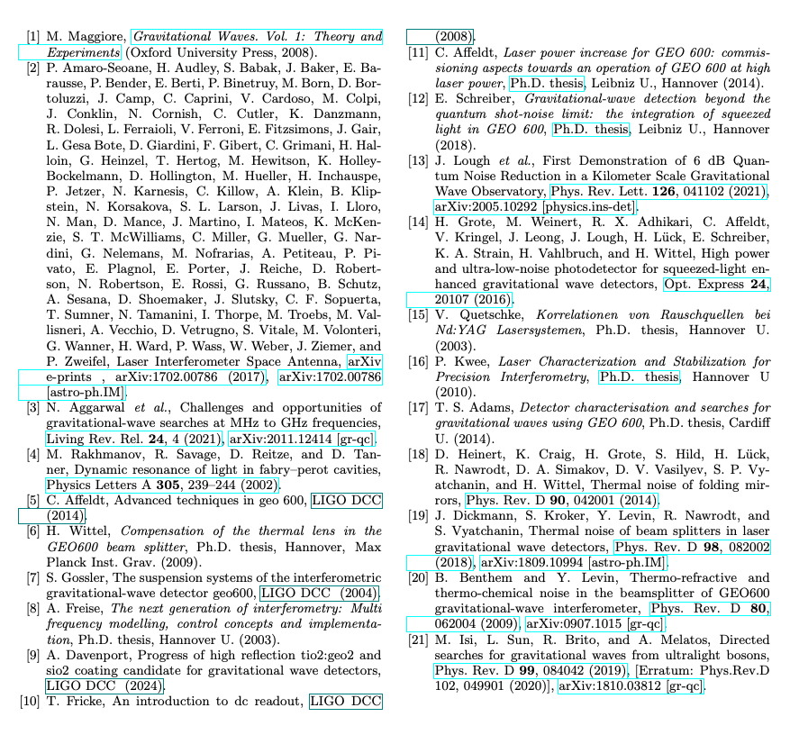
Sources

Slide 15



Acknowledgements
This work was supported by the National Science Foundation Research Experience for Undergraduates (NSF REU) program, the LIGO Laboratory Summer Undergraduate Research Fellowship program (NSF LIGO),
and the California Institute of Technology Student-Faculty Programs.
Thank you to my mentors for the continual support!

Slide 16
Within 1Mpc:
No high frequency scalar boson detection
No advantage over aLIGO for vector boson detection
  Strain undetectable at higher emission frequencies

Slide 17
Within 1Mpc:
No advantage over aLIGO for compact binary coalescence detection of any mass
  Strain undetectable at higher emission frequencies

