Slide 1
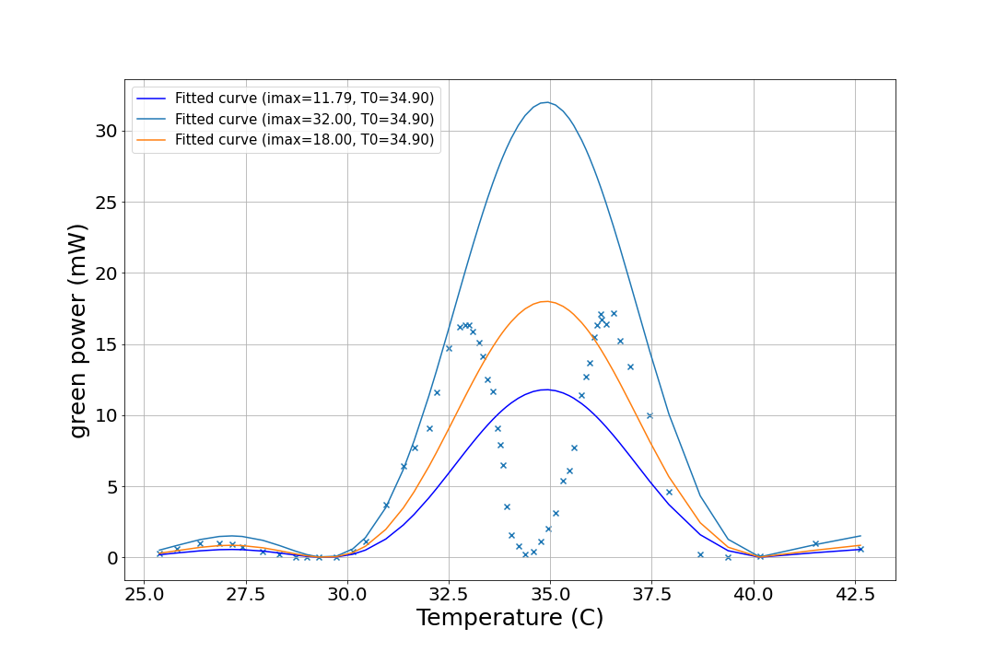
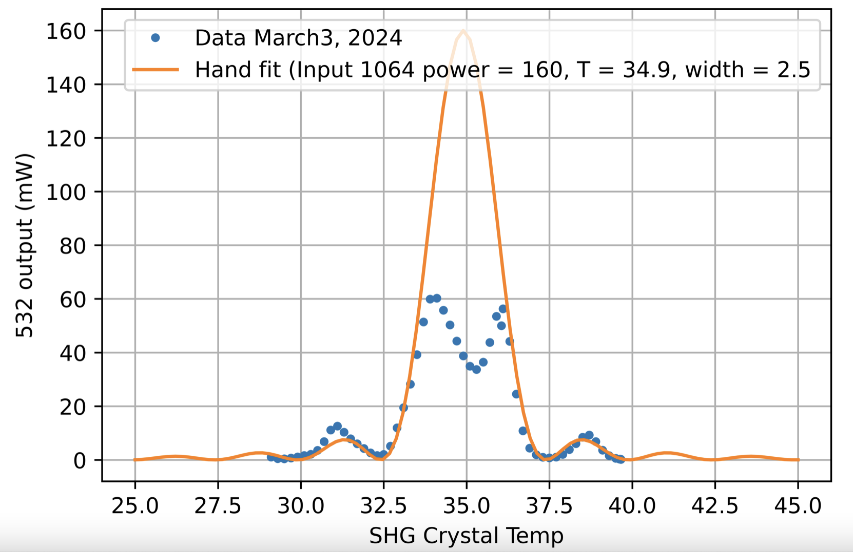
PNW mountains
Not all of them are gray-track
Daniel, Nutsinee

Slide 2
In brand new SHGs, it’s the phase mismatch!
Well turns out it’s the phase mismatch between the green and the red
https://alog.ligo-wa.caltech.edu/aLOG/index.php?callRep=78785
https://alog.ligo-wa.caltech.edu/aLOG/index.php?callRep=78715
https://alog.ligo-wa.caltech.edu/aLOG/index.php?callRep=78686
Mount Saint Helens. This one can’t be explained by the phase mismatch →
Twin Sisters Rock in a brand new SHG here
This can’t be the bloody gray-track now.

Slide 3
Daniel’s explanation
“The dispersion that matters is between the first path and the second path in the crystal. In a simple dual path system, green light will be generated in phase with the red light in the first path, then the two frequencies propagate in air towards the rear mirror, where they are reflected with potentially different phases, and then propagate back to the crystal. According to Gonzalez et al. the dispersion in air for 1064/532 is 27.4°/cm (double passed). Our SHG length is about 5 cm long with a 1 cm crystal. So, the in-air path is of order 4 cm. You need a 90° phase shift to explain the double peak. However, the phase difference of our mirror reflectivity is unknown.” alog78939

Slide 4

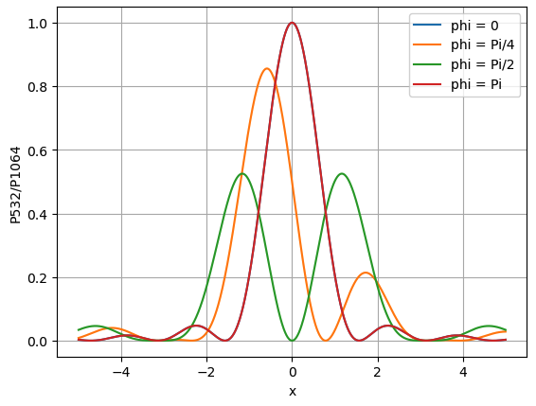
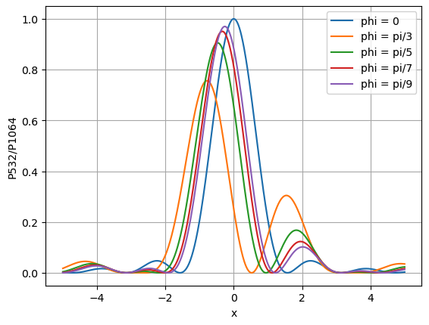
Virgo SHG paper (2018)
Leonardi et al. 2018 eq. 2 taken into account a phase difference
https://iopscience.iop.org/article/10.1088/1555-6611/aad84d

Slide 5
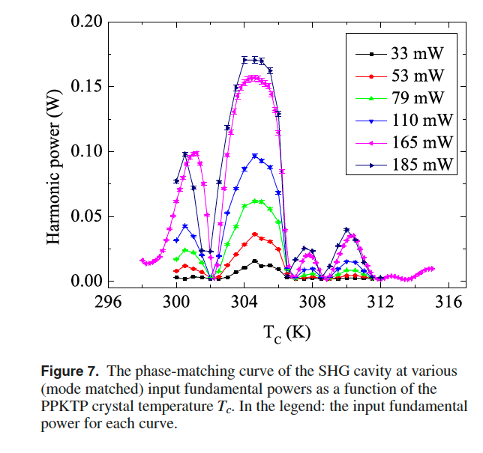
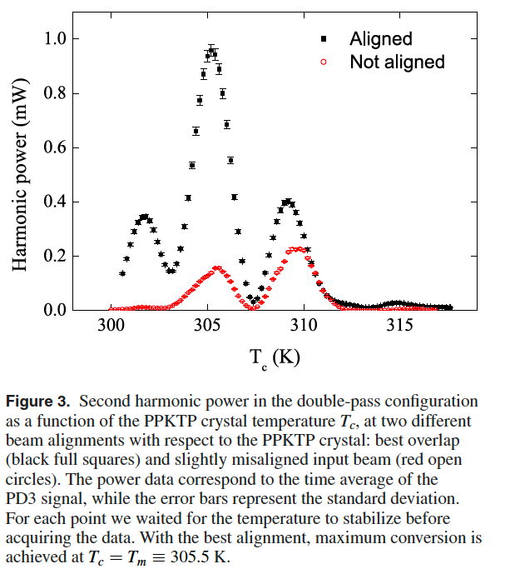
Virgo SHG paper (2018)
They saw similar things we did in the double pass

Slide 6
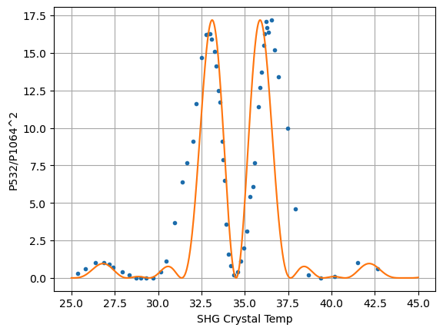
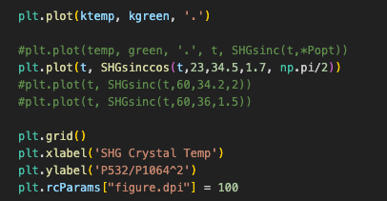
Virgo SHG paper
An actual first attempt to fit to Karmeng’s data

Slide 7
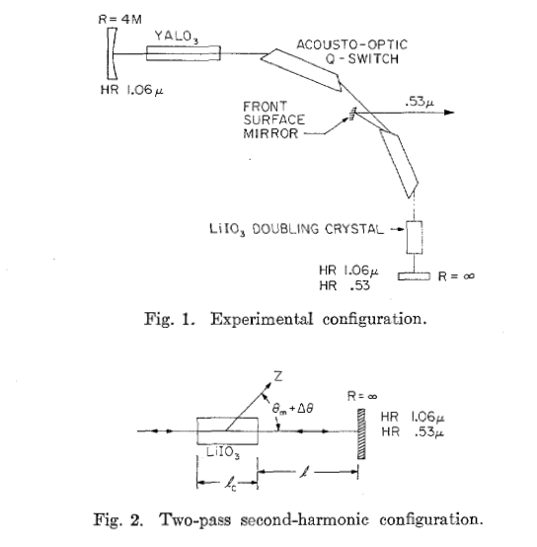
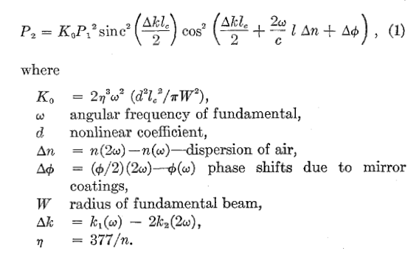
Double pass using prism (1973)
Ref 10 of the previous paper, Gonzalez, Nieh, and Steier 1973 took air dispersion into account
https://ieeexplore.ieee.org/stamp/stamp.jsp?tp=&arnumber=1077338

Slide 8
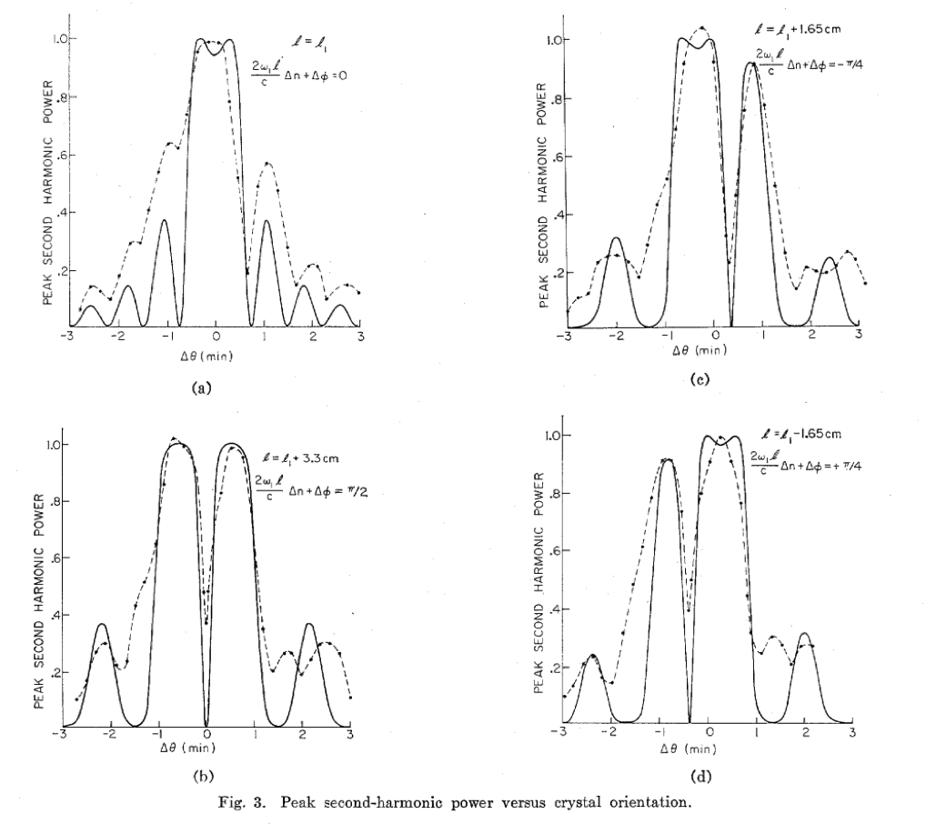
Double pass using prism (1973)
These guys saw similar behavior we saw. And the measurements don’t necessary match the model

Slide 9
Kato and Takaoka 2002
Eq 1 in the 1973 paper is a sinc^2 function in terms of phase (delta K*l). K is related to n which relates to T. We need this equation in terms of temperature.
Kato and Takaoka 2002 gives you n of ppktp at 1064 and dn/dT
Kiyoshi Kato and Eiko Takaoka, "Sellmeier and thermo-optic dispersion formulas for KTP," Appl. Opt. 41, 5040-5044 (2002)
https://opg.optica.org/ao/abstract.cfm?URI=ao-41-24-5040

Slide 10
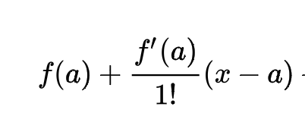
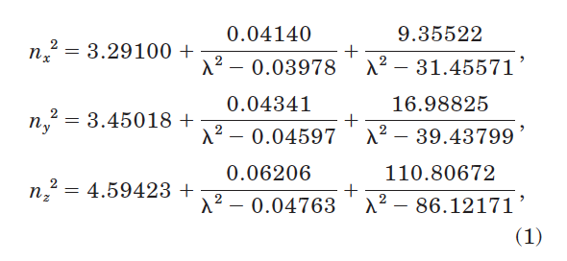
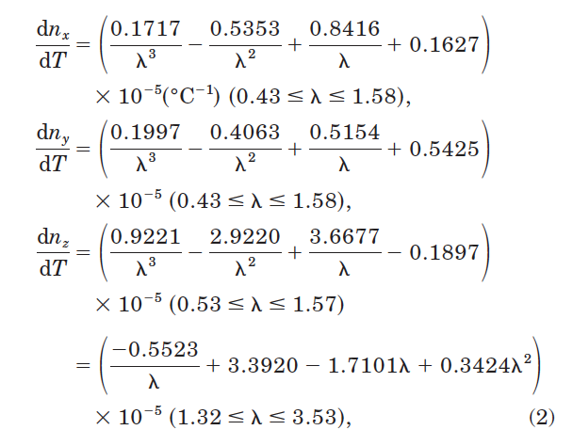
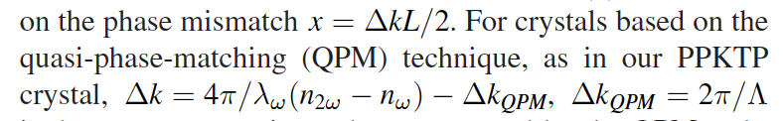
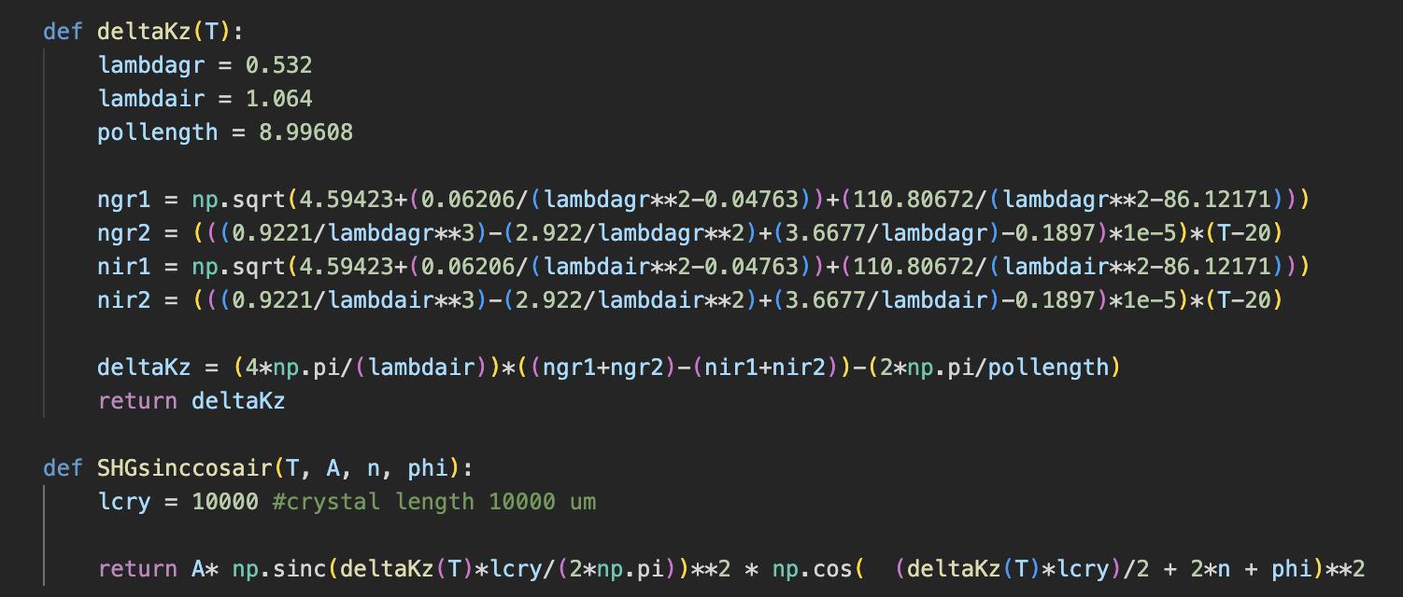
This is PPKTP n at T=20C
This is f(a) in the Taylor series expansion
(x-a) is (T-20)
Where T is the thing we want to sweep
Delta K is defined in Leonardi et al (the Virgo SHG paper), page 3 bottom right.
This is f’(a)
deltaK and the sinc^2 function becomes

Slide 11
Fitting the actual data
The function is super sensitive to the polling lenth. Raicol calims 9um polling length but that’s probably not exact.
Karmeng’s data supposed to peak at at 34.6 C. This corresponds to a polling length = 8.99608 um (deltaK = 0 at this T).
Add a phase mismatch of pi/2 and you have a self-destruc sinc^2 in the middle

Slide 12
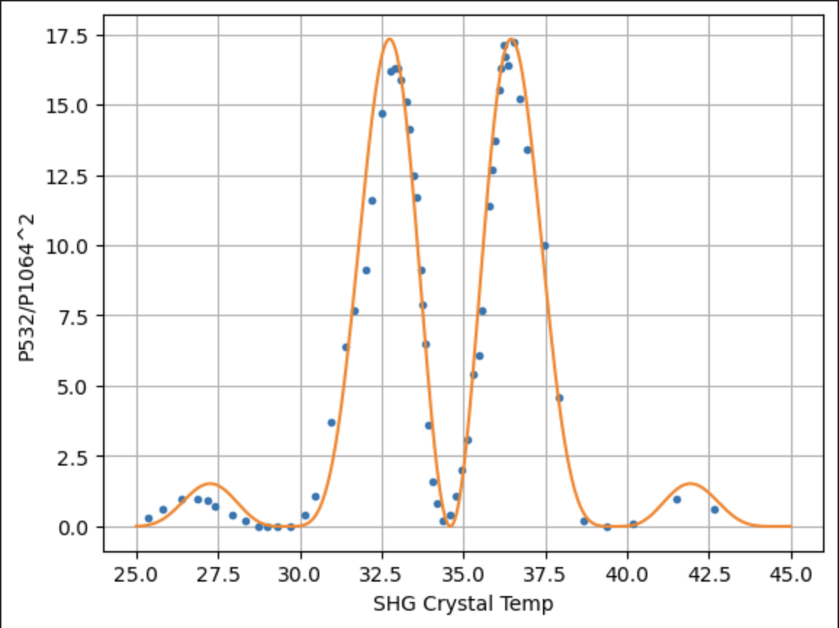
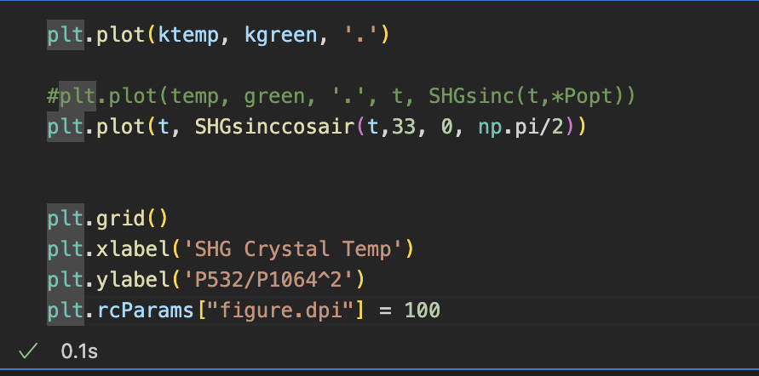
Fitting the actual data

Slide 13
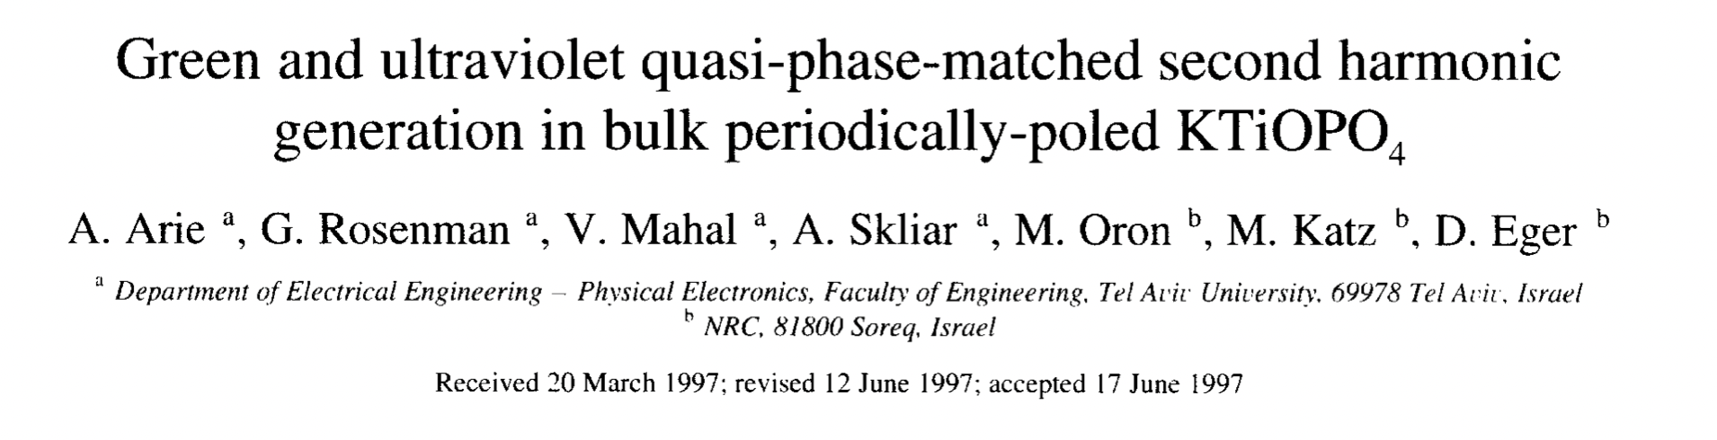
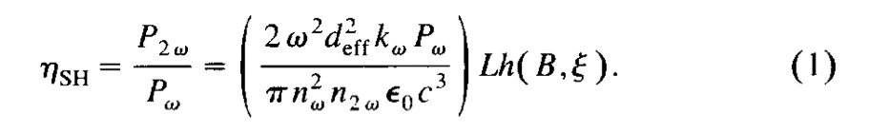
The nonlinear part
Right now the unit of K0 makes no sense.
This paper sounds more sensible
https://www.sciencedirect.com/science/article/pii/S0030401897003386?ref=cra_js_challenge&fr=RR-1

Slide 14
Boyd-Kleinman factor
G. D. Boyd and D. A. Kleinman, ‘‘Parametric interactions of focused Gaussian light beams,’
I don’t have access to J. Appl Phys. Daniel sent one to me. Why is Adelaide Library so shit?
Apparently there’s a thing call the focusing parameter l/b = 2.84 where l is the length of the crystal and b is the confocal parameter (2*Rayleigh length) and the Boyd-Kleinman factor h(B,l/b) is 1 ish in an optimal SHG.

Slide 15
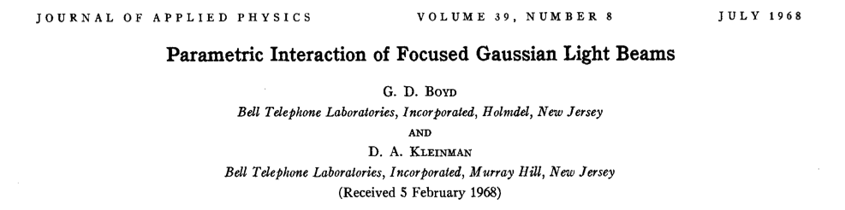
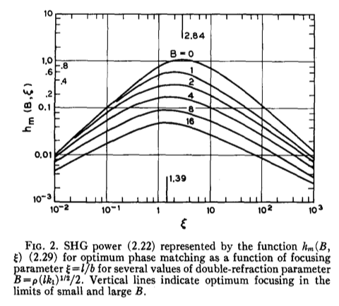

Slide 16
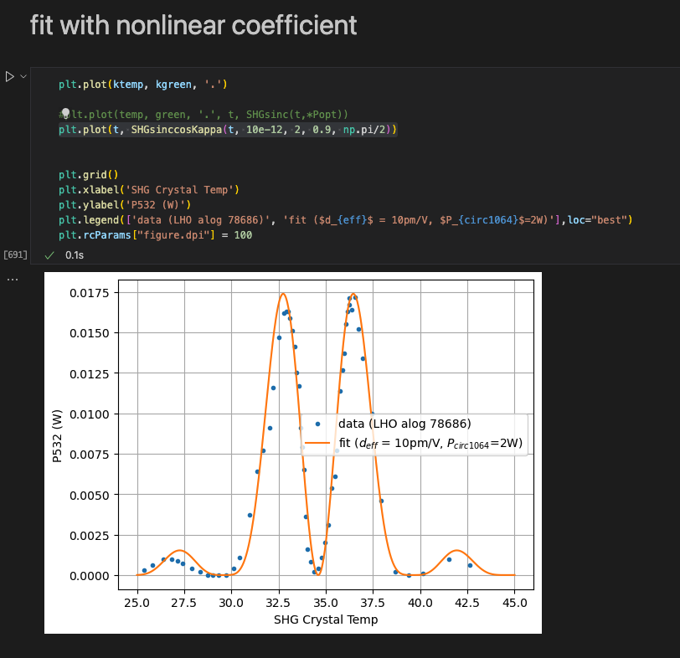
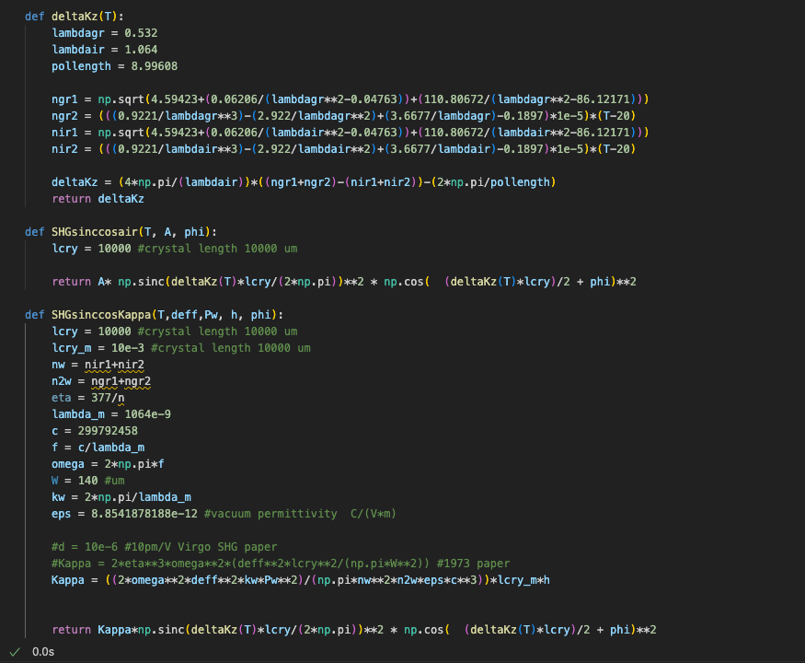
After everything was understood...
https://alog.ligo-wa.caltech.edu/aLOG/index.php?callRep=78933

Slide 17
Update Jul 11 24
Fit to a single pass measurement
Alog https://alog.ligo-wa.caltech.edu/aLOG/index.php?callRep=79017
Added a factor of 4 to K0 in double peak case (double pass power = 4 times the single pass
Need 1.5W circ to fit. Model suggests 1.7W circ with escape efficiency measurement taken into account
Modulation depth unknown.

Slide 18
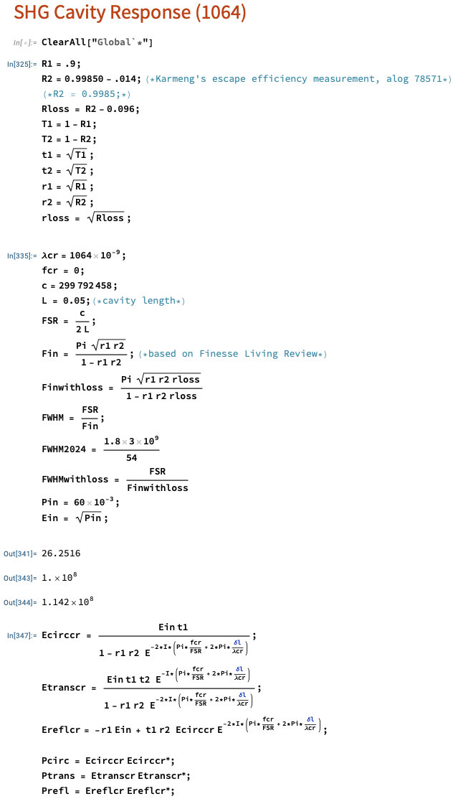
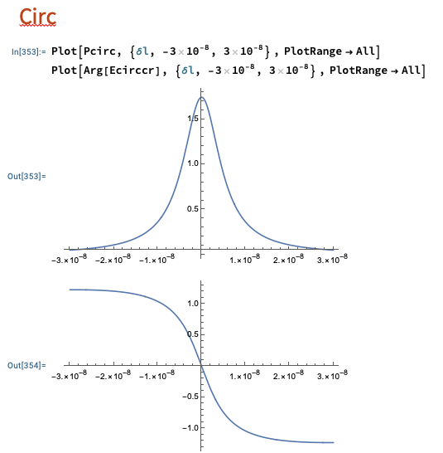

Slide 19
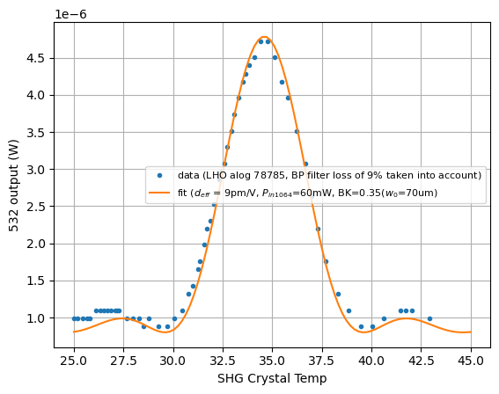
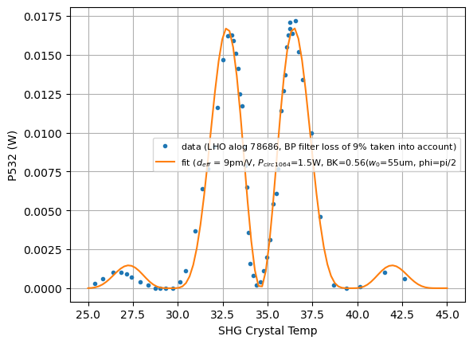
Different Boyd-Klienman factor because cavity vs no cavity

Slide 20
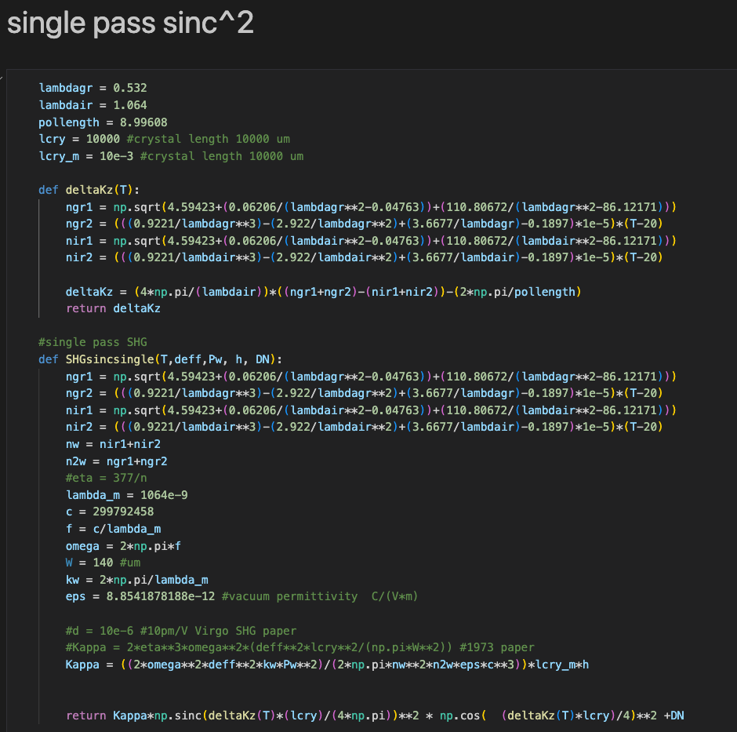
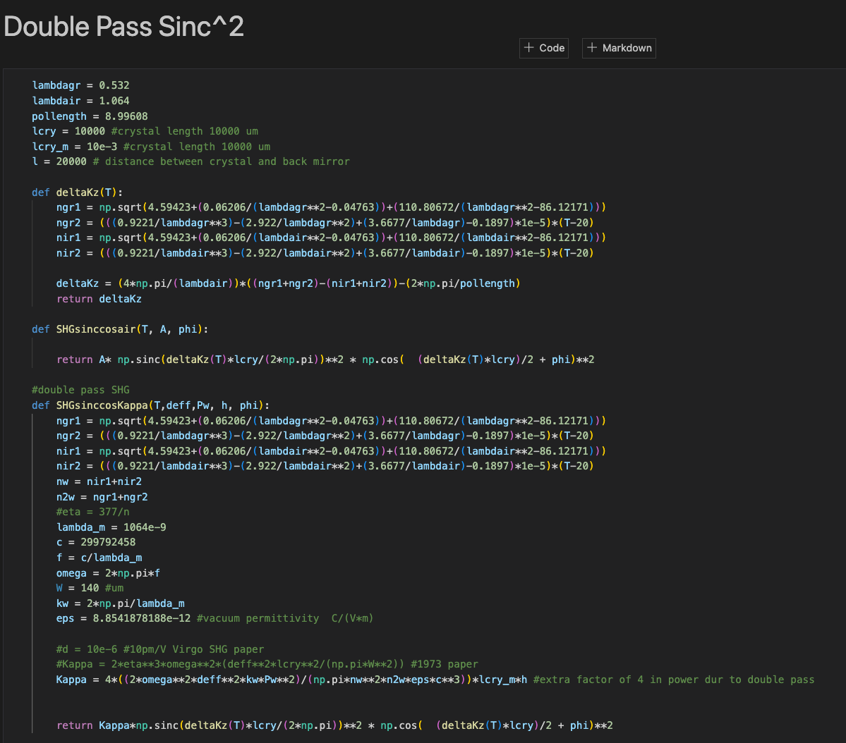

Slide 21
Beam waist
Used Finesse to determined to beam waist inside of the SHG cavity with the crystal inside given known parameters
A beam waist is required to compute Boyd-Klienman constant
Single pass waist with or without the crystal is differ by 2um. Negligible.

Slide 22
