Slide 1
Constraining the Precession of Binary Black Holes Mergers with New Parameters
Charles Gibson^{1,2} and Javier Roulet^{1,3}
¹LIGO, California Institute of Technology, Pasadena, CA 91125, USA
²Department of Physics, Allegheny College, Meadville, Pennsylvania 16335, USA
³TAPIR, Walter Burke Institute for Theoretical Physics, California Institute of Technology, Pasadena, CA 91125, USA

Slide 2
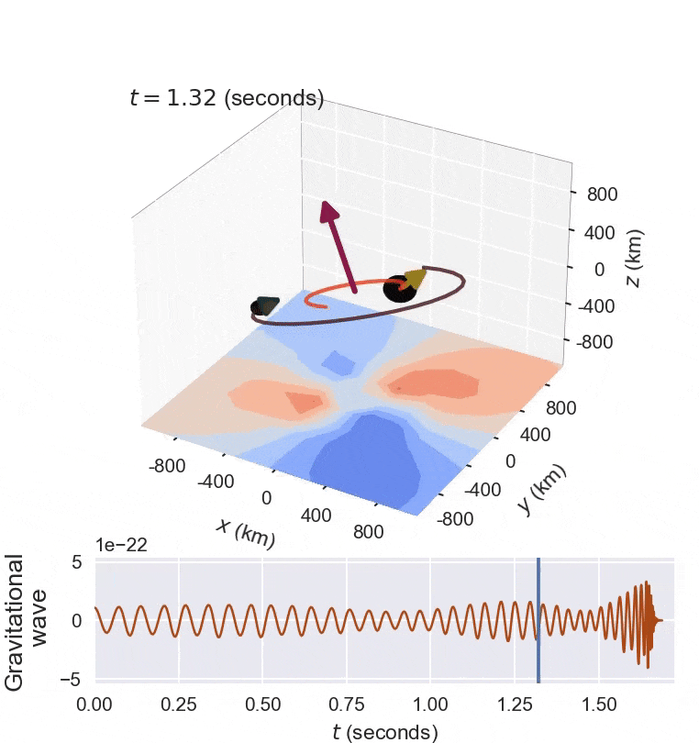
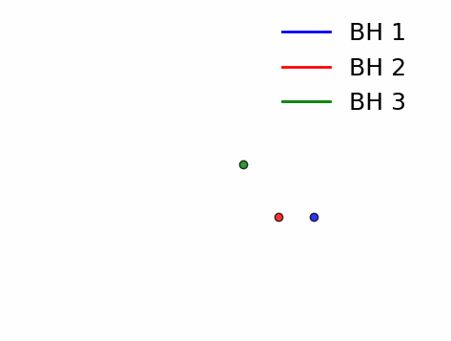
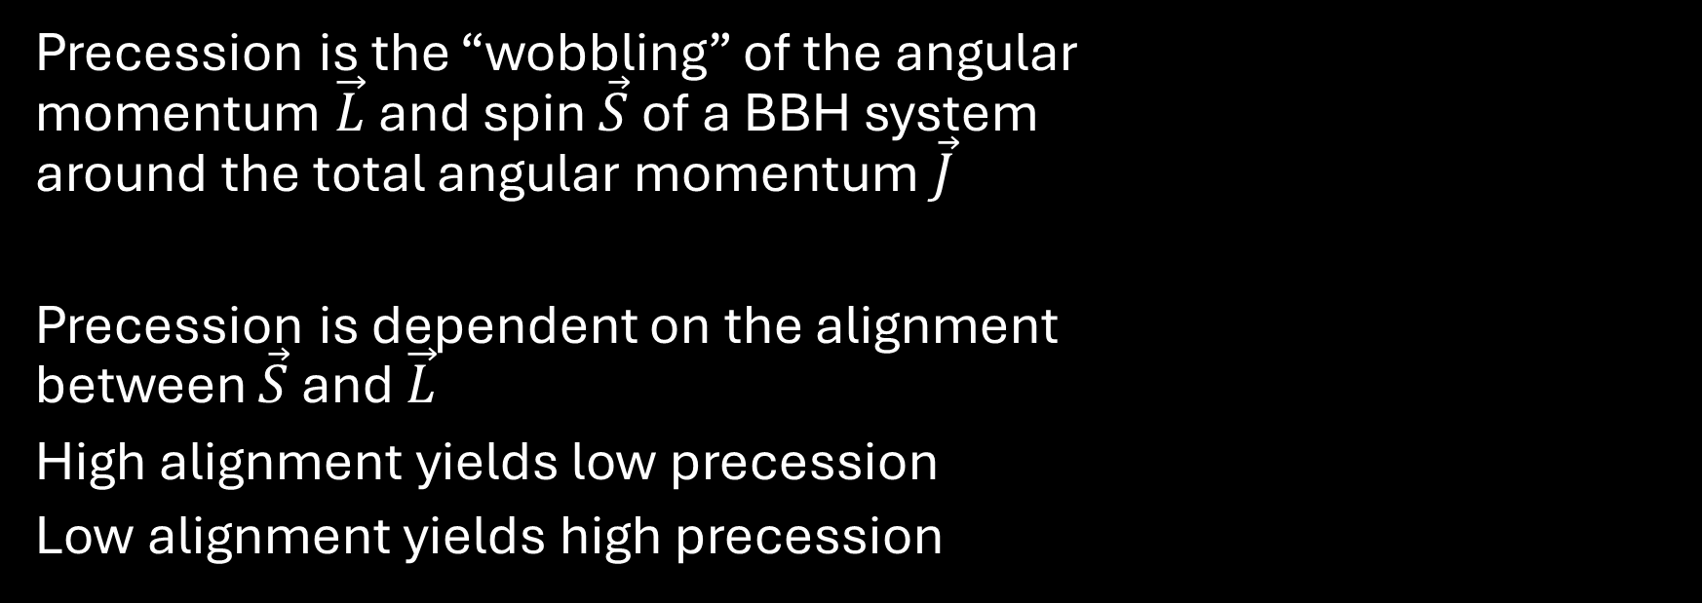
Precession can provide insight into the formation of the BBH System^{[1]}
Precession is the “wobbling” of the angular
momentum $\vec{L}$ and spin $\vec{S}$ of a BBH system
around the total angular momentum $\vec{J}$
Precession is dependent on the alignment
between $\vec{S}$ and $\vec{L}$
High alignment yields low precession
Low alignment yields high precession
Figure 1^{[A]}: A precessing CBC
Figure 2: A three-body gravitational interaction that yields a binary between BH 2 and BH 3, ejecting BH 1 from an initial binary with BH 2

Slide 3

There is already a precession parameter in use^{[2]}
The effective precession $χ_{p}$ of a system is defined as
$$χ_{p}=\max\left(χ_{1}\sin{θ_{1}},\frac{4+3q}{3+4q}qχ_{2}\sin{θ_{2}}\right)$$
When $χ_{p}=0$, there is no precession
When $χ_{p}=1$, there is maximum precession
$χ_{p}$ is a measure of the maximum contribution of the in-plane spin vectors

Slide 4
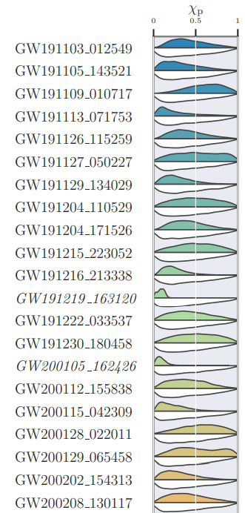

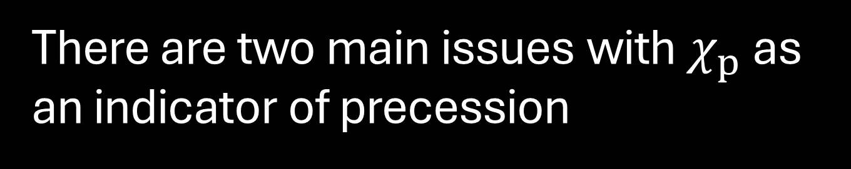
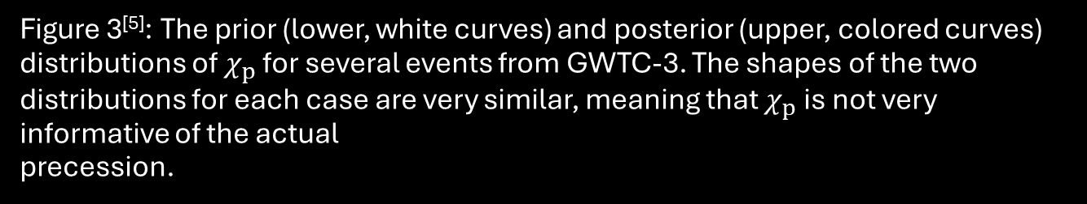
There are two main issues with $χ_{p}$ as an indicator of precession
The posterior distributions are broad and resemble the prior distribution
The prior distribution sharply approaches 0 when $χ_{p}=0$
A true precession value for individual cases cannot be easily constrained, and if it is equal to 0, it is difficult to interpret
Thus, claims of precession are debated^{[3, 4]}
Figure 3^{[5]}: The prior (lower, white curves) and posterior (upper, colored curves) distributions of $χ_{p}$ for several events from GWTC-3. The shapes of the two distributions for each case are very similar, meaning that $χ_{p}$ is not very informative of the actual
precession.

Slide 5
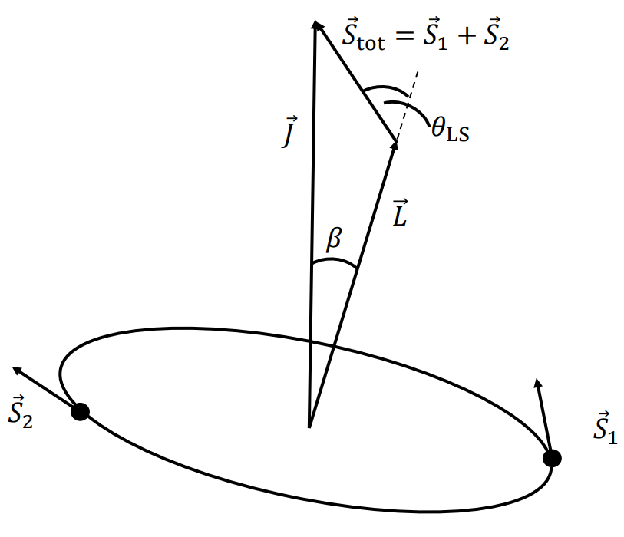
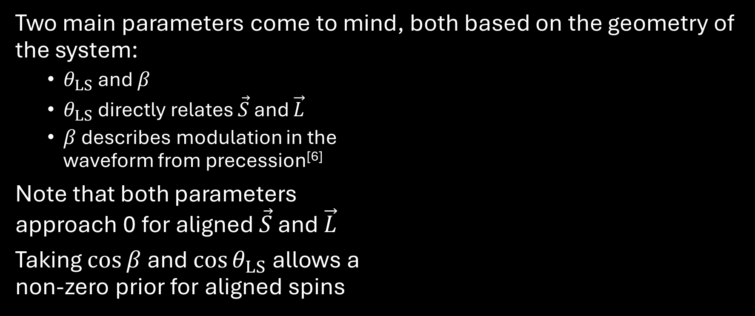
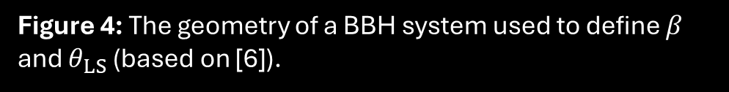
What other parameters can be used?
Two main parameters come to mind, both based on the geometry of the system:
  $θ_{LS}$ and $β$
  $θ_{LS}$ directly relates $\vec{S}$ and $\vec{L}$
  $β$ describes modulation in the
  waveform from precession^{[6]}
Note that both parameters
approach 0 for aligned $\vec{S}$ and $\vec{L}$
Taking $\cos{β}$ and $\cos{θ_{LS}}$ allows a
non-zero prior for aligned spins
Figure 4: The geometry of a BBH system used to define $β$ and $θ_{LS}$ (based on [6]).

Slide 6
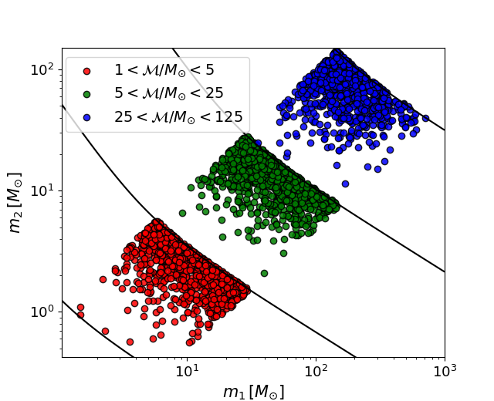

How can we test our new parameters?
We have $\sim 3000$ injections across three mass distributions
The population has an isotropic spin distribution $(π\left(\cos\left(θ_{LS}\right)=0.5\right)$
We can sample each injection and construct posterior distributions for each parameter
Statistical tests using known injections and constructed posteriors can find the most informative parameter
Figure 5: The masses of the BHs of each injected event. There are three “bins”
that each injection falls into based on the chirp mass.
*This data can be downloaded at https://zenodo.org/records/10910135

Slide 7

The Savage-Dickey Ratio can be used to compare these two hypotheses
The system is either precessing or it is not precessing
$$Hypothesis 1: ℋ_{0}≡isotropic spin population$$
$$Hypothesis 2: ℋ_{1}≡aligned spin population$$
The Savage-Dickey Ratio, derived from the Neyman-Pearson Lemma, is the strongest way to distinguish between two hypotheses^{[7]}
$$SDR=\frac{p\left(d ∣ ℋ_{1}\right)}{p\left(d ∣ ℋ_{0}\right)}⇒\frac{p\left(aligned spins ∣ d, ℋ_{0}\right)}{π\left(aligned spins∣ℋ_{0}\right)}$$
We want to choose a parameter that makes the ratio to be large when $\vec{S}$ and $\vec{L}$ are actually aligned and small when they are misaligned

Slide 8
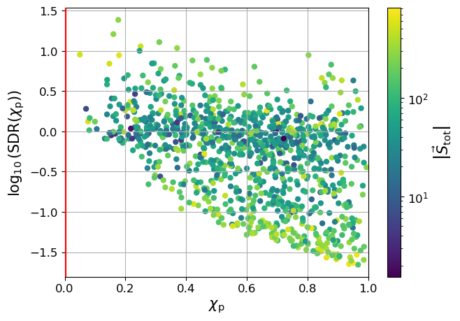
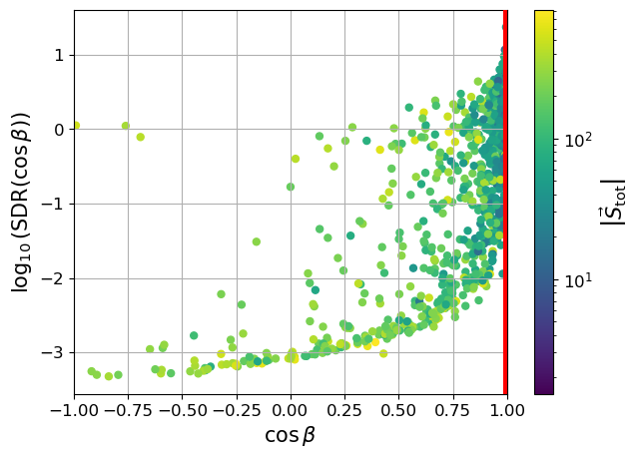
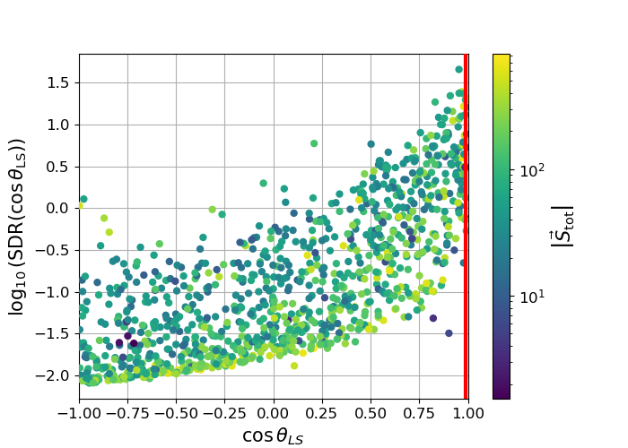

Figure 6: The SDRs of several tested parameters against the injected values for the low-mass distribution. We expect high values for aligned spins (the red lines) and low values for misaligned spins (opposite of the red lines).
$χ_{p}$ shows the least variability
$\cos\left(β\right)$ and $\cos{(θ_{LS})}$ seem to share similar information
The information of both $\cos\left(β\right)$ and $\cos\left(θ_{LS}\right)$ have a dependence on $\left|{\vec{S}}_{tot}\right|$

Slide 9

We can further summarize all SDR values
The Kullback-Leibler Divergence $D_{KL}$ shows the difference between two distributions
$$D_{KL}\left(\left(p ∣ ℋ_{0}\right)||p\left(d ∣ ℋ_{1}\right)\right)$$
$$=\int{dd p\left(d ∣ ℋ_{0}\right)\log{\frac{p\left(d ∣ ℋ_{1}\right)}{p\left(d ∣ ℋ_{0}\right)}}}$$
$$≈∫dd p\left(d ∣ ℋ_{0}\right)\log{SDR}$$
We now can summarize the divergence of the two distributions with a single value, and choose a precession parameter that maximizes this value

Slide 10
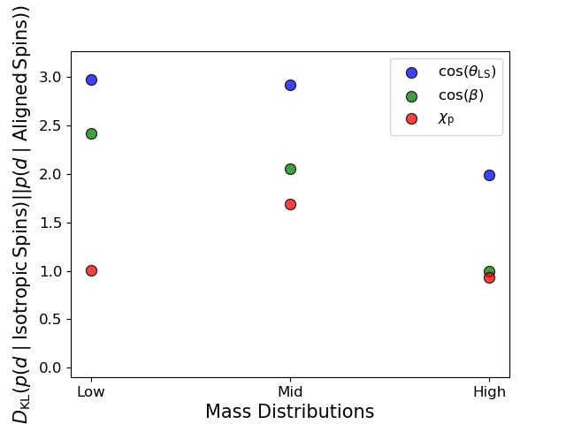

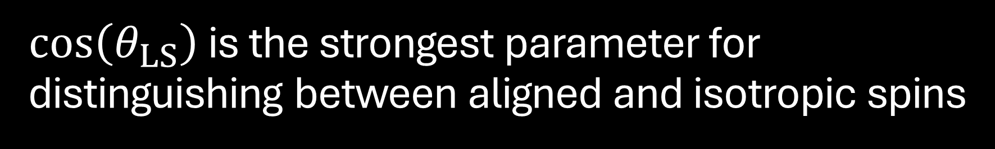
$\cos\left(θ_{LS}\right)$ is the strongest parameter for distinguishing between aligned and isotropic spins
$\cos\left(θ_{LS}\right)$ consistently has the highest divergence for all mass distributions
$χ_{p}$ consistently has the lowest divergence for all mass distributions
However, all divergences decrease for the higher mass distributions. Why is that?
Figure 7: The KL divergence for the three tested parameters at each chirp mass bin.

Slide 11
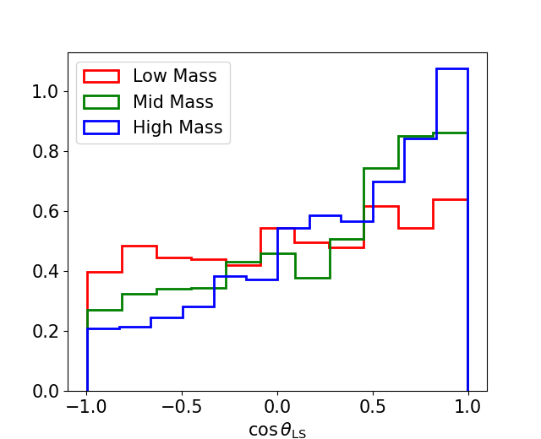
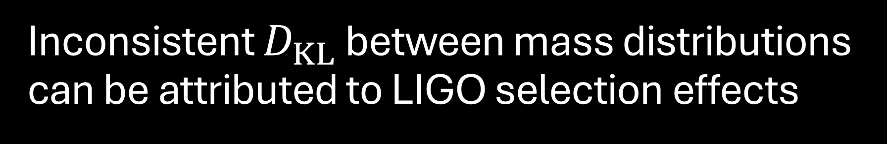
Inconsistent $D_{KL}$ between mass distributions can be attributed to LIGO selection effects
The data are originally generated with an isotropic spin distribution
However, it is naturally filtered to only allow events that could be detected by LIGO
The remaining events construct the prior (right) that has lower probabilities for higher mass cases
Figure 8: A histogram of the injections for each mass distribution

Slide 12
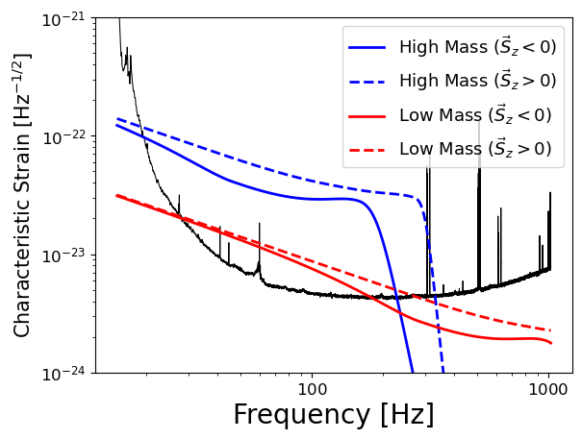

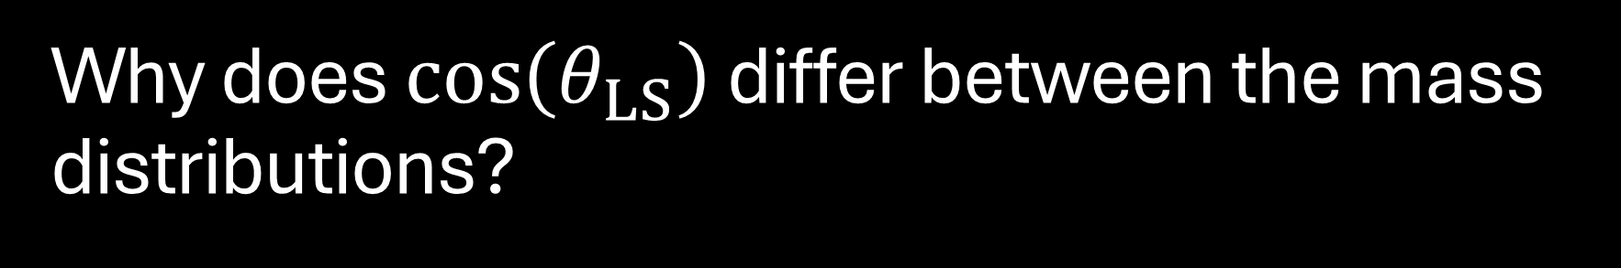
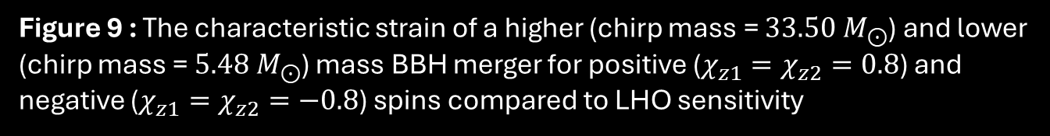
Why does $\cos\left(θ_{LS}\right)$ differ between the mass distributions?
The merger frequency is inversely proportional to mass: $f_{merger}∝1/M$
Negative spins cause an earlier merger, decreasing the SNR
This effect is most notable for higher masses
These effects make higher mass, highly precessing BBHs quieter than their non-precessing counterparts
Figure 9 : The characteristic strain of a higher (chirp mass = $33.50 M_{⊙}$) and lower (chirp mass = $5.48 M_{⊙}$) mass BBH merger for positive ($χ_{z1}=χ_{z2}=0.8$) and negative ($χ_{z1}=χ_{z2}=−0.8$) spins compared to LHO sensitivity

Slide 13

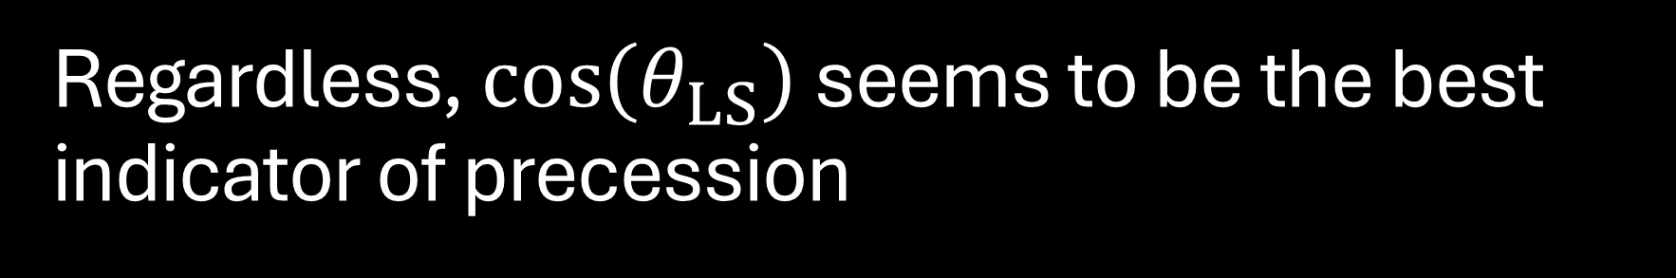
Regardless, $\cos\left(θ_{LS}\right)$ seems to be the best indicator of precession
How can we use our new, alternative parameter?
Use O3a strain data and filter out false-alarms to create a list of events with high astrophysical likelihood
We assume an isotropic spin distribution: $π\left(\cos\left(θ_{LS}\right)=0.5\right)$
We sample each astrophysical event from our list
We construct posteriors of each parameter for each event and distinguish which events have high alignment
The prior and posterior distributions can provide hints as to the least and most precessing events in our list

Slide 14
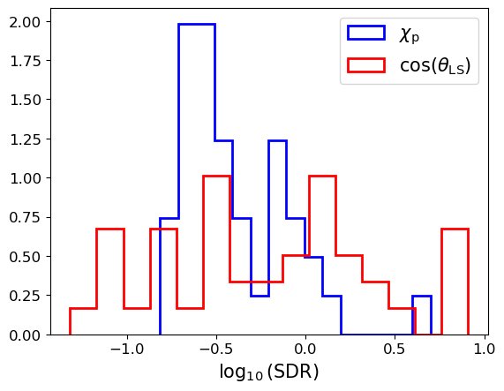

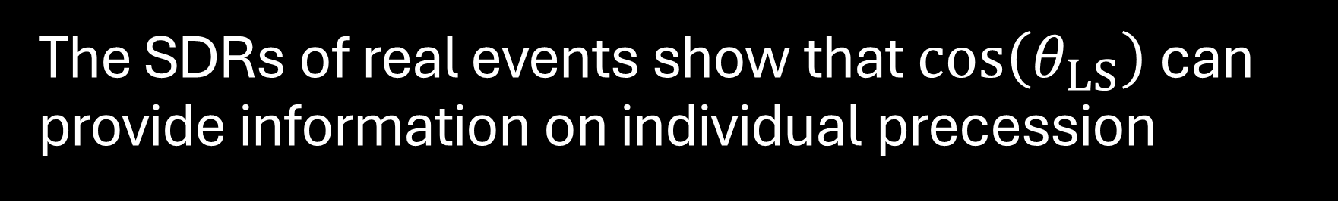
The SDRs of real events show that $\cos\left(θ_{LS}\right)$ can provide information on individual precession
A large range in ${SDR}_{isotropic}^{aligned}$ means a parameter that more strongly confirms (high SDR) or rejects (low SDR) aligned spins
Each event with extreme SDRs should have
posteriors that are localized (not resemble the broad prior)
high inverse false-alarm rates (IFARs)
Figure 10: A histogram of the $\log_{10}\left(SDR\right)$ values for $χ_{p}$ and $\cos\left(θ_{LS}\right)$ for
astrophysical triggers in O3a data

Slide 15
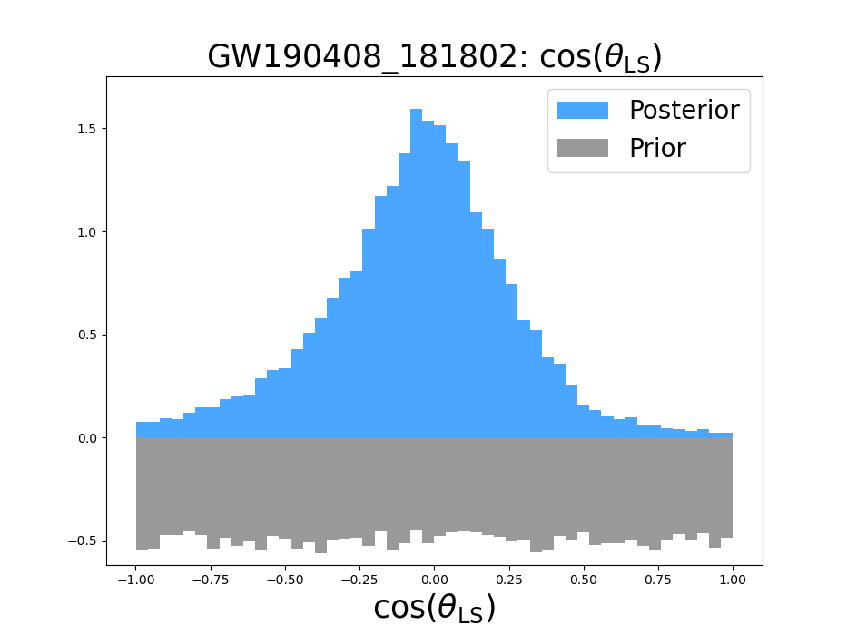
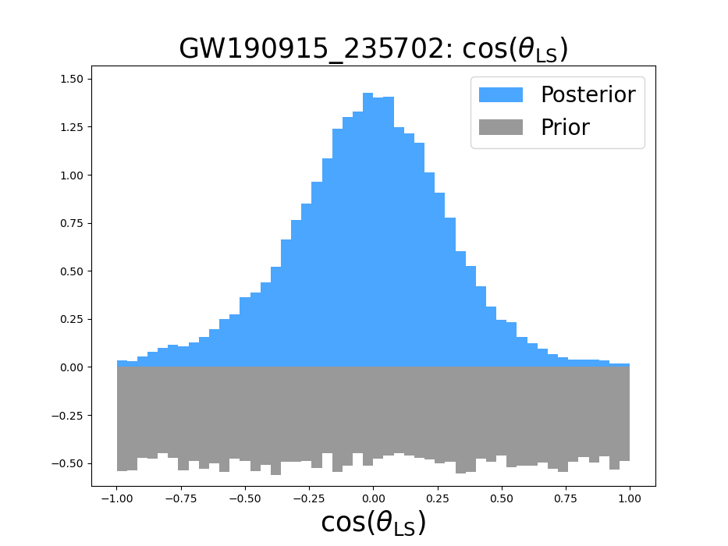
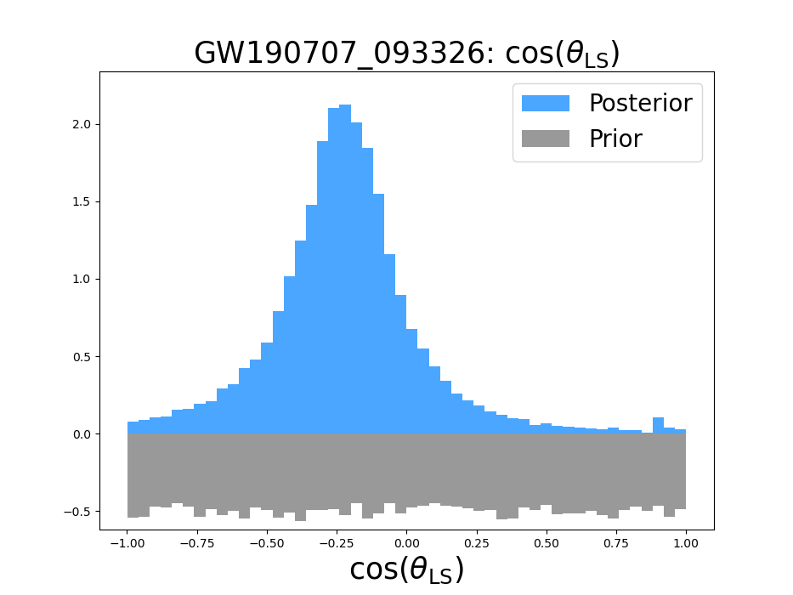
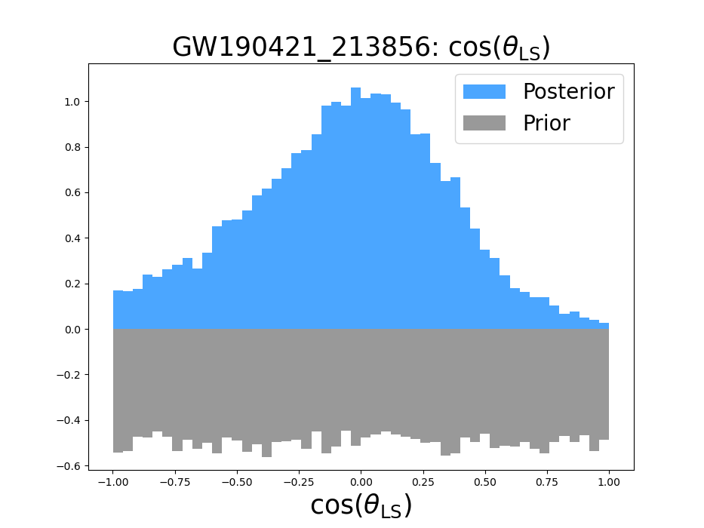




IFAR: $>{1000}^{\left[8\right]}$
IFAR: $>{1000}^{\left[8\right]}$
IFAR: ${23.2}^{\left[8\right]}$
IFAR: $>{1000}^{\left[8\right]}$

Slide 16
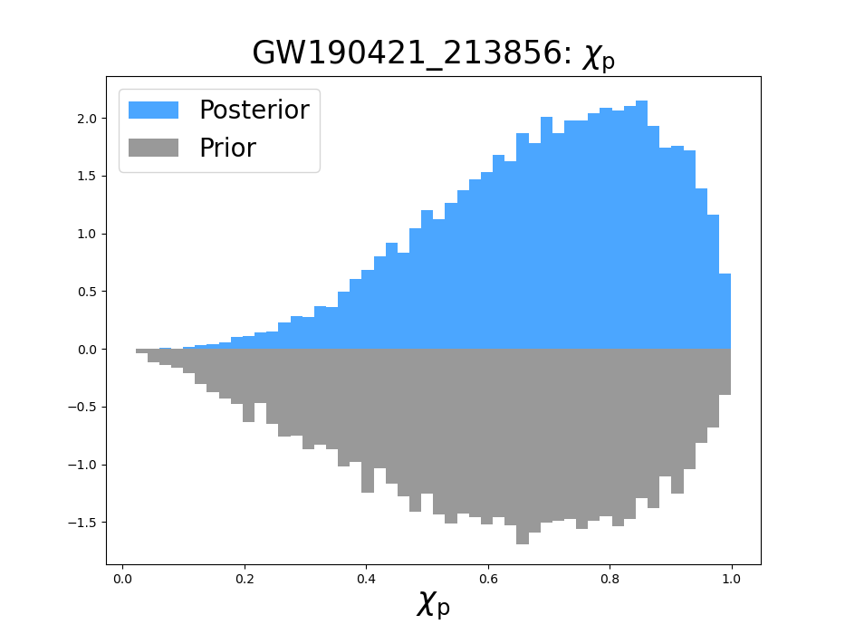
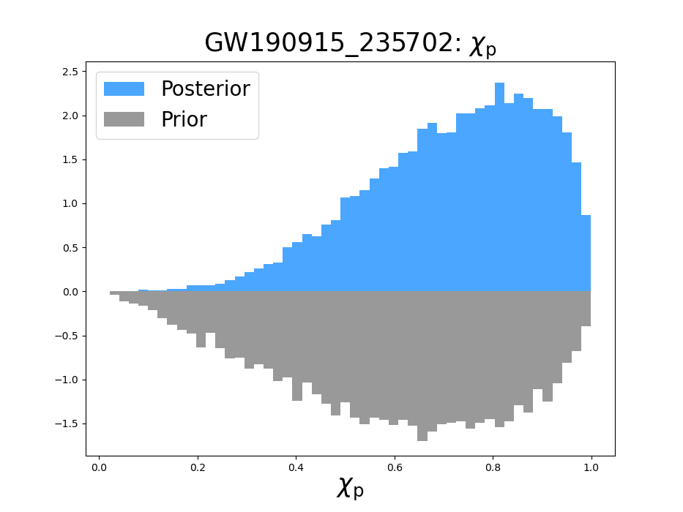
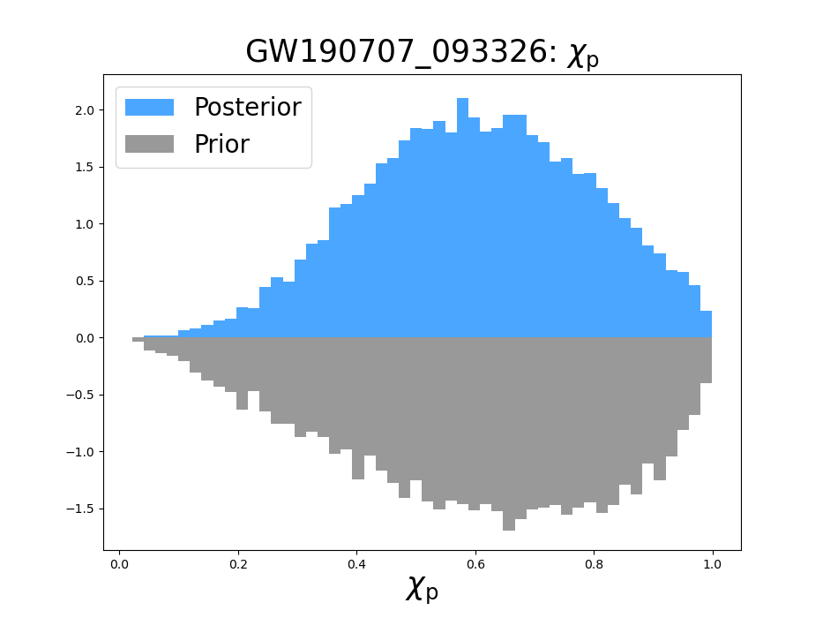
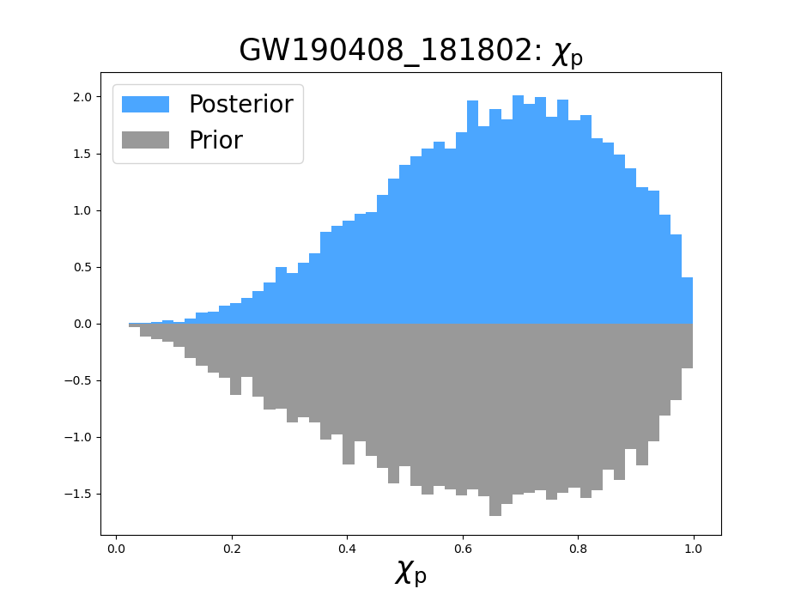




IFAR: $>{1000}^{\left[8\right]}$
IFAR: $>{1000}^{\left[8\right]}$
IFAR: ${23.2}^{\left[8\right]}$
IFAR: $>{1000}^{\left[8\right]}$

Slide 17
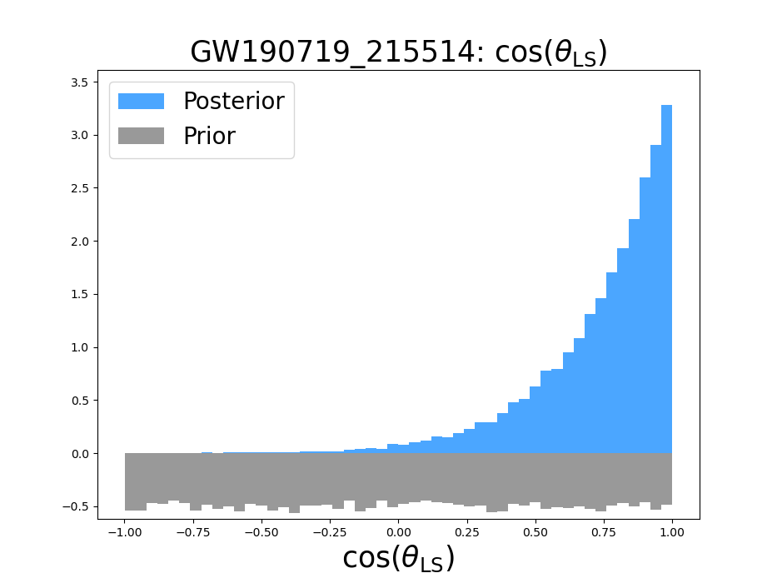
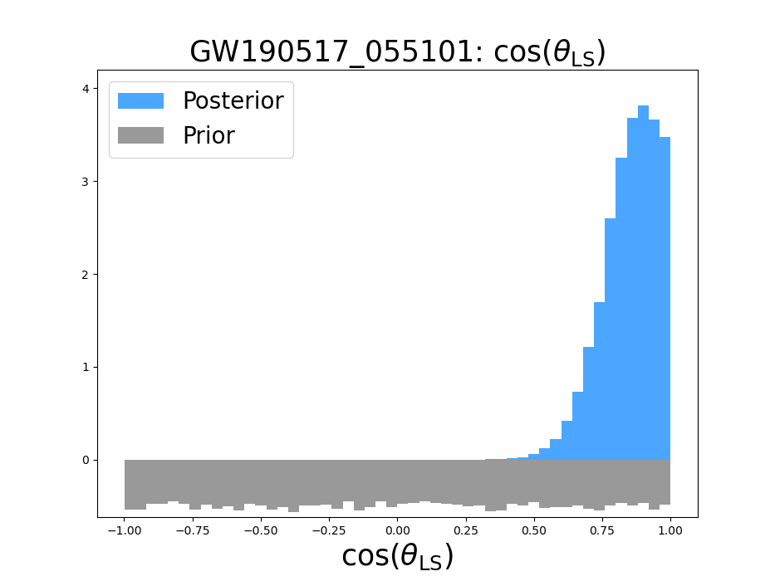

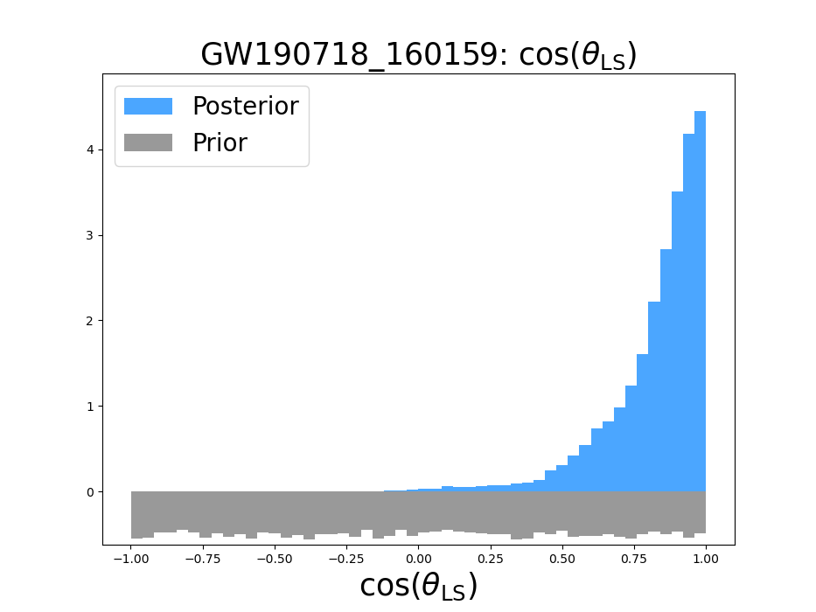




IFAR: ${0.25}^{\left[8\right]}$
IFAR: $>{1000}^{\left[8\right]}$
IFAR: ${0.56}^{\left[8\right]}$
IFAR: $>{0.48}^{\left[8\right]}$

Slide 18
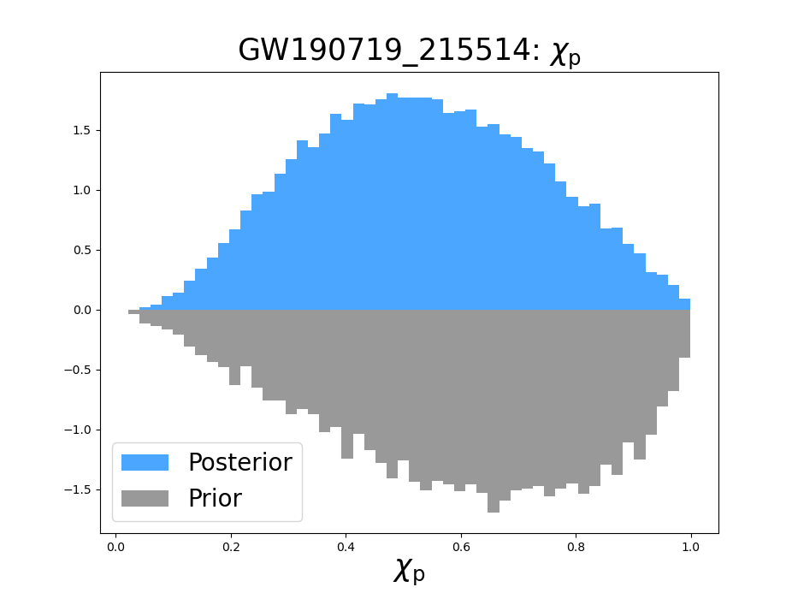
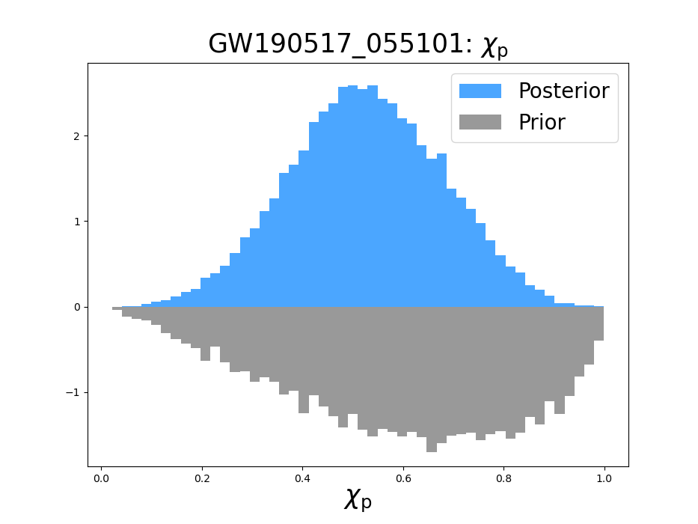
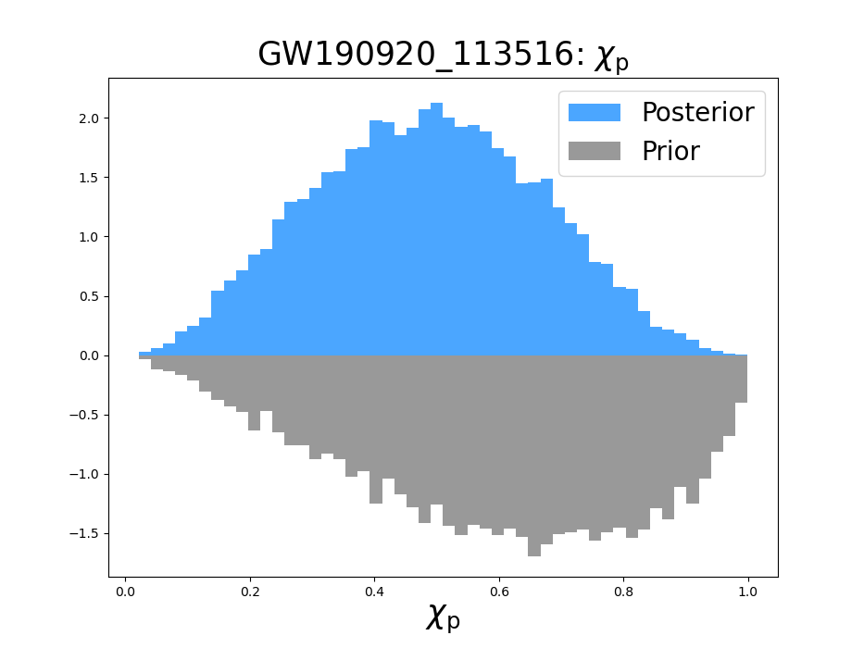
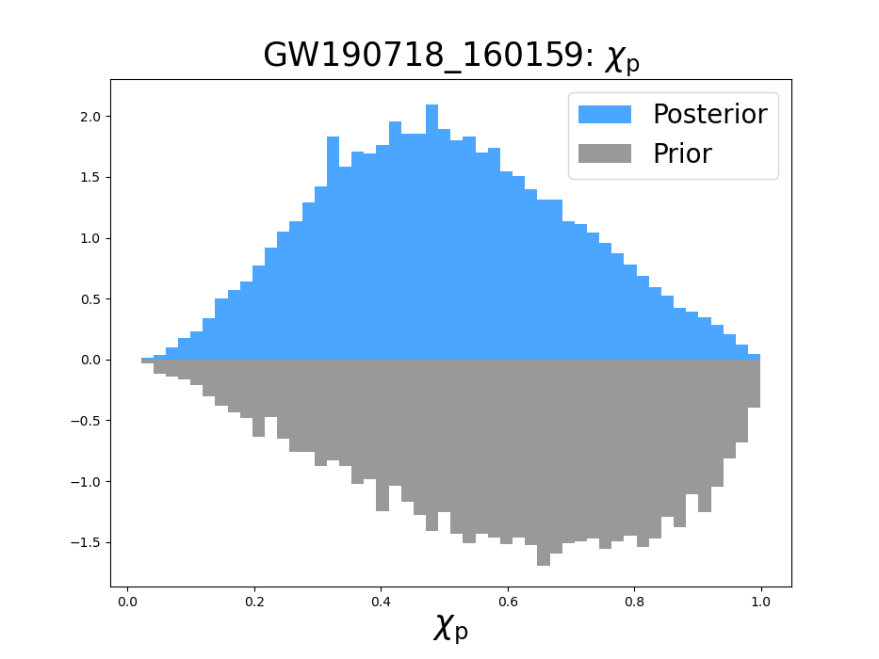




IFAR: ${0.25}^{\left[8\right]}$
IFAR: $>{1000}^{\left[8\right]}$
IFAR: ${0.56}^{\left[8\right]}$
IFAR: $>{0.48}^{\left[8\right]}$

Slide 19

Final Conclusions
Proposed new parameters as indicators of precession
Provided statistical evidence that makes $\cos\left(θ_{LS}\right)$ the strongest indicator of precession
We applied $\cos\left(θ_{LS}\right)$ to O3a data to show that there are several events that show promise for precession

Slide 20

Future Applications
Analyze precession from O3b and other observing runs to find more events with a high chance of precession
Construct a population model from the events
  This allows us to confirm precession without “cherry picking” the individual events with a non-zero $\cos\left(θ_{LS}\right)$ posterior of aligned spins
I will be working with Javier Roulet and Isha Anantpurkar on constructing this population model

Slide 21



Acknowledgements
Mandel, I., & Farmer, A. 2022, PhR, 955, 1,
doi: 10.1016/j.physrep.2022.01.003
Schmidt, P., Ohme, F., & Hannam, M. 2015, PhRvD, 91,
024043, doi: 10.1103/PhysRevD.91.024043
Abbott, R., Abbott, T. D., Acernese, F., et al. 2023,
Physical Review X, 13, 041039,
doi: 10.1103/PhysRevX.13.041039
Hannam, M., Hoy, C., Thompson, J. E., et al. 2022,
Nature, 610, 652, doi: 10.1038/s41586-022-05212-z
Payne, E., Hourihane, S., Golomb, J., et al. 2022, PhRvD,
106, 104017, doi: 10.1103/PhysRevD.106.104017
Fairhurst, S., Green, R., Hoy, C., Hannam, M., & Muir, A.
2020, PhRvD, 102, 024055,
doi: 10.1103/PhysRevD.102.024055
Neyman, J., & Pearson, E. S. 1933, Philosophical
Transactions of the Royal Society of London Series A,
231, 289, doi: 10.1098/rsta.1933.0009
Olsen, S., Venumadhav, T., Mushkin, J., et al. 2022,
PhRvD, 106, 043009, doi: 10.1103/PhysRevD.106.043009
https://bigthink.com/starts-with-a-bang/milky-way-lose-black-hole/
Software Used:
NumPy, Matplotlib, Pandas, Scipy, Cogwheel-pe

Slide 22







Marginal Events With Strong Localization of $\cos\left(θ_{LS}\right)$ at $−1$
IFAR: $>{0.17}^{\left[8\right]}$
IFAR: $>{0.65}^{\left[8\right]}$

Slide 23

Getting from Neyman-Pearson Lemma to Savage-Dickey Ratio
There are two hypotheses: an isotropic spin distribution and an aligned spin distribution. The parameters that claim precession are expressed as $θ$:
$$ℋ_{0}: θ∼π\left(θ\right)$$
$$ℋ_{1}: θ=θ_{∗}$$
$$Λ=\frac{p\left(d ∣ ℋ_{1}\right)}{p\left(d ∣ ℋ_{0}\right)}$$
$$p\left(d ∣ ℋ_{1}\right)=p\left(d ∣ θ_{∗}\right)=ℒ=\frac{p\left(θ_{∗} ∣ d, ℋ_{0}\right)p\left(d ∣ ℋ_{0}\right)}{π\left(θ_{∗} ∣ ℋ_{0}\right)}$$
$$Λ=\frac{\frac{p\left(θ ∣ d, ℋ_{0}\right)p\left(d ∣ ℋ_{0}\right)}{π\left(θ_{∗} ∣ ℋ_{0}\right)}}{p\left(d ∣ ℋ_{0}\right)}=\frac{p\left(θ ∣ d, ℋ_{0}\right)}{π\left(θ_{∗} ∣ ℋ_{0}\right)}$$

Slide 24

Getting from Neyman-Pearson Lemma to Savage-Dickey Ratio cont.
Now, we aim to capture all the precession information found in $θ$ through a single parameter $x$, and retain all other irrelevant information in $θ^{′}$: $θ=\left(x, θ^{′}\right)$
In other words
$$π\left(θ^{′} ∣ x_{∗}, {\tilde{ℋ}}_{1}\right)=π\left(θ^{′} ∣ x_{∗},ℋ_{0}\right)$$
Thus, there should be a single value in which ${\tilde{ℋ}}_{1}$ and $ℋ_{0}$ are the same (isotropic spin distribution has a non-zero probability of aligned spins)
$$π\left(θ^{′} ∣ x_{∗}, {\tilde{ℋ}}_{1}\right)=π\left(θ^{′} ∣ x_{∗},ℋ_{0}\right)$$
$$⇒π\left(θ ∣ {\tilde{ℋ}}_{1}\right)=δ\left(x−x_{∗}\right)⋅π\left(θ^{′} ∣ x_{∗},ℋ_{0}\right)$$

Slide 25

Getting from Neyman-Pearson Lemma to Savage-Dickey Ratio cont. 2
Assuming a single parameter can meet this qualification, we can rerun the calculation, where
$$p\left(d∣{\tilde{ℋ}}_{1}\right)=p\left(d ∣ x_{∗}, {\tilde{ℋ}}_{1}\right)=p\left(d ∣ x_{∗}, ℋ_{0}\right)$$
$$=\frac{p\left(x_{∗} ∣ d, ℋ_{0}\right)p\left(d ∣ ℋ_{0}\right)}{π\left(x_{∗} ∣ ℋ_{0}\right)}$$
Using the same process for the derivation for a general set of parameters:
$$Λ=\frac{p\left(d ∣ {\tilde{ℋ}}_{1}\right)}{p\left(d ∣ ℋ_{0}\right)}=\frac{p\left(x_{∗} ∣ d,ℋ_{0}\right)}{π\left(x_{∗} ∣ ℋ_{0}\right)}=Savage Dickey Ratio$$

Slide 26


Mass and Precession LIGO Selection Effects and SNR
$$ρ^{2}=\int{\frac{{\left|h\right|}^{2}}{S\left(f\right)}df}$$
$$\frac{d\log\left(f\right)}{df}=\frac{1}{f}$$
$$ρ^{2}=\int{\frac{{\left|h\right|}^{2}}{S\left(f\right)}fd\log{f}}$$
$$ρ^{2}=\int{{\left|\frac{\sqrt{f}\left|h\right|}{\sqrt{S}}\right|}^{2}}d\log{f}$$
$$C\left(τ\right)=\left\langle n\left(t\right), n\left(t+τ\right)\right\rangle$$
$$S\left(f\right)=\int{C\left(τ\right)e^{−iω}dt}$$
$$\left[S\left(t\right)\right]=\left[h\left(t\right)\right]=dimensionless$$
$$\left[S\left(f\right)\right]=\left[h\left(f\right)\right]={Hz}^{−1}$$
To find the change in SNR for a given frequency (on a log-log scale), we can integrate the strain across a frequency range, exponentiate the value, then

Slide 27


There is also a slight relationship between mass and parameter effectiveness
The low-mass distribution has a slightly higher lower bound to the distribution of $\log_{10}{SDR\left(\cos\left(θ_{LS}\right)\right)}$
This could be from the estimate of the prior probability density from the histogram

