Slide 1


Optimally Error-Tolerant Laser
Cavity Design
Sid Kannan
Mentors: Pooyan Goodarzi, Jonathan Richardson, Vagelis Papalexakis

Slide 2
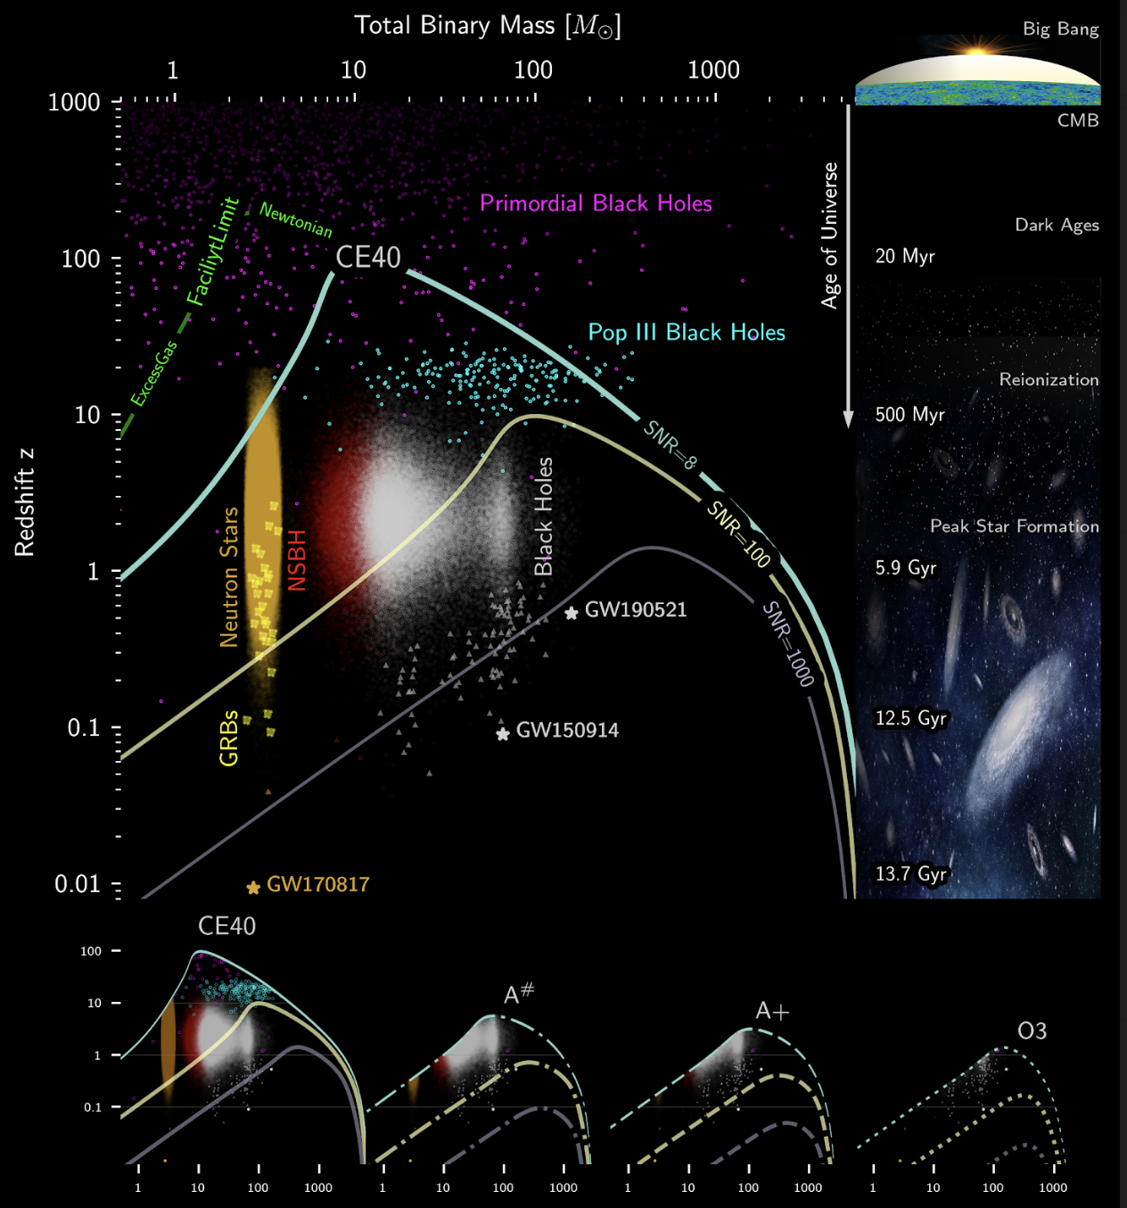
Goal
Find the set of interferometer design parameters that are least sensitive to deviations from design parameters
Cosmic Explorer provides the opportunity to design a new interferometer from scratch
Will enable studies of the early universe

Slide 3
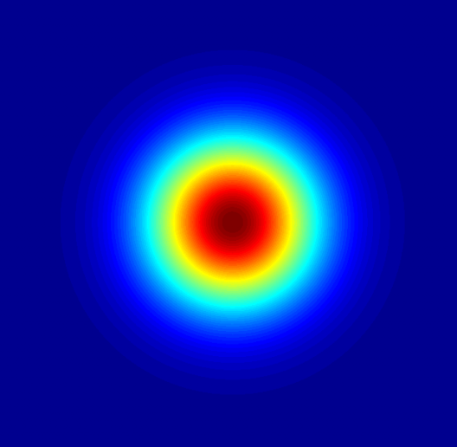
Approach
Modelling

Slide 4
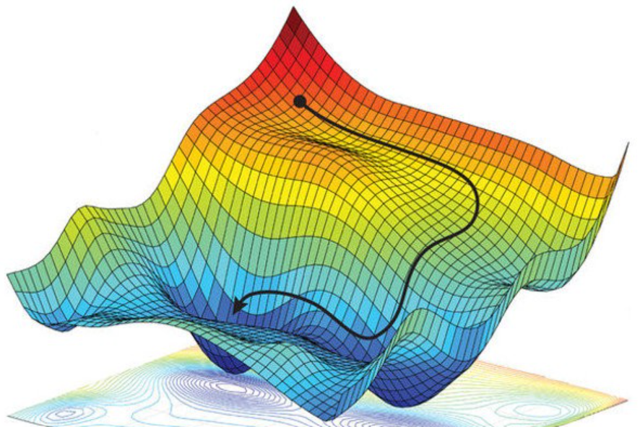
Approach
Modelling
Optimization

Slide 5
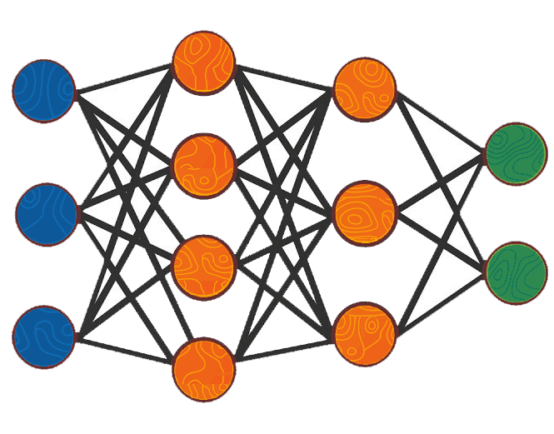
Approach
Modelling
Optimization
Machine Learning

Slide 6
Modelling

Slide 7
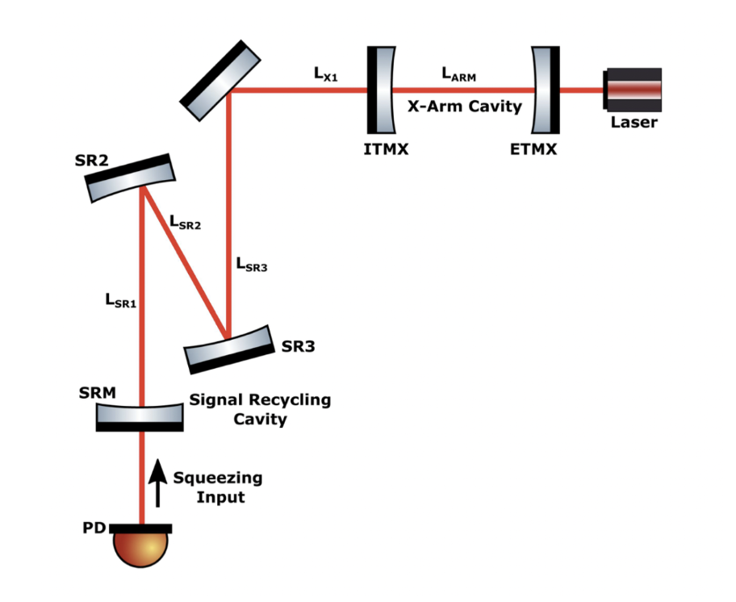
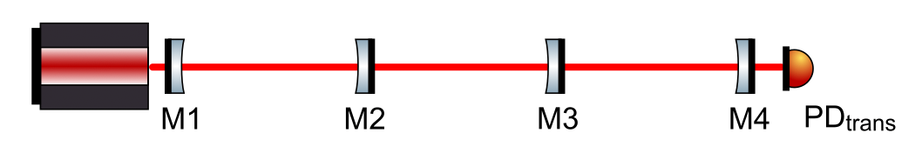
Simple CC
Half ALIGO
Images from DCC-T2000338
Notes:
Cite Swadha’s final report

Slide 8
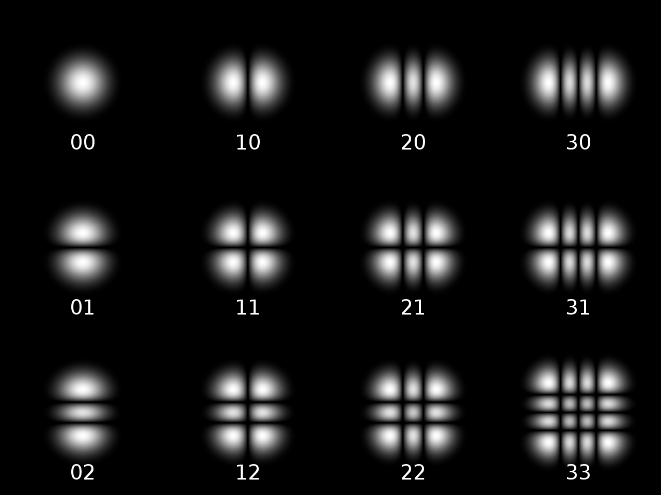
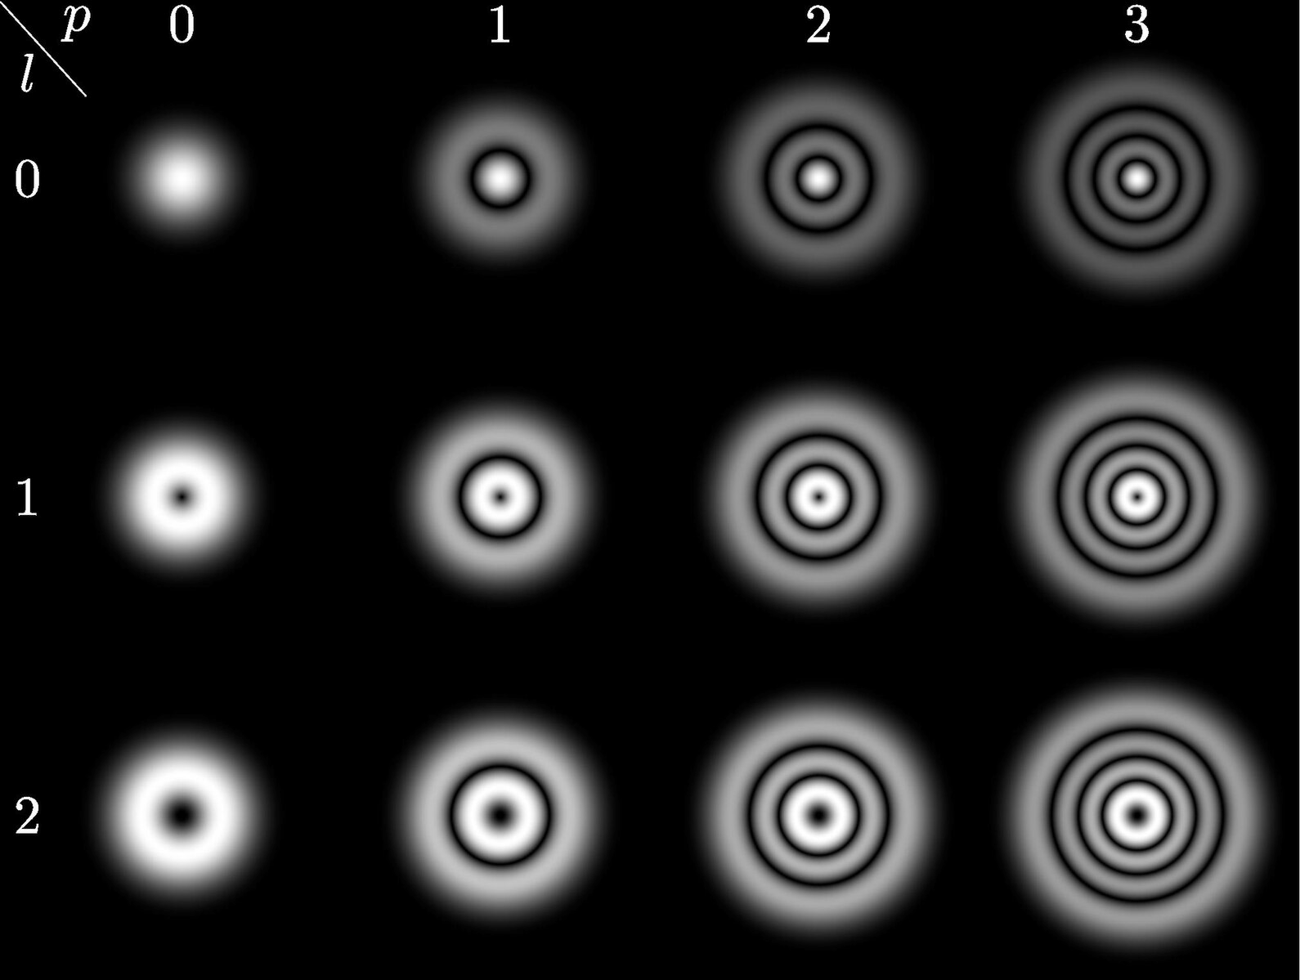
Finesse vs. SIS
Finesse
  Frequency domain simulation
  Written in Python
  Field is modelled by its modal decomposition
Image from Wikipedia

Slide 9
Finesse vs. SIS
Finesse
  Frequency domain simulation
  Written in Python
  Field is modelled by its modal decomposition
SIS
  Field is represented using its spatial Fourier transform
  Written in Matlab
Image from Wikipedia

Slide 10
Finesse vs. SIS
Finesse
  Frequency domain simulation
  Written in Python
  Field is modelled by its modal decomposition
SIS
  Field is represented using its spatial Fourier transform
  Written in Matlab
  Reproducing Finesse results in SIS provides a cross check on unexpected results
  Better at modelling sharp spatial features
Image from Wikipedia

Slide 11
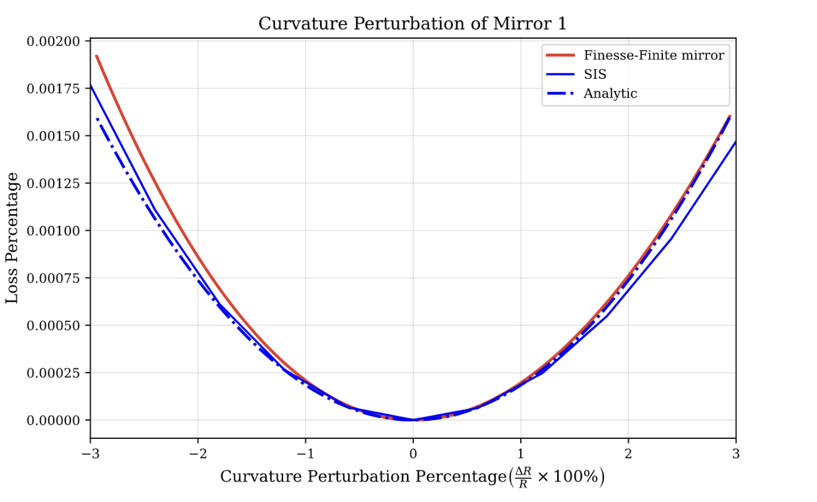
Model Comparison - Simple CC

Slide 12
Optimization

Slide 13
Problem Formulation
Given some function that tells us how good or bad a particular setup is, find the parameters that minimize it
  Parameters are the IFO design parameters
  Cost function is non-differentiable, and highly non-convex
  Cost = C_{Sqz} + C_{stable}+ C_{loss}

Slide 14
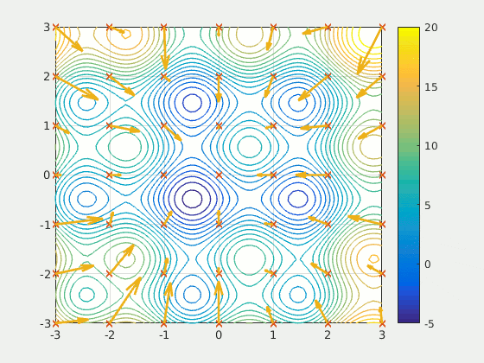
Particle Swarm
Animation from Wikipedia
Notes:
Wikipedia animation

Slide 15
Machine Learning

Slide 16
Why ML?
Simulations are slow, inference is fast
Complexity of simulation scales poorly as the IFO complexity increases
ML has been successful in other physics domains, engineering design automation

Slide 17
Problem Setup
Model Task: Given the SRC parameters as a vector, predict the squeezing level
Constraints
  SRC must be mode matched to the XARM
  Total length of the SRC is constant

Slide 18
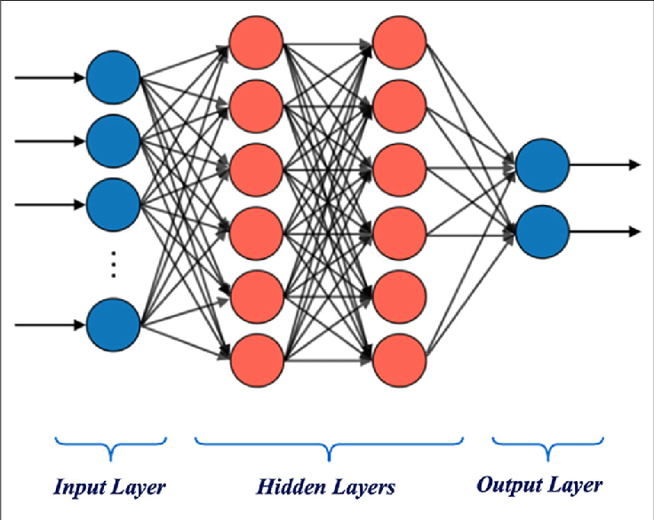
The Naive Approach - Multilayer Perceptron
Sequence of matrix multiplications followed by nonlinear “activation” functions
Learning task is to find the matrix elements that make the model predictions as close to the training data as possible
Image from doi: 10.3389/fnbot.2020.00032
Notes:
Find out where i got this and cite it

Slide 19
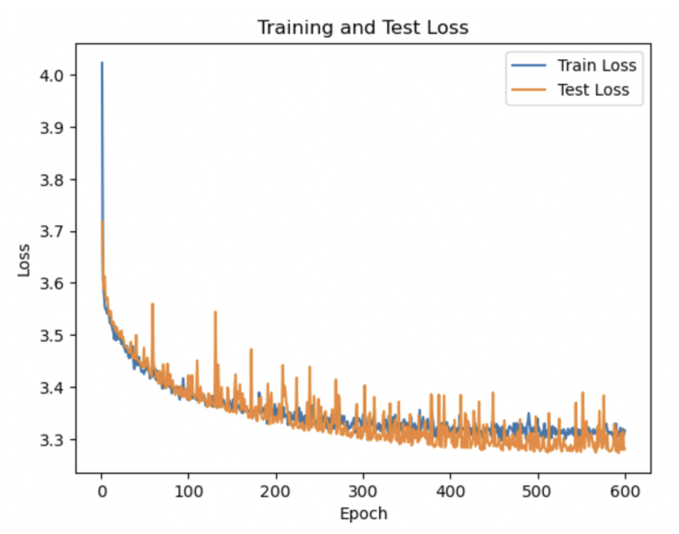
Results
Bad!
Training curves look normal, but L1 loss remains above 3 (dB)
Increasing model capacity does not significantly improve prediction quality

Slide 20
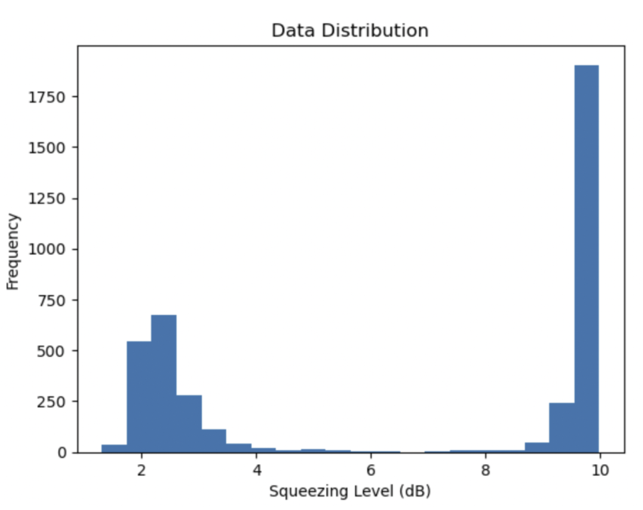
Simplify the Problem (Classification)
Model architecture remains roughly the same
  Last ReLU becomes a sigmoid
  Loss goes from L1 to Cross Entropy
Results
  98% accuracy!
  Generalized poorly to OOD data

Slide 21
Increasing the model complexity
MLP makes no assumptions about the structure of the data
Other network layers, preprocessing
  Convolutional layers
  Feature normalization
Graphs!

Slide 22
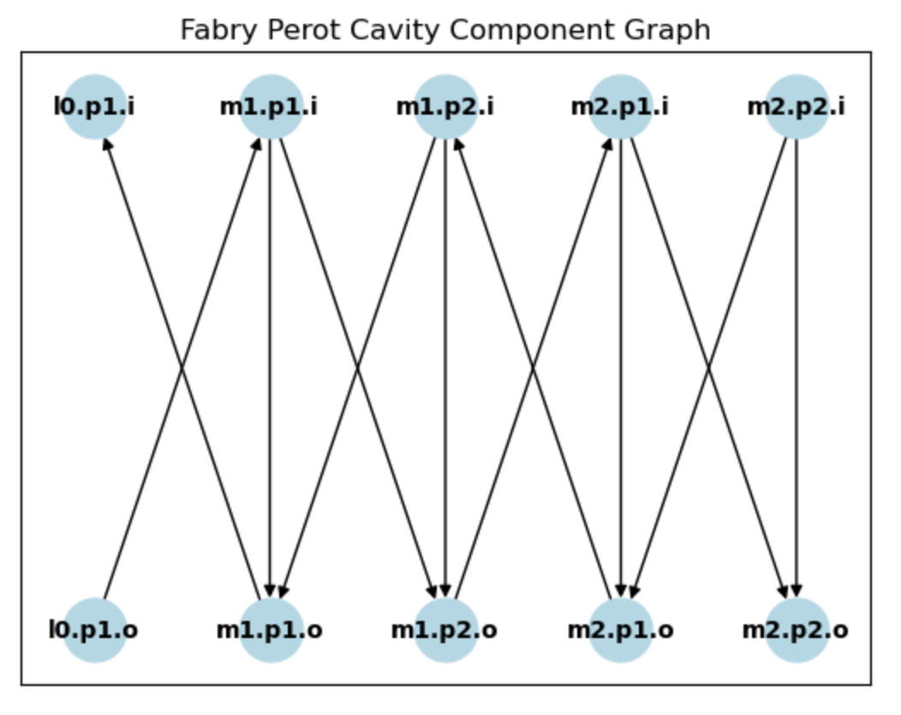
Graph Neural Networks
Take a graph as input
  Each node and edge is assigned a feature vector
    RoC or reflectivity for the nodes (optics)
    Spacing for the edges
  Learns a “node embedding”
    Power at that node
Forward Pass
  Aggregation layers are applied to the features/latent representations
    We use single headed Graph Attentional Layers (GAT)
  An MLP converts these latents into the final node embedding
Takes advantage of the graph structure that we know is present in the interferometer

Slide 23
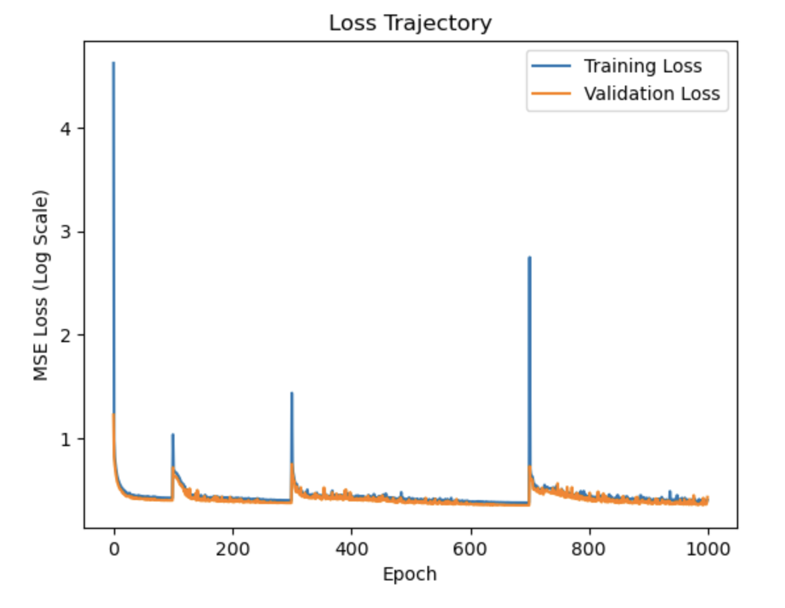
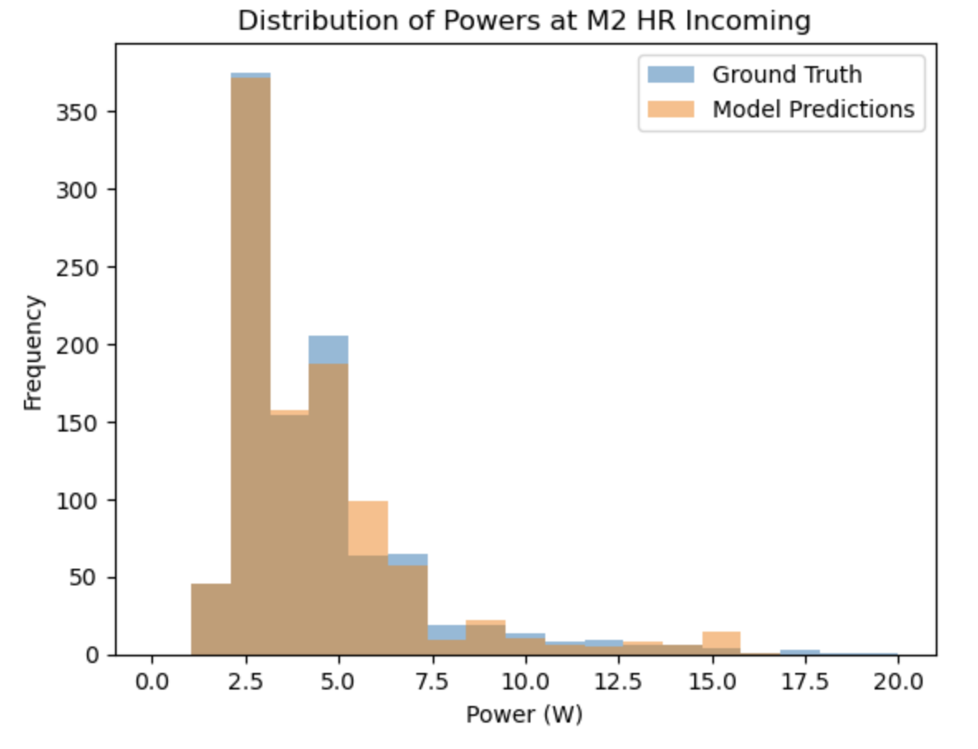
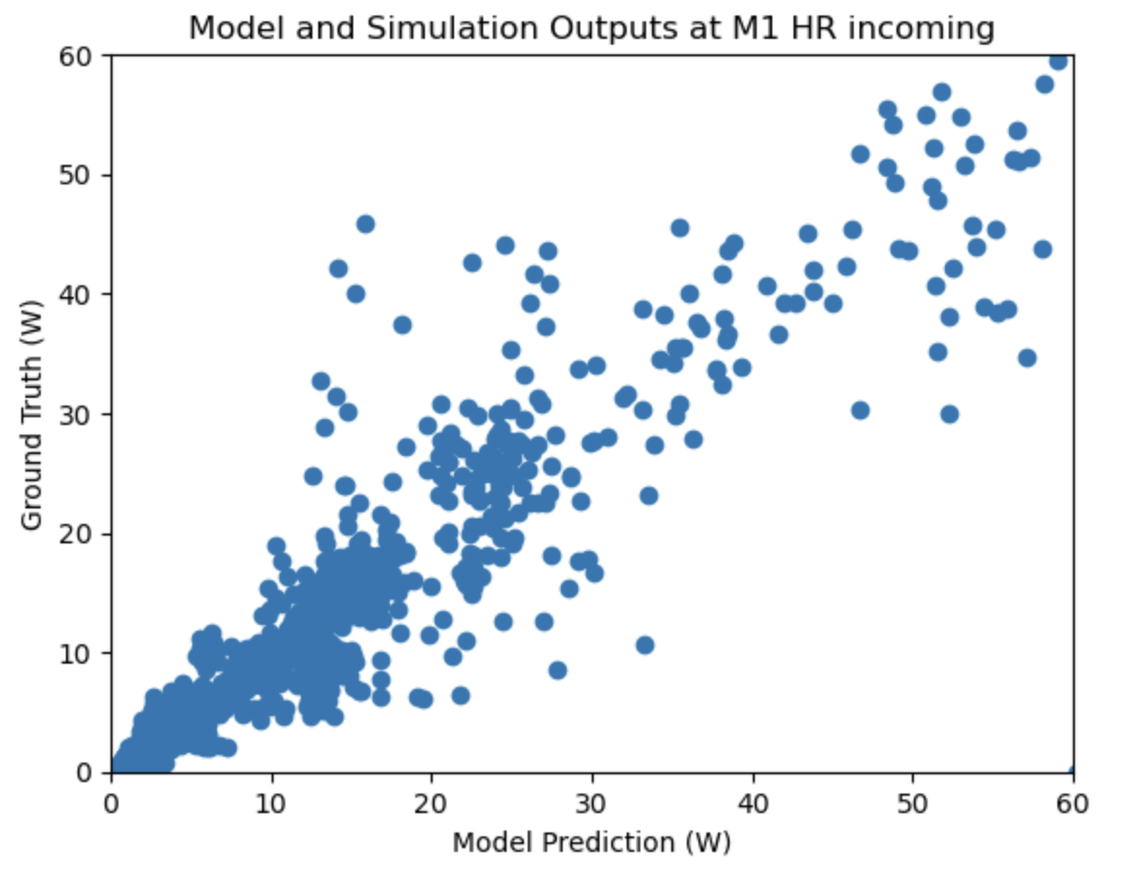
Results!
Significant improvements!
  L1 loss drops to ~1.4 W
  Predictions follow the trend of the data
    Can be trained on multiple topologies
  41x speedup over SIS for inference (0.36 s vs. 14.9 s on CPU)

Slide 24
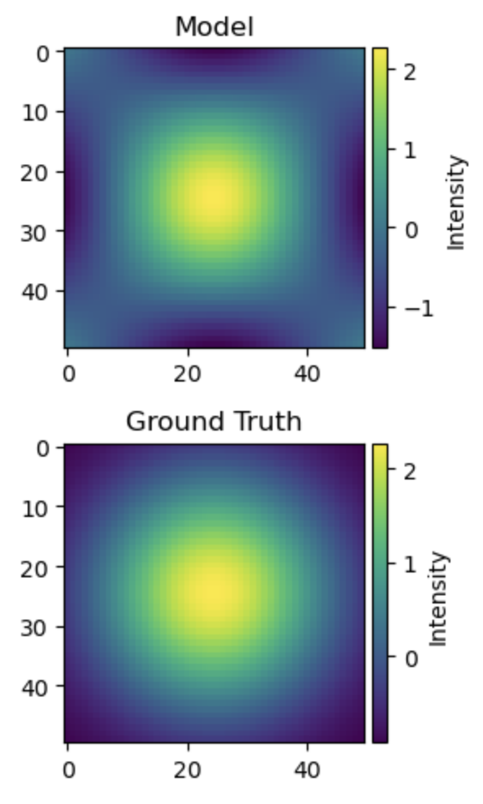
Can we do better?

Slide 25
Conclusions
Knowledge guided machine learning is a powerful tool for accelerating simulations
The interferometer modelling task is hard
Directions for future work
  Heterogenous GNNs
  Constrained emulation (power in = power out)
  Reinforcement Learning for exploring parameter space

Slide 26
Acknowledgements
My mentors for their patient guidance throughout the project
Dr. Liu Tao for guidance on using Finesse and on optical physics
Dr. Hiro Yamamoto for answering my many questions about SIS and for providing examples on how to use it
LIGO Lab and the NSF for providing me with this opportunity!

Slide 27
