Slide 1
Improving the Robustness of Next-Generation Wavefront Control: Analyzing FROSTI’s Performance Against Beam Miscenterings
Xuejun (Aeleph) Fu, University of Texas at Dallas
Tyler Rosauer and Dr. Jon Richardson, UC Riverside
1

Slide 2
Presentation Outline
FROSTI
Analysis & Modeling
Motivation
Setup & Measurements
Project Synthesis
2

Slide 3
Motivation
3

Slide 4
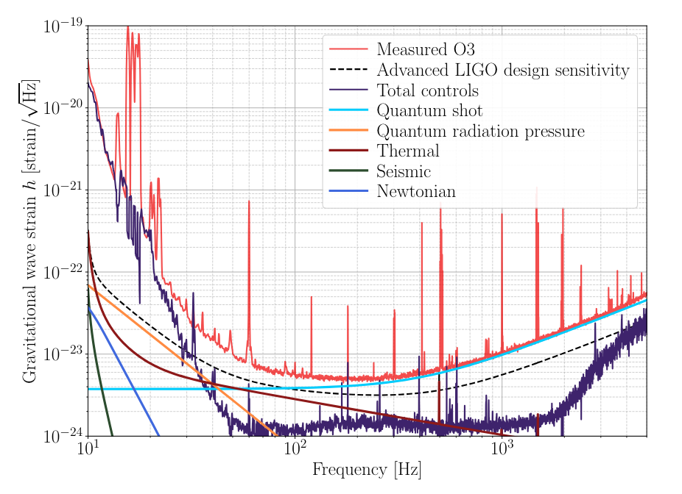
Motivation
Quantum Shot Noise makes a significant contribution to the noise budget at higher frequencies (over 100 Hz)
Increased arm cavity power reduce this noise
Amplitude spectral density of shot noise scales as 1/sqrt(N) with N being number of photons
Therefore, higher laser power is required
Noise budget of O3 LIGO Hanford
(Cahillane & Mansell, arXiv:2202.00847v1 [gr-qc])
4

Slide 5
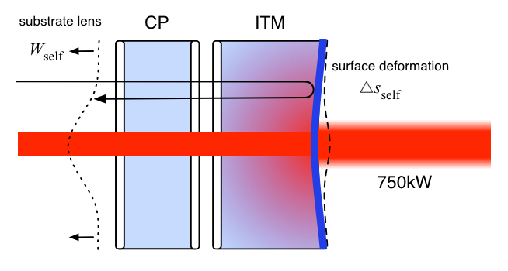
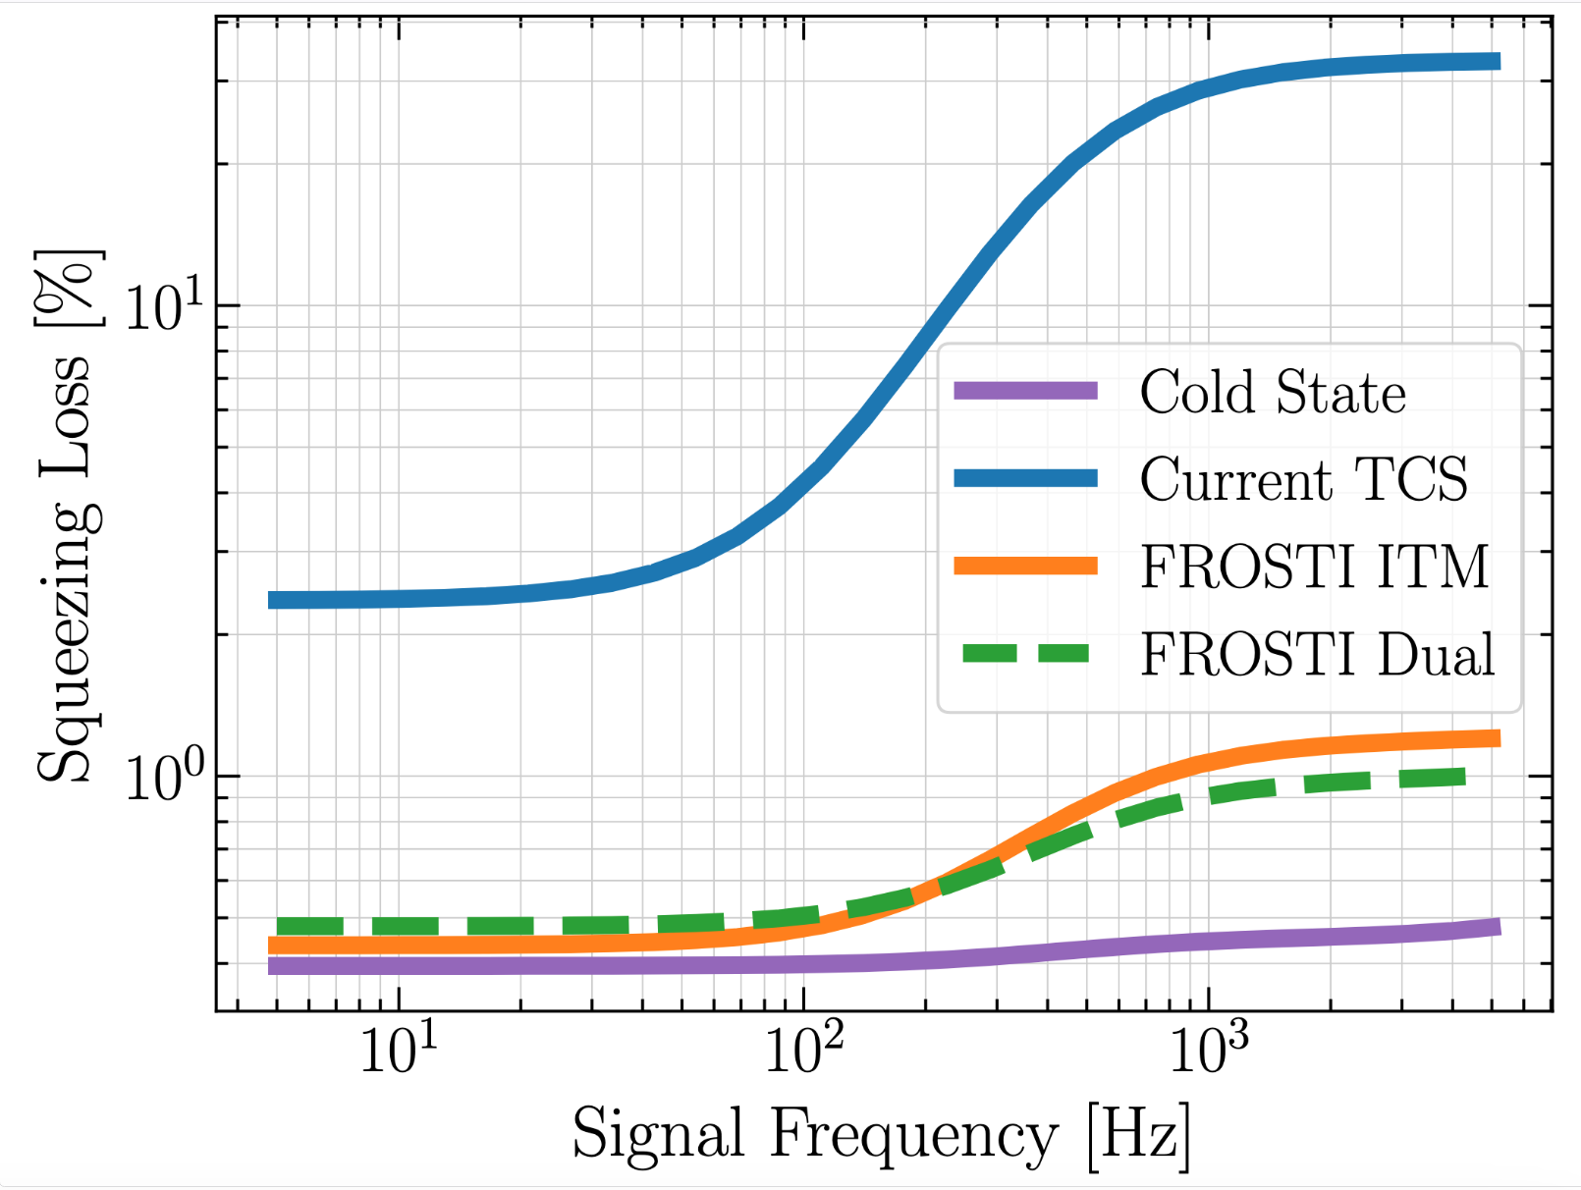
Motivation
Uniform coating absorption and point absorbers create loss of power
Thermal Compensation System (TCS) unable to fully compensate for uniform coating absorption in the future with greater arm power
Thermal aberrations cause mode mismatch between arm cavities and signal recycling cavity increasing squeezing loss
FROSTI helps return test mass to “cold state” lowering such losses
Thermal deformation of lens
(Brooks, arXiv:1608.02934 [physics.ins-det])
Squeezing loss comparison between just TCS and with FROSTI
5

Slide 6
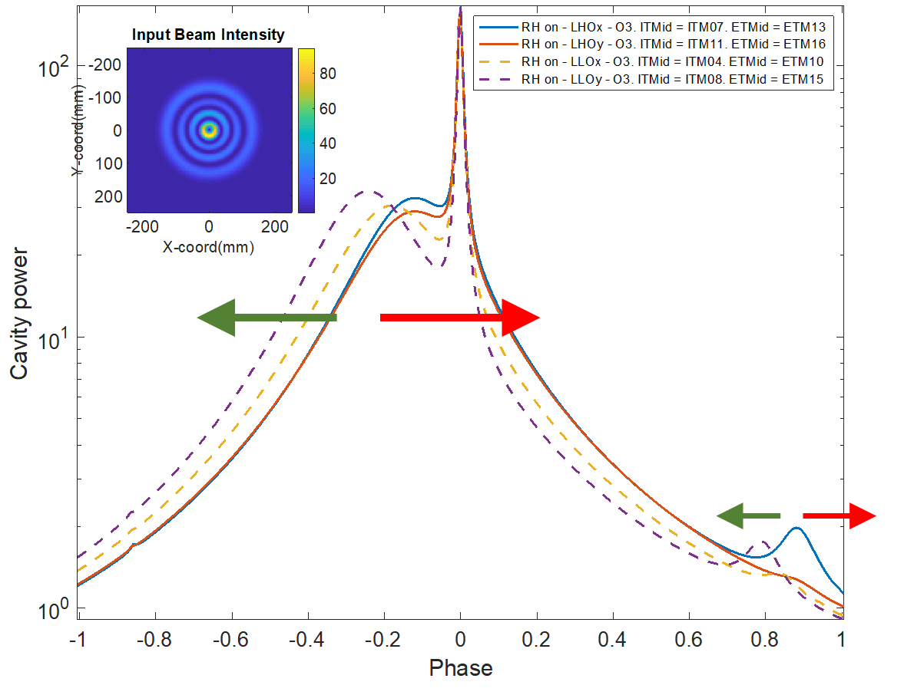
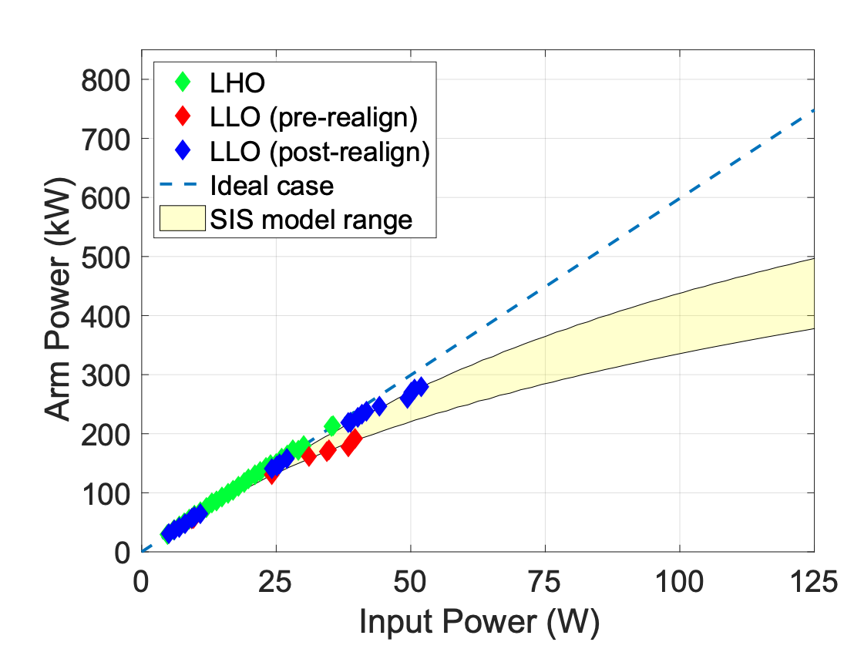
Effects of RHs on HOM Resonance Condition (G2101232)
Issue of point absorber has mostly been dealt with
FROSTI shifts seventh order modes away from resonance
Predicted losses from point absorbers
Scattering into higher order modes shifts seventh order mode toward resonance (red arrow), FROSTI shifts it away (green arrow)
aLIGO ideal vs actual arm power vs input power circa O3
(Brooks et al. 2021, P1900287)
6

Slide 7
FROSTI
(FROnt Surface
Type Irradiator)
7

Slide 8
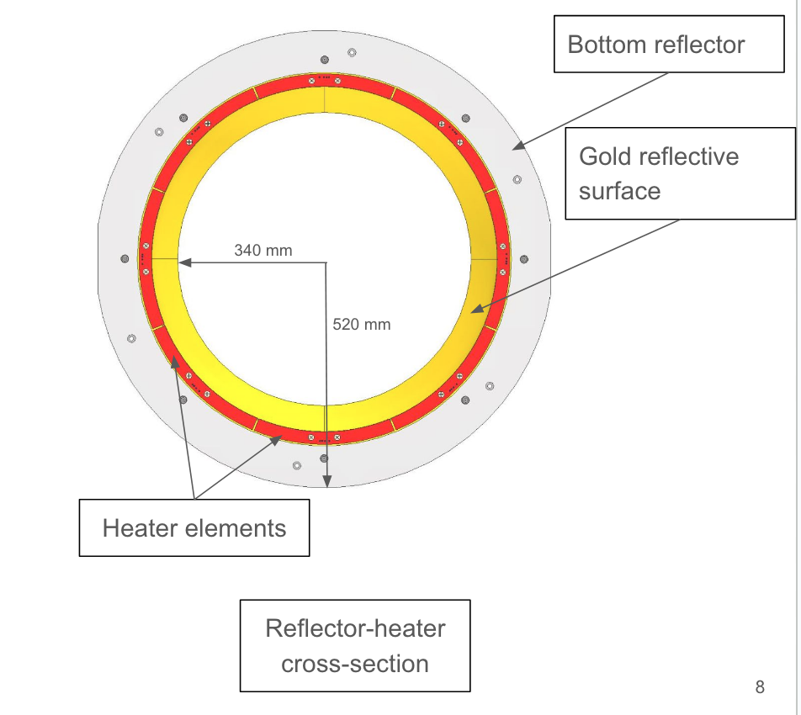
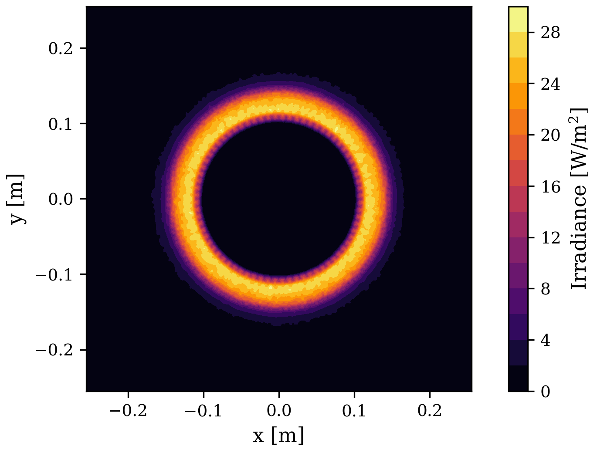
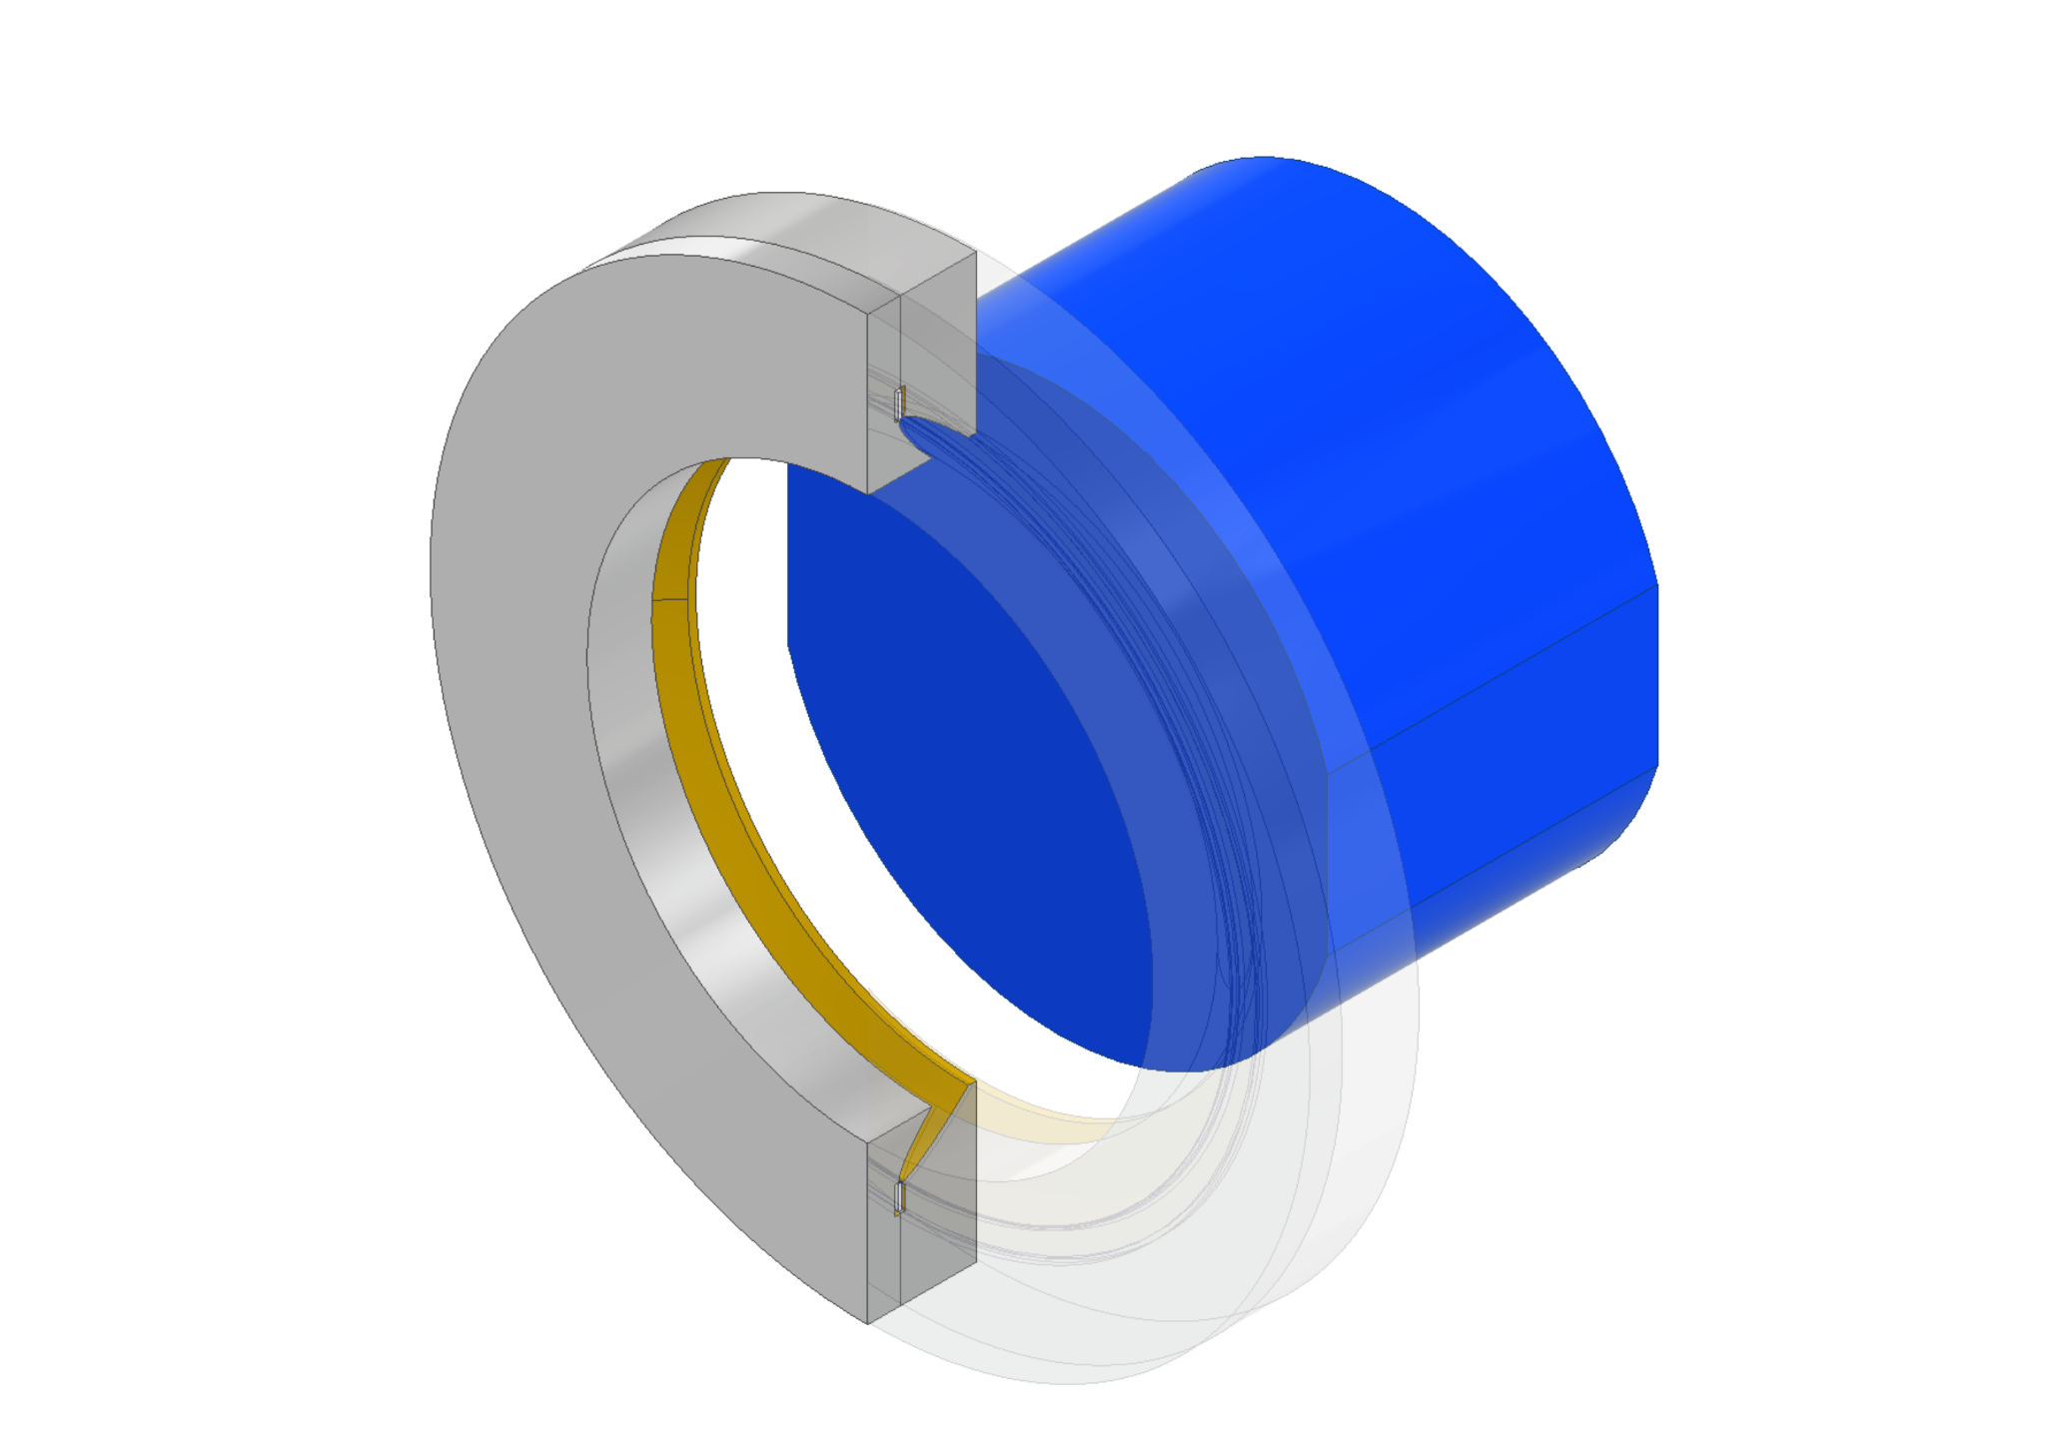
FROSTI
FROSTI’s components and structure
(G2400546)
Next generation ring heater
Annular ring heater placed 5cm in front of test mass
Shape based on nonimaging elliptical concentrators to maximize radiative transfer
Reflector component coated in gold film for maximum reflectivity
Eight individual heater elements oriented octagonally
Profile FROSTI generates
FROSTI’s placement relative to the test mass (blue)
8

Slide 9
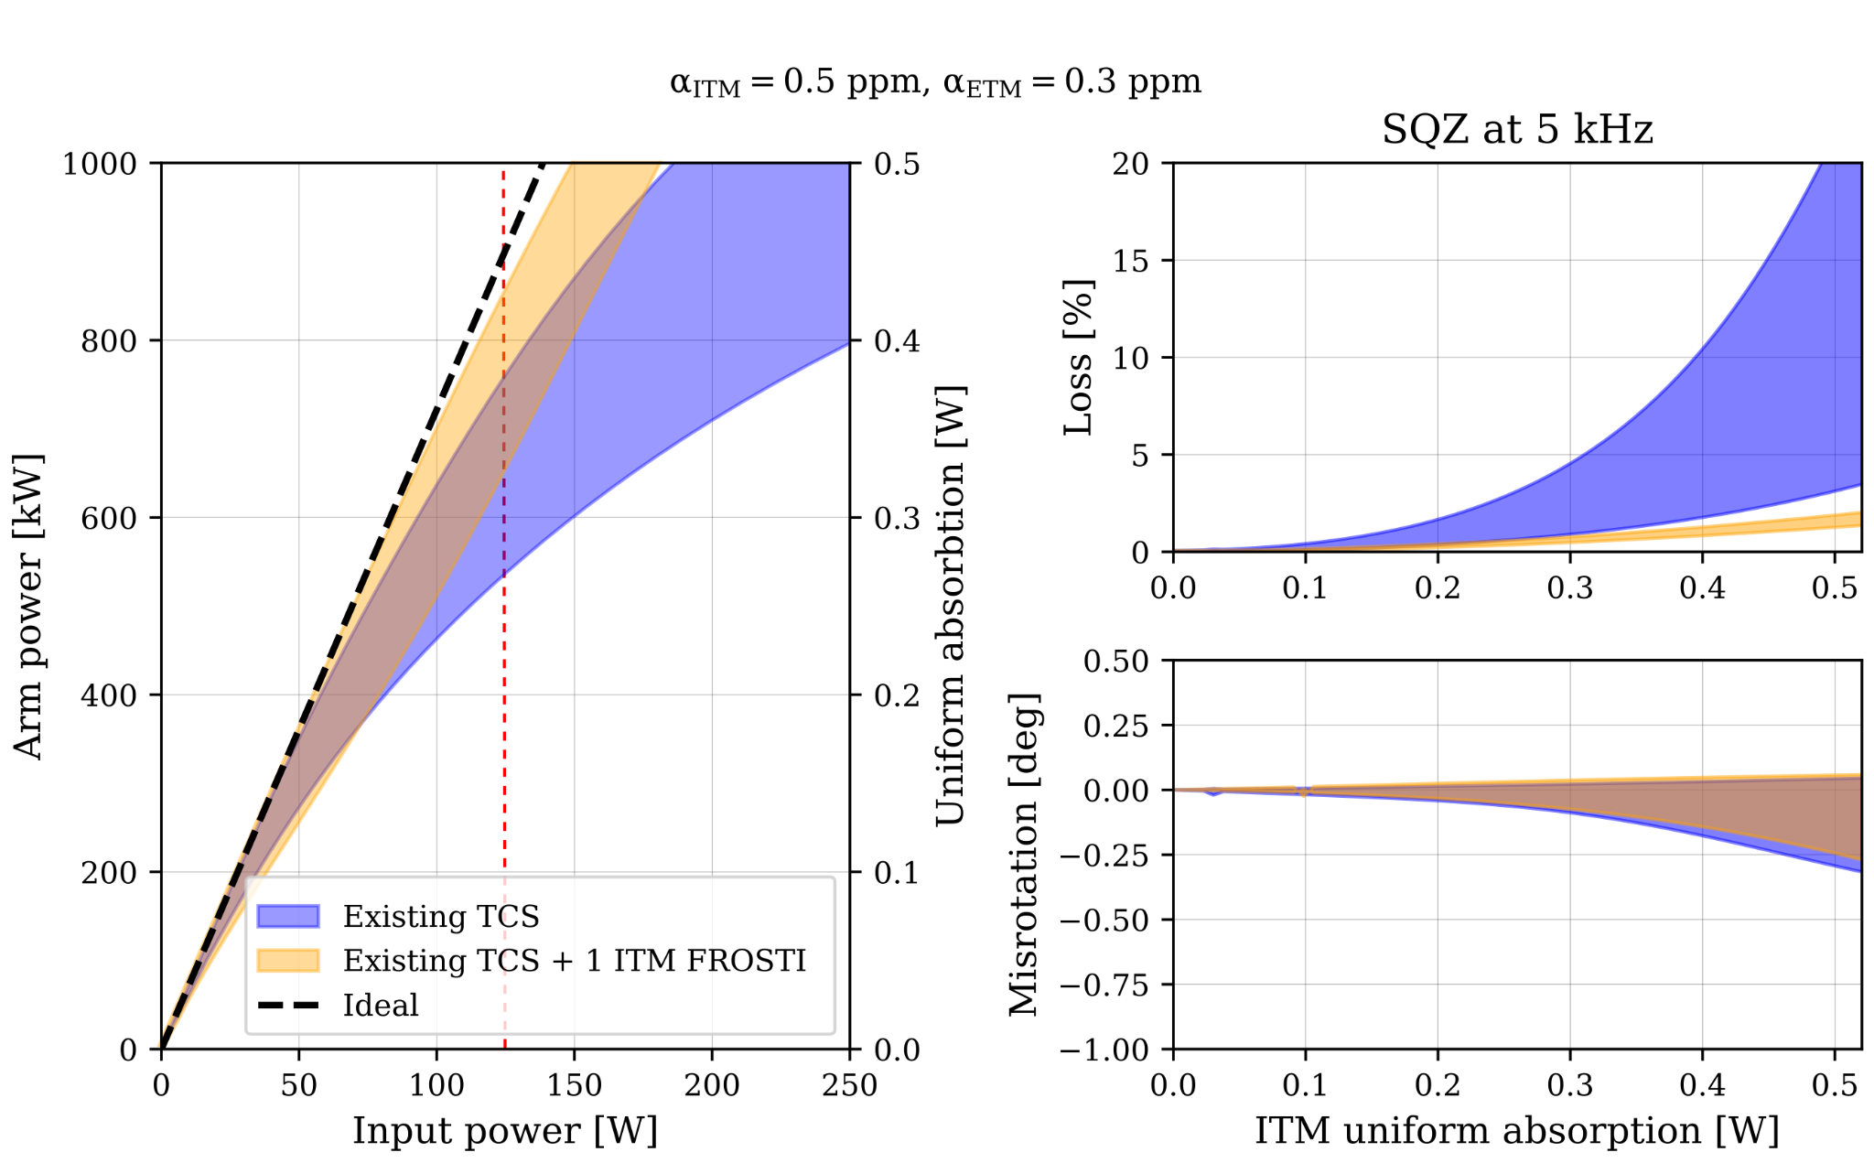
FROSTI
FROSTI helps deal with squeezing loss in O5
Small power loss causes great squeezing loss due to nature of squeezed light
Also corrects thermal deformations and minimize higher-order scattering that limits power build up
A precise wavefront control technology that reduces power loss
Comparison of achievable arm power using just TCS vs TCS + FROSTI
9

Slide 10
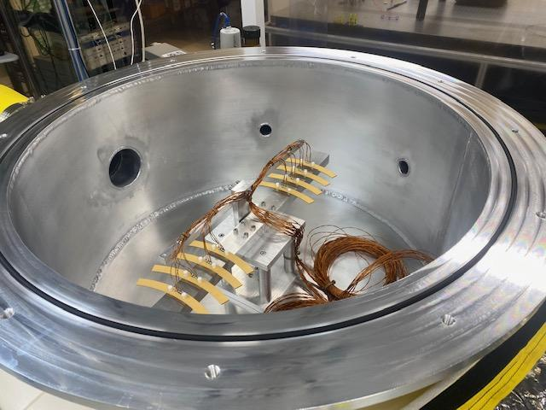
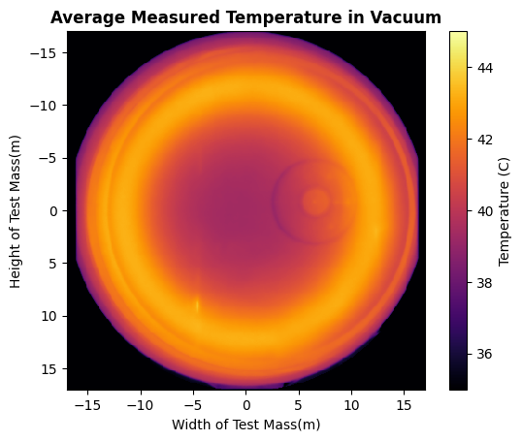
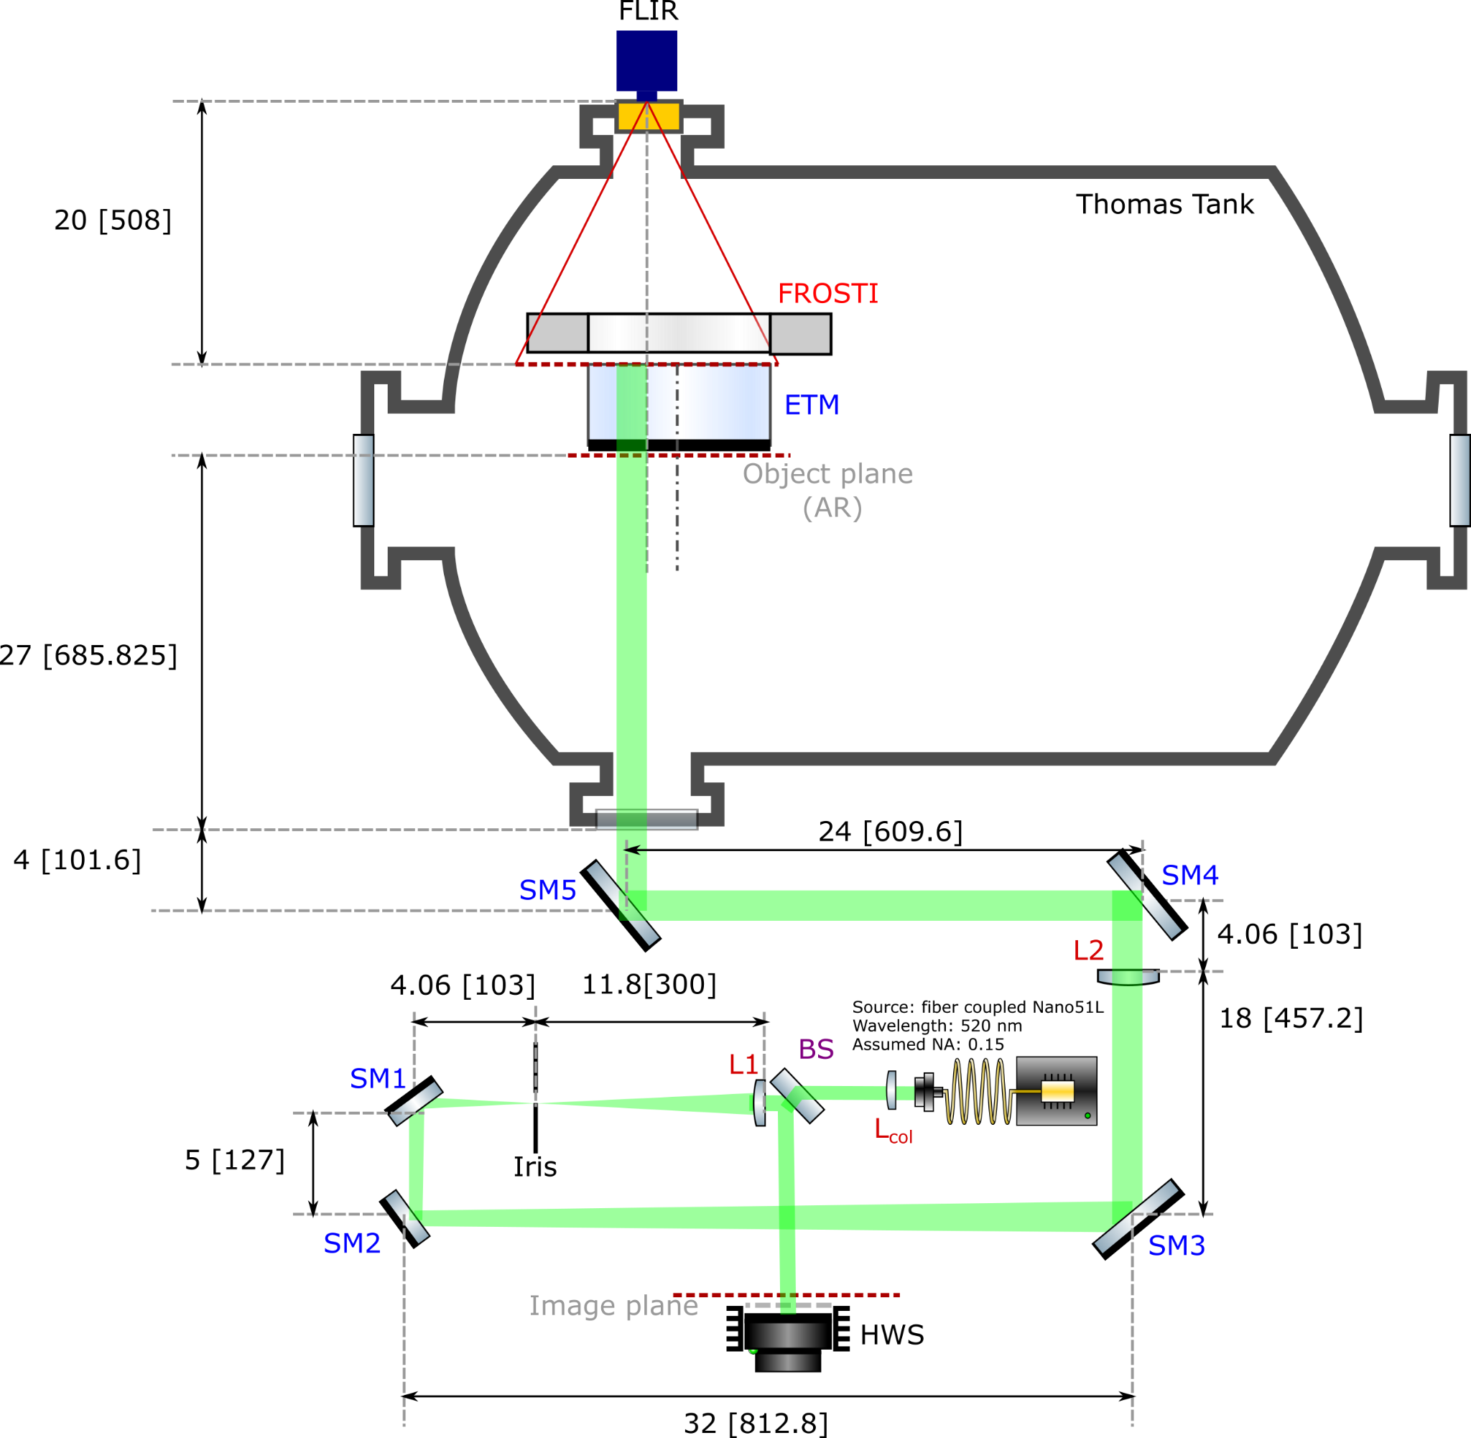
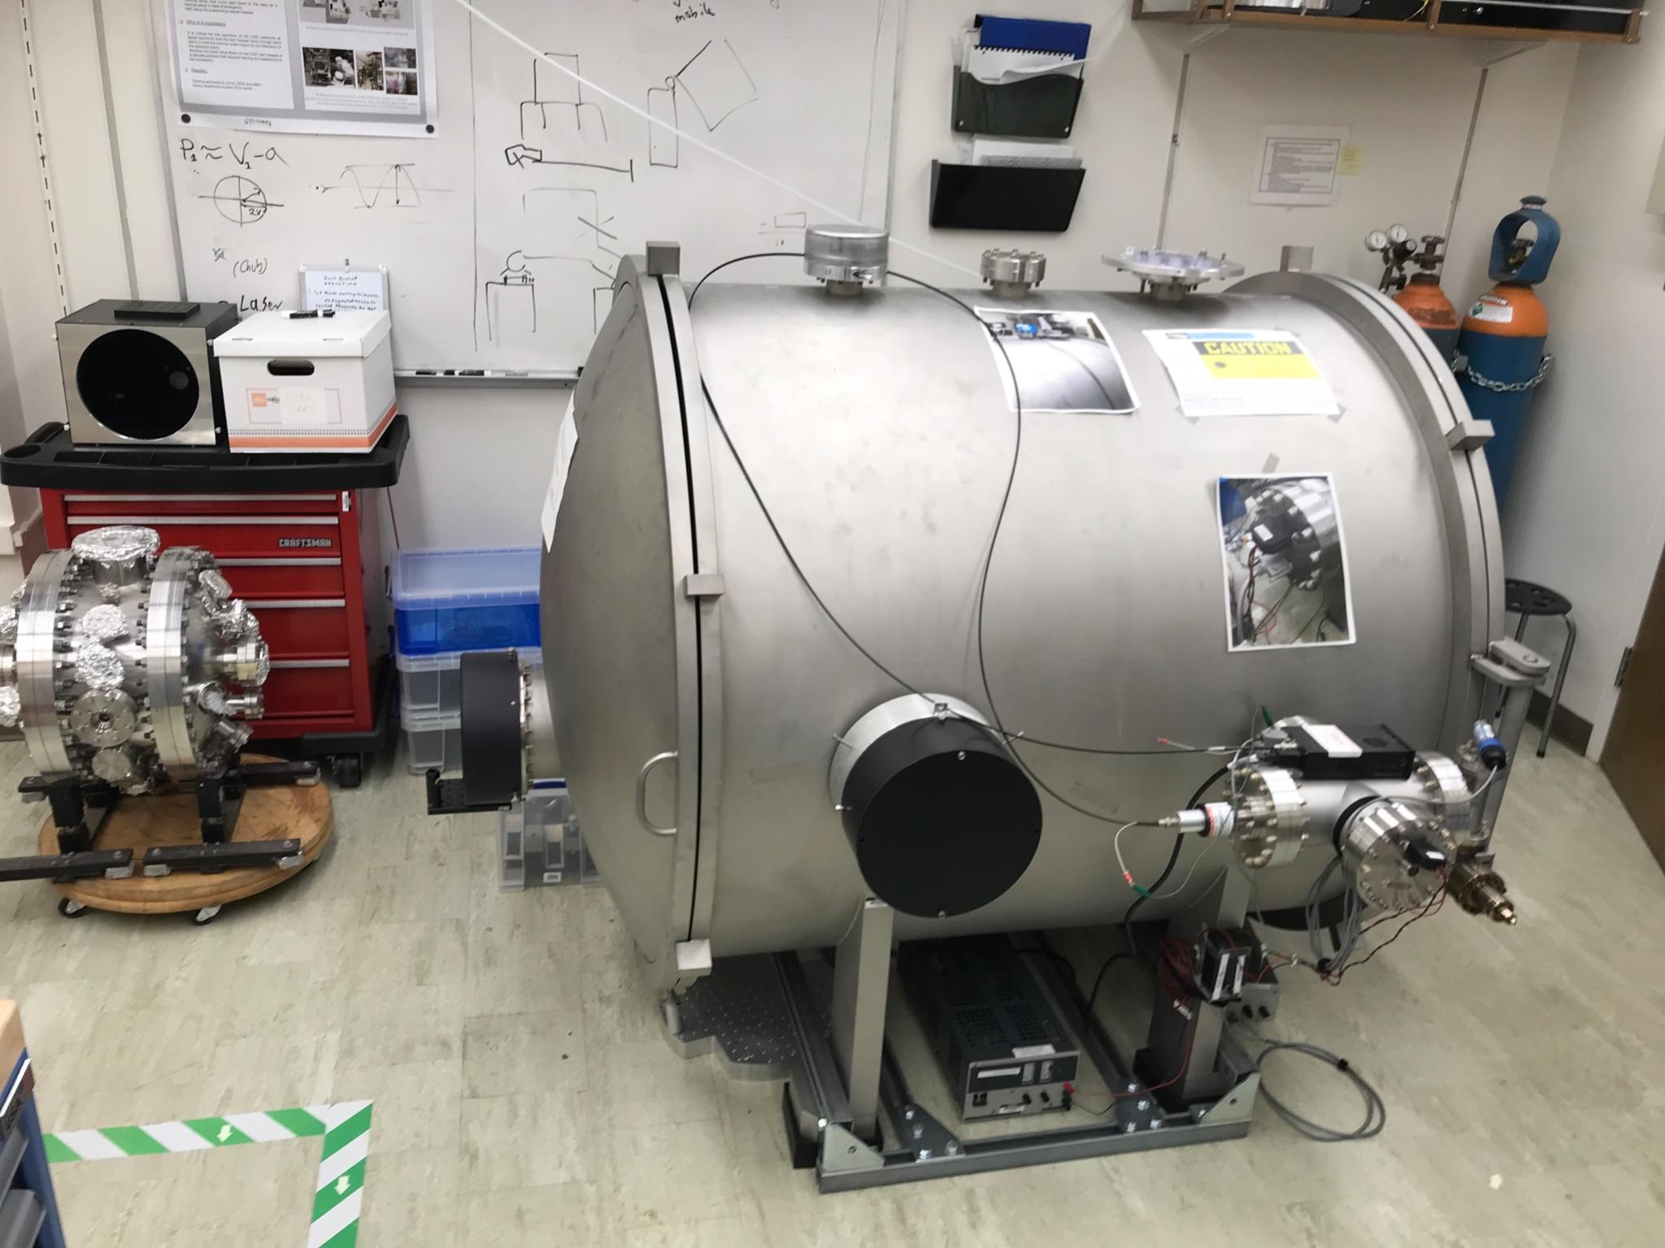
Initial in-vacuum tests have been conducted
Confirmed FROSTI’s compatibility with LIGO environment and thermal profile measurement
Heater Elements in UCR Vacuum Chamber (G2400546)
Caltech Vacuum Chamber with Hartmann Wavefront Sensor (G2400546)
Measured FROSTI thermal profile in-vacuum
10

Slide 11
Objective
FROSTI performs well in idealized simulations with perfect beam centerings so how does it perform with realistic beam miscenterings?
Measure the sensitivity of FROSTI’s corrections against static beam miscenterings
See if introducing more degrees of freedom (tuning individual heater elements) can compensate for the degradation in performance
One of the first times being able to use actual measured data from a completed FROSTI prototype
11

Slide 12
Implementation
Idealized Average Heating Profile
COMSOL Model
Construct blackbody screen model
FROSTI setup
Take heater element measurements
Irradiance Profile
Finesse Model
Generate inferred irradiance profiles
Use as input in COMSOL model
Create script to automate stabilizing thermal test mass and checking various beam miscenterings
12

Slide 13
Setup & Measurements
13

Slide 14
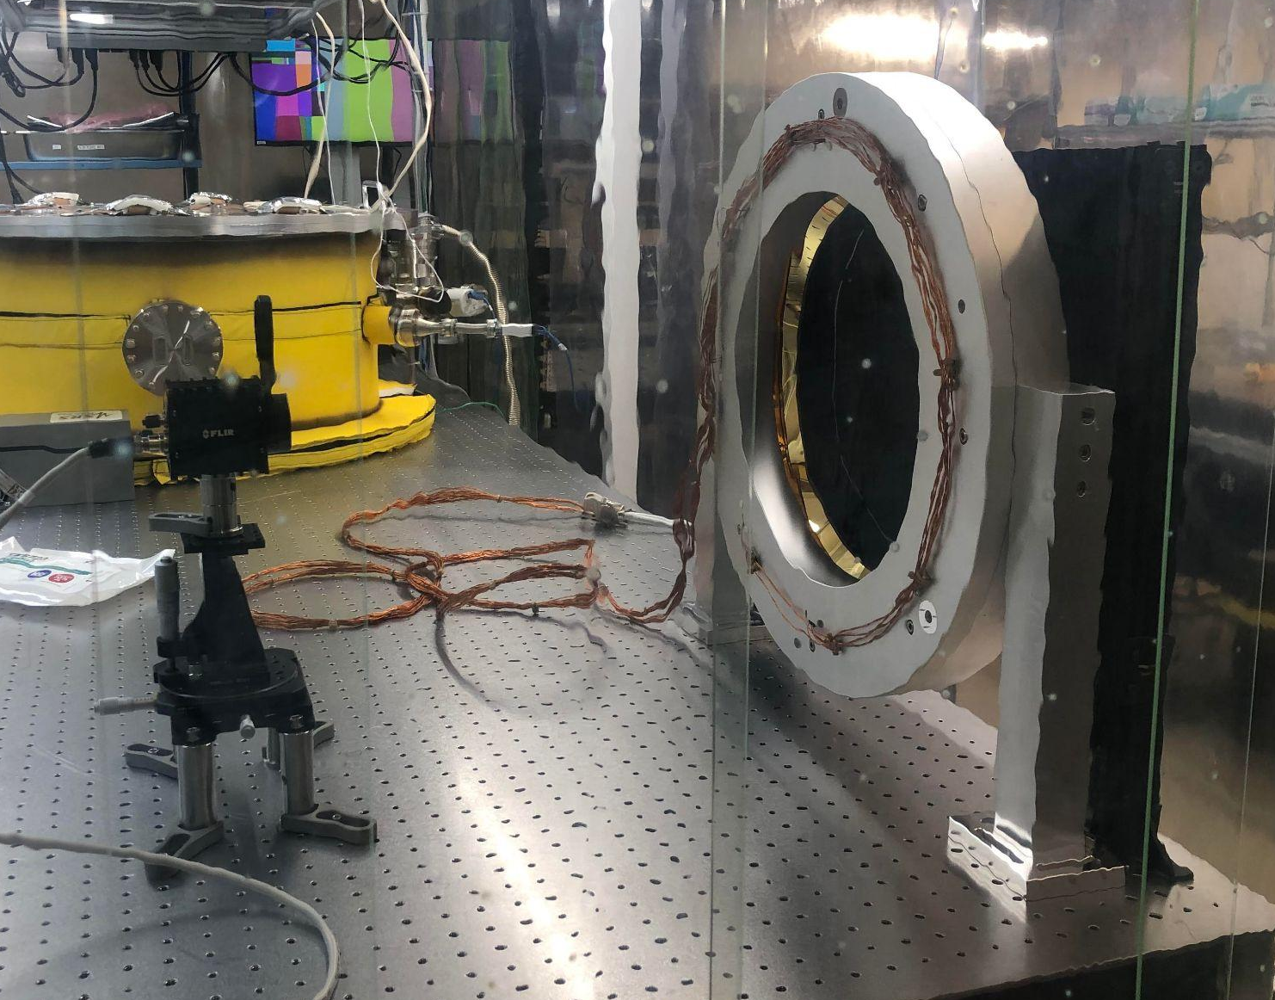
Setup
Optical System Setup
FLIR (Forward Looking Infrared) A70 infrared camera used to collect data of thermal profile
Setup utilized a blackbody screen to act as substitute for test mass
FROSTI Prototype
Test Mass Stand-In
FLIR Camera
14

Slide 15
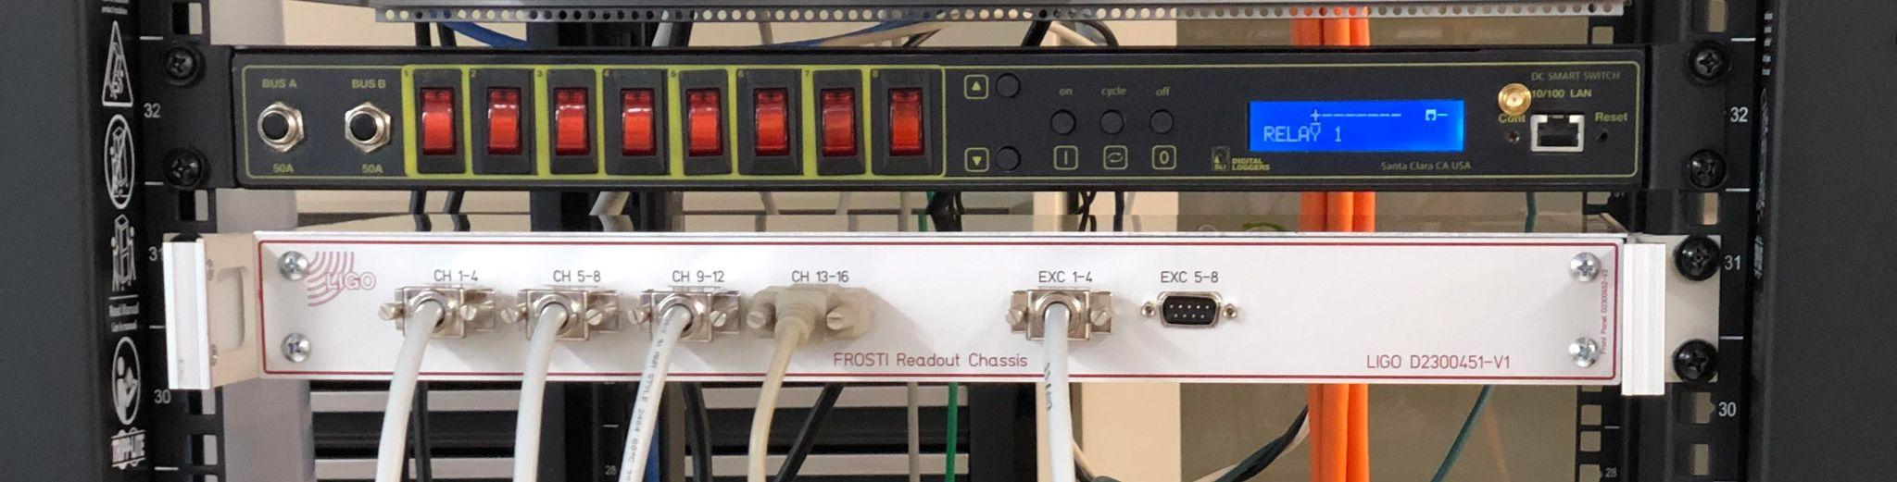
Measurements
1. Turn element on, wait for it to reach steady state
Chassis connected to all eight elements and controls which ones are on and off
Steps
3. Turn element off, wait for it to cool considerably
4. Repeat 1-3 for the remaining 7 elements
2. Once at steady state, record temperature values
15

Slide 16
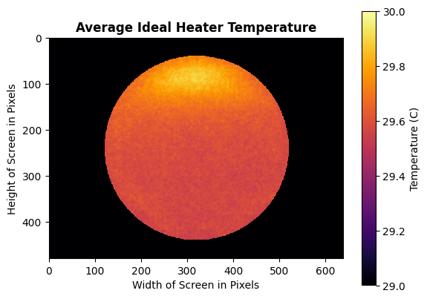
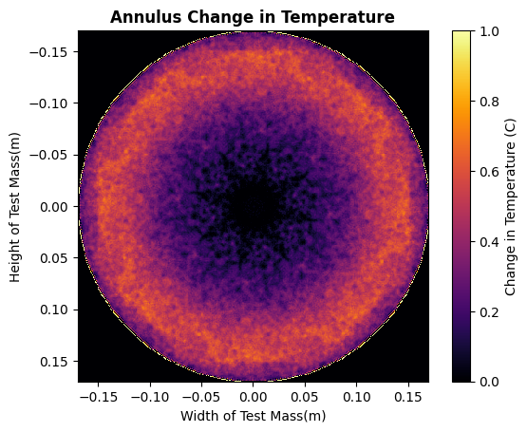
Snapshots of each element selected, rotated and stacked on top of each other
Averaged out to single idealized heater element
Ideal heater element copied and rotated 8 times to produce annulus pattern
Averaged by taking mean sweep of central 10 pixels and subtracting from profile
16

Slide 17
Analysis & Modeling
17

Slide 18
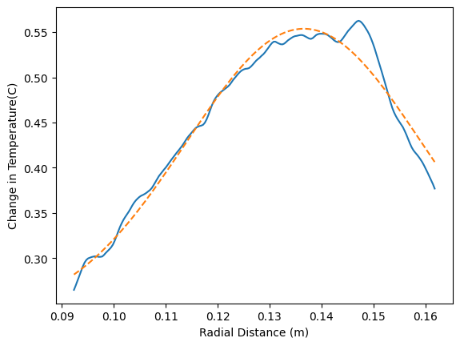
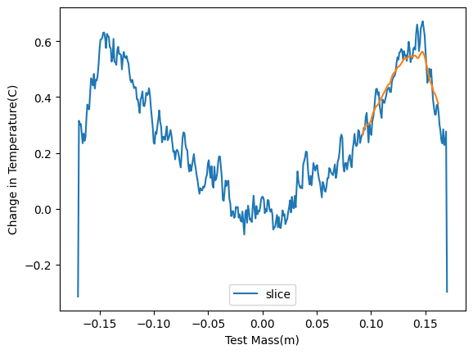
Analysis
Irradiance profile needs to be inferred from measured ΔT profile
Need width and location
Gaussian fit on a 1D slice through
x = 0 after integrating radially around the profile
Location found to be at 13.7cm with 4.53cm width
Gaussian fit on portion of ring slice
Central vertical slice of annulus w/ gaussian curve fit overlayed
18

Slide 19
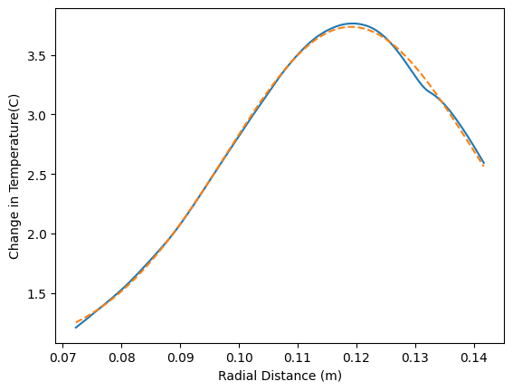
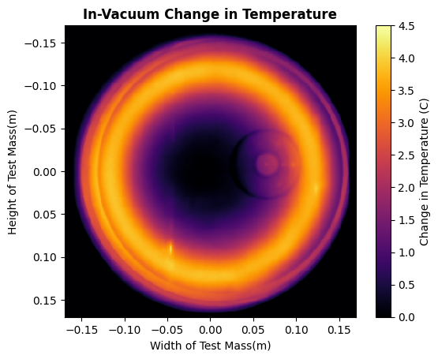
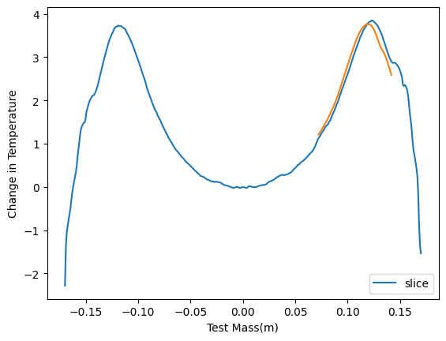
Comparison to in-vacuum profile and analysis
Location at 11.9cm from center with 4.1cm width
Gaussian fit on portion of ring slice
Central vertical slice of annulus w/ gaussian curve fit overlayed
19

Slide 20
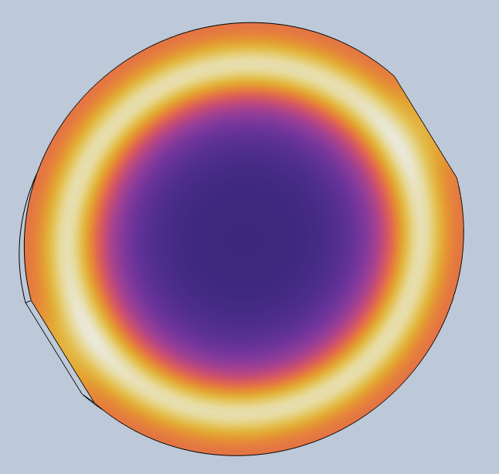
Modeling
Built model of blackbody screen in COMSOL with shape of test mass
Consideration of convection through air included
Aside from the coating emissivity (ε = 0.99), the thermal properties of the screen are that of the aluminum substrate
COMSOL model with thermal profile
20

Slide 21
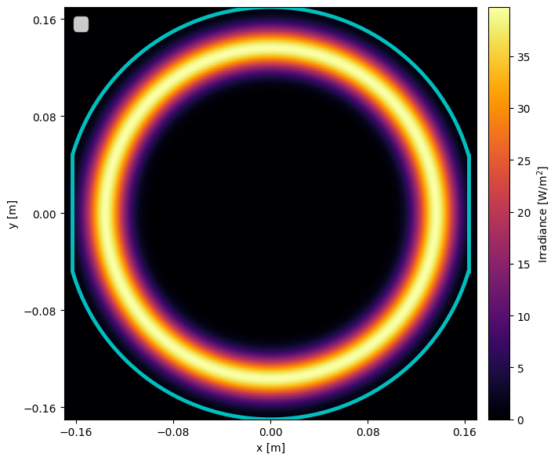
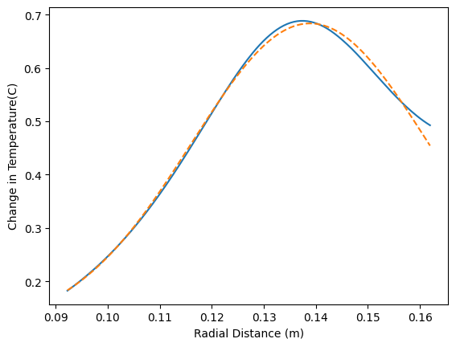
Thermal properties and air convection resulted in different irradiance and temperature widths (unlike in-vacuum on fused silica), location was the same
Inferred irradiance profiles generated in Python
Tested irradiance profiles with various widths as input for COMSOL model and applied gaussian fit
Irradiance profile with temperature change profile output most resembling measured temperature change was 2.33cm in width
Generated irradiance profile with temperature change output most resembling measured profile
Gaussian fit on change in temperature profile produced by most fitting irradiance profile
21

Slide 22
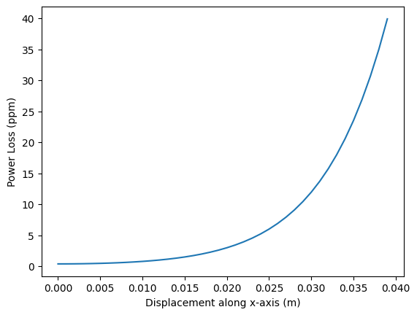
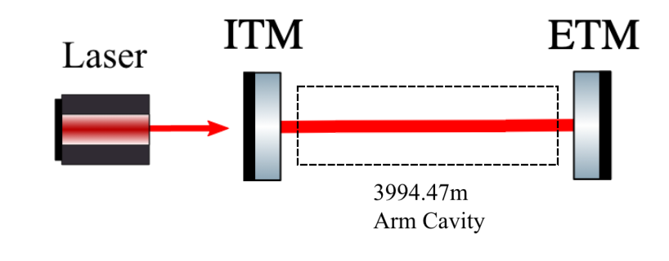
Finesse
Displace beam along only one axis to simulate beam miscenterings
Limit range of beam displacement
Only focused on ETM (End Test Mass)
Loss in ETM is 30 ppm making 3.6cm maximum displacement
Similar process has been done for ITM (Input Test Mass) with a similar graph result
Graph of Power Loss vs Displacement of ETM
Diagram of Simple Arm Cavity Finesse Model
22

Slide 23
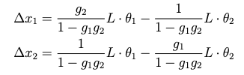
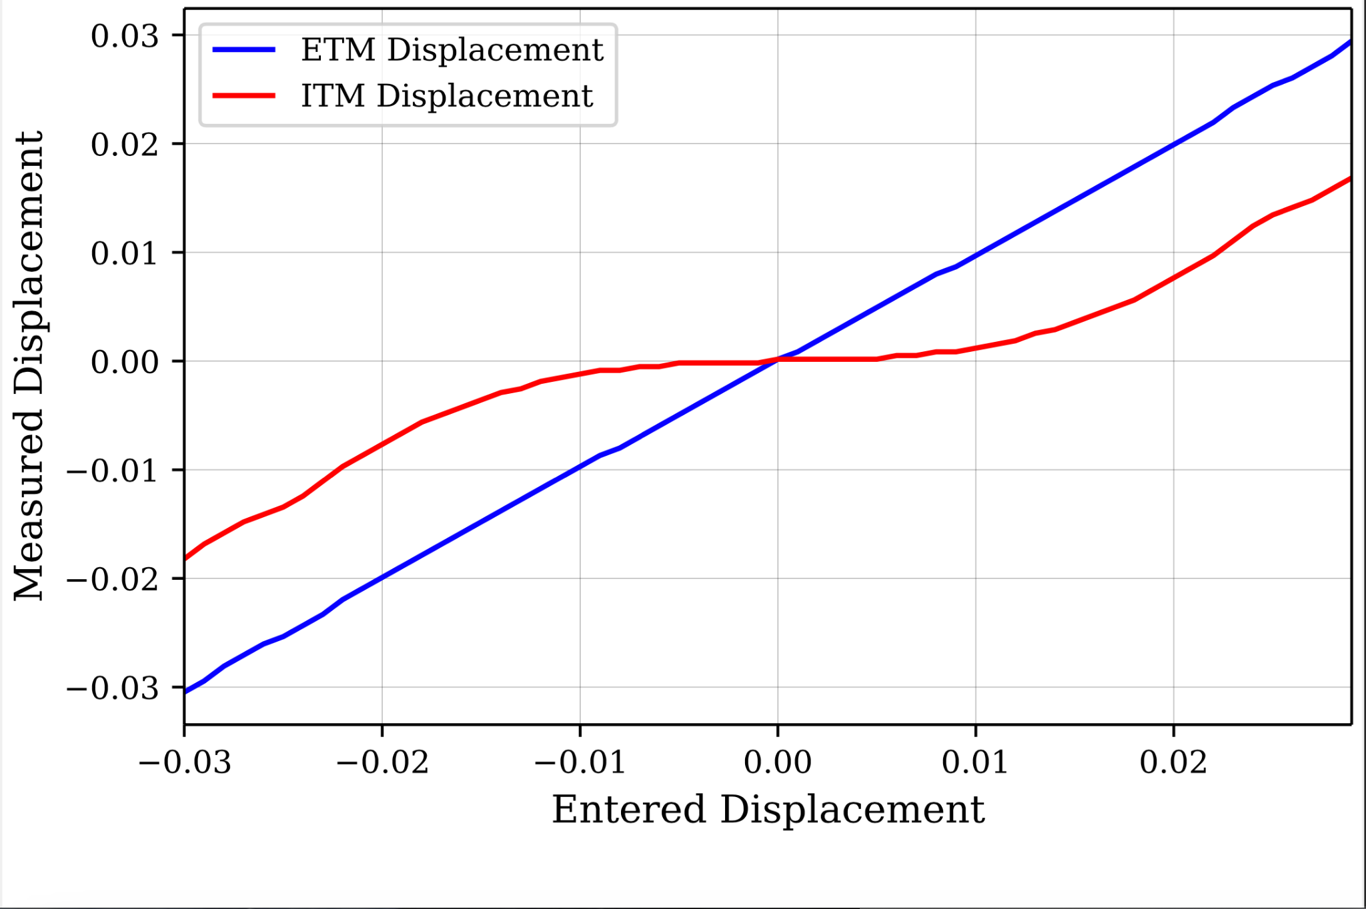
Finesse
Inverse matrix done to get mirror tilts in terms of beam displacement for Finesse model
At higher displacements, ITM deviates from the expected value of 0
Range of beam displacement to simulate lowered to -1 cm to 1 cm due to this matching closer to expected realistic beam displacements
Relation between beam displacements and mirror tilts
Relationship of entered vs measured beam displacement on ETM and ITM in Finesse model
23

Slide 24
Project
Synthesis
24

Slide 25
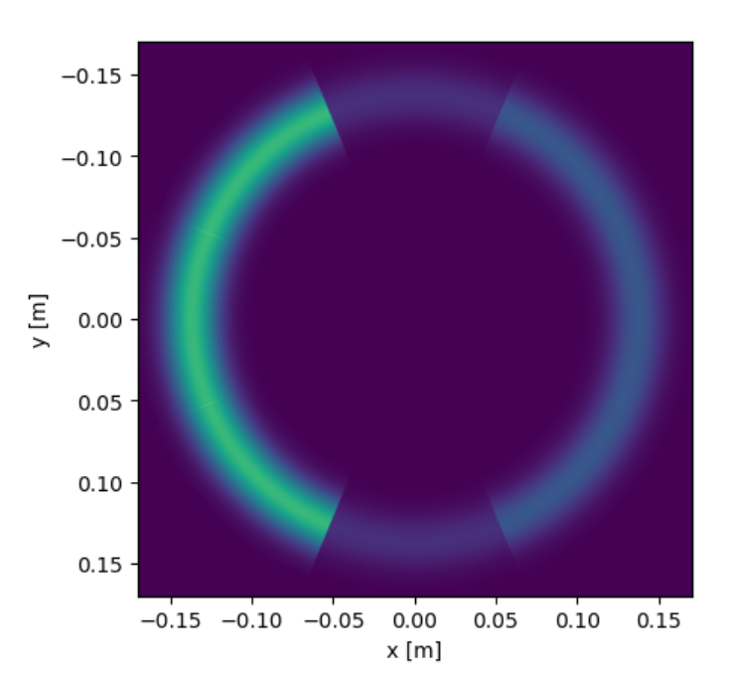
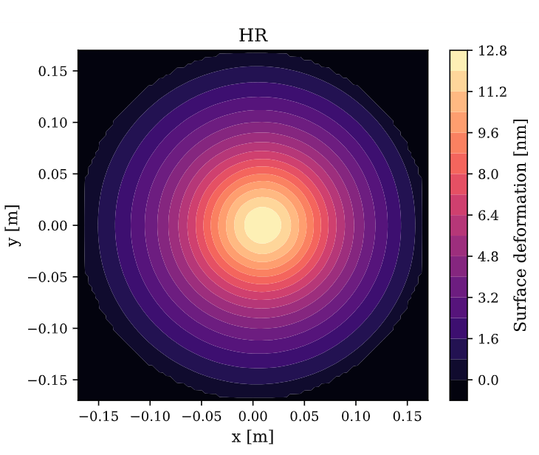
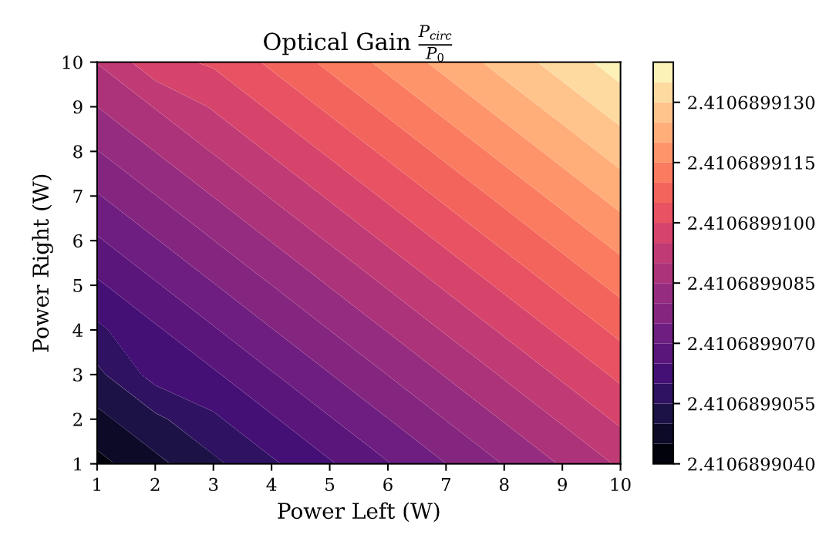
Utilizing Finesse and Fenics, script to test various configurations of elements with different power coefficients against different displacement values has been created
Code can be optimized further and automated but this is a start
Relationship between optimal configuration and beam displacement can be likely discerned with further analysis and measurements
A phase map with 1cm displacement generated with Fenics
3 regions with left three elements increased by a factor of 5, right three elements increased by a factor of 2, and top and bottom at original power
25

Slide 26
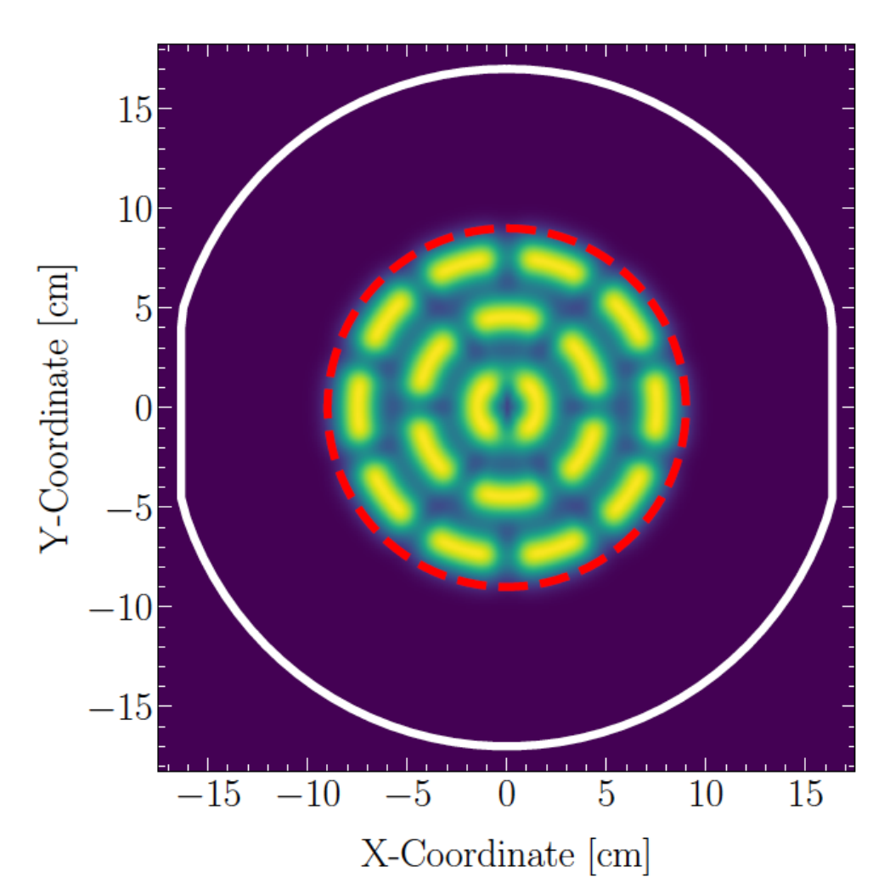
Summary
Big step into characterizing how much degradation occurs
Focus on realistic performance and not just simulated perfect beam is necessary
Constructed COMSOL model can be used for future in-air measurements
Gathered data on individual heater elements useful for future projects requiring them
Process created will provide a way to test various displacements and individual element tunings
Can provide insight on how future FROSTI prototypes should be constructed including a potential multi-element FROSTI for non-uniform absorption effects
Multi-Element FroSTI Concept
26

Slide 27




Acknowledgements
Thank you to my mentors Tyler Rosauer and Dr. Richardson for their support and insights throughout this project.
I would also like to thank Liu Tao for teaching me about how to use COMSOL
And I would like to acknowledge NSF, UC Riverside, and the Caltech SURF program, as well as LIGO Laboratory, for allowing me to be part of this wonderful program.
27

