Slide 1
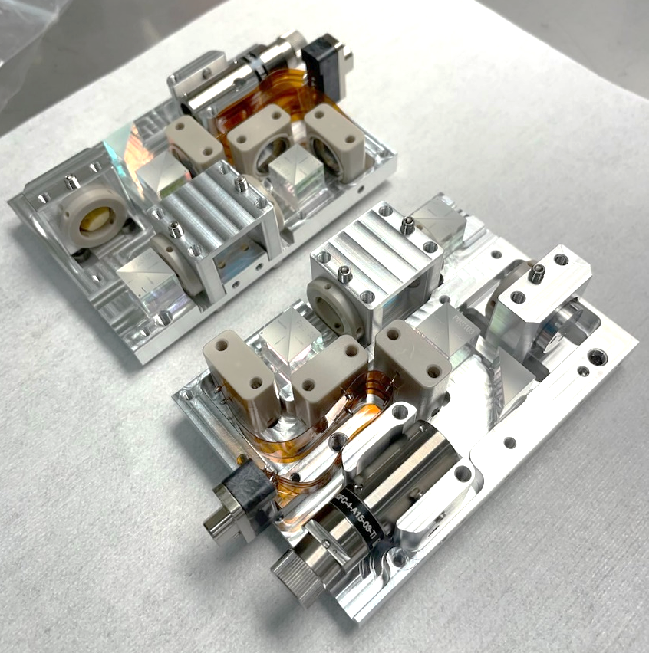
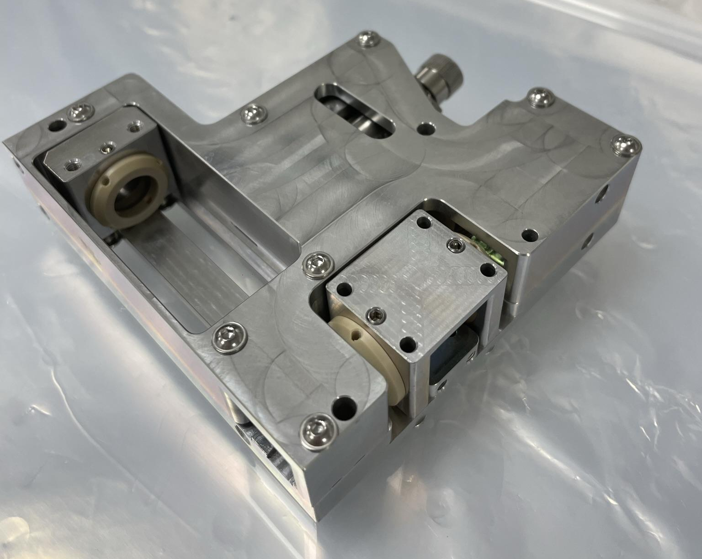
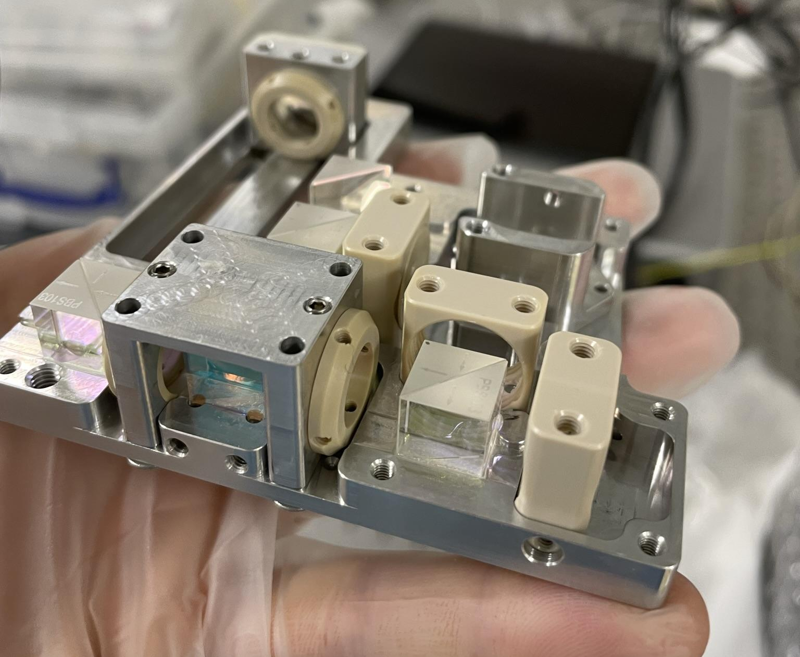
Homodyne Quadrature Interferometer - HoQI
Alexandra Mitchell

Slide 2
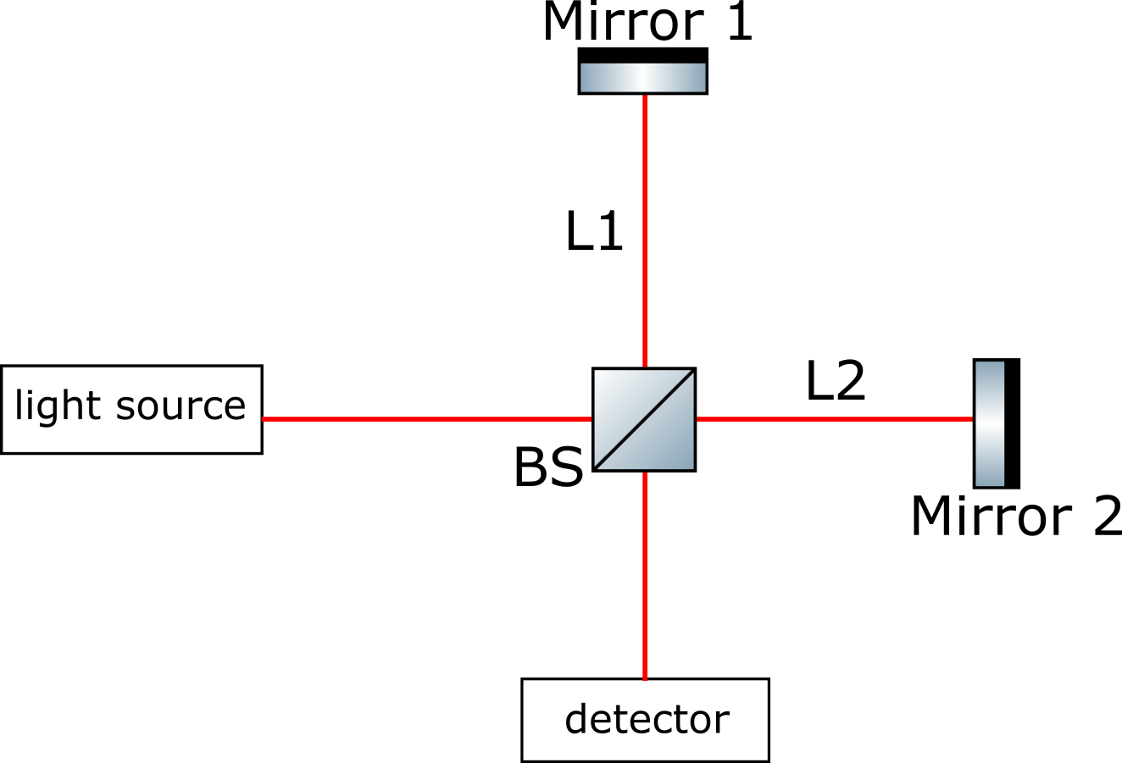
What is it?
Homodyne – one frequency of light
Quadrature – uses multiple readouts and birefringent (polarisation changing) elements (eg half/quarter waveplates) to measure changes which are sub-wavelength
Interferometer – measures relative length changes using the interference of light
Michelson interferometer (eg LIGO) →
Mach-Zehnder interferometer (eg HoQI)

Slide 3
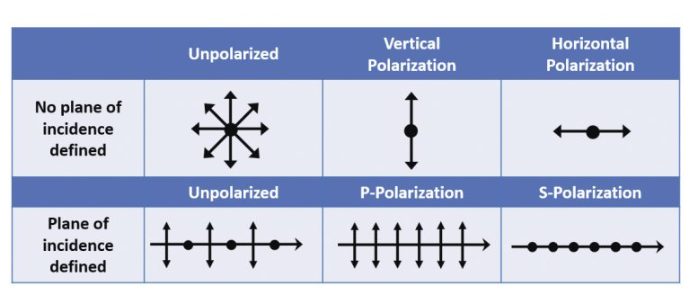
Basic optics
Polarisation – the orientation of oscillations (in light waves)
S polarisation – electric field polarized perpendicular to the plane of incidence
P polarisation – electric field polarized parallel to the plane of incidence
Half waveplate – rotates polarization orientation, introduces phase shift of π
Quarter waveplate – makes linearly polarized light elliptical, introduces phase shift of π/2

Slide 4
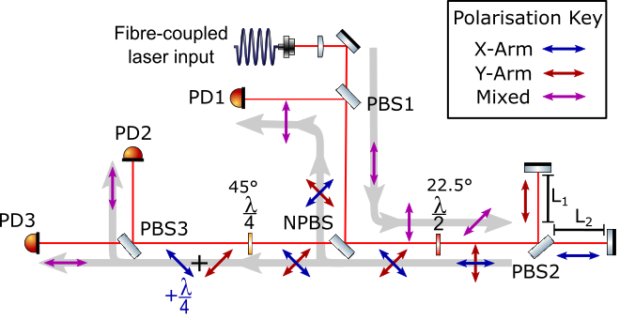
Filters polarisation so we have one input polarisation (use transmission as better extinction ratio)
Rotates polarisation so that there is 50:50 s:p polarisation
When L2 and L1 are not the same, a phase difference is introduced
Because there is equal power in s:p the polarising beamsplitter splits the beam equally and each arm has one polarisation state

Slide 5
Sin
Cos
Rotates polarisation
-Cos
As the beams are in orthogonal polarisation states, they do not interfere here
Introduces phase delay to one polarisation/beam from one arm of λ/4

Slide 6
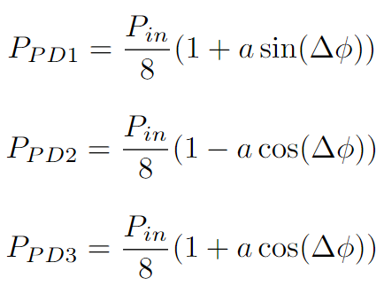
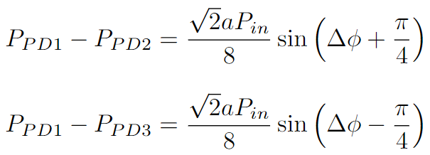
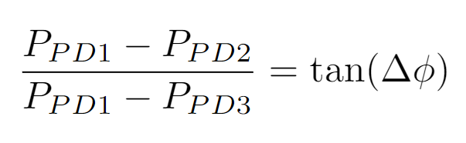


Extracting $∆ϕ$ from HoQI
Photodiode measurements
Manipulation
Extracting $∆ϕ$
Notes:
Mention terms in the equations: FV, power, phase

Slide 7
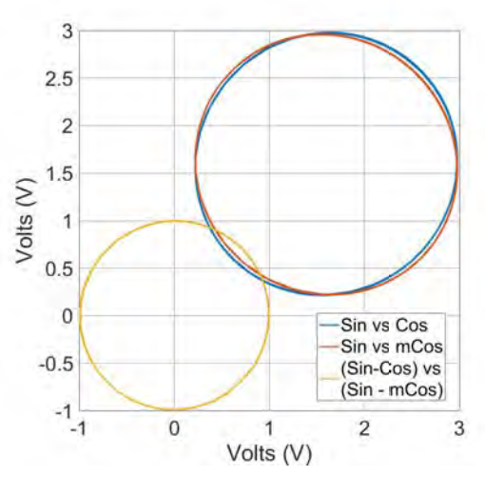

Slide 8
Temperature,
Air Pressure
Frequency /
Electronic Noise
Table mechanical
resonance
S Cooper et.al Class. Quantum Grav. 35 (2018) 095007

Slide 9
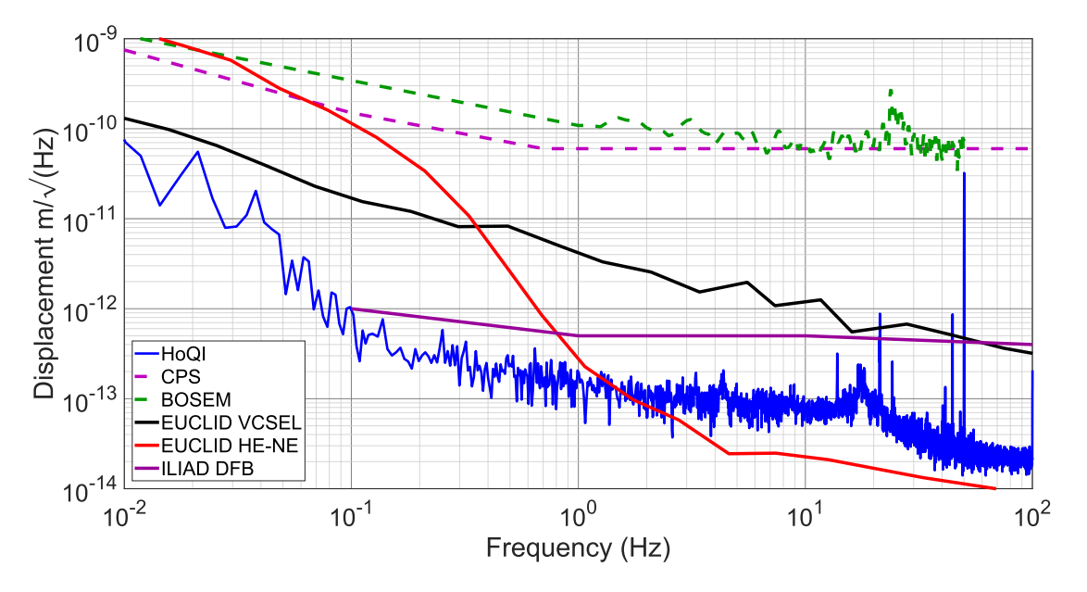
Cooper 2018, https://arxiv.org/abs/1710.05943

Slide 10
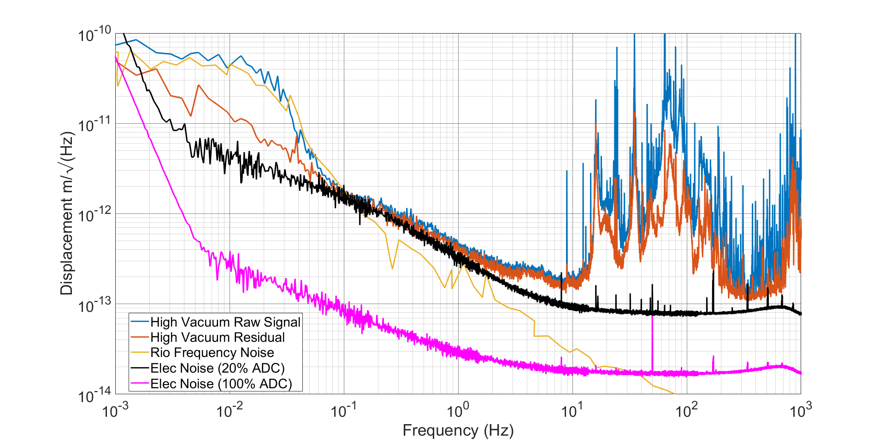
Extra, unknown noise
x5

Slide 11
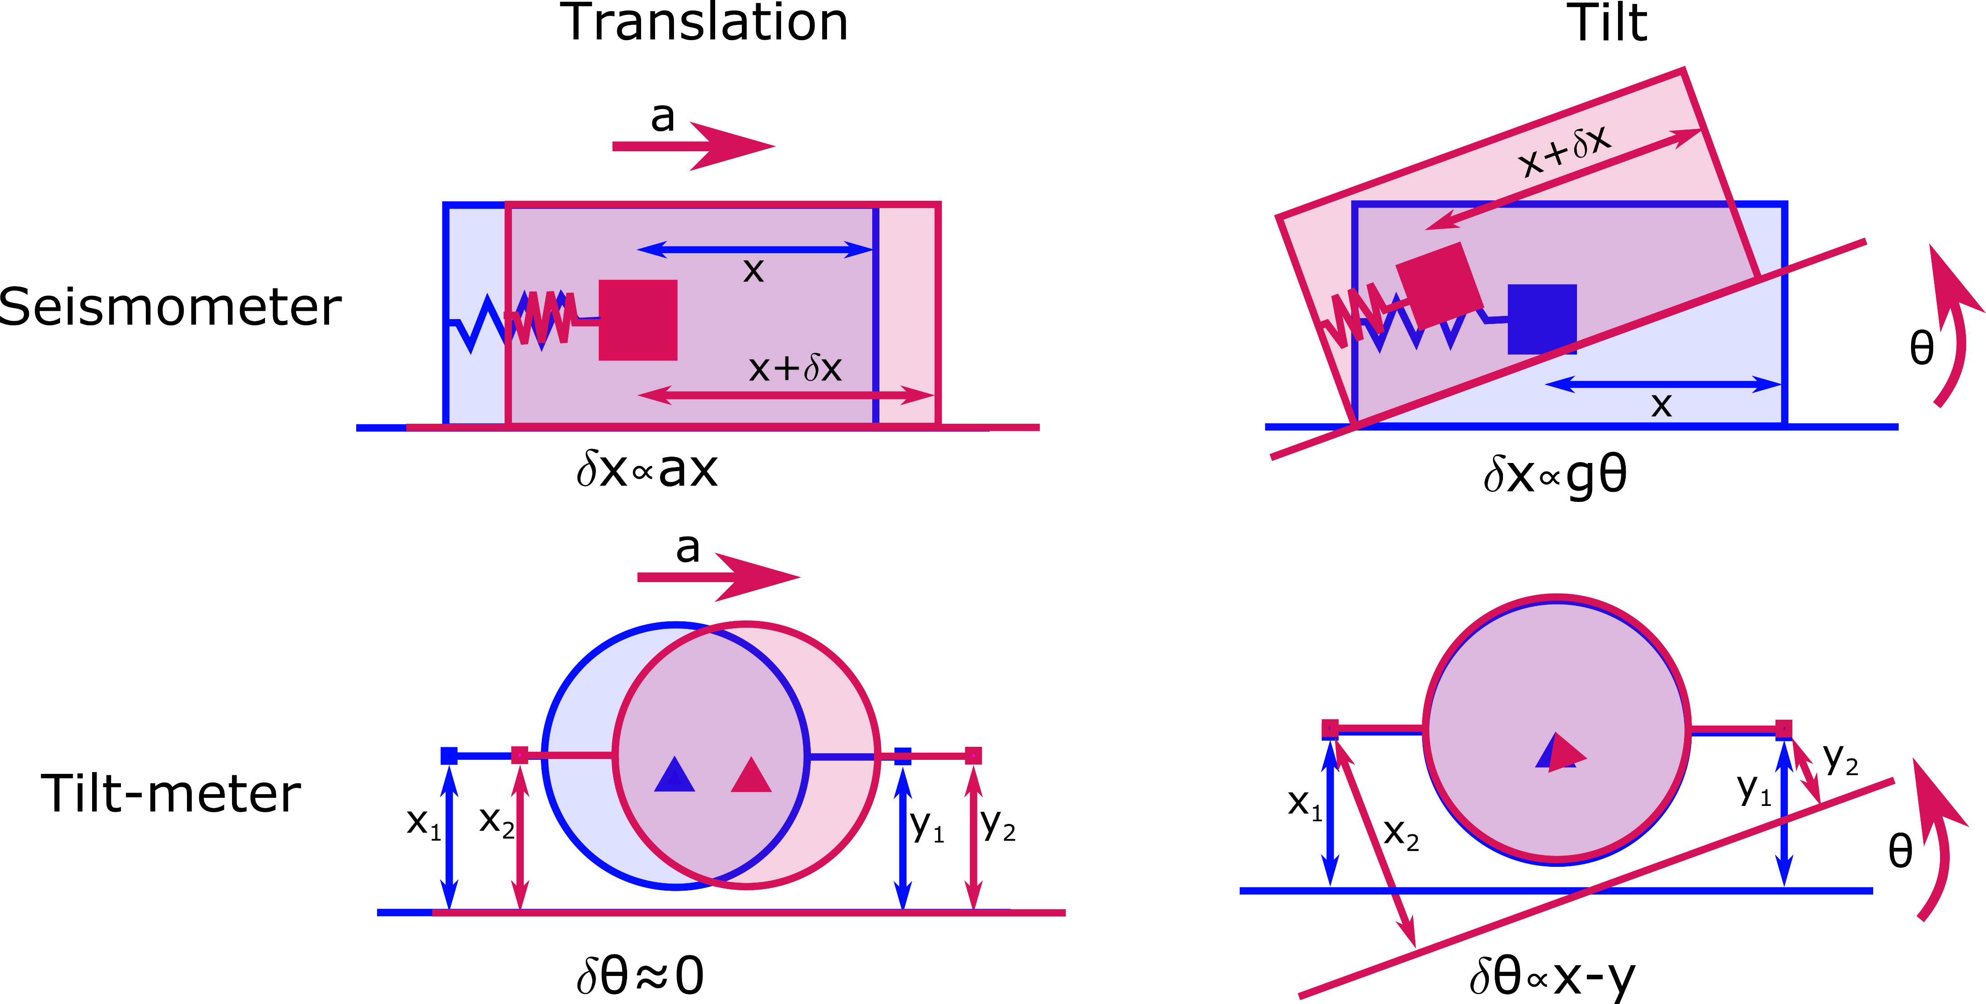
HoQI in LIGO
Cylindrical rotation sensors
  HoQI is the readout mechanism
  for these new, compact rotation
  sensors
  Want to install these on top of the suspensions in LIGO to measure tilt and correct for this
Suspensions
  Due to their lower noise floor compared to current sensors (OSEMs) they can be used to measure and damp suspension motion

Slide 12
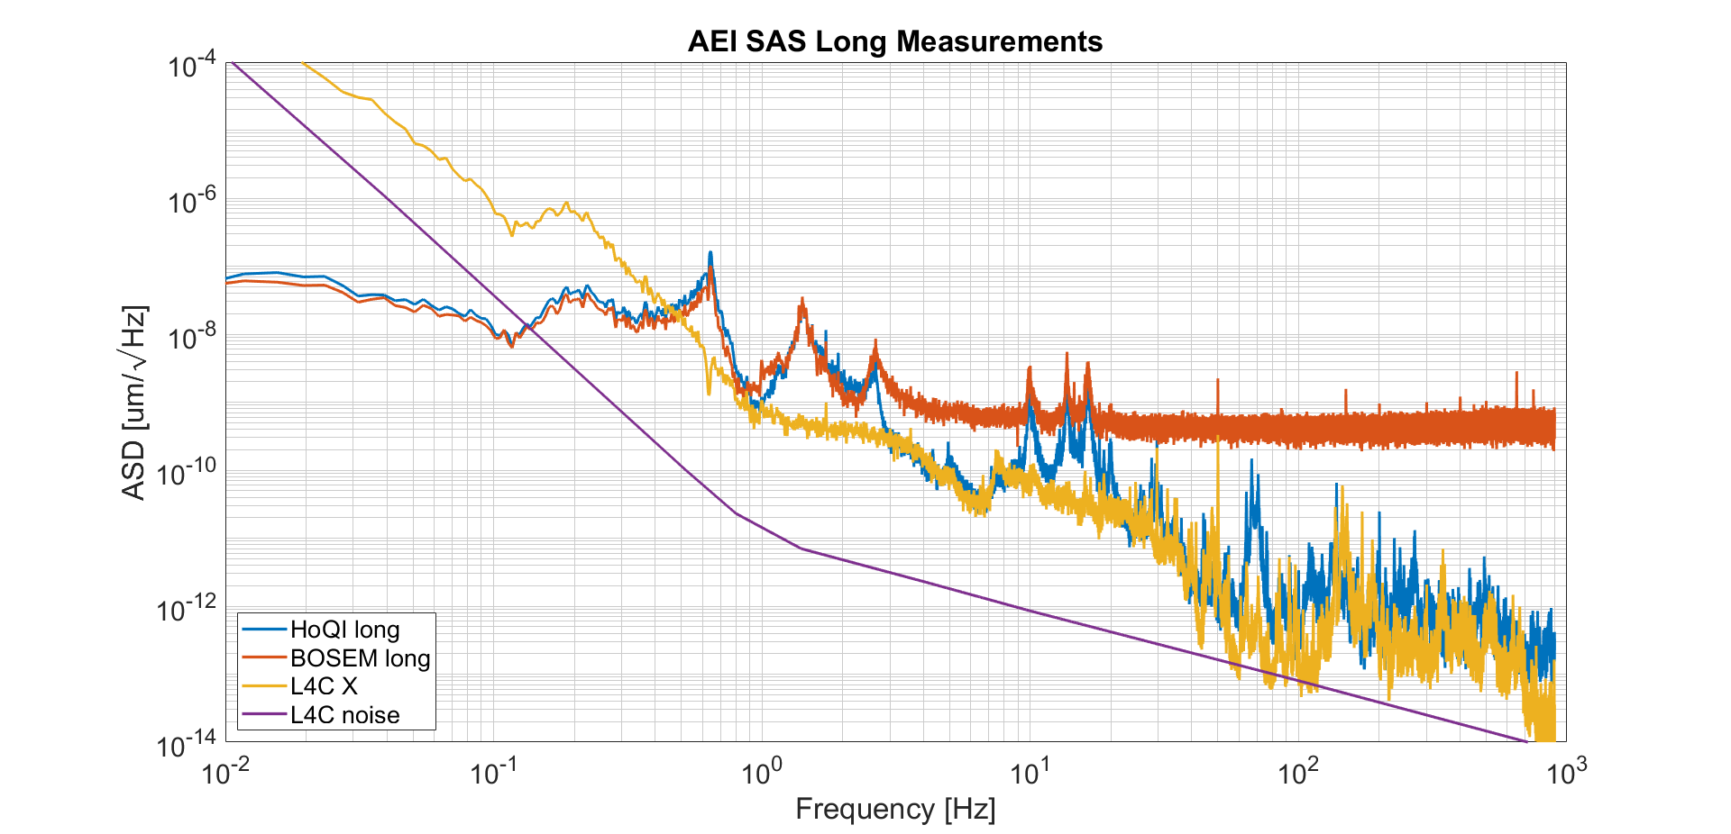

Slide 13
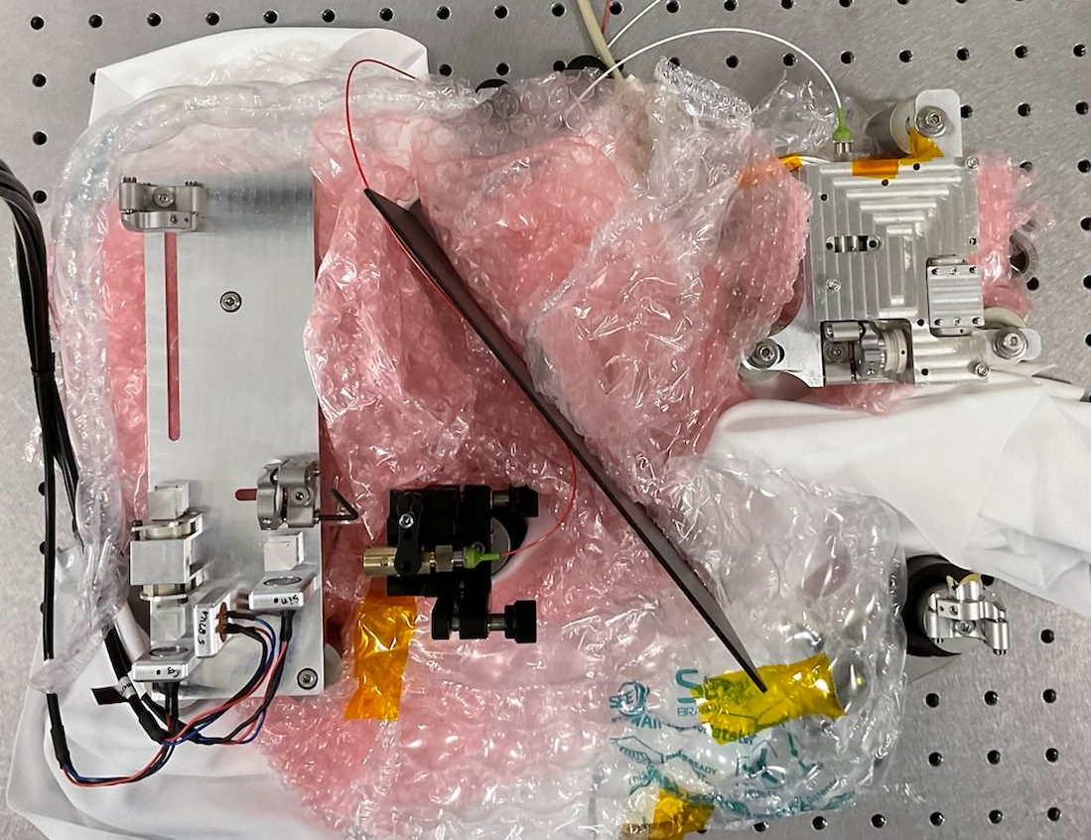
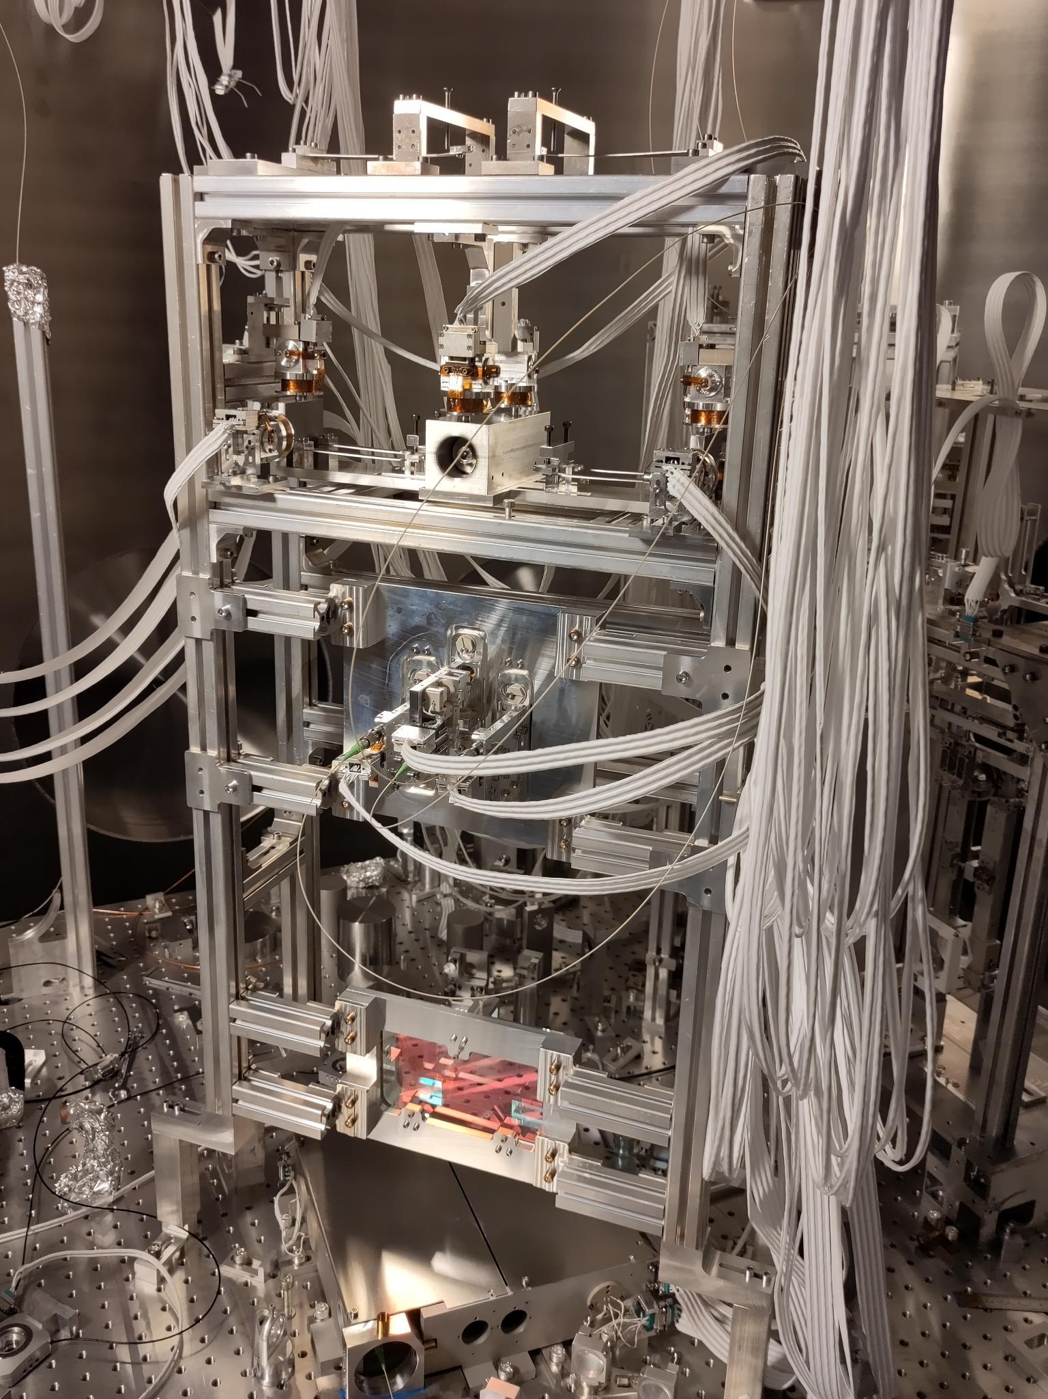
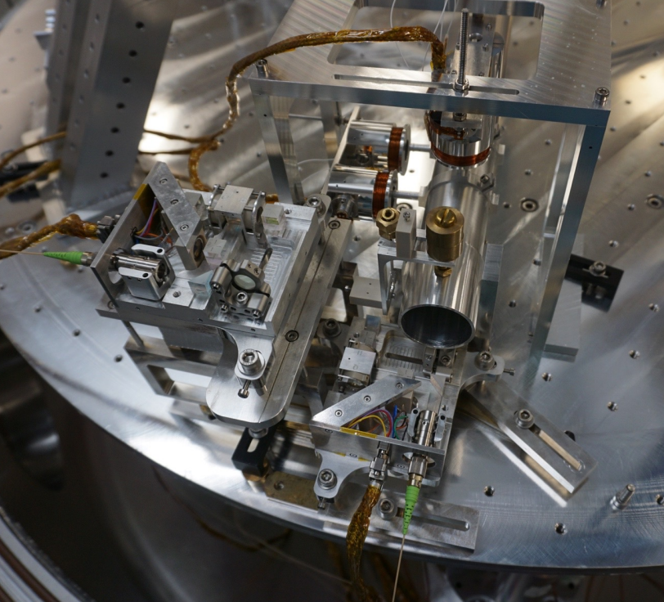
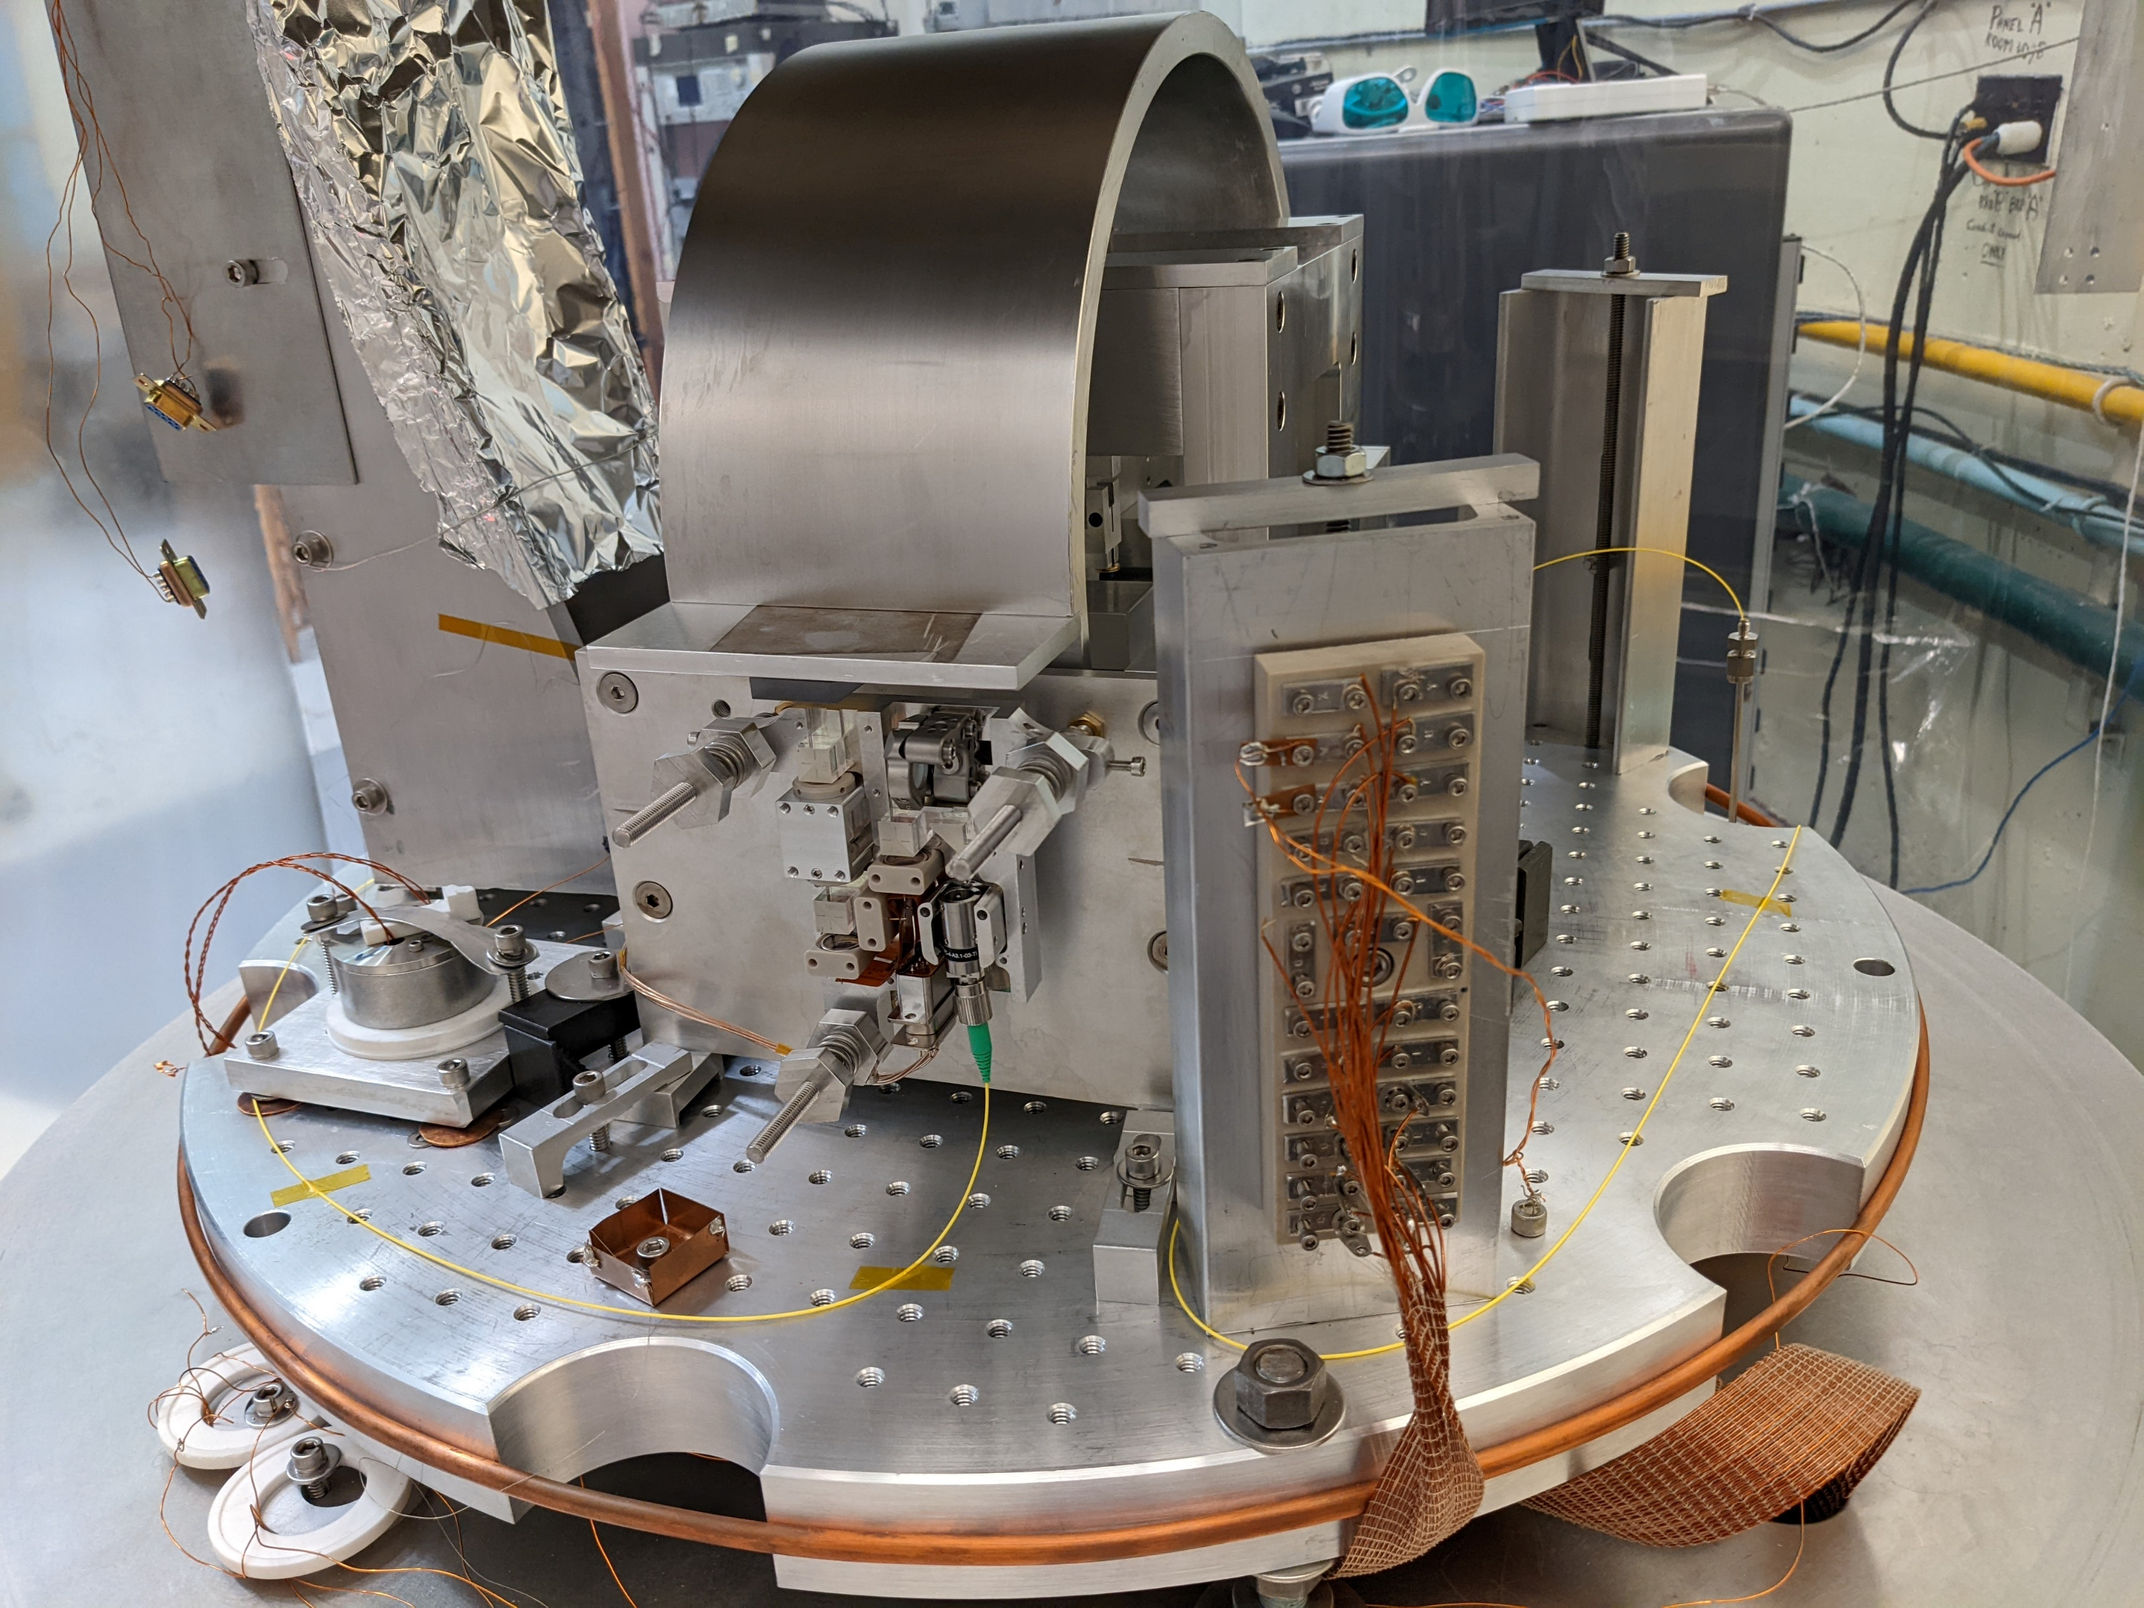
Currently in use…
Laser frequency stabilisation experiment in Amsterdam
Readout of Birmingham 6D experiment
https://dcc.ligo.org/LIGO-G2300542
Measuring IM in AEI 10m prototype beamsplitter suspension
Cylindrical rotation sensor readout at UW

