Slide 1
Gravitational-wave astronomy: Progress & Prospects
Patrick Brady,
University of Wisconsin-Milwaukee
Symposium on Gravitational Waves
3 June 2024
https://dcc.ligo.org/G2401204

Slide 2
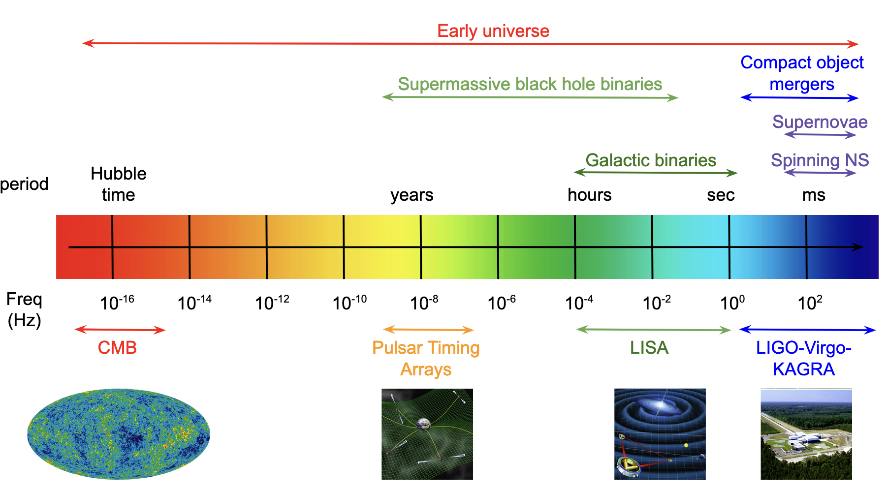
Gravitational-wave spectrum
Adapted from: Romano, J.D., Cornish, N.J.
Living Rev Relativ 20, 2 (2017). https://doi.org/10.1007/s41114-017-0004-1
Notes:
3

Slide 3
International Gravitational-Wave Observatory Network (IGWN)
Notes:
4 min

Slide 4
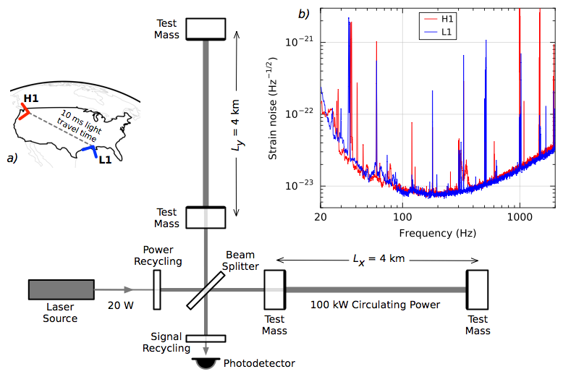
Laser Interferometer Gravitational-wave Observatory (LIGO)
First proposed by Ron Drever, Kip Thorne, and Rai Weiss in 80’s.
First funding in 1992; civil construction ended 2000; Initial LIGO 2002-2010

Slide 5
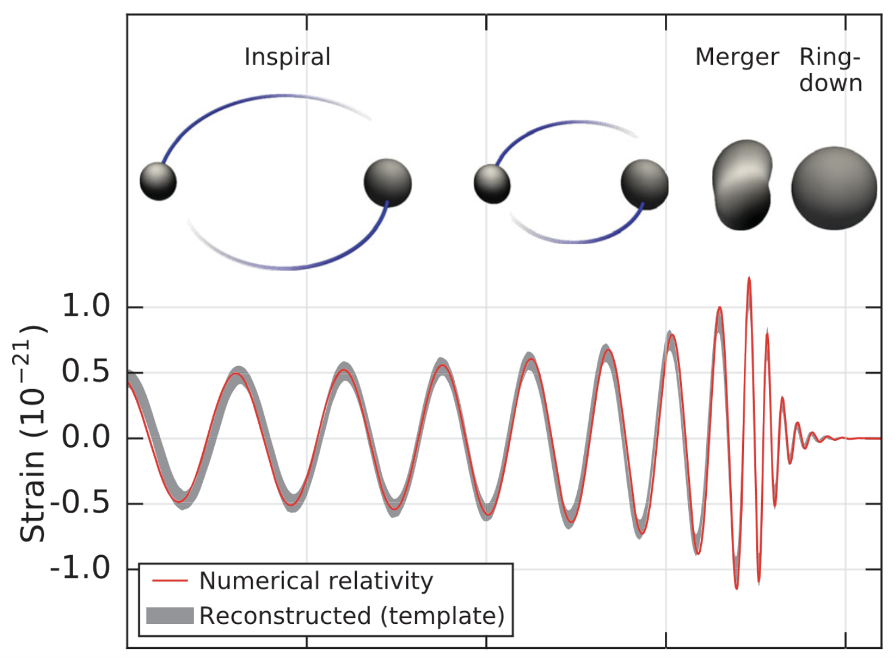
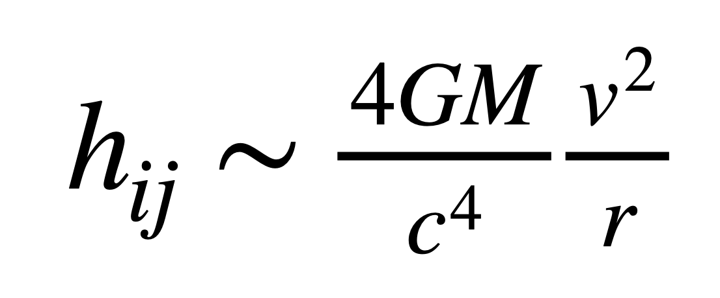
Compact object mergers
Pairs of stellar-mass black holes, neutron stars, or a stellar-mass black hole and neutron star
B. P. Abbott et al. Phys. Rev. Lett. 116, 061102
Time
Notes:
6 min

Slide 6
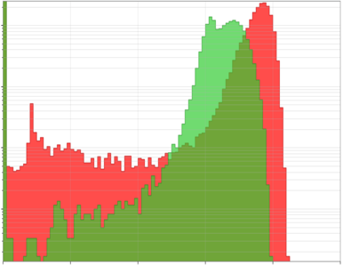
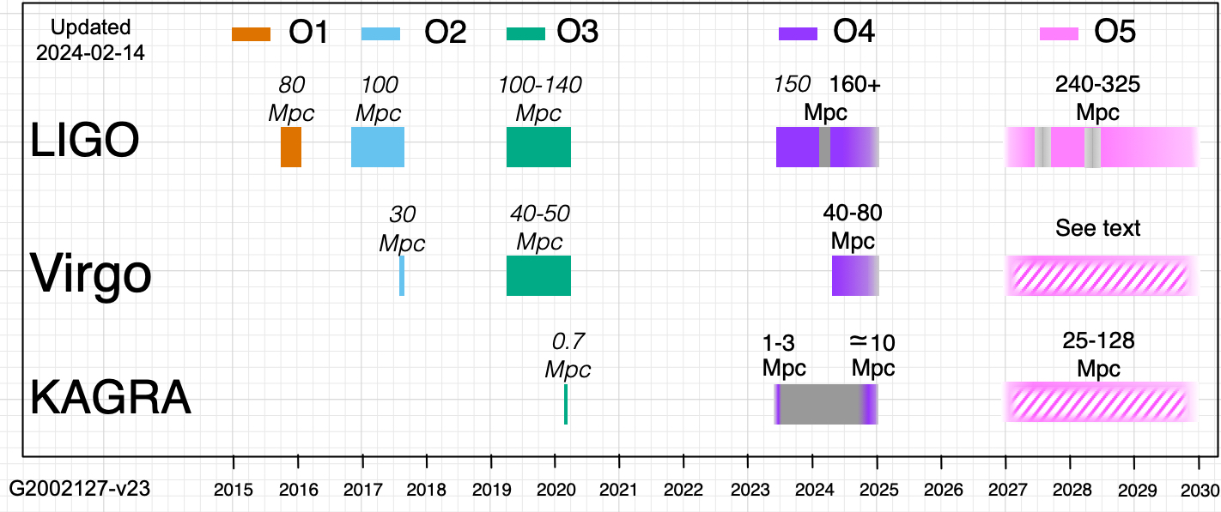
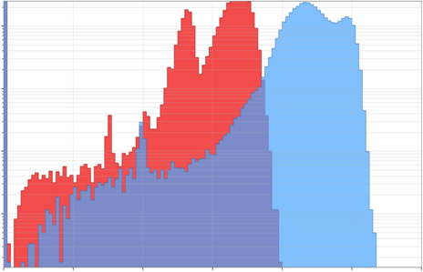
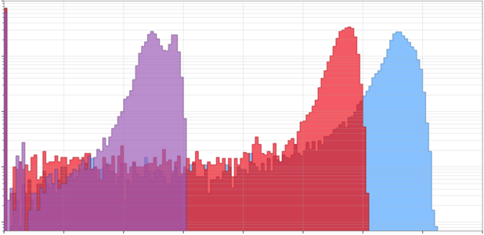
Observing runs
O1
L1
H1
H1 – LIGO Hanford
L1 – LIGO Livingston
V1 – Virgo
O2
H1
L1
Total Duration at Sensitive Distance (relative)
V1
O3
V1
H1
L1
GW170817
0
20
40
60
80
120
100
140
160
Angle Averaged Binary Neutron Star Inspiral Range
GW150914
Public Alerts
Notes:
8 min

Slide 7
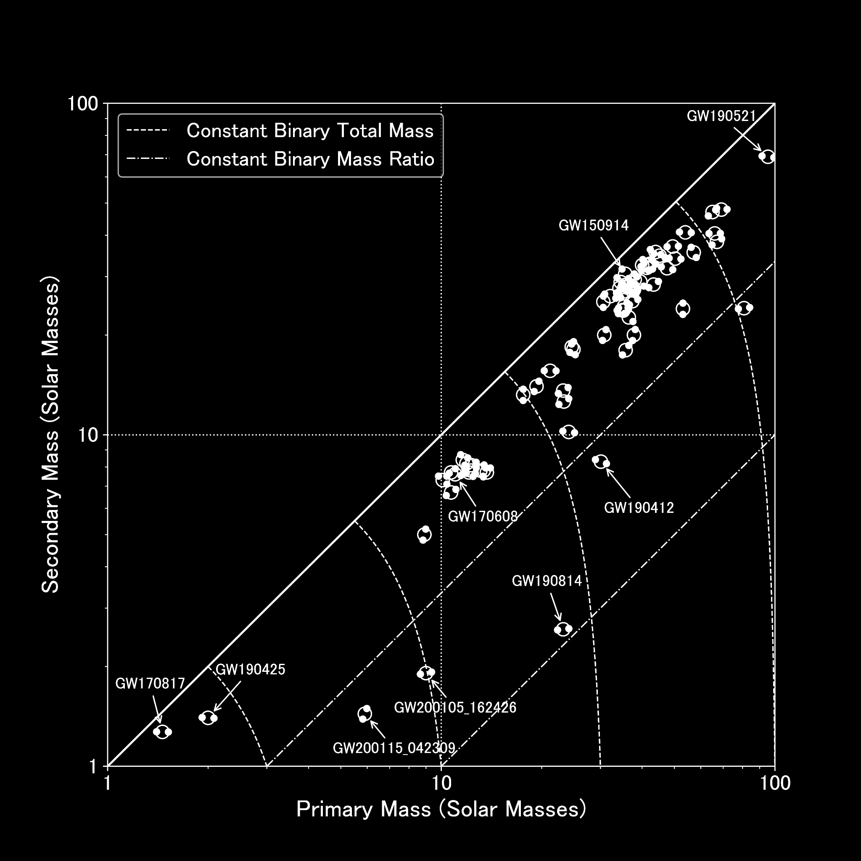
Detections
GW150914
First astrophysical source
Binary black holes exist
GW170817
Binary neutron star mergers are gamma-ray burst progenitors
GW190521
Black holes exist in pair instability mass gap
GW190814
Compact objects exist with masses between 2-5 Msun
Credit: LIGO-Virgo-KAGRA Collaborations
Notes:
10 min

Slide 8
Mergers involving neutron stars
GW170817 & GW190425
Binary neutron star (BNS) merger waves
GW170817 & GRB 170817A
Fractional difference in speed of gravity and the speed of light is between -3 x 10⁻¹⁵ and 7 x 10⁻¹⁶
GW170817 & AT 2017gfo
Binary neutron star mergers produce kilonova explosions that generate heavy elements
R. Abbott et al 2021 ApJL 915 L5
B. P. Abbott et al 2017 ApJL 848 L13
Notes:
16 min

Slide 9
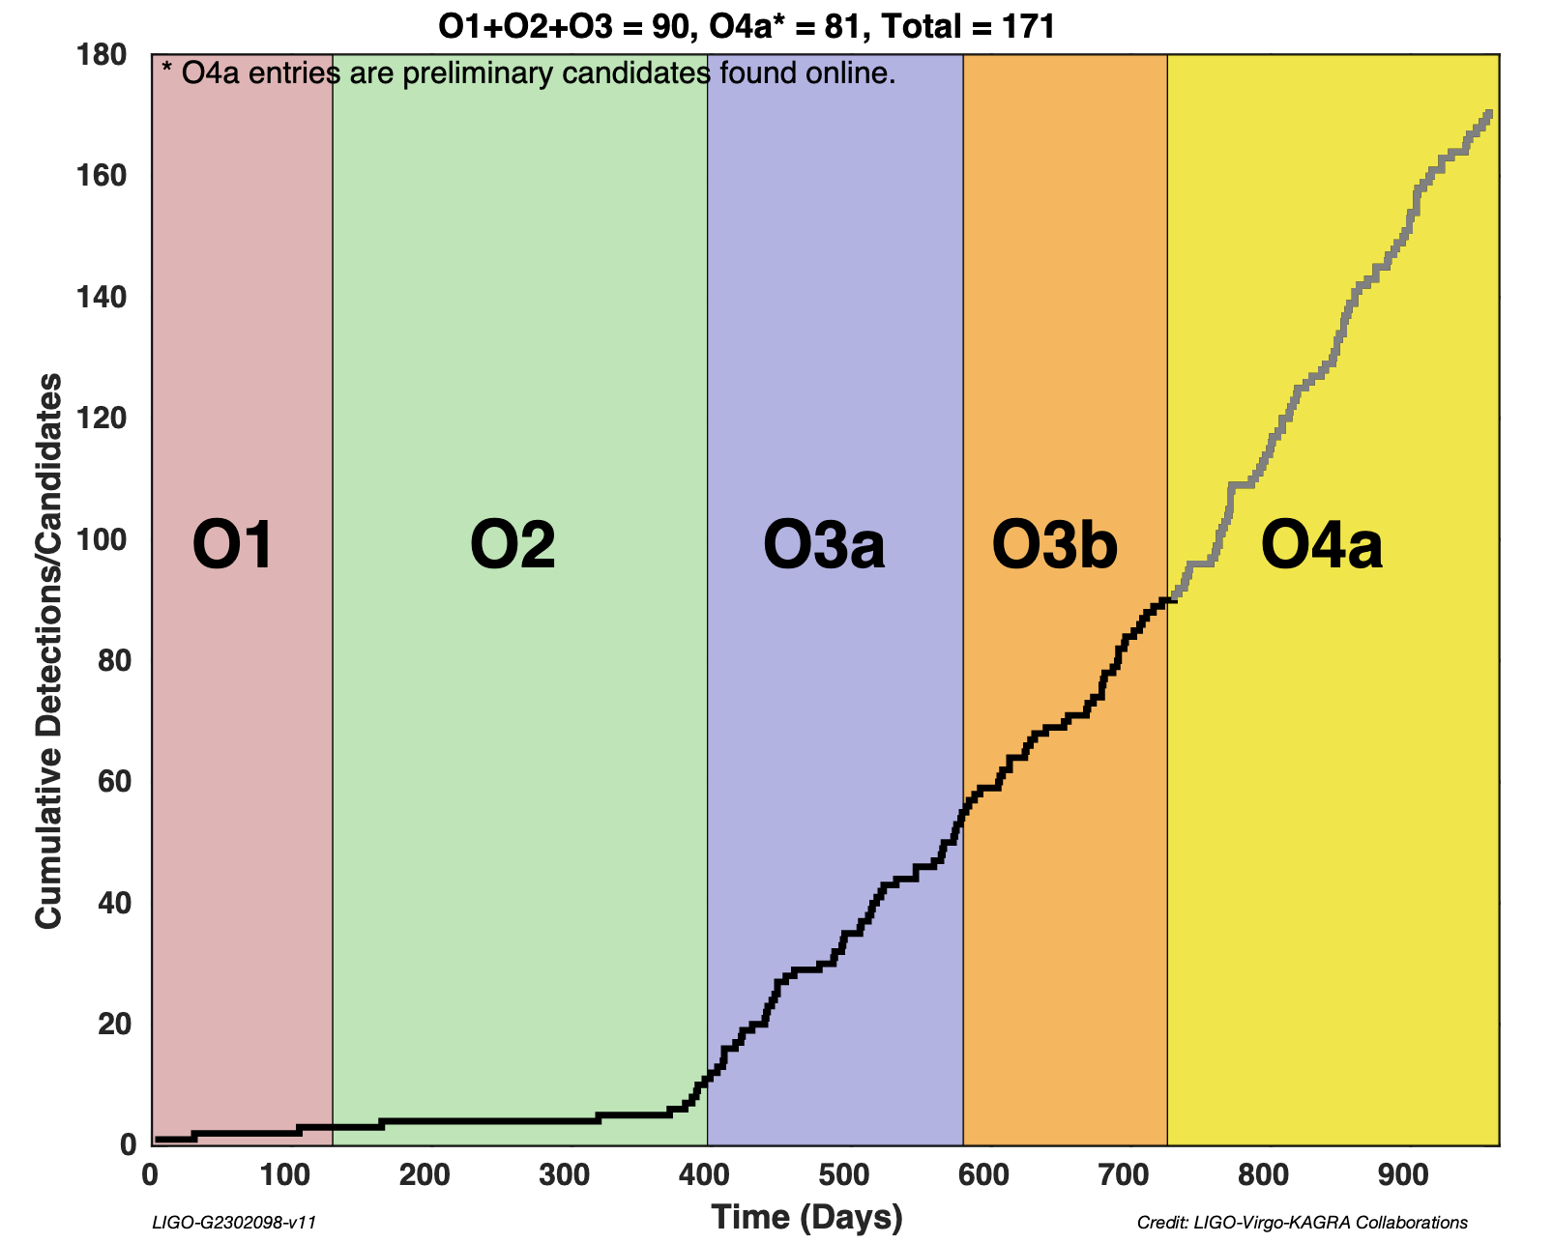
Detections versus time observing

Slide 10
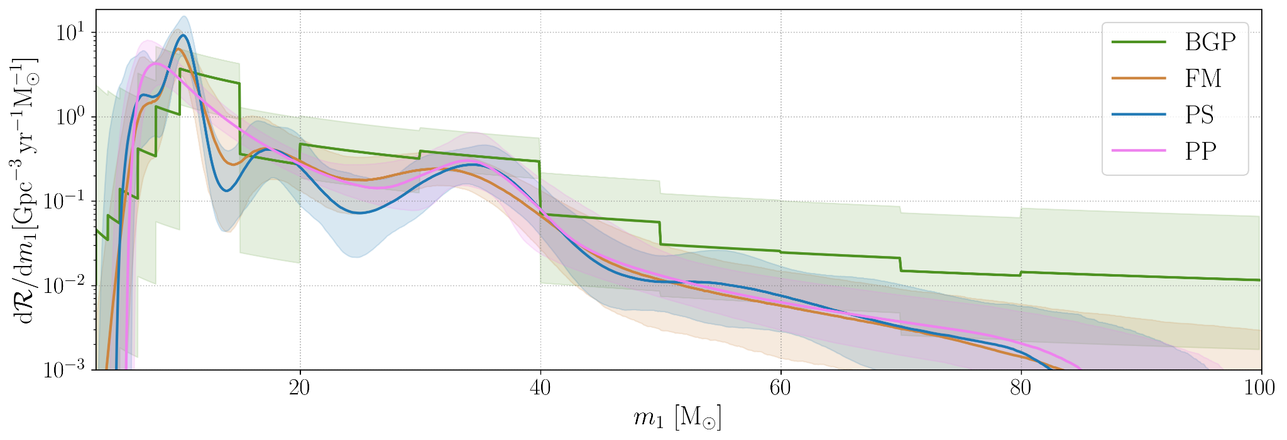
From one to many: measuring populations
LIGO-Virgo-KAGRA
Phys. Rev. X 13, 011048
Merger rate density as a function of primary mass using 3 non-parametric models compared to the power-law+peak (pp) model.
Notes:
14 min; Power law + peak (pp), BGP binned gaussian process, FM flexible mixtures, PS power-law + spline

Slide 11
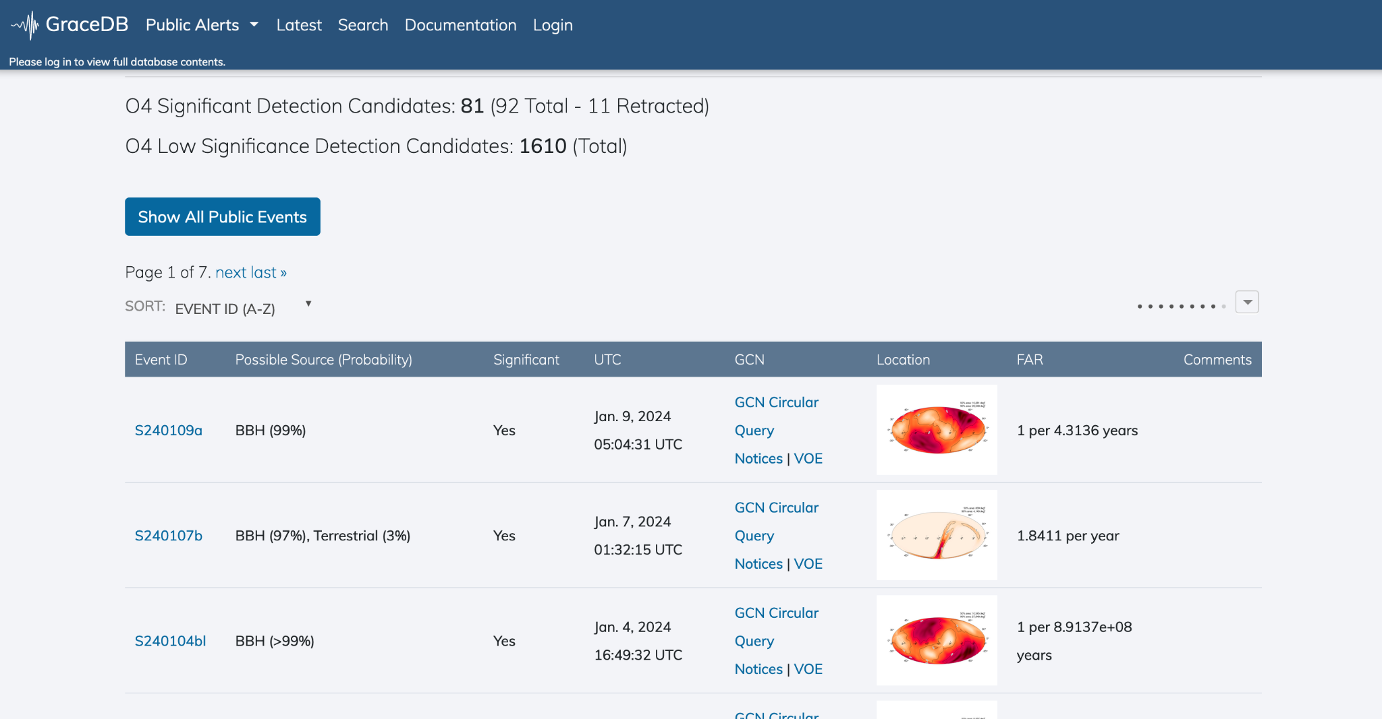
The fourth observing run (O4)
O4a: 24 May 2023 – 16 Jan 2024, LIGO and KAGRA for 1 month
O4b: 10 April 2024 – Feb 2025, LIGO and Virgo
Binary detection rates
O3 ~ 1 / 5 days
O4 ~ 1 / (2.8 days)
Improved public alerts
Localization
Classification
Latency
Early-warning
Low-significance
Improved sensitivity
> 150Mpc BNS range
Notes:
20 min

Slide 12
Masses in the stellar graveyard

Slide 13
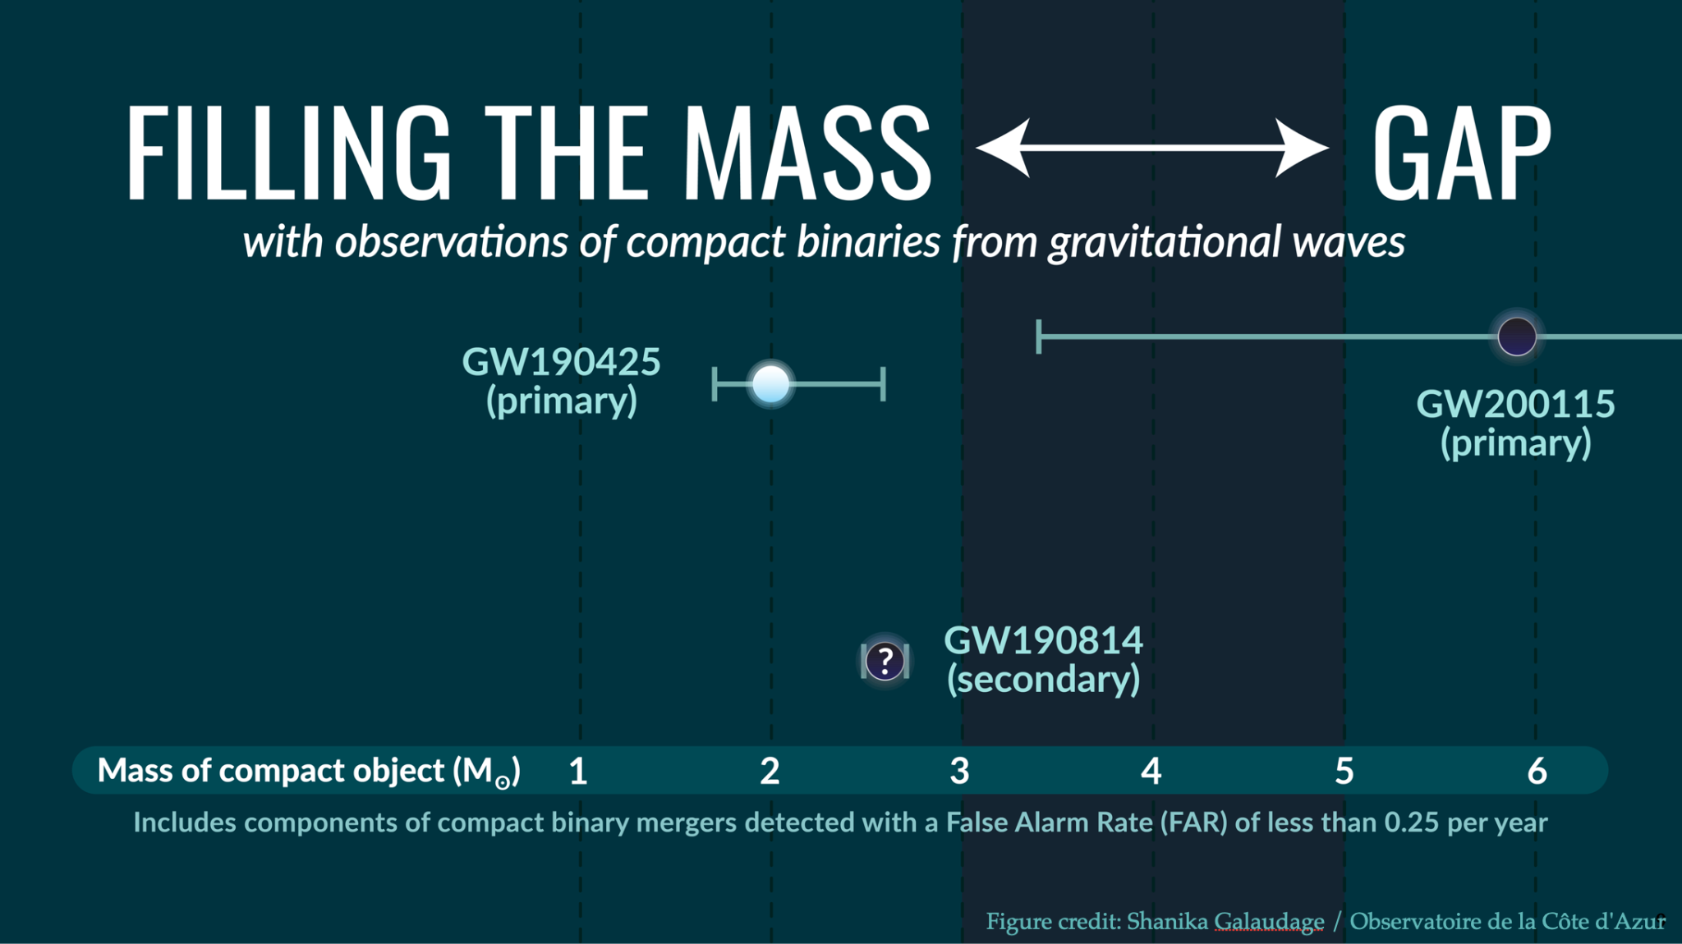

Slide 14
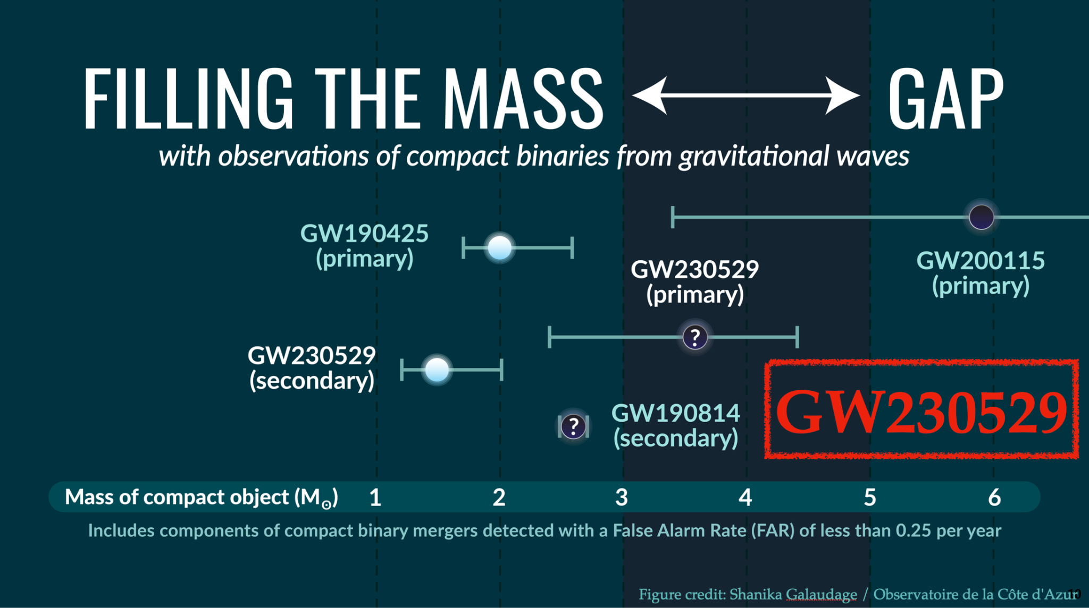

Slide 15
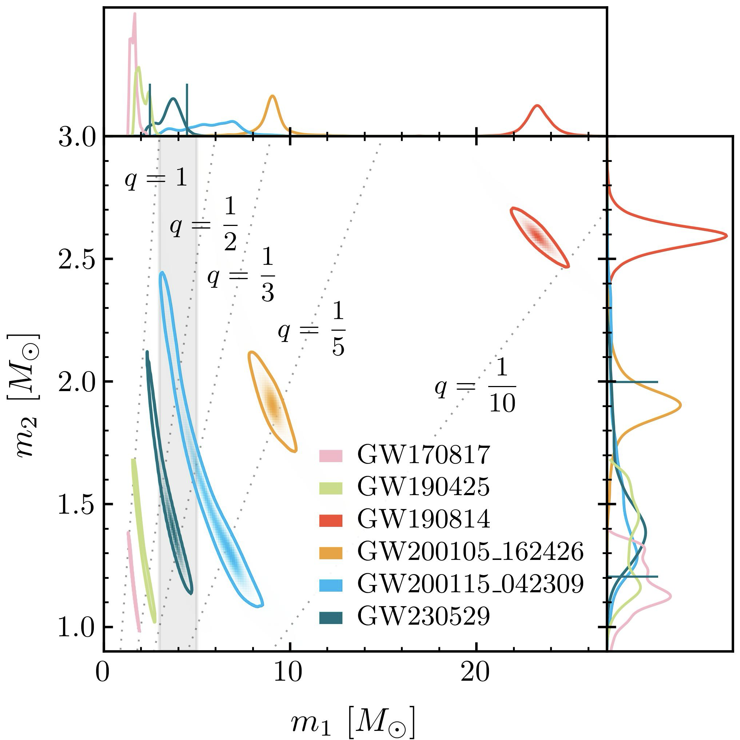
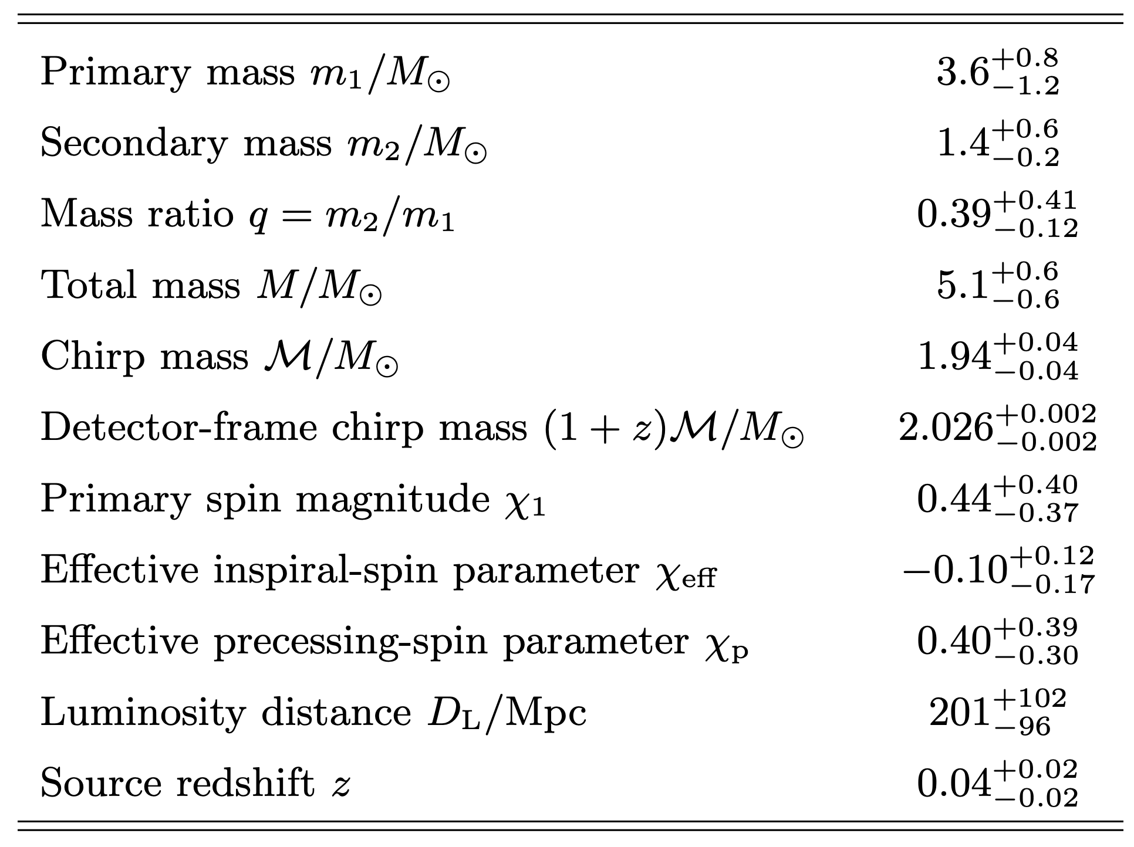
GW230529 - Properties
LIGO-Virgo-KAGRA COllaboration
https://arxiv.org/abs/2404.04248

Slide 16
Binary neutron star mergers
GW170817 & GW190425
Binary neutron star (BNS) merger waves
O4a
Doubled spacetime volume searched, no new BNS events.
Based on O1+O2+O3 rates, expected ~ 0.4 - 7 new events.
O4b (using public information)
Using naive O123+O4a rates, expect 0.2 - 3.5 new events in O4b.
Notes:
16 min

Slide 17
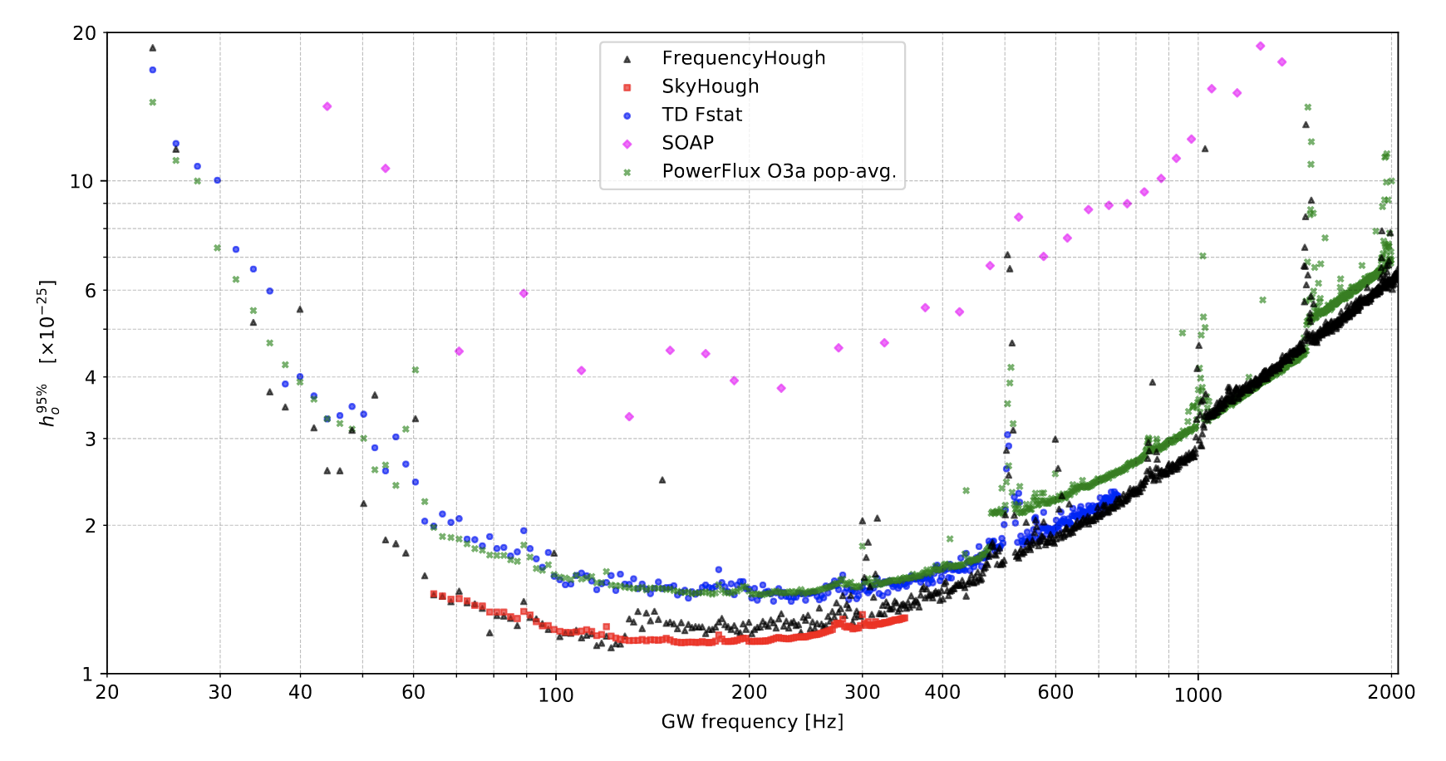
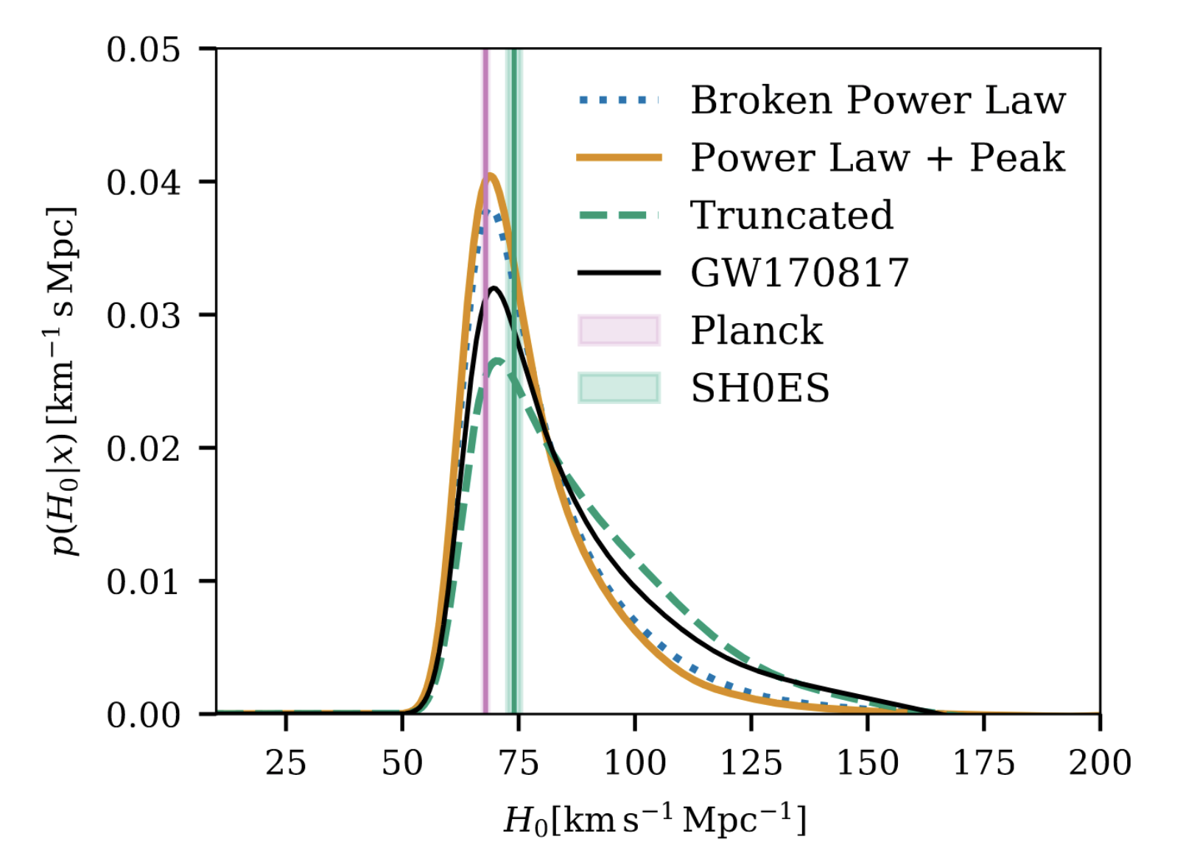
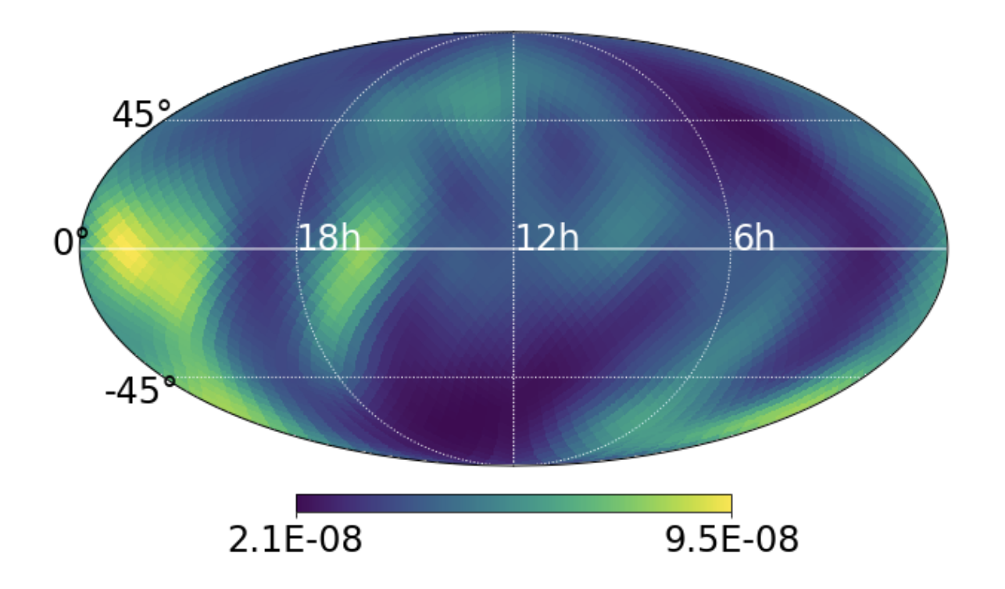
Many other observational results
Limits on waves from pulsars
Phys. Rev. D 106, 102008 (2022)
Hubble constant measurements
Astrophys. J. 949, 76 (2023)
Stochastic background limits
Phys. Rev. D 105, 122002 (2022)
And much more!
Notes:
18

Slide 18
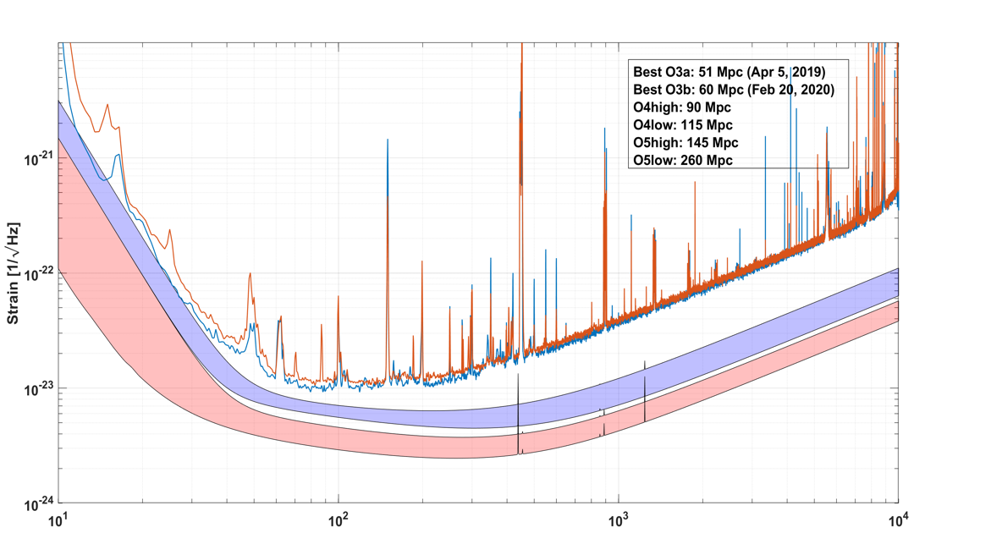
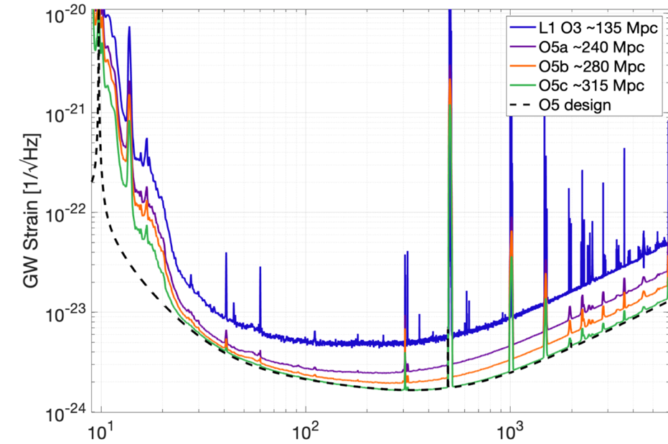
Working toward O5 sensitivity
Thanks to Dave Reitze & Giovanni Losurdo
Advanced LIGO A+
Advanced Virgo+
Frequency (Hz)
Frequency (Hz)
Full Power in the arm cavities: 750 kW
Frequency-dependent Squeezing* level of 6 dB
Test Masses with 2x lower coating thermal noise*
KAGRA will continue to work towards 130Mpc goal in O5
Notes:
Full Power in the arm cavities: 750 kW
Frequency-dependent Squeezing* level of 6 dB
Test Masses with 2x lower coating thermal noise*

Slide 19
O5 Observing Run
LIGO-Virgo-KAGRA anticipate observing to dovetail with next generation facilities
Current thinking
Start is paced by upgrades after O4: 2 years gap.
Intersperse commissioning and observations
Binary detection rates
O3 ~ 1 / 5 days
O4 ~ 1 / (2.8) days
O5 ~ 3 / day
Other science
Improved SNR
New sources?
https://observing.docs.ligo.org/plan/
Notes:
22

Slide 20
Early 2030s
LIGO Aundha Observatory (LAO) is to be constructed in India and operated as part of the LIGO network in the 2030s.
A#: targeted improvements to the LIGO detectors
Report of LSC post-O5 study group [Fritschel et al, https://dcc.ligo.org/LIGO-T2200287/public]
Achieve close to a factor of 2 amplitude sensitivity improvement with larger test masses, better seismic isolation, improved mirror coatings, higher laser power, better squeezing …
Begin observing at the end of 2031 and observe for several years.
A# an engine for observational science and a pathfinder for next-generation technologies.
A network including LIGO A# detectors would be a cornerstone for multimessenger discovery.
Virgo has scoped similar improvements, called VirgoNEXT, with similar timetable. KAGRA is focused on reaching its current target.
Notes:
24 With a nominal period of 2 years for installation and commissioning

Slide 21
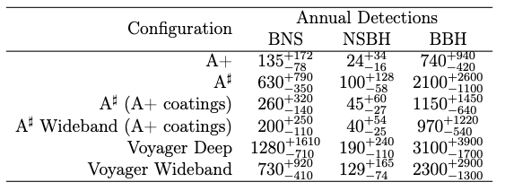
Observational Science with A#
Probe the compact object binary population with unprecedented precision
Masses, spins, sub-populations.
Clues about their formation and astrophysical environment.
Hubble constant measurement to sub-percent levels
Black hole spectroscopy via sub-dominant modes
Neutron star radius measurements to sub-km
Enlarge discovery space: nearby supernova, continuous wave sources, stochastic background
See Fritschel et al, https://dcc.ligo.org/LIGO-T2200287/public
Notes:
28

Slide 22
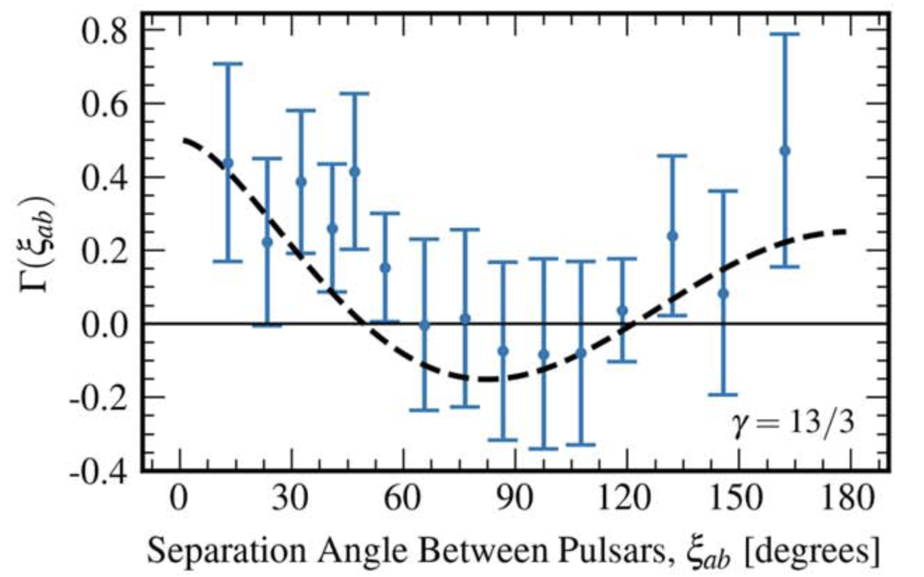
Recent Pulsar Timing Observations
Hellings-Downs interpulsar correlations from a gravitational-wave background.
Bayesian analysis ~ 3 sigma
Frequentist analysis ~ 3.5 - 4 sigma
Possibly background from supermassive black hole binaries.
Gabriella Agazie et al 2023 ApJL 951 L8
https://doi.org/10.3847/2041-8213/acdac6
NANOGrav - G. Agazie et al 2023 ApJL 951 L8
PPTA - D. J. Reardon et al 2023 ApJL 951 L6
EPTA and InPTA - J. Antoniadis et al. A&A, to appear
CPTA - H. Xu et al 2023 Res. Astron. Astrophys. 23 075024
Notes:
26 min

Slide 23
LISA mission
Illustration Credit
Olena Shmahalo for NANOGrav
The launch of the three spacecraft is planned for 2035, on an Ariane 6 rocket.
Notes:
24 min

Slide 24
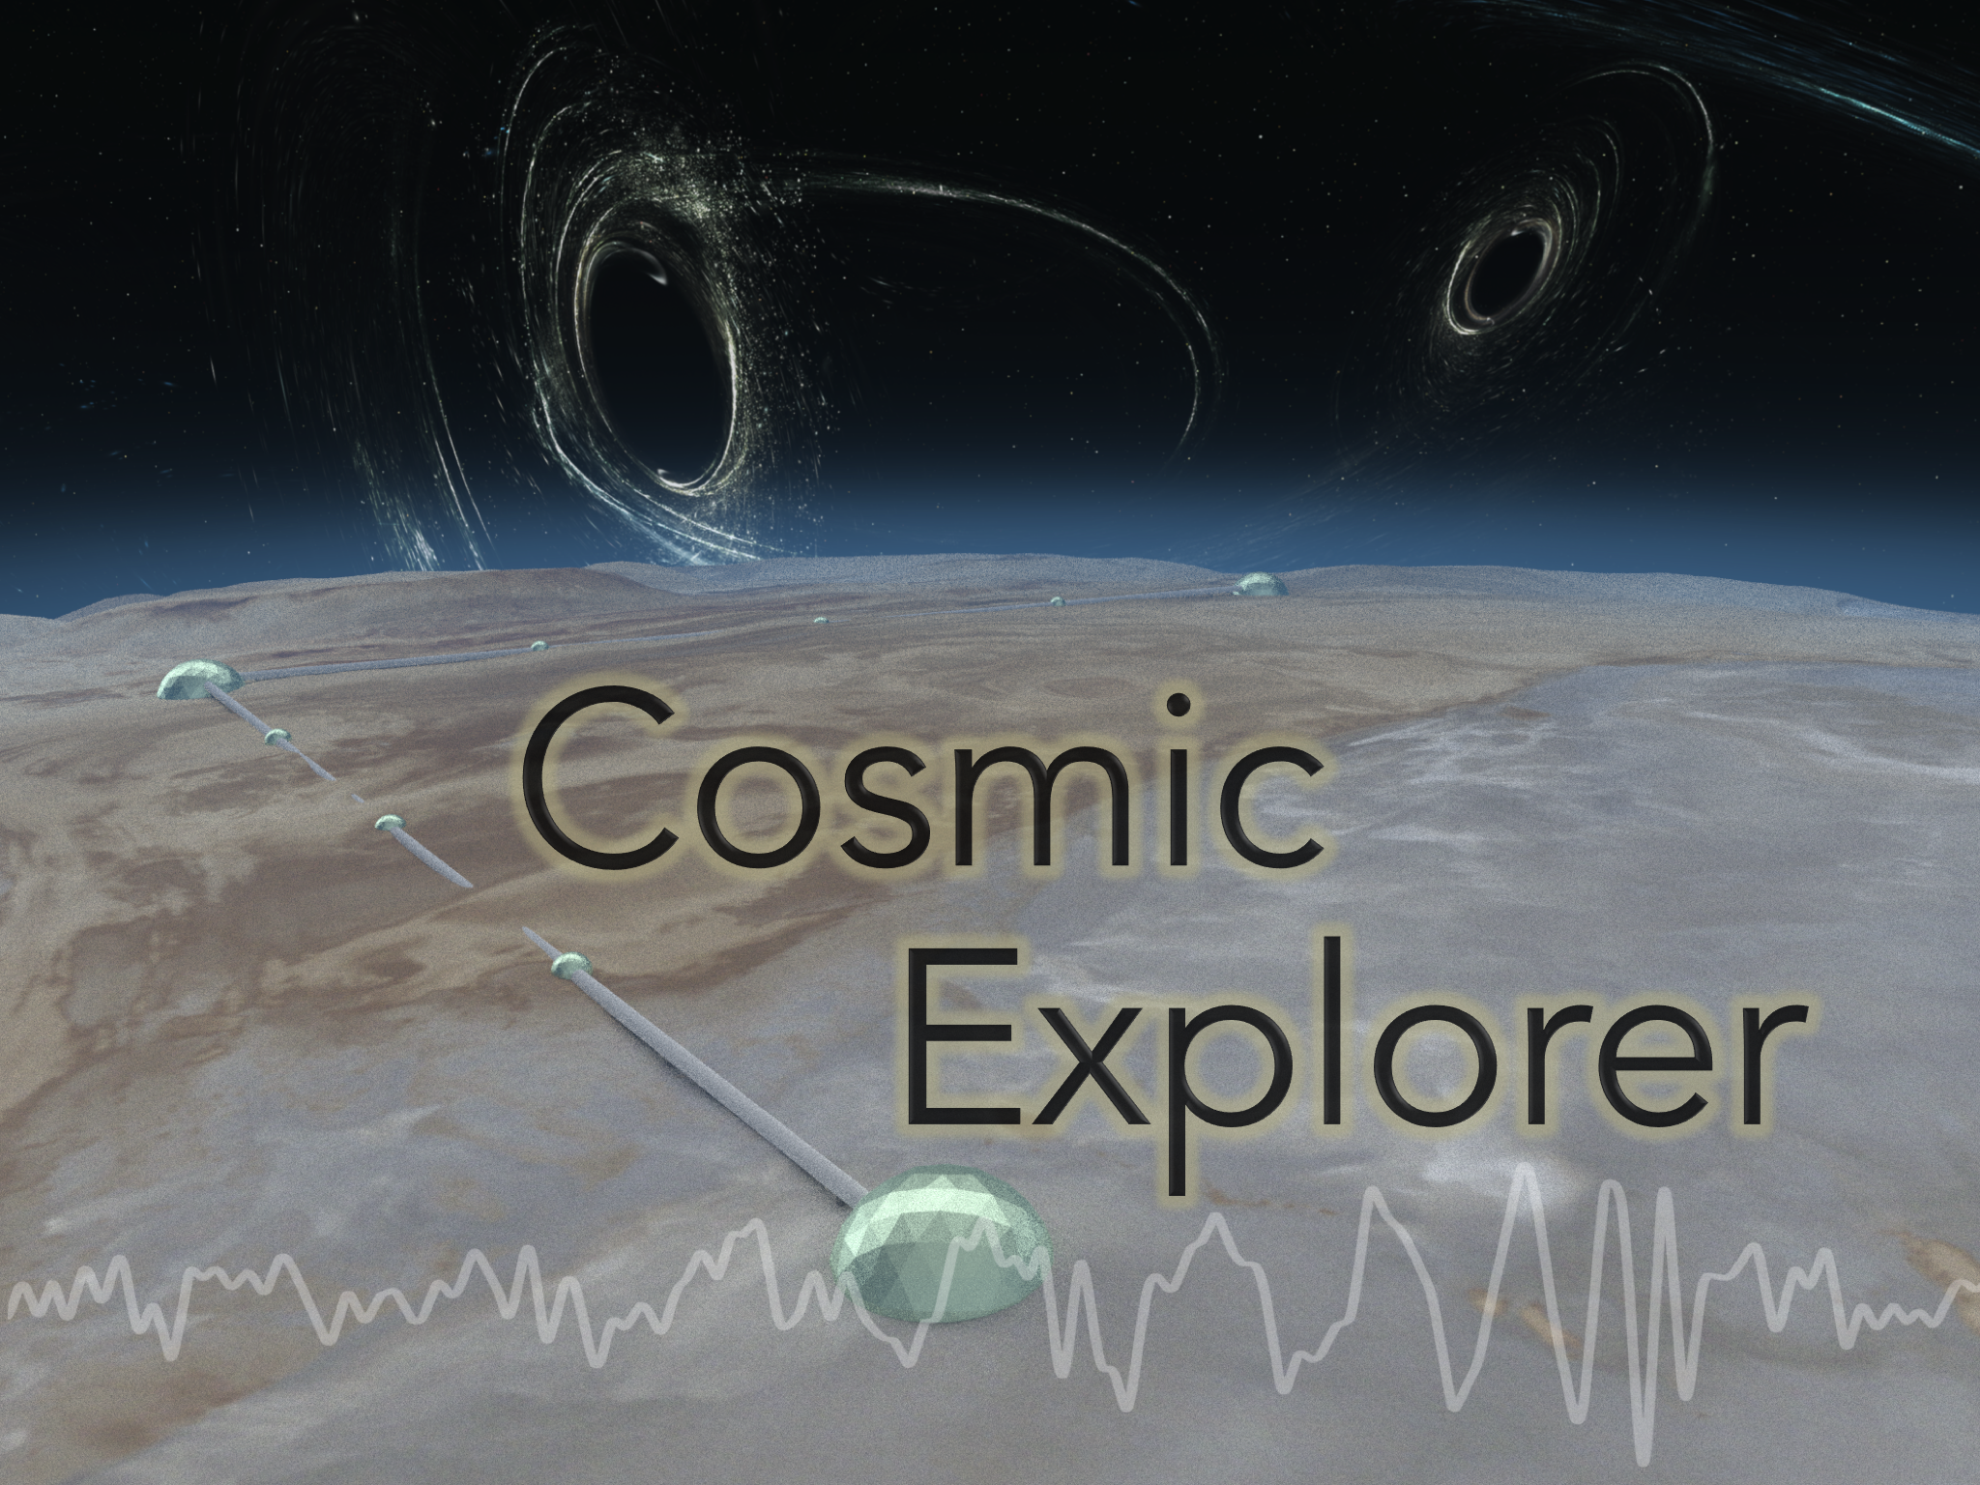
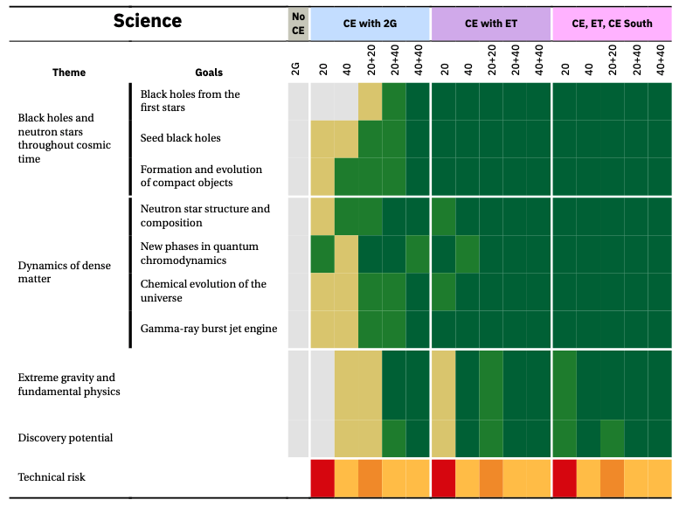
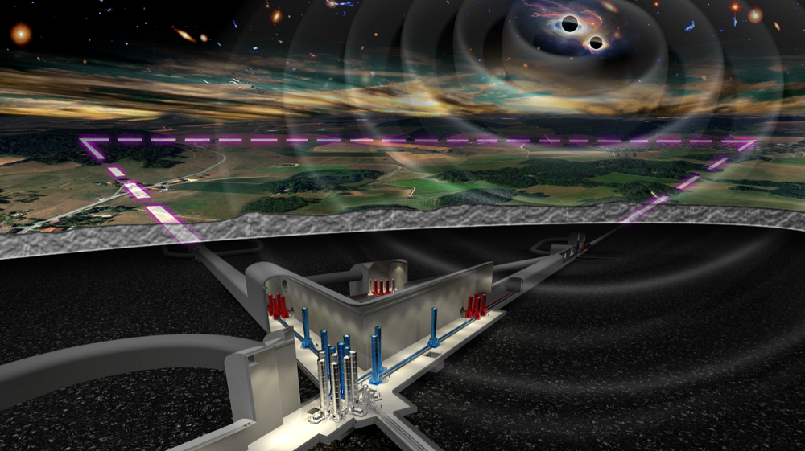
Next Generation Detectors
A Horizon Study for Cosmic Explorer
https://arxiv.org/abs/2109.09882
Einstein Telescope
Notes:
36

Slide 25
Cosmic Explorer Timeline
A Submission to the NSF MPSAC ngGW Subcommittee
https://dcc.cosmicexplorer.org/CE-P2300018/public
Top-level timeline showing a phased approach to design and construction.
Notes:
38

Slide 26
Thank you!

Slide 27
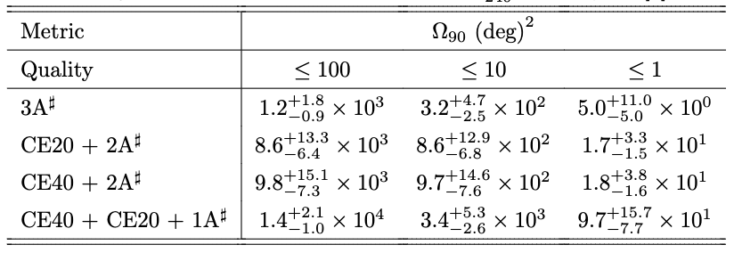
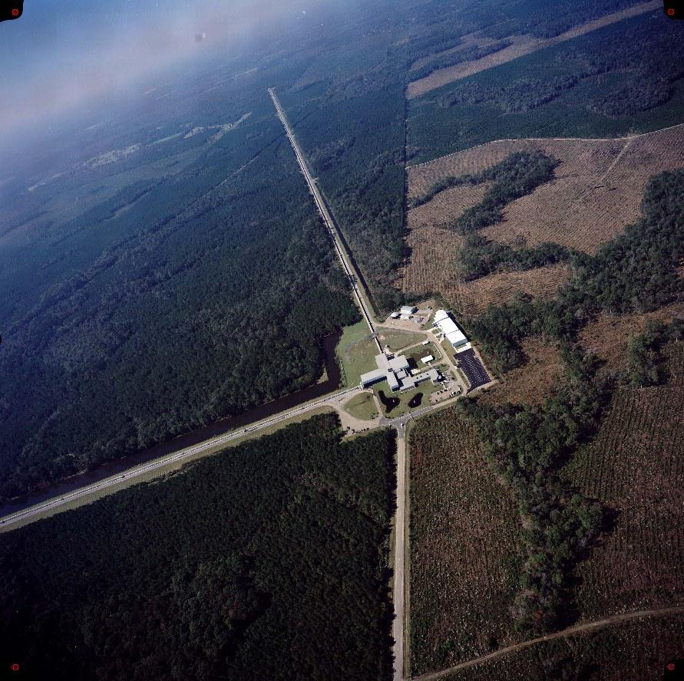
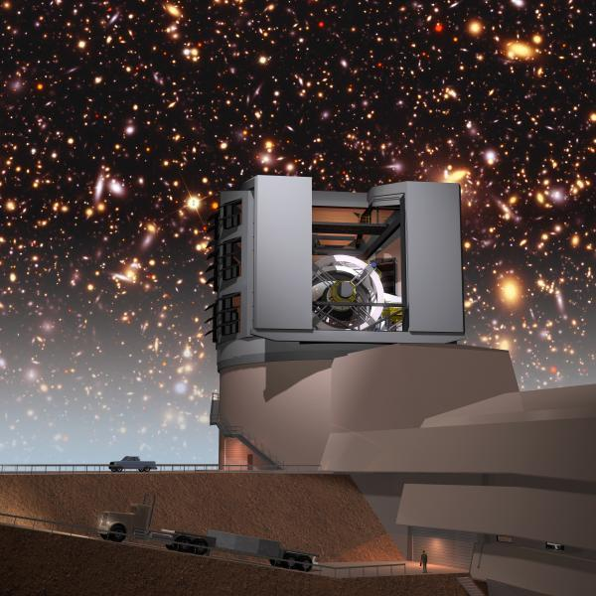
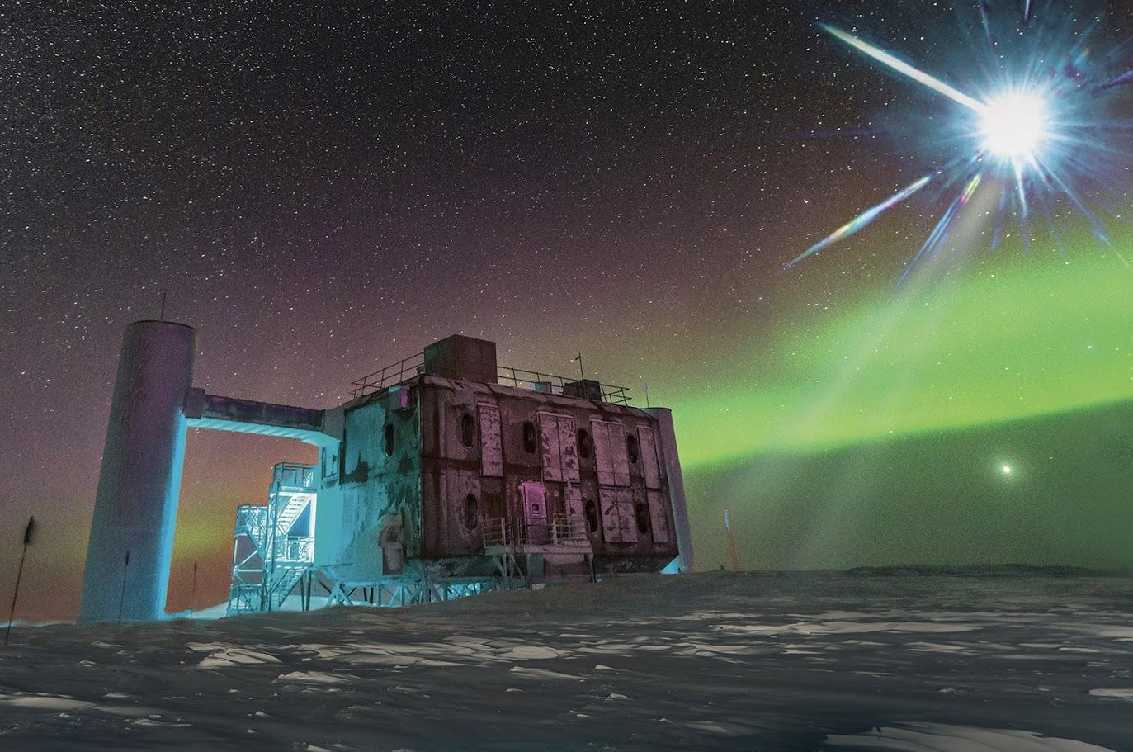
LIGO network is a cornerstone of MMA
The number of detections per year for four different detector networks for binary neutron stars within z = 0.5
Ish Gupta & B. Sathyaprakash
Notes:
30

Slide 28
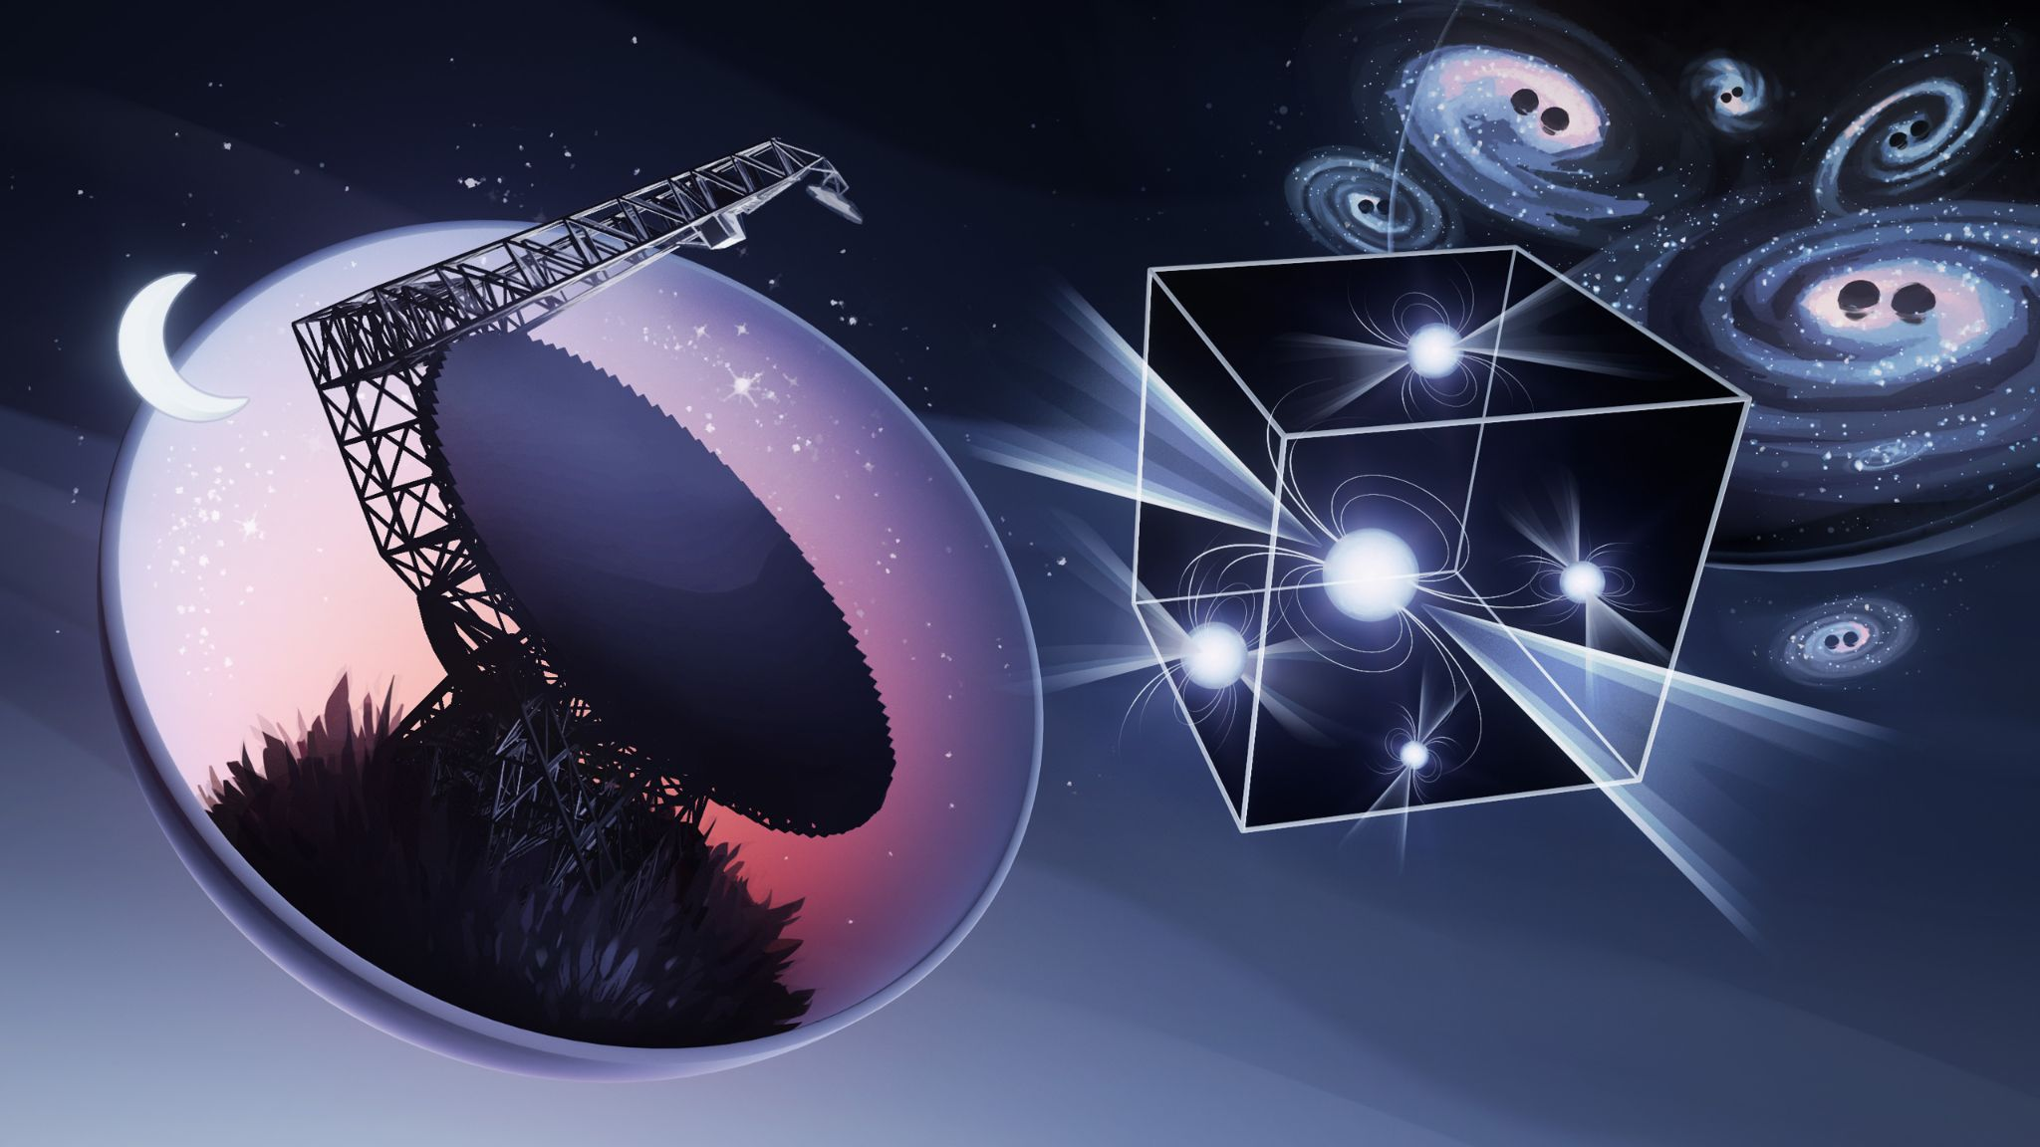
Pulsar Timing Observations
Illustration Credit
Olena Shmahalo for NANOGrav
Notes:
24 min

Slide 29
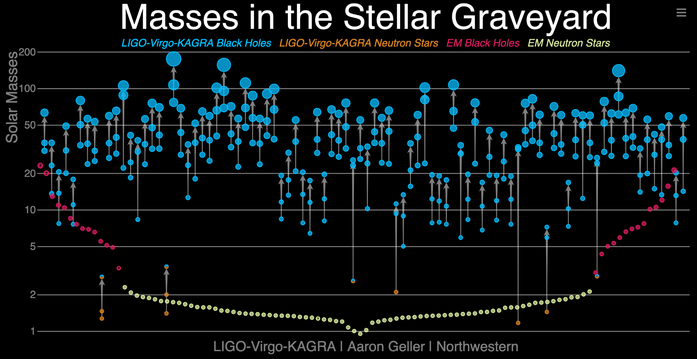
Gravitational-Wave Transient Catalog
LIGO-Virgo-KAGRA, arXiv:2111.03606 [gr-qc]
GWTC-3
Notes:
12 min

Slide 30
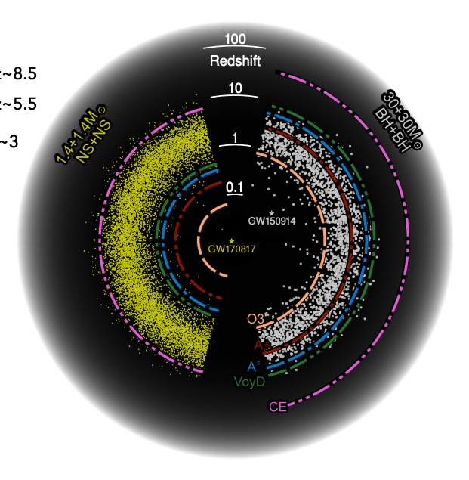
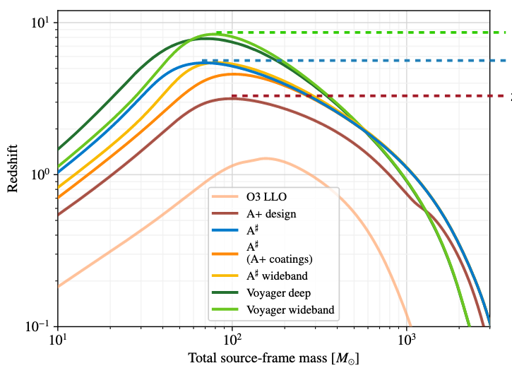
Observational Science with A#
Horizon for optimally oriented and located binary mergers
z~8.5
z~5.5
z~3
See Fritschel et al, https://dcc.ligo.org/LIGO-T2200287/public
Notes:
26

Slide 31
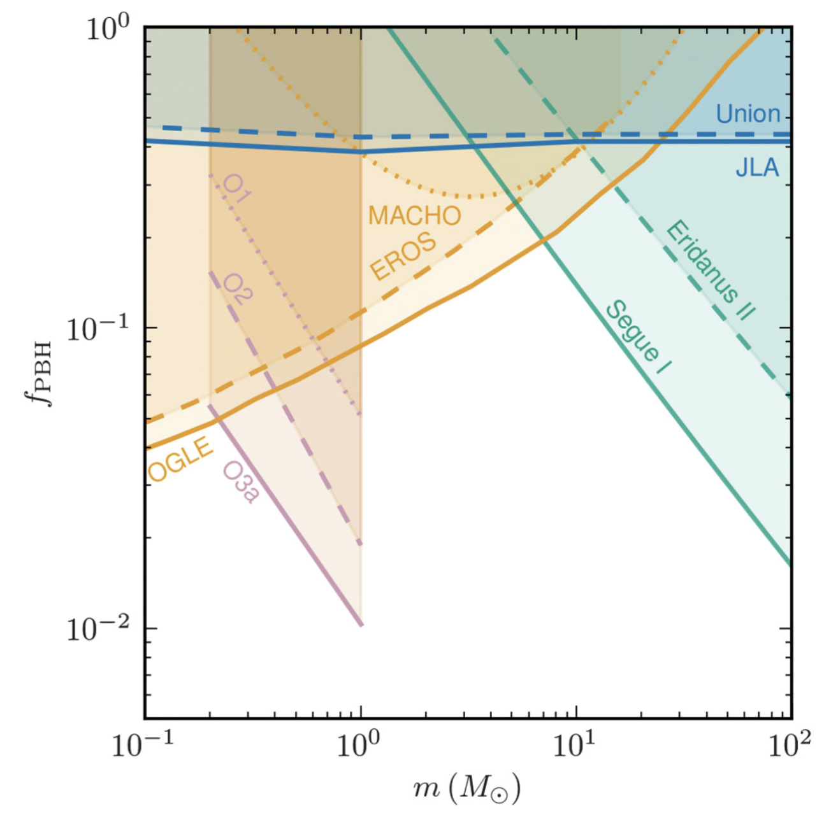
Search for subsolar-mass binaries
Search for compact binary mergers with at least one object of mass 0.2 - 1 Msun.
No detections.
Example constraints on fraction of dark matter in primordial black holes from an isotropic distribution of equal-mass binaries.
LIGO-Virgo Collaboration
Phys. Rev. Lett. 129, 061104
Notes:
18 min

Slide 32
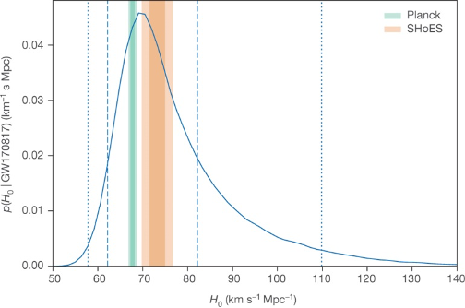
Cosmology with gravitational waves
B P Abbott et al. Nature 551, 85–88 (2017) doi:10.1038/nature24471
Gravitational waves from binaries are standard sirens
Measure the luminosity distance to the source and redshifted masses
Cannot measure redshift directly
Get redshift some other way
Electromagnetic counterpart, e.g. GW 170817, GRB 170817A, AT 2017gfo
Sub-percent accuracy with many
Cross correlate with galaxy redshifts [Schutz, Nature 323, 310 (1986)]
Mass scale imprinted on spectrum of detected binary mergers [Will M. Farr et al 2019 ApJL 883 L42]
GW170817 + AT 2017gfo
Notes:
32

Slide 33
Challenges for cosmology with GW
R Abbott et al. arXiv:2111.03604
(2021)
Binaries with detectable EM counterparts are rare
With ~5-10 BNS mergers detectable in O4, expect ~1 detectable kilonova.
GRBs further away, but only a fraction beamed to Earth.
Sub-percent accuracy with many
Completeness of galaxy catalogs decreases rapidly with redshift.
Mass scales are highly uncertain, e.g. maximum black hole mass from PISN, or must be measured simultaneously.
Notes:
34

Slide 34
Advanced LIGO
From the beginning, facilities were planned to house multiple generations of detectors
Initial LIGO: a necessary step to move to kilometer scale. Detection possible, not likely
Advanced LIGO: detection probable for compact binaries, possible for other sources
Funding started in 2008; Livingston completed in mid 2014; Hanford completed at end of 2014
Plan to interleave observing with commissioning activities starting in 2015
First detection of gravitational waves on 14 September 2015!

