Slide 1
Towards Testing Specific Theories Beyond General Relativity with LIGO
Natalie Malagon
Mentor: Ethan Payne

Slide 2
Motivation
Test general relativity (GR) in the strong-field regime
With ensembles of binary merger events
Observations have been consistent with GR to date
Multiple theories predict deviations from GR
Move towards constraining beyond GR (BGR) theories
Map the bounds of their coupling coefficients

Slide 3
Motivation
Inspiral
Merger: lack of knowledge
Ringdown:
Well described by post-Newtonian formalism (PN)
Involves even more parameters
Image Source: https://www.soundsofspacetime.org/detection.html

Slide 4
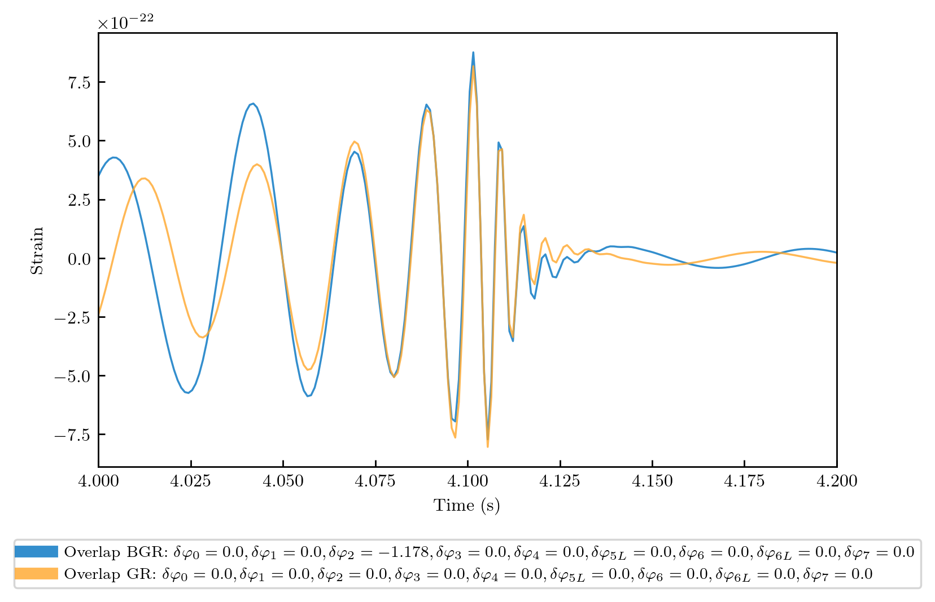
Motivation
PN coefficients are measurable parameters of the waveform

Slide 5
Post-Newtonian formalism
PN parameterization of the phase evolution during the inspiral phase of the GR waveform in the frequency domain:
and are the time and phase when the BBHs coalesce
is the symmetric mass ratio of the system
and are the PN phasing coefficients
Depend on the intrinsic parameters of the source (mass/spins of the component BHs)
IMRPhenomPv2 = phenomenological waveform model in frequency-domain

Slide 6
Multi-parameter Test
Parameters (PN phasing coefficients) that encapsulate possible deviations of a waveform from GR
Current tests of GR use a single deviation parameter
Difficult to map this information to specific theories & test them over ensembles of events
We want generic, “theory-agnostic” deviation parameters
Abbott et al. (2021) 2112.06861

Slide 7
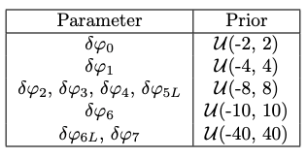
Methods
Parameter estimation to the inspiral phase of BBH merger events
15 source parameters & 10 PN deviation parameters
Each represents the fractional deviation from the GR PN phasing coefficient
Likelihood
Prior
Posterior
Evidence

Slide 8
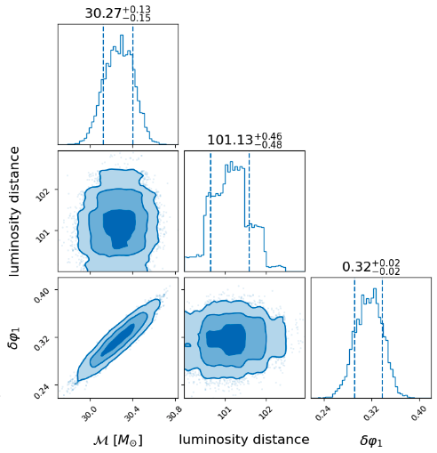
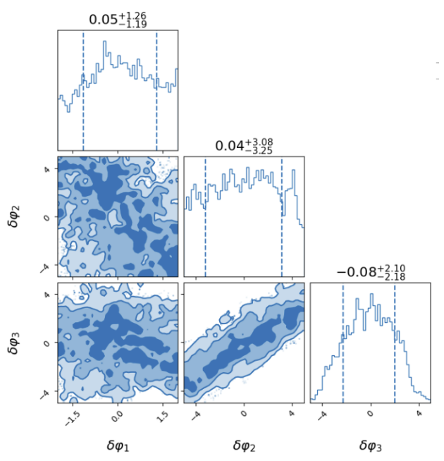
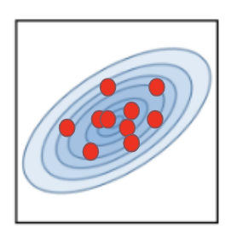
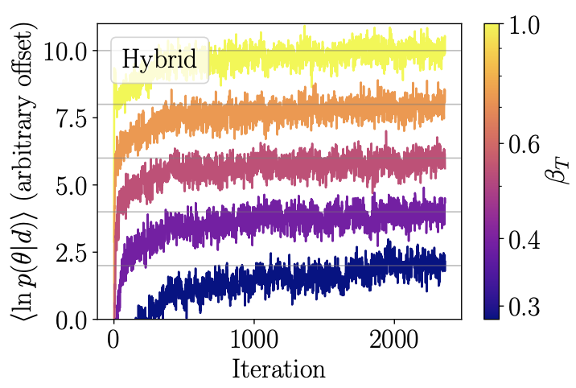
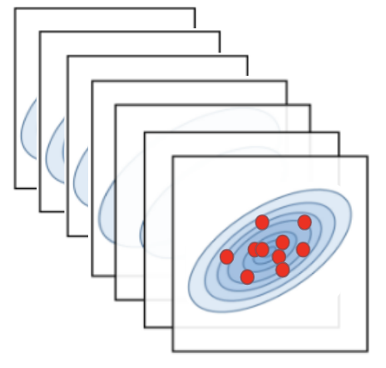
Hybrid Sampling
Iteratively break into nested slices
Combine weighted samples
Iteratively sample from each slice
Parallel- tempered MCMC
Posteriors
Nested Sampling
seeds
explores
Unknown posterior
Sample directly
Iteratively break into nested slices
Iteratively sample from each slice
Combine weighted samples
Several Markov chains in parallel
Explores posteriors at different temperatures
TLDR: Allows us to explore degenerate parameter spaces
Speagle (2020) 1904.02180, Wolfe et al. (2022) 2208.12872

Slide 9
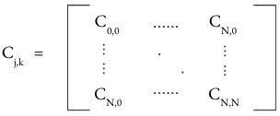
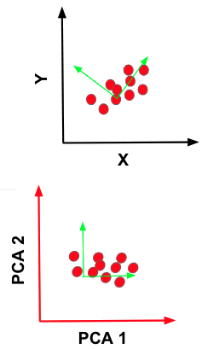
Principal Component Analysis (PCA)
Degeneracies in the parameter space make the outcome of multi-parameter tests difficult to interpret
Reduce to informative parameters
PCA Posteriors
Posteriors
Compute covariance matrix
Linear Transformation
Saleem et al. (2021) 2110.10147

Slide 10
Generating Injections
GR violated with in [-2, 2]
Chirp mass [10, 45] solar masses
Signal-to-noise ratio (SNR) & Frequency of innermost stable circular orbit (ISCO):
SNR > 20
f < f_{ISCO}
Not buried with detector noise
Capture the upper limit of the inspiral phase
Overlap (O):
O > 0.9
GR and BGR waveforms
Produce 10 injection parameters that don’t significantly deviate from GR

Slide 11
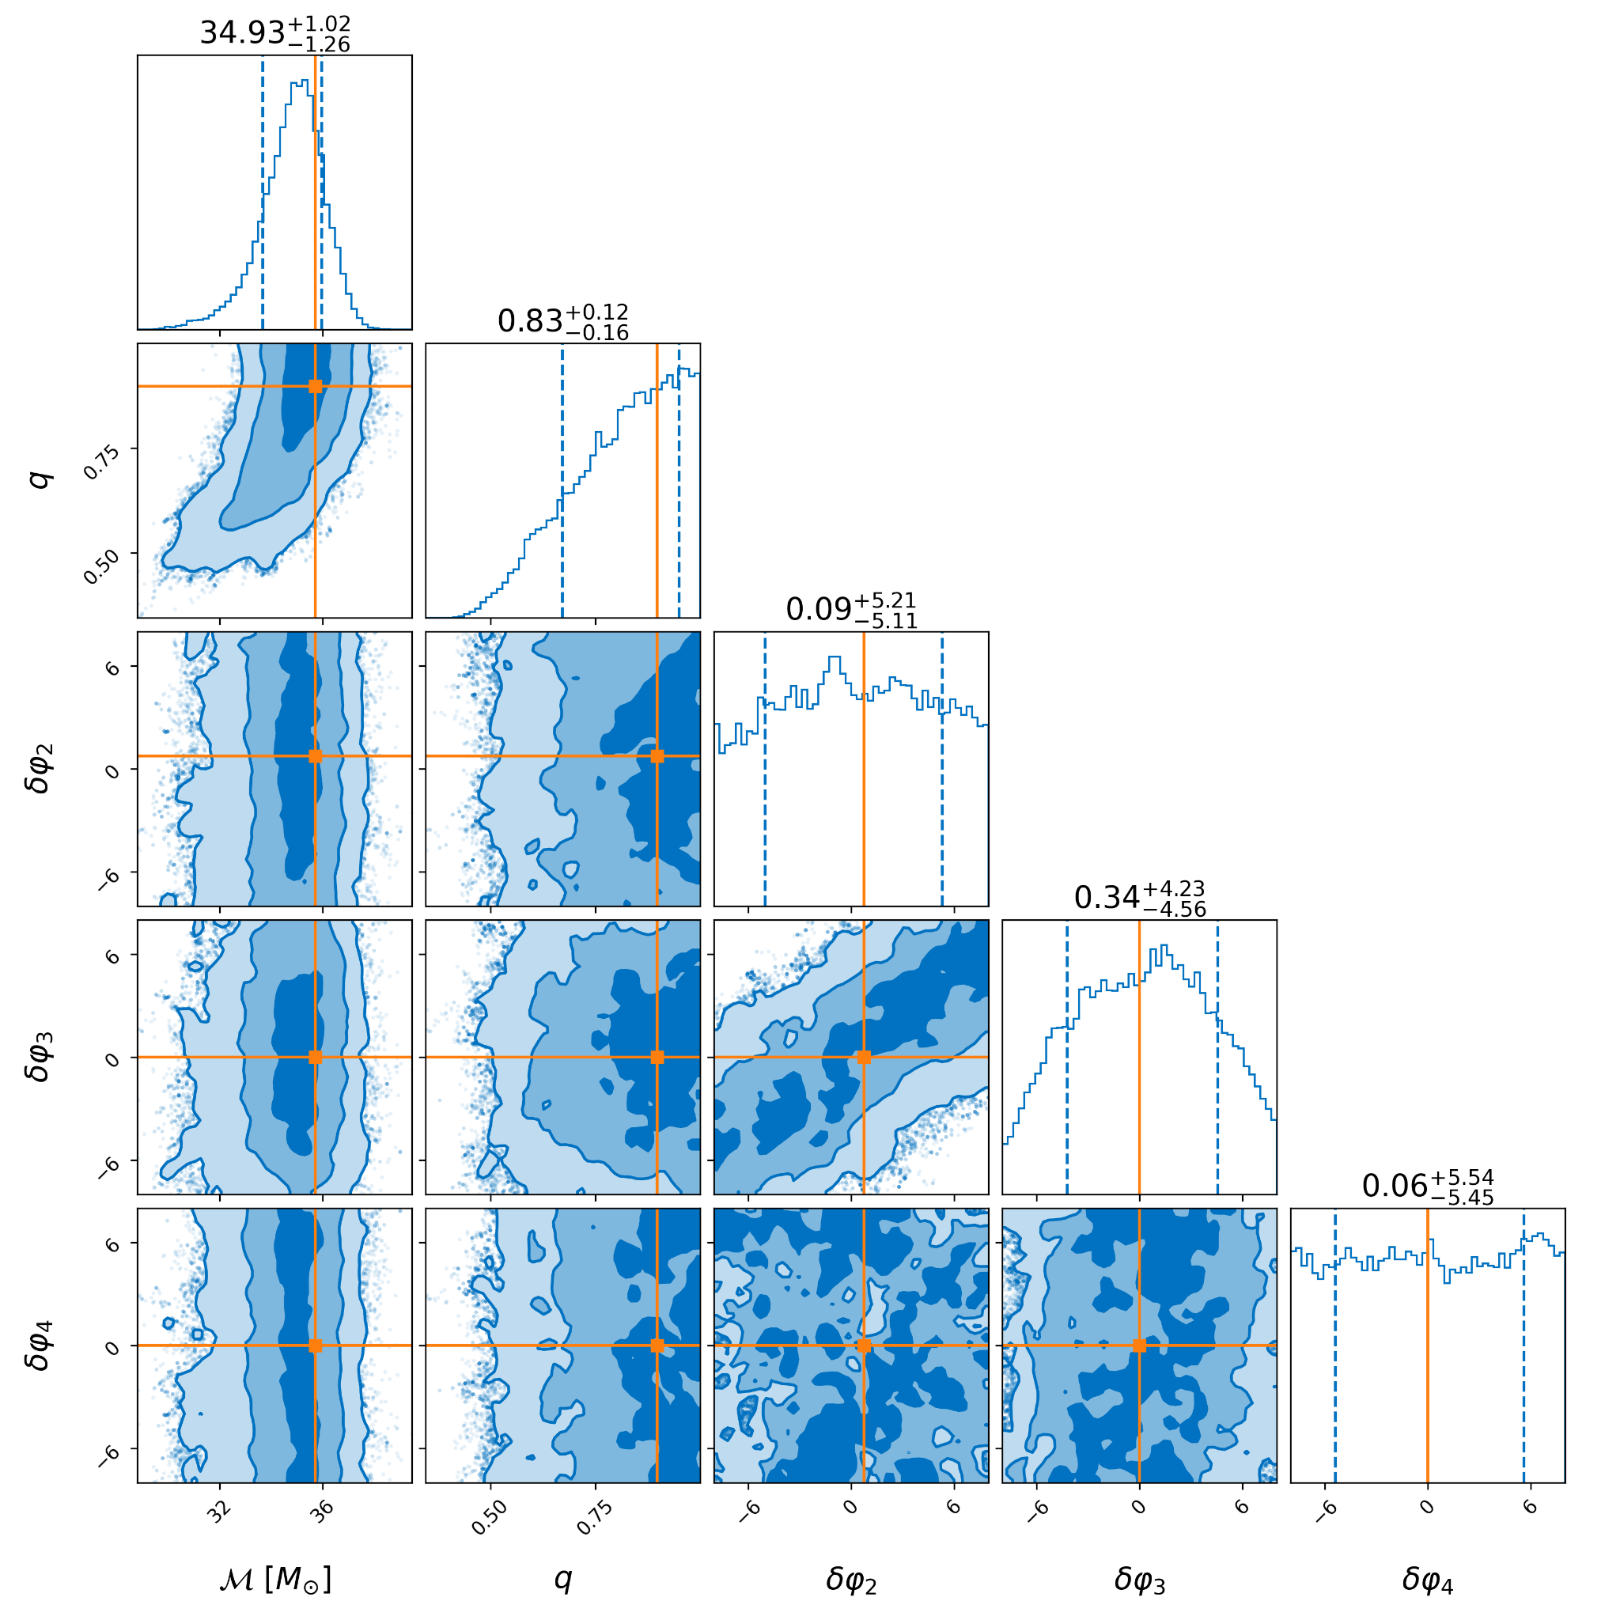
Results
Subset of jointly inferred astrophysical and deviation parameters
Vary all parameters
Correlation between and
Marginal distributions roughly converged to true parameters (orange)
is unconstrained (uniform distribution)

Slide 12
PCA Results
Most information coming from and
Widths of marginal posterior distribution get wider the farther they are from the leading PCA parameters
Consistently peaking at GR value except for the leading PCA parameter due to dominating
Generally removed correlations between parameters (as expected)

Slide 13
Next Steps
Applying hybrid sampling and PCA to real events
GW150914, GW170104, & GW170814
Found a bug in the hybrid sampling code :(
Use set of deviation parameter posteriors from individual events with a hierarchical model to constrain theories of gravity
Ultimately resulting in constraining the bounds on the coupling coefficients that characterize these specific theories via parameterized post-Einsteinian (PPE) framework
Ex. Einstein-dilaton Gauss-Bonnet (EdGB) theories

Slide 14
Conclusions
Goal is to constrain BGR theories
Applied hybrid sampling to all possible deviation parameters in the inspiral of BBHs
Mapping onto PCA parameters resulted in learning correlations
Next step is to apply hybrid sampling to real events

Slide 15
Acknowledgements
Thank you to the LIGO Laboratory, Caltech Student-Faculty Program, and the National Science Foundation.
Special thank you to Ethan, Alan, & friends!

