Slide 1
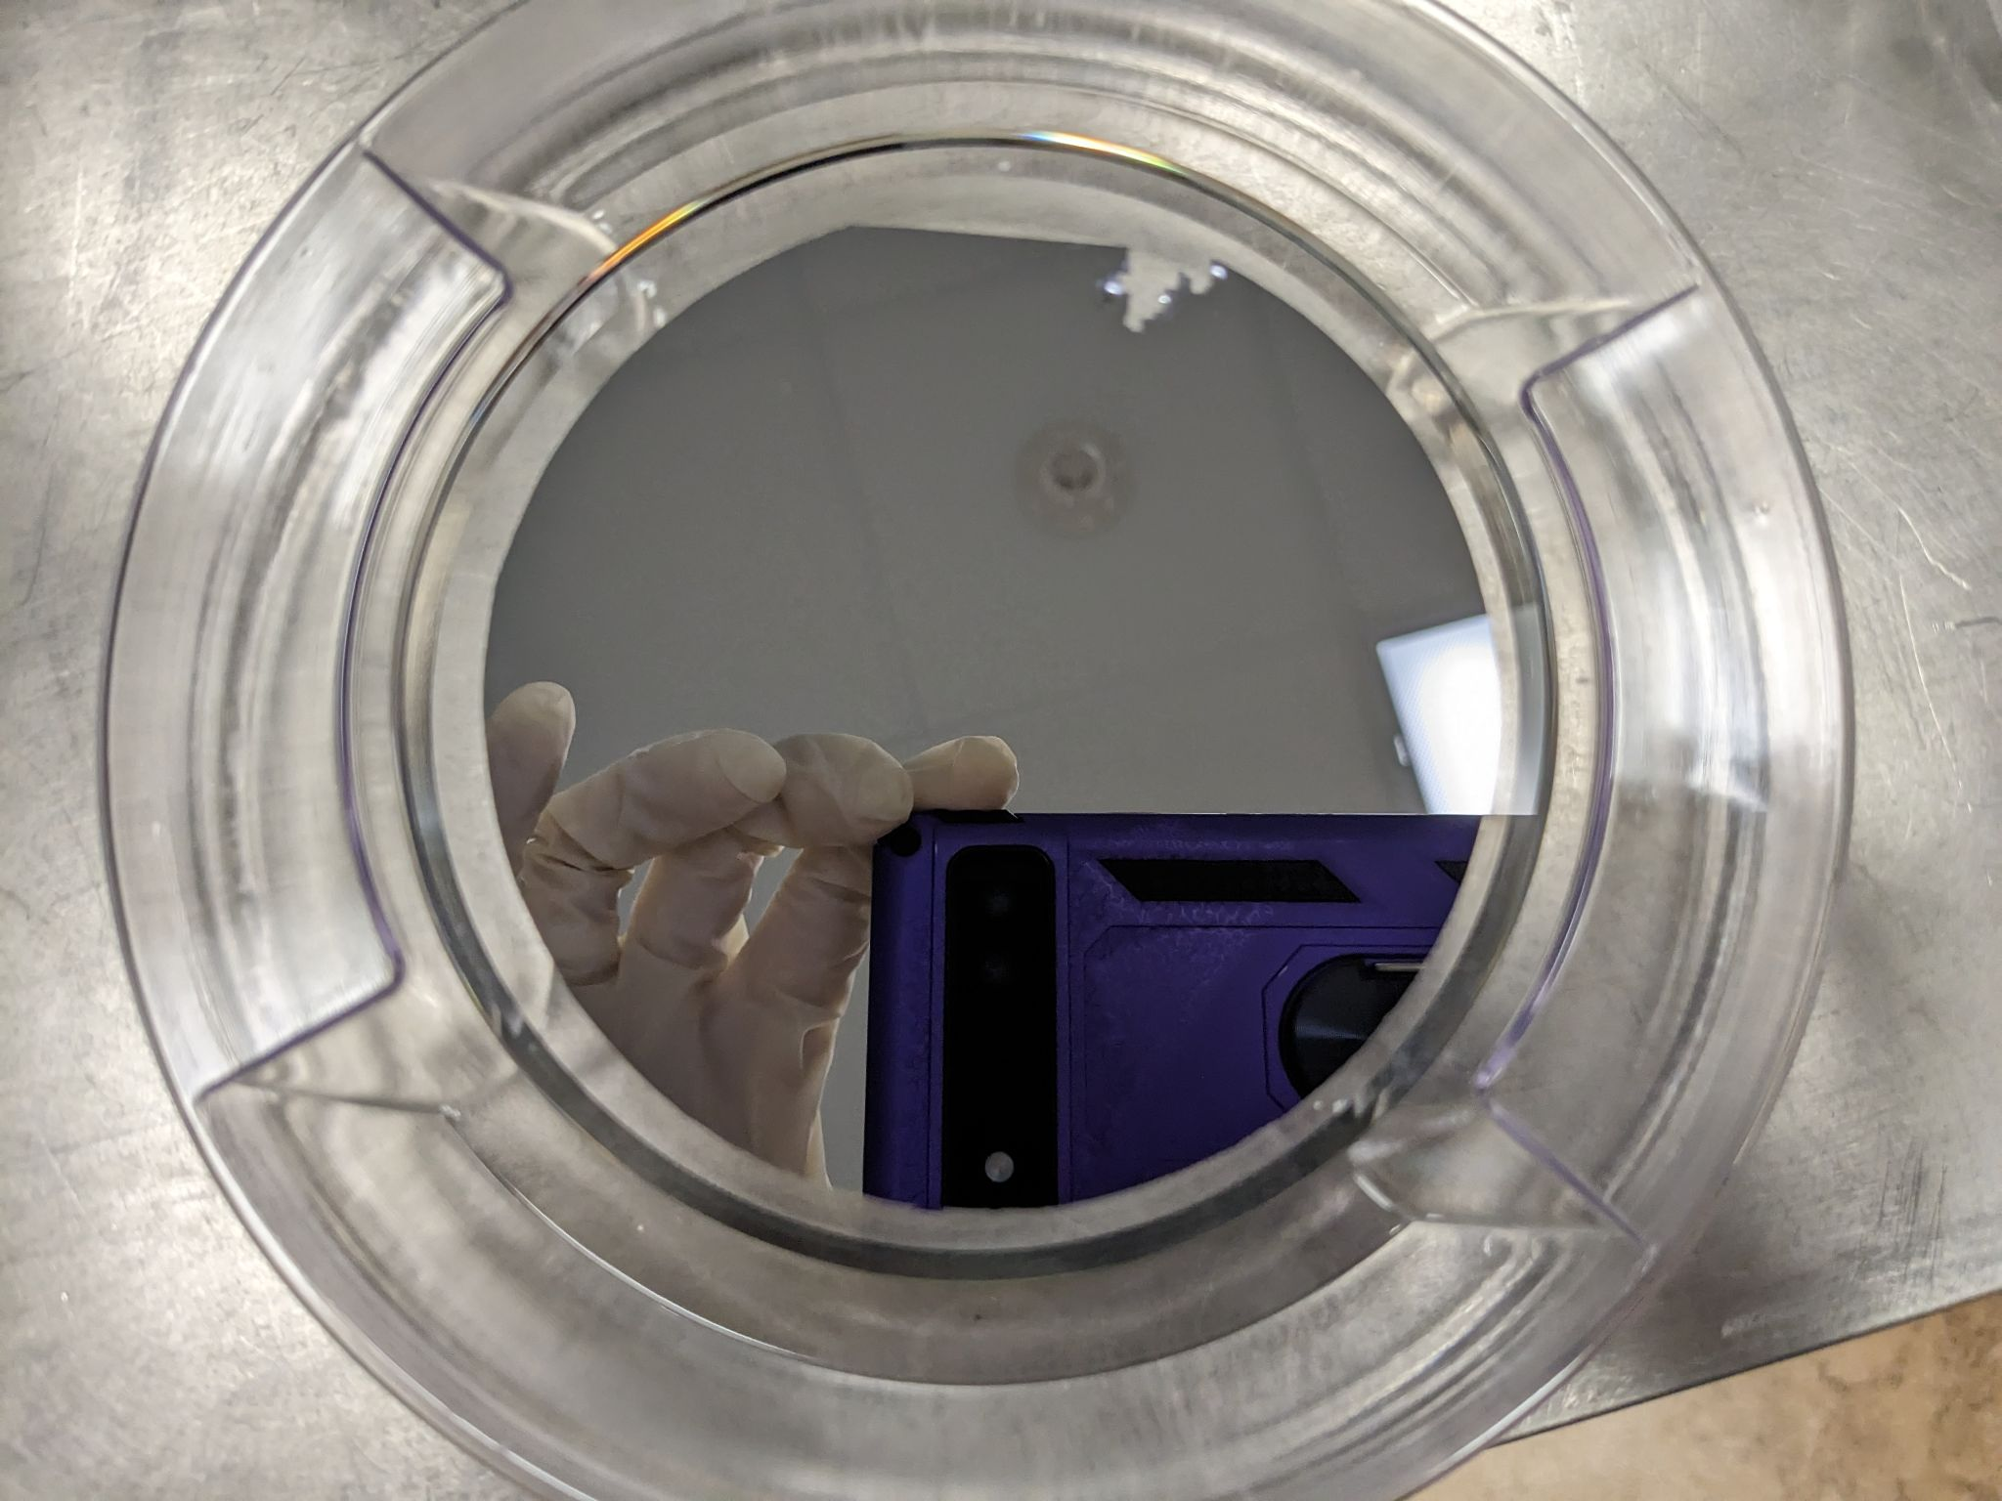
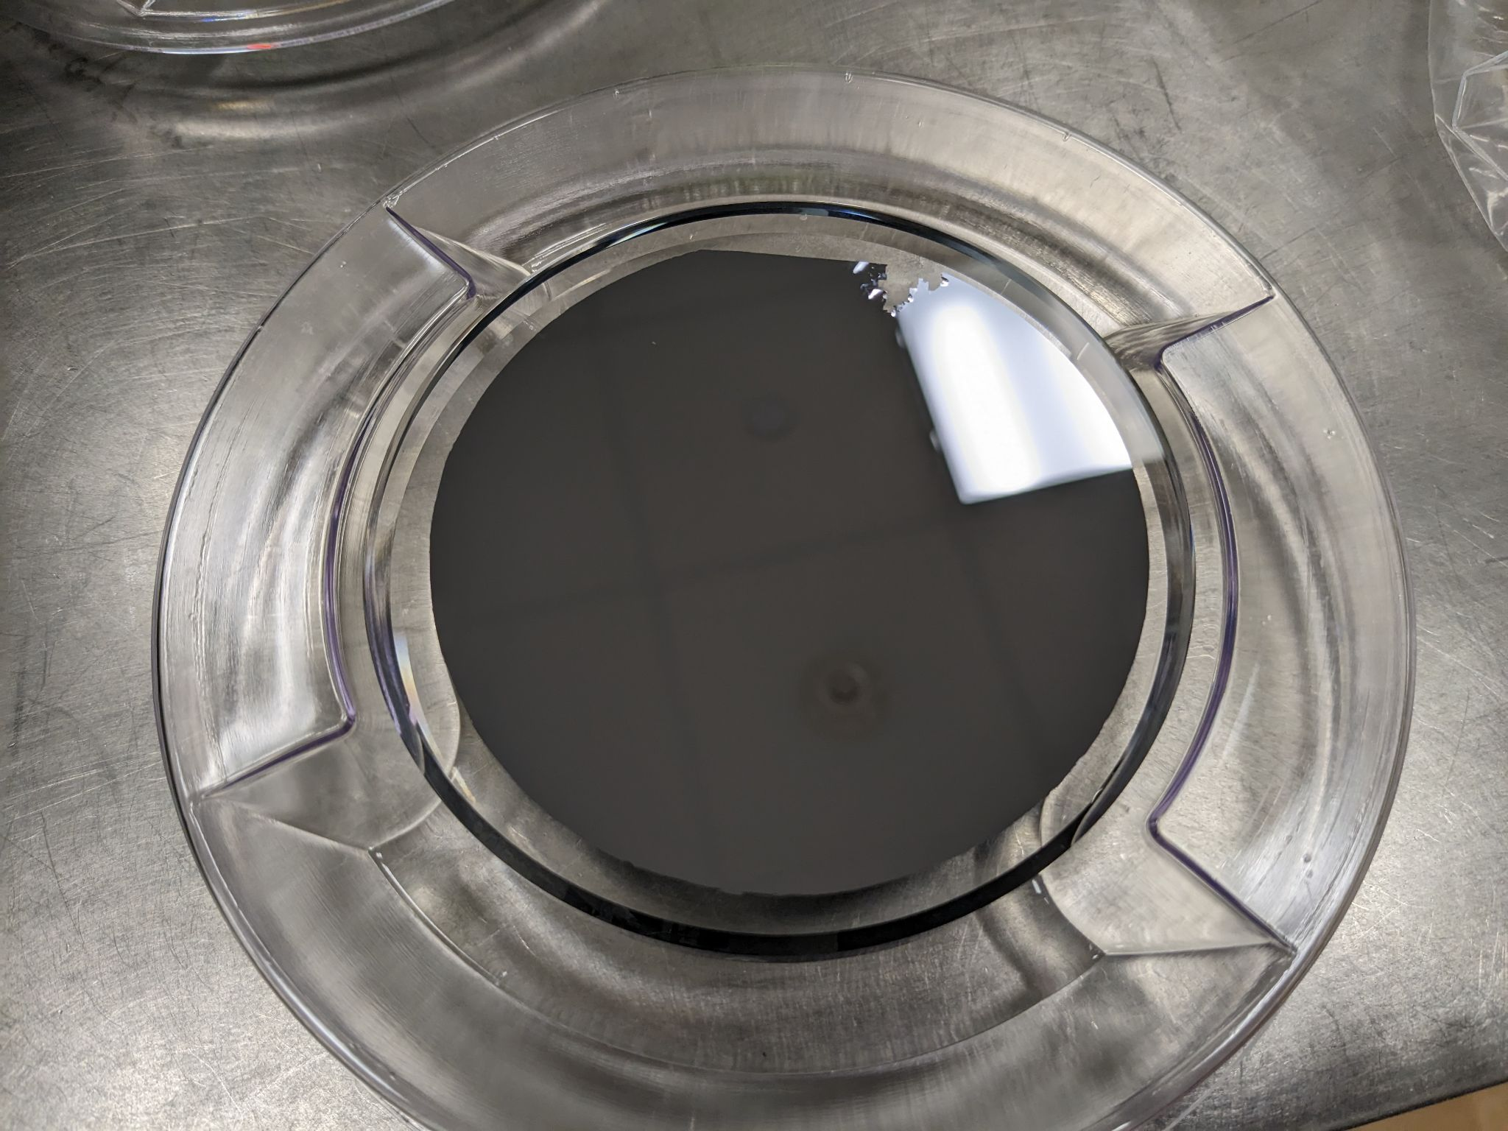
E2300026: AlGaAs Coating of 100mm Substrates
CMS-100-03
(coated with AlGaAs)
Note: Photos are flipped in horizontal direction to be comparable to Zygo images.
Notes:
(Pictures are flipped in x to match zygo data)

Slide 2
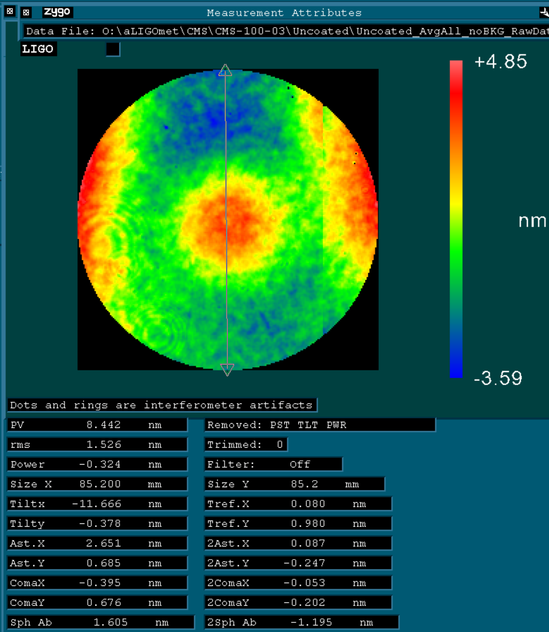
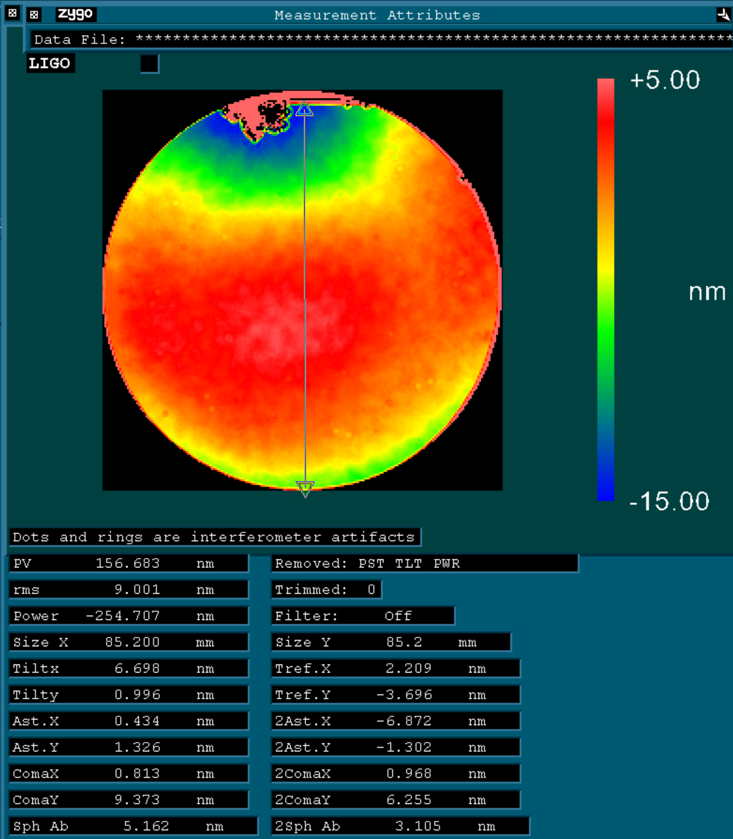
CMS-100-03
Uncoated
Coated

Slide 3
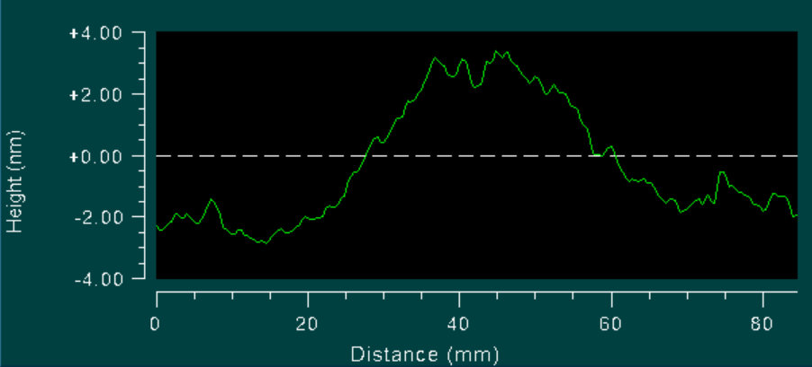
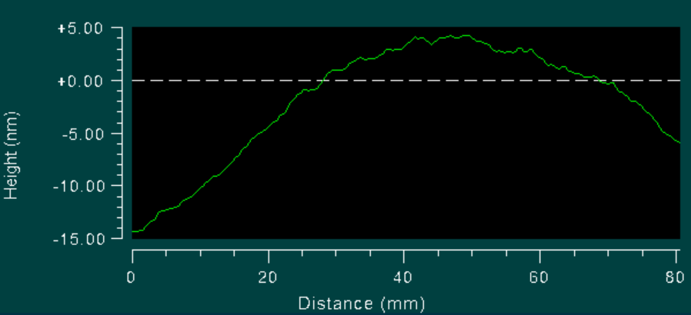
CMS-100-03
Surface Profile
Uncoated
Coated

Slide 4
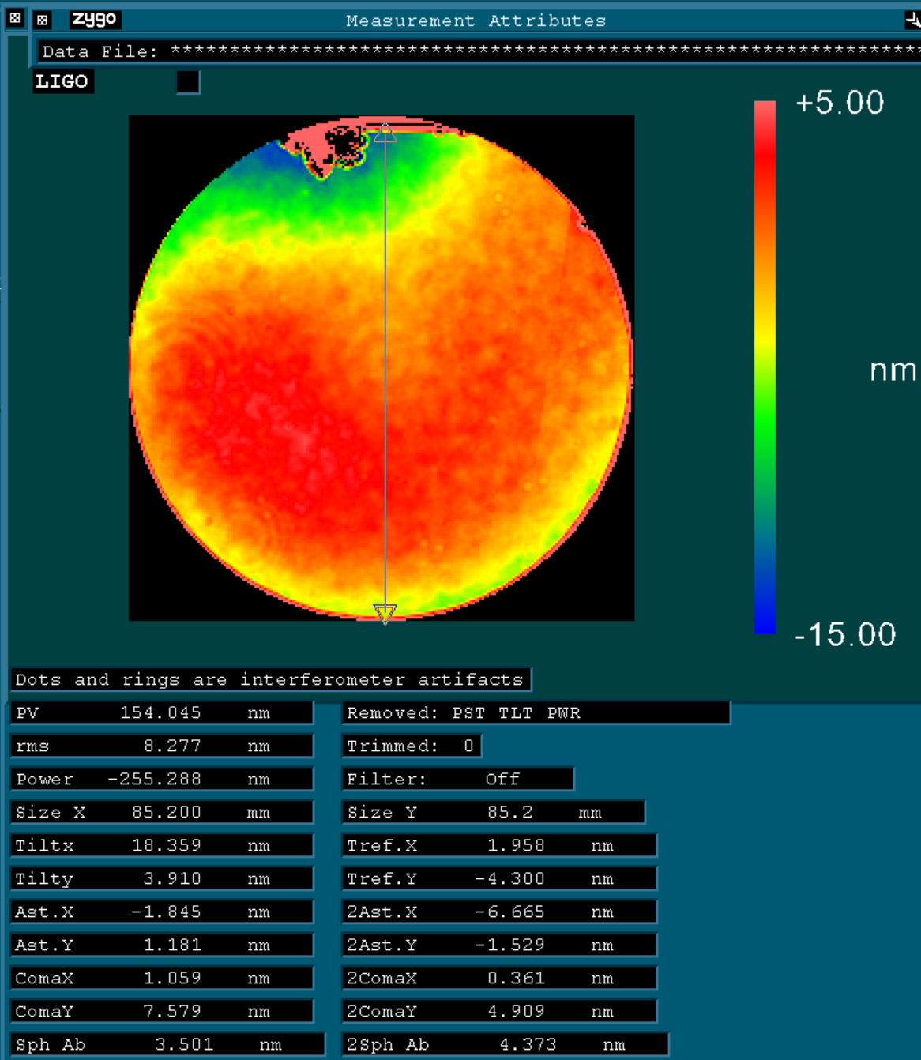
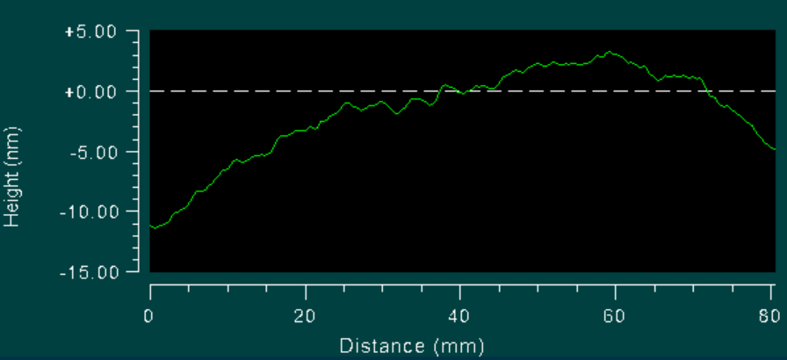
Subtracted Data
(shows coating only)

Slide 5
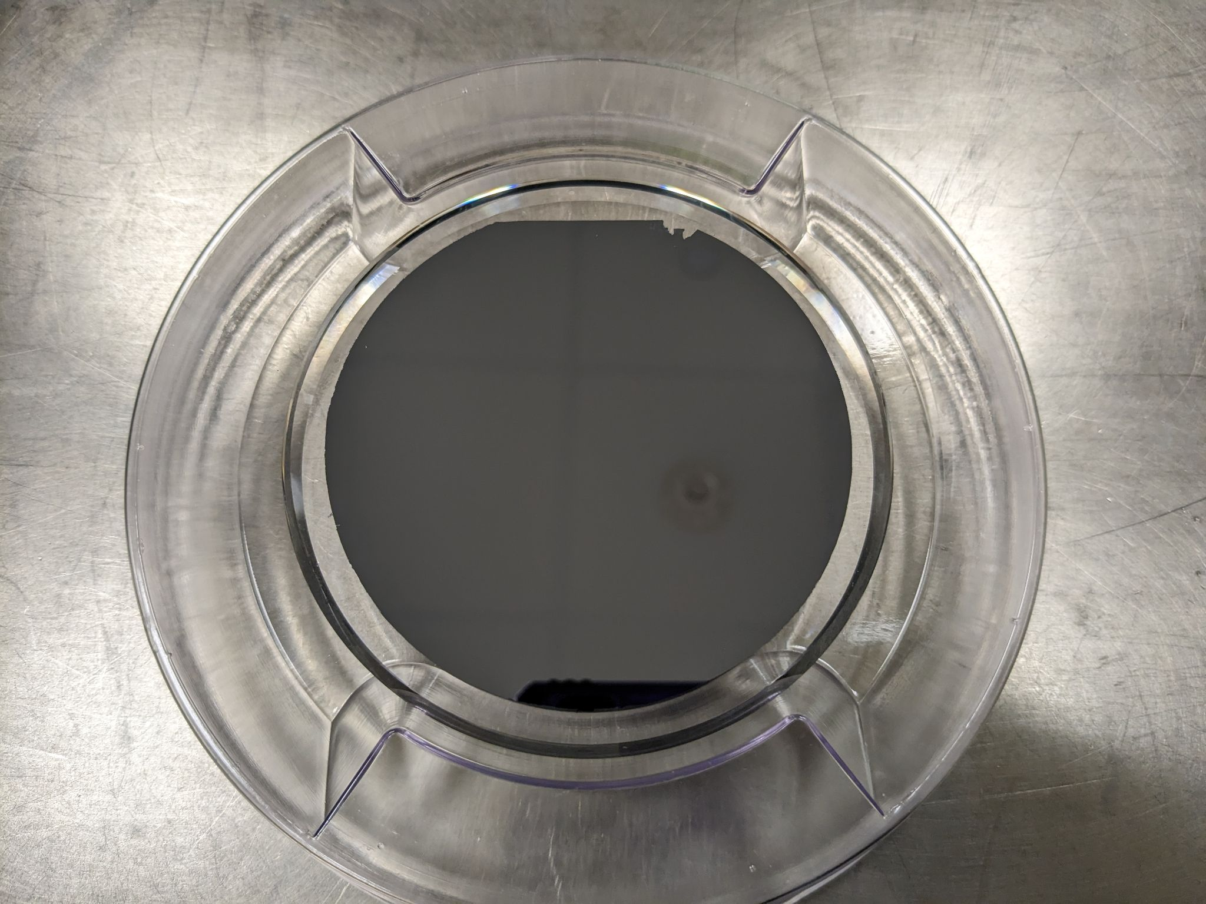
CMS-100-04
(coated with AlGaAs)
Note: Photos are flipped in horizontal direction to be comparable to Zygo images.

Slide 6
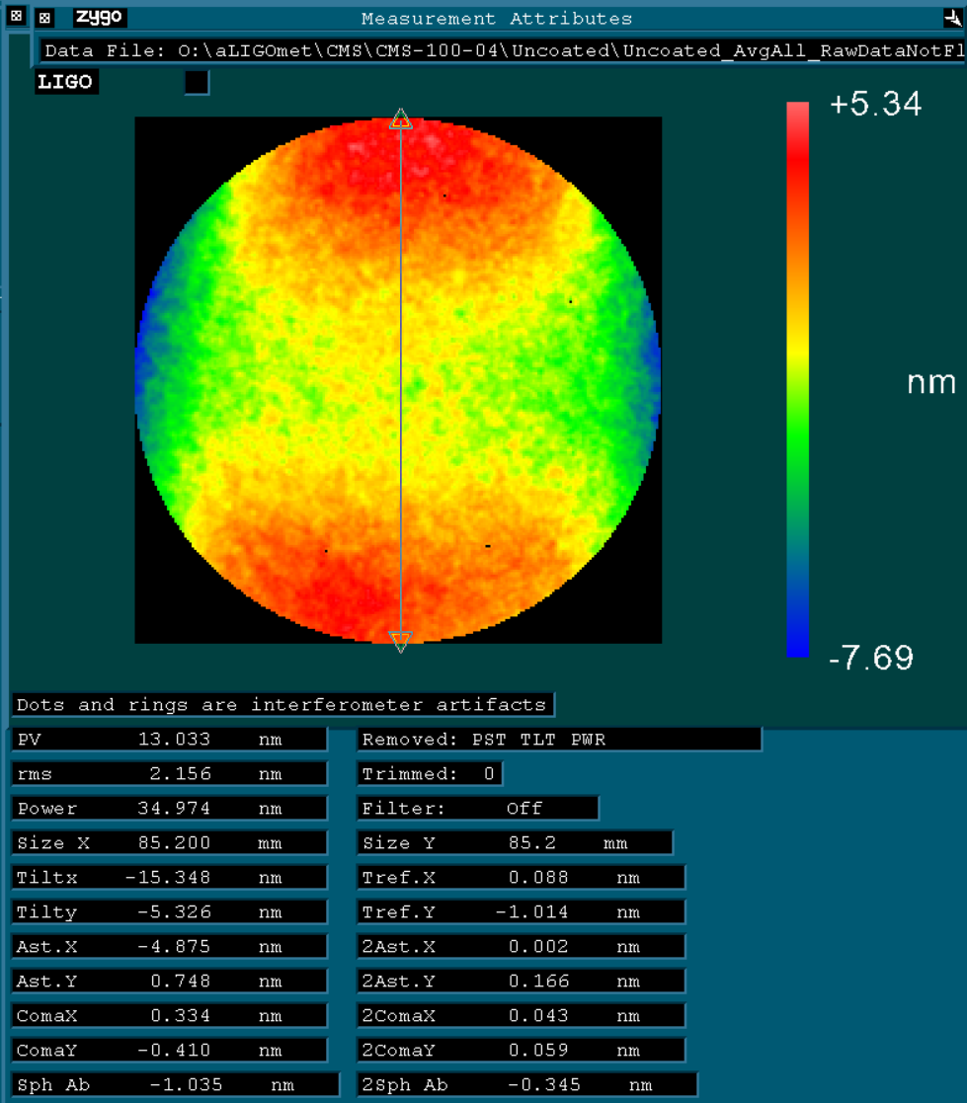
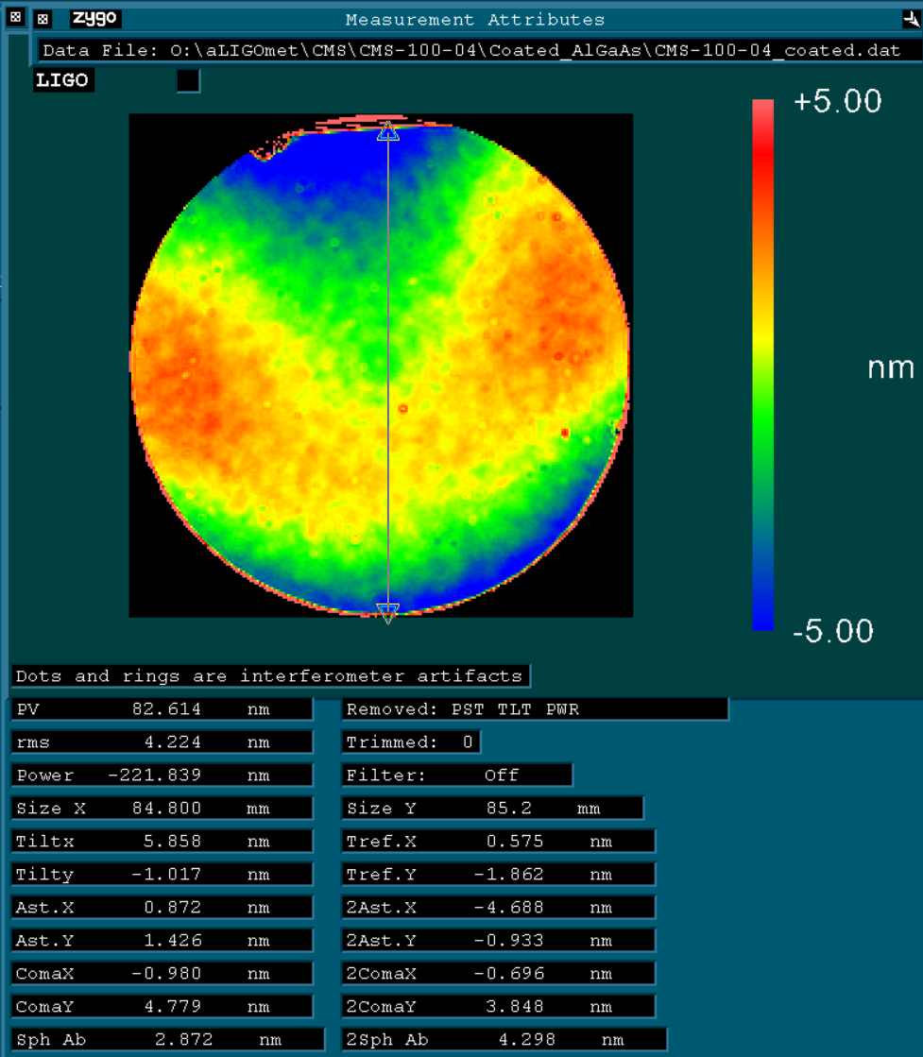
CMS-100-04
Uncoated
Coated

Slide 7
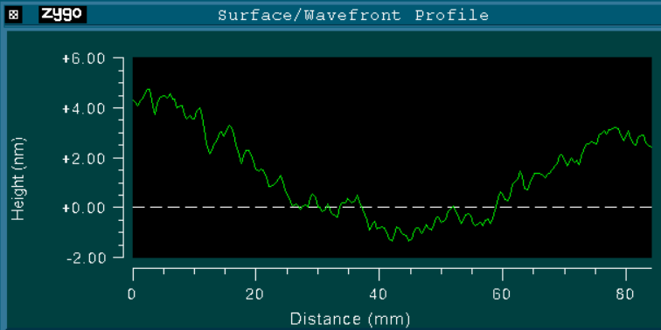
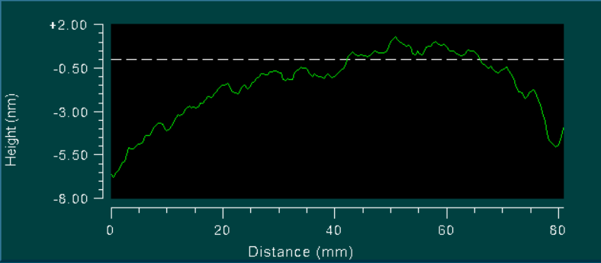
CMS-100-04
Surface Profiles
Uncoated
Coated

Slide 8
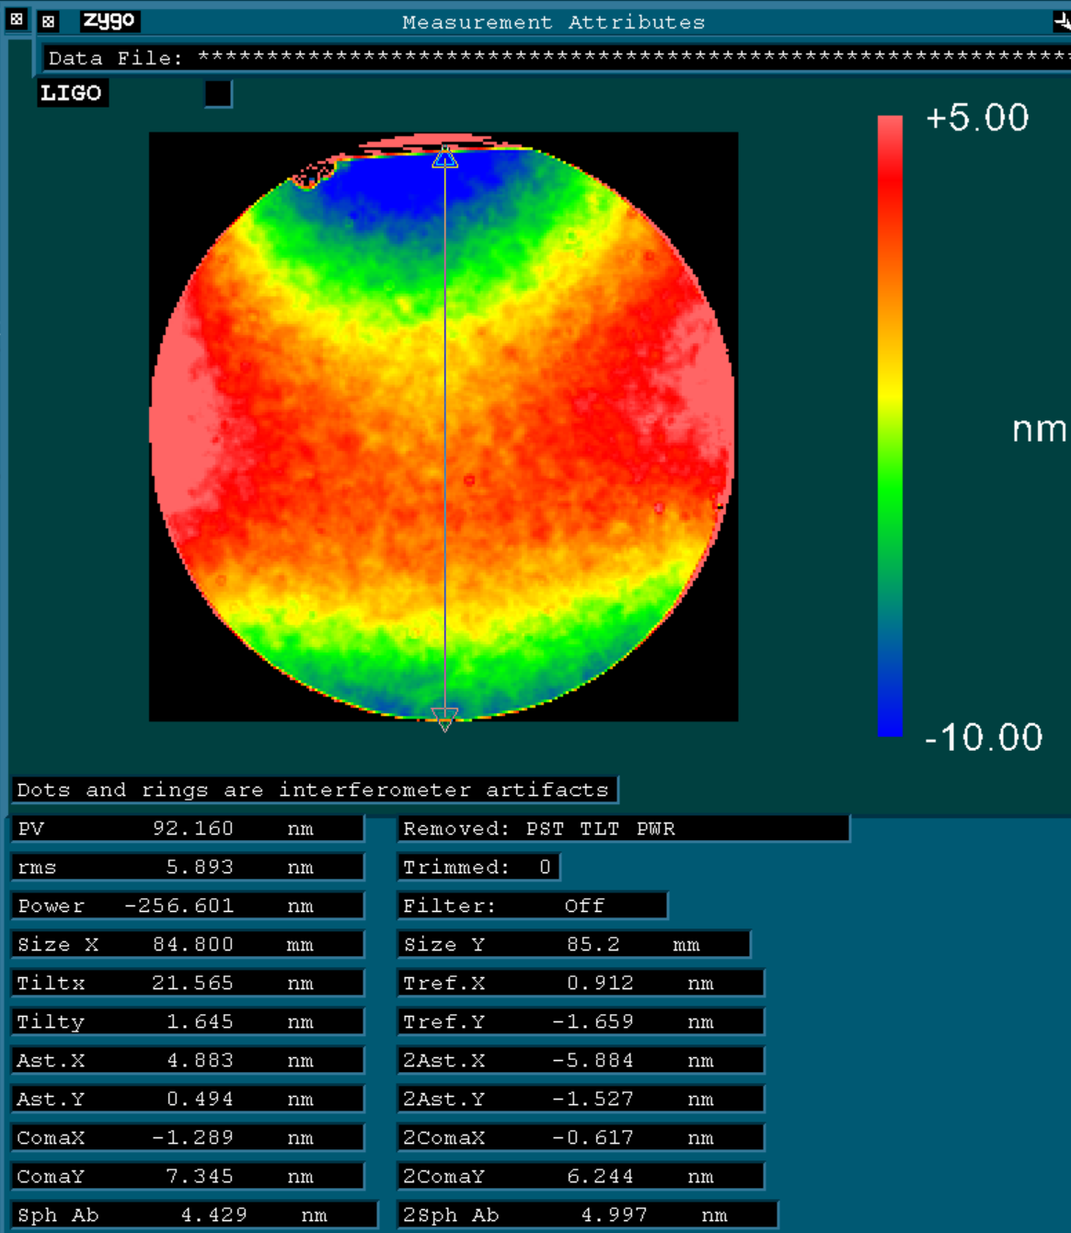
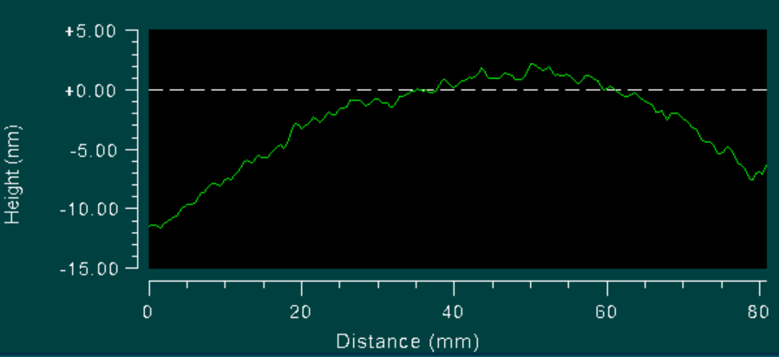
Subtracted Data
(shows coating only)

Slide 9
Summary
Surface of the substrate does not influence the coated surface profile
Both coatings are very similar in their surface profiles and Zernike coefficient values
Zernike coefficients
  Biggest change is power
  Astigmatism and Coma → Second order Zernike coefficients range from ~4-7 nm
Correlation with crystalline axis? Which direction?

Slide 10
Back-Of-Coating Measurements

Slide 11
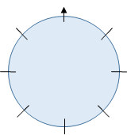
AlGaAs Back-of-Coating Measurements
Summary of previous measurements:
Substrate was rotated through different angles and averaged
Measured surface of coated & uncoated substrate
Both coated samples had similar surfaces after coating
Coating Uniformity measurements:
Measure back side of coating
→Data from back of coating is scaled and flipped in X
→Take difference between front and back to see uniformity

Slide 12
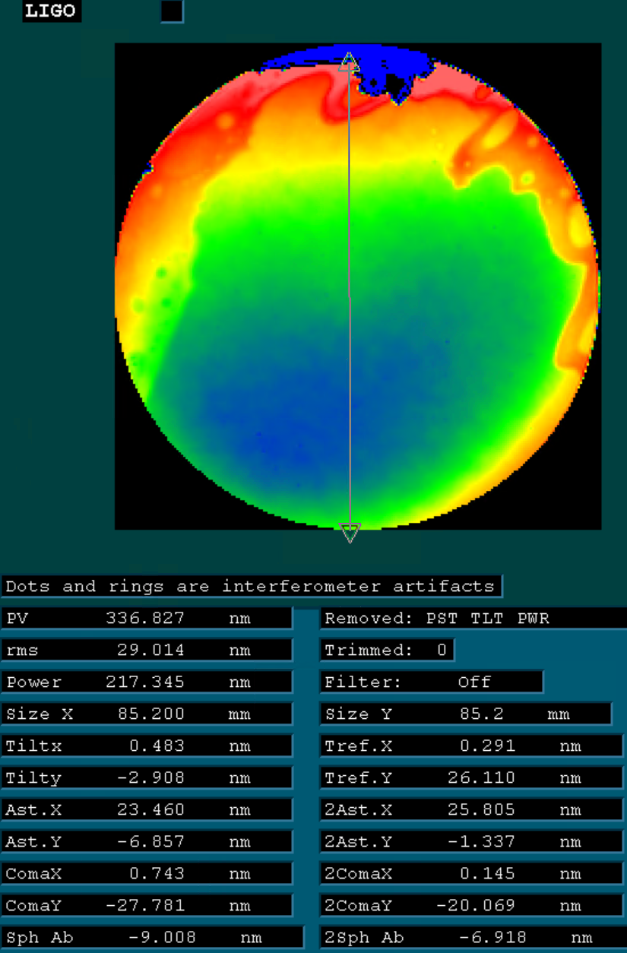
Data as collected by Zygo.
CMS-100-03
Uncoated
Coated
Back of Coating

Slide 13
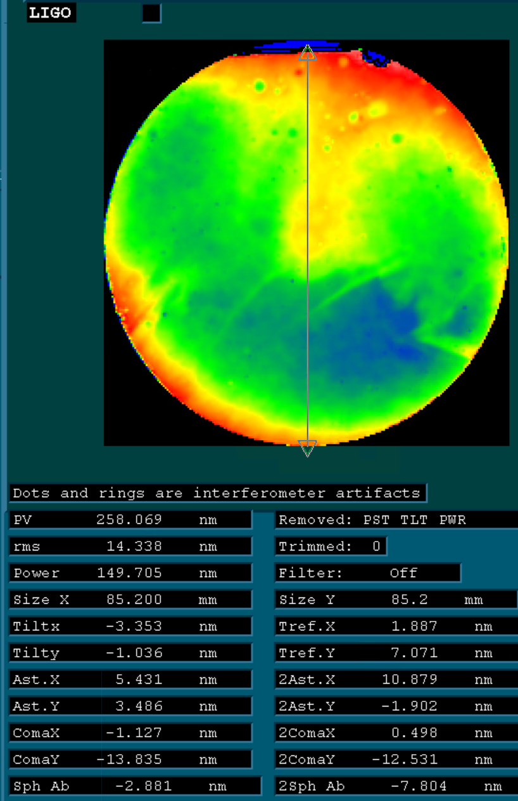
Data as collected by Zygo.
CMS-100-04
Uncoated
Coated
Back of Coating

Slide 14
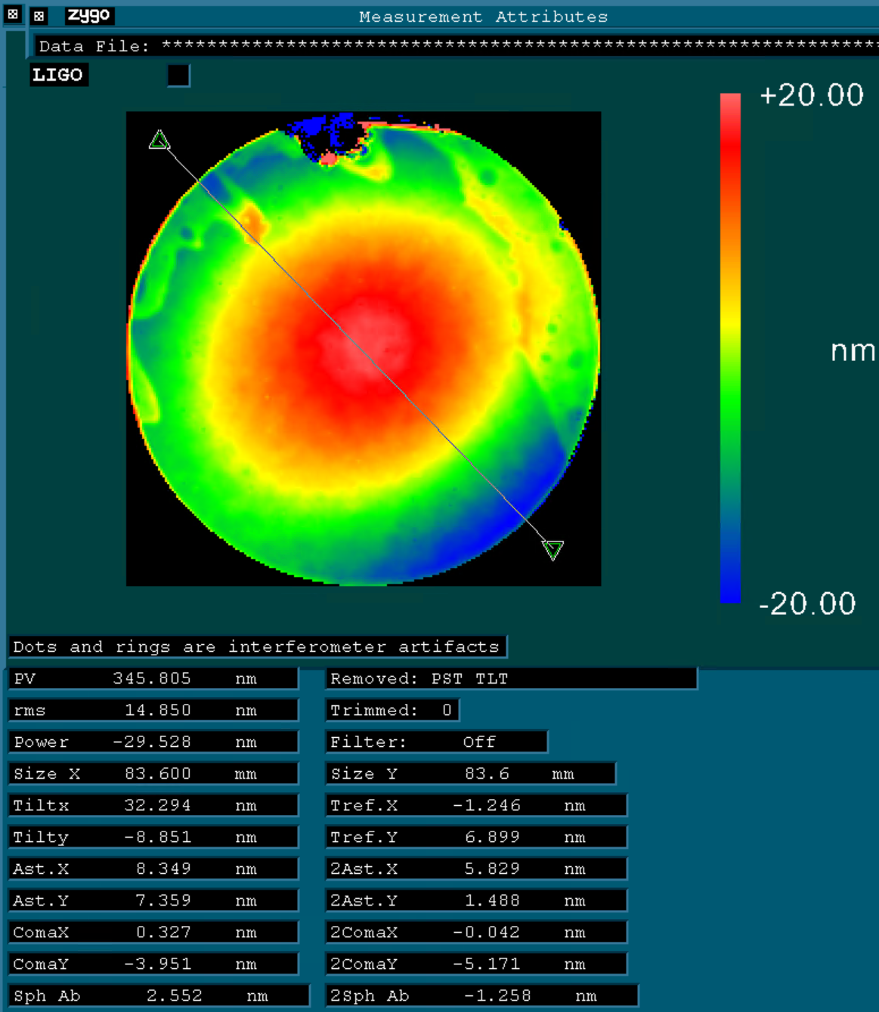
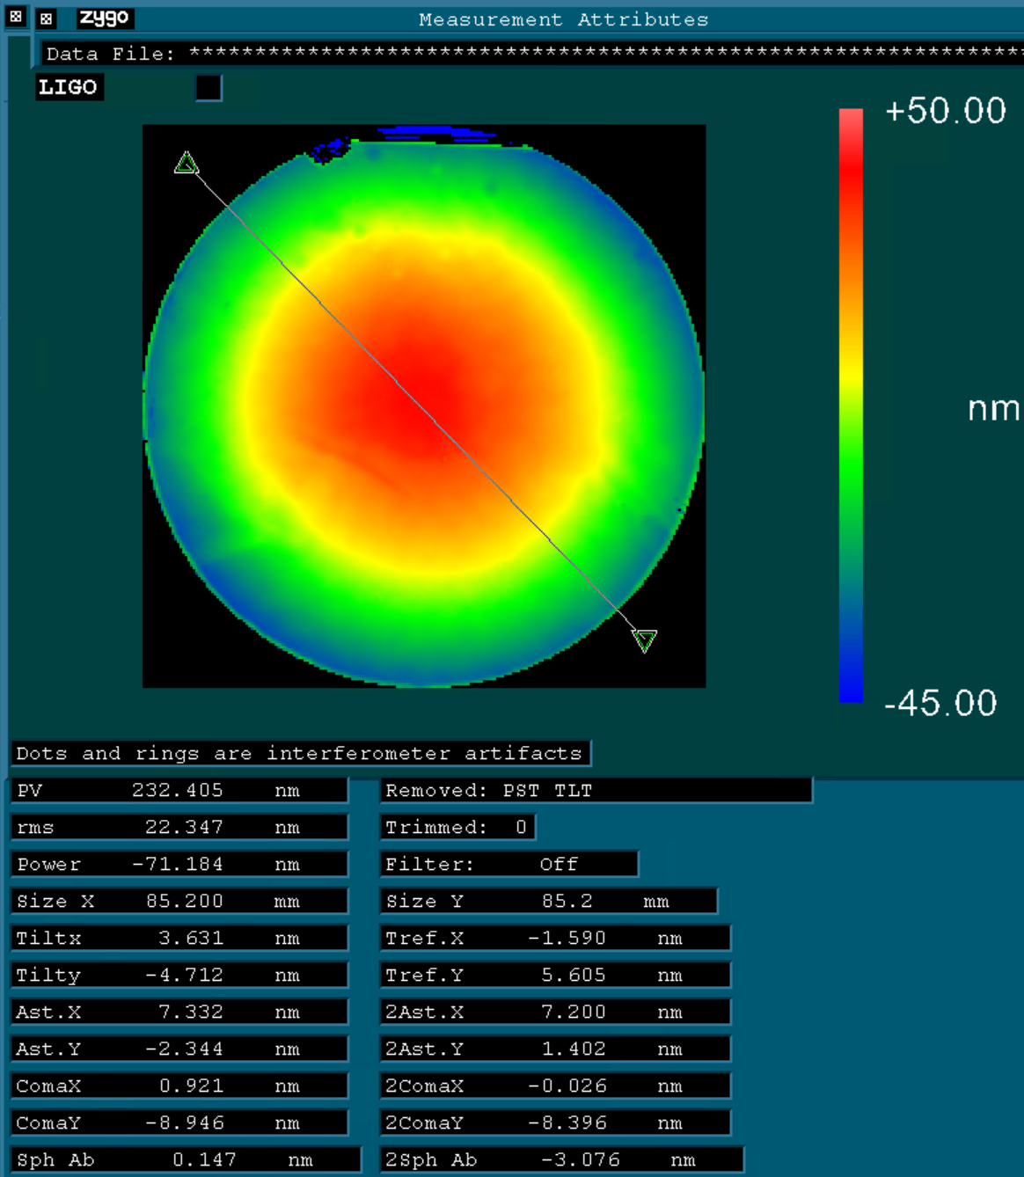
COATING UNIFORMITY: Difference between front & back
CMS-100-03
CMS-100-04

Slide 15
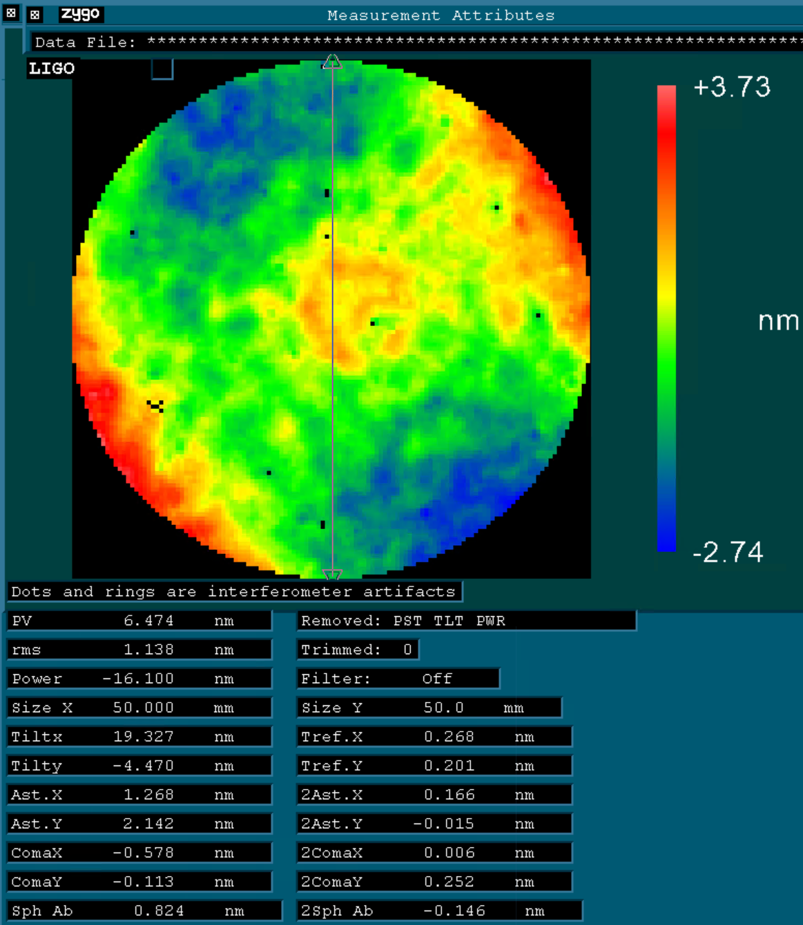
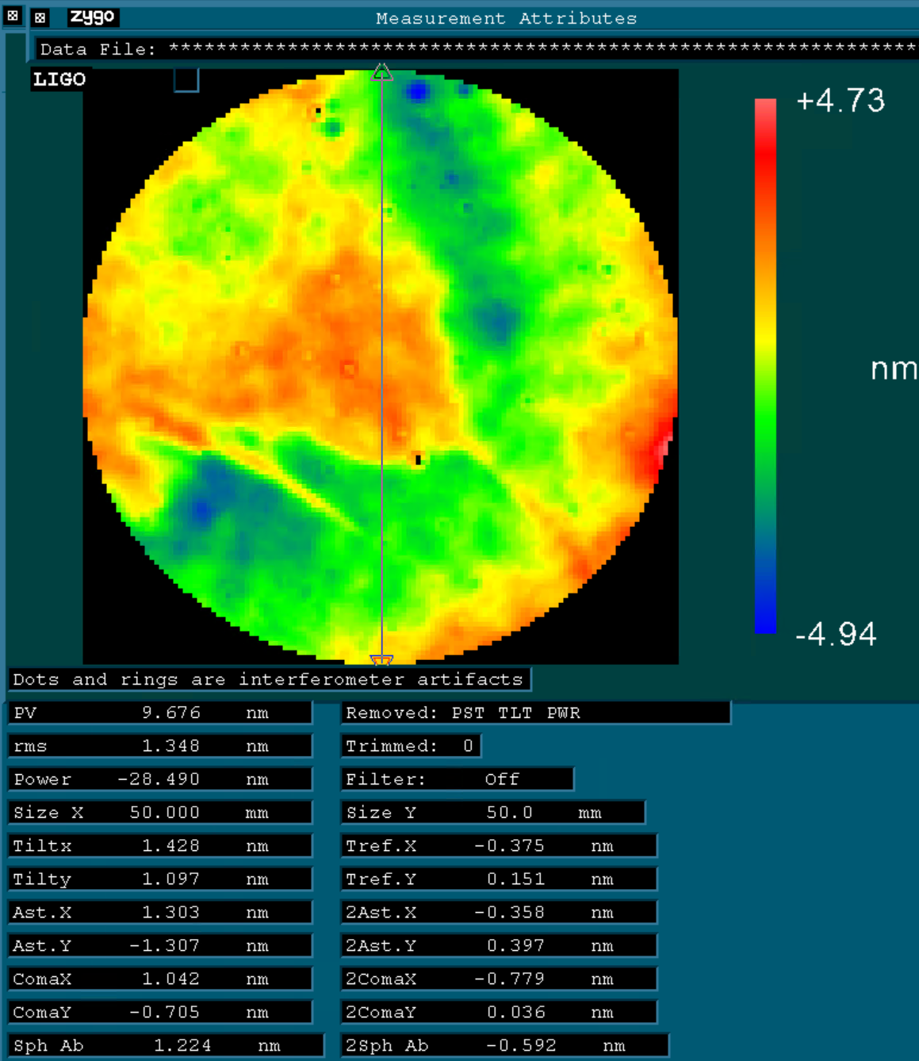
COATING UNIFORMITY: 50mm aperture (power removed)
CMS-100-03
CMS-100-04

Slide 16
Notes
Coating is thicker at edges
→Uncoated substrate is flat
→Stress on substrate
Zernike Coefficients
→ Power is dominant
→ Other Zernike values are very low; most are <1nm, astigmatism ~1-3nm

