Slide 1
CDS Hardware Update
High Reliability Ultra-Fast Shutter (HRUF)
D2200426-v1
Update 11/22/23
Dean Schaetzl for the CDS group
LIGO-G23xxxxx-v1

Slide 2
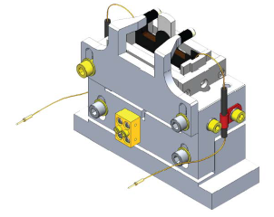
Fast Shutter Upgrade
High Reliability Ultra Fast (HRUF)
Responsible: D. Schaetzl
Updated: September 25, 2023
ECR: E1900177 DCC: E1900180
Why do we have a Fast Shutter?
Optical energy stored in the LIGO arms during normal interferometer (IFO) operation is dumped into the antisymmetric (AS) port upon loss of lock. The stored energy can be of order 50J, which appears at the AS port as an optical transient lasting a few tens of milliseconds. In order to protect sensitive photodetectors in the AS port beampath from damage, a shutter is required to quickly block the laser beam upon a lock-loss event
Current Fast Shutter design (D1003318)
Wires are attached to the moving parts
Work Hardening
Arresting of the shutter is done mechanically with hard-stops
Stress
Debris
Physical Shock (Stopping)
New electro-magnetic ultra-fast shutter design of a moving
payload consisting of magnets and a mirror with no wires attached
A non-moving coil requiring electrical attachment.
Self Arresting

Slide 3
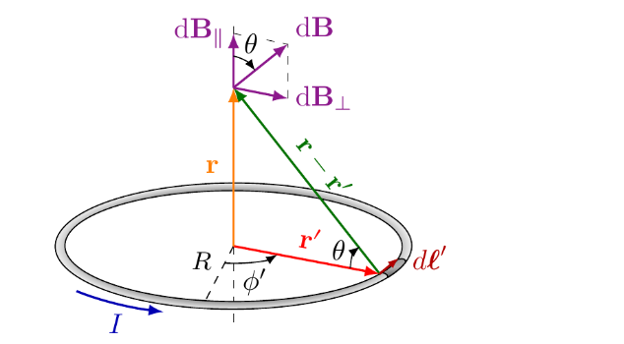
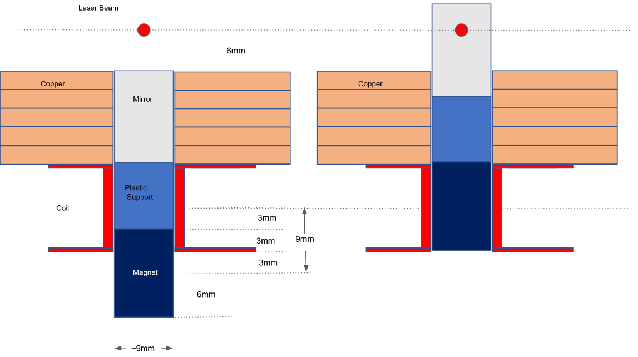
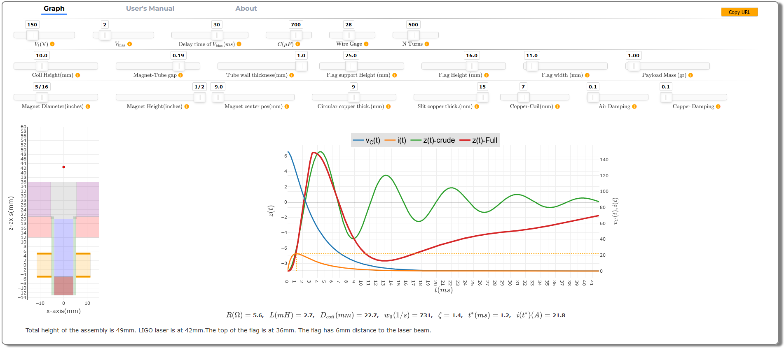
Fast Shutter Upgrade
High Reliability Ultra Fast (HRUF)
How do we make it better?
We first want to build a mathematical model of the
system to understand the parameters we can tune
to optimize the behavior. (modeling by Serkay Ölmez)
Real-Time Fast Shutter Simulator

Slide 4
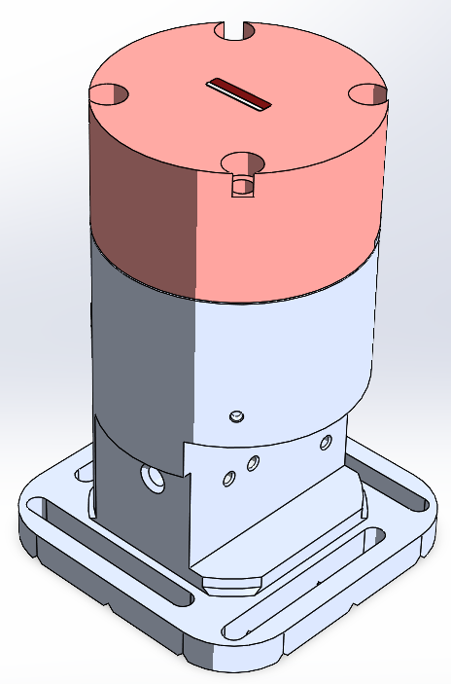
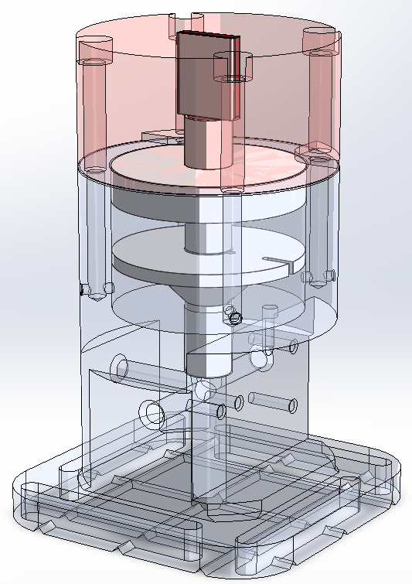
Fast Shutter Upgrade
High Reliability Ultra Fast (HRUF)
A prototype was constructed and studied to create a moving shutter without the need for wires attached to the payload
High-Reliability Ultra-Fast Mechanical Shutter (HRUF) Assy D2200426

Slide 5
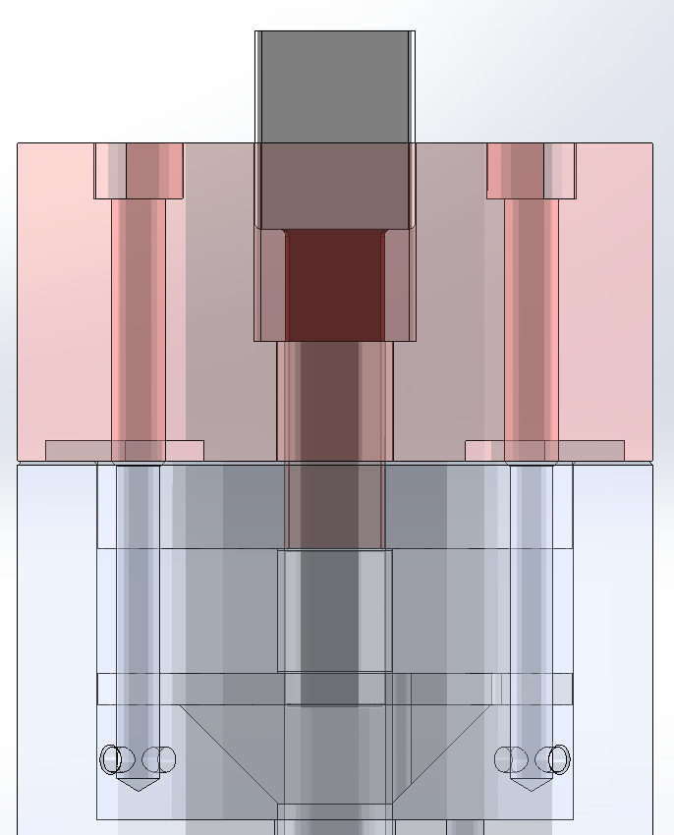
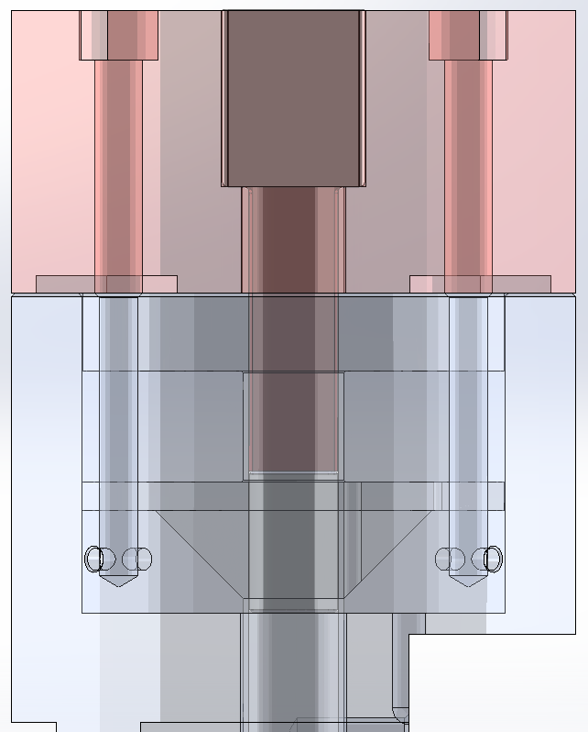
Fast Shutter Upgrade
High Reliability Ultra Fast (HRUF)
How Does it Work?
Magnet and flag rest on the flag shoulder just inside the coil
When activated the magnet pulls up into the coil raising the flag
The magnetic field interacts with the copper plate and arrests the flag
A holding current keeps the flag raised
Falls back under gravity
Mirror
Shoulder
Flag
Coil
Magnet

Slide 6
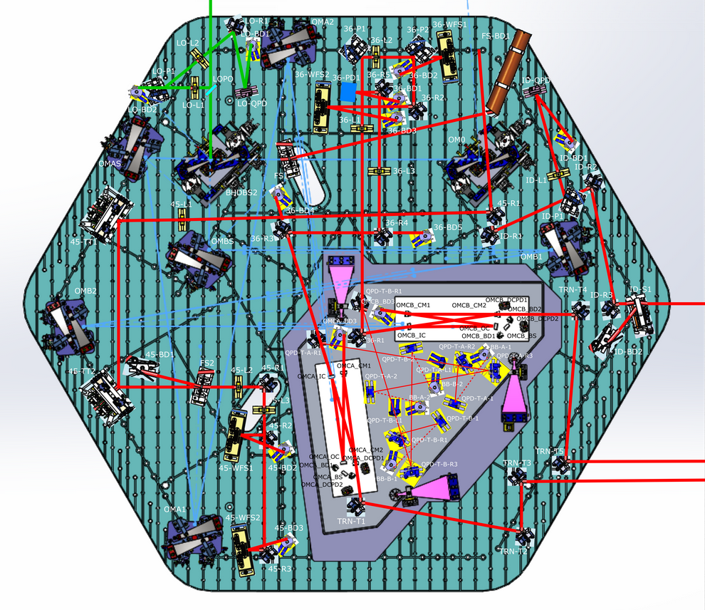
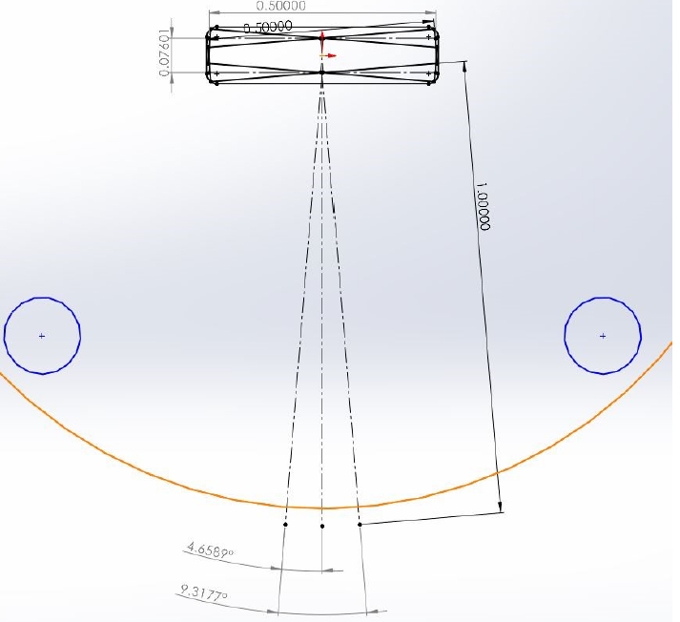
Fast Shutter Upgrade
High Reliability Ultra Fast (HRUF)
What have the issues been?
The throw to the beam-dump is relatively long so any rotation of the FS mirror on deployment could swing and “paint” the chamber
Tolerances must be kept very tight while still allowing free movement of the flag
Beam Dump
Shutter

Slide 7
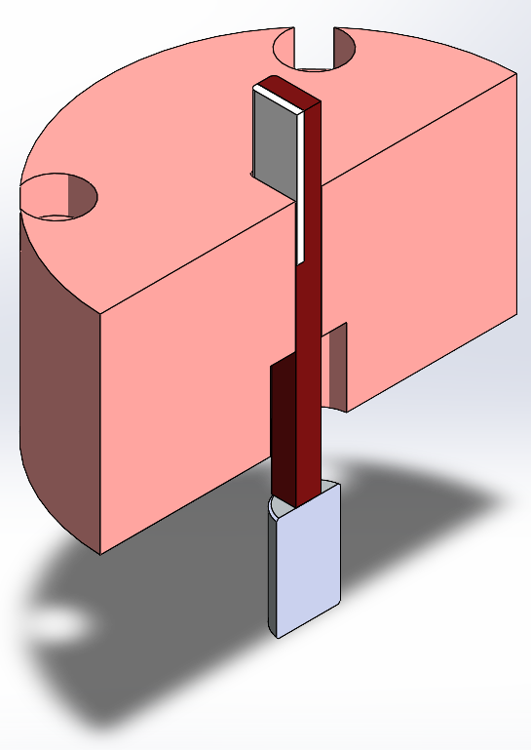
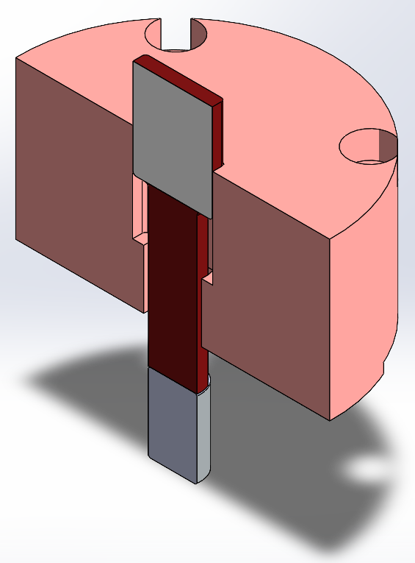
Fast Shutter Upgrade
High Reliability Ultra Fast (HRUF)
What have the issues been?
How do you assemble it?
What order?
Magnet-to-Flag
Mirror-to-Flag
The magnet doesn’t fit through the copper plate (square peg in a round hole)
The mirror cannot be attached when the flag is in the copper

Slide 8
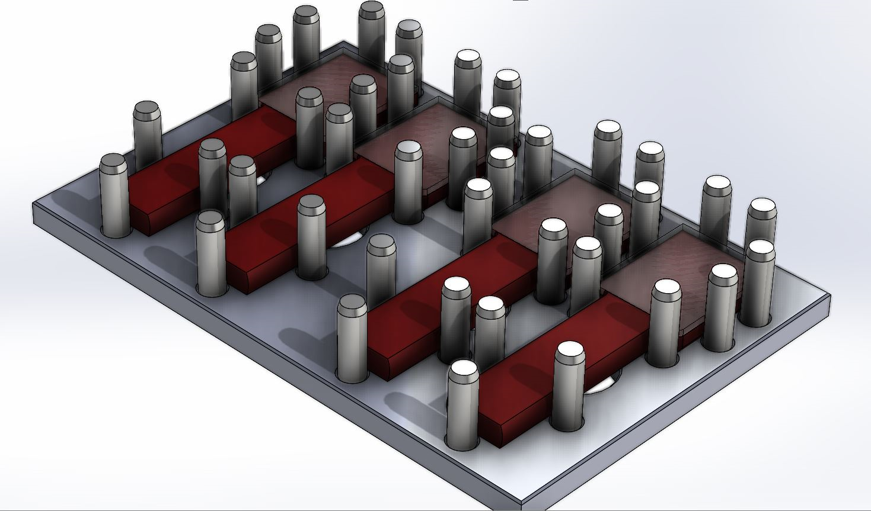
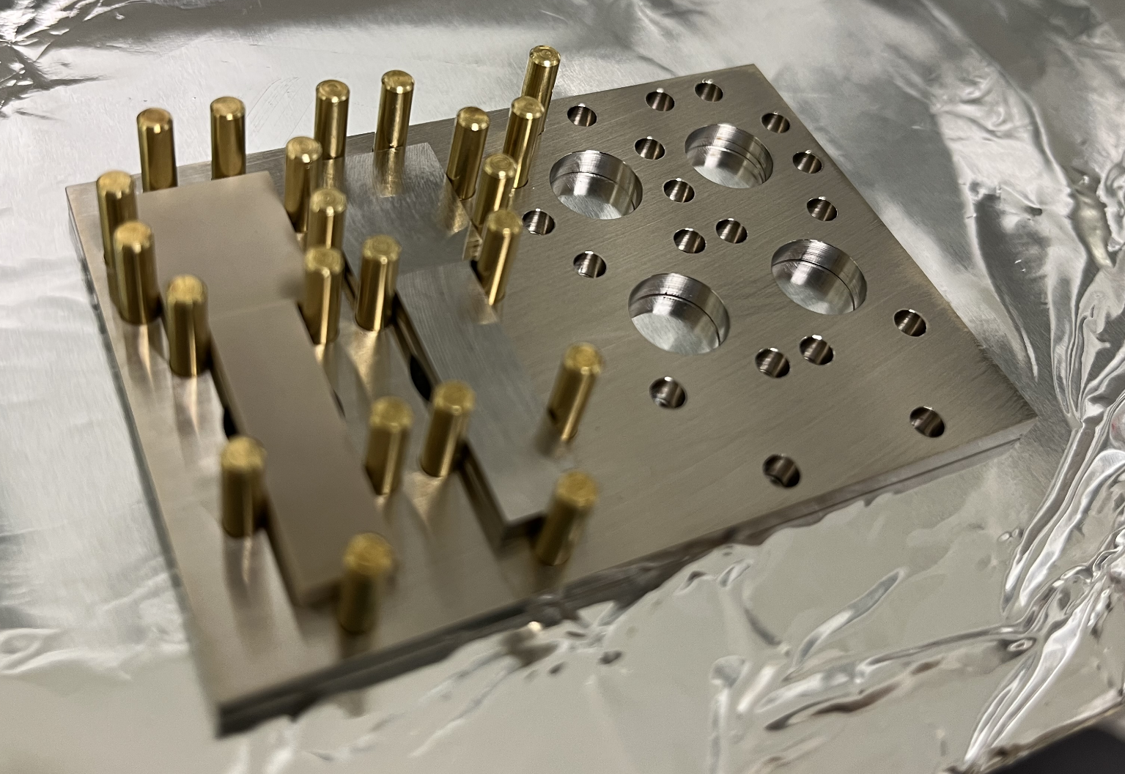
Fast Shutter Upgrade
High Reliability Ultra Fast (HRUF)
What have the issues been?
The mirror cannot be attached when the flag is in the copper
Mirror-to-Flag Fixture D2300217
Holds the flags still and positions the mirrors correctly for glue-up

Slide 9
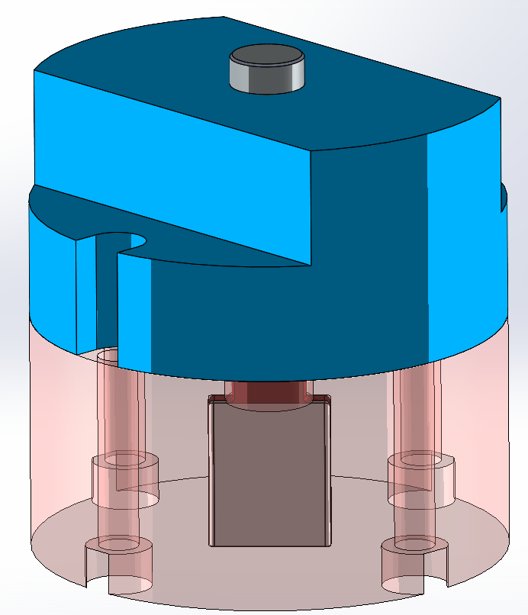
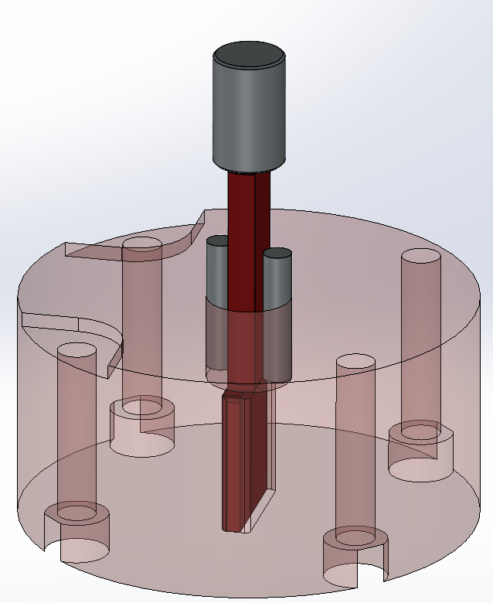
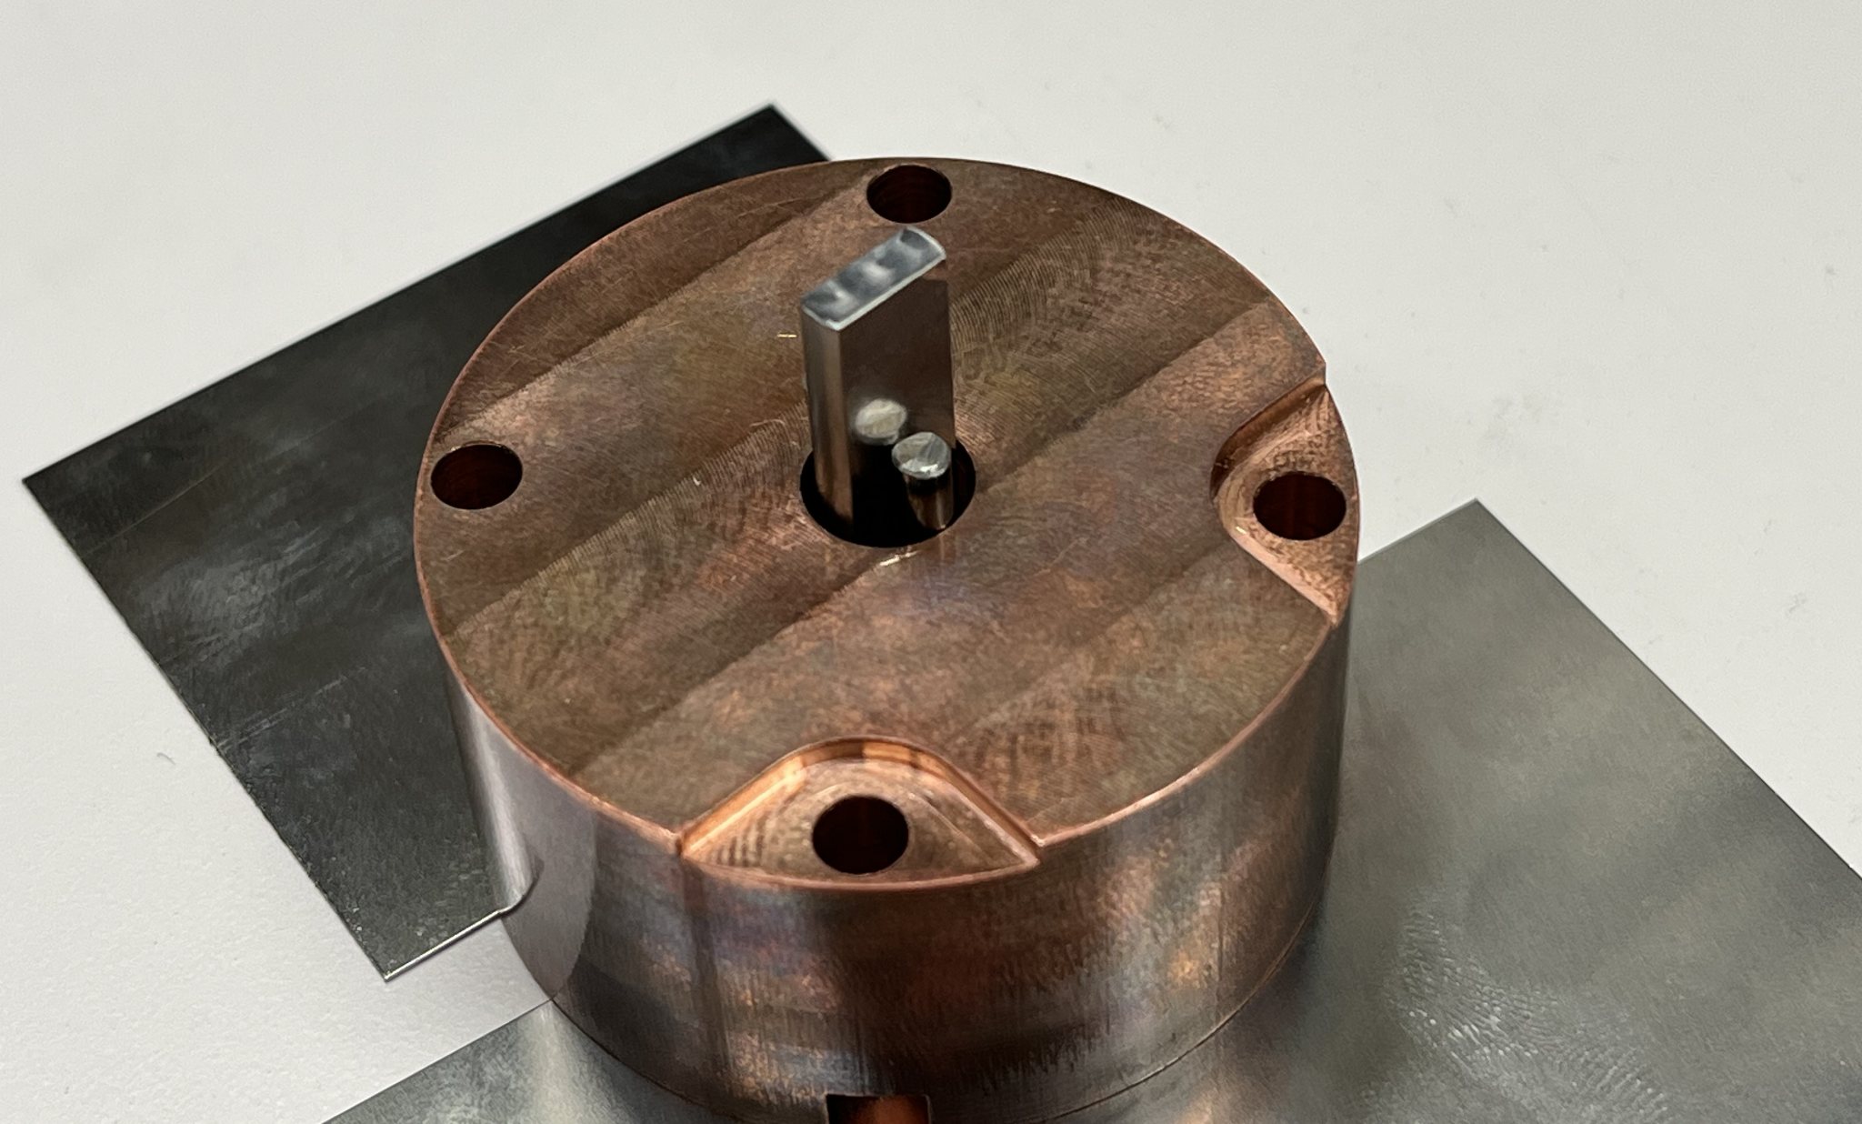
Fast Shutter Upgrade
High Reliability Ultra Fast (HRUF)
First Attempt
We first attempted to glue a magnet-to-flag
The EP-30 Epoxy used was past expiration and did not properly cure
Precision pins were used to hold the flag relative to the copper and fixture but were still too magnetic and twisted during assembly

Slide 10
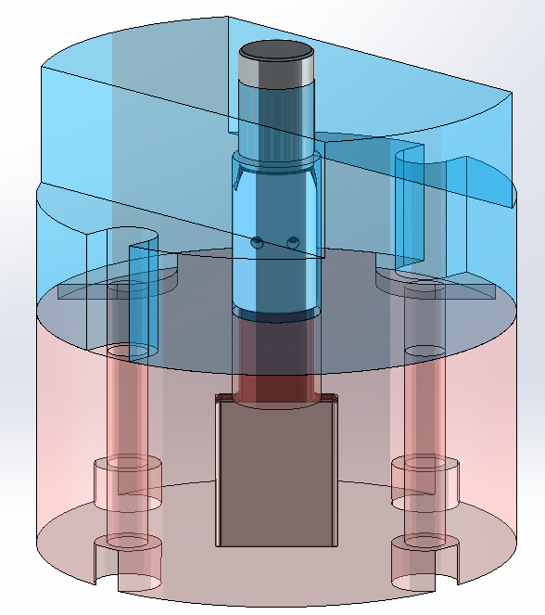
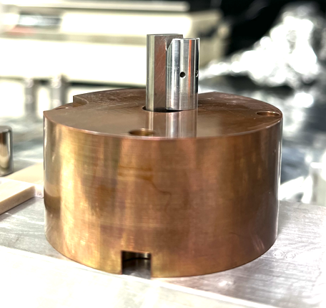
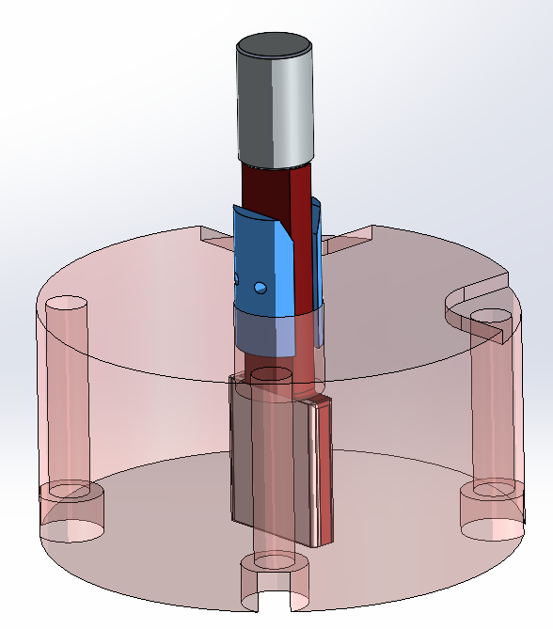
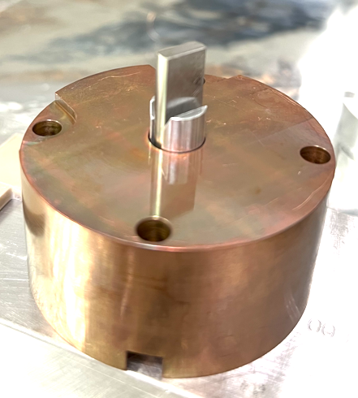
Fast Shutter Upgrade
High Reliability Ultra Fast (HRUF)
Magnet-to-Flag Fixture D2300218
The “Pac-Man” was developed to hold the flag and copper relative to the fixture
Must be short enough to be removed when the magnet is glued, but long enough to bridge the transition of the pieces
Pac-Man

Slide 11
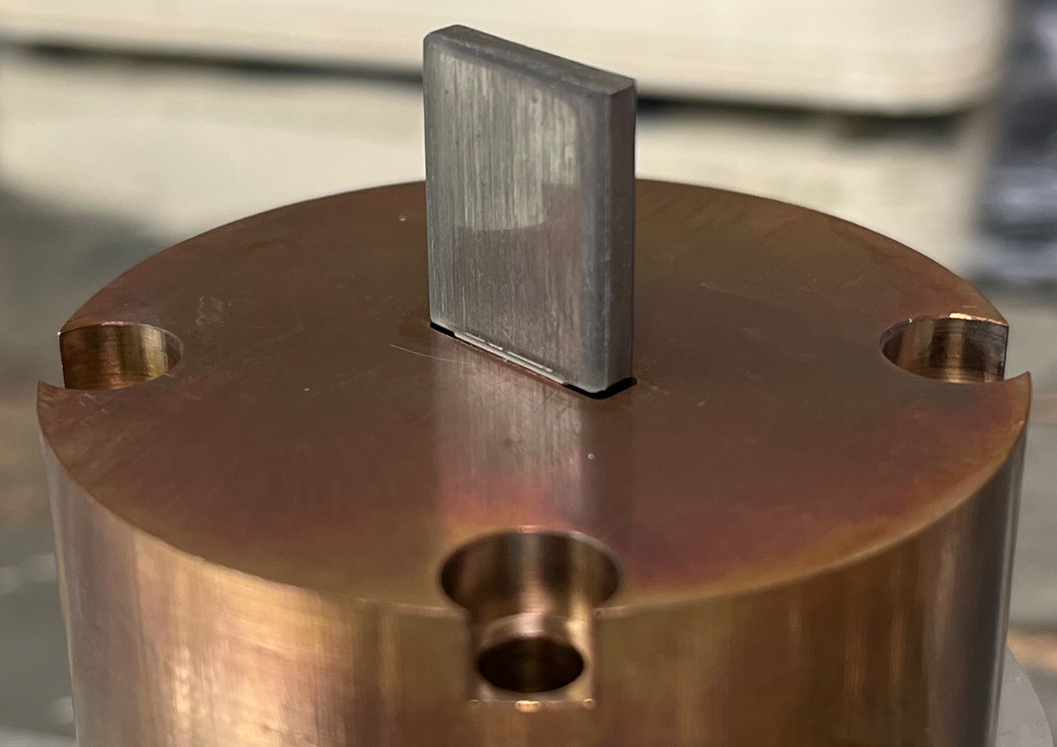
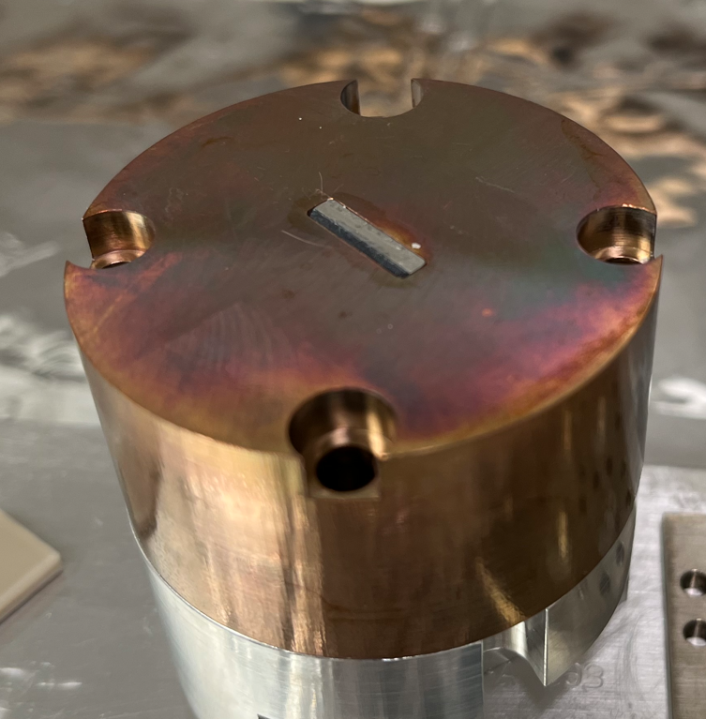
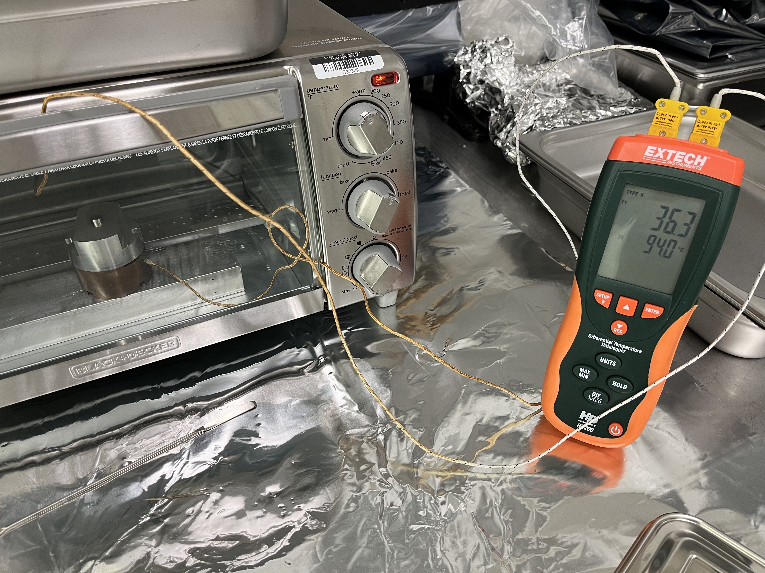
Fast Shutter Upgrade
High Reliability Ultra Fast (HRUF)
Gluing the Mirror-to-Flag
Gluing successful
Mirror Edges not beveled
Tolerance revenge!
Manual shaping of test optics
The depth of the mirror on the flag with the epoxy is
tight and does not always fall smoothly
v2 = 0.005” taken out the flag thickness at the mirror

Slide 12
Fast Shutter Upgrade
High Reliability Ultra Fast (HRUF)
Initial test firing
Does not fall back down
Does not seem to break
Slow-Mo(ish)
Real-Time

Slide 13
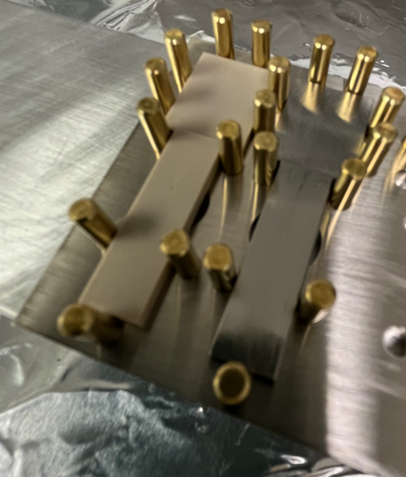
Fast Shutter Upgrade
High Reliability Ultra Fast (HRUF)
Timeline
All of the physical parts are in-hand or in production as of 9/13
Magnets and mirrors need to be epoxied together
Testing once the assembly is complete
Expenditures for 4 complete assemblies
Main Bodies S615433 $4809.11
Flag-to-Mirror Jig S612944 $1132.27
Magnet-to-Flag Jig S607572 $523.69
Copper Plates S587290 $1821.33
Bobbins S586150 $1296.54
Flags (Ti & PEEK) S603440 $2443.14
Terminal Cover S616093 $1885.25
Ti Flags, Pac-Man S621897 $3569.90
10/25/23
First epoxy test failed. Expired epoxy?
Parts sent to C&B for a proper Class B clean
10/23 Parts back from C&B
10/24 Test optic glued to flag
One PEEK and one Titanium
10/27 Glue successful
Flag thickness possible issue
Flag redesigned
11/7 New flags, M-to-F jigs arrived
Class B clean
11/20 Glue –up failed
11/22 Magnet-to-Flag glue-up curing

