Slide 1
State Estimators for SEI-SUS control
.
Edgard Bonilla, Alec Engl, Brian Lantz
DCC - G2201513

Slide 2
Outline
Motivation
State Estimators
Roadmap
Results (so far)
Conclusions

Slide 3
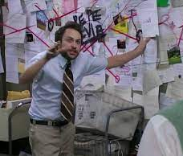
Before we start
How I think I will look:
How I might actually look:

Slide 4
Outline
Motivation
State Estimators
Roadmap
Results (so far)
Conclusions

Slide 5
Motivation
We would like to reduce the control bandwidth of the ISC loops.
We need to reduce the noise in auxiliary degrees of freedom.
Example from SRCL
(From G2001539, G2100193).
ISI motion (below 0.7 Hz)
Coupling from MICH (1-4 Hz)
OSEM noise (4-10 Hz)

Slide 6
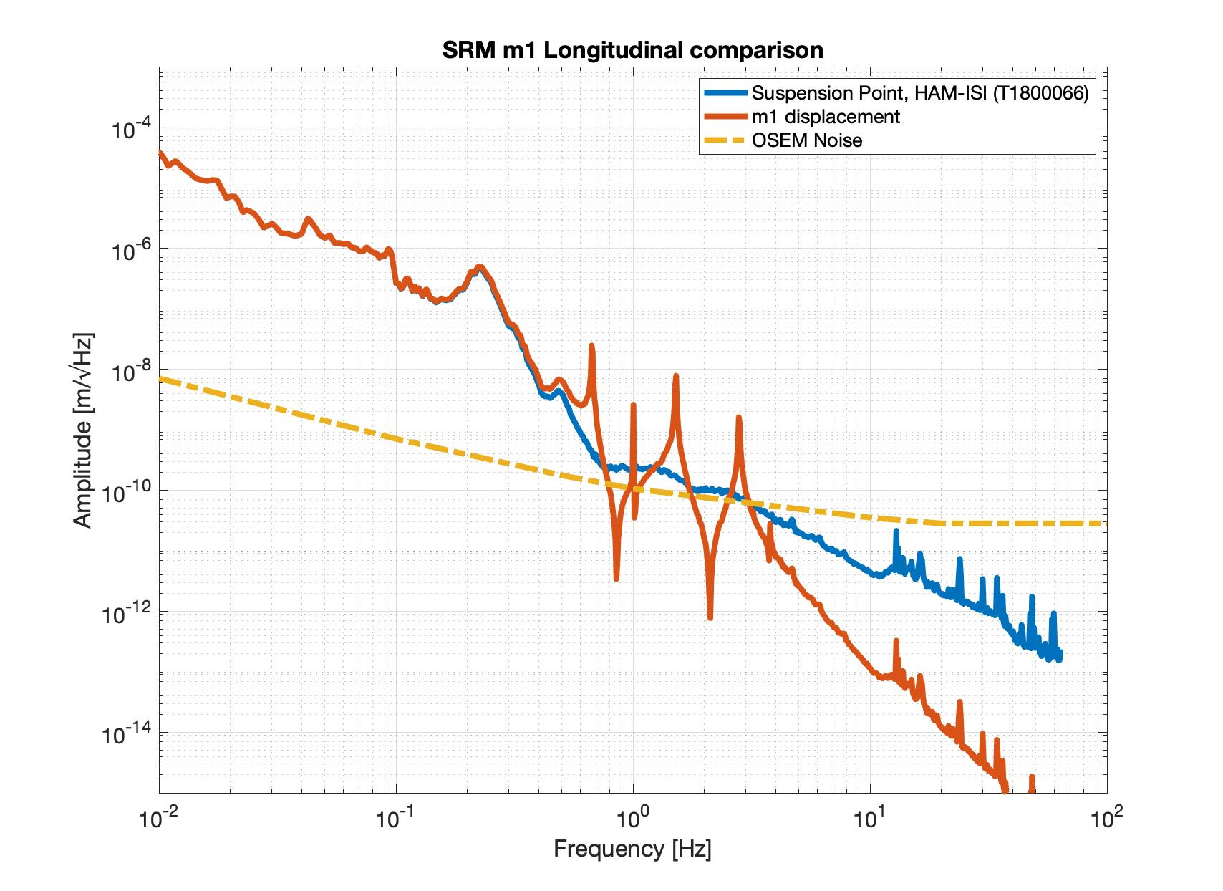
Motivation
What do we do with the OSEMs? (simplified)
Observe and damp resonances
10 times larger than HAM-ISI motion!
1000 times larger than inertial m1 motion!

Slide 7
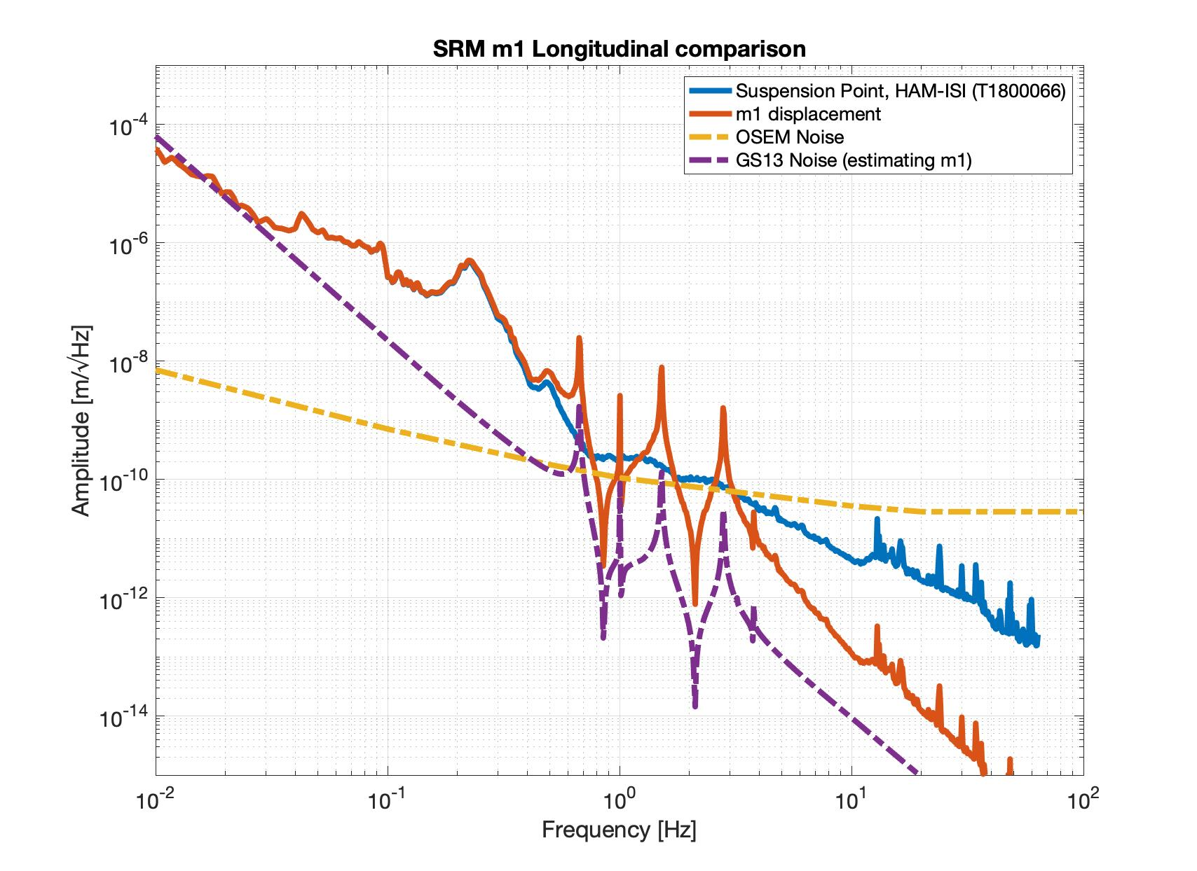
Motivation
Things we can do:
1) Improving the OSEMs
SmarAct (see, for example SWG 11766)
HoQI (see, for example, G2100400)
2) Tuning the damping loops
3) Using the other sensors we already have:
The HAM-ISI GS13 could potentially be used
to infer the m1 motion with good accuracy
BUT:
We need SUS drive information
Modelling errors can be a nuisance

Slide 8
Outline
Motivation
State Estimators
Roadmap
Results (so far)
Conclusions

Slide 9
State Estimators
Sensor measurements
State Estimator
Inferred motion
Drives
of the suspension
Mathematical Model
Especially things that weren’t directly measured
A few options:
Estimator with GS13+drives only.
Kalman Filtering.
Wiener-Hopf filtering.
H-infinity estimators.
Blending OSEMs + (GS13+drives).
Too Many Options!

Slide 10
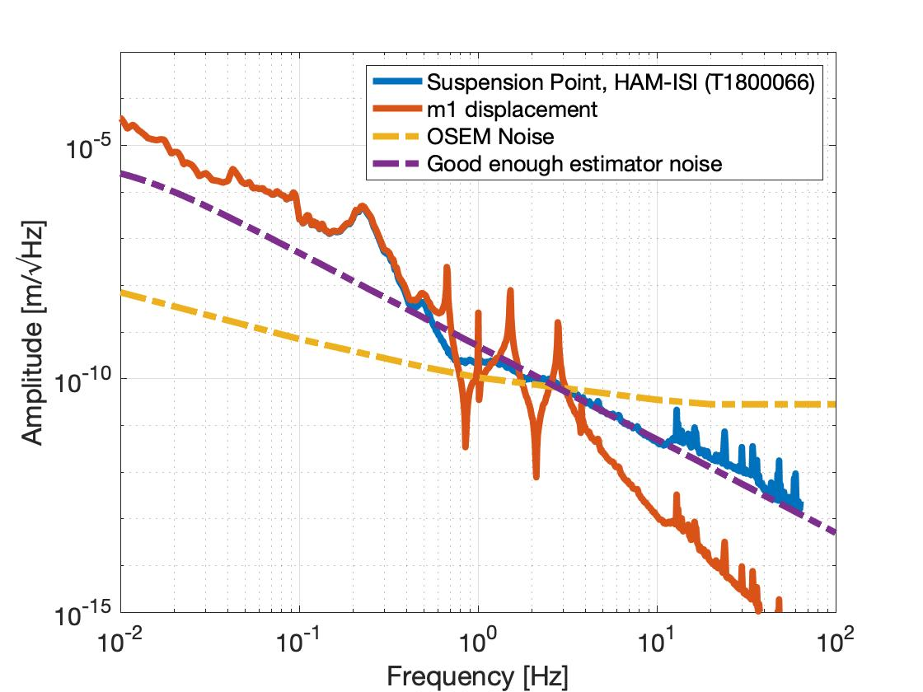
State Estimators
A good enough estimator has (at least) four properties:
Can be used for control (sees the resonances).
Better high-frequency performance than the OSEMs.
Is robust against small modelling errors.
Can be translated well into practice
How do we plan to get there?

Slide 11
Outline
Motivation
State Estimators
Roadmap
Results (so far)
Conclusions

Slide 12
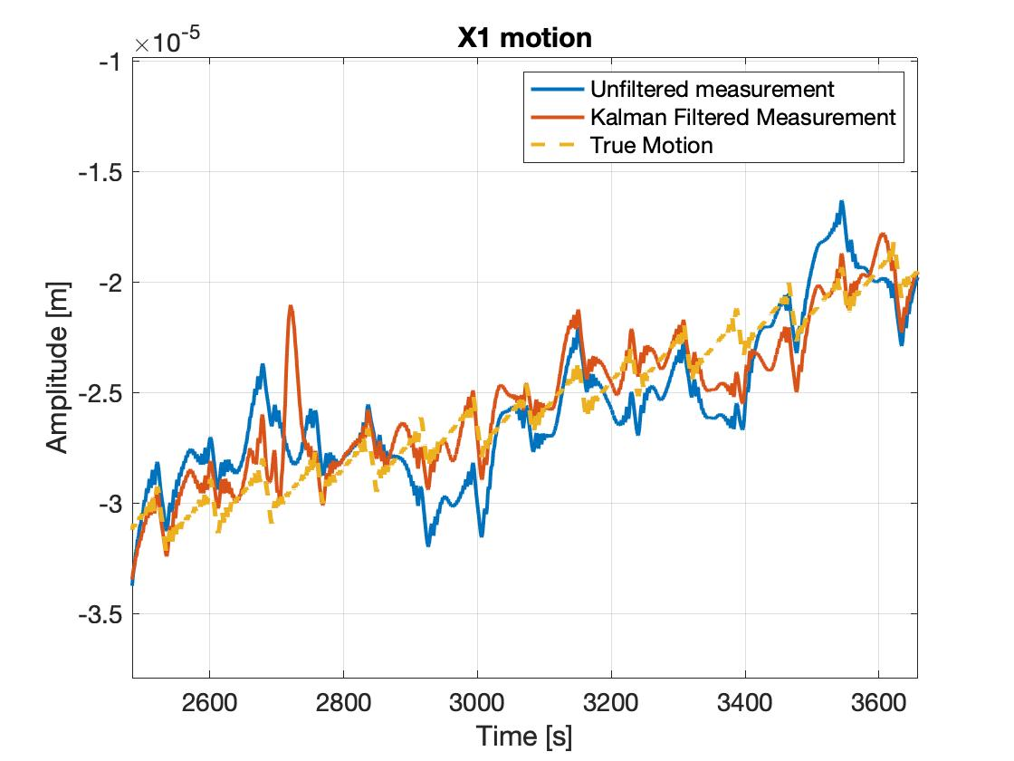
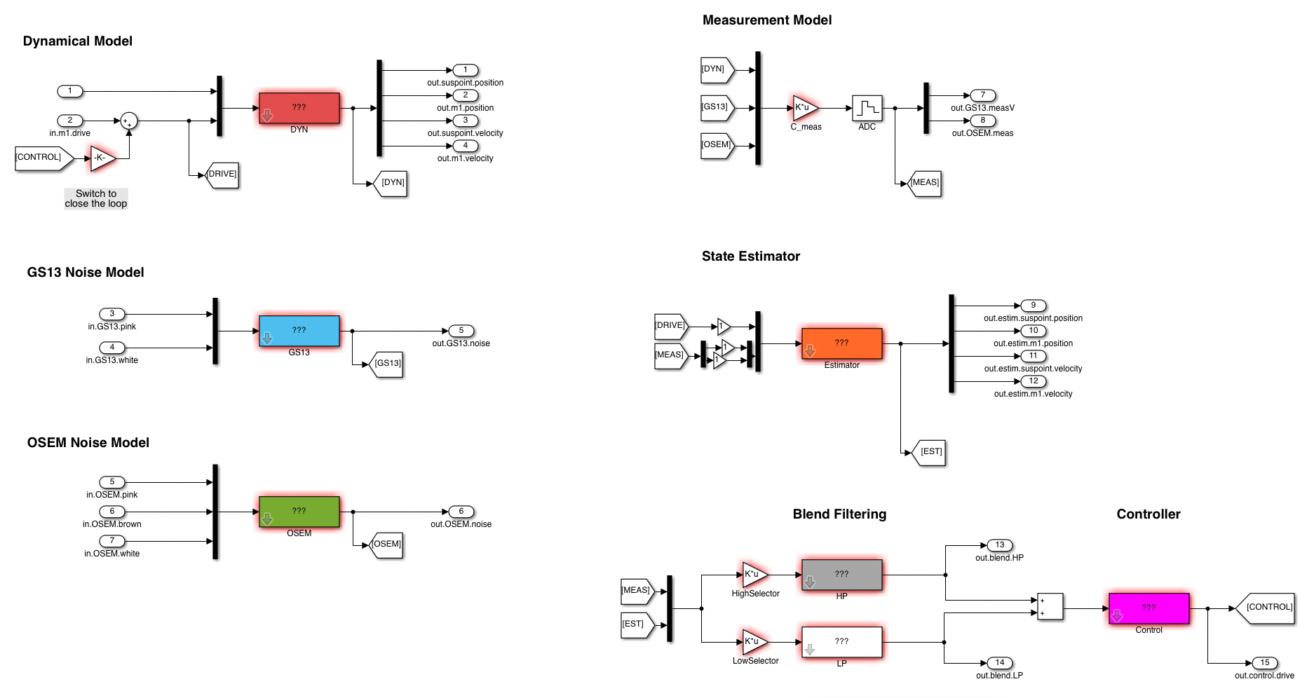
Roadmap:
Exploration (single SUS model)
Gain expertise with state estimators
Identify pitfalls
Identify opportunities
GS13
SEISMIC ISOLATION TABLE
M1
OSEM

Slide 13
Roadmap:
Explore (single SUS model)
Prototype (at the Stanford ETF)
Compare the performance of different estimation techniques
Sort out the difficulties of implementation.
GS13
GS13
$$≈$$
SEISMIC ISOLATION TABLE
STAGE 2
L4C
T240
CPS
M1
STAGE 1
OSEM

Slide 14
Roadmap:
Explore (single SUS model)
Prototype (at the Stanford ETF)
Complexify (triple SUS model)
Identify potential differences and pitfalls
GS13
GS13
SEISMIC ISOLATION TABLE
SEISMIC ISOLATION TABLE
M1
M1
M2
OSEM
OSEM
M3

Slide 15
Roadmap:
Explore (single SUS model)
Prototype (at the Stanford ETF)
Complexify (triple SUS model)
Test (maybe on the Filter Cavity suspensions)

Slide 16
Outline
Motivation
State Estimators
Roadmap
Results (so far)
Conclusions

Slide 17
Results (so far)
Learnings from single SUS model
General learnings
State estimators allow us to do inertial damping.
We want good velocity estimators

Slide 18
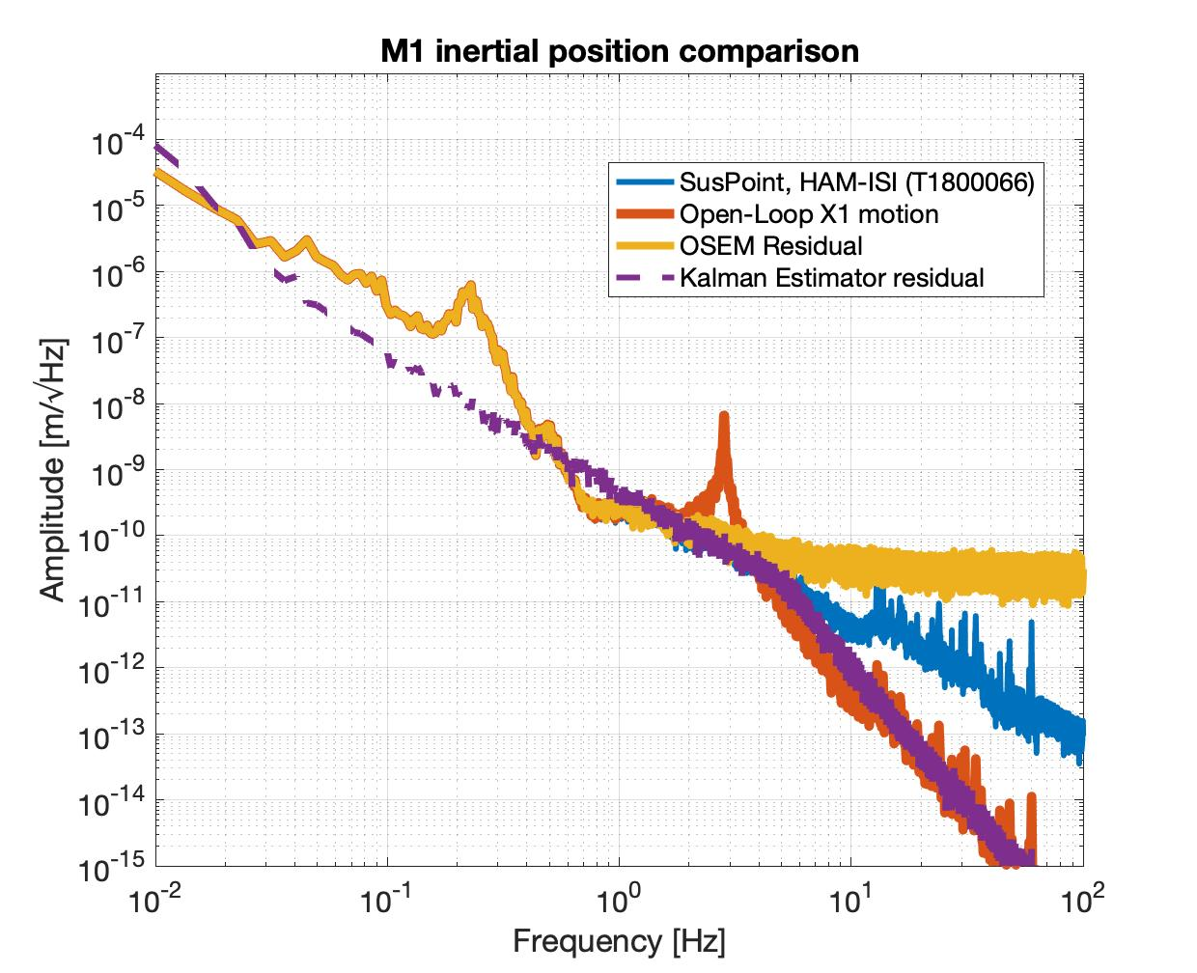
Results (so far)
Learnings from single SUS model
General learnings
State estimators allow us to do inertial damping.
We want good velocity estimators
Kalman Filtering
Steady state Kalman filtering is good enough.
Good robustness.

Slide 19
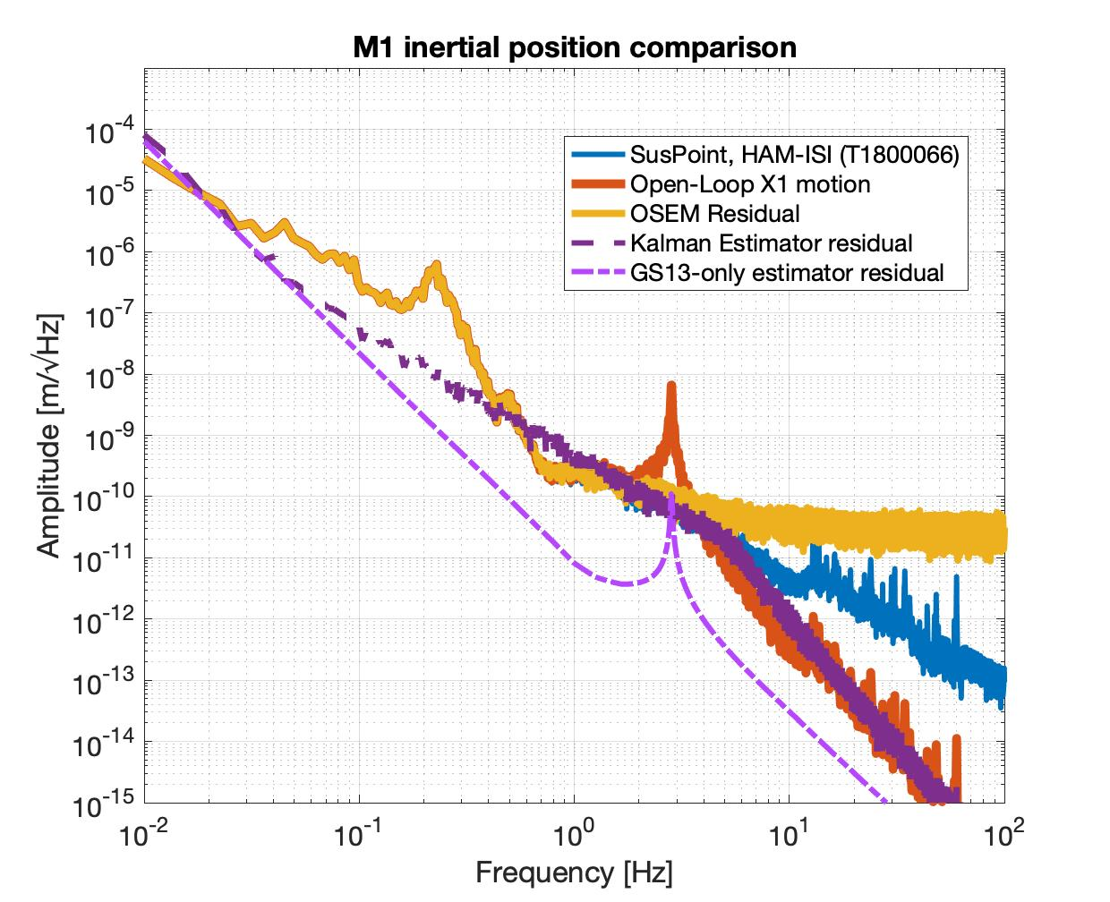
Results (so far)
Learnings from single SUS model
General learnings
State estimators allow us to do inertial damping.
We want good velocity estimators
Kalman Filtering
Steady state Kalman filtering is good enough.
Good robustness.
GS13+drives estimator
Best potential for inertial damping.
Doesn’t incorporate OSEM information.
Sensitive to model inaccuracies.

Slide 20
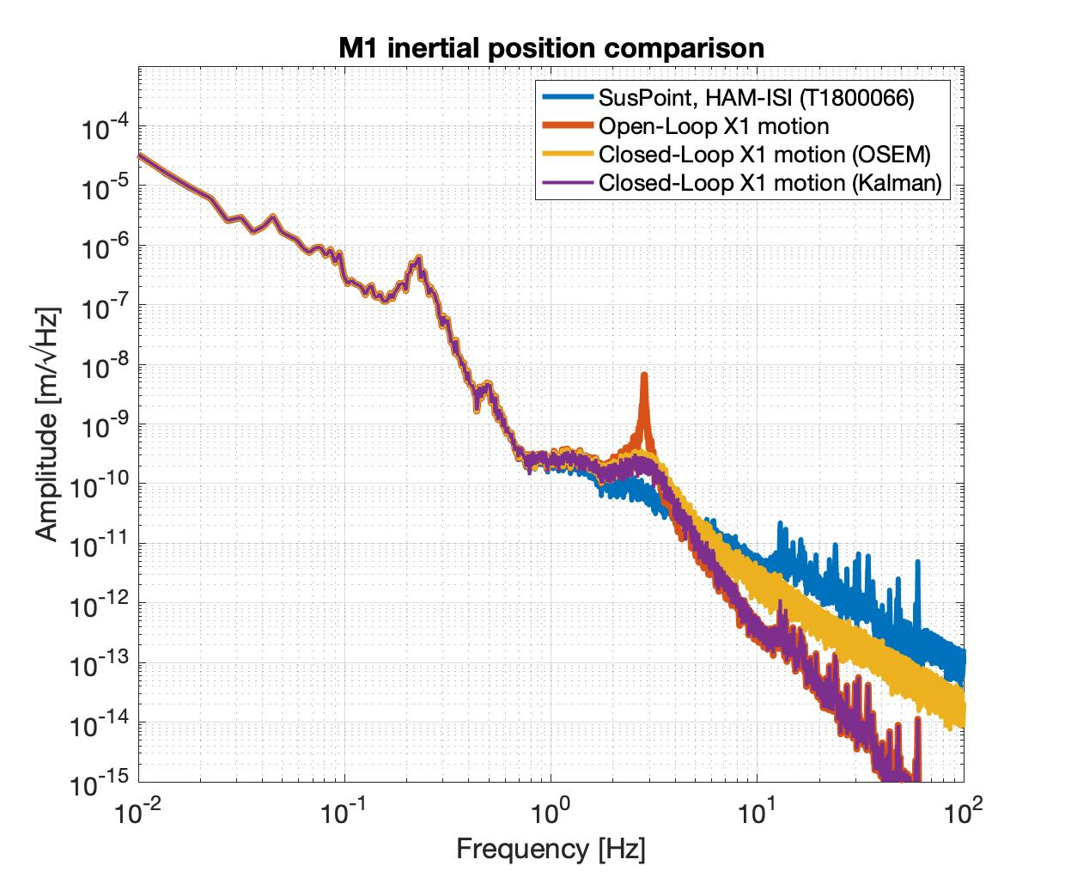
Results (so far)
Learnings from single SUS model
Other observations
The closed loop performance looks promising.

Slide 21
Outline
Motivation
State Estimators
Roadmap
Results (so far)
Conclusions

Slide 22
In summary:
We have a lot of information on our SUS and SEI systems.
State estimators could use that information to control the suspensions.
We could benefit from trying to damp to inertial space.
There are ‘Good enough’ estimators that only use CDS filters.
We will test these ideas at the prototype facility at Stanford.

Slide 23
More to do:
Explore (single SUS model)
Try other approaches to sensor fusion. (matrix Wiener-Hopf, H-infinity, etc.)
Combine this with Conor’s particle swarm optimizer for blend filters.
Incorporate more of the HAM-ISI information in the filtering.
System identification to deal with model uncertainty (IIRational, DMD, etc.)
2) Prototype (at the Stanford ETF) [As soon as we’re done with cBRS tests]

