Slide 1
GW strain calibration of LIGO detectors with high precision and low latencY
By: Naomi Shechter
Mentors: Ethan Payne and Dr. Alan Weinstein

Slide 2
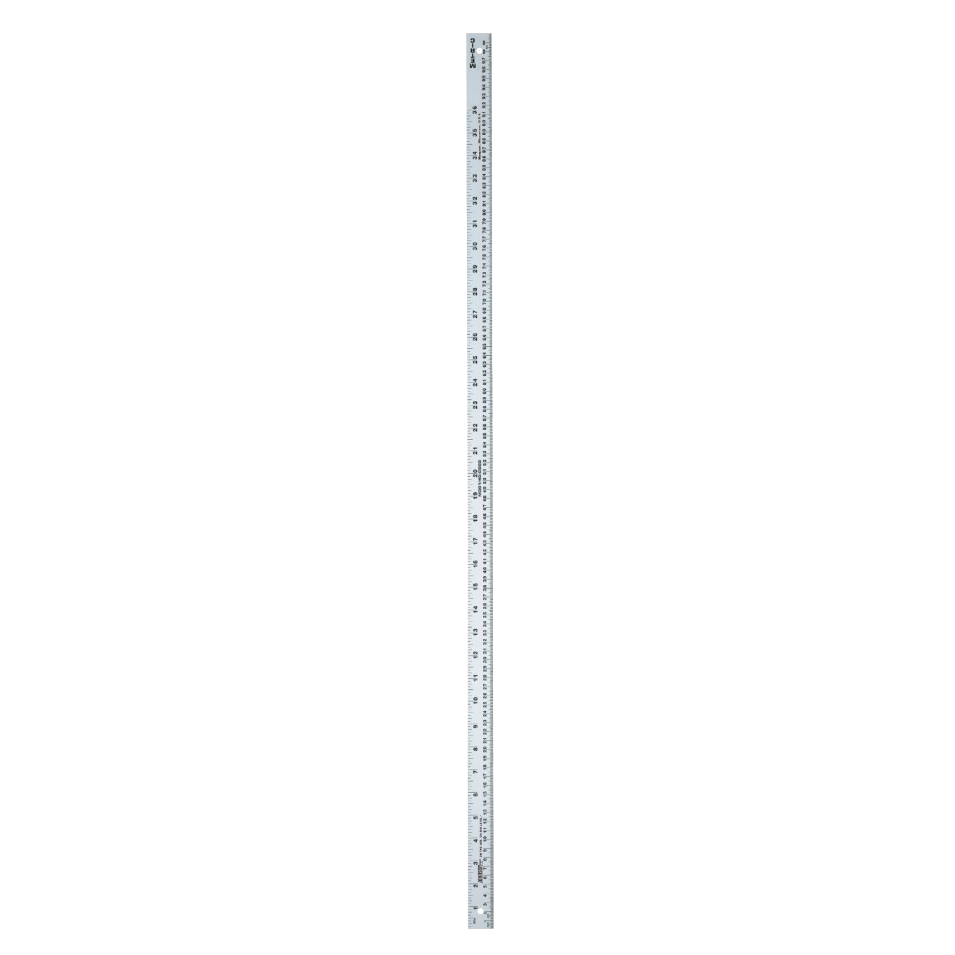
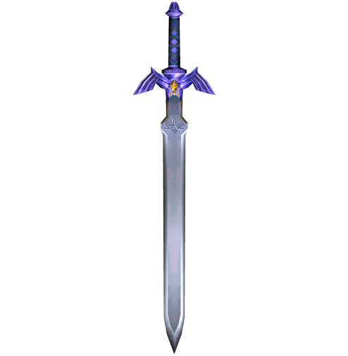
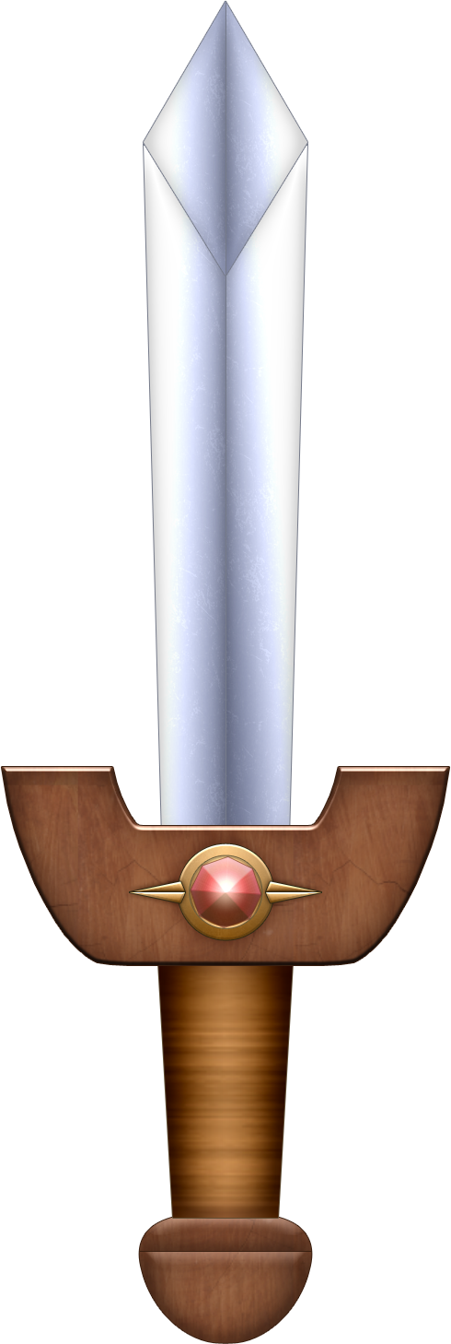
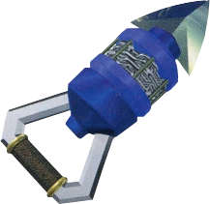
What is calibration?
A meterstick isn’t worth much if it isn’t actually a meter long. How well do we know our measuring tool? How reliable is it in providing self-consistent results?

Slide 3
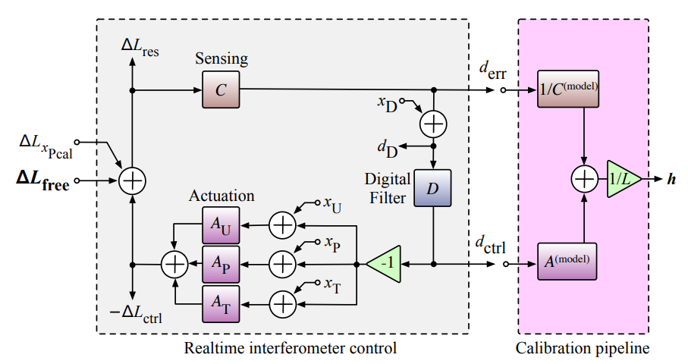
The Importance of Calibration
We want meaningful, unbiased results!
GR tests
Multi-messenger / Parameter estimation
High SNR in O5
Uncertainty: we know it to 2% in magnitude, 2° in phase.
But our ‘measuring stick’ changes! Calibration helps us characterize the detector response to strain.

Slide 4
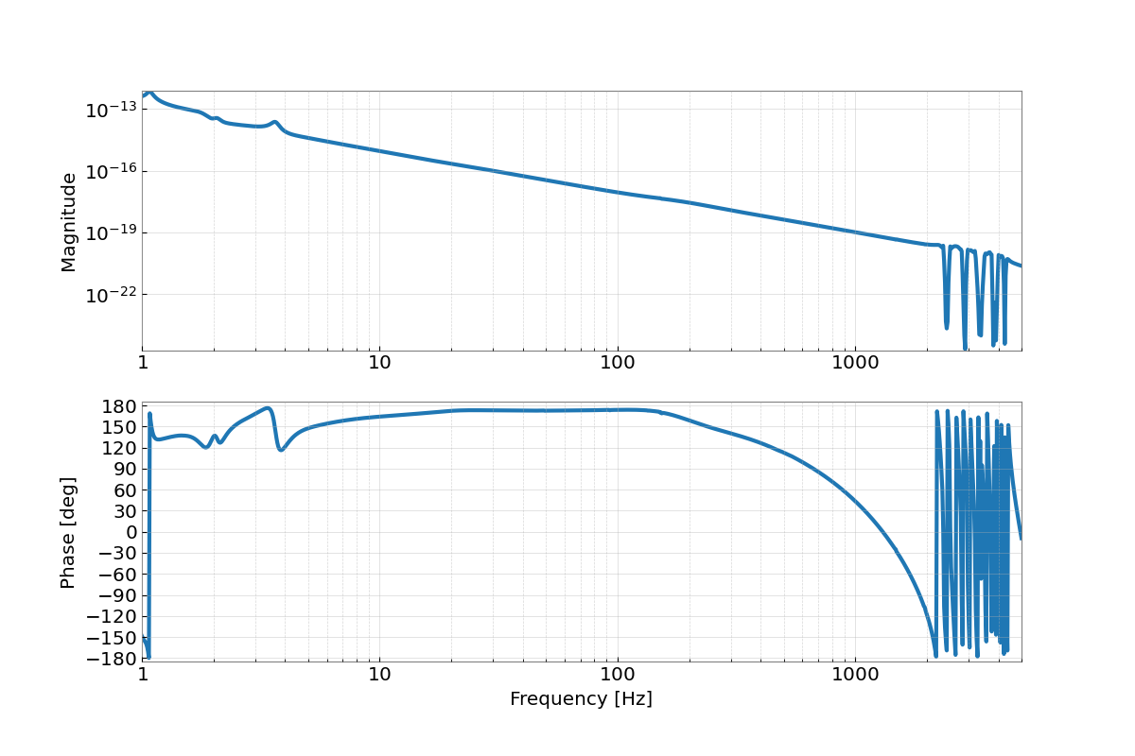
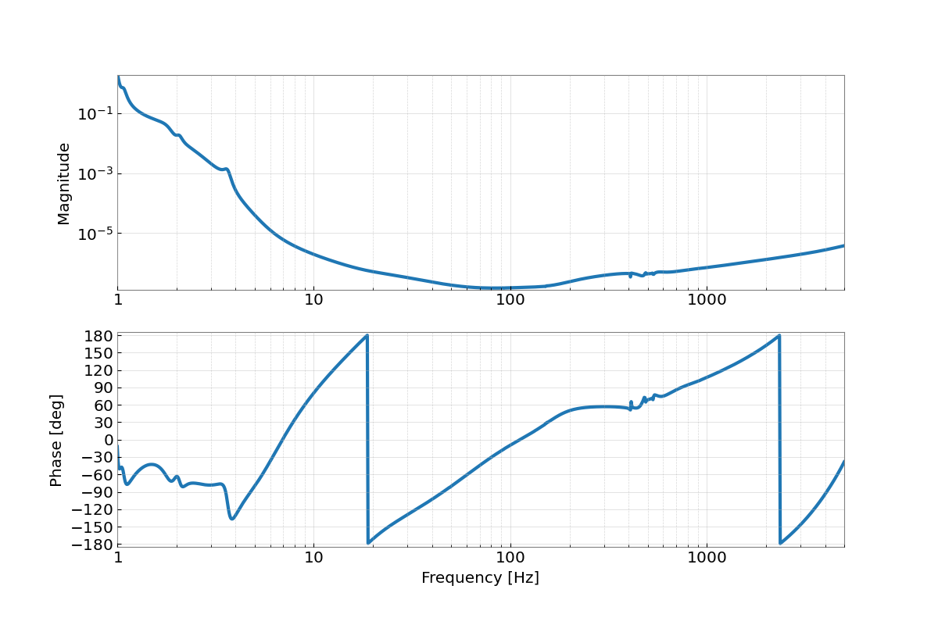
Sensing, Actuation, Response – 4/17/21
The sensing function is, as expected, most sensitive from 20-1000 Hz.
Our actuation function attenuates lower frequencies to reduce seismic noise.
The response function.

Slide 5
The goal(S):
Background information.
Transfer old measurement files into pyDARM compatible .ini files.
MCMC
GPR
Uncertainty
Monitoring software – TDCFs: the gain coefficient of the sensing function and test mass actuation function, and the coupled cavity pole frequency).
It should be a low latency, precise calibration uncertainty estimate, and the monitoring software should be both reliably and robustly, producing the estimate, diagnostics and any flags in less than an hour.

Slide 6
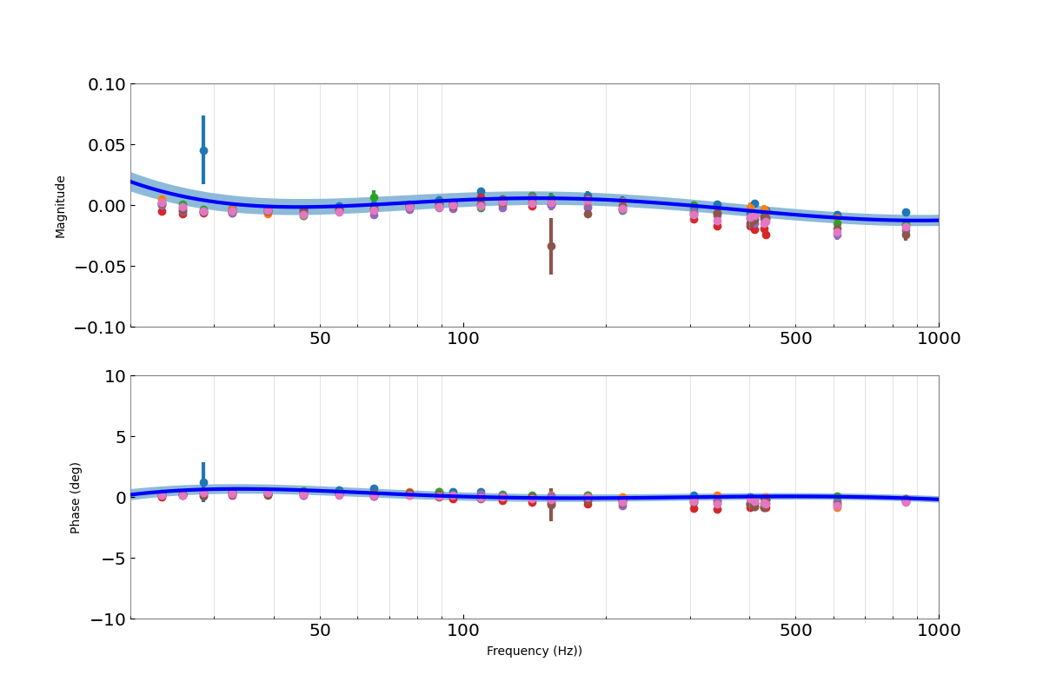
MCMC and GPR – 01/03/20
When significant changes are made to a LIGO detector, we begin a new epoch, with a new model of the response function.
Maximizing likelihood function.
MCMC characterizes how well our data fits the model of the response function.
The points are all residuals.
GPR takes full chain and characterizes the uncertainty between the residuals and the model.
The envelope is ±1σ, so 32% of points should be encompassed.

Slide 7
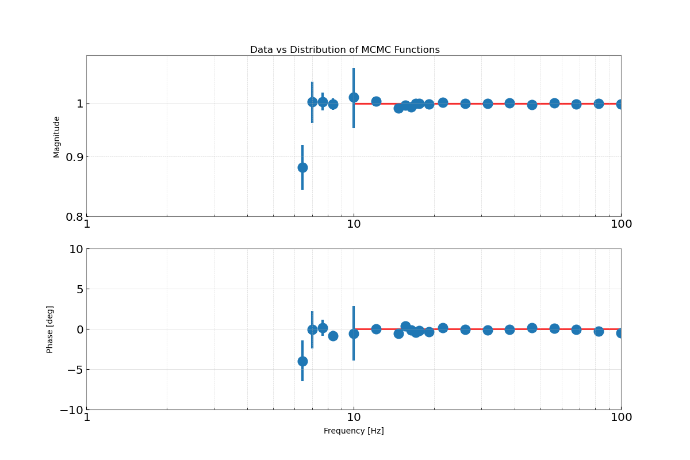
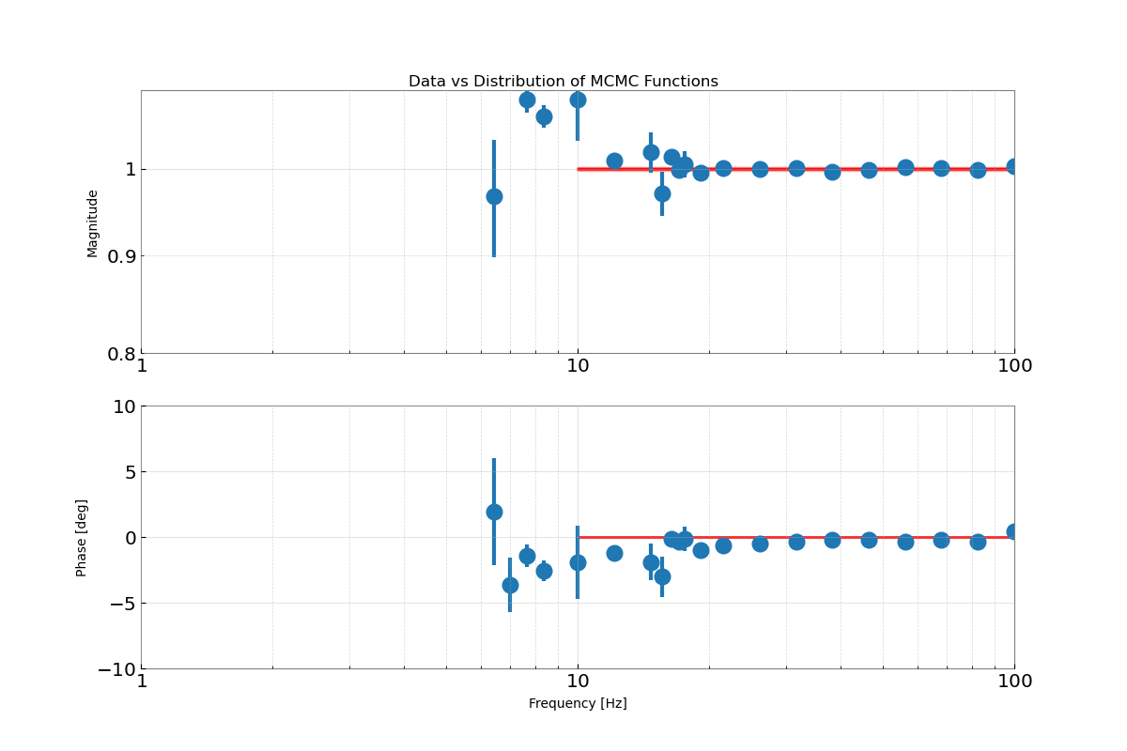
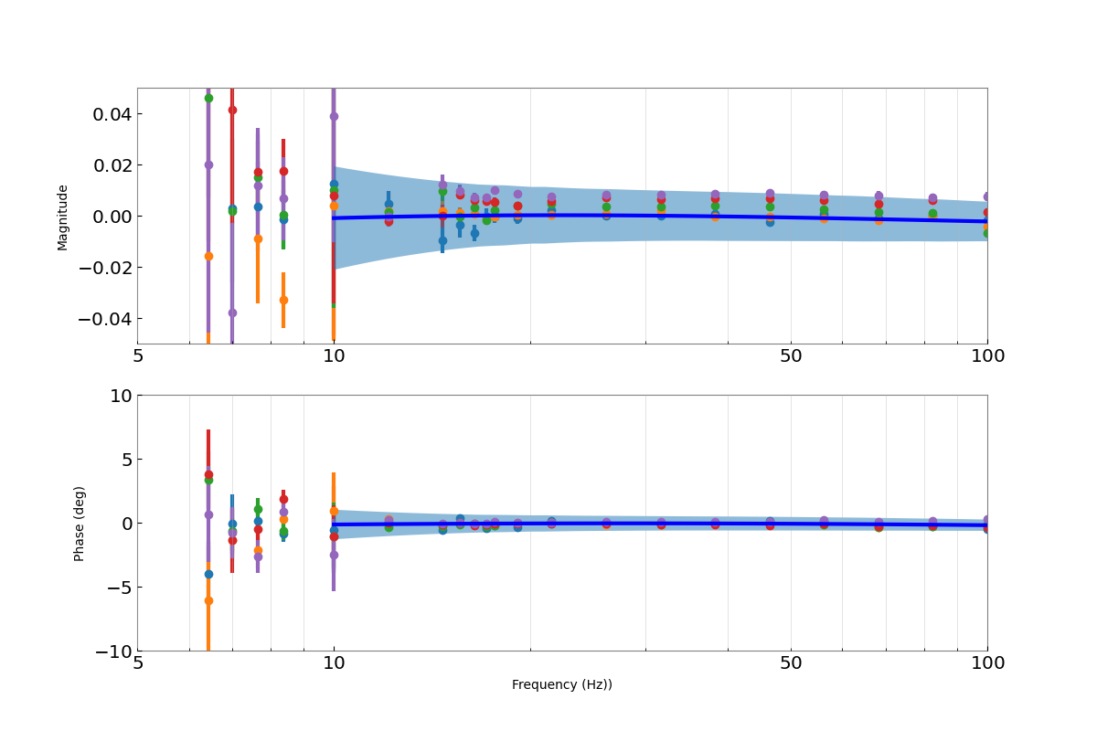
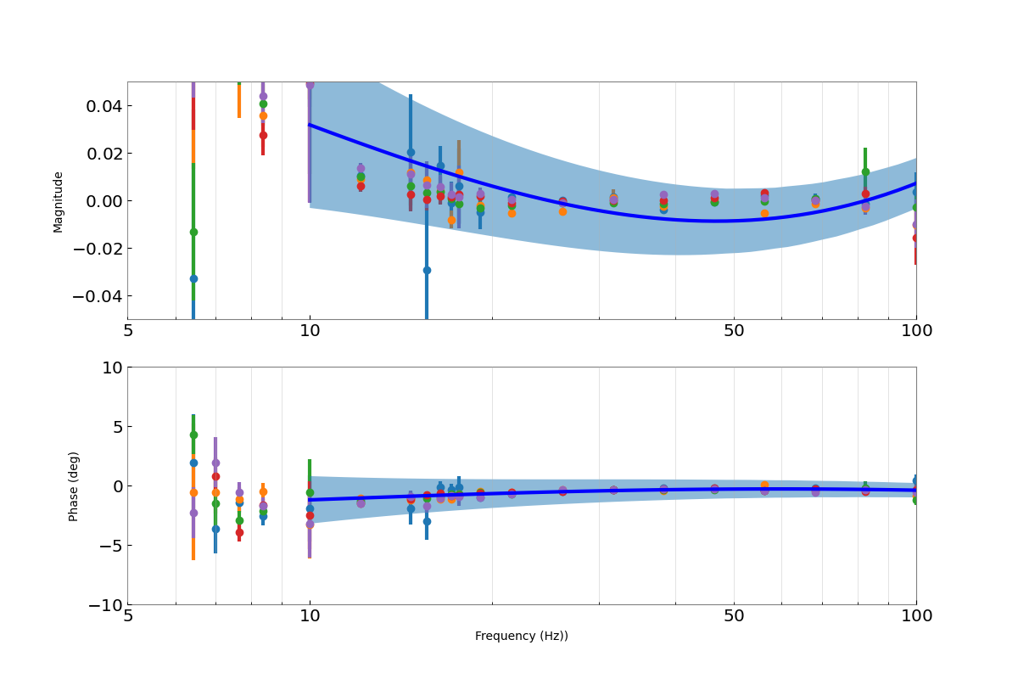
MCMC and GPR - 01/03/20
<<< TST
PUM >>>

Slide 8
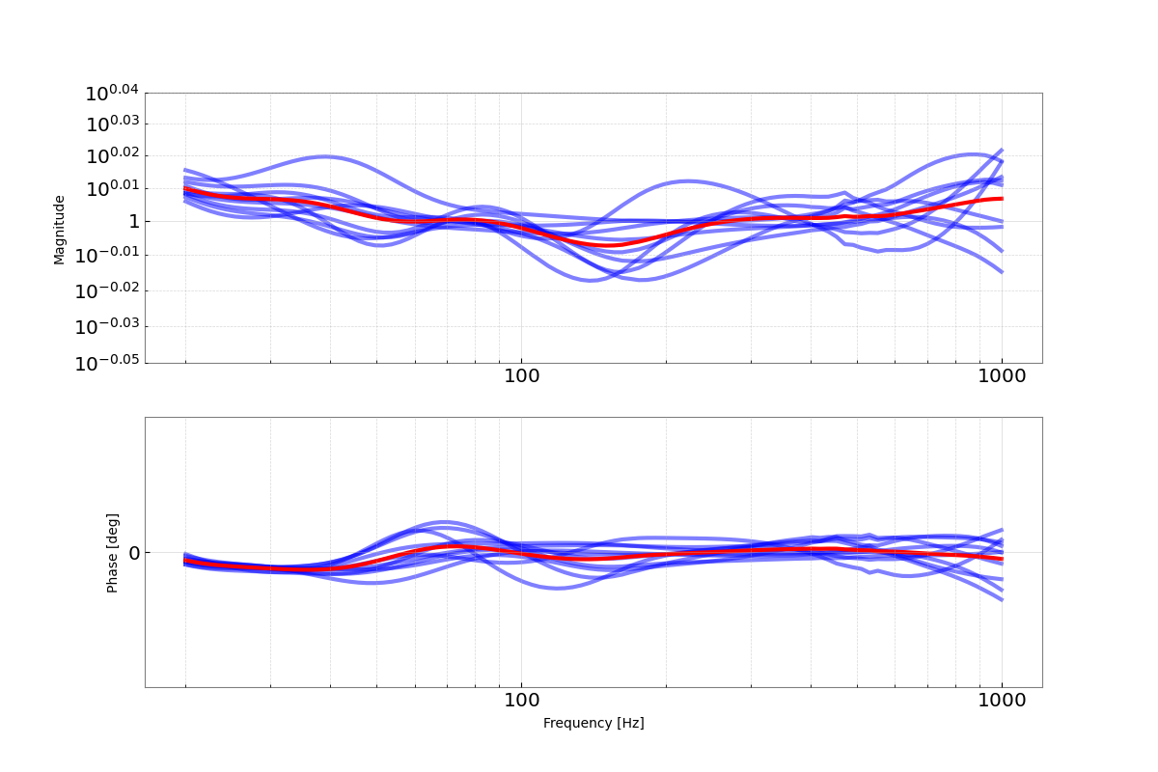
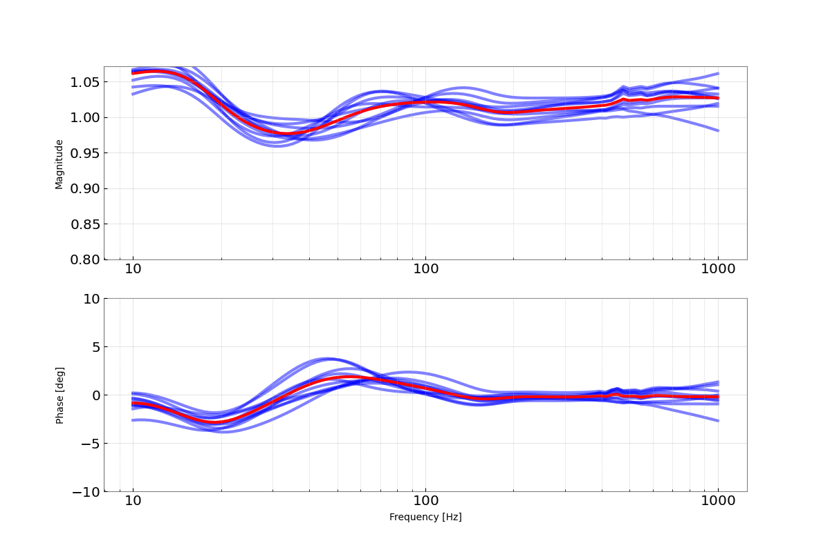
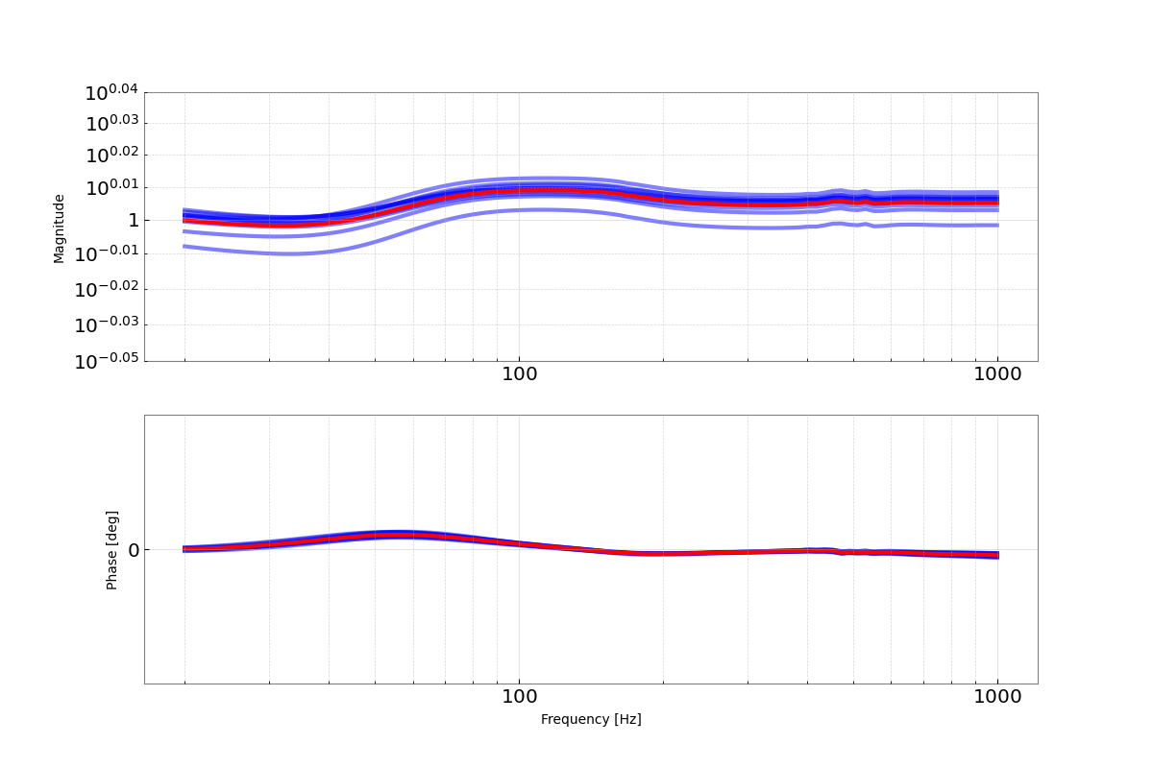
Uncertainty – 04/17 and 01/03
<<< Sensing files
Actuation files added >>>
Remember: MCMC, GPR are posterior distributions! Uncertainty samples these, divides by nominal response.
The red line is the median frequency dependent systematic error.

Slide 9
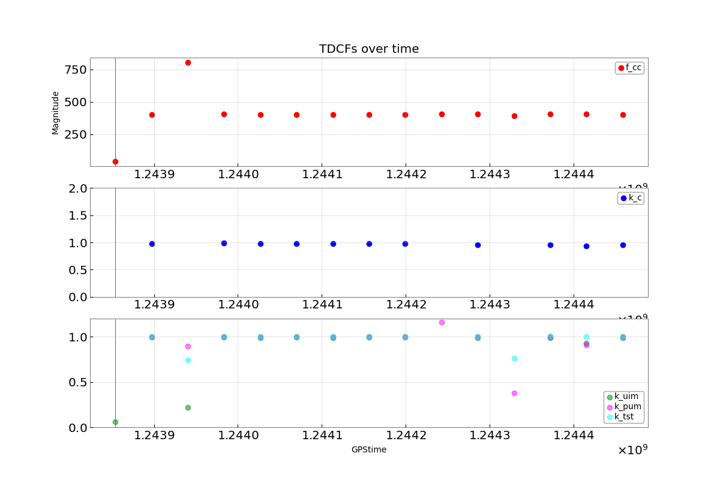
Monitoring – 06/06/19
Sampled TDCFs every 12 hours for a week after the measurement, informed by the MCMC and GPR’s previous estimates.
f_cc – sensing function bandwidth
k_c – sensing function gain
Due to changes in laser power.
k_uim / k_pum / k_tst – gain for the various actuation stages
Changes due to build up of charge on electrostatic actuators.
Unknown detector behavior or flaw in TDCF calculation when not at Unity Gain.

Slide 10
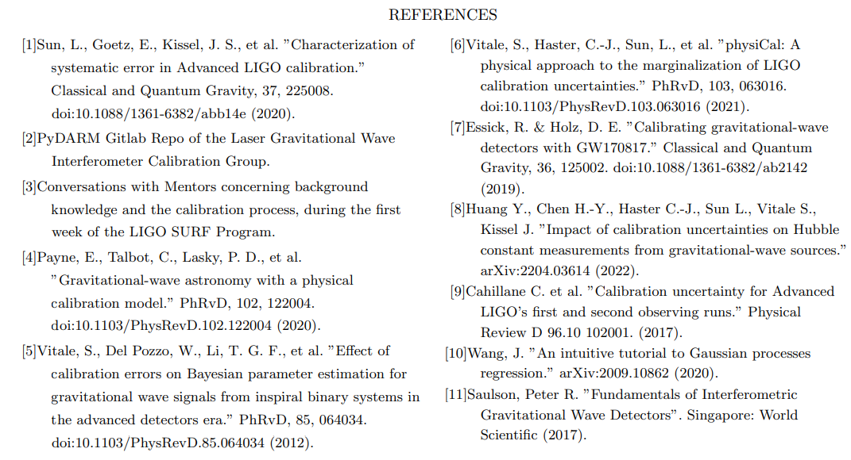
REFERENCES
I acknowledge and thank the NSF for funding the Caltech LIGO SURF program for the Summer of 2022, and my mentors Dr. Alan Weinstein and Ethan Payne.

