Slide 1
Testing Mass Distribution Estimation
of Binary Black Hole Mergers
Jingyi Zhang, Smith College
Mentors: Alan Weinstein, Jacob Golomb
LIGO SURF 2022

Slide 2
Black Hole Population
WHY do we care?
Notes:
First of all, we have ~70 events,
Different than em events, allow us to study more

Slide 3
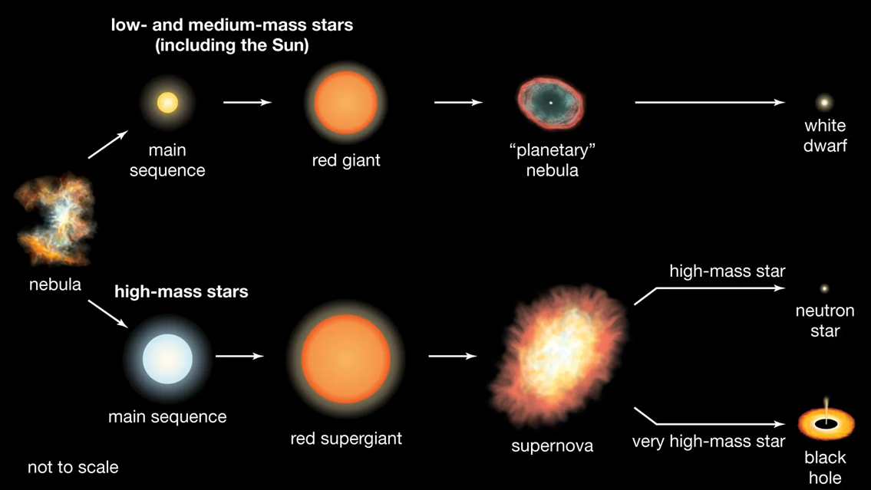
Black Hole Population
WHY do we care?
This is HARD
Notes:
Stellar evolution
Formation scenario,

Slide 4
+
Pulsational pair-instability supernova (PPSN)
Initial Mass Function
(IMF)
Image Credit: NASA, ESA, CSA, and STScI
Notes:
Mention power law at IMF,
Mention the picture from JWST, southern ring nebula, planetary nebula

Slide 5
The Model
s
Notes:
We also have non-parametric models
Different motivations: broken IMF, high-lowmass cutoff (neutron star/blackhole boundary, hirerachical mergers, or random process we don’t know)

Slide 6
HOW do we get to the population?
$$ℒ\left(d | Λ\right)∝\frac{\prod_{i}^{N}{\int{dθ_{i}ℒ\left(d_{i} | θ_{i}\right)p\left(θ_{i} | Λ\right)}}}{{p_{det}\left(Λ\right)}^{N}}$$

Slide 7
$$p\left(θ | d\right)∝ℒ\left(d | θ\right)π\left(θ\right)$$
What is the probability of the parameters?
What do we know about the parameters? Not much : (
What strain do we see (given the parameters?)
$$p\left(Λ | θ\right)∝ℒ\left(θ | Λ\right)π\left(Λ\right)$$
What is the probability of the hyper-parameters (model)?
What individual parameters do we see (given the model?)
What do we know about the model? Not much again : (
$$ℒ\left(d | Λ\right)∝\frac{\prod_{i}^{N}{\int{dθ_{i}ℒ\left(d_{i} | θ_{i}\right)p\left(θ_{i} | Λ\right)}}}{{p_{det}\left(Λ\right)}^{N}}$$
Notes:
So let’s talk about Bayesian Inference, by this time you’ve probably seen this a thousand times, but here it is again
For single events, we use the strain data to estimate the parameter that describe the event, the mass, the spin, the redshift, etc.
For the prior, if you look at any textbook, it would say “prior knowledge about the parameter”, we don’t know much about it
Similarly, for the population, we use hyper-parameters to describe the population model, the power law index, the position of the peak, the high/low mass cutoff, etc. In this case, we use the event parameter as the “data” and estimate the hyper-parameter,
Similarly we don’t know much about the prior, so we just set up some arbitrary uninformative priors
Hence, the thing we cares about the most is the likelihood.

Slide 8
Hierarchical Bayesian Inference
$$ℒ\left(d | Λ\right)=\prod_{i}^{N}{P\left(d_{i} | Λ\right)}$$
Let’s include all the events!
$$ℒ\left(d | Λ\right)=\prod_{i}^{N}{\int{dθ_{i}ℒ\left(d_{i} | θ_{i}\right)p\left(θ_{i} | Λ\right)}}$$
Wait, we don’t know the parameters : (
$$ℒ\left(d | Λ\right)=\prod_{i}^{N}{\sum_{θ_{i}∼ℒ\left(d_{i} | θ_{i}\right)}{p\left(θ_{i} | Λ\right)}}$$
We have a nicely distributed sample
$$ℒ\left(d | Λ\right)∝\frac{\prod_{i}^{N}{\sum_{θ_{i}∼ℒ\left(d_{i} | θ_{i}\right)}{p\left(θ_{i} | Λ\right)}}}{{p_{det}\left(Λ\right)}^{N}}$$
And the unavoidable selection effect
Notes:
How do we construct the likelihood?
We want to include all events, the likelihood says, given the model, want are the chances that these events happen. assuming that all events are independent, the total probability is just the product of each individual probability.
Ideally, we just know the probability of each events, we just know all, this 30 solar mass black hole happens,
In reality, we don’t know. We only have probability distributions that describe each events, so we have to integral over the distribution. E.g 50% chance of 30 msun, 50%40 Msun, we need to include both scenario
Ideally we would love to integrate over a smooth distribution, but we can’t, its just too difficult.
The way we do it is to select some samples that represent all these events. Higher likelihood corresponds to more samples. Just as we use histograms to represent probability density function.
And there is the selection bais, all astronomy observation is subjected to selection bais. Note that we care about the astrophysical population, whats out there in the universe
Malmquist bias
Third instead of intergrate, drawing samples weighted by the likelihood, too hard to continuously
Daniela is working on detector characterazaion

Slide 9
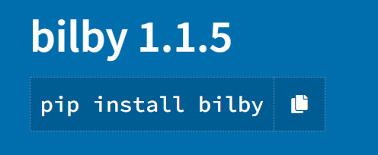
…And then,
We have tools

Slide 10
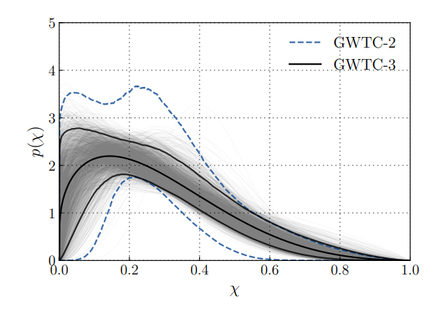
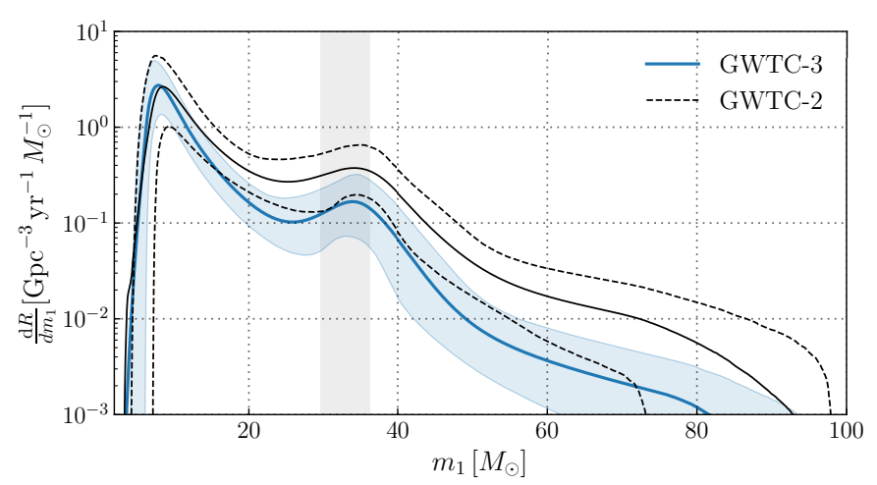
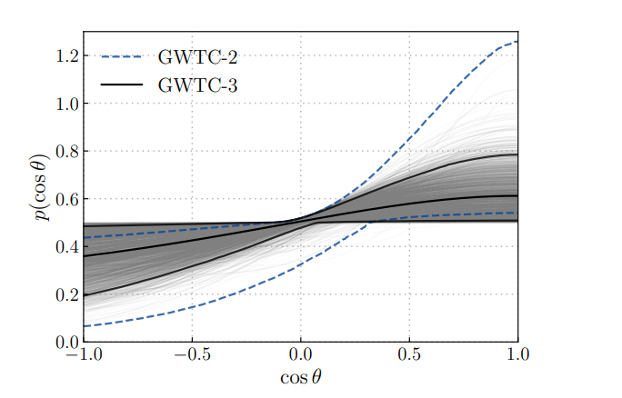
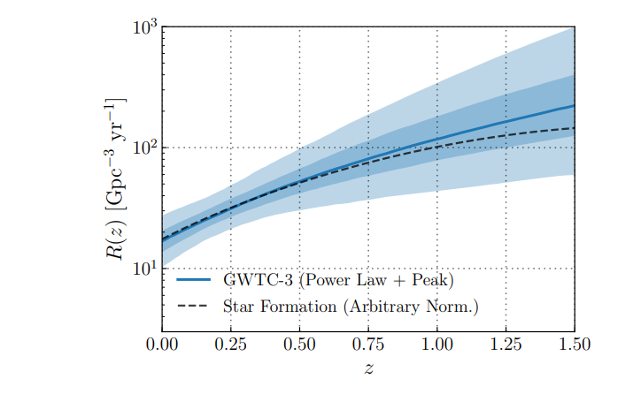
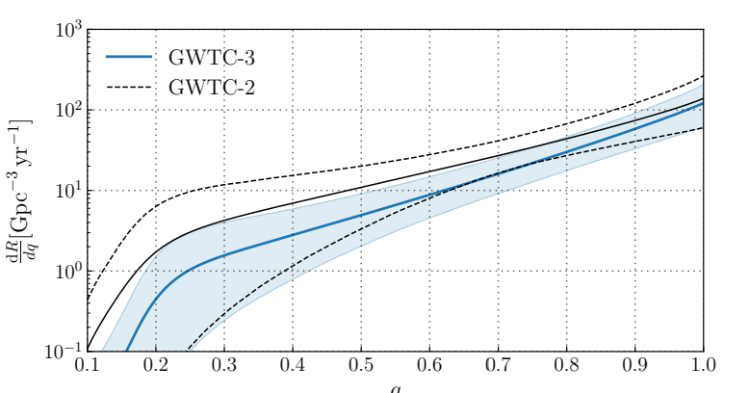
Notes:
Here is the result we get based on the power law + peak, the blue is gwtc-3, the black is getc-2
3 is better b/c the band is narrower, know for sure the peak is real
The behavior is a little unexpected
Similarly, we have the model for other parameters, mass ratio, redshift, spin, etc.
These combine can tell us formation scenario/ evolution

Slide 11
Posterior Predictive Checks:
How good is our fit?
Does the model distribution looks like the estimated ones?
Model Comparison:
Are there other models that can describe our observations?
How well do they fit our data?
Leave-One-Out:
Which ones are the outliers?
How would they change the estimation?
…So What am I Testing?

Slide 12
From Strain to the Universe
Black hole population tells us their formation channel and evolutionary path.
Motivated by IMF and PPSN, we developed the Power law + Peak model, but there are many more to explore.
Hierarchical Bayesian Inference: from strain to events to population.
Various.
Various Tests tells us about the how well we can estimate.
Notes:
Summary conclusion

Slide 13
I am grateful for the support from: My mentors Alan Weinstein and Jacob Golomb, Ligo scientific collaboration, California institution of technology student faculty program, and the National science foundation.
Notes:
Ligo virgo logo
Nsf logo

