Slide 1
Exploring LIGO sensitivity across binary black hole parameter space
LIGO-T2200251
LIGO Summer Undergraduate Research Fellowship
Daniela Hikari Yano (Barnard College)
Mentors:
Richard Udall, Jacob Golomb, and Alan Weinstein
(California Institute of Technology, LIGO Lab)
Notes:
Hi, all! My name is Daniela and today I will be presenting about the project I’ve worked on this summer: Exploring LIGO sensitivity across binary black hole parameter space.
My mentors are Richard, Jacob, and Alan

Slide 2
How far can the GW detectors hear?
The question:
Notes:
The question we are trying to answer in this project is: How far can the GW detectors hear?

Slide 3
Space-time sensitive hypervolume ⟨VT⟩
Our metric:
The comoving volume where the GW detectors can detect Binary Black Hole coalescenses → depends on the BBH population
Notes:
The metric we use to measure “how far can the GW detectors hear” is the space-time sensitive hypervolume.
That is the space-time comoving volume where the GW detectors can detect Binary Black Hole coalescences, and that depends on the populations

Slide 4
What is the merger rate density?
The big question:
Notes:
The big question we are trying to answer is: “What is the merger rate density?”
Understanding source population and is one of the primary goals of gravitational wave astronomy, and for this we need to understand the rate rate of occurrence of the astrophysical phenomenon.

Slide 5
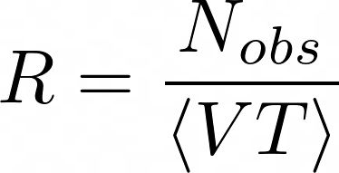
What is the merger rate density?
The big question:
Notes:
The primary ingredient in the estimation of merger rate or upper-limit on the merger rate is the sensitive volume, as the merger rate density is defined as the ratio between the number of events observed by the averaged space-time sensitive volume.
The merger rate density is measured in 1 per Gpc^3 per Yr

Slide 6
How far can the GW detectors hear?
If all the Binary Black Holes were the same, it would be easy…
SNR > SNRthreshold
Detected!
d1
d2
SNR < SNRthreshold Can’t be detected!
Notes:
Let’s go back to our question of: How far can the GW detectors hear.
If all the Binary Black Holes in the Universe were the same, determining how far the detector can hear would be fairly easy.
We would just need to find out the distance where the signal would not be loud enough for us to detect → at d1 it would be detected, and at d2 it wouldn’t be detected

Slide 7
Parameter Space
Binary black holes can be described using 15 parameters, which are divided into intrinsic and extrinsic.
Intrinsic parameters:
Extrinsic parameters:
Right ascension (𝛂)
Declination (𝛅)
Luminosity distance (DL)
Inclination (θJN)
Polarization angle (ᴪ)
Time of coalescence (tc)
Phase at coalescence (φc)
spin 1z
spin 2z
m1
spin 1x
m2
spin 2x
spin 1y
spin 2y
Changes in the parameter space affect the detectability of the merger by the GW detectors network.
Notes:
However, it is not that simple. The BBHs vary across a parameter space of 15 parameters, and those parameters affect the waveform, thus it affects the detectability of the different BBHs.
The intrinsic parameters are:
The extrinsic parameters are:

Slide 8
How far can the GW detectors hear?
If all the Binary Black Holes where the same, it would be easy…
Binary black holes vary across the parameter space.
Therefore, it is necessary to compute the efficiency (η) at each distance.
SNR > SNRthreshold
Detected!
SNR < SNRthreshold Can’t be detected!
d1
d1
Notes:
So, Binary black holes vary across the parameter space.
Therefore, if we have two black holes at the same distance, for example d1 (point at the drawings), one of them could be detected and the other not, because they have different parameter configurations.
Therefore, it is necessary to compute the efficiency (η) at each distance.

Slide 9
How far can the GW detectors hear?
If all the Binary Black Holes where the same, it would be easy…
Binary black holes vary across the parameter space.
Therefore, it is necessary to compute the efficiency (η) at each distance.
SNR > SNRthreshold
Detected!
SNR < SNRthreshold Can’t be detected!
d1
d1
Also, the Universe is expanding. Therefore, it is necessary to take the cosmological effects into account.
Notes:
One more factor that needs to be taken into consideration is that the Universe is expanding, so we need to take the cosmological effects into consideration.

Slide 10
Space-time sensitive hypervolume calculation
Notes:
To calculate the space-time sensitive hypervolume, we are integrating over the parameter space.

Slide 11
Space-time sensitive hypervolume calculation
Converts from Euclidean volume to co-moving volume
From Planck 2018 cosmology
Notes:
*Say all the parameters inside theta prime. → masses, spins, inclination angles, etc.
Theta encopasses all the 15 parameters, and theta prime encompasses all the parameters but t_c (time of coalescense), and alpha and delta (right ascension and declination) (which are in Omega) → which we average over when evaluating\eta, and D_L(z).
From left to right, the first integral is a integral over d time of coalescence, the second one is over the d solid angle of sky locations , the third one luminosity distance squared and the C(z), which is the factor that converts from Euclidean volume to comoving volume integrated over the redshift.
The rightmost part is an integral over theta prime, with eta, the efficiency times the probability distribution.

Slide 12
Space-time sensitive hypervolume calculation
Efficiency can’t be solved analytically, we will do it with waveform injections.
Notes:
Efficiency can’t be solved analytically, we will do it with waveform injections.
Efficiency is defined as the number of events detected/total number of events

Slide 13
Goal: study how the space-time sensitive hypervolume changes according to changes in the parameter space
First step: work on methods to calculate the space-time sensitive hypervolume
Second step: carry out the experiments, with variations across the parameter space
Notes:
So in summary, the goal of the project is to be able to calculate the space-time sensitive hypervolume, and study how it changes according to changes in the parameter space.
We will divide the work in two parts:
The implementation of a pipeline to carry out the calculation
Carry out experiments using the pipeline

Slide 14
Space-time sensitive hypervolume calculation
Use Monte Carlo simulations to numerically solve the integral
Need to create a large number of injections → create large populations of Binary Black Holes from probability distributions
Worked on SIFCE (Simple Injections for Computational Estimates), which is a Python package designed to carry this computation
Notes:
To solve for the space-time sensitive hypervolume, we will be using Monte Carlo simulation. This require us to create a large number of injections.
To do this, this summer I worked on SIFCE, which is a python package designed to carry this computation.

Slide 15
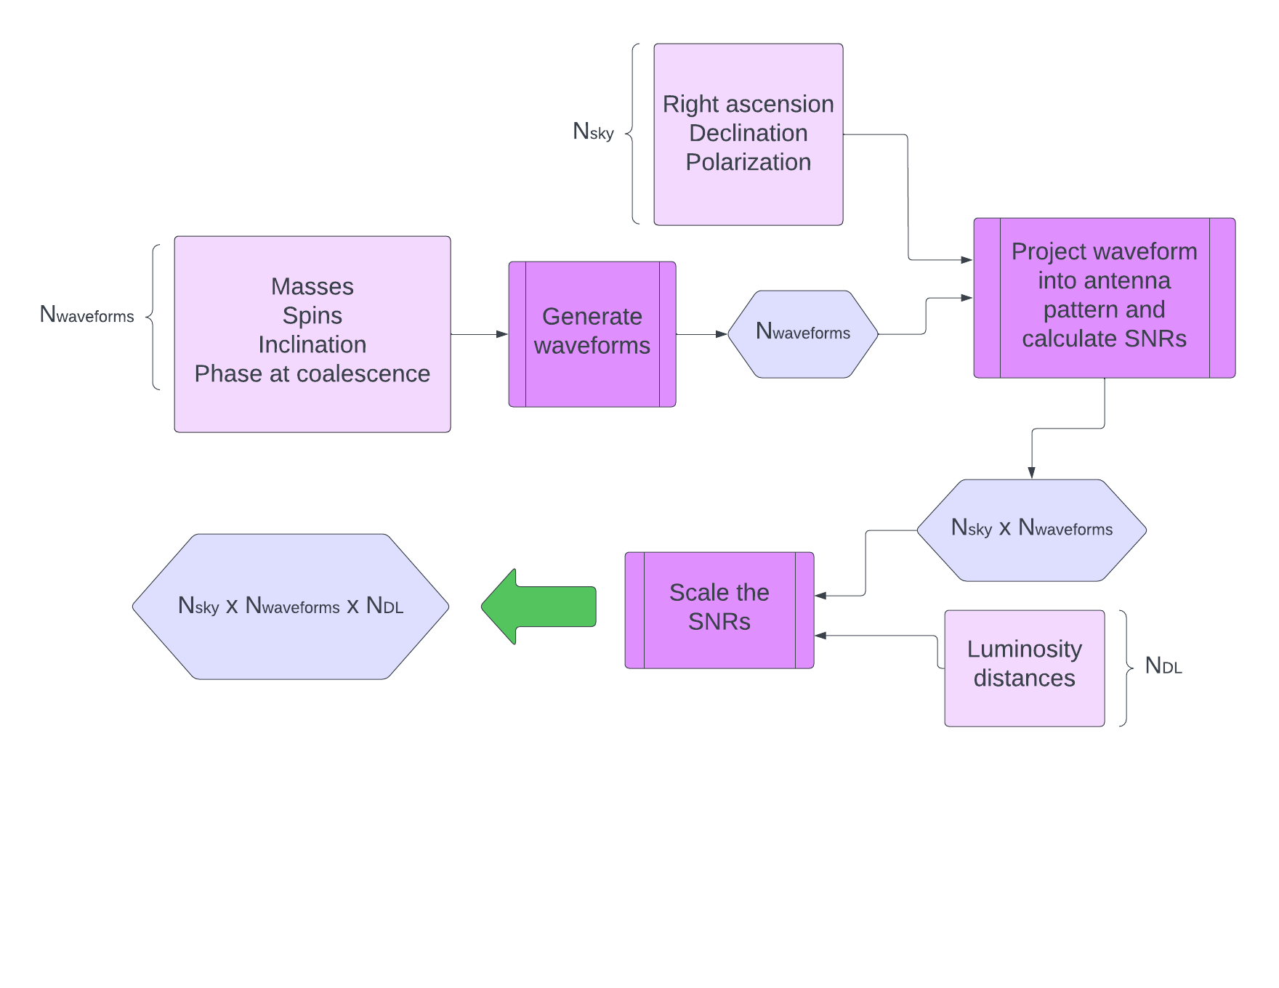
SIFCE pipeline
Notes:
The SIFCE pipeline speeds up the calculation by using the same waveform for integrating over extrinsic parameters RA, dec, Pol, D_L.
The pipeline starts with generating waveforms from a set of masses, spins, inclinations, and phases at coalescences.
For each of those waveforms, we generate a N number of sky parameters (so right ascension, declination, and polarization), and project the waveform into the antenna pattern .
From this, we can calculate the SNR (Signal to noise ratio) for each of those combinations.
After this, we can use the fact the the SNR is proportional to one over luminosity distance to scale the SNRs.
We use the SNR to determine the probability of detection for every combination → used to calculate the monte carlo sum!
This is done for order of magnitude computational efficiency

Slide 16
Experiments
How does the space-time sensitivity change according to the masses?
20 M⊙
20 M⊙
35 M⊙
35 M⊙
10 M⊙
10 M⊙
20 M⊙
10 M⊙
35 M⊙
20 M⊙
Notes:
I carried some experiments with the SIFCE pipeline, and the first one is a study on how the masses affect the VT.
Here, I kept all the probability distributions the same for all the experiments, and just changed the masses of the black holes.

Slide 17
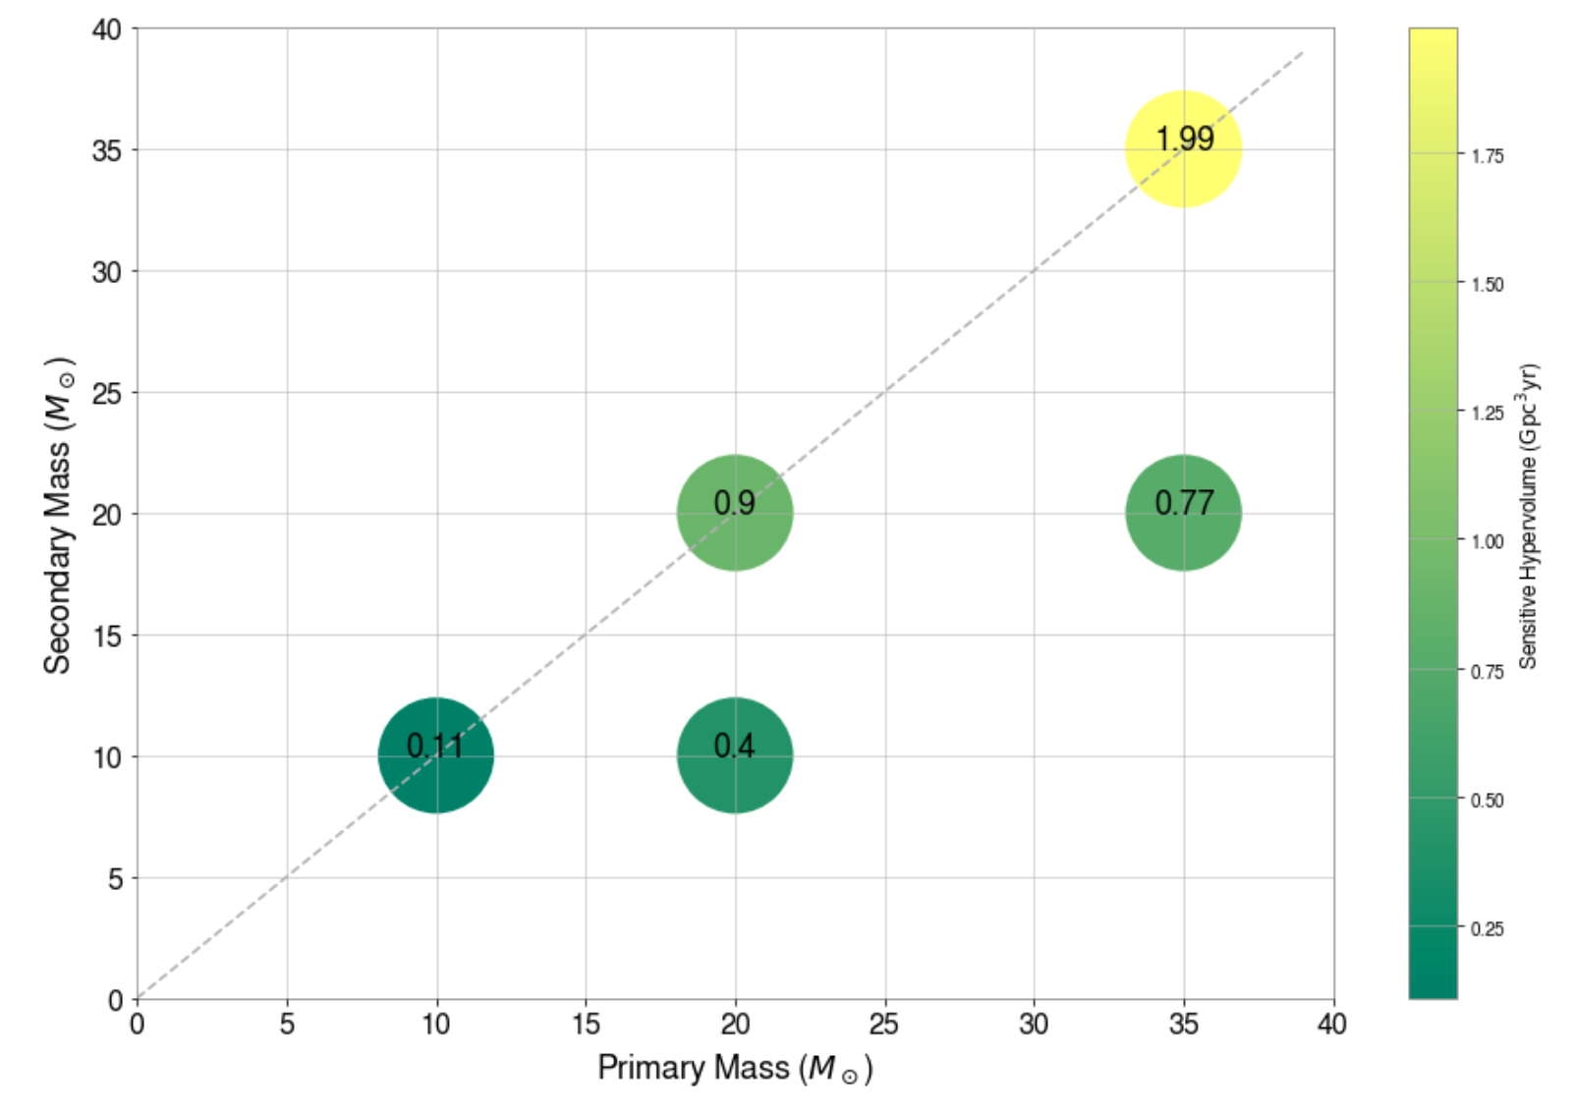
Experiments
How does the space-time sensitivity change according to the masses?
In this plot, each bubble represents a scenario where the BBH have the same mass.
Notes:
VT grows with mass, this is expected and it is what we see in this graph.
However, we expect a turnover at higher masses, because the VT goes down when signal goes out of LIGO freq band, and this study will be done at future work.
Another experiment that can be carried out in the future is a simulation with a whole population distribution of mass pairs.

Slide 18
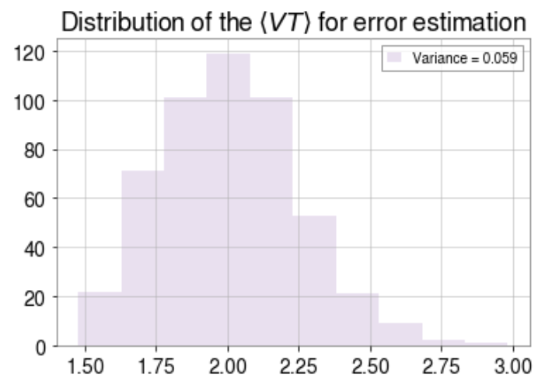
Experiments
How does the space-time sensitivity change according to the masses?
In this plot, each bubble represents a scenario where the BBH have the same mass.
Notes:
A histogram of the calculated VT for the run with black holes of 35-35 solar masses.
500 intrinsic → 500 workers

Slide 19
Experiments
How does the space-time sensitivity changes according to the spin z component?
0.2
0.2
0.4
0.4
0.6
0.6
Changing the magnitude and direction of spin z component
-0.2
-0.2
-0.4
-0.4
-0.6
-0.6
Notes:
The second experiment I carried out was how the spin z component affects the space-time sensitive hypervolume.
For this, I kept all the probability prior distributions fixed, for a 35-35 solar masses system, and changed only the spin_z components → carried out the experiment for 0.2, 0.4, 0.6, and their correspondent negative parts spin z components

Slide 20
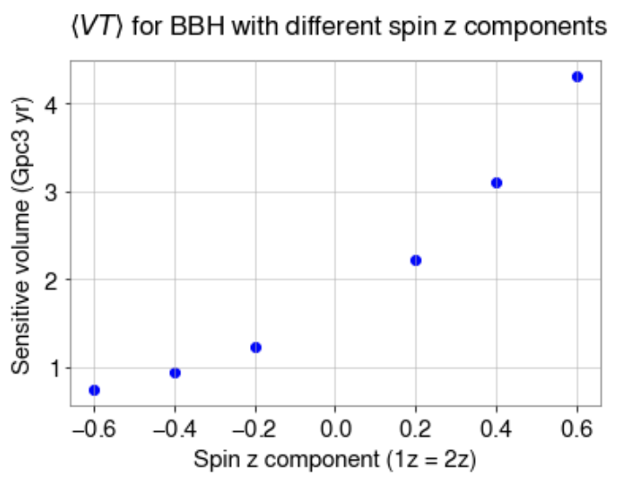
Experiments
How does the space-time sensitivity changes according to the spin z component?
In this experiment, all the points were calculated for a BBH with m1 = m2 = 35 M⊙, and changing the spin z component of both Black Holes.
Notes:
Higher spin → higher VT
spin changes the length of the inspiral → larger spin z component need to dissipate the energy before merger (hangup effect)

Slide 21
Experiments
How does the space-time sensitivity changes with the inclusion of higher modes beyond (2, 2)?
Using different approximants for the injection and recovery of the signal.
⟨injection waveform | recovery waveform⟩
⟨VT⟩ of ⟨IMRPhenomXPHM | IMRPhenomXPHM⟩ = 1.85 Gpc^3yr
⟨VT⟩ of ⟨IMRPhenomXP | IMRPhenomXP⟩ = 1.82 Gpc^3yr
⟨VT⟩ of ⟨IMRPhenomXPHM | IMRPhenomXP⟩ = 1.69 Gpc^3yr
*preliminary results
Notes:
XPHM → 5 higher order modes
XP → one higher order mode (only 2-2)
We can see that when we inject and recover with the 5 higher order modes, we get a bigger VT than when we inject and recover with only one higher mode → 1.85 vs 1.82, and this is because picking up those higher order modes will increase the SNR.
The last result is an injection with 5 higher order modes, and recovery with only one higher order mode. We can see that not not taking into consideration all the higher order modes decreases the VT, which implies that using an incorrect number of higher modes in the recovery affects negatively the detection of the BBHs.
Notes:
—--
Higher order modes → talk about the three results, how picking up higher order modes increases SNR → xp xp,
And a smaller result for ignoring the modes

Slide 22
Summary
Computed ⟨VT⟩ for a range of masses, spins, and higher order modes
Implementation of the SIFCE pipeline: (https://git.ligo.org/richard.udall/sifce )
Able to produce a large number of injections
Handles the space-time sensitive hypervolume calculation
Next steps:
Do experiments for specified populations of different masses and spins
Do experiments to study how the space-time sensitive hypervolume will improve with the next generation of GW detectors (LIGO Voyager, Cosmic Explorer, and Einstein Telescope)

Slide 23
Acknowledgements
I thank Alan Weinstein, Richard Udall, and Jacob Golomb for their tremendous support in this project. I also gratefully acknowledge the support from the National Science Foundation Research Experience for Undergraduates (NSF REU) program, the California Institute of Technology, the LIGO Summer Undergraduate Research Fellowship, and the Science Pathways Scholars Program at Barnard College.
Notes:
Thank you for my mentors and my peers!

Slide 24
References
[1] R Abbott et al. “GWTC-3: compact binary coalescences observed by LIGO and Virgo during the second part of the third observing run”. In: arXiv preprint arXiv:2111.03606 (2021). Doi: https://doi.org/10.48550/arXiv.2111.03606.
[2] B Caron et al. “The virgo interferometer”. In: Classical and Quantum Gravity 14.6 (1997), p. 1461.
[3] “KAGRA: 2.5 generation interferometric gravitational wave detector”. In: Nature Astronomy 3.1 (2019), pp. 35–40.
[4] Alex Nitz, Ian Harry, Duncan Brown, Christopher M. Biwer, Josh Willis, Tito Dal Canton, Collin Capano, Thomas Dent, Larne Pekowsky, Andrew R. Williamson, Gareth S Cabourn Davies, Soumi De, Miriam Cabero, Bernd Machenschalk, Prayush Kumar, Duncan Macleod, Steven Reyes, dfinstad, Francesco Pannarale, Thomas Massinger, Sumit Kumar, M ́arton T apai, Leo Singer, Sebastian Khan, Stephen Fairhurst, Alex Nielsen, Shashwat Singh, Koustav Chandra,shasvath, Bhooshan Uday, Varsha Gadre. gwastro/pycbc. doi:10.5281/zenodo.5347736.
[5] Gregory Ashton et al. “BILBY: A user-friendly Bayesian inference library for gravitational-wave astronomy”. In: The Astrophysical Journal Supplement Series
241.2 (2019), p. 27.
[6] Benjamin P Abbott et al. “Observation of gravitational waves from a binary black hole merger”. In:Physical review letters 116.6 (2016), p. 061102.
doi:https://doi.org/10.1103/PhysRevLett.116.061102.
[7] Junaid Aasi et al. “Advanced ligo”. In:Classical and quantum gravity 32.7 (2015), p. 074001.doi :https://doi.org/10.48550/arXiv.1411.4547.
[8] Benjamin P Abbott et al. “The rate of binary black hole mergers inferred from Advanced LIGO observations surrounding GW150914”. In:The Astrophysical journal letters 833.1 (2016), p. L1. doi: https://doi.org/10.48550/arXiv.1602.03842.
[9] Geraint Pratten et al. “Computationally efficient models for the dominant and subdominant harmonic modes of precessing binary black holes”. In: Physical Review D 103.10 (2021), p. 104056.
[10] Geraint Pratten et al. “Setting the cornerstone for a family of models for gravitational waves from compact binaries: The dominant harmonic for nonprecessing quasicircular black holes”. In: Physical Review D 102.6 (Sept. 2020). doi:10.1103/physrevd.102.064001.
url:https://doi.org/10.1103%2Fphysrevd.102.064001.
[11]John Whelan. “Visualization of antenna pattern factors via projected detector tensors”. In:LIGO Document T1100431-v26 (2012).
[12]Richard Udall, Jacob Golomb, and Daniela Yano.Simple Injection Framework for Computational Estimates (SIFCE).https://git.ligo.org/richard.udall/sifce. 2022.
[13] Planck Collaboration et al. “Planck 2018 results. VI. Cosmological parameters”.

