Slide 1
LIGO SURF 2022 Improved Targeted sub-threshold Search for Strongly Lensed Gravitational Waves with Sky Location Constraint
Final Presentation
Aidan Chong¹
Mentors
Alvin Li², Ryan Magee², Juno C.L. Chan¹, Cody Messick³, Alan J. Weinstein²
Department of Physics, The Chinese University of Hong Kong
LIGO Laboratory, California Institute of Technology
LIGO Laboratory, Massachusetts Institute of Technology

Slide 3
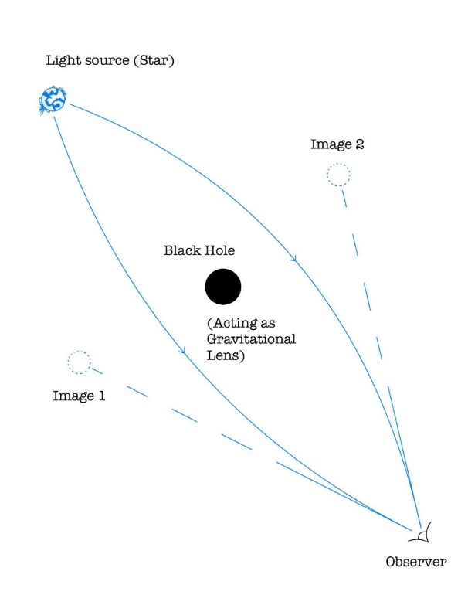
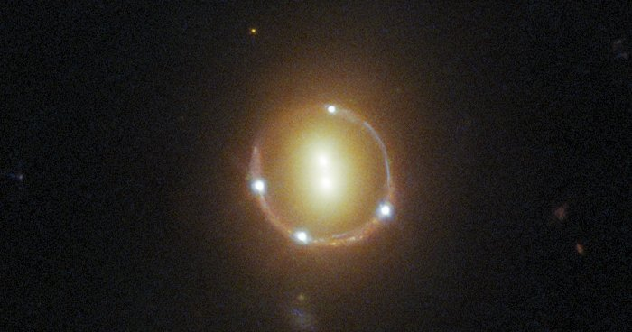
Gravitational Lensing
Change in Image position
Change in amplitude
Change in arrival time
Similar to a lens placed between the observer and the light source.
Einstein Ring
ESA/Hubble & NASA, T. Treu; Acknowledgment: J. Schmidt

Slide 4
Lensed Gravitational Waves
Strongly lensed Gravitational Waves:
$$h_{j}^{lensed}=\sqrt{|μ_{j}|}×h^{original}(f,θ,Δt_{j})×e^{isign\left(f\right)Δφ_{j}}$$
Magnification factor
Arrival time difference between a pair of lensed images
Morse phase shift
f is the frequency of the GW and θ represents other CBC parameters => same morphology

Slide 5
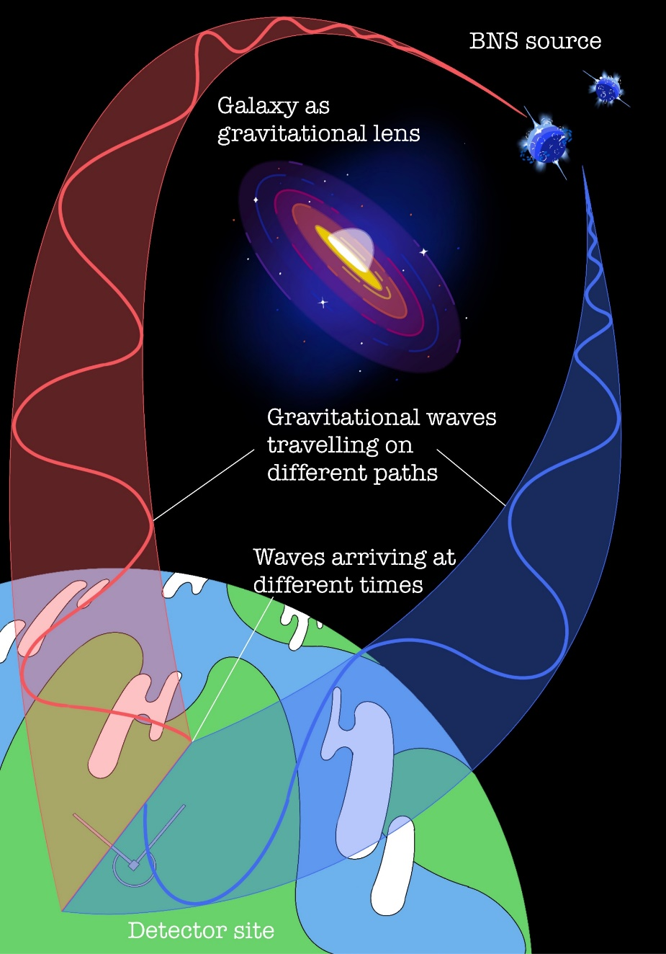
Visualisation
Difference in amplitude
Difference in arrival times
I drew it :)

Slide 6
Importance of GW Lensing
Give information on the source and the lens
Cosmology
Distribution of dark matter
Find out the large-scale geometry of the universe
Calculate the Hubble’s parameter
Expansion rate of our universe
Test of General Relativity
GR predicts the occurrence of lensed GW
No lensed GW have been detected yet
Detecting a lensed GW would prove Einstein right (Again)

Slide 8
General Search Pipeline
Matched filtering using templates
e.g. GstLAL and PyCBC
Output a ranked list of possible GW candidates
For future follow up

Slide 9
2 Types of Signals
Super-threshold signals
Events that have high enough ranking statistics
Relatively high intensity
All GWs in the LIGO catalogue are super-threshold signals
Sub-threshold signals
SNR high enough to produce a trigger
Insignificant ranking statistics

Slide 10
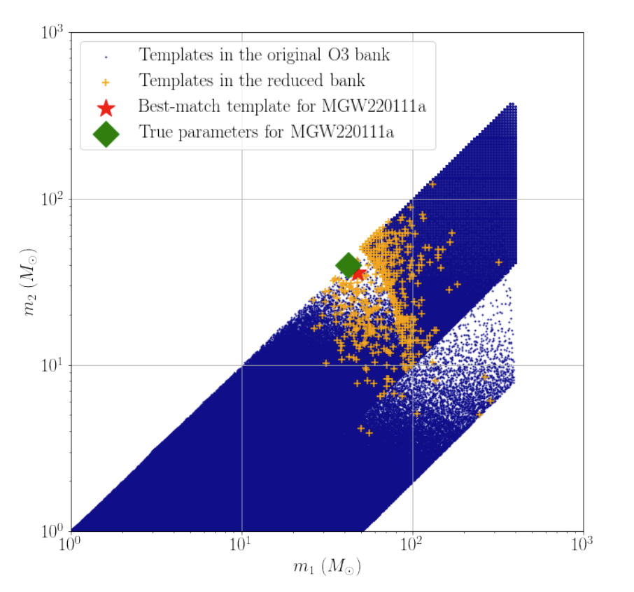
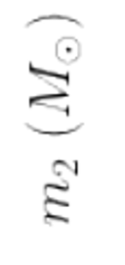
Lensing Search Pipelines
Examples
TESLA (GstLAL based)
PyCBC
Strongly lensed images would have similar intrinsic parameters
Targeted Search
Only use template banks similar to the targeted GW event
Li et al.

Slide 11
Then why am I here?
Each targeted search can return O(10) candidates
O3a has ~40 events -> return ~400 candidates
O4 would probably produce O(100) events -> return ~1000 candidates
very computationally costly

Slide 13
My Aim
Retrieve lensed GW signals
Improve Sensitivity of the pipeline
Add sky localisation constraints to improve the ranking statistics of candidates according to their location on the sky relative to the target
It’s really me this time :)

Slide 14
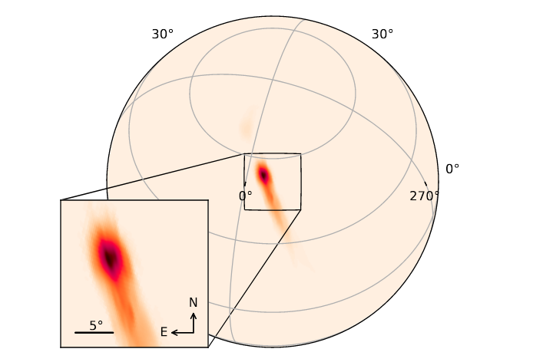
Why is it possible
LIGO can only constrain the sky location to the order of degrees
BUT
Shift in image position due to lensing is in the order of arc seconds
Just assume both images would come from the same sky location
Skymap of GW190408

Slide 15
Likelihood Ratio
The likelihood ratio of a trigger that is produced by a real gravitational wave is given by:
$\overset{⃑}{Δt}$ : arrival time difference between detectors
$\overset{⃑}{Δφ}$ : arrival phase difference between detectors
Just by considering these 2 terms can constrain the sky location

Slide 16
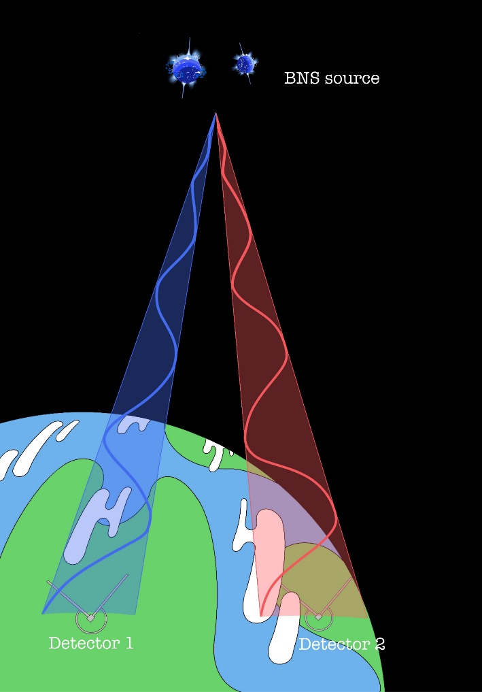
Visualisation
$$\overset{⃑}{Δt}=0, \overset{⃑}{Δφ}=0$$
$$\overset{⃑}{Δt}>0, \overset{⃑}{Δφ}>0$$

Slide 17
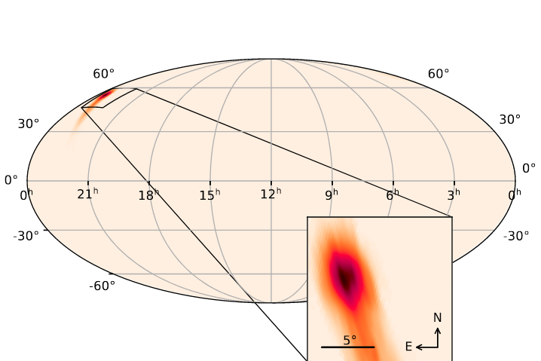
Reading Skymaps
Modify the GstLAL pipeline to allow the user to input LIGO skymap

Slide 18
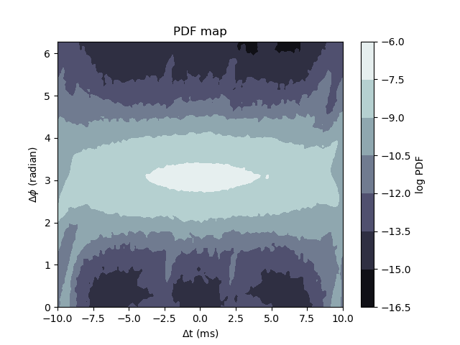
Plotting PDFs
Plot the distribution of $P(Δt, Δφ)$ in the $Δt, Δφ$ space.
Make a new plotting script to calculate the probability and plot the graph
No sky localisation
Parameters:
Detectors: H1 and L1
Horizon distance = 100MPc
SNR = 10

Slide 19
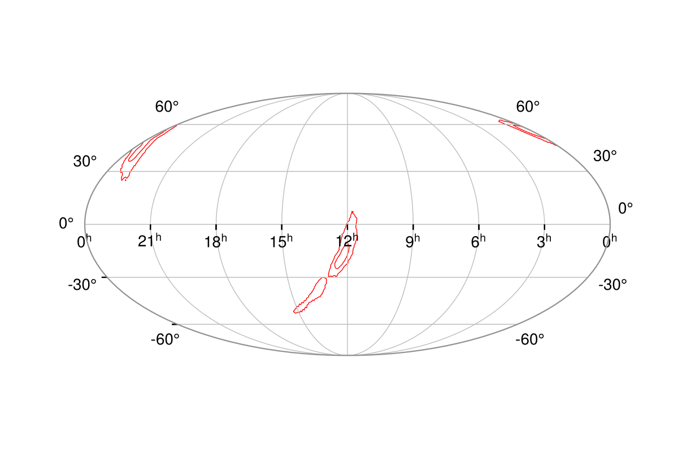
Sky Tiling
The probability density is calculated grid by grid
The image would come from the same patch of sky if it is the lensed counterpart of the target
Re-calculate the probability density

Slide 20
Removing unnecessary jobs
Reducing 3000+ jobs to O(10) of jobs (67 jobs for GW190519)
Completing a PDF map in about 2 hours
ME
67 useful jobs
3000+ useless jobs

Slide 21
Probability Distribution
Skymap of GW190519
Assumes PDF = 0 for simplicity
90% credible region: PDF > 0 and uniformly distributed among the regions

Slide 22
Program flow
3072 pixels
Within 90% credible region?
Skipping the useless jobs
65 pixels
Yes
No
3007 jobs
Calculate PDF
Set PDF = 0
Probability of that pixel
Computationally costly

Slide 23
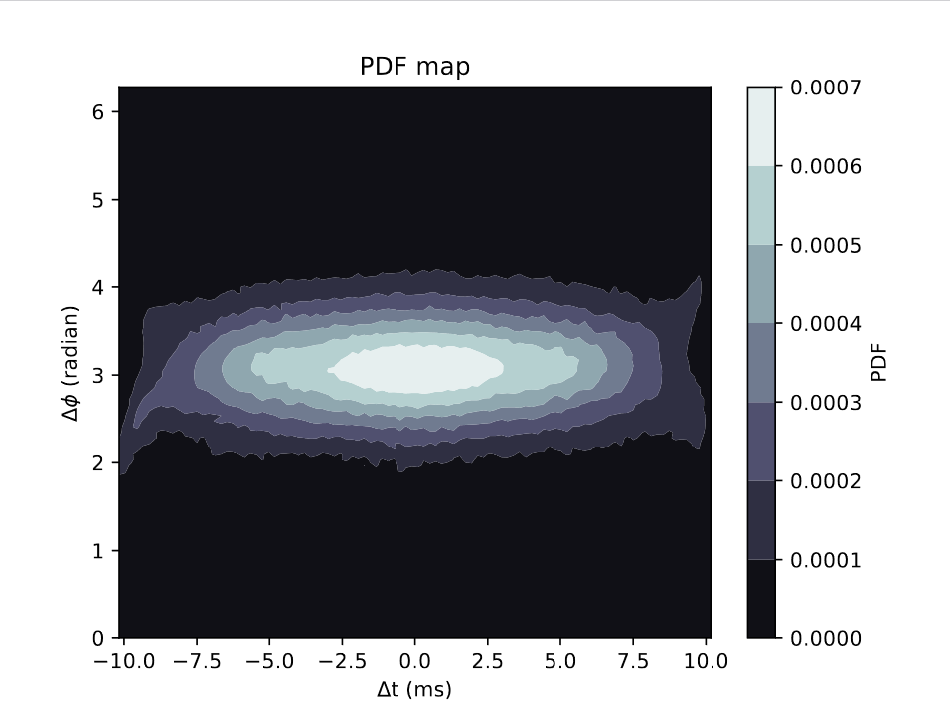
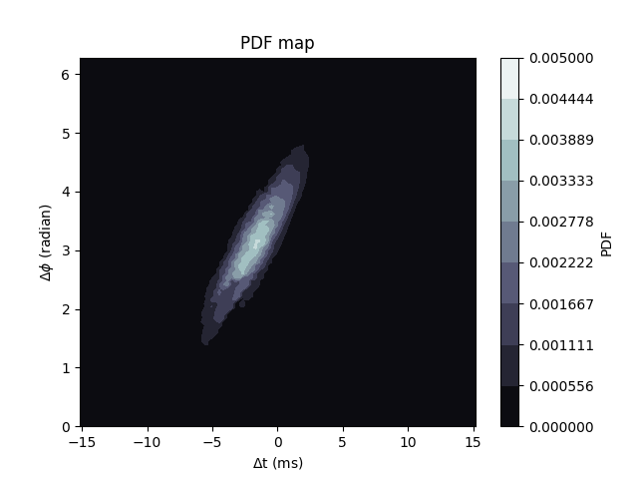
Result
No sky localisation
Parameters:
Detectors: H1 and L1
Horizon distance = 100MPc
SNR = 10
With sky localisation
Event: GW190519
Detectors: H1 and L1
SNR = 10

Slide 24
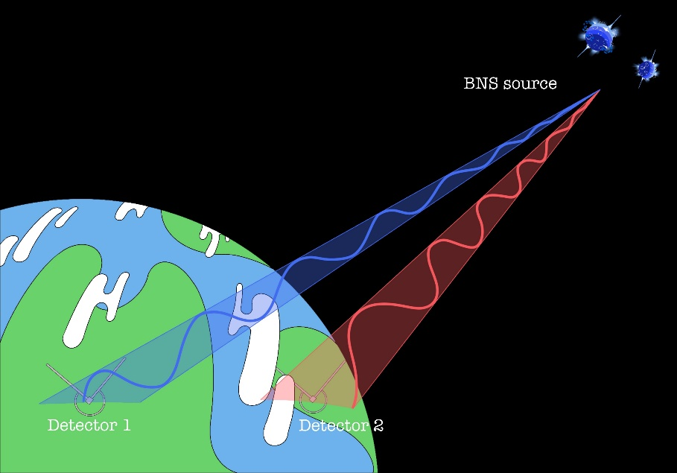
The Earth is rotating…
$Δt, Δφ$ would be different at different times
Calculate many PDFs at different times
Lensing might cause delays in O(months)
9:00am
12:00pm

Slide 25
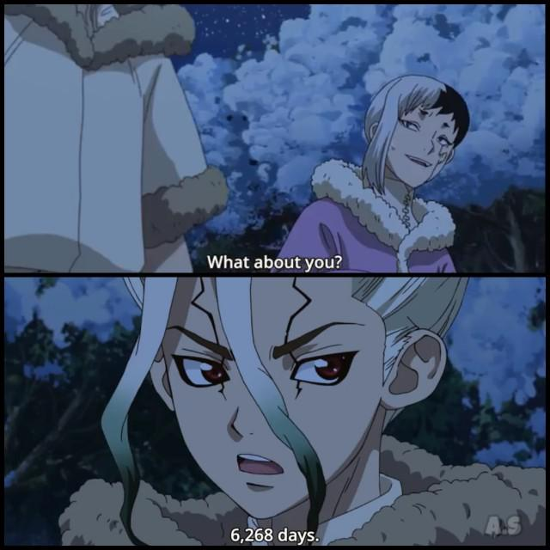
Generate PDF maps on the run?
Around O(10000) triggers for 1 targeted search
Many maps would be needed
Generating a map takes O(hours) (even after massive efficiency improvement)
Very inefficient
How long has the job been running?

Slide 26
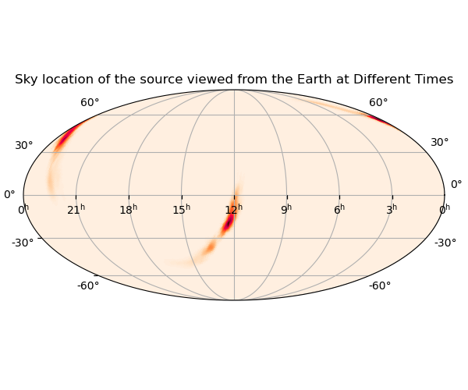
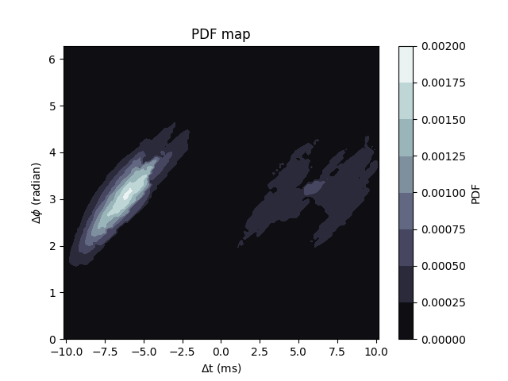
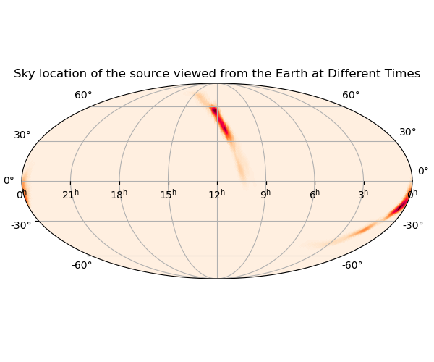
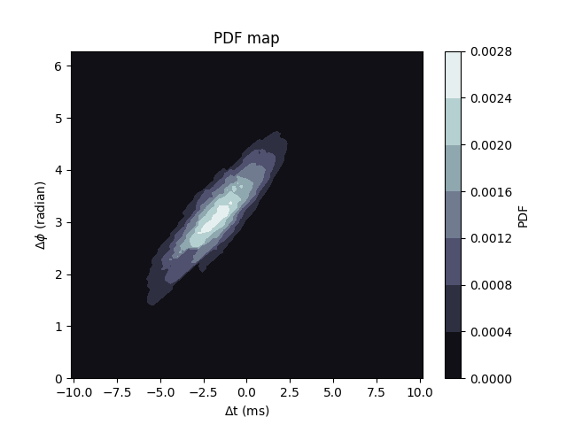
Rotating the skymaps
Calculate and plot dtdphi PDF
Rotates 180 degree to the right
Calculate and plot dtdphi PDF

Slide 27
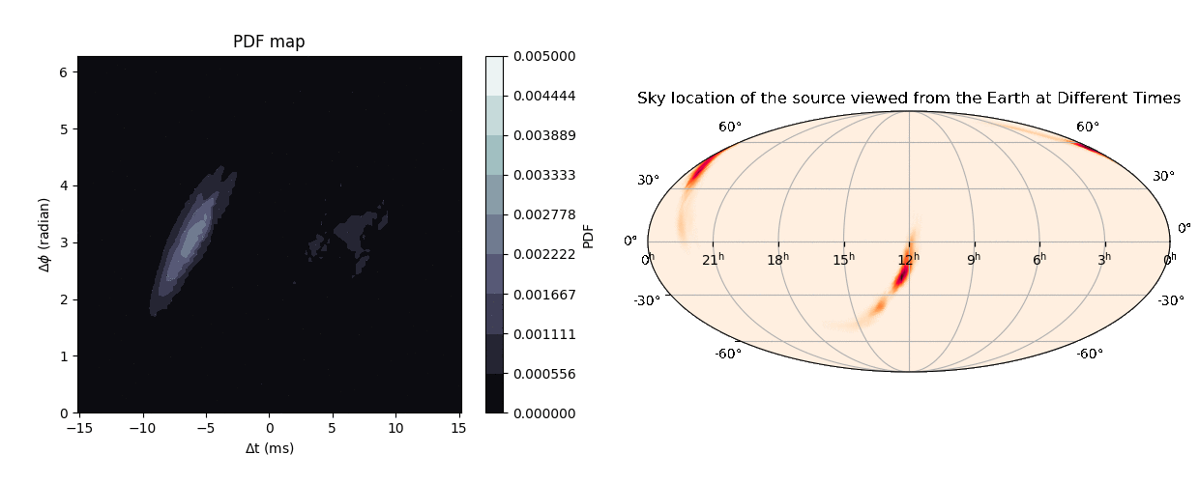
Rotating for a whole cycle
Event: GW190519
Frequency: 240 steps per sidereal day rotation
Detectors: H1 and L1
SNR = 10

Slide 28
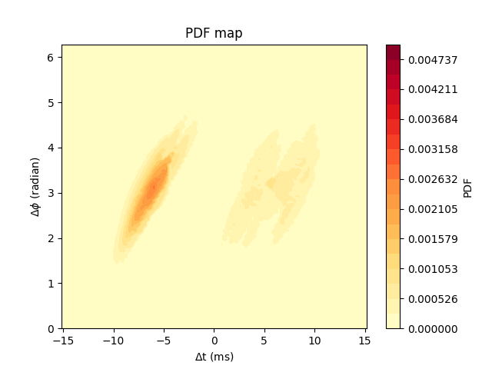
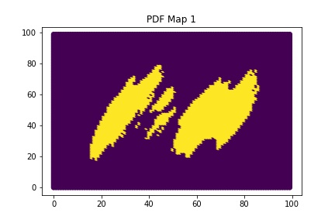
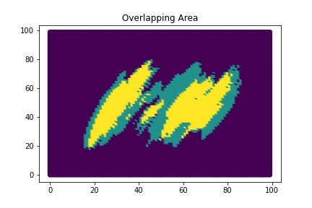
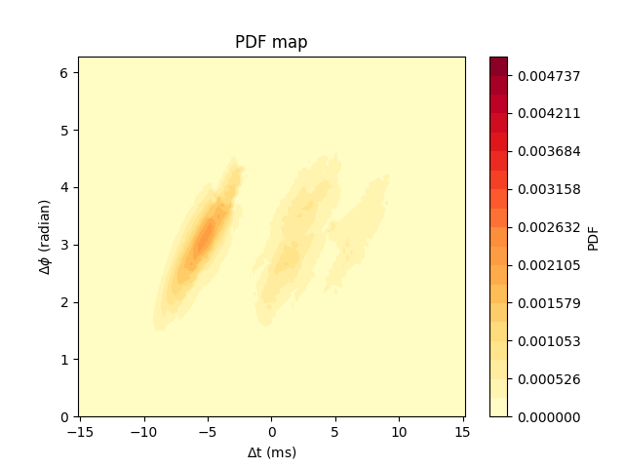
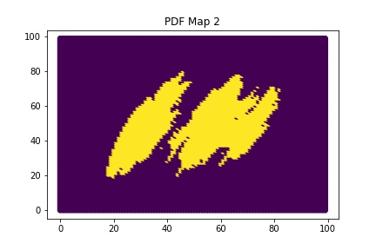
How many is enough?
Find 90% credible region

Slide 29
Overlapping Area
Yellow Region: pixels within the 90% credible regions of both maps
Green Region: pixels within the 90% credible region of only 1 map
Purple Region: pixels that are outside the 90% credible regions of both maps

Slide 30
Overlapping Percentage
Overlapping percentage:
$\frac{yellow region}{yellow region+green region}×100\%$
Requirement: the percentage of the least overlapping adjacent maps over one sidereal day rotation would be larger than 80%

Slide 31
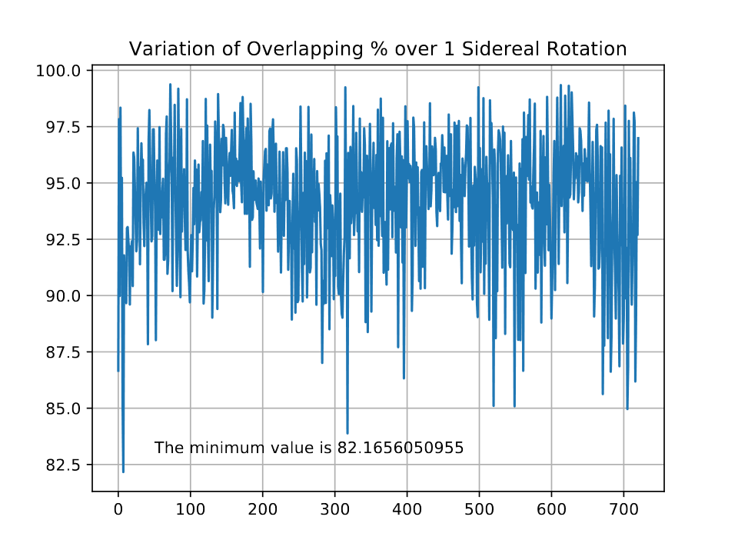
Result
720 steps per rotation satisfies the requirement with a minimum value of 82%
Generate a new map for every 2 minutes / 0.5 degrees
The minimum value is 82.2%
Special thanks to Andrew for giving me the idea of just looking for the dips to save computational time ☺

Slide 32
Implementation
Folder containing all dtdphi pdfs files
Calculate Likelihoods using the 2 maps
generate prior
Choose the one with a larger value
xml document
Choose 2 pdf maps according to the trigger time
Likelihood of that trigger

Slide 34
Mock Data Challenge
Choose a real super-threshold signal / generate a simulated signal
Produce copies of the signal with lower amplitudes (simulate sub-threshold signals)
Inject both types of signals into real noise data
Use searching pipelines to search the data and try to retrieve all injected signals

Slide 35
Mock Data Challenge
Test for:
How many injections we could retrieve
Efficiency of the search
Number of real injections retrieved vs number of noise triggers with the same ranking statistic threshold
False Alarm Rates of the real injections before (vanilla TESLA pipeline) and after the implementation of the sky location-constrain method
Prediction
New FAR
$$y=x$$
Original FAR

Slide 36
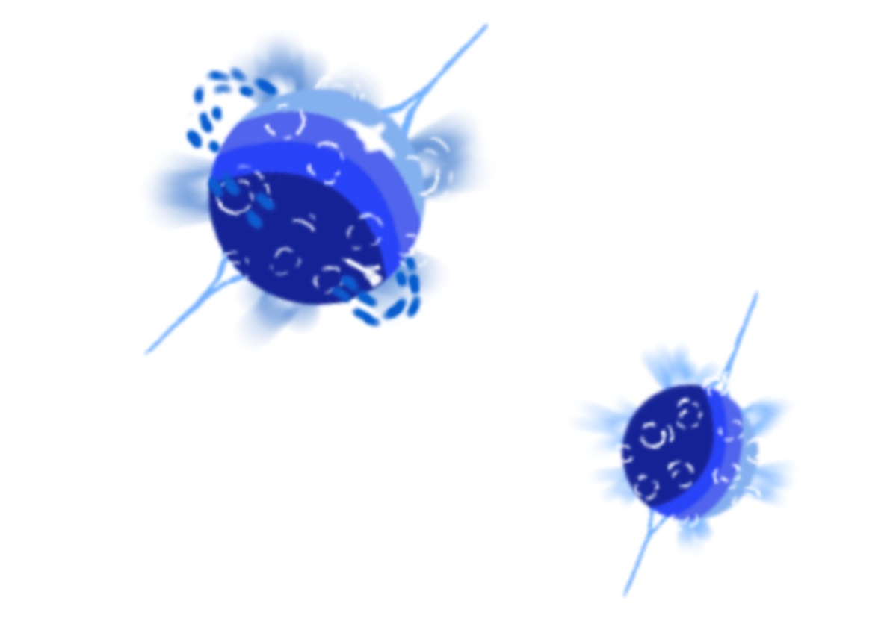
Possible Applications
GW from GRB events
BNS merger
GW from supernovae

Slide 37
Acknowledgement
Thanks for
NSF, LSC and Caltech for making the programme possible
The Chinese University of Hong Kong for funding my trip
All of my mentors
All other people who had helped me along the way

Slide 38
End of Presentation
Q&A

Slide 39
Appendix

Slide 40
Contemporary Research
LVK O3a lensing paper
Lensing statistics
Re-analysing events under lensing hypothesis
Multi-image search
Microlensing search

Slide 41
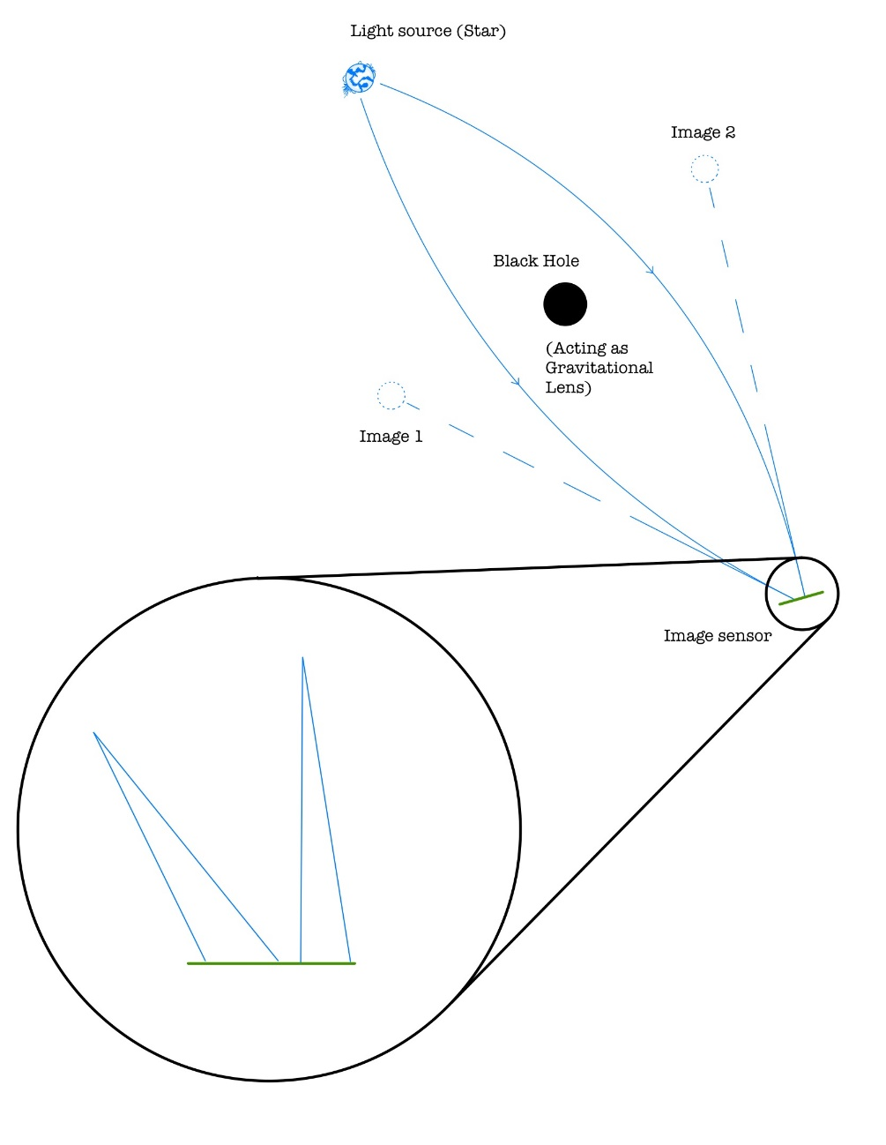
Multi-image Search
Images might be amplified or deamplified
Incident angle
Path of travel

Slide 42
Relativistic Deflection angle
Finding the deflection angle around a spherical object (e.g. BH/NS) (Assumed strong lensing)
Starting from Schwarzschild metric
$$ds^{2}=−\left(1−\frac{2GM}{r}\right)dt^{2}+{\left(1−\frac{2GM}{r}\right)}^{−1}dr^{2}+r^{2}dθ^{2}+r^{2}\sin^{2}{θ}dφ^{2}$$
Geodesic equation gives:
$$\frac{d}{dτ}\left(g_{μν}\frac{dx^{ν}}{dτ}\right)−\frac{1}{2}∂_{μ}g_{αβ}\frac{dx^{α}}{dτ}\frac{dx^{β}}{dτ}=0$$
Solving it gives:
$$α=\frac{4GM}{r_{c}}$$
No worries, Alvin will give detailed derivation during the seminar :)

Slide 43
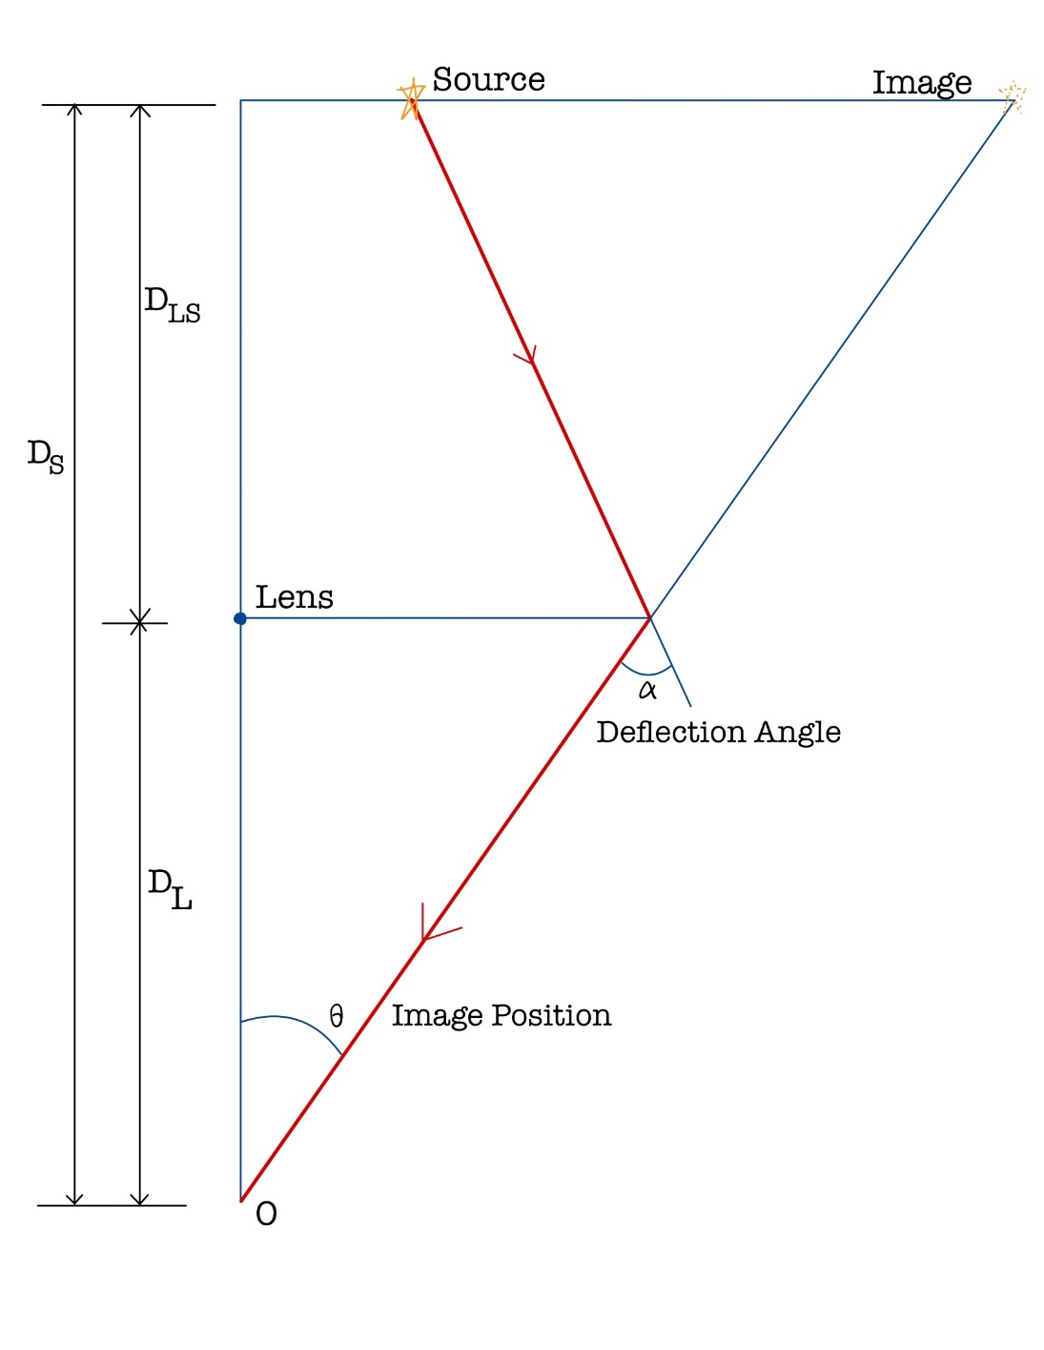
Image Position & Deflection Angle
Deflection angle:
$$α=\frac{4GM}{r_{c}}$$
When the source, lens and the observer are perfectly aligned on a plane, the image position is:
$θ=\sqrt{4GM\frac{D_{LS}}{D_{L}D_{S}}}$

