Slide 1
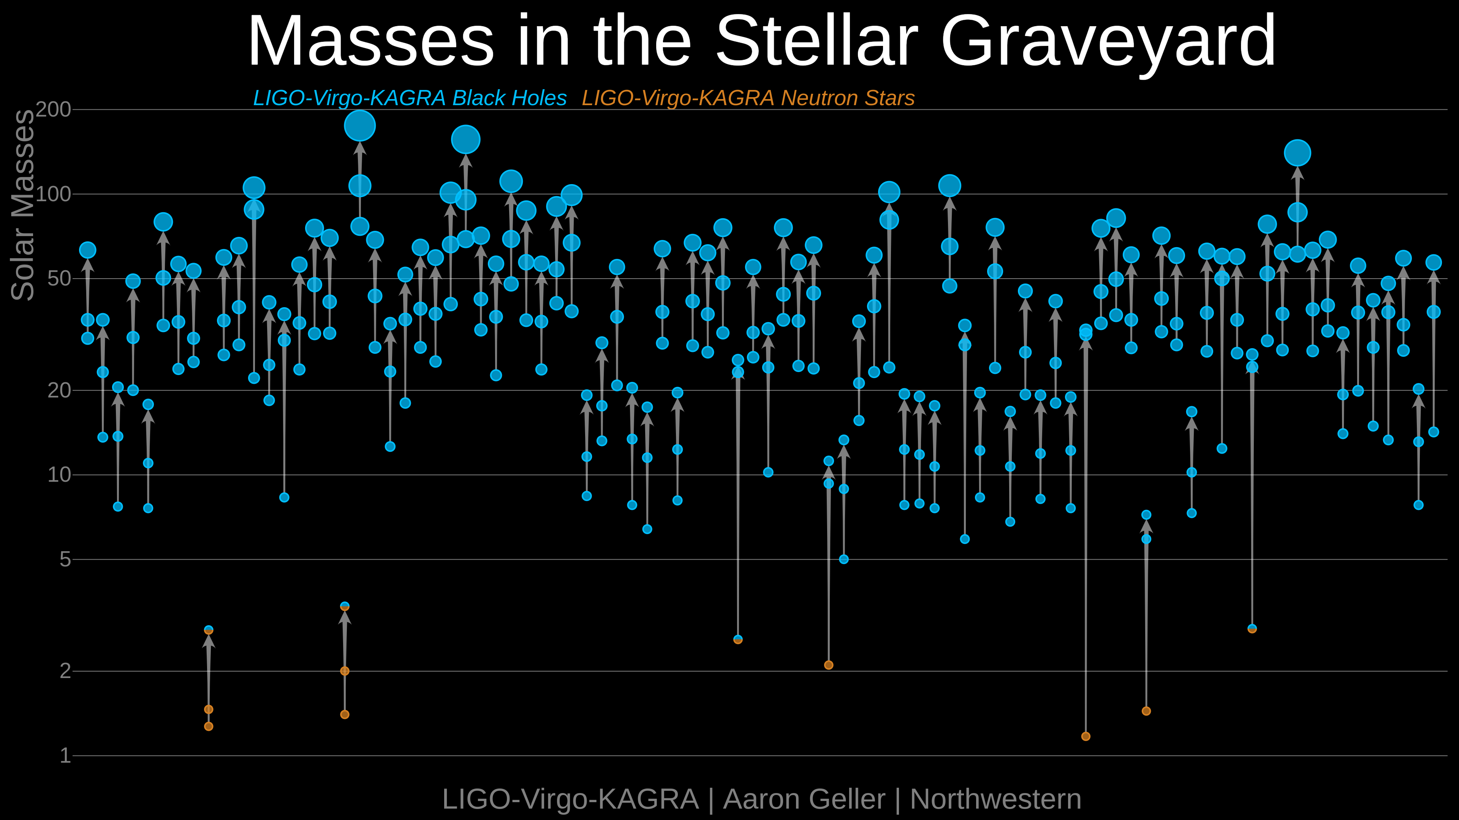
Overview of LIGO-Virgo-KAGRA Results from the O3 Observing Run
Peter S. Shawhan (University of Maryland and Joint Space-Science Institute)
for the LIGO Scientific Collaboration, Virgo Collaboration and KAGRA Collaboration
As of 13 Dec 2021— more are coming
Gravitational Wave Physics and Astronomy Workshop — December 14-17, 2021
LIGO-G2102190-v3
The Advanced LIGO and Advanced Virgo gravitational-wave detectors collected data from April 2019 through March 2020 in their third observing run (O3), while KAGRA collected its first observational data in April 2020, concurrent with ongoing GEO600 operation (O3GK). This data has greatly enlarged the catalog of observed compact binary mergers and their properties, some of which are quite exceptional. The LIGO, Virgo and KAGRA collaborations (LVK) have published papers based on those compact binary mergers and have, in addition, completed a wide range of searches for other transient, continuous-wave and stochastic gravitational-wave signals. Here we list all O3 papers released so far by the LVK, grouped to give a big-picture overview of those analyses and notable results.
The LSC and Virgo have co-authored all of these papers; KAGRA has co-authored several papers using data from the second half of the O3 run. (An analysis of the coincident GEO-KAGRA data is in preparation.) The public list of all LVK papers is maintained at https://pnp.ligo.org/ppcomm/Papers.html
Searches for Continuous-Wave GW Sources
Directed searches for GWs from supernova remnants
“Searches for continuous gravitational waves from young supernova remnants in the early third observing run of Advanced LIGO and Virgo”, ApJ 921, 80 (2021)
“Search of the Early O3 LIGO Data for Continuous Gravitational Waves from the Cassiopeia A and Vela Jr. Supernova Remnants”, arXiv:2111.15116
Searches for GWs from the X-ray pulsar PSR J0537‒6910 with timing data from NICER, glitches identified by NICER team members
“Diving below the spin-down limit: Constraints on gravitational waves from the energetic young pulsar PSR J0537‒6910”, ApJL 913, L27 (2021)
“Constraints from LIGO O3 data on gravitational-wave emission due to r-modes in the glitching pulsar PSR J0537‒6910”, ApJ 922, 71 (2021)
Searches for GWs from other known pulsars with ephemerides provided by radio and X-ray astronomers
“Gravitational-wave constraints on the equatorial ellipticity of millisecond pulsars”, ApJL 902, L21 (2020)
“Search for continuous gravitational waves from 20 accreting millisecond X-ray pulsars in O3 LIGO data”, arXiv:2109.09255
“Searches for Gravitational Waves from Known Pulsars at Two Harmonics in the Second and Third LIGO-Virgo Observing Runs”, arXiv:2111.13106
All-sky searches for continuous-wave GWs from unknown sources
“All-sky search in early O3 LIGO data for continuous gravitational-wave signals from unknown neutron stars in binary systems”, PRD 103, 064017 (2021)
“All-sky Search for Continuous Gravitational Waves in the Early O3 LIGO Data”, PRD 104, 082004 (2021)
Searches for GWs Associated with Gamma-Ray Bursts
“Search for Gravitational Waves Associated with Gamma-Ray Bursts Detected by Fermi and Swift during the LIGO-Virgo Run O3a”, ApJ 915, 86 (2021)
“Search for Gravitational Waves Associated with Gamma-Ray Bursts detected by Fermi and Swift during the O3b LIGO-Virgo Run”, arXiv:2111.03608
Exceptional Compact Binary Coalescences
Distinctly asymmetric system detected early in the O3 run — “GW190412: Observation of a Binary-Black-Hole Coalescence with Asymmetric Masses”, PRD 102, 043015 (2020)
Second binary neutron star merger detected — “GW190425: Observation of a compact binary coalescence with total mass ~3.4 $M_{⊙}$”, ApJL 892, L3 (2020)
Highest-mass confidently detected CBC — “GW190521: A Binary Black Hole Merger with a Total Mass of 150 $M_{⊙}$”, PRL 125, 101102 (2020) and “Properties and astrophysical implications of the 150 $M_{⊙}$ binary black hole merger GW190521”, ApJL 900, L13 (2020)
Extremely asymmetric system; is the secondary object an exceptionally heavy neutron star or an exceptionally light black hole?? — “GW190814: Gravitational Waves from the Coalescence of a 23 Solar Mass Black Hole with a 2.6 Solar Mass Compact Object”, ApJL 896, L44 (2020)
First confident detection of NS-BH mergers — “Observation of gravitational waves from two neutron star–black hole coalescences”, ApJL 915, L5 (2021). (Though GW200105 is not in GWTC-3.)
Events in GWTC-3 with $p_{astro}>0.5$
Fundamental Physics Searches with Continuous-Wave Signatures
“Constraints on dark photon dark matter using data from LIGO's and Virgo's third observing run”, arXiv:2105.13085
“All-sky search for gravitational wave emission from scalar boson clouds around spinning black holes in LIGO O3 data”, arXiv:2111.15507
GW200115
Searches for a Stochastic GW Background
Isotropic — “Upper limits on the isotropic gravitational-wave background from Advanced LIGO and Advanced Virgo's third observing run”, PRD 104, 022004 (2021)
Anisotropic — “Search for anisotropic gravitational-wave backgrounds using data from Advanced LIGO's and Advanced Virgo's first three observing runs”, PRD 104, 022005 (2021)
“Constraints on cosmic strings using data from the third Advanced LIGO-Virgo observing run”, PRL 126, 241102 (2021)
“All-sky, all-frequency directional search for persistent gravitational waves from Advanced LIGO's and Advanced Virgo's first three observing runs”, arXiv:2110.09834
O3a
O3b
Catalog Updates and Analysis of Collected CBC Events
O3a
“GWTC-2: Compact Binary Coalescences Observed by LIGO and Virgo during the First Half of the Third Observing Run”, PRX 11, 021053 (2021)
“Population properties of compact objects from the second LIGO-Virgo Gravitational-Wave Transient Catalog”, ApJL 913, L7 (2021)
“Search for lensing signatures in the gravitational-wave observations from the first half of LIGO-Virgo's third observing run”, ApJ 923, 14 (2021)
“Tests of general relativity with binary black holes from the second LIGO-Virgo gravitational-wave transient catalog”, PRD 103, 122002 (2021)
“GWTC-2.1: Deep Extended Catalog of Compact Binary Coalescences Observed by LIGO and Virgo During the First Half of the Third Observing Run”, arXiv:2108.01045. Note: updates properties of GWTC-2 events (FAR, $p_{astro}$) and finds eight new candidates with $p_{astro}>0.5$
O3b / Full O3
“GWTC-3: Compact Binary Coalescences Observed by LIGO and Virgo During the Second Part of the Third Observing Run”, arXiv:2111.03606
“The population of merging compact binaries inferred using gravitational waves through GWTC-3”, arXiv:2111.03634
“Constraints on the cosmic expansion history from the third LIGO-Virgo-KAGRA Gravitational-Wave Transient Catalog”, arXiv:2111.03604
“Tests of General Relativity using the third LIGO-Virgo Gravitational-Wave Transient Catalog (O3 CBC TGR)”, arXiv:2112.06861
Unmodeled Searches for GW Bursts
“All-sky search for short gravitational-wave bursts in the third Advanced LIGO and Advanced Virgo run”, PRD in press, arXiv:2107.03701
“All-sky search for long-duration gravitational-wave transients in the third Advanced LIGO observing run”, PRD 104, 102001 (2021)
Burst detection pipelines were also used to search for GW transients from cosmic strings in the paper listed above, to find some of the binary black hole mergers reported in the O3a and O3b catalog updates, and to search for intermediate mass black hole mergers in the paper listed at lower right
Download LIGO/Virgo Data and Software Tools
from gw-openscience.org
In addition to online event info and strain data, see guides to the data and analysis methods:
“Open data from the first and second observing runs of Advanced LIGO and Advanced Virgo”, SoftwareX 13, 100658 (2021)
“A guide to LIGO-Virgo detector noise and extraction of transient gravitational-wave signals”, Classical and Quantum Gravity 37, 055002 (2020)
Searches for CBCs with Higher or Lower Masses
“Search for intermediate mass black hole binaries in the third observing run of Advanced LIGO and Advanced Virgo”, A&A in press, arXiv:2105.15120
“Search for subsolar-mass binaries in the first half of Advanced LIGO and Virgo's third observing run” (by LSC, Virgo, KAGRA, D. Jeong and S. Shandera), arXiv:2109.12197
This work is supported by the U. S. National Science Foundation through grant PHY-2012159. This material is based upon work supported by NSF’s LIGO Laboratory which is a major facility fully funded by the National Science Foundation. The collaborations also gratefully acknowledge the support of the Science and Technology Facilities Council (STFC) of the United Kingdom, the Max-Planck-Society (MPS), and the State of Niedersachsen/Germany for support of the construction of Advanced LIGO and construction and operation of the GEO600 detector. Additional support for Advanced LIGO was provided by the Australian Research Council. The authors gratefully acknowledge the Italian Istituto Nazionale di Fisica Nucleare (INFN), the French Centre National de la Recherche Scientifique (CNRS) and the Netherlands Organization for Scientific Research (NWO), for the construction and operation of the Virgo detector and the creation and support of the EGO consortium. The authors also gratefully acknowledge research support from these agencies as well as by the Council of Scientific and Industrial Research of India, the Department of Science and Technology, India, the Science & Engineering Research Board (SERB), India, the Ministry of Human Resource Development, India, the Spanish Agencia Estatal de Investigación (AEI), the Spanish Ministerio de Ciencia e Innovación and Ministerio de Universidades, the Conselleria de Fons Europeus, Universitat i Cultura and the Direcció General de Política Universitaria i Recerca del Govern de les Illes Balears, the Conselleria d’Innovació, Universitats, Ciència i Societat Digital de la Generalitat Valenciana and the CERCA Programme Generalitat de Catalunya, Spain, the National Science Centre of Poland and the European Union – European Regional Development Fund; Foundation for Polish Science (FNP), the Swiss National Science Foundation (SNSF), the Russian Foundation for Basic Research, the Russian Science Foundation, the European Commission, the European Social Funds (ESF), the European Regional Development Funds (ERDF), the Royal Society, the Scottish Funding Council, the Scottish Universities Physics Alliance, the Hungarian Scientific Research Fund (OTKA), the French Lyon Institute of Origins (LIO), the Belgian Fonds de la Recherche Scientifique (FRS-FNRS), Actions de Recherche Concertées (ARC) and Fonds Wetenschappelijk Onderzoek – Vlaanderen (FWO), Belgium, the Paris ˆIle-de-France Region, the National Research, Development and Innovation Office Hungary (NKFIH), the National Research Foundation of Korea, the Natural Science and Engineering Research Council Canada, Canadian Foundation for Innovation (CFI), the Brazilian Ministry of Science, Technology, and Innovations, the International Center for Theoretical Physics South American Institute for Fundamental Research (ICTP-SAIFR), the Research Grants Council of Hong Kong, the National Natural Science Foundation of China (NSFC), the Leverhulme Trust, the Research Corporation, the Ministry of Science and Technology (MOST), Taiwan, the United States Department of Energy, and the Kavli Foundation. The authors gratefully acknowledge the support of the NSF, STFC, INFN and CNRS for provision of computational resources. This work was supported by MEXT, JSPS Leading-edge Research Infrastructure Program, JSPS Grant-in-Aid for Specially Promoted Research 26000005, JSPS Grant-in-Aid for Scientific Research on Innovative Areas 2905: JP17H06358, JP17H06361 and JP17H06364, JSPS Core-to-Core Program A. Advanced Research Networks, JSPS Grant-in-Aid for Scientific Research (S) 17H06133 and 20H05639 , JSPS Grant-in-Aid for Transformative Research Areas (A) 20A203: JP20H05854, the joint research program of the Institute for Cosmic Ray Research, University of Tokyo, National Research Foundation (NRF), Computing Infrastructure Project of KISTI-GSDC, Korea Astronomy and Space Science Institute (KASI), and Ministry of Science and ICT (MSIT) in Korea, Academia Sinica (AS), AS Grid Center (ASGC) and the Ministry of Science and Technology (MoST) in Taiwan under grants including AS-CDA-105-M06, Advanced Technology Center (ATC) of NAOJ, and Mechanical Engineering Center of KEK.

