Slide 1
Sensitivity of the Gravitational Wave Detector Network to High Mass Binary Black Hole Mergers in Observing Run 3 and Beyond
LIGO Summer Undergraduate Research Fellowship
Presenter:
Sabrina Barbaro (Boston University) _{(she/her)}
Mentors:
Alan Weinstein (California Institute of Technology)
Richard Udall (California Institute of Technology)
LIGO T2100334-v1
Notes:
‹#›

Slide 2
Background/Motivation
Background
Intermediate Mass Black Hole Binary (IMBHB) mergers
Pair Instability, Pair Instability Mass Gap
GW190521: 64 on 85 solar masses
Astrophysical implications for formation- want to observe more events
Image credit: NASA/JPL-Caltech

Slide 3
The Fate of the Most Massive Stars: Pair Instability
Background
Large stars are heated past 10⁹K
Photons dissociate into electron-positron pairs
electron-positron pairs provide less radiation pressure
Pulsational vs. Supernova Remnants
100-150M๏ are in the pulsational range
140-260M๏ have no remnant
I define the IMBHB mass range as ~ 65 to 250 M☉
Image Credits: Colm Talbot and Eric Thrane

Slide 4
Goal: Determine The Sensitivity of the Detector Network to High Mass Systems
Goals
Question: How sensitive is the detector network to IMBHB mergers?
With effects such as precession and higher order modes?
In O3? In the future? With more detectors?
Express the sensitivity as a rate of events per space-time volume
N = RVT

Slide 5
Number of Observed Events and Distance Sensitivity
Goals
N = Number of Detected Events
V_{s} = Sensitive Volume
dV_{c}/dz = Comoving Volume
R = Rate of IMBHB mergers (assumed constant)
T = Time (without dilation factor)
ε(z|θ) = efficiency function
z = redshift

Slide 6
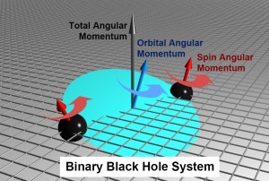
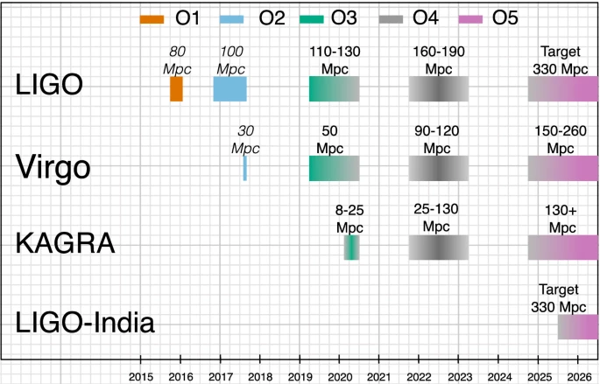
Parameters Affecting Detector Sensitivity: θ
Parameters
Masses, spins, precession, sky location, orbital orientation
Not eccentricity or tidal deformation
Antenna pattern of the detectors
Detectors in the network
Image Credits: Midori Kitagawa
Image Credits: Paper

Slide 7
Averaged Parameters vs Sampled Parameters
Parameters
Searching for overall sensitivity of the network
Average the Extrinsic Variables
Sky location/orientation
Assume uniformly random
Spin values
Assume gaussian distributions
Presence of precession/higher order modes
Sampled
Masses
Precession
Network Configurations
Redshift/ luminosity distance

Slide 8
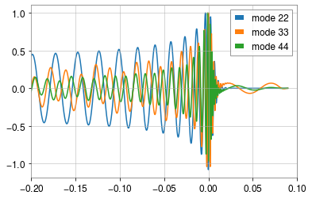
Methodology: How Parameters Affect the Waveform
Methodology
a)
a)
a)
b)

Slide 9
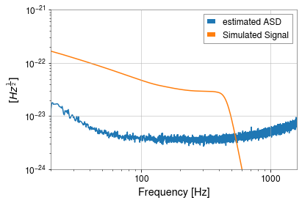
Redshift and Cosmology
Parameters
Frequency is shifted to lower wavelengths
Frequency band is 20-2000 Hz
Masses are therefore redshifted
Time dilation of the rate per spacetime volume
Rate is proportional to the comoving volume

Slide 10
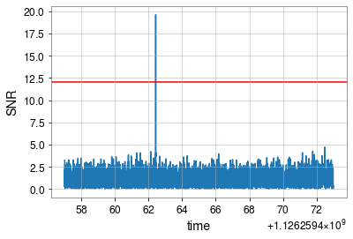
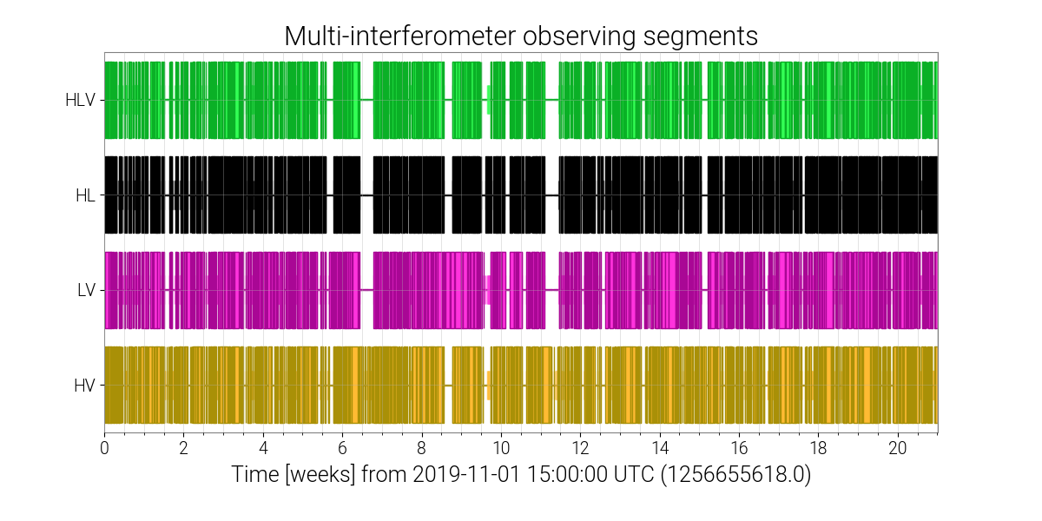
Simplifying Assumptions
Considerations
Power Spectral Densities are Estimates
SNR Threshold is the basis for detection
Duty Cycle is assumed to be 100%
Precession and higher order modes are not used in search pipeline template banks
Image Credits: Detchar Summary Pages

Slide 11
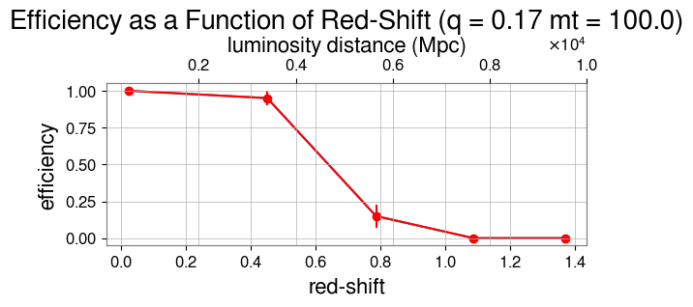
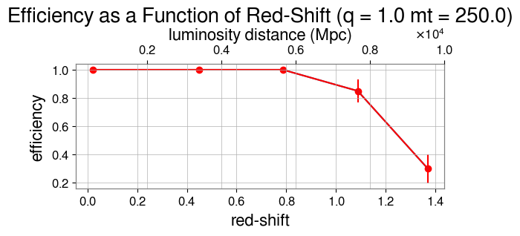
Results: Efficiency Curves
Results

Slide 12
No! Wrong Colloms!

Slide 13
Sensitive Distance by Total Mass

Slide 14
Conclusion
Precession/HOMs don’t seem to significantly affect sensitivity
IMBHB merger rates will help us infer the formation methods of high mass black holes
Developing a sensitivity range for IMBHBs will be useful for further studies

Slide 15
Acknowledgements
Thank you to those that made this project possible:
My mentors Alan Weinstein and
Richard Udall
LIGO Summer Undergraduate Research Fellowship
National Science Foundation
My fellow SURF students!

