Slide 1
Bayes Theorem and Low latency LIGO alerts
By: Nicholas-Tyler Howard
Mentor: Shreya Anand

Slide 2
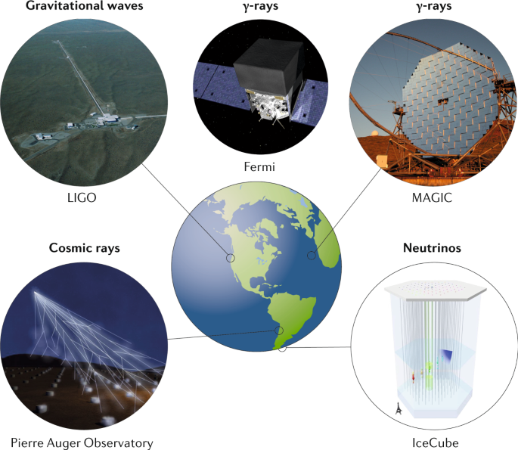
Motivation
Find an efficient low latency method of determining if alerts will make it to a pipeline catalog.
An efficient low latency method of detection is valuable because it will allow us to conduct rapid multi-messenger counterpart searches upon receiving alerts
Low latency alerts are disseminated to the public as soon as a GW detector finds a signal
https://www.nature.com/articles/s42254-019-0101-z

Slide 3
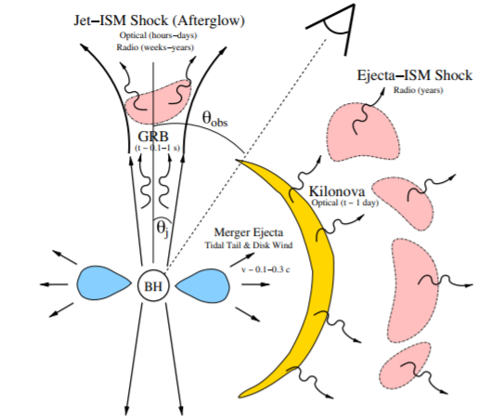
But why chase multi-messenger counterparts?
Kilonovae will require a rapid EM follow up due to their faintness, short lifespan, and because they peak in infrared, making detections difficult.
(Kasen et al. 2015)
Hubble constant measurements, NS equation of state, r process nucleoli synthesis
(Metzger B. D. and Berger E., 2012)

Slide 4
Method
Our method of obtaining a new low latency method of detection is to use the bayes factors and pastros from low latency alerts(OPA) as well as the O3 catalog(GWTC-2) and compare them.
We will treat the data from GWTC-2 as correct
The comparison may help obtain a reliable threshold that can be used in low latency that can be used to efficiently determine if alerts are astrophysical .
GWTC-2 – Gravitational Wave Transient Catalog
OPA – Open Public Alerts

Slide 5
What is pastro and terrestrial probability?
Pastro is measured by comparing the differential rates of gravitational waves and background events.
(Lynch et al. 2018)
Terrestrial probability represents the probability that an alert is the result of a terrestrial event.
Terrestrial probability is 1 – pastro.
Pastro is a sum of probabilities that an event belongs to a category in the image
https://emfollow.docs.ligo.org/userguide/content.html#notice-types

Slide 6
How do we apply bayes theorem?
There are two bayes factors that we use
BSN
- This is the signal to noise bayes factor
- I use two variants of this factor, incoherent and coherent. Incoherent is found from a single detector. Coherent is from all detectors.
BCI
The coherent versus incoherent log Bayes Factor
This Bayes factor is created from both variants of the BSN Bayes factor.

Slide 7
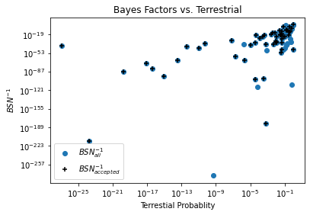
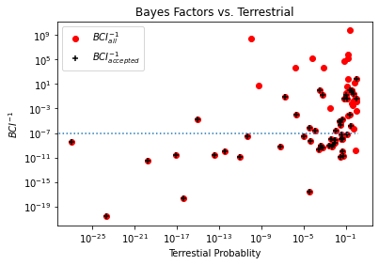
Initial method
The method used to create the scatter plot is redundant because we were comparing the low latency(OPA) terrestrial probability to the low latency bayes factors.
A more useful comparison is to compare low latency alerts to O3 catalog(GWTC-2) events.

Slide 8
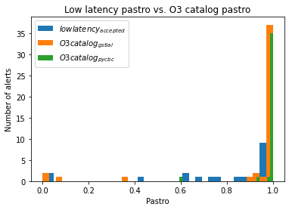
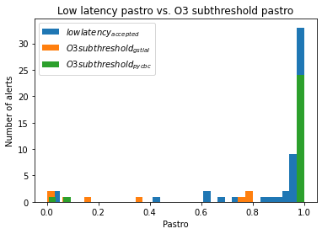
Low latency(OPA) vs. O3 catalog(GWTC-2)
Crossmatched the alerts from the O3 catalog and low latency by their superevent IDs

Slide 9
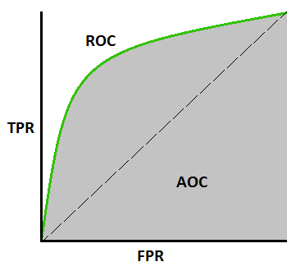
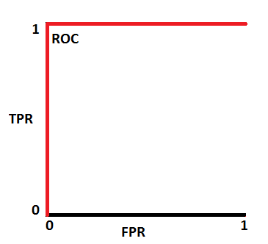
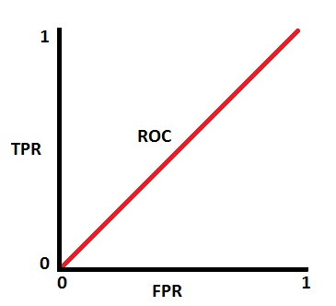
ROC(Receiver Operating Characteristics) (https://towardsdatascience.com/understanding-auc-roc-curve-68b2303cc9c5)
Helps establish threshold
Realistic
Ideal
indistinguishable

Slide 10
Finding True/False Positive Rate
TP (True Positive) : Pastro passes both low latency and catalog threshold
FN (False Negative): Pastro fails low latency but passes catalog threshold
FP (False Positive): Pastro passes low latency but fails catalog threshold
TN (True Negative): Pastro fails both low latency and catalog threshold
TPR (True positive rate) = $\frac{TP}{TP+FN}$
FPR (False positive rate) = $\frac{FP}{FP+TN}$

Slide 11
ROC of pastros
Really good way to see how the low latency is preforming at given
threshold

Slide 12
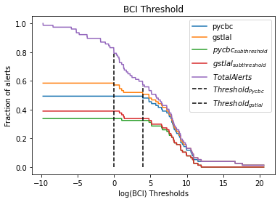
What does this tell us?
The next plot will be VERY ugly, but also very very
BAYESED
Shows how effective OPA bayes factors are
Able to establish threshold from low latency bayes factors
Actual thresholds:
-pycbc: 3.94 log(BCI) – 84%
-gstlal: -0.0261 log(BCI) – 70%

Slide 13
What comes next?
Run BAYESTAR and obtain bayes factors for O3 catalog events.
Compare O3 catalog(GWTC-2) bayes factors to low latency(OPA) bayes factors.
Obtain a reliable threshold for bayes factors.
Test it with simulated events
If effective, implement bayes factors into low latency packets

Slide 14
Thank you
GW
A HUGE thanks to the NSF, Caltech, and Shreya Anand for allowing me to partake in the REU this summer
Thank you to all the post docs and grad students who assisted me this summer as well
Thank you to my peers as well ☺

Slide 15
Questions, Concerns, or Ideas?

Slide 16
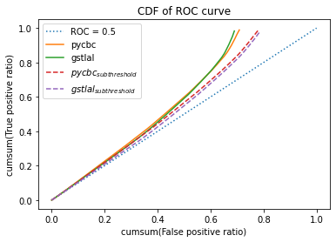
Random plots etc.

