Slide 1
Low-noise Nonlinear Cavity for Cryogenic Interferometers
Presented by: Rahaf Youssef

Slide 2
TABLE OF CONTENTS
1
2
3
Motivation
DOPO
Experimental
Setup
4
Future
Work

Slide 3
1
Motivation

Slide 4
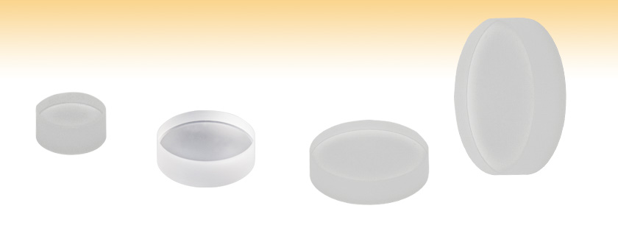
Cryogenic GW Detection
Fused Silica Mirror
Image Credits: https://www.thorlabs.com/newgrouppage9.cfm?objectgroup_id=141
Notes:
The bulk material will be absorbing the current laser wavelength, which increases the thermal noise in the bulk material. In cryogenic GW detection, we need to avoid absorbing the laser, which means we need to go to a longer wavelength than what we currently have (from 1064 nm to 2128 nm).
The Voyger upgrade will turn the test masses into cryogenic.

Slide 5
What needs to change?
Crystalline silicon test masses held at 123 K.
Laser wavelength ( > 1500 nm ).
R. X. Adhikari et al. “A Cryogenic Silicon Interferometer for Gravitational-wave Detection”. July 2020
Notes:
The current laser is very stable and its noise is well-characterized and well-controlled (frequency noise, amplitude noise, and so on), so we would like to leverage this knowledge in building the new laser. If we know the noise of the current laser very well, and we measure the noise of any sub-system that we introduce to it, then we still have a robust noise characterization of the noise introduced by the laser.

Slide 6
Degenerate
Optical
Parametric
Oscillator (DOPO)
2

Slide 7
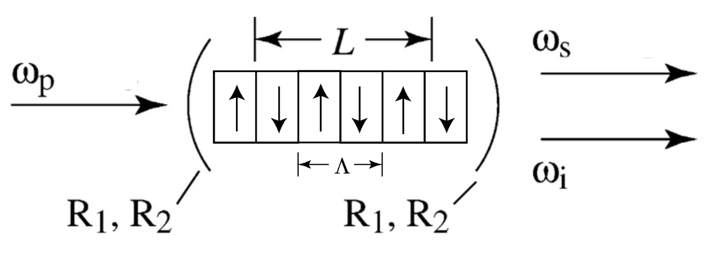
Degenerate Optical Parametric Oscillator
Signal Frequency
Pump Frequency
𝛌_{i,s} = 2128 nm
𝛌_{p} = 1064 nm
Idler Frequency
Figure 1. Boyd, Robert (2008). P 109
Notes:
There is an incoming high energy photon from the laser with frequency omega_p, and after it goes through DOPO, we get two low energy photons (omega_i and omega_s). The mirrors are highly reflective in both frequencies.

Slide 8
Goals
Design an experiment to measure DOPO’s frequency noise.
Understand noise injections in the frequency conversion process.
Developing noise mitigation techniques.

Slide 9
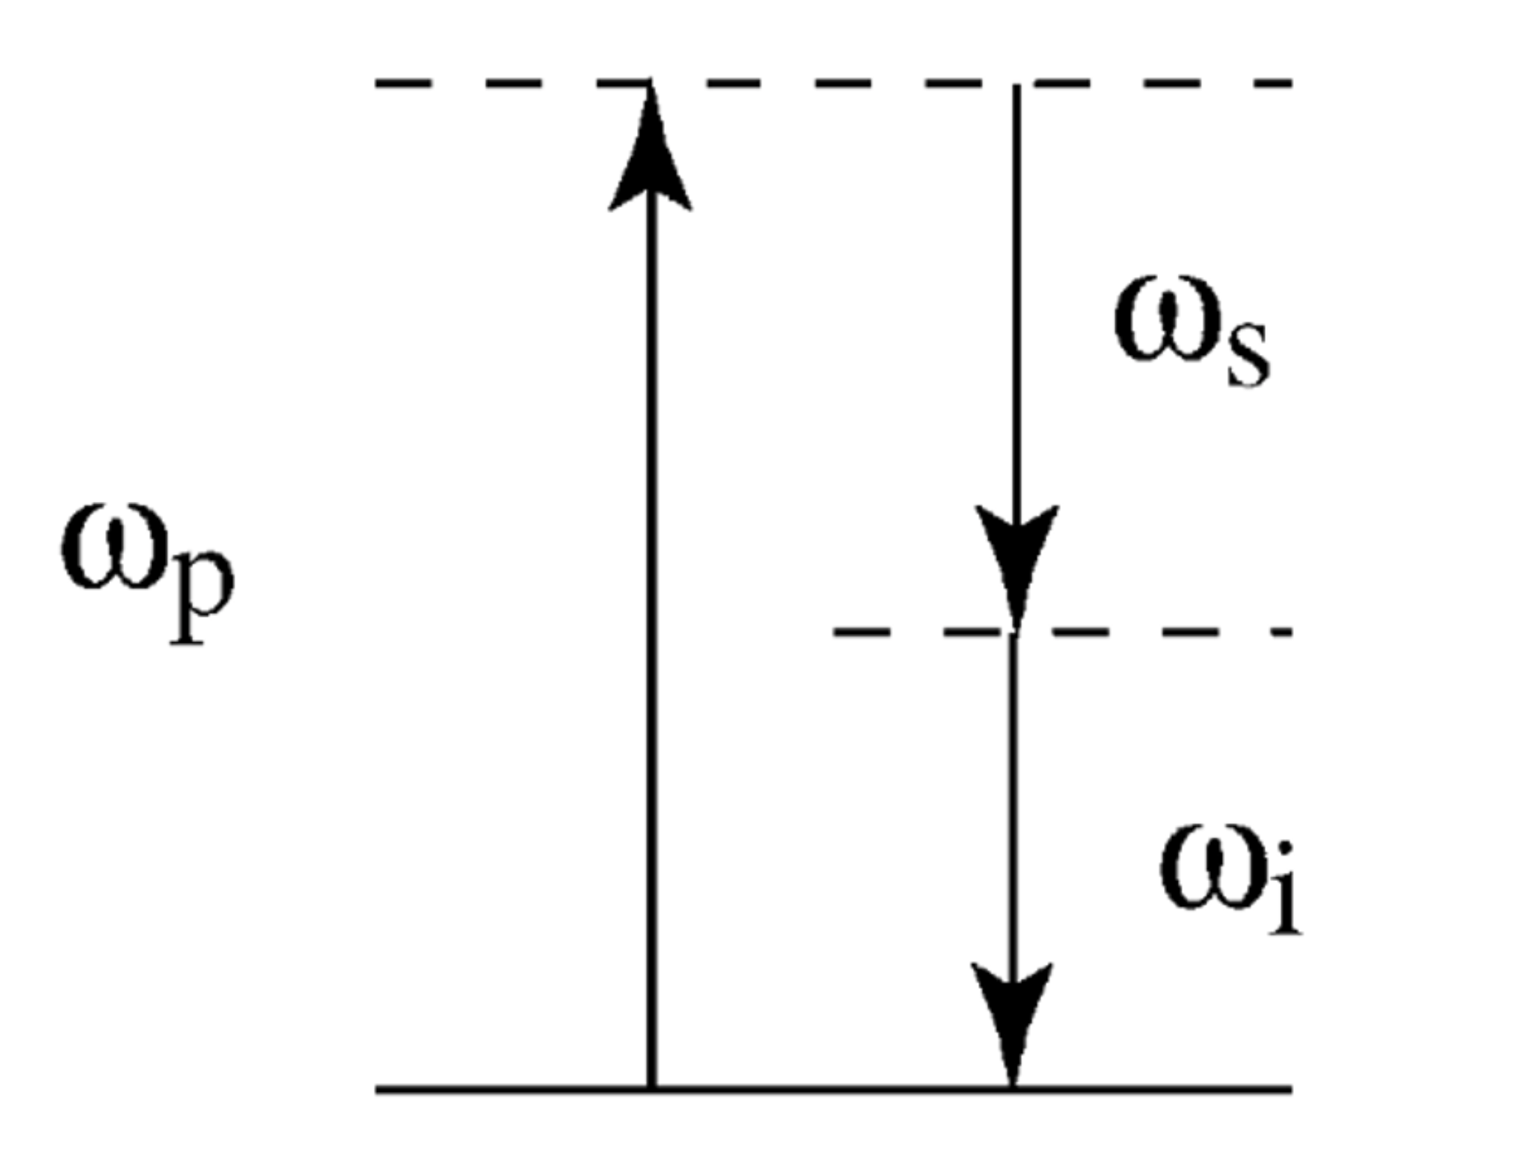
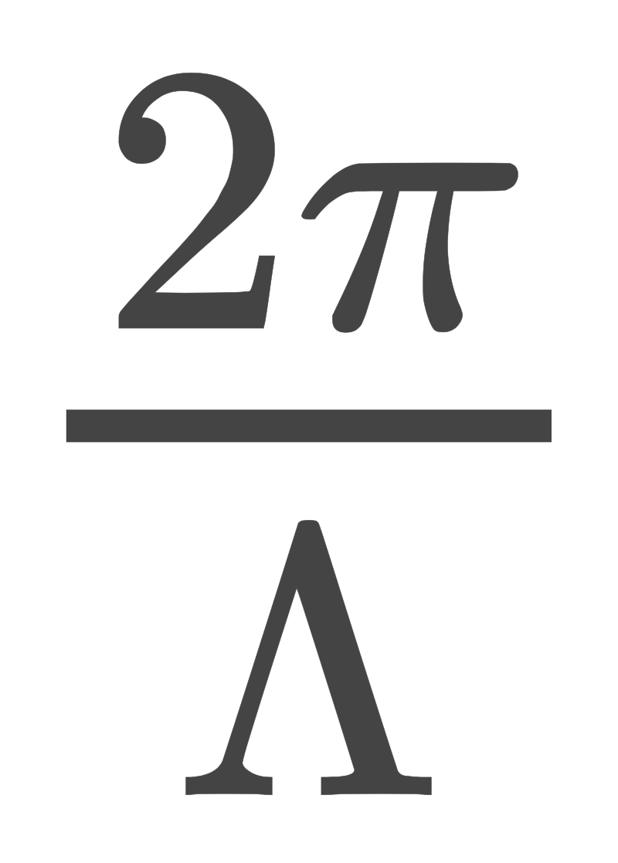
Degenerate Optical Parametric Oscillator
Momentum Conservation:
Δk = K_{p}– (k_{i} + k_{s}) –
Energy Conservation:
ω_{p} = (ω_{i} + ω_{s})
1
2
Figure 2. Boyd, Robert (2008). P 109
Notes:
Ideally, we want the two photons with frequencies (omega_s and omega_i) to be in phase with each other for the conversion process is as efficient as possible. We want the dashed line to be exactly half way through between omega_s and omega_i. This is called degenerate point.
Explain each term in equation 1. These two equations are conditions.

Slide 10
Dispersion Near Degeneracy
Phase-matching condition:
Δk = 0
Near degeneracy:
Assume and .
Taylor expand around to get .
Figure 2. Boyd, Robert (2008). P 109

Slide 11
Dispersion Near Degeneracy
3. Finally, we find that ω_{i,s}=
BUT…
n_{z} using Sellmeier equations.
X_{1,2}: parabolic coefficients.
Aerie. Ady et al. “Temperature-dependant Dispersion Equations for KTiOPO₄ and KTiOASO₄”. December 2003.
Kato, Kiyoshi et al. “Sellmeier and thermo-optic dispersion formulas for KTP”. 2002.

Slide 12
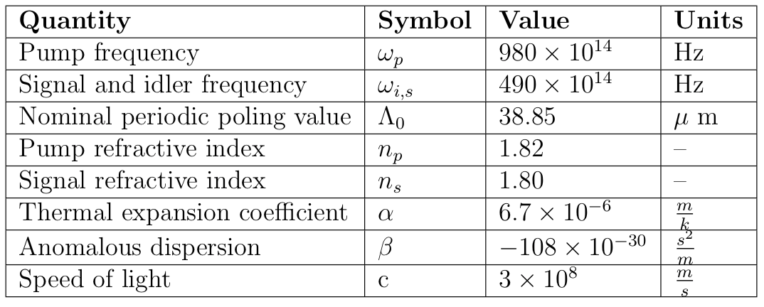
Constants
Table 1. Temperature tuning constants
Aerie. Ady et al. “Temperature-dependant Dispersion Equations for KTiOPO₄ and KTiOASO₄”. December 2003.
Kato, Kiyoshi et al. “Sellmeier and thermo-optic dispersion formulas for KTP”. 2002.
Refractiveindex.info
Notes:
Add references

Slide 13
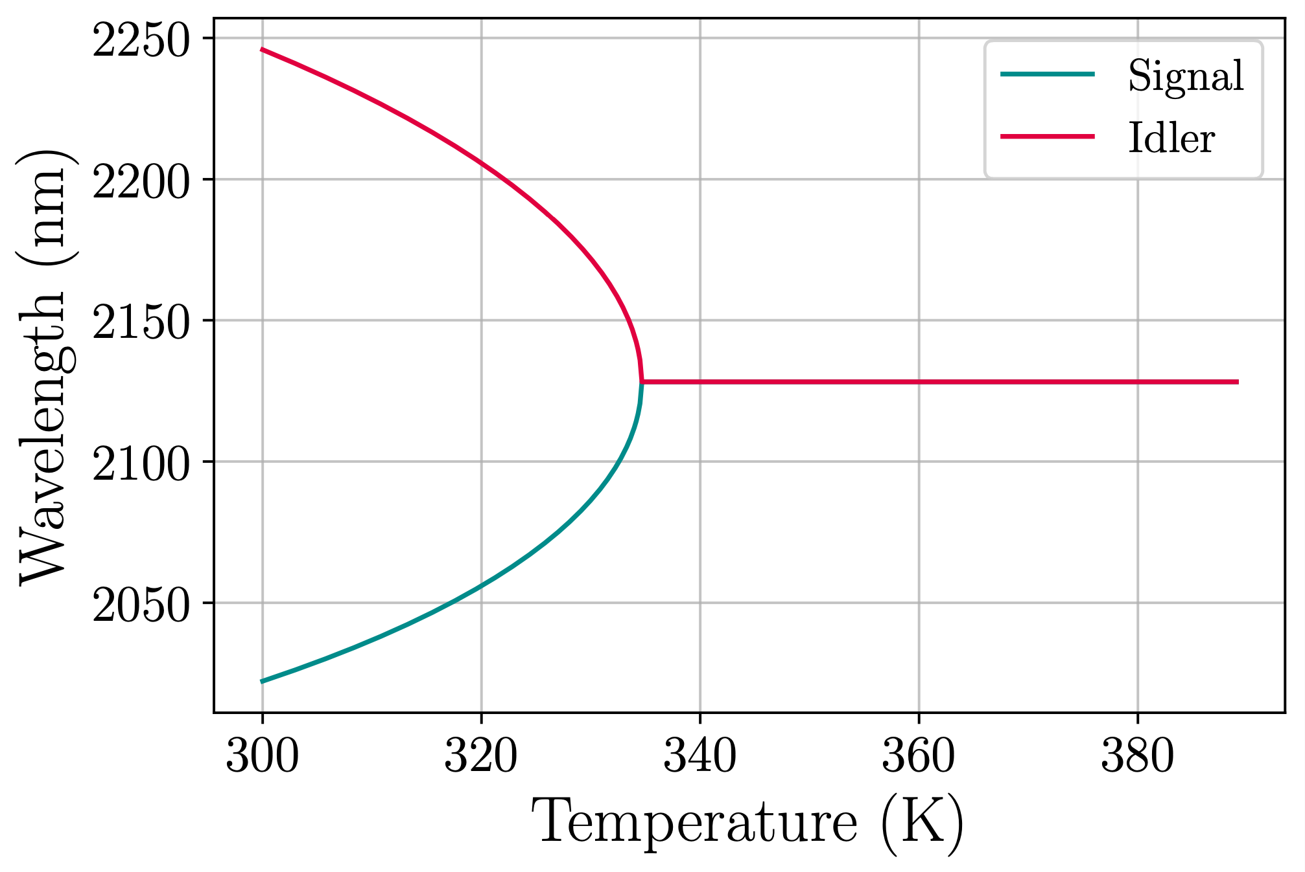
Temperature Tuning Curve
Figure 4. Temperature Tuning Curve

Slide 14
Experimental Setup
3

Slide 15
BS 1
BS 2
DOPO
SHG
PD
Laser
AOM
Mirror 1
Mirror 2
Mixer
LO
Filter
PLL
Figure 5. Heterodyne Scheme
SA
Adhikari, R. et al. “A new bound on excess frequency noise in second harmonic generation in PPKTP at the 10⁻¹⁹ level”. 2012

Slide 16
Future
Work
4

Slide 17
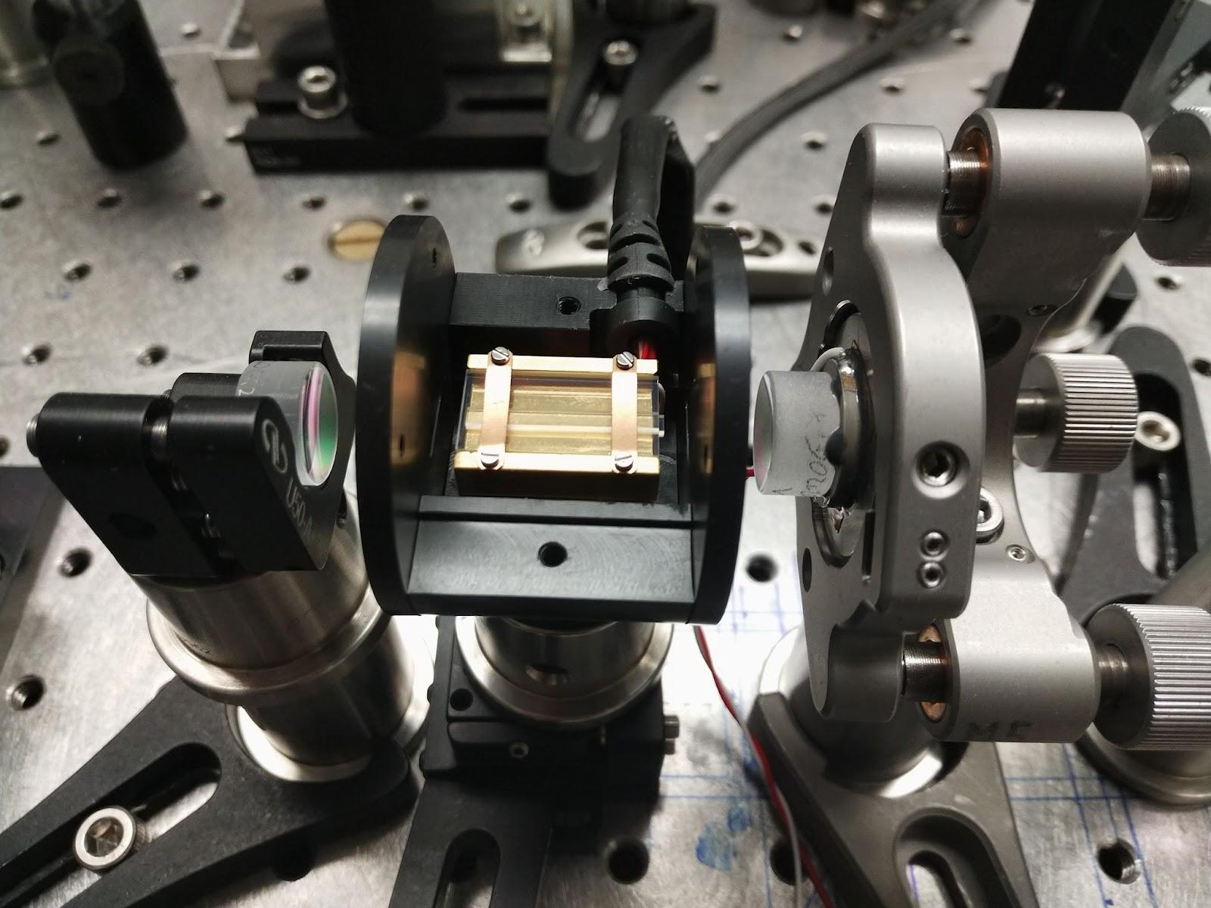
Future Work
Measure DOPO’s frequency noise.
Develop noise mitigation systems.
DOPO Setup

Slide 18
Acknowledgements
Francisco Salces Carcoba, Anchal Gupta, and Rana Adhikari.
National Science Foundation.
LIGO Lab.
LIGO SURF mentors and interns.

Slide 19
Questions

Slide 20
Dispersion Near Degeneracy
3. Since we get .
4. Finally, we find that ω_{i,s}=
BUT…
n_{z} using Sellmeier equations.
X_{1,2}: parabolic coefficients.
Aerie. Ady et al. “Temperature-dependant Dispersion Equations for KTiOPO₄ and KTiOASO₄”. December 2003.
Kato, Kiyoshi et al. “Sellmeier and thermo-optic dispersion formulas for KTP”. 2002.

Slide 21
BS 1
BS 2
10⁴/f
???
~ 10⁻³
~10⁻¹⁴
AOM
Mirror 1
Mirror 2
Mixer
-120
db*rad
Filter
PLL
Figure 4. Heterodyne Scheme
Read out

Slide 22
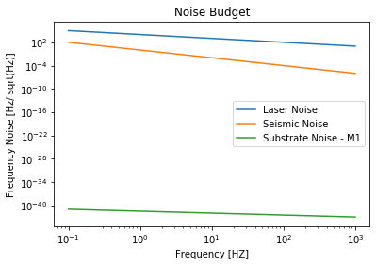
Noise Estimates
Notes:
References & equations

Slide 23
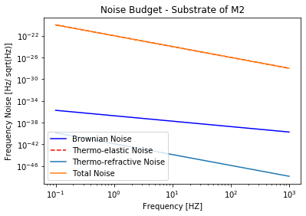
Noise Estimates
Thermo-refractive:
Thermo-optic:
where
Notes:
References:
R X Adhikari et al 2020 Class. Quantum Grav. 37 165003
Evans, M., Ballmer, S., Fejer, M., Fritschel, P., Harry, G., &amp; Ogin, G. (2008). Thermo-optic noise in coated mirrors for high-precision optical measurements. \textit{Physical Review D, 78

