Slide 1
Investigating data quality metrics for stochastic GW detection
T2100203-v1
1
Makenzi Fischbach
Mentors: Derek Davis & Arianna Renzini
2
2
1
Wellesley College
California Institute of Technology
2
August 19th 2021
Notes:
Hello, my name is Makenzi Fischbach and my mentors are Derek Davis and Arianna Renzini. My project this past summer was working on investigating data quality metric for stochastic GW detection.

Slide 2
Outline
Background
StochCharMon
Stochastic Detector Sensitivity
Final Deliverable
Notes:
Here is a brief outline of my talk. First, I will provide the initial goals for the project which were set in place prior to the start of the summer. Next, I will provide some essential background information relating to my final project. Then I will introduce you to the newest feature of StochCharMon, the stochastic detector sensitivity (or SDS). I will then show you some calculations which were essential in the implementation of the SDS. Finally, I will present my final deliverable.

Slide 3
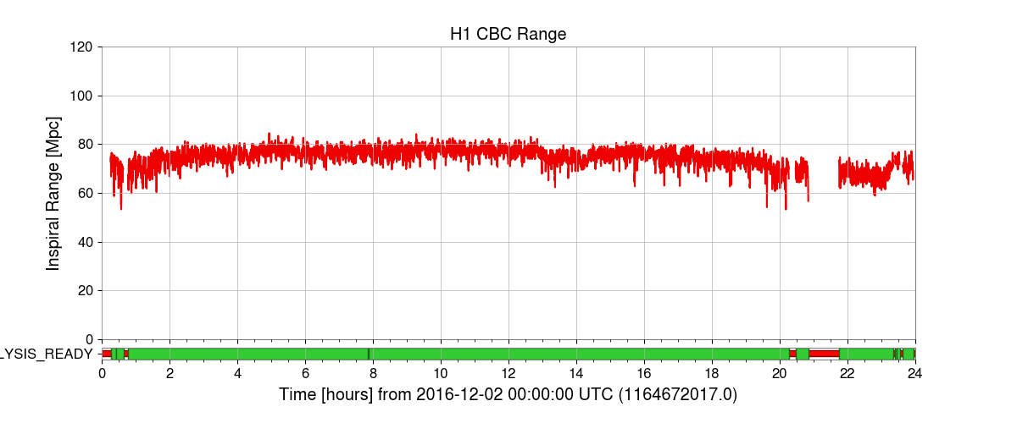
CBC Range
Compact Binary Coalescence Inspiral Range
Detector sensitivity
Higher CBC range
=
Better
Notes:
Here is the compact binary coalescence inspiral range (or CBC range) BNS which was the inspiration for the SDS. Similar to the SDS the CBC range is the main method of seeing how sensitive the detectors are. The CBC range shows the distance in Mpc of how far away a detector can detect the signal from a CBC event with two objects of 1.4 solar mass and with an SNR of 8. Time = x-axis, inspiral range in Mpc = y-axis. Unlike the SDS, the higher the CBC range the better.

Slide 4
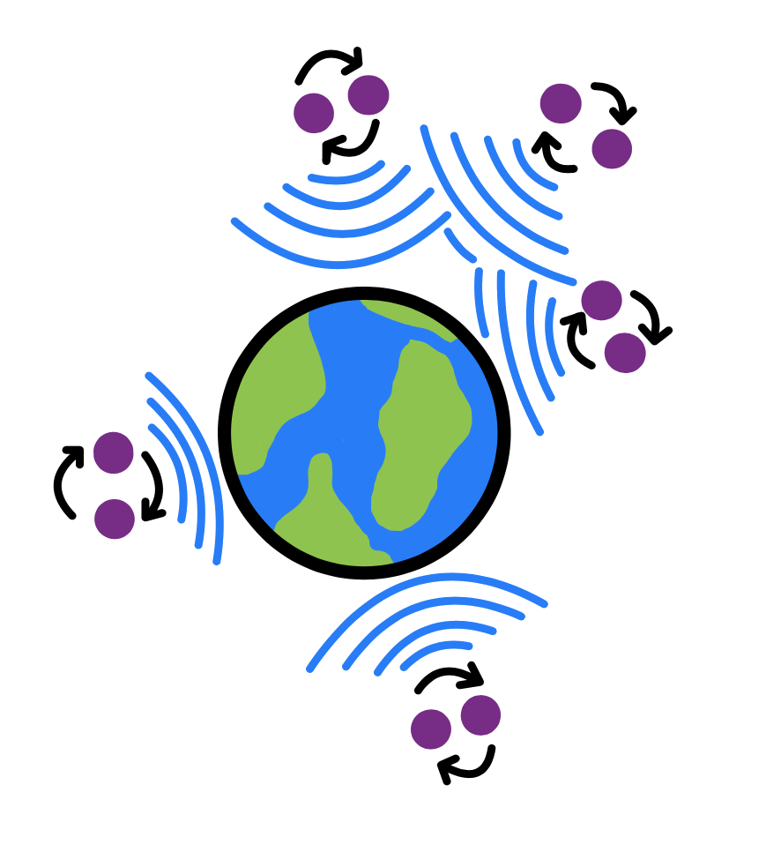
Stochastic Gravitational Wave Background
Weak signals from a collection of sources
Informative
SGWB = not close
Not yet detected

Slide 5
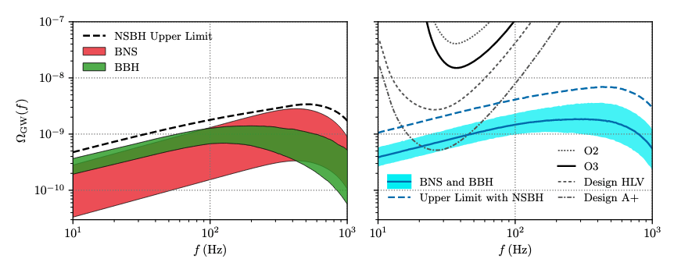
Energy Density (Ω)
GWB energy density predictions
SGWB energy density → ~7*10
-6
R. Abbott et al. 2021

Slide 6
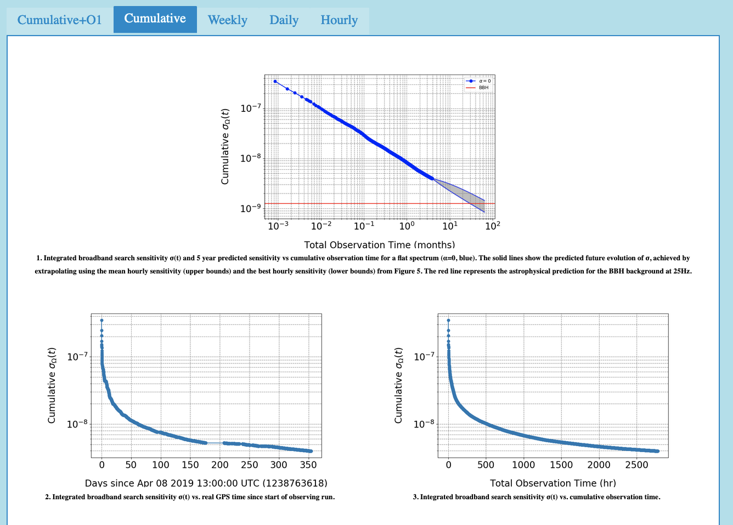
StochCharMon
Stochmon
StochCharMon
Low latency stochastic data monitoring pipeline
Update and integrate
SGWB detection
Current Summary Page
Notes:
My project focuses mainly on the stochastic data analysis tool, Stochmon, which stands for stochastic monitor. The name, and logo, have been updated to StochCharMon, since the tool now involves elements of Detchar. StochCharMon is a low latency stochastic data monitoring pipeline. My goal this summer was to update slash integrate stochmon with modern data analysis tools so that we can better gauge the efficacy of the detectors in stochastic data detection. We want the detectors to be as sensitive to stochastic data as possible because we hope to eventually detect the stochastic gravitational wave background. Tools such as stochmon can help. Here is the current stochmon summary page which has not been updated or integrated in several years so you can get a sense of the starting point.

Slide 7
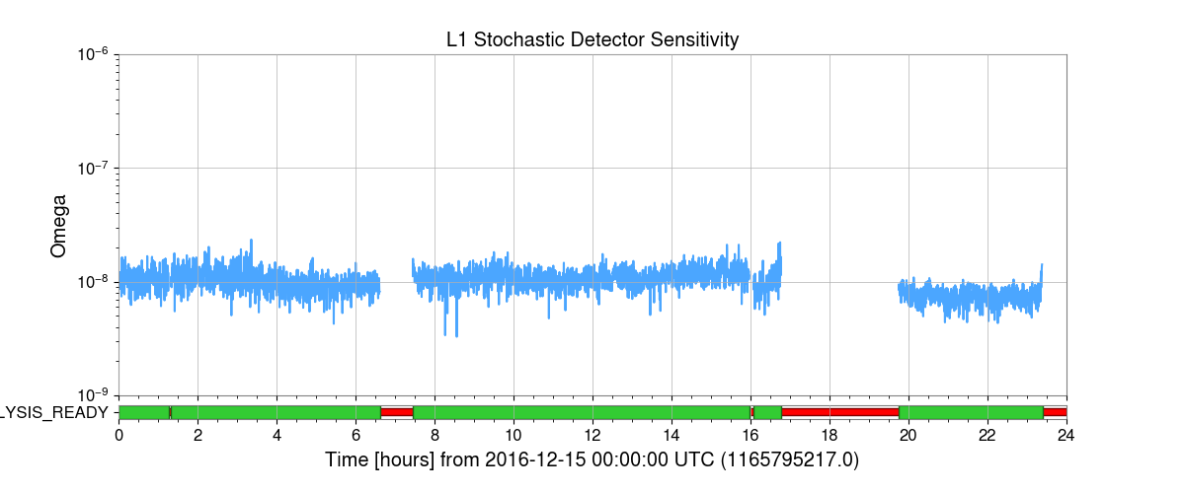
Stochastic Detector Sensitivity
SDS
Sensitivity of a singular detector
Lower SDS
=
Better
Notes:
Here is the stochastic detector sensitivity (SDS). The implementation of the SDS has been the main focus of my research this summer. It represents the sensitivity of a singular detector in stochastic data detection. Time is on the x-axis and a unitless omega value is on the y-axis. Something important to note is that for the SDS, the lower it is the better.

Slide 8
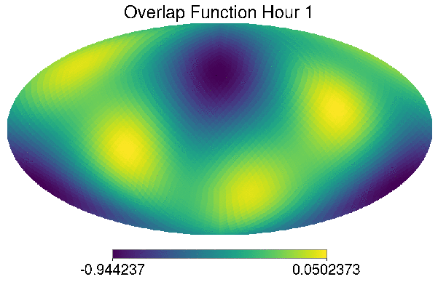
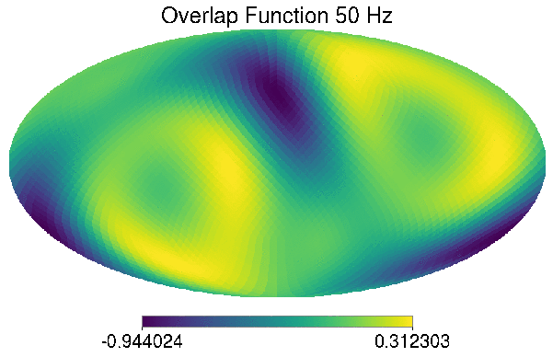
Stochastic Overlap Function
Detector polarization response function (+ and x)
Sensitivity of a pair of detectors
Time
Frequency
High
Low
High
High
Low
High
Notes:
Part of creating the SDS is the stochastic overlap function, which shows the sensitivity of a pair of detectors at certain points in the sky. This is calculated by taking the detector polarization response function in both the cross and plus polarizations of each detector. The overlap function is then is then determines using these response functions. Left plot: function of time, one sidereal day, note sensitivity color bar. Right plot: function of frequency, same color bar, higher frequency results in more zero points.

Slide 9
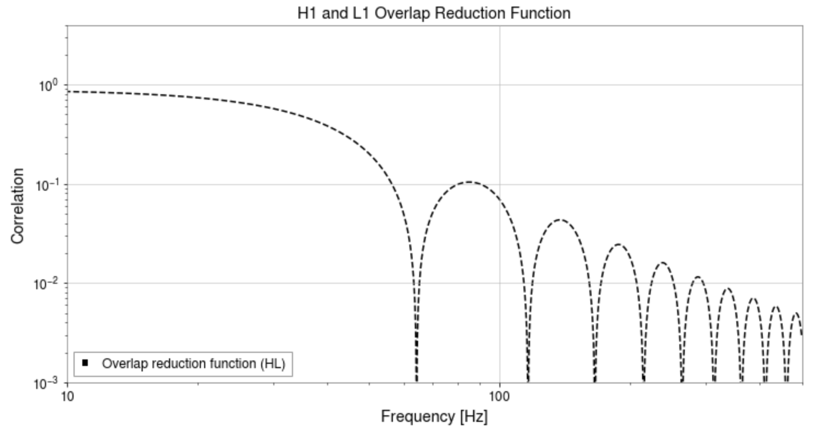
Overlap Reduction Function
Frequency dependent correlation between a pair of detectors
Notes:
The overlap reduction function, or ORF, shows the frequency dependent correlation between a pair of detectors and is key in calculating the SDS. x-axis of frequency in Hz, and a y-axis with correlation. Multiple frequencies with a zero correlation (also seen in previous slide).

Slide 10
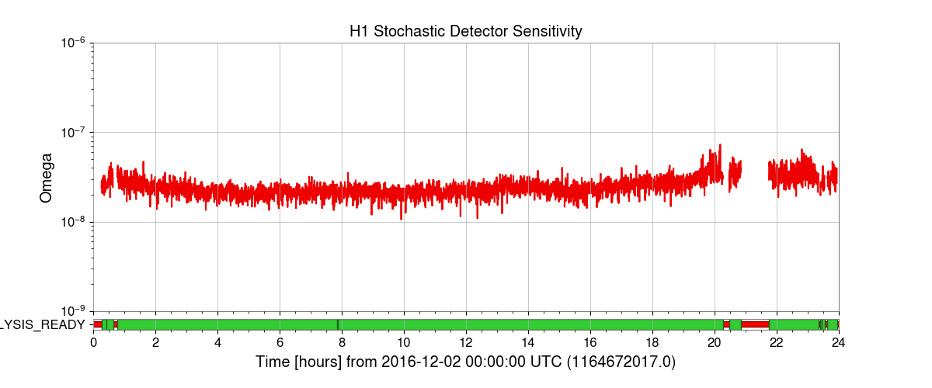
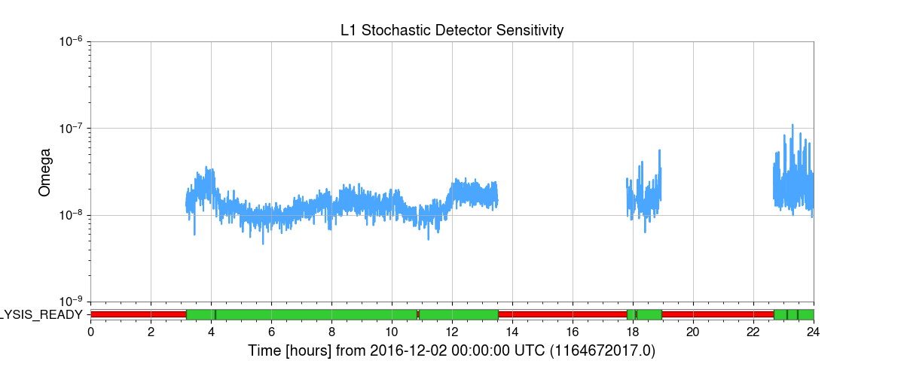
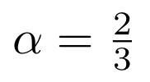
Stochastic Detector Sensitivity
Similar to CBC range calculation
ORF → pair of detectors
PSD → single detector
Same α as CBC range
For CBC:
Notes:
Now we return to the stochastic detector sensitivity. The calculation is similar to the CBC, with one major difference: the inclusion of the overlap reduction function. The equation shown here is what was used to calculate the SDS. for the CBC, the calculation is the same with the ORF taken away. For the CBC range calculation, the alpha in this equation is ⅔ and we continued to use that value for SDS calculations. The main feature of the SDS is that it is for a single detector, whereas other stochastic data analysis plots and tools look at the sensitivity of a pair or the entire network. The SDS manages to focus on a single detector since even though the included ORF is for a detector pair, the inclusion of the PSD for a specific detector specializes it. I will now talk about this omega value on the y-axis.

Slide 11
The Constant
Re-normalize the fractional energy density
Obtain the constant from energy density equation
Notes:
In order to renormalize the fractional energy density for the SDS, we needed to obtain a constant from the energy density equation shown here. The section of the equation outside of the purple box is essentially what is used in the SDS calculation while everything in the box is a constant. Through calculating the value of the constants, we were able to normalize the SDS with a unitless omega constant.

Slide 12
The Constant

Slide 13
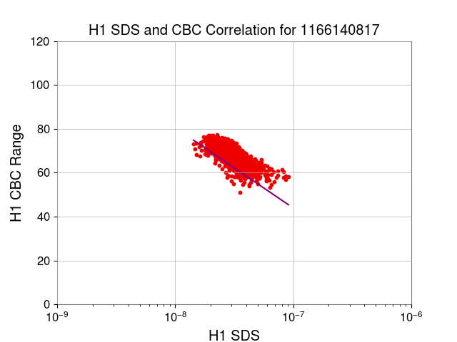
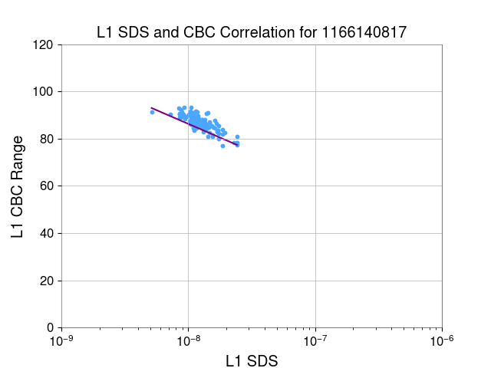
Correlation
Strong correlation (expected)
CBC range is a fairly accurate measure of stochastic sensitivity but SDS is still valuable
Notes:
In order to gauge the significance of the SDS, we looked at the correlation between the CBC range and SDS. The correlation is strong, but is still imperfect. This shows that the CBC range is a fairly accurate representation of the detector’s stochastic sensitivity and it also shows that the SDS is still valuable and unique.

Slide 14
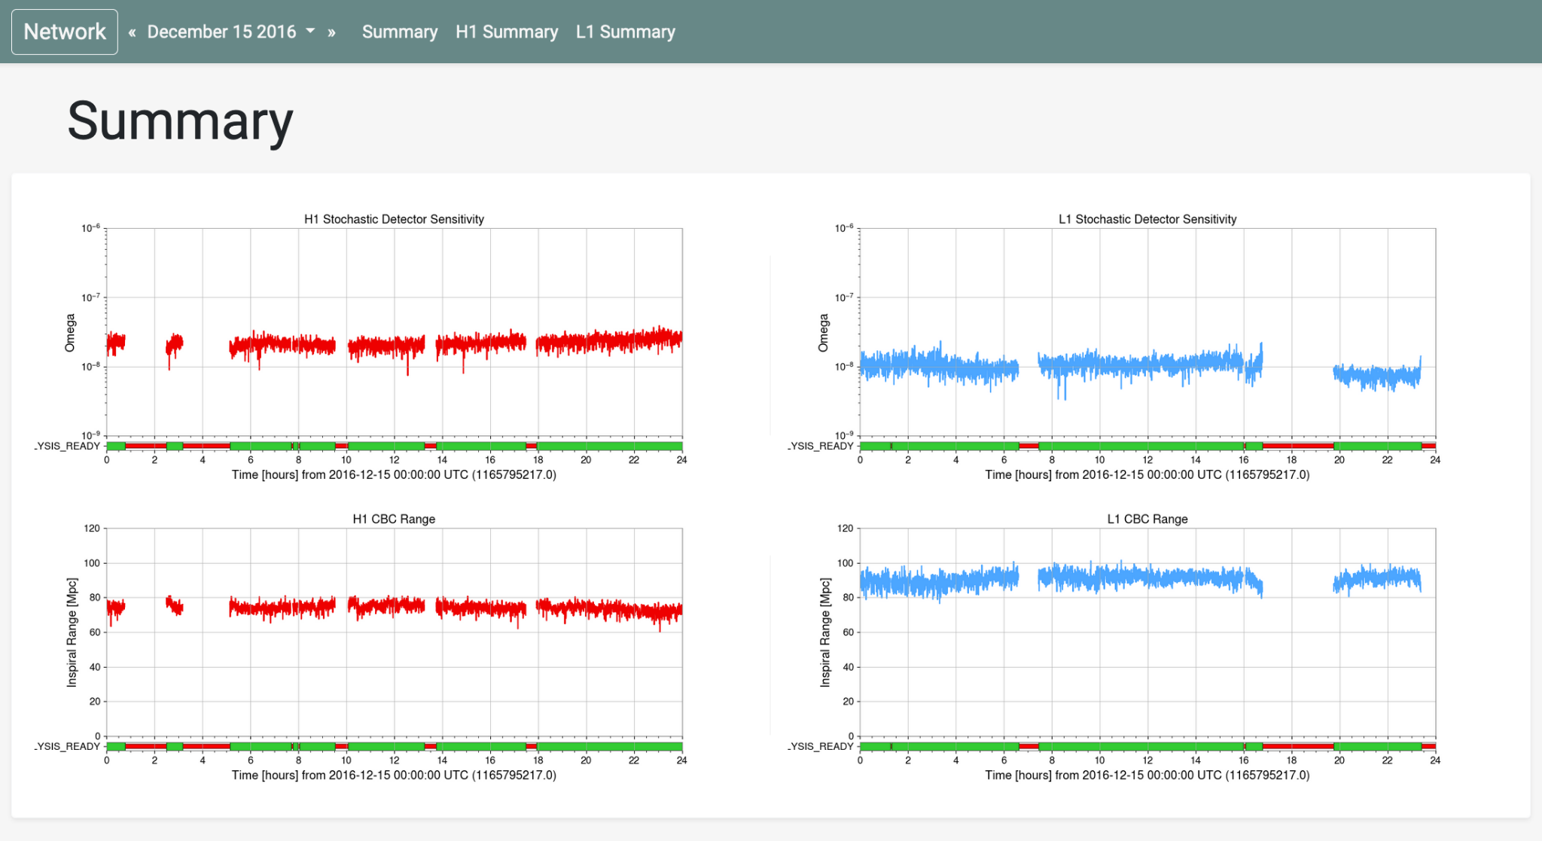
Summary Page
Summary page
Notes:
My final deliverable is a cool summary page. Yay.

Slide 15
Future of StochCharMon
Continue updating and integrating
O4
Detect the SGWB

Slide 16
Acknowledgments
Special thanks to my mentors Derek Davis and Arianna Renzini.
Thank you to Alan Weinstein and the NSF.
Thank you to all of the other mentors and all of my fellow LIGO SURFers.
Notes:
Thank you thank you thank you

Slide 17
Thank you.
Notes:
Thank you! Does anyone have any questions?

