Slide 1
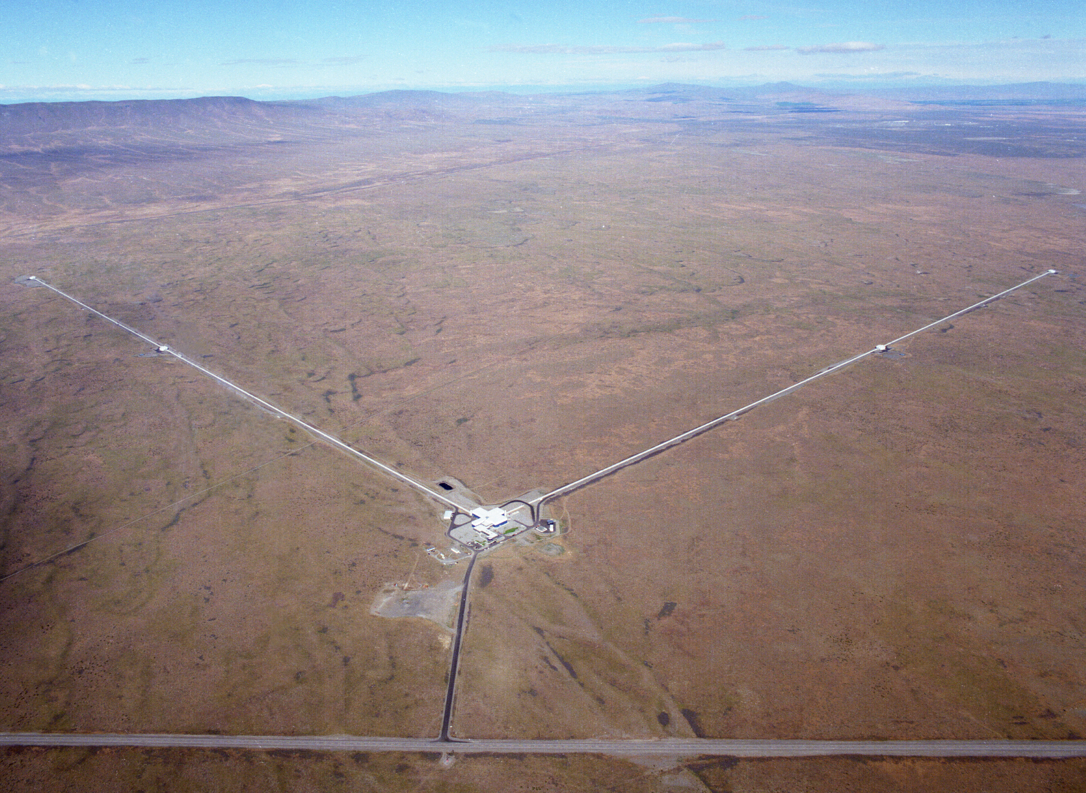
An Overview of Gravitational Wave Detection by LIGO
Fred Raab
Associate Director for Observatory Operations
LIGO Laboratory - 12 July 2021

Slide 2
Outline
What do we do? Who are we?
Basics of Gravitational Waves (GWs)
What do real GW detectors look like?
Breakthroughs!
The future.

Slide 3
What do we do at LIGO and how do we do it? (elevator version)
The LIGO team works to explore the most extreme regions of space and time and the most extreme forms of matter in the universe.
We do this by detecting the ripples in space-time, called gravitational waves, that are produced by black holes and neutron stars in some of the most violent events in our universe.

Slide 4
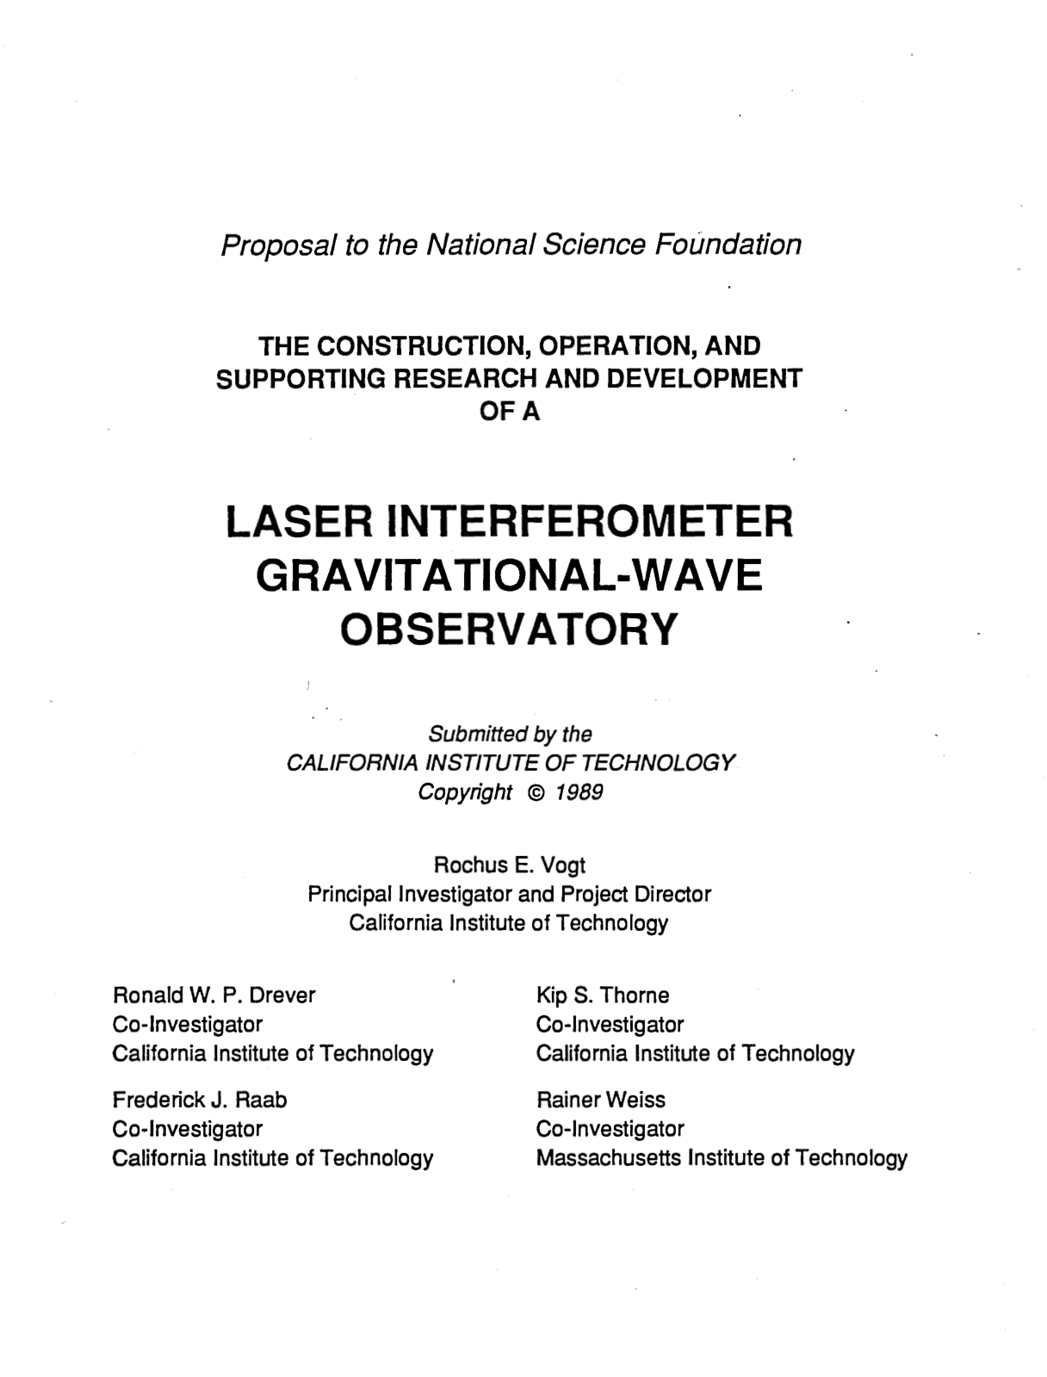
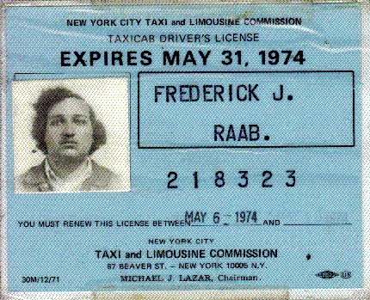
Who Am I?
Born to US immigrants in NYC in 1951.
Had an “OK” but not “strong” high school science background.
Fan of space; fell in love with Physics.
Struggled in my first college physics course, but persevered.
BS-Manhattan College, PhD-SUNY Stony Brook (1980).
U. Washington research scientist.
Kip Thorne recruited me to Caltech in 1988.

Slide 5
Who else is working on terrestrial GW detectors
LIGO Laboratory: 180 members.
LIGO Scientific Collaboration: 1100+ members in 108 institutions across 18 countries on 5 continents.
Virgo Collaboration: 650+ members in 14 countries in Europe.
KAGRA Collaboration: 200+ members from 90 institutions in 15 countries.
Science is a team sport!

Slide 6
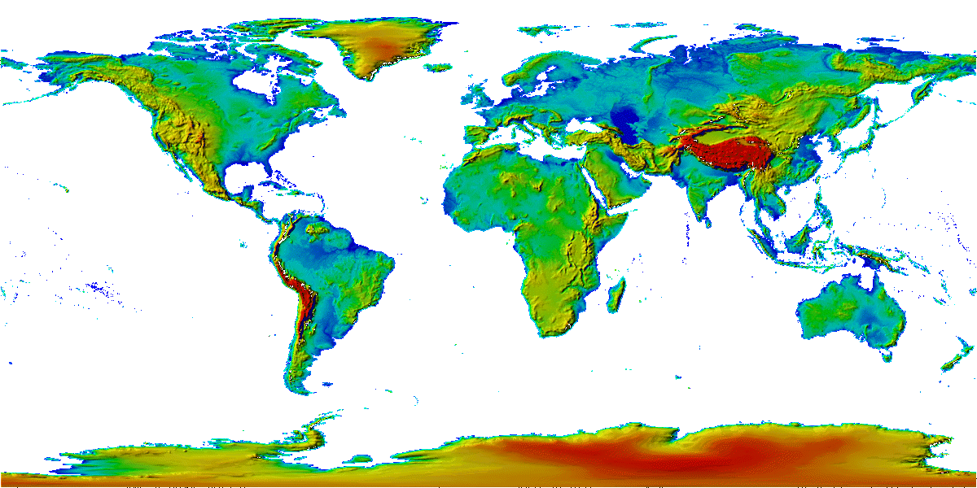
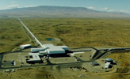
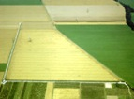
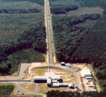
The advanced GW detector network:
2015-2030
Advanced LIGO
Hanford
2015
GEO600 (HF)
2011
KAGRA
2020
Advanced LIGO
Livingston
2015
Advanced
Virgo
2017
LIGO-India
2027
6
6

Slide 7
Basics of Gravitational-Waves

Slide 8
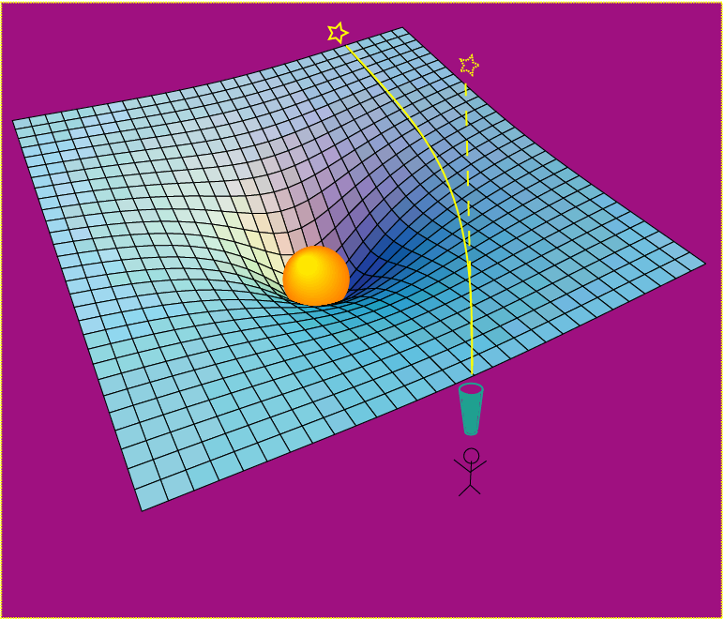
Einstein’s General Relativity:
gravity is a manifestation of space-time curvature
curved spacetime can bend light, too!
dynamic deformation of spacetime
Credit: R. Hurt - Caltech / JPL:
A massive object shifts apparent position of a star
Space has a shape, a stiffness and a maximum speed for information transfer.

Slide 9
The problem with checking relativity in Einstein’s time
A figure of merit for manifesting relativistic effects is v/c.
In Einstein’s time, there was not a lot of v/c available to observe and rulers and clocks were not so good.
v/c for a locomotive is approximately 10⁻⁷
v/c for Mercury is approximately 1.5x10⁻⁴
Ruling engines could get down to micron resolution (10⁻⁶ m)
Clocks could keep time to a second per day
Today
v/c reached 0.5 for GW150914
LIGO resolution is approximately 10⁻²⁰ m
Strontium atomic clocks are accurate to a second in 15 billion years!

Slide 10
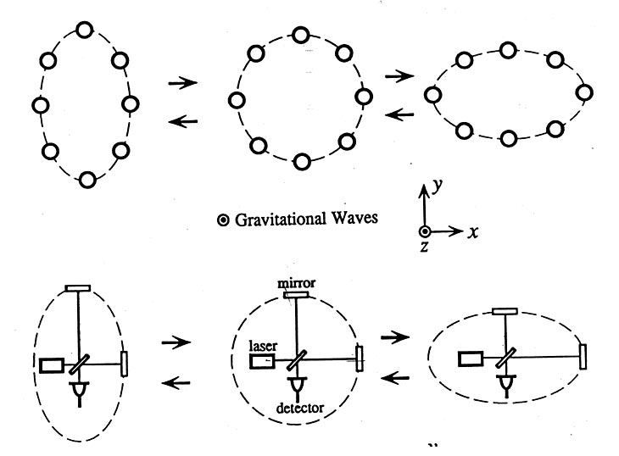
Basic idea for detection is simple
GW amplitude h = (R_{x}-R_{y})/R
When the arm lengths are equal, no light reaches the detector.
It takes longer for light to travel the longer arm path, which allows light to reach the detector.

Slide 11
What do real GW detectors look like?

Slide 12
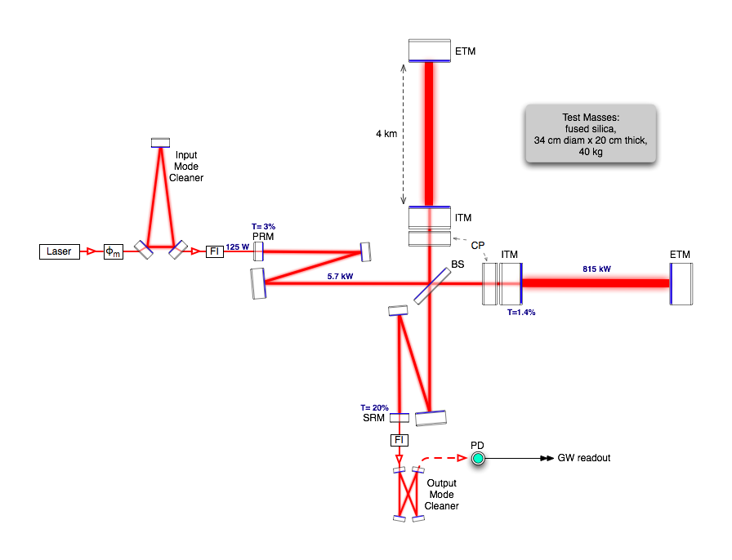
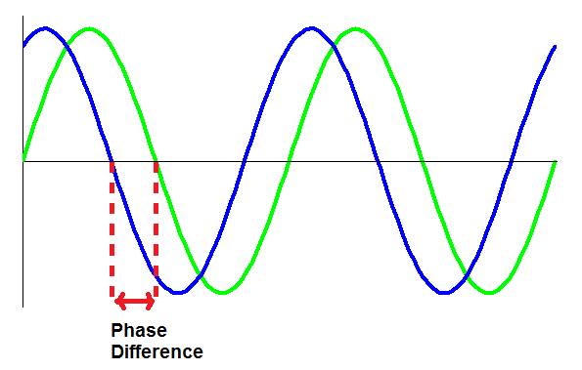
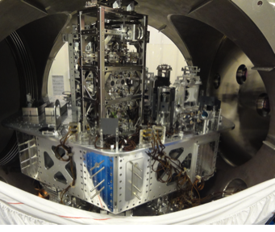
Optical configuration
physicsthings.wordpress.com
Complete detector description in Class. Quantum Grav. 32 (2015) 074001

Slide 13
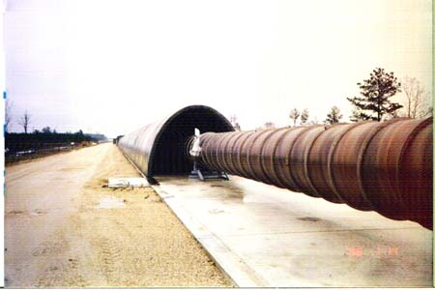
Evacuated Beam Tubes Provide Clear Path for Light
P< 10⁻⁹ Torr
Portable power supply for bakeout

Slide 14
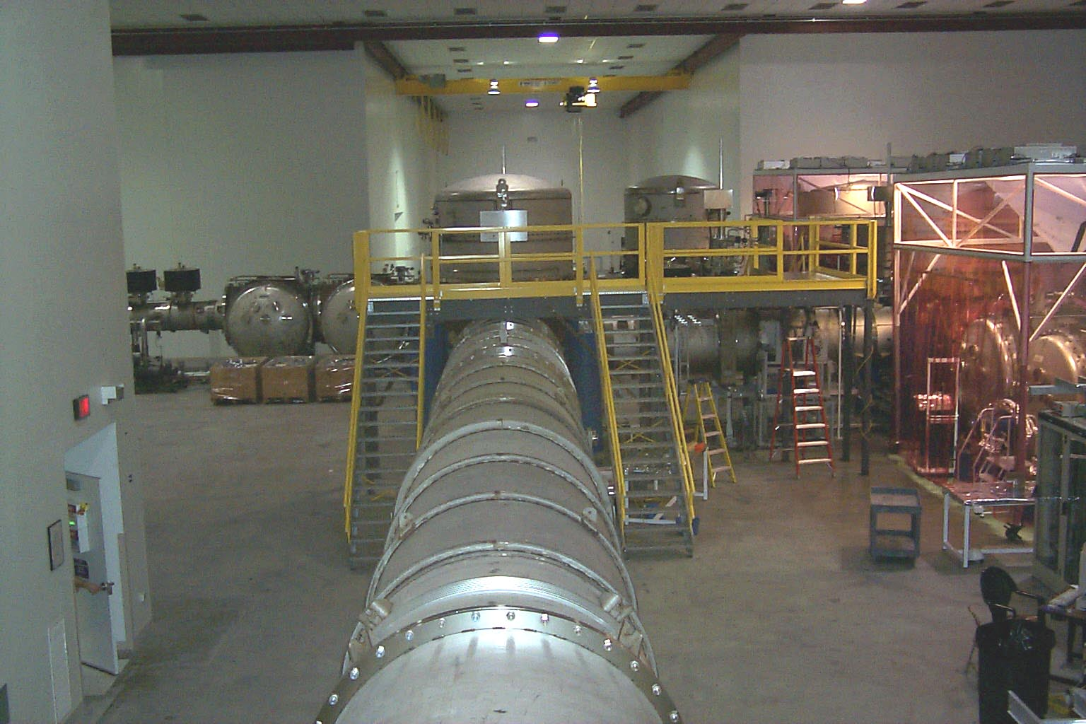
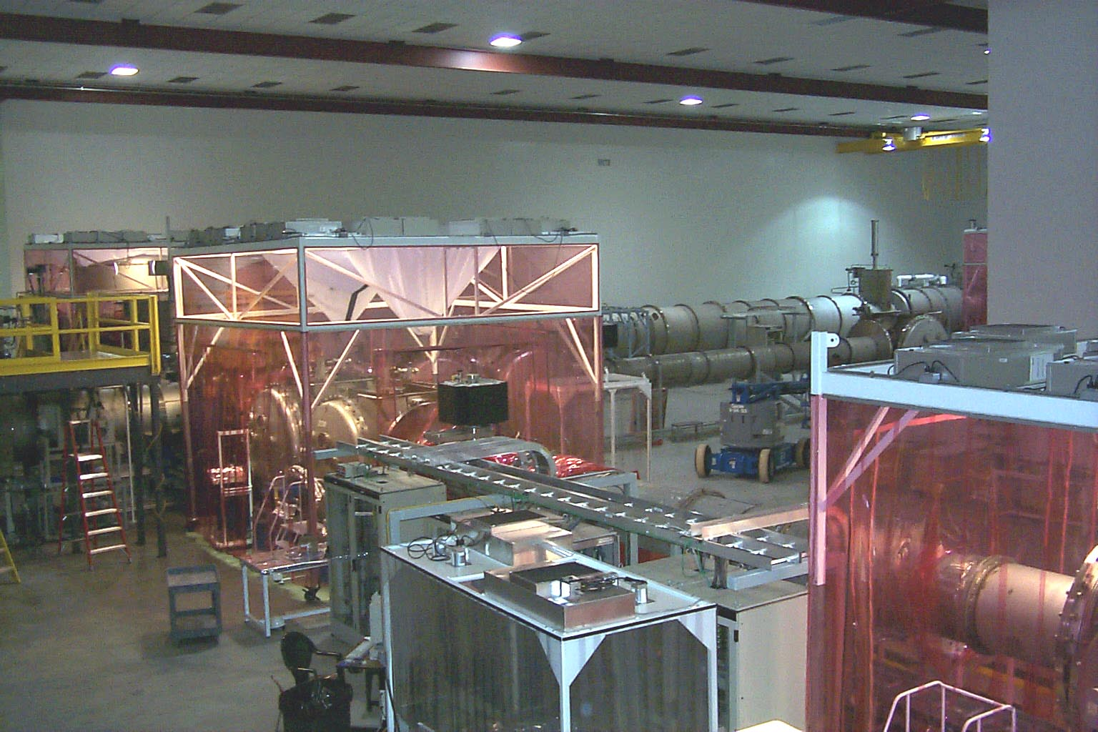
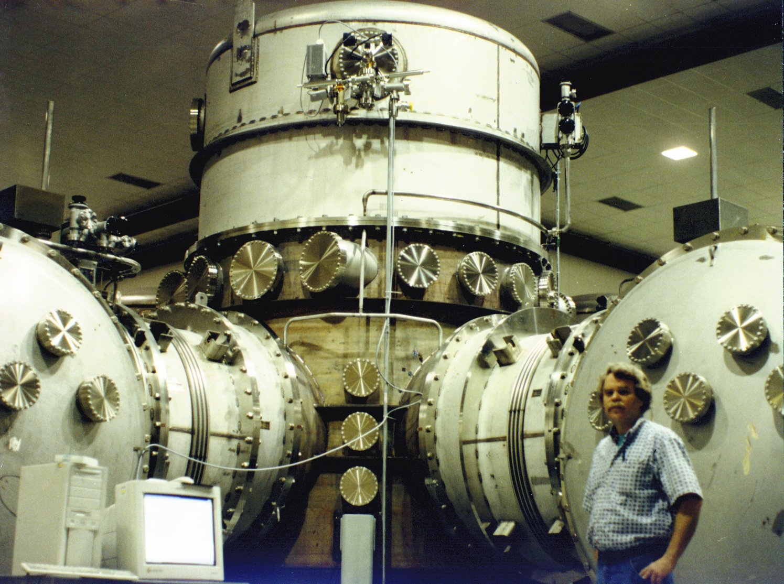
Vacuum Chambers Provide Quiet Homes for Mirrors
View inside Corner Station
Standing at vertex beam splitter

Slide 15
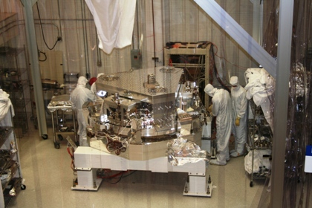
BSC Internal Seismic Isolator

Slide 16
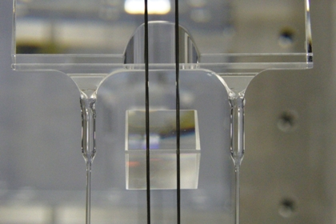
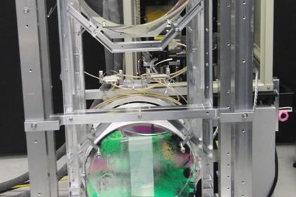
Advanced LIGO Monolithic Suspension

Slide 17
Advanced LIGO installation in progress
17-Aug-11

Slide 18
Putting it together: Seismic & Suspension & Optics
Seismic isolation
Test mass suspension
Folding mirror suspension

Slide 19
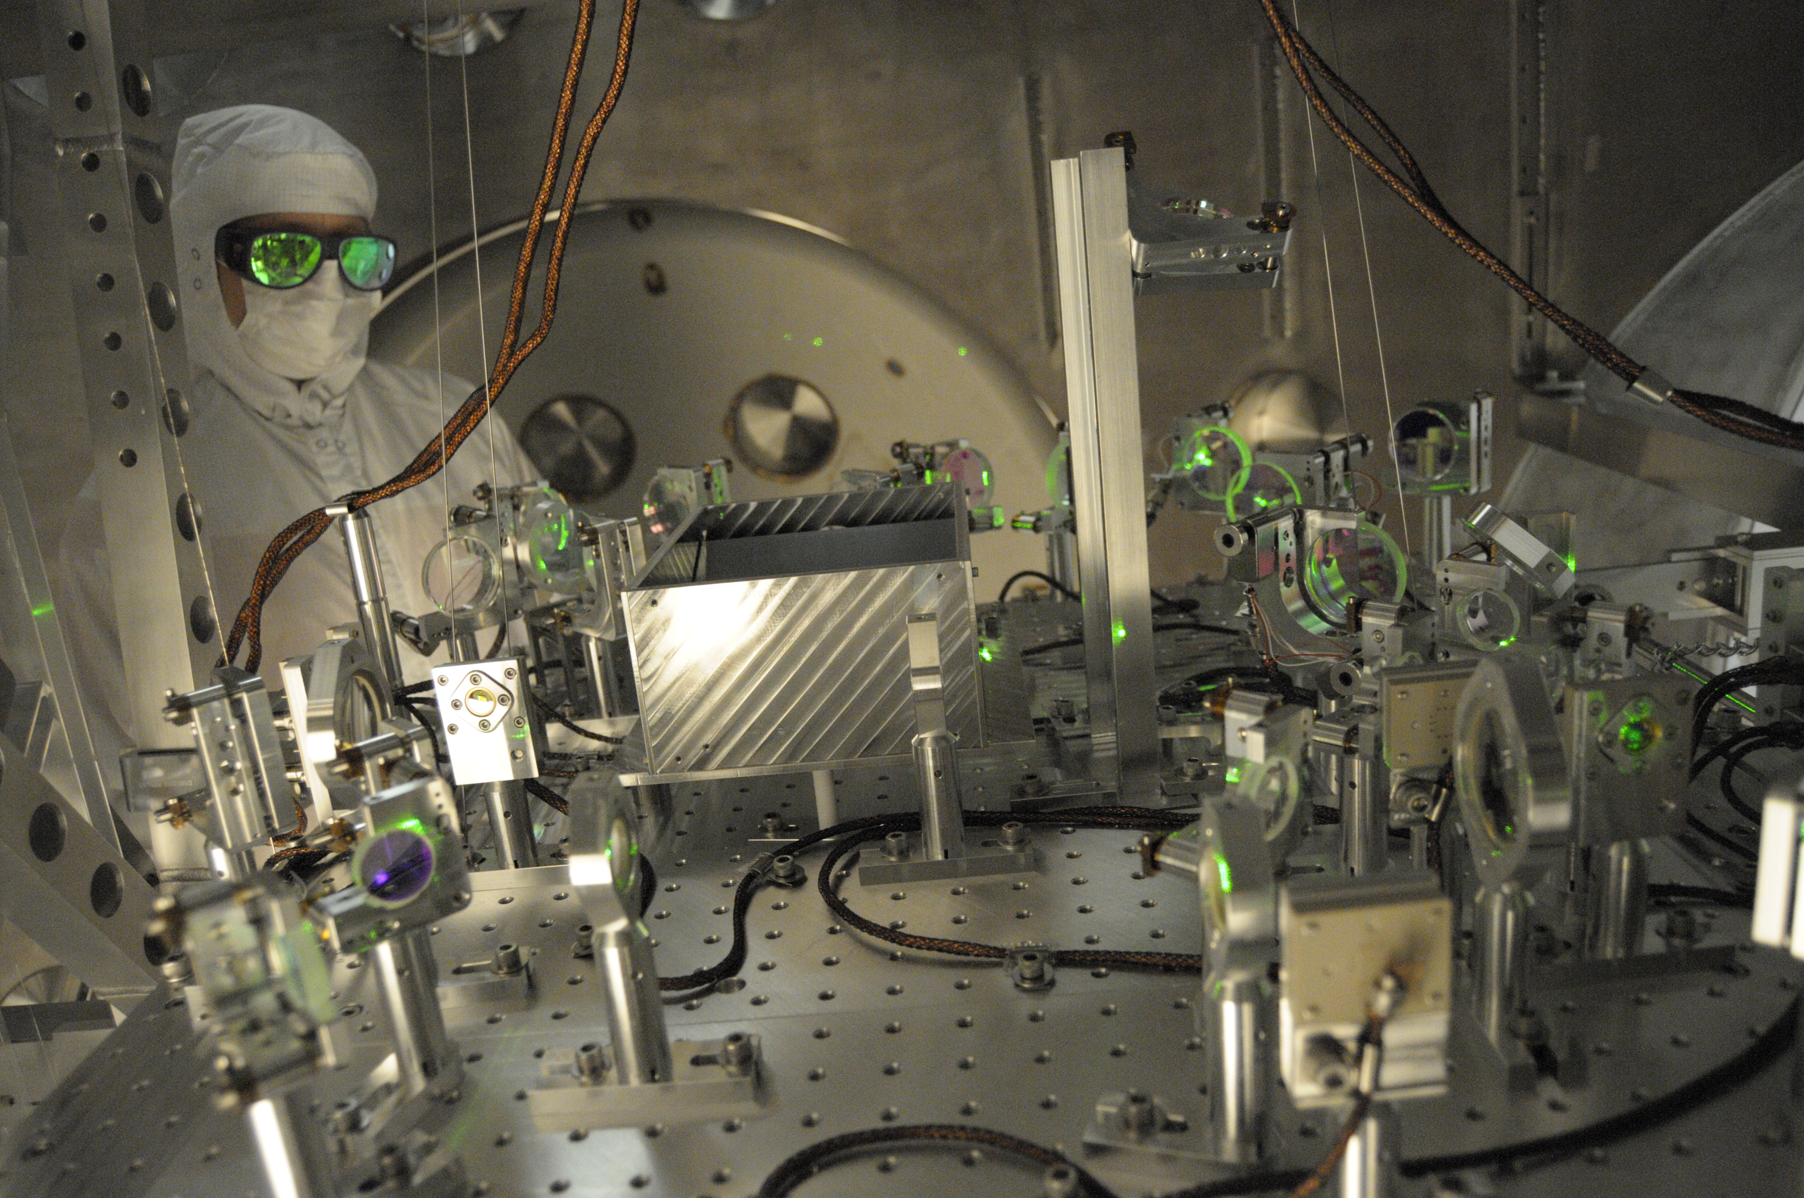
Lock Acquisition: Arm Locking Subsystem

Slide 20
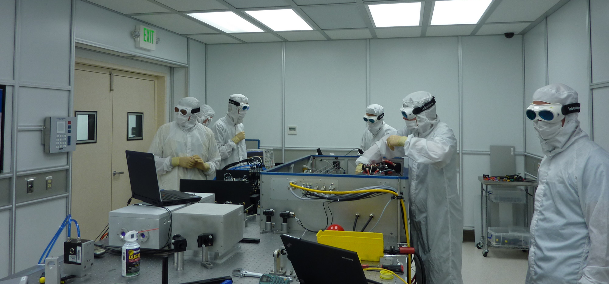
aLIGO Pre-stabilized laser

Slide 21
Breakthroughs

Slide 22
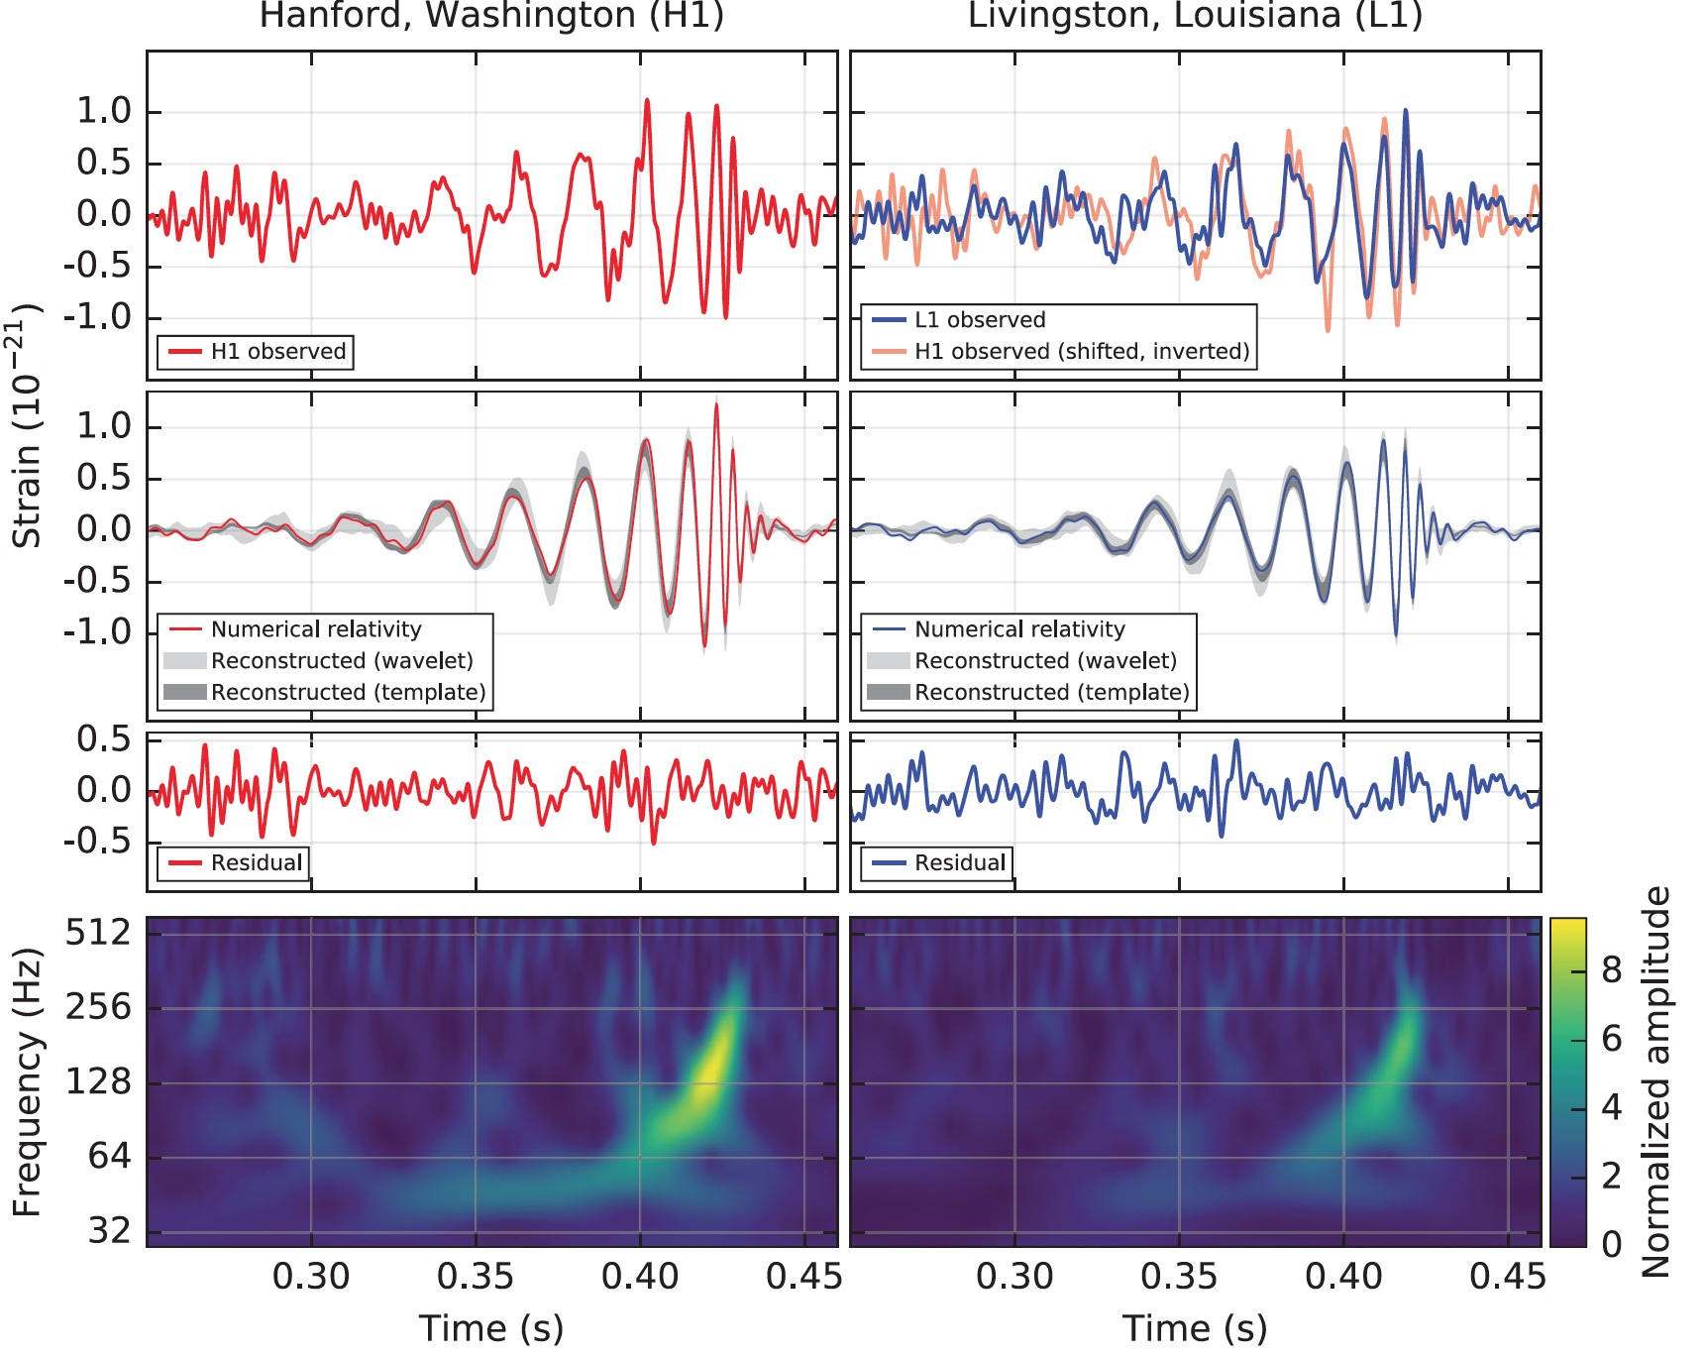
B. P. Abbott et al. (LIGO Scientific Collaboration and Virgo Collaboration), Observation of Gravitational Waves from a Binary Black Hole Merger, Phys. Rev. Lett. 116, 061102 (2016)
Notes:
The spectrum pointed immediately to large black holes.

Slide 23
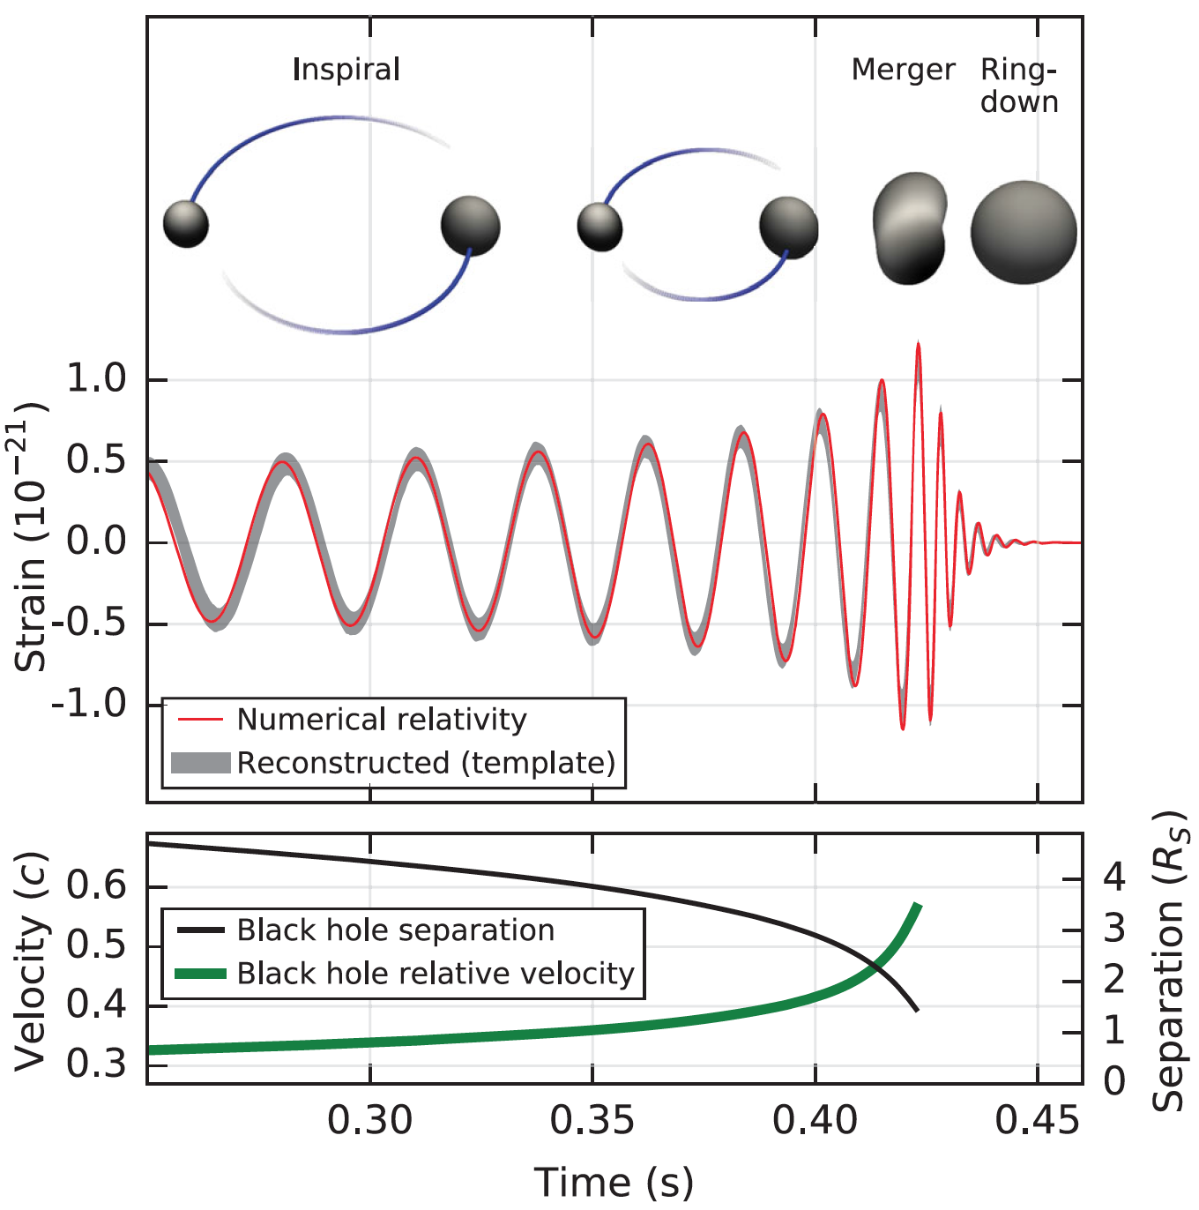
What can we learn from h(t)?
Phase evolution gives chirp mass and aligned components of spin
Amplitude scale factor gives luminosity distance (standard siren)
B. P. Abbott et al. (LIGO Scientific Collaboration and Virgo Collaboration), Observation of Gravitational Waves from a Binary Black Hole Merger, Phys. Rev. Lett. 116, 061102 (2016)
Ringdown frequency and Q give mass and spin of final black hole
Modulation of amplitude gives nonaligned spin components
Highest frequency gives sizes of objects just before merger.

Slide 24
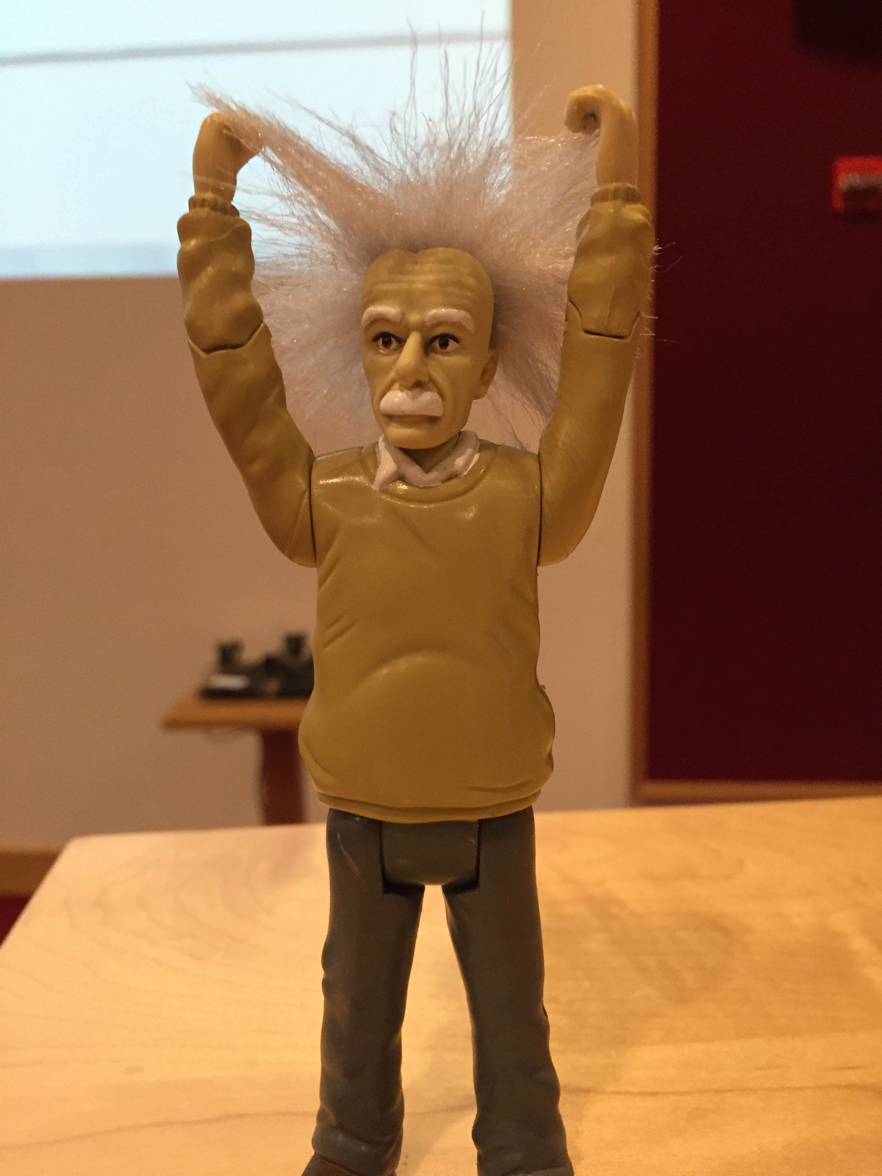
These first observations of dynamic extreme spacetimes with BBHs show us that GR is reasonably accurate in this regime and can be used as a tool for examining and interpreting extreme states of matter.

Slide 25
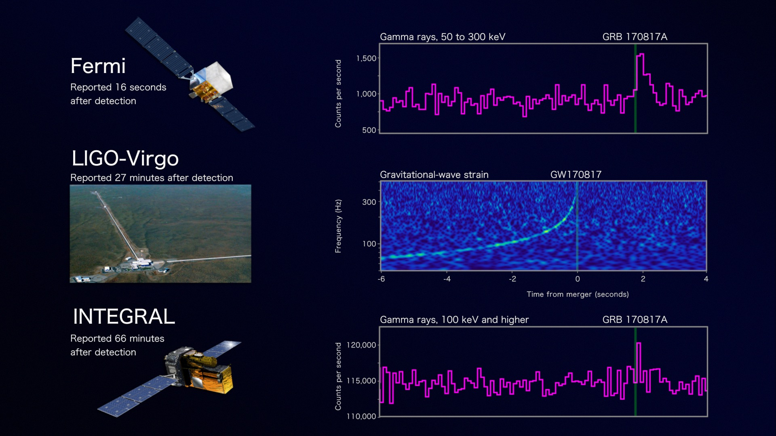
Onto the study of the most extreme states of matter
Credit: NASA's Goddard Space Flight Center, Caltech/MIT/LIGO Lab and ESA

Slide 26
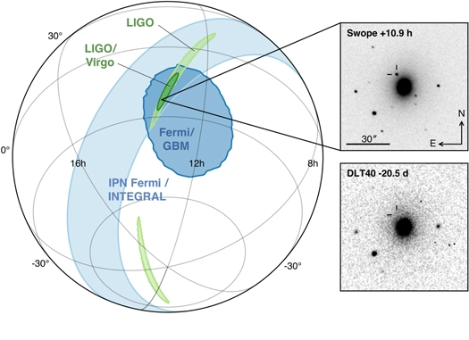
LIGO-Virgo network localization enables discovery of optical counterpart
Figure 1 from Multi-messenger Observations of a Binary Neutron Star Merger
B. P. Abbott et al. 2017 ApJL 848 L12 doi:10.3847/2041-8213/aa91c9

Slide 27
Highlights learned from GW170817
First GW from binary neutron star inspiral and merger detected.
GW detection of tidal distortions as neutron stars rip each other apart provide constraints on neutron-star equation of state.
GW follow-up conducted at 70 observatories on Earth and in space, covering EM spectrum from gamma rays to radio waves.
Confirmed that speed of gravity is equal to speed of light, at least to 15-digit accuracy.
Confirmed neutron-star-merger origin of short gamma-ray bursts.
Confirmed “kilonova” description of matter following merger.
Confirmed the formation mechanism for most of the abundance of the elements heavier than iron.
First measurement of Hubble constant using GWs.

Slide 28
The power of a “catalog” of GW detections
Astronomical catalogs tabulate astronomical objects that share common attributes, but whose representation and differences reveal fundamental information about the nature of the objects and how they form.
For example, star catalogs that tabulated colors of stars eventually led to understanding the composition of stars and how stars progress from birth to death.
Similarly, catalogs of GW-detected sources and their properties can reveal the nature of the objects involved, how they formed and the environments that they have encountered.
Think of black holes and neutron stars as the fossils of the universe.

Slide 29
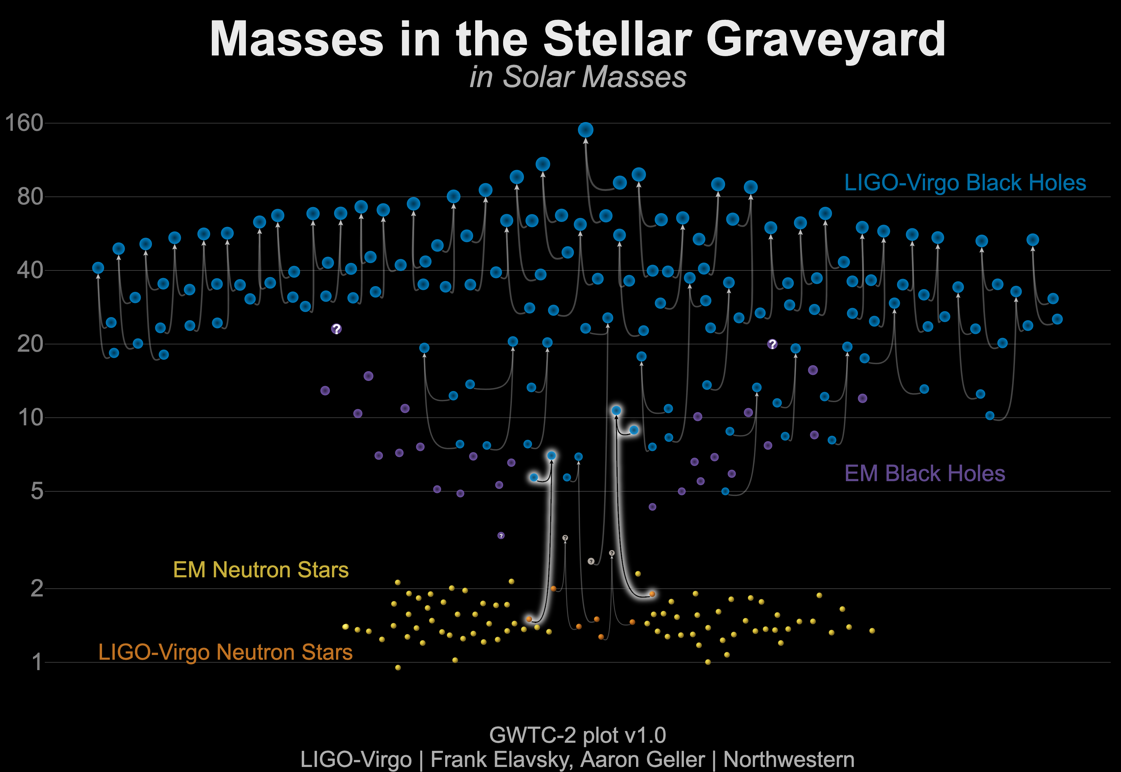
Known Masses of Stellar Remnants – July 2021 https://arxiv.org/abs/2010.14527
Non-LIGO Data Sources: Neutron Stars: http://xtreme.as.arizona.edu/NeutronStars/data/pulsar_masses.dat
Black Holes: https://stellarcollapse.org/sites/default/files/table.pdf |
LIGO-Virgo Data:
gw-openscience.org

Slide 30
Some clues from GW Transient Catalog (GWTC-2) https://arxiv.org/abs/2010.14533
Black-hole binaries are merging many times per hour somewhere in the observable universe.
Black hole binaries can have a range of mass ratios.
Black holes can form from mechanisms other than core-collapse supernovae.
Some black holes in binaries are spinning.
Some black holes have spins aligned with their binaries, but some do not, suggesting different mechanisms for how these binaries were formed.
Intermediate-mass black holes exist in the mass range between stellar-mass BHs and supermassive BHs at the centers of galaxies.
There appear to be objects in the suspected “mass gap” between neutron stars and black holes.

Slide 31
The future

Slide 32
When you come to a fork in the road, take it. – Yogi Berra
Extending the reach of GW detectors
The path traveled by LIGO’s detected waves expanded by a few times 10% as the universe expanded since the waves were launched.
We can now imagine how to develop detectors to observe the universe when it was tens of times smaller and the first generations of stars were forming and dying.
We now know that somewhere in the universe black holes mergers occur many times each hour and eventually we could observe each one.
Extending the spectrum of gravitational-wave observations.

Slide 33
Credit: NASA

