Slide 1
A+ In-Vacuum Cable Construction
T2000713-v1

Slide 2
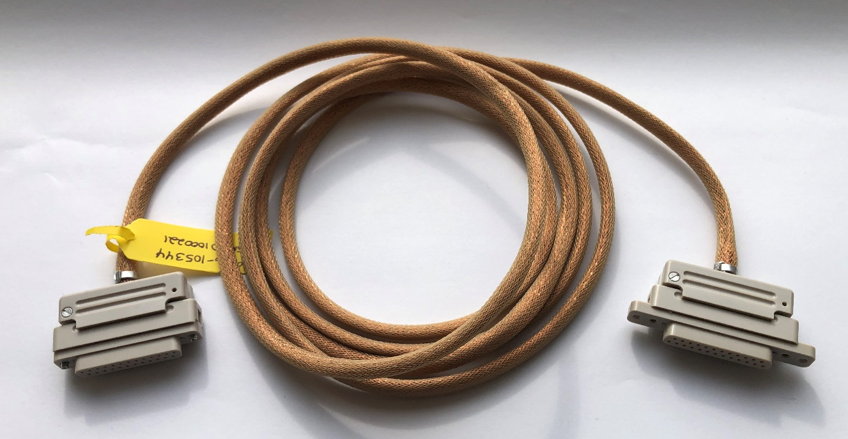
Typical A+ In-Vacuum Cable Assembly
D25F-to-D25F, (D1000221) In-Vacuum cable as received from the manufacturer

Slide 3
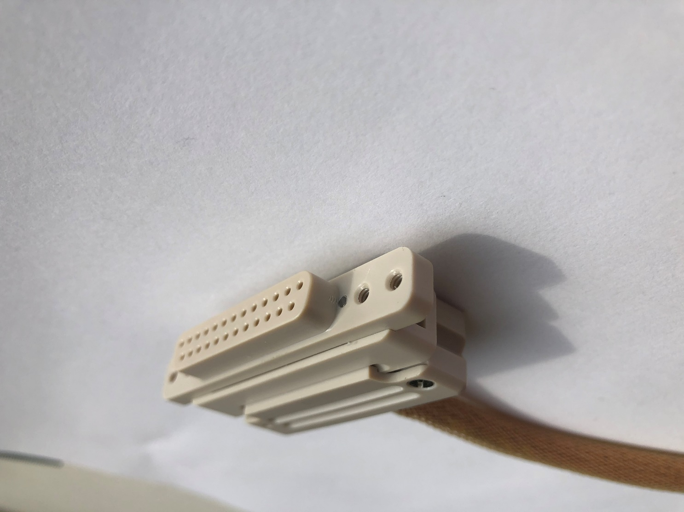
PEEK D25F Connector with Bracket Mounting Tabs
Cable bracket mounting 4-40 threaded hole
Connector-to-connector mating 4-40 threaded hole

Slide 4
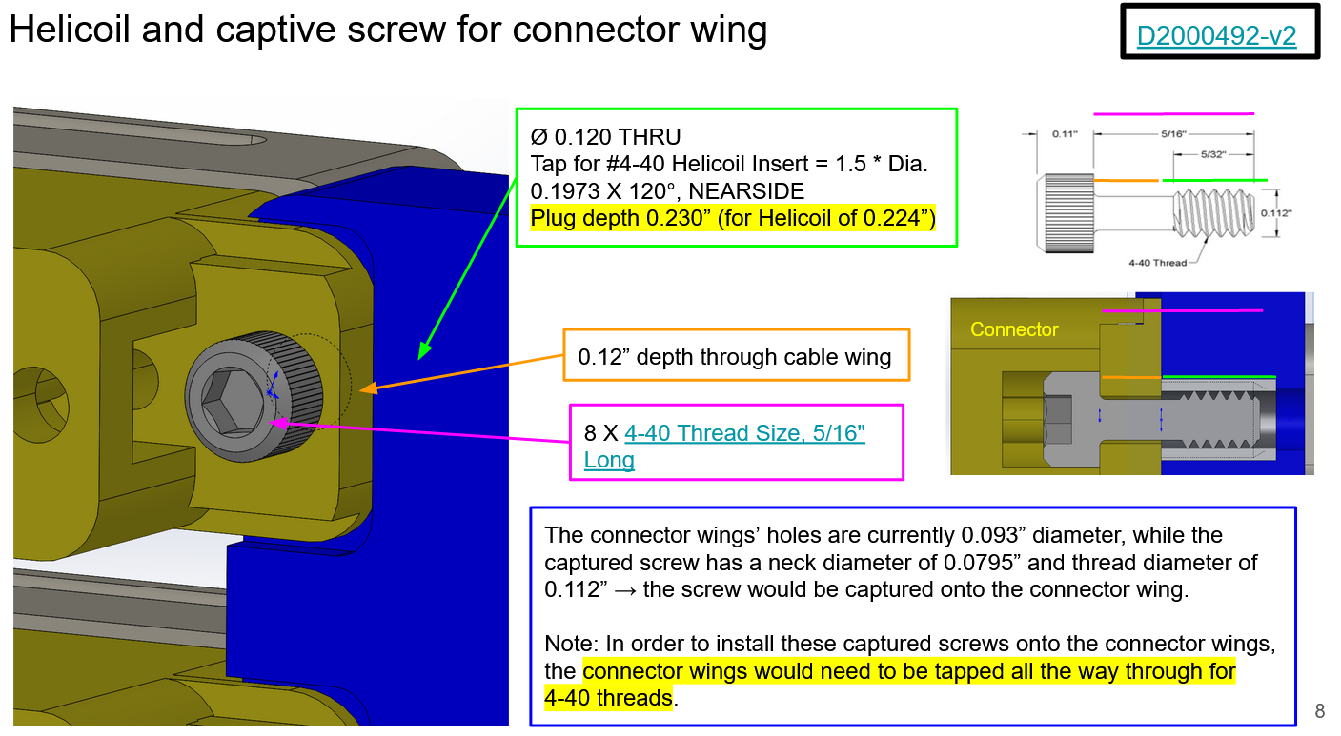
Connector Mounting to Bracket
D2000492
G2001813

Slide 5
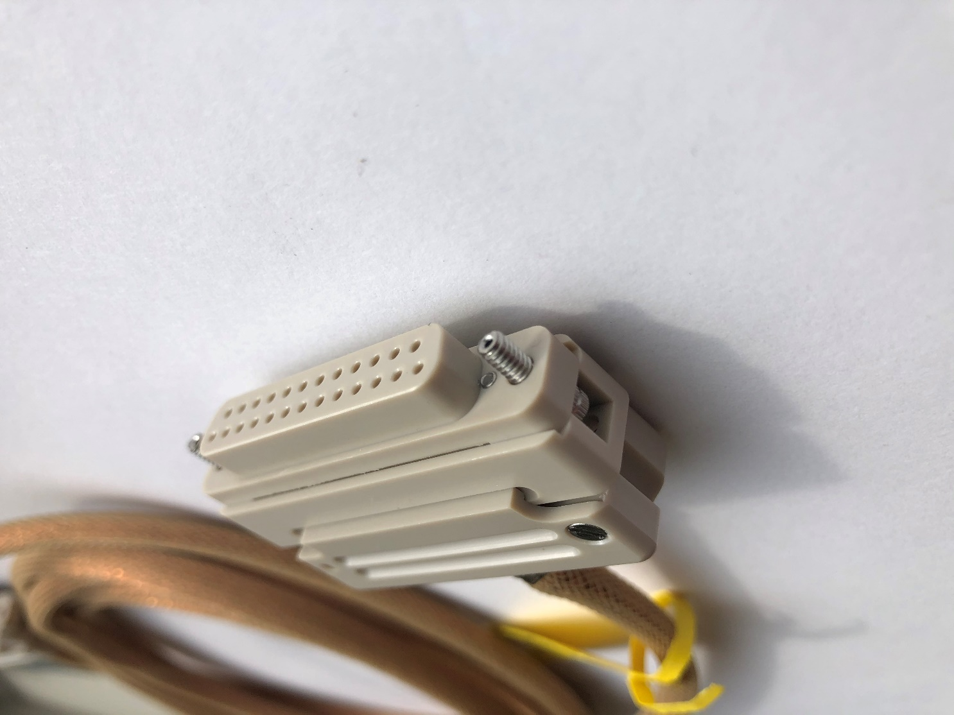
PEEK D25F Connector
Captive Stainless 4-40 Vented screw. Smooth, unthreaded hole

Slide 6
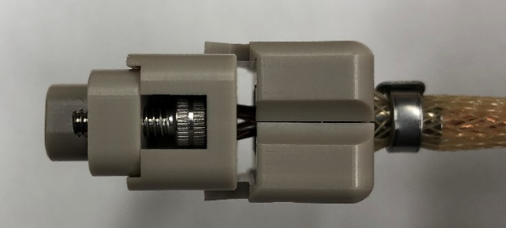
PEEK Connector w/o Tabs
Venting gap to the strain relief and connecting pins
Captive SS, Vented screw

Slide 7
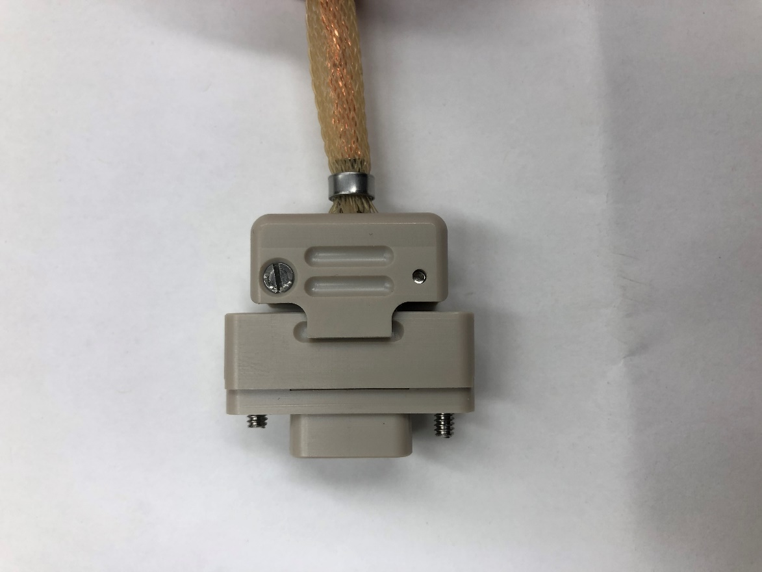
D9F PEEK Connector
Strain relief assembly screw and threaded, through hole
Stainless steel band clamp

Slide 8
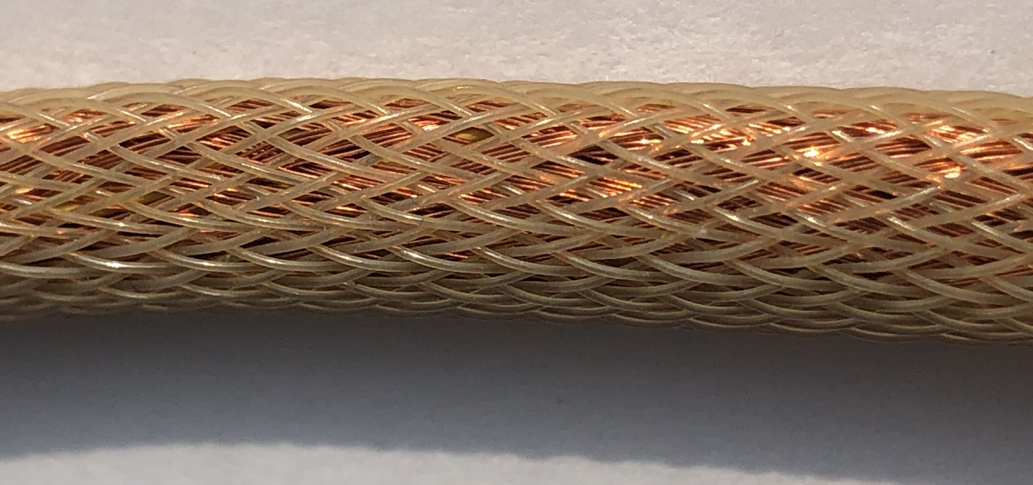
Typical Cable Construction - with copper braid
Outer PEEK Braiding
Copper braid shield
Kapton coated , twisted pair wire

Slide 9
Cable Construction w/o copper braid
Stainless steel “brake line” fitting (all cable types)
PEEK Braiding
Teflon coated, twisted pair copper wire

