Slide 1
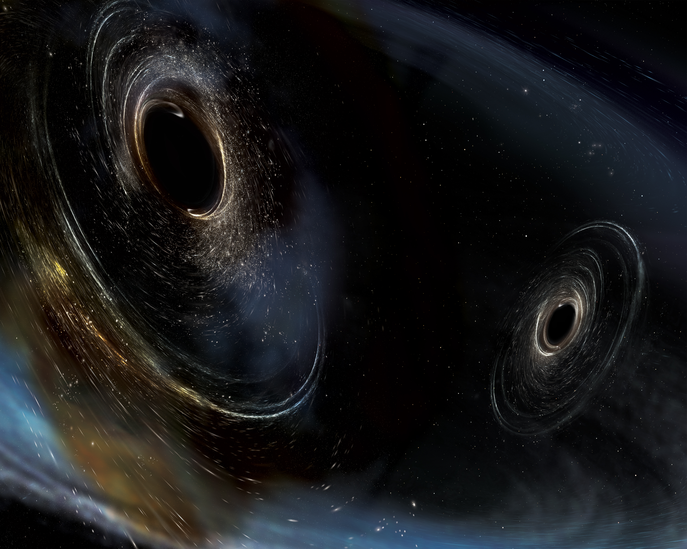
LIGO: A New Window into the Universe
Dr. Jeffrey Kissel
2020 – 11 – 23

Slide 2
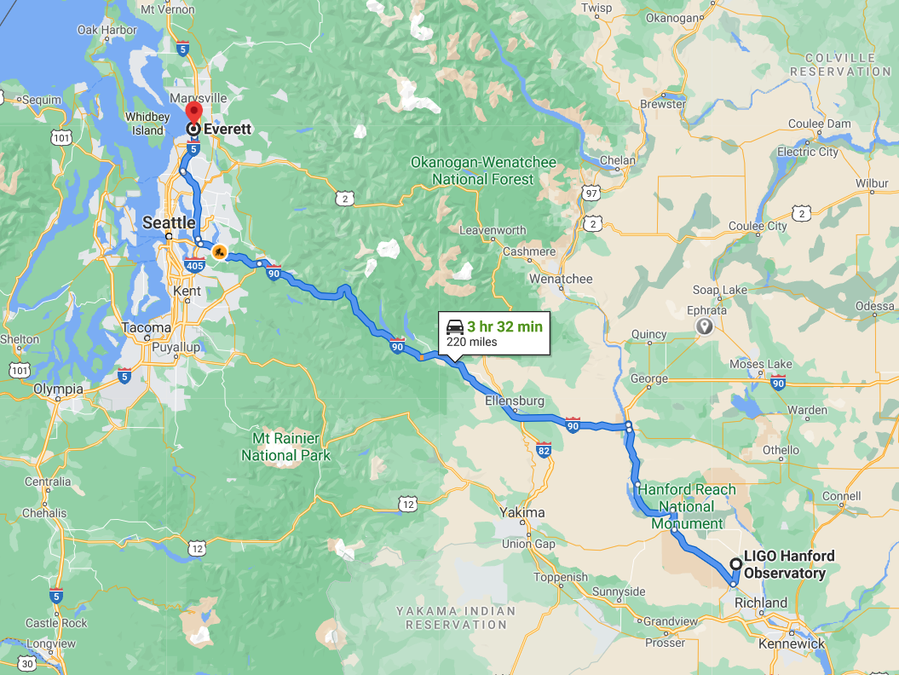

Slide 3
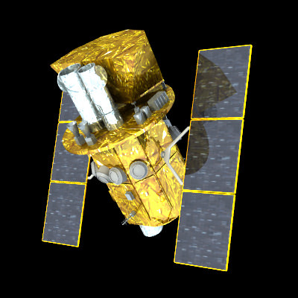
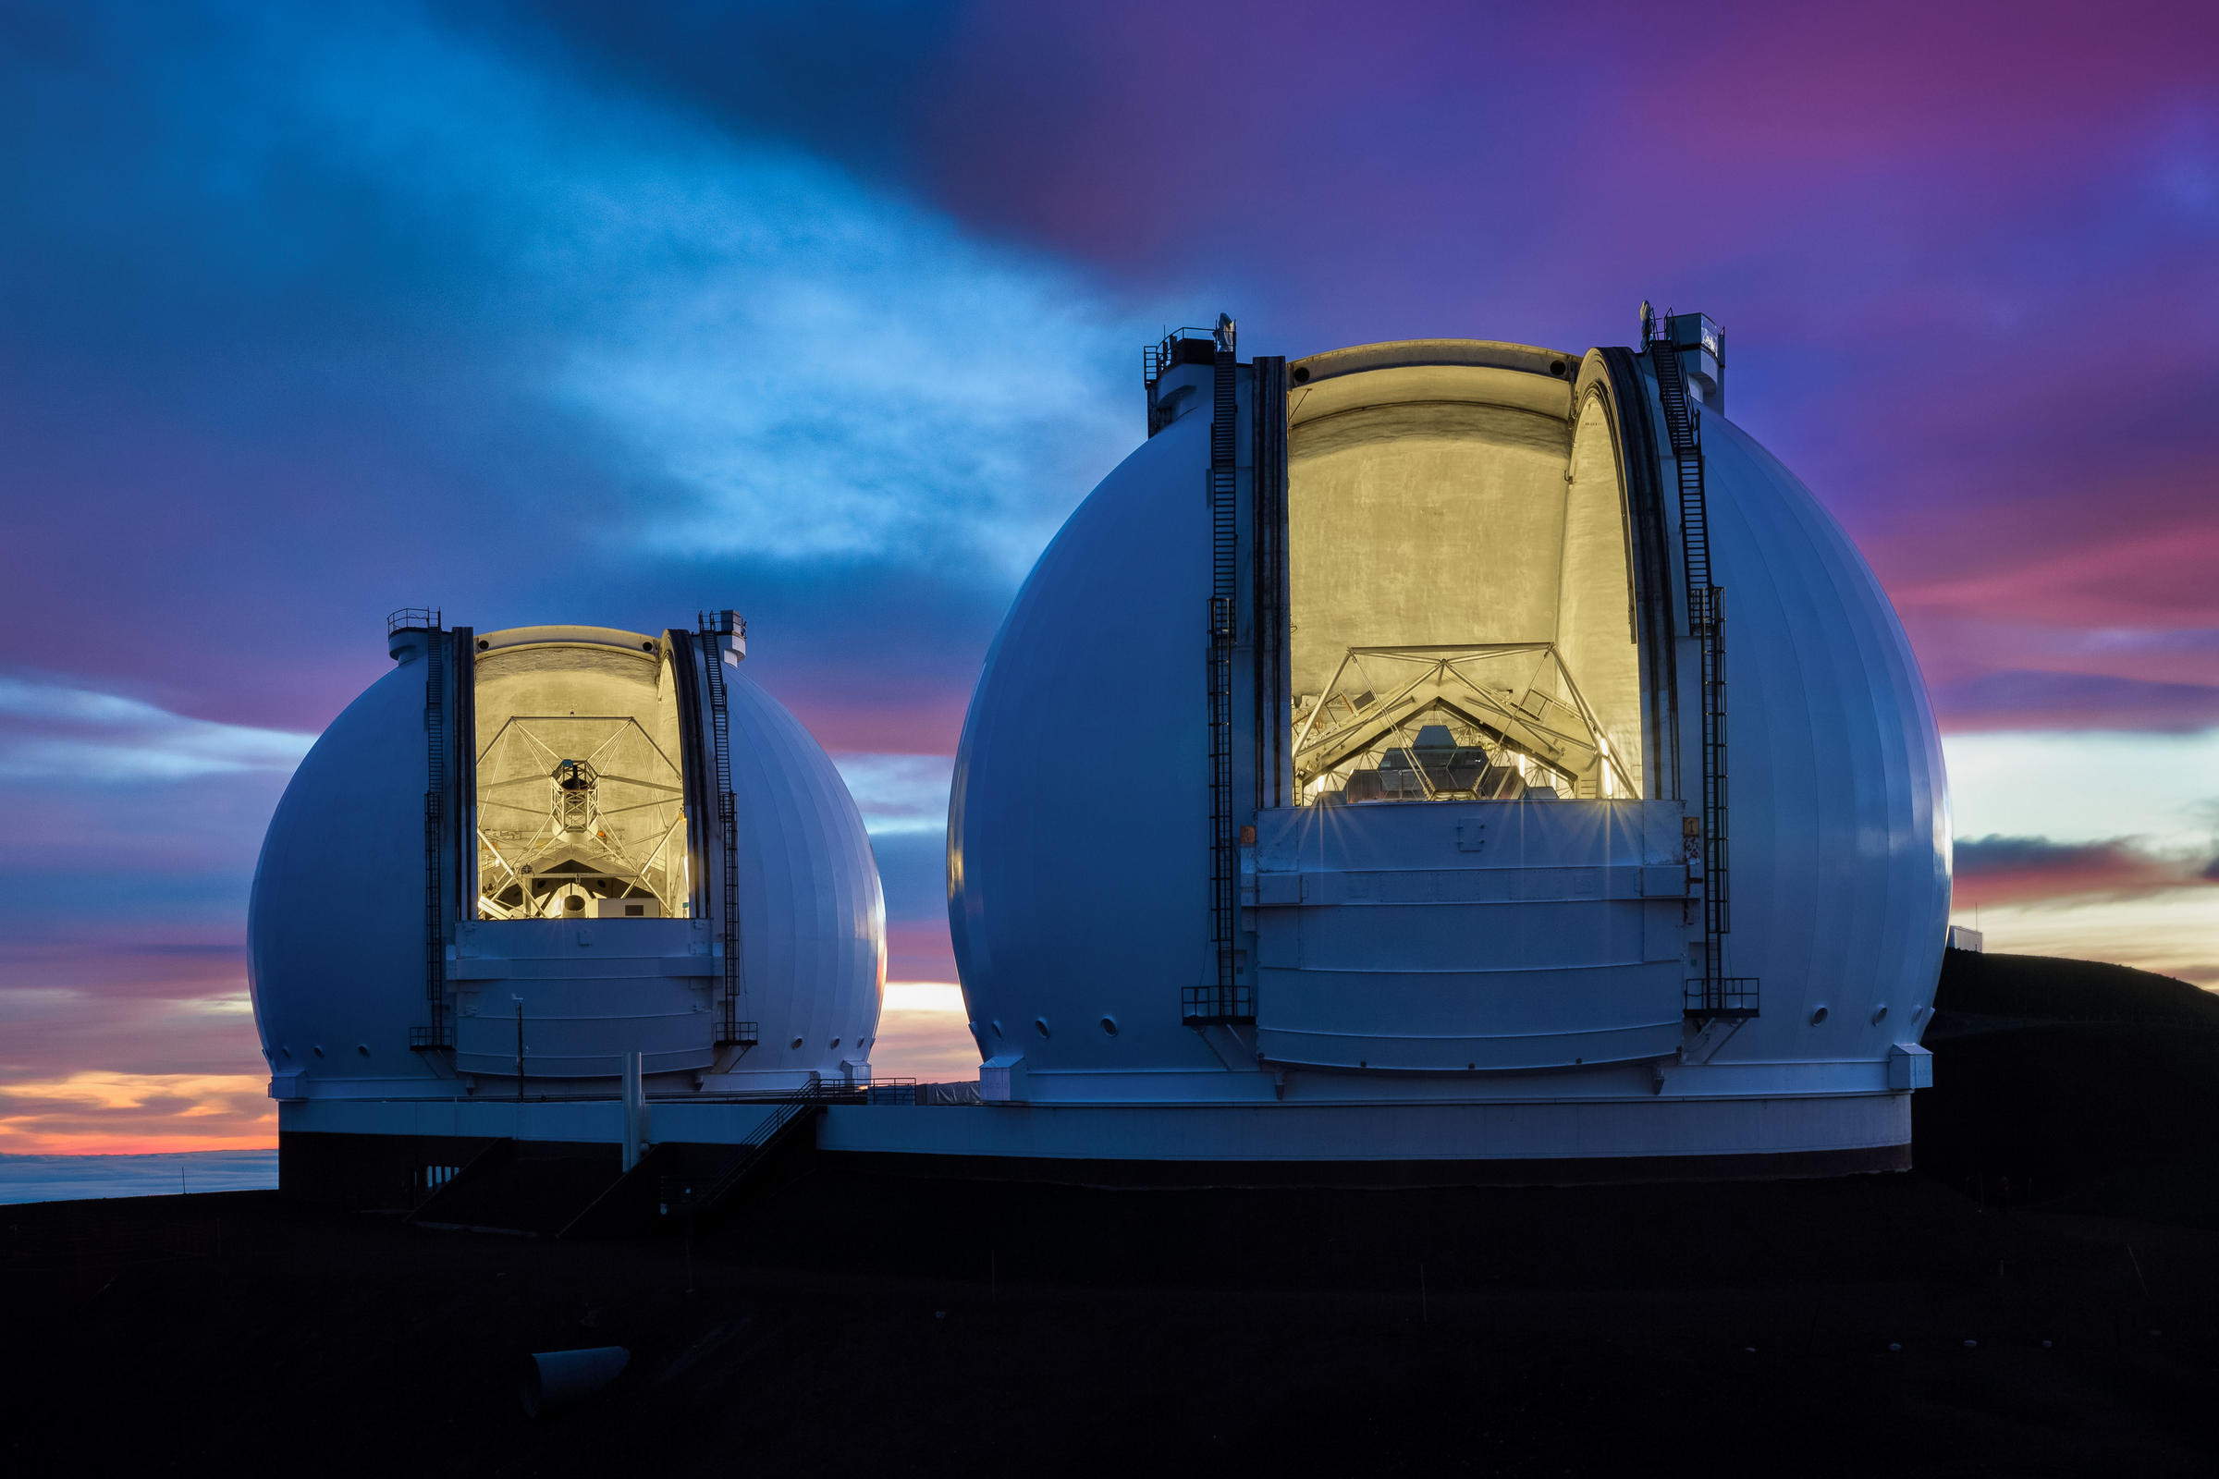
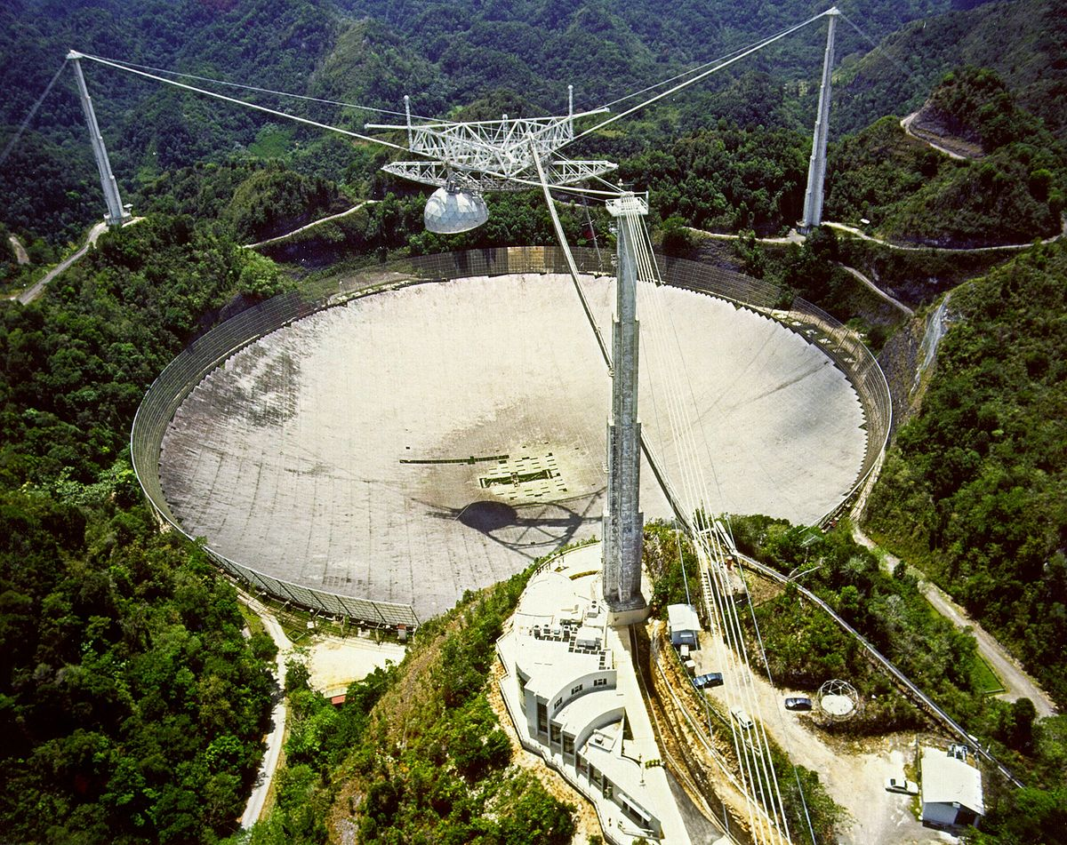
New Telescope – New Astronomy
Energy
E = M c²

Slide 4
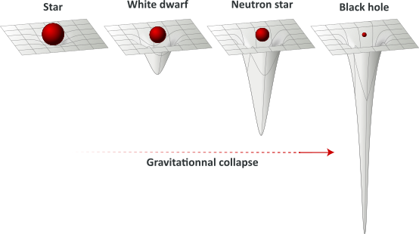
Mass tells space-time how to curve…
Average Star
White Dwarf
Neutron Star
Black Hole
Increasing mass density causes increasing curvature
For objects moving around extreme curvature, from a far-away observer’s perspective:
- Time slows down
- Distances between things decrease

Slide 5
… in 4 dimensions …
The shortest distance between two points gets shorter near heavy mass
Independent clocks near heavy mass slows down

Slide 6
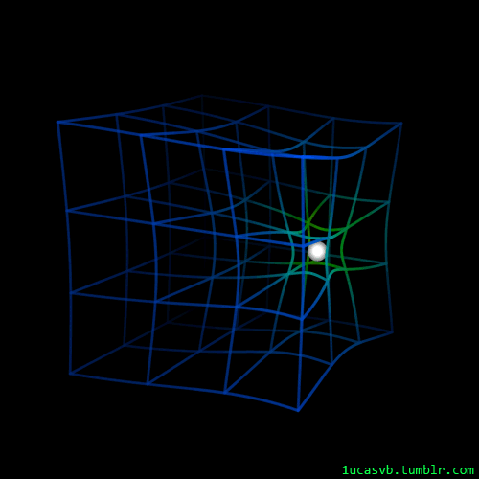
… and Moving!

Slide 7
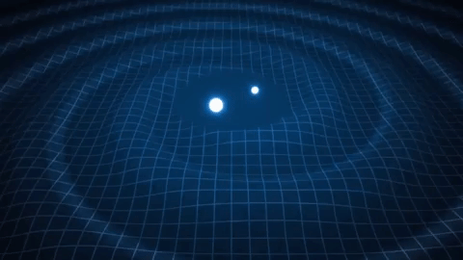
Gravitational Waves
The universe is not static!
Nor is space time!
Quadrupolar distortion
of space and time between free objects

Slide 8
Colliding Black Holes!
Tim Dietrich / AEI / BAM Collaboration
https://youtu.be/YnCccVDpmrw
1-D Cross Section
Time
1-D Amplitude
Time
Predicted Gravitational Waveform

Slide 9
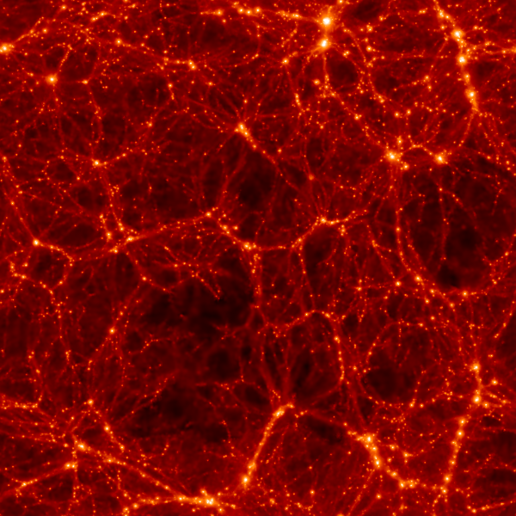
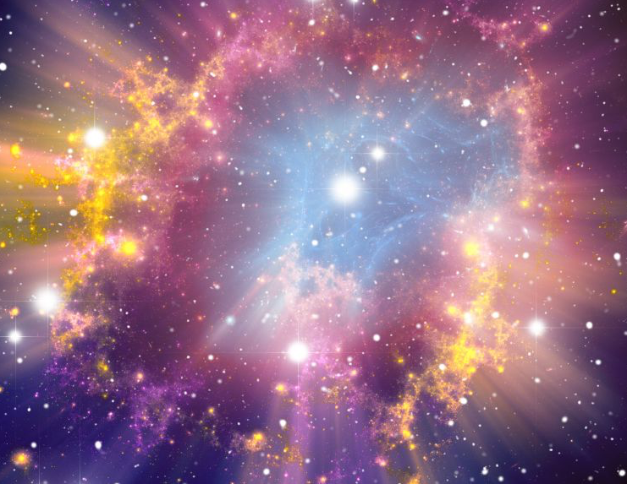
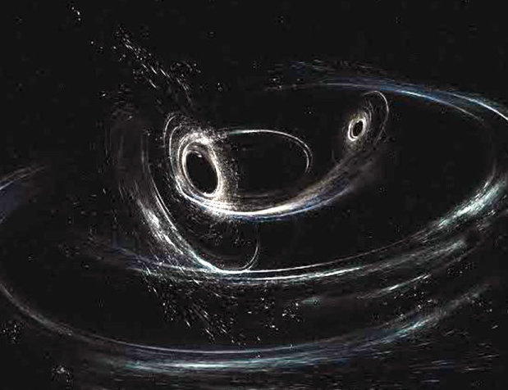
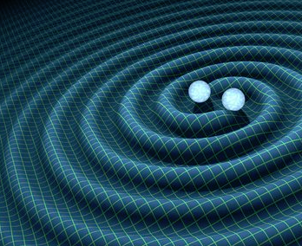
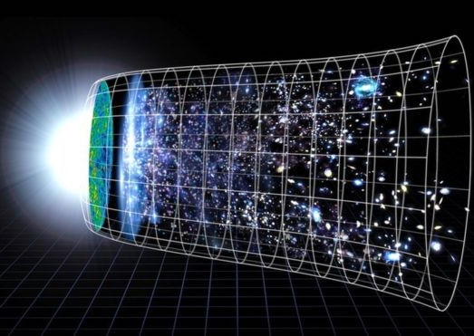
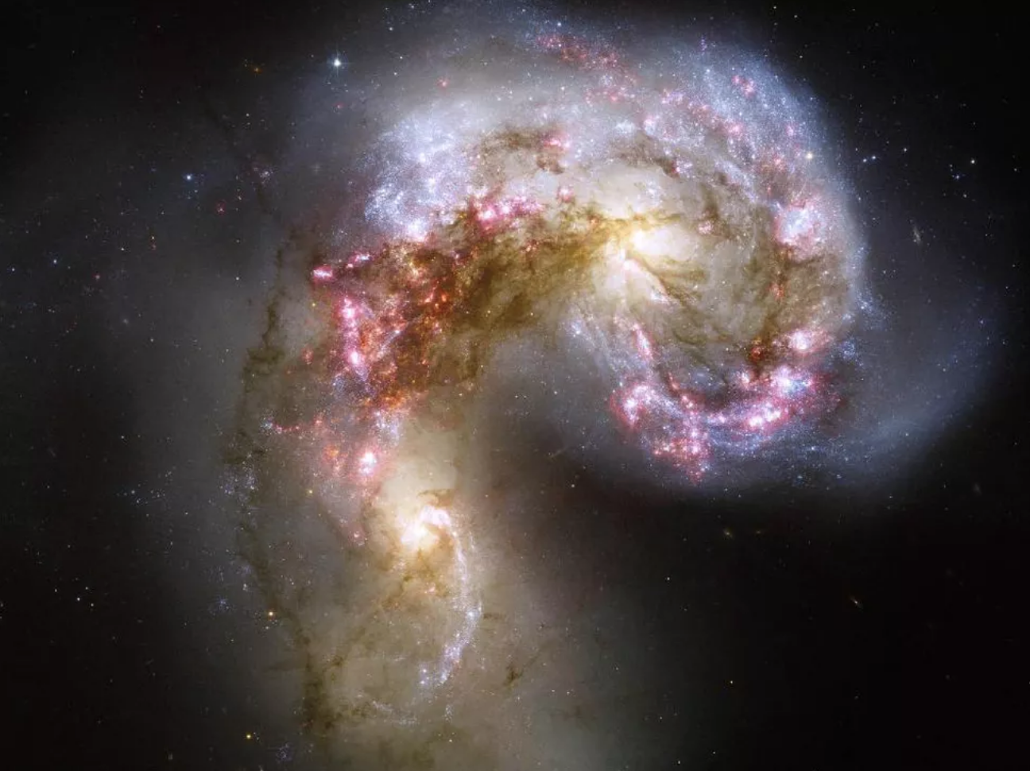
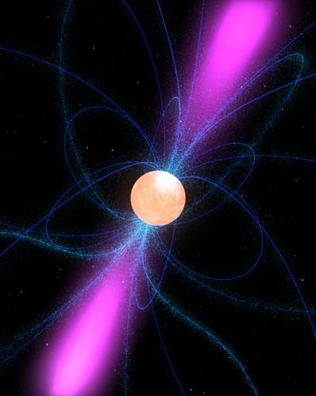
The Gravitational Wave Spectrum
Universe’s Dark Matter
Large Scale Structure
Black Hole
Collisions
Constant
“Noise” of GWs
from Binaries
Supernovae
Galaxy
Collisions
Neutron Star
Collisions
The Big Band and
the Entire Universe
Billions
of Years
Minutes
Fractions
of Seconds
Decades
Years
Days
10⁻¹⁸ Hz
10⁻⁹ Hz
10⁻³ Hz
10 Hz
1000 Hz
Universe
Galactic
Solar System
Planet
Kilometers

Slide 10
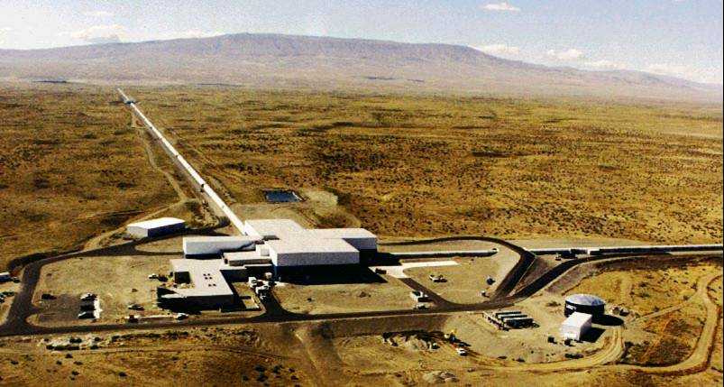
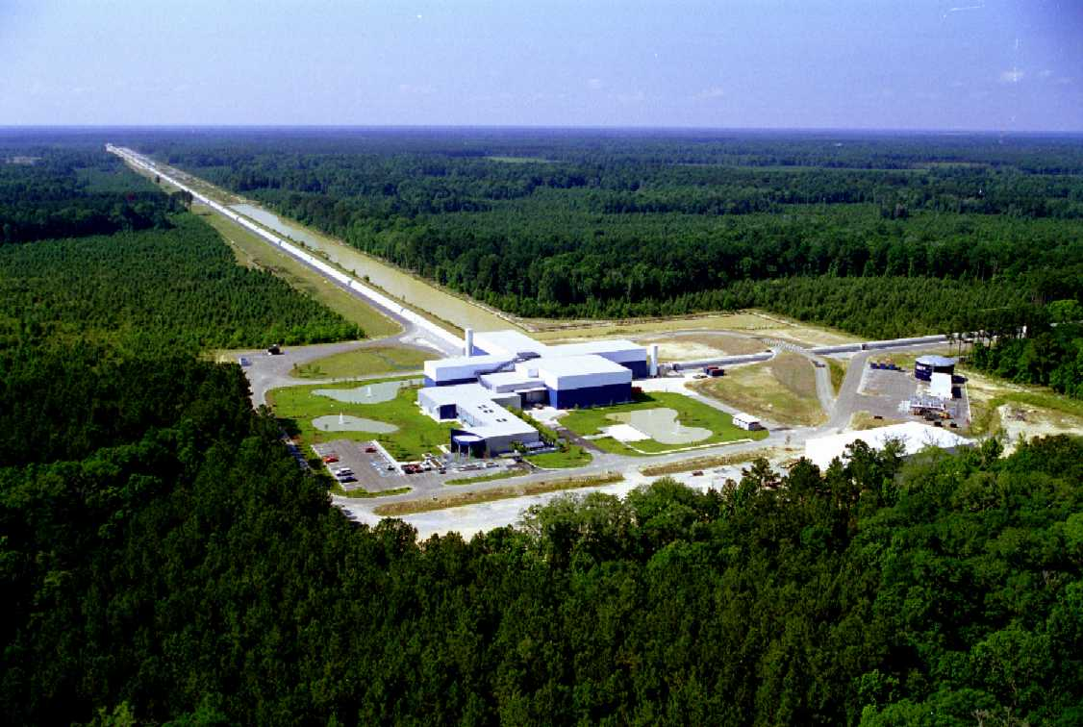
A Gravitational Wave Telescope
Neutron Star
Collisions
Black Hole
Collisions
10 Hz
1000 Hz
Kilometers
Laser Interferometer
L I G O
Gravitational wave Observatory

Slide 11
What LIGO “Hears”

Slide 12
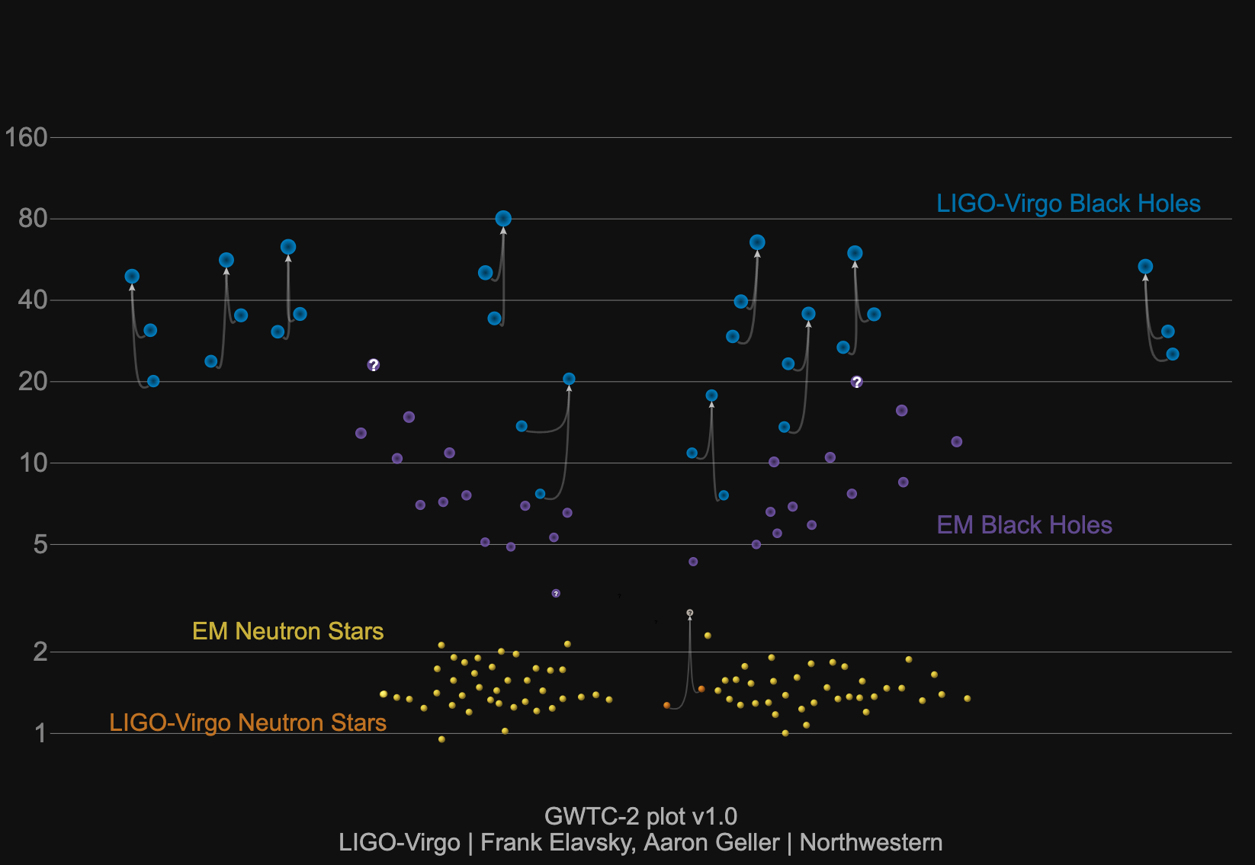
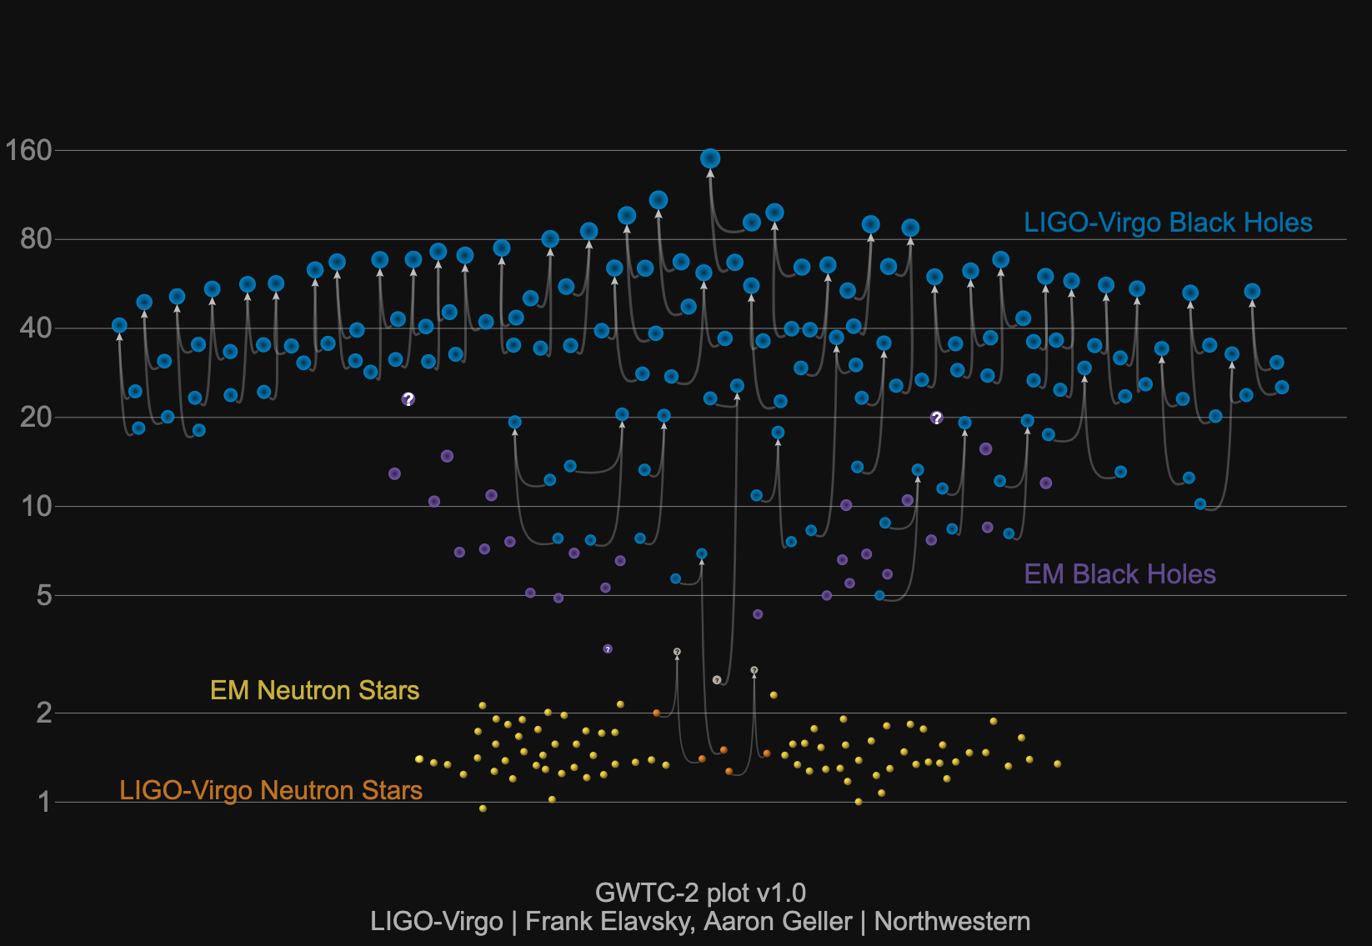
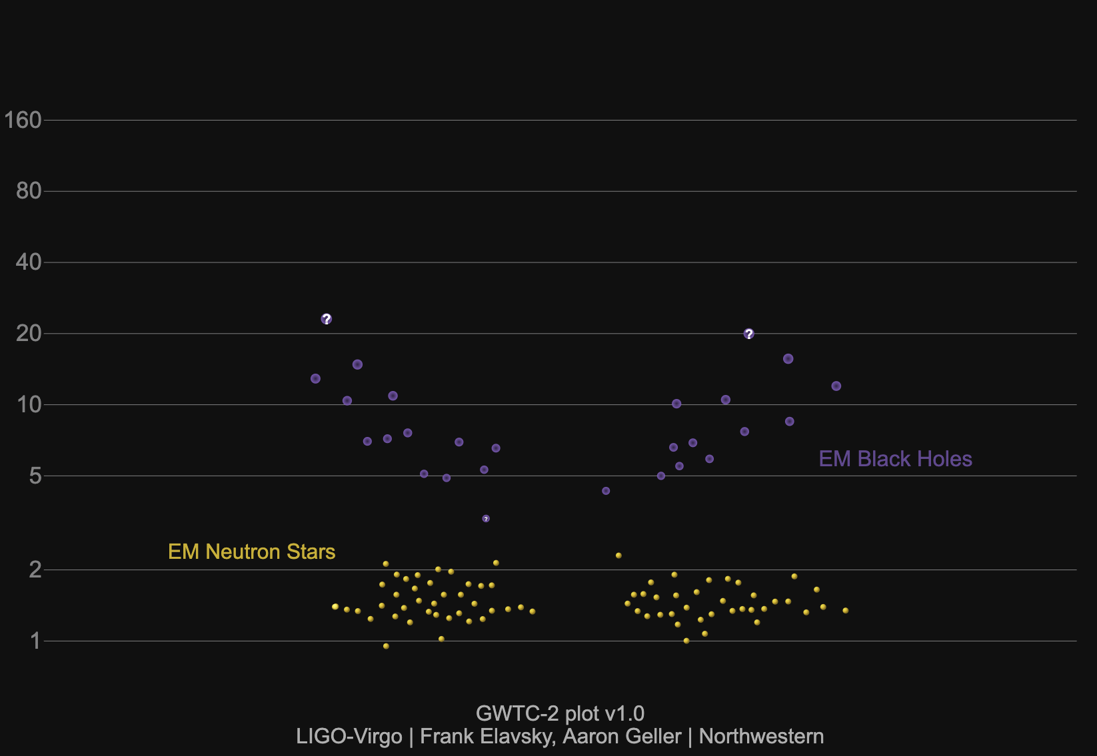
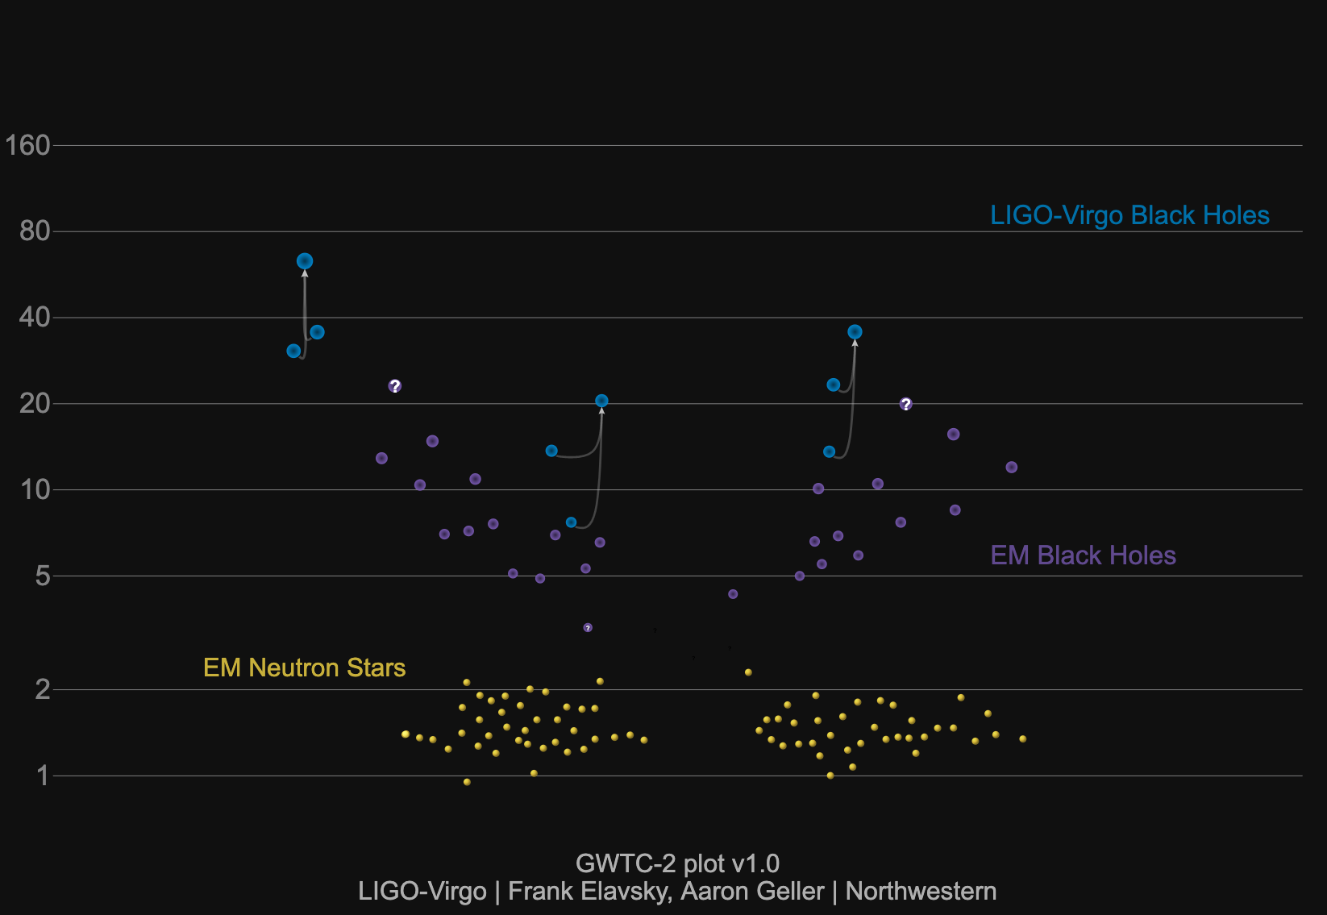
How Many?
1 Solar Mass = 333,000 Earth Masses!

Slide 13
How Fast?
1 Solar Mass = 333,000 Earth Masses
Two, ~30 solar mass objects colliding in 0.2 seconds
Traveling at 60% of the speed of light
400 000 000 miles per hour!
From here to the moon in 10 seconds!
Ripping space-time apart as they go!

Slide 14
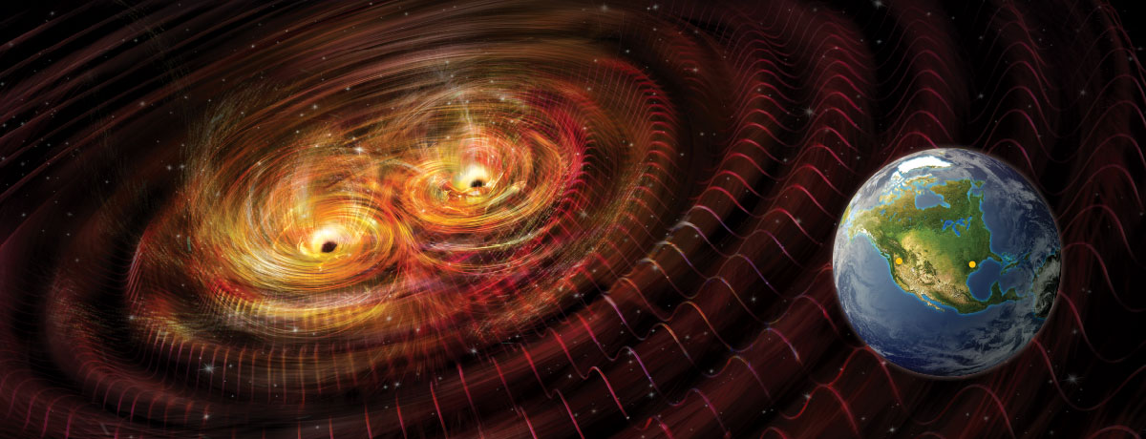
How loud?
GW170104
Original Black Holes: 31 + 29 solar masses
2 solar masses
missing….
Final Black Hole: 58 solar masses
M c² = E
2 solar masses * c² = 3 x 10⁴⁹ Watts
radiated away in gravitational waves
500 000 000 000 000 000 000 000 000 000 000 000 000 000 000 000 light bulbs!
More energy (from light waves) than the entire visible universe now

Slide 15
How far?
1.3 billion
light years
1.4 billion
Light years
3.0
billion
light years

Slide 16
LIGO’s Digital Presence
LIGO website: https://www.ligo.caltech.edu/
Caltech SURF program: http://sfp.caltech.edu/programs/surf
Citizen Science:
GravitySpy: https://www.zooniverse.org/projects/zooniverse/gravity-spy
Einstein@Home: https://einsteinathome.org/
Apps:
Laser Labs: https://www.laserlabs.org/portfolio.php
Social Media:
facebook.com/
LigoScientificCollaboration/
@LIGO,
@LIGOWA, @LIGOLA
ligo_virgo

